Slide 2


HIE-ISOLDE Report
Jose Alberto Rodriguez
on behalf of Yacine Kadi and the HIE-ISOLDE project team

Slide 3
Outline:
HIE-ISOLDE Phase 2A
Installation
Highlights of the Commissioning
First Operation with Stable Beam
Status and Schedule for Phase 2B
Summary
56th Meeting of the INTC – Jun. 28th 2017

Slide 4
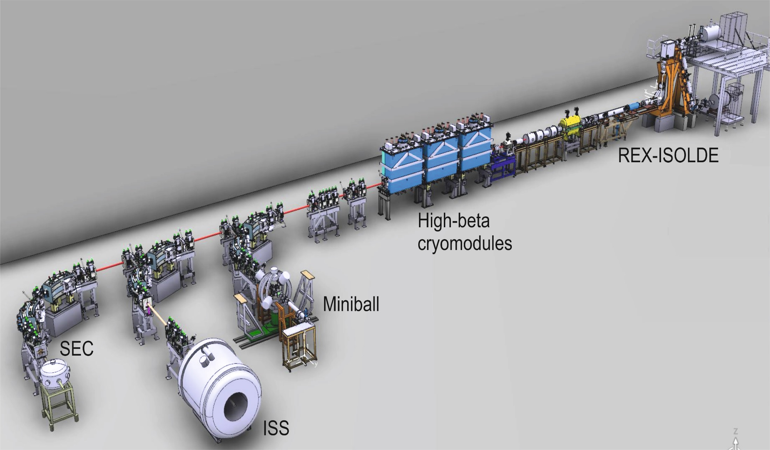
HIE-ISOLDE Phase 2A:
Phase 2A HIE-ISOLDE project:
Additional cryomodule (CM3)
Additional HEBT line (XT03)
Modification of the XT02 HEBT line
CM3 and XT00 modifications
XT03
XT02 extension and ISS
56th Meeting of the INTC – Jun. 28th 2017

Slide 5
Outline:
HIE-ISOLDE Phase 2A
Installation
Highlights of the Commissioning
First Operation with Stable Beam
Status and Schedule for Phase 2B
Summary
56th Meeting of the INTC – Jun. 28th 2017

Slide 6
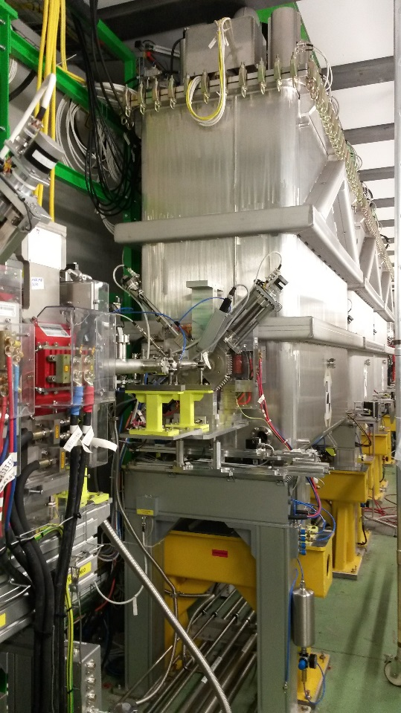
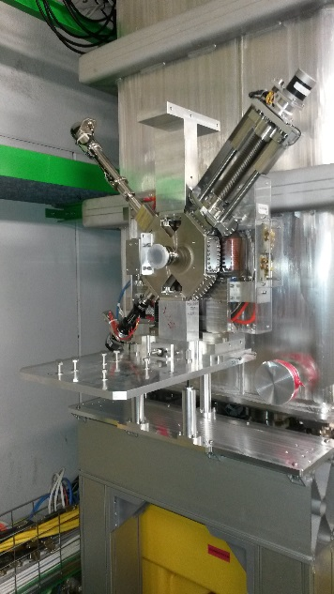
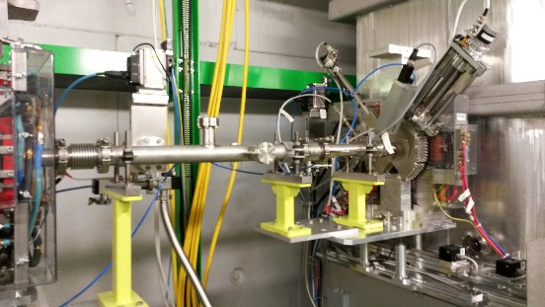
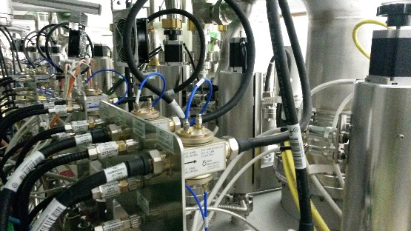
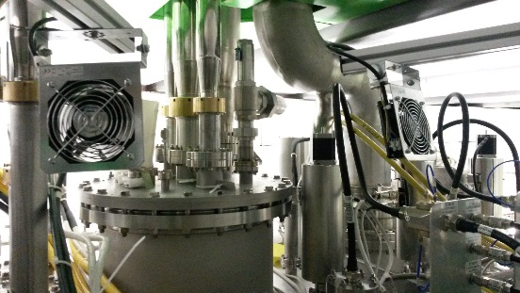
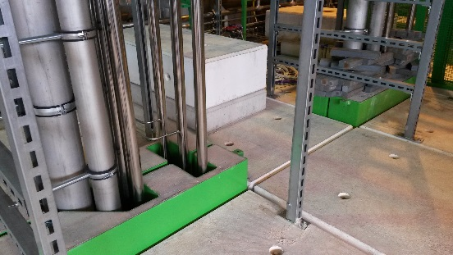
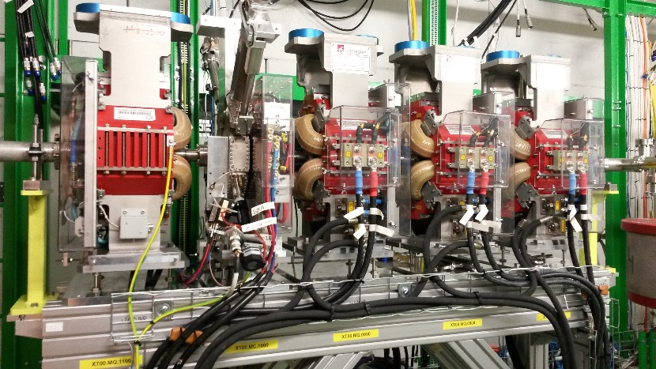
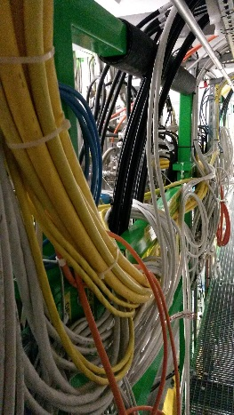
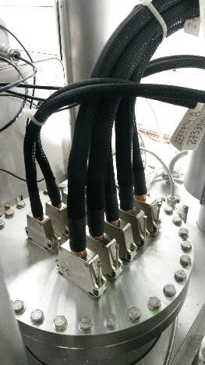
Installation: CM3 and XT00 Modification
Courtesy of E. Siesling
XLN5 intertank sector in place and vacuum closed. BCAM cameras in place
All elements connected and aligned beginning of March
Cryo tubing on the top-plate and outside on the tunnel roof finished. CM cabling all done
56th Meeting of the INTC – Jun. 28th 2017

Slide 7
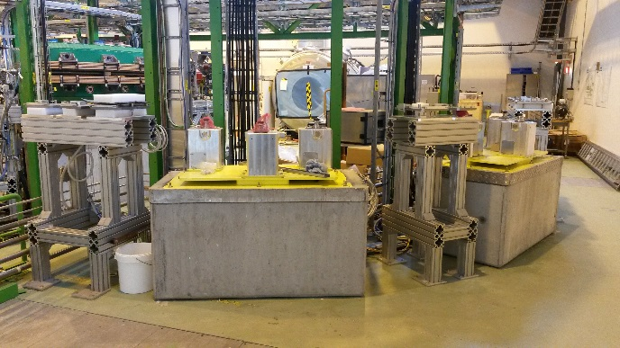
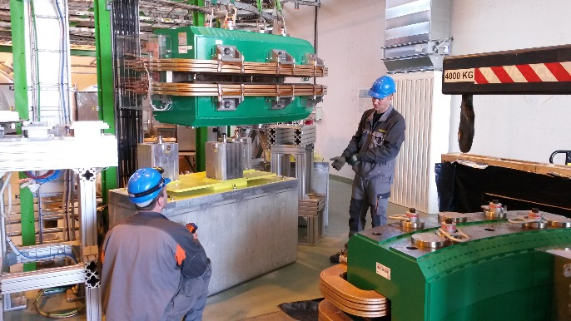
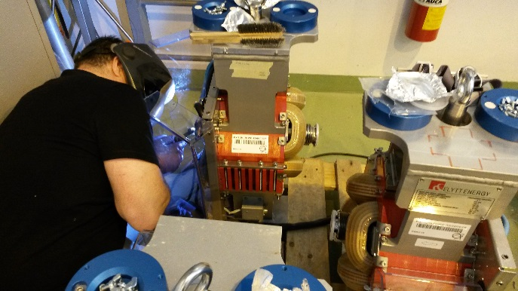
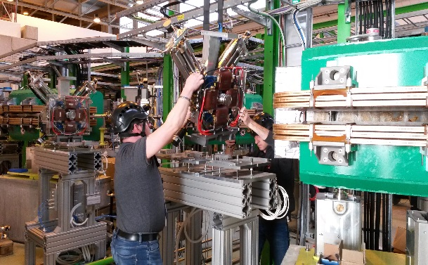
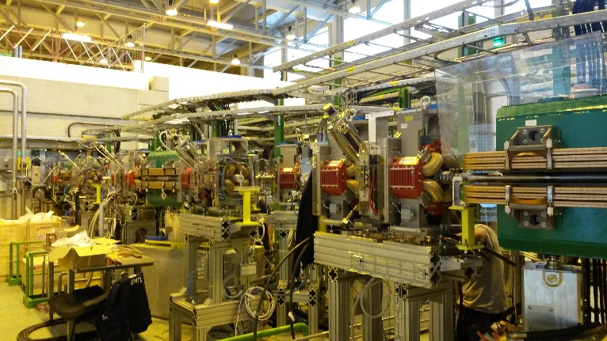
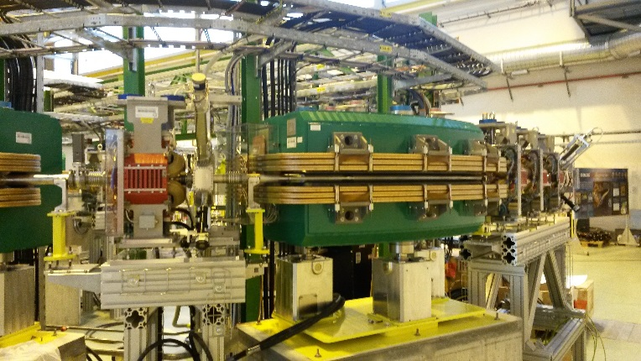
Installation: Third HEBT line (XT03)
Courtesy of E. Siesling
February – May:
XT03 supports and tables in place and re-aligned immediately after the installation of ISS
Installation of the dipoles followed by the Dbox units
Quadrupole vac chambers arrived with a delay: Welding in the hall to avoid more delay
All elements aligned
Vacuum connections, gauges and valves in place. Sectors leak tight
All DC, water, interlocks and instrumentation connected
56th Meeting of the INTC – Jun. 28th 2017

Slide 8
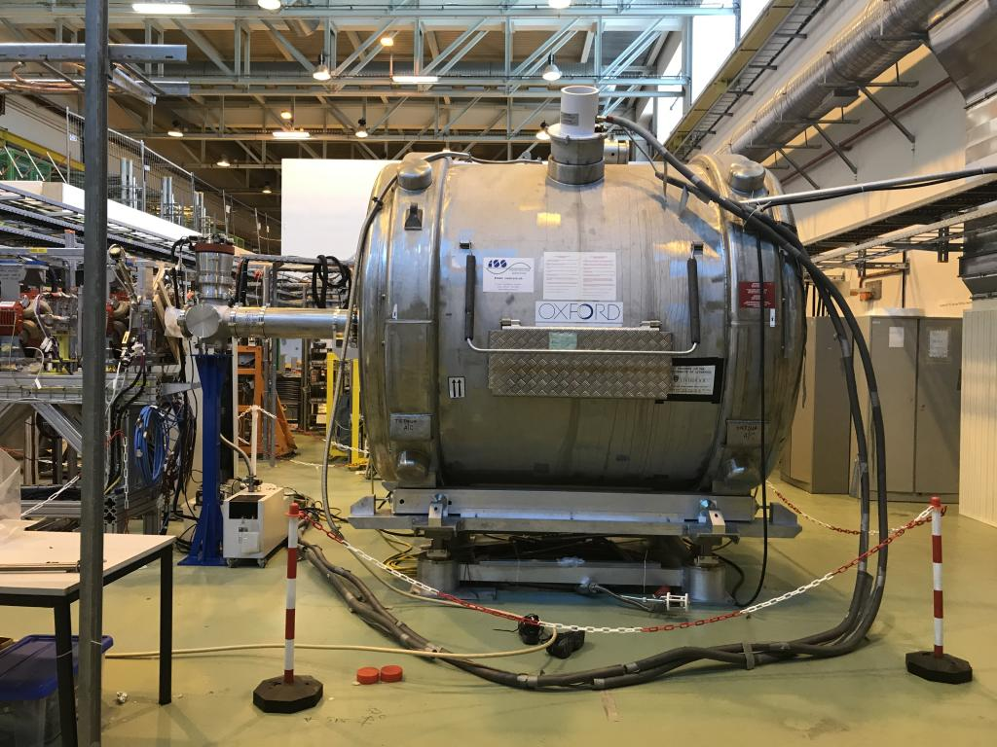
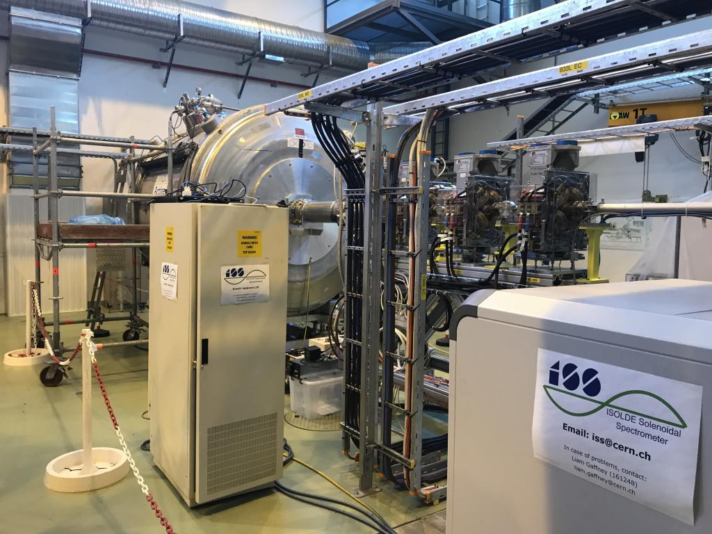
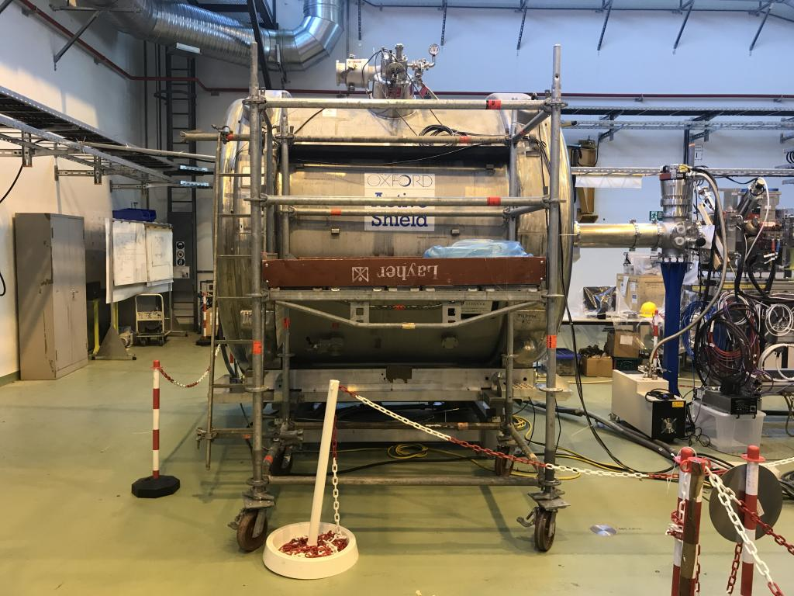
Installation: ISS and XT02 Extension
Courtesy of E. Siesling
56th Meeting of the INTC – Jun. 28th 2017

Slide 9
Outline:
HIE-ISOLDE Phase 2A
Installation
Highlights of the Commissioning
First Operation with Stable Beam
Status and Schedule for Phase 2B
Summary
56th Meeting of the INTC – Jun. 28th 2017

Slide 10
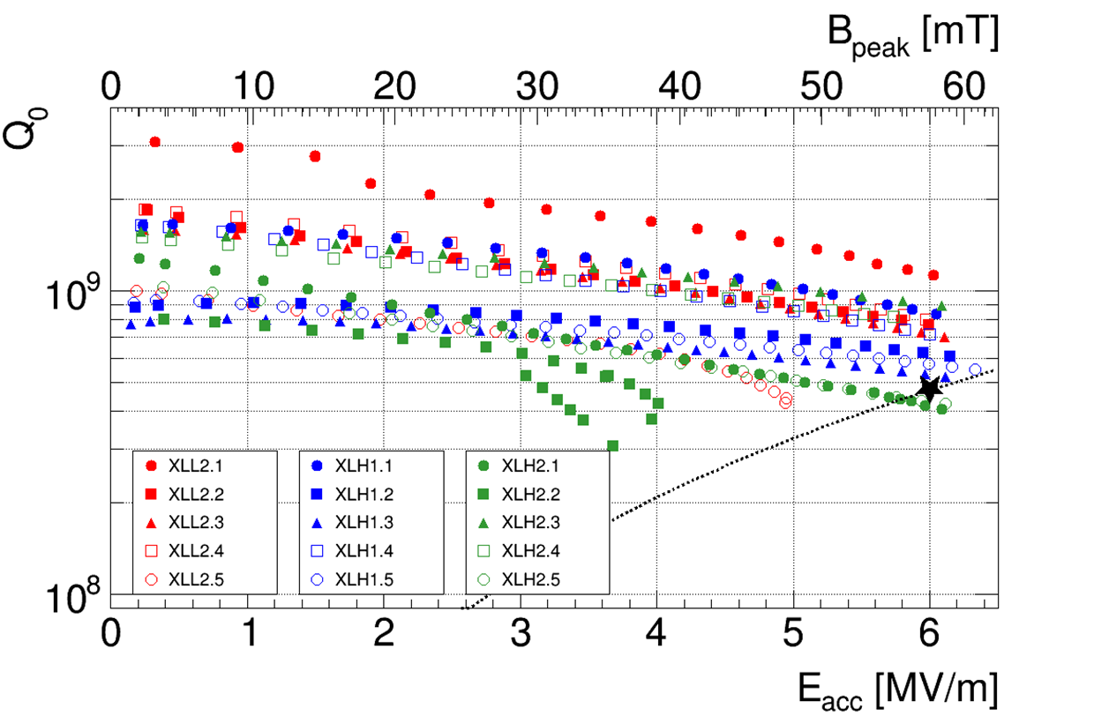
Hardware Commissioning: SRF cavities
All cavities conditioned and RF measurements done
Only one cavity in CM3 and one in CM1 limited by field emission at gradients lower than 6 MV/m
Courtesy of W. Venturini
56th Meeting of the INTC – Jun. 28th 2017

Slide 11
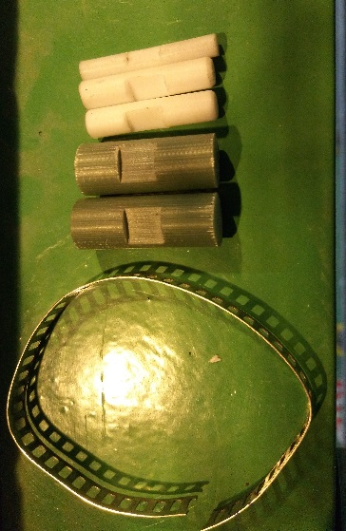
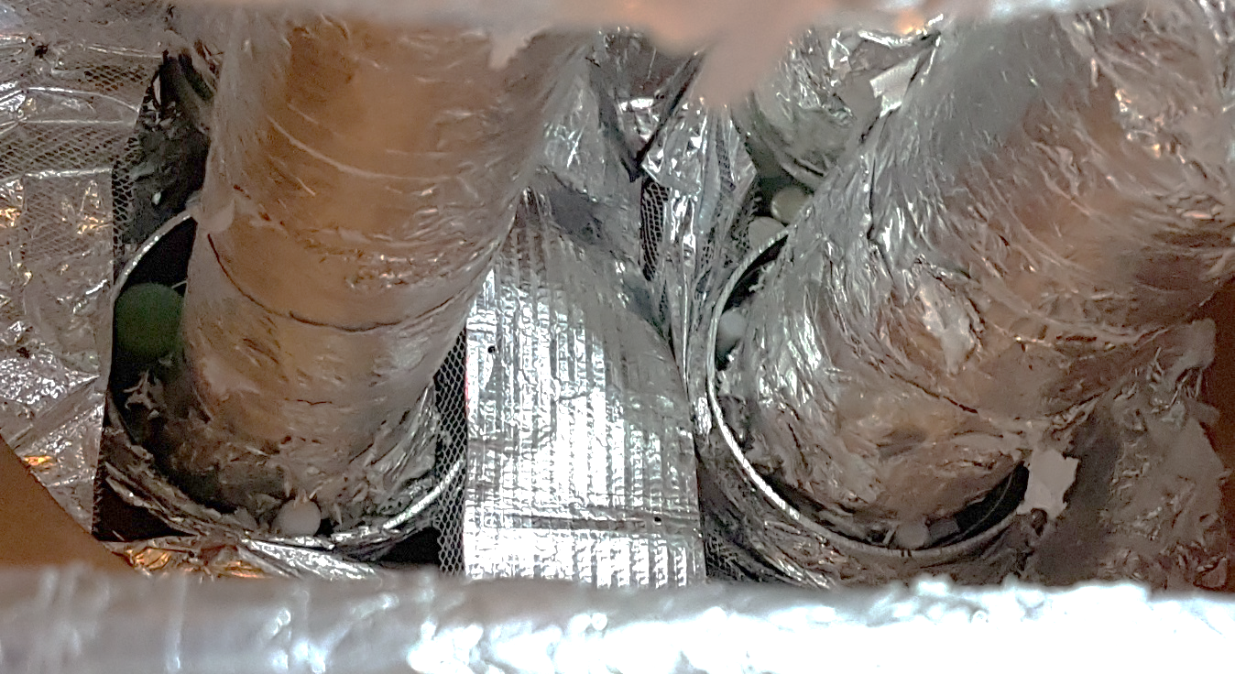
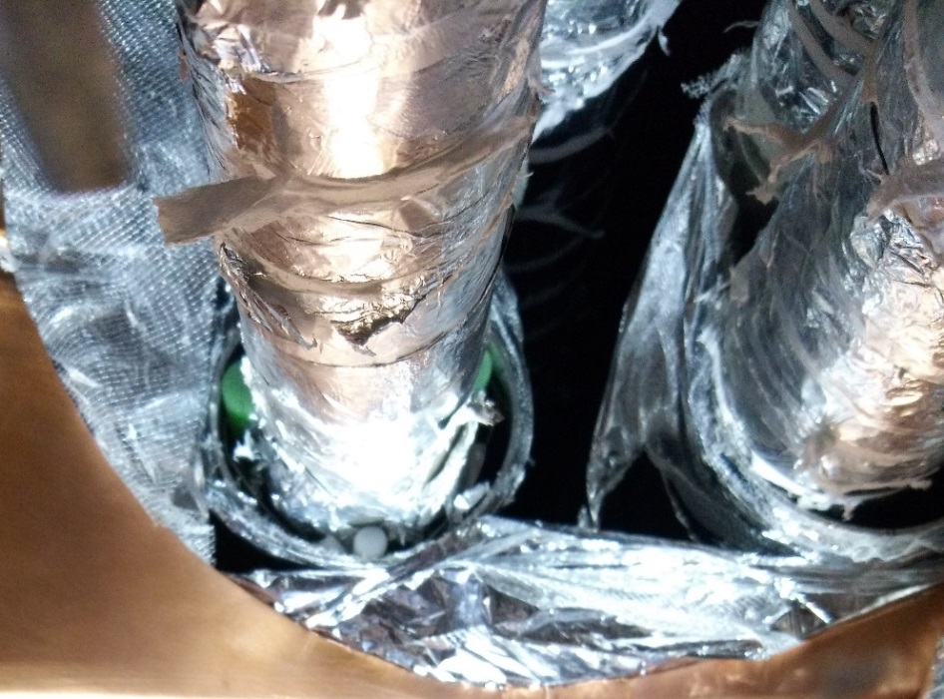
Hardware Commissioning: Cryoline
Thermal short in cryoline found and temporarily fixed
Full repair planned for the 2017/18 technical stop
Courtesy of O. Pirotte
Operation successful for LHe 4.5 K process pipe
Not fully for GHe 4.5 K process pipe (requires too much force -> risk of breaking)
56th Meeting of the INTC – Jun. 28th 2017

Slide 12
Beam Commissioning: Low Energy Tunes
Tunes for beams with A/q = 3.5 to the end of XT01 after each REX RF structure was set-up
Precise energy measurement using the dipole for each tune
Transverse beam profiles at each diagnostics box measured (data not yet analysed)
Conclusions:
Low-energy beams can be transported without additional losses
Beam losses in HIE-ISOLDE (ie. XLN2 to end of XT01) negligible or at the very least small
Differences between different types of FC noticeable
56th Meeting of the INTC – Jun. 28th 2017

Slide 13
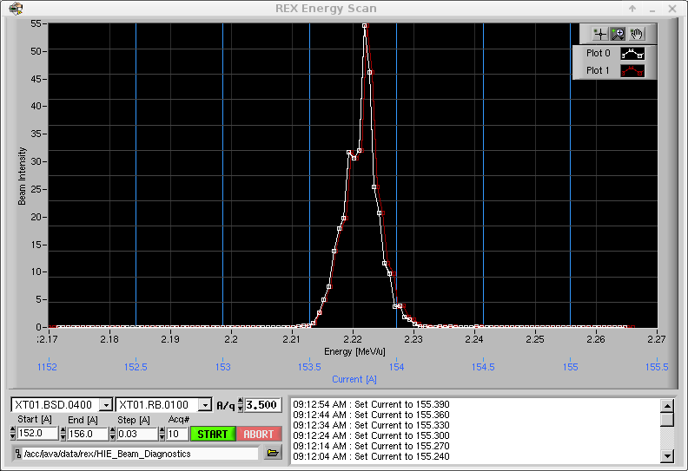
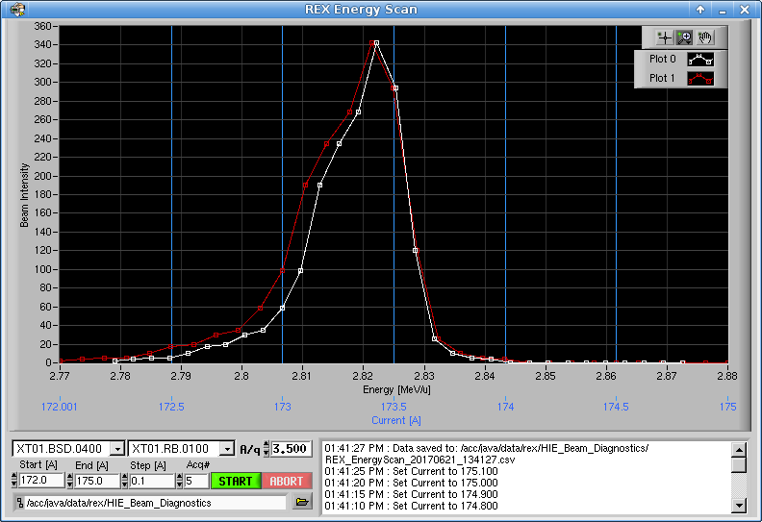
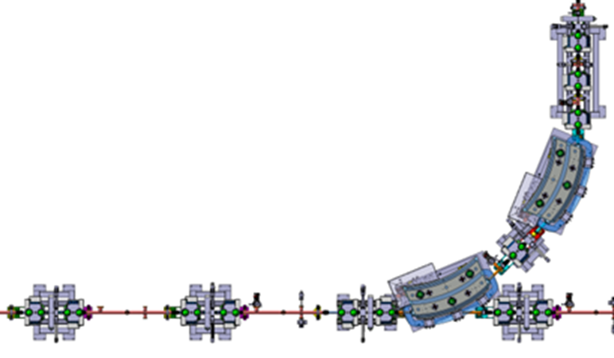
Beam Commissioning: Energy Measurement
Energy and energy spread of the beam can be carried out using the count rate measured at the Silicon detector at XT01.0400 after the first dipole magnet
Energy Scan after set-up of 7gap3 was completed
Energy Scan after set-up of 9gap was completed
The method works very well
  Can be used for low-intensity beams
  Can be completed in ~ 1 hour
  However, as with all measurements with Si detectors, special attention is required to avoid damaging it
We will need to consider installing them in the
other two HEBT lines next year
1 mm vertical slits
Silicon detector
All quads and steerers off
56th Meeting of the INTC – Jun. 28th 2017

Slide 14
Beam Commissioning: Remaining Activities
Week 26:
Phasing of cavities in CM2 and CM3 with ¹⁴N⁴⁺ (E_{final} = 6.5 MeV/u)
Scaling to A/q = 3.67 and 4.0
REX-TRAP and REX-EBIS synchronization with ³⁹K from the pilot ion source
Scaling to A/q = 3.9
Week 27-28:
Set-up for first RIB and Physics
Week 29:
Scaling to A/q = 4.33
Week 30-32:
Set-up and Physics
Week 33:
First beam to XT03
Commissioning of all diagnostics devices
Commissioning of the stripping foils
56th Meeting of the INTC – Jun. 28th 2017

Slide 15
Outline:
HIE-ISOLDE Phase 2A
Installation
Highlights of the Commissioning
First Operation with Stable Beam
Status and Schedule for Phase 2B
Summary
56th Meeting of the INTC – Jun. 28th 2017

Slide 16
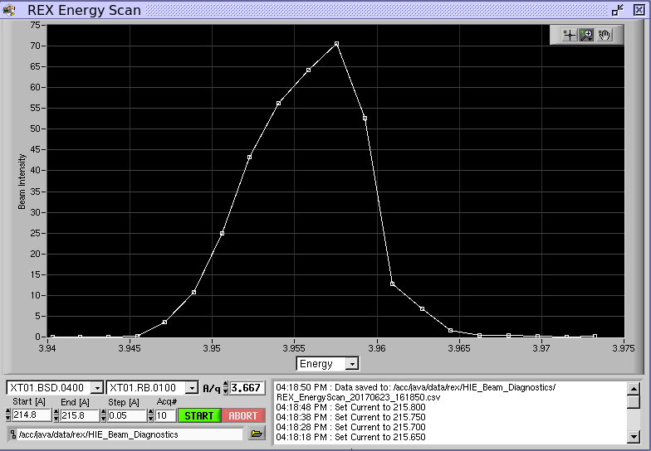
First Operation with Stable Beam:
²²Ne beam requested by Miniball users for testing and calibration last weekend
Ion | ²²Ne⁶⁺
A/q | 3.667
HEBT | XT01
Transmission | ~ 72 %
E | 3.955 MeV/u
dE_{FWHM} | 0.25 %
Length | ~ 60 hours
Rep. rate | 20 Hz
Both REX and the SRF cavities quite stable (1.5 trip/shift)
RF structure | REX |  | HIE
 | RFQ | 7GP3 | SRF02 | SRF04
# Trips | 1 | 3 | 2 | 8
Downtime [mins] | 15 | 0 | 10 | 40
Downtime [%] | 0.4 | 0 | 0.3 | 1.1
Cavity | Pf [kW]
RFQ | 32.8
Buncher | 1.45
IH | 38.0
7GP1 | 51.0
7GP2 | 50.2
7GP3 | 46.2
9GP | 61.5
Cavity | E [MV/m]
SRF01 | 4.14
SRF02 | 4.14
SRF03 | 4.14
SRF04 | 4.14
SRF05 | 3.22
However, note that 40% extra power will be needed at REX for beams with A/q = 4.33 and that the gradient of the SRF cavities was not pushed to 6 MV/m
56th Meeting of the INTC – Jun. 28th 2017

Slide 17
Outline:
HIE-ISOLDE Phase 2A
Installation
Highlights of the Commissioning
First Operation with Stable Beam
Status and Schedule for Phase 2B
Summary
56th Meeting of the INTC – Jun. 28th 2017

Slide 18
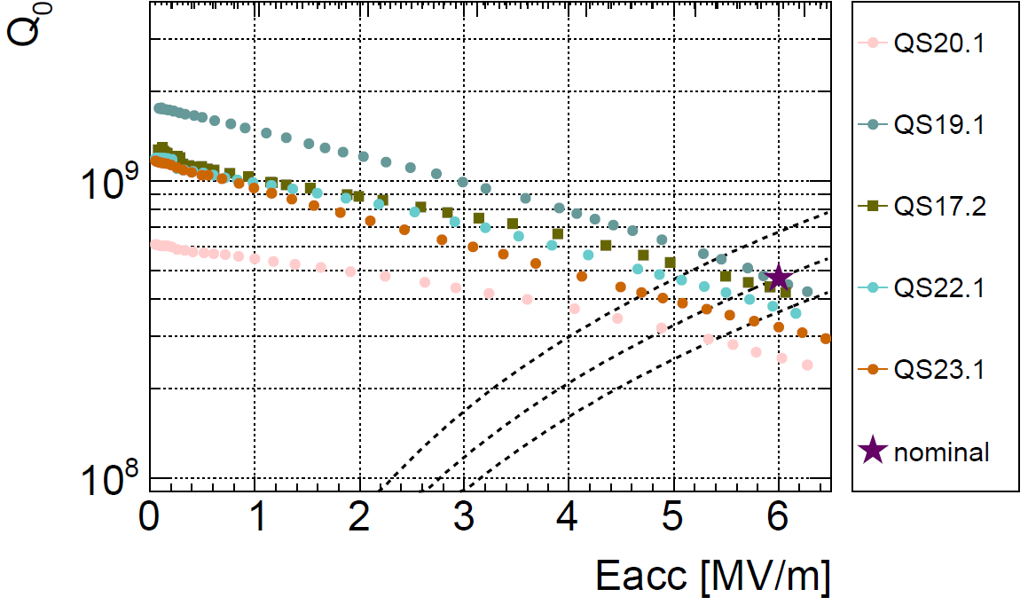
Status and Schedule for Phase 2B
Accelerating structures for CM4:
Four cavities tested and ready for installation
Additional cavity just coated with Niobium. Vertical RF test next week
Courtesy of W. Venturini
56th Meeting of the INTC – Jun. 28th 2017

Slide 19
Status and Schedule for Phase 2B
Plan for assembly of CM4:
Same assembly team as for CM1, CM2 and CM3
Same duration as for CM3 (27 weeks in clean room + 2 weeks qualification tests outside)
Planning is shifted by 7 weeks to ensure the best set of active elements:
  Solenoid #5 ready for installation in w29
  5 cavities ready for the installation in w33
CM4 finished and tested at warm in w42
Courtesy of Y. Leclerq
SM18 cryo shutdown
Solenoid installation
cavity installation
56th Meeting of the INTC – Jun. 28th 2017

Slide 20
Status and Schedule for Phase 2B
Plan for 2018:
Installation of CM4 after refurbishing of cryoline starting in February
Hardware commissioning and cryomodules cool-down starting in March
Beam commissioning starting in May
Physics starting in July
Courtesy of W. Venturini and Y. Kadi
56th Meeting of the INTC – Jun. 28th 2017

Slide 21
Outline:
HIE-ISOLDE Phase 2A
Installation
Highlights of the Commissioning
First Operation with Stable Beam
Status and Schedule for Phase 2B
Summary
56th Meeting of the INTC – Jun. 28th 2017

Slide 22
Summary:
Installation and hardware commissioning of HIE-ISOLDE Phase 2A completed
(3 cryomodules with 5 QWR each, 3 HEBTs lines)
Hardware commissioning completed:
  All power converters/magnets circuits tested
  All SRF cavities conditioned and tested
  Source of the cavity trips identified and mitigated
  Source of thermal loss in cryoline identified and mitigated
Beam commissioning on-going:
  Low energy tunes to the end of XT01 prepared (80% transmission)
  Cavities in CM1, CM2 and part of CM3 phased
  New low and high level control software tested
  Commissioning of XT03 on week 33
Operations:
  First stable beam (²²Ne at 4 MeV/u) delivered to the Miniball Spectrometer
Phase 2B status and plan:
  Four cavities ready for installation in CM4, one more will be tested on wk. 27
  Assembly of CM4 will be completed before the end of 2017
  Installation in tunnel in February 2018
  Physics campaign in July 2018
56th Meeting of the INTC – Jun. 28th 2017

