Slide 1


n_TOF Report
Daniela Macina
n_TOF Run Coordinator
CERN
55th INTC Meeting, 8-9 February 2017

Slide 2
OUTLINE
Follow up Shutdown Activities
Proton delivery from PS
First Operation in 2017
Conclusions

Slide 3
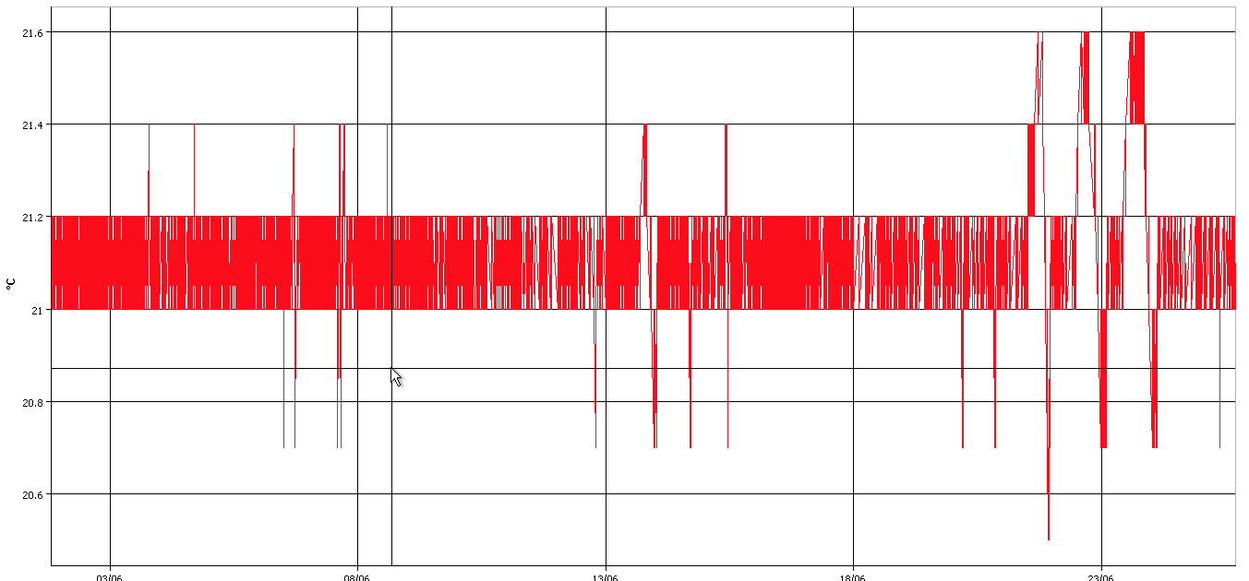
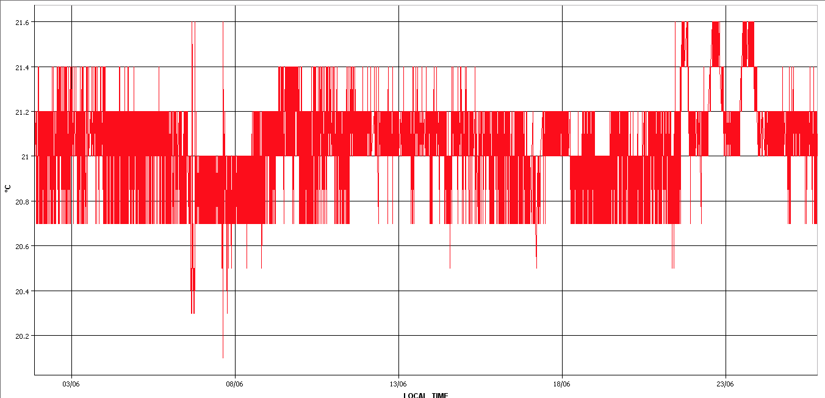
Follow up shutdown activities
Safety: SIR course to enter the experimental areas under evaluation by the
appropriate bodies. It will be made available in August and will become
mandatory by the end of the year
Cooling in EAR2
21.6 °C
Bunker
21.6 °C
Rack area
20.6 °C
20.2 °C

Slide 4
Proton delivery from PS
Achievable Integrated Intensity (1.85E+19)
Planned
Intensity (Charge)
Measured
1-May 27-June 20-Nov

Slide 5
Program for 2017 (first part)
Test magnet & filter box
n_TOF Schedule 2017 ver. 1.3
May
June
July
Aug
Wk | 18 | 19 | 20 |  | 21 |  | 22 |  | 23 |  | 24 |  | 25 |  | 26 | 27 | 28 |  | 29 |  | 30 |  | 31 |  | 32 |  | EAR1
Mo | 1 | 8 | 15 |  | 22 |  | 29 |  | 5 |  | 12 |  | 19 |  | 26 | 3 | 10 |  | 17 |  | 24 |  | 31 |  | 7
Tu
We
Th
Fr
Sa
Su
Beam profile XY MGAS
¹⁶O & detector test
⁸⁹Y+⁸⁸Sr (3.5x10¹⁸)
^{69,71}Ga (4.0x10¹⁸)
May
June
July
Aug
Wk | 18 | 19 | 20 | 21 | 22 | 23 | 24 | 25 | 26 | 27 | 28 | 29 | 30 | 31 | 32 | EAR2
Mo | 1 | 8 | 15 | 22 | 29 | 5 | 12 | 19 | 26 | 3 | 10 | 17 | 24 | 31 | 7
Tu
We
Th
Fr
Sa
Su
Detector test
Beam profile
XY MGAS & Simon 2D
²⁴⁶Cm+²⁴⁴Cm (8.0x10¹⁸)

Slide 6
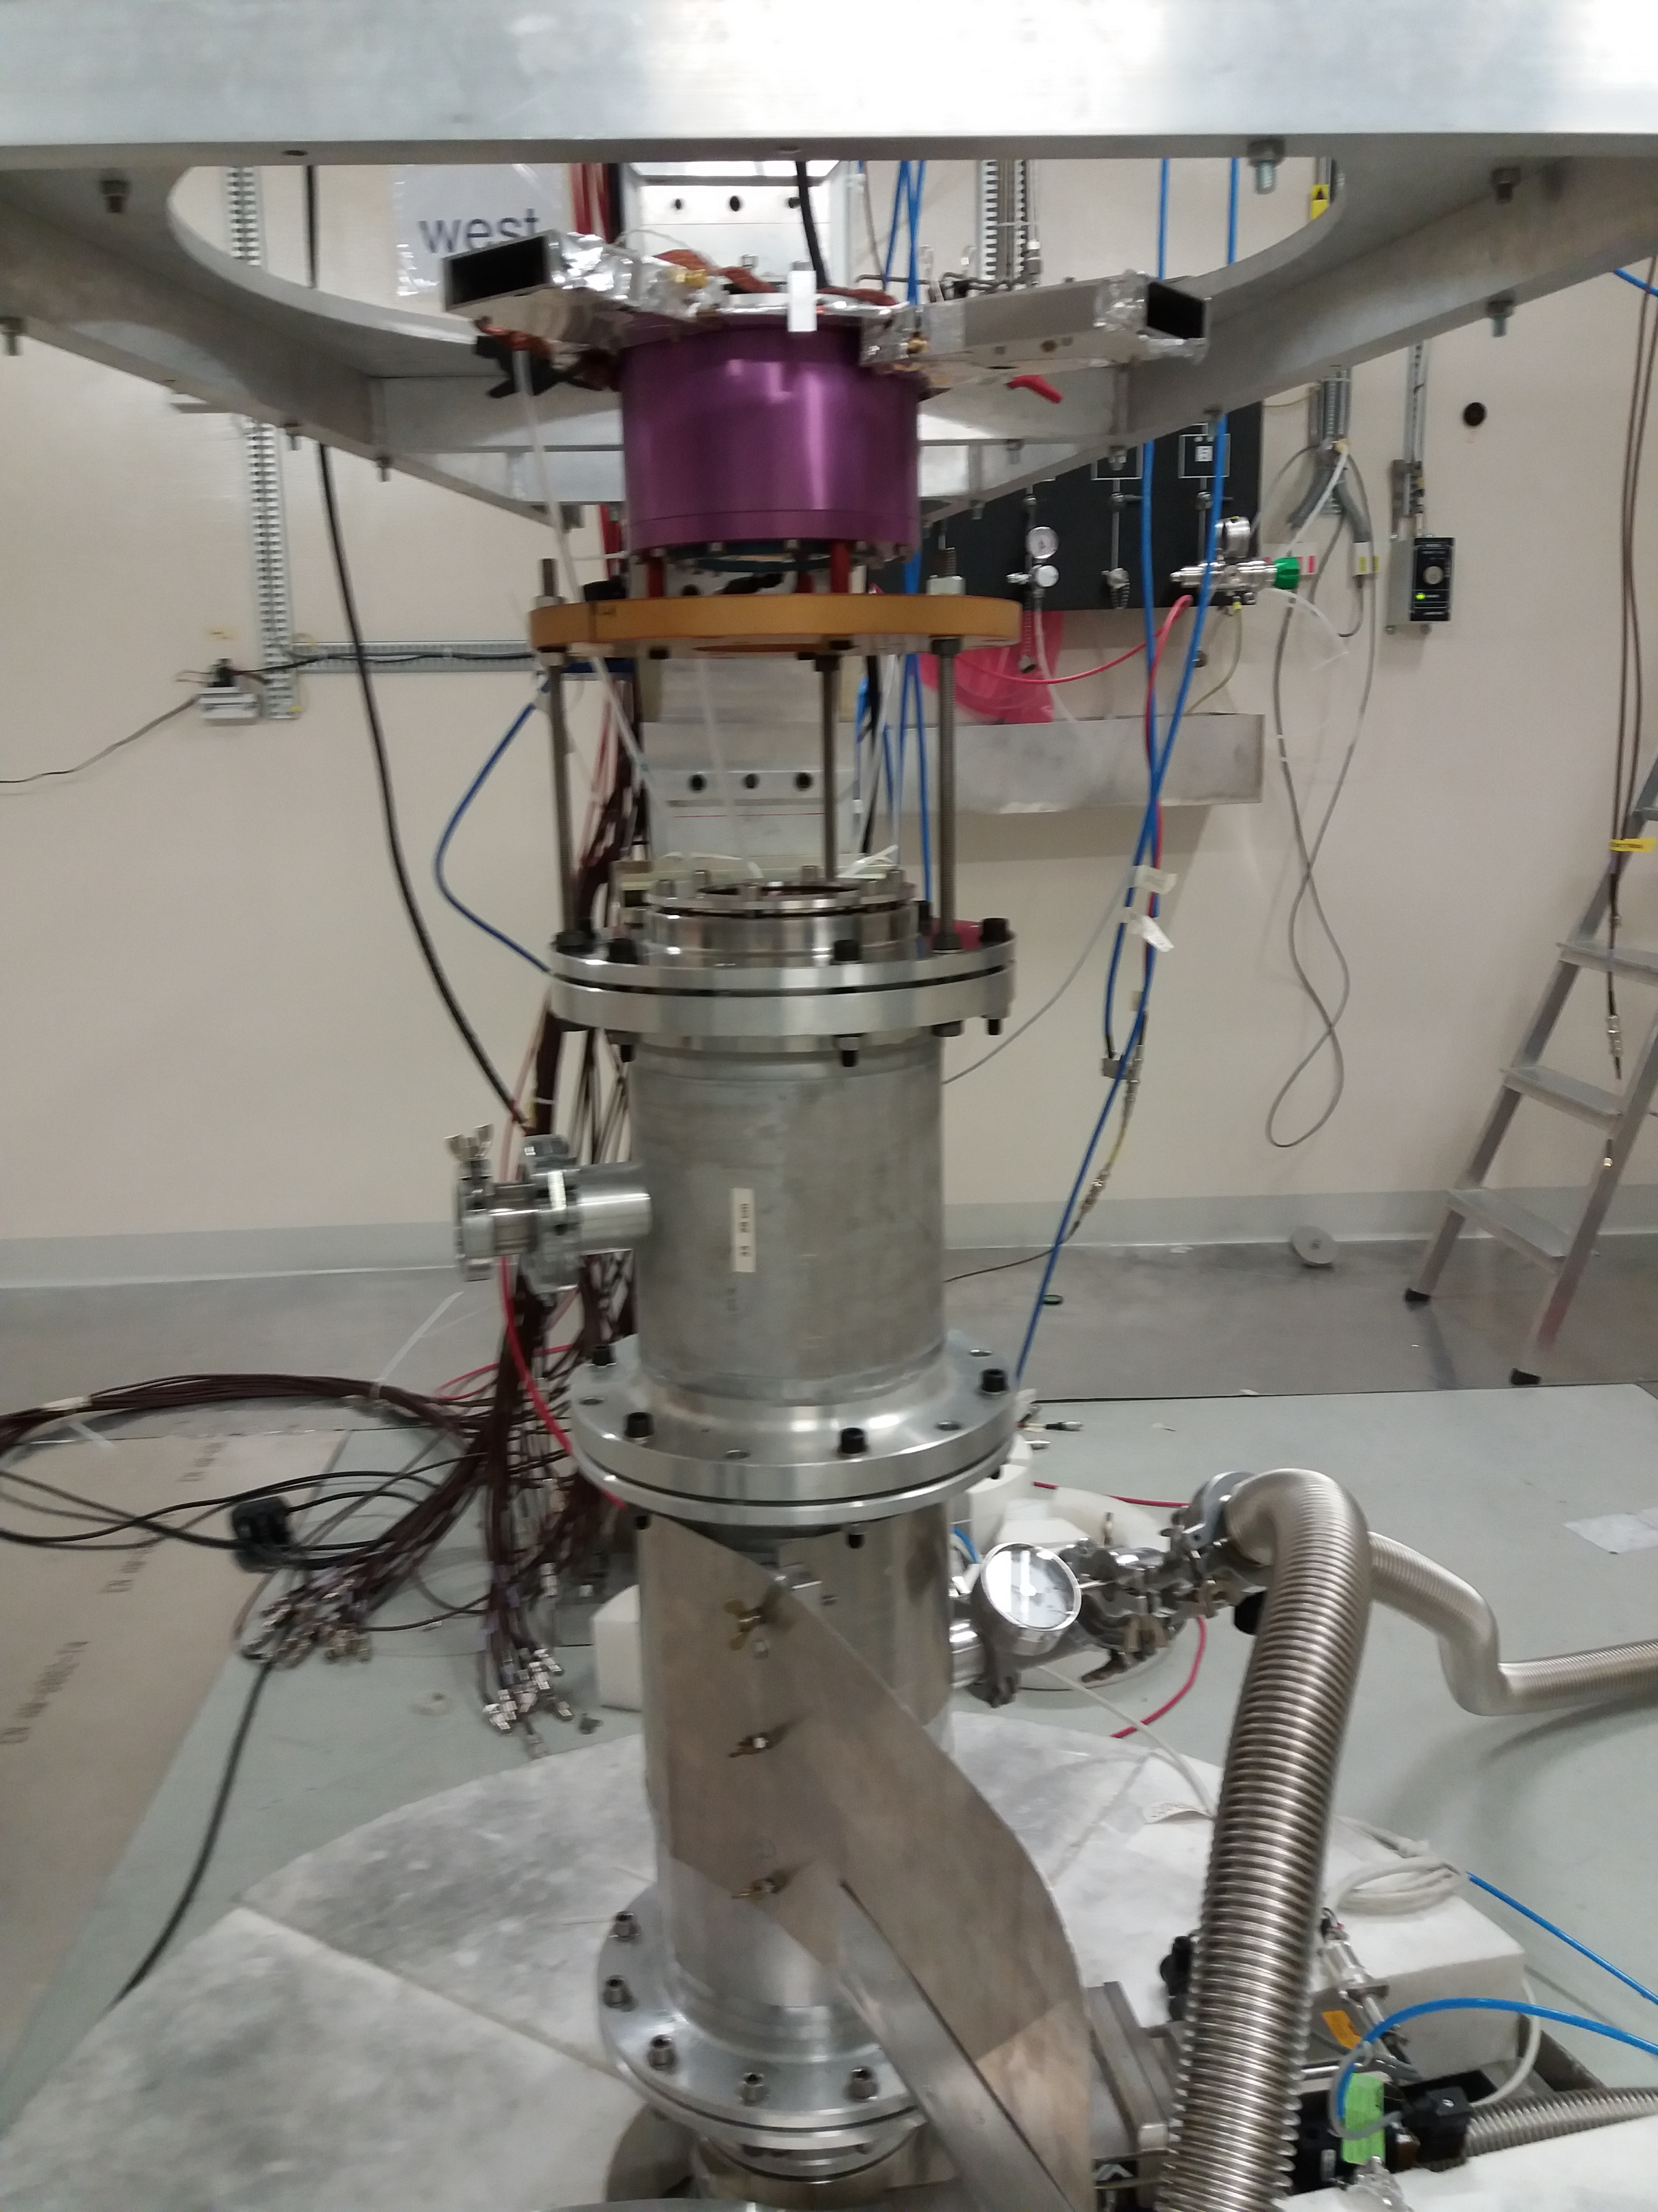
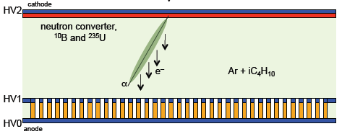
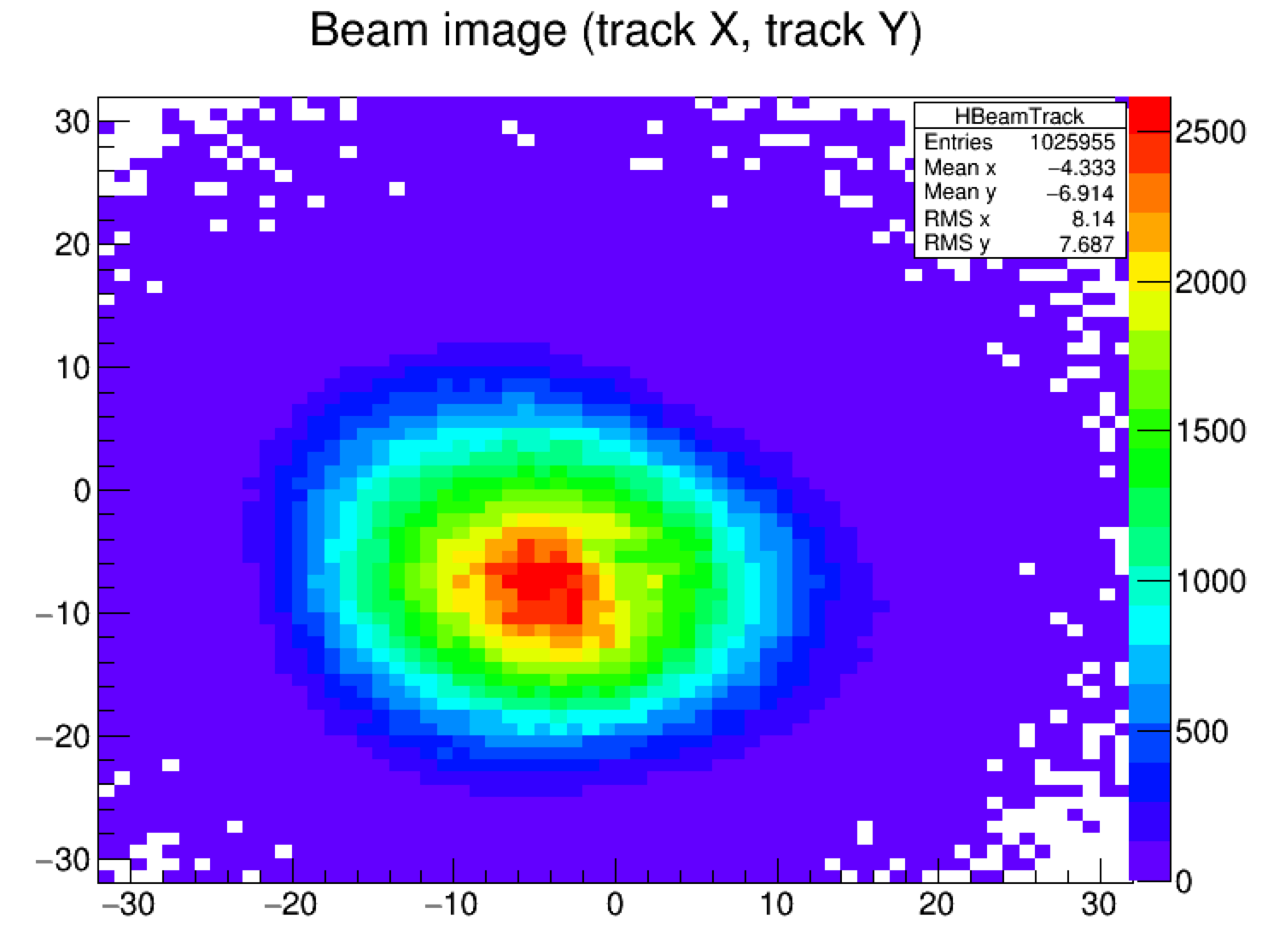
Beam profile measurement
XY MICROMEGAS
(both mesh and anode segmented into strips)
Cathode signal for the fluence extraction
neutron converter: ²³⁵U
²³⁵U(n,f)
XY MICROMEGAS
Ar + 10% CF₄ + 2% iC₄H₁₀
FF
Mesh :
charge+ collection
Si 2D
Anode:
charge- collection
Very preliminary !
2 days data taking !!
Strip nb (1.1 mm width)

Slide 7
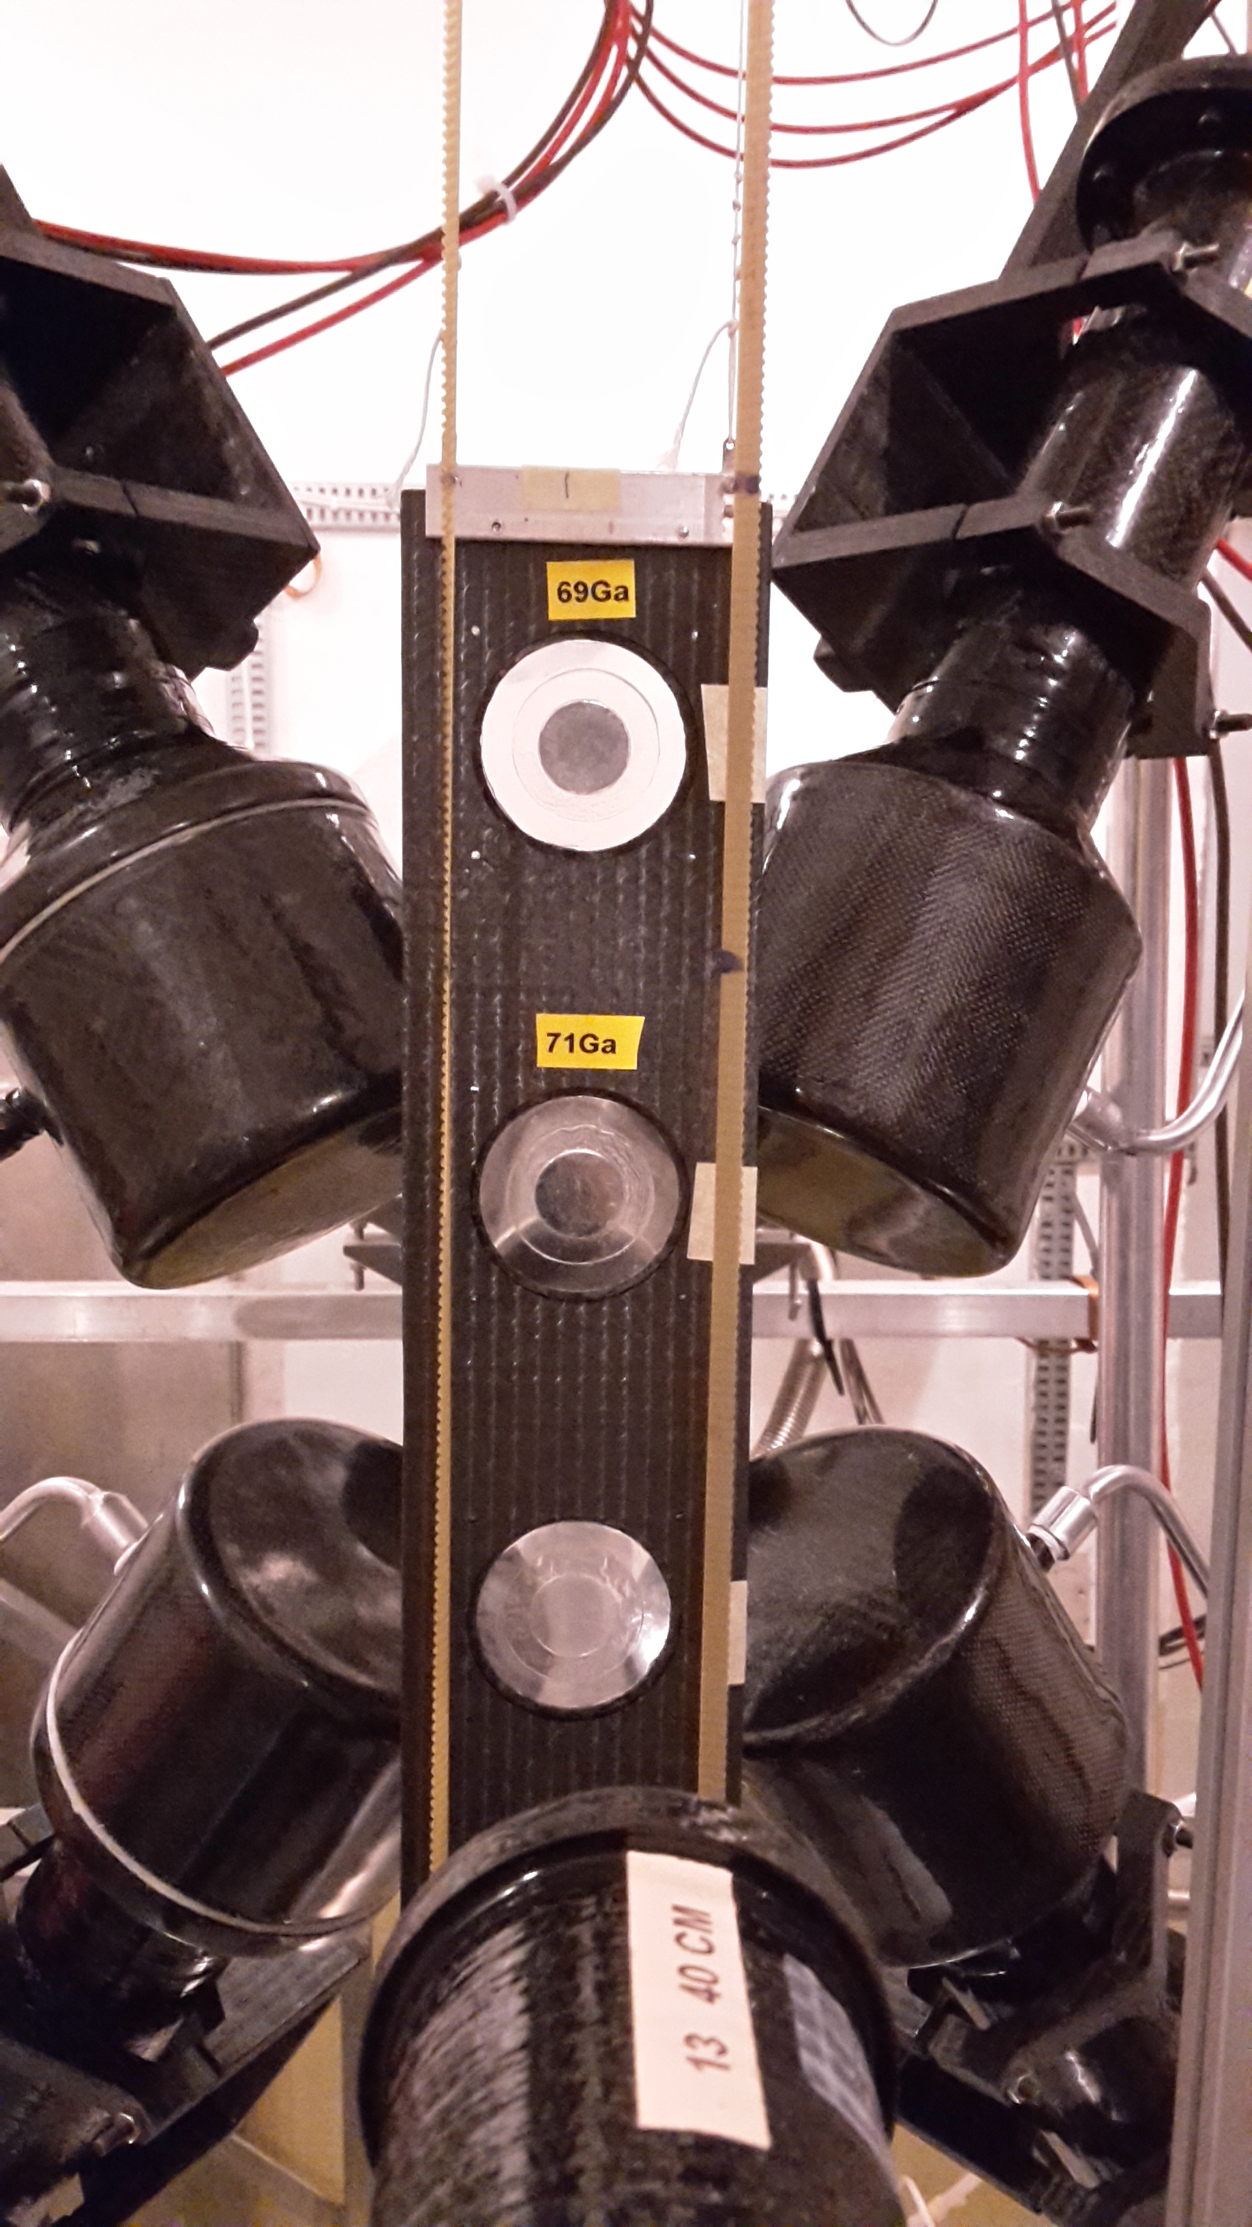
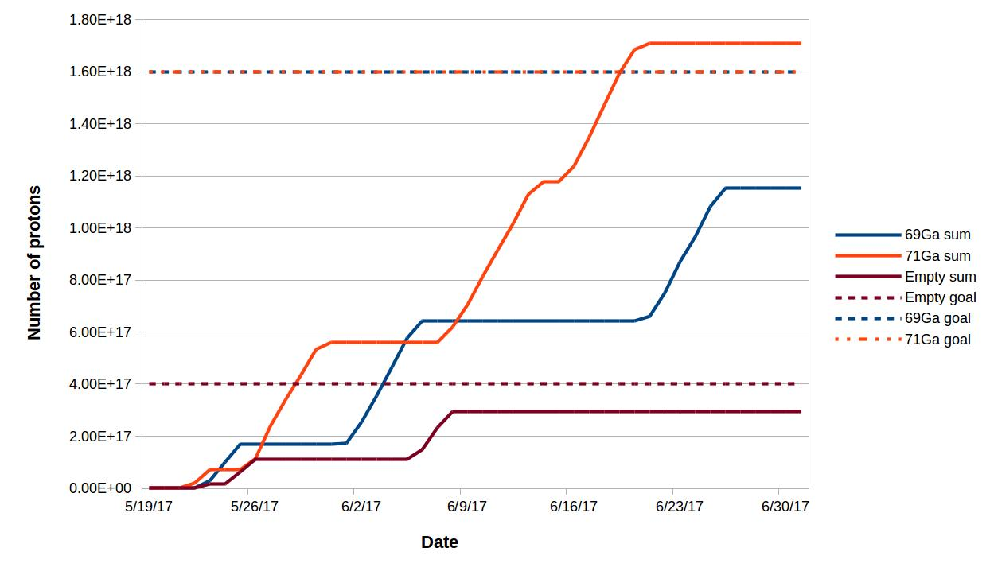
^{69,71}Ga(n,γ) measurement (EAR1)
Reactions important for the astrophysical s-process which produces about half of the elements heavier than Fe

Slide 8
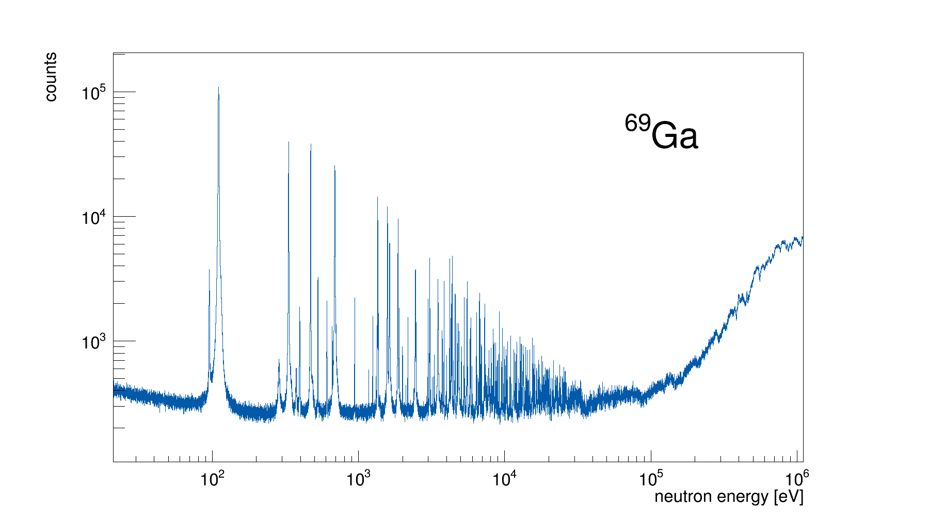
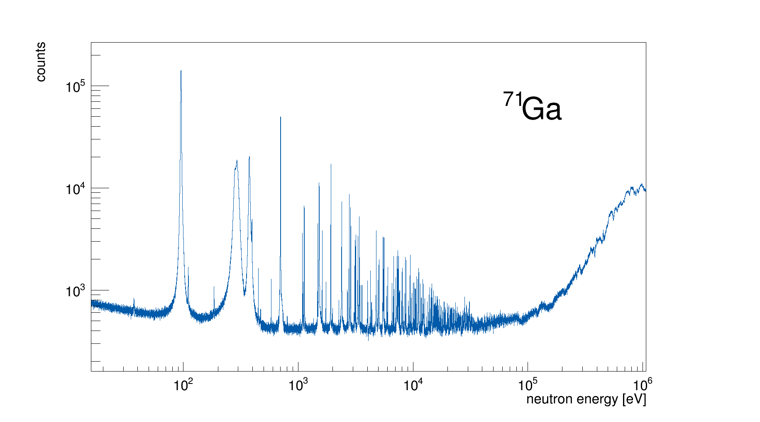
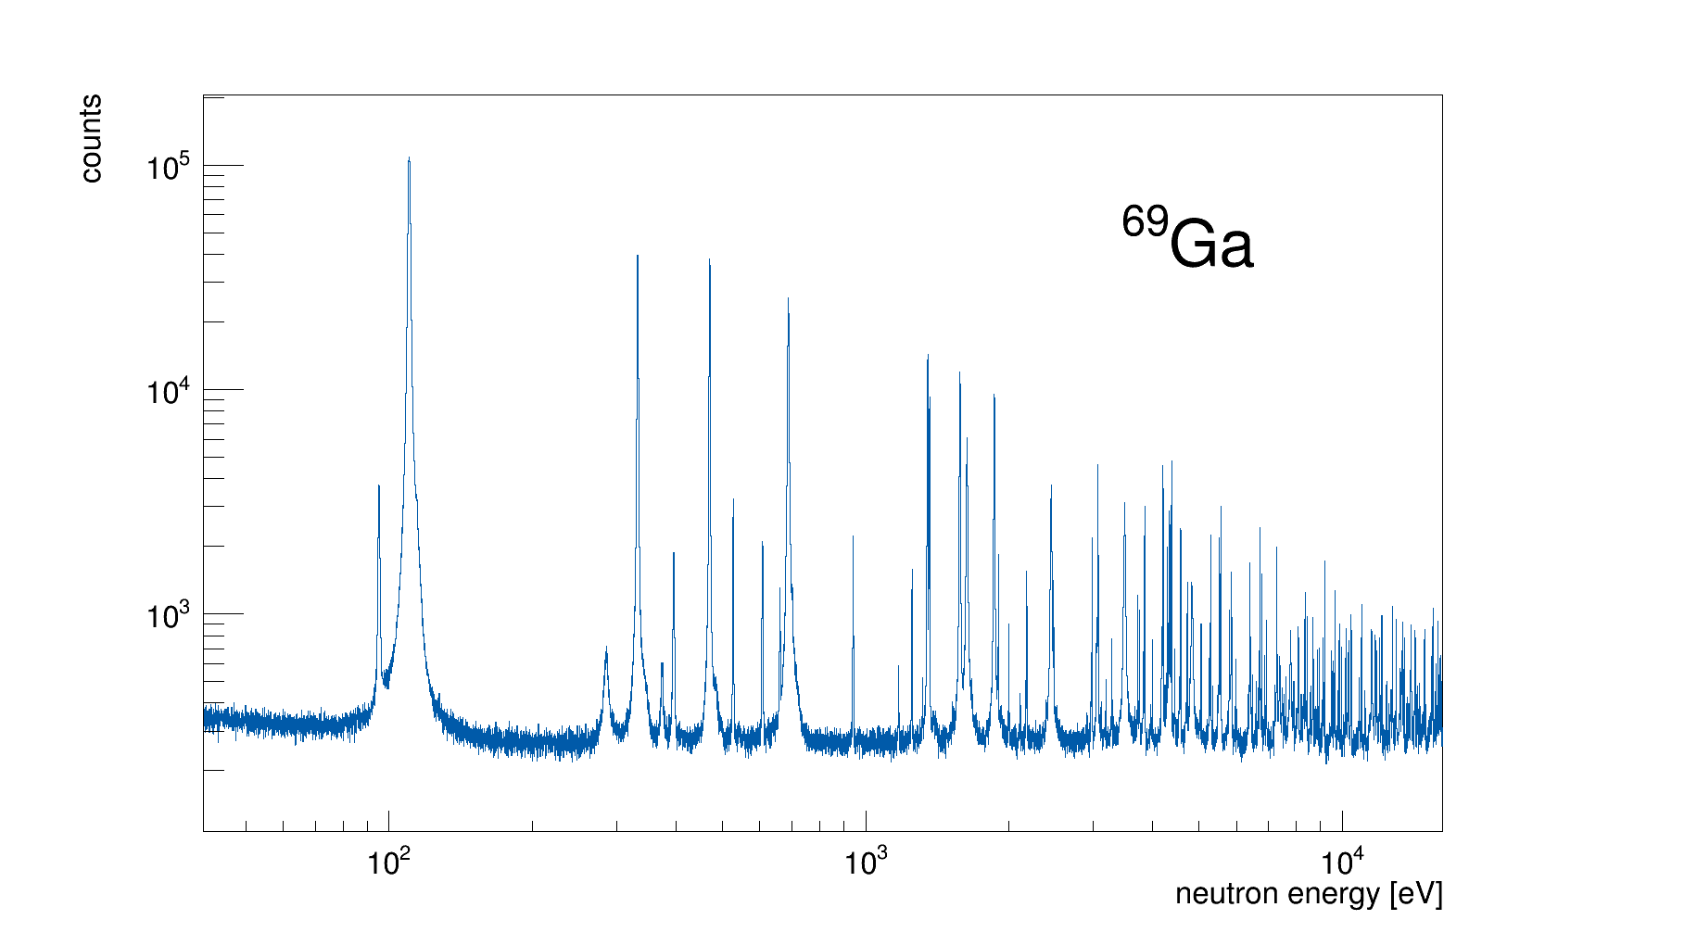
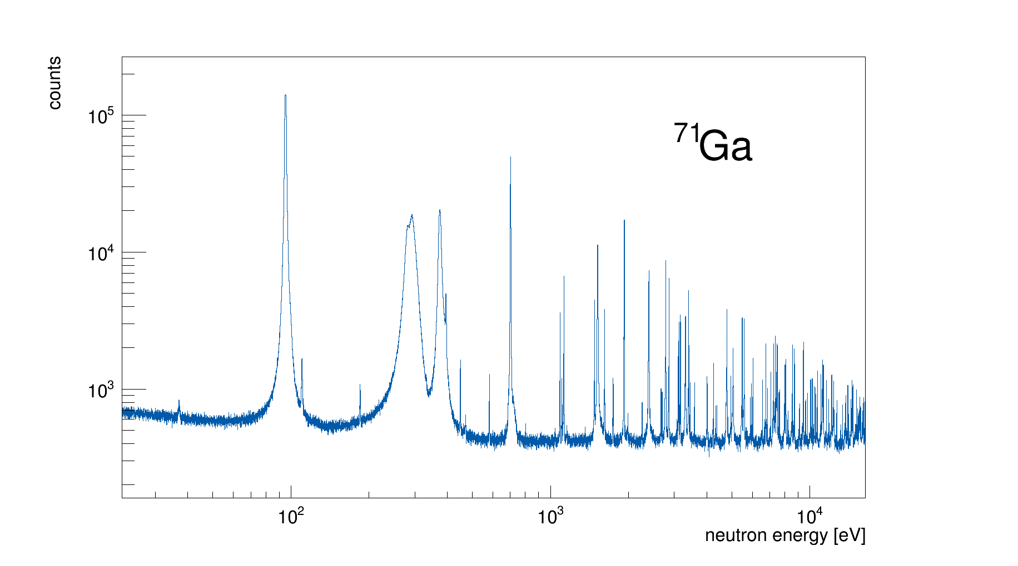
^{69,71}Ga(n,γ) measurement (EAR1)
Region interesting
for Astrophysics
Region interesting
for Astrophysics
Very preliminary !!
Resonance from ⁷¹Ga contamination

Slide 9
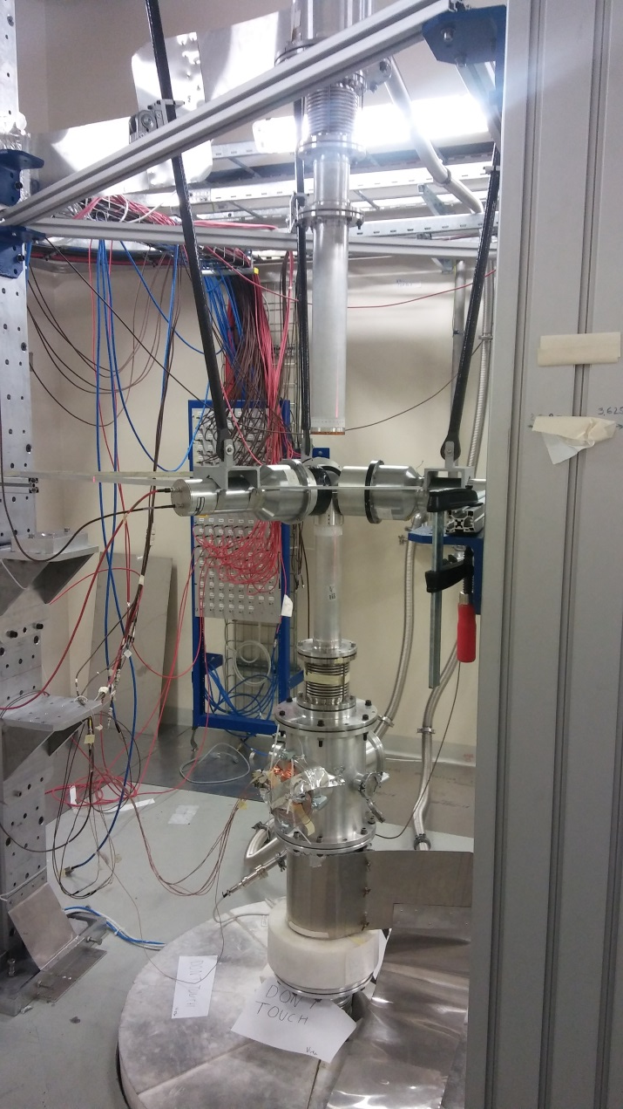
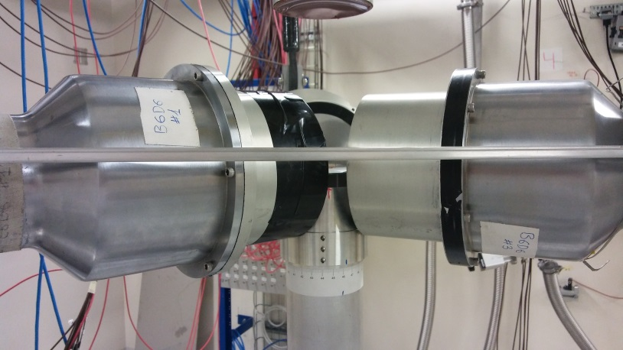
^{244,246}Cm(n,γ) measurement (EAR2)
Neutron Capture Cross Sections of minor actinides (MAs) and long-lived fission products (LLFPs) are important:
for improving the performance and safety of our actual reactors,
for designing new types of reactors & for reducing the high-level radioactive Waste (transmutation)
Measurement important
Samples radioactivity: 1.2GBq / target
Investigated two possible experimental setups:
Detectors shielded with lead, to improve the capture to background ratio.
Detectors without lead shielding, with higher detection efficiency.
Best configuration was the one without the lead shielding:
3 C6D6 detectors, placed very close and perpendicular to the beam pipe. The source is in the middle.

Slide 10
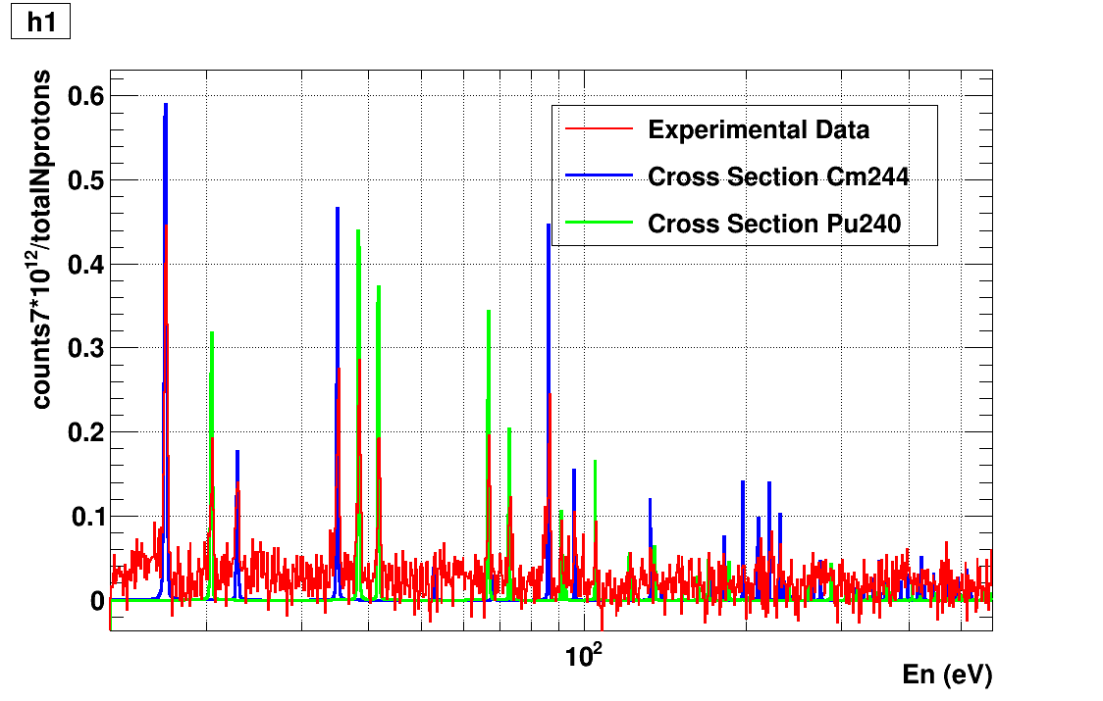
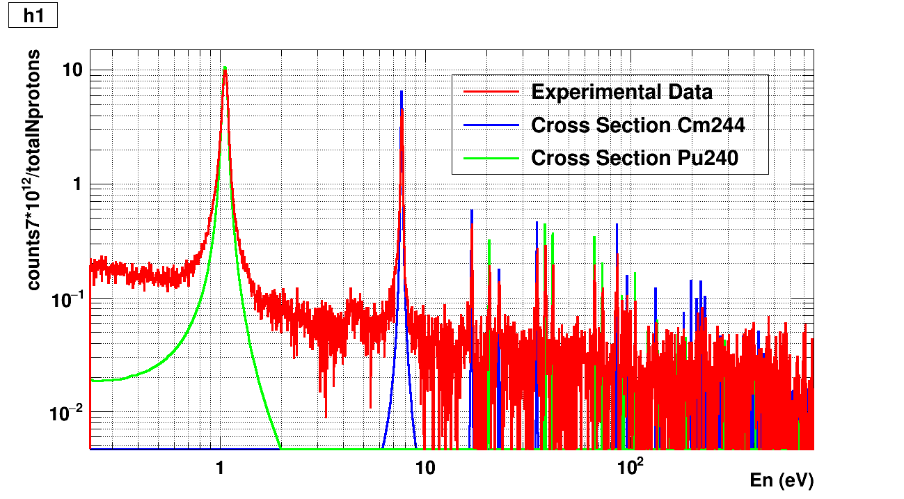
^{244,246}Cm(n,γ) measurement (EAR2)
Preliminary results show that is possible to measure the ²⁴⁴Cm capture cross section up to 200-250 eV, as expected (²⁴⁶Cm data taking will start by the end of the week).
In the bottom figures, part of the obtained ²⁴⁴Cm data, together with the ²⁴⁴Cm and ²⁴⁰Pu cross section shapes (the sample also contain ²⁴⁰Pu, which comes from the decay of the ²⁴⁴Cm), for comparison. Note that the effect of the resolution function has not been included in the ²⁴⁴Cm and ²⁴⁰Pu shapes.
Very preliminary !!

Slide 11
Summary and conclusions
Shutdown activities: all completed
PS performance very good
First experiments are taking good data

