Slide 1
The displacements per atom (dpa), a universal parameter describing the effect of high energy irradiation on Nb₃Sn –
Expected radiation effects in HL-LHC and FCC
R. Flükiger, T. Spina, F. Cerutti, A. Ballarino, C. Scheuerlein and L. Bottura
CERN, TE – MSC
1211 Geneva, Switzerland

Slide 2


Working strategy
CERN launched a campaign to study the variation of the superconducting properties of Nb₃Sn wires during the entire acceleration lifetime.
Same industrial multifilamentary Nb₃Sn wires
Nb₃Sn bulk samples
Proton irradiation study
@ CERN
(65 MeV, 24 GeV)
Neutron irradiation study
@ Atominstitut Vienna
(T. Baumgartner,
M. Eisterer et al.)
Proton irradiation study
NRC Kurchatov (Russia)
(A. Ryazanov,
Y. Zubavichus et al.)
Notes:
The investigation was carried out on the same industrial multifilamentary Nb₃Sn wires chosen for the QXF quadrupole for the HL LHC

Slide 3
Outline
Motivation of this work
Definition of the «displacement per atom» (or dpa)
Relationship between dpa and some physical properties
Expected effects in HiLumi-LHC
Estimated effects in FCC

Slide 4
Motivation of this work
Evaluate the damage caused by high energy irradiation on the superconducting properties of Nb₃Sn wires for the quadrupoles of HiLumi-LHC and FCC
What is known:
Number of total dpa
(displacement per atom)
From FLUKA calculations (MonteCarlo code):
(A. Lechner, F. Cerutti et al. 2014)
dpa vs. ∆T_{c}
dpa vs. ∆J_{c}
These correlations have never been studied before
Task: to determine
Notes:
Lifetime.......
Since no available reactor is able to produce simultaneously different high energy sources, irradiation effects have to be studied separately for each one of them being present in the HL LHC radiation environment, i.e. Photons, electrons, pions, neutrons and protons.

Slide 5
The radiation damage event
Transfer of the kinetic energy, T, from projectile to the solid and the resulting distribution of target atoms (displacement cascade)
Exiting particle
Frenkel pair
T>E_{d}
Incident particle
PKA (Primary Knock-on Atom)
The radiation damage event is concluded when the PKA comes to rest in the lattice as an interstitial
Frenkel pairs: link between the dpa (displacement per atom) and S (atomic order parameter)
Notes:
The radiation damage event is defined as the transfer of the kinetic energy from an incident projectile to the solid and the resulting distribution of target atoms. It can be described as follows: when an energetic incident particle interacts with a lattice atom it transfers a kinetic energy, $T$, to the lattice atom giving rise to a primary knock - on atom (PKA). If $T$ is higher than a threshold value (the displacement energy, E_{d}) the PKA is displaced from its lattice site. The displaced atom travels through the lattice encountering other lattice atoms and if such encounters involve sufficient energy transfer (at least equal to the displacement energy E_{d}) additional knock–on atoms are created resulting in the production of a displacement cascade. The radiation damage event is concluded when the PKA comes to rest in the lattice as an interstitial. The result of a radiation damage event is the creation of point defects (vacancies and interstitials, known as Frenkel pairs) and clusters of these defects in the crystal lattice

Slide 6
Irradiation by multiple particles in accelerators
In accelerators, high energy irradiation occurs simultaneously by several particles:
Neutrons, protons, pions, electrons, photons
Each one is defined by its energy and its fluence or dose (photons).
In order to describe the cumulated radiation damage, these individual quantities have to be replaced by a more general quantity: the number of displacements per atom, or dpa.

Slide 7
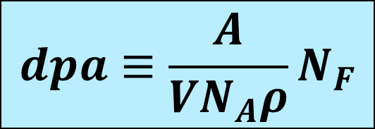
The «displacement per atom» or dpa
http://www.fluka.org
dpa: calculated by the FLUKA code:
Multipurpose interaction, incl. a Monte Carlo simulation
$$dpa≡\frac{A}{{VN}_{A}ρ}N_{F}$$
Frenkel pairs:
A: molar mass (g/mol), V: vol. (cm³), N_{A}: Avogadro number (mol⁻¹), ρ: mass density (g/cm³)
dpa = Σ (dpa)_{i}
i are the various high energy particles
Fluence dpa
Notes:
FLUKA is a fully integrated particle physics Monte Carlo simulation package. It has many applications in high energy experimental physics and engineering, shielding, detector and telescope design, cosmic ray studies, dosimetry, medical physics and radio-biology.

Slide 8
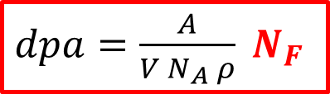
Correlations in irradiated Nb₃Sn wires
T_{c} in Nb₃Sn depends directly on the atomic order parameter S, i.e. the occupation of Nb (chain) sites by Sn atoms
T_{c} = T_{c} (S)
Order parameter S: depends directly on the number of Frenkel pairs, N_{F}
T_{c} = T_{c} (N_{F})
The number of Frenkel pairs N_{F} is proportional to the number of displacements per atom, or dpa. It can be calculated with great accuracy using the FLUKA code, developed by nuclear engineers at CERN:
$dpa=\frac{A}{V N_{A} ρ} N_{F}$
A: molar mass (g/mol), V: vol. (cm³), N_{A}: Avogadro number (mol⁻¹), ρ: mass density (g/cm³)
The calculation of dpa involves Monte Carlo simulations and takes into account the effect of secondary ions produced during irradiation.

Slide 9
The importance of the number of Frenkel defects
It follows that knowing the value of dpa, calculated by the FLUKA code, it is possible to describe the behavior of all physical quantities depending on the number of Frenkel pairs.
Quantities depending on the number of Frenkel pairs:
* The atomic order parameter, S
* The value of T_{c}
* The lattice parameter a
Recently, we have shown that the function T_{c} = T_{c} (dpa) for Nb₃Sn wires irradiated by neutrons and protons falls on the same curve.

Slide 10
Decrease of T_{c} after high energy irradiation
Different PROJECTILES (protons, neutrons) and ENERGIES
φt (p/m² or n/m²)
dpa
Protons: T. Spina et al, IEEE Trans.Appl.Supercond., 25,6000505 (2015)
Neutrons: T Baumgartner et al., Supercond. Science and Technol., 27,1(2014)
For a given value of dpa the decrease of T_{c} is the same regardless of the type of projectile and the different energy during irradiation.
«Universal relation between T_{c} and dpa»

Slide 11
Irradiation by multiple particles in accelerators
We have just shown that T_{c} = T_{c} (dpa) falls on the same curve for both, neutron and proton irradiation.
Question: is this a general correlation or is it just a coincidence?
In order to find a supplementary, independent proof for this, it was decided to study the effect of radiation on two other quantities being directly depending on the number of Frenkel pairs, N_{F}:
* The lattice parameter, a and
* The Bragg-Williams order parameter, S.
The experiments have been performed in Kurchatov, on bulk Nb₃Sn samples. Goal: to show that T_{c} and the order parameter are the same, for filamentary and for bulk Nb₃Sn

Slide 12
Determination of the order parameter in bulk Nb₃Sn

Slide 13
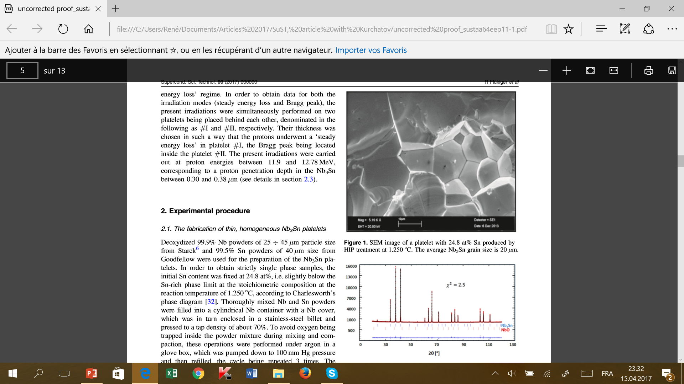
Preparation of high quality Nb₃Sn samples
24 hours at 1’250 °C under 2 kbar
Essentially single phase samples

Slide 14
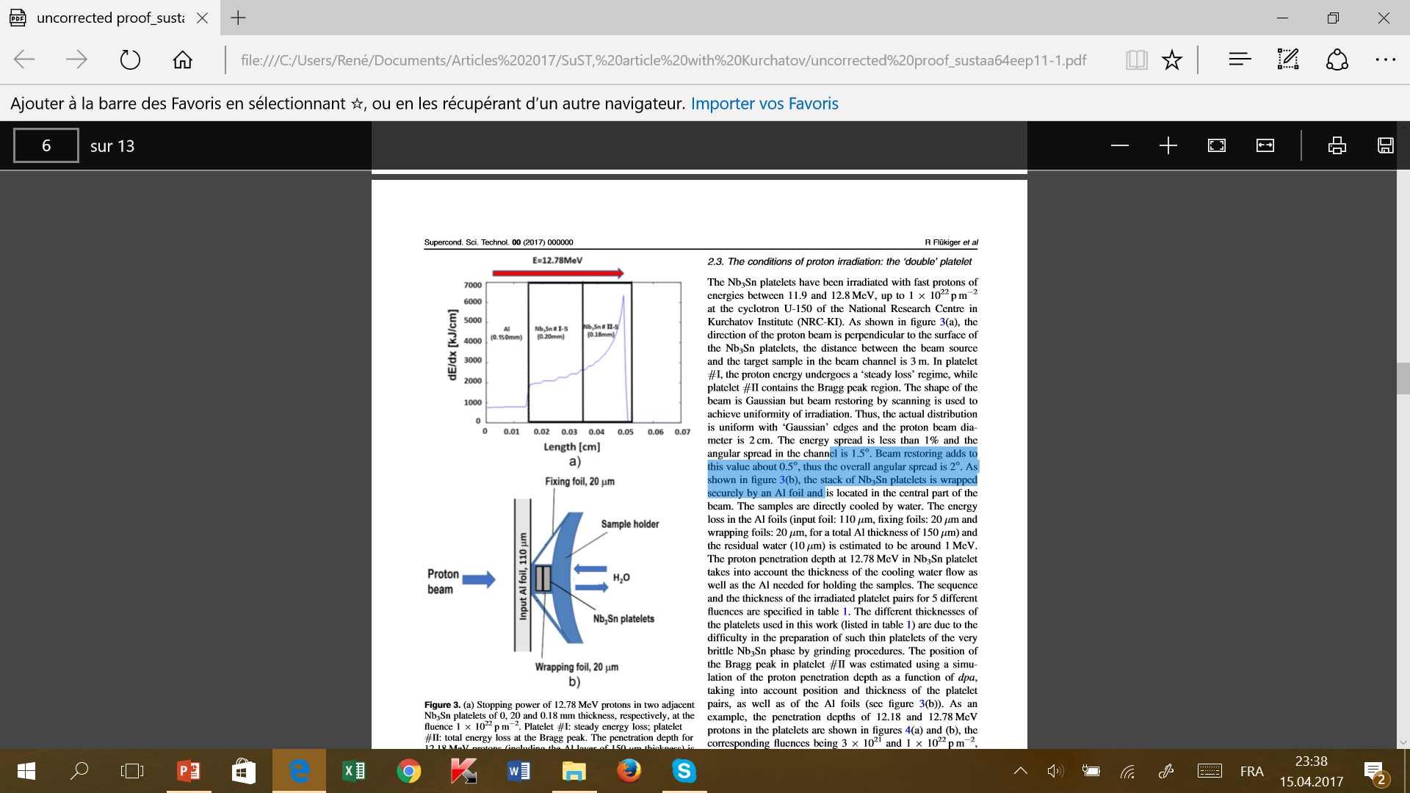
Double-platelet irradiation setup
Simultaneous measurement of the steady energy loss and the total energy loss at the Bragg peak
Passes
through
Bragg peak
At the Bragg peak: higher energy loss, thus higher damage for the same fluence, with the same radiation load: * lower T_{c}
* lower atomic order parameter S
* higher lattice expansion

Slide 15
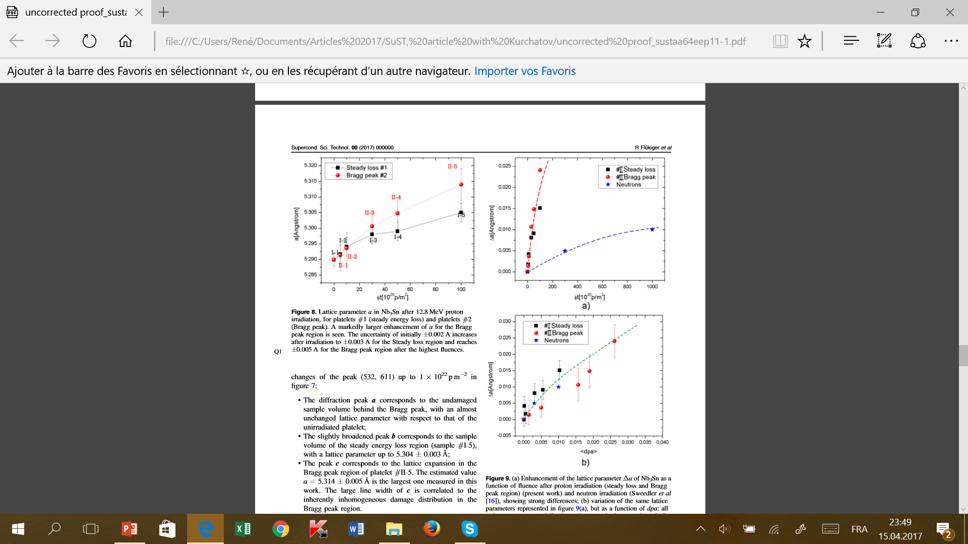
dpa: universal parameter for lattice expansion
a = a(dpa), same curve
regardless of the particle
(neutrons or protons)
This confirms the direct dependence of the lattice parameter on the number of Frenkel pairs.
φt (10²⁰ p/m²)
R. Flükiger, T. Spina, F. Cerutti, A. Ballarino, C. Scheuerlein, L Bottura, Y. Zubavichus, A. Ryazanov, R.Svetogovov, S. Shavkin, P. Degtyarenko, Y.Semenov, C. Senatore and R. Cerny,
Supercond. Sci. Technol., 30, March 31 (2017)
dpa

Slide 16
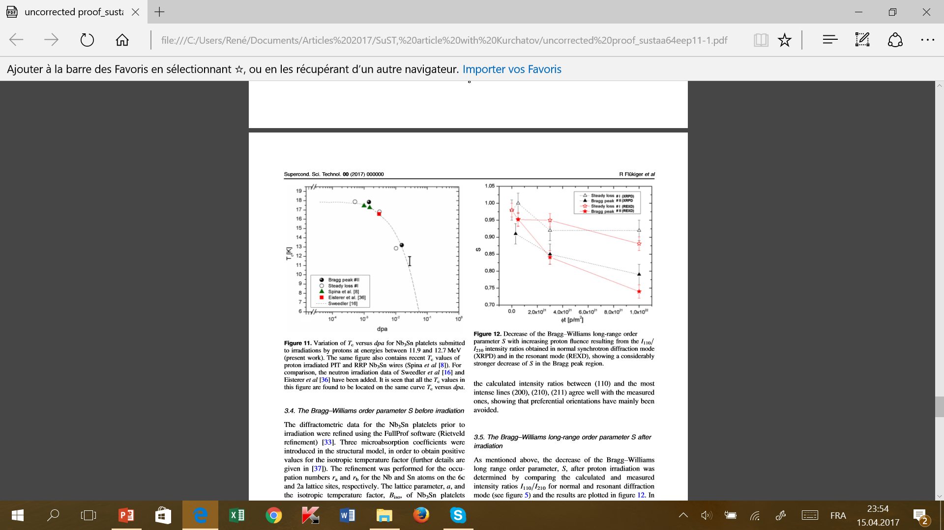
Variation of T_{c} with dpa from various experiments
Wires and bulk samples on the same curve.
Confirmation: T_{c} depends only on dpa, regardless on the particle and on the kind of energy loss
(steady loss or total loss at the Bragg peak)
References contained in:
R. Flükiger, T. Spina, F. Cerutti, A. Ballarino, C. Scheuerlein, L Bottura, Y. Zubavichus, A. Ryazanov, R.Svetogovov, S. Shavkin, P. Degtyarenko, Y.Semenov, C. Senatore and R. Cerny,
Supercond. Sci. Technol., 30, 054003 (2017)

Slide 17
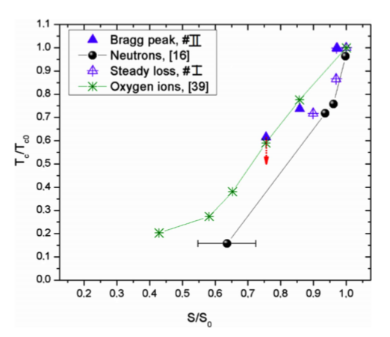
Effect of dpa on the Bragg-Williams order parameter
Essentially the same curve for various particles:
Neutrons, protons and oxygen ions.
References contained in:
R. Flükiger et al., Supercond. Sci. Technol., 30, March 31 (2017)

Slide 18
First conclusions
We have experimentally proven by independent measurements that
The transition temperature T_{c},
the order parameter S and
the lattice parameter a
of Nb₃Sn depend only on the number of Frenkel pairs N_{F}, and thus of dpa.
T_{c} and S and are directly correlated, this constitutes an additional proof!
The prediction of these three quantities in future accelerators can be performed with a good precision.
What about J_{c}?
As expected, the prediction of J_{c} vs. dpa shows a considerably higher uncertainty, but a prediction can be done within certain limits (see later).

Slide 19
Variation of superconducting properties in HiLumi-LHC

Slide 20
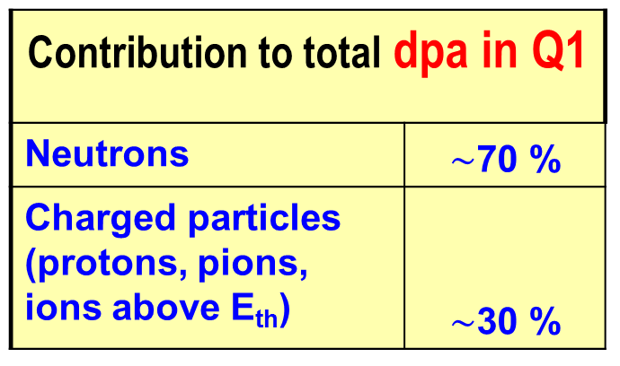
Radiation environment in the HL-LHC quadrupoles
HL-LHC: Integrated luminosity: 4’000 fb⁻¹
W shield: Reduces dose from 150 to 30 MGy
FLUKA calculations (with W shield) for Q1
Total dpa in Q1 $\sim 2.4×{10}^{−4}$ (A. Lechner, F. Cerutti, 2014)
Contribution to total dpa in Q1
Neutrons | $\sim$70 %
Charged particles (protons, pions, ions above E_{th}) | $\sim$30 %
Particle Max. Fluence in Q1
Neutrons 1.8 x 10²¹ n/m²
Protons 1.8 x 10¹⁹ p/m²
Pions 1.8 x 10¹⁹ pions/m²

Slide 21
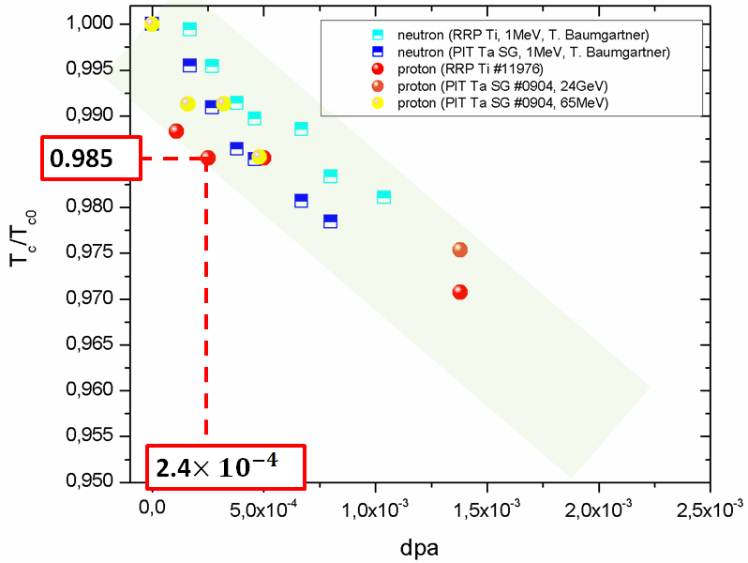
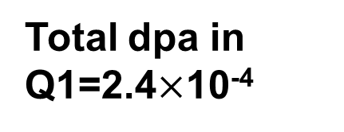
Decrease of T_{c} in Nb₃Sn wires for HL-LHC
Total dpa in Q1: 2.4$×$10⁻⁴ for 4’000 fb⁻¹
Total dpa in Q1=2.4$×$10⁻⁴
∆T_{c} ≤ 0.25 K

Slide 22
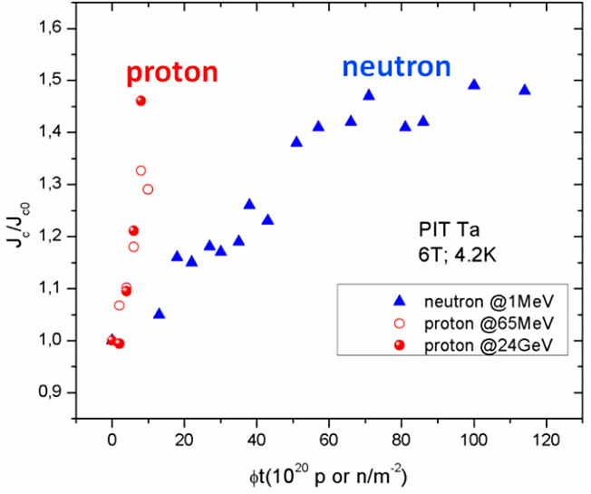
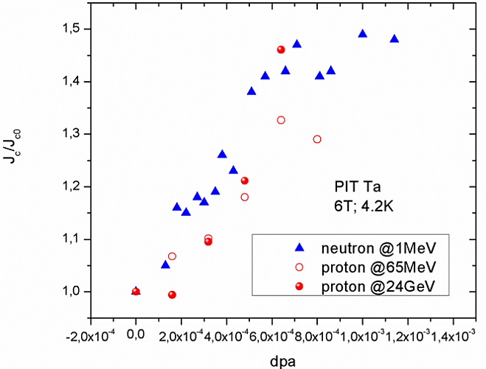
Enhancement of the critical current density
In contrast to T_{c}, the link between the variation of J_{c} and dpa is not established by S but by the radiation induced defects (point pinning)
PIT Ta
4.2K/6T
J_{c}: +20 %
T. Spina et al, IEEE Trans.Appl.Supercond., 25,6000505 (2015)
T. Baumgartner et al. , Supercond. Science Technol., 27,1,2014
Increasing the dpa number enhances the quantity of stable point defects, which is influenced by the number of Frenkel Pairs
Notes:
The correlation is not straightforward as in the case of T_{c}

Slide 23
Conclusion for HiLumi-LHC
For the luminosity of 4’000 fb-1: dpa = 2.5 x 10⁻⁴
T_{c} will decreases by 0.25 K
B_{c2} will only be enhanced by 1 – 2 %
J_{c} will increase by 20 - 25 % at 6T and
by ≤35% % at 10T
The enhancement of J_{c} depends not only on N_{F}, but also on the additional effect caused by the additives: Ta and Ti have a very different mass. The situation is more complex, but within certain limits, a reasonable extrapolation can be done.

Slide 24
Estimated variation of superconducting properties in FCC

Slide 25
The radioactive load in the FCC accelerator
The following remarks reflect a very recent discussion (13.4.2017) with Francesco Cerutti (CERN) and his team.
The data are subject to further changes, depending on the progress of the FCC project: they are a first approximate view of the radiation load.
Material classes: Changes during accelerator operation
* Insulator materials: Most sensitive to high doses: no recovery
* Stabilizing Cu: RRR decreases with fluence, but can be
recovered at 300K
* SC quadrupoles: T_{c} slight decrease with fluence
B_{c2} increases slightly with fluence
J_{c} marked increase with fluence
* Mechanical structures: Small effects expected

Slide 26
Effects on the FCC quadrupoles
Insulator: Most sensitive component on high energy irradiation
The damages are irreversible
Tolerable dose on the insulator :
5 MGy for 5’000 fb⁻¹
30 MGy for 30’000 fb⁻¹
this will determine thickness of the W shield inside the quadrupole.
HiLumi LHC FCC
3000 fb⁻¹ 5’000 fb⁻¹ 30’000 fb⁻¹
_____________________________________________
Coil ID 155 mm 205 mm 248mm
DPA 2.5 x 10⁻⁴ 3 x 10⁻³ 2.5 x 10⁻³
W Shield 6-12 mm 15 mm 55 mm

Slide 27
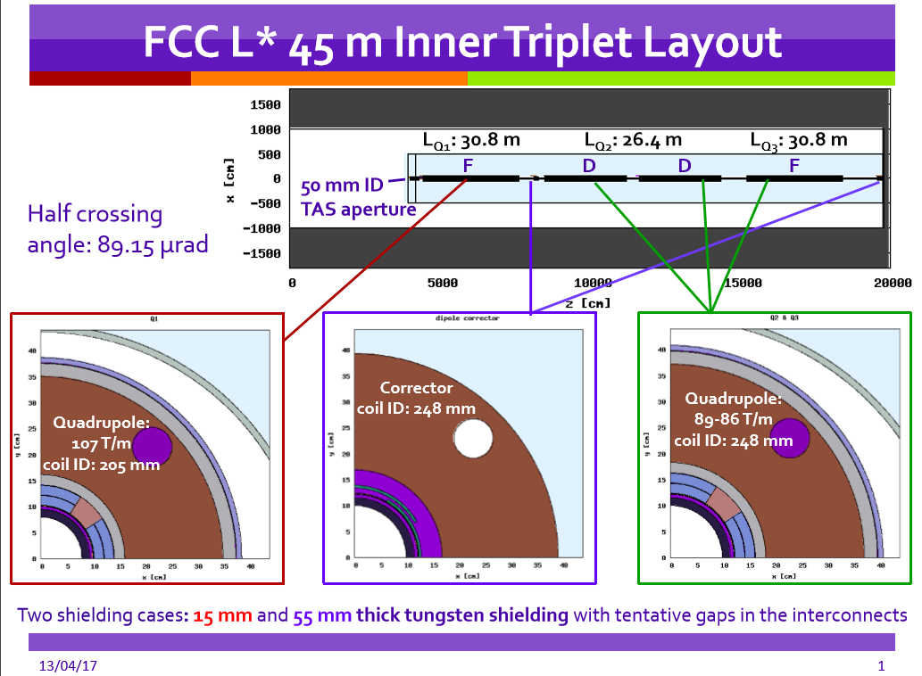
Maria Ilaria Besana and Francesco Cerutti, CERN

Slide 28
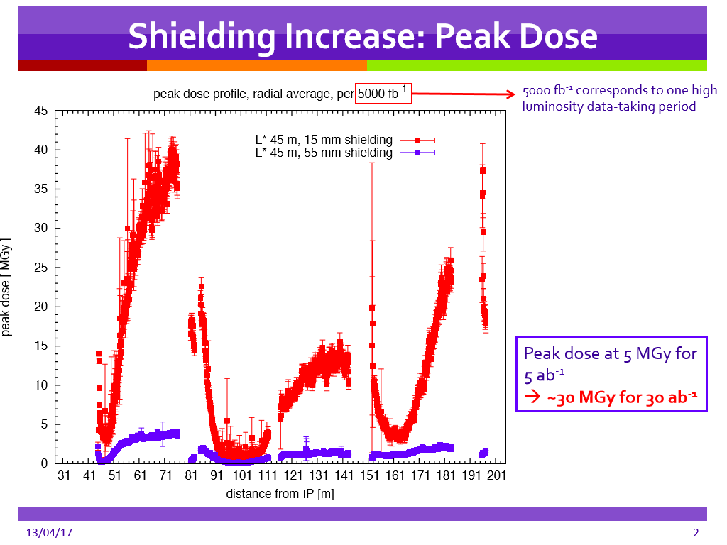
Maria Ilaria Besana and Francesco Cerutti, CERN

Slide 29
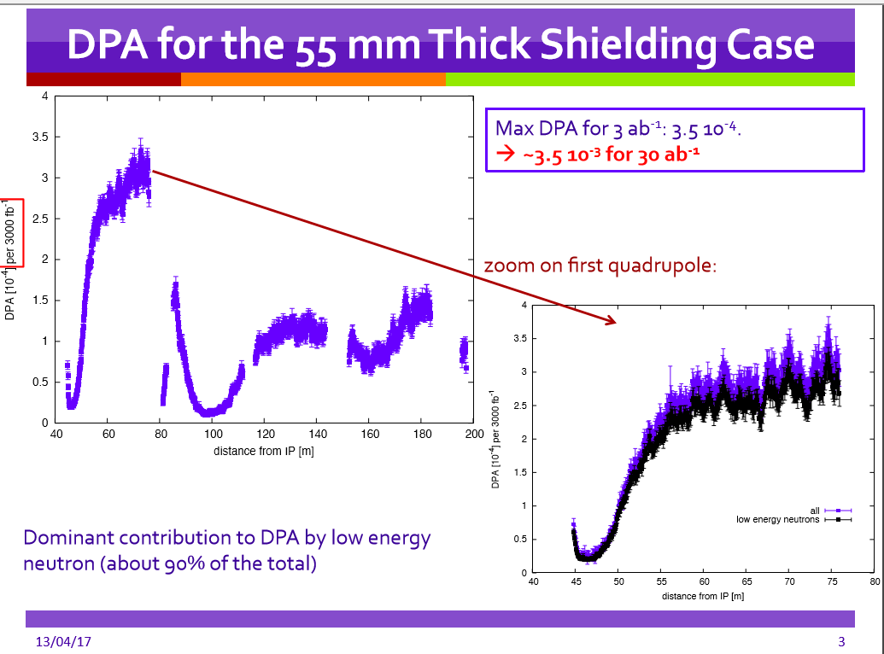
Maria Ilaria Besana and Francesco Cerutti, CERN

Slide 30
Effects on the superconducting properties of the quadrupoles
The following results are based on the following articles, in the frame of collaborations of ATI Vienna (A) and NRC KI, Kurchatov (Russia): Inductive measurements at 6 and 10T:
* T. Spina, C. Scheuerlein, D. Richter, A Ballarino, F. Cerutti, L.S. Esposito, A. Lechner,
L. Bottura, R. Flükiger, EUCAS 2016
* T. Baumgartner, M. Eisterer, H. W. Weber, R. Flükiger, C. Scheuerlein and L. Bottura,
Sci. Reports, 5, 10236 (2015); FCC workshop, April 2016
* R. Flükiger, T. Spina, F. Cerutti, A. Ballarino, C. Scheuerlein, L Bottura, Y. Zubavichus, A.
Ryazanov, R.Svetogovov, S. Shavkin, P. Degtyarenko, Y.Semenov, C. Senatore and R.
Cerny, Supercond. Sci. Technol., 30, 954003 (2017)
Earlier publication (so far the only paper with transport J_{c} measurements on irradiated binary, Ta and Ti alloyed bronze Nb₃Sn wires, up to 20T (14 MeV neutrons).
* F. Weiss, R. Flükiger, W. Maurer, M.W. Guinan, IEEE Trans. Magn.,MAG-23 (1987) 976

Slide 31
Estimated variation of T_{c} in FCC quadrupoles

Slide 32
Estimated variation of T_{c} in FCC quadrupoles
This estimation is performed based on:
calculation of the dpa for FCC by Maria Ilaria Besana and Francesco
Cerutti, CERN
recent results on T_{c} vs. dpa obtained by the collaboration with Kurchatov
recent results on J_{c} vs. neutron fluence obtained by the collaboration with the ATI Vienna, and finally
an earlier determination (Weiss et a., 1987) of J_{c} , T_{c} and B_{c2} vs. neutron fluence on binary and ternary alloyed Nb₃Sn wires (this «old» study is the most complete so far; it is the only one where J_{c} was measured by transport (up to 20T), in contrast to all other articles, where it was measured inductively).

Slide 33
dpa: «Universal» parameter for T_{c} after neutron and proton irradiation
2.5x10⁻⁴
3.5 x10⁻³
HiLumi LHC
FCC
3.0x10⁻³ 3.5x10⁻³
3.0x10⁻³
dpa
Extrapolated from:
T. Spina, C. Scheuerlein, D. Richter, A Ballarino, F. Cerutti, L.S. Esposito, A. Lechner L. Bottura and R. Flükiger, EUCAS 2016

Slide 34
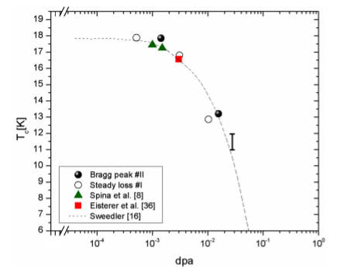
FCC: Expected value of T_{c} in Nb₃Sn for 30’000 fb⁻¹
For E ≥ 0.1 MeV neutrons, dpa = 3.5 x 10⁻³, yields a T_{c} value of 16 K
T_{c} ~ 16 K
T_{c} value after 30’000 fb⁻¹
dpa = 3.5 x 10⁻³
ΔT_{c} ~ 16 K
Master curve: from Flükiger et al., SUST, 30, 054003 (2017)

Slide 35
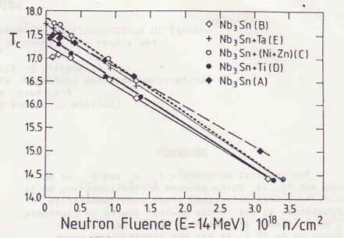
Comparison with earlier neutron data at 16 MeV (1987)
Data for various binary and ternary alloyed Nb₃Sn wires
The value of T_{c} = 16K is supposed to occur at the same dpa value.
For 14 MeV neutrons, T_{c} = 16 K is obtained at ~ 1.5 x 10²² n/m²
dpa
This value will be used for comparison in the next figures
F. Weiss, R. Flükiger, W. Maurer, M.W. Guinan,
IEEE Trans. Magn.,MAG-23 (1987) 976

Slide 36
Variation of J_{c} and B_{c2} in FCC quadrupoles

Slide 37
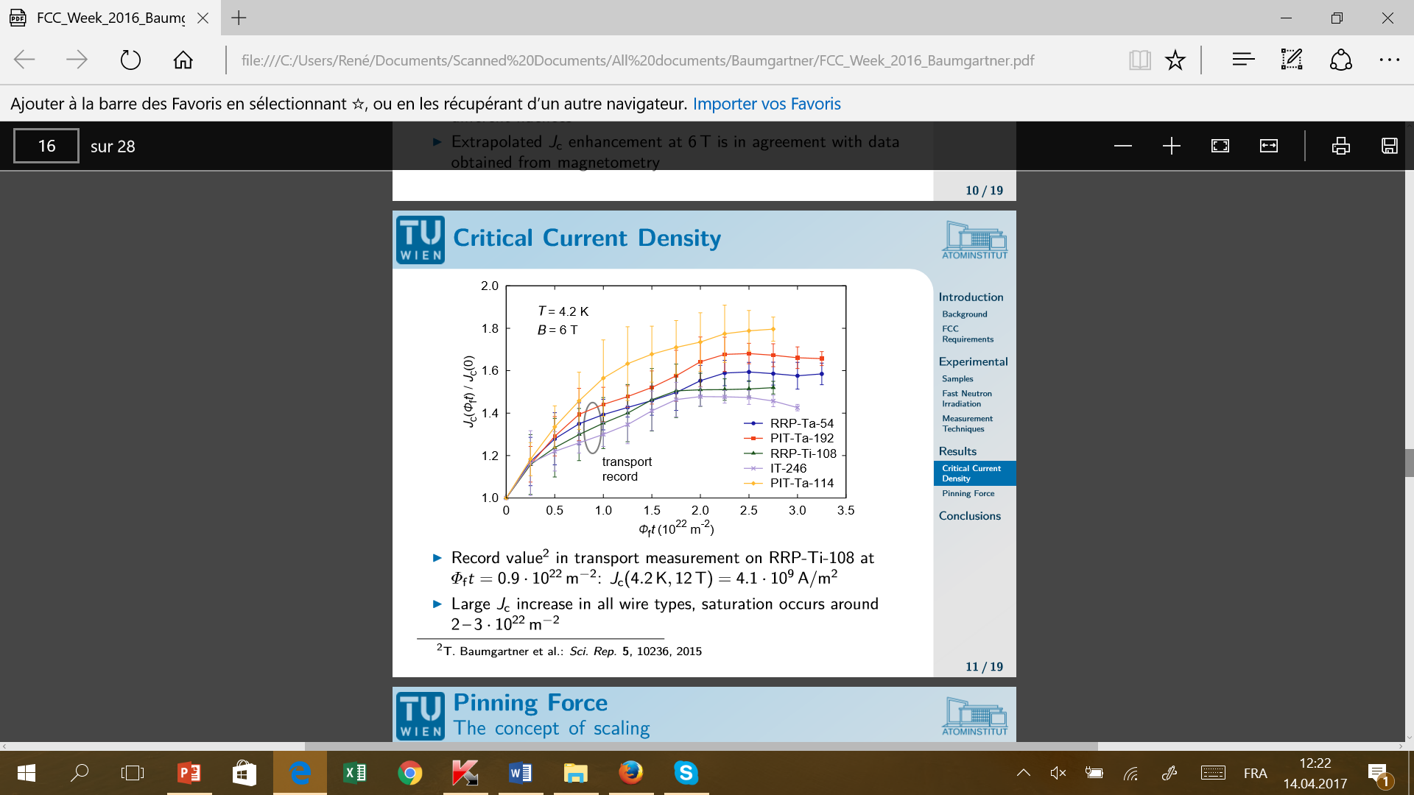
T = 4.2K
B = 6T
FCC
dpa (x 10⁻³)
J_{c}/J_{co} vs. Fluence: T. Baumgartner, M. Eisterer, H. W. Weber, R. Flükiger, C.Scheuerlein, L.Bottura, Sci. Rep. 5,10236 (2015).
Maximum of J_{c} approximately at dpa = 2.5 x 10⁻³
The dpa values have been estimated in the present work, based on the data of Weiss et al. (1987)

Slide 38
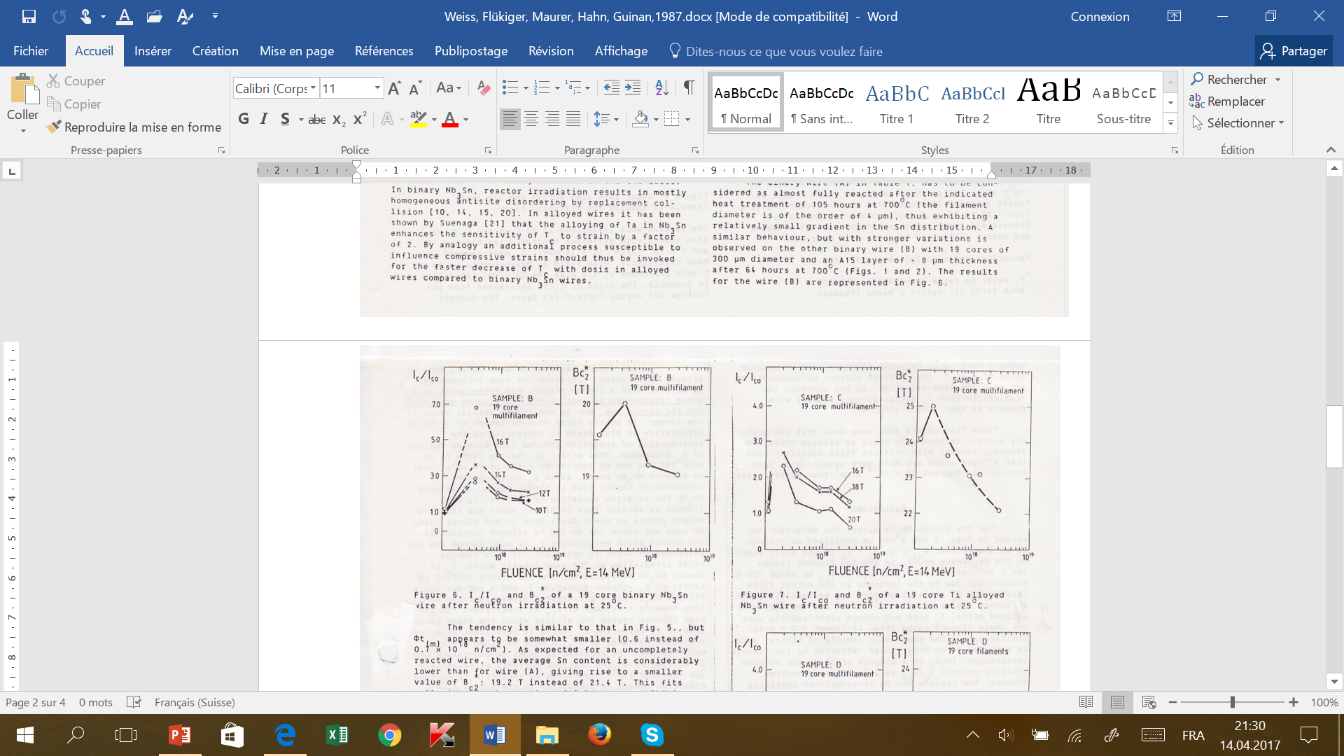
Estimation of J_{c} and B_{c2} after 30’000 fb⁻¹
16 MeV neutrons on Ti alloyed Nb₃Sn wire: transport measurements
F. Weiss, R. Flükiger, W. Maurer, M.W. Guinan, IEEE Trans. Magn.,MAG-23 (1987) 976
1.5 x 10²²
ΔB_{c2}
ΔJ_{c}
10²¹ 10²² 10²³ 10²² 10²³
φt [n/m²]
φt [n/m²]
J_{c}(4.2K/16T): + 60%
B_{c2}(4.2K): - 1.2T (-5%)

Slide 39
Summary: Expected superconducting properties in FCC
under the conditions dpa = 3.5 x 10⁻³ for 30 ab⁻¹
* From a comparison between the recent data (≥ 1 MeV neutrons and
65 GPa protons) and older 14 MeV neutron data, a first estimation can
be made for the change of properties of Ti and Ta alloyed Nb₃Sn wires:
30’000 fb⁻¹: T_{c} = 16 K ; ΔT_{c} = - 2 K
ΔJ_{c} = + 40 - 60 %
ΔB_{c2} = - 1.2 T
The effect on the insulator has been taken into account
The effect of secondary radiation has been taken into account
This result is a first estimation, based on experimental data, and is subject to small changes.

Slide 40
Summary: Expected superconducting properties in FCC
A first estimation is performed about the expected superconducting
properties in the FCC quadrupoles at 4.2K/16T and dpa = 3.5 x 10⁻³.
The estimation has been made under the condition that no other,
unexpected effects will appear during the development phase.
This first rough estimation was made under the condition that no
other effects will occur. In view of the complexity of the project, new
and unexpected problems may appear during the development
phase.

