Slide 1


Impact of irradiation on margins of high-luminosity IR triplet magnets
Daniel Schoerling
23rd of June 2017

Slide 2
High luminosity IRs
For the design of the 2 IRs (β* = 0.3 m, L* = 45 m) a table with the quadrupole strength limit vs aperture has been established [1]
The separation and recombination dipoles D1 and D2 can be normal-conducting (an alternative design with 4-5 T dipole magnets to be evaluated)
Nested H/V orbit correctors with a field of 3 T, length 1.3 m, are proposed
Radiation and heat load limits:
  Peak power limit: 5 mW/cm³ (compare [2] and [3])
  Radiation limit: 30 MGy (baseline) and 250 MGy (ultimate)
  Displacement-Per-Atom (DPA) limit: 3.5 ⋅ 10⁻³ (Ti-doped, limit under discussion)
  55 mm tungsten shielding (baseline) and 15 mm (ultimate) fulfil the limits (cooling, DPA, aperture, activation to be confirmed, see simulations [4])
Reduction of aperture for thin shielding to be evaluated
Alternative IR design under study (baseline to be decided)
Aperture | G
(mm) | (T/m)
72 | 249
100 | 193
120 | 166
140 | 149
160 | 133
180 | 120
200 | 110
220 | 102
240 | 94
260 | 88
 | MQXA | MQXB | MQXC | D1 | D2
Number of units | 8 | 16 | 8 | 12 | 12
G, B | 115 T/m | 94 T/m | 94 T/m | 1.97 T | 1.97 T
L | 15 m | 13.2 m | 15 m | 12.5 m | 12.5 m
Aperture | 190 mm | 240 mm | 240 mm | ~200 mm | ~70 mm
[1] E. Todesco in CAS-CERN Accelerator School, Erice, Italy, 24 April – 4 May 2013, CERN–2014–005 (CERN, Geneva, 2014); here was assumed: Nb₃Sn , 25% NCu in the coil cross-section, 20% load line margin, 15% below the maximum achievable gradient
[2] M. La China and D. Tommasini, Phys Rev STAB 11, 082401 (2008)
[3] P.P. Granieri, IEEE Trans. Appl. Supercond., Vol. 24, No. 3, June 2014;
[4] M.I. Besana, 28. April 2017, FCC-hh magnet-beam dynamics coordination meeting 02

Slide 3
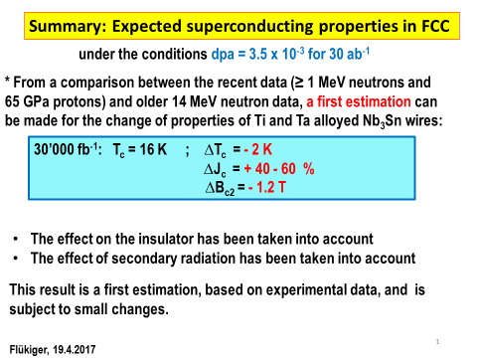
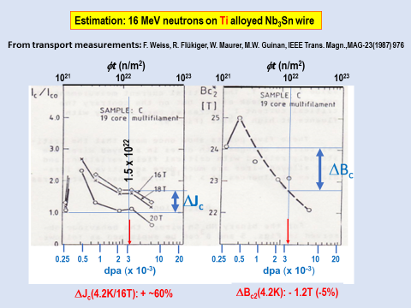
Introduction
We suggest to use as DPA limit 3.5 ⋅10⁻³

Slide 4
Effects on margins
The margins are:
EuroCirCol parameters, before irradiation
J margin | 56%
Temperature margin in K | 4.5
Load line | 20.0%
EuroCirCol parameters, after irradiation
J margin | 66%
Temperature margin in K | 4.2
Load line | 23%
 | EuroCirCol Parameter | Delta | After irradiation
Bc20 | 29.38 | -1.2 | 28.18
Tc0 | 16 | -2 | 14
alpha | 0.96 |  | 0.96
C0 | 267845 | 1.4 | 374983
[1] M. China and D. Tommasini, Phys. Rev ST Accel. Beams 11, 082401 (2008)

Slide 5
Conclusion
The J_{c} performance after irradiation up to the specified limits for Ti-doped conductor is better
The only ‘magnet’ margin which might be reduced until this limit is the temperature margin (around 0.3 K). This further reduction in temperature margin should be taken into account for the heat deposition (0.5 K+0.3 K = 0.8 K)
For FCC high-luminosity IR quadrupoles (triplets), we are far from the limit for both 15 mm and 55 mm thick shielding with an integrated luminosity of 5 ab⁻¹
We are close to the limit for an integrated luminosity of 30 ab⁻¹. A number of open questions may be addressed in the next years: How far are we really from the cliff? What is the uncertainty and repeatability over a large(r) production?

