Slide 1
Database of Scientific Simulation and Experimental Results
Outline:
What is DoSSiER?
Why do we need a repository for experimental data?
Requirements
Components
Choice of technologies
Steps to create a new test
Summary and Conclusions.

Slide 2
What is DoSSiER?
Name says it all: Database of Scientific Simulation and Experimental Results
Collection of experimental data that can be used to validate all aspects of Geant4.
Tests that compare the simulation with the experimental data.
Test results and experimental data are stored in a database and easily available as web pages (web application) or programmatically (web service) → DoSSiER. Continuously run the tests: regression and validation testing.
Should provide a one stop location covering all aspects of Geant4 (em, hadronic, medical, …..)
2

Slide 3
Many sources of experimental data
Existing databases:
  HEPData: https://hepdata.net/
  ExFor: http://www.nndc.bnl.gov/exfor/exfor.htm
  Inspire: https://inspirehep.net/ → cross link for references
  Particle Data Group: http://pdg.lbl.gov/
Directly from article/thesis: if only paper copy OCR, engauge digitizer….
Both e.g. geant4 or Genie developers have data collections.
Experimental web sites: https://spshadrons.web.cern.ch/spshadrons/
Compilations: https://www.oecd-nea.org/dbdata/bara.html
Labor intensive and error prone, biased. Currently ~ 3500 experimental data curves in the db. (compared to 128K simulated results)

Slide 4
Requirements
Provide repository:
  to store experimental validation data as raw data.
  to store simulation results as raw data and as static plots.
Provide display web-application which:
  allows to select and overlay compatible tests,
  allows to overlay experimental data,
  allows automatic upload into repository,
  allows to display static images,
  provides search functions and easy navigation.
Provide REST-ful Web service which:
  allows programmatic access to the data
Modern look, meaningful search, easy to navigate menus.
Based on modern internet technology and industry standards.
Secure!
Must have defined deliveries/timeline.

Slide 5
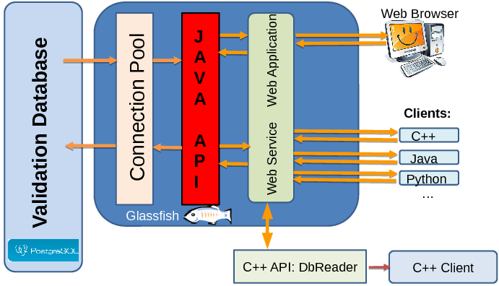
Components
+ python ancillary tools: e.g. converter between various data formats: root, ascii, json
to DoSSiER json format. Needs to be changed for new json format!

Slide 6
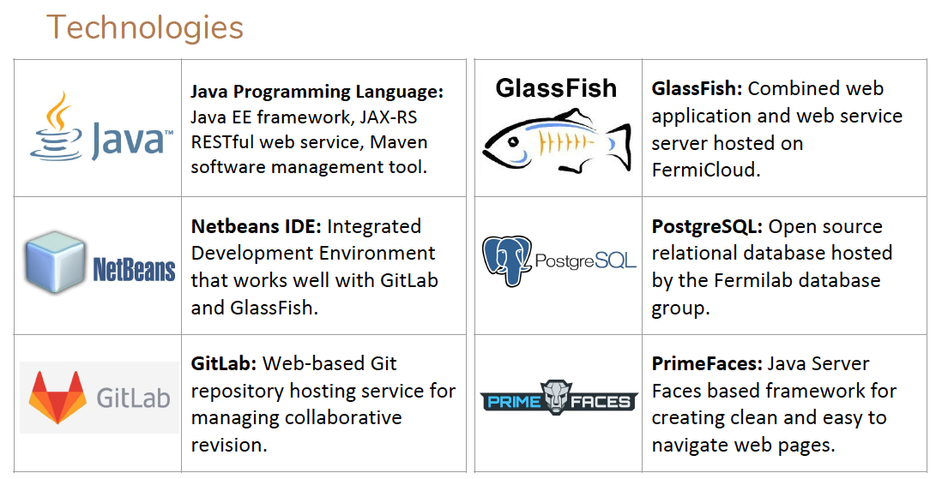
Choice of technologies

Slide 7
Steps to create a new test
Create a new test description in db:
  Required meta data:
    Id, Name of test, Description, Responsible(s), working group, references to experimental data, keywords
  Done manually by myself → not a very high frequency.
Provide your test data (e.g. as root files) and metadata → use python tool to obtain json files, that can be uploaded to the data base.
Authenticate and use web application to upload the data into Dossier.
Decide on default selection → manually done by myself.
For future uploads just repeat step 2 and 3. Usually very minor changes to meta data needed.

Slide 8
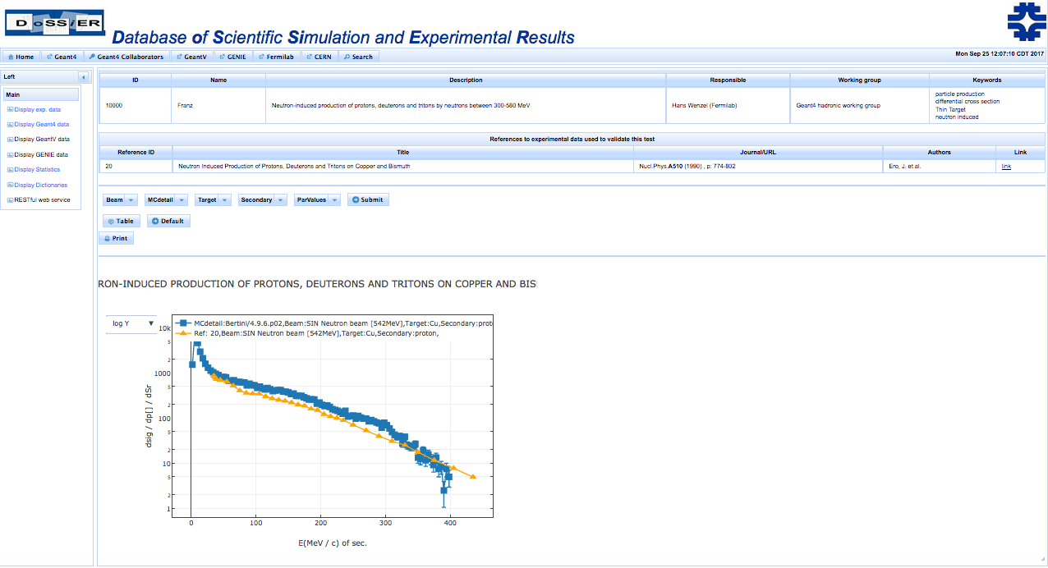

Slide 9
Python Upload Tool: usage
Usage: plot_histofiles.py [--comand|-c <cmd>] [--output|-o <ofile>] [--metadata|-m k[:type]=v] [--metadatafile <mdf>] <files>
where:
<files> are the files to read.
File extension determines format. CSV is the text format
from G4Analyais. For ROOT format, you need t specify the
name of the file to be read in. Ex: file.root:h1
pickle format is supported (file should be created with command "save")
<cmd> is one of ("plot", "convert","save","genmd","list")
"plot" (default) to plot the content of the file
(requires matplotlib)
"convert" creates an output file in JSON format suitable
for FNALdb upload
"save" saves histograms in internal format to pickle file "histos.pkl"
"genmd" generates a metadata skeleton file as specified in <files>
"list" shows content of ROOT File (TKey). Only for ROOT format.
<ofile> is the output file name (default="output.json") for
converted output for FNALdb
<hn:k[:type]=v> is a key-value pair to add as metadata to FNALdb output
hn is a regexp to assing the metadata to histogram based on names.
k is the key of the metadata, type (default INT) can be INT if the value has to
interpreted as integer value of STR if it must be interpreted as string
or FLT if it is a floating point value
e.g. -m .*A:INT=1 means add to all objects the integer metadata 1 with key A
<mdf> is a json of pickle file containing the metadatada in a format of the type:
{ "regexpName" : { metadata } } where regexpName is a regular expression that
matches a converted object name (the name being the ROOT TObject name or CSV full-filename)
9/14/2016

Slide 10
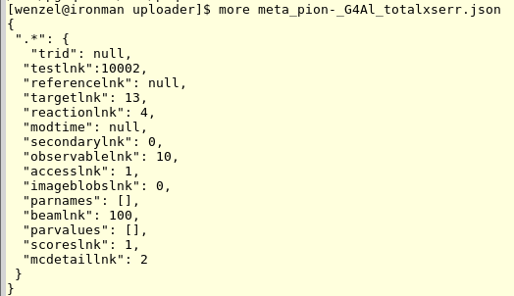
e.g. Extracting TGraph from a root file and creating json file for upload to DoSSiER
Command used to add one record to the database
(cross sections for pion- on Aluminium)
python ./plot_histofiles.py --metadatafile meta_pion-_G4Al_totalxserr.json \
-c convert \
--output pion-_G4Al.json pion_xs.root:pion-_G4Al_totalxserr
The Meta Data file: (in addition from the meta data provided by root)
Note: meta data format will change to more human readable form!

Slide 11
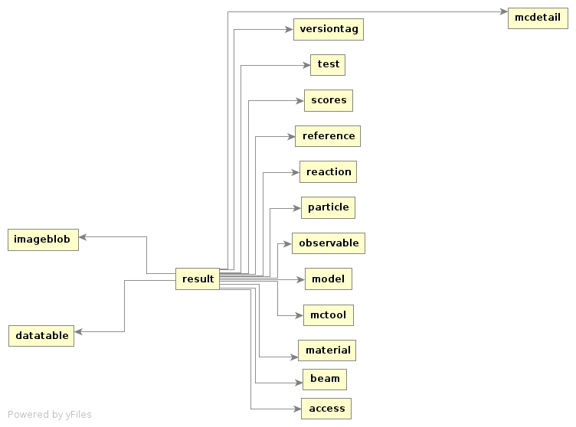
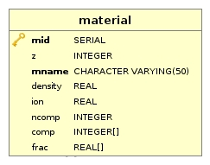
Information about DoSSiER Dictionaries
DoSSiER uses “dictionaries” of different objects so that the metadata of results can be referenced by their ID keys or unique name, expandable, no duplication.

Slide 12
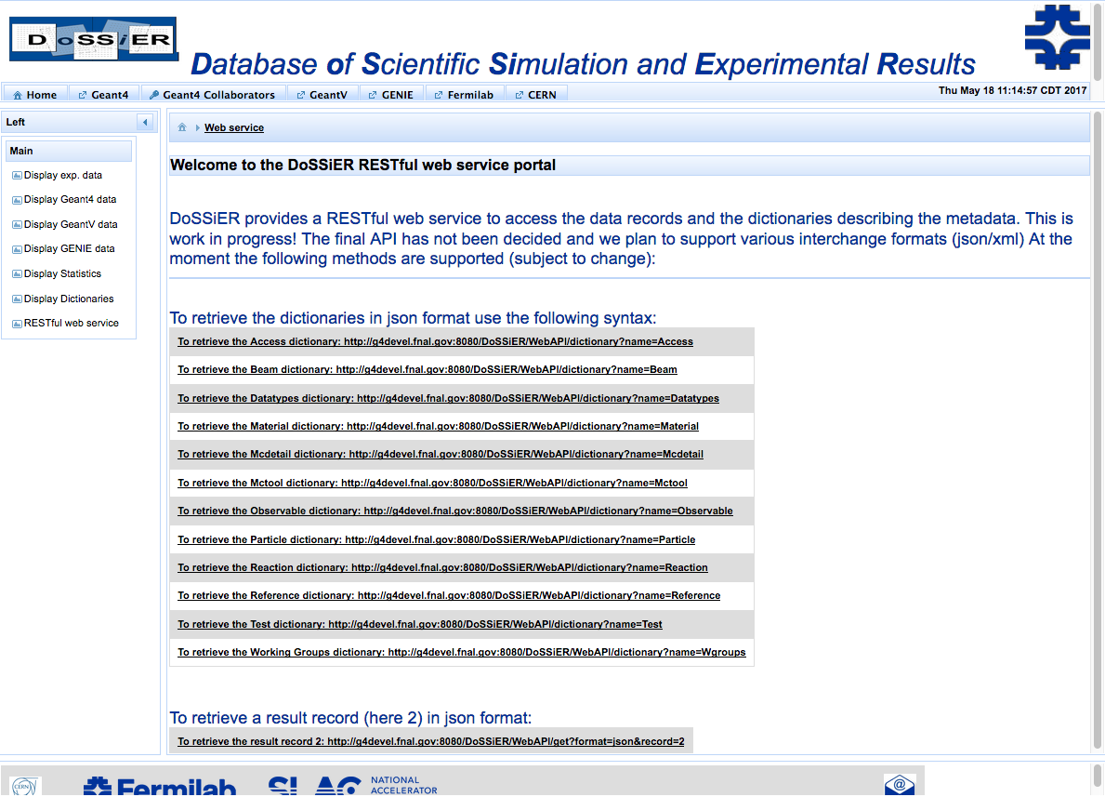
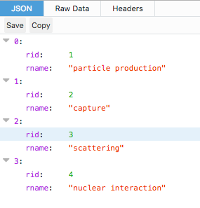
Retrieving dictionary data (reaction) via the web-service

Slide 13
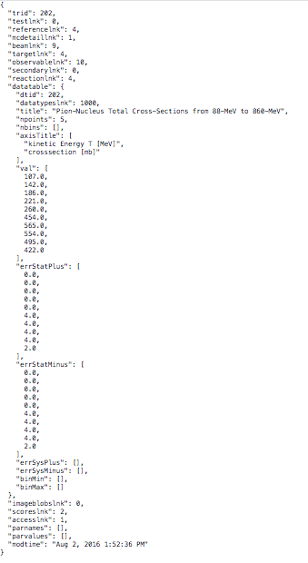
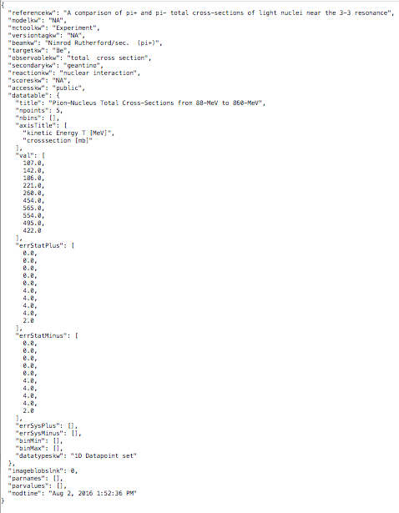
Change to human readable json interchange format
Human readable
Less error prone
Makes current exchange format for simplified calo obsolete
Deployed on Development sever

Slide 14
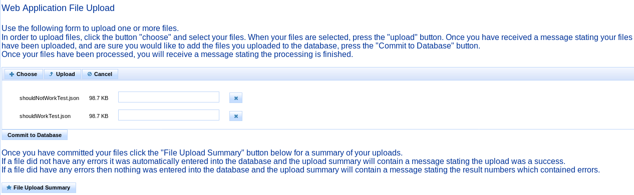
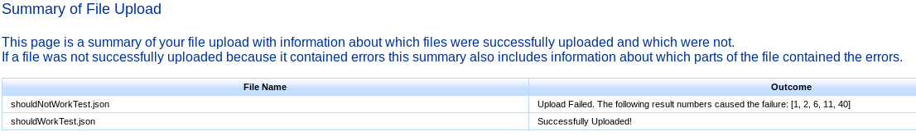
Images of the Web Page File Upload

Slide 15
DoSSiER Summary and Conclusions
DoSSiER: Database of Scientific Simulation and Experimental Results is actively being developed with participation by Geant4 groups at Fermilab and SLAC. https://g4devel.fnal.gov:8181/ (https protocol; for end to end encryption)
We already identified features in Geant4 that needed fixing.
Experimental data and results from simulation are stored in a relational database.
Data can be imported and exported using json/xml formats. (python scripts are provided to extract data from root files or ASCII tables and convert to json/xml.)
Web application:
  allows to select and search.
  allows to overlay experimental and simulated data.
  authentication is necessary to have access to internal data and functions (e.g. upload, edit, delete).
Web service: allows to programmatically access the repository (read only).

Slide 16
DoSSiER Summary and Conclusions
Finding good experimental data and adding to DoSSiER is a continuing effort.
So is developing new test to validate the Simulation vs. this data.
We need more Geant 4 collaborators to upload their data, pretty easy with he ancillary python tools developed by Andrea, new uploads require only minor changes to the meta data→ will provide tutorial! Would like to have all geant4 tests in DoSSiER.
Change to ‘human readable json format well under way.

Slide 17
backup

Slide 18
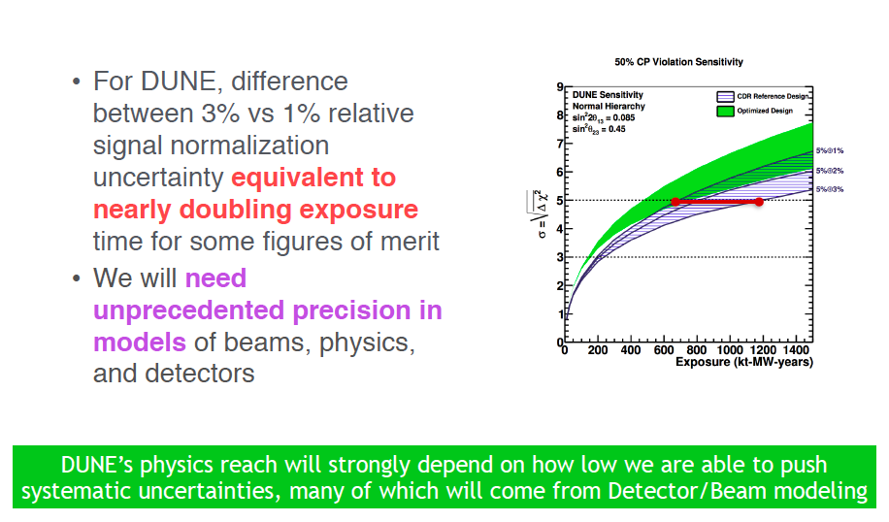
Motivation: e.g. Neutrino physics

Slide 19
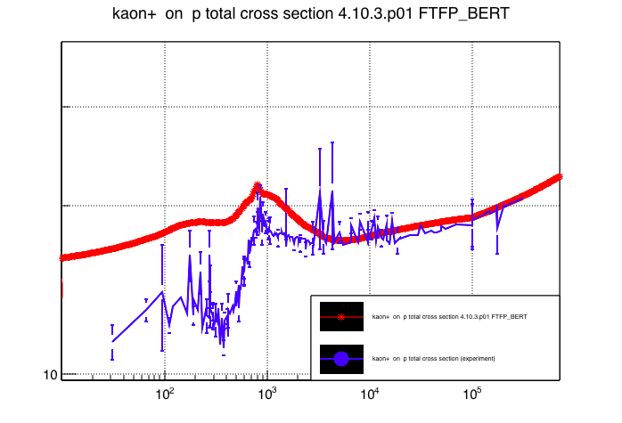
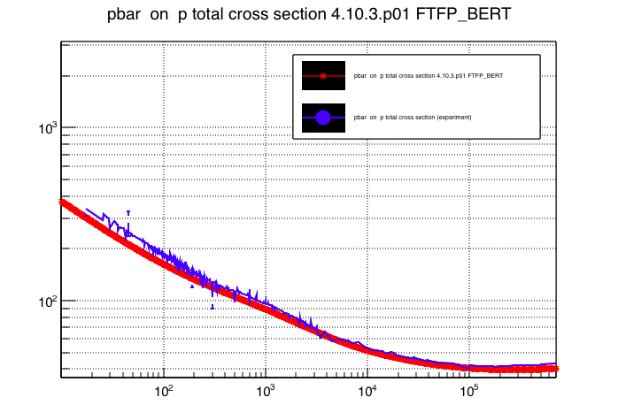
Sometimes the result is surprising
Kaon cross sections in reference physics list uses old Geisha tables→
Bug not caught because results were not compared to data and test used different method to access physics list

Slide 20
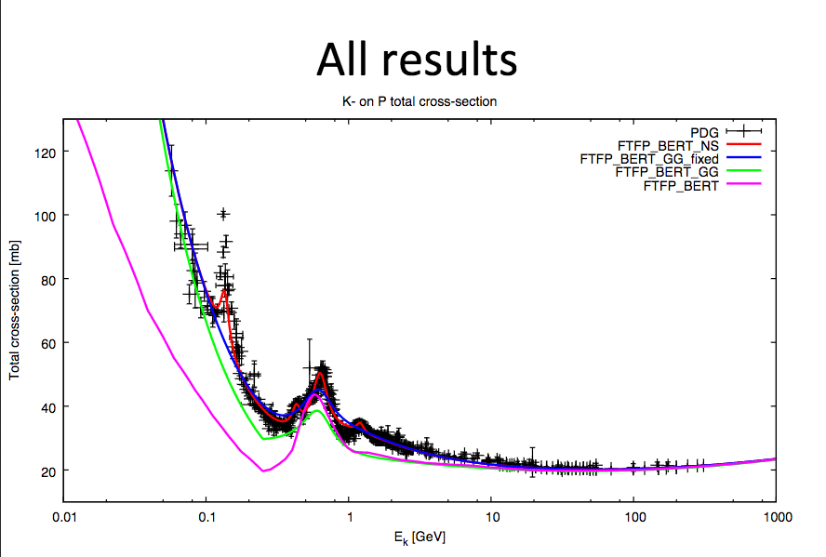
From Witek’s presentation at Geant 4 hadronics meeting
Good argument for continuously adding data and perform new tests. Sometimes new introduced bugs can worsen results that were previously validated or validated with different test. Sometimes the same thing is not really the same thing.

Slide 21
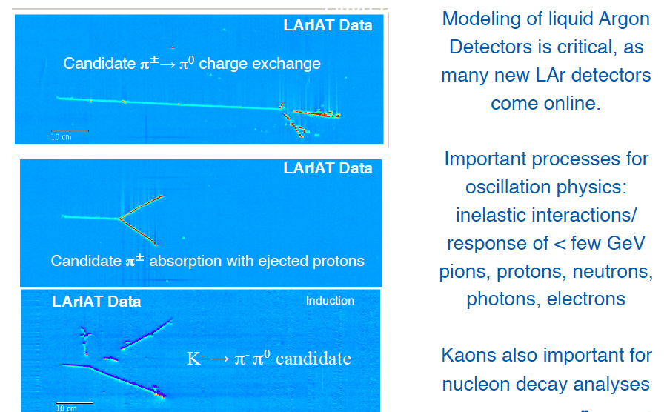
Detector Simulation

Slide 22
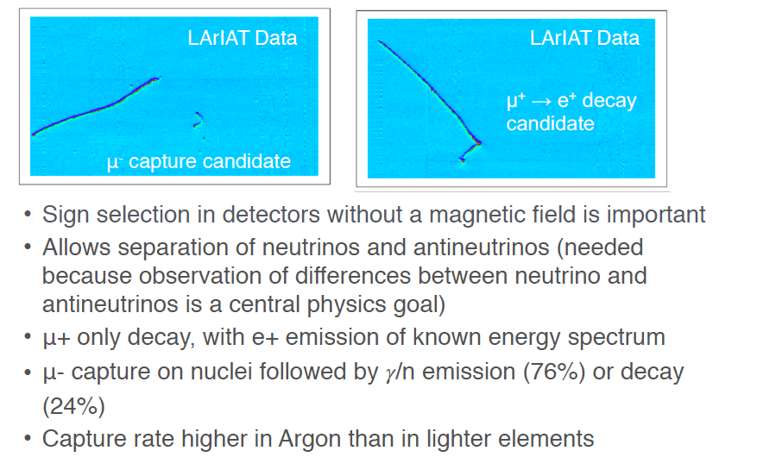
Detector Simulation

Slide 23
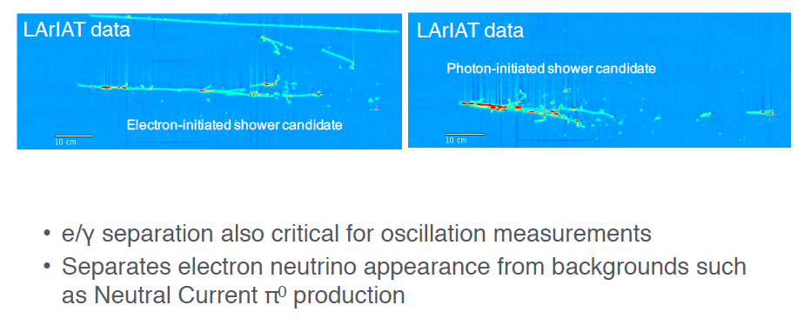
Detector Simulation

Slide 24
Meta data to classify a result
Beam: mono energetic neutrons
Target: Carbon.
Secondary: protons.
Observable: differential cross section
Reaction: particle production
Model: e.g. BIC
Version: geant4.10.1.p02
In addition parnames/parvalue pairs can be added
n (500 MeV)
p
C
Example: n induced p production
Note:
Values for metadata stored in dictionaries:
(Beams, Materials, Particles, Observable, Reaction, Model, Version…).
Meta data used to match experimental and simulated results.
Complicated Beams (e.g. neutrino flux files, test beams consisting of many
particles can be described by the schema).
Ditto for Materials .
Dictionaries can evolve as needed.
24

Slide 25
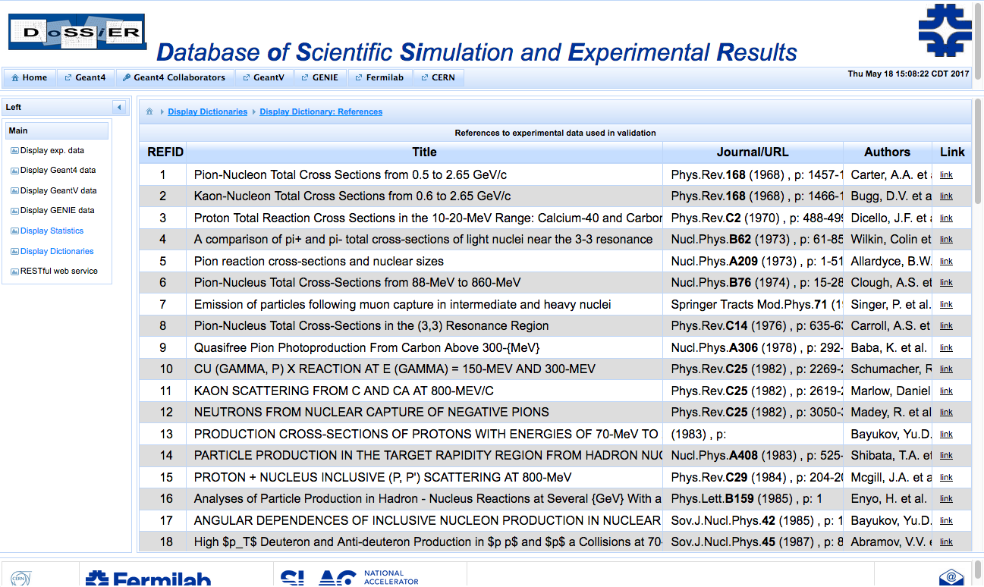
Experimental data
Inspire

Slide 26
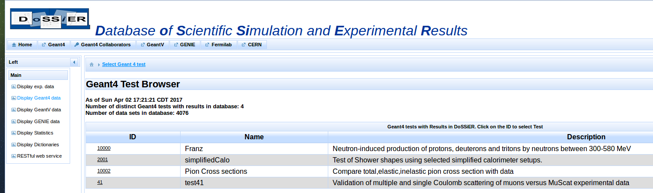
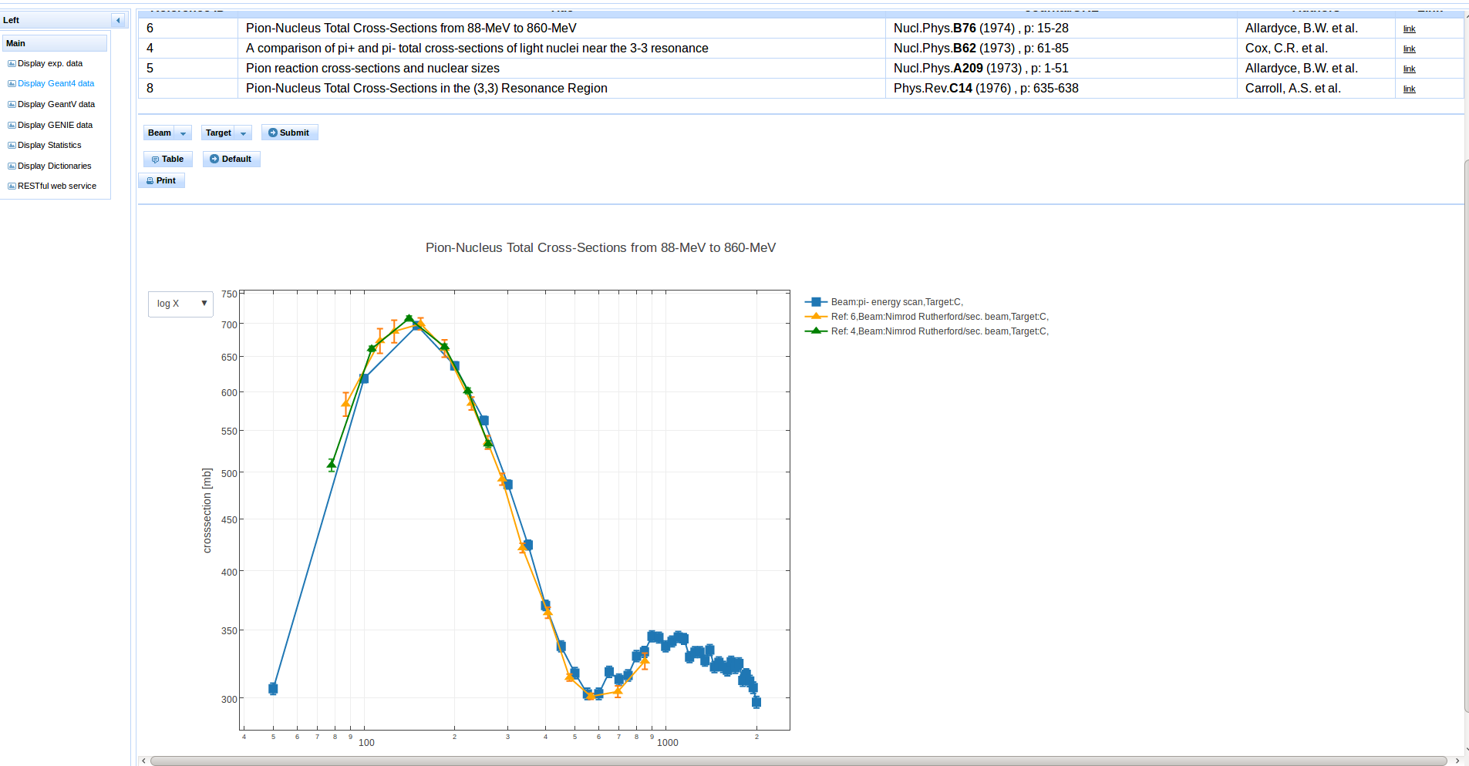
Overlay: simulation and matching experimental data
Select Pion Cross Sections in Geant 4 test browser
Menus created on the fly
Java script allows for
interactive graphs
Results from Geant 4 simulations and all the experiments where the meta data (particle, target material energy range …) matches the selection are overlaid automatically.

Slide 27
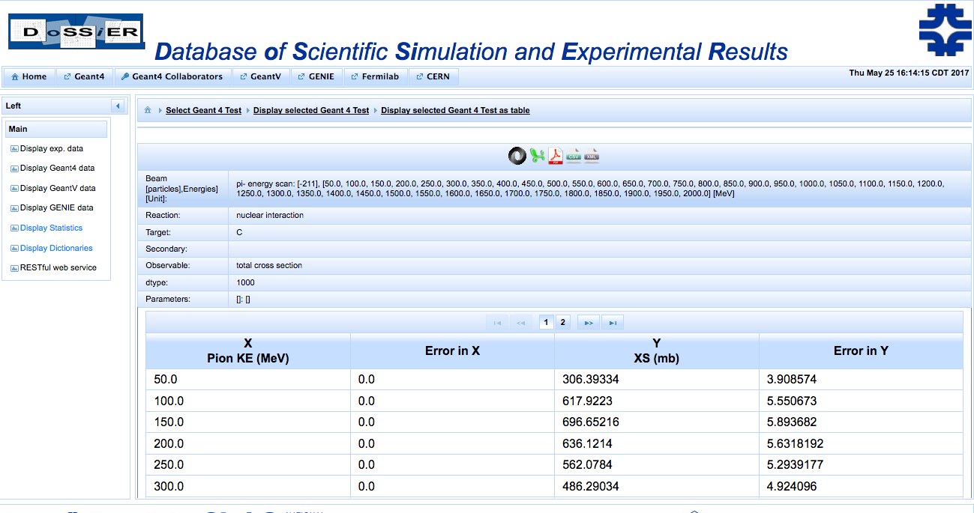
Display as tables

Slide 28
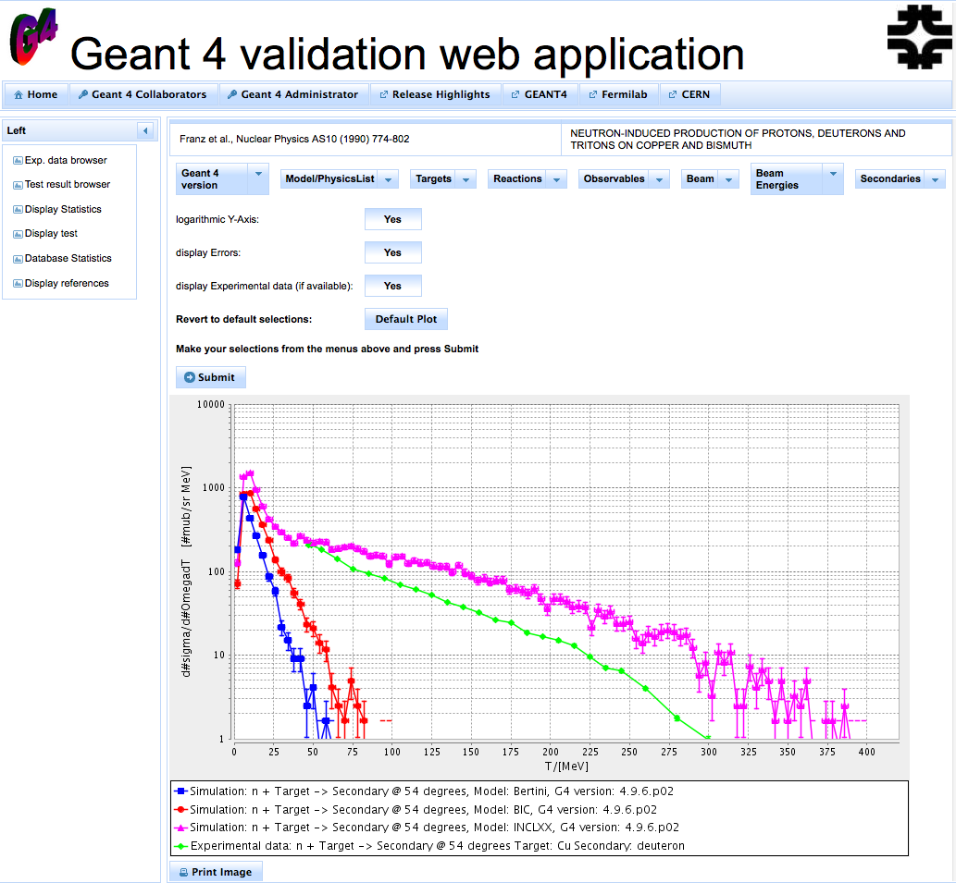
Test Result Browser
  This allows to select Geant4 simulation results of interest, and to compare them to the experimental data as applicable. Shown on the right is neutron induced deuteron (default selection).
  Different Models:
  BIC(blue),
  Bertini (red)
  INCL++(magenta)
  Experimental Data (green)

Slide 29
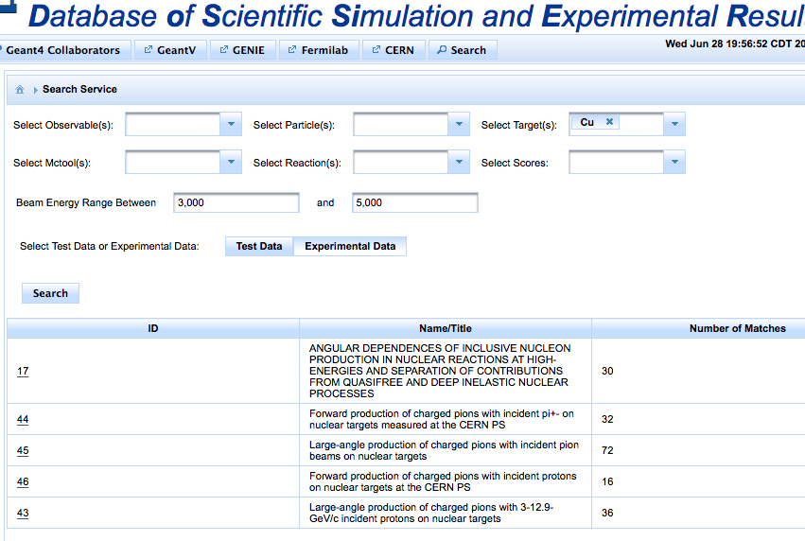
Web Page Search (Nicole Serpico)
Options are selected from searchable drop down menus
Beam energy is inputted or just left blank
Test or experimental data is chosen
The results include the ID of the matching experiment or test, which links to the display of the corresponding data

Slide 30
Web Page File Upload (Nicole Serpico)
Accessed through the G4Expert secure web page
Multiple file upload that can handle hundreds of small files (∼100 results) as well as large files (∼50,000 results or ∼0.5 GB).
Goes through each uploaded file twice: first checks to make sure it doesn’t have any formatting errors, then after doing that, uploads the file to the database.
Still need to elevate errors that happen when adding to the database.
Links to a summary page that details which files were successfully uploaded and which had errors. If a file contains errors the summary page shows where those errors are so they can be easily corrected.

Slide 31
The Web service
Based on: Java API for REST - ful (Representational State Transfer) Services (JAX-RS)
Deployed on the development server: https://g4devel.fnal.gov:8181/
Allows to programmatically retrieve results in json or xml format (with dictionaries expanded or not)→ these are the same formats used for uploads!
C++ clients already used by selected Geant4 validation jobs!
Dictionaries are retrieved by python upload tool to create look up tables so that dictionary can be accessed by keyword (not number)→ change to human readable json interchange format.
Over the summer Niccole added:
  Search functions like in INSPIRE/SPIRES.
  Programmatic upload to database works but not enabled until we can secure the application.
  Provide examples in python and java to deal with https.
  Improved multiple file upload web application.

