Slide 1









Update on GeantV
F.Carminati for the GeantV collaboration
22nd Geant4 Collaboration Meeting – 25th - 29th September 2017

Slide 2

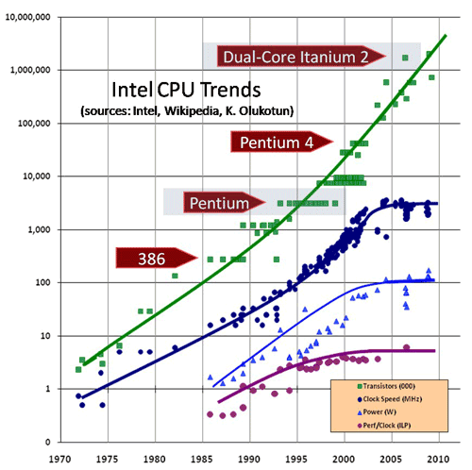
Just a reminder
Technology at ~20%/year will bring x6-10 in 10-11 years
We would like really to be here
10⁷
10⁶
CPU:
x60 from 2016
10⁵
}
We are now probably here
10⁴
transistors
10³
clock
10²
We used to be here
Simple model based on today’s computing models, but with expected HL-LHC operating parameters (pile-up, trigger rates, etc.)
At least x10 above what is realistic to expect from technology with reasonably constant cost
10
1
power
ILP
10⁻¹
70
75
80
85
90
95
00
05
10
More than 50% of WLCG power used for simulations
  Faster full simulation & more fast simulation !
GeantV: path towards a faster toolkit 2-5 x Geant4
Alpha and beta releases (2017 and 2018) for the community to test
2

Slide 3
New transporter with scalar and vector processing combined
Event server
Stage buffers
Select
Select
Select
GeometryStage
PropagationStage
PhysicsStage
Linear prop.
Field prop.
Volume1
Volume2
Process1
Process2
Handlers
Basketizer
Basketizer
Basketizer
Basketizer
Scalar DoIt()
Vector DoIt()
Threads on same propagator/socket
Scalar code
Vectorized code

Slide 4
NUMA awareness vs. OS policy
GeantV
run manager
NUMA discovery service
(libhwloc)
Propagator
Propagator
(…)
Scheduler
Scheduler
node
socket
socket
socket
~9% gain
Basketizer
Basketizer
Topology detection using hwloc
A propagator will use threads bound to the same NUMA node

Slide 5
GeantV roadmap
RELEASE | CORE | USER INTRFACES | GEOMETRY | PROPAGATOR | EM PHYSICS | HADRONIC PHYSICS | FAST SIMULATION | OTHER
alpha (2017) stable interfaces allowing experiments to create own examples | v3, vectors (all) NUMA, TBB | functional | vectorized, most solids | RK vectorized | shower (e⁺, e⁻, 𝛾), most processes, scalar/validated | elastic scattering validated, scalar | Simulation stage hooked in core v3 | examples, demonstrators vs. Geant4
beta (2018) most of GeantV features/optimisations. Allowing to actually integrate experimental simulations with GeantV as toolkit | vectors (all) NUMA, TBB HPC, device¹ | finalized | vectorized, full set, fully validated | RK vectorized | shower (e⁺, e⁻, 𝛾), all processes, most vectorized² | elastic scattering, vectorized² Bertini, EPOS, QGS³ (?) | Inference from ML-based module | Reproducibility, error handling at event/track level, integration with exp. frameworks
¹ non-standard processor & GPU
² full assessment of vectorization potential not available for all models
³ partial implementation

Slide 6
Memory control & scalability
2 sockets * 8 cores
complex geometry setup
high number of steps/secondaries
Stack-like control using a special filter inserted in the stepping loop preventing inflating the memory
Higher generation secondaries flushed with priority
No difference in profile for N/2N threads
Memory operations are high in the profile, expected to improve when having more (vector) work on physics side

Slide 7
GeantV EM physics status
* under development
particle | processes | models(s)
 |  | GeantV | Geant4
e⁻ | ionisation | Møller[100eV-100TeV] | Møller[100eV-100TeV]
 | bremsstrahlung | Seltzer-Berger [1keV-1GeV] | Seltzer-Berger [1keV-1GeV]
 |  | Tsai (Bethe-Heitler) w. LPM. [1GeV-100TeV] | Tsai (Bethe-Heitler) w. LPM. [1GeV-100TeV]
 | Coulomb sc. | GS MSC model [100eV-100TeV] | GS MSC model [100eV-100TeV]
 |  |  | Mixed model [100MeV-100TeV]
e⁺ | ionisation | Bhabha [100eV-100TeV] | Bhabha [100eV-100TeV]
 | bremsstrahlung | Seltzer-Berger [1keV-1GeV] | Seltzer-Berger [1keV-1GeV]
 |  | Tsai (Bethe-Heitler) w. LPM. [1GeV-100TeV] | Tsai (Bethe-Heitler) w. LPM. [1GeV-100TeV]
 | Coulomb sc. | GS MSC model [100eV-100TeV] | GS MSC model [100eV-100TeV]
 |  |  | Mixed model [100MeV-100TeV]
 | annihilation | - | Heitler (2𝛾) [0-100TeV]
𝛾 | photoelectric | new Livermore (*) | SANDIA par. [100eV-100TeV] + deEx.
 | incoherent sc. | Klein-Nishina⁺ [100eV-100TeV] | Klein-Nishina⁺ [100eV-100TeV]
 | e⁺e⁻ pair production | Bethe-Heitler⁺ [100eV-100TeV] | Bethe-Heitler⁺ [100eV-100TeV]
 |  | Bethe-Heitler⁺ w. LPM [80GeV-100TeV] (*) | Bethe-Heitler⁺ w. LPM [80GeV-100TeV]
 | coherent sc | - | Livermore
+ | energy loss fluct. | - | Urban
Notes:
The models are not a port from Geant4, but code derived from theoretical models. Geant4 implementation was checked for consistency and fixed wherever needed. The implementations in GeantV/Geant4 are very different due to framework constraints, but also sampling methods (rejection vs. tables) and in future vectorization.

Slide 8
EM Physics validation
e⁻
𝛾
Thin layer, MSC test
e⁻
e⁻
e⁻
Thin layer, bremsstrahlung test
Semi-infinite block, MSC test

Slide 9
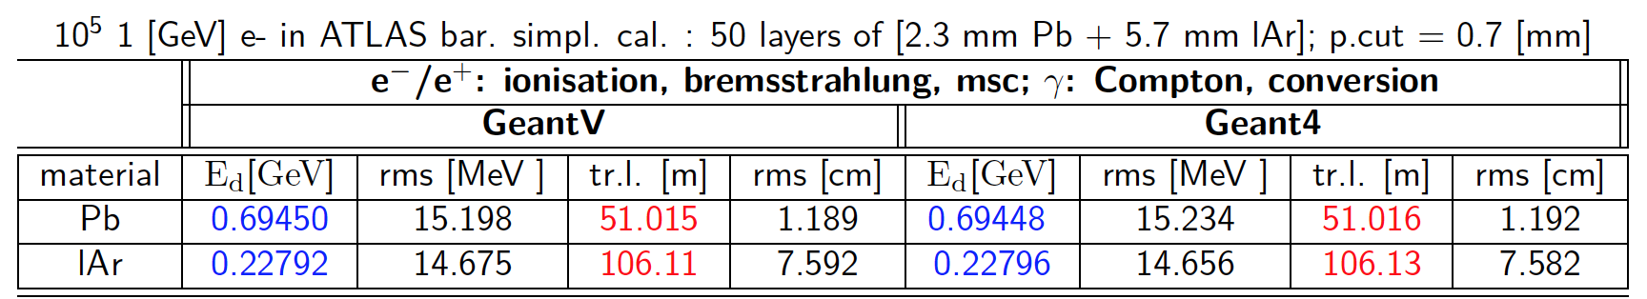
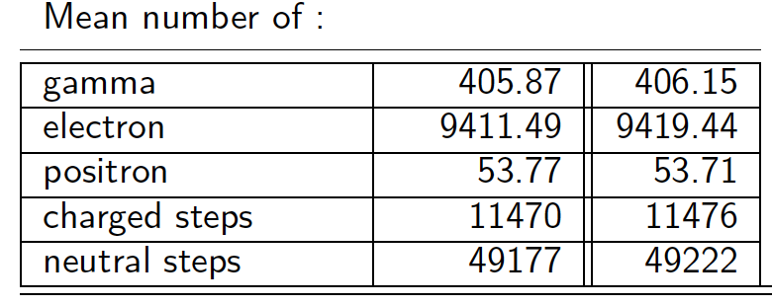
EM Physics validation
e⁻
Multi-layered target
ATLAS simplified sampling calorimeter

Slide 10
User interfaces
Similarities with Geant4:
  User detector construction, generator
  Scoring interfaces
New features:
  Concurrent scoring, limited number of events in flight
  Multi-particle interfaces, tracks from multiple events mixed
  Data structures per thread and per event + merging
GeantV support:
  Examples demonstrating efficient data access patterns
  On-demand merging service
  Hit factory & concurrent I/O
  Task-based parallelism support and example of external event loop - ongoing

Slide 11
Example: concurrent scoring (transient)
main thread/task
Create/attach user data to task data
UserApp::
Initialize()
UserApp::
FinishRun()
UserApp::
AttachUserData(td)
UserApp::
SteppingActions(td)
Data registration -> handler
TaskData *td
Merge run user data (on demand)
Retrieve user data using handler,
score inclusive or per event info
UserData<T>
UserApp::
AttachUserData(td)
UserApp::
SteppingActions(td)
UserApp::
FinishEvent(event)
TDManager
TaskData *td
Merge event user data providing handler to a service (on demand)
workers
UserData<T>
UserApp::
AttachUserData(td)
UserApp::
SteppingActions(td)
TaskData *td
data per run
UserData<T>
data per event
MyData
[0..nslots]
vector<MyDataPerEvent>
Merge(int evslot, const MyData &other )
Clear(int evslot)

Slide 12
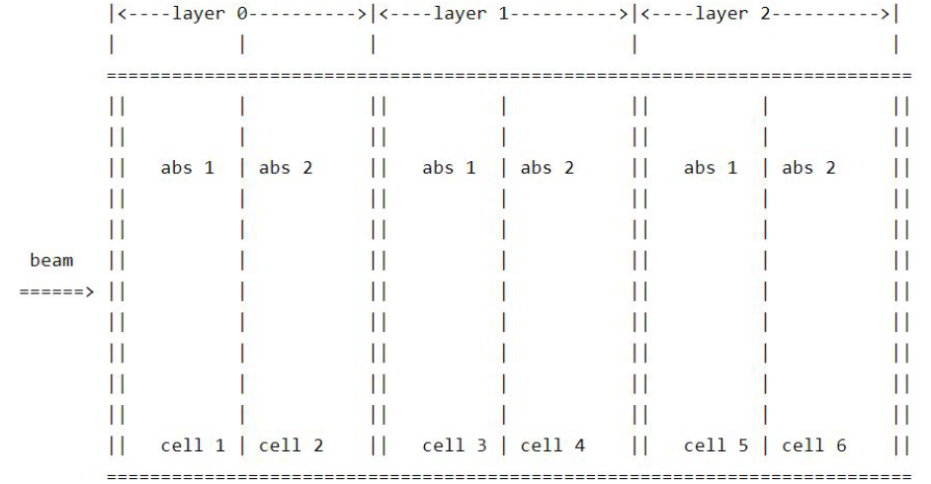
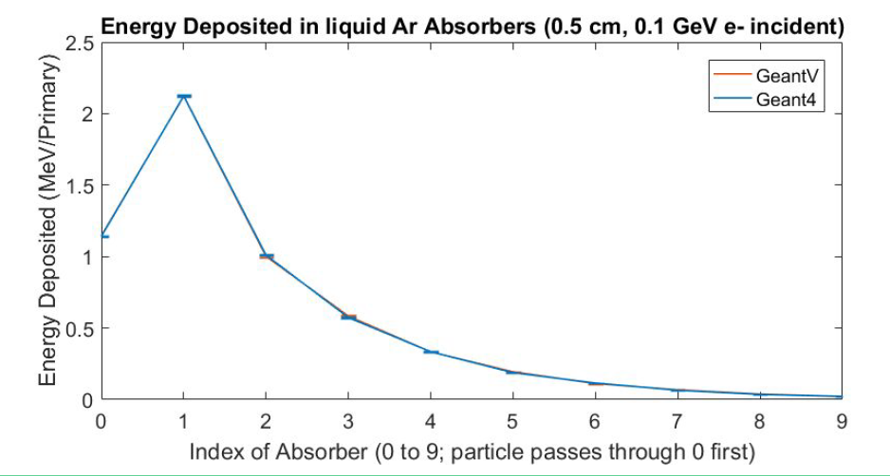
User application: examples
Fully configurable GeantV example applications
  Including configurable user defined detector construction, geometry, physics list with custom physics process, primary generator
  Showing how to do scoring
  Geant4 equivalent also demonstrated and compared
Current examples
  Simple calorimeter
  More examples being prepared

Slide 13
Hadronic physics
For the alpha release we will have no hadronic physics
For the beta release we are planning two actions
Bertini is self contained enough to be interfaced to GEANTV as an external package
  With some surgery & mostly for testing purposes
EPOS (T.Pierog, Karlsruhe Institute of Technology, KIT) will be interfaced both to GEANT4 and to GEANTV as an external library
Depending on manpower, we should be able to make it for the beta

Slide 14
Neutrons
Neutron transport could be a sweet-spot for vectorization
We are preparing two “normalized tests”:
  The TARC experiment
  The “Troitsk” experiment (ADS proposed setup)
These exist in GEANT4 and we will reproduce them in GEANTV

Slide 15
A reflection on simulation evolution
VecCore
VecMath(?)
VecGeom
G4
G4
G4
G4
G4
GV
EPOS

Slide 16
The fate of the toolkit
GEANT4 has been conceived as a toolkit
  But it has always been a logical rather than a physical toolkit
VegGeom has pried open the door for a modularisation of GEANT4
The advantages are potentially large
  Can concentrate on the “core business” (physics)
  Be more open to external contributions
  Allow a simpler evolutionary path
The GEANT4 collaboration should decide whether this is a specific situation or if it wants to embrace this evolution

Slide 17
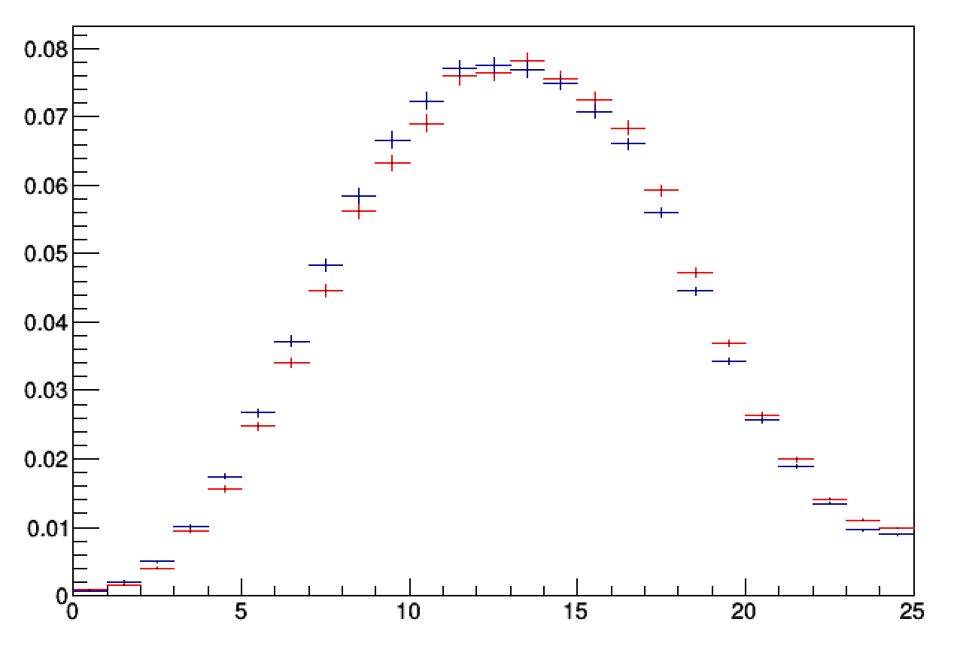
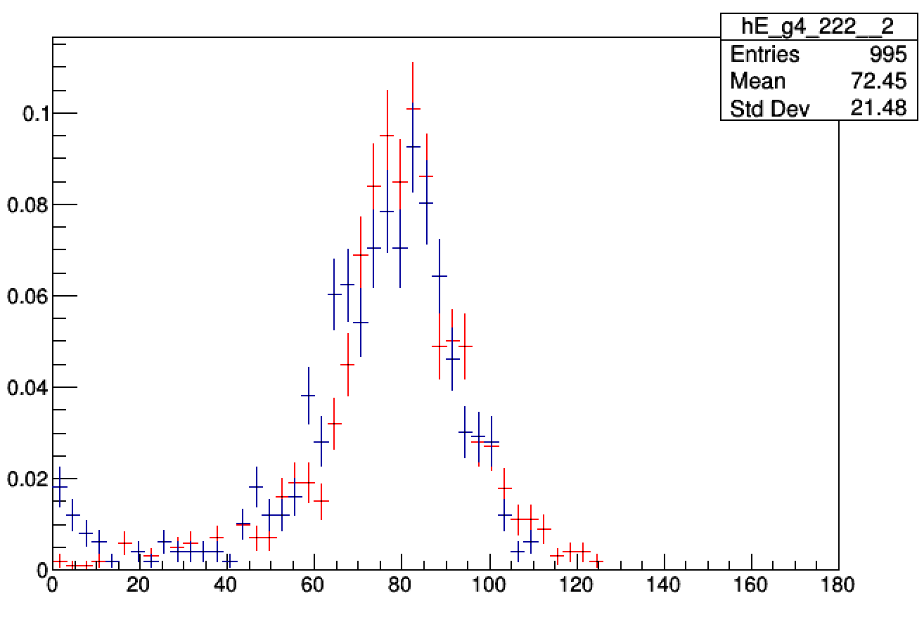
ML prototype for fastsim in the alpha
Fast simulation “hooks” à la G4 designed according to v3 flow
  First implementation of the user interfaces
First ML prototype for simulation of high granularity calorimeters
Complete GAN based model for the simulation of particle showers in calorimeter (including particle type, energy, and trajectory)
First algorithm meta-optimization according to calorimeter geometry
Integration of the inference step as simulation stage
a.u.
Geant4
GAN generated
Shower longitudinal section
Z
Single energy response
S.Vallecorsa INTEL IPCC
100 GeV electrons

Slide 18



GeantV HPC mode
Data
Worker #1
Worker ID
Assigned jobs
Worker IDs
Pending jobs
Time of last contact
...
Job request, confirmation, heartbeat
Scheduler
Worker list
and
Job pool
handshake at start-up
List of Events that should be processed
Worker #2
Worker ID
Assigned jobs
Going beyond data parallelism:
Scheduling the work from the application
Optimizing work per machine using topology discovery;
Handle un-even load, policies for work (re)distribution
Resilience to hanging/dead workers
Job ID
Events
Number of Events which are “Done”
Applicable to other CPU-bound applications than GeantV
Notes:
We don’t want to re-invent HPC, just to study if we can optimize the use of resources in a cluster, taking into account that GeantV is topology aware and does not have much input. What we see so far is quite encouraging…

Slide 19
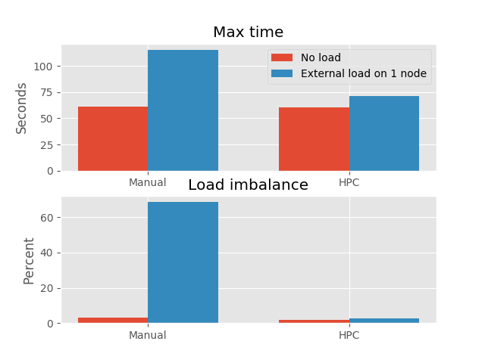
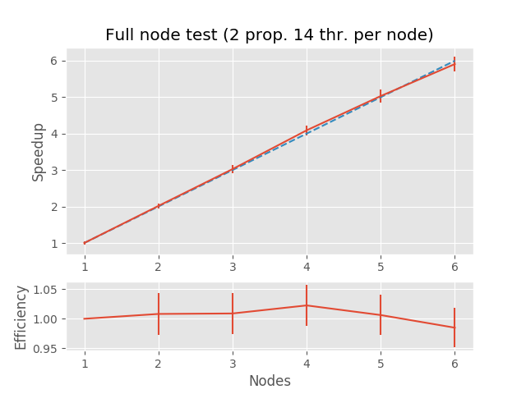
GeantV HPC mode: preliminary results
(max_time/avg_time -1)*100

Slide 20
Outlook
GeantV developments on a tight schedule towards the end-of-year release
  Program of work became much more focused on releases
  Most components almost ready (core, EM physics, interfaces & examples), others still under development (field propagation, hadronic physics, more complex examples with new EM physics, complete flow including GPU)
The alpha release will feature mainly shower EM physics
  Delivering part of the design performance (vectorized geometry but scalar physics)
  Interfaces mature enough to make the product usable by experiments for testing
  Many more features and design performance expected in the beta version
Important R&D still ongoing
  Event loop steered by user application + CMSSW demonstrator
  Generic fast simulation approach + integration as simulation stage
  GeantV optimization for HPC

Slide 21
Thank you !

Slide 22
GeantV Team
Harphool Kumawat harphool.kumawat@cern.ch BARC
Abhijit Bhattacharyya abhijit.bhattacharyya@cern.ch BARC
Raman Sehgal raman.sehgal@cern.ch BARC
Shiba Behera shiba.prasad.behera@cern.ch BARC
Alberto Ribon Alberto.Ribon@cern.ch CERN
Andrei Gheata Andrei.Gheata@cern.ch CERN
Dmitri Konstantinov Dmitri.Konstantinov@cern.ch CERN
Farah Hariri farah.hariri@cern.ch CERN
Federico Carminati Federico.Carminati@cern.ch CERN
Gabriele Cosmo Gabriele.Cosmo@cern.ch CERN
Guilherme Amadio guilherme.amadio@cern.ch CERN
Gul Rukh Khattak gul.rukh.khattak@cern.ch CERN
Ilias Goulas Ilias.Goulas@cern.ch CERN
John Apostolakis John.Apostolakis@cern.ch CERN
Marilena Bandieramonte marilena.bandieramonte@cern.ch CERN
Mihaela Gheata Mihaela.Gheata@cern.ch CERN
Mihaly Novak mihaly.novak@cern.ch CERN
Oksana Shadura oksana.shadura@cern.ch CERN
Patricia Mendez Lorenzo Patricia.Mendez@cern.ch CERN
Przemyslaw Ryszard Karpinski przemyslaw.karpinski@cern.ch CERN
Rene Brun Rene.Brun@cern.ch CERN
Sandro Christian Wenzel sandro.wenzel@cern.ch CERN
Sofia Vallecorsa Sofia.Vallecorsa@cern.ch CERN
Vladimir Ivantchenko Vladimir.Ivantchenko@cern.ch CERN
Witold Pokorski Witold.Pokorski@cern.ch CERN
Daniel Elvira daniel@fnal.gov FNAL
Guilherme Lima lima@fnal.gov FNAL
Krzysztof Genser genser@fnal.gov FNAL
Philippe Canal pcanal@fnal.gov FNAL
Soon Yung Jun syjun@fnal.gov FNAL
Laurent Duhem laurent.duhem@cern.ch Intel
https://geant.web.cern.ch/content/publication-author-list-geantv-team

