Slide 1
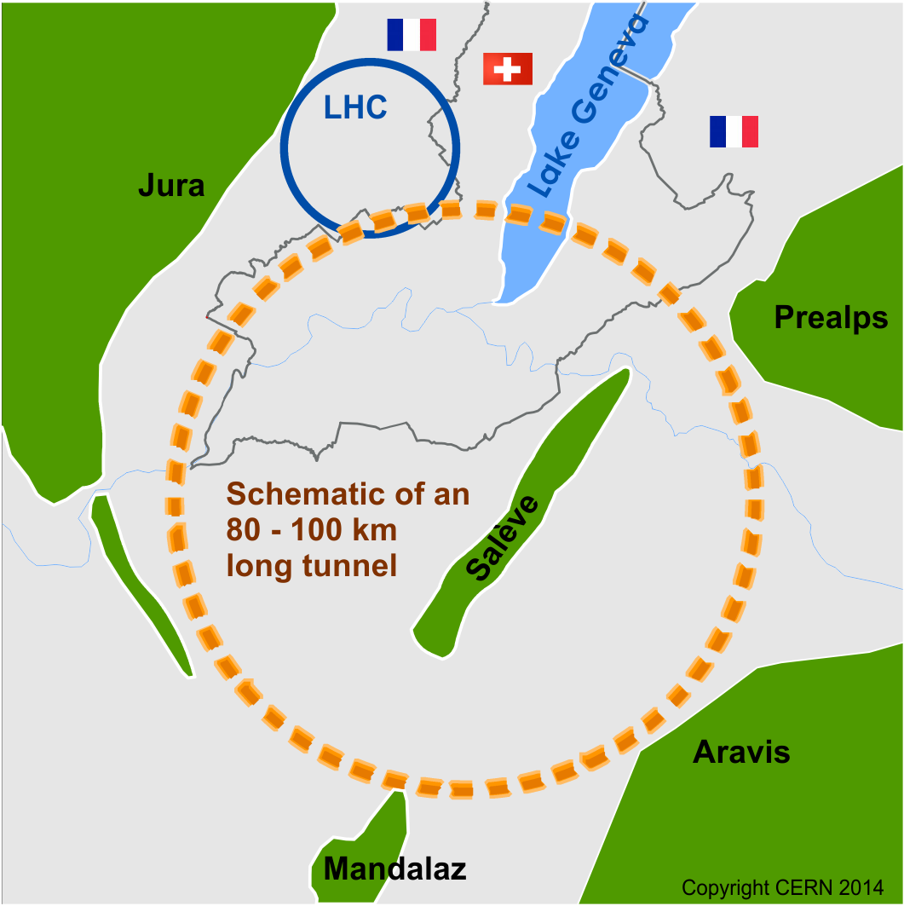
Progress in the Design of Beam Optics
for FCC-ee Collider Ring
K. Oide, K. Ohmi, KEK, Tsukuba, Japan
A. Bogomyagkov, E. Levichev, D. Shatilov, BINP SB RAS, Novosibirsk, Russia
M. Benedikt, H. Burkhardt, B. Holzer, A. Milanese,
J. Wenninger, F. Zimmermann, CERN, Geneva, Switzerland
A. Blondel, M. Koratzinos, DPNC/Geneva University, Geneva, Switzerland
M. Boscolo, INFN/LNF, Frascati, Italy
May 16, 2017 @ IPAC’17 TUOCB1
Many thanks to S. Aumon, E. Belli, B. Harer, P. Janot, R. Kersevan, D. El-Khechen, A. S. Langner, A. Novokhatski, S. Ogur, D. Schulte, J. Seeman, S. Sinyatkin, H. Sugimoto, M. Sullivan, T. Tydecks, D. Zhou

Slide 2
Future Circular Collider Study
GOAL: CDR and cost review for the next ESU (2018)
International FCC collaboration (CERN as host lab) to study:
pp-collider (FCC-hh) → main emphasis, defining infrastructure requirements
80-100 km infrastructure in Geneva area
e⁺e⁻ collider (FCC-ee) as potential intermediate step / as a possible first step
p-e (FCC-he) option, HE-LHC …
~16 T ⇒ 100 TeV pp in 100 km

Slide 3
FCC-ee Beam Optics
A baseline optics* for FCC-ee was once established in Oct. 2016 characterized by:
  100 km circumference, 2 IP/ring
  common lattice for all energies
  90°/90° FODO cell in the arc with non-interleaved sextupole pairs
  30 mrad crossing angle at the IP, with the crab-waist scheme
  local chromaticity correction for y-plane, incorporated with crab sextupoles
  100 MW total SR power for all energies
  limit the SR toward the IP below 100 keV at 175 GeV, up to 450 m upstream
  Tapering of magnets along the ring to compensate the effects of SR on orbit/optics
  Sufficient dynamic aperture for beamstrahlung and top-up injection
Motivations for change in 2017:
  Mitigation of the coherent beam-beam instability at Z
    Smaller βx*
    60°/60° cell in the arc, only at Z
  Adopt the “Twin Aperture Quadrupole” scheme for arc quadrupoles
  Fit the footprint to a new FCC-hh layout
*Phys.Rev.Accel.Beams 19 (2016) no.11, 111005

Slide 4
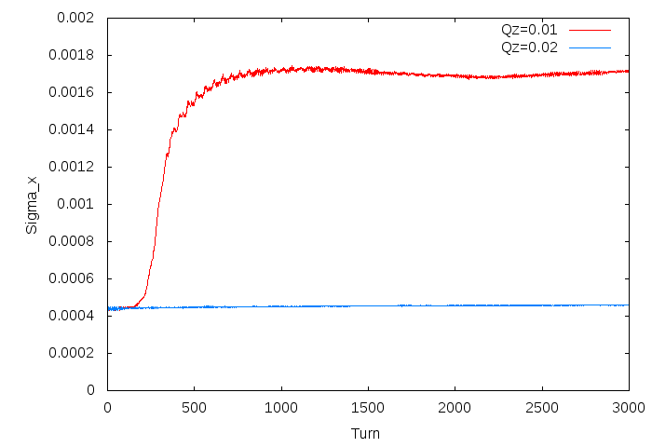
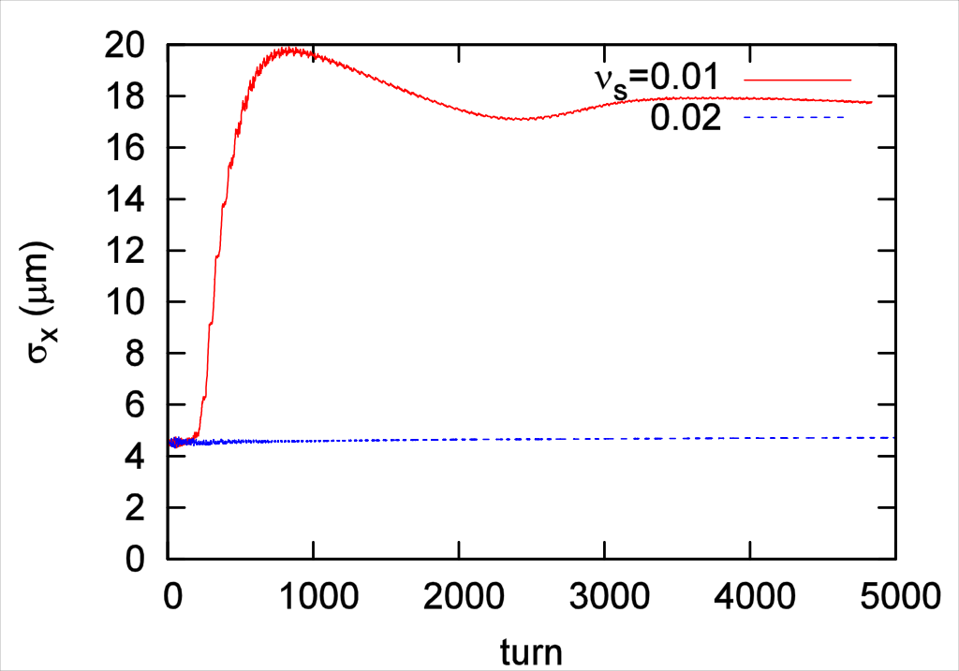

Mitigation of Coherent Beam-Beam Instability at Z
A new coherent instability in x-z plane was first found by K. Ohmi by FCC Week 2016 with a strong-strong beam-beam simulation.
D. Shatilov confirmed their phenomenon by a completely independent simulation with a tunr-by-turn alternating quasi-strong-strong simulation. The result of these two agrees with each other very well.
A semi-analytic scaling the threshold bunch intensity has been derived by K. Ohmi, et al.*:
Thus a smaller βx* and a larger momentum compaction αp are favorable. The latter can be achieved by changing the phase advances at Z.
We have reduced βx* to about 1/3, and increased αp by a factor of 2.
D. Shatilov
K. Ohmi
*K. Ohmi, N. Kuroo, in these preceedings, THPAB021

Slide 5
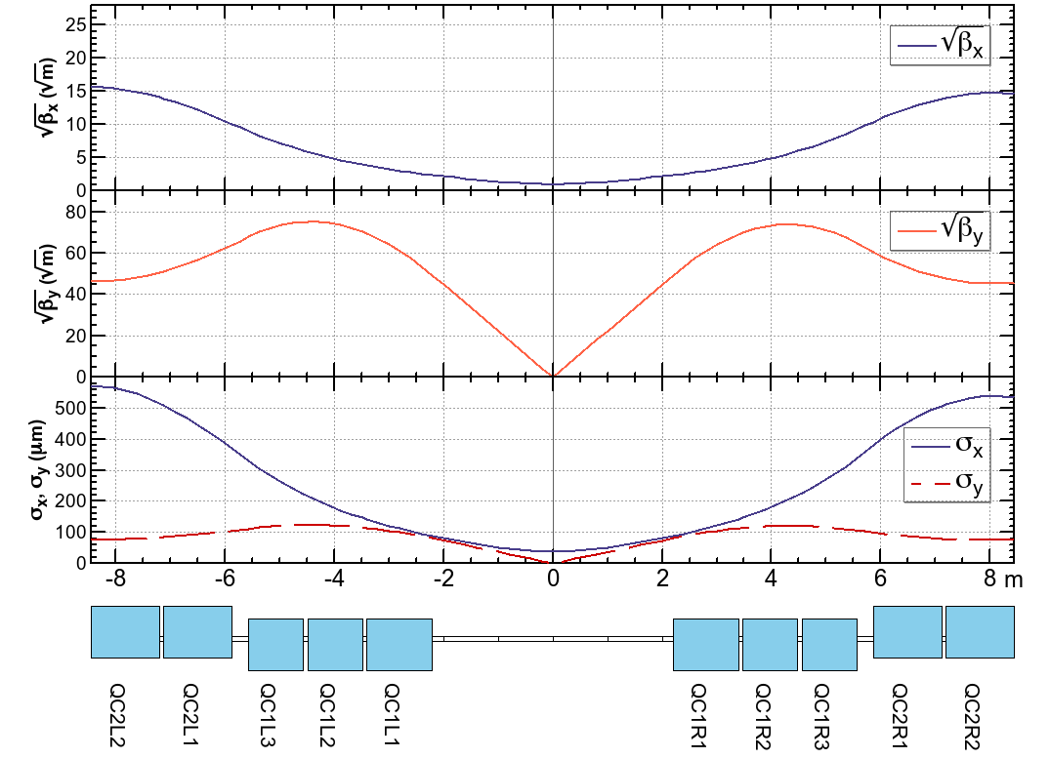
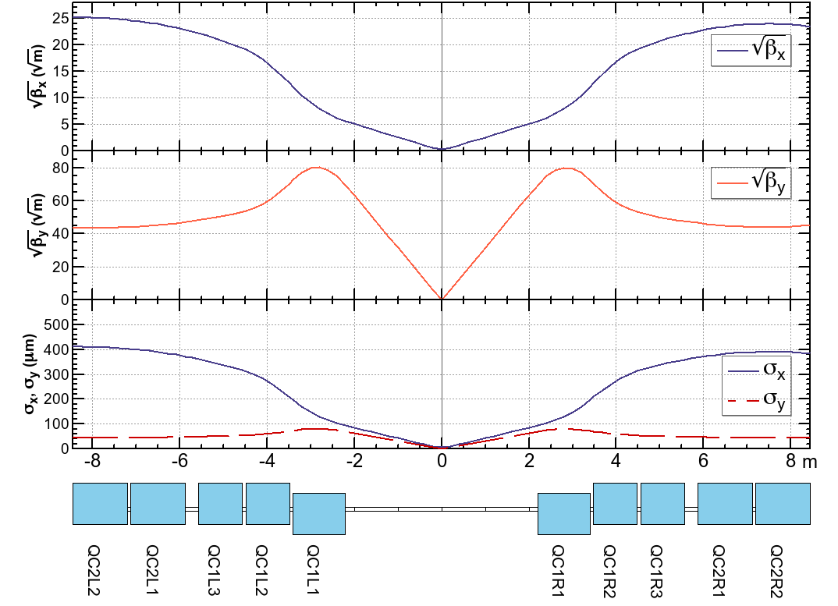
Reduce βx*, from 50 cm to 15 cm
βx,y* = (1 m, 2 mm) @ tt
βx,y* = (15 cm, 1 mm) @ Z
IP
IP
Divide QC1 into three independent pieces, reverse the polarity at Z.
 | L (m) | B’ @ tt (T/m) | B’ @ Z (T/m)
QC1L1 | 1.2 | -94.4 | -96.3
QC1L2 | 1 | -92.6 | +50.3
QC1L3 | 1 | -96.7 | +9.8
QC2L1 | 1.25 | +45.8 | +6.7
QC2L2 | 1.25 | +74.0 | +3.2
 | L (m) | B’ @ tt (T/m) | B’ @ Z (T/m)
QC1R1 | 1.2 | -99.9 | -97.2
QC1R2 | 1 | -99.9 | +51.2
QC1R3 | 1 | -99.9 | +12.0
QC2R1 | 1.25 | +78.6 | +7.3
QC2R2 | 1.25 | +76.2 | +7.2
By this split the chromaticity and the peaks of βx,y around the IP are suppressed for the reduction of βx,y* at Z to (1/7, 1/2) at tt.

Slide 6
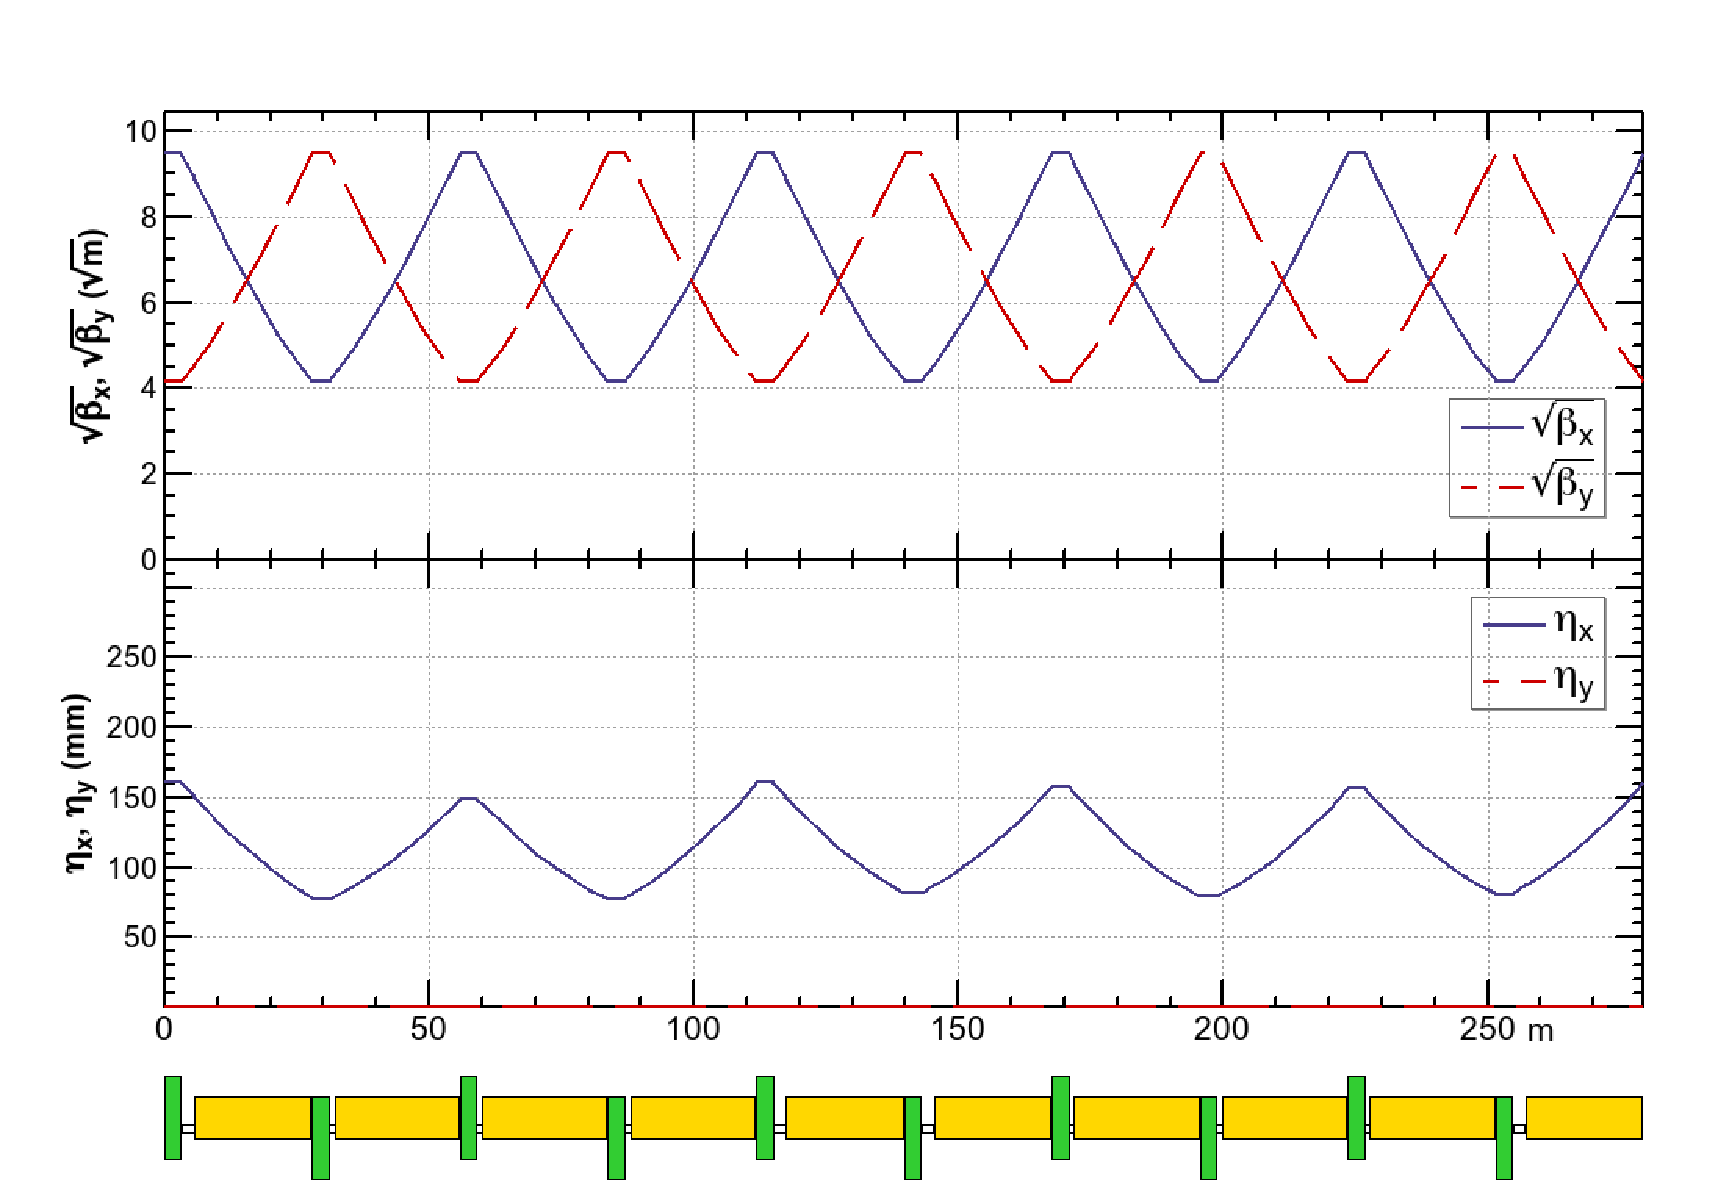
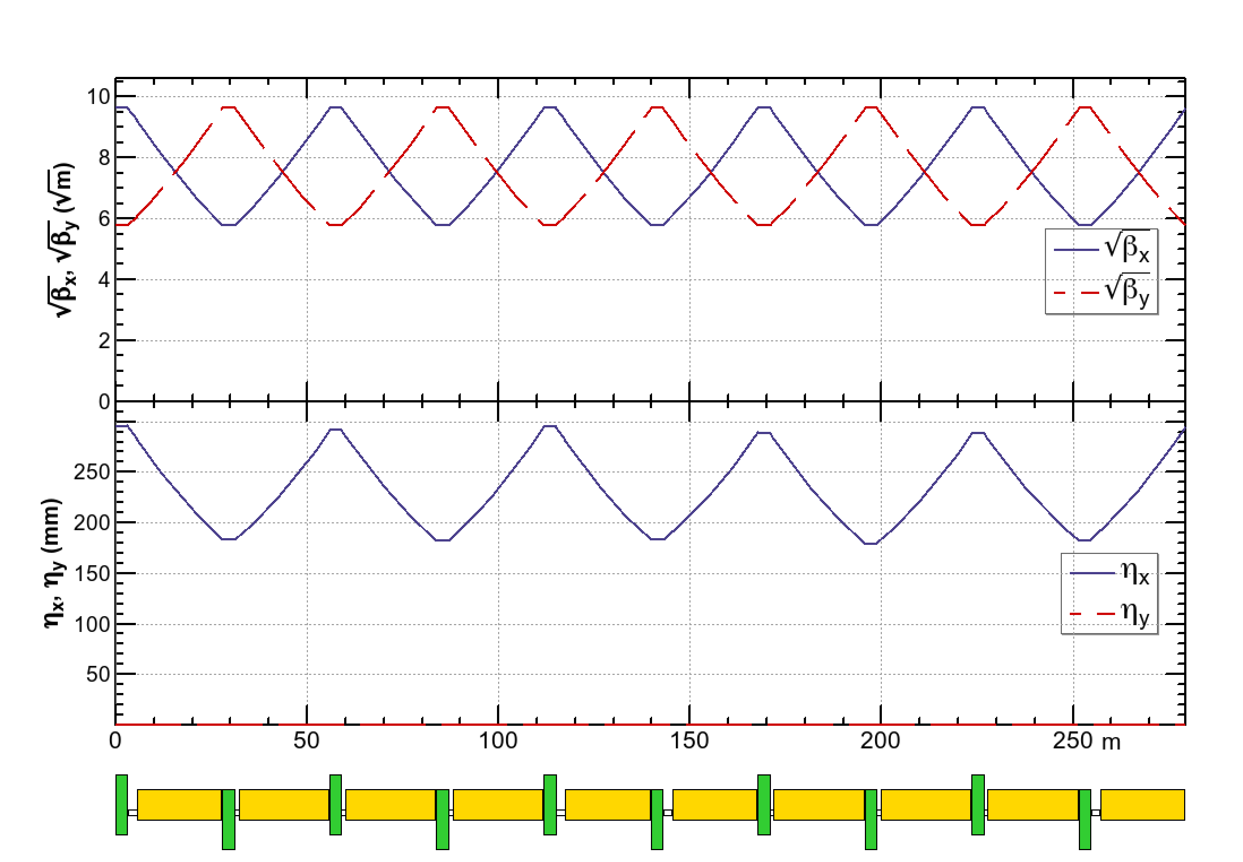
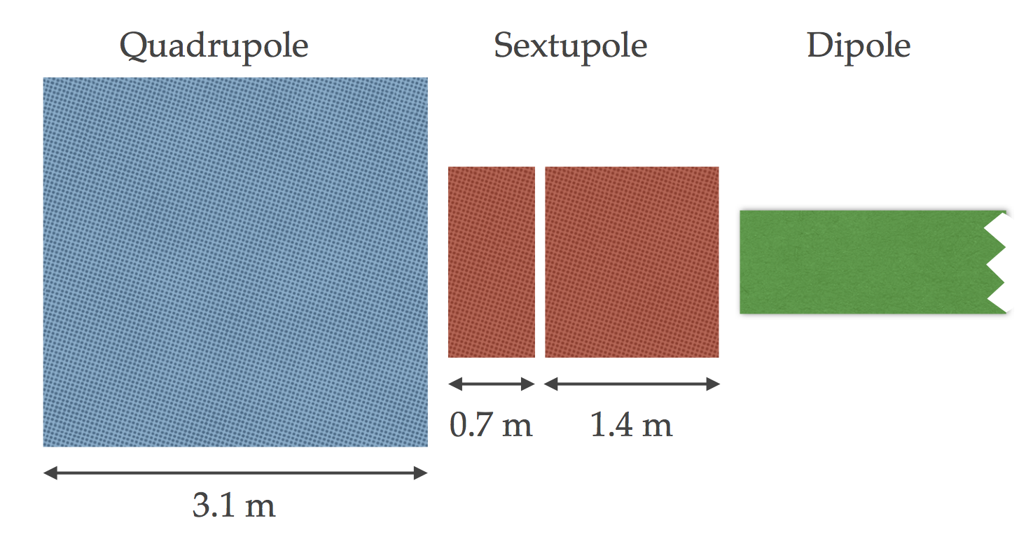
60°/60° Arc FODO Cell at Z
90°/90° at WW, Zh, tt
60°/60° at Z
IP
There are two lengths for the space for sextupoles between quads and dipoles.
The longer ones are used for sexts in the case of 90°/90° cell. Some of shorter ones are used in the 60°/60° cell, making -I transformation between a pair of sextupole.
There are two lengths for the dipole, with the same field strength, thus a small irregularity is seen in the dispersion.
The sextupole at the longer space consists of two slices.
Only the shorter one is used/inserted at Z.

Slide 7
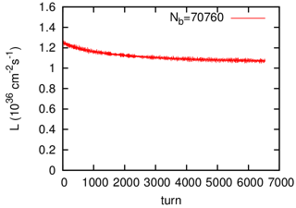
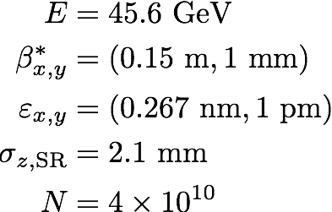


The mitigation for the beam-beam instability looks OK
Strong-strong simulation (K. Ohmi)
Energy | β*x,y (m, mm) | Geometrical | Strong-Strong (K. Ohmi) | Remarks
Z | (0.15, 1) | 137 | 107 | a small blowup
W± | (1, 2) | 16.4 | 12.5 | νx,y = (0.57, 0.61)
 | (0.5, 1) | 30.0 | 23 | νx,y = (0.57, 0.61)
Zh | (1, 2) | 4.6 | 5.0
 | (0.5, 1) | 8.0 | 8.0 | νx,y = (0.57, 0.61)
tt | (1, 2) | 1.35 | 1.55
 | (0.5, 1) | 2.09 | 2.3 | νx,y = (0.57, 0.61)
half turns
The luminosity by the strong-strong beam-beam simulation agrees with the geometrical ones within ±20% differences.
This means the blowup due to beam-beam effect is not large.
Further tuning of the bunch charge, β-tron tunes, bunch length, etc., will improve the luminosity further.
More, independent results with quasi-strong-strong model will be presented by D. Shatilov in this workshop.

Slide 8
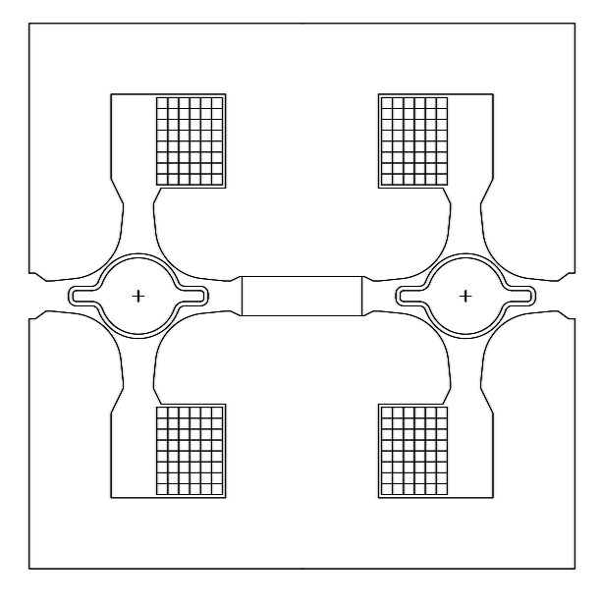
Twin Aperture Quadrupole
An idea of “twin aperture quadrupole” has been developed by A. Milanese to save the power consumption of quadrupole magnets.
The currents in the magnet are always surrounded by iron to maximize the usage.
An example of the cross section of a twin aperture quadrupole for FCC-ee (A. Milanese).
The separation between two beams is 30 cm.
The power consumption of the twin aperture quad: 22 MW at 175 GeV with Cu coil = half of single-aperture quads.
Dipoles are also “twin”: power consumption = 17 MW at 175 GeV with Al bus bar.

Slide 9
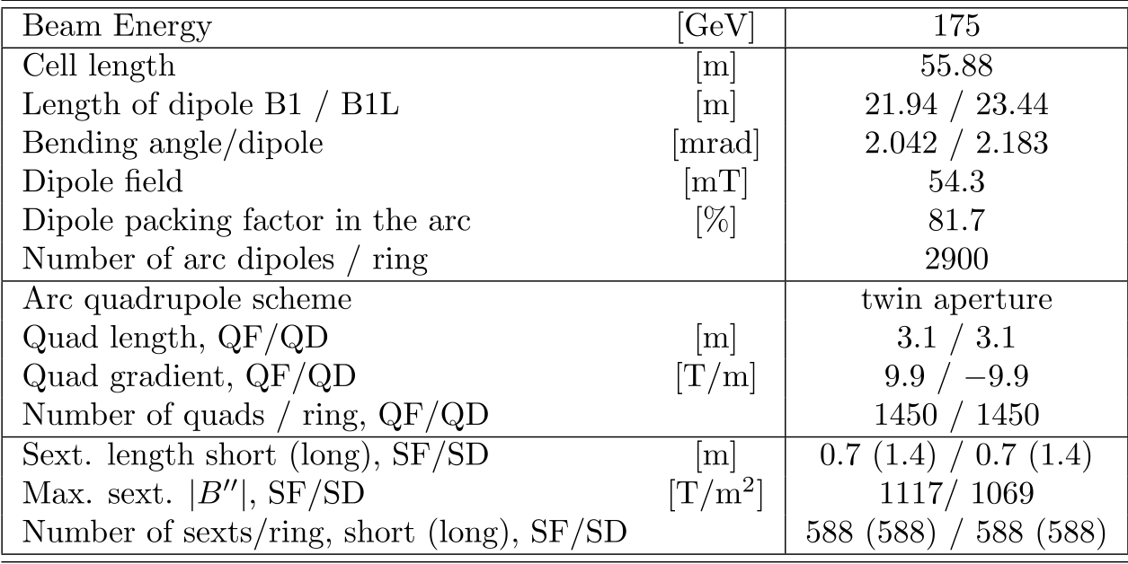
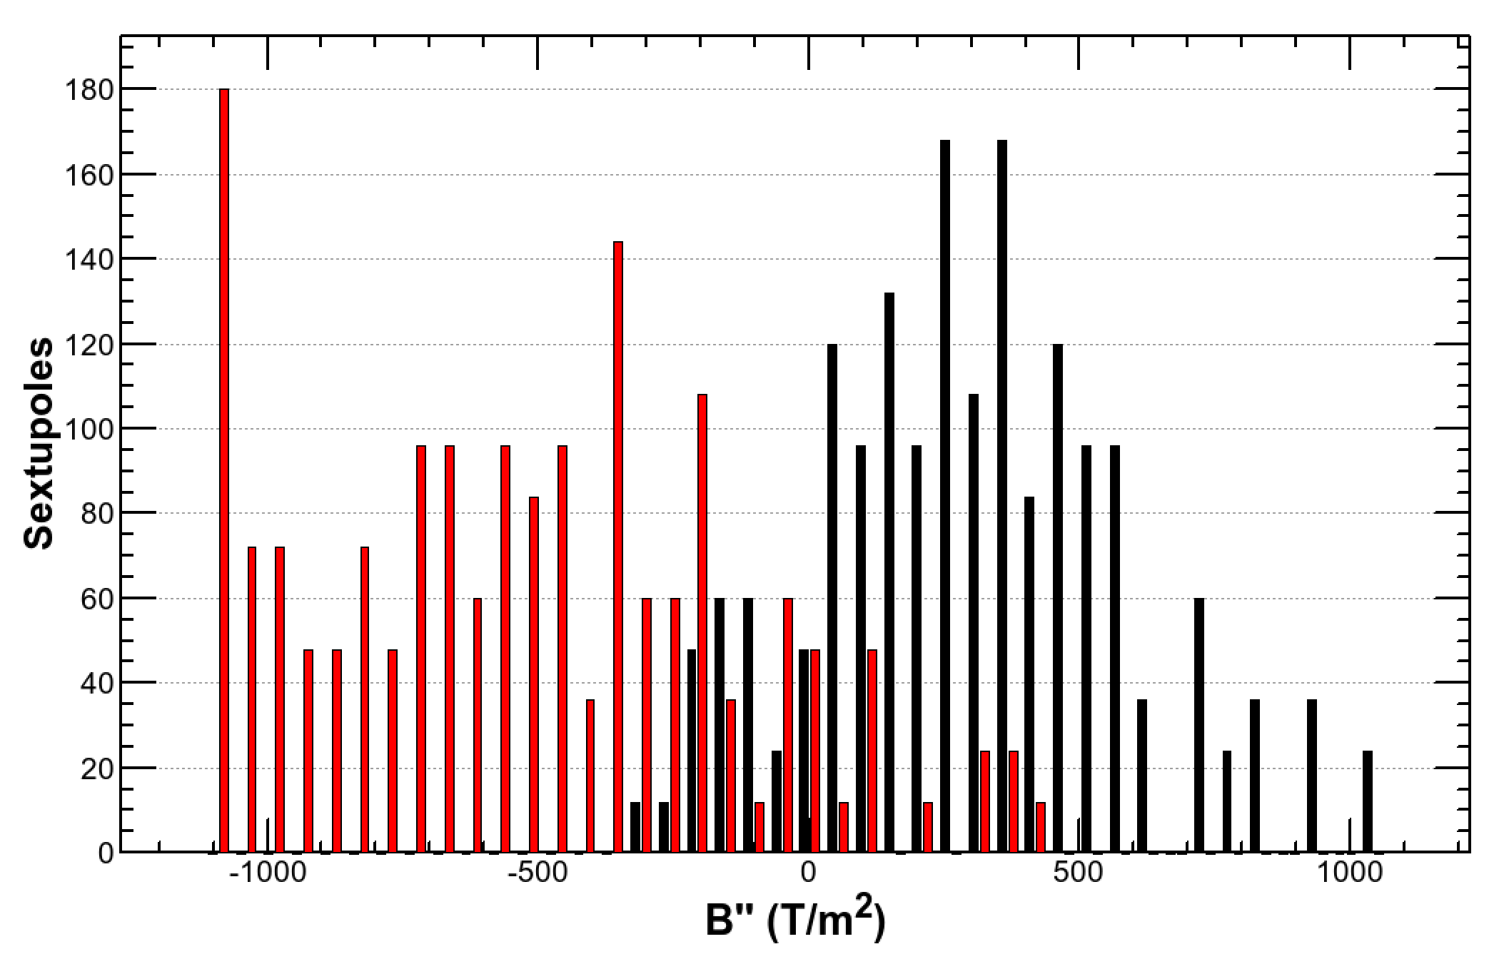
Parameters for Arc Magnets
Although the sextupoles seem very strong, the average of them is still reasonable.
∼10% of them may need a special dedicated architecture.
SD*
SF*

Slide 10
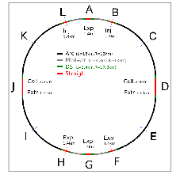
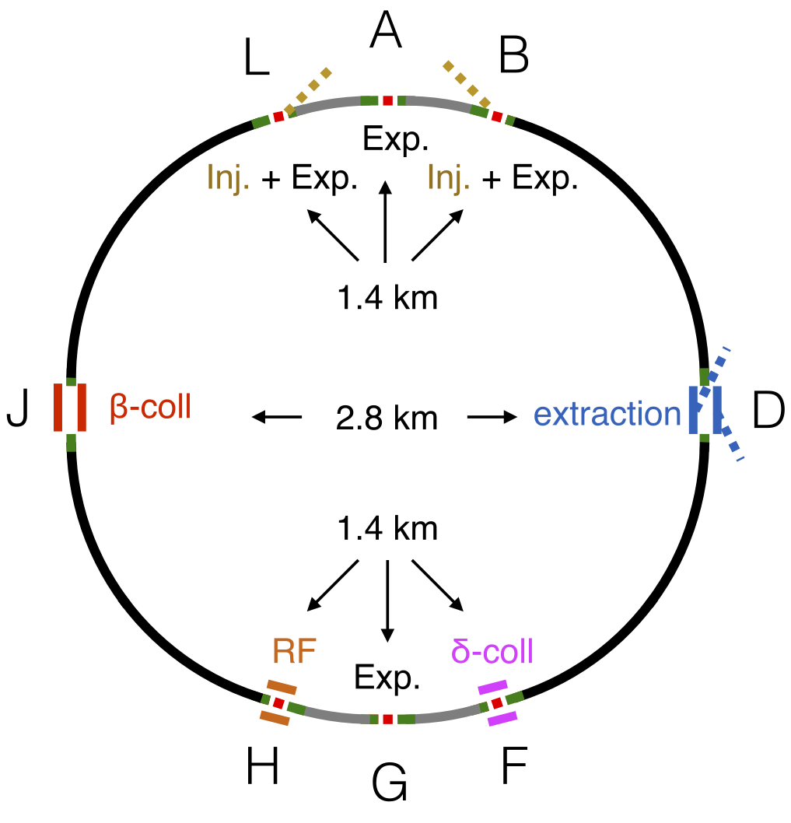
Fitting to the new geometry of FCC-hh
Old Layout
New Layout
The straight sections D&J have been shortened from 4.2 km to 2.8 km each.
The circumference has shortened by 2.2 km.
The location of sections B, F, H, L are slightly changed.

Slide 11
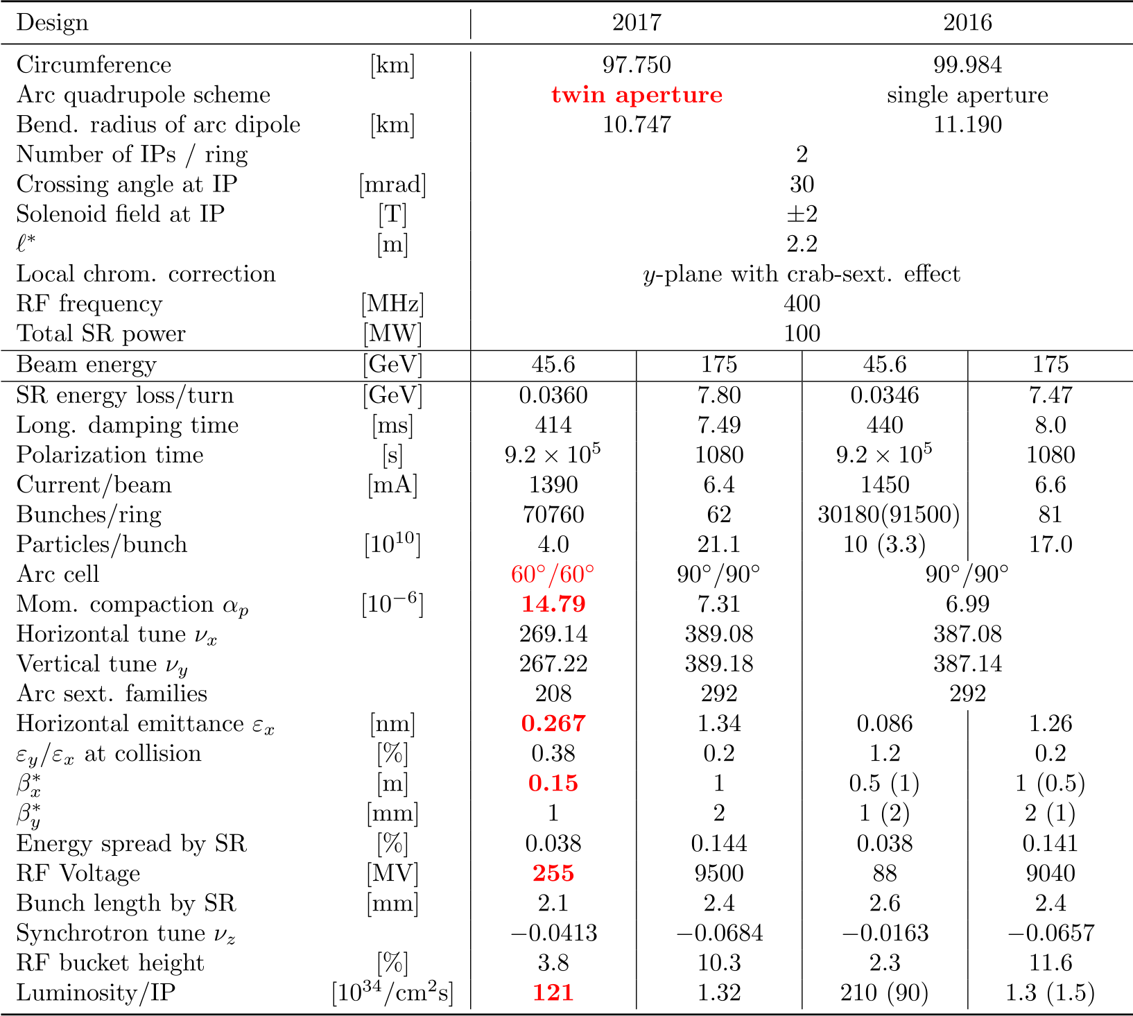
Parameters

Slide 12
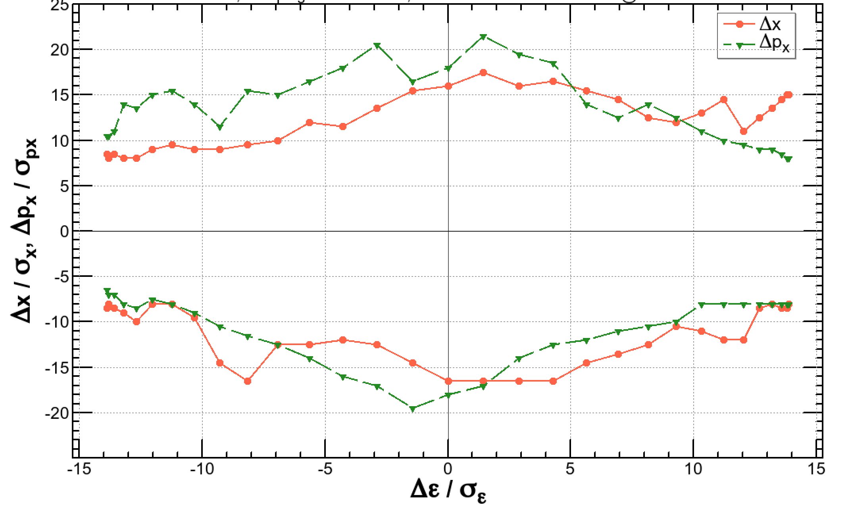
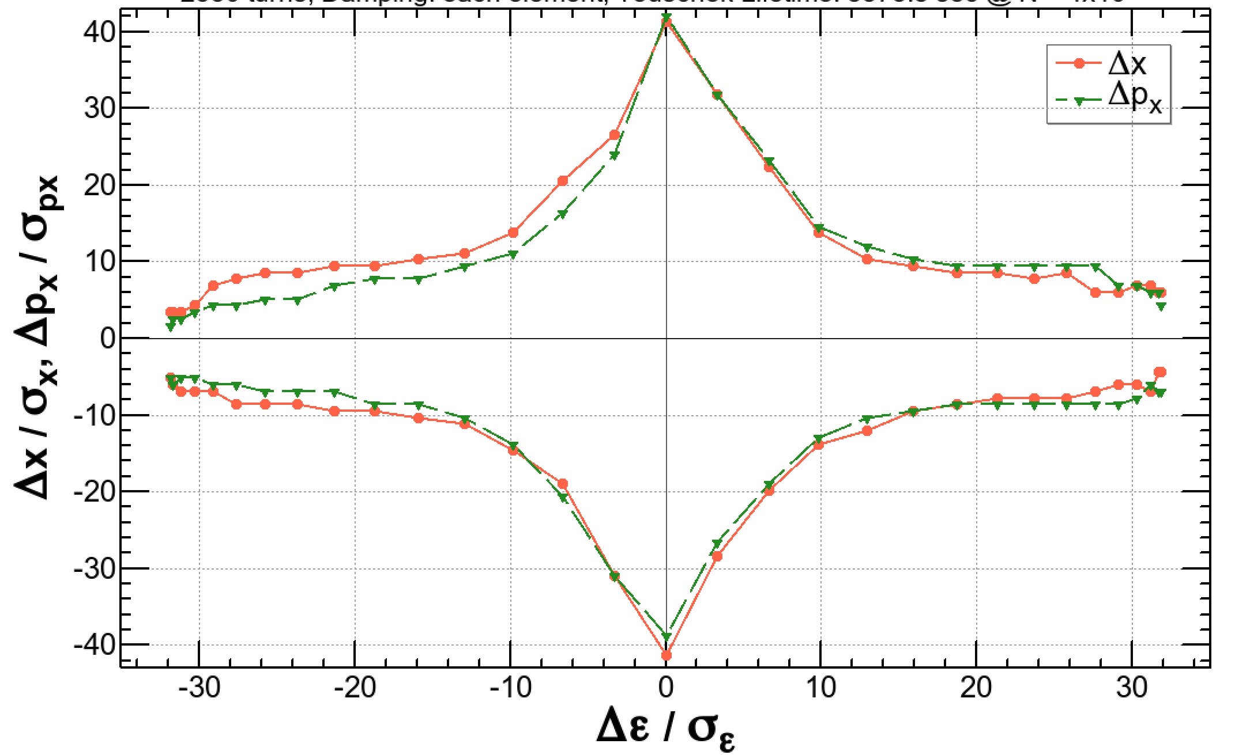
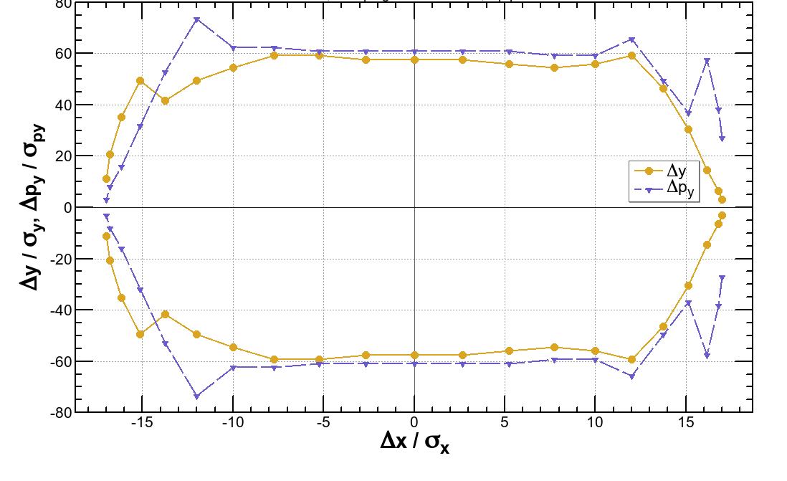
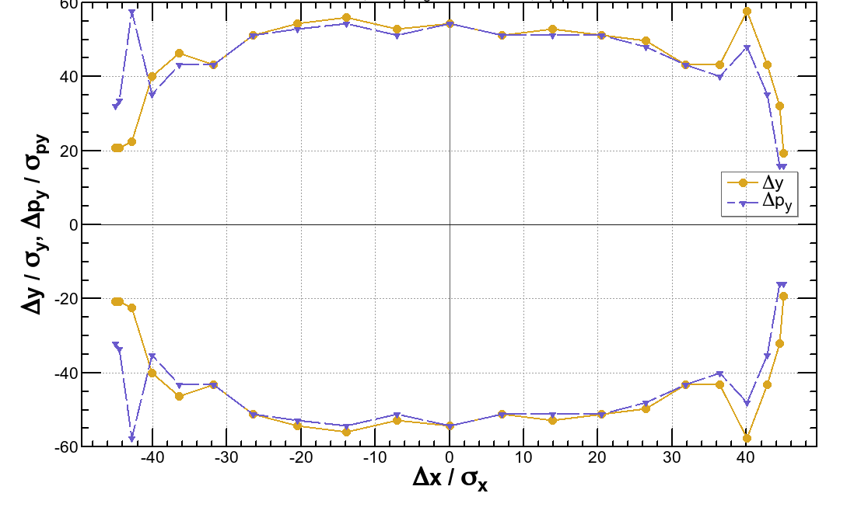
Dynamic Aperture satisfies the requirements
175 GeV, β*x,y = (1 m, 2 mm)
45.6 GeV, β*x,y = (0.15 m, 1 mm)
(a)
(b)
±2%
±1.2%
(c)
(d)
On-energy
On-energy
Momentum acceptances: ±2% = 11σδ @ tt, ±1.2%=±14σδ @ Z, including beamstrahlung.
Tracking 50 turns @ tt, 2550 turns at Z. Synchrotron motion, synchrotron radiation damping in dipoles & quads, tapering, Maxwellian fringes, kinematical terms, crab waist are included.

Slide 13
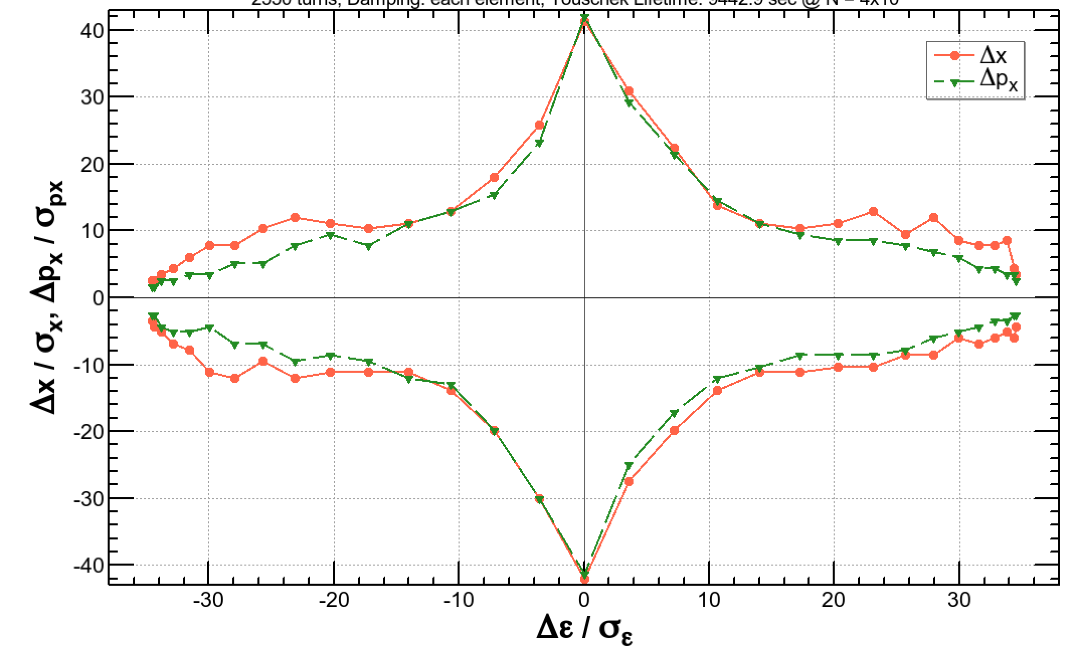
Dynamic Aperture satisfies the requirements (revised at FCC Week)
175 GeV, β*x,y = (1 m, 2 mm)
45.6 GeV, β*x,y = (0.15 m, 1 mm)
(a)
(b)
±2%
±1.3%
(c)
(d)
On-energy
On-energy
Momentum acceptances: ±2% = 10.4σδ @ tt, ±1.3%=±17.8σδ @ Z, including beamstrahlung.
Tracking 50 turns @ tt, 2550 turns at Z. Synchrotron motion, synchrotron radiation damping in dipoles & quads, tapering, Maxwellian fringes, kinematical terms, crab waist are included.

Slide 14
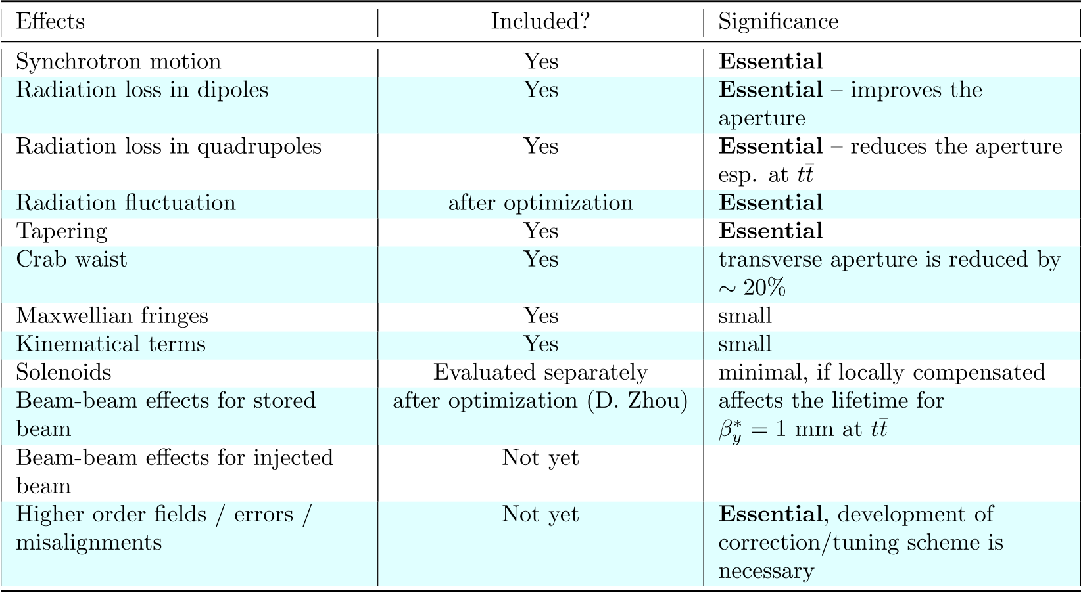
Effects included in the dynamic aperture survey

Slide 15
Summary
Modification of the beam optics for FCC-ee has been performed over the base line optics 2016:
  Mitigation of the coherent beam-beam instability at Z
    By achieving smaller βx*
    Applying 60°/60° cell in the arc, only at Z, compatible with 90°/90° cell at higher energies.
  Adopt the “Twin Aperture Quadrupole” scheme for arc quadrupoles
  Fit the footprint to a new FCC-hh layout
The resulting dynamic aperture is sufficient for the beamstrahlung and top-up injection.
Please visit related posters:
  Vertical Dispersion and Betatron Coupling Correction for FCC-ee, MOPIK097
  Conceptual Design of a Pre-Booster Ring for the FCC e+e- Injector, MOPVA029
  Beam Dynamics Simulation in Two Versions of New Photogun for FCC-ee Electron Injector Linac, TUPAB011
  Optimisation of the Design of CERN's Future Circular Collider from a Civil Engineering Perspective, TUPVA127
  Advanced Beam Dump for FCC-ee, WEPIK001
  Challenges and Status of the Rapid Cycling Top-Up Booster for FCC-ee, WEPIK031
  Progress in the FCC-ee Interaction Region Magnet Design, WEPIK034
  Coupling Impedances and Collective Effects for FCC-ee, THPAB020
  Coherent Beam-Beam Instability in Collision With a Large Crossing Angle, THPAB021

Slide 16
Backups

Slide 17
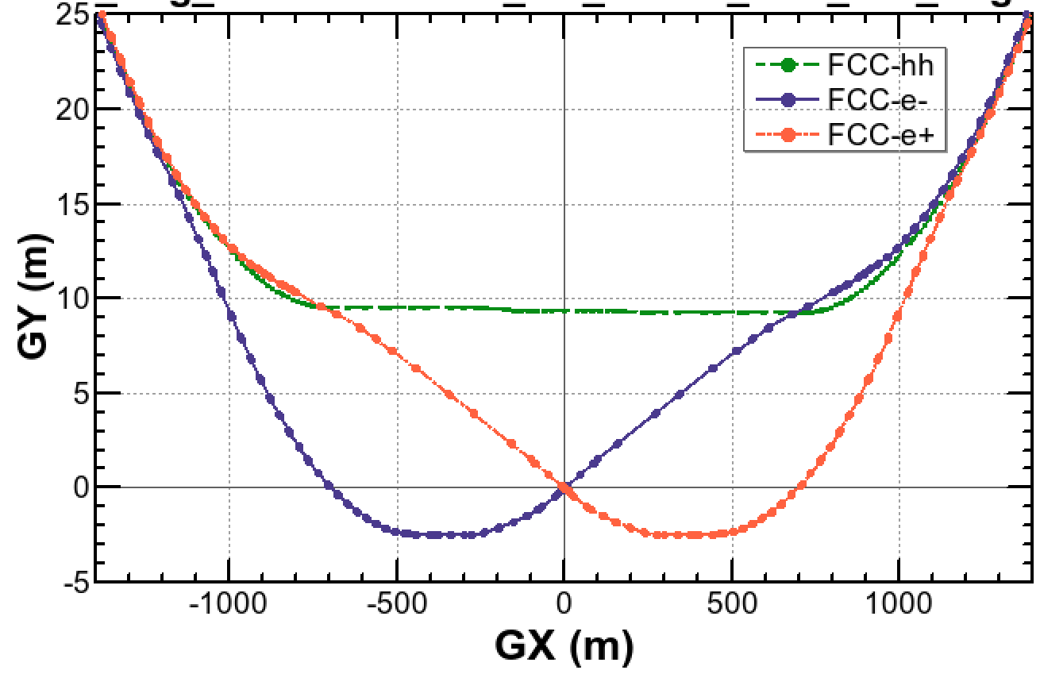

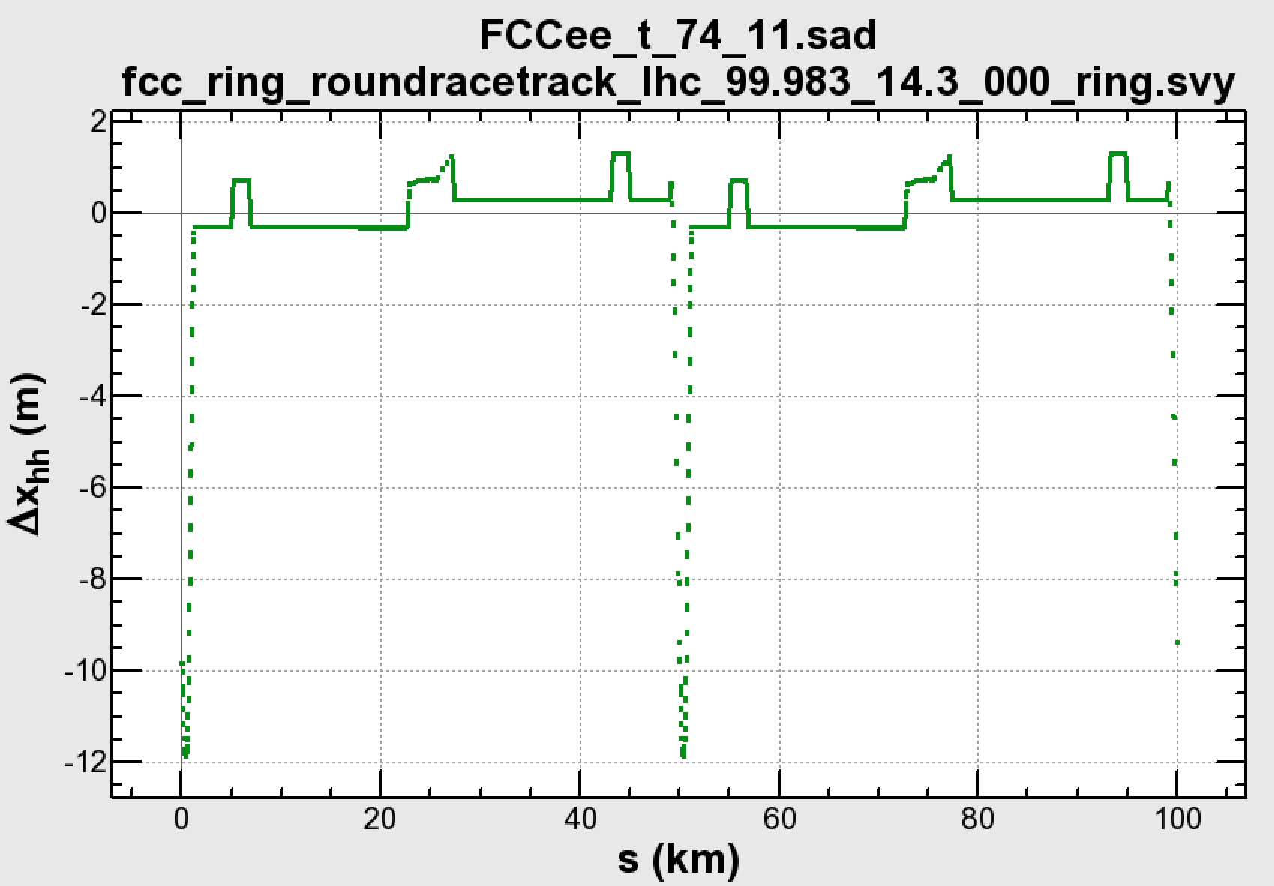
Layout of FCC-ee
IP (A)
30 mrad
“Middle straight”
∼1570 m
L
FCC-hh/
Booster
B
11.9 m
9.4 m
Beams must cross over through the common RF (@ tt) to enter the IP from inside.
Only a half of each ring is filled with bunches.
FCC-hh
0.6 m
“90/270 straight”
∼4.7 km
J
RF
RF
D
The separation of 3(4) rings is about 12 m:
wide tunnel and two tunnels are necessary around the IR, for ±1.2 km.
A more compact layout/optics around the IP is also possible(A. Bogomyagkov).
IP
H
F
Relative distance to FCC-hh
IP (G)

Slide 18
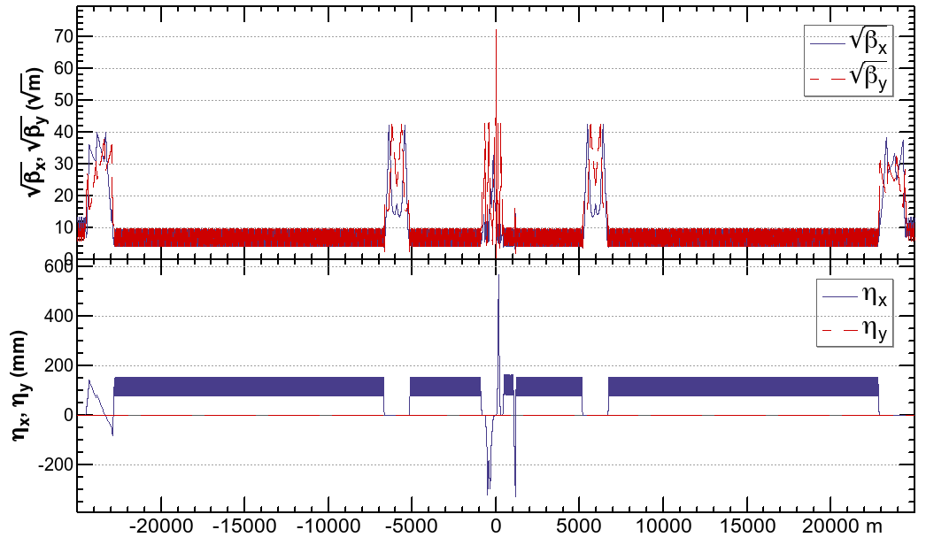
Half Ring Optics
IP
RF
RF
Above are the half optics β*x/y = 1 m / 2 mm.
2 IP/ring.
The optics for straight sections except for the IR are tentative, to be customized for infection/extraction/collimation/beam instumentation, etc.

Slide 19
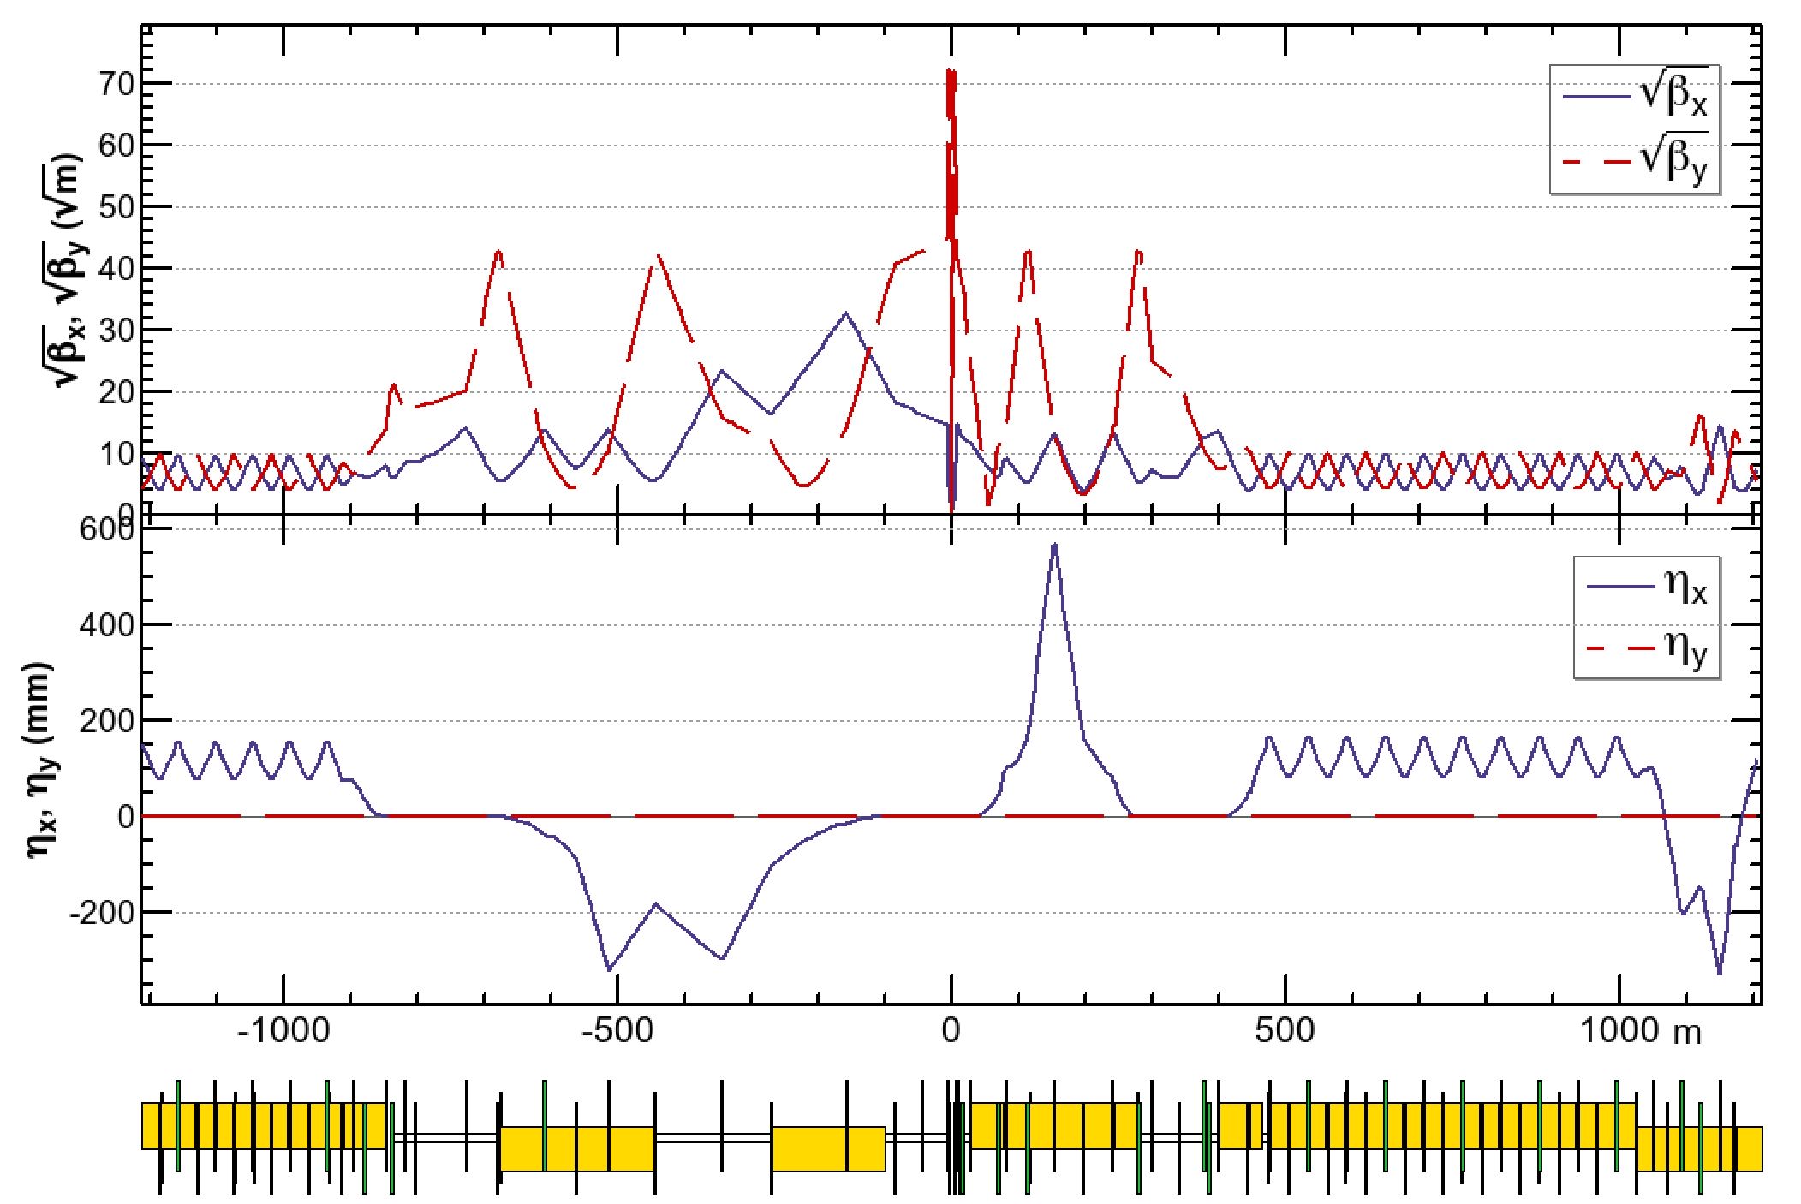
FCC-ee Interaction Region
Local chromaticity correction
+ crab waist sextupoles
Local chromaticity correction
+ crab waist sextupoles
Beam
IP
yellow boxes: dipole magnets
The optics in the interaction region are asymmetric.
The synchrotron radiation from the upstream dipoles are below 100 keV up to 450 m from the IP.
The crab sextuples are integrated in the local chromaticity correction system in the vertical plane.

Slide 20
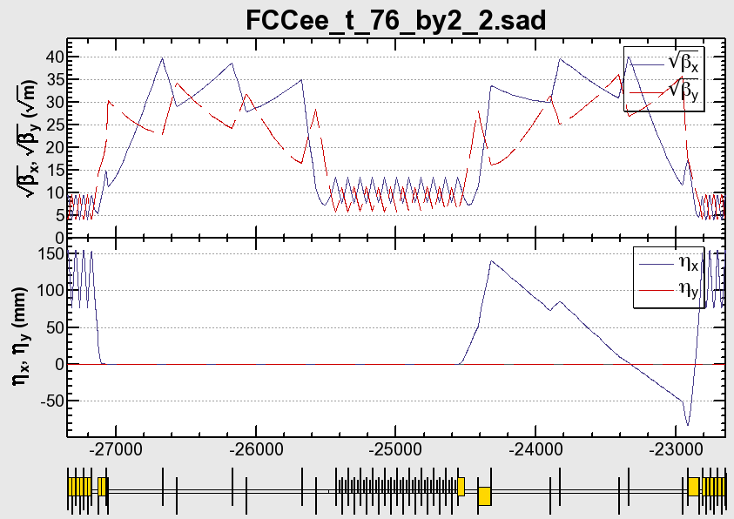

The RF section (FCC-ee @ 175 GeV)
beam
Beams cross over through the RF section.
RF cavities: 400 MHz, 4.5 GV / section
An electrostatic separator, combined with a dipole magnet
      The usage of the straights on the both sides of the RF is to be determined.
      If the nominal strengths of quads are symmetrical in the common section, it matches to the optics of both beam.
      This section is compatible with the RF staging scenario. For lower energy, the common RF and cross over will not be necessary.

Slide 21
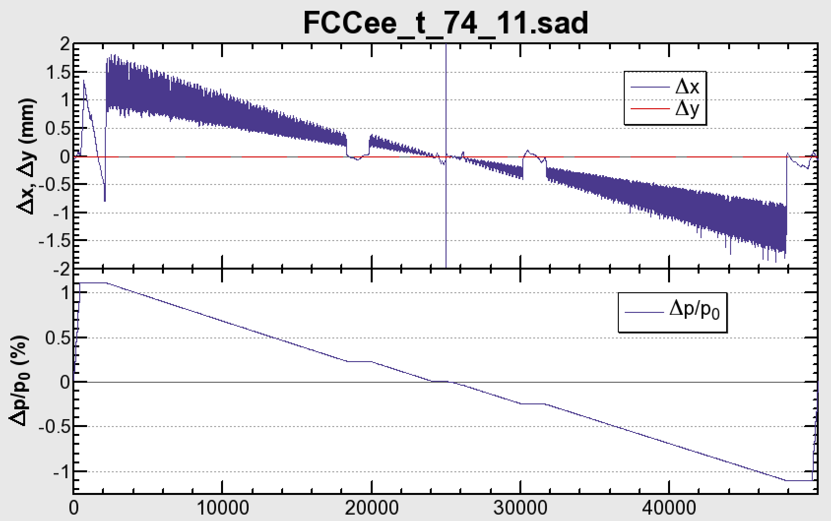
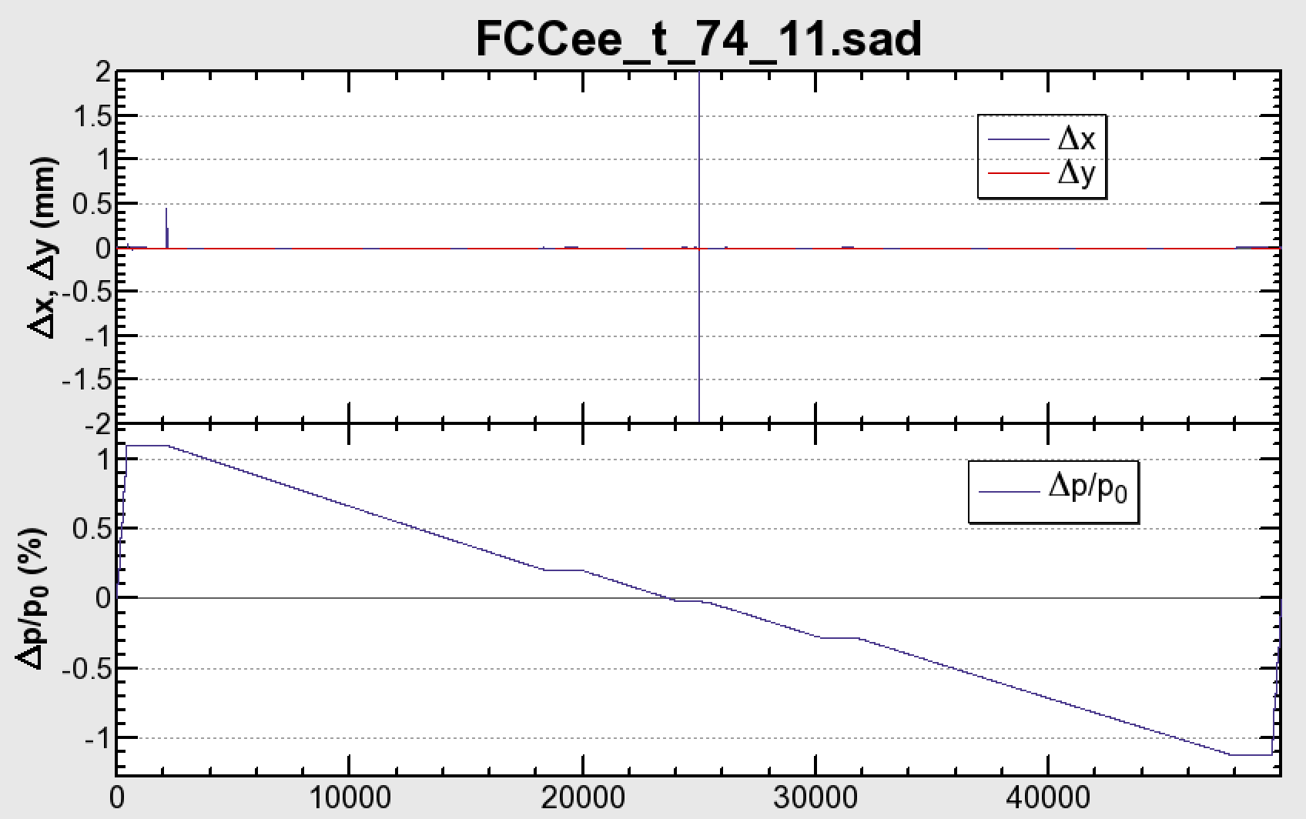
The Sawtooth & Tapering (FCC-ee @ 175 GeV)
No Taper
Tapered
      The change of the orbit due to energy loss along the arc causes serious deformation on the optics, causing the loss of the dynamic aperture.
      Everything can be cured almost completely by “tapering”, i.e. scaling the strengths of all magnets along the local energy of the beam: this is one of the best merits of a double-ring collider (F. Zimmermann).

Slide 22
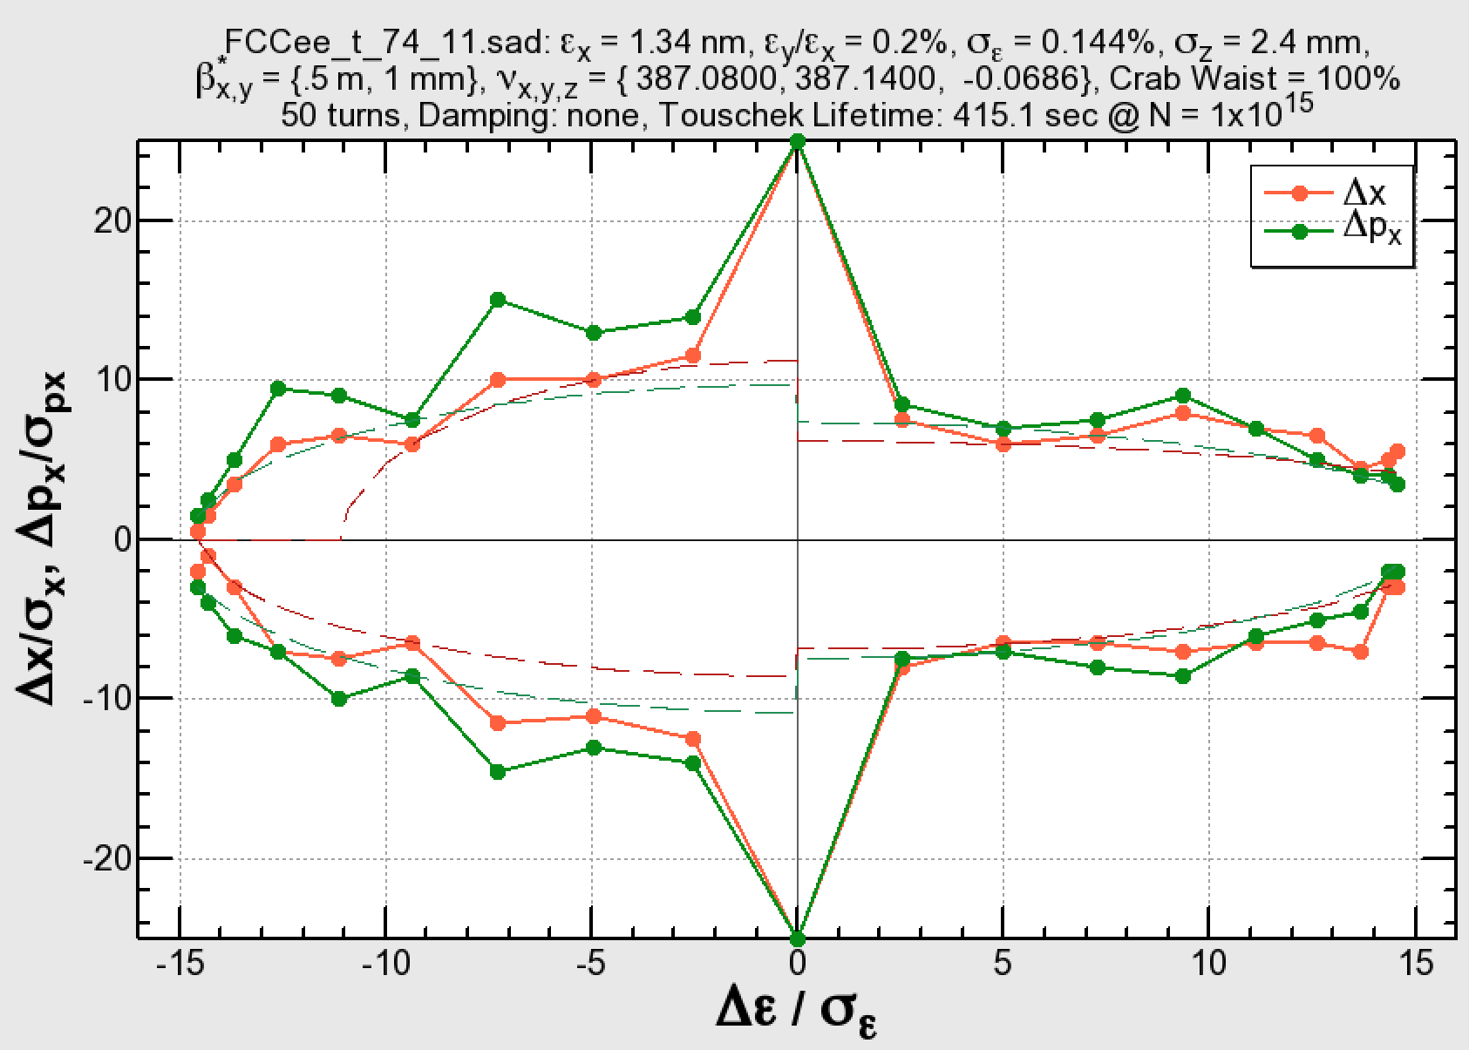
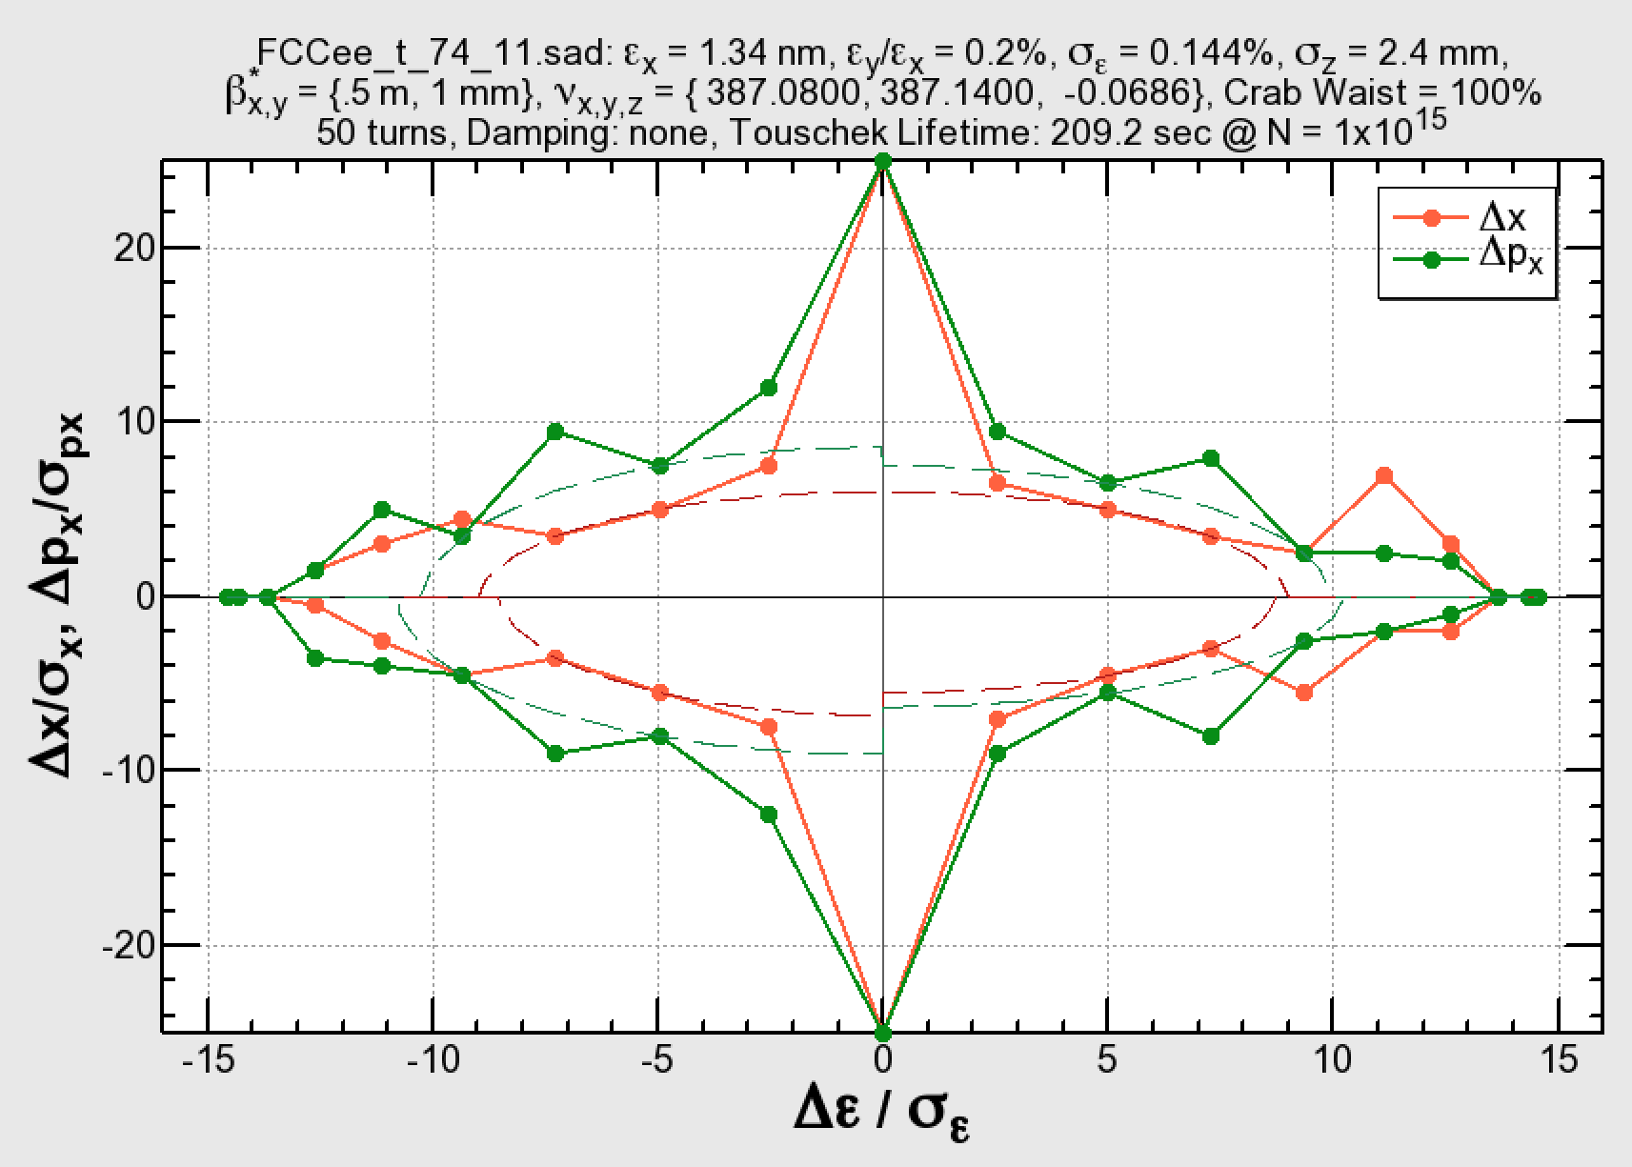
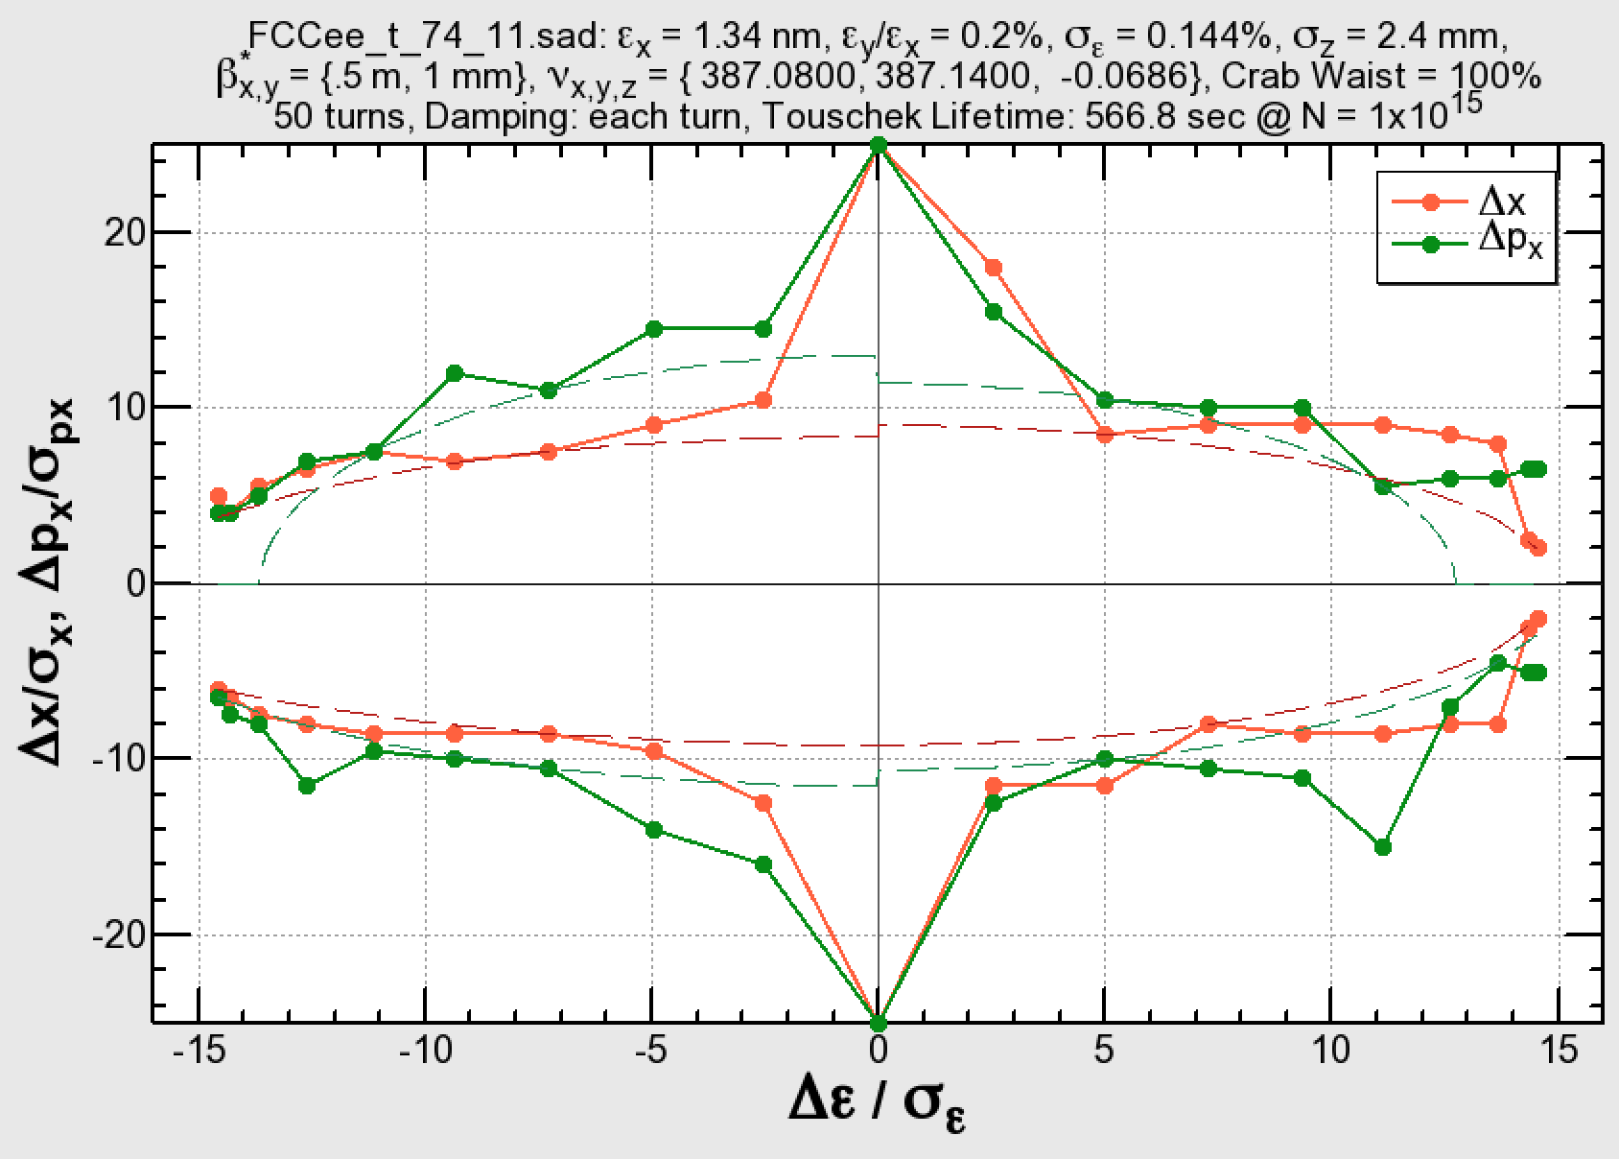
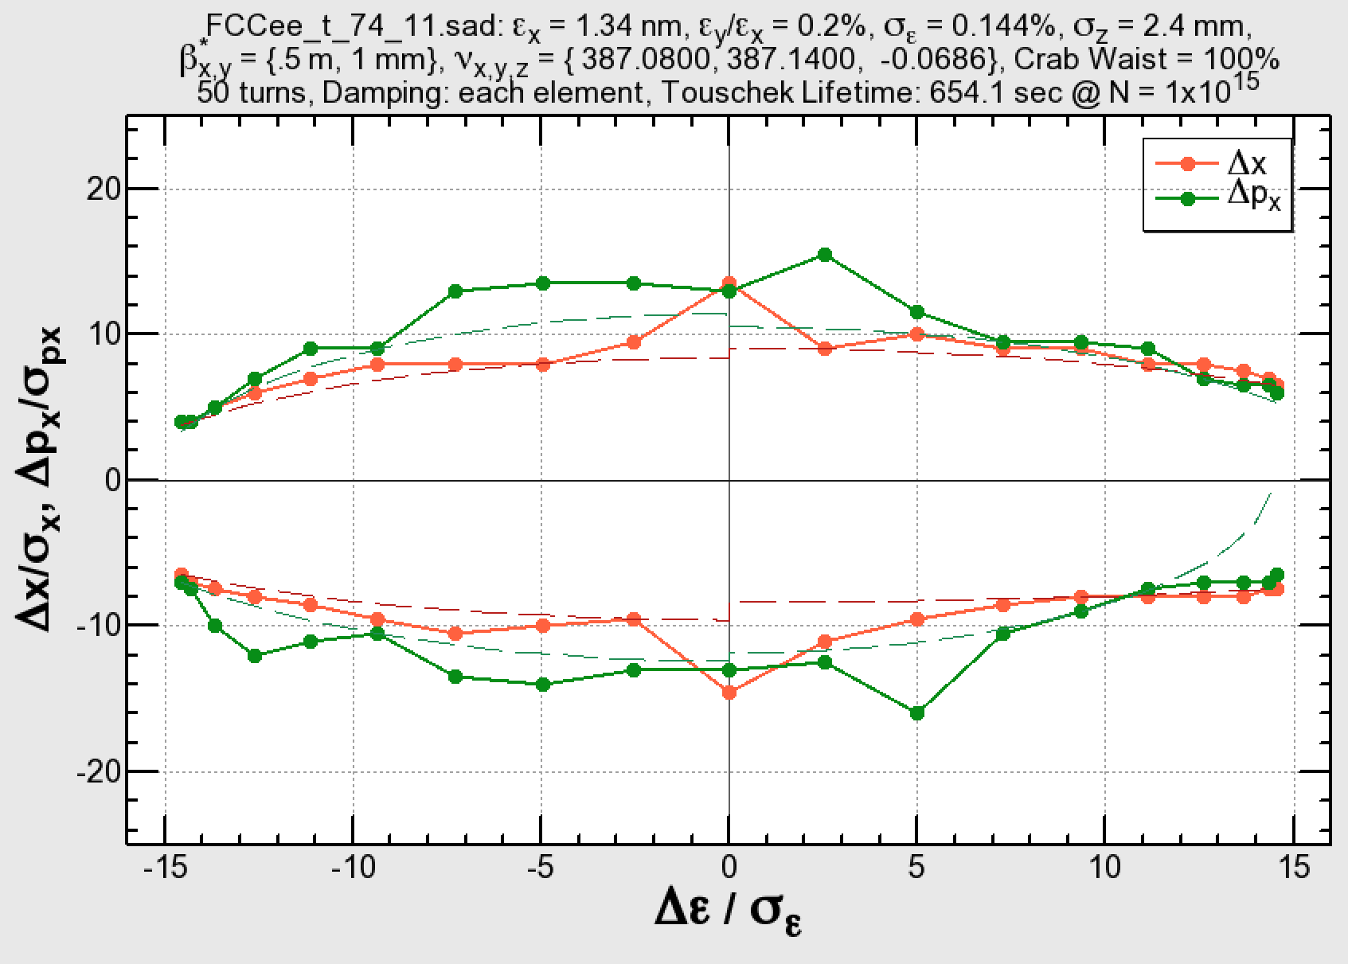
Several effects on the dynamic aperture
No RF, No radiation
RF, No radiation
±2%
±2%
RF, radiation damping each turn
RF, radiation in each element
K. Oide

Slide 23
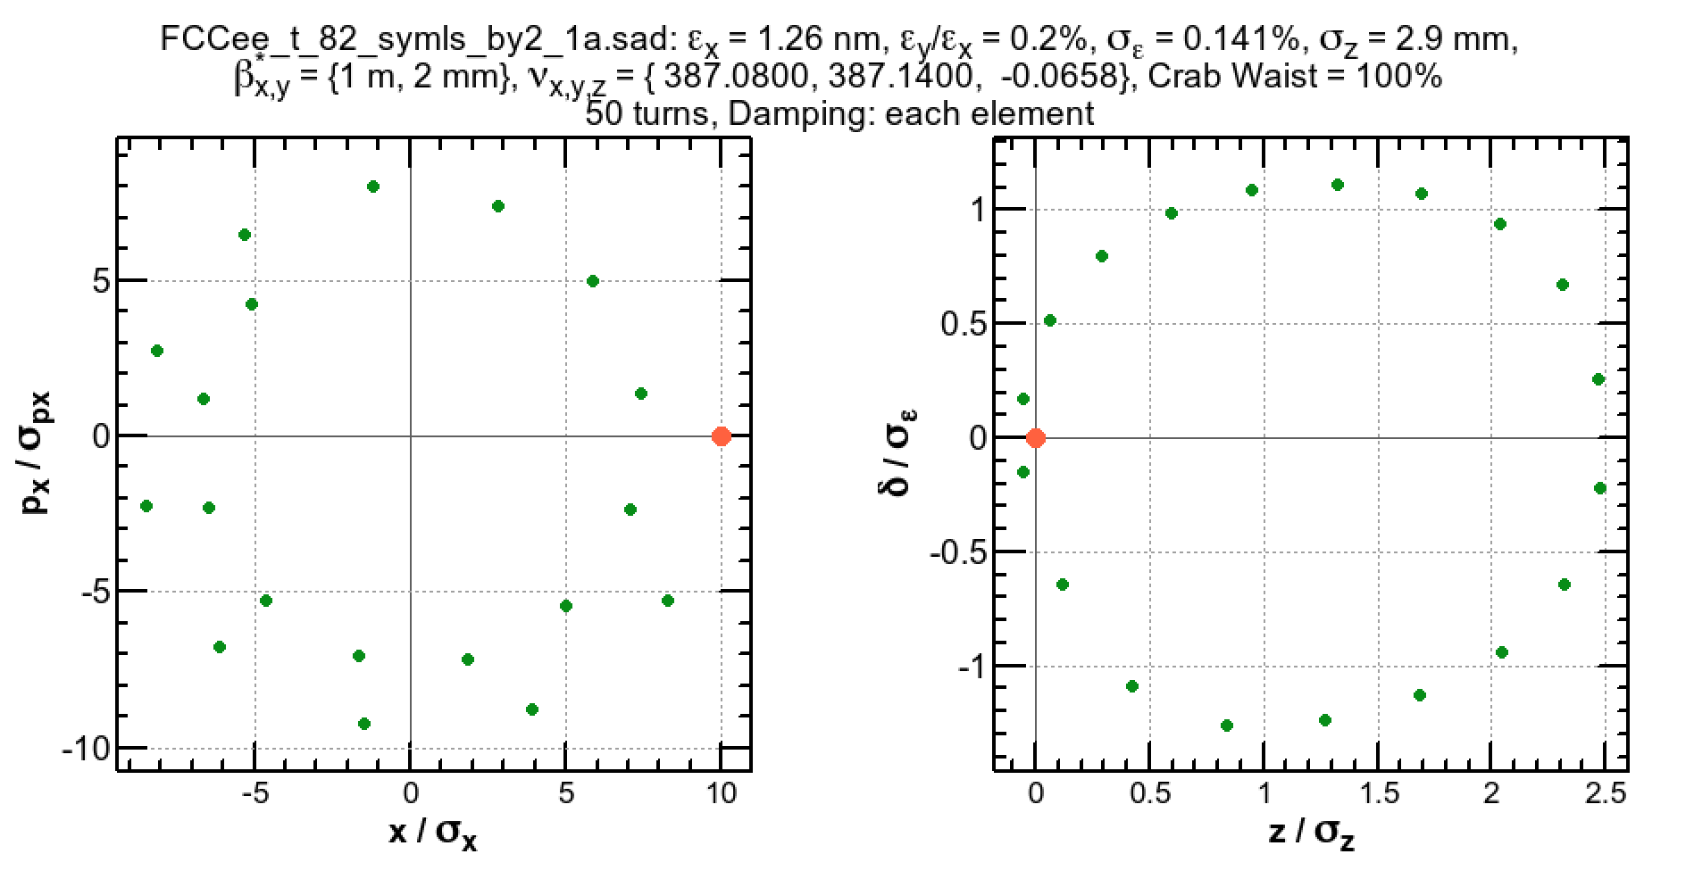


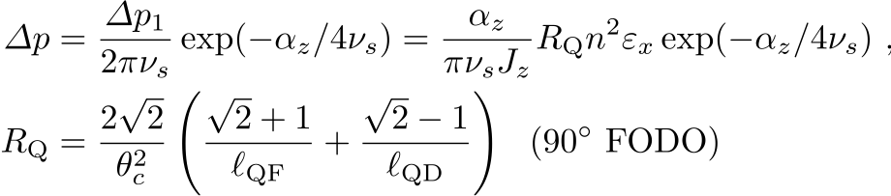
Synchrotron radiation in quadrupoles
0
0
1
1
2
2
Horizontal betatron oscillation (left) causes a synchrotron motion (right) due to the energy loss by the synchrotron radiation in arc quadrupoles.
Such particles can not stay on momentum: reduction of the dynamic aperture.

Slide 24
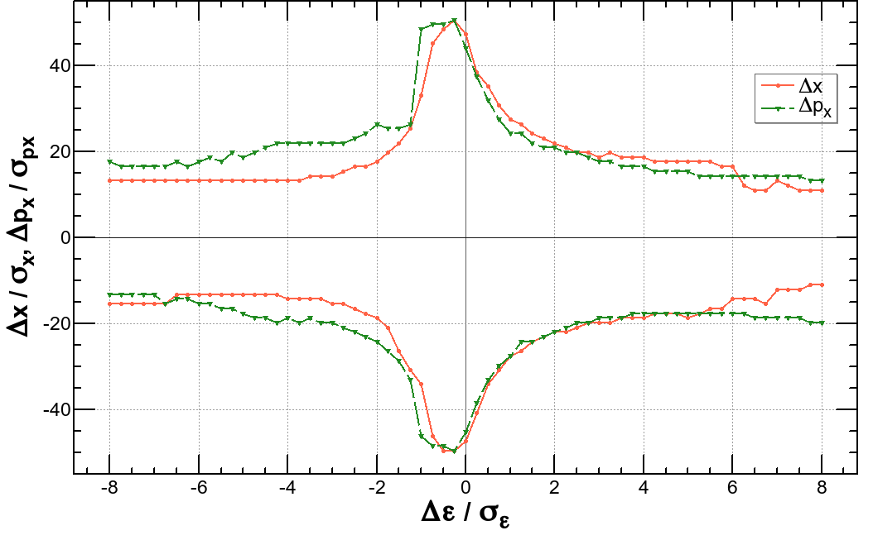
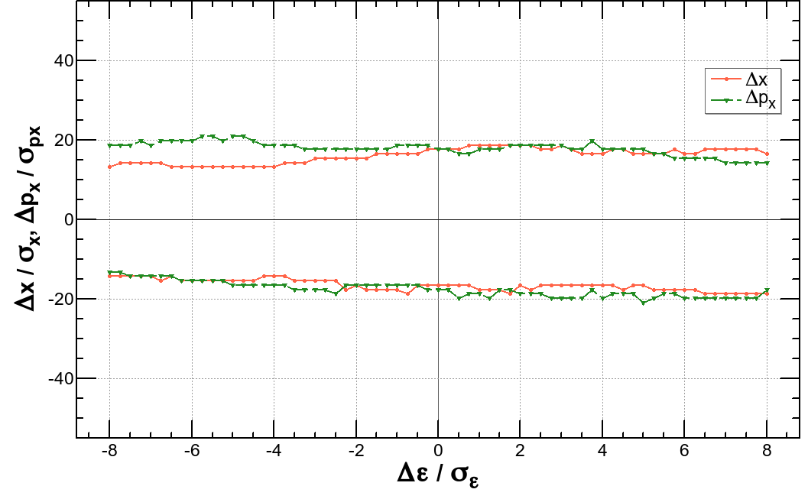
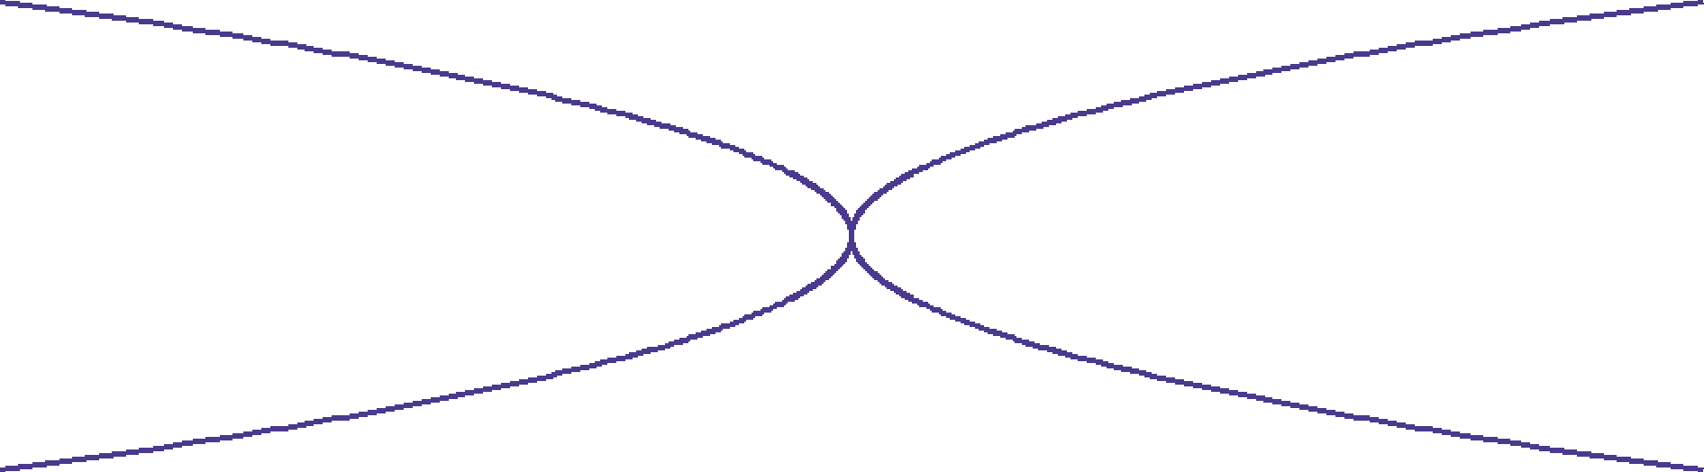
Synchrotron radiation in quadrupoles (cont’d)
E = 175 GeV, βx,y = (1 m, 2 mm)
The dynamic aperture without radiation loss in quadrupoles (left) has a sharp peak at on momentum.
The peak is destroyed if the radiation in quads is turned on (right).
The parabolas on the left show the amplitude of the synchrotron motion due to the radiation in the quadrupole. For a given transverse amplitude, if the parabola is beyond the DA, the particle with that amplitude will be lost.

Slide 25
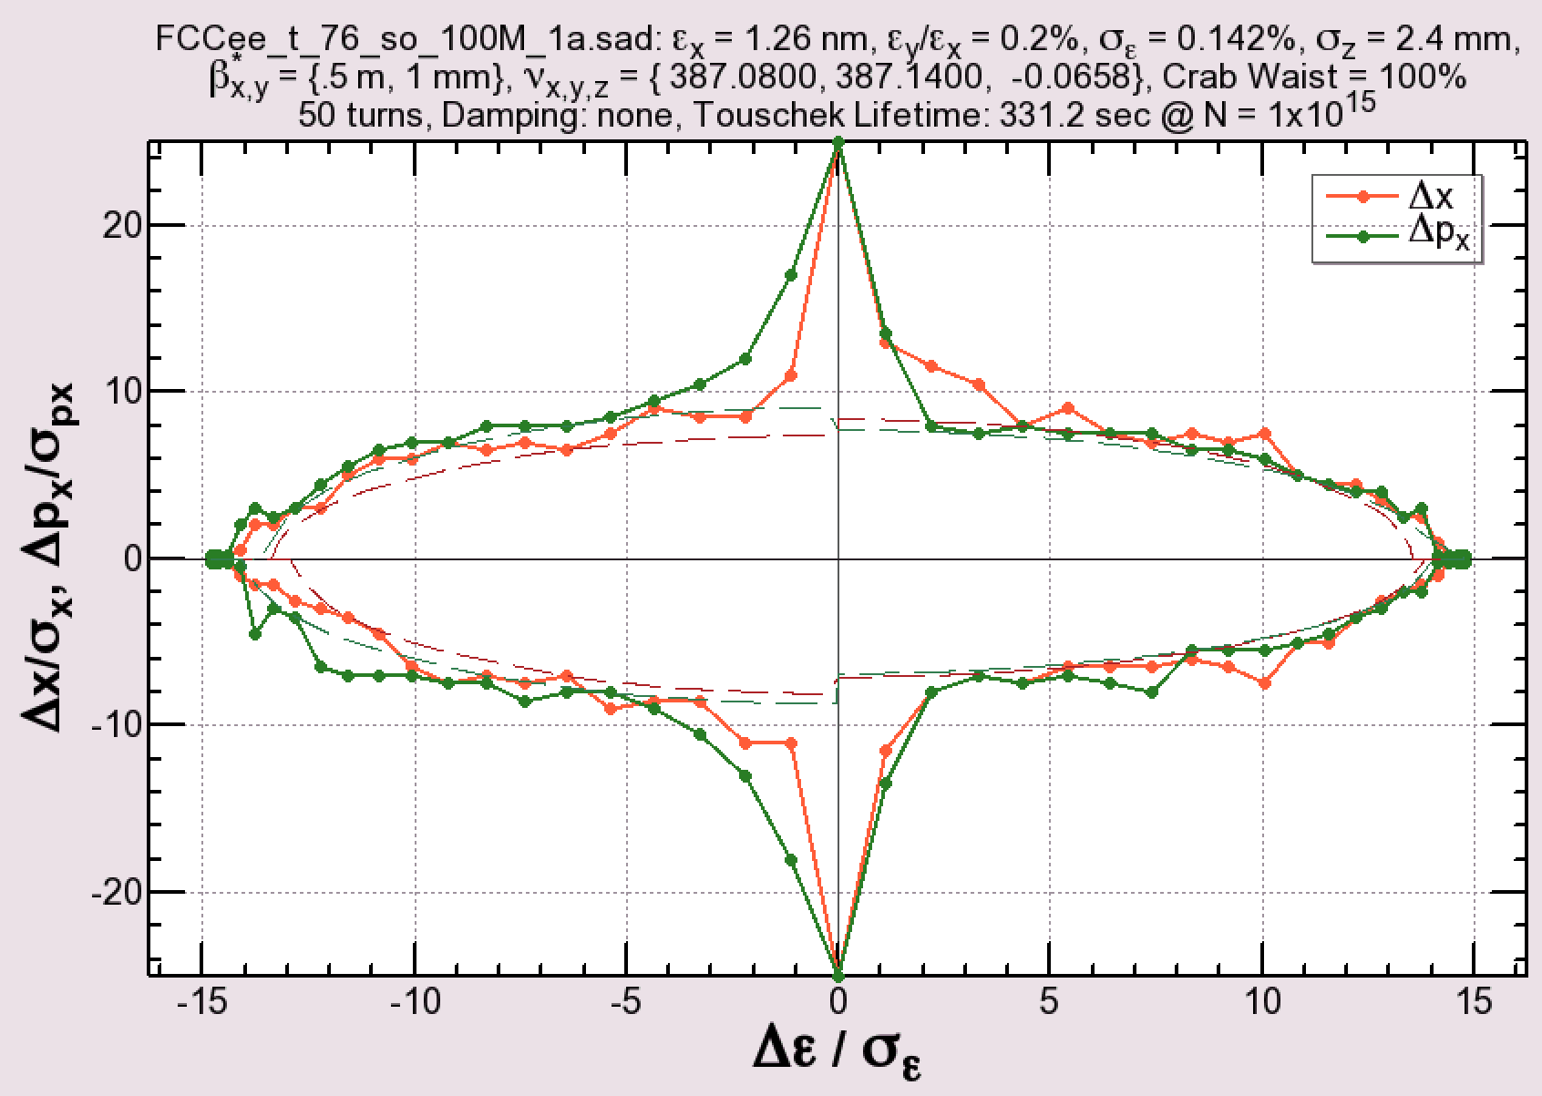
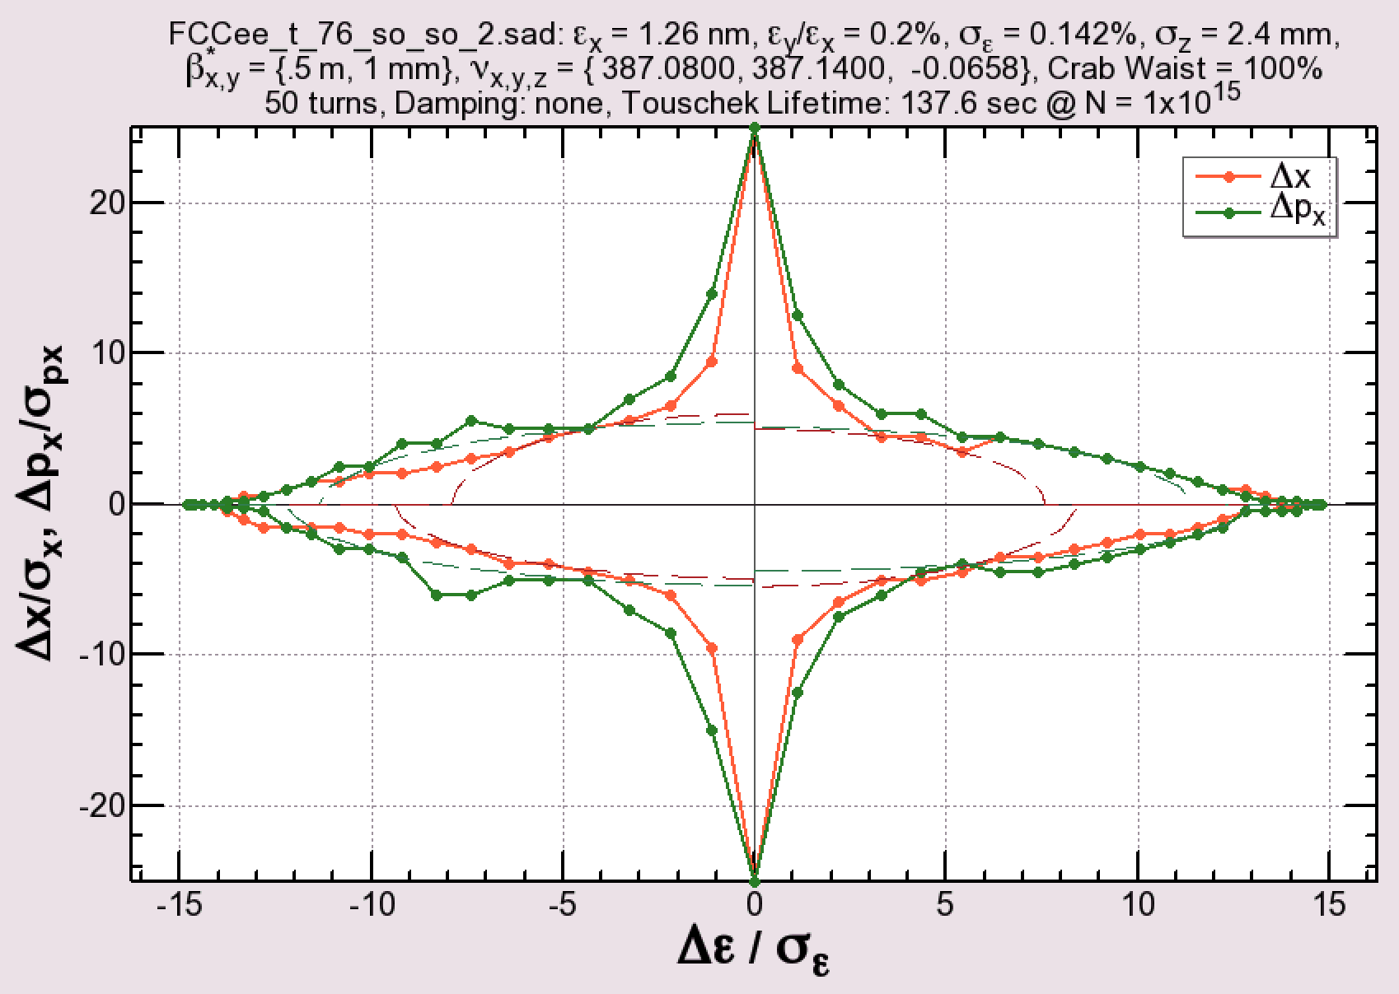
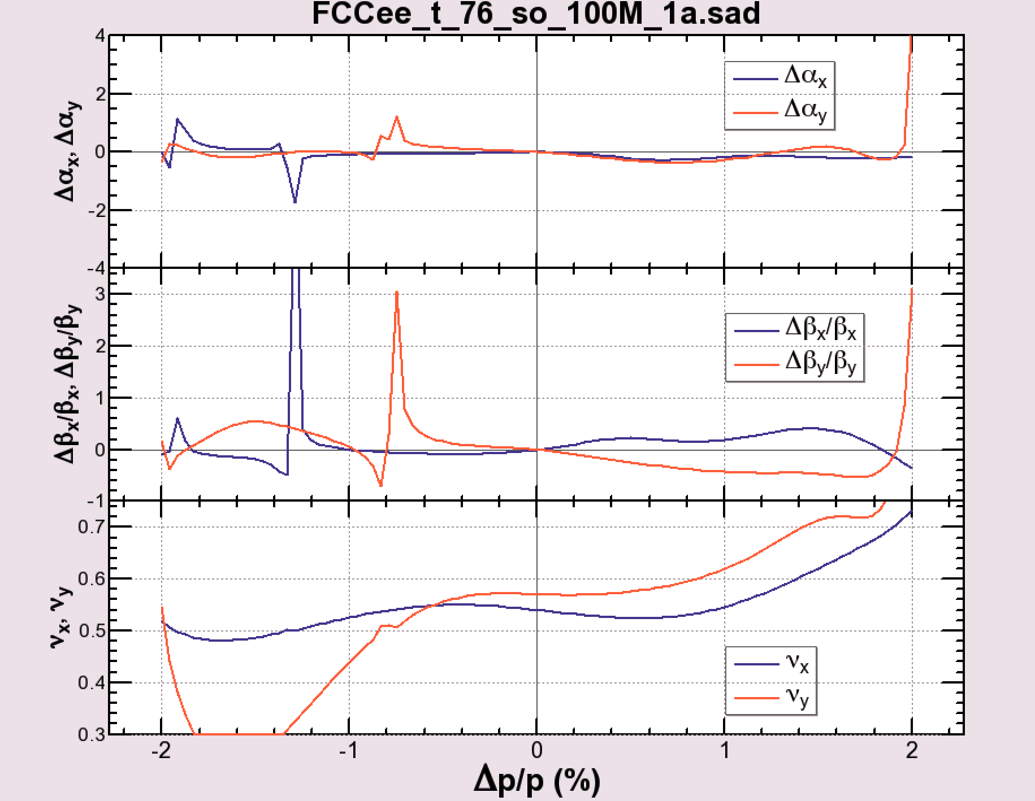
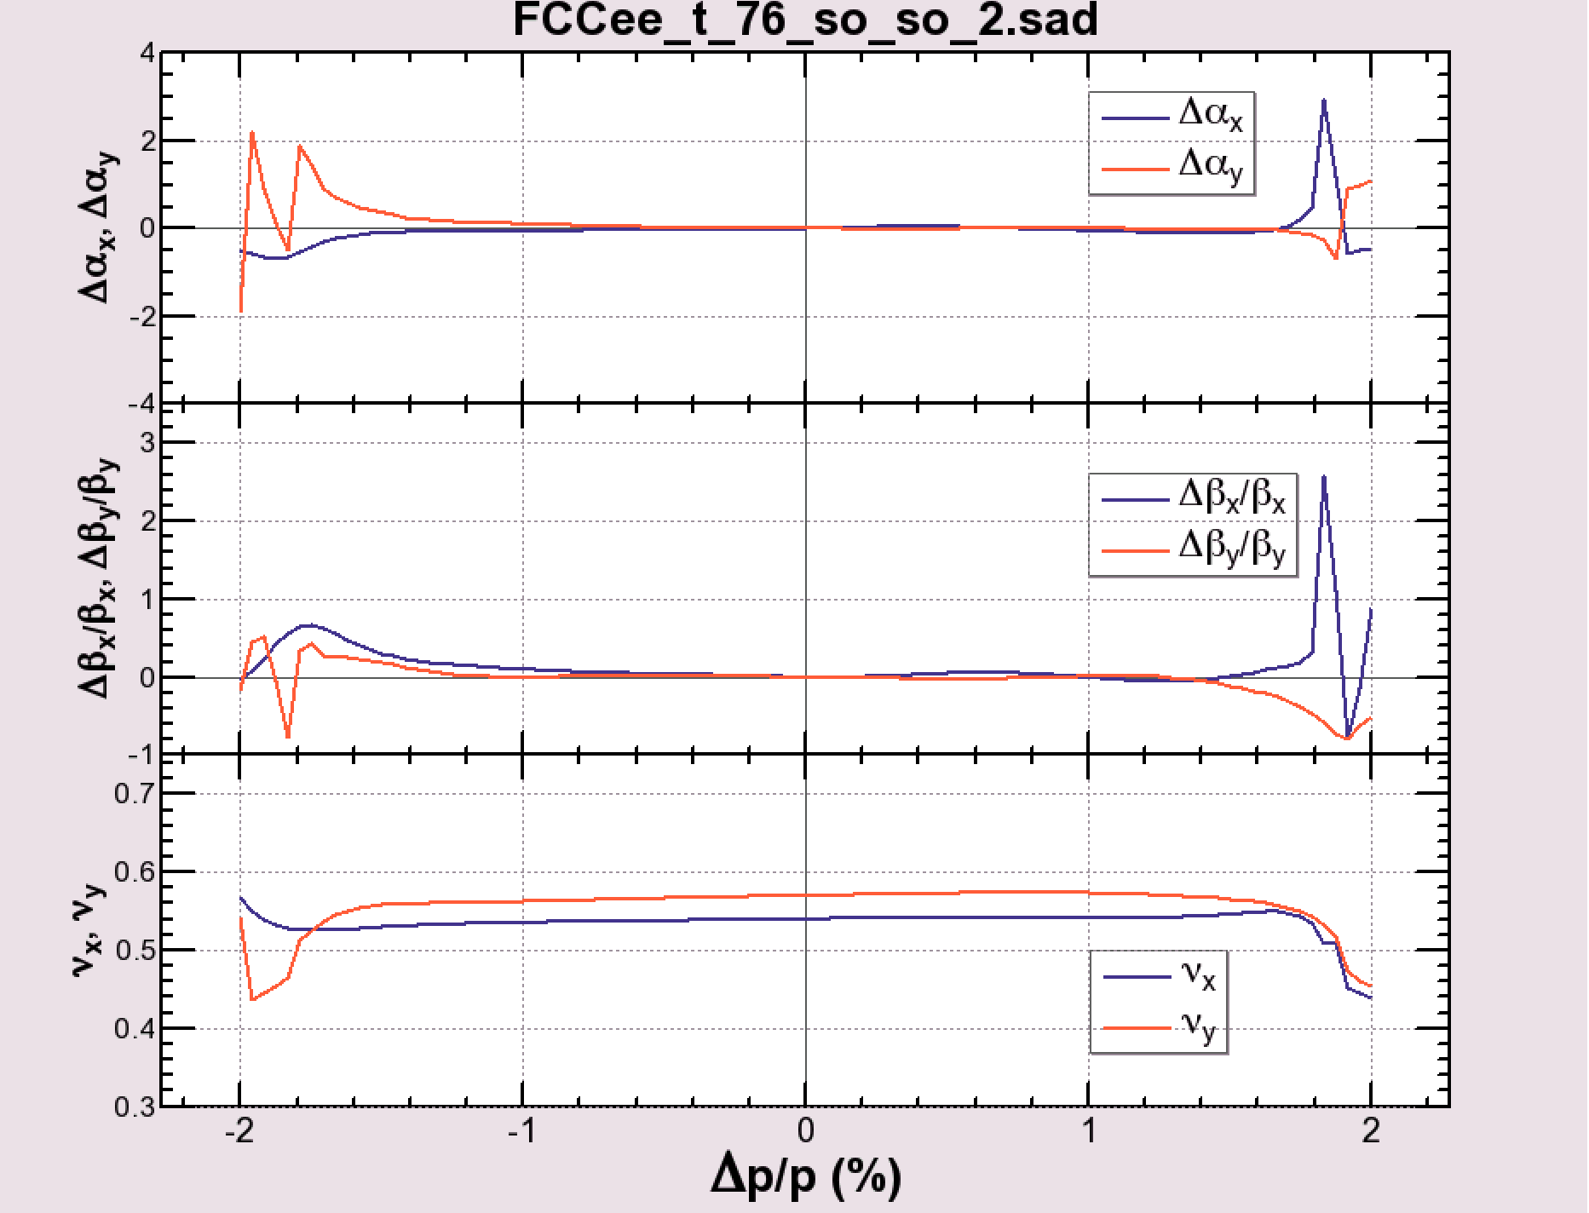
Less chromaticity ≠ better dynamic aperture
β*x,y = (0.5 m, 1 mm), no radiation damping
DA-optimized
Chromaticity
-optimized

Slide 26
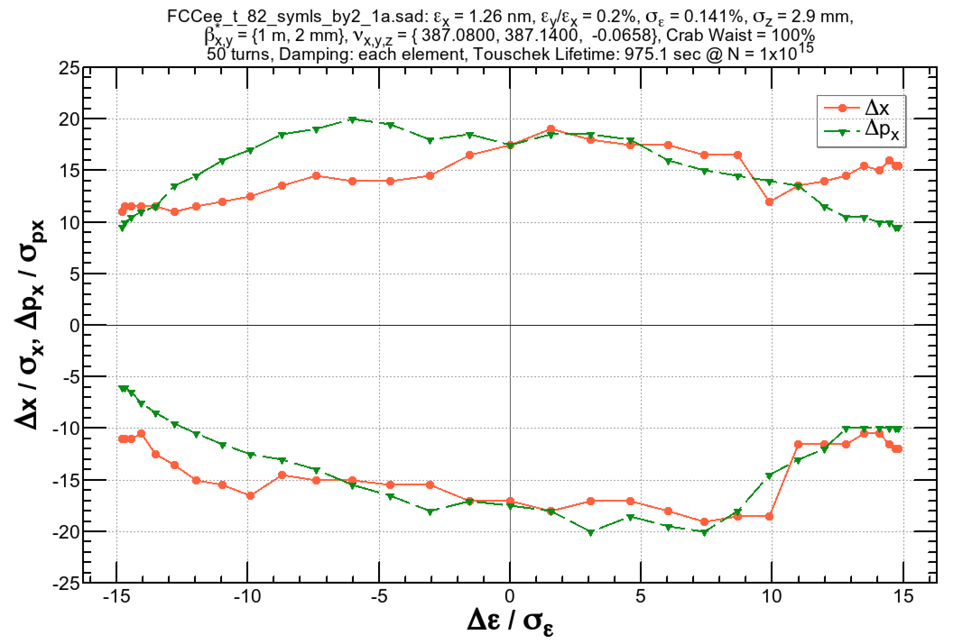
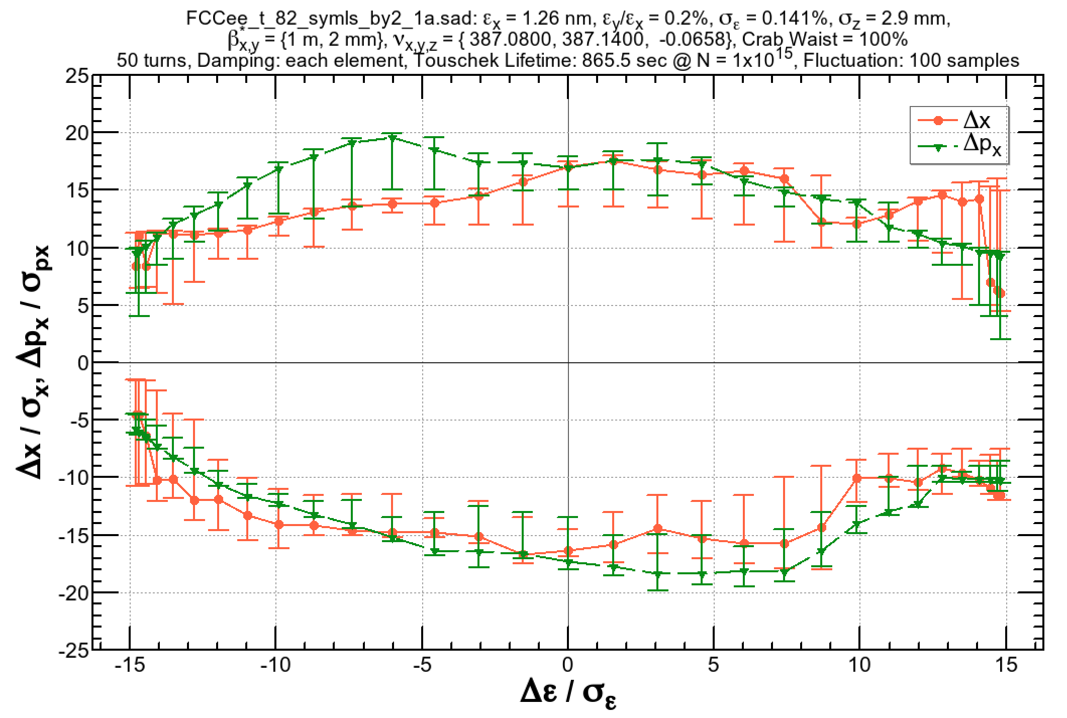
Effect of Radiation Fluctuation
E = 175 GeV, βx,y = (1 m, 2 mm)
Radiation damping only
Radiation damping + fluctuation
±2%
±2%
(Right figure) 100 samples are taken to evaluate the dynamic aperture with radiation fluctuation.
  Within the lines: particles survive for 75% of the samples.
  Error bars correspond to the range of survival between 50% and 100% of the samples.
It may reasonable that the 50% loss corresponds to the original aperture.
The thickness between 50% and 100% survival can be attributed to the fractal structure of unstable orbits or resonances in the phase space.

Slide 27
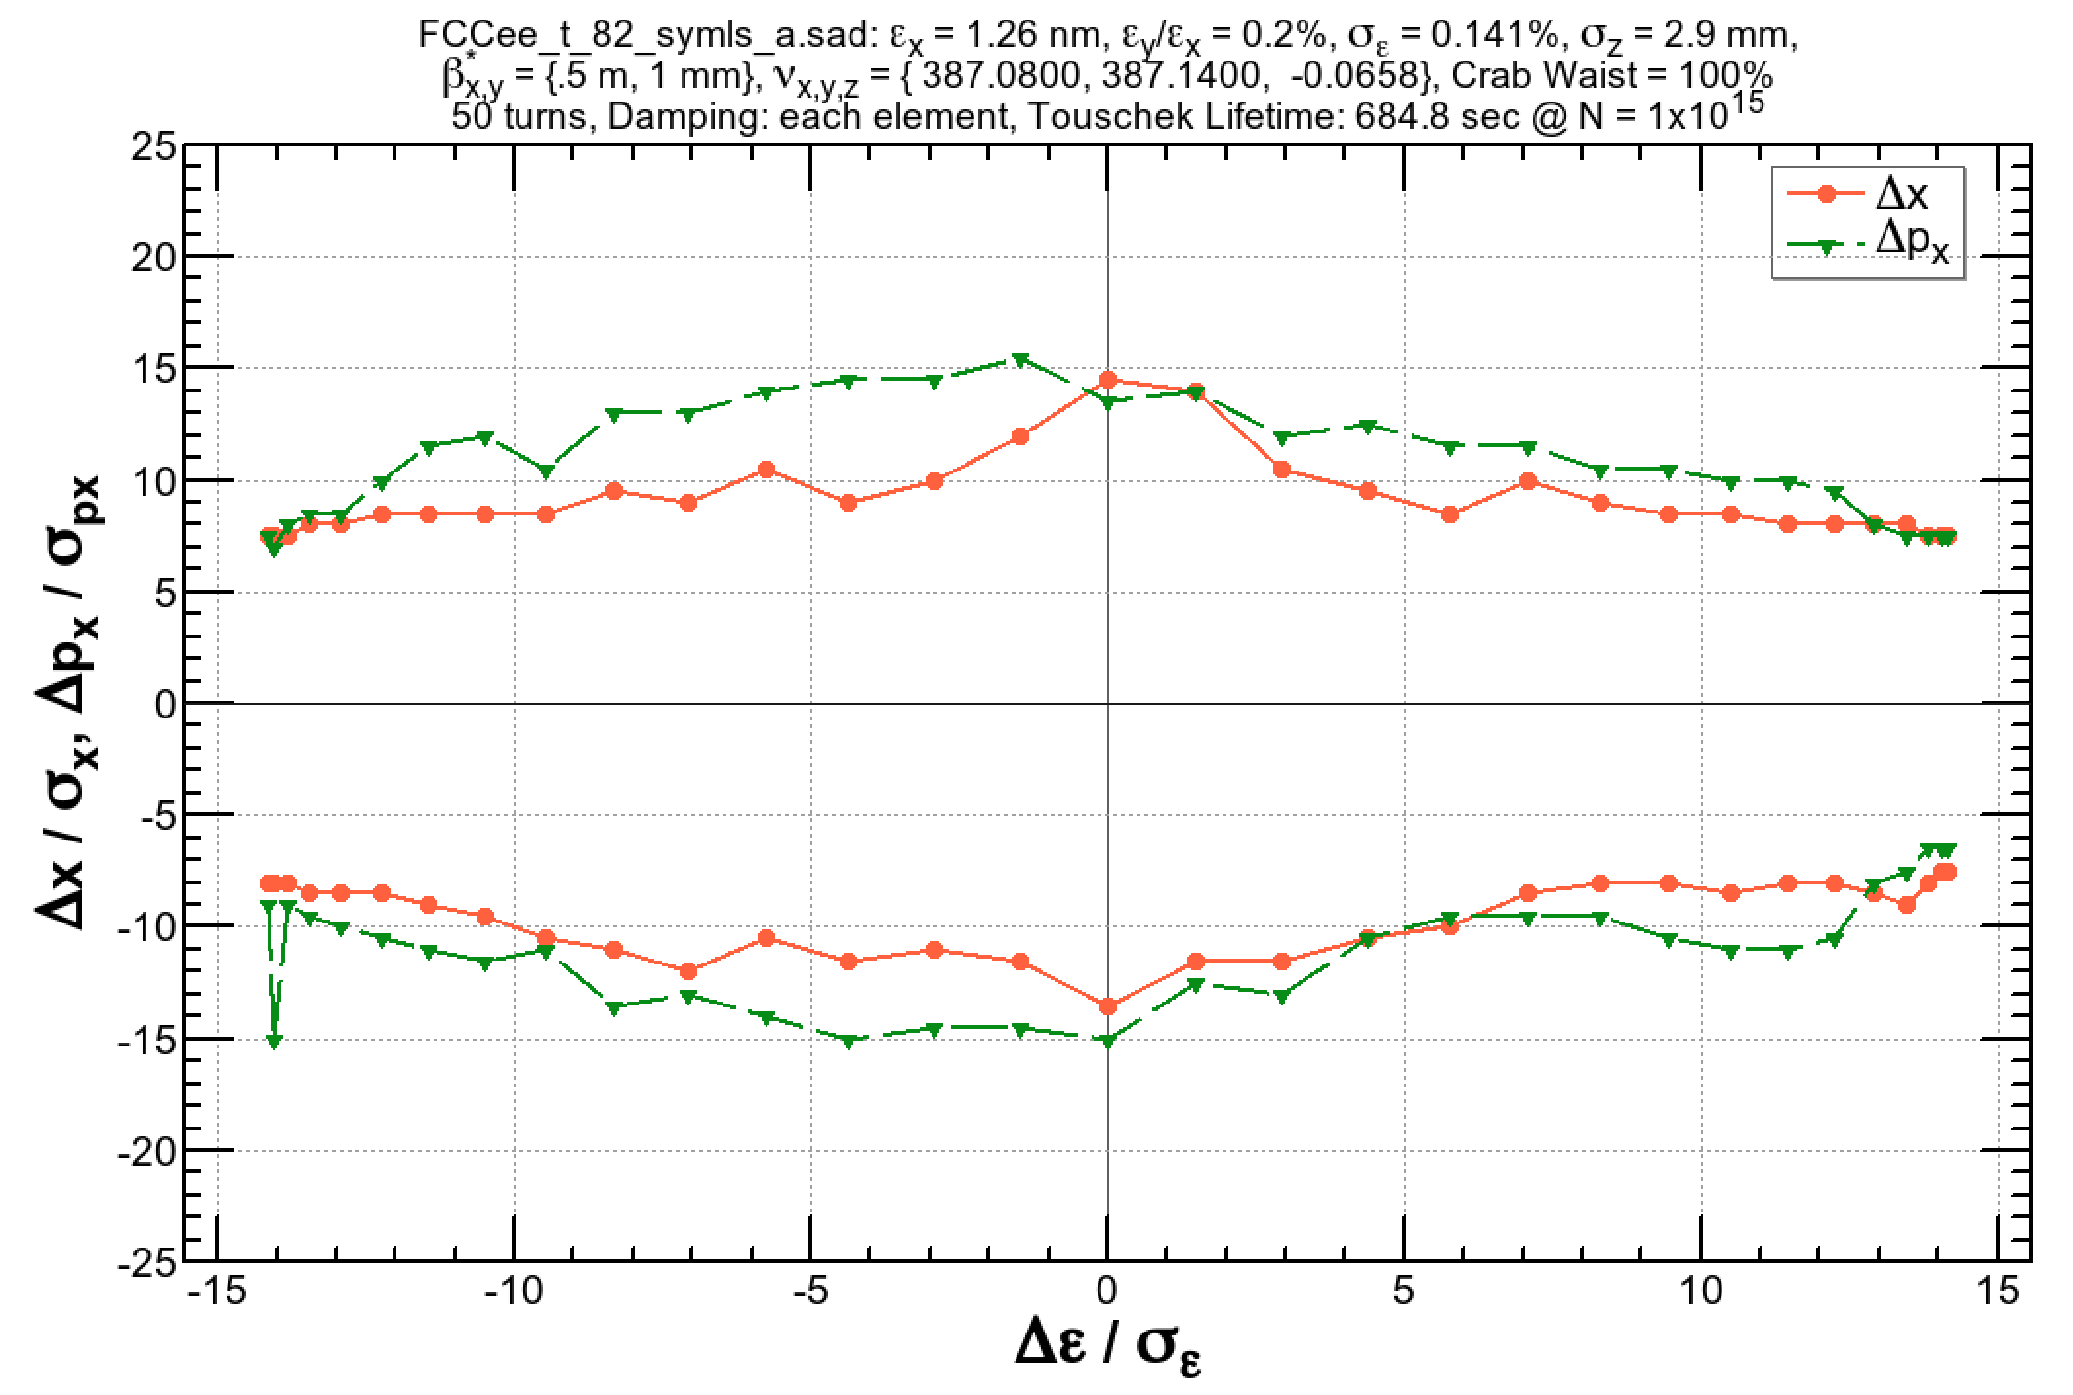
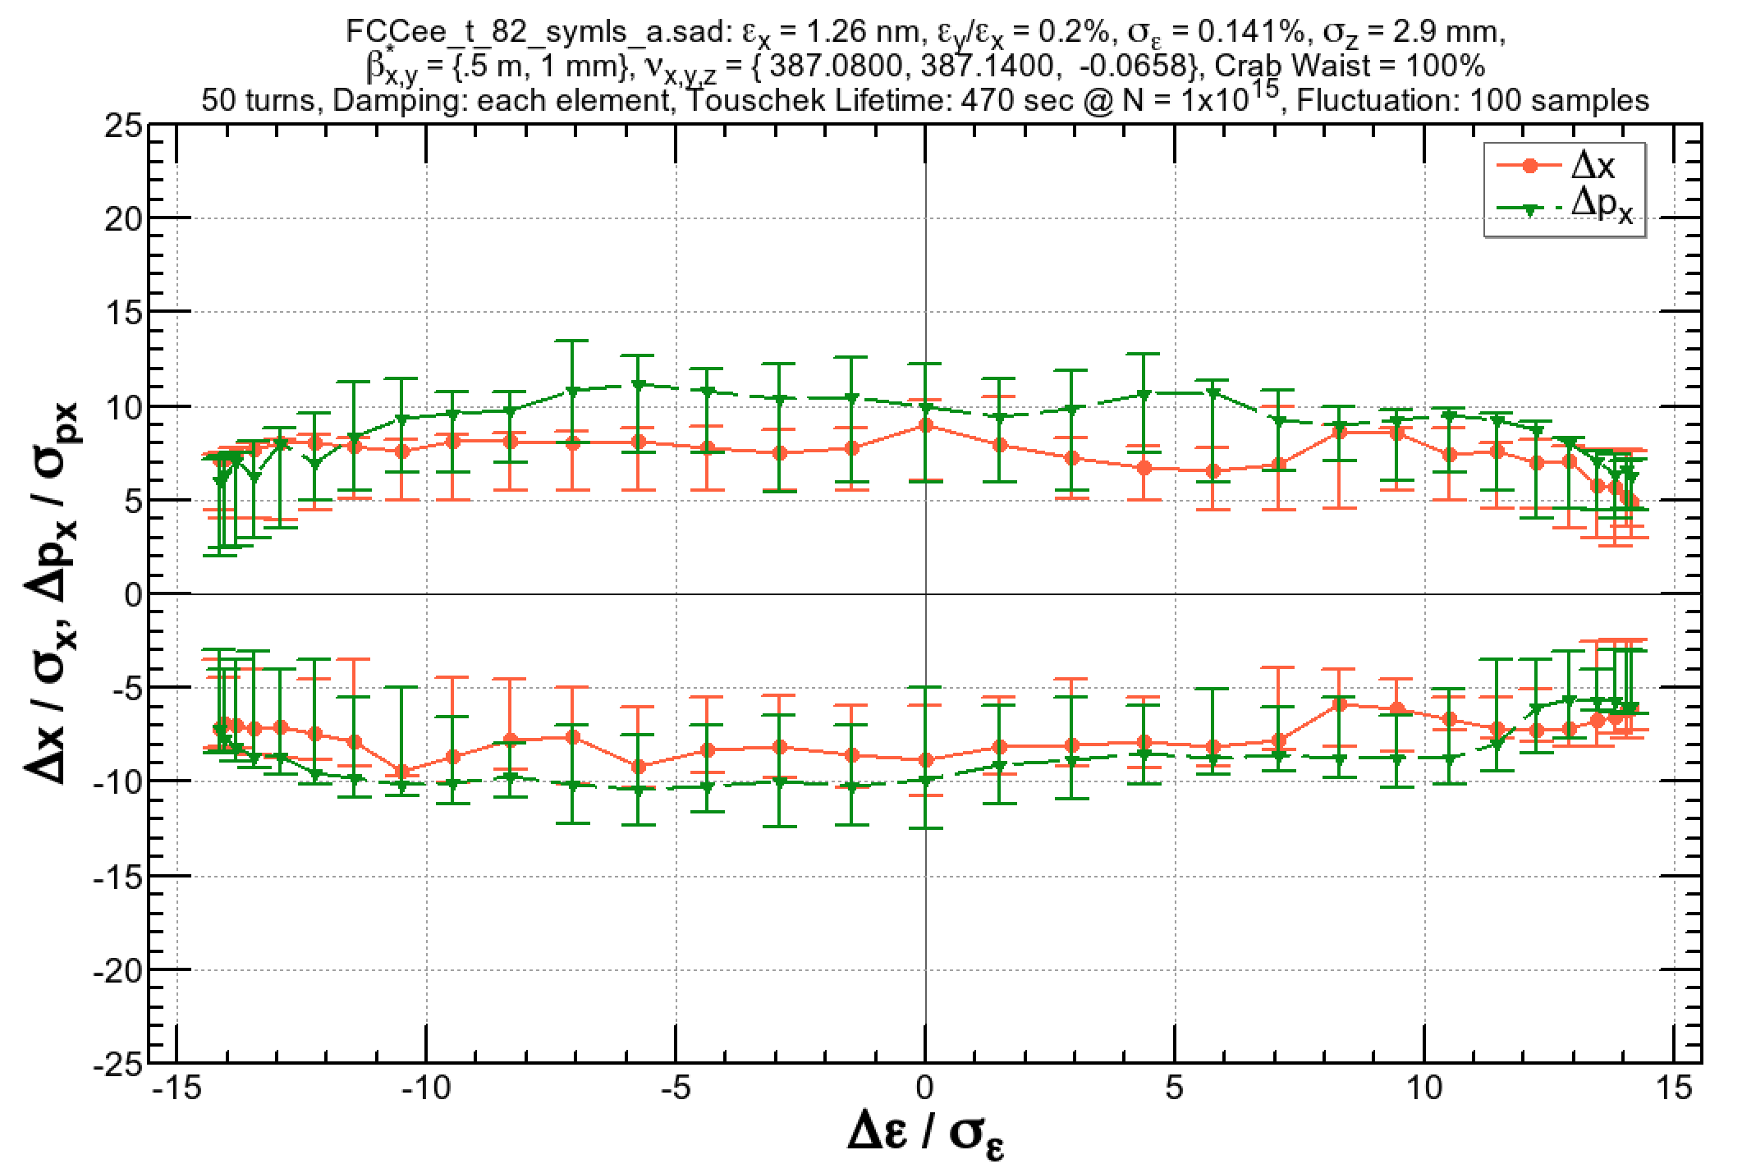
Effect of Radiation Fluctuation (2)
E = 175 GeV, βx,y = (0.5 m, 1 mm)
Radiation damping only
Radiation damping + fluctuation
±2%
±2%
(Right figure) 100 samples are taken to evaluate the dynamic aperture with radiation fluctuation.
  Within the lines: particles survive for 75% of the samples.
  Error bars correspond to the range of survival between 50% and 100% of the samples.
The reduction of the 100% survival aperture is more significant than βx,y = (2 m, 2 mm). However, it still maintains ±2% momentum acceptance.

Slide 28
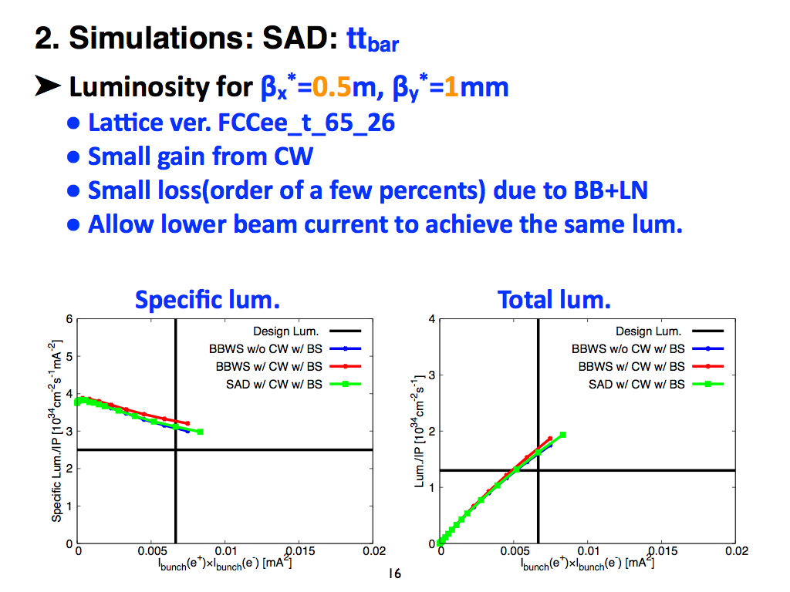
Beam-beam effect + Lattice (FCC-ee, D. Zhou)

Slide 29
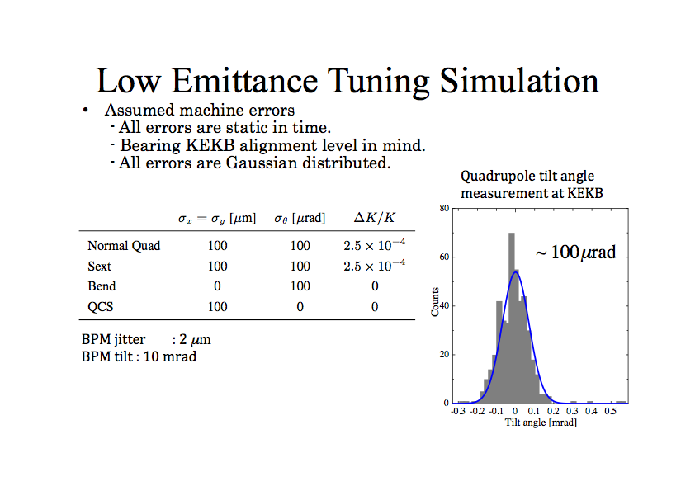
Emittance Tuning — SuperKEKB
FCC-ee talks later:
Emittance tuning: S. Aumon
Tolerance/misalignment: S. Sinyatkin
H. Sugimoto

Slide 30
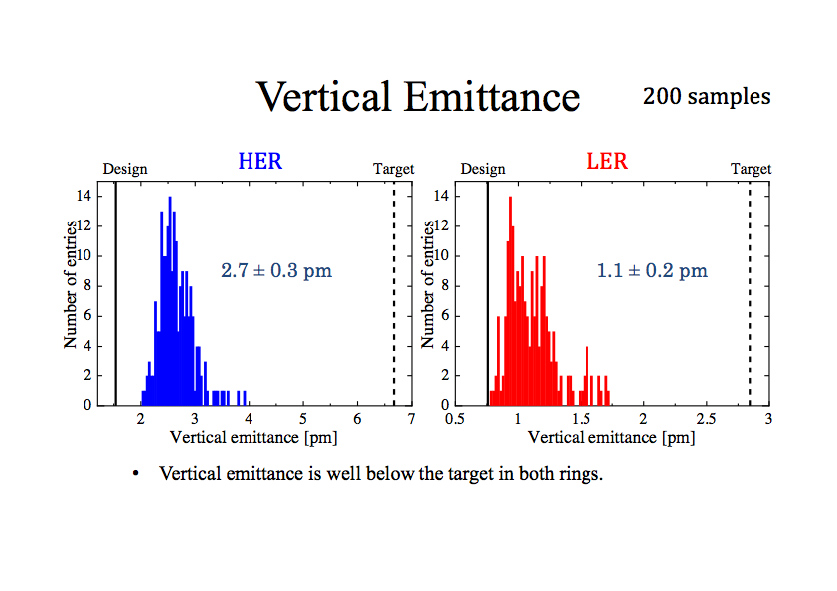
Emittance Tuning — SuperKEKB (2)
H. Sugimoto

Slide 31
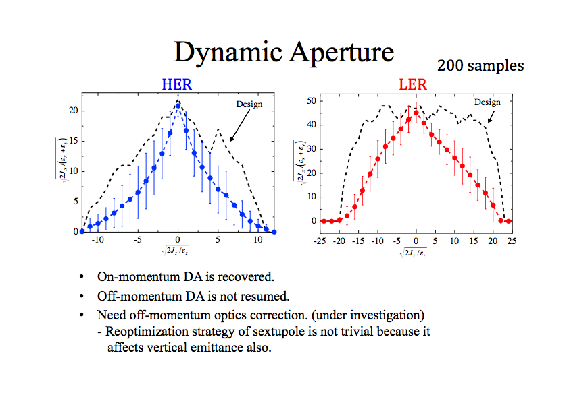
Emittance Tuning — SuperKEKB (3)
H. Sugimoto

Slide 32




A possibility of combined function dipole in the arc
flat dipole
A negative field gradient in the main dipole of the unit cell provides:
longer cell length for a given emittance / better packing factor
larger momentum compaction (longer bunch length for a same RF voltage)
larger energy spread (thus not good for polarization, esp. at WW).
larger dispersion
weaker sextupoles
Suggested by E. Levechev

