Slide 1

Final Results From the CLIC Test Facility (CTF3)
Roberto Corsini
For the CLIC Collaboration

Slide 2
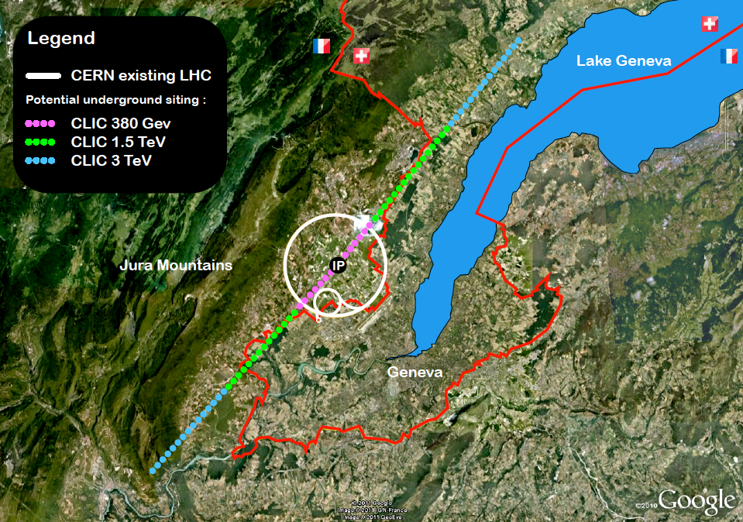
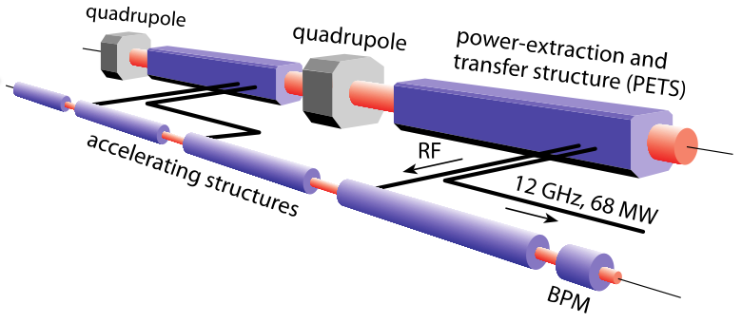
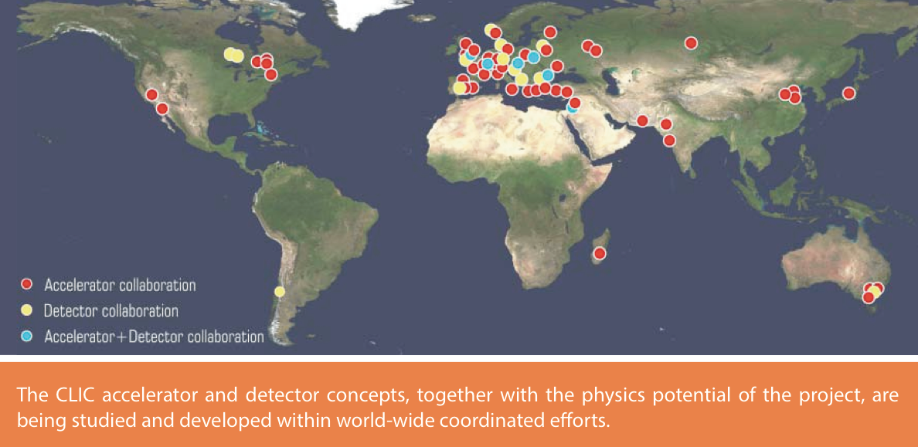
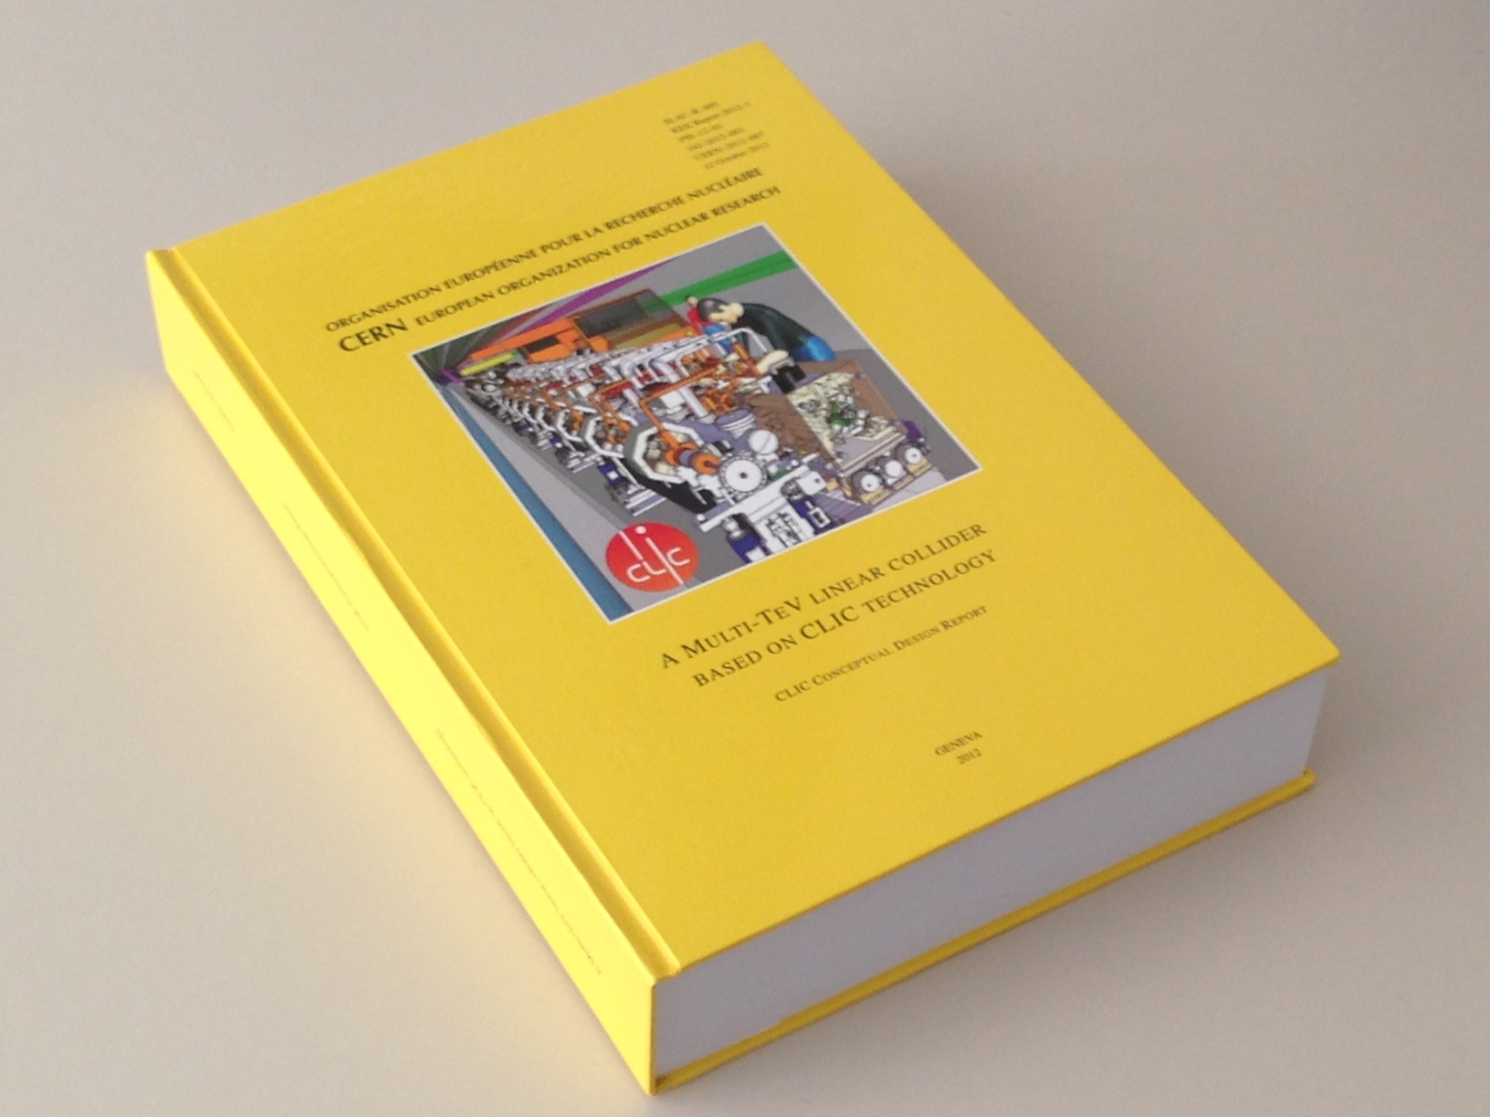
CLIC in a nutshell
CLIC will be built in stages of increasing collision energy: starting from 380 GeV, then ~ 1- 2 TeV, and up to a final energy of 3 TeV.
To limit the collider length, the accelerating gradient must be very high - CLIC aims at
100 MV/m, 20 times higher than the LHC.
CLIC is based on a two-beam acceleration scheme, in which a high current e- beam (the drive beam) is decelerated in special structures (PETS), and the generated RF power is used to accelerate the main beam.
The feasibility of CLIC has been demonstrated and documented in the
CLIC Conceptual Design Report
CLIC International Collaboration

Slide 3
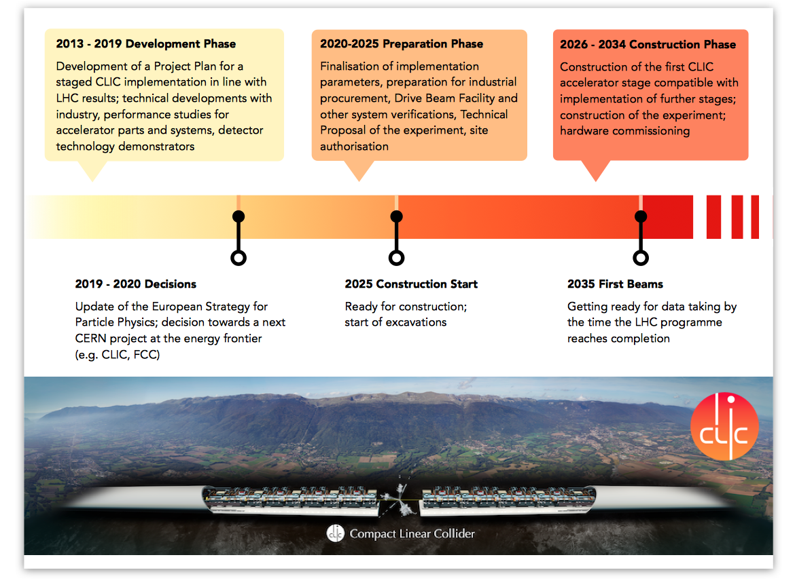
CLIC Timeline

Slide 4
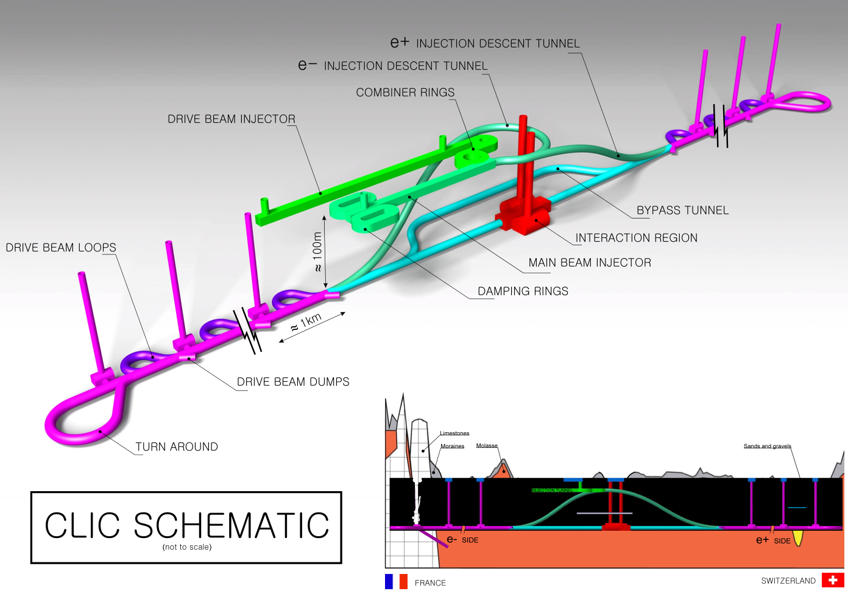

The CLIC study

Slide 5
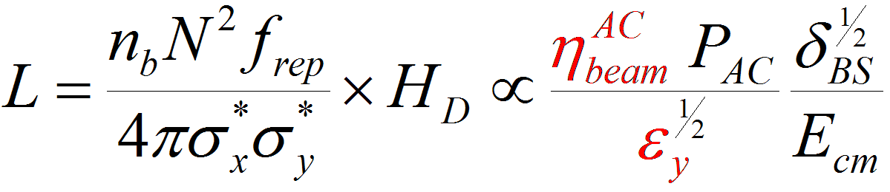
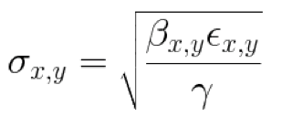
What matters in a linear collider ?
E_{cm} ≈ L_{linac} G_{acc}
High gradient
X-band normal conducting
Energy reach
CLIC specific Issues
Luminosity
N.B.:
Acceleration efficiency Two-beam scheme
Generation of small emittance Damping rings
Conservation of small emittance Wake-fields, alignment, stability
Extremely small beam spot at IP Beam delivery system, stability

Slide 6
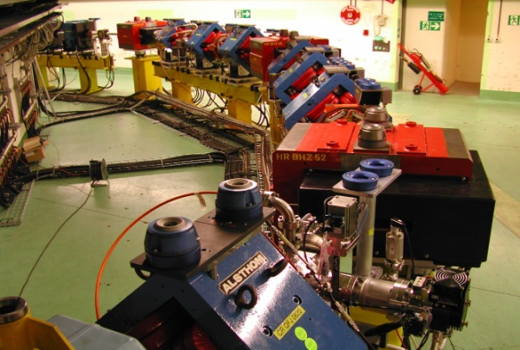
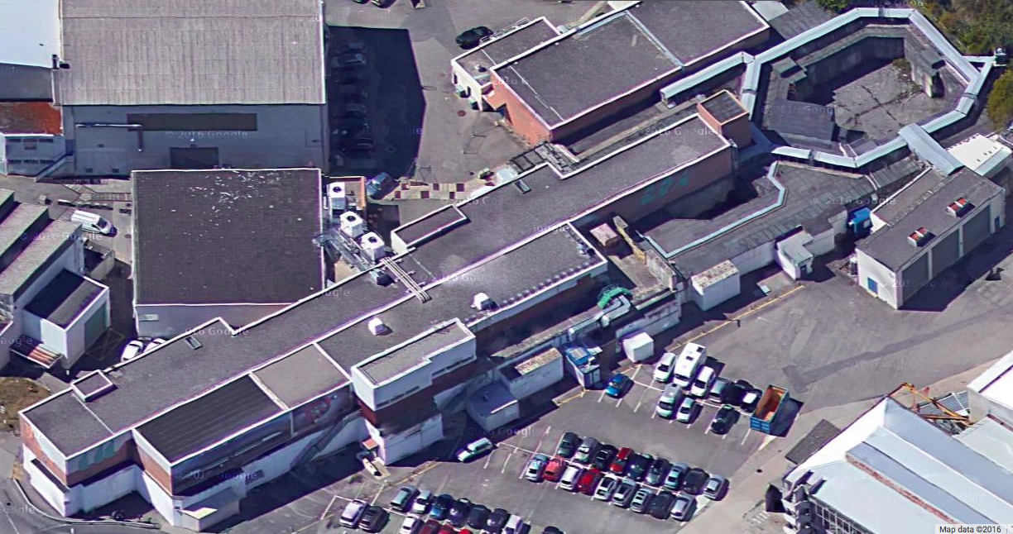
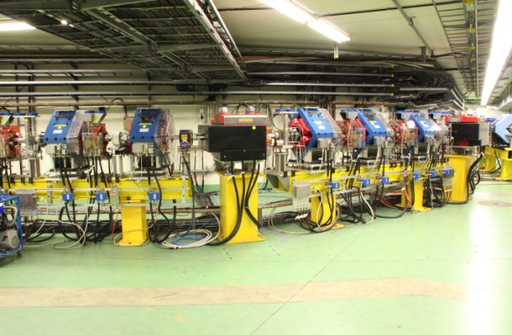
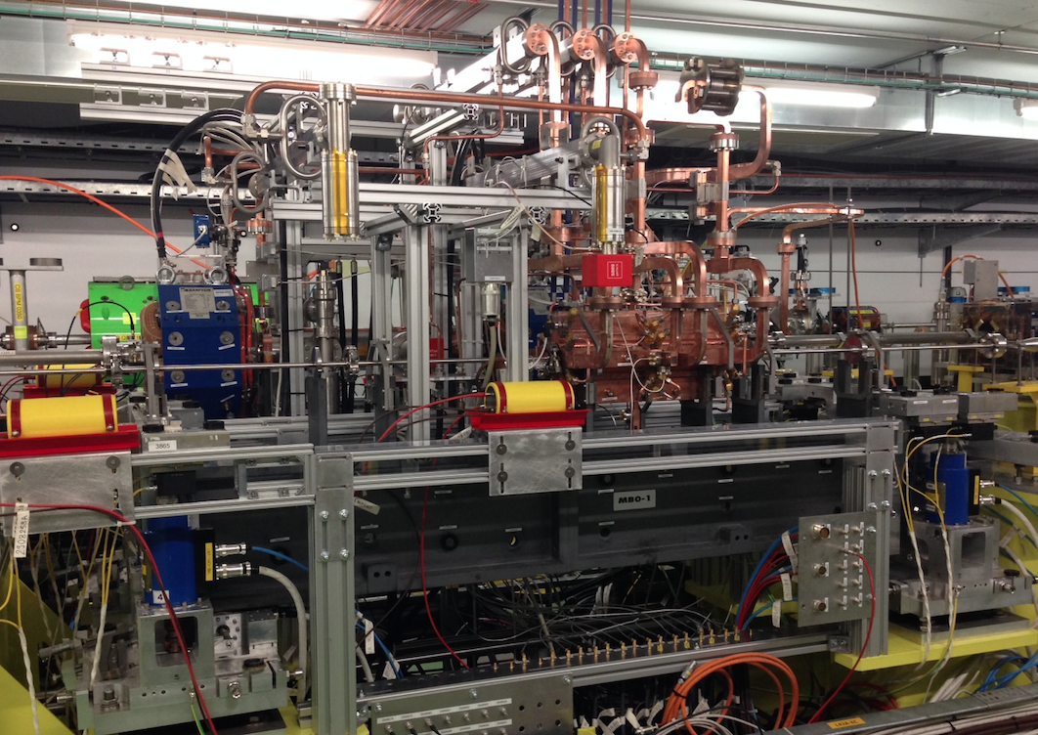
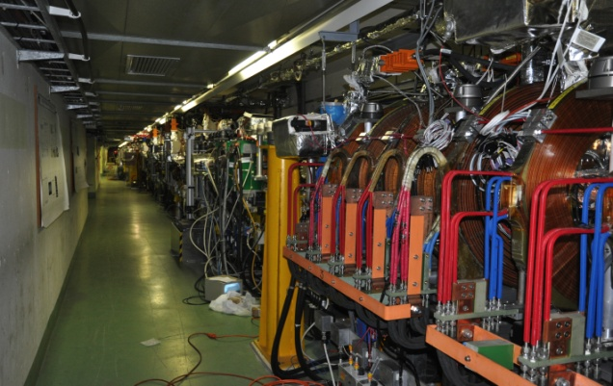
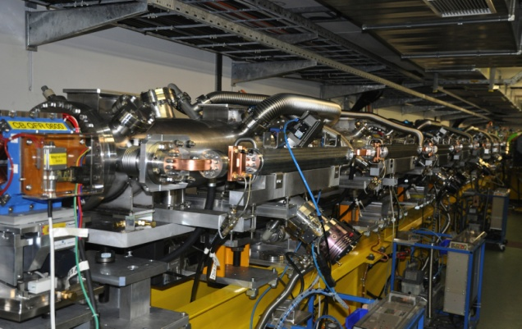
CLIC Test Facility (CTF3)
DELAY LOOP
COMBINER
RING
CLEX
DRIVE BEAM LINAC
TBL
Two Beam Module

Slide 7
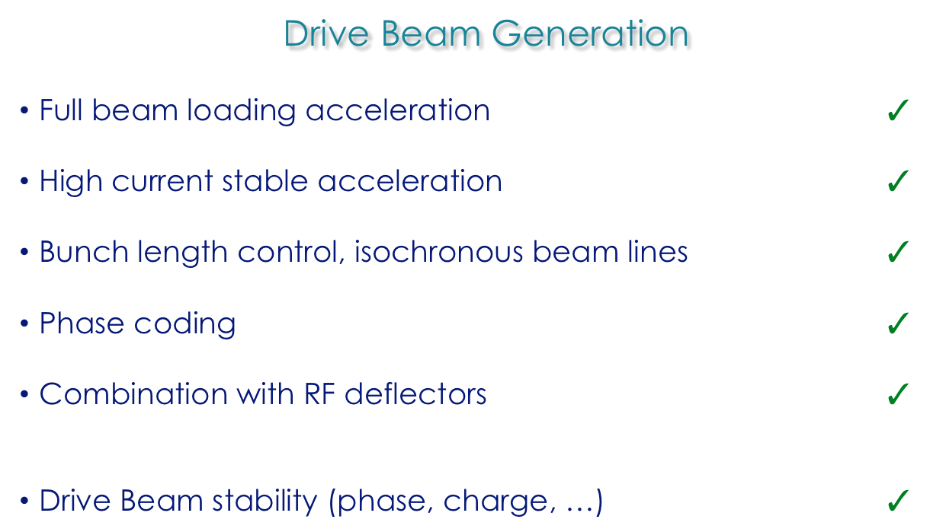
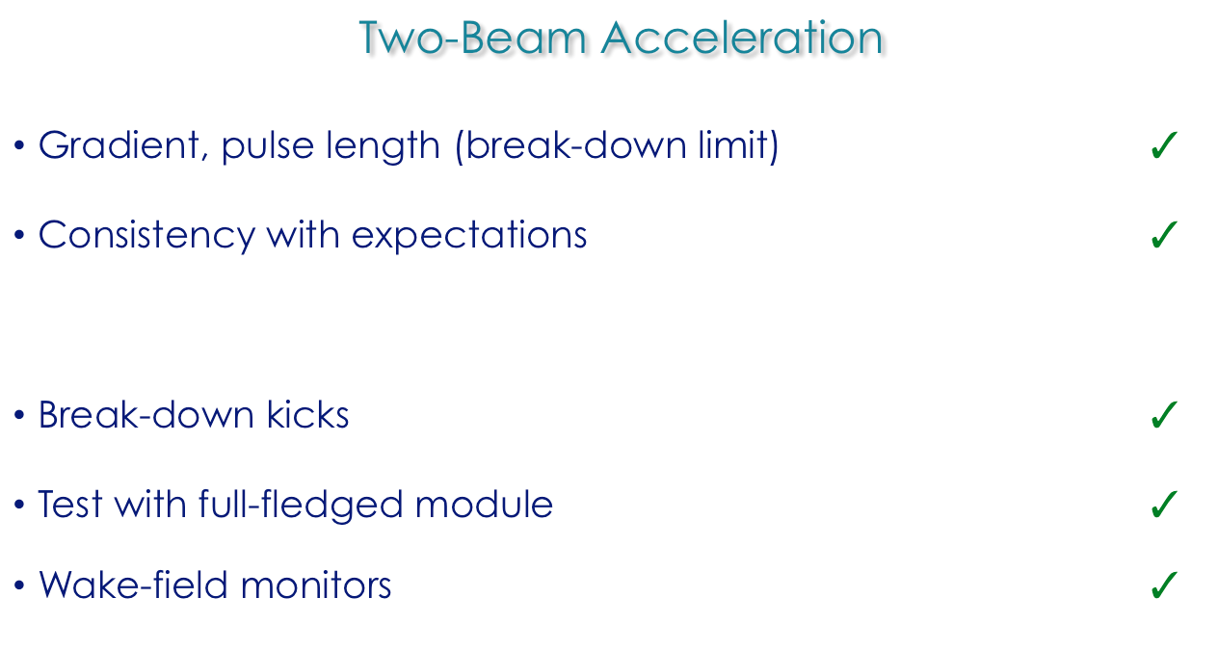
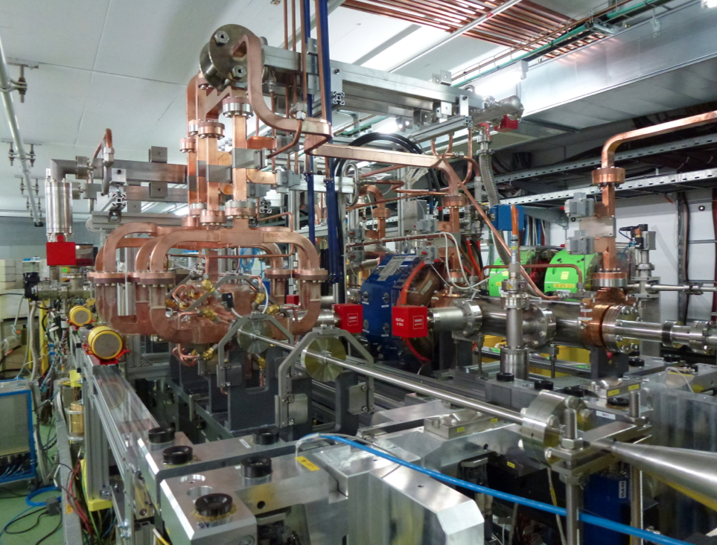
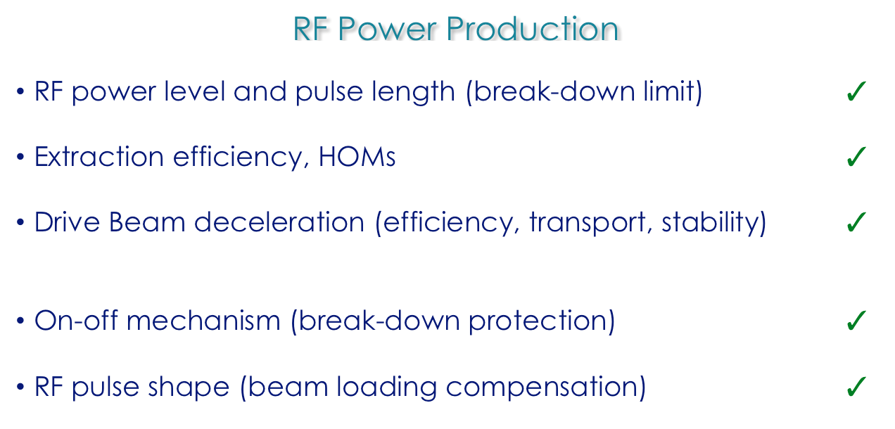
Two-beam scheme issues
All covered in CTF3

Slide 8
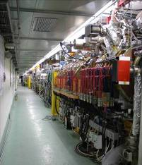
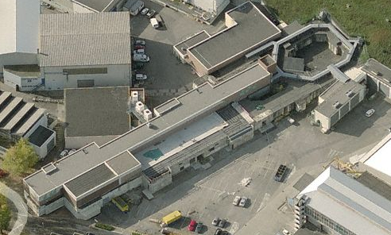
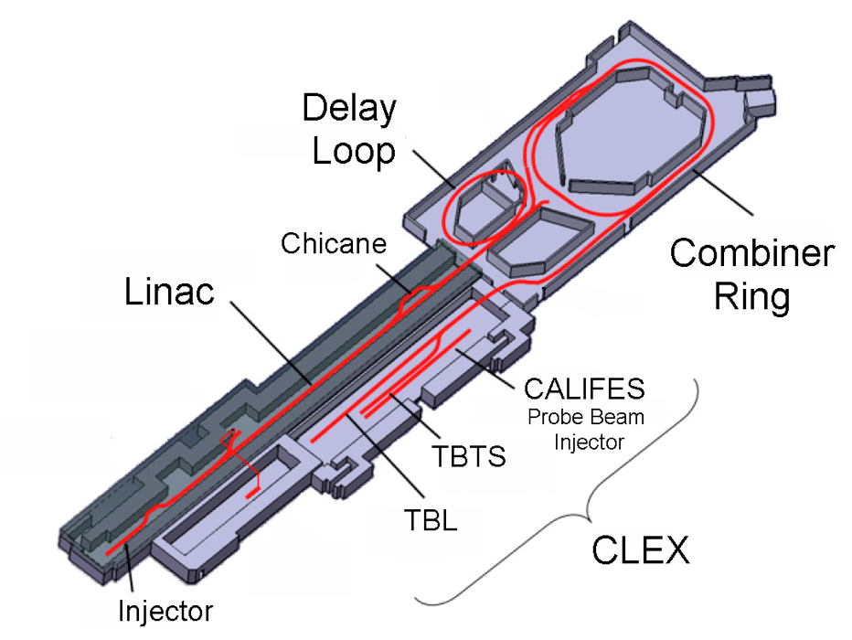
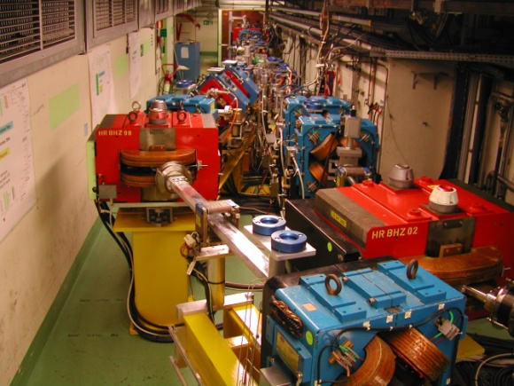
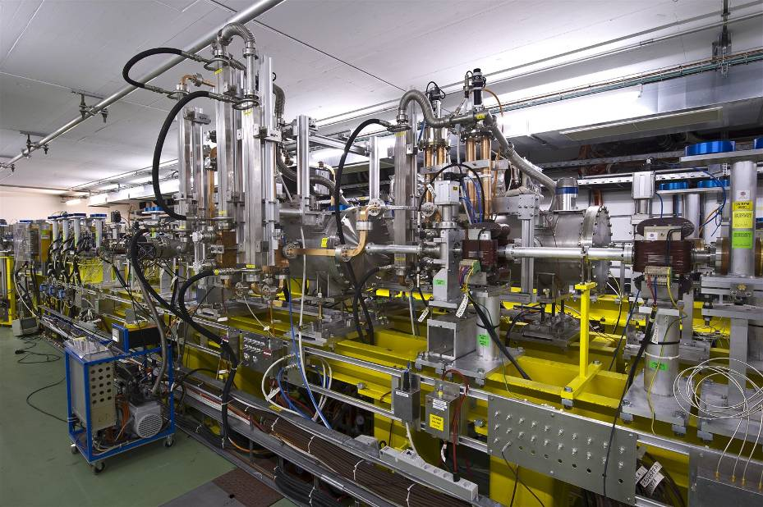
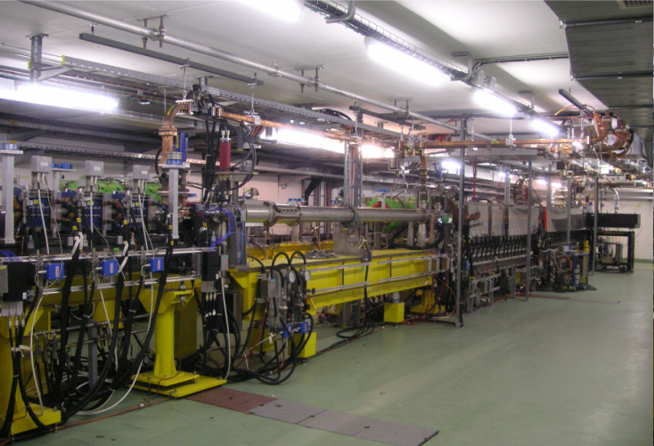
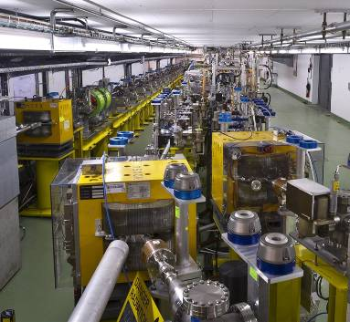
CTF3 – the original mission
Operation of isochronous lines and rings
4 A, 1.4us
120 MeV
30 A, 140 ns
120 MeV
High current, full
beam-loading operation
Beam recombination and current multiplication by RF deflectors
12 GHz power generation by drive beam deceleration
High-gradient two-beam acceleration
30 A, 140 ns
60 MeV
Bunch phase coding
First beam – June 2003

Slide 9
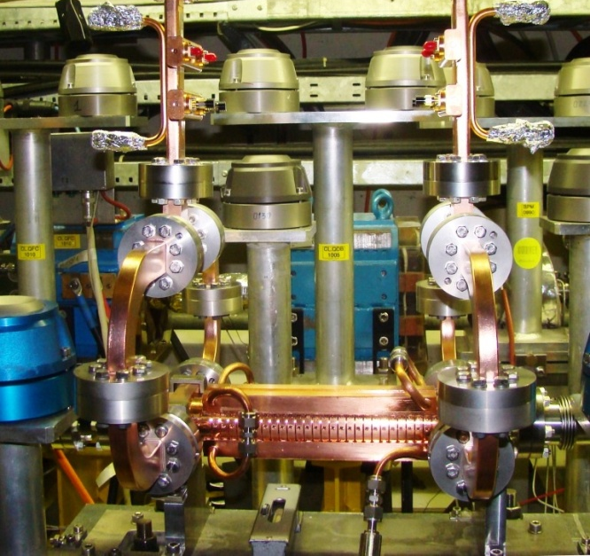
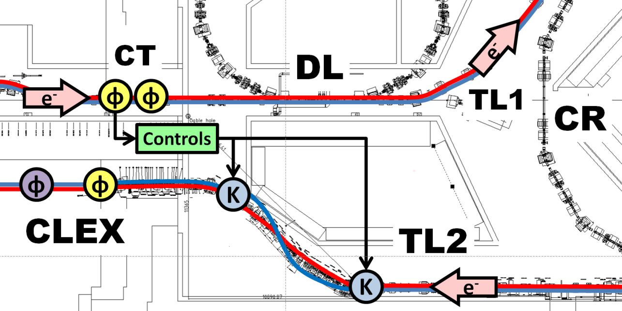
CTF3 in 2015-2016
Phase feed-forward experiment
Diagnostics R&D using CALIFES
Dogleg Beam loading experiment
Two Beam Module,
Wake-field monitors…
TBL deceleration
Last beam – December 2016

Slide 10
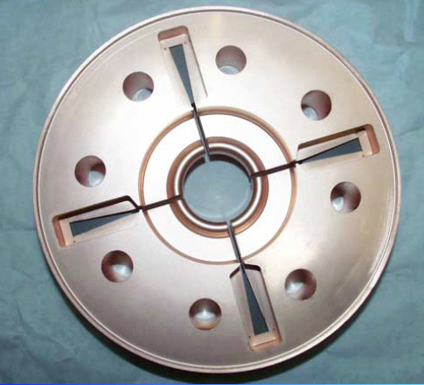
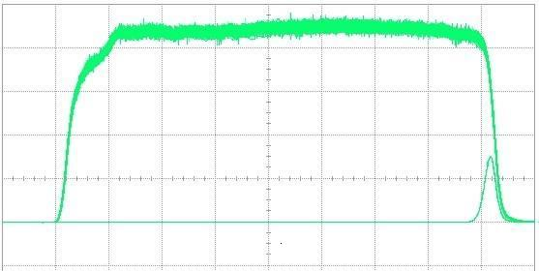
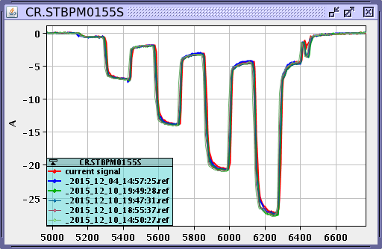
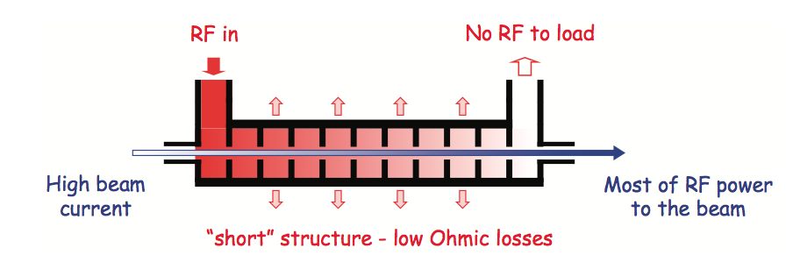
Drive Beam Generation
damping
slot
Full beam loading acceleration
95.3% RF to beam efficiency
Stable high current acceleration
Factor 8 current & frequency multiplication
RF pulse at structure input
10 m
RF pulse at output
SiC load
RF in
No RF to load
High beam current
Most RF power
to beam
“short” structure – low Ohmic losses
Factor 8 combination

Slide 11
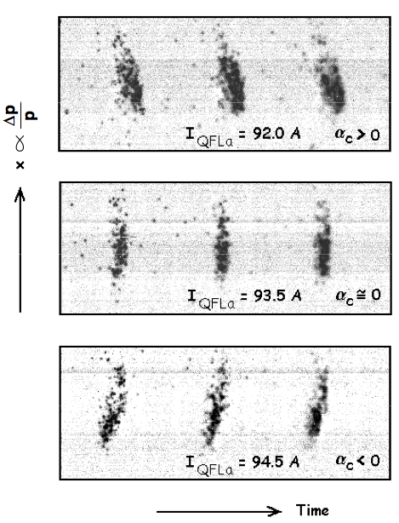
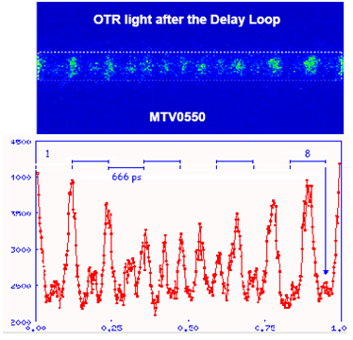
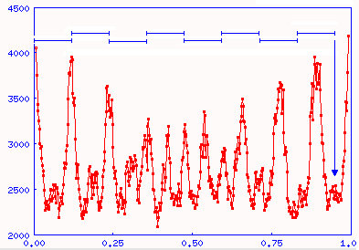
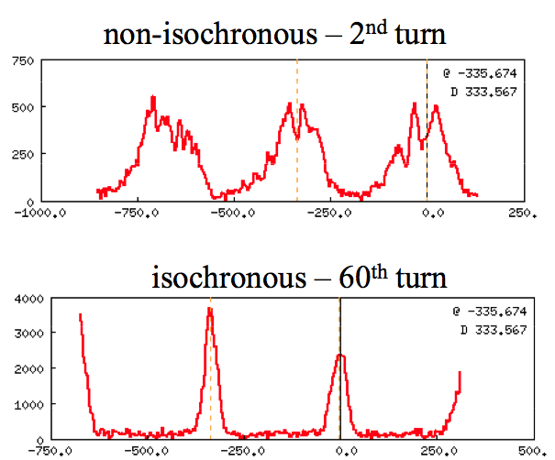
Drive Beam Generation
Beam recombination
Fast bunch phase switch in SHB system
Operation of isochronous rings and beam lines
6 ns

Slide 12
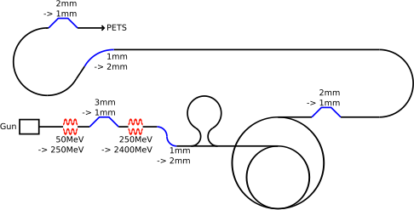
Drive Beam Stability
CLIC Drive Beam requirements
Verified in CTF3
1 to 3 ×10⁻³
< 0.2°
Tests in CTF3
ε_{x} ≤ 250μm, ε_{y} ≤100μm
≤ 0.1σ
Emittance ε_{x,y} ≤ 150μm
Transverse jitter ≤ 0.3σ
Current stability 1 ×10⁻³
Phase stability 0.2° @ 12GHz
Feed-forward tests in CTF3
RF power stability 0.2%
RF phase stability 0.05°
Current stability 0.75 ×10⁻³
Phase stability
2.5° @ 12GHz
Verified in CTF3
0.21%
0.035°
0.2 ×10⁻³
Verified in CTF3
~1° @12 GHz

Slide 13
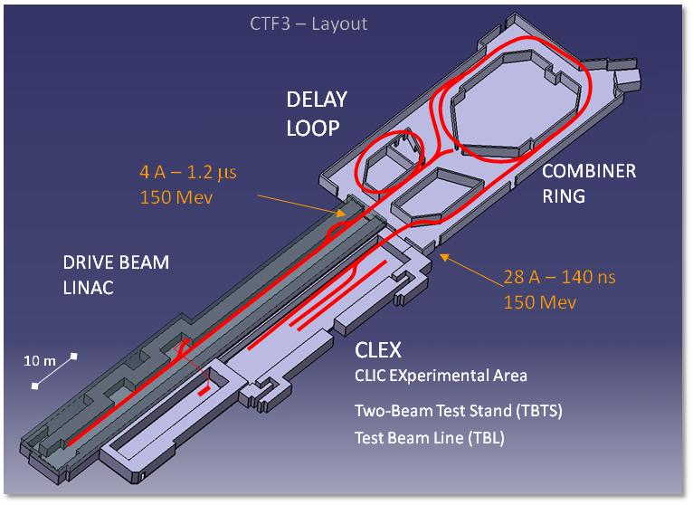
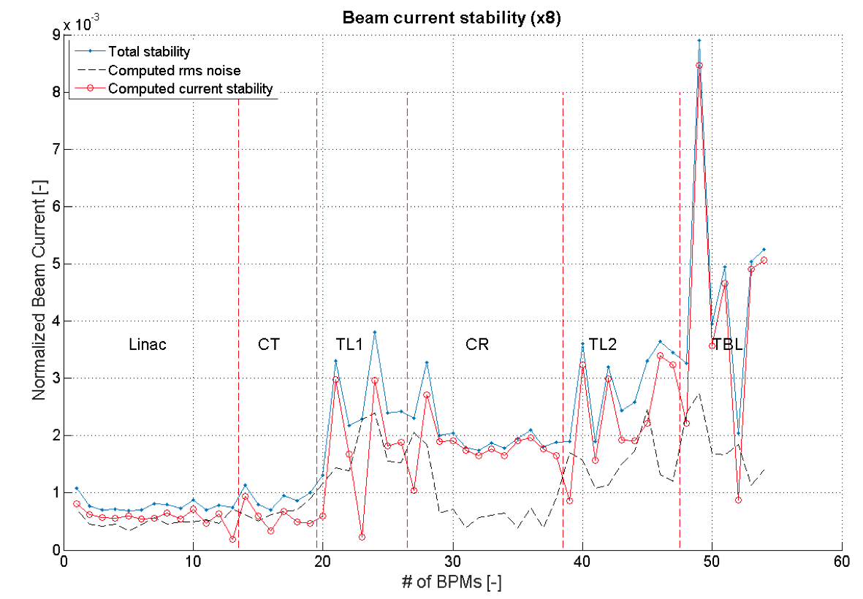
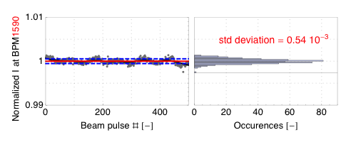
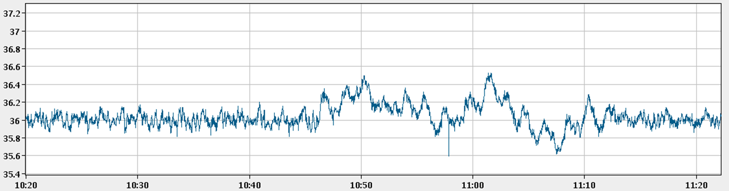
Drive Beam Stability
Pulse charge stability at end of the linac better than CLIC requirements
Charge stability – Factor 8
General lesson from CTF3 (and SLC): Diagnostics, tuning procedures and feedbacks are vital
2 10⁻³
5 10⁻⁴
Repeatibility and long term current stability greatly improved in final years.
Many feed-back loops operational, for temperature, RF phase and power and gun current.
RF power feedback, MKS 13
Feedback off
P [MW]
Feedback on
Feedback on
Time [h:m]

Slide 14
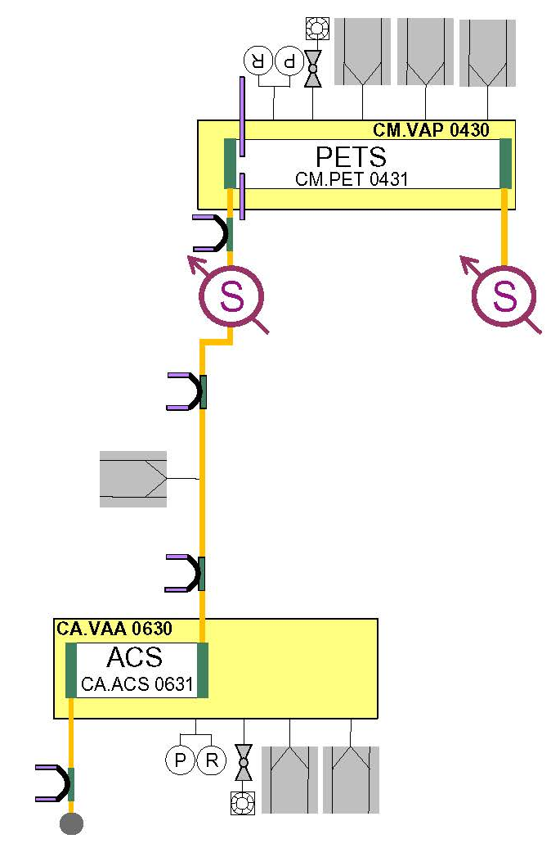
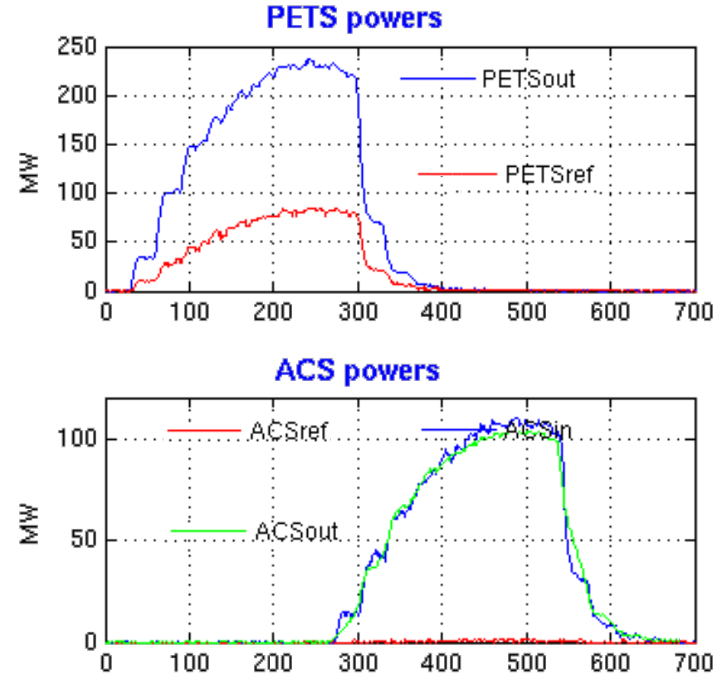
Power production in the
Two-Beam Test Stand
PETS operated routinely above 200 MW peak RF power
providing reliably pulses ~ 100 MW to accelerating structure.
About twice the power needed to demonstrate 100 MV/m acceleration in a two-beam experiment with the nominal
CLIC structure.
CLIC target
Two-Beam Test Stand
(TBTS) Layout
CLIC target
135 MW
t [ns]

Slide 15
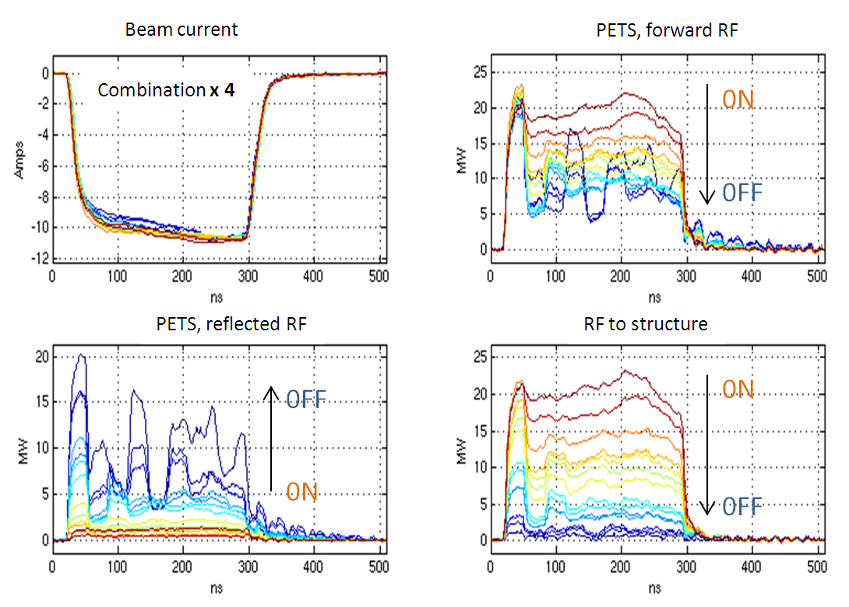
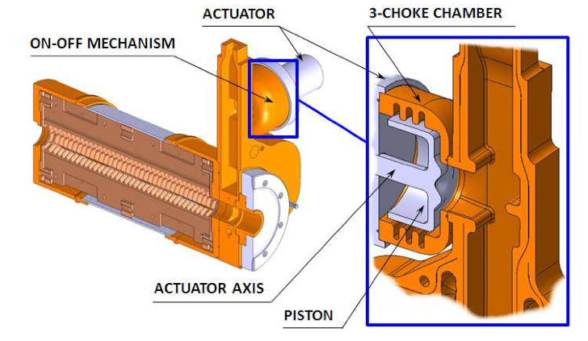
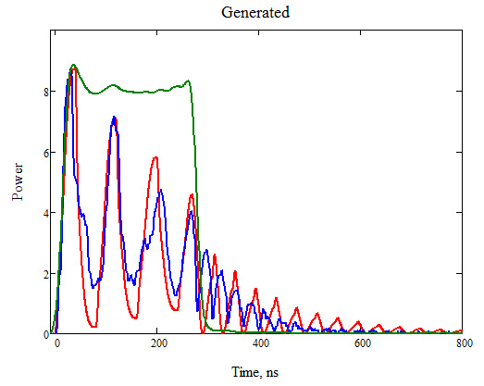
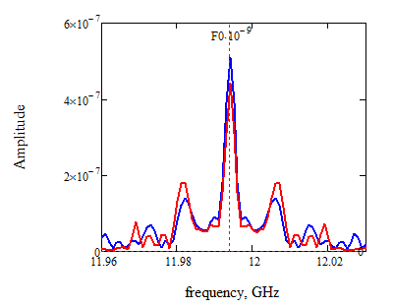
TBTS – PETS On-off mechanism
Demonstration of PETS of-off mechanism
Feasibility issue
  Switch off power from individual PETS to accelerating structure in case of breakdown
  Reduce substantially power in PETS, to cope with PETS breakdowns
PETS on-off principle fully tested
Conditioned at high power
(135 MW - nominal) by recirculation
System routinely used in CTF3 for power enhancement and tuning
Simulation vs. experiment
PETS , forward RF
Spectra
comparison
ON
OFF

Slide 16
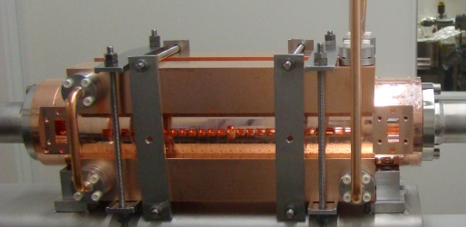
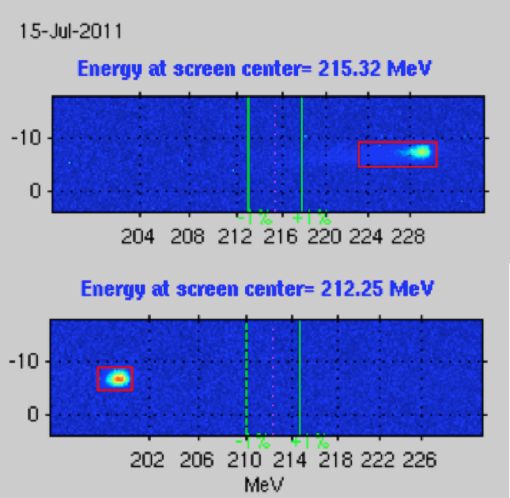
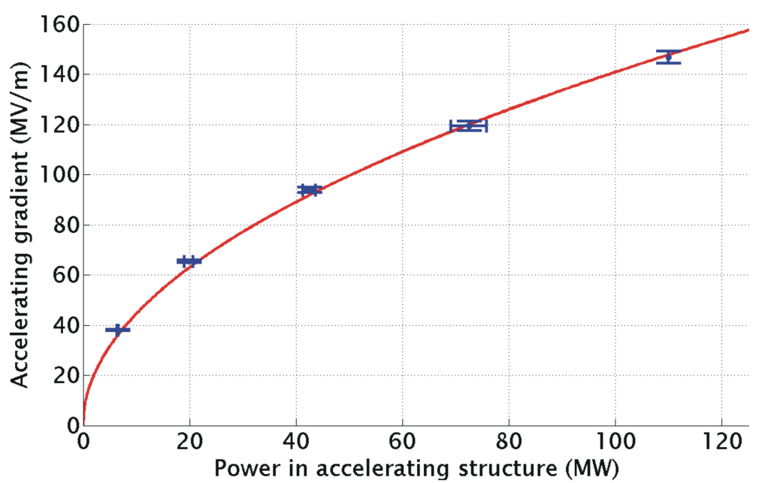
Two-Beam Acceleration
TD24
Two-Beam Acceleration demonstration in TBTS
Up to 145 MV/m measured gradient
Good agreement with expectations
(power vs. gradient)
Maximum stable probe beam acceleration measured: 31 MeV
⇒ Corresponding to a gradient of 145 MV/m
CLIC Nominal, unloaded
Drive beam ON
CLIC Nominal, loaded
Drive beam OFF

Slide 17
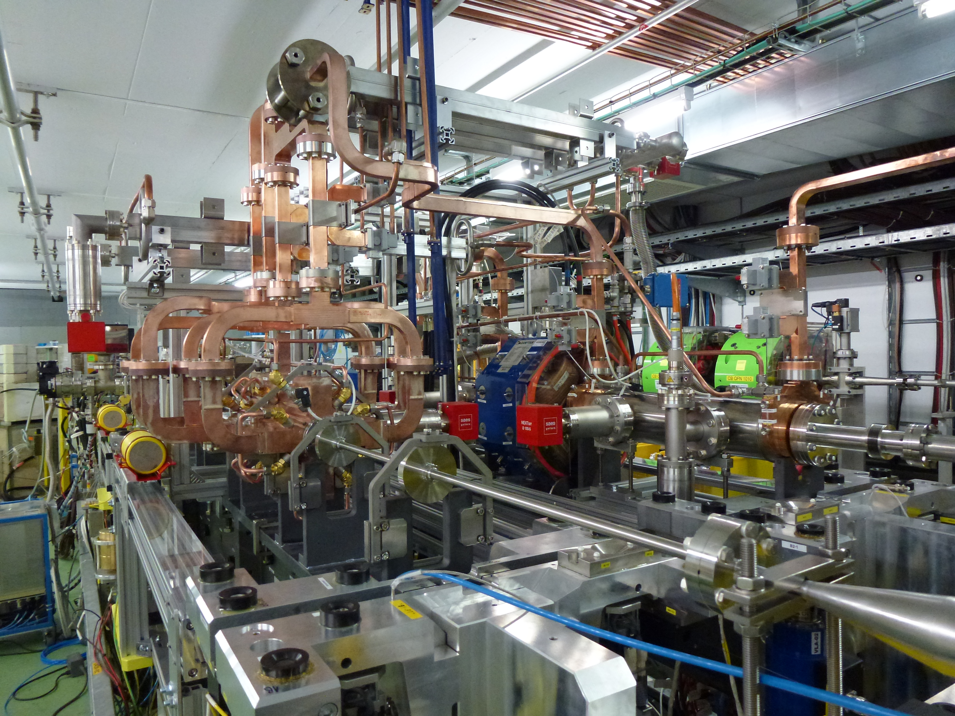

Two-Beam Module Experimental Program 2015-2016
  CLIC two-beam module tests
Power production, stability + control of RF profile
RF phase/amplitude drifts along TBL, PETS switching at full power
Two-beam acceleration, power transfer & phasing, breakdown detection and effects of breakdowns…
Alignment tests, with and w/o beam, including Wake-Field Monitors and main beam prototype BPMs
  Aim: gather all possible information, to feed back into next generation Two-Beam Module design
Two-beam acceleration in TBM thoroughly tested
Verified again power production/energy gain vs. expectations
Operated at nominal CLIC gradient and pulse length, ~ 100 MV/m and 240 ns
Experiment on control of RF profile (beam loading compensation) done

Slide 18


TBM – accelerating gradient in 2016
  Accel. Grad. = 110 MV/m

Slide 19




TBM – wake-fields effect
Low charge
Beam at the centre of the ACS
Low charge
Wake (girder movers)
  85.3 kV/nC/mm/m
Wake (corrector scan)
  85.5 kV/nC/mm/m
High charge

Slide 20





Test Beam Line
14 Power Extraction & Transfer Structures (PETS)
installed and running from 2015
Full beam transport to end-of-line spectrometer, stable beam
Power produced (90 MW/PETS) fully consistent with drive beam current (24 A) and measured deceleration.
PETS tank during installation
Beam deceleration, measured in spectrometer and compared with expectations
About 1.3 GW of 12 GHz peak power!
TBL line in CLEX
41%

Slide 21






Drive beam phase feed-forward
Goal:
stabilize drive beam phase to the CLIC requirement
0.2° @ 12 GHz (50 fs)
DB feed-forward results, 2015
  Drive-beam phase feed-forward tests in 2016
From about 1° to
0.2° @ 12 GHz,
or 50 fs

Slide 22


CTF3 Exp. Program 2015-2016 – Beam Loading Experiment
Gradient along the structure
Unloaded
Beam loading changes the field distribution for the same average gradient
⇨ how is the break-down rate affected?
Average gradient 100 MV/m
Increasing current
Loaded (CLIC)
12 GHz RF from klystron
12 GHz accelerating structure
CTF3
DELAY LOOP
BL - BDR experiment
COMBINER
RING
LINAC
Drive beam
1-3A
130-50 MeV
CLEX

Slide 23


Beam Loading Experiment
A BDR reduction by beam loading up to an order of magnitude was measured.
BDR seems dominated by the peak gradient, confirmed by the measured distribution inside the structure, which follows roughly the gradient profile.
Possibility to further optimise the CLIC structure by targeting a flat gradient along the structure during the operation with beam.

Slide 24




CTF3 Exp. Program 2015-2016 – Instrumentation Tests
  2014 TBTS data
  4um resolution
  Wake-Field Monitors
  4 um resolution
  Studies of DB noise
  Confirmed by new version
  Drive Beam BPM
  Confirm 2.5 um resolution
  Rad hardness
  Optical Fiber Beam Loss Monitors in TBL
  Localization of losses below 2 m (2015)
  Multi-loss location case
  Main beam BPM prototypes
  Sub-micron resolution measured
  Time resolution (50 nm) OK

Slide 25



Wake Field Monitors
Wake field monitors precisely determine the beam position with respect to the electrical center of an accelerating structure
In CLIC, WFM signals will be used to center the beam in the structure and minimize transverse wake-fields
Requirement: 4.5 um resolution

Slide 26

CLIC Test Facility (CTF3)
✝ 2016

Slide 27

CERN Linear Electron Accelerator for Research (CLEAR) ꙳ 2017

Slide 28


The CLEAR (CERN Linear Electron Accelerator for Research) proposal
CTF3 ended operation in
December 2016
However, the probe beam injector CALIFES will become the focus of a new multi-purpose facility, CLEAR
CLEAR, among other activities, will continue some CLIC related studies on high-gradient and diagnostics

Slide 29
CONCLUSIONS
CTF3 has addressed and solved the CLIC issues related to drive beam generation, power production and two-beam acceleration.
CTF3 successfully completed its planned experimental program in December 2016 as planned, and stopped operation.
The experience gathered in CTF3 is now being documented, in view of the update of the European Strategy in 2019.
The approval of the CLEAR program gives the opportunity to maintain local testing capability at CERN for CLIC instrumentation and high-gradient structure testing with beam, alongside with other non-CLIC activities.

Slide 30
The CLIC Test Facility has been the collective effort of a large collaboration over more than a decade.
Many thanks to all individuals who participated over this period to the conception, design, construction, commissioning and operation of CTF3!

