Slide 1
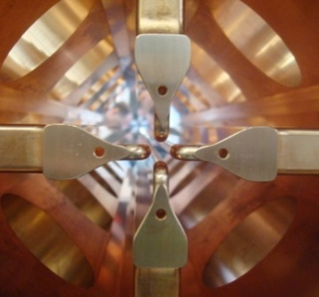
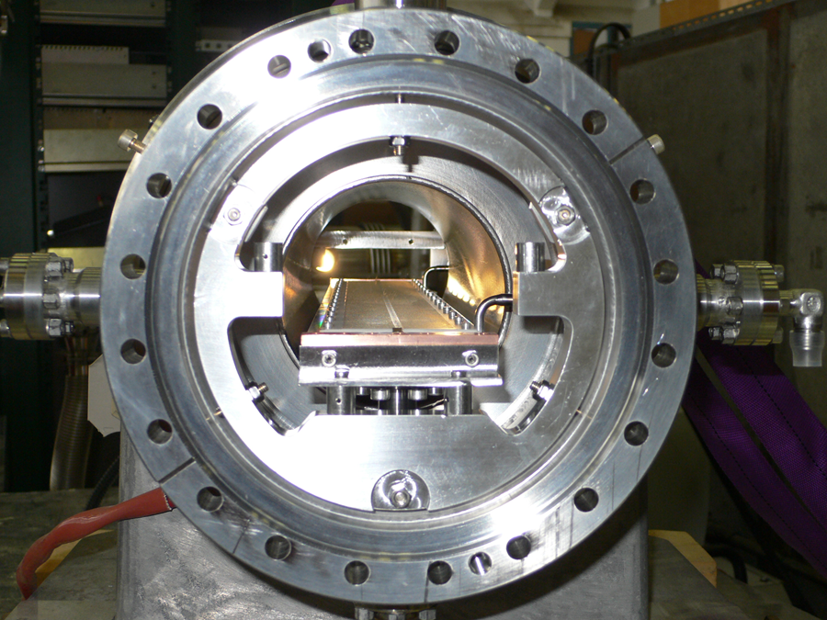
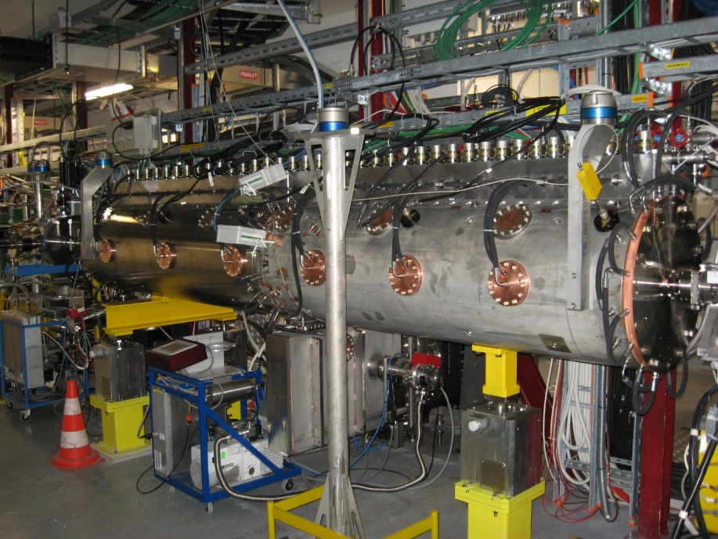
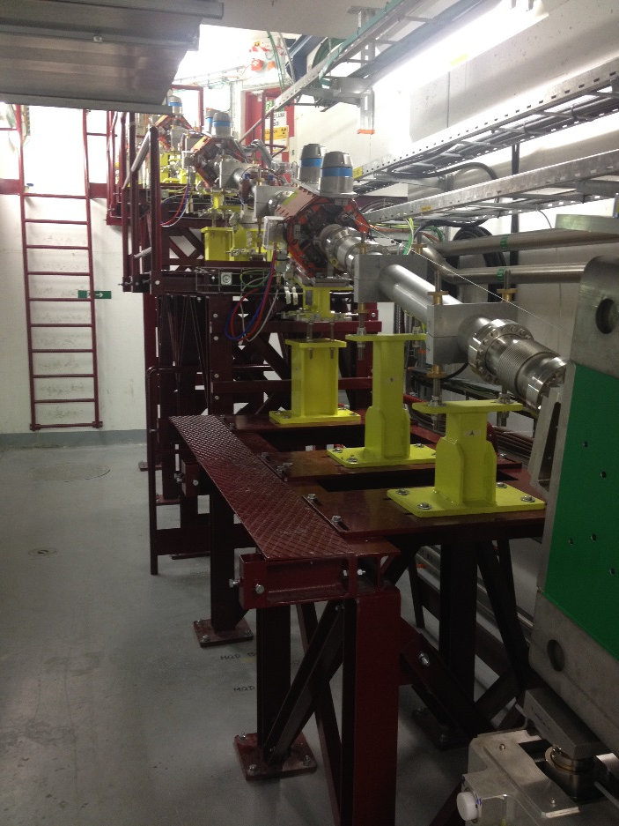


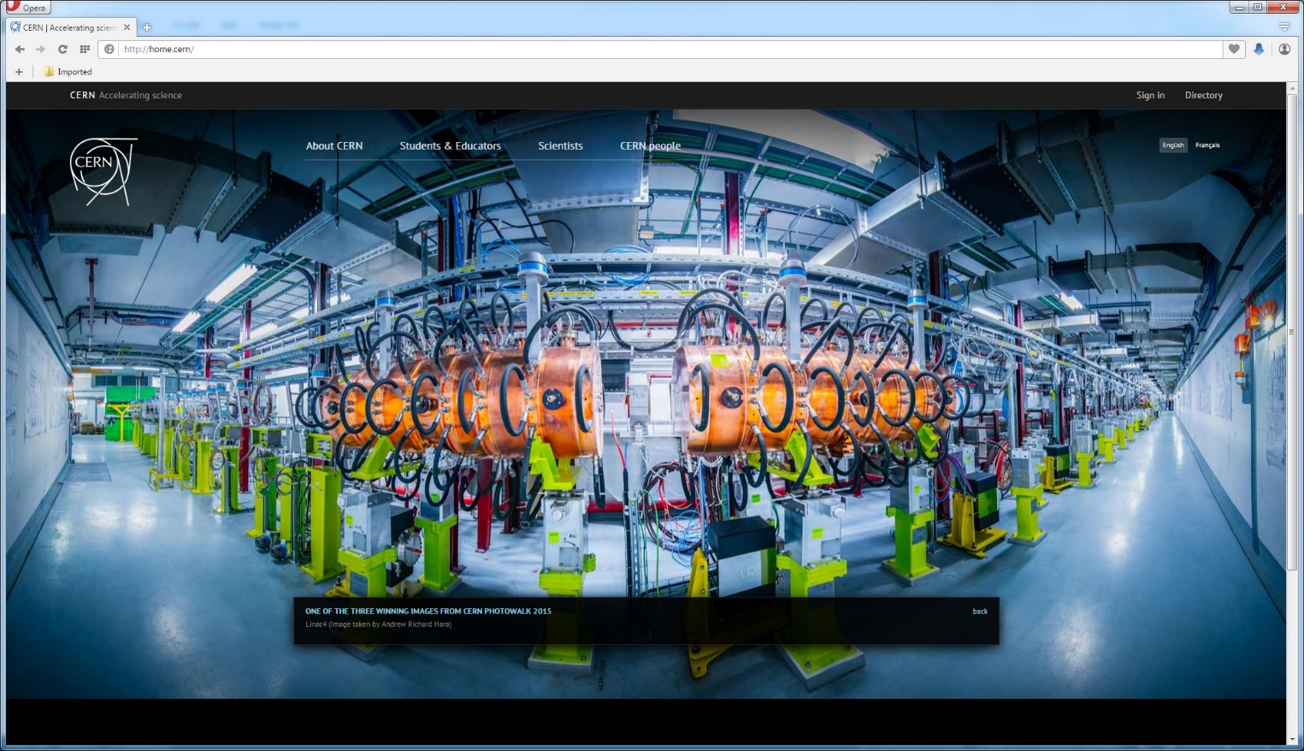
Linac4: From Initial Design to Final Commissioning
Alessandra M Lombardi for the LINAC4 Team

Slide 2








Oliver.Abevrle,Davide.Aguglia,Luca.Arnaudon,Philippe.Baudrenghien, Giulia.Bellodi Caterina.Bertone,Yannic.Body,Jan.Borburgh,Enrico.Bravin,Olivier.Brunner,Jean-Paul.Burnet,Marco.Buzio,Christian.Carli,Etienne.Carlier,Miguel.Cerqueira.Bastos,julie.coupard,Jean-Marc.Cravero,Pierre.Dahlen,Benoit.Daudin,Jurgen.de.Jonghe,Nuno.Dos.Santos,L.Ducimetiere,Tony.Fowler,jean-frederic.fuchs,Delphine.Gerard,Frank.Gerigk,jean-michel.giguet,Silvia.Grau,Jean-Claude.Guillaume,Louis.Hammouti,Klaus.Hanke,Michael.Hourican,Mark.Jones,Quentin.King,Ioan.Kozsar,Jean-Baptiste.Lallement,Gilles.Le.Godec,Franco.Lenardon,Alessandra.Lombardi,Luz.Lopez-Hernandez,Serge.Mathot,Stefano.Moccia,Eric.Montesinos,Antony.Newborough,David.Nisbet,Mauro.Paoluzzi,Aurelie.Pascal,Daniel.Perrin,Jerome.Pierlot,Serge.Pittet,Bruno.Puccio,Uli.Raich,Suitbert.Ramberger,Carlo.Rossi,Richard.Scrivens,Lars.Soby,Jocelyn.Tan,Hugues.Thiesen,Pierre.Alexandre.Thonet,Giovanna.Vandoni,Maurizio.Vretenar,Wim.Weterings,Christos.Zamantzas,Thomas.Zickler, Elena.Benedetto,Alessandro.Bertarelli,Etienne.Carlier,Jean-Pierre.Corso,julie.coupard,Yves.Cuvet,Alessandro.Dallocchio,L.Ducimetiere,Gilles.Favre,Alan.Findlay,Jan.Hansen,Lars.Jensen,Rhodri.Jones,Detlef.Kuchler,Jean-Michel.Lacroix,Bettina.Mikulec,Dominique.Missiaen,john.molendijk,Benoit.Riffaud,Federico.Roncarolo,Carlo.Rossi,Jose-Luis.Sanchez.Alvarez,Andrzej.Siemko,Marco.Silari,Lars.Soby,Didier.Steyaert,Jocelyn.Tan,Pierre.Alexandre.Thonet,joachim.vollaire,Rolf.Wegner,Sylvain.Weisz, Michel.Arnaud,Luca.Arnaudon,Sonia.Bartolome,Cedric.Baud,cyrille.patrick.bedel,aurelio.berjillos,christian.marc.bernard,Ana-Paula.Bernardes,Alessandro.Bertarelli,Sebastien.Bertolo,thomas.william.birtwistle,Jan.Blaha,Sebastien.Blanchard,Yannic.Body,philippe.boisseaux-bourgeois,robert.borner,Olivier.Brunner,pawel.andrzej.burdelski,Didier.Chapuis,Ahmed.Cherif,Laurent.Colly,Fabio.Corsanego,Jean-Pierre.Corso,julie.coupard,Christophe.Coupat,Jean-Marc.Cravero,Olivier.Crettiez,Maryse.Da.Costa,Alessandro.Dallocchio,jose.delagama,gian.piero.di.giovanni,Tobias.Dobers,Gerald.Dumont,John.Etheridge,Gilles.Favre,ja.ferreira,Ramon.Folch,Katy.Foraz,Robert.Froeschl,jean-frederic.fuchs,Anne.Funken,javier.galindo,georgi.minchev.georgiev,Frank.Gerigk,jean-michel.giguet,Gael.Girardot,David.Glenat,Paulo.Gomes,Marine.Pace,Silvia.Grau,Jean-Louis.Grenard,Damien.Grenier,Serge.Grillot,jean-francois.gruber,Roberto.Guida,greta.guidoboni,Jean-Claude.Guillaume,abel.gutierrez,Louis.Hammouti,Jan.Hansen,Steve.Hutchins,Stephane.Joffe,Mark.Jones,Ioan.Kozsar,Jean-Michel.Lacroix, David.Landre,raphael.langlois,jean.marc.lassauce,patrick.lelong,Jacques.Lettry,Yann.Lupkins,Jose.Marques,Christophe.Martin,alex.martinez,Pablo.Martinez.Yanez,Albert.Masson,Christian.Mastrostefano,Simon.Mataguez,Serge.Mathot,Bettina.Mikulec,Stefano.Moccia,Richard.Mompo,Boris.Morand,richard.francis.morton,Antony.Newborough,Christophe.Nicou,Pierre.Ninin,David.Nisbet,Remy.Noulibos,Miguel.Ojeda-Sandonis, Francesco.di.Lorenzo, Micheal.o.Neil, Chiara Bracco, Federico Roncarolo

Slide 3
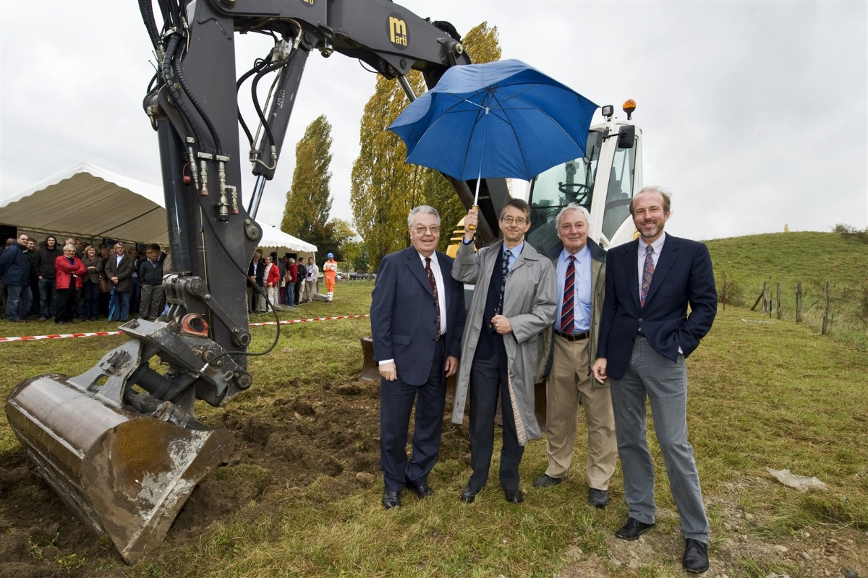
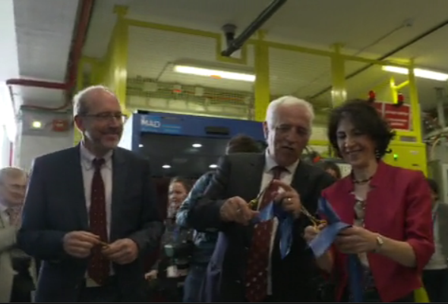
1-Proposals from 1996 to 2006 | In its June 2007 session the CERN Council has approved the White Paper "Scientific Activities and Budget Estimates for 2007 and Provisional Projections for the Years 2008-2010 and Perspectives for Long-Term", which includes construction of a 160 MeV H- linear accelerator called LINAC4, and the study of a 5GeV, high beam power, superconducting proton Linac (SPL). 2-Decision in 2007 R. Aymar director general
3-Ground Breaking ceremony : 16 October 2008 | 4-Inauguration : 9 May 2017
Notes:
A story of hardware, people and international collaboration

Slide 4


The big picture : LHC Luminosity
  N_{b} number of particles per bunch
  n_{b} number of bunches
  f_{r} revolution frequency
  ε_{n} normalised emittance
  β* beta value at Ip
  F reduction factor due to crossing angle
LHC INJECTOR CHAIN :
Linac2 (50 MeV) 1978 length 40 m
160mA , 100 µsec , 1 Hz
Max Space Charge Tune Shift reached
↓
PS Booster (1.4 GeV) 1972 – radius 25 m
4 rings stacked
Output energy already upgraded twice
↓
PS (25 GeV) 1959 – radius 100 m
↓
SPS (450 GeV) - 1976 radius 1100 m
From optics at Interaction point
Brightness from Injectors : defined at low energy
From machine design and limitations (e cloud)
See K. Hanke WEPVA036
Notes:
Mention 4 rings

Slide 5
Baseline beam parameters
 | LINAC4 – CDR -2006 | LINAC4 – achieved (2016)
* | H- | Stripping and more tested in Half Sector Test
 | 70mA peak at the source 65 ma peak at 3 MeV 40 mA after chopping | 50mA peak (in twice the acceptance of the RFQ) 30 mA peak at 3 MeV (record) 20 mA after chopping | Peak current from the source Average beam current after chopping (LEBT and RFQ transmission and chopping factor)
* | 160 MeV | 160.48 MeV | All RF structures performing to specs
 | 0.4 π mm mrad | 0.3 π mm mrad (at 160MeV) | Smaller emittance , allows for more turns injected
 | 400 µsec 1Hz (4 rings) | Up to 600 µsec 1Hz | Longer injection in the PSB (100-150turns)
 | Fast Chopping at 3 MeV 2µsec inj kicker rise-time | Demonstrated , including transmitted beam quality | Unprecedented flexibility, to be exploited Beam from 1µsec to 150µsec
 | Energy painting with the last accelerating modules | Not yet tested

Slide 6
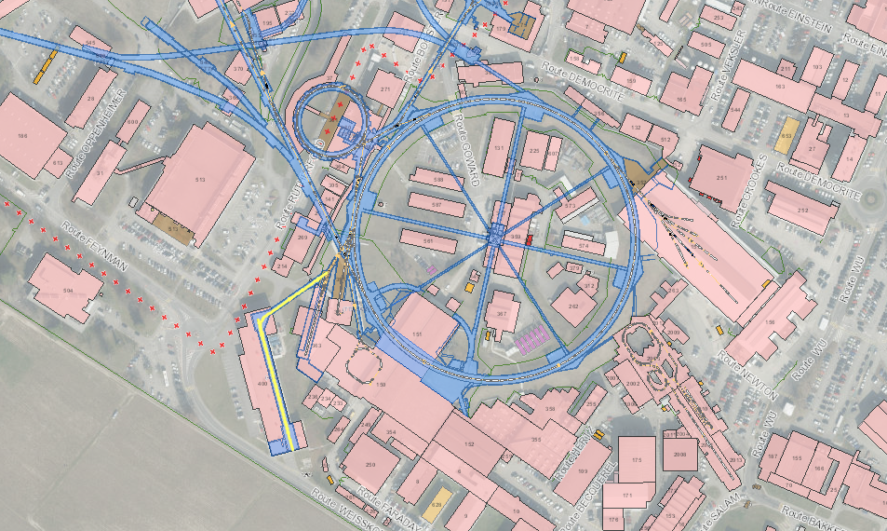
Frequency : 352 MHz
Duty cycle for PSB : 0.06 %
Max duty cycle : 5%
Located 12m underground

Slide 7
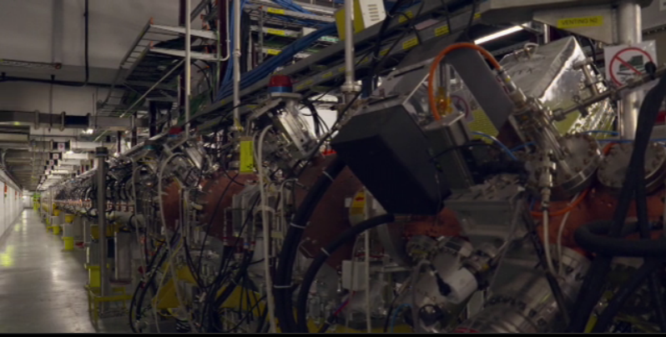

Slide 8
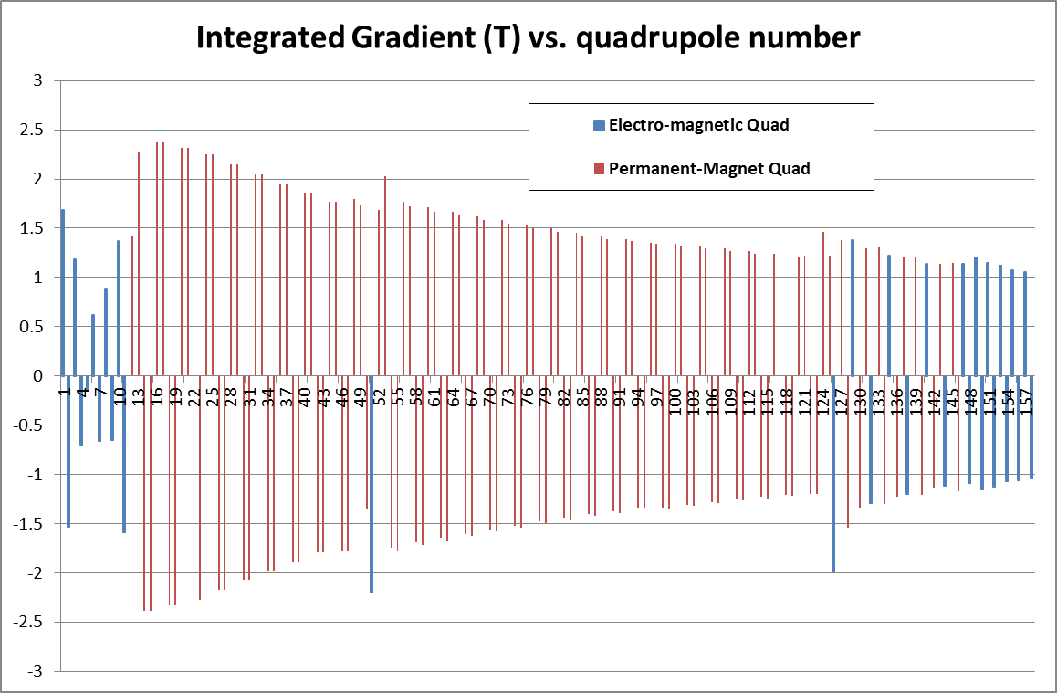
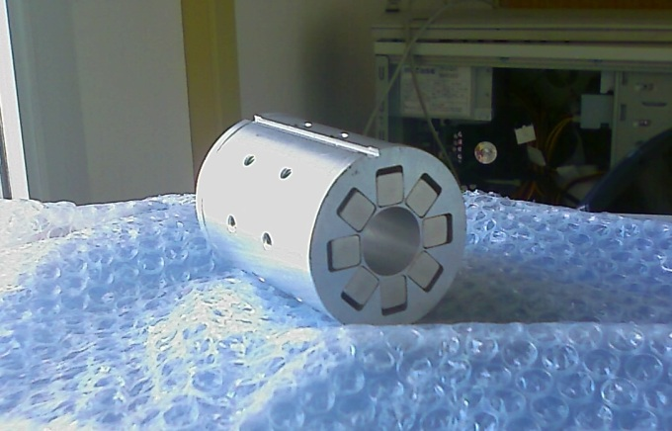
Quadrupoles :mostly PMQ (127/158)
-Flexibility in matching and chopping 0-80 mA currents from the pre-injector.
-Flexibility in bringing beams with energy from 50 MeV onwards to the PSB.
PMQ for tank2 , 60 mm in diameter and 80 mm in length
Notes:
Permanent magnets /

Slide 9
Accelerating Gaps (262) voltage and phase
Quasi-synchronous structures with external focusing from 50MeV
Sequence of 3 identical gaps from 50 to 100MeV and 7 identical gaps from 100 to 160MeV

Slide 10
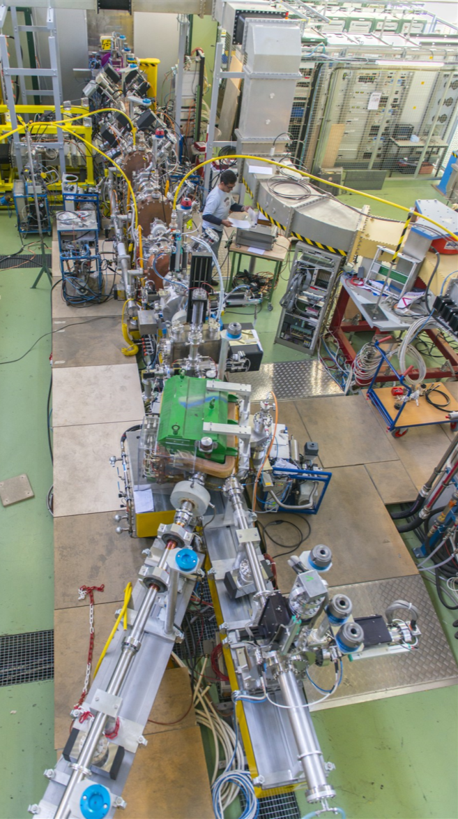
Pre-injector –source to 3 MeV (Oct 13)
ion source
Critical part was tested in a dedicated test stand equipped with a diagnostics line including :
1)direct emittance measurement
2) bending spectrometer magnet
3) time-of-flight
RFQ
chopper line
Diagnostics line
spectrometer
beam dump

Slide 11
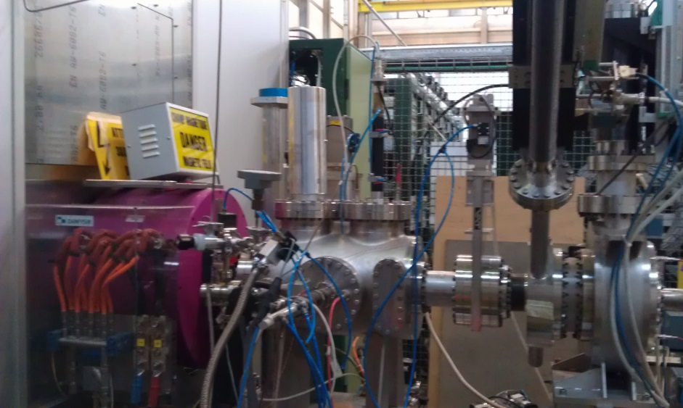
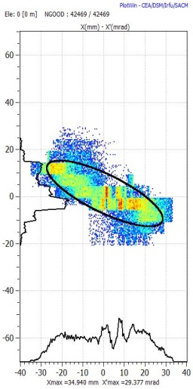
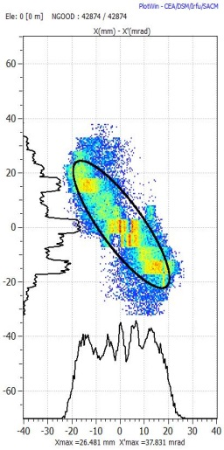
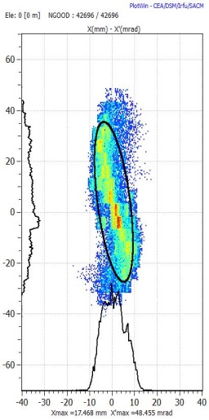
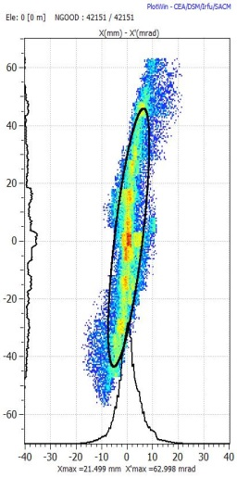
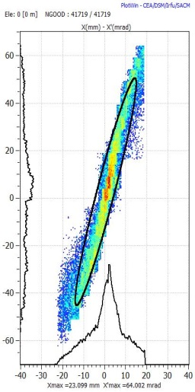
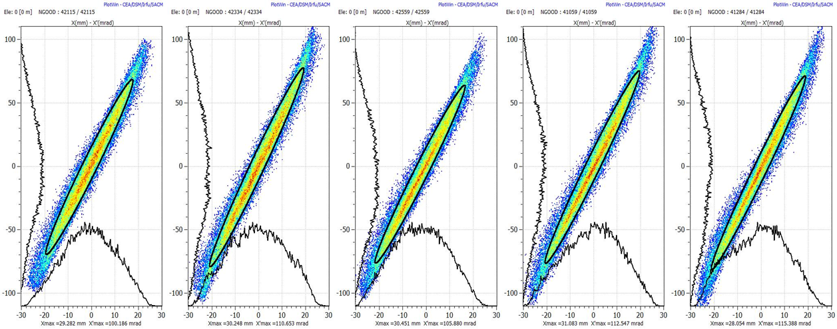
Extensive measurements at 45 keV
1- take measurements varying solenoidal field and generate in tracking code
source
Solenoid
Emittance metre
2 – back-trace to source out
3 - Result : we have an empirical input beam distribution that very well represents the dynamics in the LEBT and the rest of the accelerator.

Slide 12
Pre-injector
3 MeV/ 352 MHz/ 3 m long RFQ
Commissioned with beam 2013
Fast chopper, functionality validated 2013
Risetime<10nsec/ extinguish factor 100%

Slide 13
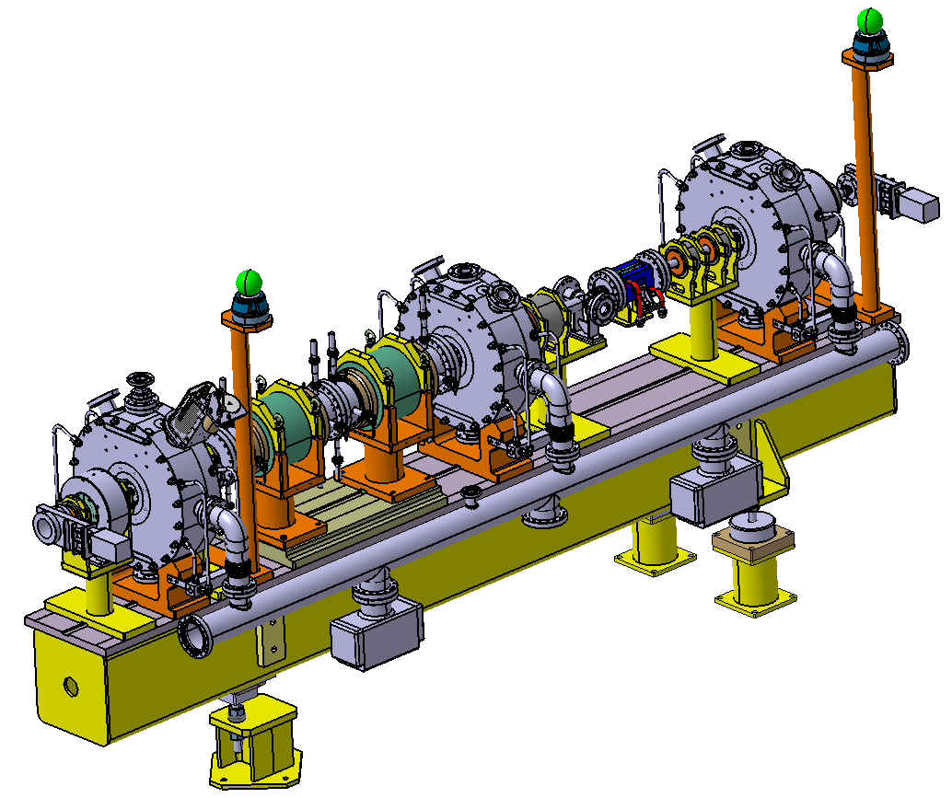
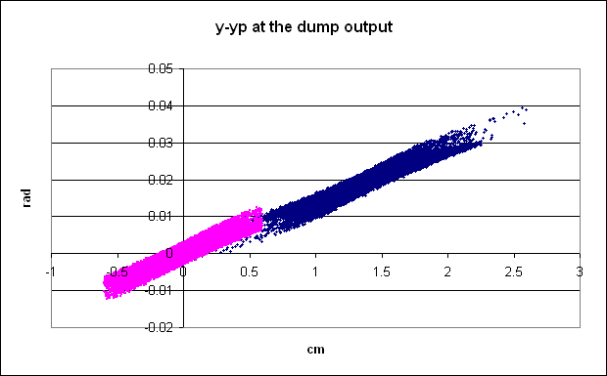
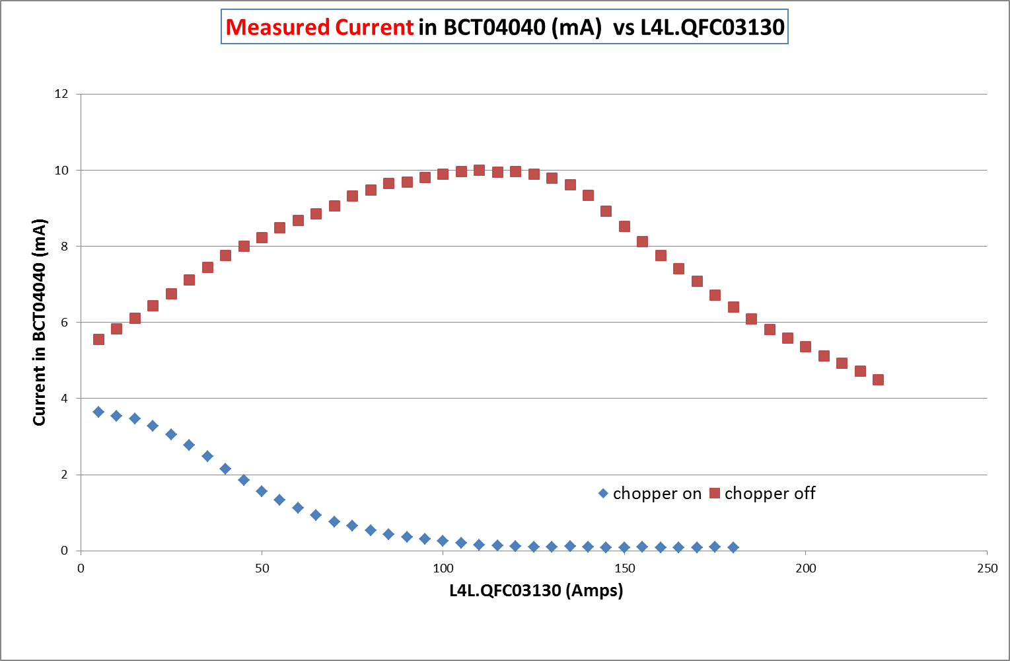
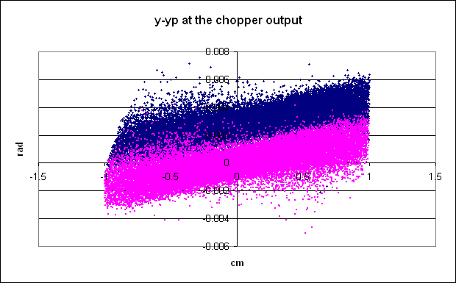
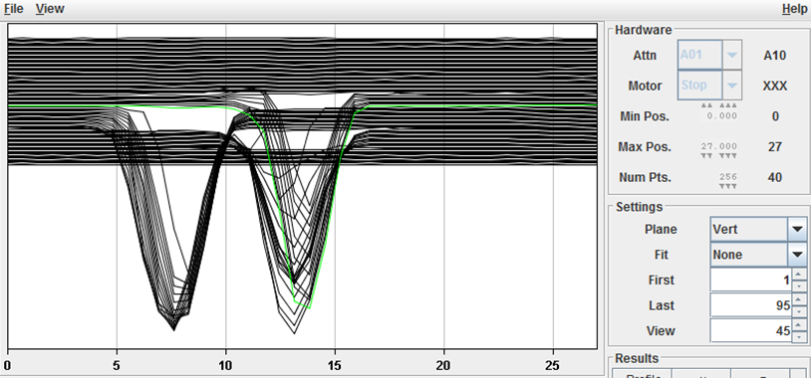
CHOPPING at 3 MeV emoving microbunches (150/352) to adapt the 352MHz linac bunches to the 1 MHz booster frequency
Match to the DTL
Match from the RFQ
Chop
Meas 2014
Beam current downstream the dump

Slide 14
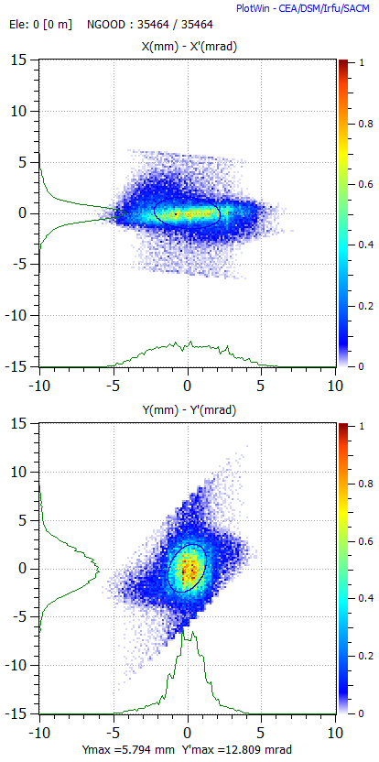
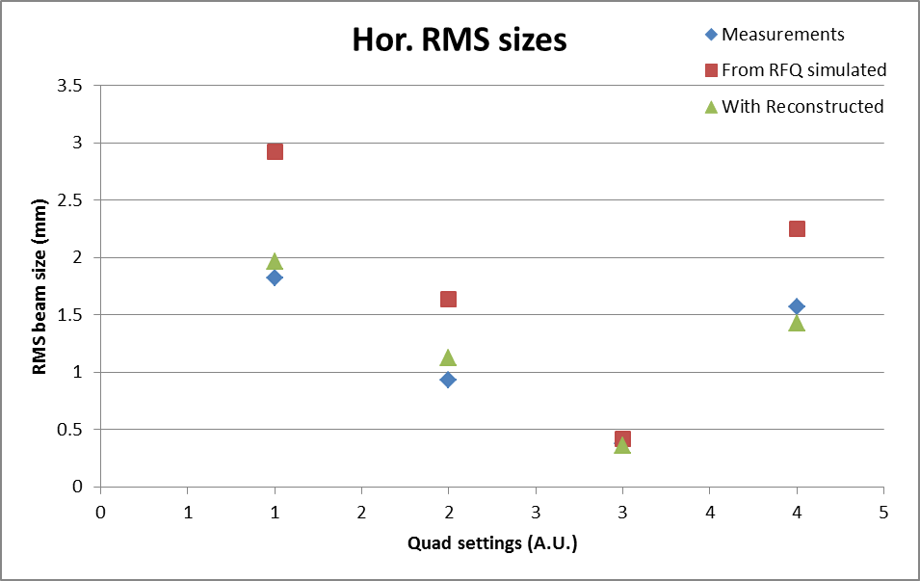
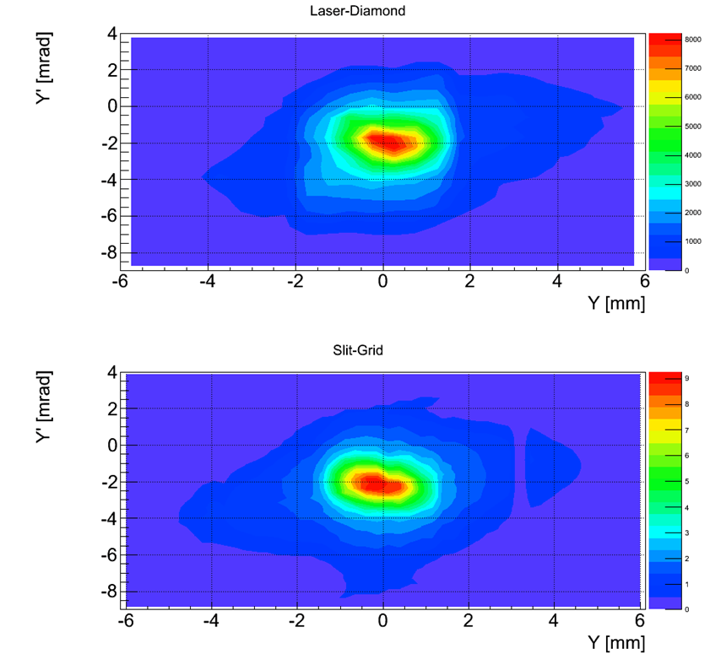
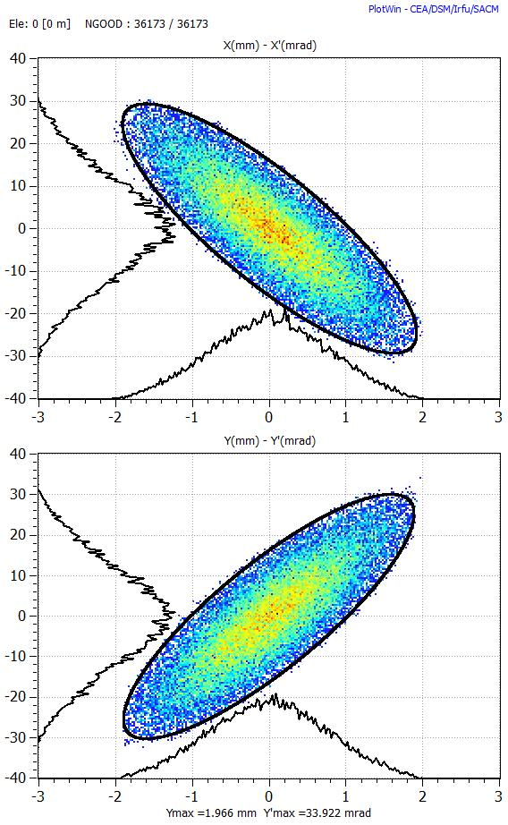
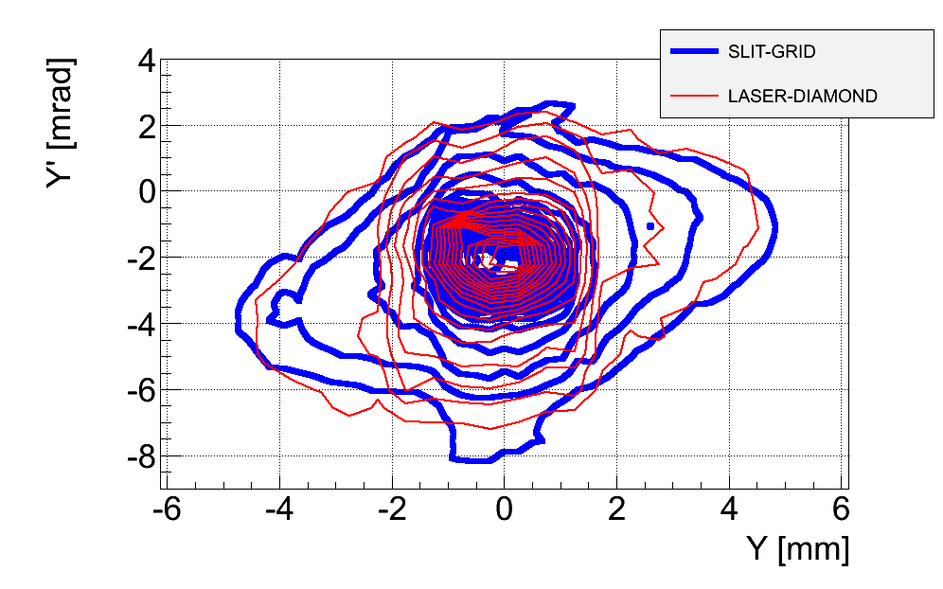
Pre-injector : validation of diagnostics
Slit-and-grid | From profile meas | Laser + diamond
rms normalised Transverse emittance at 3 MeV measured by 3 independent systems is 0.3 pi mm mrad

Slide 15
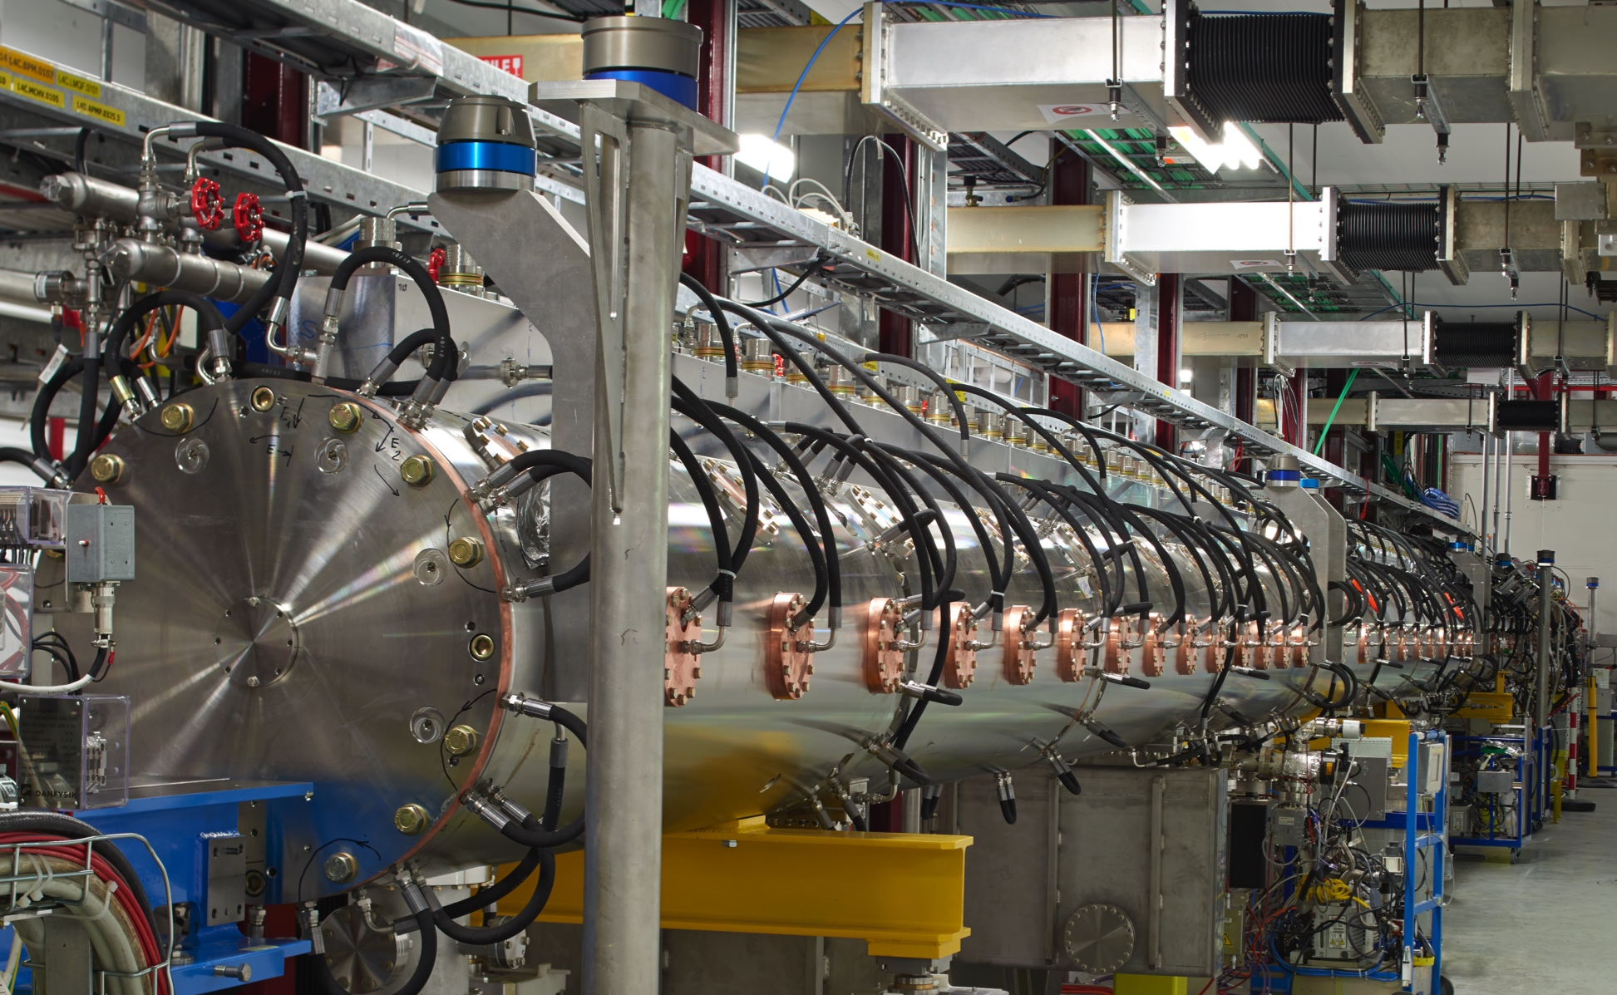
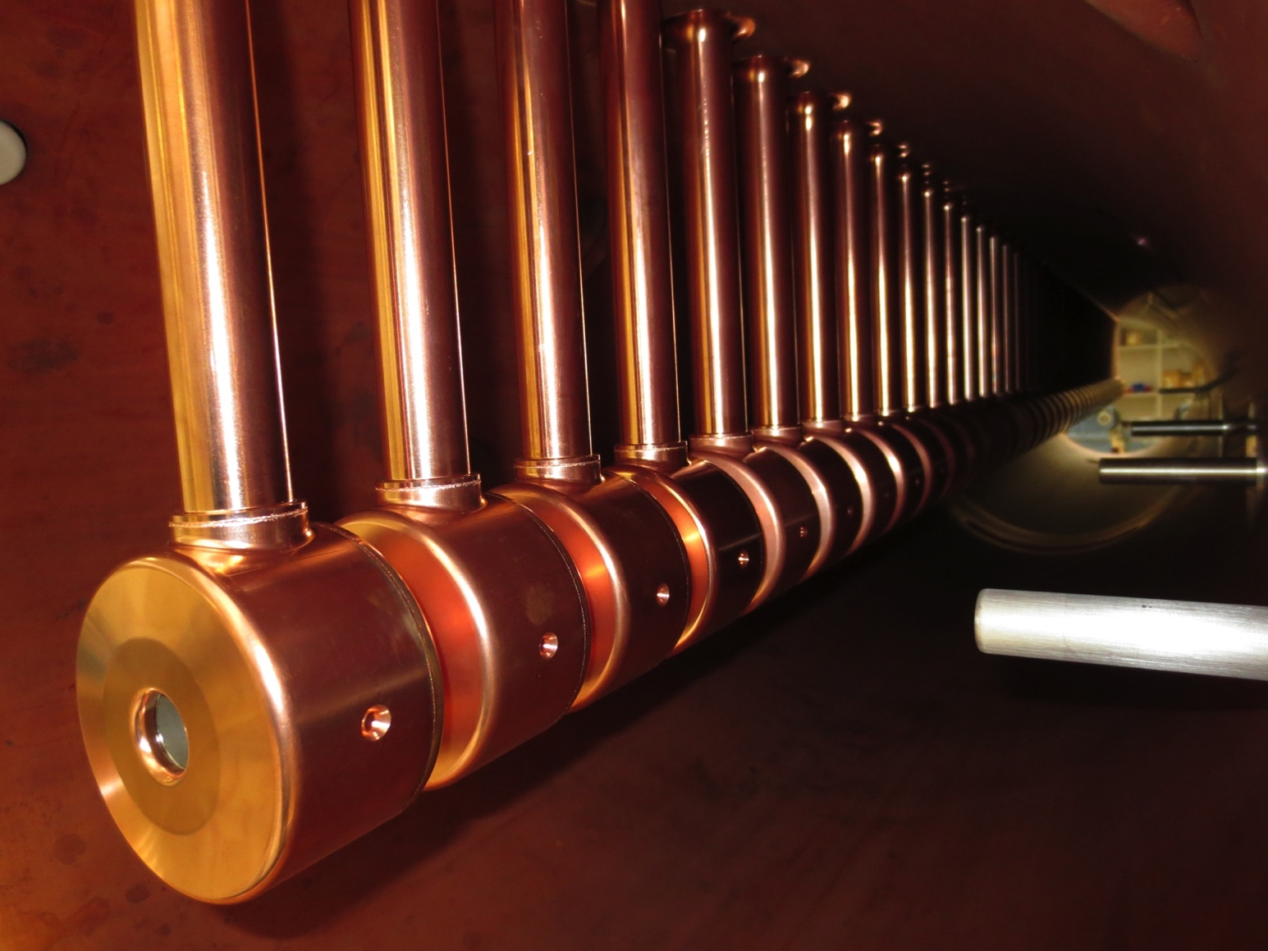
Drift Tube Linac : 3-50 MeV
(3-12-30-50 MeV, commissioned in 2 stages Aug 14 and Nov 15)
Designed for ≥30 years of reliable operation with up to 10% duty cycle
Rigid self supporting steel tanks assembled from <2m long segments
Tank Design almost without welds, heat treated after rough machining
PMQs in vacuum for streamlined drift tube assembly
Adjust & Assemble: Tightly toleranced Al girders w/o adjustment mechanism
Spring loaded metal gaskets for vacuum sealing and RF contacts
Easy to use patented mounting mechanism
Additional C-seal and temperature probe channel employed for leak testing
Increased gap spacing in first cells of T1 to reduce breakdown in PMQ fields
Cooled RF-port & vacuum grid in AISI 304L tank for 10% duty-cycle

Slide 16
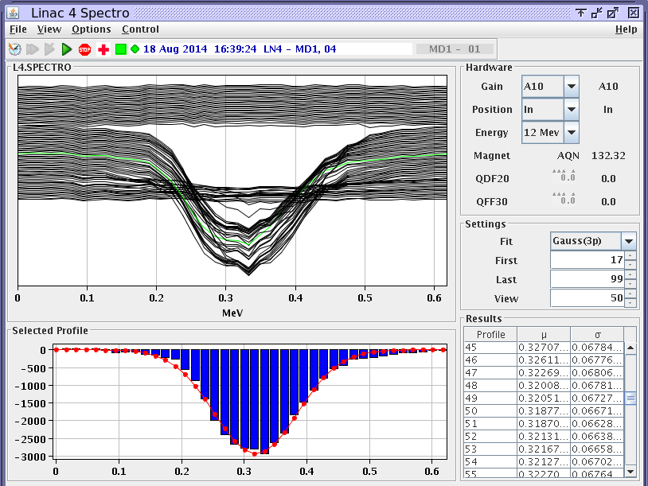
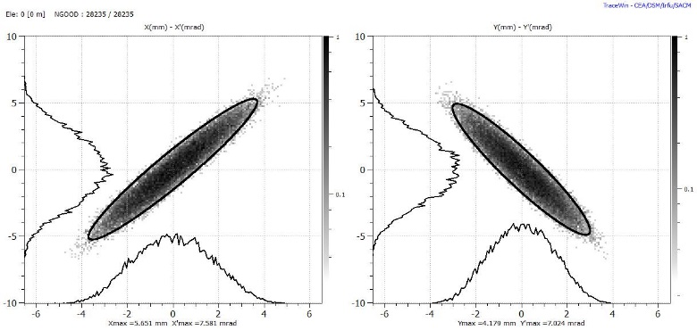
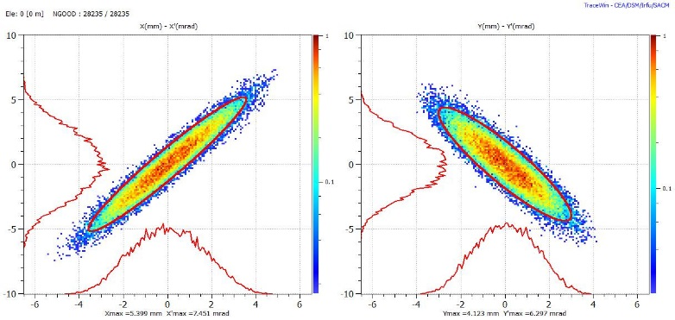
Drift tube LINAC – beam measurements
Expected - Measured
Spectrometer (bending + grid) measurements indicate an rms energy spread of 52.8 keV (vs 49.2 keV expected) after DTL tank1,12MeV, August 2014
Transverse emittance at 50 MeV
after the Drift Tube Linac, Nov 2015

Slide 17
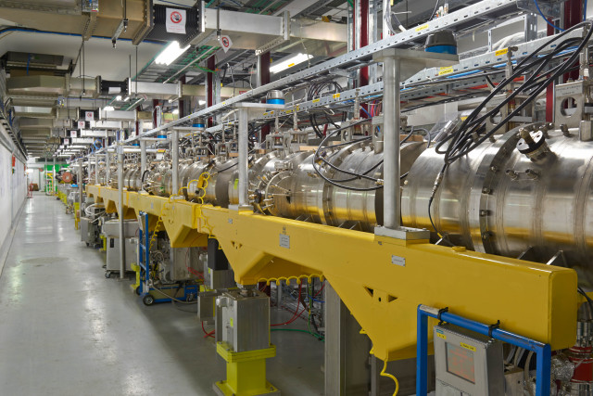
Cell Coupled Drift Tube LINAC : 50-100MeV
(commissioned June 16)
7 modules of 3 accelerating cavities (3 gaps each) and 2 coupling cells,
quadrupoles outside of RF structure,
copper plated stainless steel,
time-consuming assembly because of high number of C-shaped metal seals, several attempts necessary to achieve vacuum tightness,
around 1 month of conditioning needed to clean surfaces,
non-trivial support mechanics because of 12 support points per module,
all drift tube centres are aligned within ±0.1 mm
first-ever CCDTL in a working machine!

Slide 18
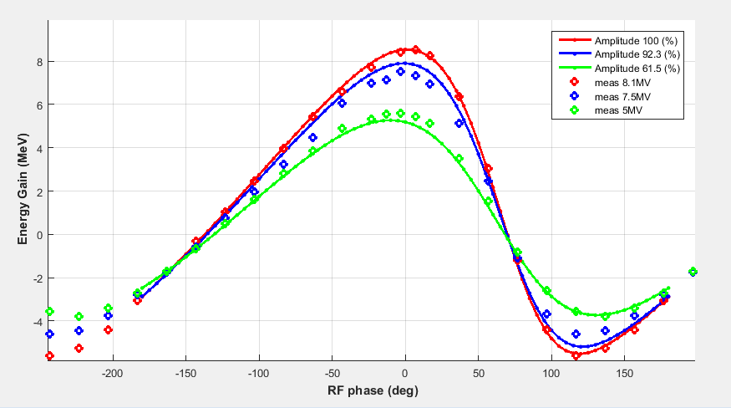
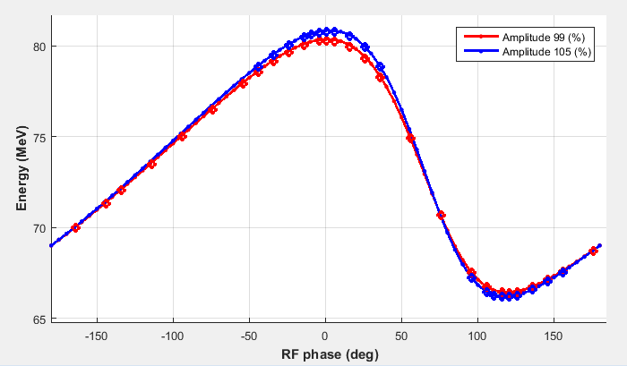
CCDTL beam measurements
Average energy vs cavity phase for CCDTL module 3 and 4 measured June 2016 with Time-of-Flight
Refer to F. Roncarolo MOPAB120
Notes:
If it all works out like this is because all systems (RF, vacuum control, …) are working up to their specs

Slide 19
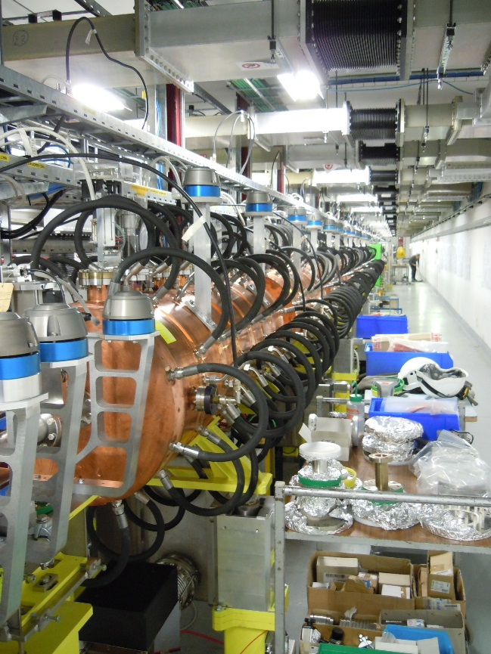
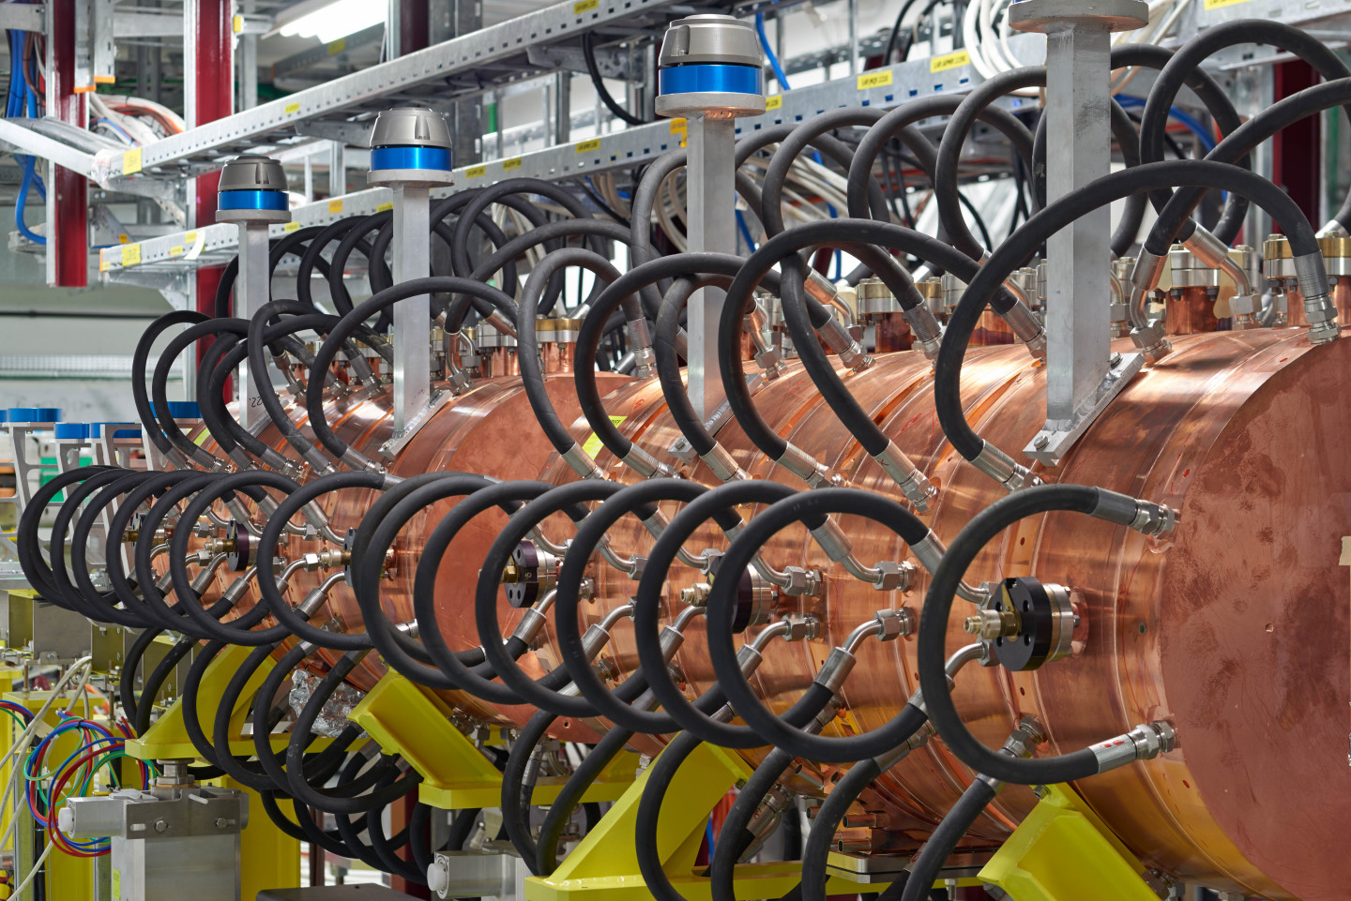
Pi-mode structure : 100-160 MeV
(commissioned Oct 16)
Bulk copper, no RF seals, discs and rings are tuned and electron-beam welded at CERN
Long qualification period for series production (~3 years), critical point was precision machine large pieces of copper (10 - 20 um on 500 mm diameter pieces)
Conditioning time of prototype: 24 hours
First low-beta pi-mode structure to go into operational machine

Slide 20
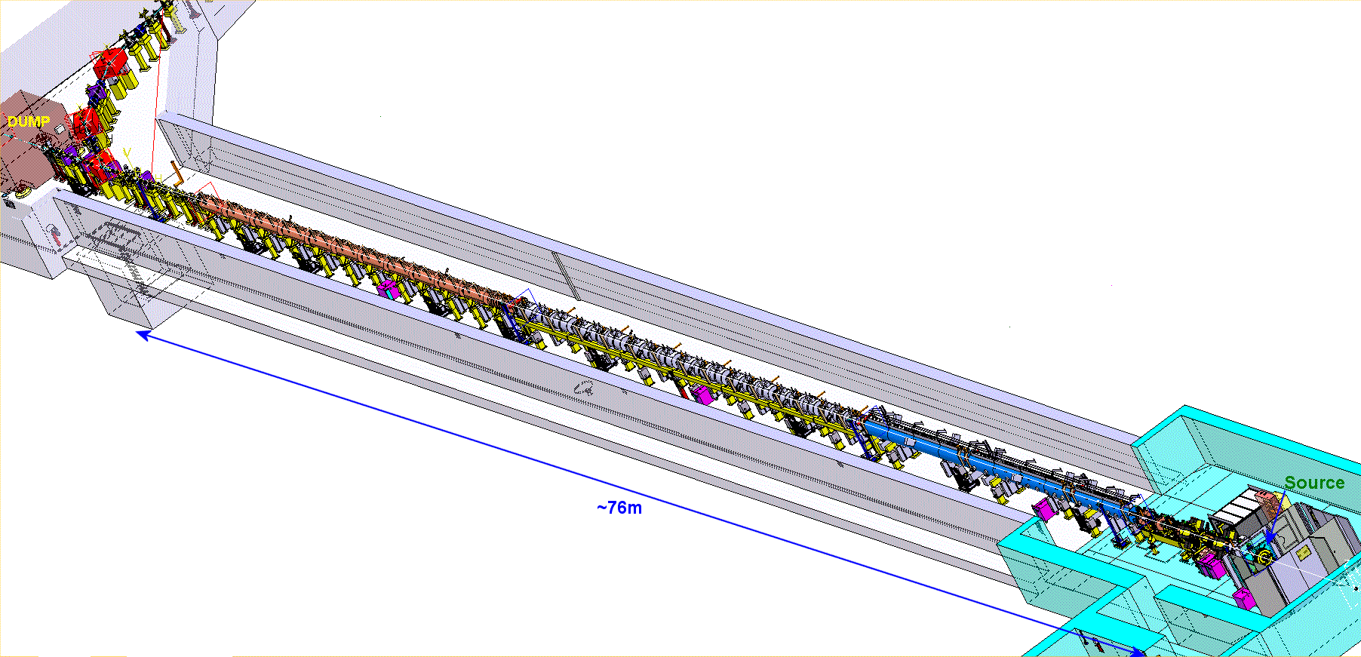

Made it to the final energy!
Oct 2013
3MeV
30 mA
Nov 2016
160 MeV 18mA
Jun 2016
105 MeV 20mA
Nov 2015
50 MeV
20 mA
Safely on the dump.
It has been stripped.
It has been delivered to the Half Sector Test.
45 keV
50 mA
Notes:
Commissioning done in stages of increasing energies. Details in another transparency

Slide 21
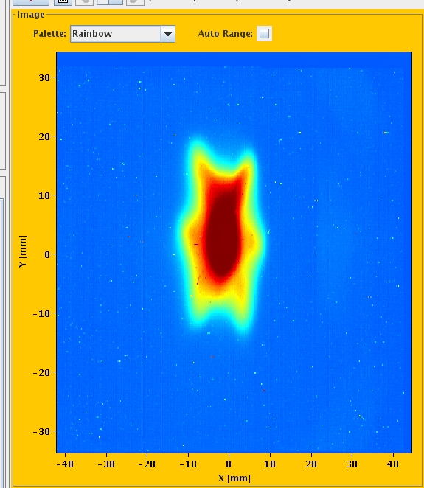
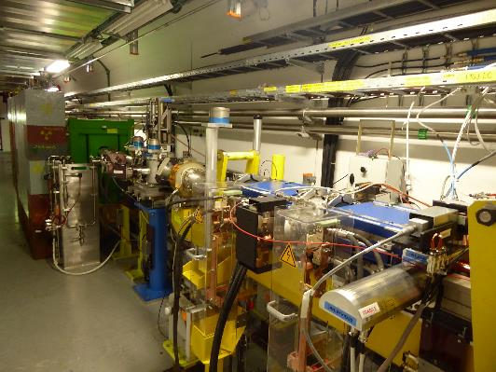
Half Sector Test (Oct 2016-mar2017)
Run the beam through half the injection chicane with aim of mitigating risks for Future PSB H⁻ Injection Section
Temporary
dump
Chicane
magnets +
H⁰/H⁻ dump
Stripping foil
system
Beam transverse footprint – stripped – 160 MeV at BTV1077 , Mar 2017
Refer to MOPIK047, MOPAB120, MOPIK041

Slide 22
What next?
- demonstrate long term reliability
“non availability of the injectors is the main cause of down time for the LHC”
-connect to the PSB
-achieve the nominal and possibly the ultimate current

Slide 23
Reliability run (June17-Mar18)
Insure a smooth transition from commissioning to operation: train operators, necessary software development, learn to deal with the increased flexibility.
Find any weak points and mend them in time for the connection
Achieve a beam-availability for the PSB as high as possible and possibly above 90% : importance of the fault tracking system

Slide 24
To complete the transfer lines and connect to the PSB
160 MeV H- as planned
50 MeV protons in emergency
During LS2 for 6 months
  Install new BHZ20 and build the shielding around that area
  Renew the LBE line (emittance measurement)
  Install the H- injection equipment in the PSB
After LS2
  inject via charge-stripping up to 3 10¹² protons per ring at 160 MeV (e.g. an average current of 25 mA along the pulse before chopping, injection over 40 turns of 40 µsec)
  The beam injected into each ring can be tailored to durations from 1 to 150 µsec,
  Average energy can be dynamically varied by ±1.2 MeV over 40 µsec
  the rms energy spread varied from 85 to 450 keV rms
During two weeks :
  Close the line (blank pipes available)
  Reposition the BHZ20
  Switch the source to proton
With 50MeV protons from LINAC4 the PSB would be able to deliver 75% of the present performance for the LHC beam. (CERN-ATS-Note-2012-047 PERF. – 2012)

Slide 25
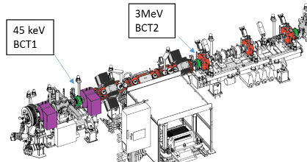
A word on the source
Many improvement since march 2015
Intensity
Stability
Auto-Pilot (automatic regulation of critical source parameters for increased stability)
Caesiation with autopilot , time needed went from half day w/o beam to few hours in degraded beam conditions
Parallel program at the test stand
Control of the emittance
Optimised electrode shape
Matching into the LEBT
Mastering neutralisation?
Current at 3 MeV before chopping
Today’s LINAC4 | 20 mA
Record LINAC4 | 30 mA
Nominal LHC Inj. Upgrade | 40 mA
Ultimate LINAC4 | 60 mA
The gap to the nominal LIU can be compensated with twice the injected number of turns in the PSB.

Slide 26
Final remarks
LINAC4 :
  All the hardware except the source in its final configuration
  There is an enormous flexibility built into LINAC4 to be exploited by the PSB and this will require time and trials
  Linac4 is upgradeable
    in terms of duty-cycle (factor 5) and peak current (factor 3) without any modification to the hardware
    In terms of duty cycle (factor 50) and final energy with substantial hardware modification
More general :
  The importance of a test stand which includes the full pre-injector
  The importance of validated machine model and accuracy of particle tracking codes
  Also for a relatively small quantity (about 150 Permanent Magnet Quadrupoles pieces) the procurement of the linac4 quadrupoles was an occasion to transfer knowledge to the European industry.

Slide 27
Extra slides

Slide 28
Linac4 at CERN
Siting and scheduling
New building and test stand
Strategy of interlacing installation and commissioning : test stand and movable test bench
Preparing for the connection : half sevtor test and reliability run

Slide 29

Status of commissioning / installation
LINAC4 machine layout- 352MHz
Pre-injector (9m) |  | DTL (19m) |  | CCDTL (25m) | Π-mode (23m)
3MeV |  | 50 MeV |  | 100 MeV | 160 MeV
SOURCE Plasma Generator Extraction e-Dump LEBT 2 solenoids Pre chopper | RFQ CHOPPER LINE 11 EMQ 3 Cavities 2 Chopper units In-line dump | 3 Tanks 3 Klystrons : 5 MW 1 EMQ 114 PMQ 2 steerers |  | 7 Modules 7 Klystrons : 7 MW 7 EMQ + 14 PMQ 7 steerers | 12 Modules 8 Klystrons: 12MW 12 EMQ 12 steerer
Beam Commissioning stages
45 keV | 3 MeV | 12 MeV | 50 MeV | 105 MeV | 160 MeV
Not yet the final source – details later (50mA standalone) (30mA-Nov15)***** | Octobre 2013 (10mA- Aug 14) (30mA-oct 15) (20mA-Nov15) | August 2014 (10mA- Aug 14) (20mA – Nov15) | November 2015 (20mA – Nov 15) | June 2016 (20mA – June16) | Octobre 2016 (18mA – Oct 2016)

Slide 30
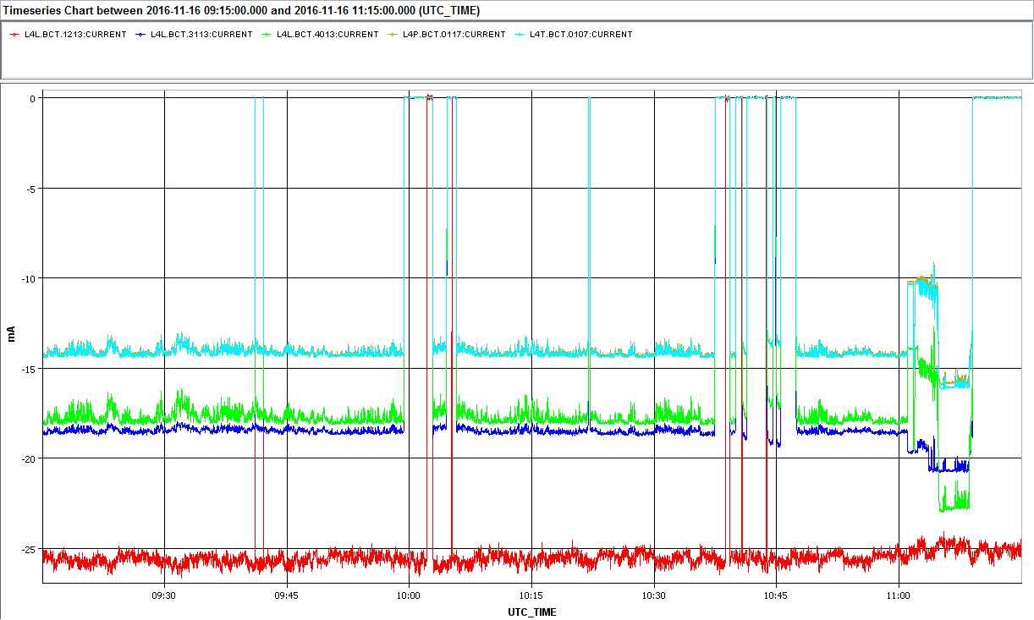
Beam CURRENT
160 Mev
3 MeV
45 keV
matching and steering
Source emittance
RFQ acceptance

Slide 31
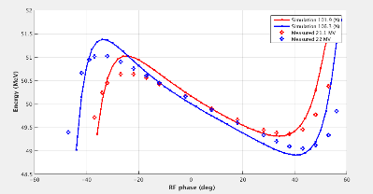
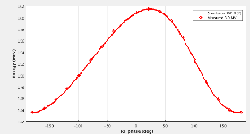
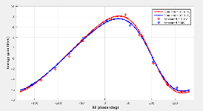
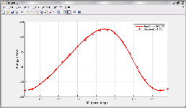
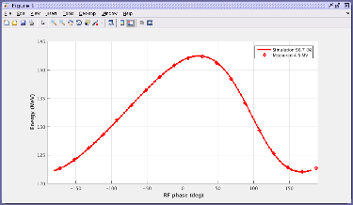
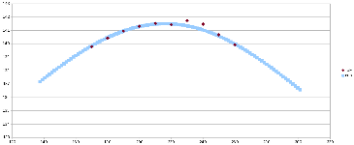

Reaching the final energy
Characteristic curves : energy out of an RF cavity as function of amplitude and phase.
Solid line : simulations,
Dotted : measurements

