Slide 1
CernVM-FS: An Introduction
Lillian Huang
IT-ST-FDO (IT Storage Group Operations Section)
June 30, 2017
Notes:
CVMFS: CERN Virtual Machine File System—a storage place for physics to store software written (including deal with version releases), hold data, etc. This was developed at CERN so people can efficiently store files without needless duplication and to more quickly access the software or data needed. CVMFS is the tool by which physics software is distributed over the Worldwide LHC Computing Grid (WLCG).

Slide 2
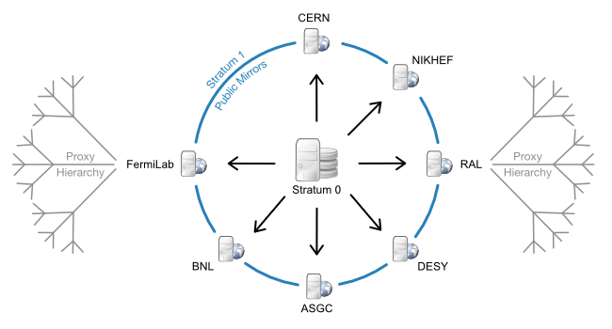
The CVMFS Infrastructure
Notes:
Some background:
-this is what the architecture of CVMFS looks like. The center of everything is Stratum 0, which stores everything in repositories, and also handles making changes to the files stored there with virtual machines called release managers. Basically, CVMFS is normally completely read-only, since the vast majority of people only want to access/use the stuff stored there, not necessarily change them. For the few people who do want to make changes, they use the release managers to write changes to the repository and then publish them to Stratum 0, where it can then be accessed by any client. Stratum 0 and Stratum 1 re-synchronize (update) every hour. Stratum 1, the next layer, provides a number of web servers for clients, and who have a failsafe so that if the one you try to connect to fails, it redirects you to another one. Then we have the proxy hierarchy, which have caches on them in order to make retrieving files from the file system faster and easier.

Slide 3
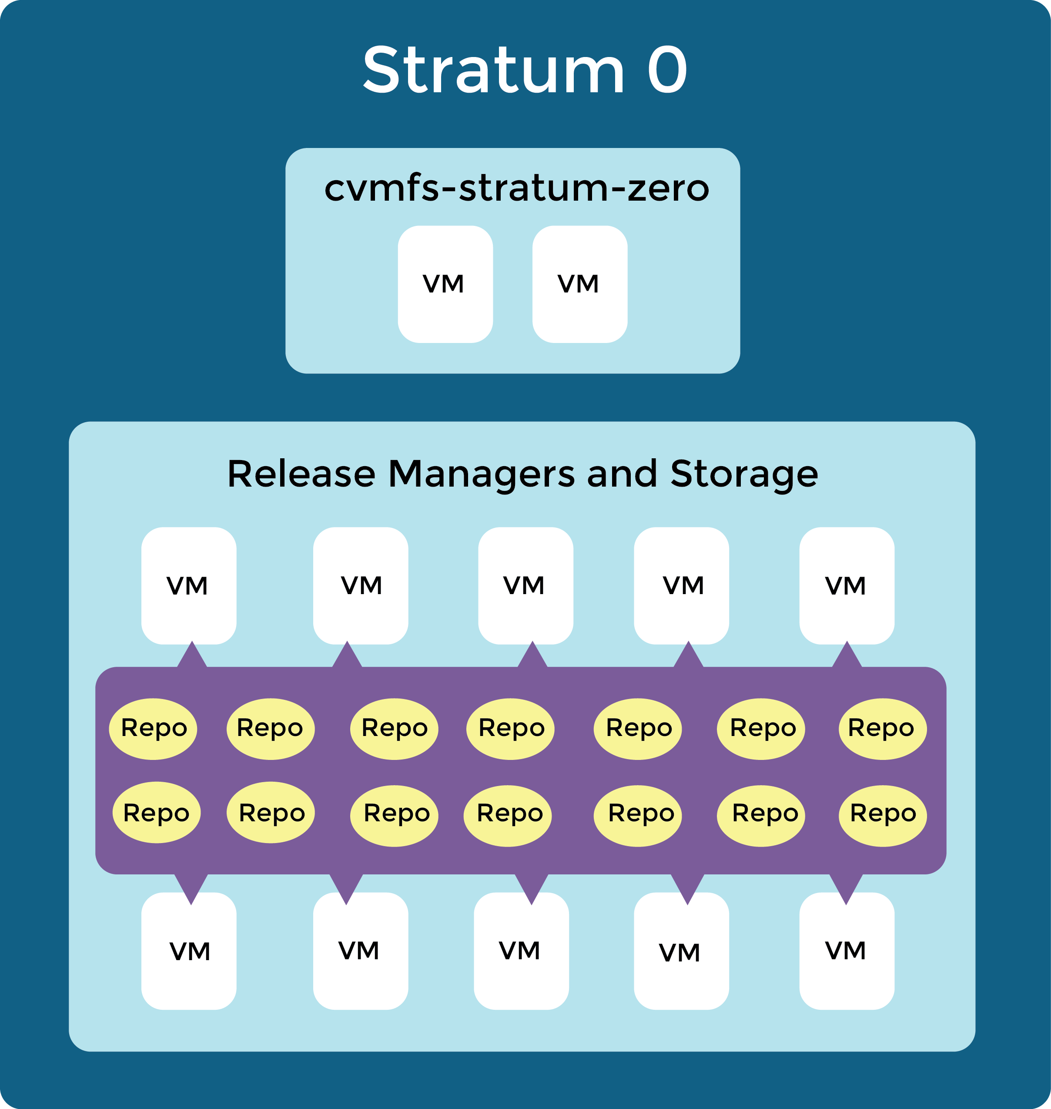
Stratum 0 Infrastructure
Notes:
I’m working with Stratum 0, which currently looks like this. There are a number of virtual machines that have attached storage in various repositories and that also work as release managers.
The cvmfs-stratum-zero VMs are transparent reverse proxy servers. These are more for the actual acquisition of files stored on CVMFS and are not important to my project but if you want to know what they do you can ask.
Basically there is one actual server that runs the Apache webserver. When clients ask for some file, they ask one of these cvmfs-stratum-zero VMs for it, and that machine will ask the real server for it. Then it gives it back to the client. There are a bunch of VMs that can do this, so if one of them crashes or is overloaded, then it will automatically switch to another one.

Slide 4
Current Concerns
Stratum 0 is currently a single point of failure
Virtual machines at Stratum 0 sit idly, taking up space
Notes:
Stratum 0 = single point of failure—it’s not that bad because we still do have the caches, but when Stratum 0 and 1 try to synchronize, that will cause issues. So we want to fix that.
VM problem = Most of the time, people aren’t actually interacting with the VMs at Stratum 0—only when people want to write changes to a repo, which isn’t that often. So the VMs are basically useless most of the time and also take up a bunch of room. Want to fix this too.

Slide 5

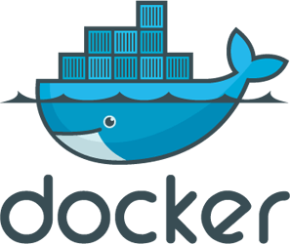
Goals for the Summer
Move repositories to cloud storage using CERN’s S3 cluster
Use Docker containers as release managers instead of virtual machines
Notes:
To fix single point of failure issue, make storage more redundant by putting it on cloud storage. We have the S3 (simple storage service) protocol at our disposal, which is a cloud storage protocol originally invented by Amazon. It’s hosted here at CERN’s IT department, using Ceph, which is a free-software storage platform that can implement object storage on a computer cluster (all of these things are ultimately just tools). So, we have all of these available already; it just comes to “hooking it up” properly.
You can host your S3 storage system at Amazon Web Services, but we don’t cuz we cool like that
To fix idle VM problem, we want to use Docker containers instead of VMs. VMs are, functionally, entire computers that run inside a bigger host machine. They can basically run a whole separate operating system and have their own kernel (a kernel is a program that basically tells a computer’s operating system what to do; controls CPU, memory, input/output, etc. and connects applications to the computer’s hardware). A container has similar functionality, but the main difference is that it doesn’t have its own kernel and it has way lower overhead than VMs, so you could fit more containers in a host than VMs. Also, they can be saved as images, which basically are a template for a potential container, and thus can be launched whenever you need them and then removed when you’re done using them. So, they’d only exist and take up resources in those relatively rare times we want to use them, instead of running all the time like the VMs currently do. So of course they’re better for our purposes than VMs and would fix the idle VM/take up space issue.
More container facts: it’s an abstract data type that basically limits access to just inside that container, so a container can’t access anything outside of itself on the host machine. The way we use them is basically the same as how we want to use VMs but there is some functionality VMs have that containers don’t.

Slide 6
3-Week Progress
Figuring out the current release manager system; become acquainted with Docker images and containers
Created test container to have functionality of current release manager VMs, and test repos in S3 storage that can be written to from the test release manager container
Begin to write performance tests on this new system to compare with the old
Notes:
Pretty self-explanatory?

Slide 7

Source: https://imgflip.com/memegenerator/One-Does-Not-Simply
Notes:
heh

