Slide 1
FCC and Higgs Invisible decays (VBF)
Ella King

Slide 2
Presentation OUTLINE
What is vector boson fusion?
What is a Higgs invisible decay?
How can the FCC help detect Higgs invisible decays?
My project

Slide 3
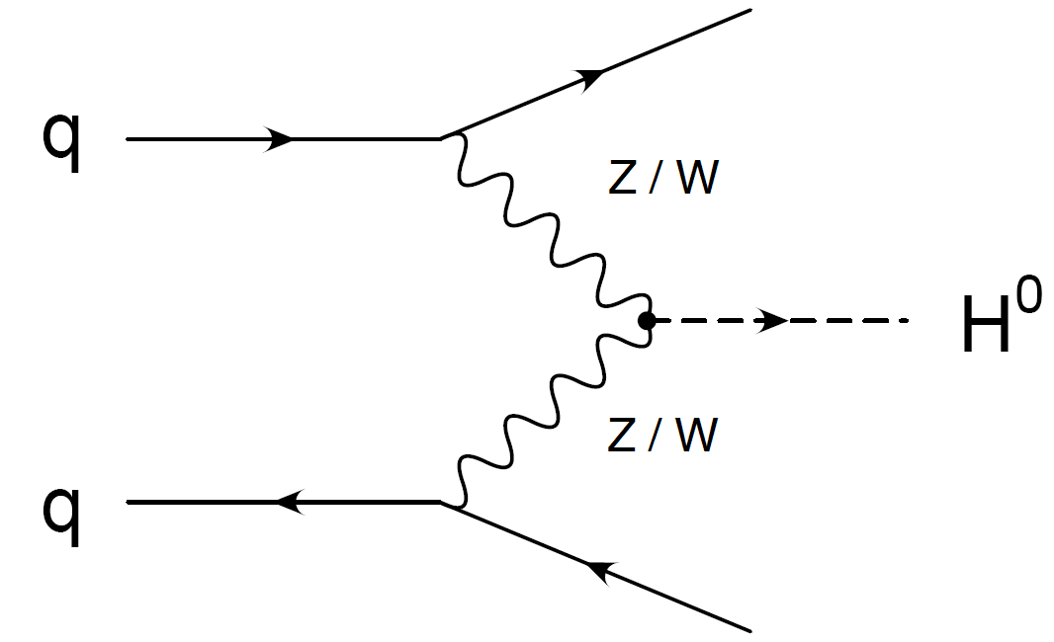
Vector Boson Fusion
Higgs production via VBF (vector boson fusion)

Slide 4
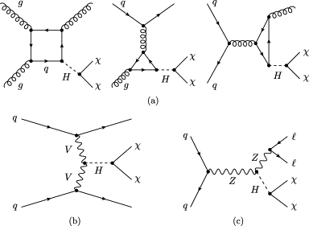
Higgs Invisible Decays

Slide 5
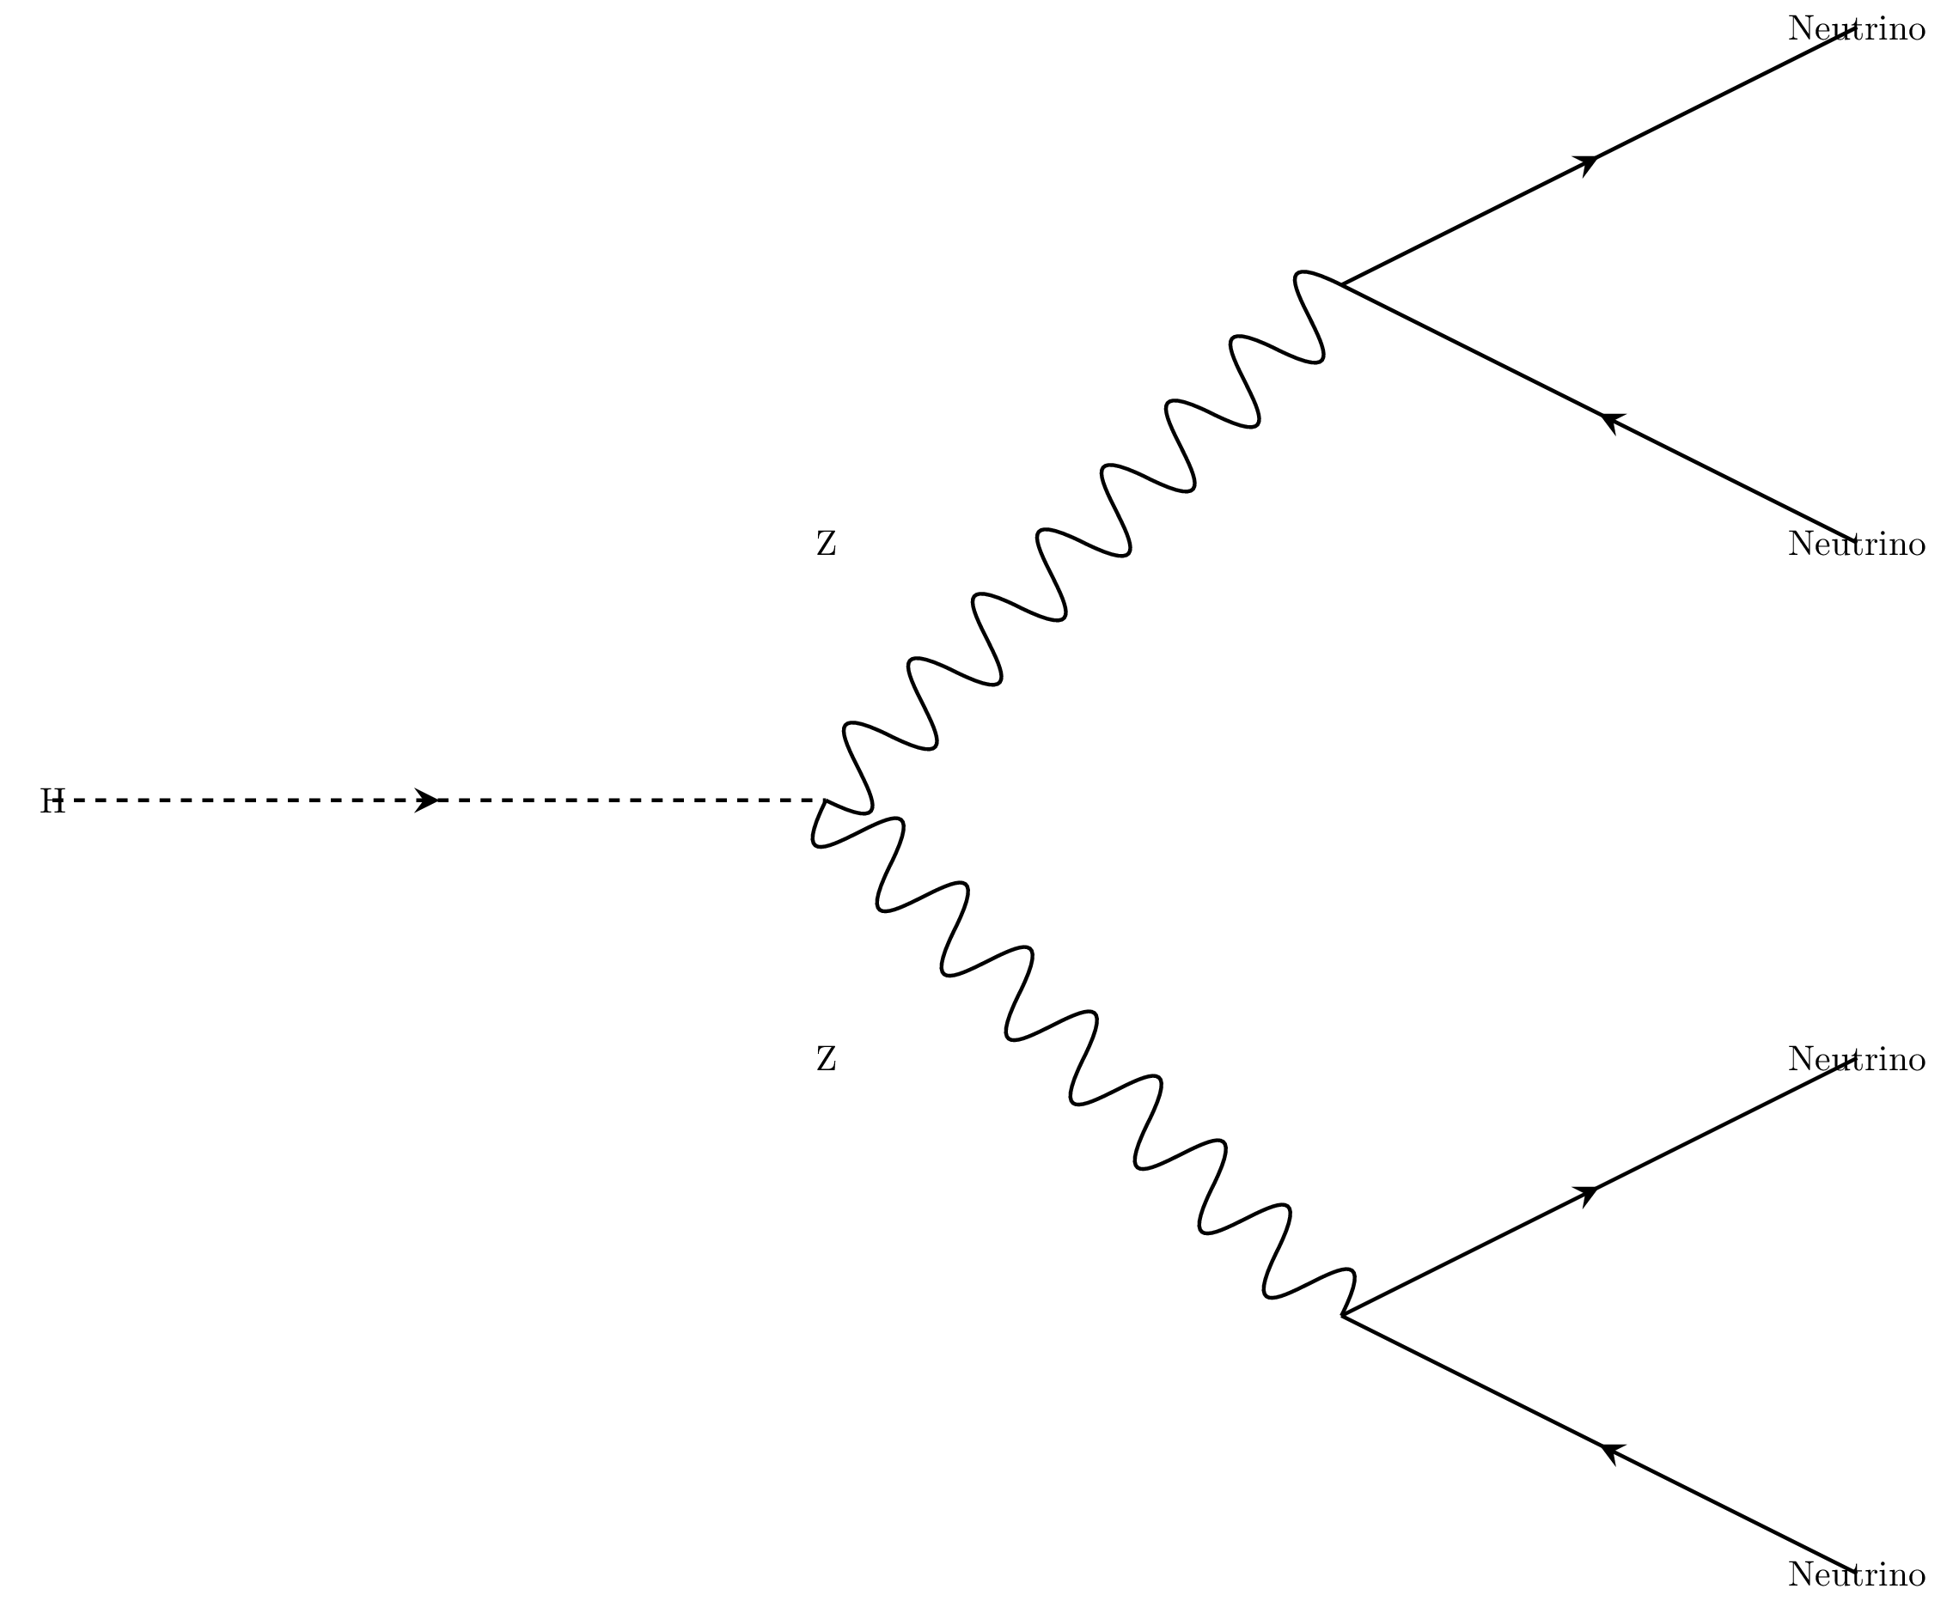
How can the FCC help?
Standard model already predicts an invisible decay (Z to neutrinos)
FCC explores regions parameter space in which deviations from the predicted rates of decay become apparent

Slide 6
MY Project
How sensitive will the Future Circular Collider (FCC) be to Higgs decays to dark matter via VBF?
GENERAL OUTLINE:
  Model the data from Higgs invisible decays (signal and background) at ~100 TeV energies
  Identify and detect the main background events
  Eliminate as many background events as possible
  Determine best sensitivity to signal amid remaining background events

Slide 7
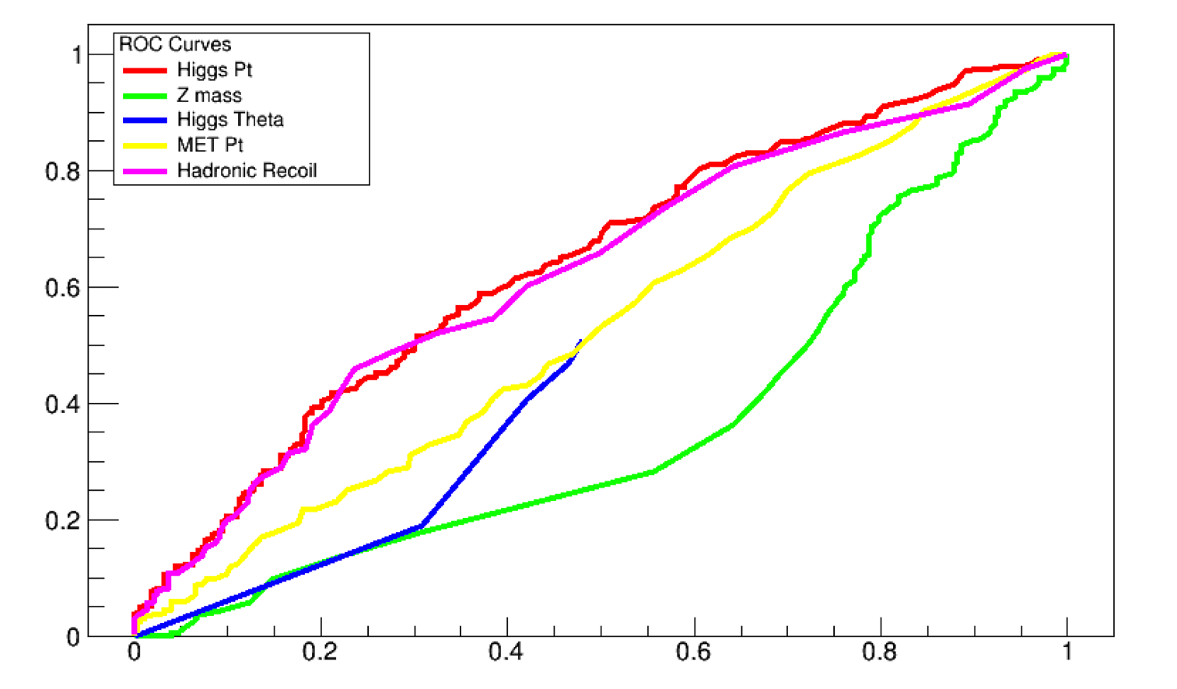
Current Progress
  Using simulated data, can now:
  remove the H >> Z background
  Remove H >> W background events
  Quantify signal strength against background
ROC Curves for H >> ZZ >> 4l
  Use to compute Gini index (measure of how well signal stands out against background)

Slide 8
Next Steps
With the vector boson fusion samples:
Identify the three main background events:
  Z to neutrinos (done)
  W to undetected lepton + neutrino (done for detected lepton)
  T-Tbar to Ws
Maximize signal strength against background
  ROC plots to determine the best variables (e.g. pt, eta, etc) to distinguish signal from background
  Use neural network to conclusively find the best combination of variables to distinguish signal from background

Slide 9
Questions?

