Slide 1
Muon Beam Studies in the H4 beam line and the Gamma Irradiation Facility (GIF++)
Rachel Margraf
Supervisor: Nikolaos Charitonidis
Goliath Field Mapping performed in collaboration with:
Nikos Charitonidis & Yiota Chatzidaki (EN-EA-LE)
EP/DT magnet group (Felix Bergsma & Pierre-Ange Giudici‎),
Henric Wilkens and the kind support of RD51 Collaboration (Eraldo Oliveri & Yorgos Tsipolitis) and GIF++.
Field mapping interpolation script written by Marcel Rosenthal

Slide 2
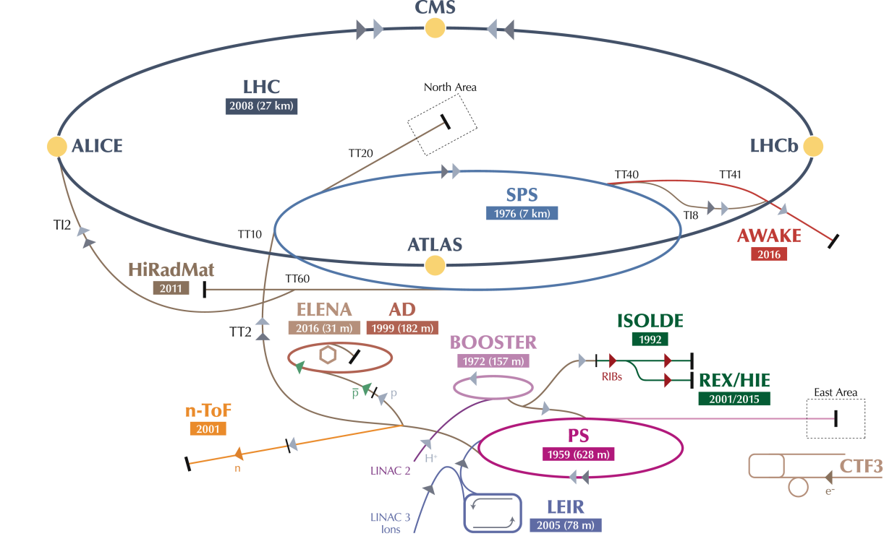
H4 Beam Line
Protons extracted from the SPS are incident on a target to form secondary beam lines of a variety of particles
The H4 beam line in the North Area supplies GIF++ with charged particles

Slide 3
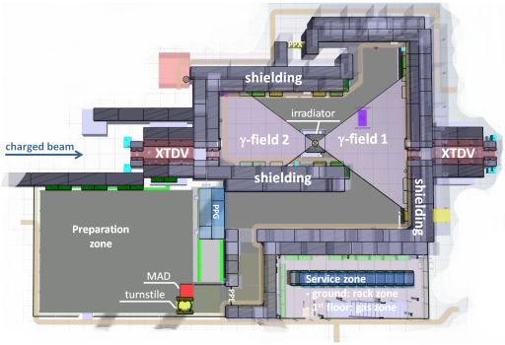
GIF++
CERN’s Gamma Irradiation Facility
  Supplies users with a mixed field of charged particle beams and gamma photons
  For this project, we are interested in supplying GIF++ with a muon beam
Notes:
Mixed beam realistic for conditions equipment will experience in underground experiments such as Atlas and CMS

Slide 4
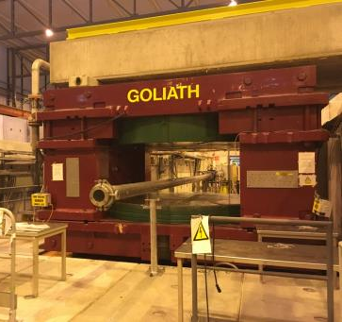
Sharing a Muon Beam
Upstream GIF++ is a large dipole magnet, “GOLIATH”
This magnet is used by experiments such as RD51 to test equipment in conditions of strong magnetic fields and charged particle beams
Muons still reach GIF++ after passing through the magnet, however, their trajectory is bent
Goal: determine muon trajectory so that GIF++ users can continue to receive muons while Goliath is on

Slide 5
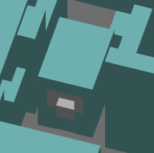
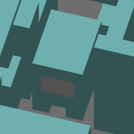
Modeling the H4 Beam Line - Steps
Model shielding upstream GIF++ Hall using G4beamline software
Simulate exact muon beam position under several different conditions:
  GOLIATH at -1.5,-1, 0, 1, 1.5T
  XTDV Dumps open/closed
Measure the magnetic field map for Goliath and refine simulations using this map
XTDV beam dumps modeled in “open” (left) and “closed” (right) configurations

Slide 6
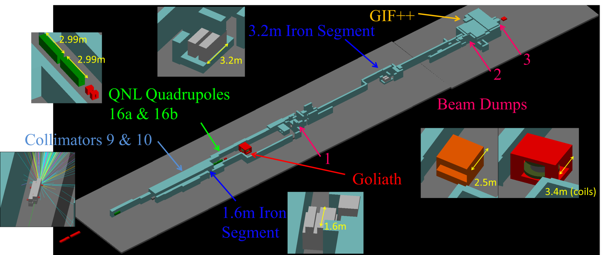
G4beamline Model of H4 Beam Line

Slide 7
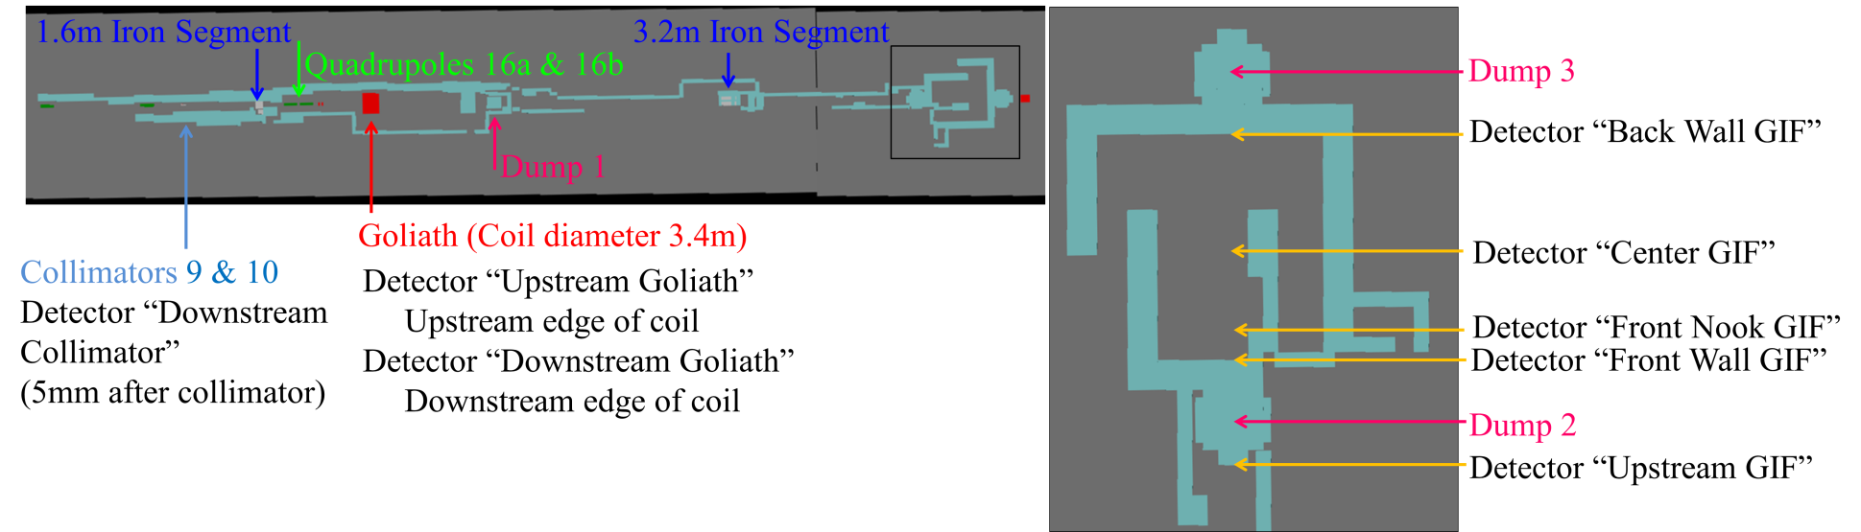
Analysis Points
x
z
y
z
x
y

Slide 8
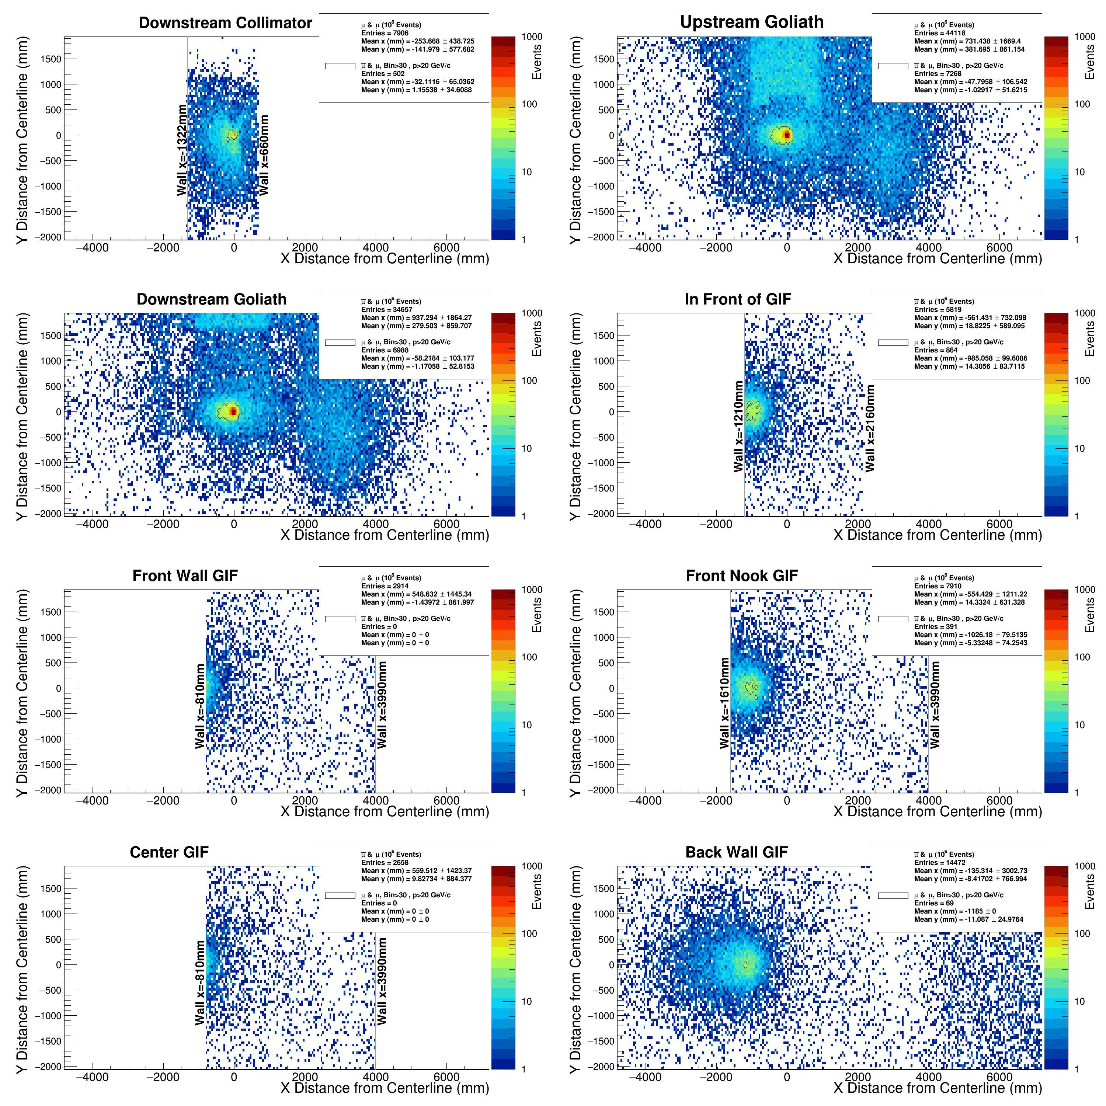
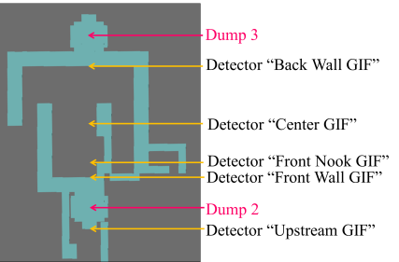

Analyzing Simulation in ROOT (1.5T)
(Pure Pions on collimator)
-1185mm
For the 1.5T setting of Goliath, muon beam passes through the right wall of GIF++
Notes:
Tell audience to note that positive x is defined to the left. This simulation is for both dumps closed without the additional 1.6m of iron.

Slide 9
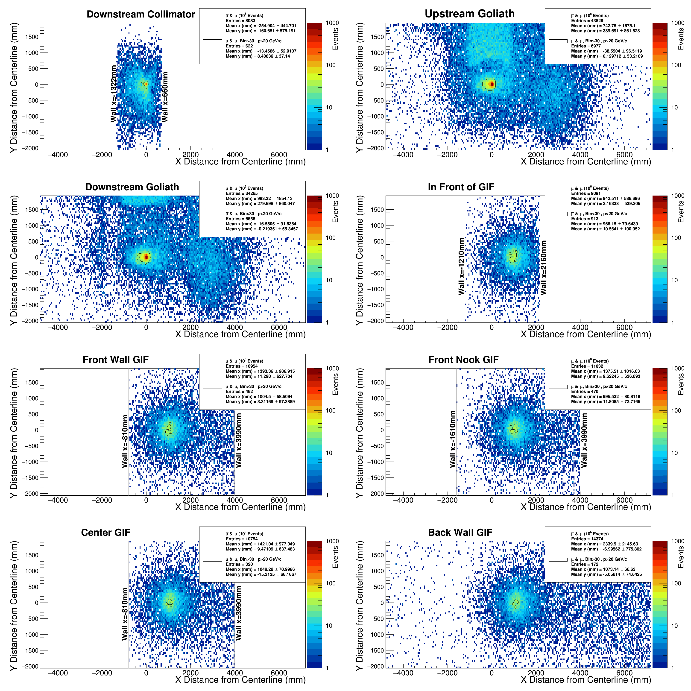
Analyzing Simulation in ROOT (-1.5T)
(70% Pions on collimator)
1073mm
For the -1.5T setting of Goliath, muon beam is deflected to the left, away from the wall
Notes:
Tell audience to note that positive x is defined to the left. This simulation is for both dumps closed without the additional 1.6m of iron.

Slide 10
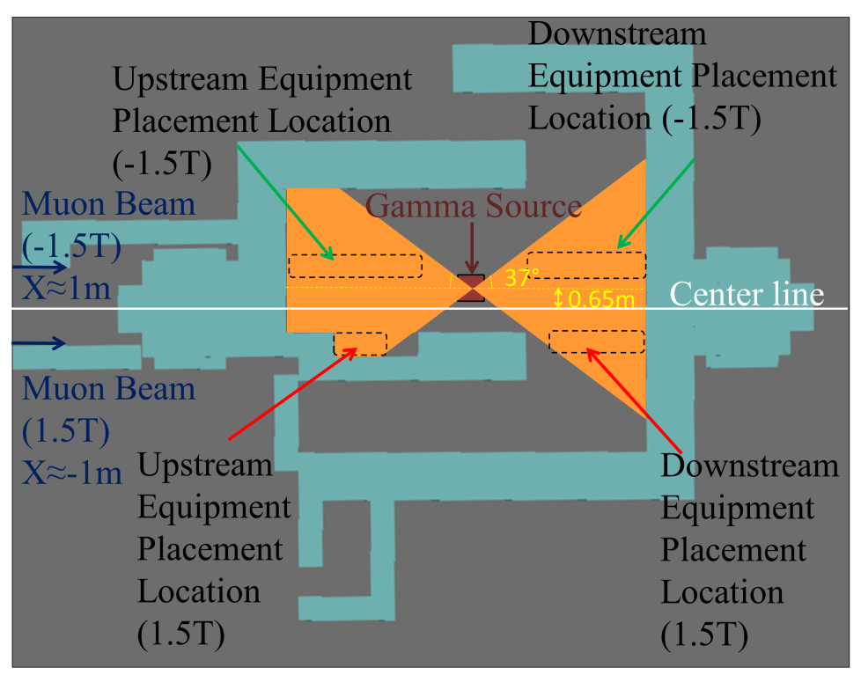
Locations with Usable Beam
With these simulations, we can advise GIF++ users on where to place their equipment to receive muons and gamma photons while Goliath is on

Slide 11
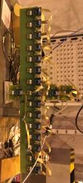
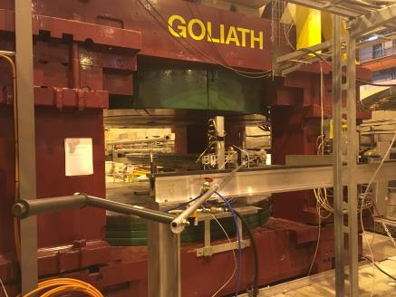
Mapping of Goliath
To refine these and future simulations, need up to date magnetic field map of Goliath
I spent several days working with a team to measure the magnetic field of Goliath (July 4-6, Aug 2-4)
y
z
y
y
z
x

Slide 12
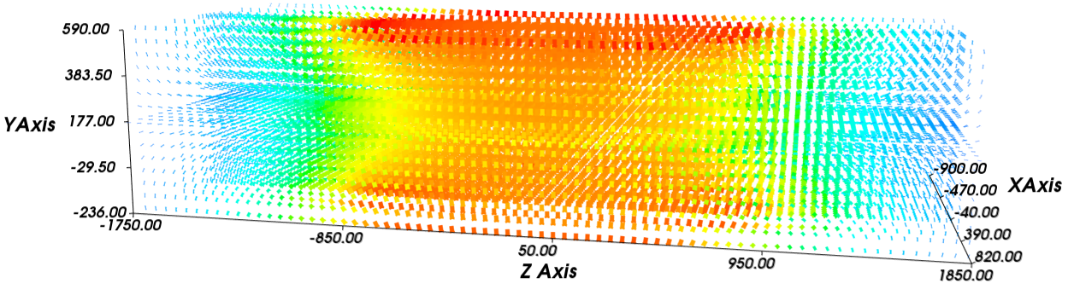
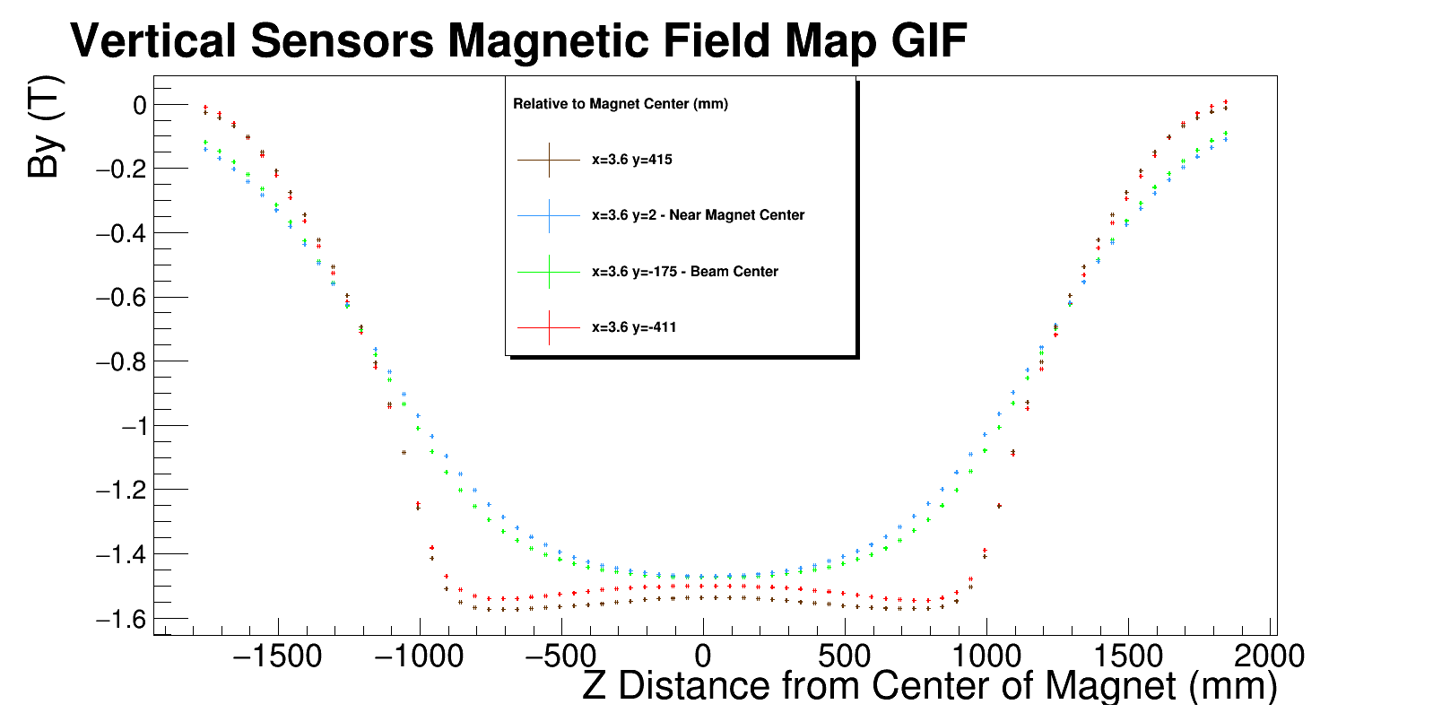
Field Maps
I constructed ROOT macros to plot our field measurements, and utilized Mayavi and Matplotlib Python packages to produce vector plots of our field map
(1.5T Design Setting)

Slide 13
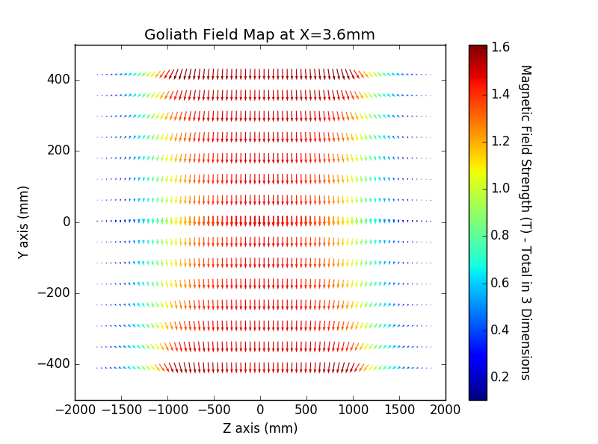
Final Remarks
Last step is to incorporate the field map of Goliath into the G4beamline simulation
These simulations will allow GIF++ users to place their equipment correctly in the muon beam while Goliath is on
  Allows users of Goliath and GIF++ to share a muon beam on the H4 beam line
Future analysis could also examine additional steering of the muon beam by placing another dipole downstream Goliath

Slide 14
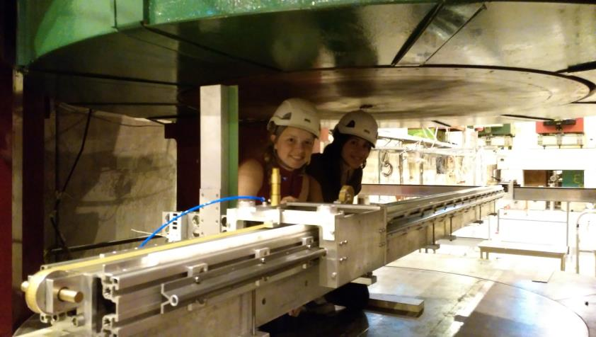
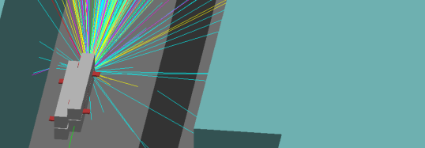
Questions?
GIF++
x
z
y
z
x
y
Special thanks to the UM-CERN REU program, funded by the National Science Foundation, for making this experience possible!

Slide 15
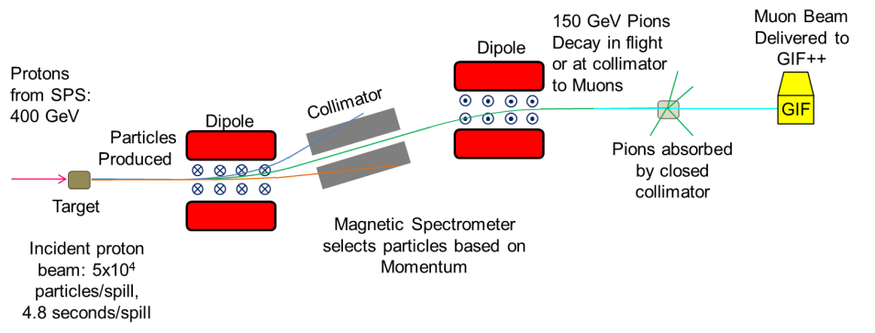
Producing a Muon Beam

