Slide 1
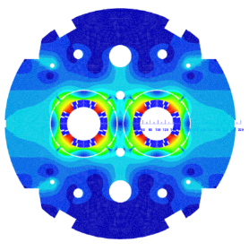

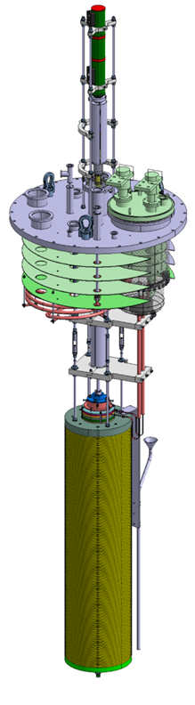
MQYYM magnetic MEASUREMENT
MQYYM
magnetic measurements
TECHNICAL REVIEW
Damien Simon for the MQYYM team
CEA: H. Felice, D. Simon, J.M. Gheller, D. Bouziat, A. Madur, M. Segreti, J.M. Rifflet, S. Somsom, R. Machado-Correia
CERN: L. Fiscarelli, O. Dunkel, A Foussat, J.C. Perez, E. Todesco, P. Viret

Slide 2
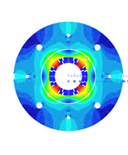
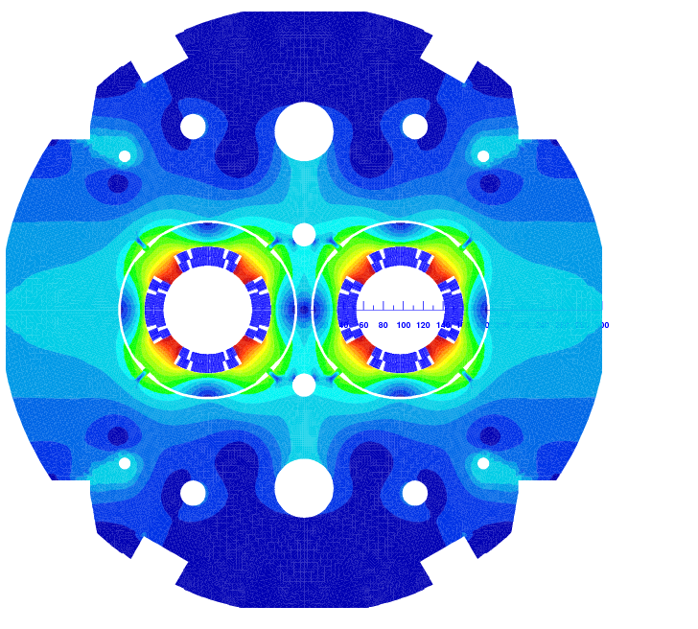
INtroduction
The MQYY project:
  Collaboration CERN-CEA for the HL-LHC
  Design of the MQYY a double aperture cos(2θ) Nb-Ti matching section magnet
  Fabrication and test of the MQYYM single aperture magnet short model of the MQYY magnet
  Fabrication of the MQYYM coils at CEA
  Assembly and warm magnetic measurements at CERN: CEA team supported by CERN team
  Cold magnetic measurements at CEA: CEA team (with hopefully some CERN support…)
The MQYY
The MQYYM

Slide 3
Introduction to the MQYYM magnet
THE MQYYM QUADRUPOLE
Aperture | 90 mm
Nominal gradient | 120 T/m
Nominal Current | 4590 A
110% Nominal Current | 5049 A
Short Sample Current | 5997 A
Harmonics | B_{3,6,10} < 1 unit B₁₄ < 1,5 units
Reference radius | R_{ref} = 30 mm
Margin on the loadline | 23,4 %
MQYYM coil physical length | L = 1350 mm
MQYYM magnetic length | L = 1204 mm at 1,9 K

Slide 4
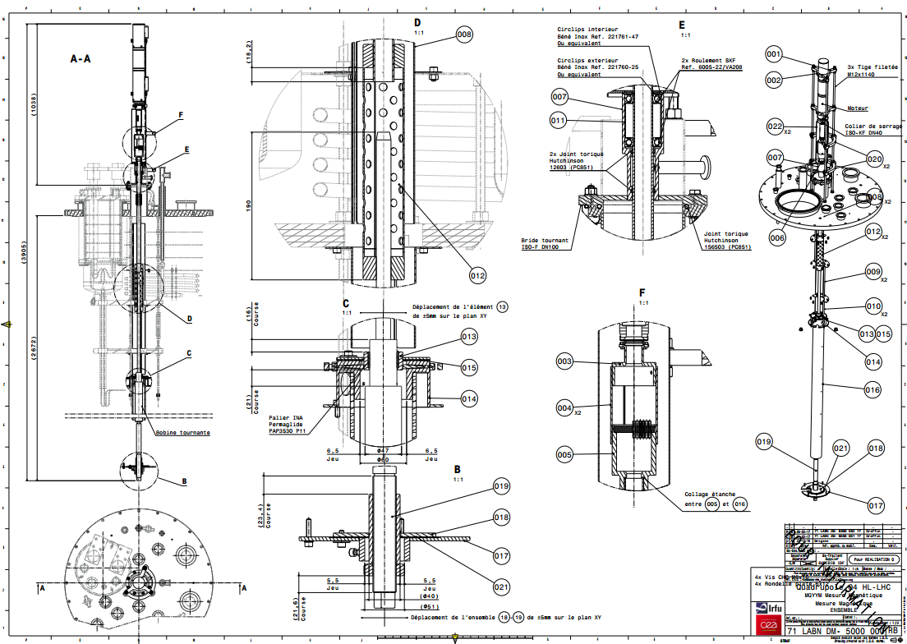
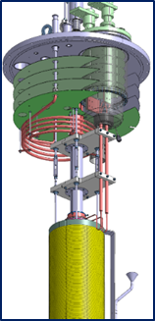
Goal of the review
Main goal of the review: To validate the design before the call for tenders
How to get there?
  Presentation of the CEA adaptation design for the magnetic measurements
  Discussion on the CEA test facilities (Acquisition system, software and hardware of the test facility)
  Discussion on the CERN equipment necessary for the measurements
  Preliminary schedule of the tests preparation magnetic tests

Slide 5
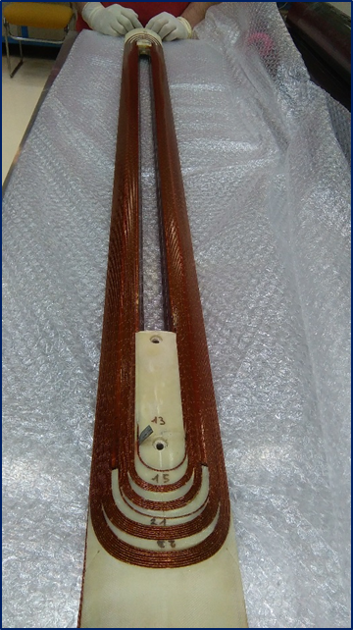
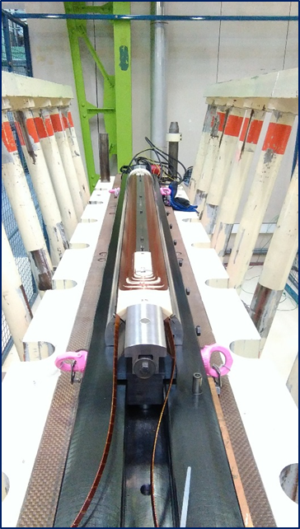
Agenda of the review
09h00-11h30: Presentation of the magnetic measurements system at cold for the MQYYM tests and review of the drawings
11h30-12h00: Discussion on warm magnetic measurement
12h00-13h30: Lunch break
13h30-13h45: Visit of the CEA winding facility and presentation of the MQYYM Coil 0
13h45-15h00: Visit of the test facility
15h00-16h00: Planning and conclusion

Slide 6
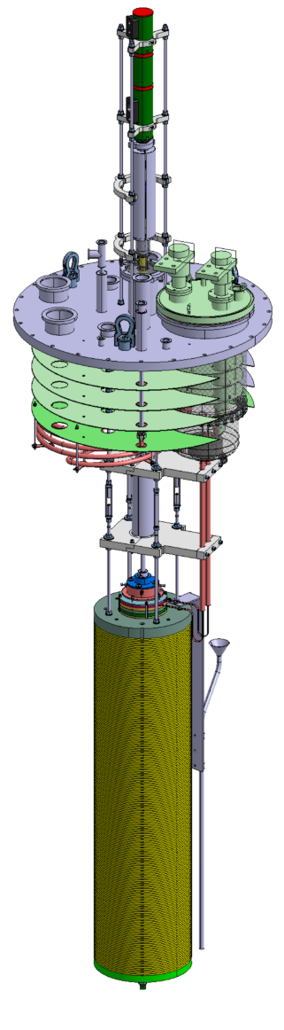
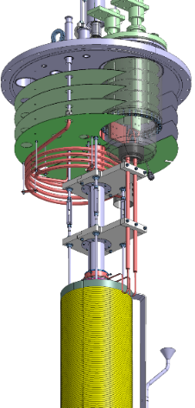
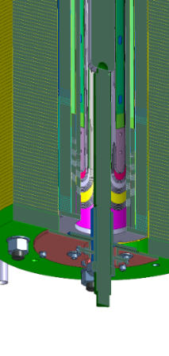
PRESENTATION of of MQYYM TEST
Test of MQYYM in the vertical cryostat at Saclay:
  8m cryostat equipped with a 3 m long « sock » (tank)
  Saturated LHe bath at 1,9 K 23 mbar
    Main difference with the CERN system
    Importance to seal the system for test at CEA
  Adaptation of an existing top plate
  Parts manufactured and received in Saclay in May
MQYYM Magnetic measurements
  Cold system identified (Probe LHCMMWEC0209 with a diameter of 47 mm and an effective length of 1180 mm)
  Adaptation of the CERN magnetic system done
  Order has to be placed soon

Slide 7
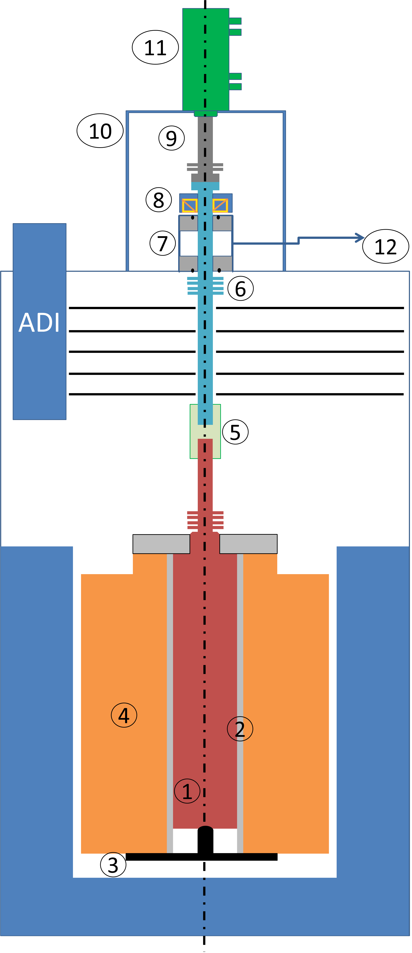
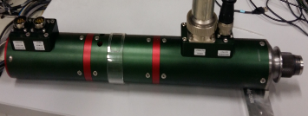
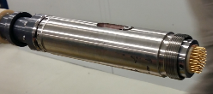
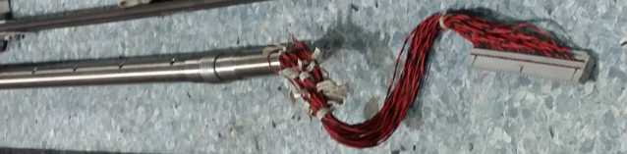
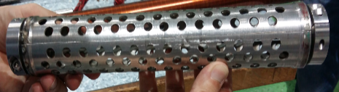
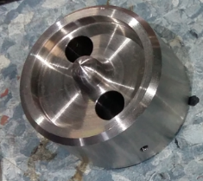
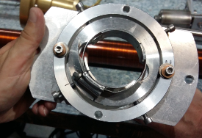
Adaptation Design
Main adaptation to CERN components to do:
1: Rotating Probe (CERN)
2: Protection tube (CEA – CERN)
3: Pin (CEA)
4: MQYYM (CEA)
5: Protection for Electrical connection + Drive shaft (CEA)
6: Drive shaft (CEA)
7: Sealing part (CEA)
8: Rolling bearing (CEA)
9: Adaptation part (CERN)
10: Motor support (CEA)
11: Motor (CERN)
12: Void pump (CEA)

Slide 8
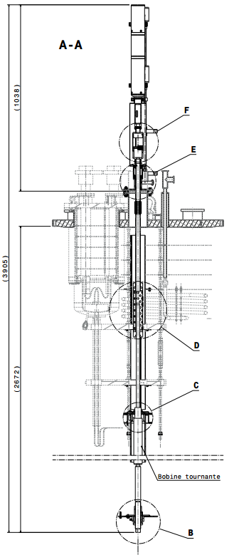
Adaptation Design

Slide 9
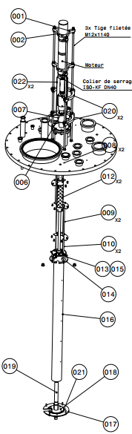
Adaptation Design
21 Parts designed and to be manufactured
5 interface area with the MQYYM magnets or the CERN magnetic mesurements system (rotating coils, motors)
Sealing electrical connections of the rotating coil to the motor (F)
Sealing Part (E)
Protection for Electrical connection + Drive shaft (D)
Centering of the probe in the magnet aperture parts (C)
Maintain of the rotating probe (B)

Slide 10
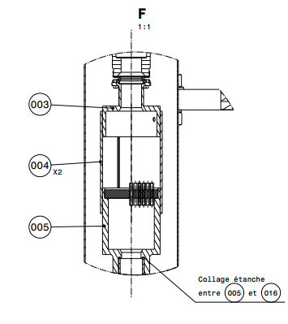
Adaptation Design
Sealing electrical connections of the rotating coil to the motor

Slide 11
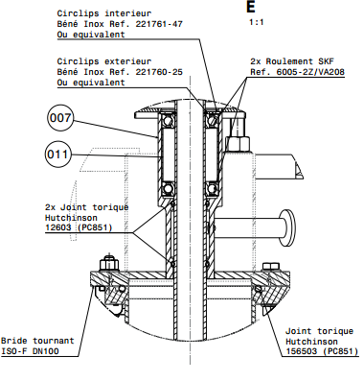
Adaptation Design
Sealing Parts

Slide 12
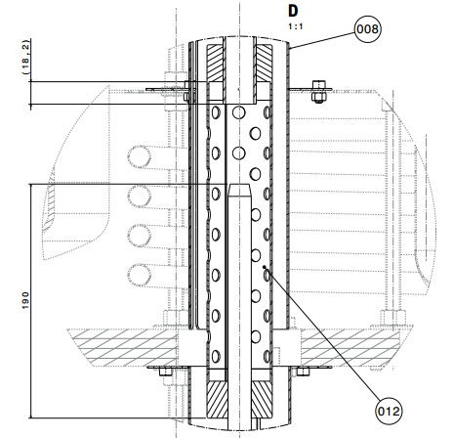
Adaptation Design
Protection for Electrical connection + Drive shaft

Slide 13
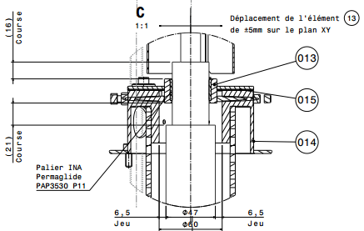
Adaptation Design
Centering of the probe in the magnet aperture parts

Slide 14
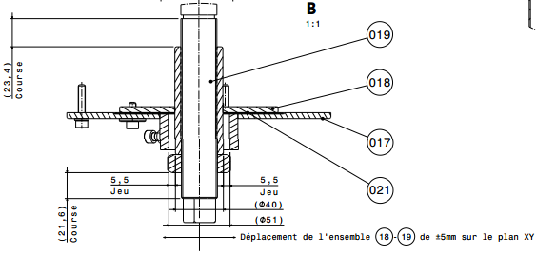
Adaptation Design
Maintain of the rotating probe

Slide 15
Presentation of the CAD
Presentation of the 3D CAD model:
  Presentation of the components
    Presentation of the probe centering technics
    Presentation of the shaft (torsion limitation)
    Presentation of the sealing parts
    Presentation of the probe protection
  Discussion on the connection (acquisition, supra)
  Discussion on the assembly
  Discussion on the cryogenics
Jean-Marc GHELLER, Patrick GRAFFIN, Denis BOUZIAT

Slide 16
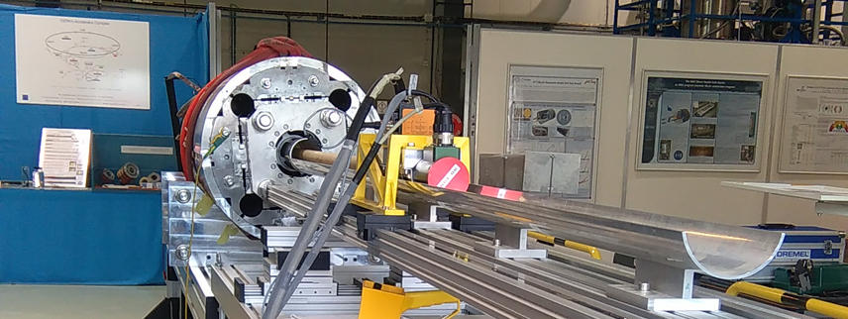
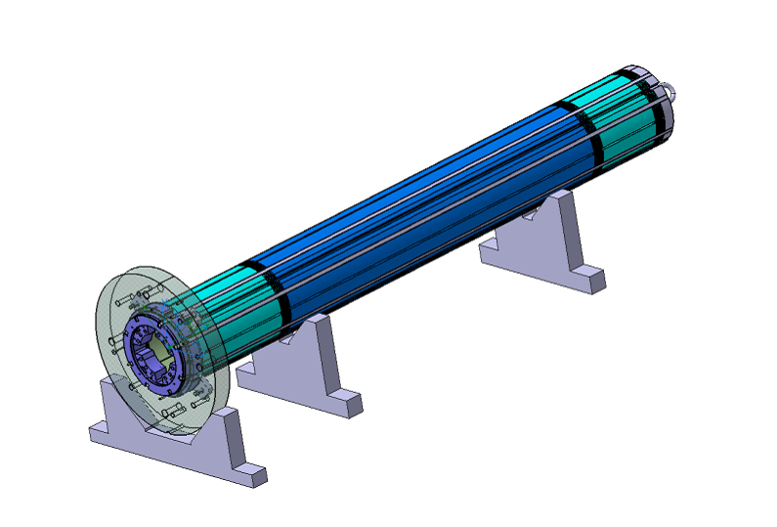
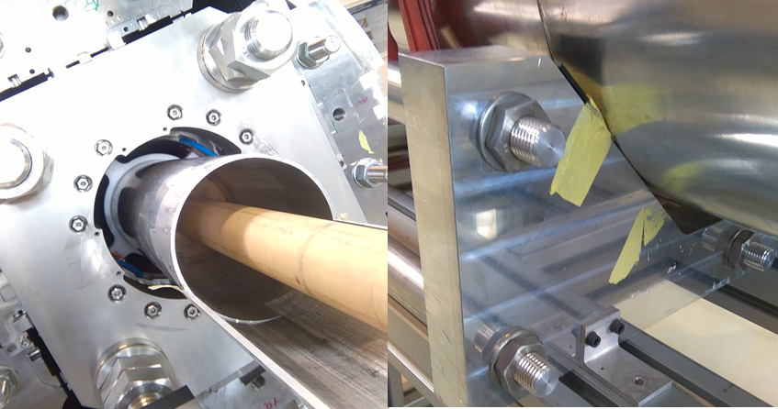
WARM Magnetic measurement
Warm magnetic measurement on 927:
  Assembly of the magnet on 927
  Warm magnetic measurement before and after yoking

Slide 17
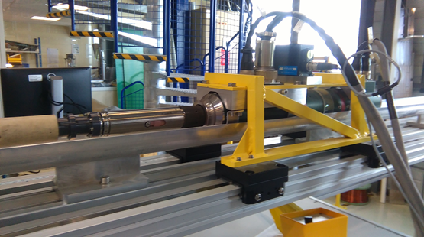
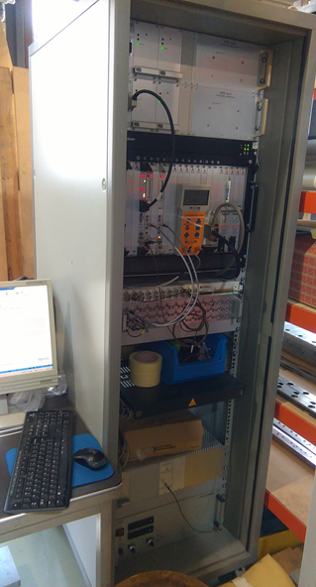
WARM Magnetic measurement
Warm magnetic measurement on 927:
  Assembly of the magnet on 927
  Warm magnetic measurement before and after yoking

Slide 18
Schedule overview
* pending availability of the CERN team. To be discussed with JC Perez and N Bourcey
Warm magnetic measurements: end of 2017
Cold magnetic measurements (incl. prep): T1-T2 2018

