Slide 1
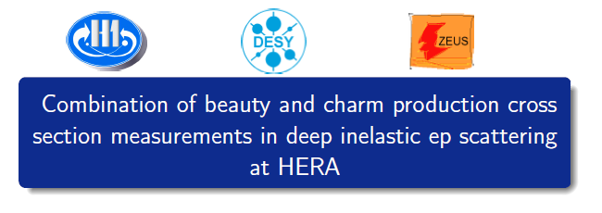

PDF4LHC Sept 2017
A M Cooper-Sarkar
On behalf of H1 and ZEUS collaborations
With special thanks to O Zenaiev and A Geiser
A new combination of charm production data which will supersede
EPJ C73 (2013) 2311
The first (and last) combination of beauty data
Extraction of the running masses m_{c}(m_{c}) and m_{b}(m_{b})

Slide 2
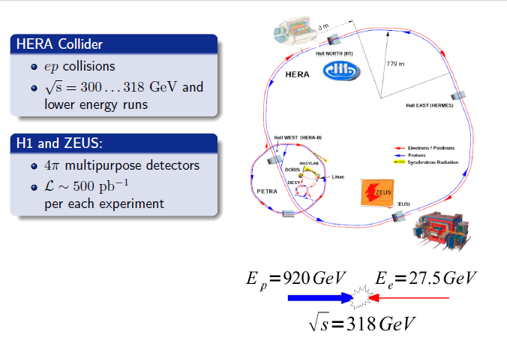

Slide 3
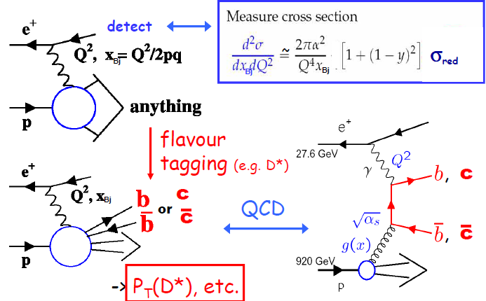

Slide 4
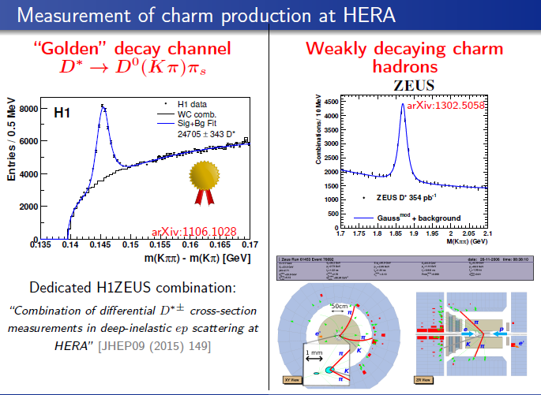

Slide 5
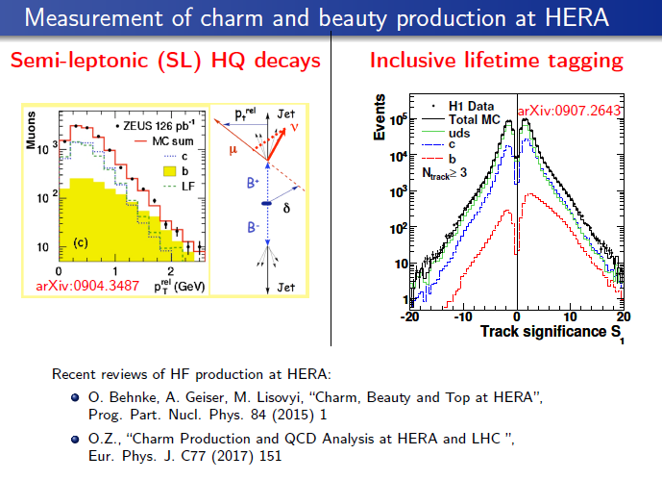

Slide 6
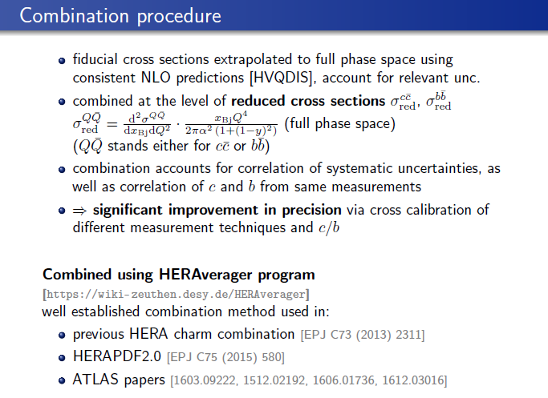

Slide 7
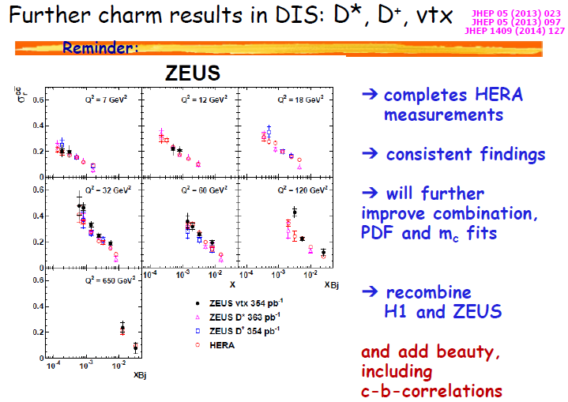
The HERA charm combination data EPJ C73(2013)2311 is used in most modern PDF fits BUT there are now new data sets

Slide 8
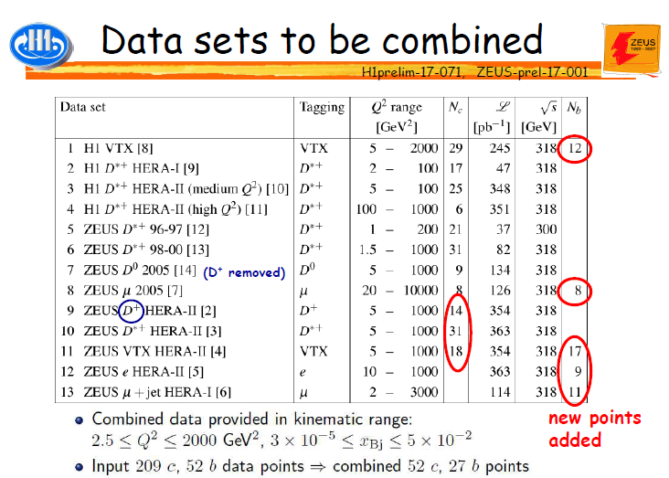

Slide 9


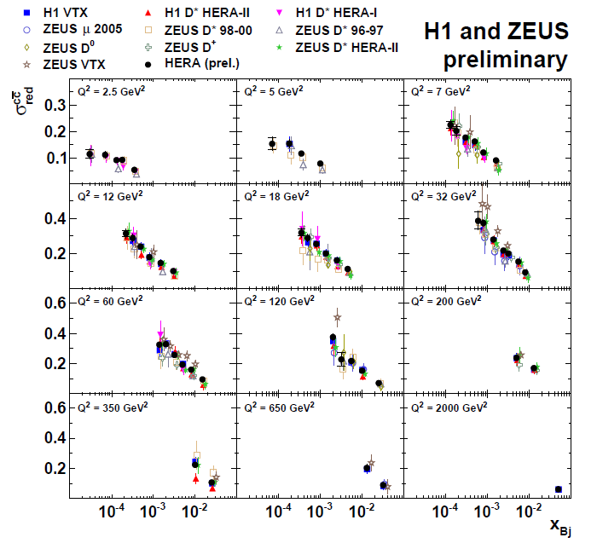
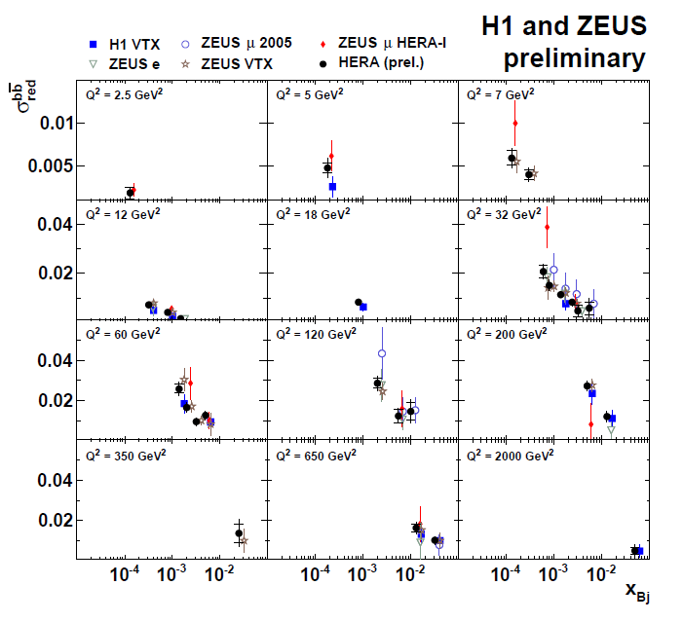

Slide 10
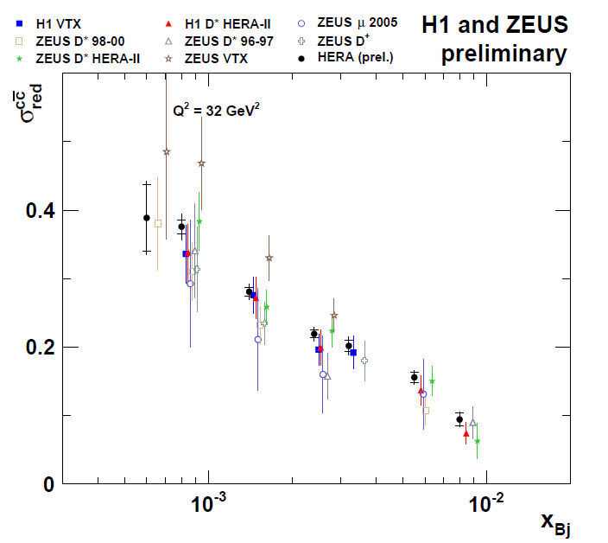
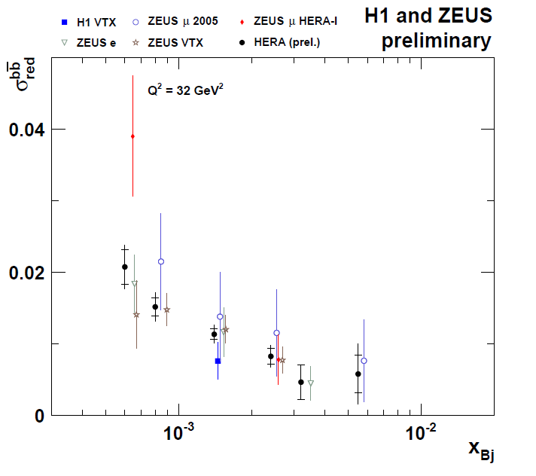
Let’s take a closer look at Q²=32 GeV² so we can really see the power of the combination
Significantly improved precision compared to individual measurements and up to 20% improvement from the previous combination
Significantly improved precision compared to individual measurements. First and final HERA beauty combination.

Slide 11
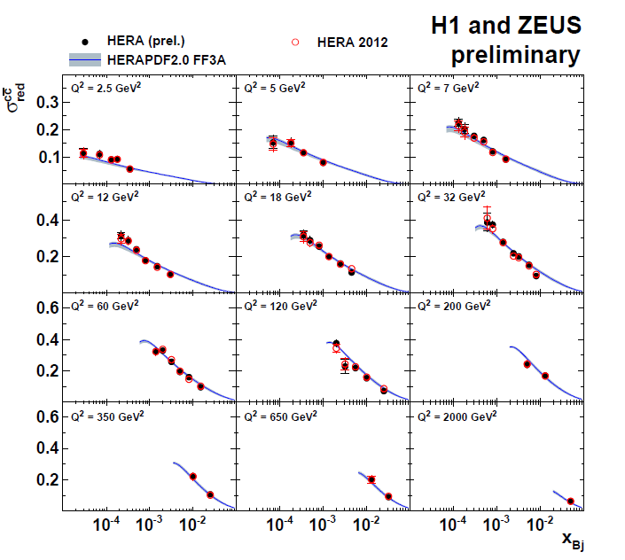
Comparison to previous combination for charm
And comparison to the predictions of HERAPDF2.0 fixed flavour number PDF-
Very similar trends

Slide 12
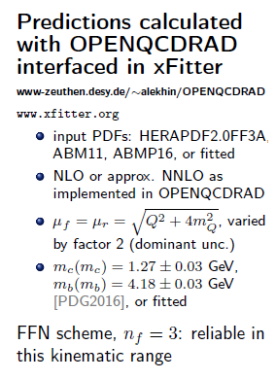
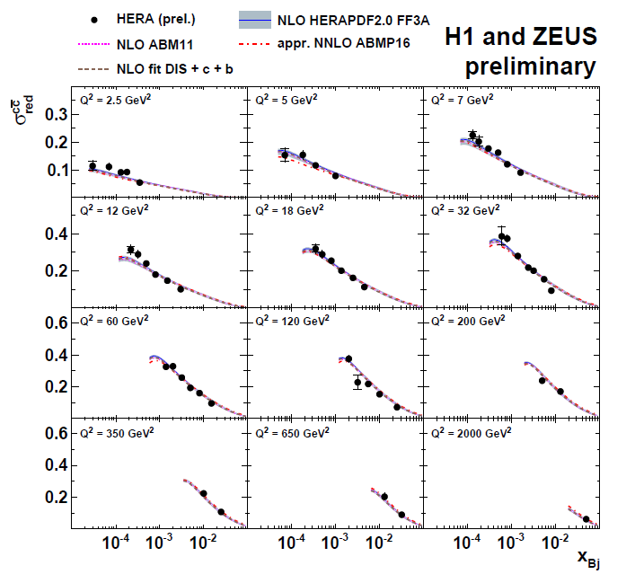
Overall reasonable description, only small sensitivity to different PDFs

Slide 13
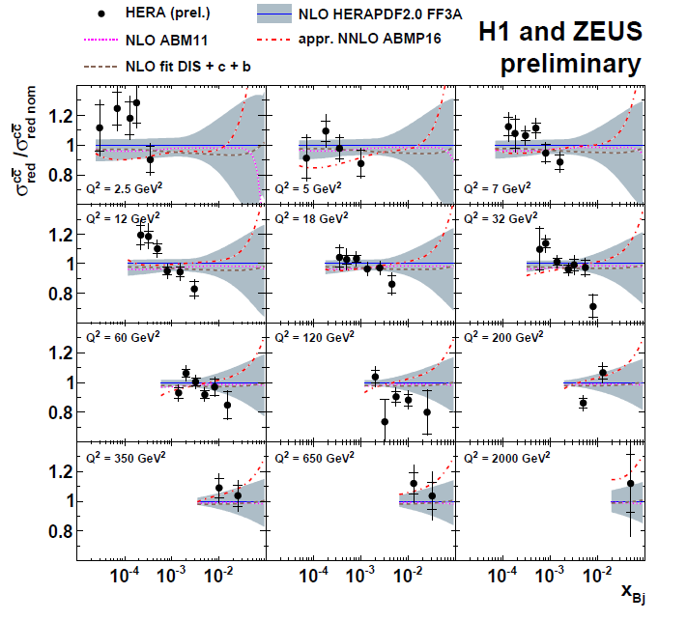
In ratio we can see some shape disagreement at low and medium Q², which is more apparent due to increased precision in the new combination χ2/ndp ~85/52
Approximate NNLO charm treatment does not improve this description

Slide 14

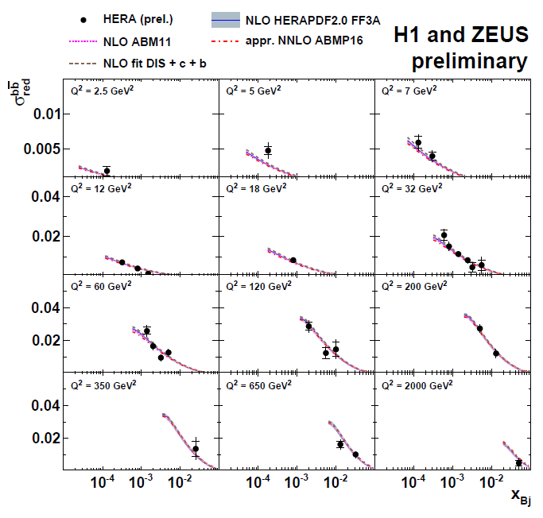
Overall reasonable description, only small sensitivity to different PDFs

Slide 15
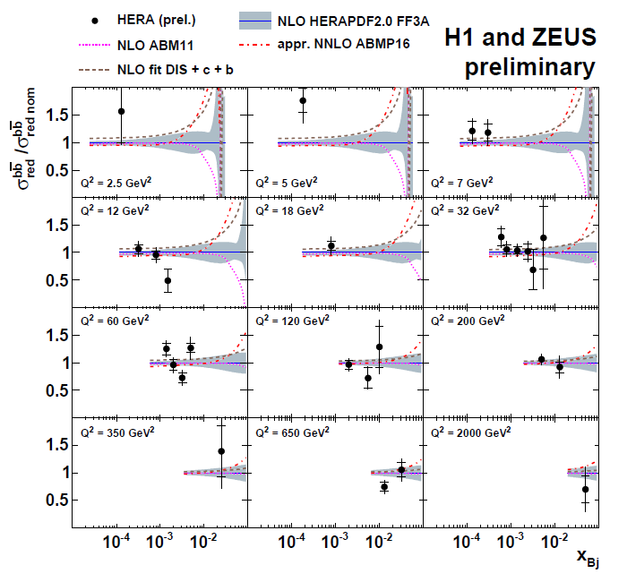
Overall reasonable description, only small sensitivity to different PDFs and to higher order corrections

Slide 16
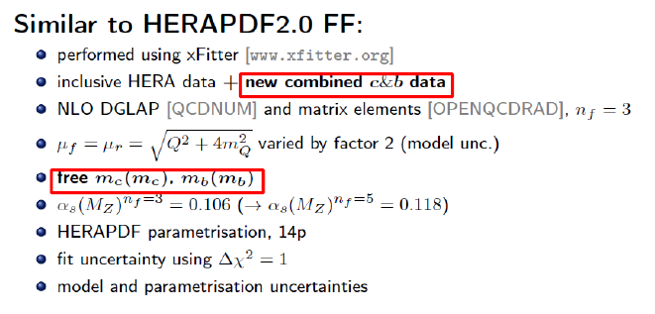
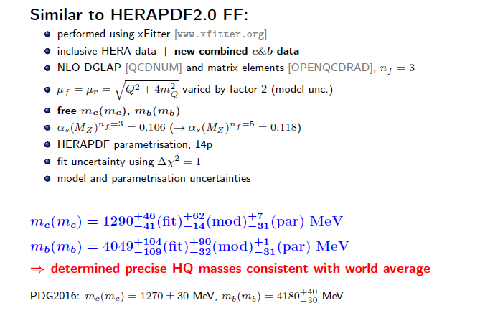

Slide 17
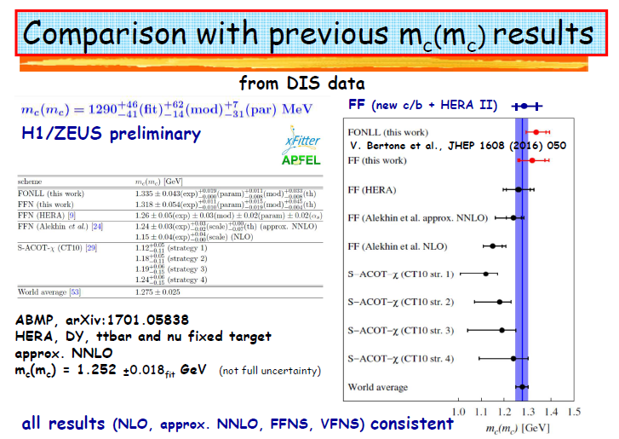

Slide 18
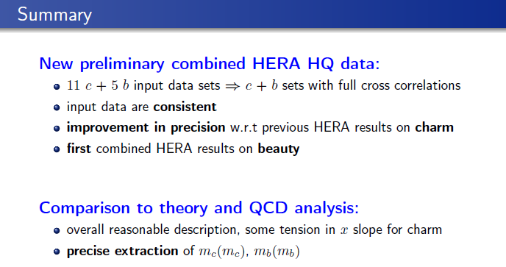


Slide 19
Back-up

Slide 20
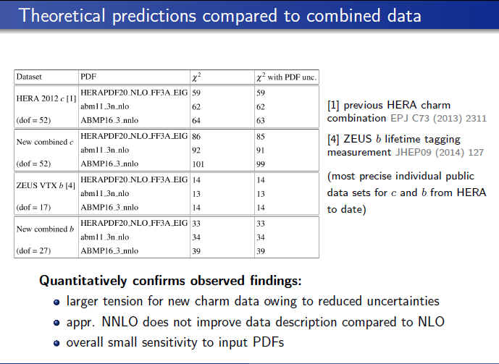

Slide 21
