Slide 1
Authentication and Authorisation for Research and Collaboration
FIM4R Meeting
18-19 Sept, 2017
Montreal

Slide 2




The project
EC-funded project
  AARC (2015-2017),
  AARC2 started in 2017 and will end in 2019
NRENs, research and e-Infrastructure providers as equal partners
  25 Partners in AARC
About 3M euro budget
https://aarc-project.eu/
2

Slide 3
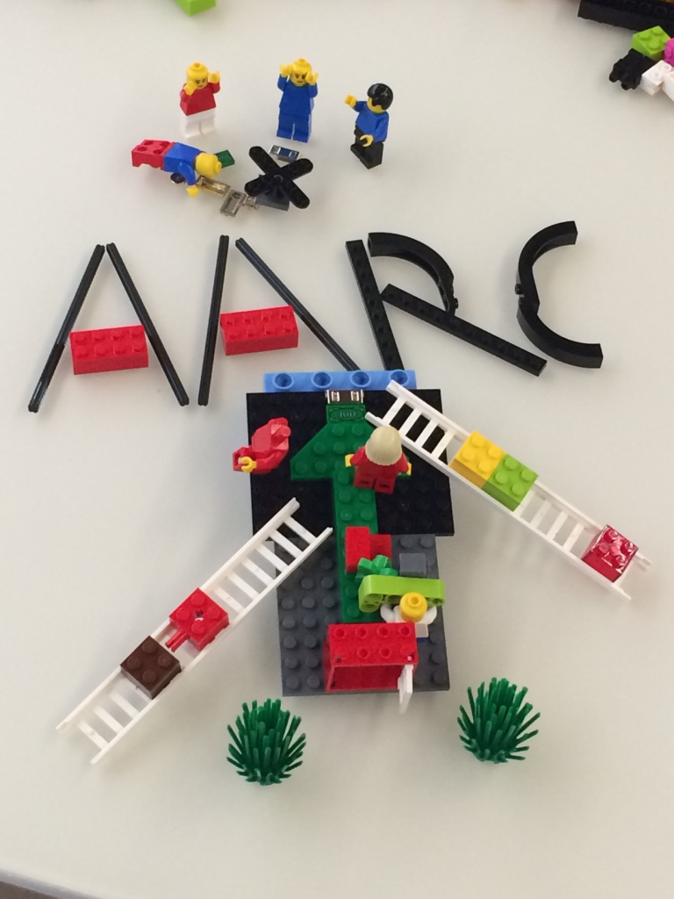
What AARC wants to achieve?
Improve adoption of FIM – Promote FIM key aspects, leverage identity providers outside the academic boundaries and deliver training modules.
Address eScience requirements – Enhance the blueprint architecture to enable FIM to meet eScience requirements.
Offer support for global policies – Work on and sponsor the development of key policy frameworks that aim to add additional ‘flavours’ to eduGAIN.
Make results sustainable – Pilot results in production environments and ensure that pilots operations and, security and policy frameworks rest with r/e-infrastructures.

Slide 4
Main focus of AARC for the next two years
  Promote and get inputs on the results produced over the last year
  Work more on authorisation aspects
  Work on assurance and combined levels
  Build a policy toolkit for r-infras
  Consolidate AARC as the neutral platform to bring together r/e-infra to align polices
  Consolidate the engagement with r-infras
  Pilot proposed solutions

Slide 5
AARC Results for r/e-infrastructures
https://aarc-project.eu/infrastructures/
https://aarc-project.eu/pilots/piloted-solutions/

Slide 6

Sirfti online training
Online ‘course’ to promote Sirtfi, the Security Incident Response Trust Framework for Federated Identity:
  Provides security contact information for each participant (IdPs and SPs)
  Guarantees a baseline of operational security
  Guarantees confidential, reciprocal collaboration during a security incident
http://e-academy.geant.org/
  Thanks to Hannah !
Please provide inputs and help us to improve it!

Slide 7

AARC Results for Libraries
https://aarc-project.eu/libraries/

Slide 8

AARC Engagement Groups: CEF
A bilateral channel to:
  Report on AARC recommendations and pilots with research collaborations in AARC
  Get feedback on AARC solutions from the wider FIM4R community
Explore possibility to pilot solutions more widely
Effectively supporting FIM4R
  AARC supports participation of AARC research collaborations at FIM4R

Slide 9
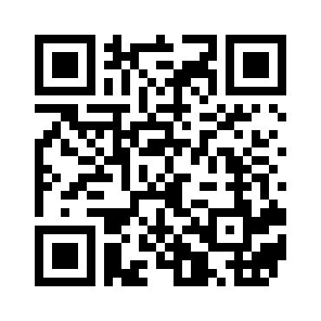
For more info watch the AARC video
licia.florio@geant.org

