Slide 1



HL-LHC AUP in US after CD-1:
Status and Goals at 7th HL-LHC Collaboration Meeting
Giorgio Apollinari
CIEMAT, Madrid, Spain – Nov 13th, 2017

Slide 2

Content
HL-LHC Status: Critical Decision #1
  CD-1 Review
  Response to CD-1 Reviews
Documentations and Goals for this Collaboration Meeting
  DOE-mandated Reviews
  Specifications, Parts Exchange, Acceptance, Agreements and all that !
AUP Technical Status
LARP

Slide 3
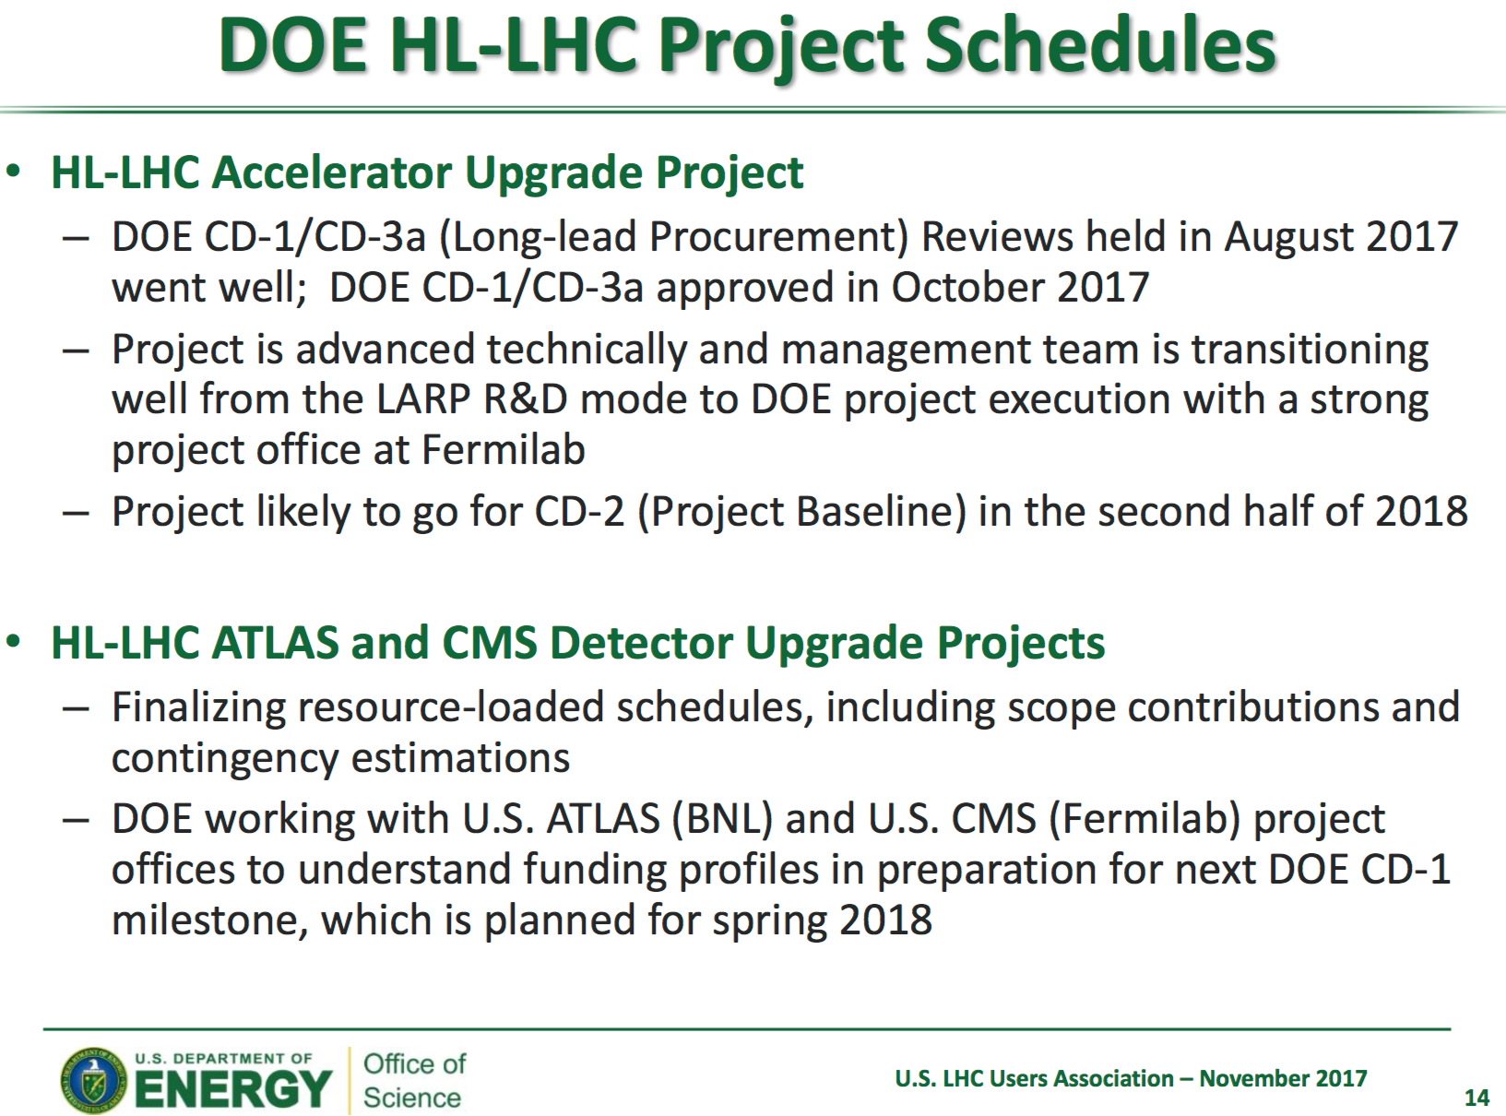
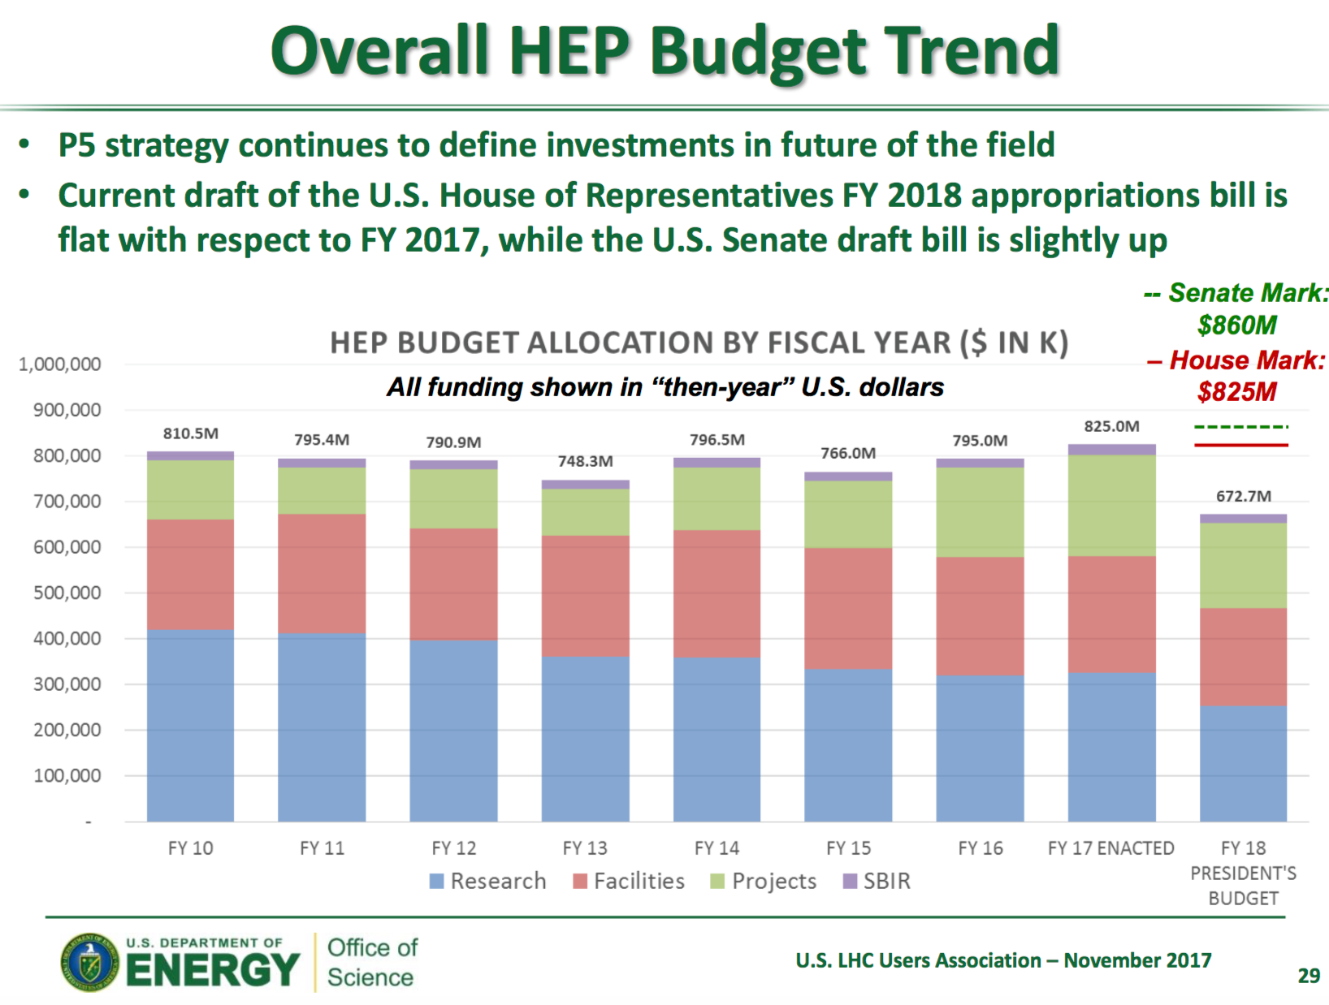
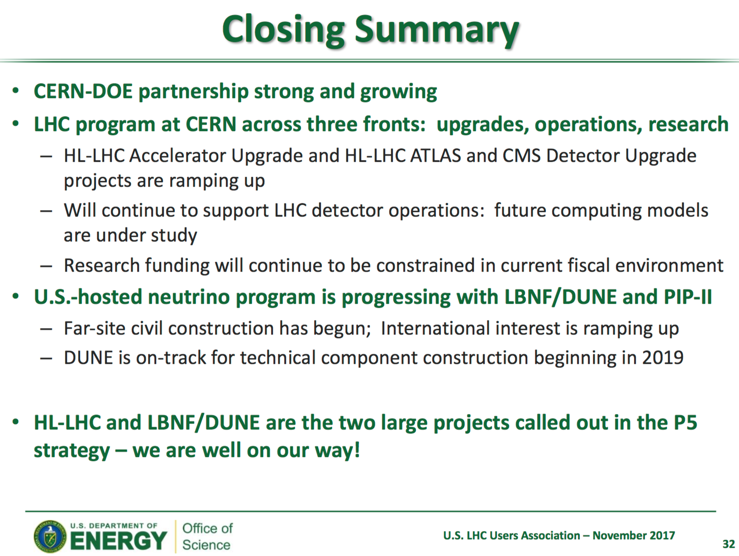
DOE Inputs
Abid Patwa at
2017 USLUA

Slide 4

HL-LHC Accelerator Upgrade Project
HL-LHC AUP is a formal DOE Construction Project
A DOE construction project is governed by DOE Order 413.3B
DOE projects typically progress through five Critical Decision (CD) gateways, which serve as major milestones
  Each CD marks an authorization to increase the commitment of resources by DOE and requires successful completion of the preceding phase or CD
    CD-0: Mission Need Approved Apr ‘16
    CD-1: Alternative Selection and Cost range
  Approved Oct ’17 ! (also CD-3a)
    CD-2: Baseline Approval Planned for late FY18
    CD-3: Construction Approval Phased in late FY18 and FY20
    CD-4: Project Complete
A typical CD-x process involves:
  External reviews run by the Project
  “CD-x Director Review” run by the FNAL Director Jun. ‘17
  “CD-x IPR” run by DOE Aug. ‘17
  Approval by ESAAB Oct. ’17
  Spending Authority finally comes from Congress approval of the Budget
ESAAB = Energy System Acquisition Advisory Board

Slide 5
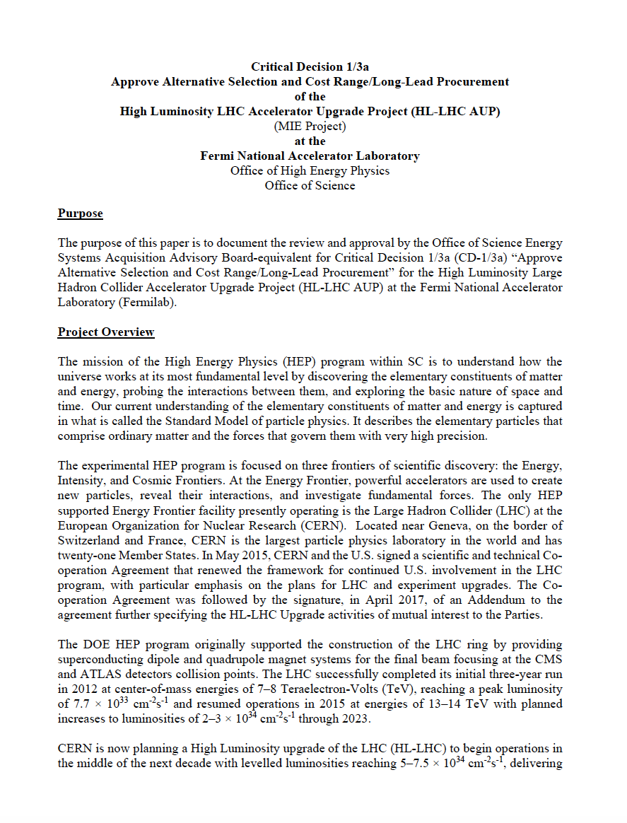
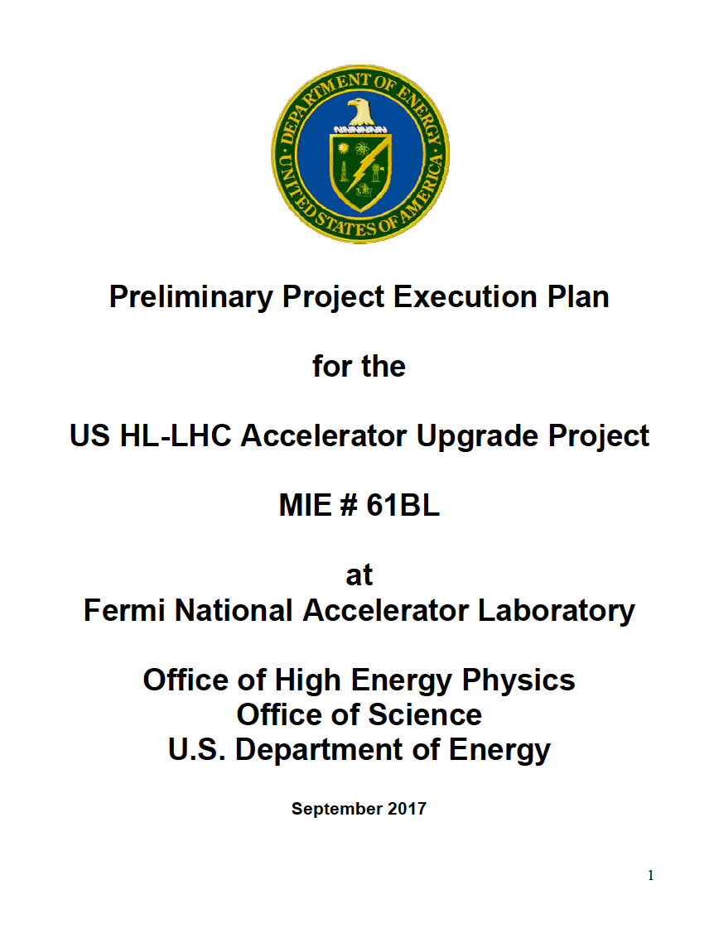
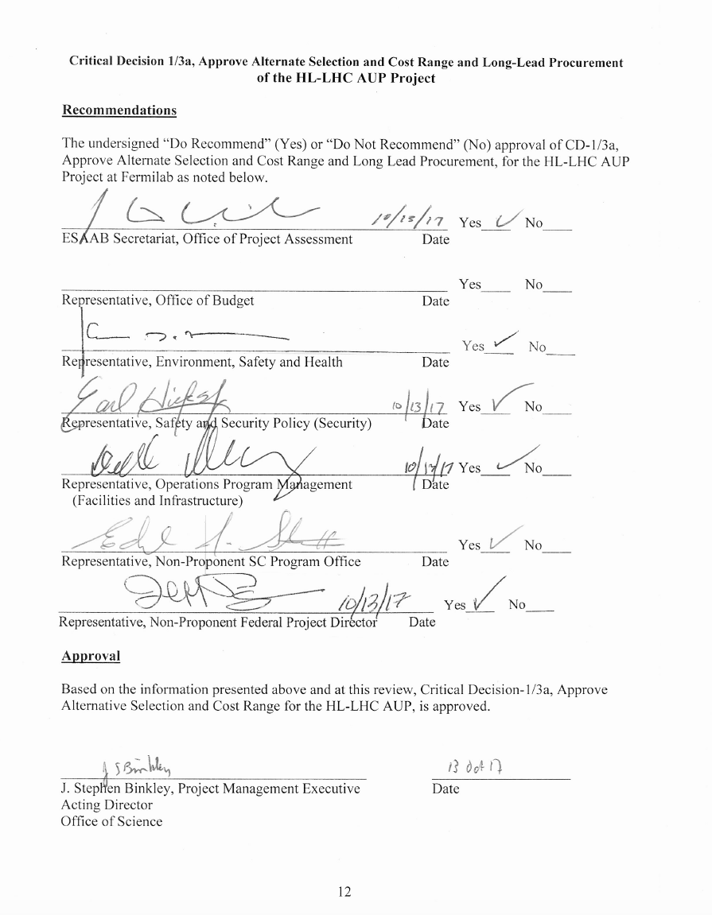
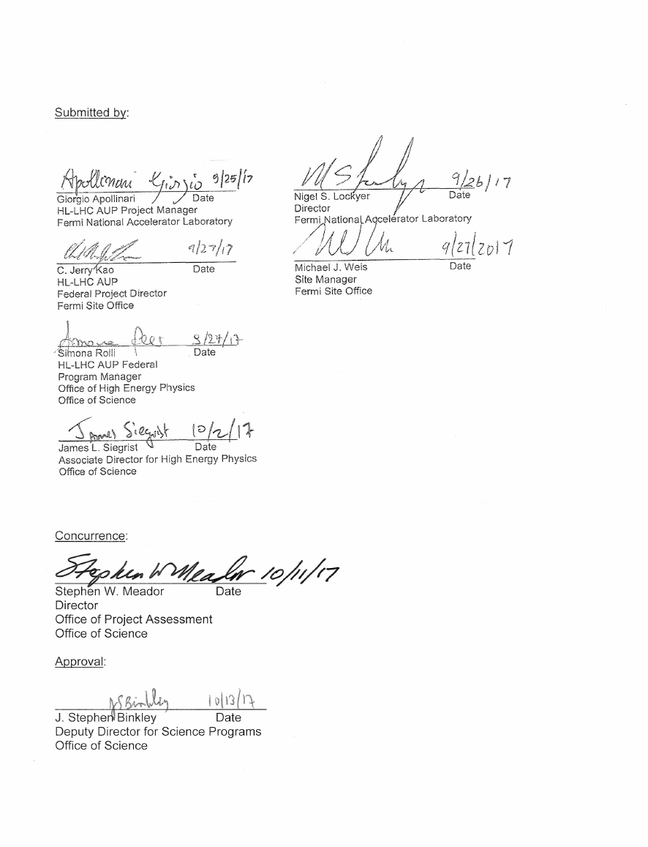
Obtained AUP CD-1 ESAAB Approval on Oct. 13th 2017 !
Thanks to FPD (Jerry Kao) !
  Cost Range: 209 M$ to 252 M$
  Schedule Range: 3QFY28 with 36 months float

Slide 6
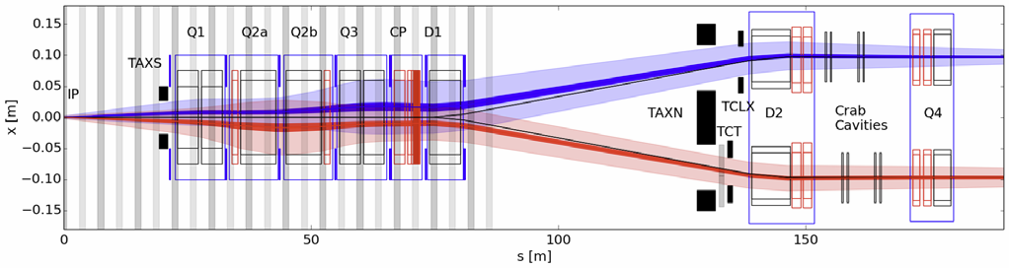
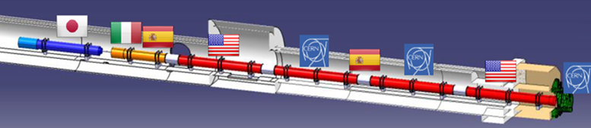
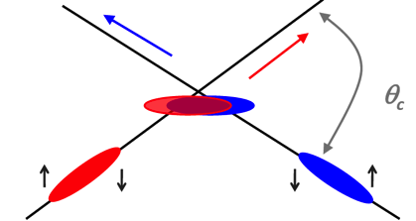
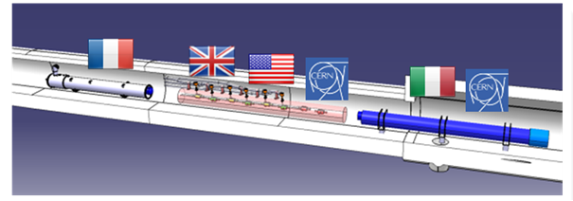
Preliminary U.S. contributions to HL-LHC
(in pictures)
Insertion Region layout from the IP to Q4
Large Aperture IR Quadrupoles:
From 70 mm MQXA/B to 150 mm MQXF
From NbTi to Nb₃Sn for higher field/gradient
Minimum β* from 0.55 m to 0.15 m
Compatible with 10x integrated luminosity
Crab cavities:
Deflect bunch at IP to collide head-on
Restore luminosity loss due to crossing angle
Requires compact superconducting cavities

Slide 7
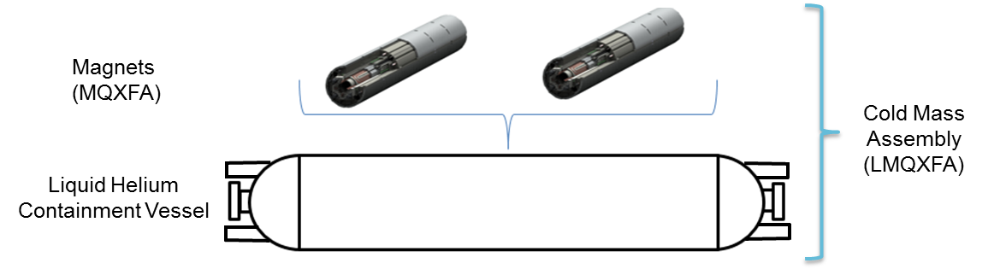
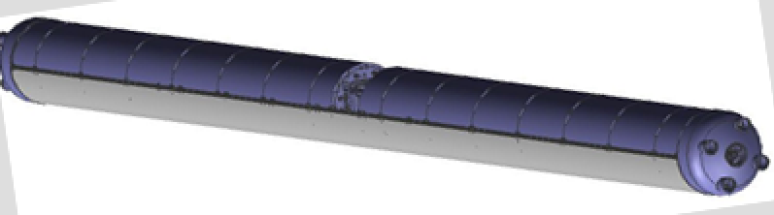
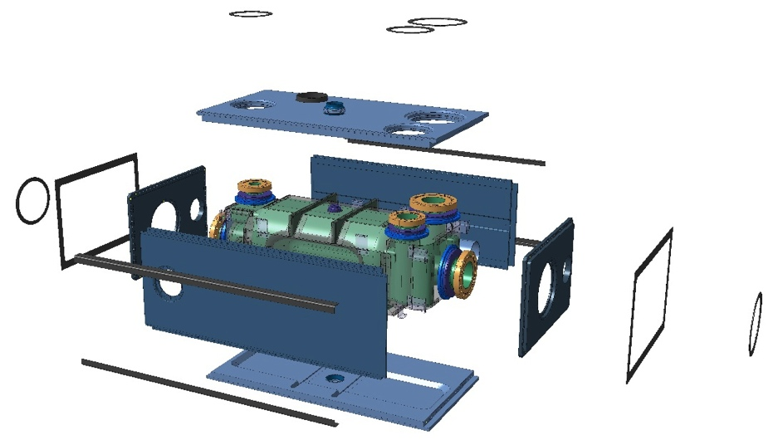
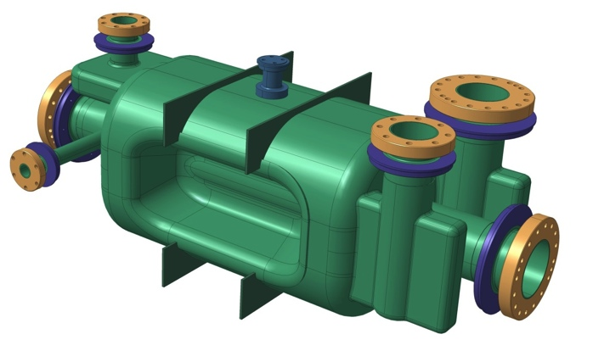



Preliminary U.S. contributions to HL-LHC
(in pictures)
Q1/Q3 Cryoassembly
Dressed RFD Cavity
V-HOM
RF Pickup
H-HOM

Slide 8
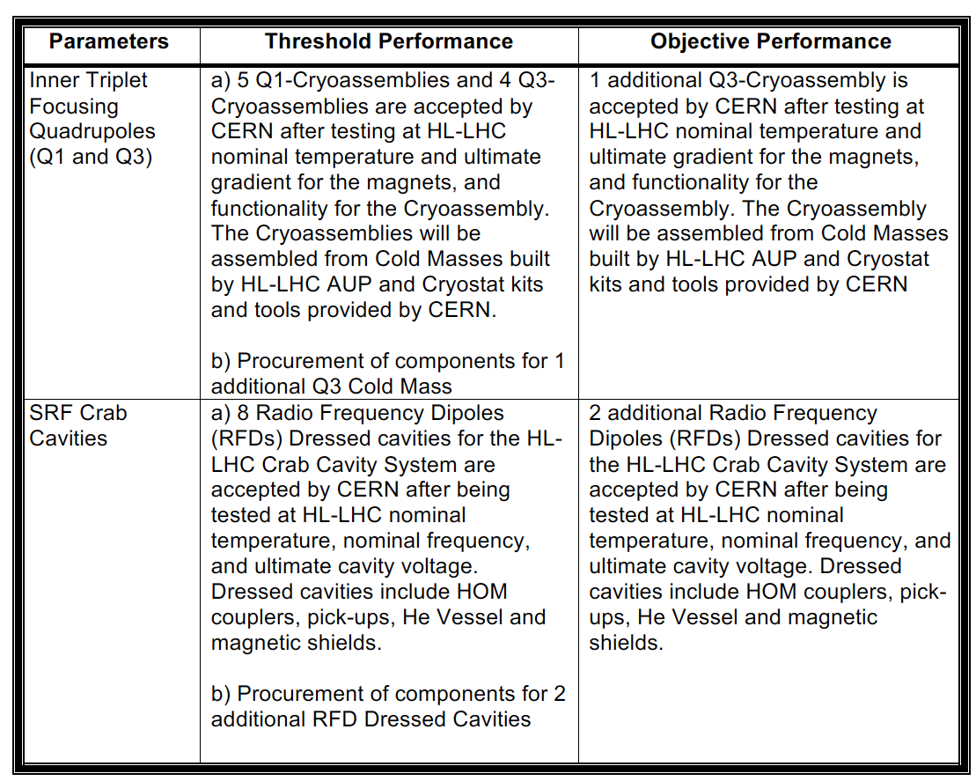

Preliminary U.S. contributions to HL-LHC
(in words)
At this time (pre-CD-1) the following deliverables are entertained for the US contribution to HL-LHC:
  From the approve Preliminary Project Execution Plan
Delivery Date Needs (from CERN):
  Q1/Q3 Cryoassembly #1 at CERN by Late ’21
  Cryoassembly #8 at CERN by Summer ’24
  RFD Dressed Cavity #1 at CERN by Late ’22
  Dressed Cavity #8 at CERN by Summer-Fall ‘23
Approximately 50%
of the Q1/Q2a & b/Q3 Final Focusing Triplets of HL-LHC
50% of the total number
of Crab Cavities for
HL-LHC
CERN is also suggesting financial contribution to cavities built in Europe or e-lens contributions (“Up-scope” Opportunities)

Slide 9
Good News from CD-1 ESAAB !
At ESAAB, the approved CD-1 Funding Profile reflect what was requested at CD-1 IPR Review with increased funding in FY20.
There is funding space in FY20 to advance procurements and speed up production, subject to the following constraints:
  Keep FY19 cost the same
  Keep cable to coil free float the same (~ 3 months)

Slide 10
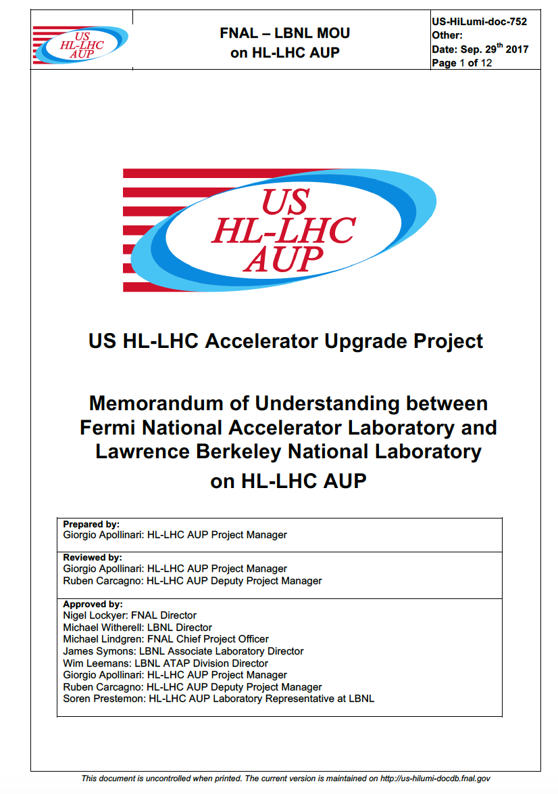
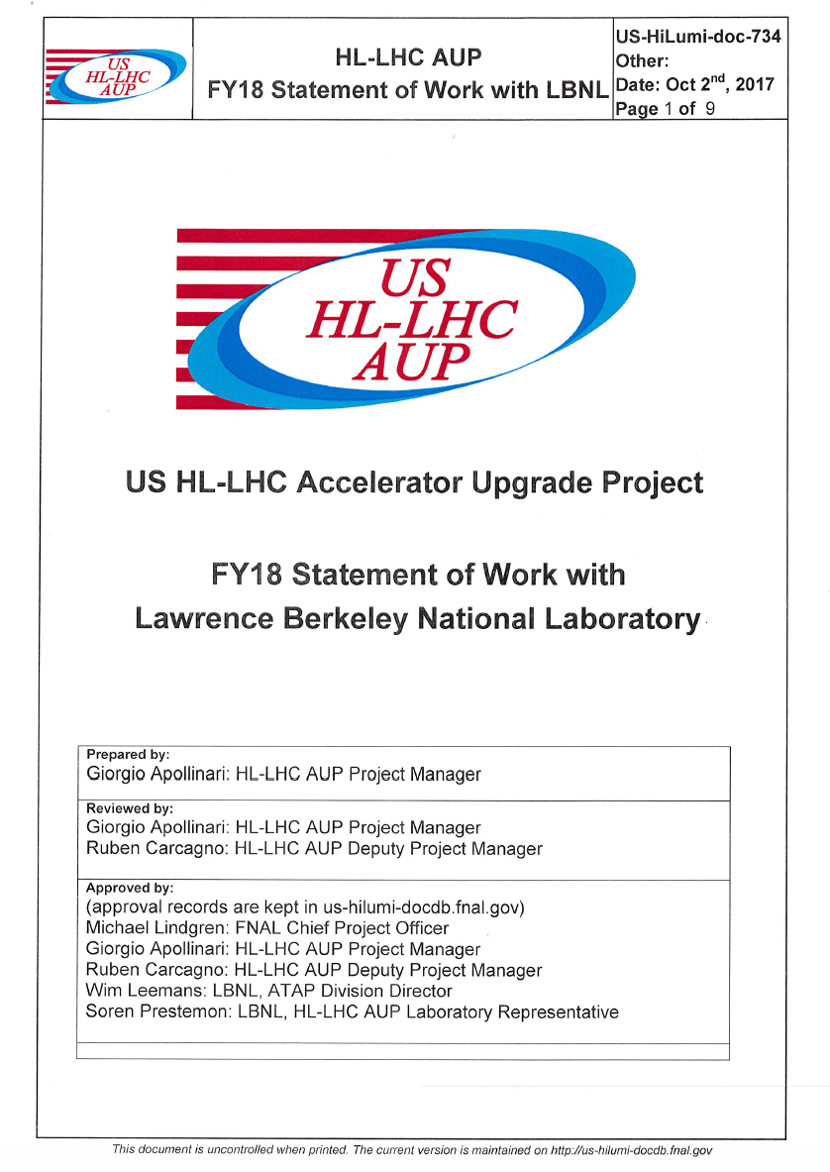
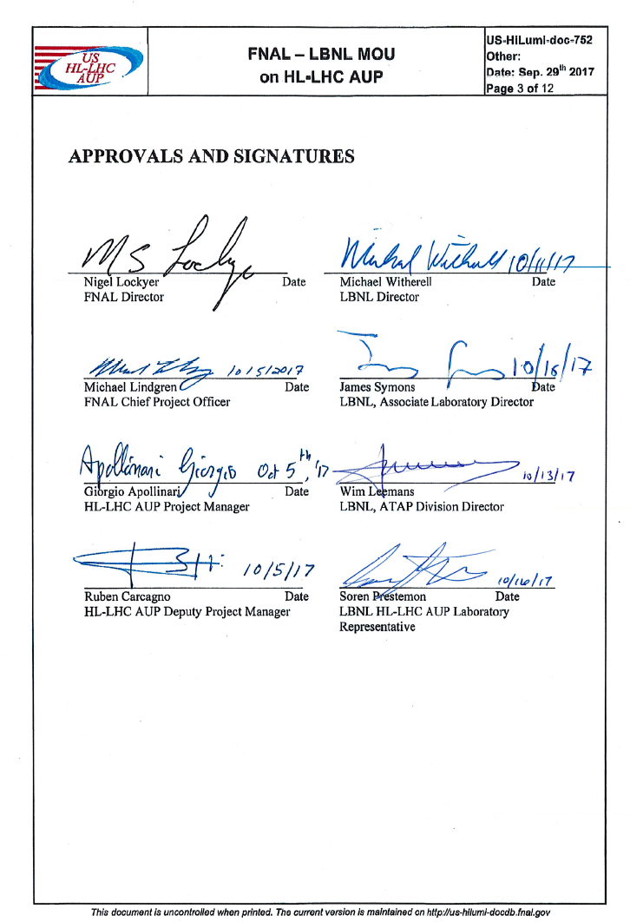
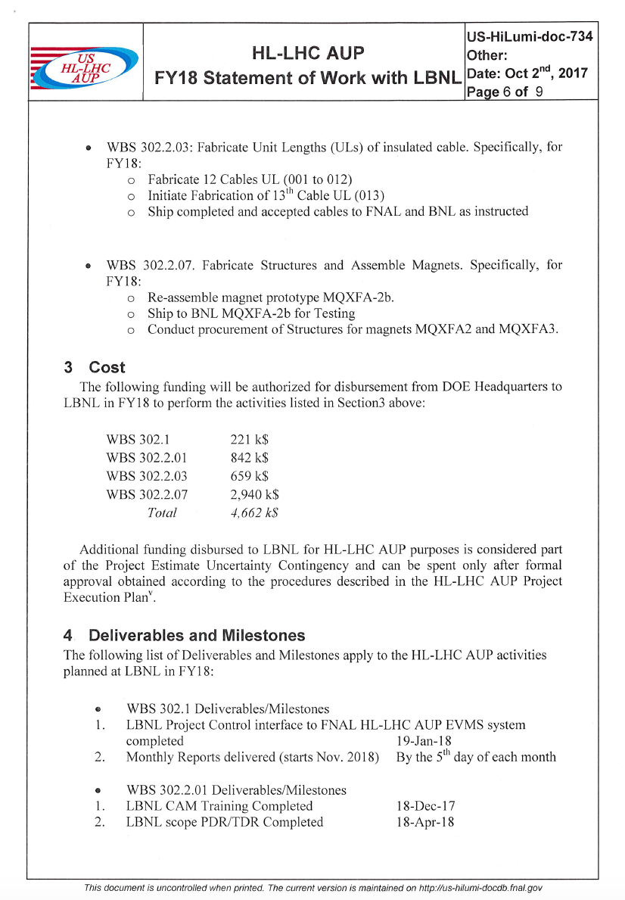
MOUs and FY18 SOWs
What are they:
  MOUs: Govern agreements between collaborating Laboratories and the Project.
  SOWs: document the work to be accomplished at contributing institutions . Annual statements of work between Fermilab and the contributing institutions as well as frequent milestones are used to track progress of the contributions.
MOU and SOW with LBNL fully signed and approved.
SOW with BNL preliminarily signed. MOU with BNL still under BNL Directorate scrutiny.

Slide 11
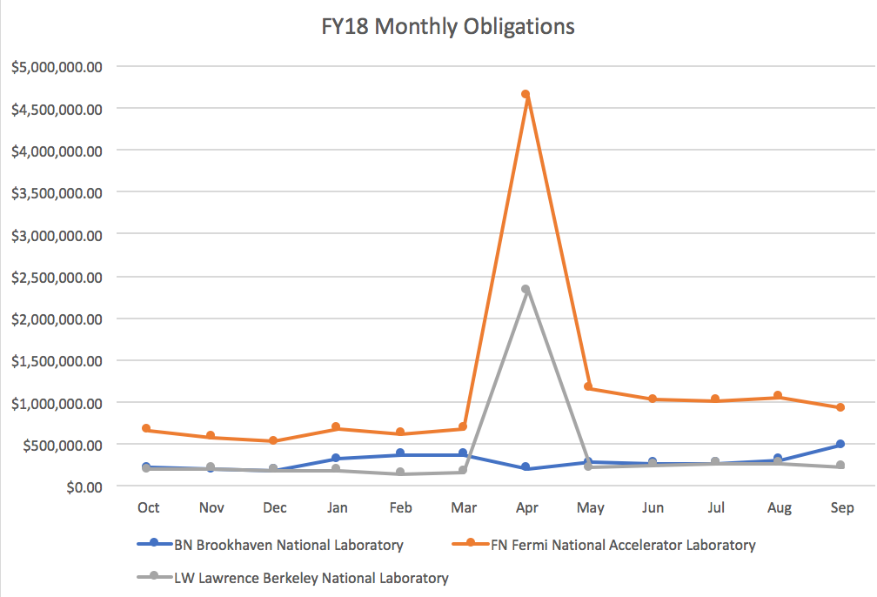
HL-LHC AUP: Funding Profile at CD-1
FY18 Funding: 27 M$
  Activities at FNAL: 13.8 M$
  Activities at BNL: 3.5 M$
  Activities at LBNL: 4.6 M$
  Contingency: 5.1 M$
  Monthly Funding Profile
All FY18 funding going toward potential “tunnelable” (i.e. Production) elements such as MQXFA03 coils
  Every $ spent from now onward is a not-recoverable $ !

Slide 12
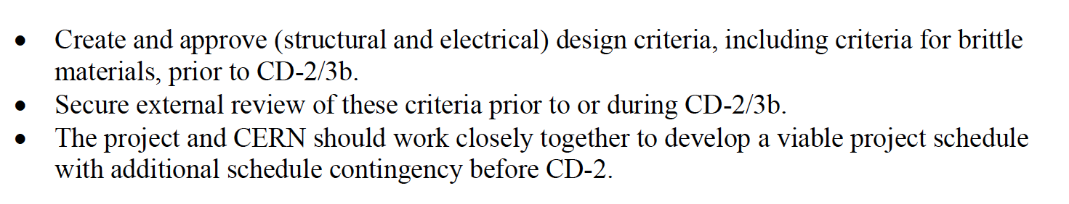
Feedback from HL-LHC AUP CD-1 Review
Key Recommendations
Crab Cavities Recommendations
Cost & Schedule/Manag. Recommendations

Slide 13
CD-1 Nomenclature & “CD-1Baseline”
MQXFAP1
Prototype CM
LARP
MQXFA02
AUP
Magnet MQXFA03: 1st Magnet
fully conforming with AUP FRS
MQXFA03
Pre-Series Magnet
CD-3b (approval Magnet Prod.) - June ’18 (at the latest)
MQXFA04
CM#1: based on CERN Kit, execution
after CD-3 approval (May ‘20)
Prod. CM#1
MQXFA05
MQXFA06
Prod. CM#2
MQXFA07
....
....
MQXFA18
CM#8: delivered to CERN on Apr. ’24,
~3 mo before CERN “Need-by-Date”
(Jul.’24)
Prod. CM#8
MQXFA19
....
All “Prod.” are KPPs deliverables

Slide 14
“CD-1 Baseline” (cont.)
Extremely Compressed schedule for mandated reviews
CD-3b Reviews (under US Responsibility):
  Specific Magnets:
    Design Criteria Jan ’18 Called by Project, external rev. Team
    Magnet FDR Jan ‘18 Called by Project, external rev. Team
  Specific Cavities
    Nb Material FDR Jan ‘18 Called by Project, external rev. Team
  Overall Reviews
    Director’s Review Feb ‘18 Called by FNAL Director
    DOE IPR Apr. ‘18 Called by DOE
CD-2 would have to be postponed to ~FY20, with CD-3 (Start of Full Production)
  Not enough time to include CERN Installation schedule

Slide 15
Modified Nomenclature & “CD-1 Baseline”
MQXFAP1
Prototype CM
LARP
MQXFA02
AUP
MQXFA03
Both Magnet MQXFA03 and MQXFA04
are fully conforming with AUP FRS.
They are assembled in “Pre-Series CM”
Pre-series CM/
Potential Prod. CM#1
MQXFA04
CD-3b (and CD-2) - February ‘19
MQXFA05
Prod. CM#2
By maintaining same assembly rate,
the opportunity offered by MQXFA03
can be capitalized in accelerating deliveries
to CERN.
Usage of MQXFA03 increases schedule
float by ~2mo
MQXFA06
MQXFA07
MQXFA08
…...
.....
MQXFA17
Prod. CM#8
MQXFA18
....
“Pre-Series CM” can be KPP deliverable upon certification
of performance (gain ~2 mo. of float), otherwise MQXFA4
is recovered for future use. All “Prod.” are KPPs deliverables.

Slide 16
Modified Nomenclature “CD-1 Baseline” (cont.)
CD-2/CD-3b Reviews (under US Responsibility):
  Specific Magnets:
    Design Criteria Apr ’18 Called by Project, external review Team
    Magnet FDR May ‘18 Called by Project, external review Team
    Cold Mass/CA PDR Jun ‘18 Called by Project, external review Team
  Specific Cavities
    FDR for Nb Material May ‘18 Called by Project, external review Team
    Sys. Int. Review Jun ‘18 Called by Project, external review Team
    PDR for Cavities Jun ‘18 Called by Project, external review Team
  Overall Reviews
    Director’s Review Aug-Sep ‘18 Called by FNAL Director
    DOE IPR Oct-Nov. ‘18 Called by DOE
    ESAAB Dec ‘18 or Jan ’19
CD-3 in FY20
  Full approval for CryoAssemblies and RFD Production

Slide 17
Project Close-End in a slide
An additional float of 2 months can be gained by reducing the duration of the winding step by 2 days starting October 2020 (40% into coil production). This change is expected to fit within the CD-1 funding table.
Expectation of additional float
at CERN after completion of
Installation Schedule
(L. Rossi Verbal Communication
at CD-1 Aug. Review )
~2 mo.
~2 mo.
~3 mo.
~4 mo.
Dec ‘23
Feb ‘24
Apr ‘24
Jul ‘24
Nov ‘24
Time
“CD-1 Baseline”
AUP Delivery
of CM#8
“CD-1 Baseline”
CERN “Need-by-Date”
for CM#8
“Modified CD-1 Baseline”
with MQXFA03 as part of AUP
deliverables
Total expected schedule float before CERN “Need-by-date” of ~11 months.
  Closer to the ~12-14 mos. we suspect we need to demonstrate to pass CD-2 without issues.

Slide 18
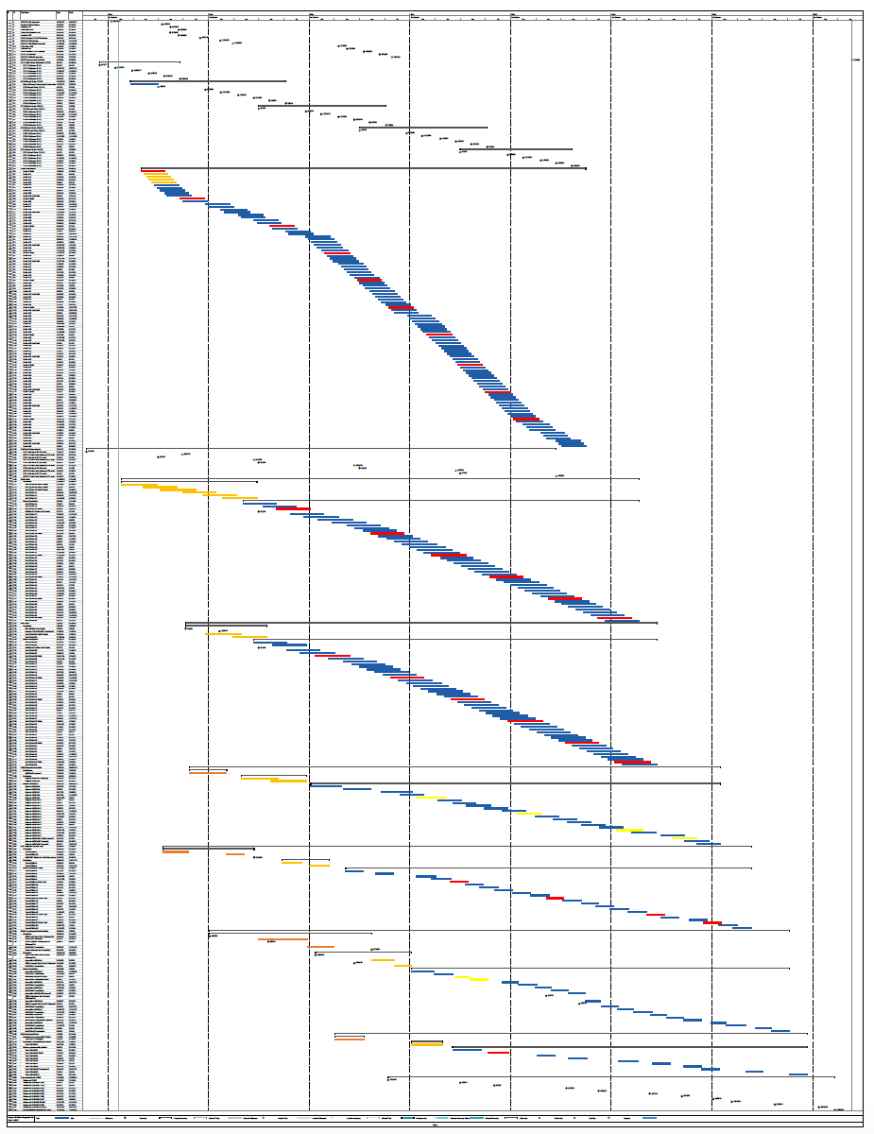
“Post-CD-1 Review” Plan
Proposal shown to DOE and endorsed in early November.
Modified schedule provided to CERN on Nov 8th and used as basis for discussion at Madrid, and for preparation for future DOE CD-n Reviews.

Slide 19
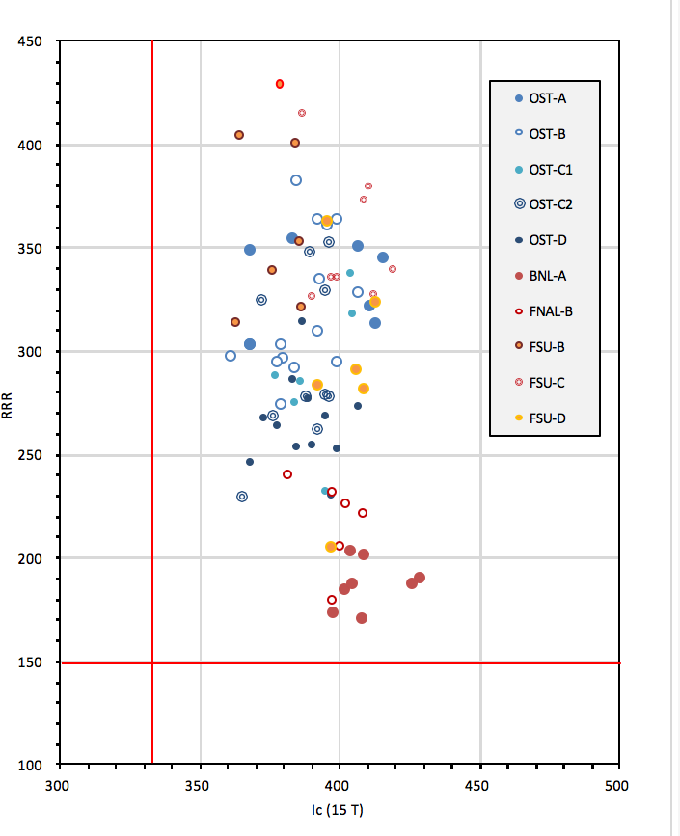
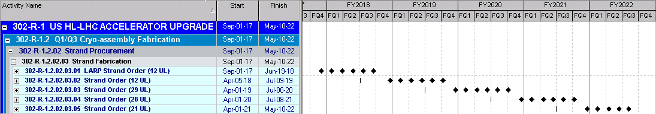
CD-3a on Nb₃Sn
ESAAB/DOE also provided approval (CD-3a) for procurement of 9 metric tons (1,800 km) of Nb₃Sn.
Acquisition Plan for conductor available (US-HiLumi-doc-37, L. Cooley)
Nb₃Sn Acquisition fully integrated in AUP P6 Schedule
Ready to proceed with Phased Procurement as soon as CR is over.

Slide 20
AUP Preparation for next CDs
Planning to start process to obtain CD-2 and CD-3b in Spring 2018
This will be a ~6 months long process (see slide #16).
  CD-2 will require Preliminary Design Readiness
    Preliminary design is complete when it provides sufficient information for development of the Performance Baseline in support of CD-2.
    Quantifiable in ~50% - 70% drawings available
    PDR needed for CM, CA and CC
  CD-3b (Magnet Construction) will require Final Design Readiness
    Quantifiable in more than 95% drawings available.
Several elements will rely on CERN leadership, support or involvement in order to converge on CD-2/CD-3b for AUP

Slide 21
Documentation Goals for 2018
To be addressed at this Collaboration Meeting
Functional Requirement Specifications
  Magnets OK
  Cold Mass To be Finalized. In CERN hands.
  Requirements for CA Assembly Draft exist (AUP)
  Crab Cavities OK
Materials, Interfaces, Agreements and MIPs/MTFs Approvals
  Materials for Q1/Q3 Magnets Assembly
  Critical for Q1/Q3 Coil and Magnets MIPs/MTFs
  Timely for Q1/Q3 Cold Mass (to include welding)
  Timely for CC Nb Raw material
  Timely Interfaces for Magnets
  Timely for Pressure Vessel Safety Agreement
Acceptance Criteria
  Timely for Q1/Q3 Magnets Draft Exist (AUP)
  Timely for Cold Mass Draft Exist (AUP)
  Initial development for CryoAssembly
  Initial development for Crab Cavities
Critical: Needed Yesterday !
Timely: Needed for CD-2/CD-3b Reviews (~Jun. 18)
Initial: Needed for CD-3 Review (~FY20)

Slide 22
Material Approvals and MIPs
Magnet Materials list shared with CERN/WP3 in early 2016.
  Comments on Co-content of SS Materials
  MQXF Magnets from AUP are expected to be amply below 0.1% Co-content request.
  Thank You very much for EDMS Approval !
MIPs (Manufacturing & Inspection Plans) & MTFs
  Submitted to CERN MIPs for MQXFA Cables and Coils
    Thanks for uploading Cables MIPs in EDMS !
      Eagerly awaiting their approval since MQXFA03 is a “tunnel-bound” magnet.
    MIPs for Coil Manufacturing will require determination on Inner Quench Heater by late Nov. 2017
      Upcoming decision: stop MQXFA03 Coil Production or continue with possibly NC Magnet by Dec. ‘17.
    Thanks for uploading Coils MIPs in EDMS !
      Eagerly awaiting their approval by ~Dec.’17 since MQXFA03 is a “tunnel-bound” magnet.
  MIPs for MQXFA Structure Assembly to be submitted by ~Mar. ’18
    MQXFA Structure Assembly MIPs approval needed by Jun ’18, in time for MQXFA03 Structure Assembly in later CY18 !
Approval Path

Slide 23
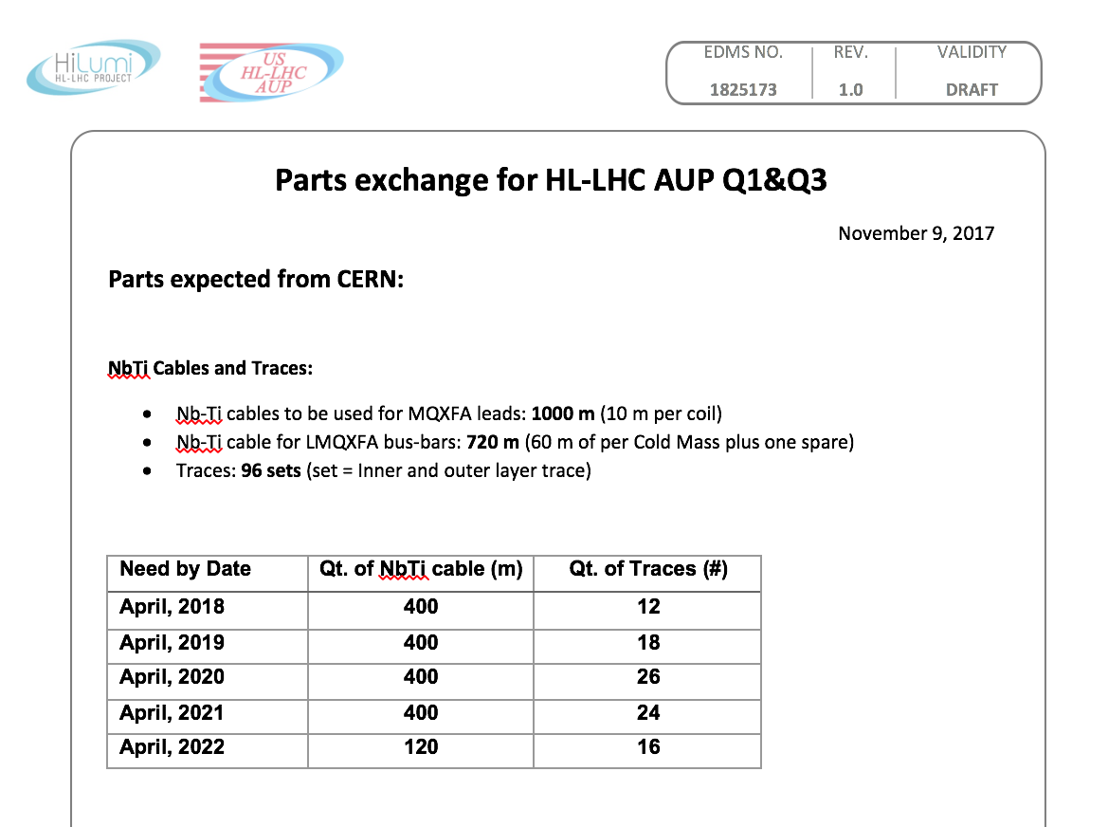
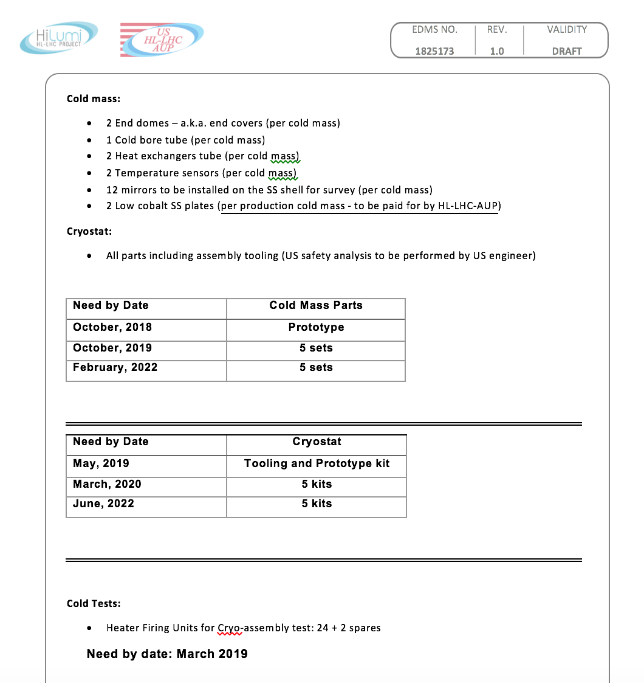
Parts/Tooling Exchange
Parts Exchange (EDMS 1825173)
  (Proposed) Timeline of Exchange
  Convergence expected in HiLumi-Madrid !
Tooling
  Tooling expected from CERN is CryoAssemby tooling designed & built as a carbon-copy of CERN design/procurement
  Tentative agreement reached on Oct 10th, EDMS-1865080
~3 mo.
~2-3 mo.
Time
Shipped
from CERN
Expected
in USA
Needed “on floor”
by AUP

Slide 24
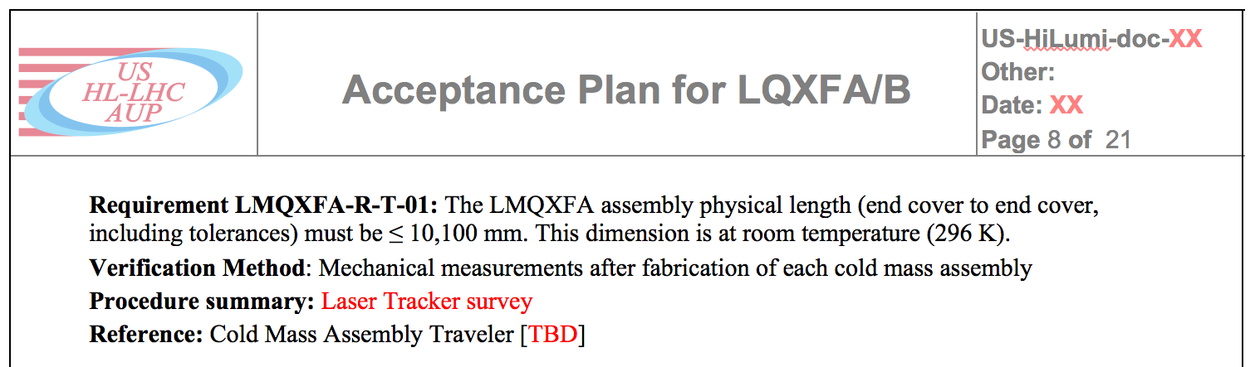
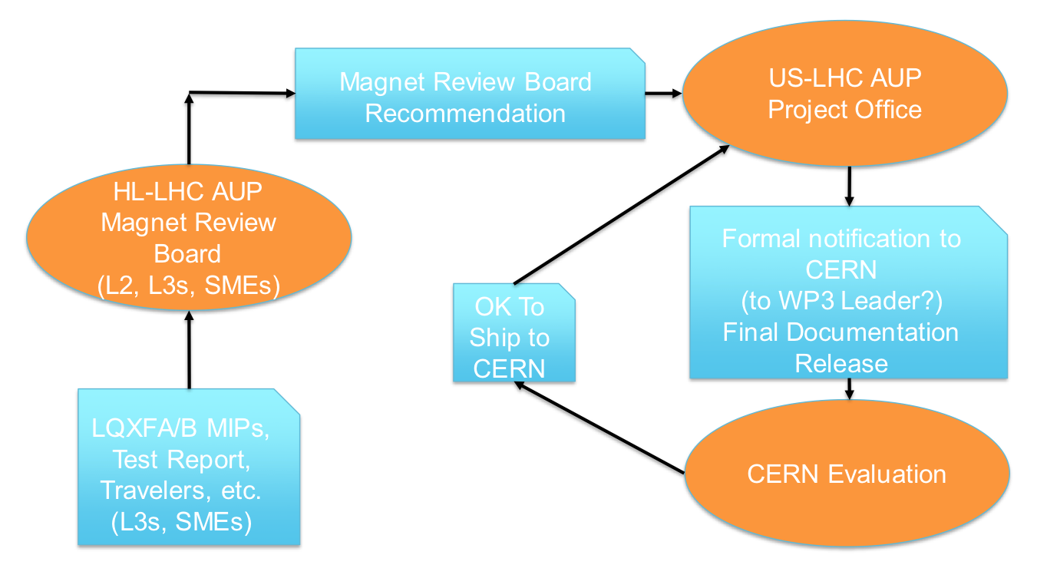
LQXFA/B Acceptance Criteria
Document developed by Ruben, shared at Madrid with WP3/CERN.
Based on FRS for Magnets and Cold Mass, and on (yet to be written) “Requirements for CA Assembly”.
Designed around:
  Verification Method
  Procedure Summary
  Reference(s)
Acceptance Flow-Chart

Slide 25
Interfaces
Interfaces definitions critical for design and start of production.
  Magnet interfaces needs to be finalized by MQXFA Final Design Review for CD-3b (Summer ‘18)
    Electrical Interfaces
    Cryogenic Interfaces
    Electrical Interfaces
    Quench Protection Interfaces
  Cold Mass, CryoAssembly and CC interfaces needed to achieve preliminary definition by Preliminary Design Review (Summer ‘18) and final definition by CD-3 (Summer 2020)
    CryoAssembly
    CC
Magnet Interfaces Workshop (remote is fine) with CERN by April 9th-20th, 2018 ?
  Maybe 2 workshops, on Mech./Cryo. and Elec./QP Interfaces ?
  Is there a CERN formal Interface Control System?
  Can we keep building on whatever it contains today for Magnet Interfaces ?
  Approval path for Interfaces ?

Slide 26
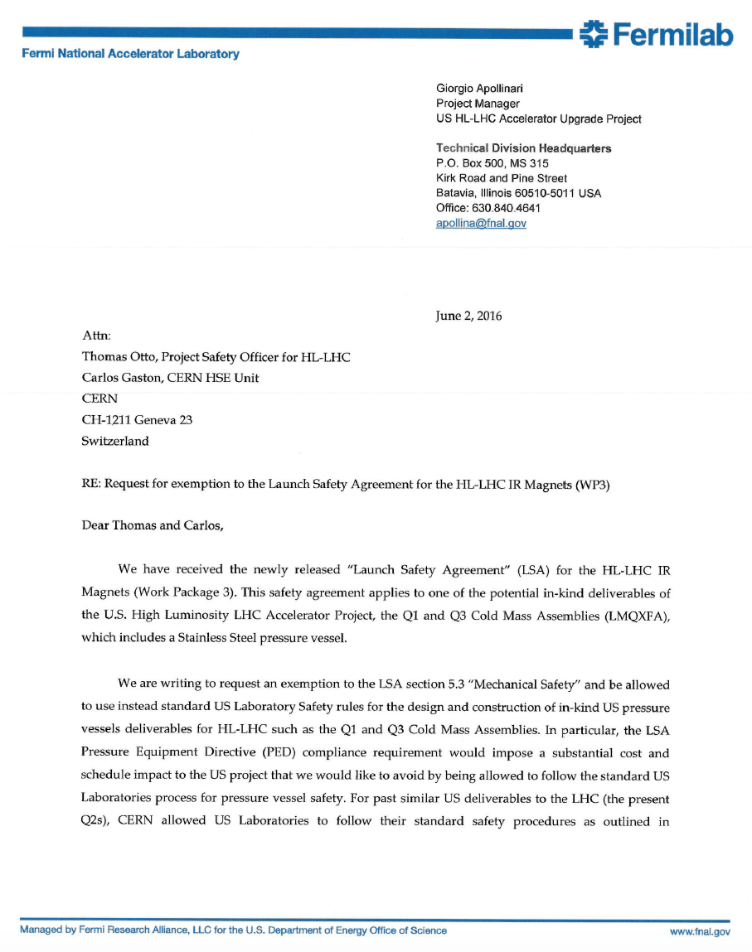
Pressure Vessel Safety
First request sent to HiLumi Project office on June 2016.
  Request to adopt FNAL Pressure Vessel Safety Code (ASME-based)
Will be followed by Tom Page (AUP System Integration Engineer)
  Functions documented in AUP PMP:
    Mostly focused on coordinating activities across the entire Project focusing on preparing the standards and procedures required to manage and execute the Project in accordance to the lead laboratory Engineering Manual and in agreement with the requirements from the final customer.
Interact with HiLumi Project Office (T. Otto) in order to obtain HSE exemption for Pressure Vessel equipment
  Timely for He-Vessel Test on US Short Model Magnet
  Convergence by Spring ‘18 (or earlier) ?

Slide 27
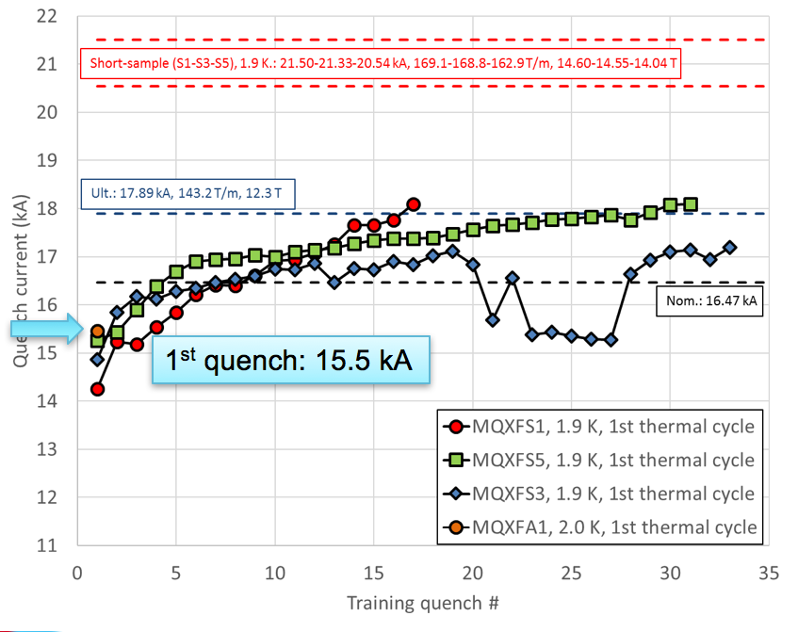
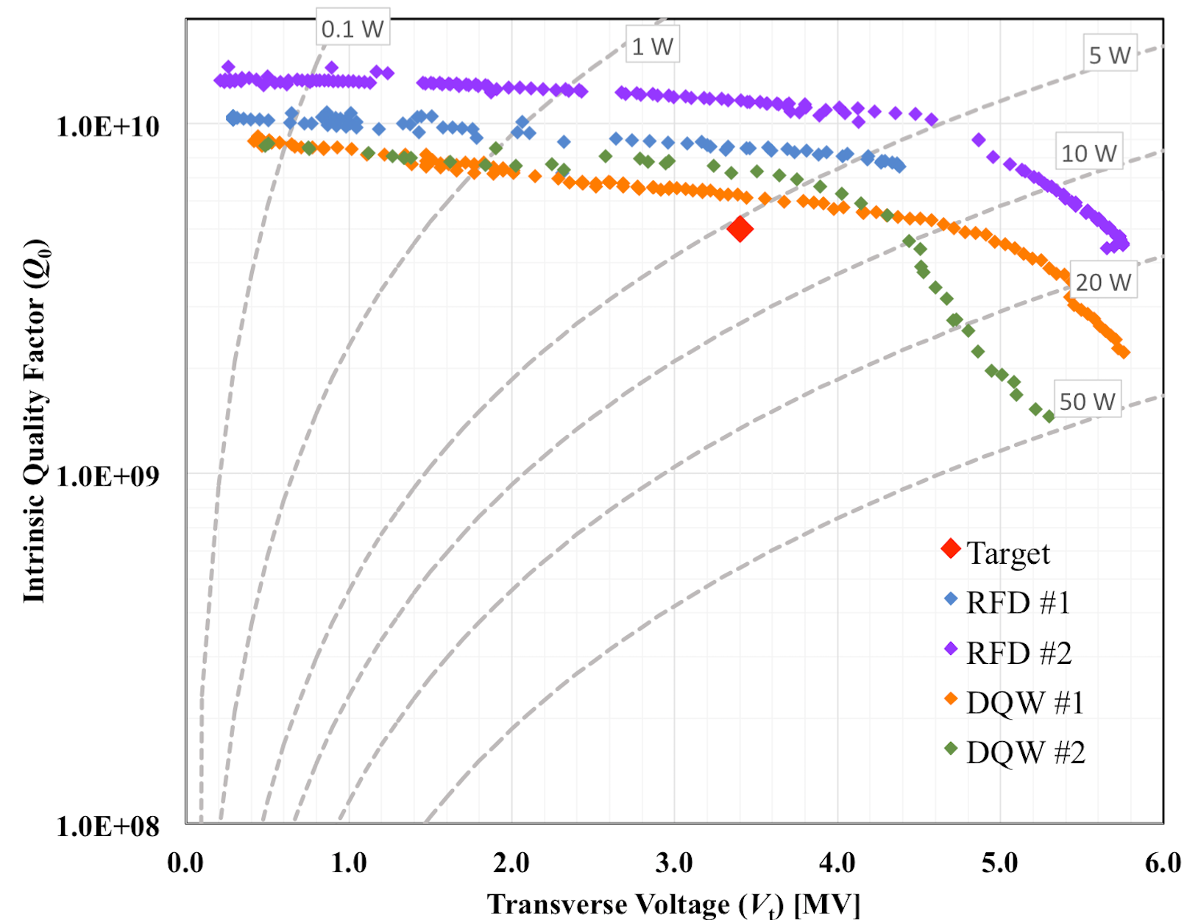
FY17 AUP Technical Achievements
Successfully completed assembly of first long HL-LHC quad: MQXFA1P. 4m long coils in 4.2m long Structure
Magnet at BNL for testing since late July ‘17.
  First quench in Aug ‘17 at 15,475 kA.
  LARP Team had to address and solve several problems since then: strain gauges signals, burst disk breakage, He contamination, QP signal delays, o-ring in cryo expansion engines.
  End of this “extenuating wait” eagerly awaited !
Started coils for MQXFA03, first potentially tunnel-bound magnet !
Successfully completed and measured all LARP NW cavities at JLAB.
  All Cavities exceeding HL-LHC performance requirements
Successfully tested at FNAL one RFD, confirming JLAB measurement and identified quench location with 2nd sound technology

Slide 28
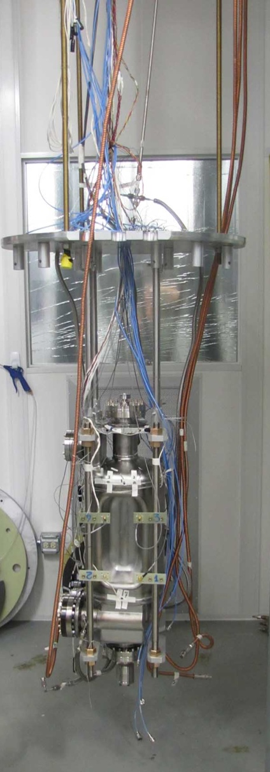
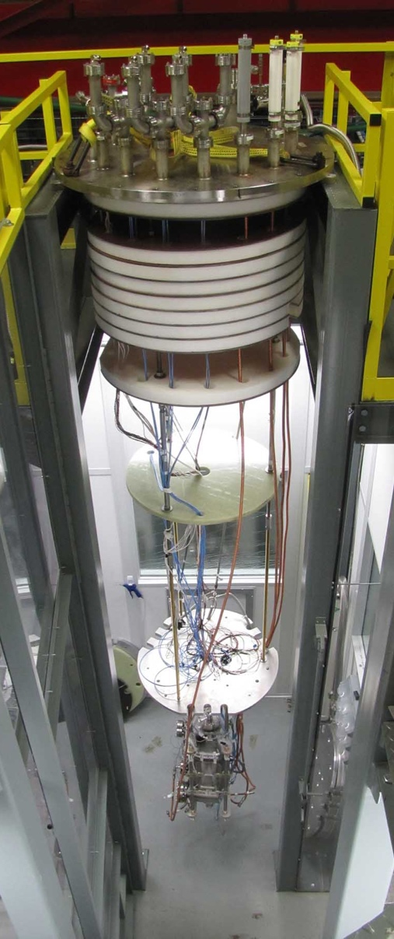
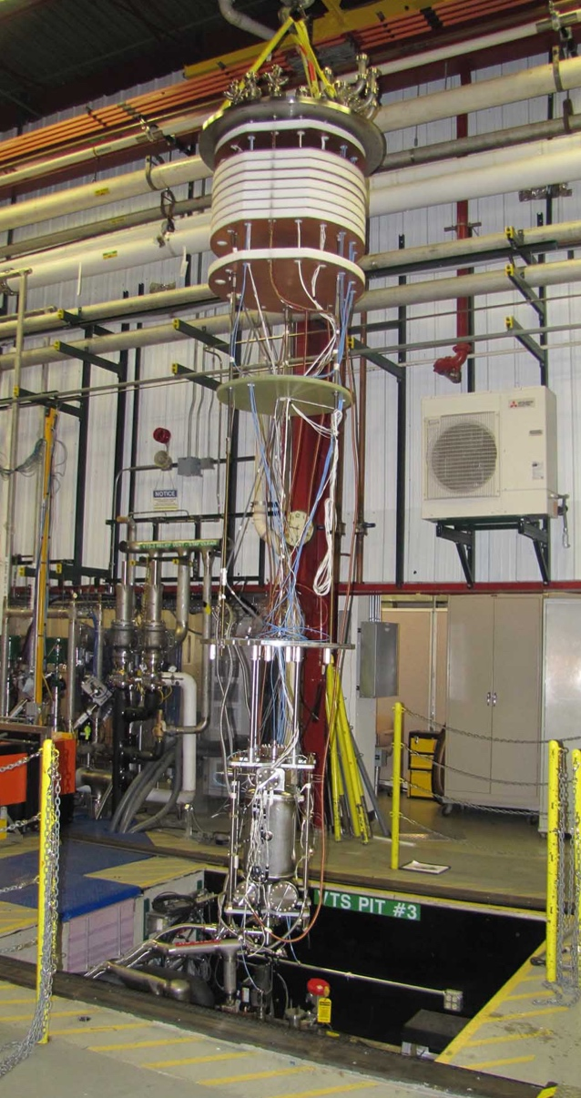
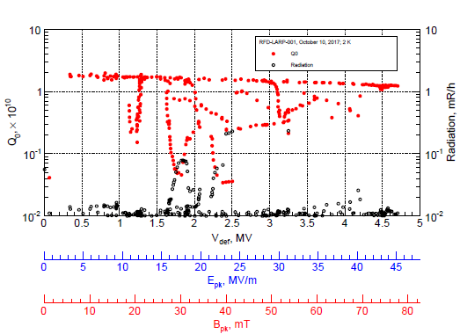
Cavity Insertion in VTS #3

Slide 29
FY18 AUP “Technical” Goals
Complete Test of MQXFAP1
  Quench campaign should have been completed by September. Good hopes for end-November.
Complete Assembly of MQXFA02 and first test
  Focus on FQ, Alignment
Continue production of MQXFA03,… coils
Place Nb₃Sn Procurement
Rotating BCP Tool developed (ANL) and tested on NW RFD cavity
Place order for RFD Prototypes

Slide 30
LARP
As expected from the P5 report in the US, LARP effort is strongly re-dimensioned after start-up of HL-LHC AUP
FY18 LARP funding has been directed by DOE to support handshaking on MQXFA magnets in LARP (MQXFAP1 and MAQXFA02) and AUP (MQXFA03 onward).
  No LARP funding in FY18 (and, likely, beyond) for CC, e-lens, Acc. Physics, etc.
  Support of Toohig Fellowship is expected.
 | FY14 | FY15 | FY16 | FY17 | FY18
e-lens | 150 | 150 | 340 | 500 | ~300
Acc. Systems | 592 | 150 | 149 | 130 | 0
Quad. Magnets | 7,854 | 10,500 | 11,428 | 13,157 | ~4,700
Management | 1,485 | 1,375 | 1,445 | 1,635 | 0
Crab Cavities | 1,136 | 1,200 | 1,458 | 2,137 | 0
WBFS | 1,183 | 625 | 560 | 300* | 0
Reserve |  |  |  | 641 | 0
Total | 12,400 | 14,000 | 15,380 | 18,500 | 5,000

Slide 31

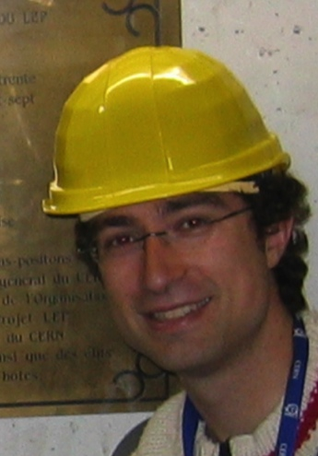
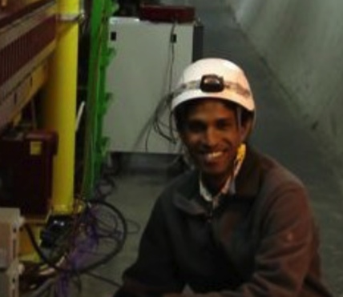
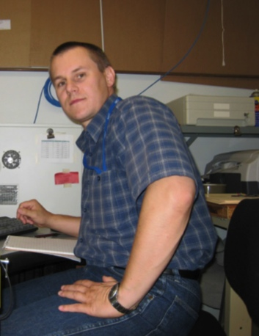
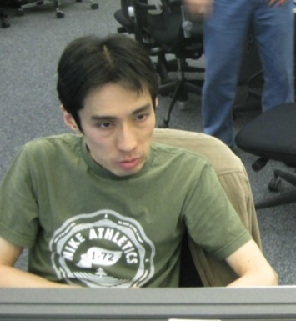
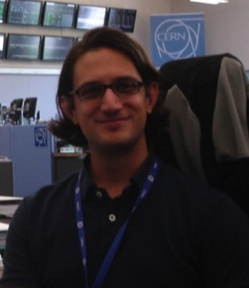
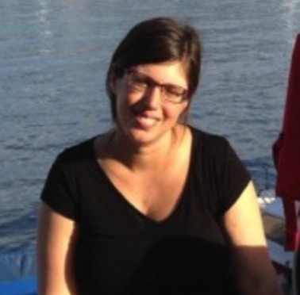
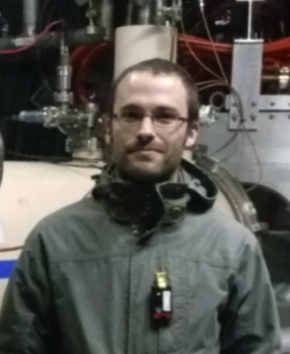
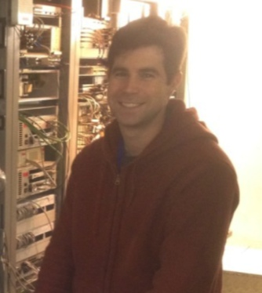
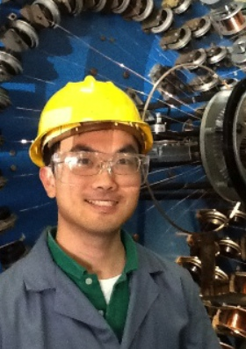

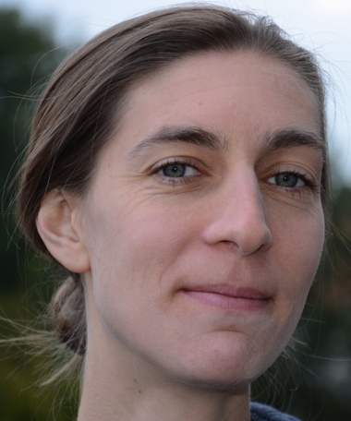
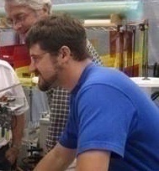
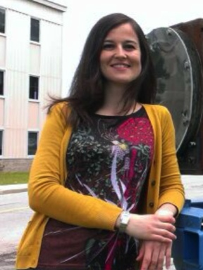
Toohig Fellowship
Extremely successful Fellowship program – Toohig Felloship - with several young Accelerator Scientist providing vital contributions to the LHC and field in general
H. Felice – CEA
R. Calaga – CERN
R. DeMaria –CERN
D. Bocian
Prof. HNINP
V. Previtali
Teacher, Geneve
J.Cesaratto
Phillips
R. Miyamoto – ESS
T. Mastoridis
Prof. CPU
I.Pong
LBNL
S. White – ESRF
S. Verdu
BNL
T. Holik
FNAL
E. Ravaioli
LBL
M. Fitterer FNAL
V. Marinozzi FNAL
31

Slide 32
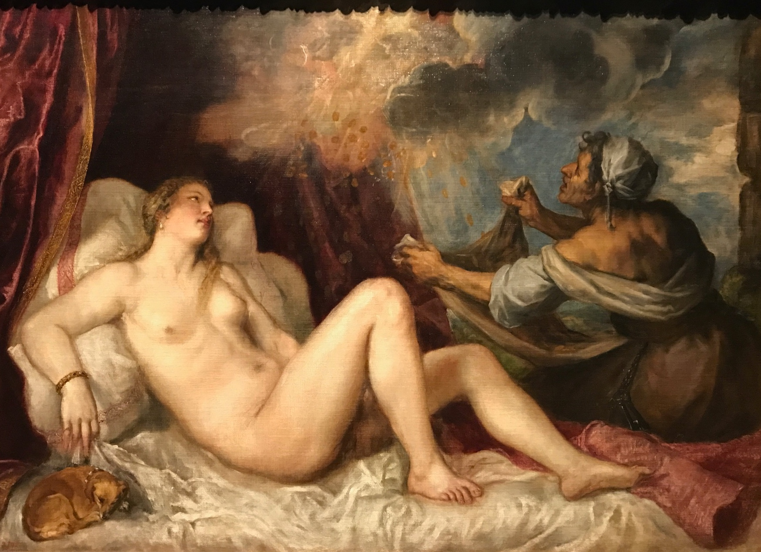
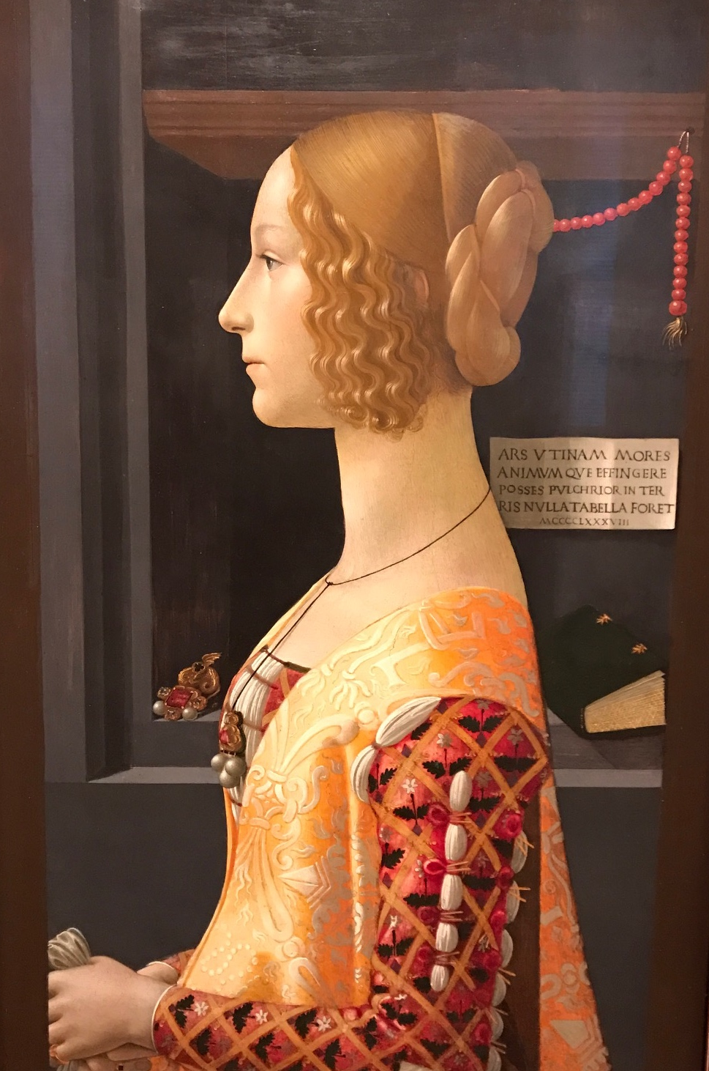



Conclusions
Support from DOE and CERN for CD-1/CD-3a
process highly appreciated.
Good team effort to achieved CD-1/CD-3a in FY17.
  Next goal is to fully develop the new plan and aim for CD-2/CD-3b in late CY18.
Coil and Magnet production continues with good progress
  Delay in MQXFAP1 vertical magnet testing should be over. Need to complete MQXFAP1 since MQXFA02 is coming soon !
LARP CC effort brought to a soft, successful landing.
  RFD team organizing for pre-series cavities in AUP.

