Slide 1
Overview of HiLumi collaborations and status of the options
O. Brüning, B. Di Girolamo, L. Rossi
HL-LHC Annual Meeting – Collaboration Board – Madrid – 13 November 2017

Slide 2
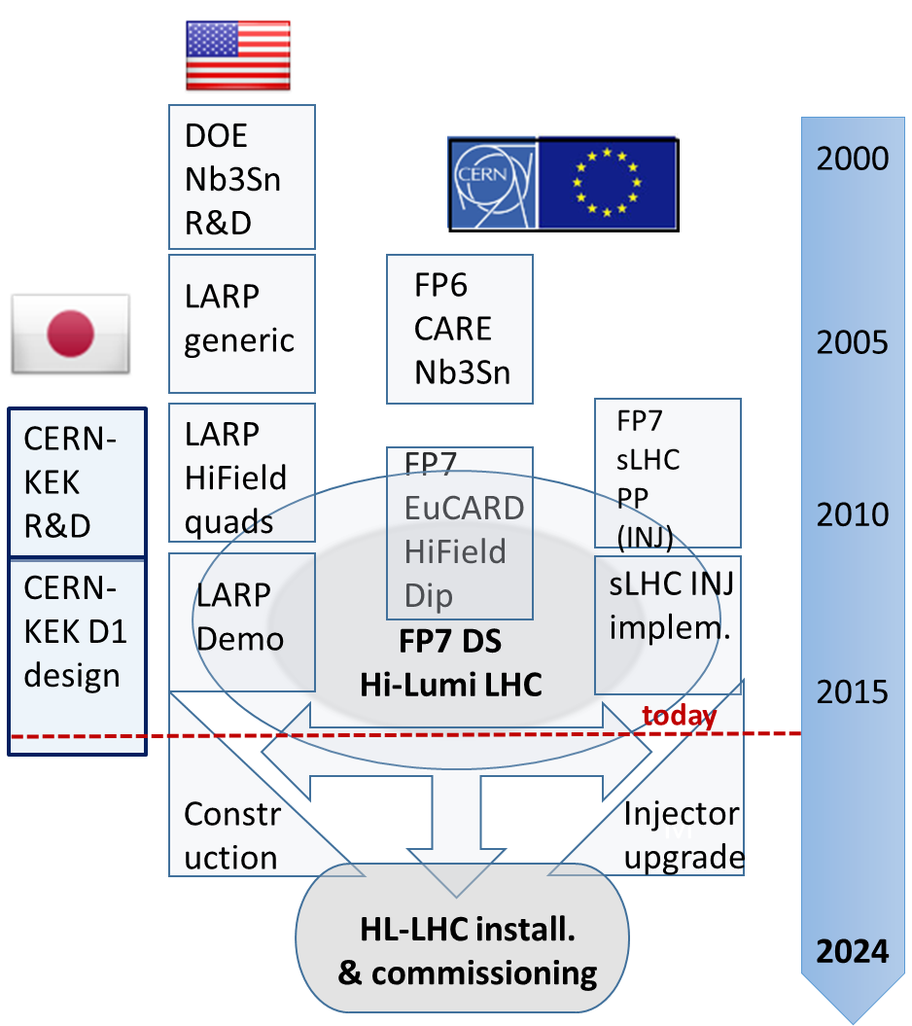
HL-LHC & Collaborations: the long route
Non binding MoU for HL-LHC Collaboration partners with contributions added in addendums
➔
Means for forming a community for the HL-LHC partners
Beyond FP7:
CEA, INFN, UK
CIEMAT, Uppsala
Search for new in-Kind contribution:
Canada/Triumf?
China/IHEP?
Russia/BINP?
Transition from
Design Study to
Construction Project!!

Slide 3
HL-LHC Technical Collaborations
Launched effort for building collaborations beyond the FP7:
  Continuation of collaboration that were started under FP7
  proposals for new in-kind contributions ‘k-contracts’
    ca. 50-50 cost sharing for deliverables plus resource
    contributions for MS / full cost contribution for NMS
Preparation of new general framework / collaboration contract
for the HL-LHC project: MoU
  Non-committing general agreement (no entry or annual fee!)
  Deliverables and commitments specified in dedicated
  addendums

Slide 4
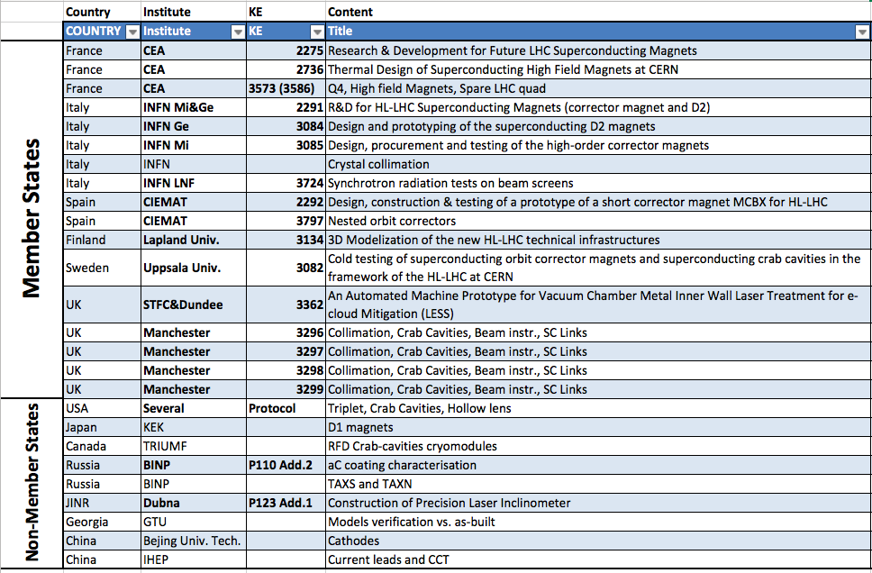
Current Contributions Status
In bold the agreements already signed or being imminently signed

Slide 5
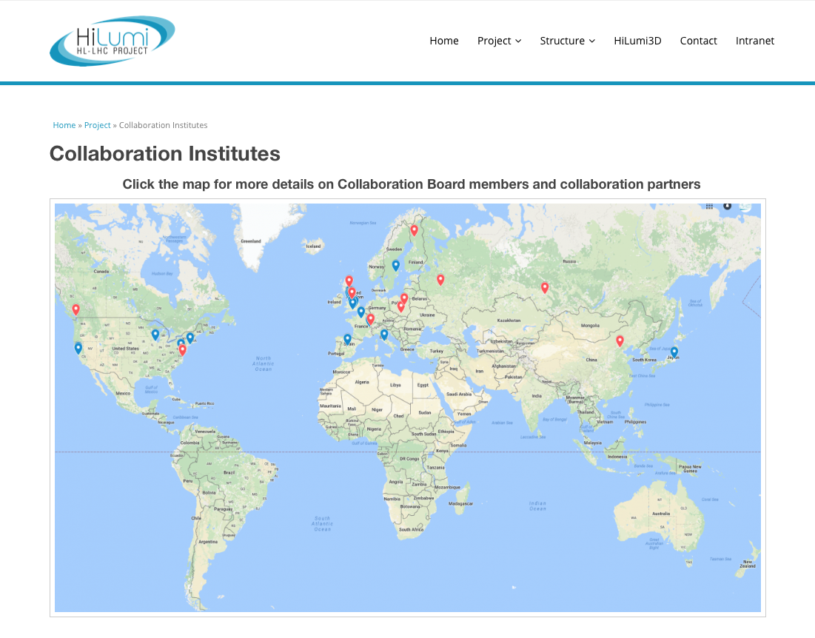
Collaborating Institutes on HL-LHC WEB
O. Bruning, B. Di Girolamo, L. Rossi – HL-LHC Annual meeting in Madrid - 13 November 2017

Slide 6






The Inner Triplet region with in-kinds
Connection to LHC (UL)
Service gallery (UR)
SC Links
Q2a
Q1
TAXS
Q2b
Q3
CP
DFX
D1
DFM

Slide 7


The MS region with in-kinds
UA gallery
Service cavern
(BBLR)
Q4
Crab cavities
D2
Collimators
TAXN

Slide 8
HL-LHC Technical Collaborations
New HL-LHC Collaboration Board:
  First meeting at the annual HL-LHC meeting in Paris in 2016
  Election of the new HL-LHC CB Chairperson:
    Rob Appleby, Manchester University, elected for 2 years
    The HL-LHC CB will meet once per year: today at CIEMAT
        next meeting at CERN?
Existing Collaborations with in-kind contributions:
  9 MS [16 contributions] & 3 NMS signed [+ 6 in preparation] with
  several agreements including multiple deliverables & partners
  e.g. UK (7 partner & 4+ contributions) and
  USLARP (4 members + 2 partner & 5+ contributions)

Slide 9
HL-LHC Project Governance:

Slide 10
HL-LHC Collaboration Board: HLCB
Mandate:
The HL-LHC Collaboration Board [HLCB] is the official forum for information exchange and dialogue between the HL-LHC collaborators, the HL-LHC project management and the CERN management.
The HL-LHC Project Leader will inform the HLCB regularly about the situation of the project, including technical and financial aspects and the overall project schedule, and will make proposals for in-kind contributions and collaboration topics. The HL-LHC collaboration partners will report via the HLCB to the HL-LHC project management and the other collaboration partners about delivery schedule and progress of technical implementations of their contributions or changes in the expected performance scope and reach of their contributions. When needed, the HLCB will discuss measures to cope with technical or financial shortfall, as well with delay of deliverables from the collaboration partners and give advice and recommendations to the project management for the resolution of such issues
➔ The HLCB reports to the HL-LHC Project Leader.

Slide 11
HL-LHC Collaboration Board: HLCB
Organization:
'The chair of the Collaboration Board chairs the HLCB meetings and discussions between the HLCB members. The chair will also communicate any recommendations or advice from the HLCB to the HL-LHC project management’
The chair is appointed for a 2 year mandate but can be re-elected.
Composition:
HL-LHC Collaboration Board consists of one representative per collaborating institute of the HL-LHC project and ex-officio of the HL-LHC project management, i.e., HL PL, HL DPL and the HL Project Office Manager. The Director of the Accelerator and Technology Sector at CERN, or his/her representative, will also be ex-office member.
'Collaboration partners include laboratories and institutes who have either signed directly a HL-LHC collaboration agreement or are part of an overreaching general collaboration agreement and provide either significant in-kind contributions or studies and personnel for the HL-LHC project.'
Institutes that have signed the framework agreement but not a Collaboration agreement with an explicit contribution to HL-LHC can be invited as observers.
Each MoU signatory with explicit contribution has one representative

Slide 12
HL-LHC Collaboration Board
Members
Observers
Name | Institute/University
APOLLINARI, Giorgio | FNAL/LARP
APPLEBY, Rob | University of Manchester
BORDRY, Frederick | CERN
BRUNING, Oliver | CERN
BURT, Graeme | University of Lancaster
EKELOF, Tord | University of Uppsala
FABBRICATORE, Pasquale | INFN Genova
GARCIA, Luis | CIEMAT
GIBSON, Stephen | Royal Holloway University
OGITSU, Toru | KEK
PRESTEMON, Soren | LBNL
RAUBENHEIMER, Tor | SLAC
ROSSI, Lucio | CERN
SORBI, Massimo | INFN LASA
TAVIAN, Laurent | CERN
VEDRINE, Pierre | CEA
WANDERER, Peter | BNL
WELSCH, Carsten | University of Liverpool
WHEELHOUSE, Alan | STFC
YANG, Yifeng | University of Southampton
Name | Institute/University
ABDOLVAND, Amin | University of Dundee
BARLOW, Roger | University of Huddersfield
BUGADOV, Julian | JINR
DELAYEN, Jean | JLAB
DELAYEN, Jean | ODU
KARLSSON, Kenneth | LAPIN AMK
KESTER, Oliver | TRIUMF
LEVICHEV, Eugene | BINP
RIVKIN, Lenny | EPFL
SYNTFELD-KAZUCH, Agnieszka | NCBJ
WANG, Yifang | IHEP CAS
Invited
Name | Institute/University
RATOFF, Peter | Cockcroft Institute
ROLLI, Simona | DOE – US HL-LHC AUP
STRAUSS, Bruce | DOE - LARP
ZOCCOLI, Antonio | INFN

Slide 13
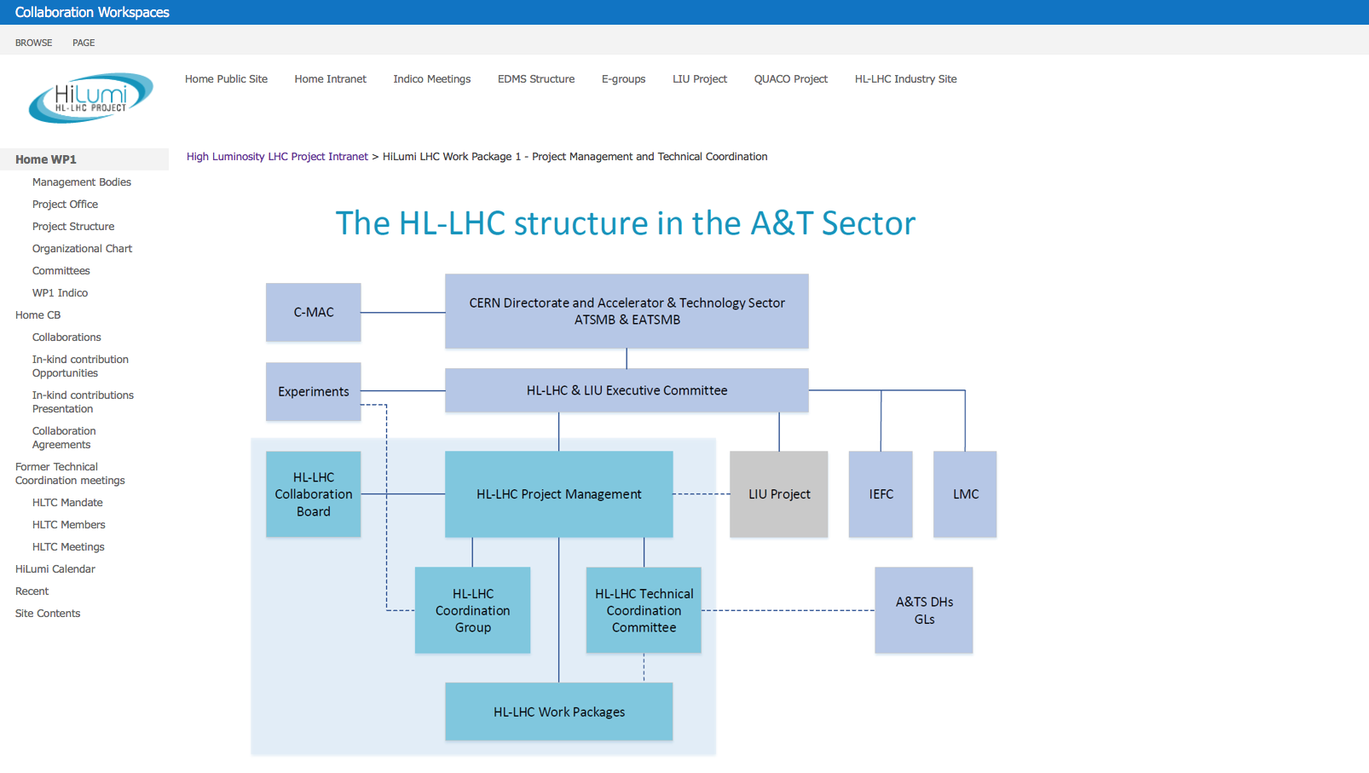
HL-LHC Intranet Page:
https://espace.cern.ch/HiLumi/WP1/default.aspx

Slide 14
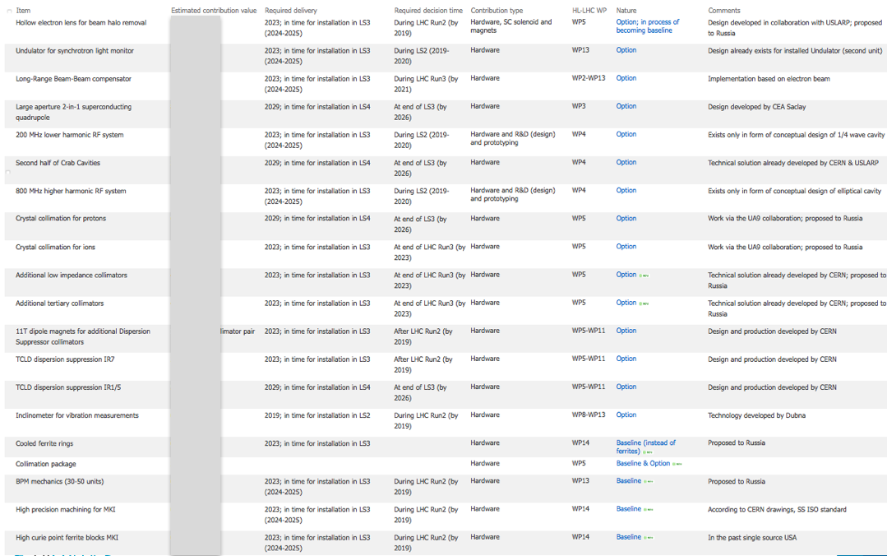
Excel Table for in-kind contributions:

Slide 15
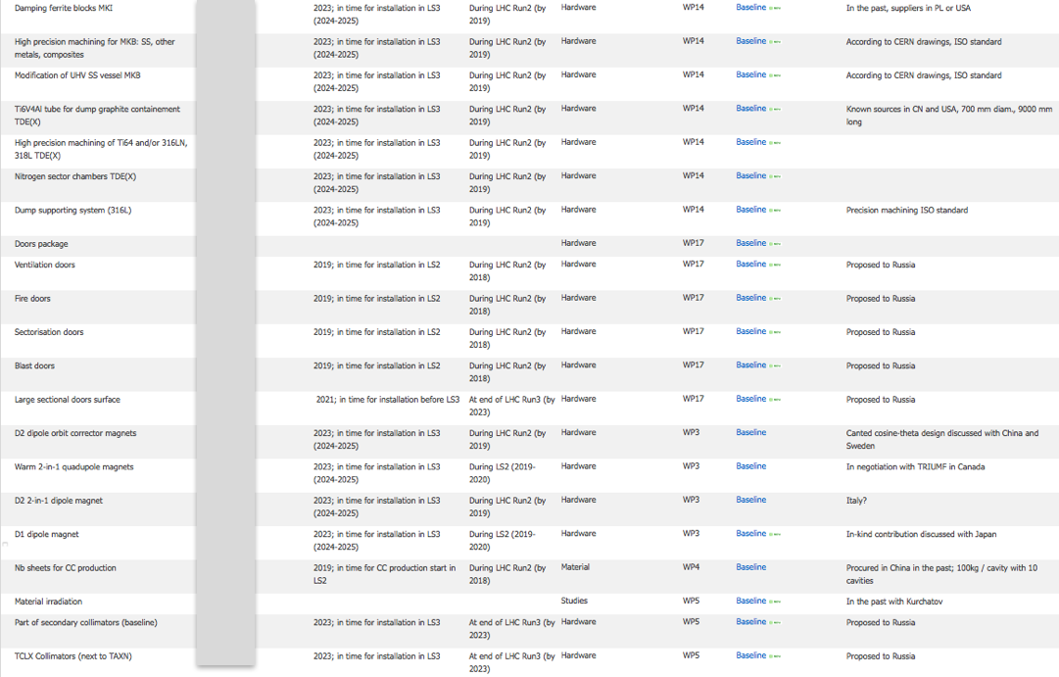
Excel Table for in-kind contributions:

Slide 16
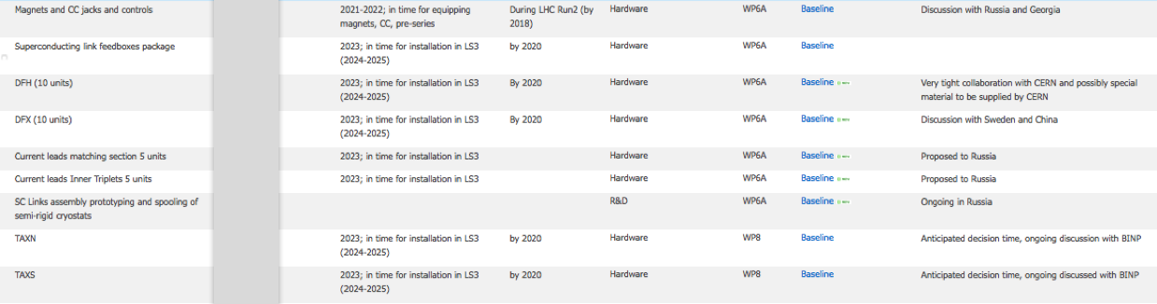
Excel Table for in-kind contributions:

Slide 17
New Collaboration Agreement: MoU
New multi party MoU [finished and ready for distribution] specifies explicitly for each partner institute the general link persons for the general, non-committing part of the agreement
-dynamic list of laboratory representatives
-dynamic list of contributions and deliverables
Collaboration partners will receive automatic updates of the membership list whenever a new partner signs the agreement
-transparent membership list
Concrete deliverables that imply commitment from the partner institutes are described in dedicated addendums
-safety link person
-technical expert

Slide 18
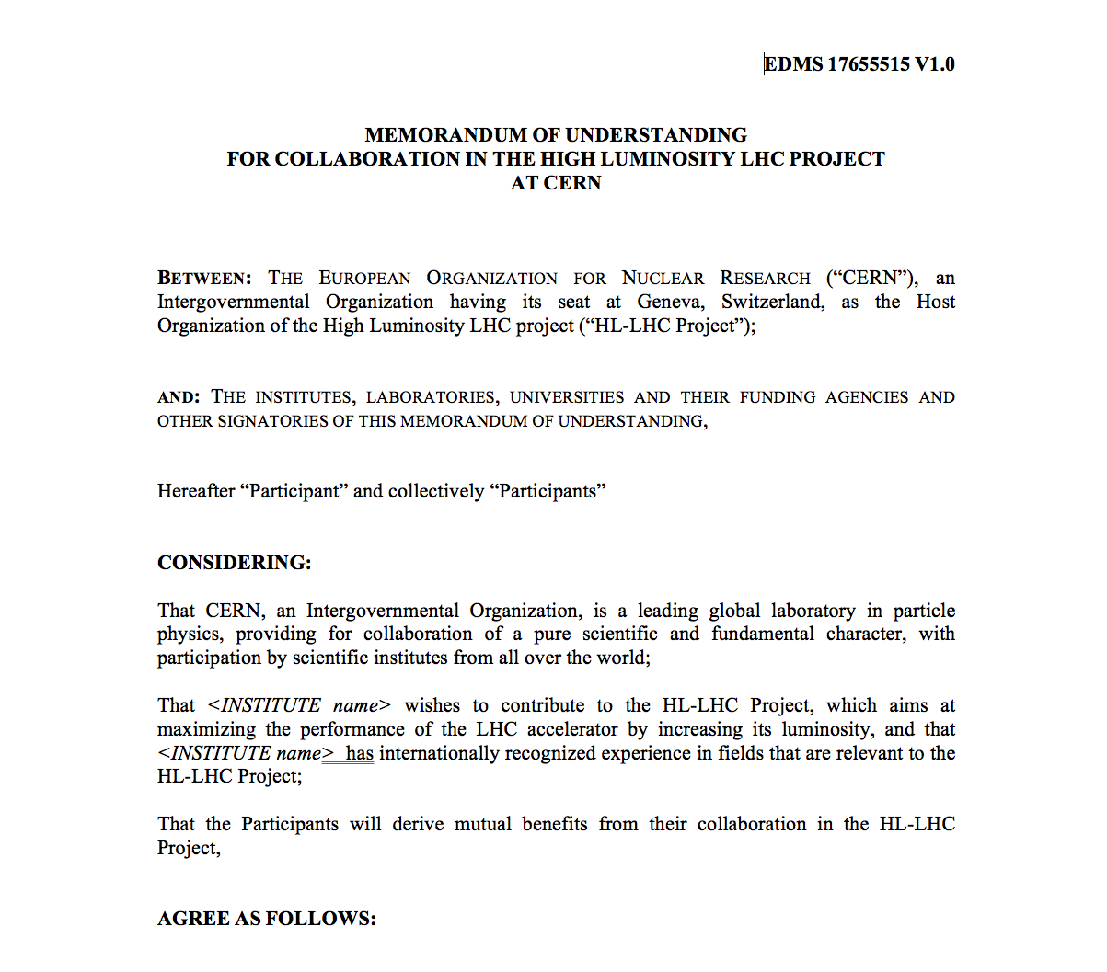
Memorandum of understanding

Slide 19
Status of MoU and Agreements in one table

Slide 20
Contributions summary table

Slide 21
Conclusions
The HL-LHC project is becoming a construction project
Time is running and it is time to close the loop: In-kind contributions contributions have to be finalized very very soon
More opportunities are available:
baseline [e.g. D2] and options [e.g. hollow e-lens]!
What will not be covered by collaboration agreements will go to industry via normal procurement processes

Slide 22


Slide 23
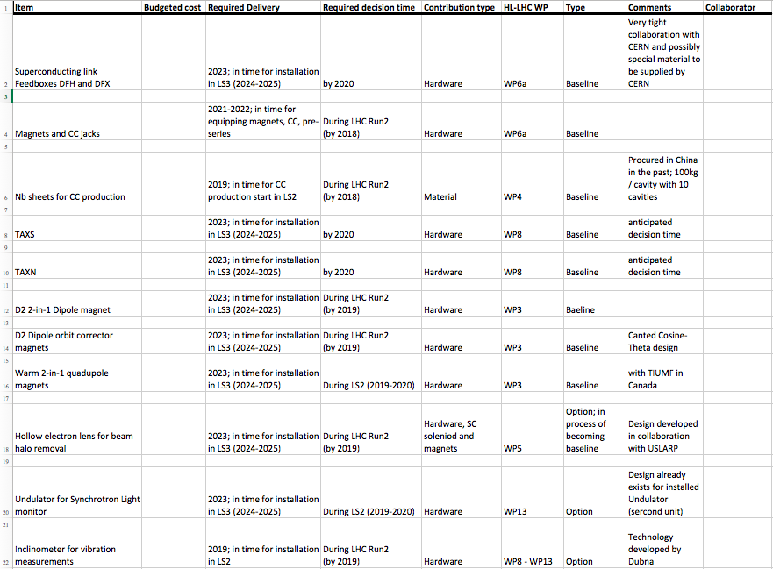
Excel Table for in-kind contributions:

Slide 24
Memorandum of Understanding
We had a pilot circulation of the MoU text to few institutes
We are launching a second wave for everybody
We also have the first example of:
  An addendum for expert support, not used so far
  An addendum for a hardware contribution: cathodes R&D with BJUT China
  They are the basis for future addenda
The advantage is in the higher flexibility given by the long validity of the frame document

