Slide 1
Update on the HiLumi/LIU parameters and performance ramp up after LS2
G. Rumolo and M. Meddahi
LIU-PT: R. Alemany, D. Carloni, J. Coupard, H. Damerau, A. Funken, B. Goddard, K. Hanke, A. Lombardi, B. Mikulec, F. Pedrosa, R. Scrivens, E. Shaposhnikova
LIU beam parameters and beam commissioning: H. Bartosik, V. Kain
    Outline:
    Recap of LIU baseline
    Proton and Pb ion beam parameters
      Targets and present status
    Post-LS2 beam commissioning milestones

Slide 2
Present LIU baseline I
(main items)
PSB
  Connection to Linac4 → New H⁻ charge exchange injection at 160 MeV from Linac4 to double brightness of LHC beams
  Acceleration to 2 GeV
    New main power supply POPS-B
    Replacement of C02-C04-C16 RF systems by Finemet based RF system
Linac3 + LEIR
  Source and LEBT improvements to increase current from Linac3 and improve reproducibility
  Intensive studies on LEIR modeling and monitoring to increase transmission
  100 ms injection rate into LEIR to accumulate larger current

Slide 3
Present LIU baseline II
(main items)
PS
  New injection at 2 GeV for protons to mitigate space charge
  RF improvements to improve beam quality and increase longitudinal coupled bunch instability threshold
    Impedance reduction of the RF systems
    Installation of new Finemet RF system as longitudinal feedback
  Operational deployment of transverse feedback system
SPS
  200 MHz RF system upgrade
    Power upgrade and rearrangement of cavities
    New LLRF including slip stacking capability
  Electron cloud mitigation and impedance reduction to increase intensity reach
    a-C coating of QFs + one full arc
    QF-type flange shielding and HOM damping in 200 MHz cavities
  New beam dump system in LSS5 and new design of protection devices to comply with the target HL-LHC beam parameter values

Slide 4
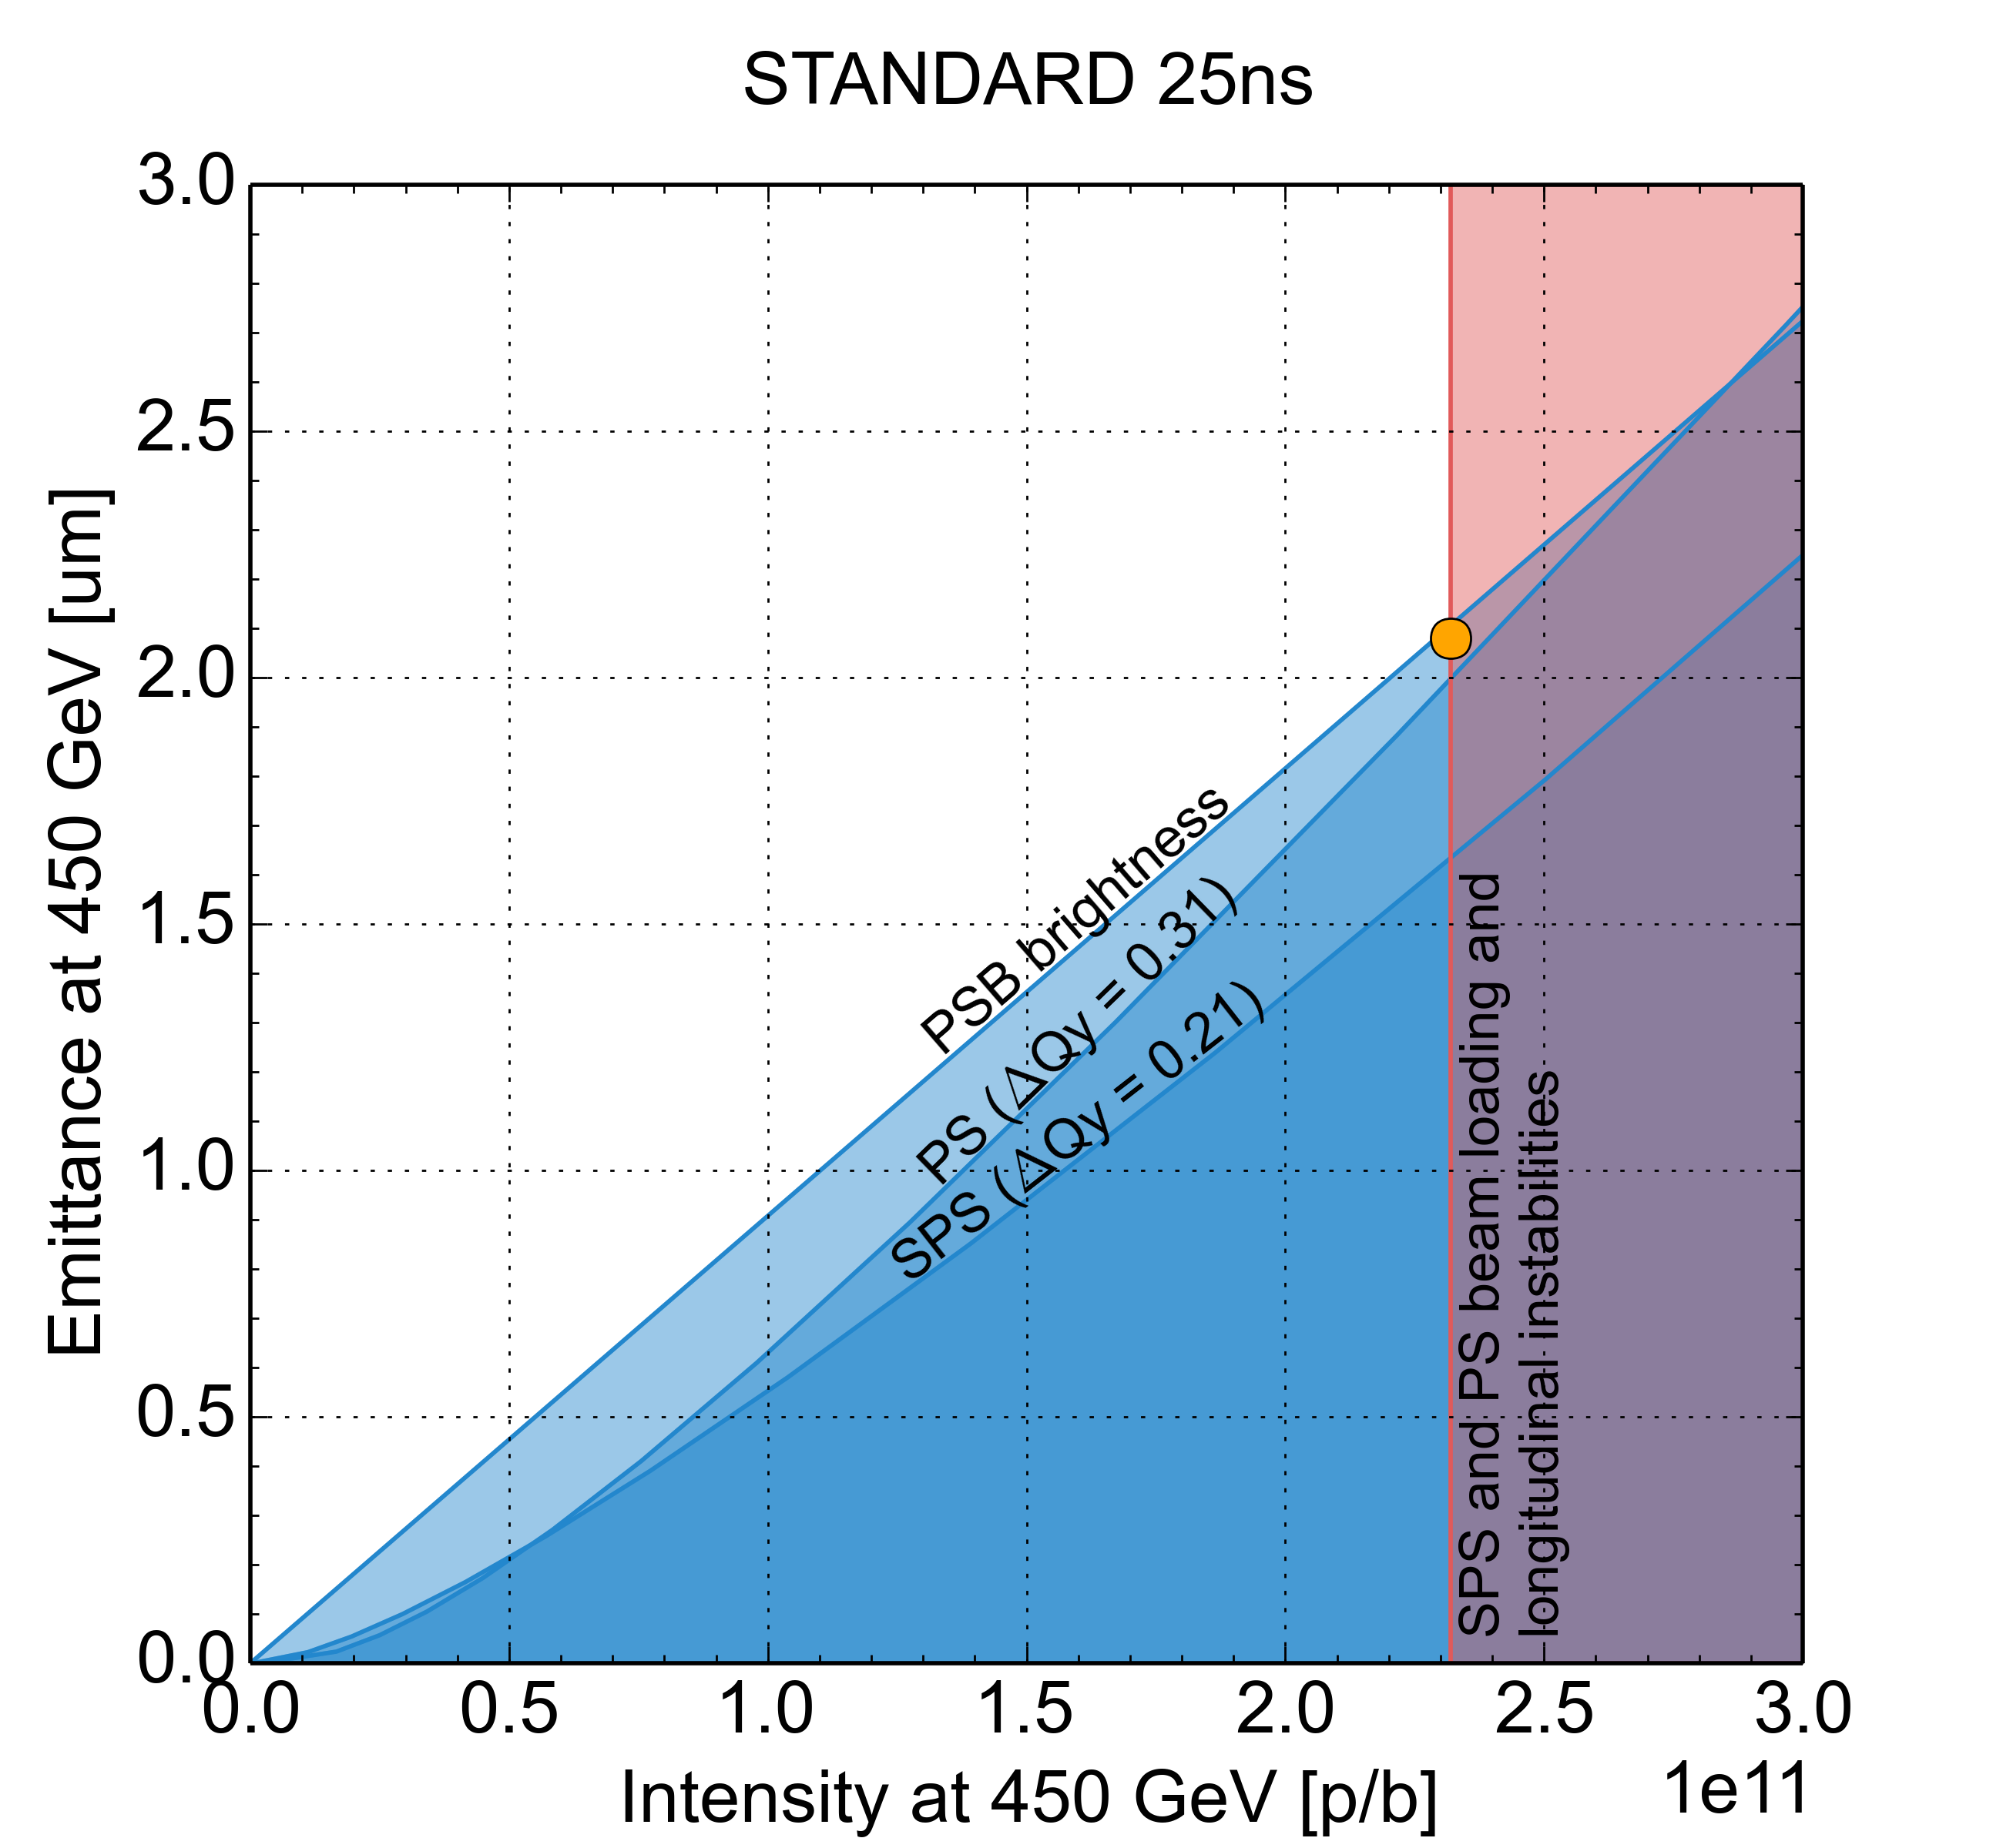
LIU performance reach for protons
Beam loss and emittance blow up budgets
PSB brightness + intensity limitations in PS and SPS inferred from simulations
Space charge limitation curves in PS and SPS based on assumed tune spreads and optimised beam parameters at transfers
budget | PS | SPS
losses | 5% | 10%
blow-up | 5% | 10%
HL-LHC
request
 | PS | SPS
ΔQ_{V, max} | 0.31 | 0.21

Slide 5

LIU performance reach for protons
Beam loss and emittance blow up budgets
PSB brightness + intensity limitations in PS and SPS inferred from simulations
Space charge limitation curves in PS and SPS based on assumed tune spreads and optimised beam parameters at transfers
budget | PS | SPS
losses | 5% | 10%
blow-up | 5% | 10%
HL-LHC
request
Details of beam parameters at injection in all machines can be found in this document
At SPS extraction:
 | N (x 10¹¹ p/b) | ε (μm)
LIU/HL-LHC | 2.3 | 2.1
 | PS | SPS
ΔQ_{V, max} | 0.31 | 0.21

Slide 6
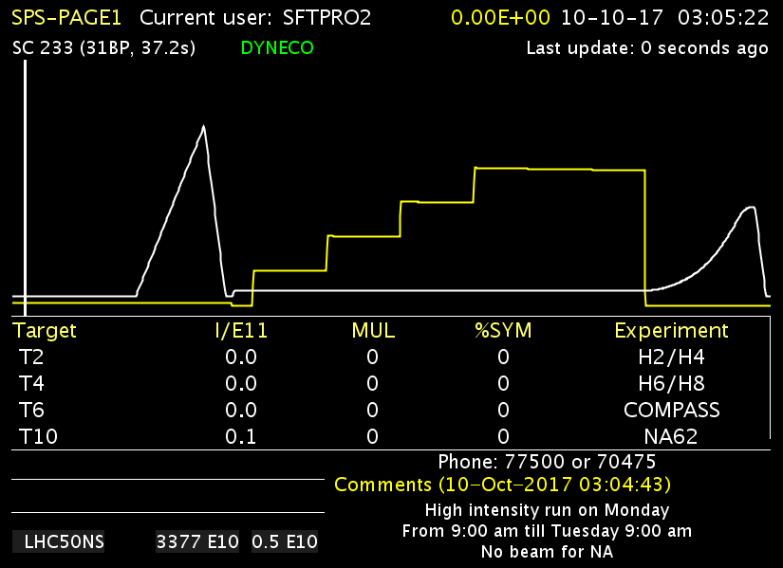
Where we are standing (protons)
Intensity limitation: experience from high intensity run 2017
  2e11 p/b injected into SPS in trains of 48 and 72 bunches (BCMS and standard) and kept along a long energy plateau at 26 GeV/c

Slide 7
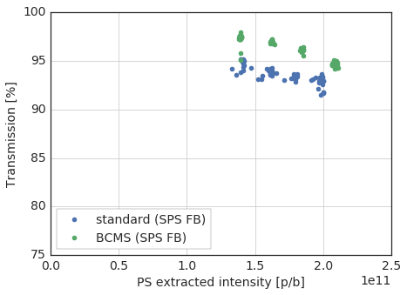
Where we are standing (protons)
Intensity limitation: experience from high intensity run 2017
  2e11 p/b injected into SPS in trains of 48 and 72 bunches (BCMS and standard) and kept along a long energy plateau at 26 GeV/c
  Some encouraging observations:
    Excellent beam quality from PS up to this intensity
    No important e-cloud signs in SPS, coupled bunch instability observed in 2015 not an issue
    SPS losses at 26 GeV/c increase with intensity, but also with transverse emittance
Measured transmission (%) along SPS flat bottom

Slide 8
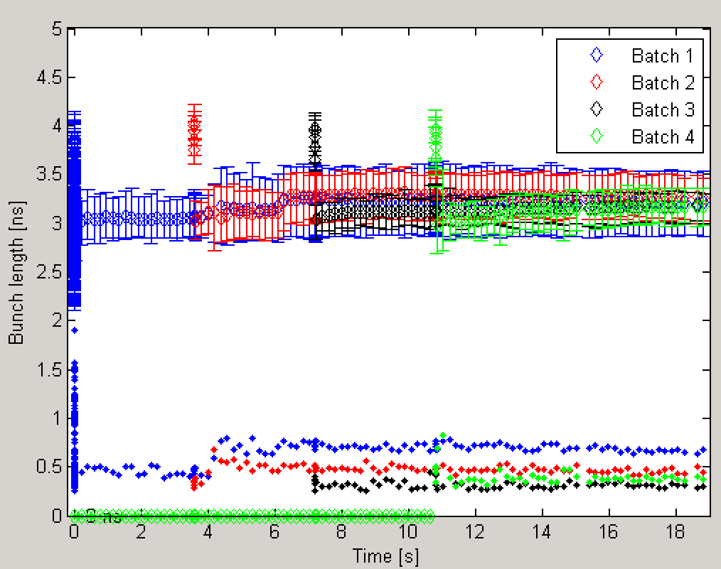
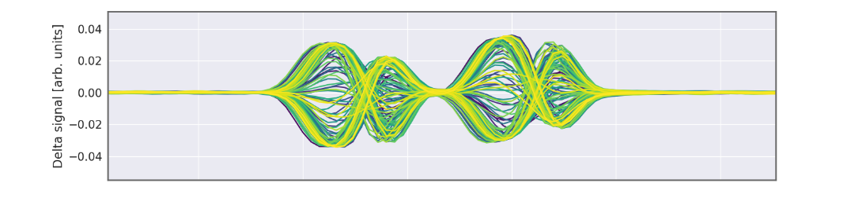
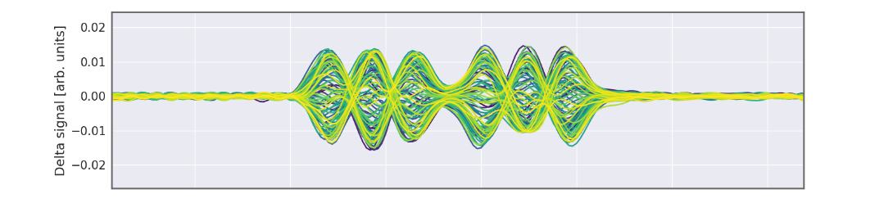
Where we are standing (protons)
Intensity limitation: experience from high intensity run 2017
  2e11 p/b injected into SPS in trains of 48 and 72 bunches (BCMS and standard) and kept along a long energy plateau at 26 GeV/c
  Some encouraging observations:
    Excellent beam quality from PS up to this intensity
    No important e-cloud signs in SPS, coupled bunch instability observed in 2015 not an issue
    SPS losses at 26 GeV/c increase with intensity, but also with transverse emittance
  Still quite some work to do:
    Even with fully deployed longitudinal feedback, PS cannot provide higher intensity
    Transverse single bunch and longitudinal instabilities in SPS
Measured horizontal intra-bunch oscillations
ξ_{H} ~ 0.1 – 0.2
Bunch lengthening seen after injection of second batch
ξ_{H} ~ 0.3 – 0.5

Slide 9
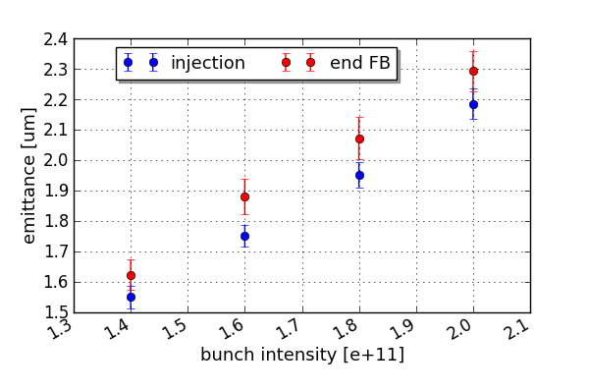
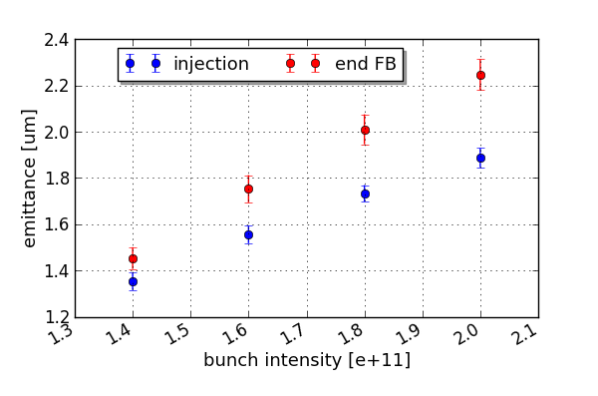
Where we are standing (protons)
Brightness limitation: experience from 2017
  Emittance blow up at PSB-PS transfer intensively under study
    Observed also on operational beams
    No benefit observed when transferring large longitudinal emittances
    Many potential contributors (mismatch, injection scheme, space charge, accuracy of measurements)
  Emittance blow up in the SPS
    Increasing with increasing intensity in the vertical plane
    Mechanism to be understood
H plane
V plane

Slide 10
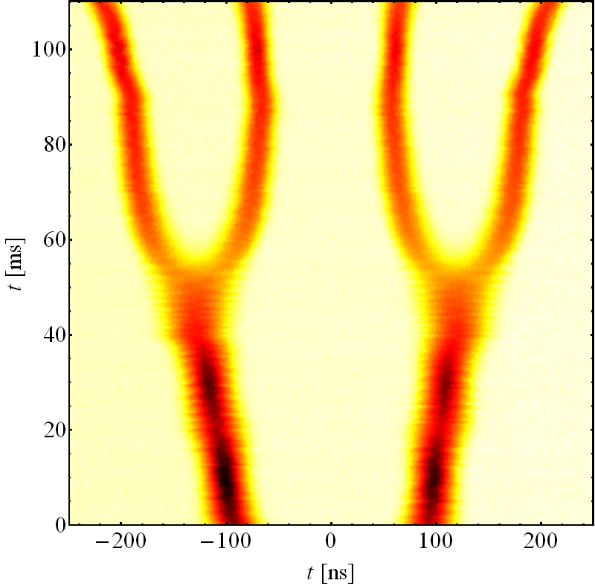
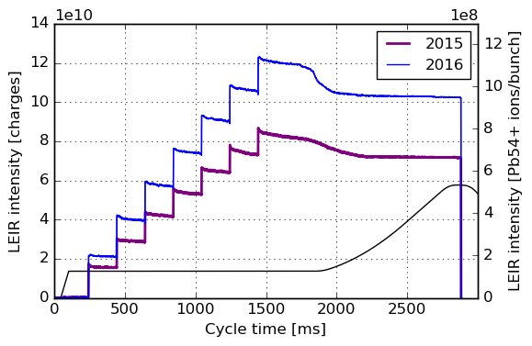
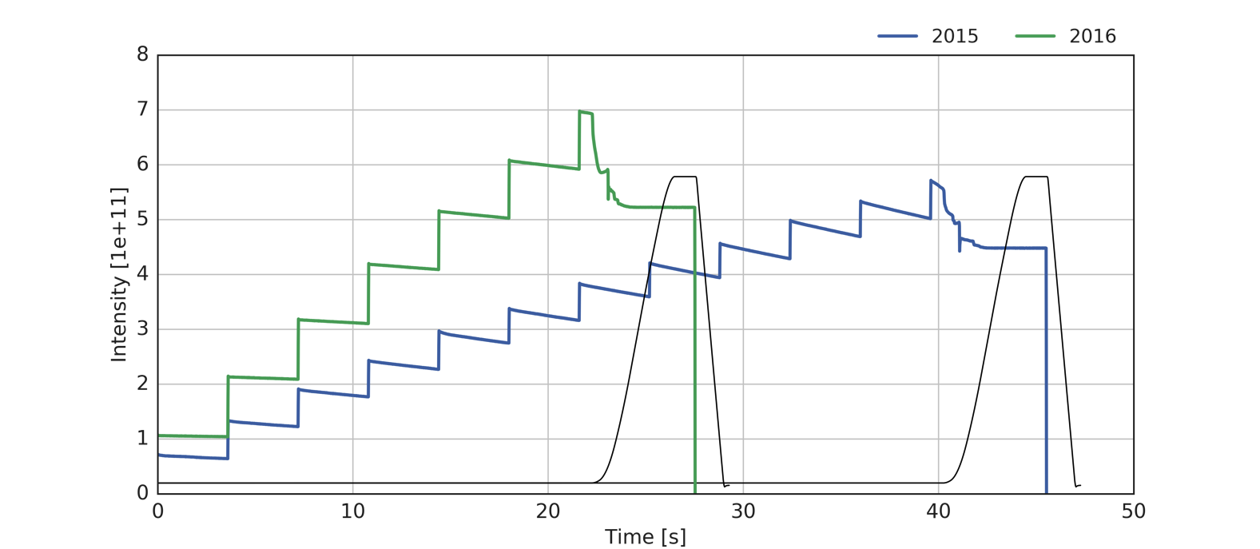
LIU performance reach for Pb ions
Intensive study program in 2015-2016 across injector chain
  Performance in 2015 was already outstanding thanks to improved LEIR performance
  Performance in 2016 was pushed even further thanks to improvements in source + Linac3, continued LEIR studies, bunch splitting in PS, 7 injections in SPS
PS
LEIR
SPS
4 bunches per injection
2 bunches per injection
Pre-2015
RF capture

Slide 11
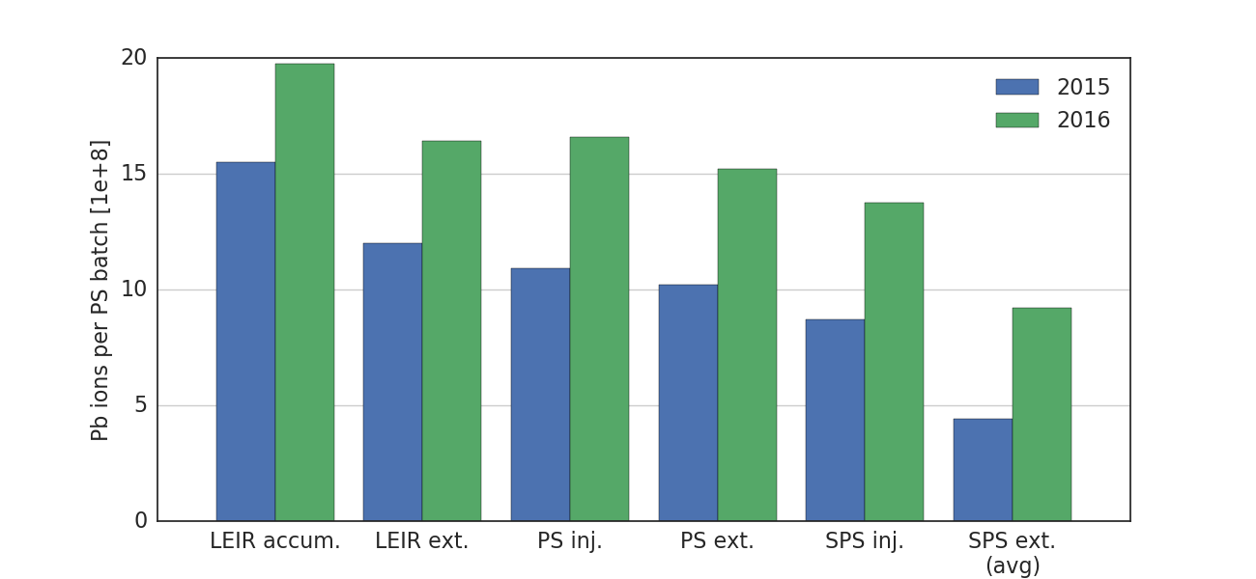
LIU performance reach for Pb ions
Intensive study program in 2015-2016 across injector chain
  Performance in 2015 was already outstanding thanks to improved LEIR performance
  Performance in 2016 was pushed even further thanks to improvements in source + Linac3, continued LEIR studies, bunch splitting in PS, 7 injections in SPS

Slide 12

LIU performance reach for Pb ions
Intensive study program in 2015-2016 across injector chain
  Performance in 2015 was already outstanding thanks to improved LEIR performance
  Performance in 2016 was pushed even further thanks to improvements in source + Linac3, continued LEIR studies, bunch splitting in PS, 7 injections in SPS
Baseline LIU Pb ion parameters compliant with HL-LHC request
  Single bunch parameters at SPS extraction from 2016 experience translate into requested ones when including additional losses in SPS due to longer injection plateau and slip stacking
  Number of bunches can be achieved including slip stacking in the SPS (otherwise only 60% of integrated lumi target)
 | N (x 10⁸ ions/b) | ε (μm) | # of bunches
Achieved | 2.2 | 1.5 | 548
LIU/HL-LHC | 1.9 | 1.5 | 1248

Slide 13
LIU timeline and milestones
Activities until LS2
  Beam studies to further test performance, evaluate risks and study mitigations
  Final design, procurement and test of hardware (e.g. protection devices, cables, power converters, amplifiers)
  Anticipated installation/cabling work during YETS
  Work on surface (e.g. civil engineering, racks), Linac4 Reliability Run & commissioning to desired performance
Main LIU installations and hardware work during LS2
Beam commissioning of LIU beams after LS2
  Ion beams to be ready for 2021 LHC ion run
  Proton beams during Run 3 to be ready for LHC physics after LS3
Run 2
Run 2
LS 2
LS 2
Run 4

Slide 14
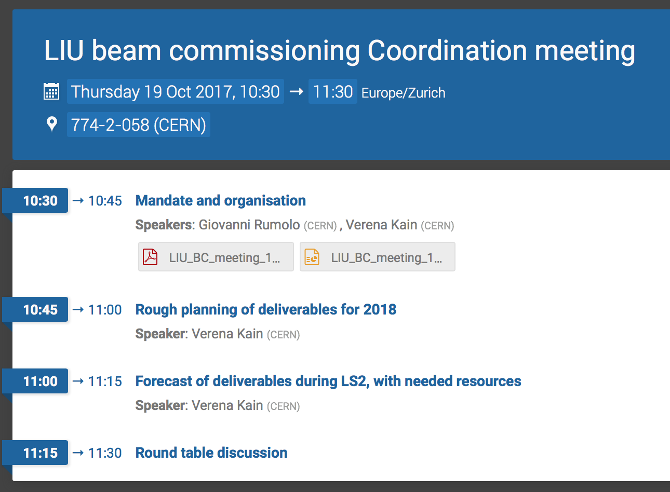
Post-LS2 beam commissioning
The first year of Run 3 (2021) will have to be fully devoted to
  Recovery of needed pre-LS2 proton beams (LHC and FT) with all new LIU (and CONS) equipment
  Production of Pb ion beams with slip stacking in SPS for 2021 ion run
2020-21
Commissioning of pre-LS2 beams with Linac4 and newly installed equipment + commissioning of the Pb ion beams with slip stacking in SPS

Slide 15
Post-LS2 beam commissioning
The first year of Run 3 (2021) will have to be fully devoted to
  Recovery of needed pre-LS2 proton beams (LHC and FT) with all new LIU (and CONS) equipment
  Production of Pb ion beams with slip stacking in SPS for 2021 ion run
2022 should be devoted to accelerating 2e11 p/b in the SPS
  Build on 2017-18 experience
  Overcome stability issues in PS-SPS in new operating conditions + acceleration in SPS
Further intensity steps (additional 15% and 10%) in 2023 and 2024
  These intensity steps are unprecedented and will require dedicated scrubbing runs in the SPS and fine transverse and longitudinal optimisations
  While high intensity is being commissioned, corrective actions could be applied in YETS’s or planned for LS3, as identified and needed.
2020-21
2022
Commissioning of pre-LS2 beams with Linac4 and newly installed equipment + commissioning of the Pb ion beams with slip stacking in SPS
Commissioning of 1.8 10¹¹ p/b with the desired brightness and loss budgets out of SPS
2023
2024
Commissioning of 2.1 10¹¹ p/b up to SPS extraction and tests of higher intensity at least up to the SPS injection
Commissioning of 2.3 10¹¹ p/b up to SPS extraction with the desired brightness and loss budgets

Slide 16
Conclusions
LIU beam performance with baseline upgrades has been analysed leading to the estimation of robust beam parameter sets
  Future operation scenarios are based on simulations and present knowledge of the machines – constant improvement and validation with better simulations and machine studies using already installed hardware
  LIU beam parameters match HL-LHC requests both for protons and ions
  Performance risk items have been identified for both protons (intensity limitation in PS, losses in SPS) and ions (slip stacking in SPS) and mitigations are under study
Beam commissioning after LS2 will mainly follow physics requests
  LHC and FT proton beams re-commissioned to pre-LS2 performance with new hardware in 2020-2021
  Ion beams to be commissioned to full LIU performance in 2021
  Gradual intensity ramp up of LHC beams to LIU/HL-LHC values over Run 3
  Beam commissioning working group for injectors to prepare, coordinate and oversee post-LS2 return to operation and beam production to LIU specifications
Notes:
has started operating to define procedures applications and tools necessary to guarantee smooth start up and beam commissioning for all machines after LS2

Slide 17

THANK YOU FOR YOUR ATTENTION!

Slide 18
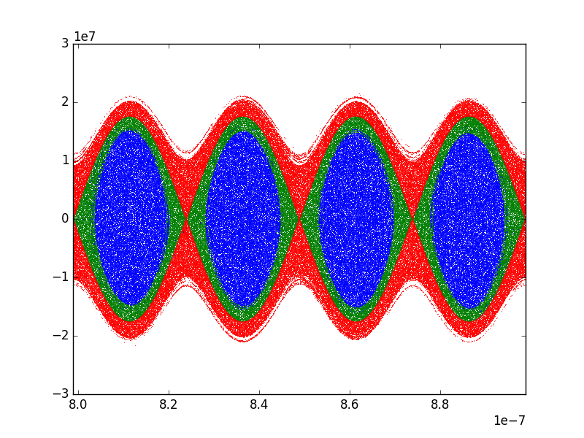
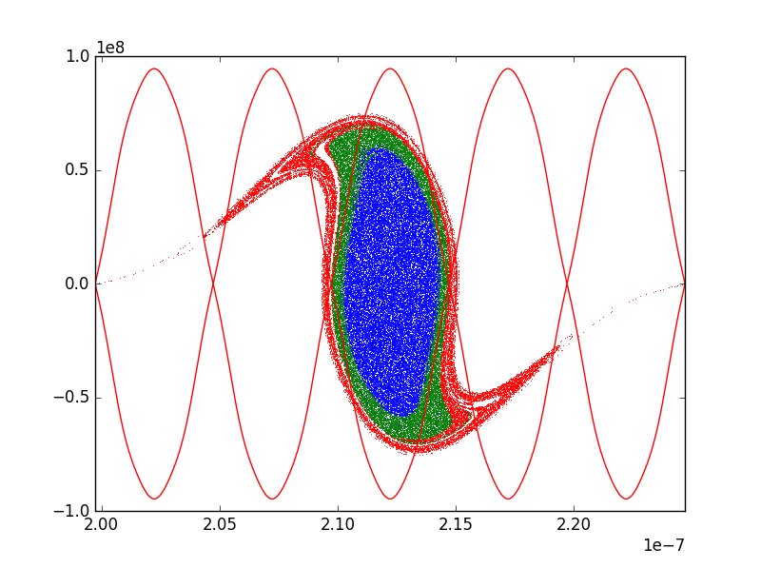
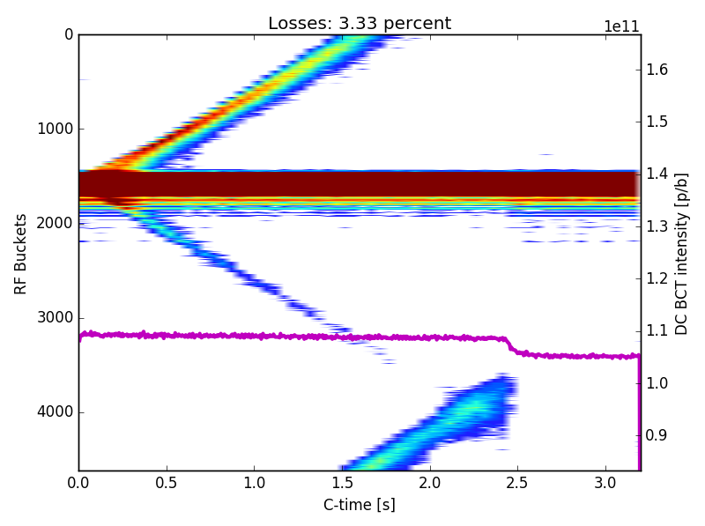
SPS losses
A. Lasheen

Slide 19
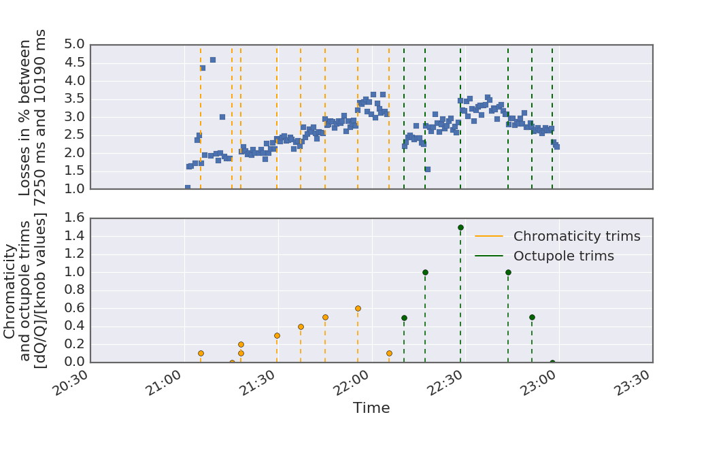
SPS losses
K. Li

Slide 20
SPS momentum aperture
Aperture measurement:
+0.76 % / -0.59 %
Optics | dp/p [%] | Aperture [σ]
Q20 | +0.76 / -0.59 | +4.9 / - 3.8
Q22 | +0.9 / - 0.73 | + 5.8 / - 4.8
Q26 | +1.7 / - 1.3 | +10.5 / - 8.3
V. Kain

Slide 21
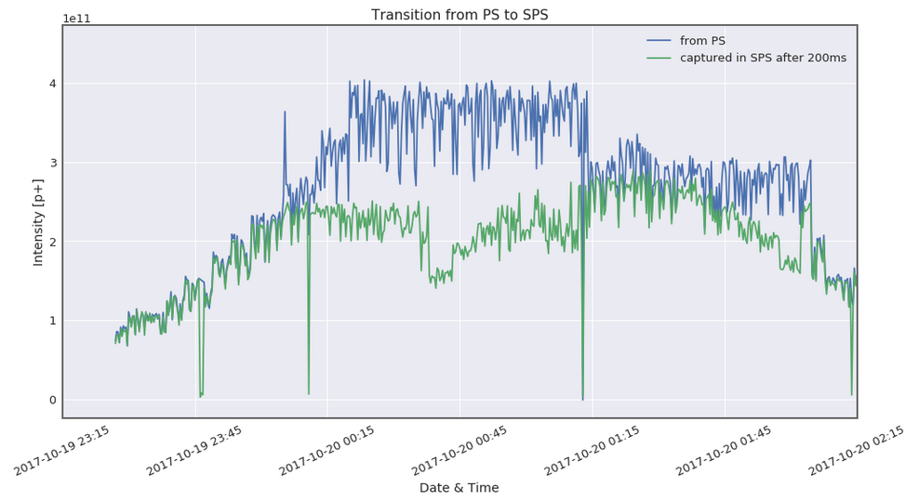
Q22 TMCI
Threshold at 2.7 MV around 2.4e11
V. Kain
H. Bartosik

Slide 22
Emittance blow up in PS
Challenging LIU baseline
  transfer of bunches with large longitudinal emittance (3.0 eVs)
Observation in 2016: significant blow-up of the horizontal emittance at injection
F. Asvesta, H. Bartosik

