Slide 1
Status of the short nested orbit corrector MCBXFB prototype
Pablo Abramian, Jesús Calero, Jesús Ángel García-Matos, Pablo Gómez, Jose Luis Gutiérrez, Luis García-Tabarés, Daniel López, Luis Miguel Martínez, Javier Munilla and Fernando Toral (CIEMAT)
Nicolas Bourcey, Susana Izquierdo Bermudez, Juan Carlos Pérez and Ezio Todesco (CERN)
13th November 2017

Slide 2
Outline
Final magnetic design
Final mechanical design
Short mechanical model
Prototype fabrication
Conclusions

Slide 3
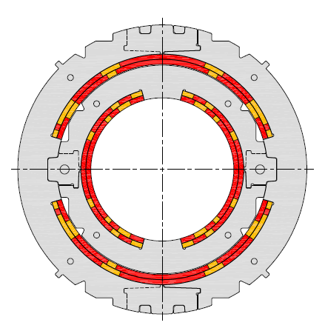
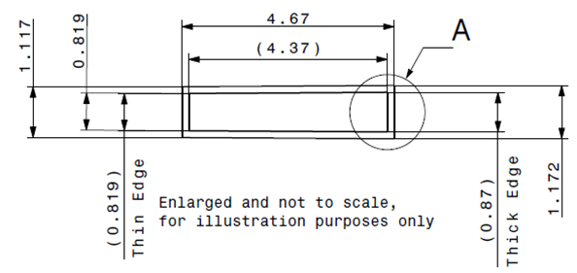
Magnet and cable specifications
MCBXFB Technical specifications
Magnet configuration | Combined dipole (Operation in X-Y square)
Integrated field | 2.5 Tm
Minimum free aperture | 150 mm
Nominal current | < 2500 A
Radiation resistance | 35 MGy
Physical length | < 1.505 m
Working temperature | 1.9 K
Iron geometry | MQXF iron holes
Field quality | < 10 units (1E-4)
Fringe field | < 40 mT (Out of the Cryostat)
Vertical dipole field
(2.1 T)
Combined
dipole field
(Variable orientation)
Horizontal
dipole field
(2.1 T)
Cable Parameters
No. of strands | 18
Strand diameter | 0.48 mm
Cable thickness | 0.845 mm
Cable width | 4.37 mm
Key-stone angle | 0.67º
Cu:Sc | 1.75

Slide 4
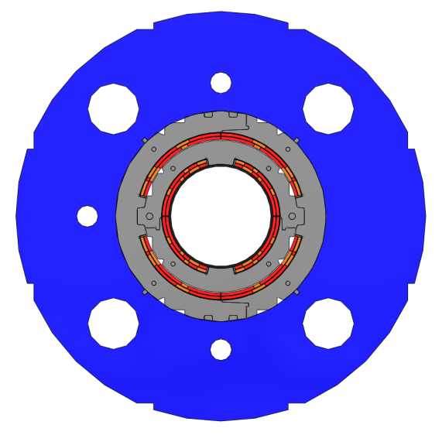
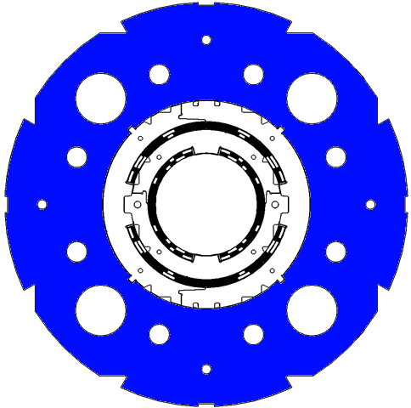

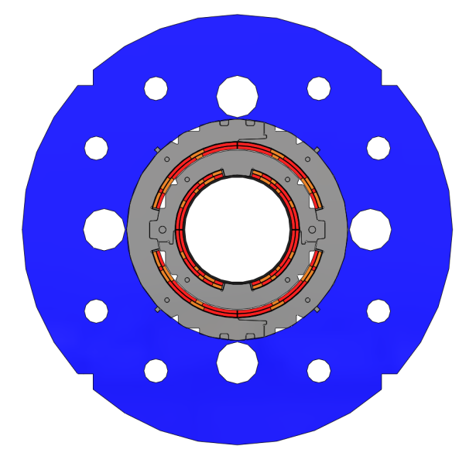
Final iron geometry
PREVIOUS DESIGNS
Rod holes
Cooling channel
(Ø77 mm)
MCBXFB
MCBXFA
Support
&
Handling
Holes for elastic pins
Welding
housing

Slide 5
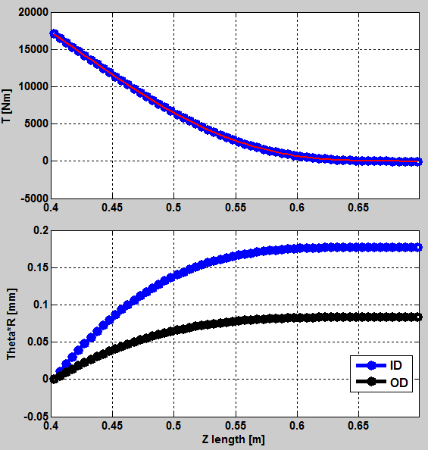
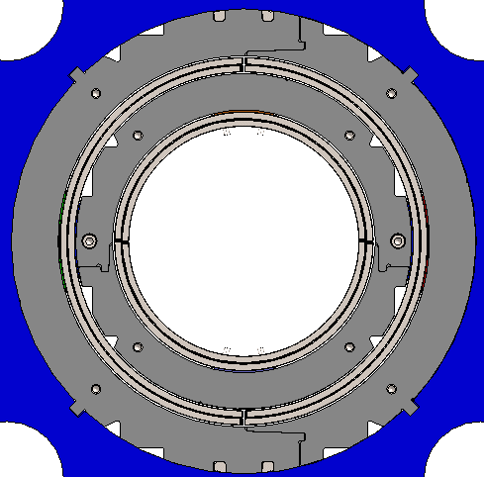
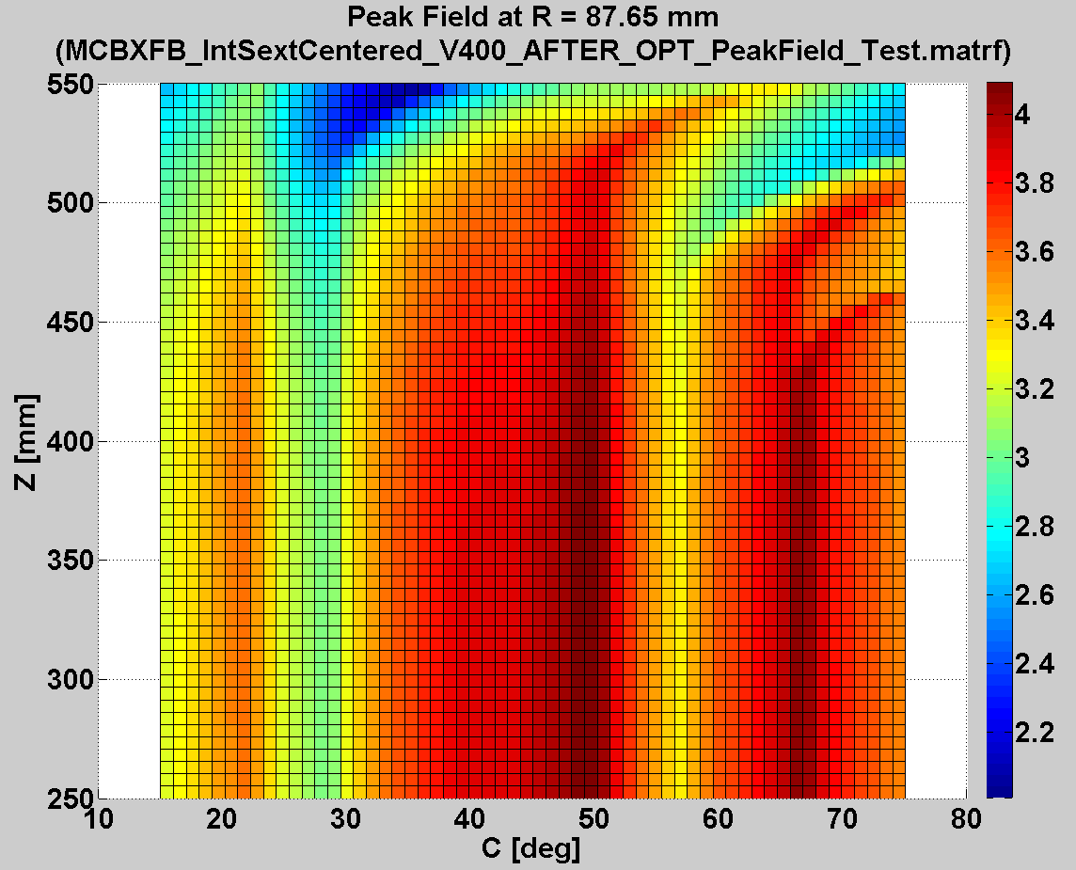
Detailed magnetic design:
Torque and peak field at coil ends
Torque cannot be azimuthally locked at coil ends.
Coil ends should be shortened to improve the torque clamping.
Look out endspacers not to be too slender.
Field is not aligned with coil poles at nominal current (45º orientation)
Peak field is always at the straight section.

Slide 6
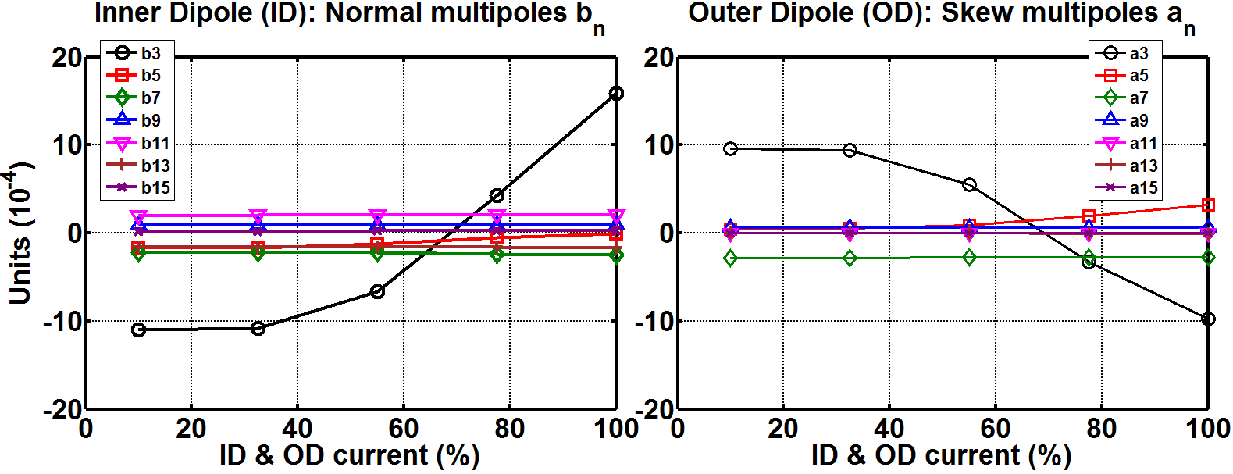
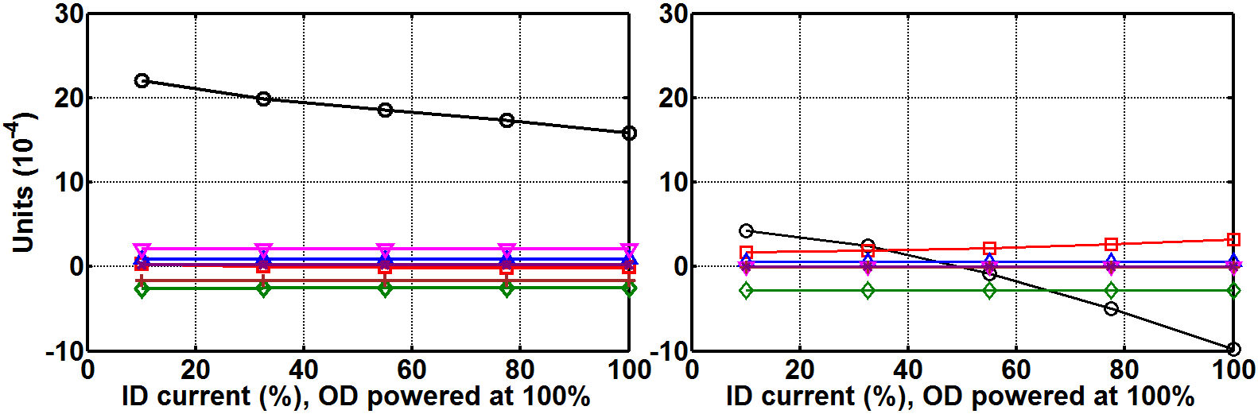
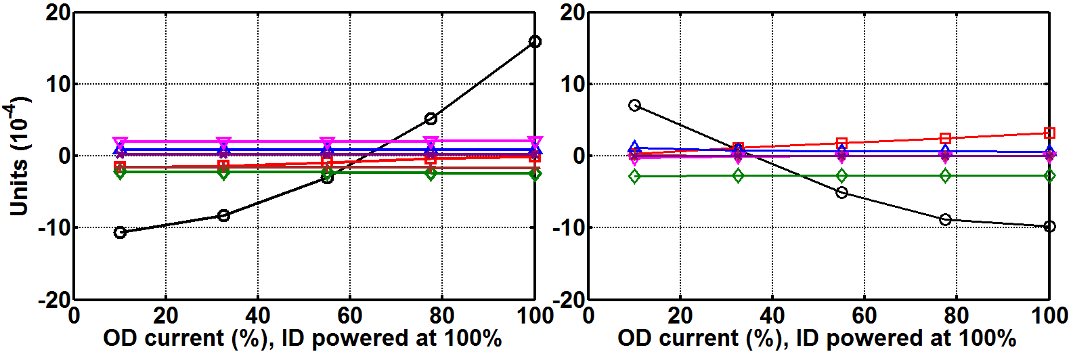
Detailed magnetic design:
Computation strategy and field quality
Optimization needed for any powering scenario
(infinite cases)
Reduced to only three powering scenarios
Each case takes like an hour to compute (3D iron)
The optimization is performed without iron.
The objectives are shifted to take it into account.
< 10 units required

Slide 7
Outline
Final magnetic design
Final mechanical design
Short mechanical model
Prototype fabrication
Conclusions

Slide 8
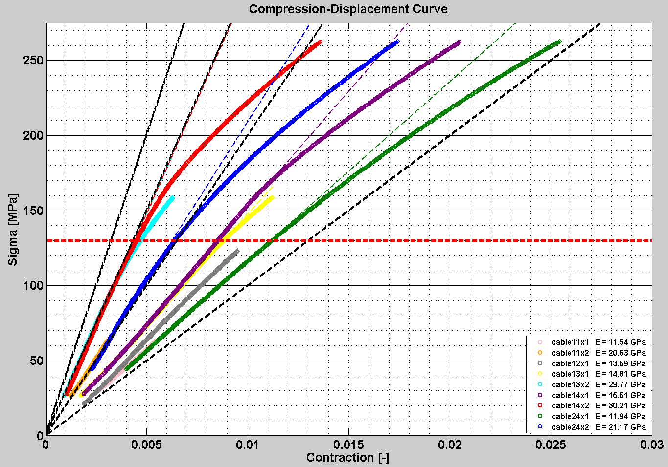
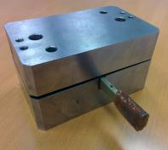
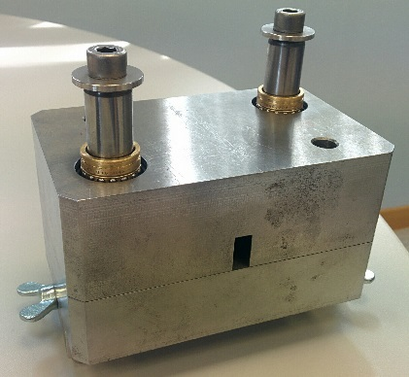
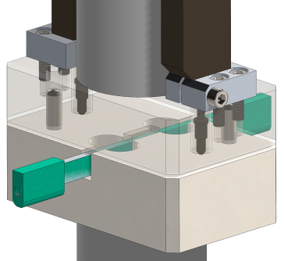
Measurement of cable Young’s modulus
After improving the tooling, the tests confirm that Young’s modulus of the cables is close to 20 GPa.
Custom tooling was used to obtain the Young’s modulus of ten-cable stack impregnated samples. First results showed half the expected rigidity.

Slide 9
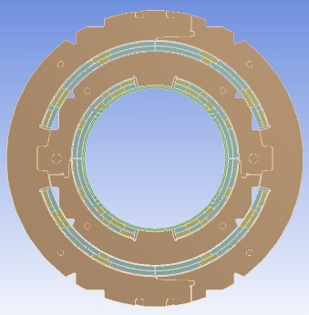
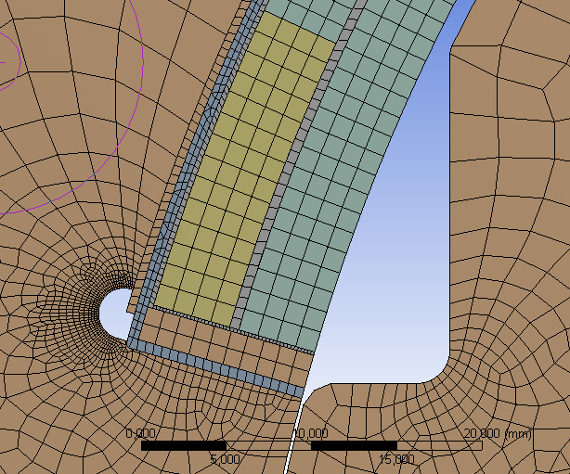
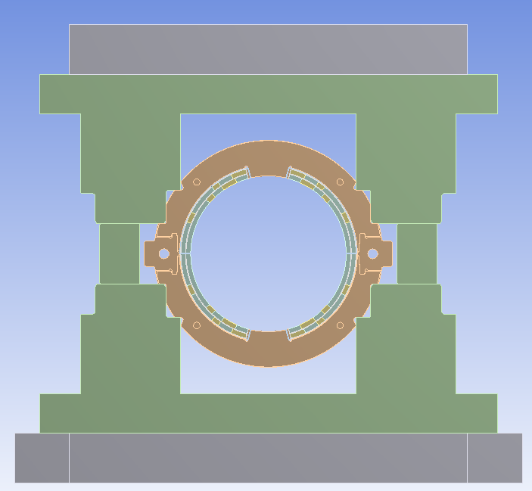
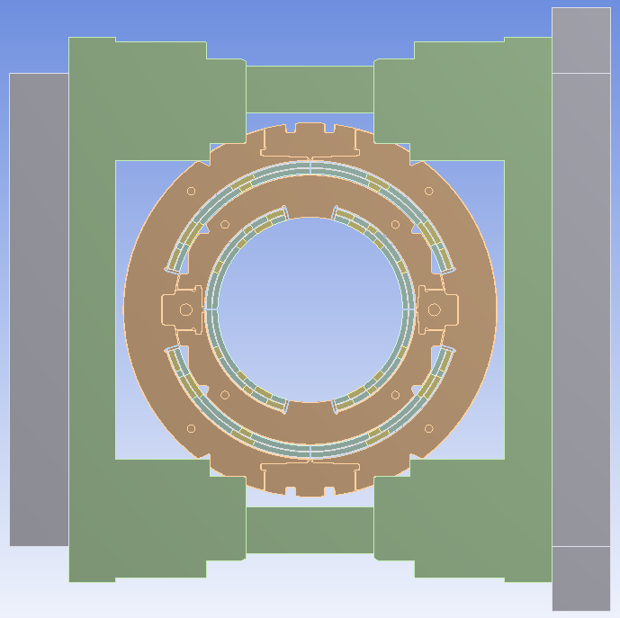
Mechanical design update (I)
The new cable rigidity (20 GPa) has been included in the mechanical model.
An additional 0.1 mm of interference is necessary to achieve the same coil pre-compression than before:
  Inner dipole: 0.35 mm instead of 0.25 mm.
  Outer dipole: 0.45 mm instead of 0.35 mm.
This is coherent considering coil smeared-out properties.
Stress distribution is checked at the different load steps.
40 GPa Cable blocks + 130 GPa copper wedges ≅ 70 GPa Coil
20 GPa Cable blocks + 130 GPa copper wedges ≅ 50 GPa Coil

Slide 10
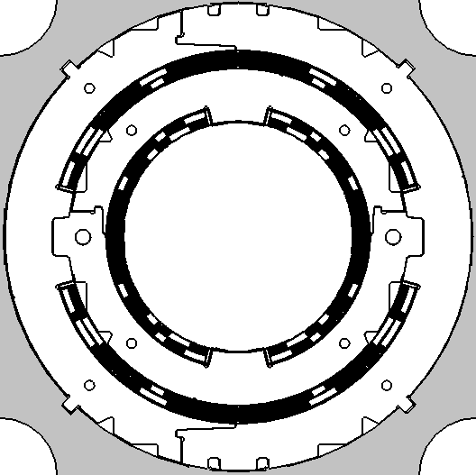
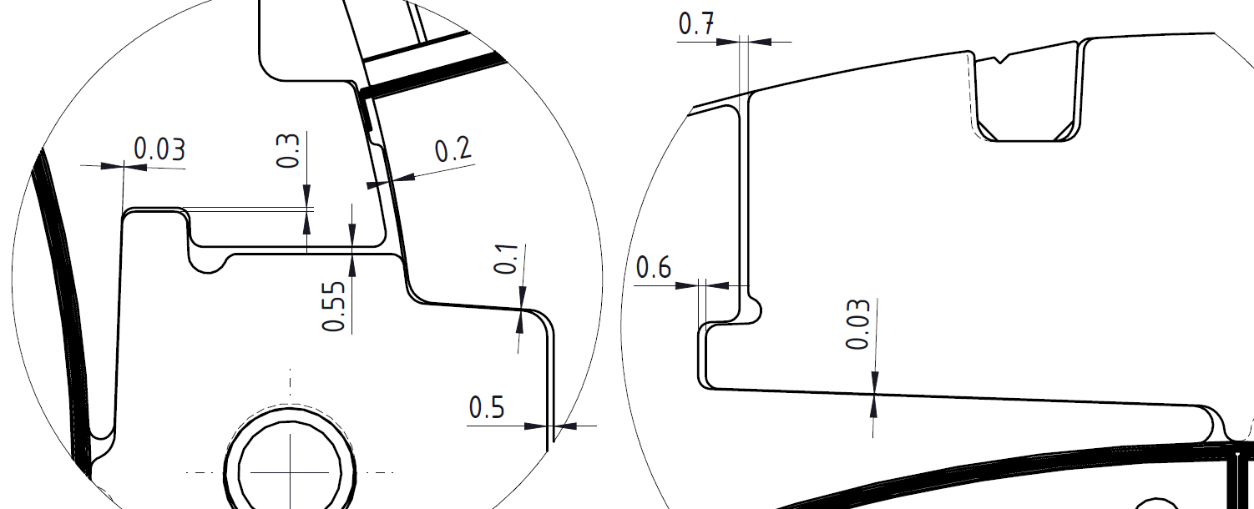
Mechanical design update (II)
Gap | Original gap | ID Press | ID Spring Back | Before OD Press | OD Press | OD Spring back | Cool- down | 108% Power.
A | 0,2 | - | - | opens | 0,13 | opens | opens | 0,08
B | 0,1 | - | - | opens | 0,08 | 0,08 | 0,085 | contact
C | 0,5 | - | - | opens | 0,47 | opens | opens | 0,4
D | 0,55 | 0,42 | opens | opens | opens | opens | opens | opens
E | 0,3 | 0,18 | opens | opens | opens | opens | opens | opens
F | 0,03 | ≅0,03 | contact | contact | contact | contact | contact | contact
G | 0,7 | - | - | opens | 0,55 | opens | opens | opens
H | 0,6 | - | - | opens | 0,45 | opens | opens | opens
I | 0,03 | - | - | contact | contact | contact | contact | ºcontact
Motivation: There is no previous experience in nested collaring structures.
Undesired contact between parts could spoil the assembly.
Too large gaps could spoil the field quality or cause clattering during operation.
All values in mm
b
a)
b)
G
F
a
E
A
H
B
D
I
C

Slide 11
Outline
Final magnetic design
Final mechanical design
Short mechanical model
Prototype fabrication
Conclusions

Slide 12
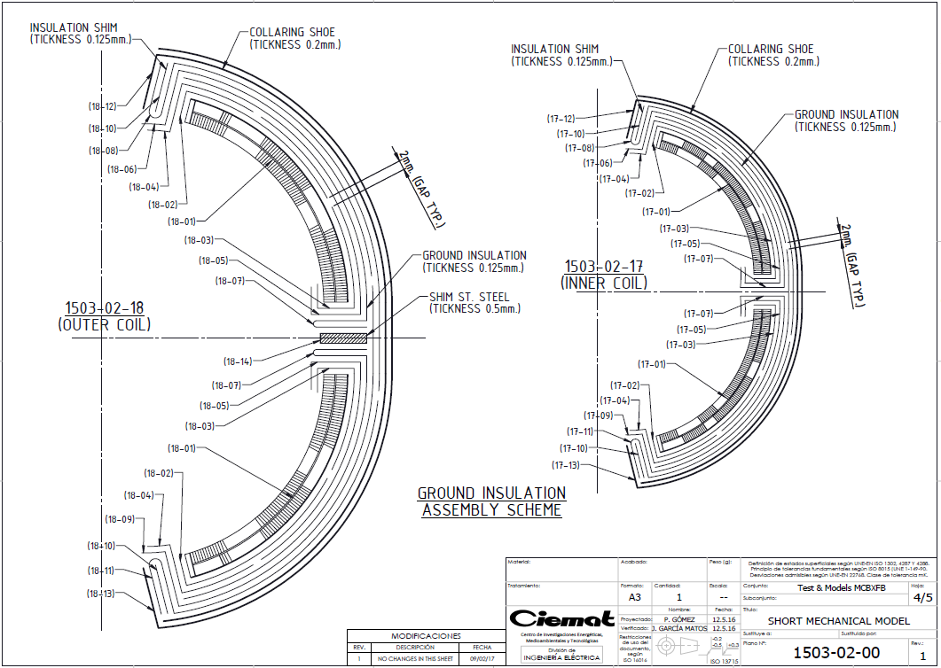
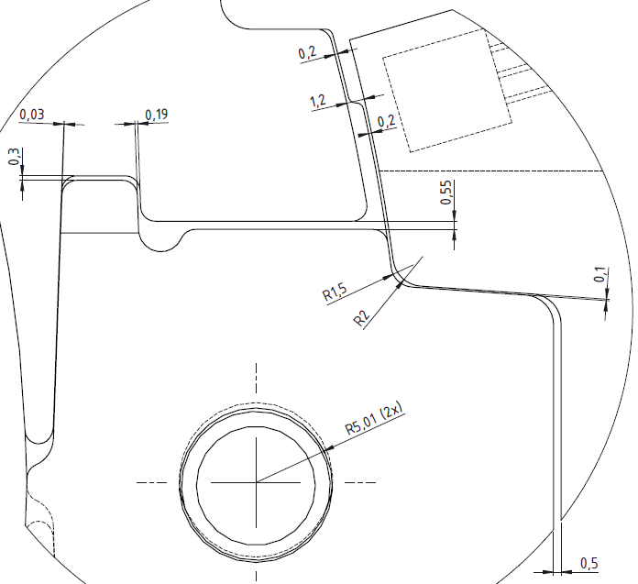
Short mechanical model: Motivation
A short mechanical model, as close as possible to the real magnet, becomes essential to:
  Validate the assembly process of the nested dipoles: feasibility, gaps, ground insulation, collaring shoes...
  Test part of the tooling to be used in the prototype assembly.
  Validate the FE mechanical model.

Slide 13
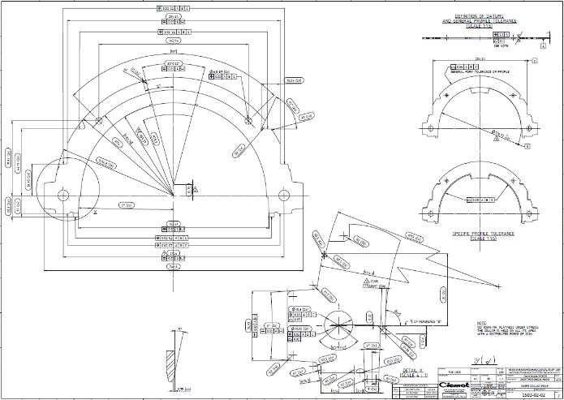
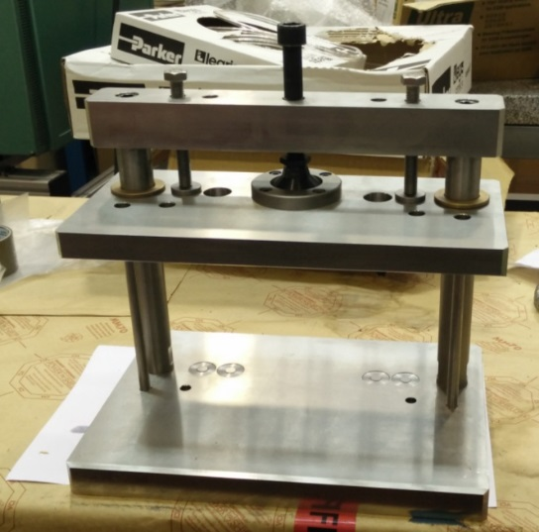
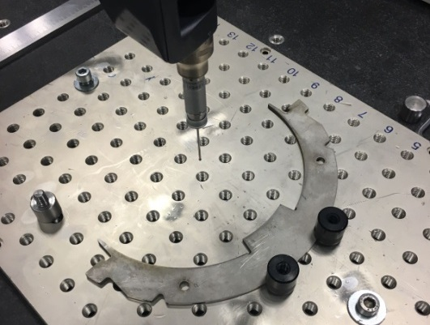
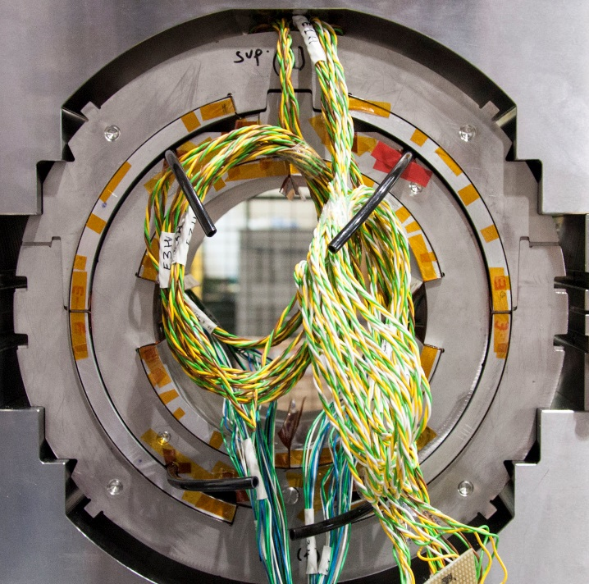
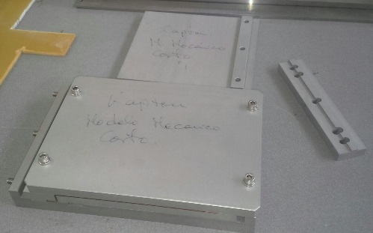
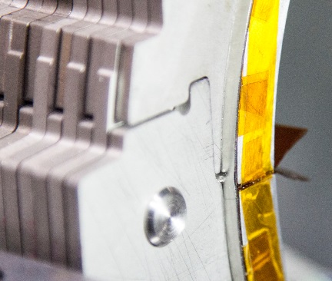
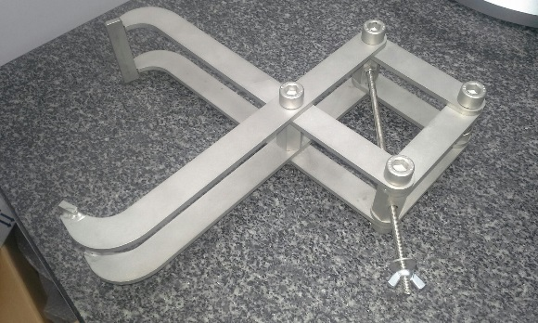
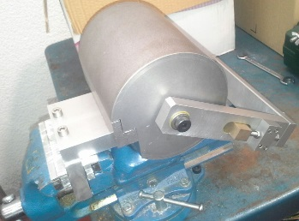
Short mechanical model: Fabrication
Collars
(Laser + EDM)
Collar packaging tool (ID & OD)
Kapton bending
tooling
Aluminium dummy coils
Collaring shoe preforming tooling
Handling scissors (ID & OD)

Slide 14
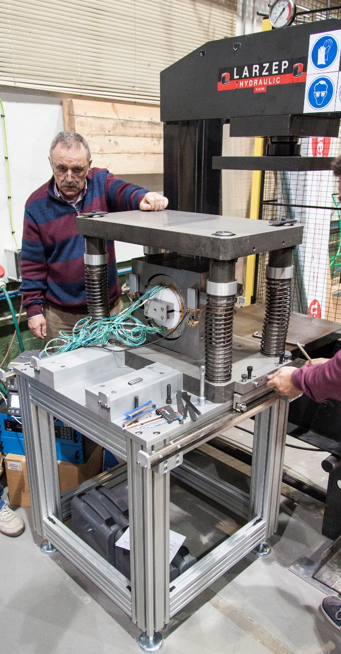
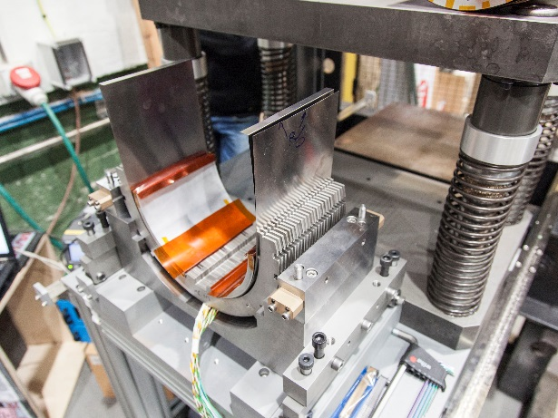
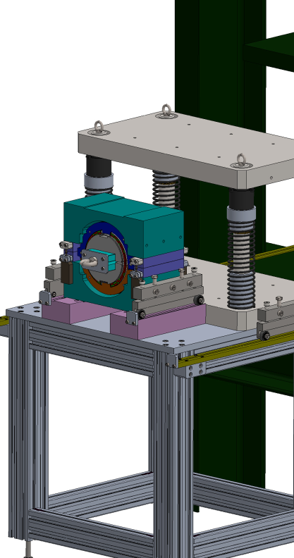
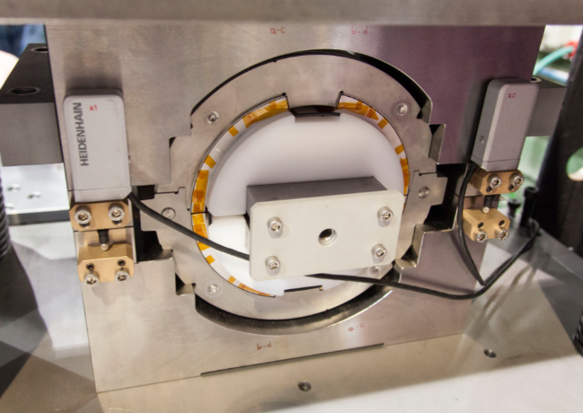
Short mechanical model: Assembly
120 Ton press refurbished and calibrated
Alignment
cage
Handling/sliding
system
Pressing craddles and stoppers
Support/assembly table
Inner collapsible mandrel

Slide 15
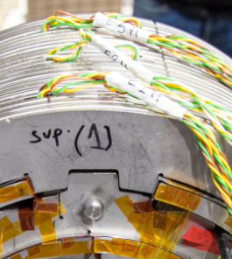
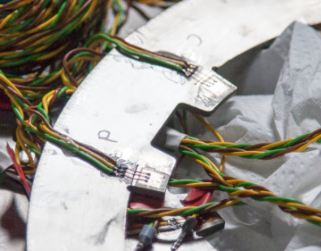
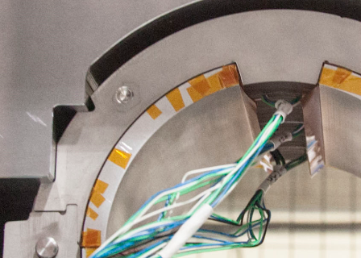
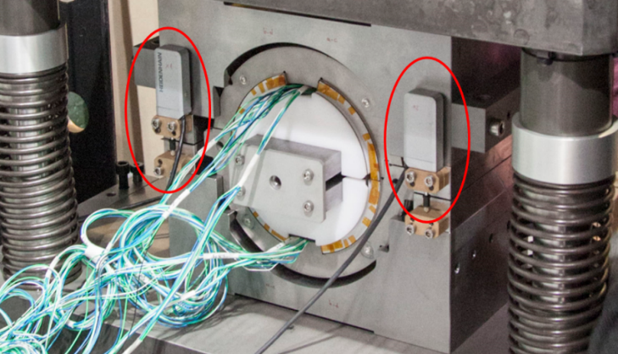
Short mechanical model: Instrumentation
Three sections are monitored by strain gauges
(ID & OD)
Four strain gauges per collar: on both sides of the collars and noses
Four displacement gauges: micrometric precision
All gauges configuration, installation, cabling and data acquisition have been developed in-house

Slide 16
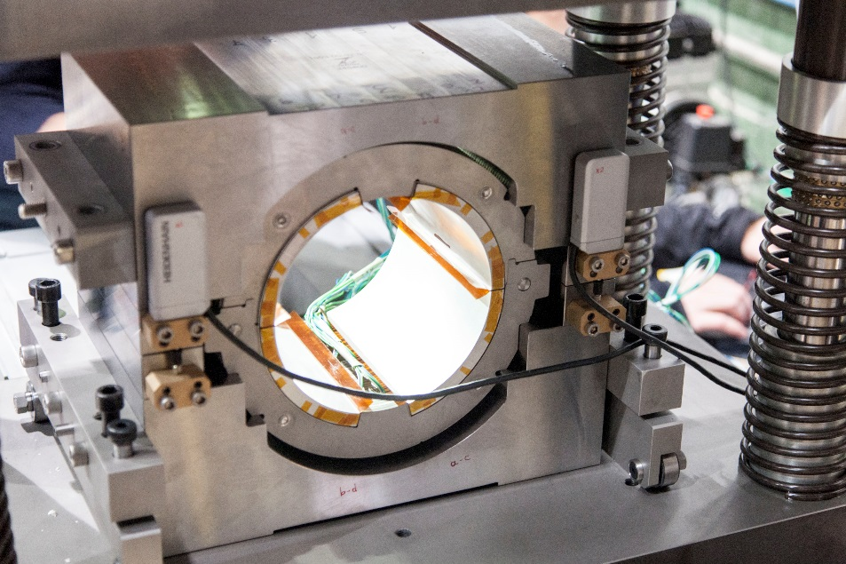
Short mechanical model: Inner collaring test
Very good agreement between calculations and measurements when the pins are inserted and afterwards (spring-back).
The collapsible mandrel is easily extracted.
Gap [mm] | Press force [ton] | Average stress measured [MPa] | Average stress simulated [MPa]
0.5 | 26 | 52 | -
0.4 | 34 | 71 | -
0.3 | 40 | 90 | -
0.2 | 40 | 106 | 108
Spring-back | - | 72 | 74

Slide 17
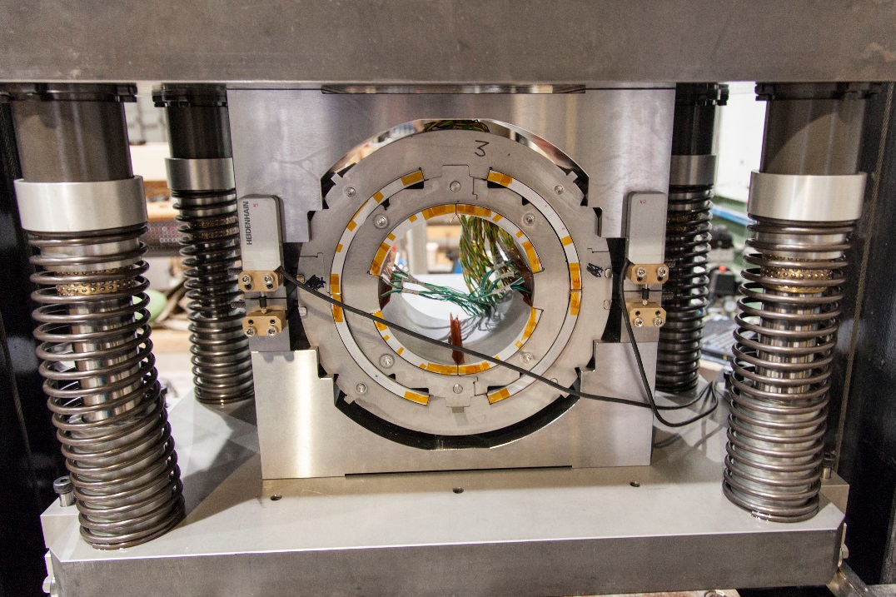
Short mechanical model: Outer collaring test
Very good agreement of average measurements and calculated ones, when the keys are inserted and afterwards.
However, gauges in the lower half measured about twice the pressure of the upper ones.
The coils have not tried to collapse inwards. Gaps are correct.
The assembly is repeated two times and measurements were balanced. We think that the assembly procedure was not right the first time.
Gap [mm] | Press force [ton] | Average stress measured [MPa] | Average stress simulated [MPa]
0.5 | 33 | 76 | -
0.4 | 38 | 90 | -
0.3 | 40 | 105 | -
0.2 | 40 | 124 | 110
Spring-back | - | 89 | 81

Slide 18
Outline
Final magnetic design
Final mechanical design
Short mechanical model
Prototype fabrication
Conclusions

Slide 19
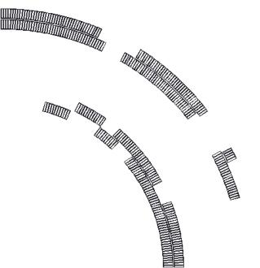
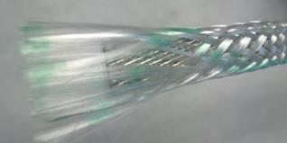
Manufacturing concept and coil fabrication remarks
Double pancake coils of small NbTi cable with large aperture lead to large number of turns: fully impregnated coils.
Cable should be insulated with glass-fibre to ease the impregnation (CTD 101K).
CTD binder 1.1 will be used to allow double pancake winding. It is compatible with the resin.
Coil pre-stress will be provided by self-supported stainless steel collars.
Iron yoke will be laminated and will not provide additional mechanical support.
  MCBXF are 2-in-1 magnets, given the inner/outer dipole configuration, so tooling is thought to be used in both magnets if possible, in order to reduce production costs.

Slide 20
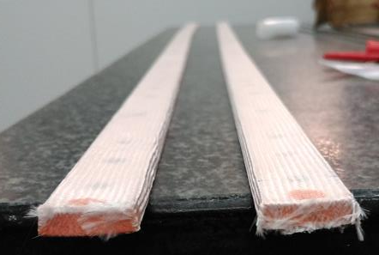
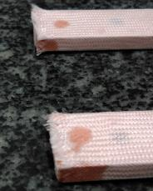
Fabrication of coil parts: cable and wedges
66TEX933 fiberglass is woven around the cable, which is compatible with the resin and close to the nominal thickness of 135 micron (131 micron measured on ten-stack).
Each coil cross section needs 5 different wedges to provide a good field quality. They are produced by machining in parts of approximately 300 mm length. So each coil needs 30 parts.

Slide 21
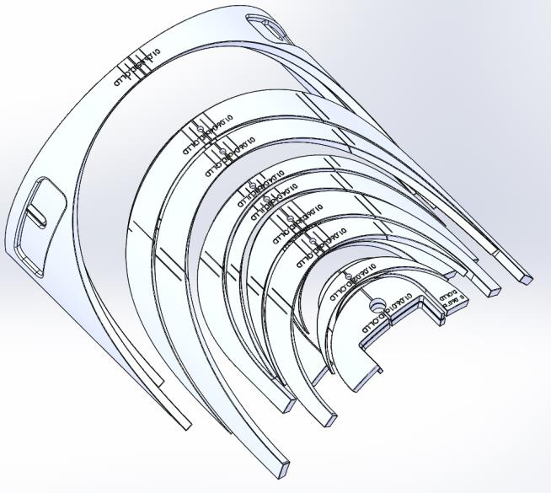
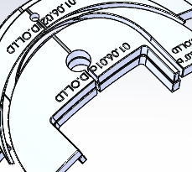
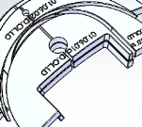
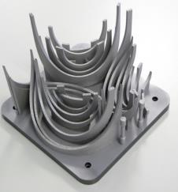
Fabrication of coil parts: End spacers
Alignment groove
Support pointing
holes
EDM cuts
Connection
box
Stress relieving cut
Loading plate extension
There are 58 different end spacers per magnet!!
Produced by 3D printing, several improvements and add-ons have been introduced after the first tests.
Large deformations (up to +/- 2 mm): EDM cuts are introduced.

Slide 22
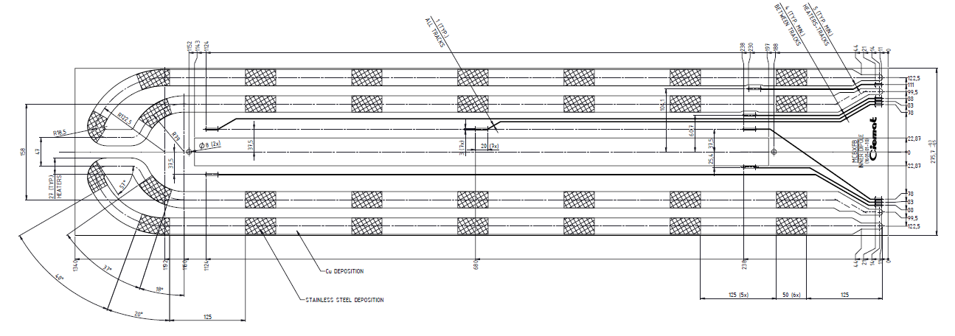
Coil Fabrication: Quench heaters
Quench simulation with CIEMAT code SQUID, based on finite difference method.
Baseline strategy is: short magnet is self-protected, long one is protected by dump resistor.
Heaters are being implemented in the short prototype for validation. If successful, they will be likely implemented instead dump resistor.
Heaters produced by 927 team.
One voltage tap per cable block and at both sides of the layer jump.

Slide 23


First winding and binding test
About 60 m of cable were used.
Cable did not lay down at the coil ends as expected. Coil is a bit shorter than nominal.
All tooling worked relatively well.
Some minor improvements were implemented:
  Regulation of the height of the cable exit from the spool.
  Additional arcs for cable clamping during winding.
  Narrower glass fiber tape for insulation of end-spacers.
  Fiber glass for end-spacer insulation is impregnated with binder.

Slide 24

First coil winding
The cable has been partially unwound twice, due to some problems with a voltage tap and end spacers.
Cable is very flexible, so un-winding is not a problem.

Slide 25


First coil winding
Spacers
Longitudinal position at coil ends is shorter than nominal. Few tenths of mm at the first turn after an end spacer, up to 2 mm at the last turn before an end spacer. Both ends behave in the same way.

Slide 26




Quality Control
The structure at EDMS has been created.
The equipment codes for CDD storage have been created. About 500 drawings of the short mechanical model and the inner dipole tooling have been already sent to CDD team.
The MTF equipment codes are also generated.

Slide 27
Schedule
 | Task | Date
Design | Detailed mechanical calculations | Done
 | ID fabrication drawings | Oct-17
 | OD fabrication drawings | Dec-17
Fabrication | Cable MCBXB H+V delivered (4 ID + 3 OD unit lengths) | Oct-17
 | Winding machine ready | Jun-17
 | First winding test | Sept-17
 | First ID coil | Nov-17
 | ID coils | Jan-17
 | ID Collaring | Feb-18
 | ID Magnet assembly | March-18
 | OD coils | April-18
 | OD Collaring | May-18
 | Magnet Assembly | June-18
Test | ID in vertical cryostat | April-18
 | Magnet prototype in vertical cryostat | July-18

Slide 28
Conclusions
Magnetic and mechanical design is finished.
A short mechanical model has been produced and successfully tested to validate the feasibility of the assembly. Test results are in good agreement with simulations.
Fist winding and binding tests have been successfully performed.
First coil fabrication is ongoing.

Slide 29
Thank you for your attention

