Slide 1

HL-LHC Circuits and Protection Options
Samer Yammine on behalf of the Magnet Circuit Forum
7th HL-LHC Collaboration Meeting – 14th November 2017

Slide 2
Content
Background and Current Global Status
Progress on the Inner Triplet Circuits
Progress on the Matching Section Circuits
Progress on the 11T Dipole Circuit
Conclusions

Slide 3
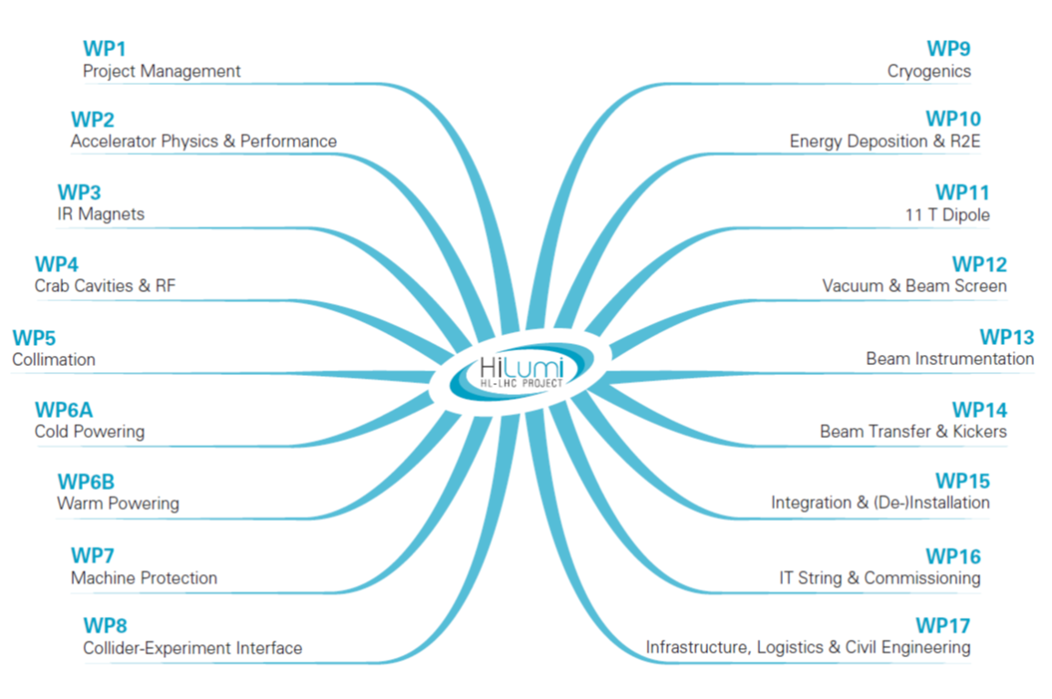
HL-LHC Magnet Circuit Forum
Mandate
The Magnet Circuit Forum (MCF) is the meeting where all aspects related to powering and protection of the HL-LHC circuits are discussed, in particular the ones pertaining to the optimization of circuit layouts and definition of protection means.
Subjects in the agenda are defined in close collaboration with the relevant WPs.
Interface aspects between systems are clarified through meetings at the forum. To this end, a documentation plan has to be developed and completed.
The aim is to prepare a set of functional interface specifications that can be used as input for the design (technical specifications) of the different systems.
Assessment on realistic failure scenarios and required mitigation strategies on a global basis is part of the activities of the MCF.
The MCF is the meeting where aspects related to high voltage withstand levels are discussed and harmonized.
The MCF reports regularly to TCC and takes up any relevant discussion within the domain of cold/warm powering and protection of the HL-LHC circuits in collaboration with the relevant WPs.
MCF Contributors

Slide 4
Background
Since the 6th Hilumi Collaboration Meeting:
Common work with relevant WPs within Magnet Circuit Forum (MCF)
  Sixteen regular meetings and eight topical meetings (link)
CERN internal review on HL-LHC magnet circuits (17th March 2017 - link)
  Very useful exercise that provided many recommendations and statements
  Important work to follow-up the recommendations with concerned work packages
Following the review, several changes have been applied to the baseline of the circuits (ECR to the HL-LHC baseline in TDR is in draft)
This presentation shows the consolidated changes to the baseline
The several options will be shown as well

Slide 5
Inner Triplet Main Circuit : Changes to Baseline of TDR V0.1 after the Internal Circuits Review
Removal of Q2a trim power converter (sorting of Q2a and Q2b magnets will be applied before installation to mitigate transfer function differences)
Addition of warm diodes over Q2a to limit the voltage to ground during quench
Addition of a Q1a K-modulation circuit to meet the HL-LHC optics requirements
Upgrade the s.c. link trim cables capability to 7 kA and 5 MIITs
Addition of crowbar resistance to the RQX power converter to discharge the circuit faster (in case of cryogenic failure, water failure, powering failure, etc.)

Slide 6
Current Status of the Inner Triplet Circuits
Cold Powering Status:
Document by WP6a and MCF – EDMS 1821907
Talk by A. Ballarino on Thursday (link)
Warm Powering Status:
Talk by M. Martino on Thursday (link)
Quench Detection and Protection:
Talk by R. Denz on Thursday (link)
Cold Diodes Option:
Later in talk
Circuit Separators Option:
Later in talk
EE Option for MCBXF & MQSXF:
Talk by E. Todesco on Thursday (link)

Slide 7
Current Status of the Matching Section Circuits
Cold Powering of the MS Circuits:
Document by WP6a, WP9 and MCF
To be released soon
DFHM: D2 + correctors
DFBL: Q4 + 6xQ4 correctors, Q5 and Q6
Local: 2xQ4 correctors, Q5 correctors and Q6 correctors
Option for Warm Diodes in Series with Q5 and Q6:
To reduce squeeze time
EE Option for MCBRD:
Talk by E. Todesco on Thursday (link)

Slide 8
Open Issues & Class of Uncertainty
Circuits | Powering Scheme | Open issue | Class
Inner Triplet | Baseline | Q1a k-modulation circuit design | 2
 |  | IT main circuit bus-bars design | 3
 |  | Design and integration of the cables and feedthroughs for CLIQ | 3
 |  | Polarities of the connection of quench heaters and CLIQ | 3
 |  | Design and implementation of interconnects and splices | 4
 |  | Design and integration of protection instrumentation | 4
 | Options | Study on the IT alternative configurations | 1
 |  | Circuit separators | 3
 |  | Local integration of leads for the superferric correctors | 4
 |  | Cold diodes qualification and integration studies | 4
Matching Section | Baseline | Follow-up on the DSL dismantling decision | 4
11T | Baseline | Define the global 11T interlock strategy within the RB circuit | 1
 |  | Flux Jumps: Prototype test to elaborate a suitable QD strategy | 3
 |  | Current leads and protection scheme for 11T trim | 3
 |  | Decision on test the impact of the trim PC on the QDS in case of power abort on the 11T and neighbouring MB magnets in SM18 | 4
Estimate Class | % of complete definition
Class 1 | 50 – 100
Class 2 | 30 – 70
Class 3 | 10 – 40
Class 4 | 1 – 15
Class 5 | 0 – 2

Slide 9
2) Progress on the Inner Triplet Circuits
Circuit Consolidation: Simulations and Cross-check Simulations
Option: Cold Diodes and Quench Protection
Option: Circuit Separators

Slide 10
2.a) Baseline Consolidation: Simulations and Cross-check Simulations on the Inner Triplet

Slide 11
Conclusions from Simulations & Analysis in a Nutshell
For standard cases of quench, currents in the 2kA trim leads can go up to 4.3 kA and 2.2 MIITs (up to ultimate currents) => 5 kA current capability in s.c. state would suffice for not quenching the conductors within the s.c. link
For the very conservative scenario, those values could go up to 6.1 kA (nominal) and 6.8 kA (ultimate), and 5 MIIts (nominal and ultimate), these numbers are obtained considering a full magnet suddenly quenching in its whole volume
the analysis covers the whole spectrum of operating conditions, from low to ultimate current
TALES Simulations by E. Ravaioli (LBNL)
May 2017
Extract from Panel Report of the 2017 HL-LHC circuits internal review (link):
The panel considers that the presented powering circuit is a robust solution, provided the 2 kA and 120 A SC trim cables in the superconducting link can be upgraded to a rating of about 5-6 kA (to avoid quenching of the SC link in almost all cases of a magnet quench, an event considered rare and estimated in once a year) and 5 MIITS (to provide safety against any event of quench).

Slide 12
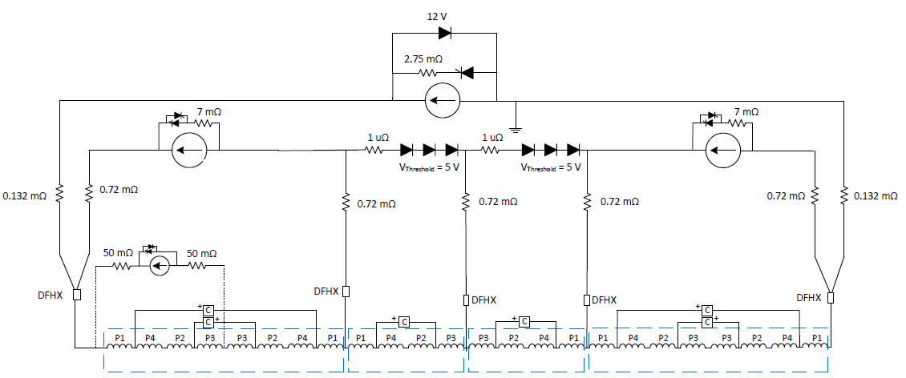
Cross-check Simulations
October 2017
Assumptions
Maximum current, ramp rate, and MIITS evaluated under different scenarios (Reference cases provided by E Ravaioli)
Regular quench: Detection + validation time = 15 ms
Global magnet quench: Detection + validation time = 10 ms
Trim Q1
Trim Q3
F
A
B
C
D
E
Highest values | Leads A / E | Leads B / D | Lead C | Lead F | Trim Q1 | Trim Q3
Current [kA] | 17.8 | 6.1 | 4.3 | 4.1 | 5.1 | 4.2
Ramp rate kA/s | 250 | 170 | 100 | 70 | 160 | 160
MIITs | 32.6 | 3.8 | 1.9 | 1.5 | 2.9 | 1.9
STEAM-LEDET simulation results consistent with previous TALES simulations
M. Mentink on Thursday (Link)

Slide 13
2.b) Option: Cold Diodes and Quench Protection

Slide 14
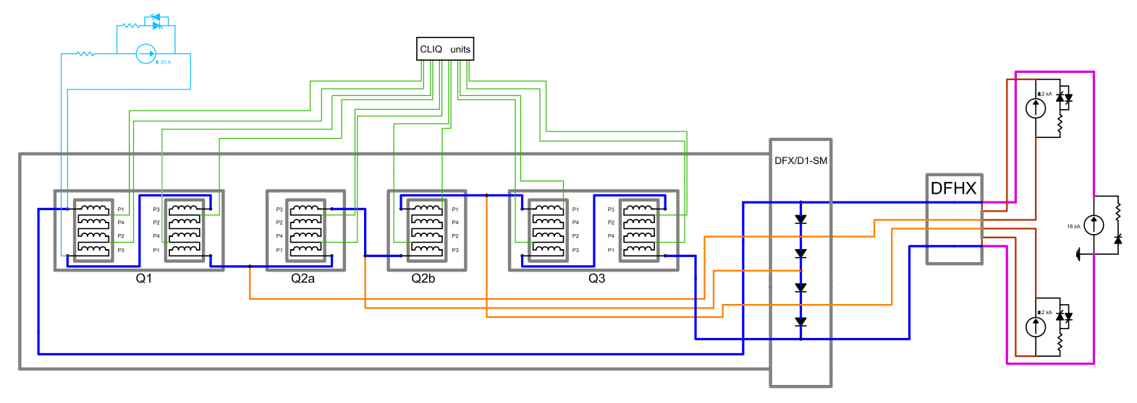
Inner Triplet Main Circuit with Cold Diodes
Leads layout (TBD)
Advantage of cold diodes as considered by the Panel of the Internal Circuit Review :
Diodes will protect the cold powering components from high over currents in case of quench unbalance in between magnets.
Diodes will also provide more margin and flexibility in case of unforeseen larger over-currents, decoupling the warm and cold part of the circuit.

Slide 15
Options to Protect MQXF Magnets and Bus-bars
Protection baseline: Any quench in any element → Fire all the QHs/CLIQ systems
R. Denz on Thursday (Link)
When introducing the cold diodes, two possible strategies:
  One element quenches → All QHs/CLIQ systems will be fired. Diodes carry only the over-currents (capability of more than 13 kA peak if LHC diodes are re-qualified) for an equivalent time = 100 ms
  One element quenches → Selective QHs/CLIQ fired. Diodes should carry 18 kA, time constant = 100 s
Possible additional advantage for option 2:
If a quench of the other magnets following the first cannot be completely avoided, it would happen at lower current.
Reduction of the stress on the magnet and the heat dissipated into the cryogenic system, which will allow a faster recovery.

Slide 16
Conclusion on Cold Diodes Options
Option 1: One element quenches → All QPS systems will be fired
Advantages to WP3:
Bus-bar integration in the cryostat is less complex
No need to size the trim bus bars to 18 kA (s.c. state and quenching state)
No need to integrate heat sinks for diodes
Advantages to WP7:
Keeps the QDS reliability like in the LHC’s IT circuit
The triplet circuit in itself is the most complex HL-LHC circuit. Option 1 does not add further complexity from the QDS point of view.
The use of the LHC diodes if qualified for radiation levels.
Disadvantages:
When quench, no quick distinction between quench in coil and bus-bars in terms of detection
Option 2: Selective quench strategy
Possible advantages of the selective quench protection:
Triggering of the QHs/CLIQ of the other (not initially-quenching) magnets at a lower current (expected ca. 10% less from one magnet to the adjacent one)
It will allow more energy to be dissipated in the crowbar of the RQX PC
Disadvantages:
It includes complexity in the implementation of the QDS which leads to a less reliable system.
Due to the quench propagation, all the magnets could eventually be fired (in the order of ten seconds between the quench of the different magnets)
Diodes (+heat sinks) and bus-bars will be significantly bigger
Imposes new (non-LHC) diodes to support the current of 18 kA
After discussions, MCF considers option 1 as more adequate and proposes to discontinue efforts in the direction of option 2. TCC endorsed this consideration.

Slide 17
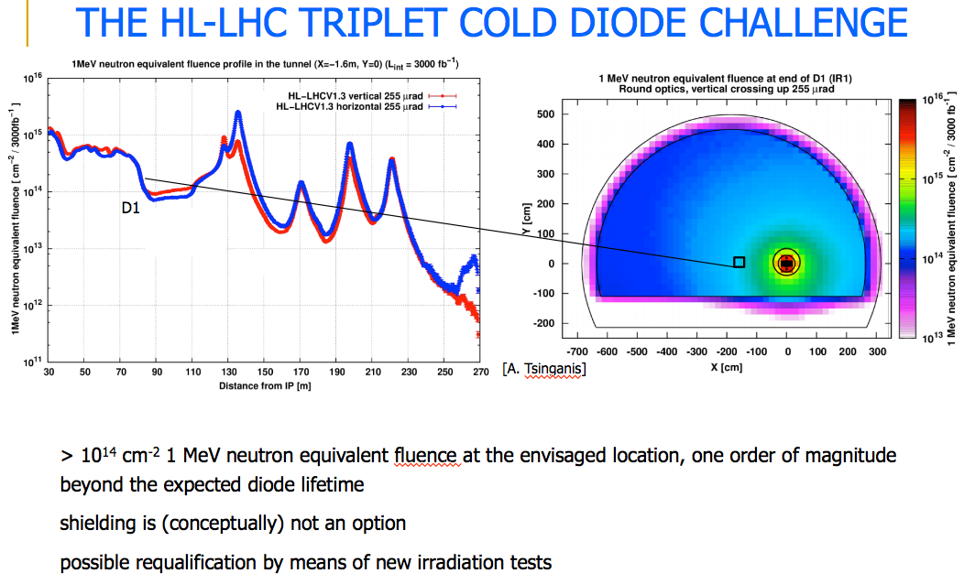
Radiation Doses and Qualification of Cold Diodes
Courtesy F. Cerutti, R2E Cost and Schedule Review, 12.10.2017
LHC type diffusion diodes tested (15 years ago) up to ~2 kGy and 3x10¹³ n cm⁻² (LHC project Report 688)
Qualification is required up to 30 kGy and 10¹⁵ n_{eq}.cm⁻²

Slide 18
2.c) Option: Circuit Separators

Slide 19
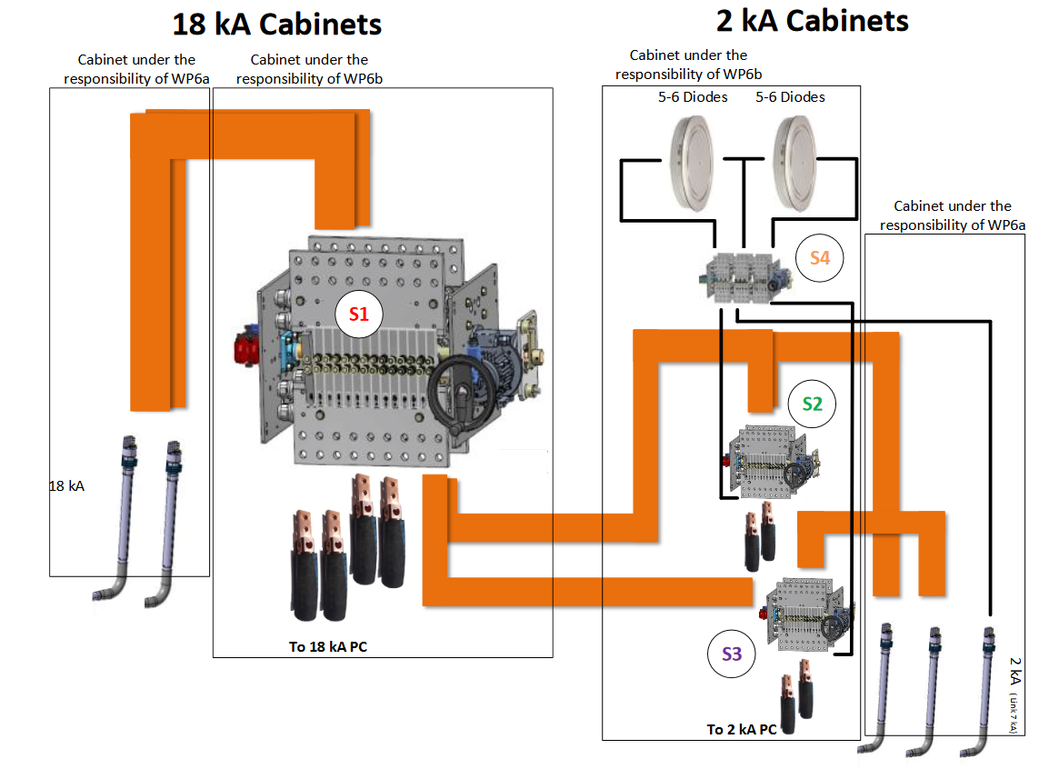
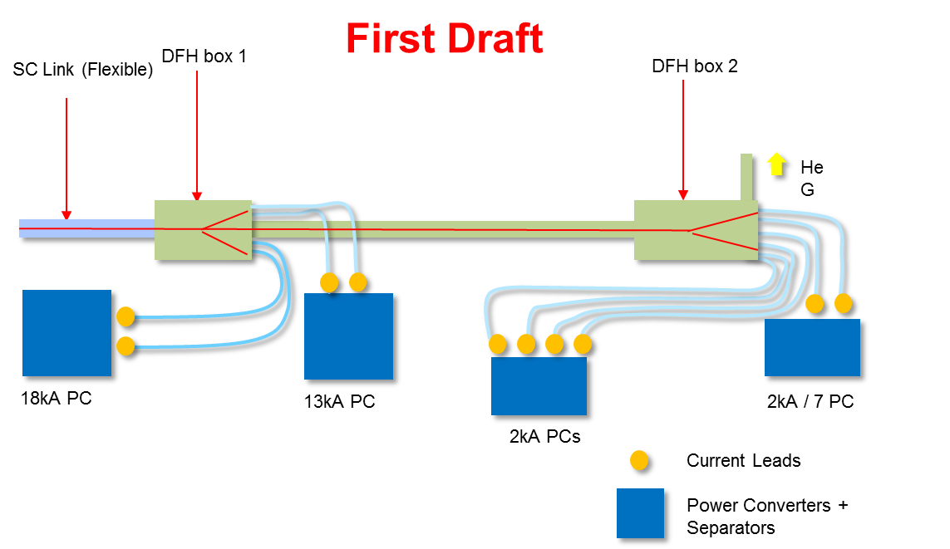
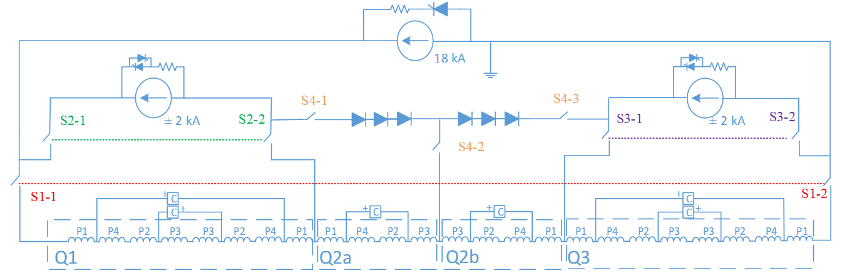
Circuit Separators in a Nutshell
Separators in IP2x cabinets provide a viable solution for personnel and equipment protection (Commissioning, Operation, ELQA, etc. )
Disconnect, connect, short circuit and to ground connections
Circuit of Q1a not shown for simplification but can have the same principle

Slide 20
3) Progress on the Matching Section Circuits

Slide 21
Status on the Powering of the MCBYs
Q4 and Q5 correctors will be powered individually
Upon a request by WP6b (transmitted to the MCF), WP6a has accepted to provide enough leads to feed individually the corrector MCBY magnets of Q4 and Q5. This means that 1 assembly of four leads will be integrated in the Q4 cold mass and 3 assemblies in the cold mass of Q5.
This will mitigate the development of a new family of power converters to deal with the high energy and the inductance of two MCBYs in series.
The decision on the necessity of dismantling the DSL during LS3 should be taken by the end of 2017 or beginning of 2018. By then, a roadmap on the strategy will be proposed to MCF and TCC.

Slide 22
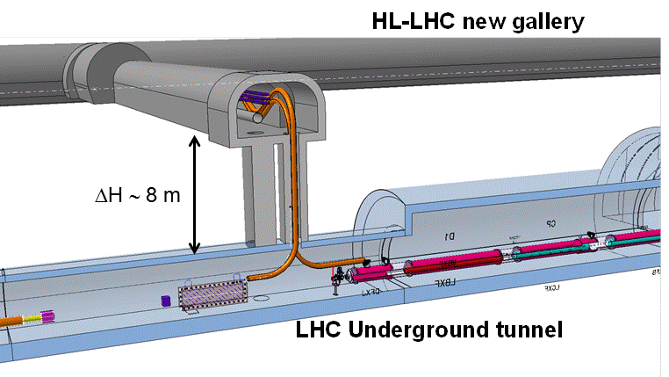
Matching Section Overall Powering Scheme
D2
Powering of D2 from UR (DFHM):
  2x13 kA + 8x0.6 kA
DFBL + DSL for Q4 + 6xQ4 correctors , Q5 and Q6
Local powering for supplementary 2xQ4 correctors
Local powering of Q5 correctors
Q6 as LHC configuration

Slide 23
4) Progress on the 11T Dipole Circuit
11T Powering Interlock Controller
11T Trim Powering with Conduction-Cooled Leads
11T Dipole – Powering and Protection Document

Slide 24
4.a) 11T Dipole and RB Circuit Interlock System

Slide 25
Proposed Implementation of 11T Trim Circuit Interlock
PIC RB quench loop
odd side
PIC RB quench loop
even side
PIC
odd
3 km QPS
RB quench loop
PC ±250A
QPS
QPS
PIC
even
PC 13kA
11 T trim PIC proposal
PIC 11T quench loop
Hardware connection to the Power Interlock Controller (PIC) of the main dipole quench loop at the odd side
Separate the 11T trim and the RB (dipoles) circuit → easier diagnostics in case of trip
Slow power abort requests of both power converters would be implemented in the PIC as a function of the status of the systems.

Slide 26
4.b) 11T Trim Powering with Conduction-Cooled Leads

Slide 27
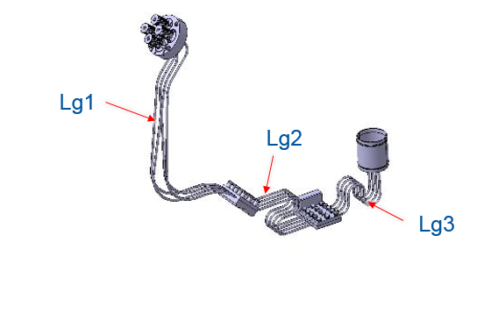
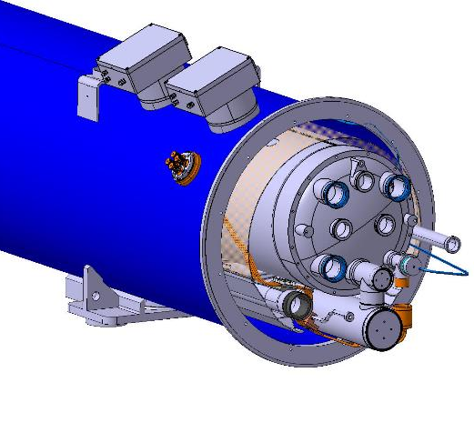
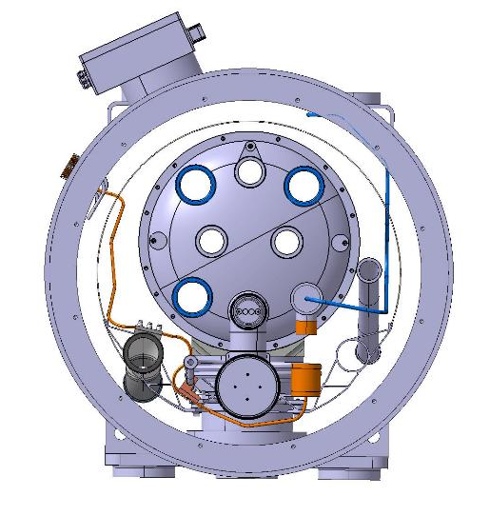
11T Trim Powering with Conduction-Cooled Leads
Electrical insulation tests on LHC conduction-cooled leads (V_{ins} > 5 kV in He gas, RT, atmospheric pressure)
Two CLs per polarity
Requirements:
  Protection of leads when voltage across lead ≈ 100mV
  Protection of leads when I_{CL} >125A
  Protection by slow power abort (≈ 10 s)

Slide 28
4.c) 11T Dipole Powering and Protection Document

Slide 29
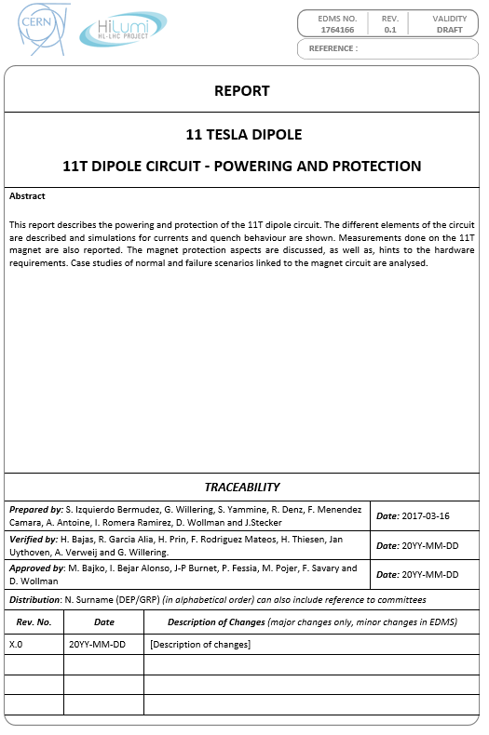
11T Dipole Powering and Protection
This report describes the powering and protection of the 11T dipole circuit. The different elements of the circuit are described and simulations for currents and quench behaviour are shown. Measurements done on the 11T magnet are also reported. The magnet protection aspects are discussed, as well as, hints to the hardware requirements. Case study of normal and failure scenarios related to the magnet circuit are analysed.
EDMS no: 1764166 (Link)
Authors: S. Izquierdo, G. Willering , S. Yammine, R. Denz, F. Menendez, A. Antoine, I. Romera, D Wollman and Jens Steckert
Under verification process

Slide 30
5) Conclusions

Slide 31

Conclusions
Great effort carried out with the different work packages
Significant advancements to optimize the circuits
Follow-up activity on recommendations from the review
Good status with respect to the open issues
ECR on the modifications to the baseline (in TDR) under preparation

Slide 32
Thanks for your attention

Slide 33
Spare slides

Slide 34
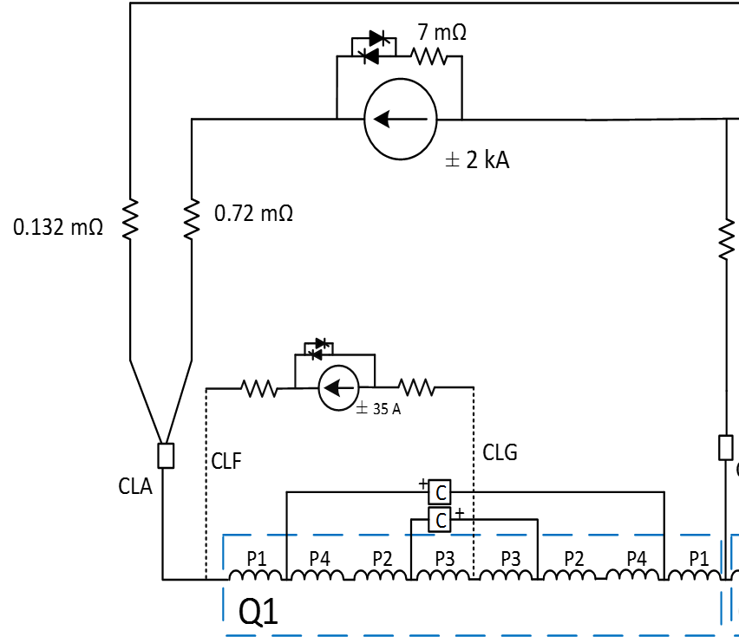
Q1a k-modulation circuit simulations
Developed simulations on
Current profile during magnet quench
Current profile during power aborts (without quench)
Required PC voltage
Control performance during operation
Copper cable section for cold powering
Summary of the simulations
DC cable resistance (resistance during operation) value of less than 265 mOhm is optimal from a powering point of view (PC voltage and design)
DC cable resistance + Crowbar resistance should be at least 230 mOhm to limit current looping above the DC design value of the circuit
Overcurrent due to quench for the ‘most conservative scenario’ generate a hot spot temperature of 314 K.
If integration accepted, it is fairly straightforward to define the parameters of the circuit (2x20mm2).
Standard HL-LHC-60A-10V can be therefore used.
Current proposal
Circuit resistance: 230-240 mOhms
Max current: 4.2 kA
Max MIITs: 1.66
Copper cable section: 20 mm2
Hot-spot temperature: 314 K

Slide 35
Document co-authored by WP6a and MCF - MS
Magnet | Circuit type | Current (A) | Feedbox Type | Lead Type | N_{TOT} leads | SC Link Type | N_{TOT} cables in the SC link
MQY | Q4 Quadrupole | 6000 | *DFBL | HTS* | 3 | *DSL | 3*
MCBY | Q4 Correctors | 120 120 | *DFBL - | Resistive* Local** | 12 4 | DSL - | 12* -
MQY | Q5 Quadrupole | 6000 | *DFBL | HTS* | 3 | *DSL | 3*
MCBY | Q5 Correctors | 120 | - | Local** | 12 | - | -
MQML | Q6 Quadrupole | 6000 | *DFBL | HTS* | 3 | *DSL | 3*
MCBC | Q6 Correctors | 120 | - | Local** | 4 | - | -
MCBRD | D2 Correctors | 600 | DFHM | HTS*** | 8 | DSH | 8***
MBRD | D2 Recombination Dipole | 13000 | DFHM | HTS*** | 2 | DSH | 2***
Circuit | Rating (A) | Worst case V to Gnd (V) | Acceptance |  | Installation |  | Current (µA) | Time (s)
 |  |  | RT | NOC | RT | NOC
D2 | 13000 | 110 | 1440 | 720 | 335 | 705 | 10 | 30
D2 Corr. | 600 | 660 | 3640 | 1820 | 364 | 792 | 10 | 30
Q4 | 6000 | 110 | 1440 | 720 | 150 | 150 | 15 | 30
Q4 Corr.* | 120 | 160 | 1640 | 820 | 300 | 600 | 3 | 30
Q4 Corr.** | 120 | 60 | 1240 | 620 | 300 | 600 | 3 | 30
Q5 | 6000 | 110 | 1440 | 720 | 150 | 150 | 15 | 30
Q5 Corr. | 120 | 60 | 1240 | 620 | 300 | 600 | 3 | 30
Q6 | 6000 | 110 | 1440 | 720 | 260 | 480 | 15 | 30
Q6 Corr. | 120 | 60 | 1240 | 620 | 300 | 600 | 3 | 30

