Slide 1


Progress on Beam Separation Superconducting Dipole Magnet (D1) R&D for HL-LHC
Tatsushi NAKAMOTO (KEK)
On behalf of CERN-KEK Collaboration for D1 Development for HL-LHC
7th HL-LHC Collaboration Meeting, CIEMAT, Madrid, Nov. 14, 2017

Slide 2

IR Upgrade for HL-LHC
LHC (2008-2023): 300 fb⁻¹, 1x10³⁴ cm⁻² sec⁻¹
IP
HL-LHC (2026-2037):
3000 fb⁻¹, 5x10³⁴ cm⁻² sec⁻¹
Crab cavities
For new beam separation dipole (D1)
Large aperture to obtain smaller β* : φ70 mm → φ150 mm
Stronger kick for shorter distance between D1 and D2:
Field integral 26 Tm → 35 Tm by SC magnet

Slide 3
Scope
Beam separation dipole (D1) by KEK
  Participation to the design study of the HL-LHC upgrade since 2011
    under the framework of the CERN-KEK collaboration
    in the context of enhancing the Japanese contribution to the physics outcome from the ATLAS experiment.
150 mm single aperture, 35 Tm (5.6 T x 6.3 m), Nb-Ti technology.
  2 m long model magnets (MBXFS): 3
    MBXFS1b tested in 2017 successfully demonstrated improved training performance.
In-kind contribution of MBXF magnets in consideration
  Prototype: 1
  A series production: 4 + 2 spares

Slide 4
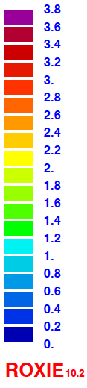
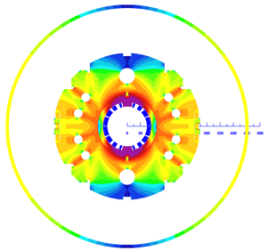
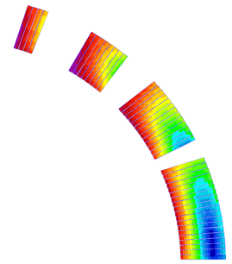
Design overview (w/ 2 HX holes) up to 1st Model
 | A series production | 2 m model
Coil aperture | 150 mm
Field integral | 35 T m | 9.8 T m
Nominal field | 5.57 T
Peak field | 6.44 T (SS), 6.56 T (coil end)
Operating current | 12.0 kA
Operating temperature | 1.9 K
Field quality | <10⁻⁴ w.r.t B₁ (R_{ref}=50 mm)
Load line ratio | 75.4%（SS）, 76.6%(coil end） at 1.9 K
Differential inductance | 4.0 mH/m
Conductor | Nb-Ti: LHC-MB outer cable
Stored energy | 340 kJ/m
Magnetic length | 6.33 m | 1.73 m
Coil mech. length | 6.57 m | 2.00 m
Magnet mech. length | 6.72 m | 2.15 m
Heat load | 135 W (Magnet total) 2 mW/cm³ (Coil peak) > 25 MGy
Radiation dose
4
8
13
4 blocks
44 turns
19
Technical challenges
・Large aperture： Management of coil size and pre-stress.
・Radiation resistance：Radiation resistant material for coil parts. Cooling capability.
・Iron saturation：Good field quality from injection to nominal current

Slide 5
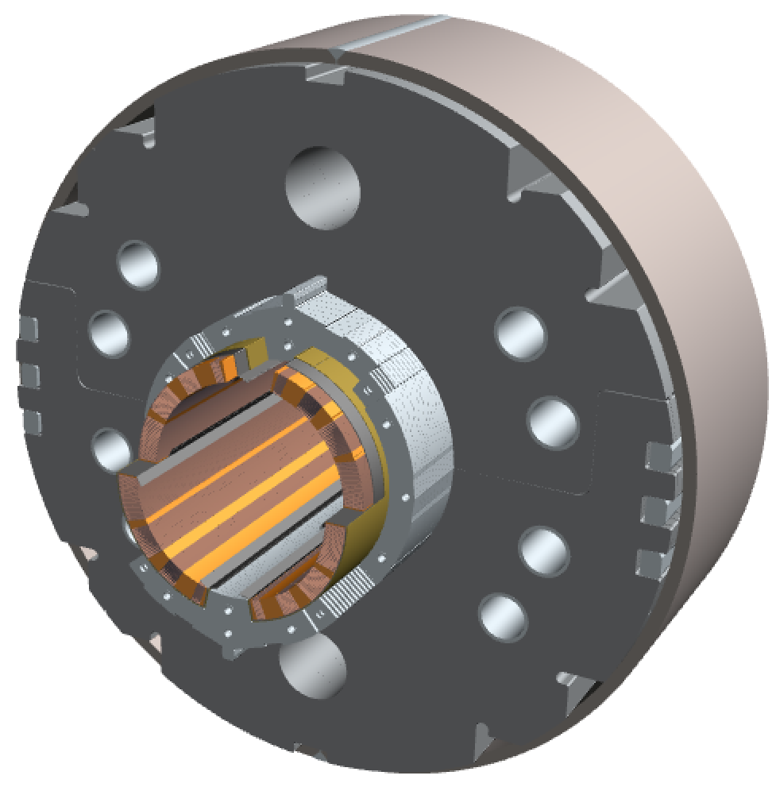
Cutview of MBXFS1
Field tuning hole
φ60 mm HX hole
Shell (SUS304L)
4-way split stainless steel collars
(NSSC130S)
Stack tube (S45C)
Brass shoe
QPH + Insulations
key (S45C)
Cu/NbTi cable (LHC MB outer) +
Apical insulation
Iron yoke
(EFE by JFE steel )
Radiation resistant
GFRP wedge for dose of 25 MGy
(S2 glass + BT resin)
Nb-Ti/Cu cable with APICAL and PIXEO insulations, same as MB outer cable.
Collared yoke structure to increase amount of iron yoke.
Design features for better cooling (Heat load 135 W in total, 2 mW/cm³ at local peak).
  A single layer coil.
  Void spaces and packing factor of collar and yoke: less than 100% for passage of superfluid helium.

Slide 6
Recall: Quench Performance of MBXFS1
MBXFS1
(Before reassembly)
2016
Maximum quench current = 105% of the nominal current (I_{nom}=12.0 kA)
Quench current did not reach the ultimate current of 13.0 kA.
Erratic behavior after the maximum quench current

Slide 7
Recall: Insufficient Coil Pre-stress in MBXFS1
2016
MBXFS1 (Before reassembly)
Straight section
Coil end
Variation of coil pre-stress at pole
during excitation
Coil size measurement after curing
T-b
T-a
B-a
B-b
35 MPa
I=13 kA
Straight section
  Flattening at around 8.5 kA
  → Pre-stress should be increased by more than 35 MPa.
Coil end
  Very low pre-stress at coil ends

Slide 8
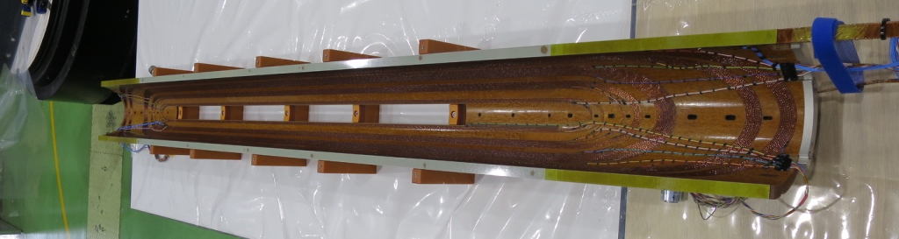
Pre-stress Enhancement in MBXFS1b
G10 shim +
Polyimide tapes
0.8 mm-thick G10 shim
Re-assembly with enhanced azimuthal coil pre-stress → MBXFS1b
Coil pre-stress was increased by inserting the G10 shims to the MP.
Required shim thickness in the straight section was estimated from the results of coil size measurements.
→ Δσ=+45 MPa is expected with 0.8 mm-thick shim.
At coil end, qualitative measurements of pre-stress have not been succeeded. In MBXFS01b, shim thickness was set to be 0.9 mm.

Slide 9
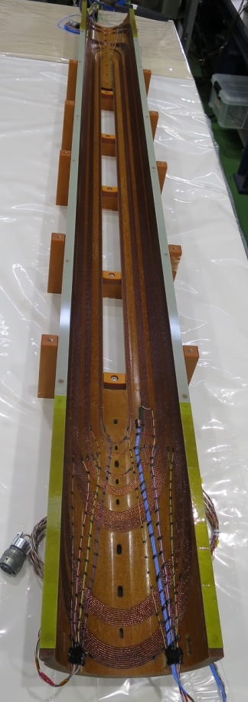
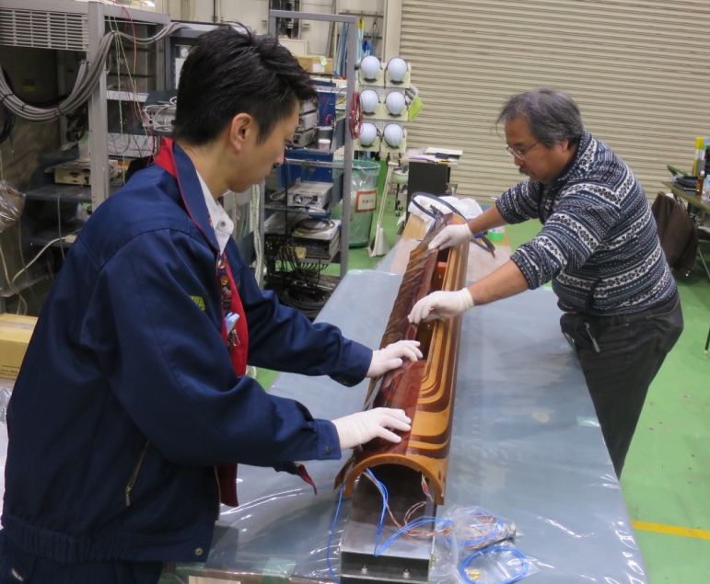
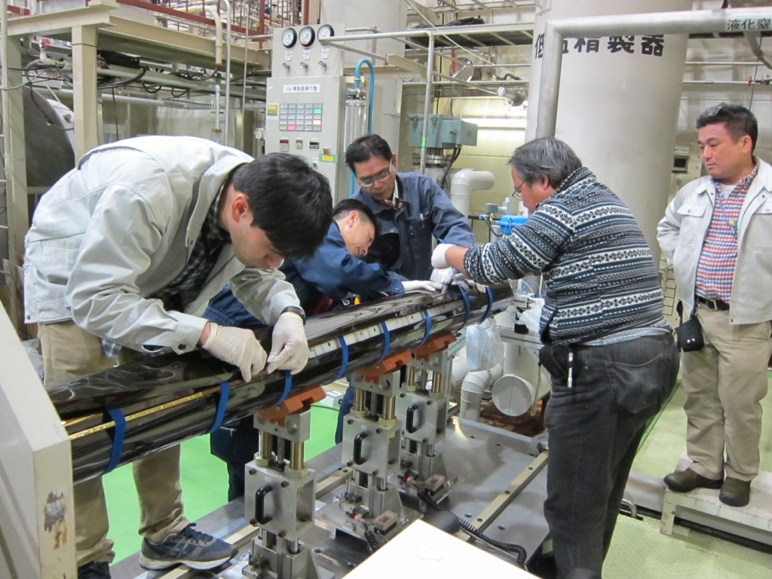
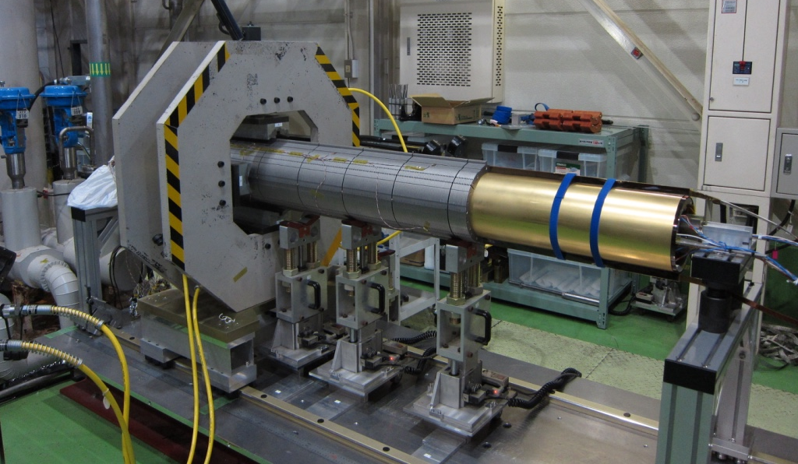
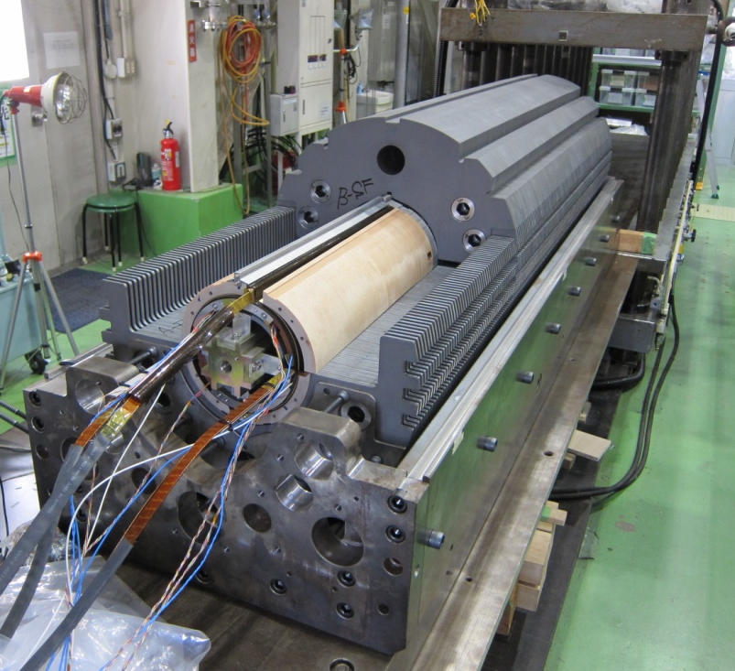
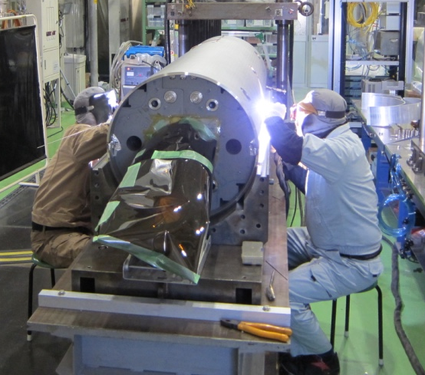
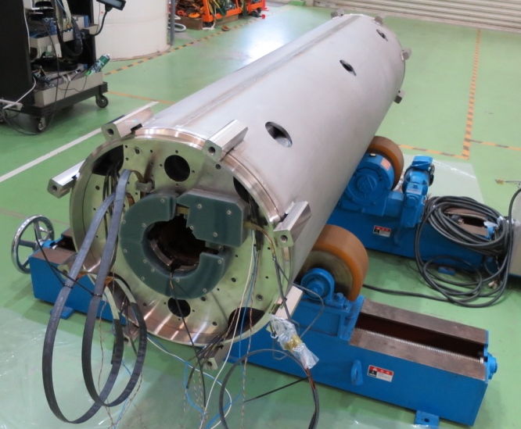
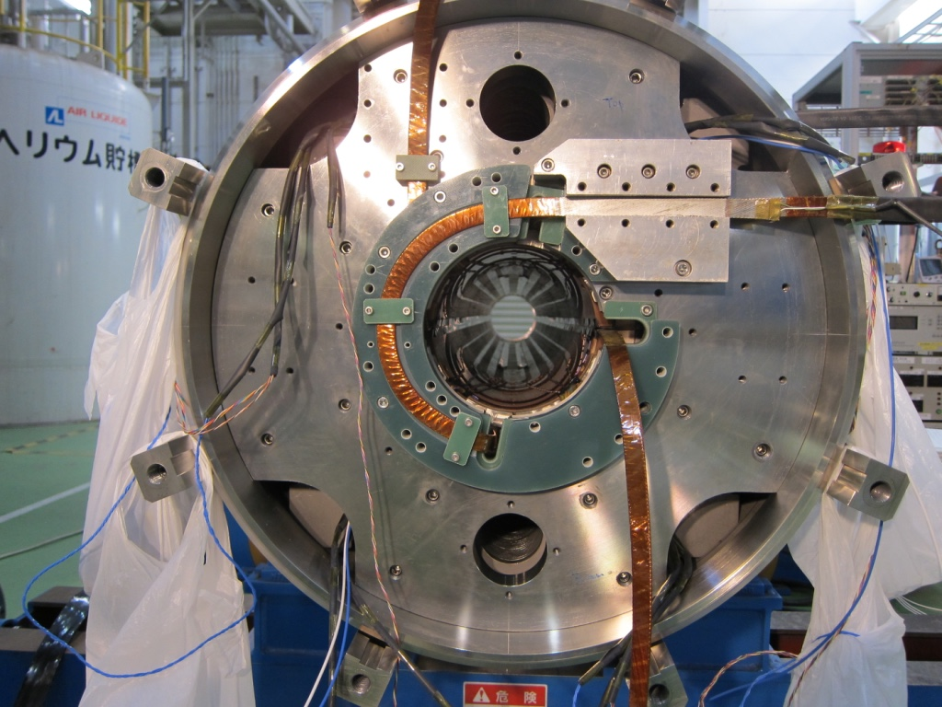
Assembly of MBXFS1b
Nov 2016 – Jan 2017
QPH and ground insulations wrapping
Collaring
Instrumented
coil
Splice work
Yoking
Shell welding
Completion of assembly

Slide 10
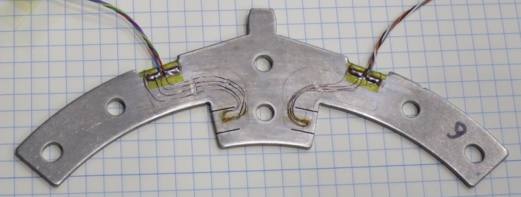
History of Coil Pre-stress in MBXFS1b
MBXFS1b
Coil pre-stress measured using strain
gauges on a collar pole
MBXFS1
Increase of pre-stress in MBXFS1b
compared with MBXFS1 (MPa)
After collaring | 6
Yoking with load | 33
After yoking | 35
Before shell welding | 30
After shell welding | 30
Detectable stress even after collaring in MBXFS01b
Pre-stress after yoking in MBXFS1b is 35 MPa higher than that in MBXFS1.

Slide 11
Training performance
(MBXFS1b)
MBXFS1b
Nominal
Ultimate
Substantial improvement of training performance from #1 to #1b by increasing azimuthal coil pre-stress
  Nominal at the third quench, ultimate after five quenches, good training memory
Even in #1b, azimuthal coil pre-stress was relieved at the ultimate current.
→ For further magnets, increase of azimuthal coil pre-stress by 15 MPa is needed.

Slide 12
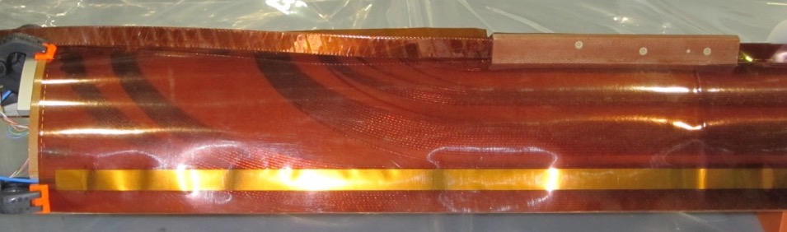
Quench Protection Study on MBXFS1b
Quench Protection Heater (QPH) tentatively implemented in the 1st models
Full energy dump test
As a result of full energy dump test, MIITs reached the allowable limit (MIITs=32 at 300 K) even at 10.5 kA (while I_{nom}=12 kA).
New design of QPHs needed to reduce the peak temperature.

Slide 13
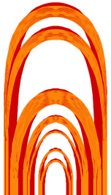
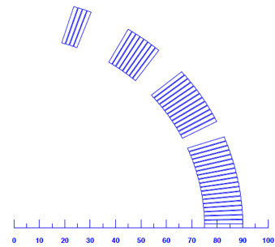
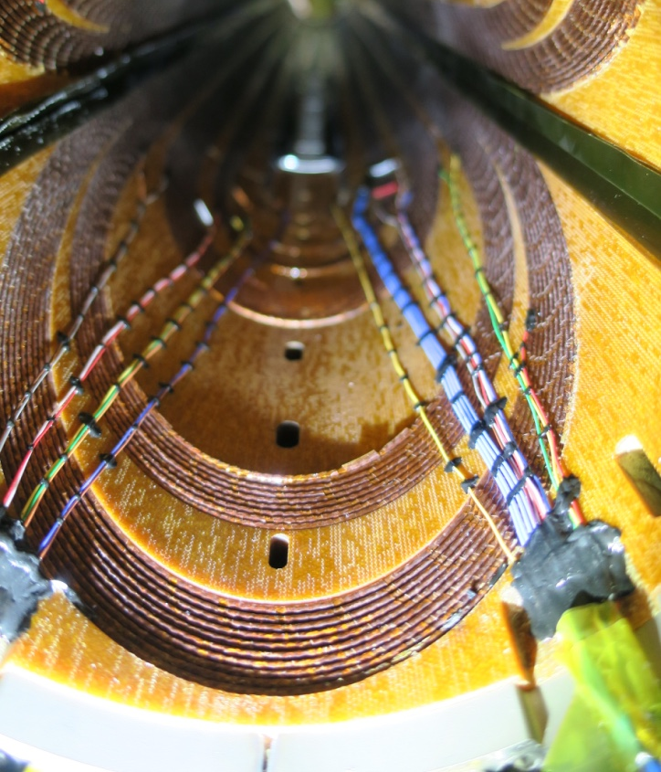
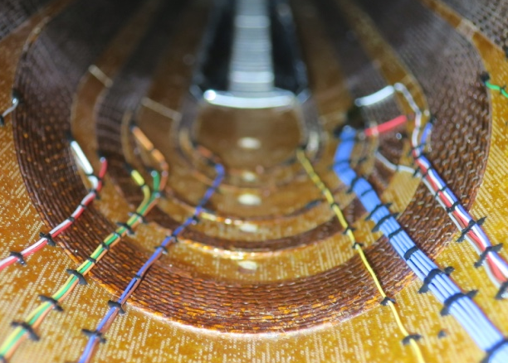
Coil deformation at coil end (MBXFS1b)
CB4
CB3
CB2
CB1A
CB1B
CB2
CB3
CB4
CB1
Largest deformation
(CB1B innermost turn,
26-27 turn)
Second largest deformation
(CB2 innermost turn,
12-13 turn)
Similarly to #1, coil deformation towards the coil bore was observed in the #1b.
Largely deformed turn in #1b is the same as #1.
The largely deformed turns coincide with ones at which quench started,
though it has not been clarified if such cable deformation can cause quench.
→ Mechanical support of the cable at coil end should be reinforced.

Slide 14
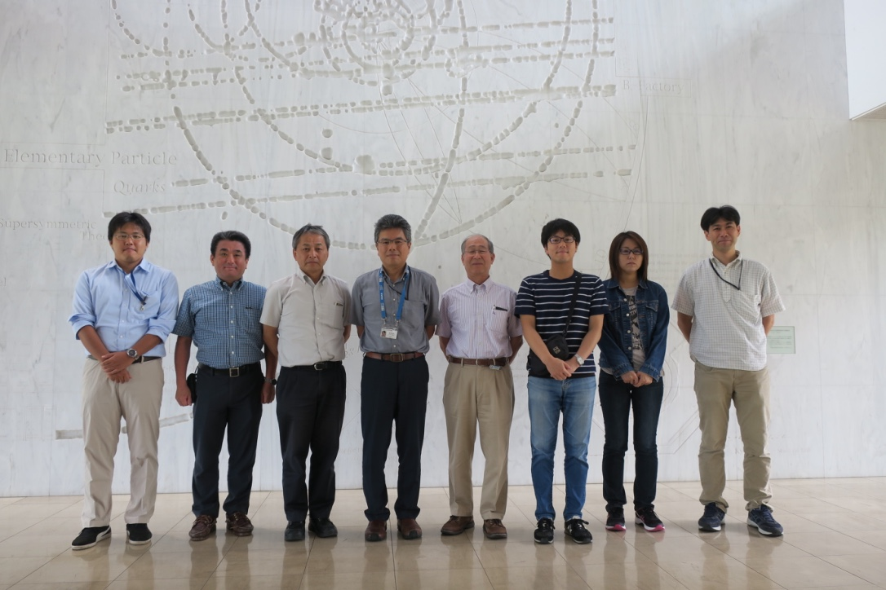
2nd D1 Magnet Review (KEK internal)
9 August, 2017 at KEK
Reviewers:
  Toru Ogitsu
  Akira Yamamoto
  Kiyosumi Tsuchiya
https://kds.kek.jp/indico/event/24965/

Slide 15
Report: 2nd D1 Magnet Review (internal)
Recommendations from the reviewers
  Countermeasures against coil deformation at coil end
  New design of QPH
  Field quality study for the 2nd model

Slide 16
Strategy for the 2nd model (MBXFS2)
Magnetic design
  Change of HX holes to be in line with those in Q1-Q3
  (two holes at 90º → four holes at 45º) REQUEST from CERN
  Optimization of iron shape, 2D coil block arrangement and coil end design
Mechanical design
  Increase of azimuthal coil pre-stress
  Countermeasures against coil deformation at coil end
Quench protection
  Newly designed QPH will be implemented.
Field quality
  To reproduce measured results, field calculation model will be improved.

Slide 17
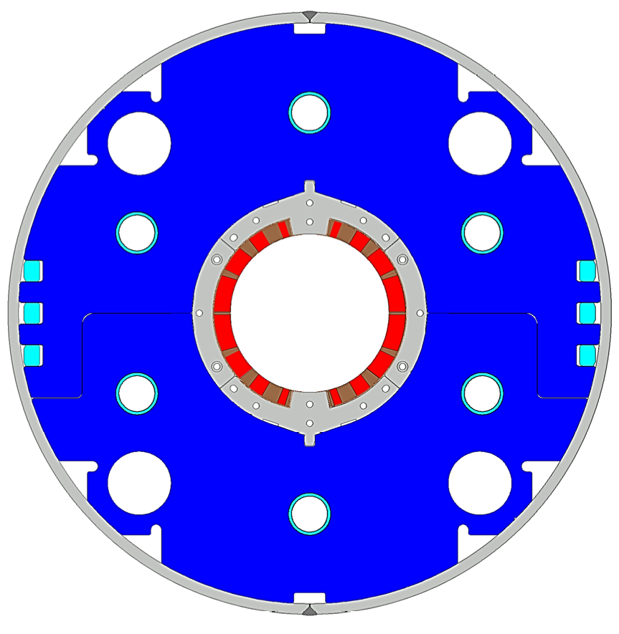
Design Parameters: 1st vs 2nd Models
4
8
13
4 blocks
44 turns
19
Item |  | MBXFS1, 1b | MBXFS2
Target pre-stress / load | lateral | #1: 80 Mpa, #1b: 110 MPa | 115 MPa
 | axial | 51 kN/coil | ? kN/coil
Coil | 2D | 4 blocks (4+8+13+19)
 | Coil end | 7 blocks | 8 blocks
 | Resin | 100 % CE (BT-2160RX) | Epoxy + CE (EC-1HA, B, w/ filler?)
 | length | 525,1100,375mm | 561.2,1025.5,413.3mm
QPH |  | straight | zigzag
Yoke |  | 2 HX holes | 4 HX holes
Cold tube Support |  | No | Yes
Nominal Current |  | 12.000 kA | 12.047 kA
Main Field |  | 5.573 | 5.569
Coil Peak Field |  | 6.56 T | 6.58 T
Load line ratio |  | 76.3% | 76.7%
Coil Mech. Length (full-scale) |  | 6518 mm | 6580 mm

Slide 18
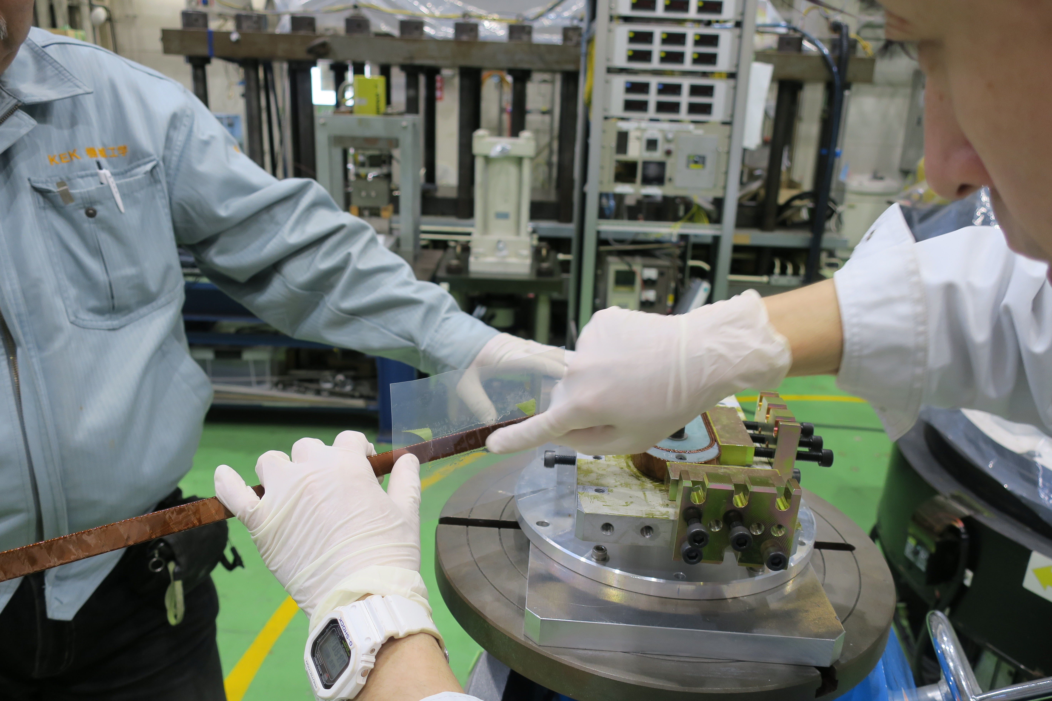
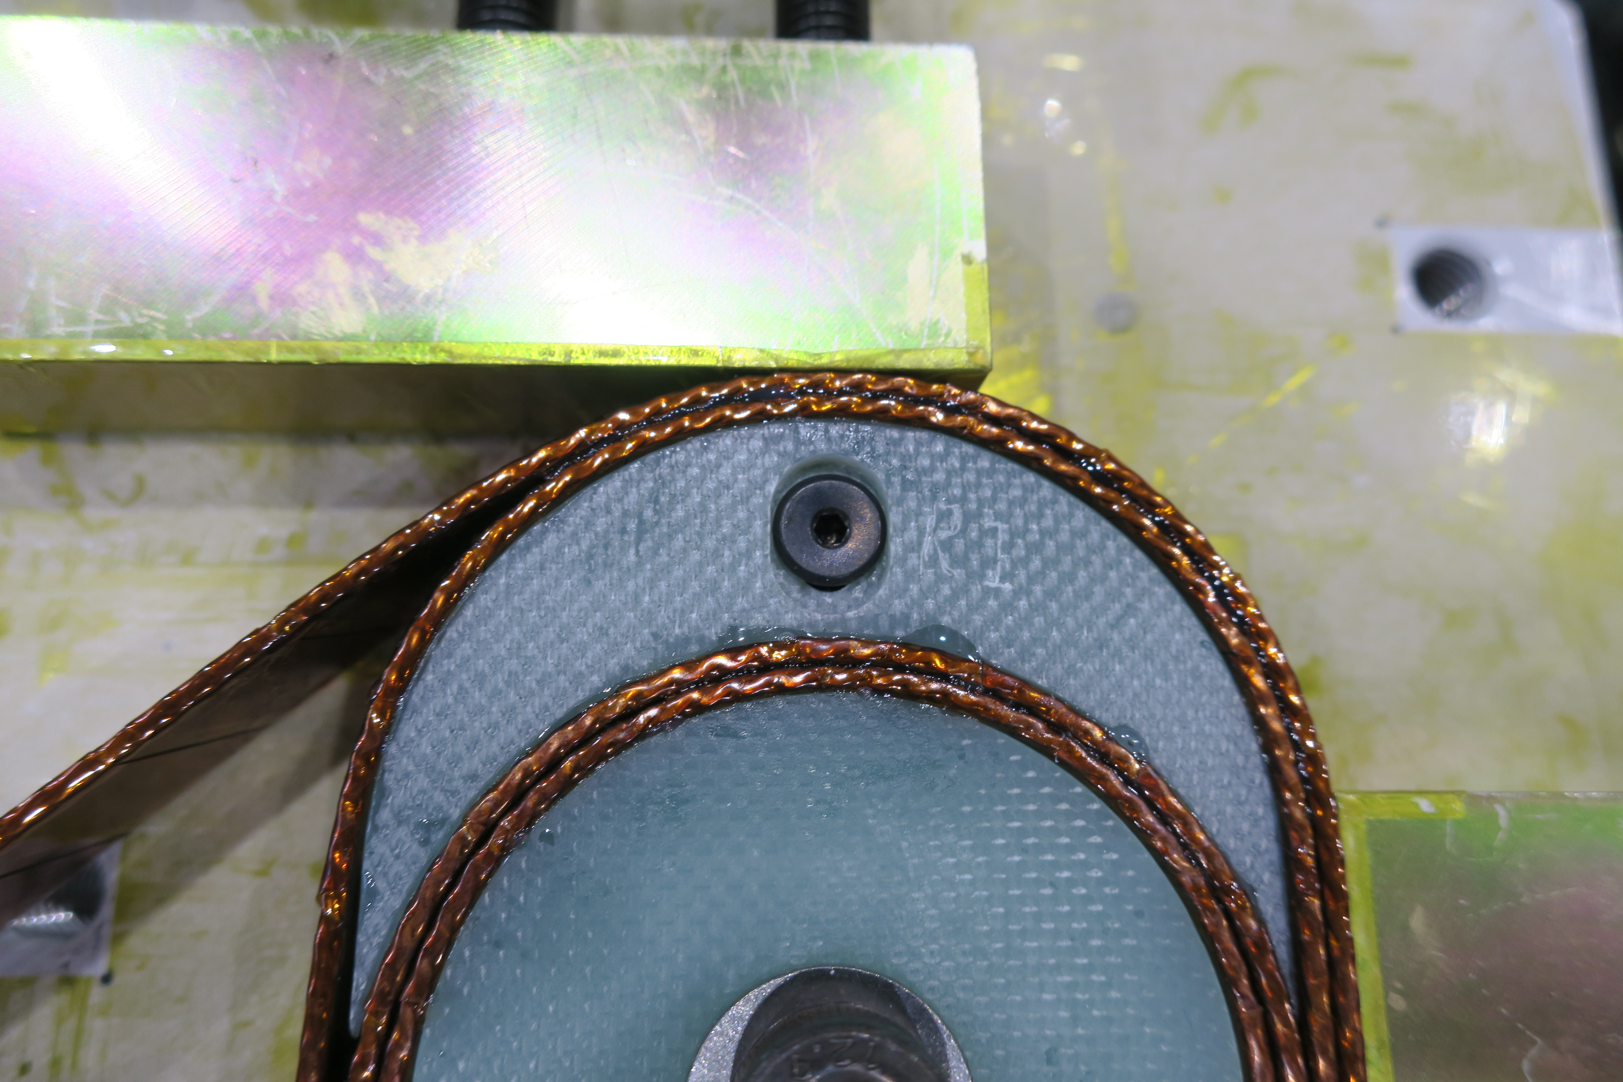
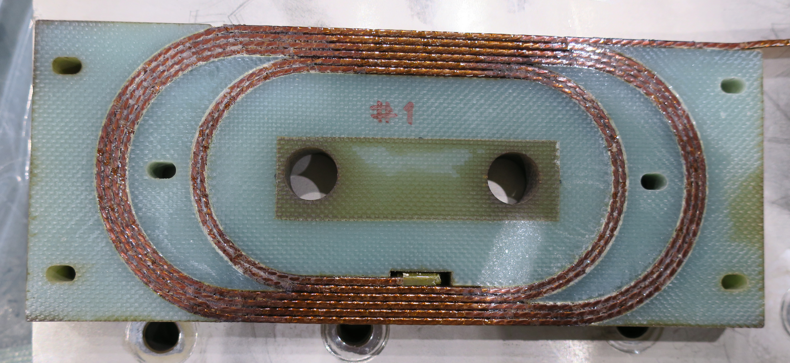
Test Coil Winding w/ Resins
R&D of wet-winding or injection w/ block
New resin (epoxy & cyanate ester, proven for ITER) with filler
  Appropriate viscosity and lifetime.
  120ºCx12h + 150ºCx24h +190ºCx0.5h
R&D of test coil winding w/ wet-winding is ongoing: outcomes will be implemented in the 2nd model.

Slide 19
Quench Protection Heater Design
Under discussion w/ CERN experts
Most likely candidate: A & B, all 2 strips in quad. will be fired.

Slide 20
Schedule
2017
4/4
2018
1/4
2018
2/4
2018
3/4
2018
4/4
2nd model
Coil winding starts in Nov.
Cold test in May 2018
3rd model
Cold test in Dec 2018
Possible in-kind contribution scenarios for D1 magnets (MBXFs) are in consideration.

Slide 21
Summary
Development of beam separation dipole (D1) for HL-LHC has been carried out by KEK.
  With a scope of Japanese in-kind contribution to the project.
Modified 1st model magnet (MBXFS1b) with higher pre-stress showed improved training quench performance.
  Nominal current was reached at the third quench and ultimate current was also achieved after five quenches.
Development of the 2nd model magnet (MBXFS2) has been carried out.
  Several design updates (enhanced coil pre-stress, 4 HX holes, improved coil end shape & wet-winding, new QPH, etc.) have been implemented.
  Coil winding will start in November, 2017 and cold test will be performed in May 2018.
  Continuously followed by the 3rd model magnet (MBXFS3) in 2018.

