Slide 1

MAGNET TEST PLAN INCLUDING COLLABORATIONS, STRING AND TEST STAND
M. Bajko on behalf of the testing team of CERN and the collaborators
G. Chlachidze (FNAL), H. Felice(CEA), T. Nakamoto (KEK), J. Muratore (BNL), M. Sorbi (INFN), R. Ruber (FREIA), M. Pojer (CERN), L. Fiscarelli (CERN),
Special thanks for M. Barberan for the Master Plan
7th Collaboration Meeting HL-LHC Madrid Nov 2017

Slide 2

CONTENT
Testing for HiLumi WPs
Test Catalogue for cold powering with planning
Test plan and considerations for planification
Status of the test facilities
Conclusions

Slide 3
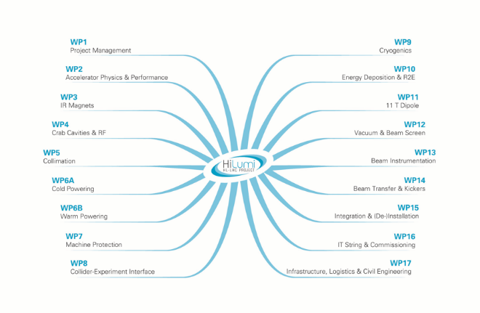
Testing for HL-LHC WPs

Slide 4
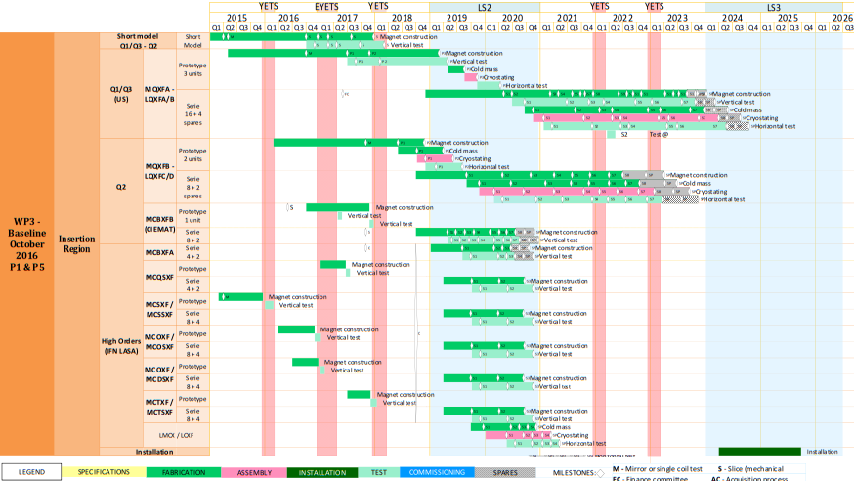
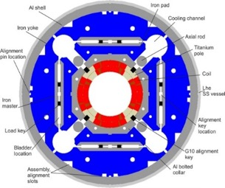

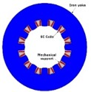





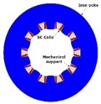
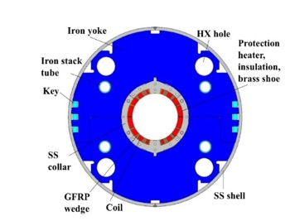
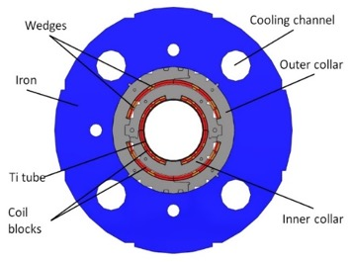
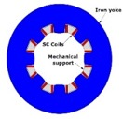
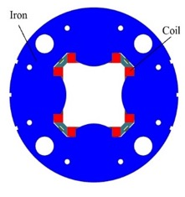
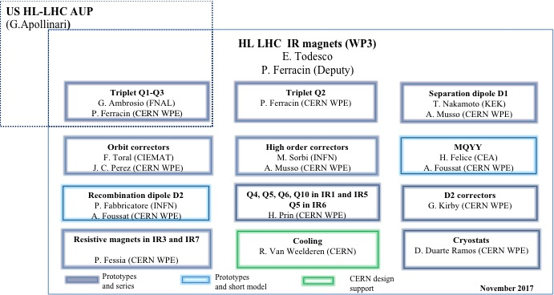
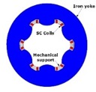
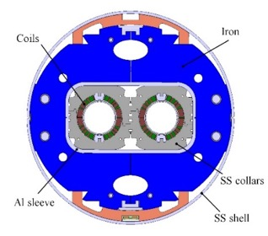
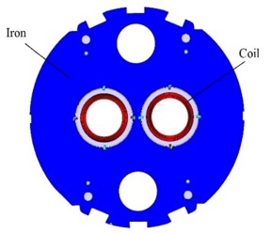
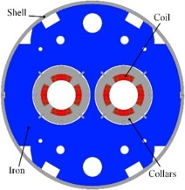
Testing WP3
Dodecapole
Triplet [G. Ambrosio, P. Ferracin et al.]
Decapole
Octupole
D1[T. Nakamoto, et al.]
MCBXF [F. Toral, et al.]
Skew quad
Sextupole
[M. Sorbi, M. Statera, et al.]
D2 [P. Fabbricatore, S. Farinon, et al.]
D2 correctors [G. Kirby]
MQYY [H. Felice, et al.]

Slide 5

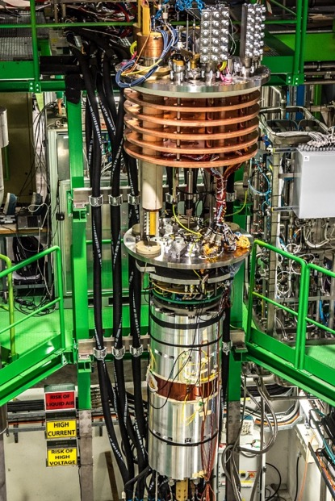
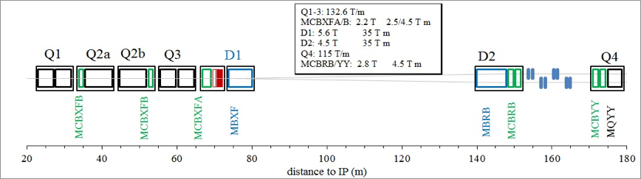
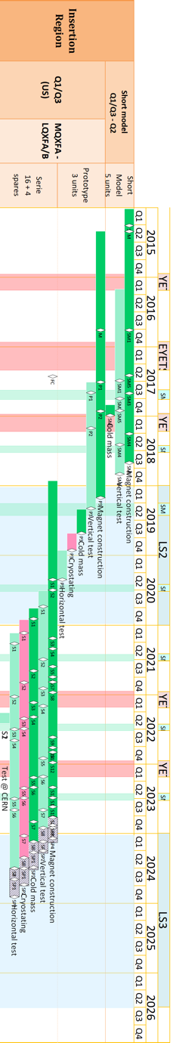
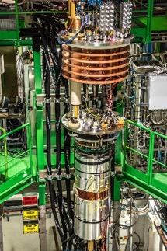


MQXFA test stand: BNL
LQXFA(Q1) LQXFB(Q3)
5 Models test at CERN D/BNL
Back up solution:
CERN Cluster D
20 + 3 prototype magnets to be tested
Test Responsible: Joseph Muratore

Slide 6

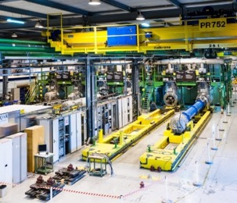


LQXFA/B (Q1/3) test stand: FNAL
MQXFA MQXFA
Back up solution:
CERN Cluster A/F
10 + 1 proto cold masses to be tested
Test Responsible: Guram Chalchidze

Slide 7
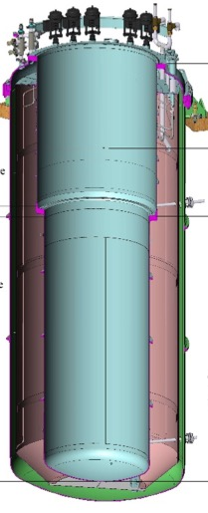


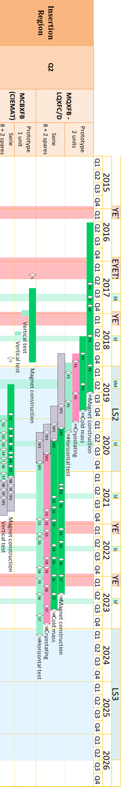


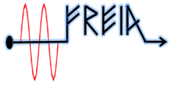
MCBXFA/B test stand: CERN / FREIA
LQXFC(Q2a) LQXFD(Q2b) CP
50 % CERN and 50% FREIA
18 + 3 prototype magnets to be tested
Test Responsible: Marta Bajko (CERN)
Roger Ruber (FREIA)

Slide 8

MQXFB test stand: -
LQXFC(Q2a) LQXFD(Q2b)
4 short models test at CERN
12+ 2 prototype magnets will be NOT tested

Slide 9
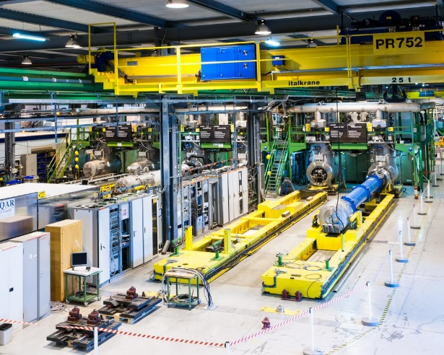

LQXFC/D (Q2a/b) test stand: CERN
MCBXFB MQXFB
Installations
on going
Complete by end 2019
No EE
Back up solution:
CERN Cluster F
10 cold masses + 2 prototypes to be tested
Test Responsible: Marta Bajko

Slide 10
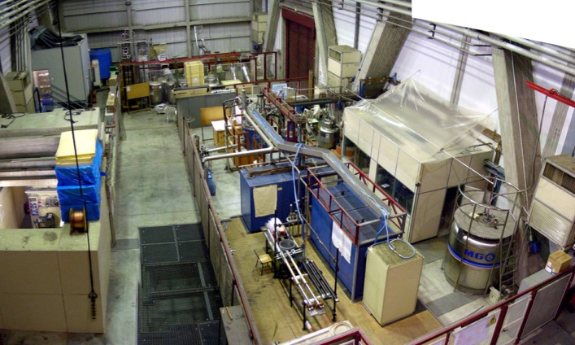
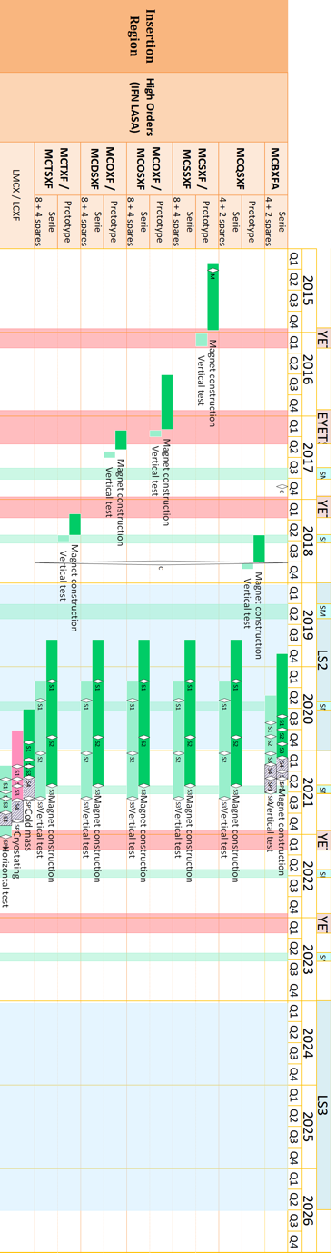


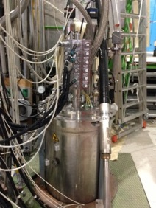
HO Correctors test stand: LASA
LCXF (CP)
Models test at CERN Siegtal
54 magnets + 5 prototypes to be tested
Test Responsible: Massimo Sorbi

Slide 11
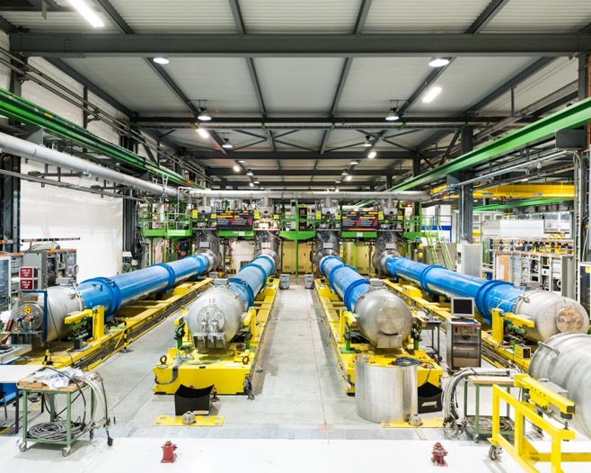
LCXF (CP) test stand: CERN
MCBXFA/MQSXF/MCTXF/MCTSXF/MCDXF/MCDSXF /MCOXF/MCOSXF/MCSXF/MCSSXF/MBXF /MQXFA
Modification of existing to be done
6 cold masses to be tested
Test Responsible: Marta Bajko

Slide 12
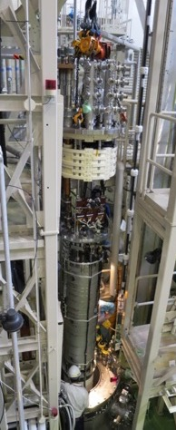
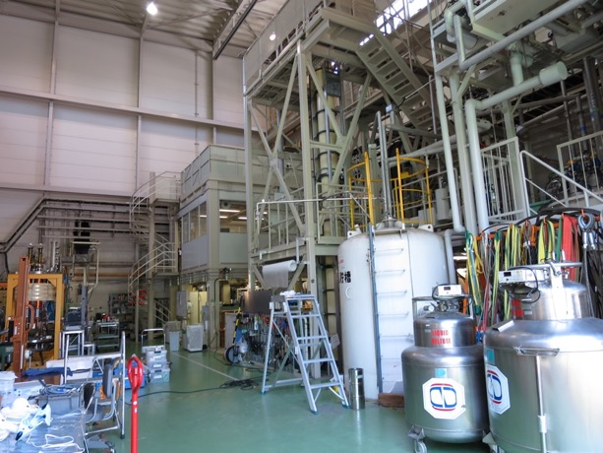
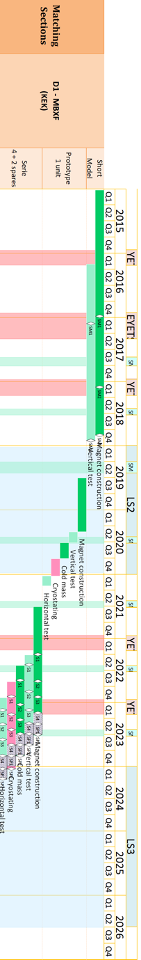

MBXF test stand: KEK
LBXF (D1)
3 Model test at KEK/CERN
1 prototype + 5 series magnets to be tested
Test Responsible: Tatsu Nakamoto

Slide 13
LBXF (D1) test stand: CERN
MBXF
1 proto+ 6 series cold masses to be tested
Test Responsible: Marta Bajko CERN

Slide 14
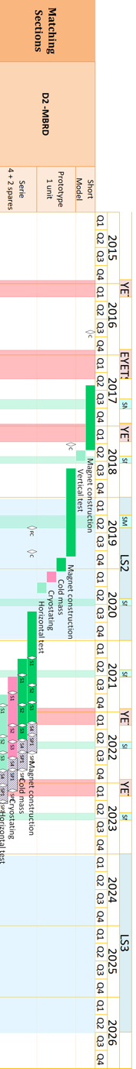
MBRB test stand:
LBRD (D2)
Model test at CERN D
6 magnets NOT TESTED

Slide 15
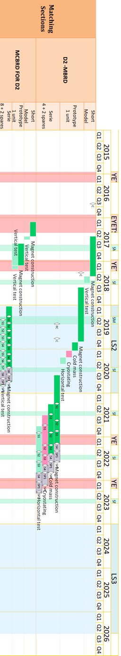

MCBRB test stand: CERN/FREIA
LBRD (D2)
50 % CERN and 50% FREIA
1 Model test at CERN D
1 proto + 12 series magnets to be tested
Test Responsible: Marta Bajko (CERN)
Roger Ruber (FREIA)

Slide 16
LBRD (D2) test stand: CERN
MBRD MCBRD MCBRD
1 proto+ 6 series cold masses to be tested
Test Responsible: Marta Bajko CERN

Slide 17
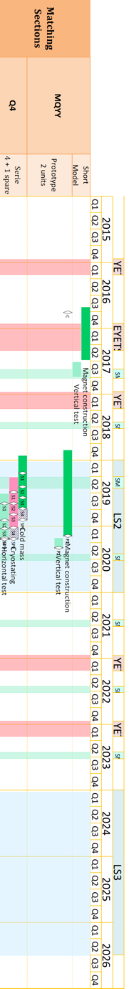



MQYY test stand: CEA
LQYY (Q4)
Existing test stand modification planned.
2 proto magnets to be tested: CEA
Test Responsible: Helene Felice

Slide 18
LQYY (Q4) test stand: CERN
MQYY MCBYY MCBYY
4 cold masses to be tested
Test Responsible: Marta Bajko CERN

Slide 19
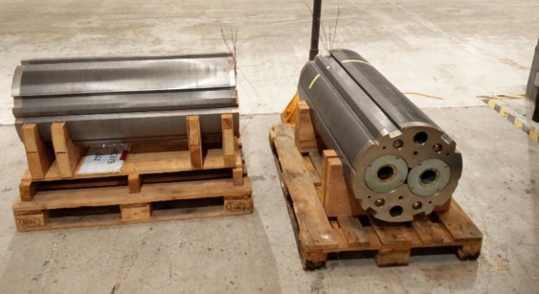
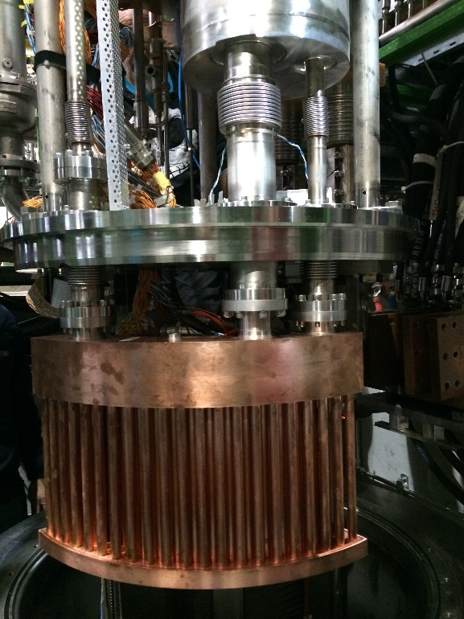
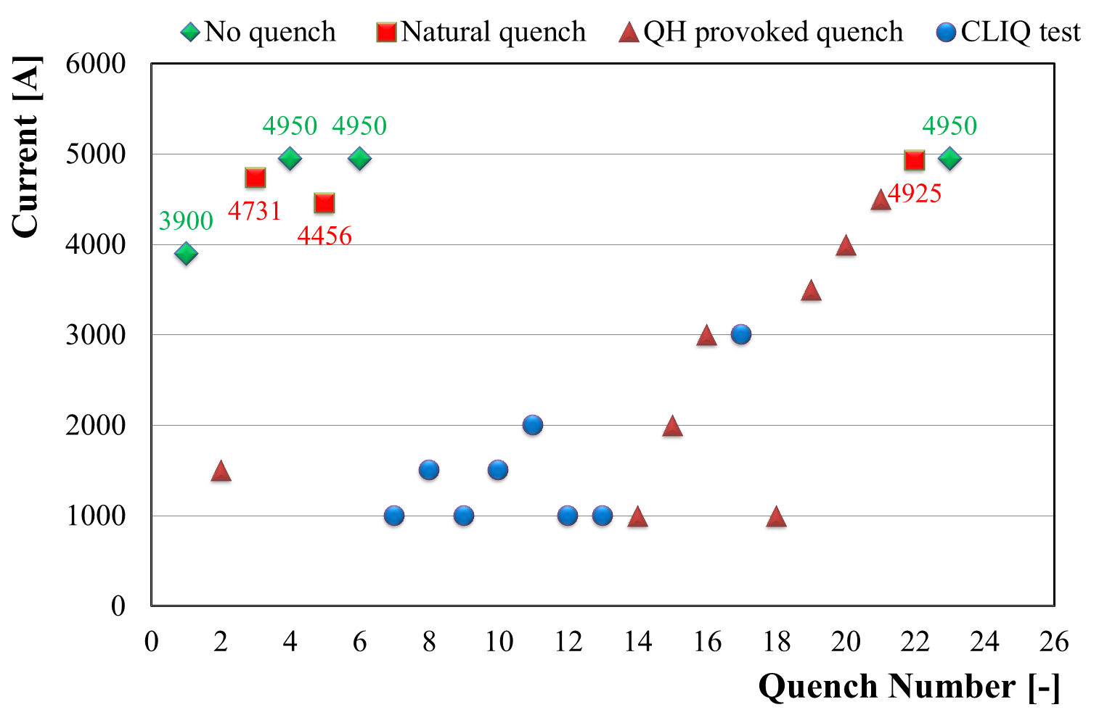
MCBY/MQY test stand: CERN
LQYY (Q4)
Magnets tested
Test Responsible: Marta Bajko

Slide 20
LQ (Q10) test stand: CERN
MQ MCBY MCBY
4 cold masses to be tested
Test Responsible: Marta Bajko CERN

Slide 21
Testing for HL-LHC WPs

Slide 22
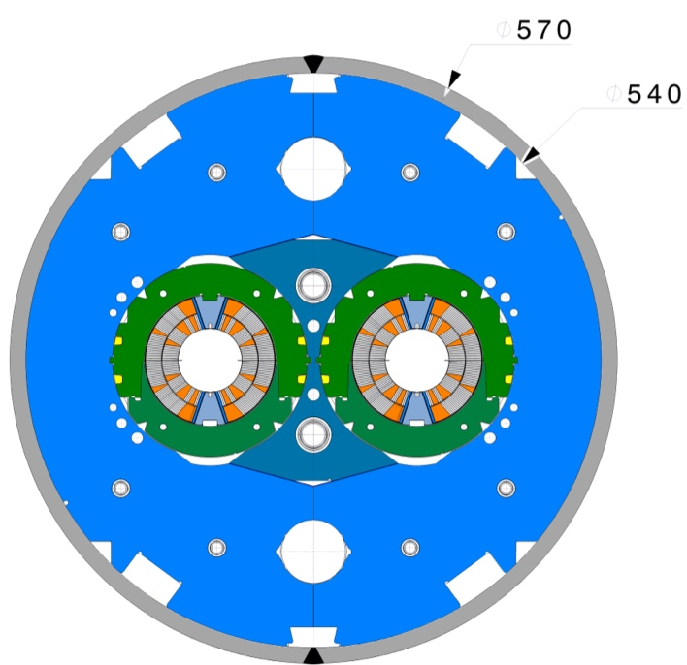
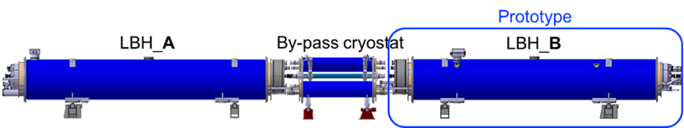
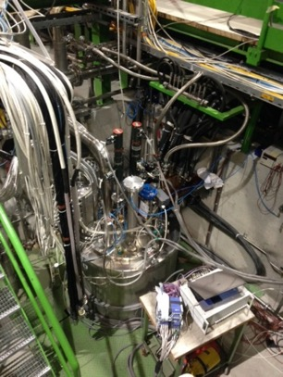
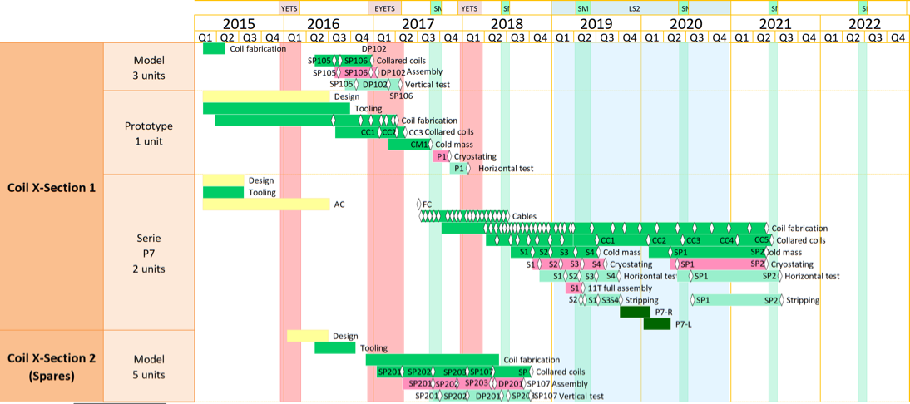
Testing WP11: magnets test stand:-
Model test at CERN LONG
Test Responsible: Marta Bajko CERN
Magnets will be not tested

Slide 23
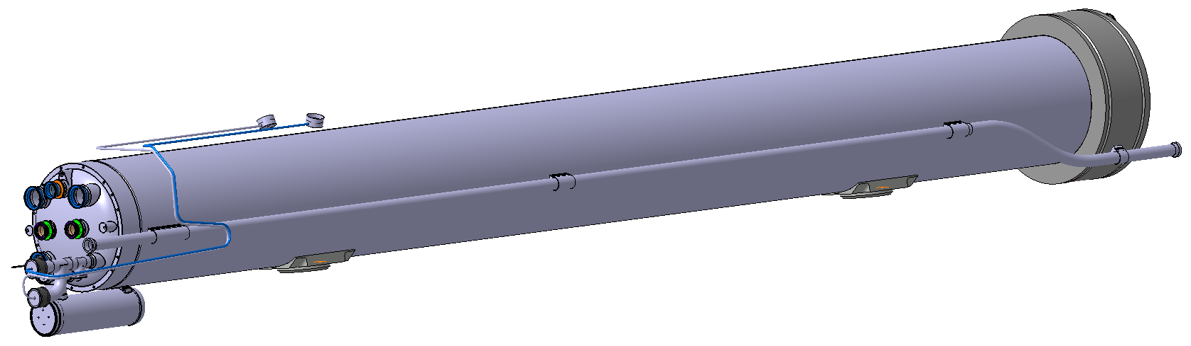
Testing WP11 cold mass test stand: CERN
LMBHA
4 +2 cold masses to be tested
Test Responsible: Marta Bajko CERN

Slide 24
Testing for HL-LHC WPs

Slide 25
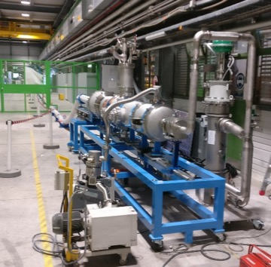
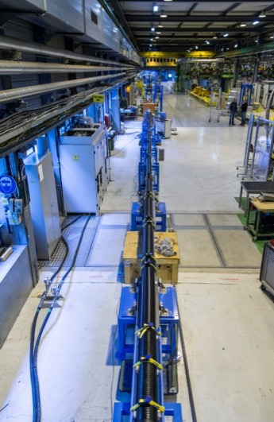
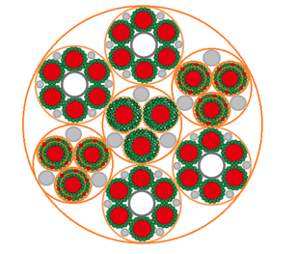
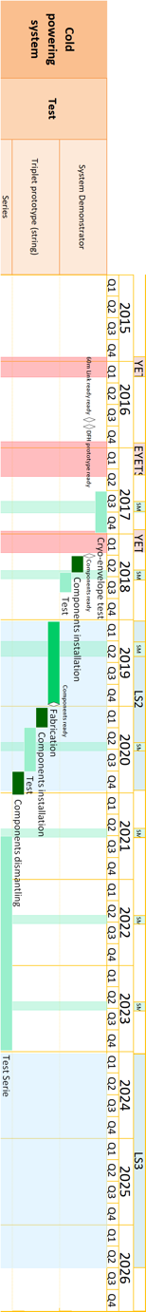
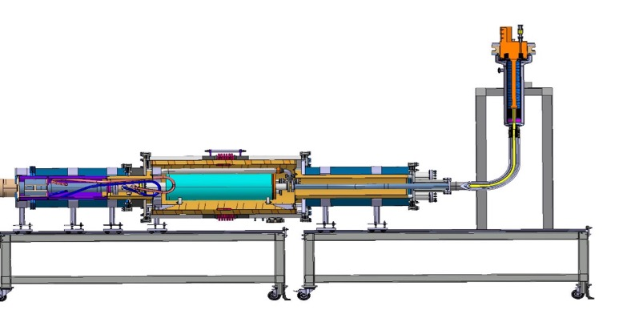
Testing WP6A test stand: CERN
- 18 kA
Cluster F 20 kA,7 kA, 2kA, 0.6 kA, 0,12 kA
Cluster G 20 kA
Protective insulation (outer layer)
+ 18 kA
6×2 kA
3× 2 kA (7 kA)
6×2 kA
+ 13 kA
- 13 kA
Instrumentation wires
(twisted and cabled)
Φ∼ 75 mm
Including insulation
Specification under revision
PC 20 kA and leads for 2 kA for end 2018
Test of 60 m long cryostats on going

Slide 26
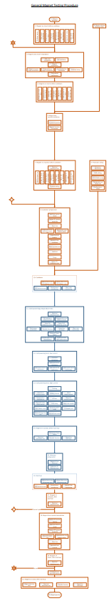
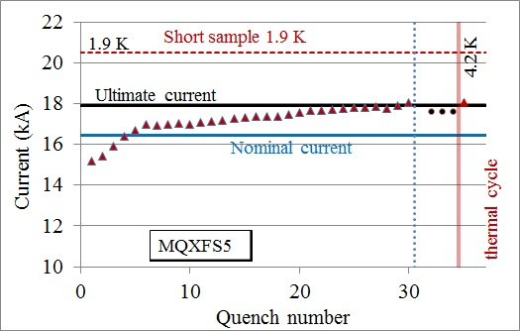
Magnet test plan
Magnet arrives at SM18
Installation in cryostat
Magnet arrives at SM18
Warmup
Installation in cryostat
Cold powering tests
Cooldown
TRAINING
TRAINING
Cold powering tests
Cooldown
Warmup
Magnet leaves SM18
Magnet leaves SM18

Slide 27
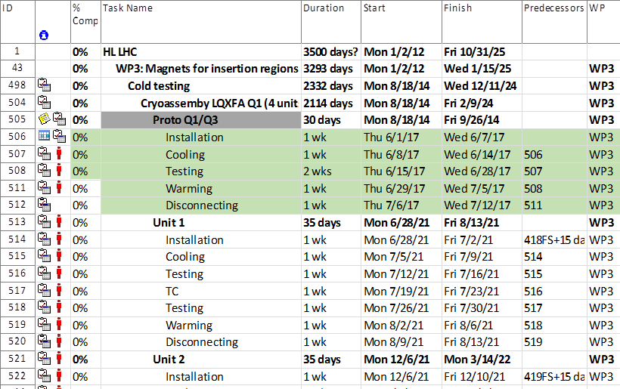
Planning of test
Every single magnet will be tested at cold and up to I_{ultimate}= 108% I_{nom} in nominal cooling conditions (1. 9K)
Systematic Powering at I_{nom} for 8 h
High Voltage test will be performed according to individual magnet electrical insulation and design values up to 3400 V for 120 s, <20 mA
Magnet protection will be done following the individual design CLIQ, QH, EE
Magnet protection is based on quench detection at 50-100 mV, verification time of 10 ms and protection simultaneously with all systems
Splice resistances measured individually and < 2 nOHM
Quench localisation with V_{taps} and quench antenna
Magnetic measurement with shaft
The global SM18 magnet test planning contains apart of the HL LHC test requirements: 30 magnet test for LHC ( to be changed in LS2) and other 34 without name for the moment eventually to be changed in LS3. For those magnets there is no TC foreseen. The planning does not contain any re-test of those and is 6 weeks long.
Typical test is over 7 weeks and systematically includes a thermal cycle (TC) unless is produced in the USA and tested before sent to CERN. In that case no TC is considered so a total of 5 weeks for series and 6 weeks for prototypes.
PERFORMANCE TEST CAPACITY estimated to :
20 quench /magnet
+ Corrector test, Splice resistance, Magnetic measurement, High Voltage test

Slide 28
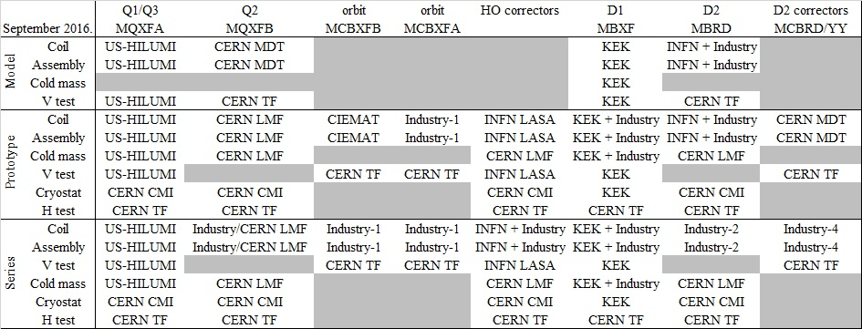
Magnetic Measurements @CERN
By L. Fiscarelli
reception
https://lhc-div-mms.web.cern.ch/lhc-div-mms/tests/MAG/docum/hilumi/Magnets/sharing.jpg
At room temperature: rotating-coils (TF and field quality)
At room temperature: rotating-coil (TF, field quality, angle, center)
At 1.9 K vertical station: rotating-coil shaft in helium bath
Short models and correctors
At 1.9 K horizontal bench: rotating-coil long shafts + stretched wire
Anti-cryostat is required

Slide 29
Testing for HL-LHC WPs

Slide 30







WP16 STRING plans
I_{ultim} is considered
In the phase of HWC of the STRING 120 quenches were estimated to be done till I nom. An other 50 quenches are planned to do with the goal of “special test” not done in the shadow of the HWC.
P5L is the most complicated and coherent set up with the Sm18 installations and the tunnel is the smallest .
We plan to reproduce the space allowed in that place of the tunnel for the interventions
The SLOPE of the tunnel will be NOT REPRODUCED in the STRING
P5
We consider that each medium or high current quench is recovered in 12h. This is to be verified with the presently planned infrastructure and magnet + cavity test plan.
QRX
DFX
D1
CP
Q3
Q2b
Q2a
Q1
This installation order seems to be the more difficult and have more interest for the WP15 and for Vac as allows instrumenting the beam screen of Q1 ( the tick version)
CP
Q1
Q3
Q2a
Q2b
D1
HL LHC IT STRING
3rd Q 2019
2020
2021
3rd Q 2021

Slide 31
STATUS of FACILITIES
To be remarked that there is NO PLAN TO TEST individually the :
7.2 m long MQXFB ( Q2a/b)
5.5 m long MBH 11T dipole ( LBH)
8.2 m long MBRB (D2)
before their integration into the cold masses

Slide 32


BNL STATUS
By Joseph F Muratore
Each magnet must meet the requirements set forth in US-HiLumi-doc-137 before shipping to FNAL for assembly into LQXFA cold masses.
27 MQXFA magnet tests (including prototypes at BNL Vertical Test Facility
6 m-deep vertical test cryostat to accommodate 5 m-long MQXFA testing at 1.9 K and 1 bar, and powering to 24 kA.
Energy extraction system 30-150 mΩ and fast switching with IGBTs
Anti-cryostat for “warm” measurements with quench antenna and magnetic field measuring systems
Quench antenna with 16 dual-winding sensing elements
Magnetic field rotating probe with two sets of windings using PCB technology
New data acquisition system for fast and slow data logging
Dual quench detection system for both fast and slow discharges
12 independent firing units for quench protection heaters
500 V CLIQ quench protection system
Vertical Test Facility at BNL, showing two of the five test cryostats and the backup refrigerator. Arrow points to Vertical Test Cryostat 2 (1.9K and 24kA).
BNL Vertical Test Facility has been upgraded to accommodate the testing of 5 m-long MQXFA magnets at 1.9 K and 1 bar and powering up to 24kA, more than meeting the requirements of US-HiLumi-doc-137.
The test facility has been commissioned with the successful test of the first full length MQXF coil in a mirror configuration. The quench plot below demonstrates the capability of the facility to provide the necessary superfluid He and the required test currents.

Slide 33









CERN STATUS
By Marta Bajko
Aprox. 90 magnets/cold masses to be tested for HL-LHC in vertical or horizontal test benches + SC link and STRING
Model magnets and SC link
Model magnets and MCBXF/MCBRD
Q1/Q2a/Q2b/Q3/D2
Cluster G
Cluster D
Cluster A
I=18 kA
Duration: 1 hour
30 kA EE IGBT+ Dump
20 kA+ 2x 2 kA
Test performed on A1 aswell with nominal cooling parameter!!!
20 kA EE Thyristor based switch
For 2018:
2 x +/- 2kA PC and EE for Cluster D
Qualification to 20 kA of Cluster A
Cluster F
Cluster B-C/E
Other cold masses
2 x 2kA PC and 2 kA CL for Cluster A/F in 2018 and + 20 kA PC for Cluster F
Q1/Q2a/Q2b/Q3/D2
SC link 120 m
Interface for SC link on Cluster F and all magnets in discussion or production
SC link . Test of 60 m long items
Test facilities are operational, but still optimisation is ongoing. He pumping capacity under revision.

Slide 34





CEA STATUS
By Helene Felice
Effort to find synergy to minimize cost and down time
1 MQYYM: NbTi
90 mm single aperture quadrupole
360 mm OD
1.2 m magnetic length
CEA Team: J.M. Gheller, D. Bouziat, D. Simon, H. Felice, J.C. Barriere, J. Belorgey, F. Molinié, J. Relland
Target date for operation: Summer 2018
Cryogenic facility
CEA 8 m vertical cryostat equipped with a 3 m long « sock » (tank)
Adaptation of an existing top plate
Saturated LHe bath at 1.9 K 23 mbar
Data acquisition and magnet protection
Based on existing infrastructure
Max Dump resistor: 100 mohm
Power supply: 20 kA
Resistive current leads 10 kA
CEA Team: J.M. Gheller, H. Allain, H. Felice,C. Lorin, D. Simon, J.C. Barriere, J. Belorgey, F. Molinié, J. Relland
Target date for operation: End of 2019
Cryogenic facility
Design and fabrication of an inner cryostat to be inserted in the 8 m vertical cryostat
Pressurized LHe bath at 1.9 K
Introduction of Lambda plates in the main Lambda plate to accomodate the anticryostats and bus bars
Connection to a liquifier
Data acquisition and magnet protection
Upgrade under discussion
Max Dump resistor: 100 mohm
Power supply: 20 kA
HTS current leads under investigation
Magnetic measurement
CERN probe (47 mm diameter)
rotatiing in LHe and DAQ
Adaptation (seal) (saturated bath)
Operation by CEA
Test plan
Under discussion
Quench relief valve
Rods
6 MQ: NbTi
56 mm double aperture quad
452 mm yoke OD
3.1 m magnetic length
Spare magnets for LHC
4.2K bath
Heat exchanger 4.2 K /1.9 K
Filling cord
J-T valve
2 MQYYP: NbTi
90 mm double aperture quad
614 mm yoke OD
3.6 m magnetic length
Manufactured within Quaco for HL-HC
Vertical Test Facility at BNL, showing two of the five test cryostats and the backup refrigerator. Arrow points to Vertical Test Cryostat 2 (1.9K and 24kA).
Lambda plate
Saturated He II
Anti-cryostat for magnetic measurements

Slide 35


FNAL STATUS
By Guram Chlachidze
One prototype and ten production Q1/Q3 cryo-assemblies for the HiLumi LHC upgrade will be tested at Fermilab’s Horizontal Test Stand
  Q1/Q3 are part of the final focusing triplet magnets before the interaction point
  Each cryo-assembly comprises two 150 mm aperture 4.2 m long Nb₃Sn low-β quadruples inside the cryostat
  Test requirements for Q1 and Q3 elements are the same
Test stand previously was used for testing the existing LHC inner triplet quadrupoles
All major test facility components are available
  Refurbishment is necessary to meet new test requirements
Primary test objective is full qualification and acceptance of LQXFA (Q1) and LQXFB (Q3) cryostat assemblies
  Quench performance checkout at 1.9 K up to the ultimate current of 17.9 kA
  Alignment measurements
  Field quality measurements: Integrated gradient and harmonics
Refurbishment of the test stand components already started
  Upgrade of the top plate and the feedbox assembly
  New quench recovery & pumping lines
  Design of transfer lines to the cryostat
  Design of the quench protection and detection systems
The prototype cryo-assembly test is expected in summer 2019, the first production test in about 1 year afterwards
  Peak production rate is 3 tests per year
Vertical Test Facility at BNL, showing two of the five test cryostats and the backup refrigerator. Arrow points to Vertical Test Cryostat 2 (1.9K and 24kA).

Slide 36







KEK STATUS
By Tatsu Nakamoto
Cryostat
Operating Temp. of 4.4K to 1.9K, HeII Sub-cooler (55W)
Capacity: 1.9 K bath: 7524 mm deep, 700 mm in a diameter.
  Weight: 8.6 ton (MQXA). Need to check for D1.
New header for the D1 (MBXF)
  Anti-cryostat for MFM (O.D. 141.3) w/ Quench Antenna
  15 kA Current Leads (nominal of D1: 12 kA)
Refrigerator/Liquefier for Test Stand
Main: 160 L/h, 2400 L dewar + Sub: 350 L/h, 5000 L dewar
  In linkage operation: 510 L/h max.
Power Converter
15 kA, 15V, thyristor switch for prompt shutoff.
Dump resistor (0, 12.5, 25, 50, 75 or 100 mW)
Concern: accuracy and stability of DCCT output
  New DCCT will be installed in early 2018.
Measurement system
Isolation Amp: NF P-62A, 76 ch
NI PXI 1643 (16bit, 250 kS/s/ch), 88 ch
KEYSIGHT 3458A multimeter (8.5 digit) x 3
Kyowa UCAM-60B for strain gauge measurement, currently 30 ch (80 ch max.)
Labview (& KEYSIGHT VEE only for field measurement)
Vertical Measurement
Rotating coil in anti-cryostat (I.D. 108.3mm) at “warm” temperature.
  Printed-circuit board
  3 radial coils: B1 and analogue bucking
  Long (350mm) and short (80mm) arrays
  GN₂ flow from the end to suppress thermal shrinkage of the pipe
7 m long GFRP shaft
  not long enough for the full-scale magnet, but it can be extended.
Encoder: HEIDENHAIN RON 255
Integrator: MetroLAB PDI-5025 x 3
Magnet scale: SONY LY51
For 2-m models:
Cold tests for MBXFS1 & MBXFS1b completed.
2nd model (MBXFS2) will be tested in May 2018.
  New design features: higher pre-stress, coil ends, HX holes, QPH, etc.
  Test item:
    Training quench at 1.9 K, QPH quench, ramp rate dependence, excitation at 4.4 K.
    Field measurement: DC loop at magnet center, Z-scan by 80-mm long coil.
    Strain gages: collar (pole), axial
  Afterward, shipping to CERN for further cold test (beam tube insertion).
3rd model (MBXFS3) in Dec. 2018 (…maybe with some delay).
Full-scale magnets:
Japanese in-kind contribution is under discussion in the meantime.
  Deliverables should be defined by HL-LHC C&S review (March 2018).
  * The following is based on the initial plan (not approved yet).
A full-scale prototype (7-m long) will be produced by the end of 2020:
  In time for String Test at CERN in 2021.
  Vertical test to be done at KEK, horizontal test at CERN.
A series magnet production: 6 units including 2 spares.
  From 2021 to early 2024.
  Vertical tests at KEK, horizontal test at CERN.

Slide 37






FREIA STATUS
By Roger Ruber
Gersemi test stand at FREIA
µGersemi simulator
Under construction
  December ➔ factory test valve box & controls with µGersemi simulator
  February ➔ installation in Uppsala
  April ➔ commissioning
Training of personnel “ CERN is planned from February 2018
Dipole orbit corrector testing
  2 circuits up to 2 kA each
  (pressurized) liquid bath
Vertical cryostat
  2645 x ø1100mm below lambda plate
  design includes joint for lambda plate
  two inserts will be available (start) : a. liquid bath b. pressurized bath with 2K heat exchanger
Powering system
  2x 2kA CERN type power converters
  switch and power extraction unit
Control system
  cryostat: PLC, EPICS
  magnet: CERN type quench monitoring
Vertical cryostat top flange and inner vessel
26-Oct-2017
Opened valve box & electrical cabinet
26-Oct-2017
Vertical Test Facility at BNL, showing two of the five test cryostats and the backup refrigerator. Arrow points to Vertical Test Cryostat 2 (1.9K and 24kA).
Vertical cryostat vacuum vessel
28-Apr-2017

Slide 38




INFN STATUS
By Massimo Sorbi
New cryostat for testing MCTXFP1 (12P), MCQSXFP1 (4P) and then for HO series magnets
New power supply for magnet test (200 A, 50 V)
New main switch for power supply (fast solid state switch, Dt<1 ms)
New acquisition system for test monitoring
Installation of system for magnetic measurement at low/room temperature (supplied by CERN)
Ordering started in 2017
Installation to be completed in 2018
600
2350
In production are necessary 3 batches:
  18 magnets
  2X4P 2X12P
  5 cooldowns
Different possible configurations for housing the magnets of each batch
The flange is designed for housing the magnetic measurement system
The tests will be performed at 4.2 K
Mag.meas.
4P
Safety
Valve and disk
12P
CL : 2+4
Connections X3
HE inlet
Vertical Test Facility at BNL, showing two of the five test cryostats and the backup refrigerator. Arrow points to Vertical Test Cryostat 2 (1.9K and 24kA).

Slide 39

Testing for HL-LHC: Conclusions
Test facilities for model testing are operational at CERN , KEK, BNL, and for series at LASA .
The horizontal test stands are quite well advanced as we are ( FNAL and CERN) are re-using existing facilities with modifications
Uppsala is preparing a complete new test stand: installations are well advanced and in time
Important to work out QA/QC together and implement accessible platforms for good data exchange
2nd Workshop on Superconducting Magnet Test Facilities is foreseen in BNL in Spring 2018

