Slide 1
Crab Cavities: SPS test Scope
SPS-BA6 Status
Test Overview w.r.t performance
Foreseen machine development time
F. Antoniou, R. Calaga, G. Vandoni on behalf of WPs 2/4/9/12/13
CERN
7th HL-LHC Collaboration Meeting, Madrid – 15 Nov 2017

Slide 2
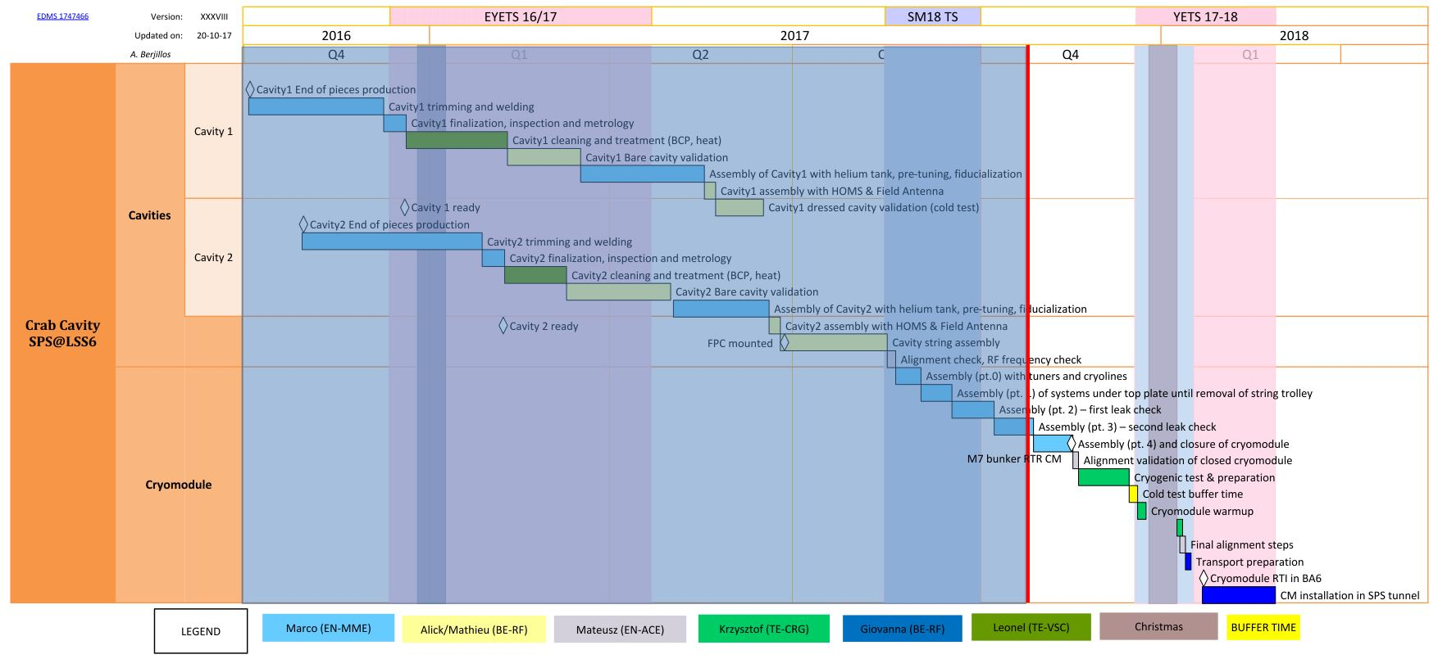
Recap SPS-CM Schedule
CM cooldown start ~Dec 4, 2017 (2 wk)
CM at SPS-BA6 – Jan 22, 2017

Slide 3
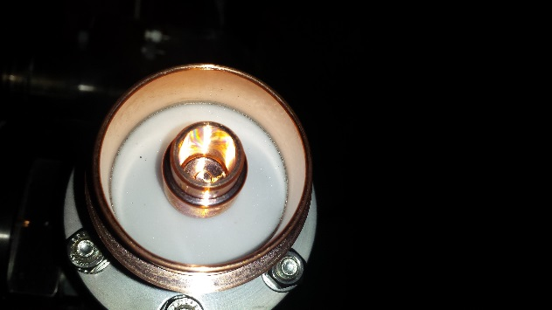
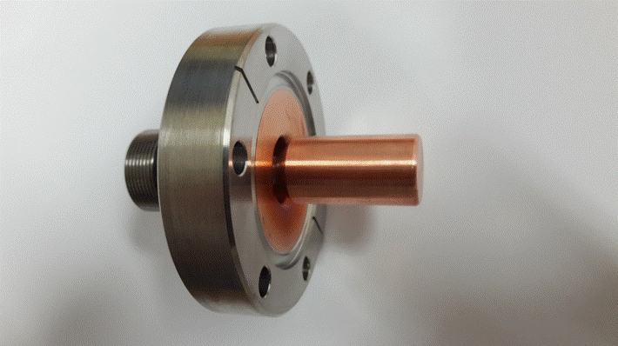
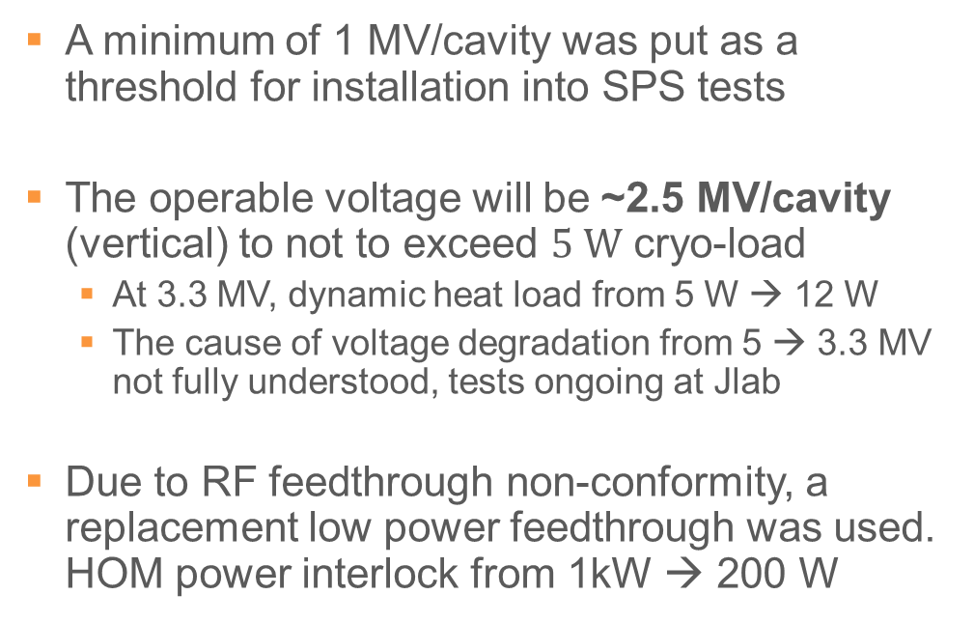
RF Performance Expectations
A minimum of 1 MV/cavity was put as a threshold for installation into SPS tests
The operable voltage will be ~2.5 MV/cavity (vertical) to not to exceed $5 W$ cryo-load
  At 3.3 MV, dynamic heat load from 5 W → 12 W
  The cause of voltage degradation from 5 → 3.3 MV not fully understood, tests ongoing at Jlab
Due to RF feedthrough non-conformity, a replacement low power feedthrough was used. HOM power interlock from 1kW → 200 W

Slide 4
Overview SM18/SPS Installation
Week: 47-48
SM18 Installation
Week: 49-51
SM18
Cool-down
Xmas TS
Week: 02-04
RF/Align Checks, Transport
Week: 4-7
SPS Installation
Week: 8-9
SPS
Cool-down
Cryomodule tests in SM18
  Main goal is to perform a cool-down cycle
  Limited RF tests (cavity tuning & conditioning)
SPS installation
  Very detailed YETS planning (2-shifts/day + nights)
  Reduced time (-1 wk) + additional safety cabling

Slide 5
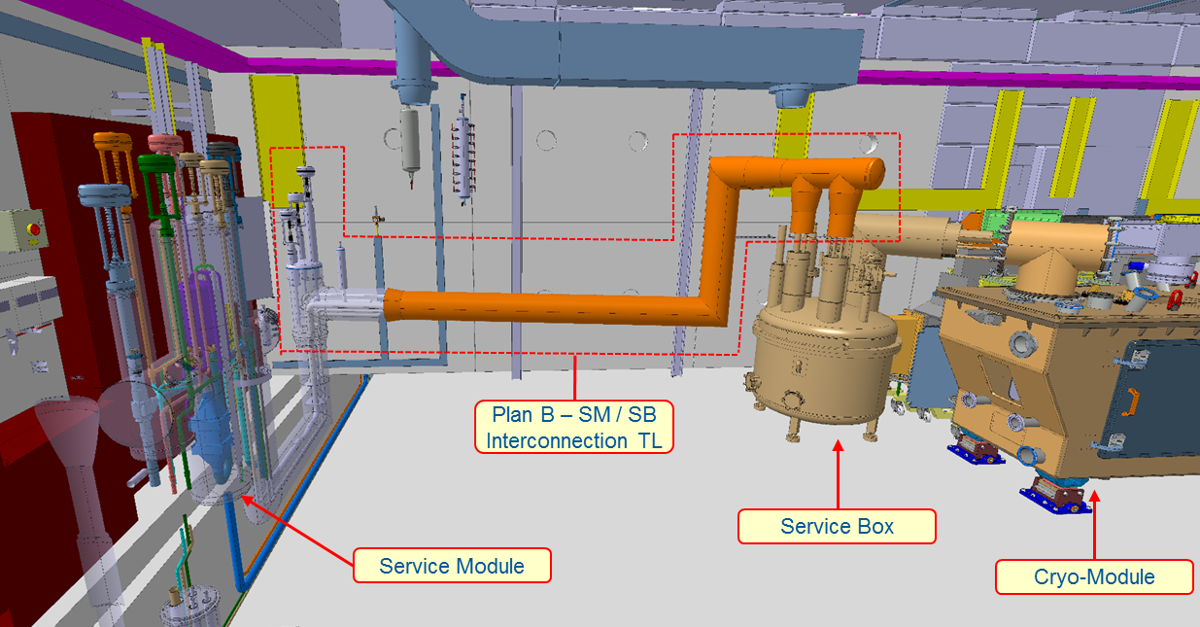
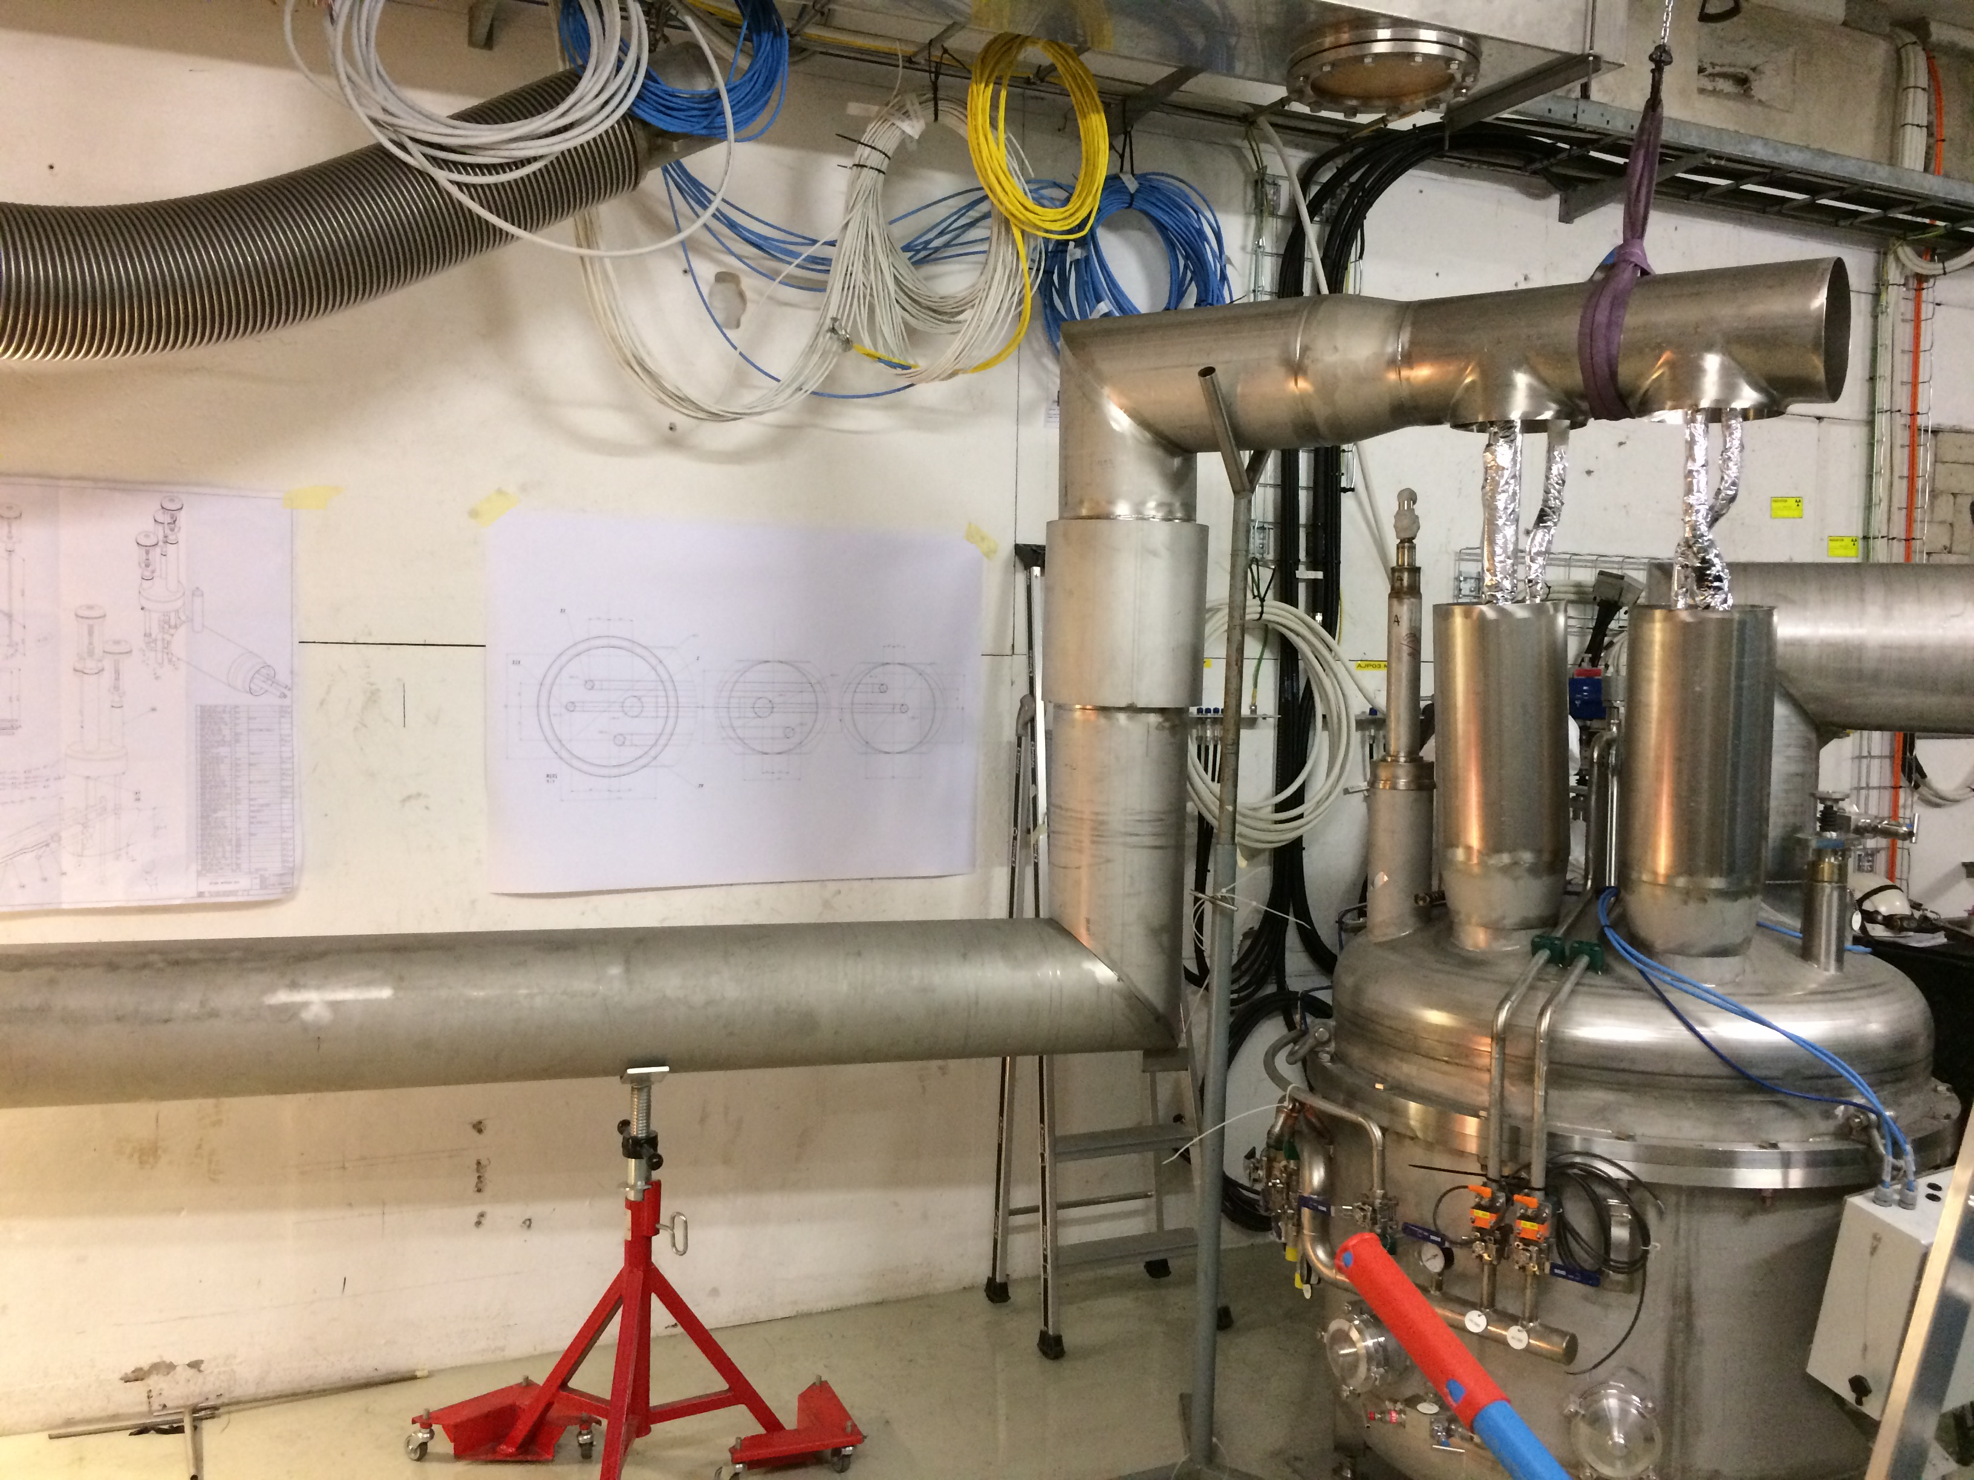
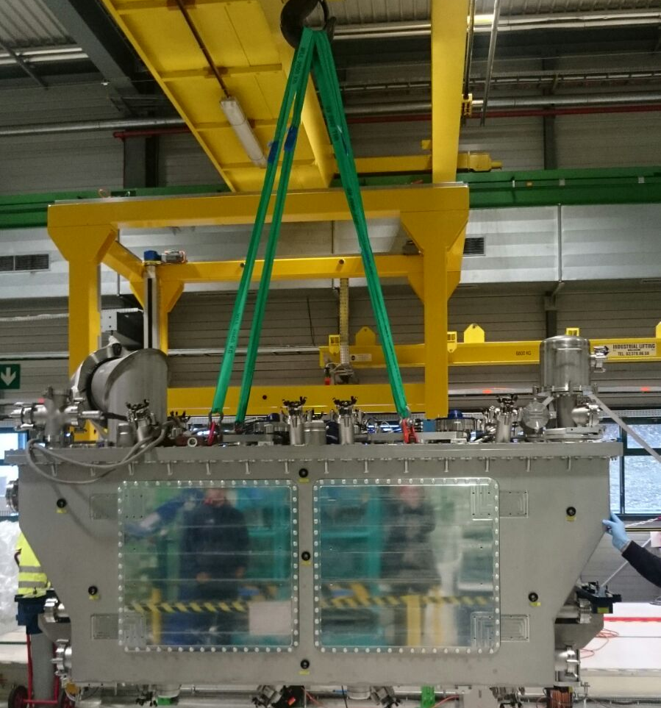
SM18 Bunker Preparation
Service box and infrastructure in its final steps
Courtesy TE-CRG
Courtesy
EN-MME

Slide 6
SPS Infrastructure (YETS)
cryomodule
cryogenics
cabling
Effective duration now 7 weeks
First week (51) only partial access, extra cabling

Slide 7
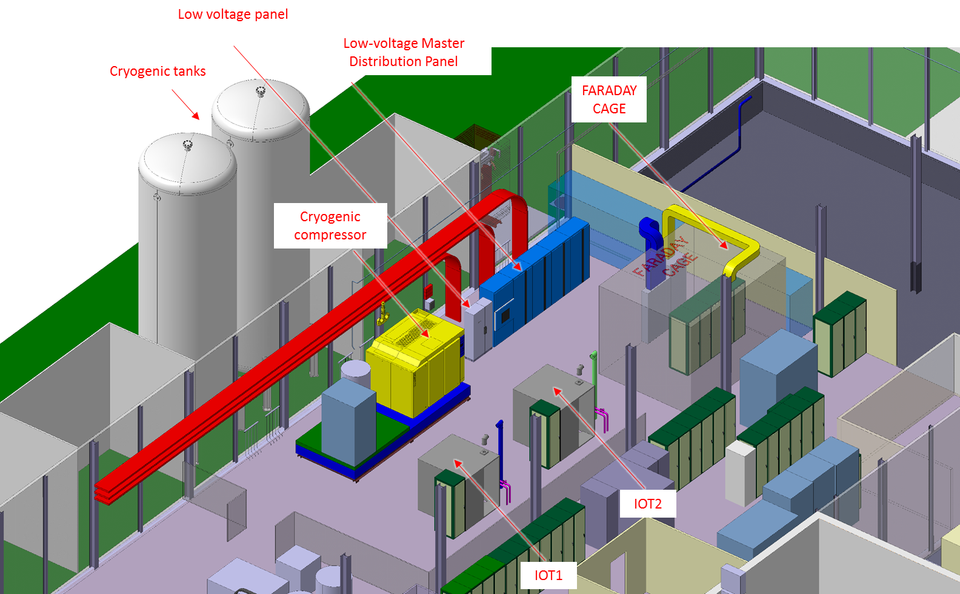
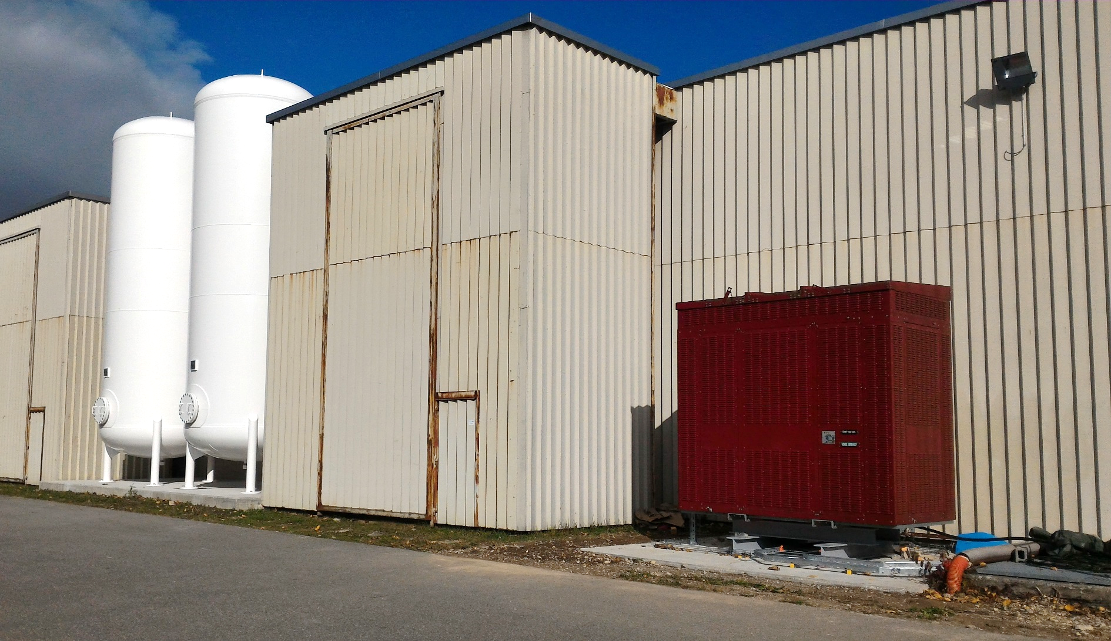
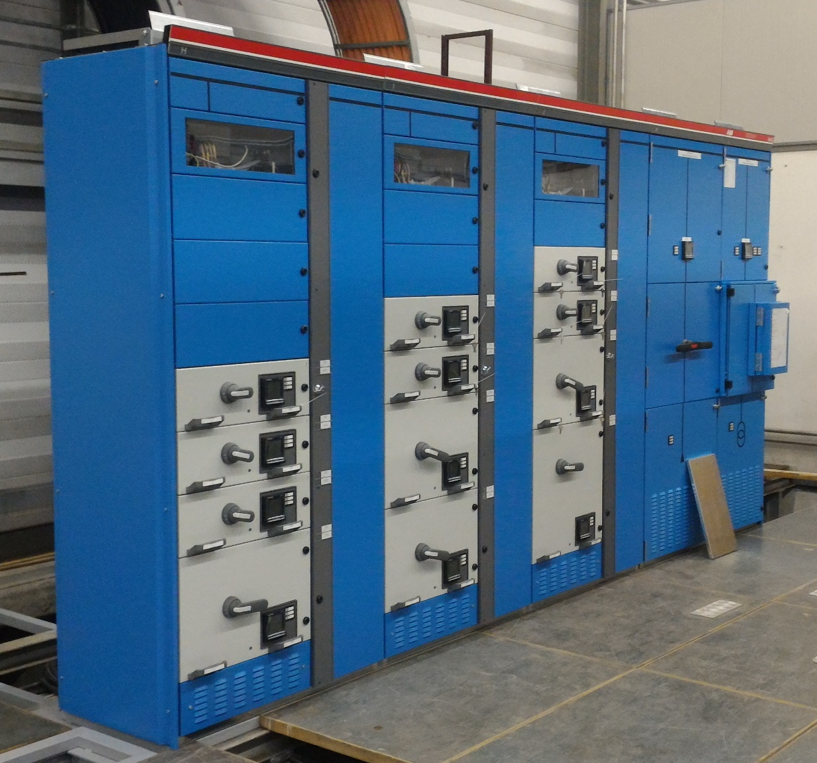
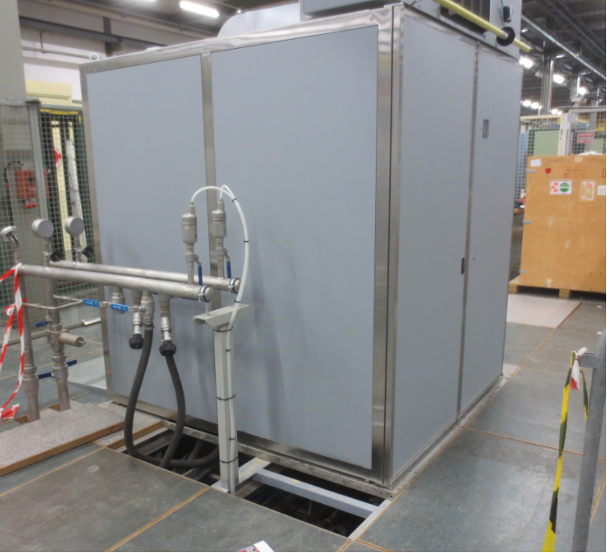
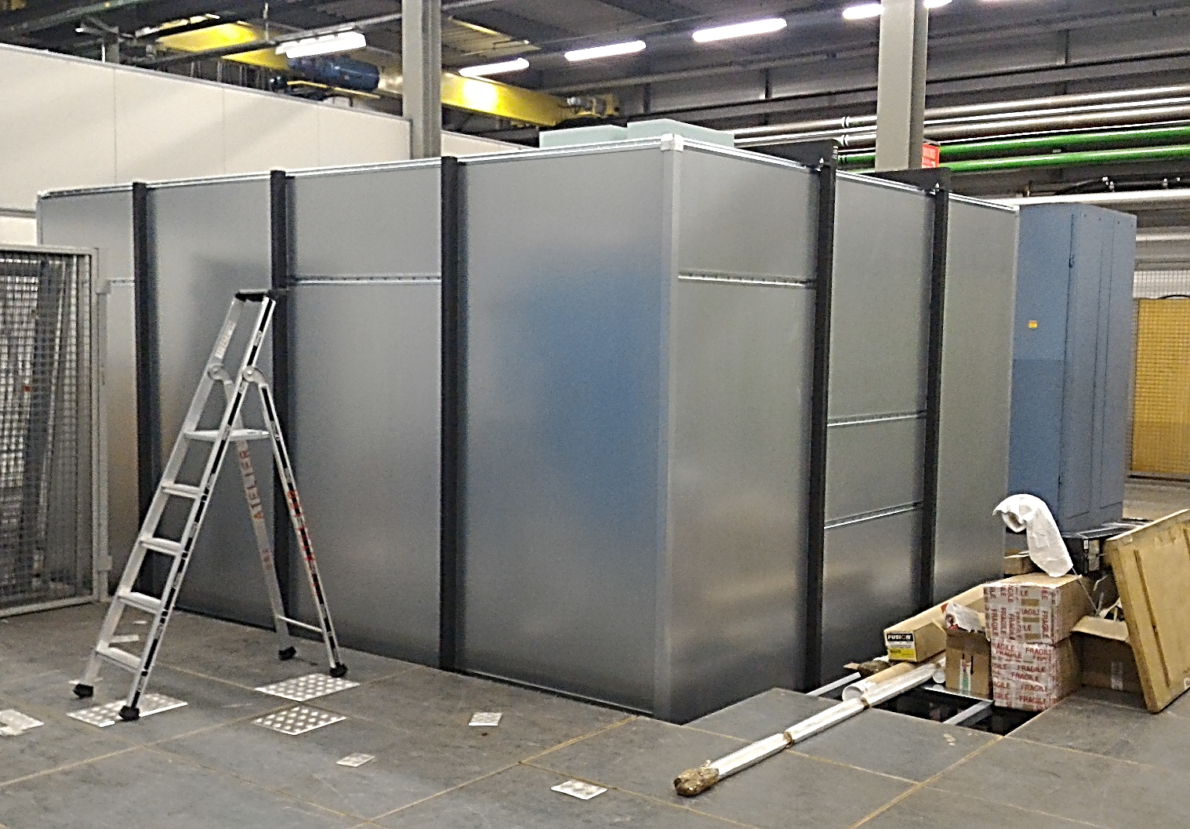
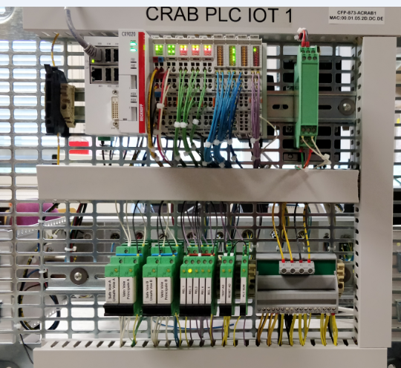
BA6-Surface Installation
Transformer and GHe tanks
Low Voltage distribution
IOT RF Amplifier
Faraday cage

Slide 8
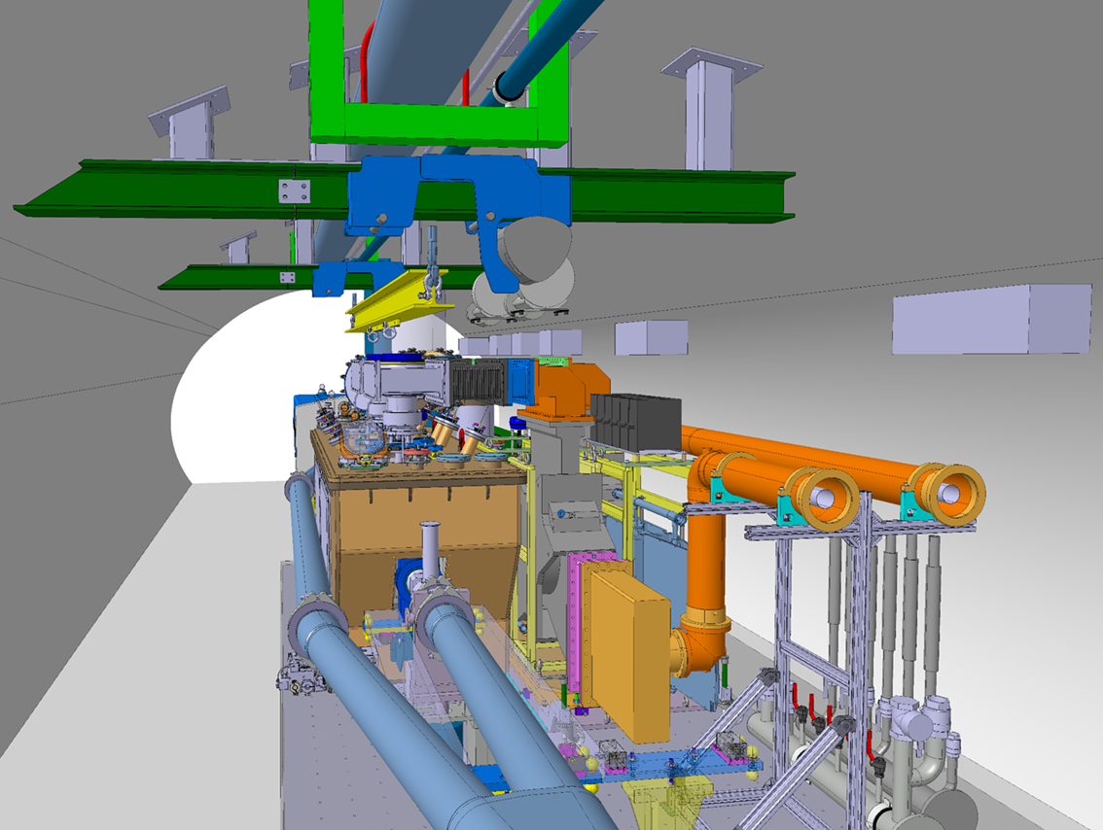
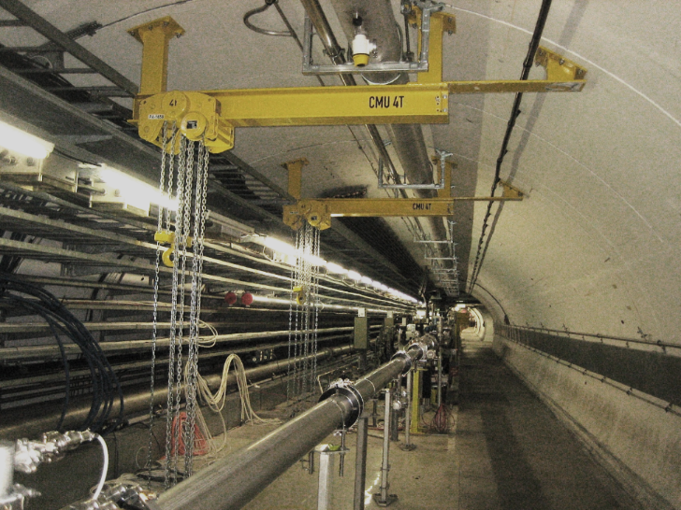
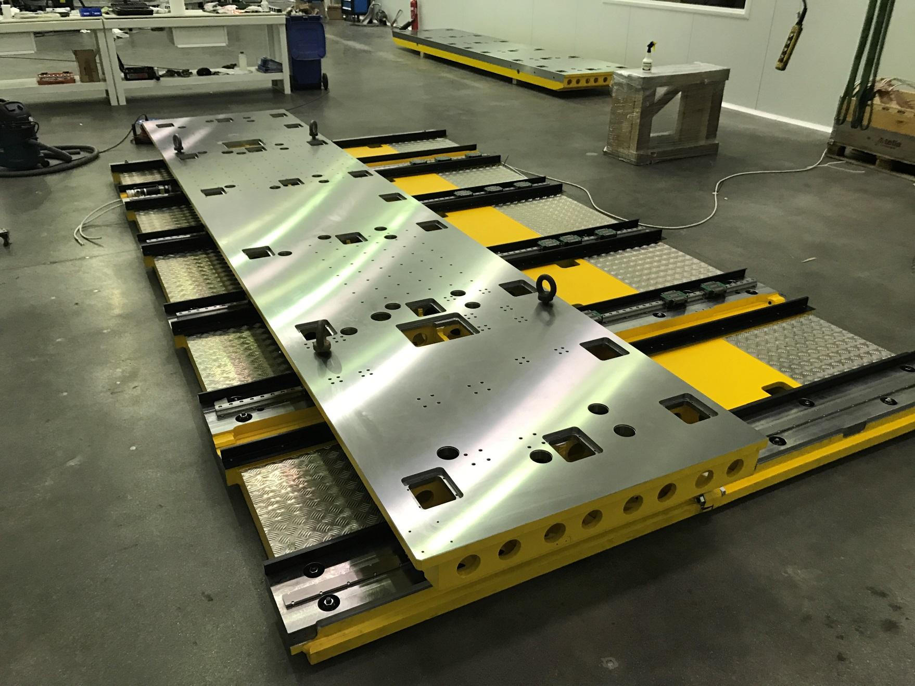
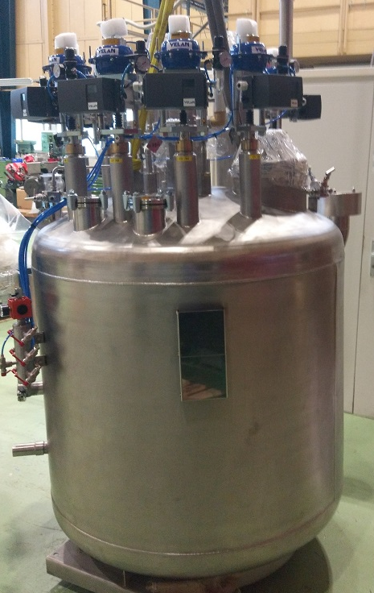
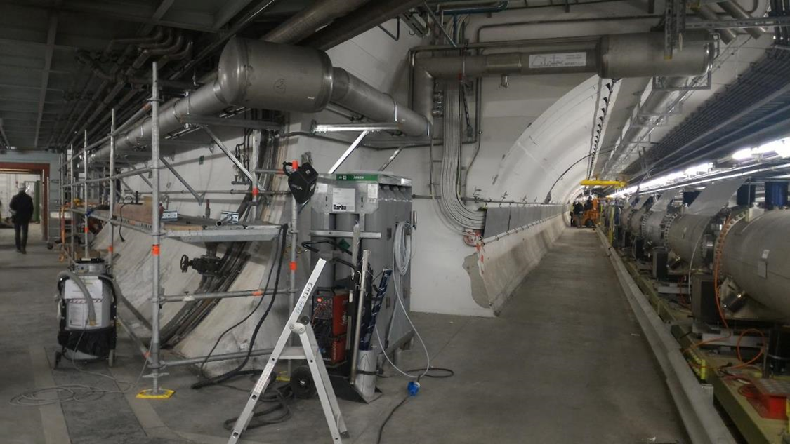
SPS-LLS6 Tunnel Installation
Rails
Cryo-lines
RF Lines
RF Cables
New Vacuum sectorization
Transfer Table
Cryogenic distribution line
Valve Box

Slide 9
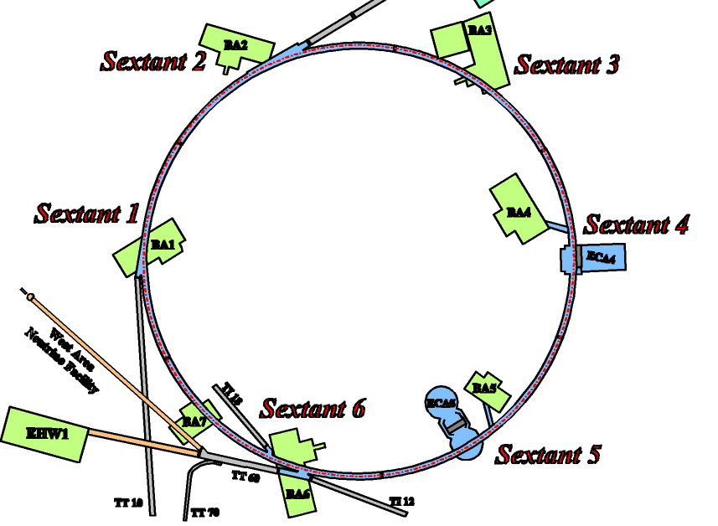
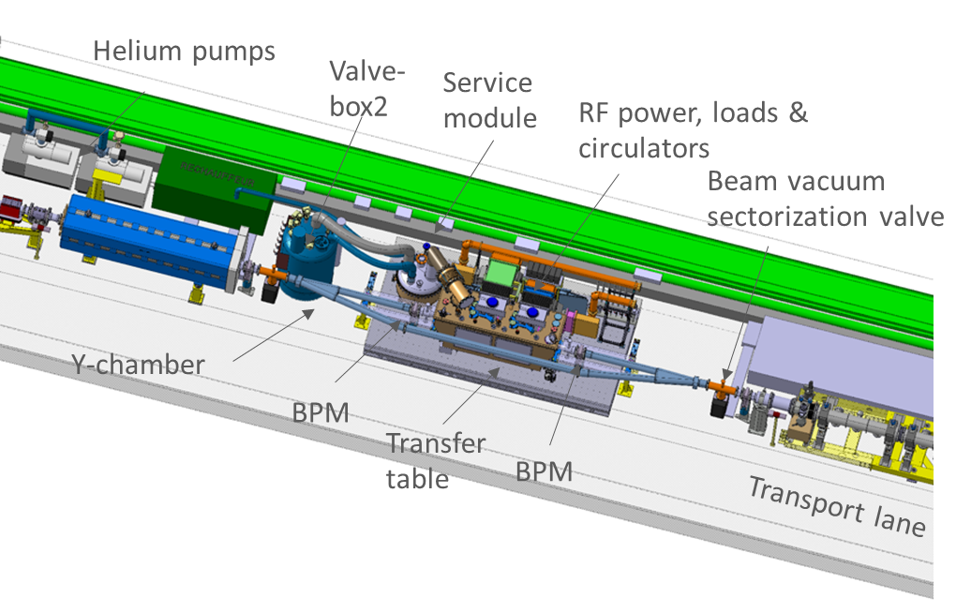
Why do SPS tests ?
Decided in 2011 that beam tests with protons are a pre-requiste before going into LHC (SPS obvious choice). After a long campaign, SPS-LSS6 chosen to insert a new SCRF test stand
The SPS tests will be first stepping stone not only for technology-beam validation, but also establish the robustness. This will be one of the main workhorses for luminosity production in the HL-LHC

Slide 10
What do we Validate ?
Some critics ask, is it necessary ?
Cavity validation with beam is vital, but it is only part of the story. It be the first time to circulate high energy/current protons, the RF gymnastics needed to operate in LHC was never done before!
Three major systems (cost drivers)
  A complex RF system with 16 high power systems
  The 2K sub-atmospheric cryogenics in LHC & its proper dimensioning for stable operation
  The crab vacuum system including coatings

Slide 11
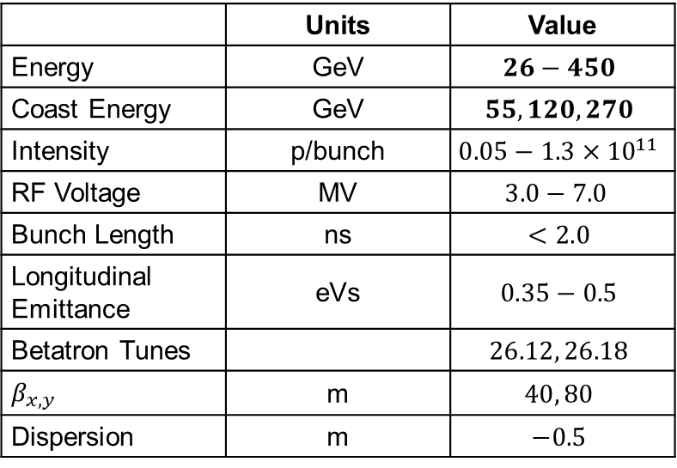
SPS Beam Parameters for Crab Tests
 | Units | Value
Energy | GeV | $$26−450$$
Coast Energy | GeV | $$55, 120, 270$$
Intensity | p/bunch | $$0.05−1.3×{10}^{11}$$
RF Voltage | MV | $$3.0−7.0$$
Bunch Length | ns | $$<2.0$$
Longitudinal Emittance | eVs | $$0.35−0.5$$
Betatron Tunes |  | $$26.12, 26.18$$
$$β_{x,y}$$ | m | $$40, 80$$
Dispersion | m | $$−0.5$$
Some concern at 55 GeV with machine protection for low voltages under investigation with machine protection team

Slide 12
Expected SPS Test Sequence
 | What | When | MD slots
0 | RF commissioning (no-beam) | Mar-Apr | ~ 4 weeks
1 | RF-beam synchronization | Apr-June | 2 x 24h
2 | Transparency to beam | Jul-Aug | 2 x 24h
3 | Performance & Stability | Sept-Oct | 2 x 24h
4 | High intensity RF operation | Nov-Dec | ≥2 x 24h
Steps 1) & 2) mandatory to declare success for the 2018 SPS tests (will be dedicated MDs)
Due to the complex movement of “cold” cryomodule in the bypass and hardware setup, early beam commissioning is essential for MD program into 2018
Crab-bypass is designed for full remote control: no need for access for MDs

Slide 13
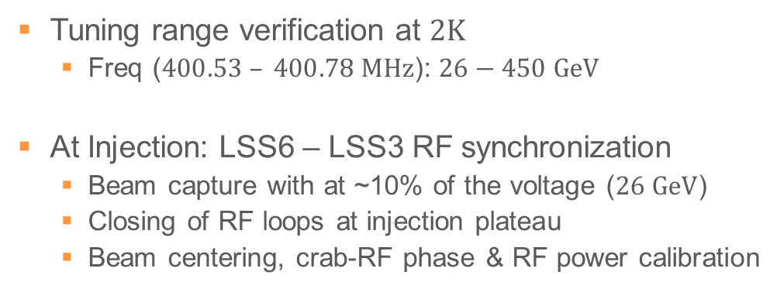
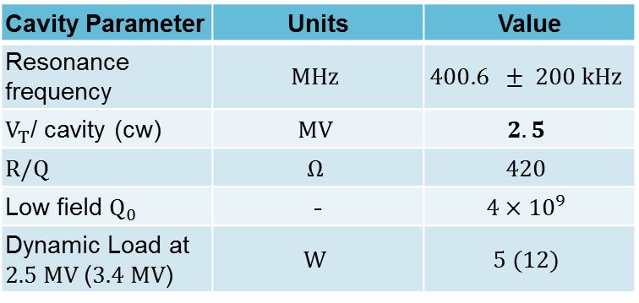
How to synchronize Crab-RF ?
Tuning range verification at $2K$
  Freq ($400.53 – 400.78 MHz$): $26−450 GeV$
At Injection: LSS6 – LSS3 RF synchronization
  Beam capture with at ~10% of the voltage ($26 GeV$)
  Closing of RF loops at injection plateau
  Beam centering, crab-RF phase & RF power calibration
Cavity Parameter | Units | Value
Resonance frequency | $$MHz$$ | $$400.6 ± 200 kHz$$
$V_{T}$/ cavity (cw) | $$MV$$ | $$2.5$$
$$R/Q$$ | $$Ω$$ | $$420$$
Low field $Q_{0}$ | - | $$4×{10}^{9}$$
Dynamic Load at $2.5 MV$($3.4 MV$) | $$W$$ | $$5 (12)$$

Slide 14
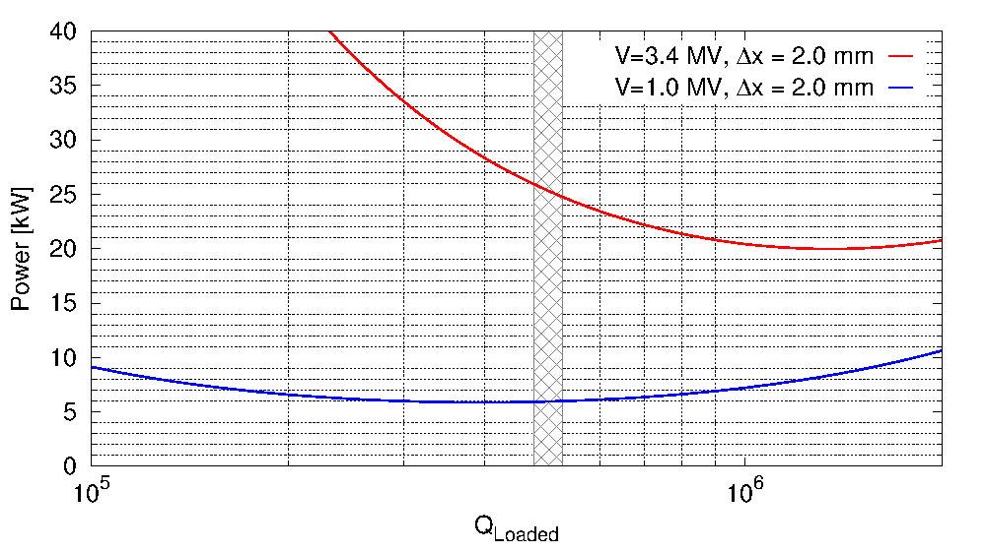

Sizing of RF Power (in SPS)
Maximum required power with $I_{b}=350 mA$
(200 bunches, $N_{b}=1.7×{10}^{11}$p/b)
Available maximum is 40 kW including in LHC

Slide 15
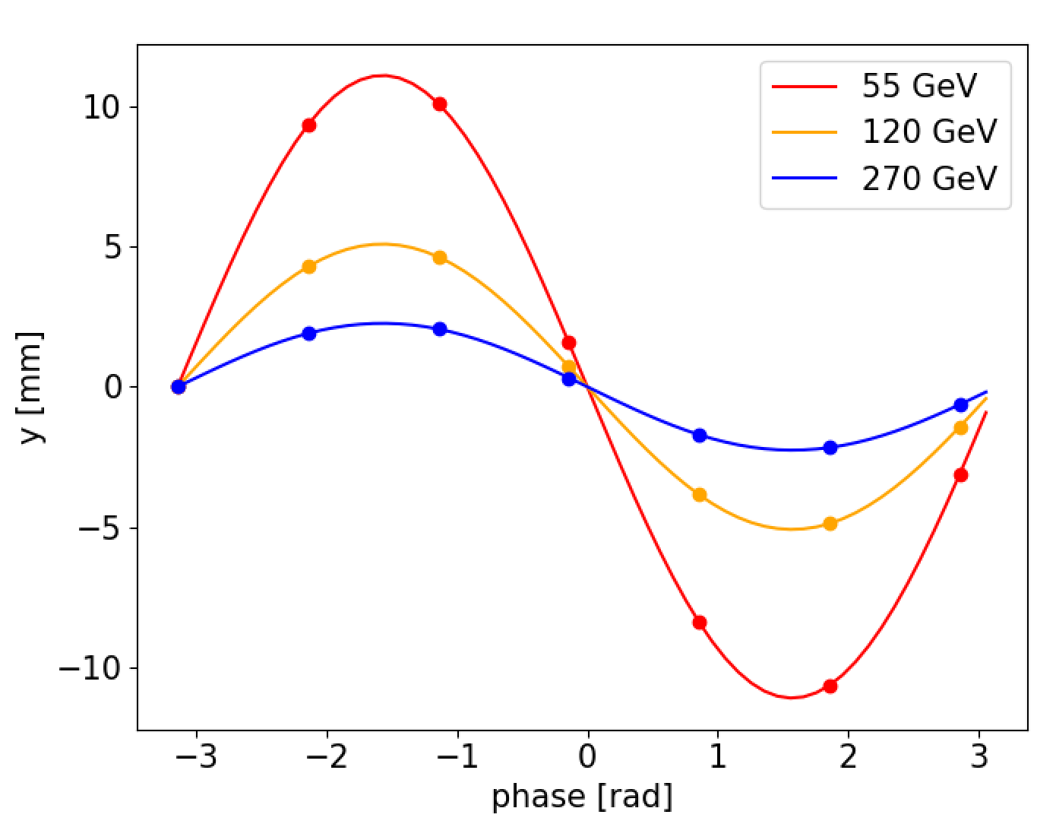
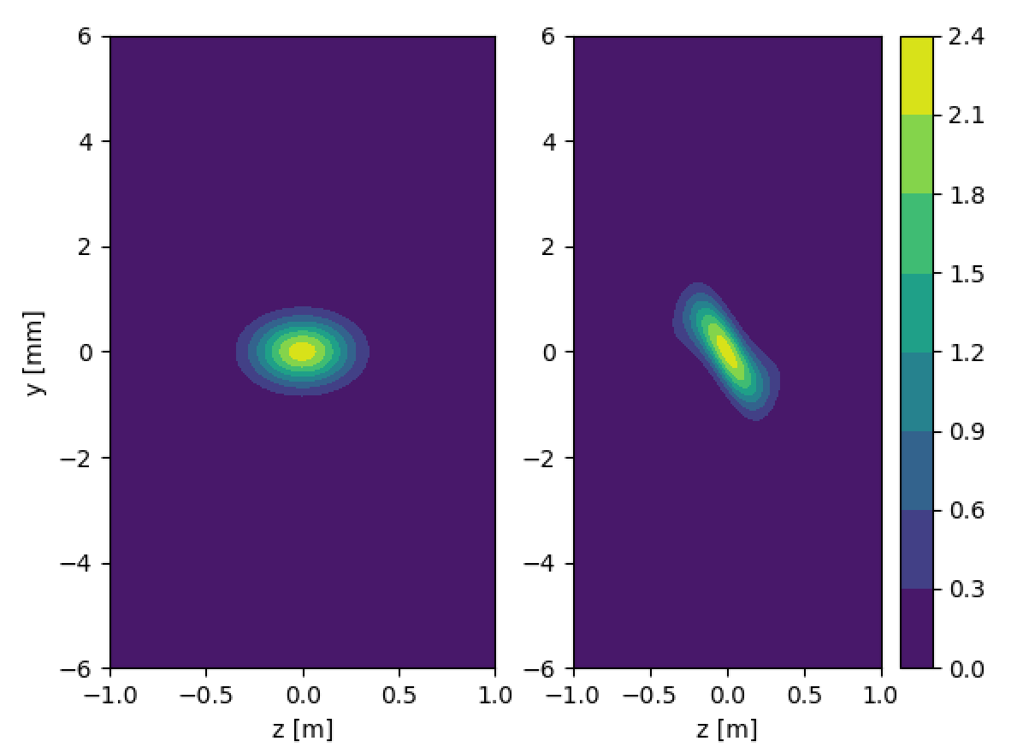
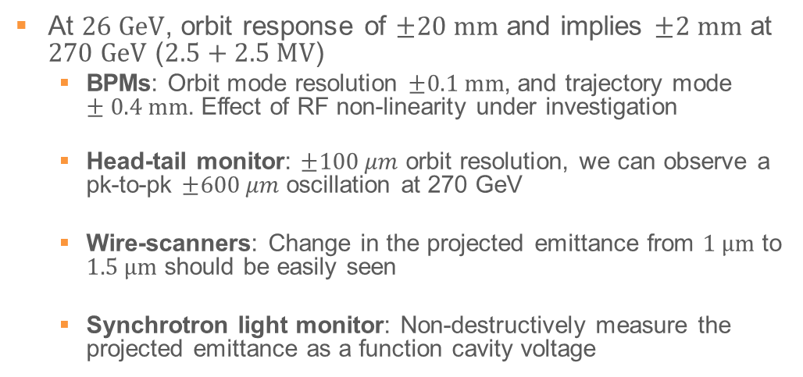
Is the Instrumentation Sufficient ?
At $26 GeV$, orbit response of $±20 mm$ and implies $±2 mm$ at $270 GeV$ ($2.5+2.5 MV$)
  BPMs: Orbit mode resolution $±0.1 mm$, and trajectory mode $±0.4 mm$. Effect of RF non-linearity under investigation
  Head-tail monitor: $±100 μm$ orbit resolution, we can observe a pk-to-pk $±600 μm$ oscillation at 270 GeV
  Wire-scanners: Change in the projected emittance from $1 μm$ to $1.5 μm$ should be easily seen
  Synchrotron light monitor: Non-destructively measure the projected emittance as a function cavity voltage
Courtesy WP13, Simulations: A. Alekou

Slide 16
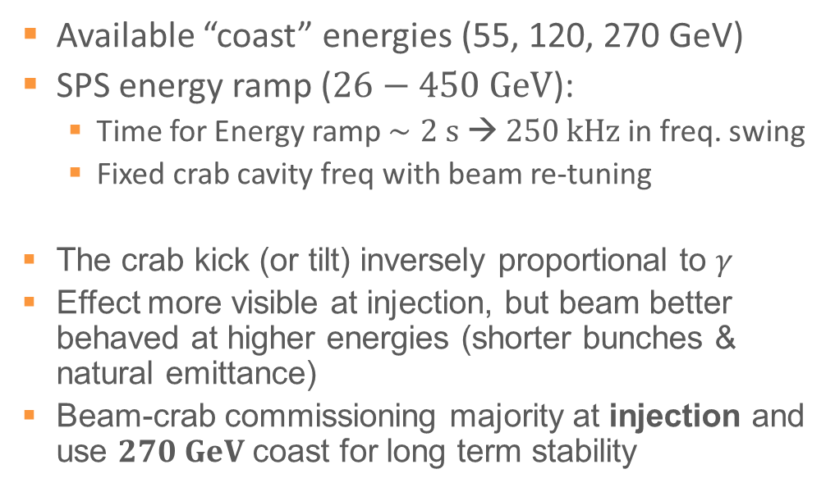
What is the preferred Energy ?
Available “coast” energies (55, 120, 270 GeV)
SPS energy ramp ($26−450 GeV$):
  Time for Energy ramp $∼2 s → 250 kHz$ in freq. swing
  Fixed crab cavity freq with beam re-tuning
The crab kick (or tilt) inversely proportional to $γ$
Effect more visible at injection, but beam better behaved at higher energies (shorter bunches & natural emittance)
Beam-crab commissioning majority at injection and use $270 GeV$ coast for long term stability
*LHC ramp: ~20min, 1kHz

Slide 17
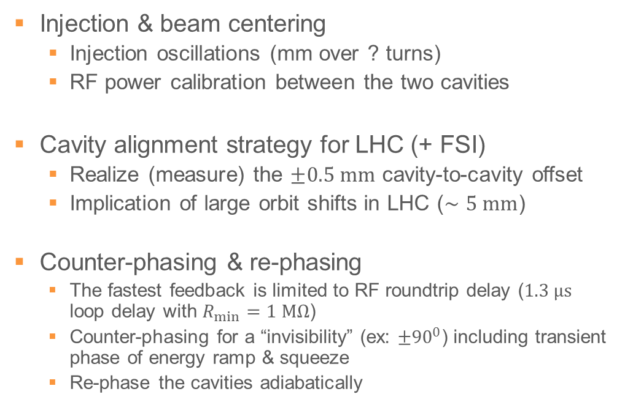
Transient Effects ?
Injection & beam centering
  Injection oscillations (mm over ? turns)
  RF power calibration between the two cavities
Cavity alignment strategy for LHC (+ FSI)
  Realize (measure) the $±0.5 mm$ cavity-to-cavity offset
  Implication of large orbit shifts in LHC ($∼5 mm$)
Counter-phasing & re-phasing
  The fastest feedback is limited to RF roundtrip delay ($1.3 μs$ loop delay with $R_{min}=1 MΩ$)
  Counter-phasing for a “invisibility” (ex: $±{90}^{0}$) including transient phase of energy ramp & squeeze
  Re-phase the cavities adiabatically

Slide 18
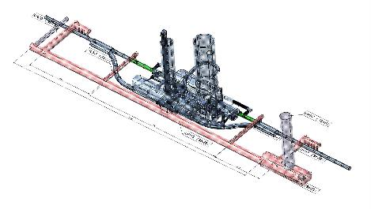
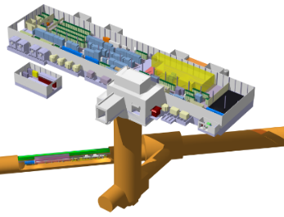
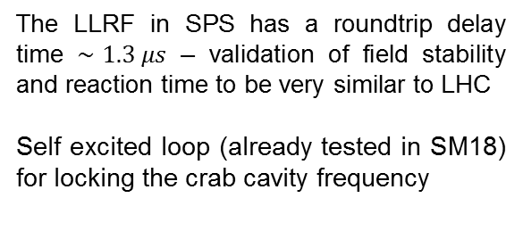
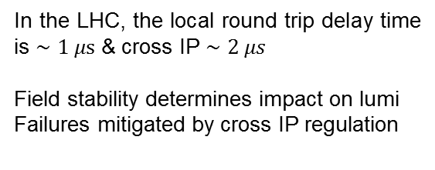
LLRF with Long Distances
2 cavities /beam /IP side
In the LHC, the local round trip delay time is $∼1 μs$ & cross IP $∼2 μs$
Field stability determines impact on lumi
Failures mitigated by cross IP regulation
HL-LHC Integration
Surface RF/Cryo
The LLRF in SPS has a roundtrip delay time $∼1.3 μs$ – validation of field stability and reaction time to be very similar to LHC
Self excited loop (already tested in SM18) for locking the crab cavity frequency
Cavities
Cold box

Slide 19
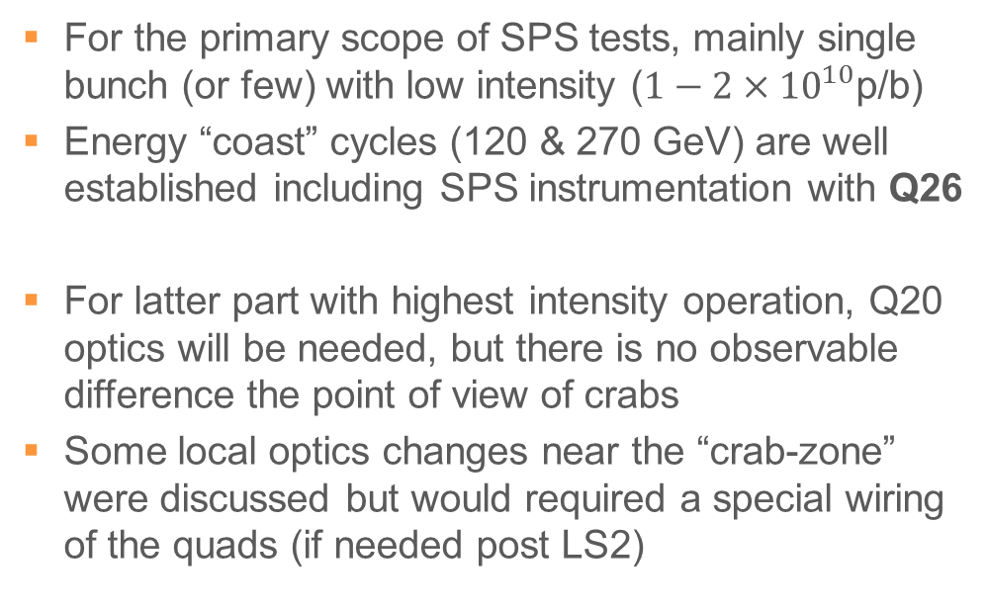
What about SPS Optics (Q26, Q20….)
For the primary scope of SPS tests, mainly single bunch (or few) with low intensity ($1−2×{10}^{10}$p/b)
Energy “coast” cycles (120 & 270 GeV) are well established including SPS instrumentation with Q26
For latter part with highest intensity operation, Q20 optics will be needed, but there is no observable difference the point of view of crabs
Some local optics changes near the “crab-zone” were discussed but would required a special wiring of the quads (if needed post LS2)

Slide 20
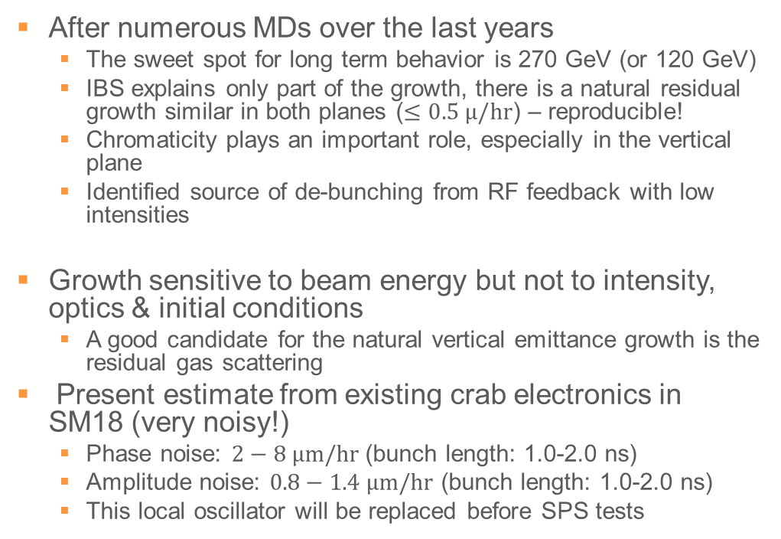
Where are we with Emittance Growth ?
After numerous MDs over the last years
  The sweet spot for long term behavior is 270 GeV (or 120 GeV)
  IBS explains only part of the growth, there is a natural residual growth similar in both planes ($≤0.5 μ/hr$) – reproducible!
  Chromaticity plays an important role, especially in the vertical plane
  Identified source of de-bunching from RF feedback with low intensities
Growth sensitive to beam energy but not to intensity, optics & initial conditions
  A good candidate for the natural vertical emittance growth is the residual gas scattering
Present estimate from existing crab electronics in SM18 (very noisy!)
  Phase noise: $2−8 μm/hr$ (bunch length: 1.0-2.0 ns)
  Amplitude noise: $0.8−1.4 μm/hr$ (bunch length: 1.0-2.0 ns)
  This local oscillator will be replaced before SPS tests

Slide 21
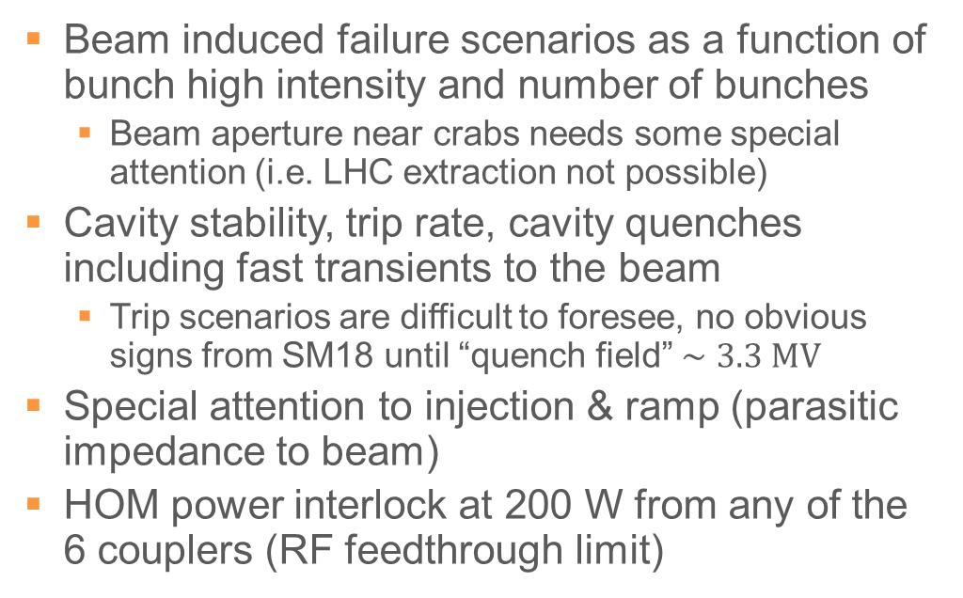
4) High Intensity Operation
Beam induced failure scenarios as a function of bunch high intensity and number of bunches
  Beam aperture near crabs needs some special attention (i.e. LHC extraction not possible)
Cavity stability, trip rate, cavity quenches including fast transients to the beam
  Trip scenarios are difficult to foresee, no obvious signs from SM18 until “quench field” $∼3.3 MV$
Special attention to injection & ramp (parasitic impedance to beam)
HOM power interlock at 200 W from any of the 6 couplers (RF feedthrough limit)

Slide 22
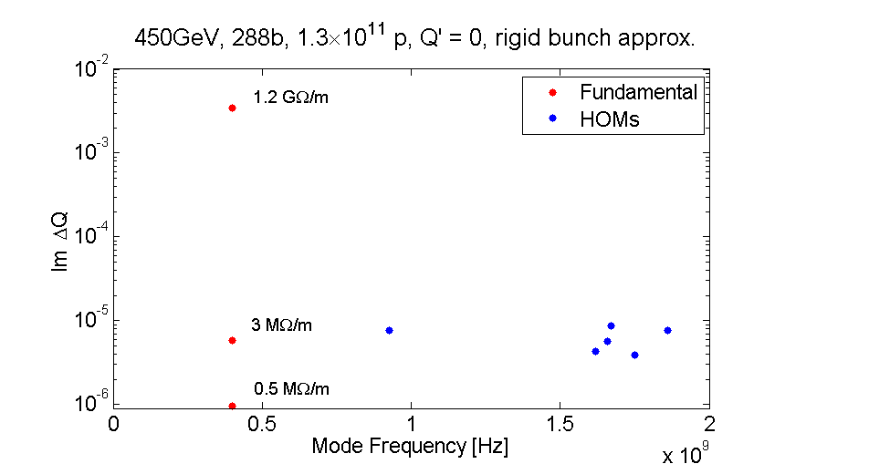
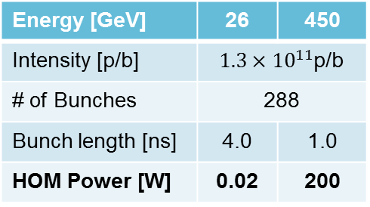
Can we measure Crab Cavity Impedance
No significant impedance or HOM power is expected in SPS
Will investigate the selective un-damping of fundamental mode & HOMs and it effect on stability and HOM power
Energy [GeV] | 26 | 450
Intensity [p/b] | $1.3×{10}^{11}$p/b
# of Bunches | 288
Bunch length [ns] | 4.0 | 1.0
HOM Power [W] | 0.02 | 200
Courtesy: WP2-Impedance

Slide 23
What about Collimation ?
Like crabs, the LHC collimation system was first tested in the SPS
  A full prototype & instrumentation present in SPS-LSS5
  Was essential to validate the collimation system (design, alignment, impedance, software & studies)
  Drawback 2018 – Horizontal collimators, vertical crabs
The main driver is machine protection includes fast failures and loss vs. time, crab-dispersion leakage and collimation hierarchy optimization
Studies: Longitudinal collimation, colored noise for halo scraping, crab kick for extraction (crystals)

Slide 24
How to Determine Robustness of Crabs
The ideal robustness check would be to leave the crab cavities in “transparent mode” during SPS regular operation
  Will asses the feasibility towards the end of the run after the first period of crab validation
The main constraint is aperture restriction for LHC extraction at LSS6
What is essential is an extended program until LS3 to optimize the operational scenarios in the SPS
CCCM
H. Bartosik

Slide 25
Recap of the MD Outline
 | What | When | Approx time
0 | RF commissioning (no-beam) | Mar-Apr | ~ 4 weeks
1 | RF-beam synchronization | Apr-June | 2 x 24h
2 | Transparency to beam | Jul-Aug | 2 x 24h
3 | Performance & Stability | Sept-Oct | 2 x 24h
4 | High intensity RF operation | Nov-Dec | ≥2 x 24h
Steps 1) & 2) mandatory to declare success for the 2018 SPS tests (will be dedicated MDs). Early beam commissioning is essential for very precise definition of the MD program into 2018
For 3) & 4), if cavity is truly transparent during the SPS energy cycle, some parasitic MDs feasible but will restrict the beam to LHC

Slide 26
Thank you

Slide 27
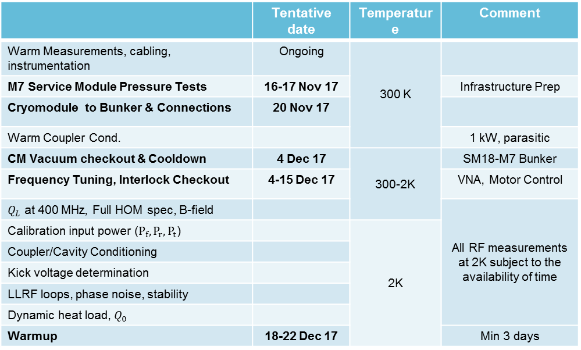
SM18 Test Plan
Week: 47-48
SM18 Installation
Week: 49-51
SM18
Cool-down
Xmas TS
Week: 02-04
RF/Align Checks, Transport
Week: 5-8
SPS Installation
Week: 8-9
SPS
Cool-down
 | Tentative date | Temperature | Comment
Warm Measurements, cabling, instrumentation | Ongoing | 300 K
M7 Service Module Pressure Tests | 16-17 Nov 17 |  | Infrastructure Prep
Cryomodule to Bunker & Connections | 20 Nov 17
Warm Coupler Cond. |  |  | 1 kW, parasitic
CM Vacuum checkout & Cooldown | 4 Dec 17 | 300-2K | SM18-M7 Bunker
Frequency Tuning, Interlock Checkout | 4-15 Dec 17 |  | VNA, Motor Control
$Q_{L}$ at 400 MHz, Full HOM spec, B-field |  |  | All RF measurements at 2K subject to the availability of time
Calibration input power ($P_{f}, P_{r}, P_{t}$) |  | 2K
Coupler/Cavity Conditioning
Kick voltage determination
LLRF loops, phase noise, stability
Dynamic heat load, $Q_{0}$
Warmup | 18-22 Dec 17 |  | Min 3 days

Slide 28
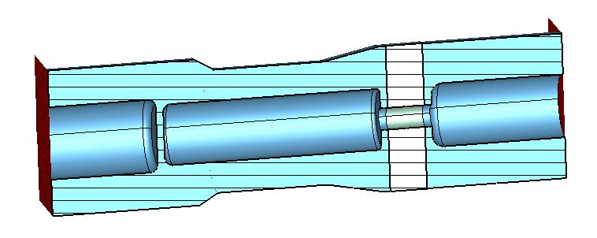
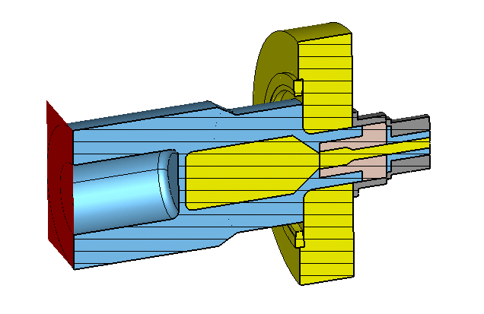
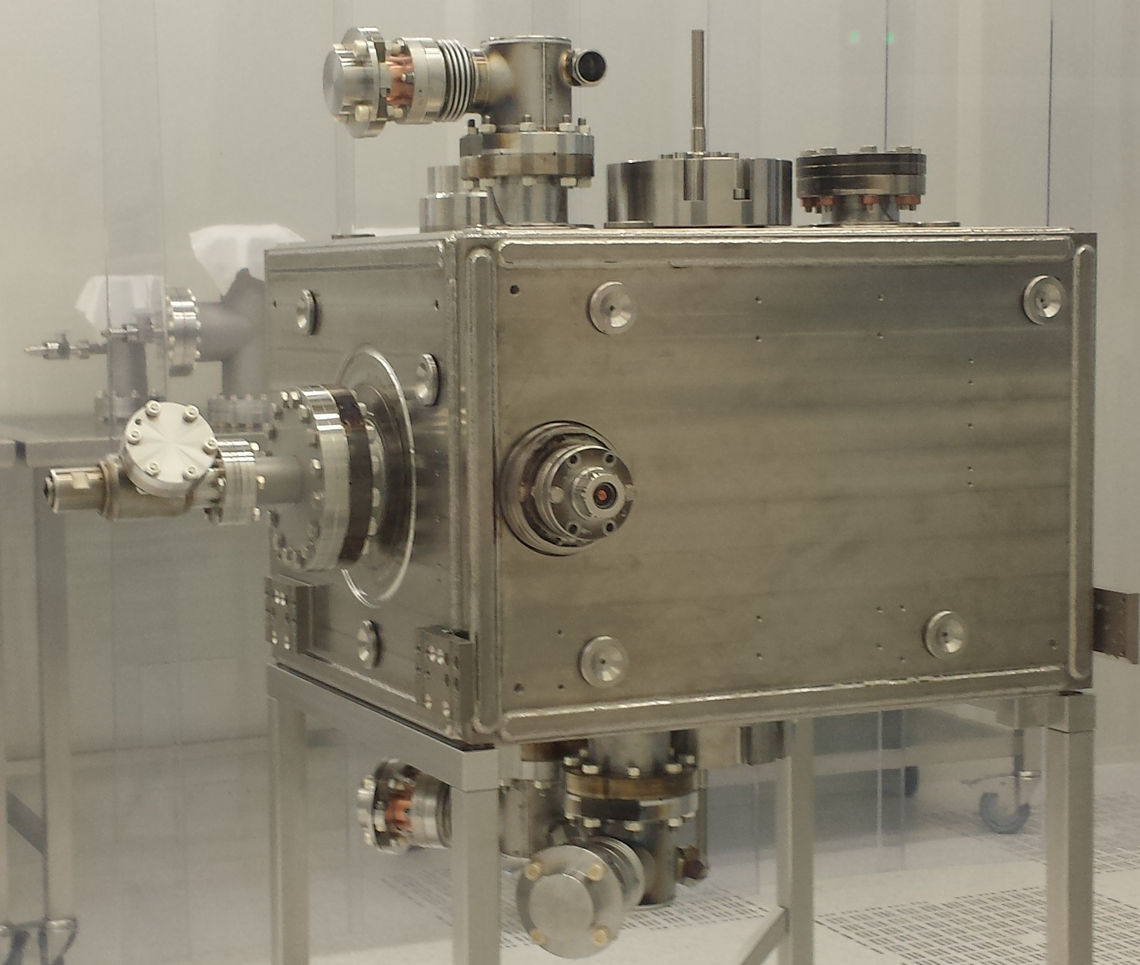
HOM Feedthrough Replaced
Original feedthrough
1kW HOM power
Replacement feedthrough
~200 W HOM power
New interlock added to RF chain
2 out three leak during warm up
In the SPS with special filling and high current, 200 W is expected to be max

Slide 29
Status of SPS Tests
Design and Documentation
  Integration concluded on surface premises and underground
  Electrical distribution layout designed and implemented
  Safety review and follow-up with risk analysis for vessel, test stand, cryogenics
  Layout of Oxygen Deficiency Hazard detectors worked out
  Interlocking schemes determined by Machine protection and Personnel Safety
  Modification to the Personnel Protection System (Access Safety)
Preparatory work in EYETS-2016/17
  Large part of infrastructure installation: cables, RF power lines, handling equipment, civil engineering, warm- and cold pipework
  Beam line layout modified for new vacuum sectorization
  Installation of equipment on surface premises: IOT RF amplifiers, Cryo storage tanks, electrical distribution equipment, Faraday cage for LLRF
  Production of vacuum chambers, BPMs
Procedures & Planning
  Common procedures for surface (SM18) and underground activities
  Operation scheme worked out
  Planning in very challenging Year-End Technical Stop framework

Slide 30
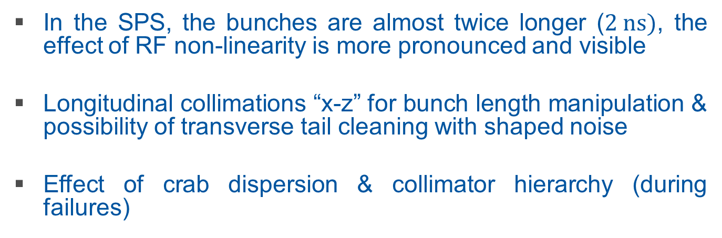
RF Non-Linearity
In the SPS, the bunches are almost twice longer ($2 ns)$, the effect of RF non-linearity is more pronounced and visible
Longitudinal collimations “x-z” for bunch length manipulation & possibility of transverse tail cleaning with shaped noise
Effect of crab dispersion & collimator hierarchy (during failures)
Courtesy R. Tomas
Courtesy T. Mastoridis

Slide 31
Can we Leave Crabs in regular Operation ?
Crab cavity in beam is compatible with slow extraction to North Area with respect to aperture
We need to make sure that the CC does not affect the fixed target operation, in particular because the fixed target beam has very high intensity and therefore can damage the machine.
Mostly a machine protection issue.
The high intensity fixed target beam might damage the CC in case of beam loss.
The critical point is the protection of the CC.
Both aspects are quite critical, therefore for the moment no plan to use the CC during fixed target operation, unless absolutely necessary (e.g. lack of dedicated MD time).

Slide 32
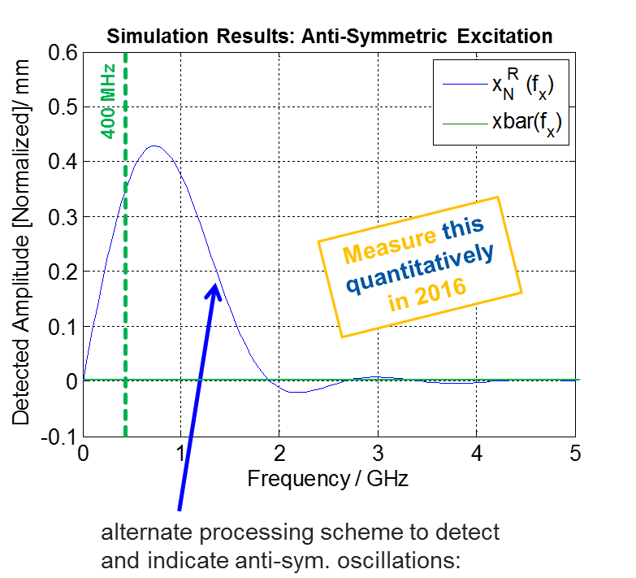
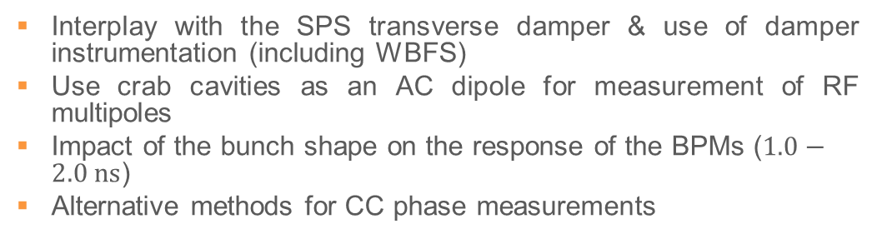
Additional Topics
Interplay with the SPS transverse damper & use of damper instrumentation (including WBFS)
Use crab cavities as an AC dipole for measurement of RF multipoles
Impact of the bunch shape on the response of the BPMs ($1.0−2.0 ns$)
Alternative methods for CC phase measurements
Present Damper
Wideband FB
CC as AC-Dipole
Courtesy: G. Kotzian, R. Tomas et al.

Slide 33
Compatibility with SPS Operation
LHC Fast Extraction, LSS6
  Slow extraction of fixed target beam
CCCM
  @400GeV, incl extraction bump
  purple : raw beam envelope, red: beam envelope + tolerance
Courtesy: H.Bartosik

