Slide 1


US-LARP crab cavity program and future performance improvement plans
Alessandro Ratti (SLAC)
on behalf of HL-LHC/LARP crab cavity team
7th HL-LHC Collaboration Meeting| Ciemat | 15 November 2017
https://indico.cern.ch/event/647714/

Slide 2
Outline
LARP Crab Cavity Development and Testing Summary
  DQW
  RFD
Transition to the US HL-LHC AUP construction project
Plans for the US FY18
  LARP(-less)
  AUP
  Other

Slide 3
LARP Recap
Started the Crab Cavity proposal in 2006
  Rama’s first “child”
Developed Proof of Principle cavities that demonstrated a major point
  It is possible to achieve the required field strength within the dimensional constraints
    No more ‘global’ crab scheme
Continued to develop initial cavity designs
  Strong collaboration with CERN and the UK
  Demonstrated the electromagnetic designs and production processes of bare cavities of both styles
  Field in excess of required threshold, no field emission
  Adding HOM couplers and filters now

Slide 4
Summary of CC test results
 | CERN DQW1 | CERN DQW2 | USLARP DQW1 | USLARP DQW2 | USLARP RFD1 | USLARP RFD2 | USLARP RFD1 @FNAL
Max voltage [MV] | 5.0 | 4.8 | 5.8 | 5.3 | 4.4 | 5.7 | 4.7
Epeak [MV/m] | 56 | 54 | 65 | 59 | 42 | 54 | 45
Bpeak [mT] | 109 | 103 | 125 | 114 | 73 | 95 | 78
Rs min [nOhm] | 10 | 10 | 9 | 10 | 11 | 7 | 6
Rs @ 3.4MV [nOhm] | 15 | 18 | 15 | 12 | 13 | 9 | 7
FE onset [MV] | 4.0 | 3.5 | 4.1 | 2.8 | No FE | 4.5
Q0 max |  |  | 9.2E+9 | 8.8E+9 | 1.1E+10 | 1.5E+10
Q0 @3.4MV |  |  | 6.2E+9 | 7.3E+9 | 8.5E+9 | 1.2E+10
All cavities meet functional requirement: V_Max >4.1MV: P_Loss of < 5W@3.4MV

Slide 5
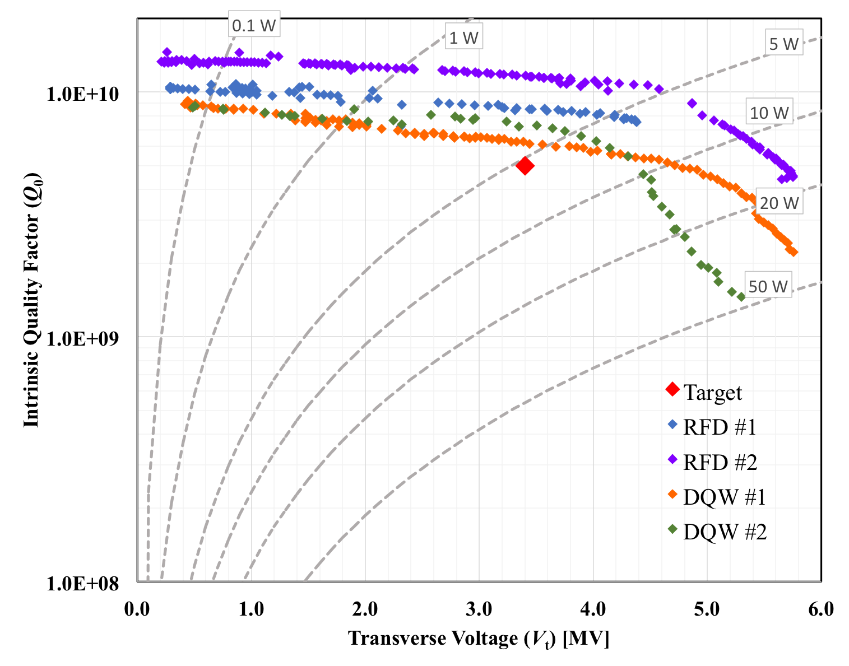
US LARP Cavities Test Summary at JLAB

Slide 6
RFD-1 Test Results
At low fields for both rf tests Q₀ is > 1.0×10¹⁰
Multipacting barrier was processed easily and didn’t reoccur
No field emission observed during Test 2
At 2.0 K | Test 2
Max V_{t} [MV] | 4.4 MV
E_{p} [MV/m] | 42
B_{p} [mT] | 73
Q₀ at 3.4 MV | 8.5×10⁹
P_{diss} ar 3.4 MV [W] | 3.2
S. De Silva

Slide 7
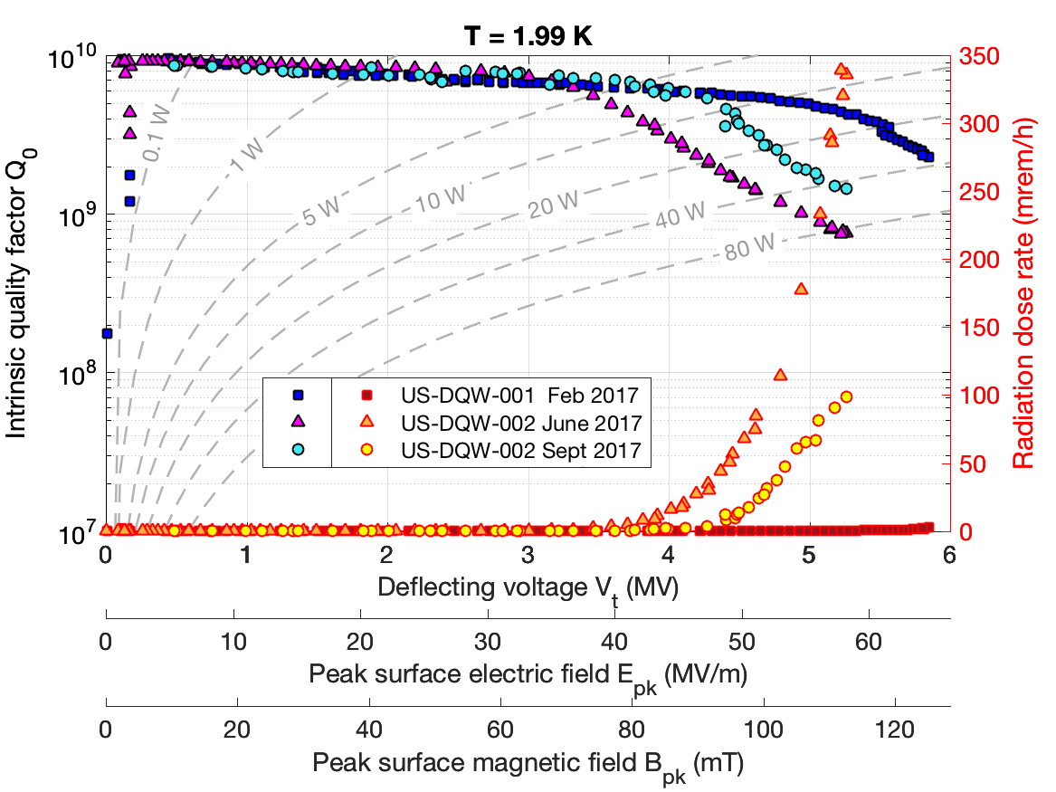
DQW-2 Test Results
Cavity #2: same quench field during CW and pulsed operation ~~> magnetic quench.
Improved FE onset for cavity #2 after 18 um BCP and HPR, but still not optimal: lower Q₀ and higher radiation.
However, max. B_{peak} comparable for both cavities when uncertainty accounted.
after BCP+HPR
(5.9 ± 0.4) MV
(5.3 ± 0.4) MV
admin power limit
58
65
S. Verdu-Andres
113
125

Slide 8
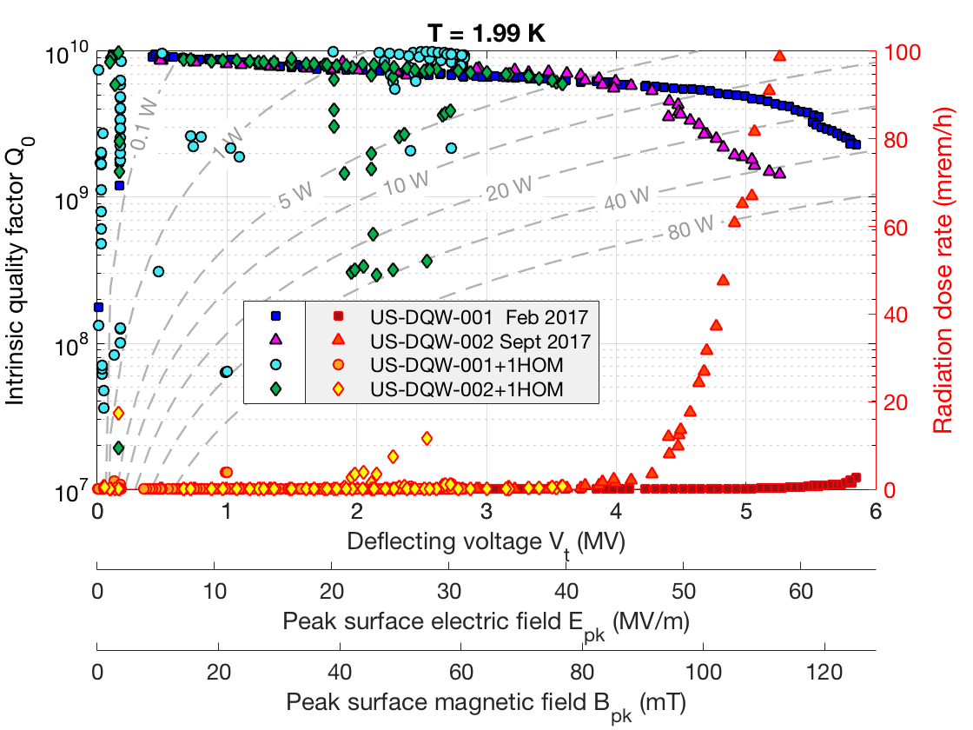
DQW2+HOM Test Results
Quench field level significantly lower than for bare cavity tests.
Sharp quench at 3.6MV, with no significant radiation increase.
Quench field level higher in pulsed mode ~~> thermal quench.
after BCP+rinsing
S. Verdu-Andres

Slide 9
Ongoing (final) LARP developments
RFD HOM Damper prototyping at JLAB
Final cold testing of DQW with one HOM damper

Slide 10
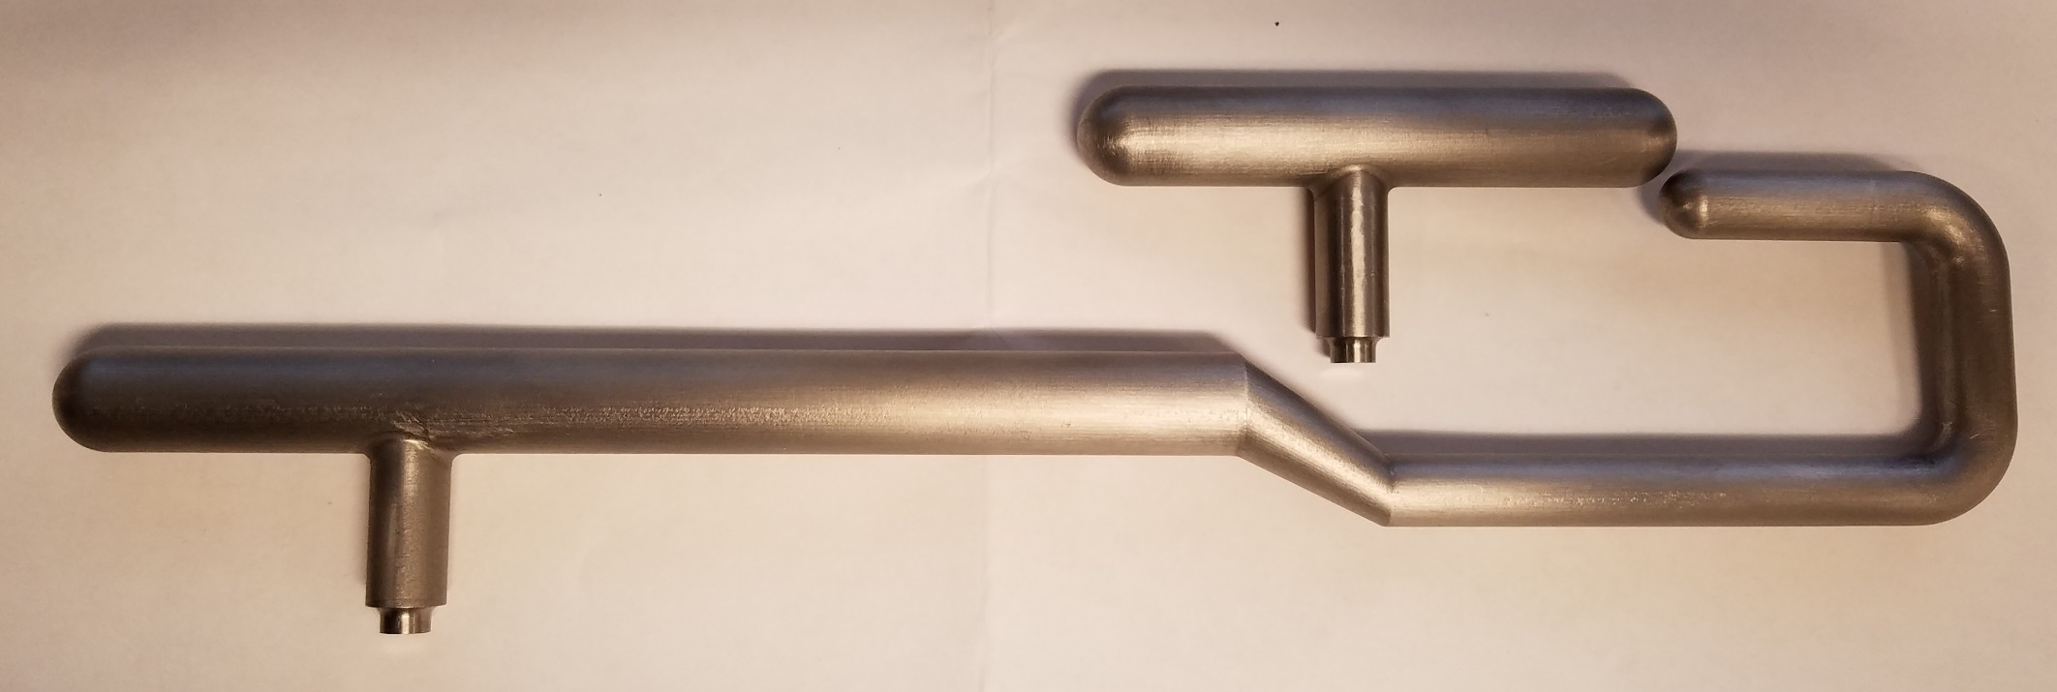
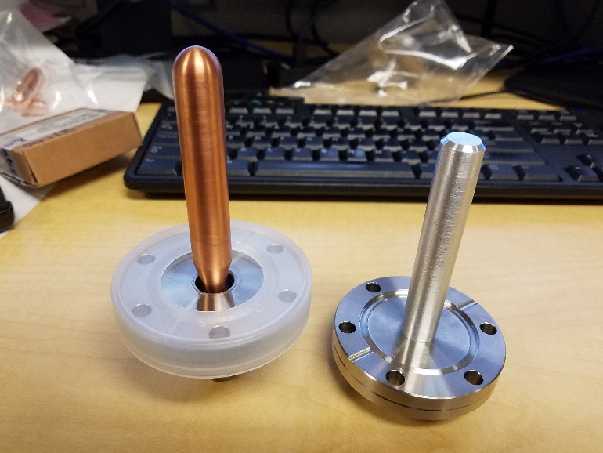
RFD HOM Damper Fabrication at JLAB
JLAB is fabricating a full set of H and V HOM couplers and filters for the two existing RFD cavities.
Expected by early 2018 for cold testing and RF measurements
N. Huque

Slide 11
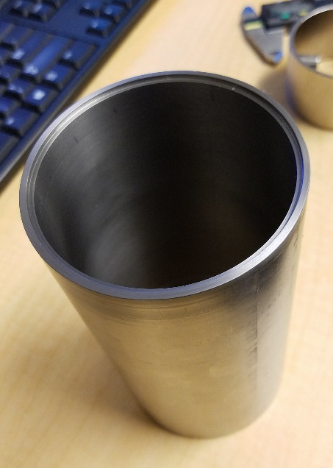
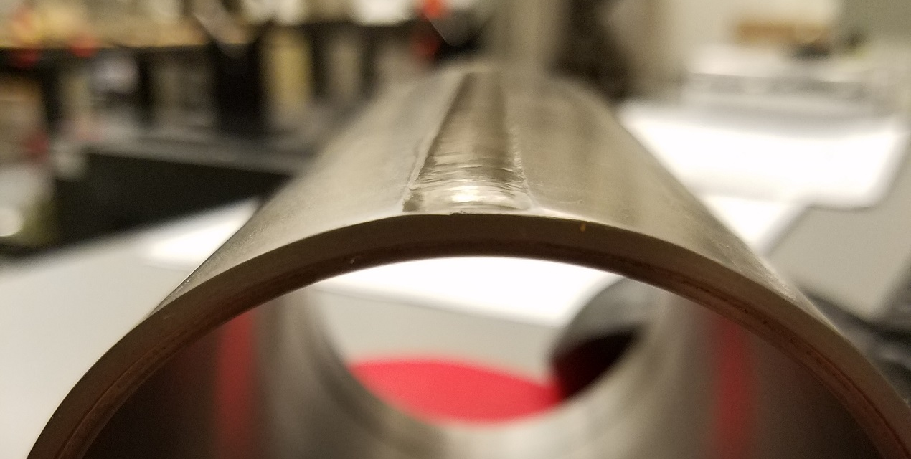
RFD HOM Damper Fabrication at JLAB (2)
Dummy Nb Can fabrication complete
  Seam weld being inspected as per CERN standards (ETD this week)
Brazing tests and qualification underway
  Other test samples also being brazed (ETD by the end of next week)
RRR Nb sent to FNAL for QC
Far Left: Dummy Nb can for weld test. Near Left: Seam weld on Nb can to be inspected
N. Huque

Slide 12
FY18 DQW studies
Final cold testing of DQW2 at JLAB with one HOM damper
  Spending carryover of last CC funds from LARP
  More studies needed to understand and improve cavity performance with HOM dampers
Warm measurements to characterize EM behavior
  Multipoles, HOMs
DQW2 remains at JLAB for further testing
DQW1 goes to BNL for warm measurements
  Field mapping, multipoles, HOM damping…
  Note: not all this work is funded by LARP and is outside of AUP scope
    CERN support and/or funding could help

Slide 13
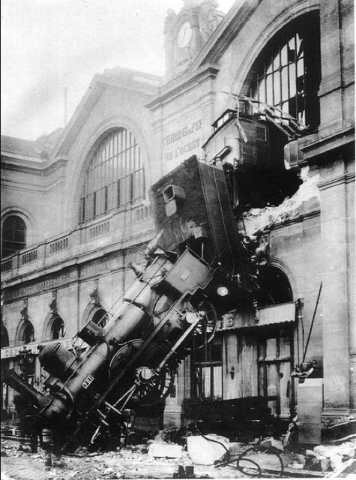
Soft Landing of LARP’s CC program
New roles between AUP and CERN for dressed cavities production
  AUP carries RFD development into production
  CERN carries DQW development and production
LARP ending with the completion of RFD HOM and cold testing at JLAB
US LARP team continues towards the support of AUP’s RFD deliverables

Slide 14
US HL-LHC AUP Project Plans for FY18
Develop RFD prototype of US cavity deliverable
  RFD with magnetic shield, He Tank and HOM filters
  Industrialize production through early vendor selection
    In close collaboration with CERN
Finalize cavity design and Complete the preparation of the PDR
  Including a dressed cavity PD review
Prepare for CD-2
  Define scope and cost baseline
  Complete associated documentation (acceptance criteria, Manufacturing Inspection Plan…)
Lessons learned from both DQW and RFD fabrication, processing and testing
Described in detail tomorrow by Leonardo

Slide 15
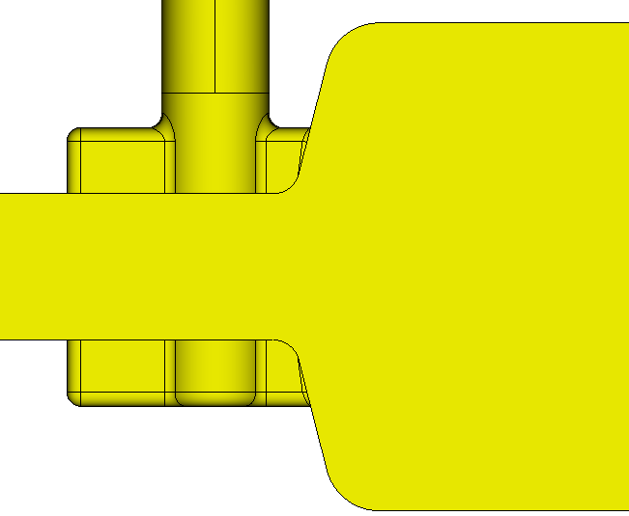
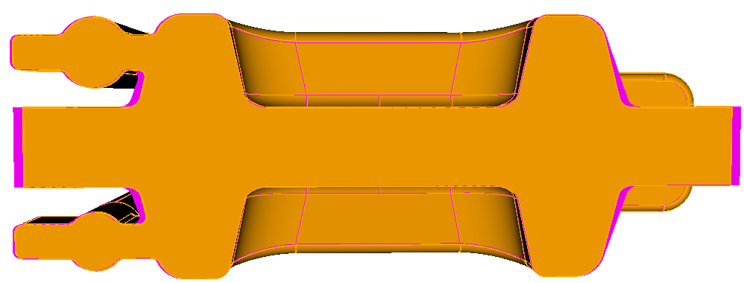
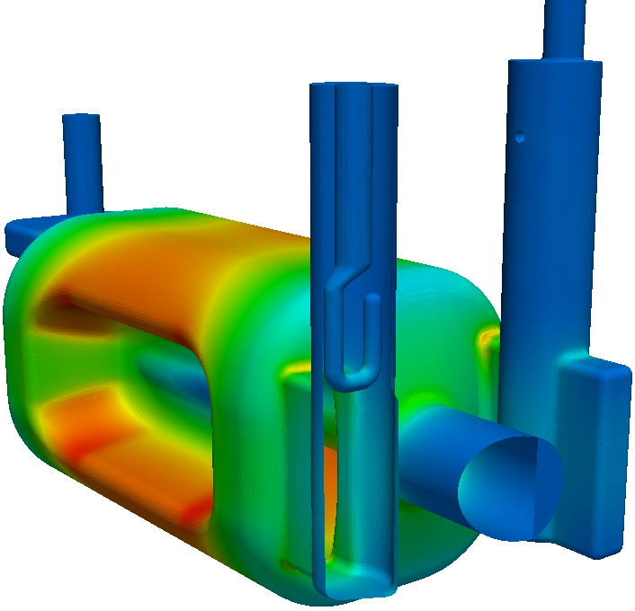
Cavity Optimization for HOM
In response to the need to minimize impedance to the beam - Avoiding 760 MHz HOM frequency/beam harmonic
End-plate reduced tilt angle
20mm
Shrink gap from the end plate lowers 760 MHz mode frequency
Operating mode tuned to 400 MHz by change outer can rounding
Z. Li, S. De Silva

Slide 16
760.9MHz HOM now detuned to 755MHz
Impedance
HOM beam power
HOM impedance spectrum provided to CERN beam dynamics team for beam instability analysis
HOM power calculated for 1-AM beam
σ_{z}=76mm factor included in power calculation
Beam HOM power well below design requirement of 1 kW
Z. Li/S. De Silva
3D Model and HOM spectra released to CERN for review

Slide 17
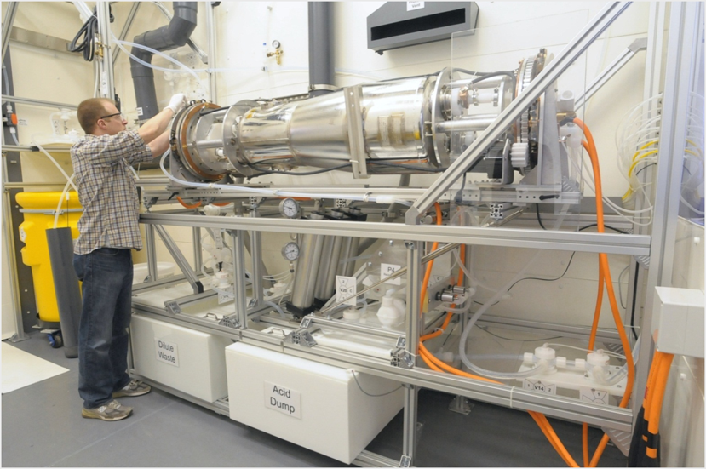
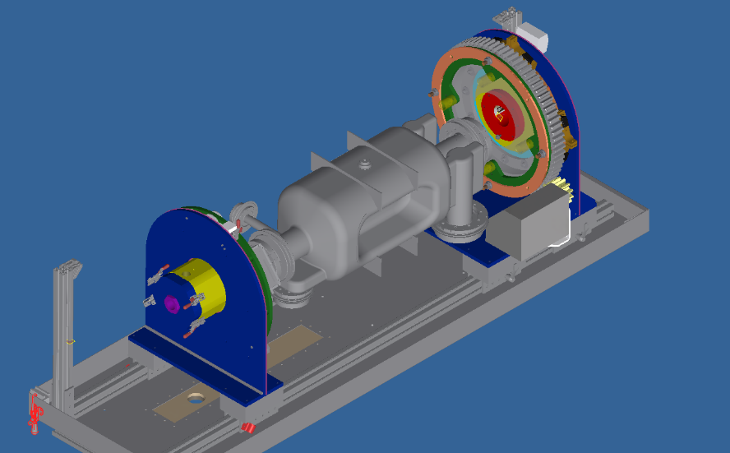
RFD1 - Next Steps
RFD 1 cavity now at ANL
PO with ANL in place for upgrade of rotational BCP tool to accept RFD cavity (see image)
Buffer Chemical Polishing at ANL in Jan 2018
Test at FNAL in March 2018
Existing Rotational Tool at ANL (with QWR resonator installed)
Upgrade of Rotational Tool at ANL to accept RFD Cavity
L. Ristori

Slide 18
RFD2 - Next Steps
Cavity remains at JLAB/ODU for:
  Field mapping, multipole measurements,
  Elastic and plastic tuning sensitivity studies
In addition, ODU interested in more studies
    Nitrogen doping treatment and Vertical Tests
  Work outside the scope of AUP, yet of interest to the collaboration

Slide 19
Non-FNAL AUP Team Activities for FY18
BNL | ODU | SLAC
Interfaces in SM18, SPS and LHC | Warm measurements of electromagnetic and mechanical properties of the RFD cavity | Produce a RFD cavity design addressing the 760 MHz HOM issue
Lessons learned from DQW production | Elastic and plastic tuning sensitivity, including behavior of fundamental and higher-order modes | Calculate the full HOM impedance spectrum up to 2 GHz
Preliminary MIP for RFD pre-series production | Warm measurement of the electromagnetic properties of the HOM couplers | Design HOM coupler RF windows (feed through)
 | Oversee Design of dressed cavity (bare cavity, magnetic shields and helium tank) | Analyze cavity and coupler tolerance for engineering design;
Contribute the relevant sections of the Preliminary Design Report | Contribute the relevant sections of the Preliminary Design Report | Contribute the relevant sections of the Preliminary Design Report
L. Ristori

Slide 20
Conclusions
Lots of progress made since the last HL-LHC collaboration meeting
Both cavity designs demonstrated performance required for SPS test and LHC
  Much work left to be done
  Leveraging existing cavities to support HL-LHC pre-series
With AUP’s achievement of CD-1, the collaboration transitioned to new roles
  Still working together with CERN and the UK
  Planning for a CD2 review in ~1 year
LARP’s CC R&D ends after many successes…
  …and the rollercoaster ride continues into the AUP Project

