Slide 1
Results of the Beam-Beam Long-Range compensation experiment in LHC
Y. Papaphilippou, A. Rossi and G. Sterbini on behalf of the BBLR compensation team
HL-LHC Meeting, 13-16 November 2017, CIEMAT, Madrid
Notes:
Good morning,
thank you for the opportunity to present on behalf of the team the results fo the Beam-beam long-range in LHC
1

Slide 2
Outline
Introduction of the wire compensation
The LHC wires prototypes
The experimental results
Conclusions and plans
2
Results of the Beam-Beam Long-Range compensation experiment in LHC
Notes:
After having introduced the wire compensation concept, I will describe the experimental 2017 experiment in LHC, first introducing the experiment condition and then the results.
2

Slide 3
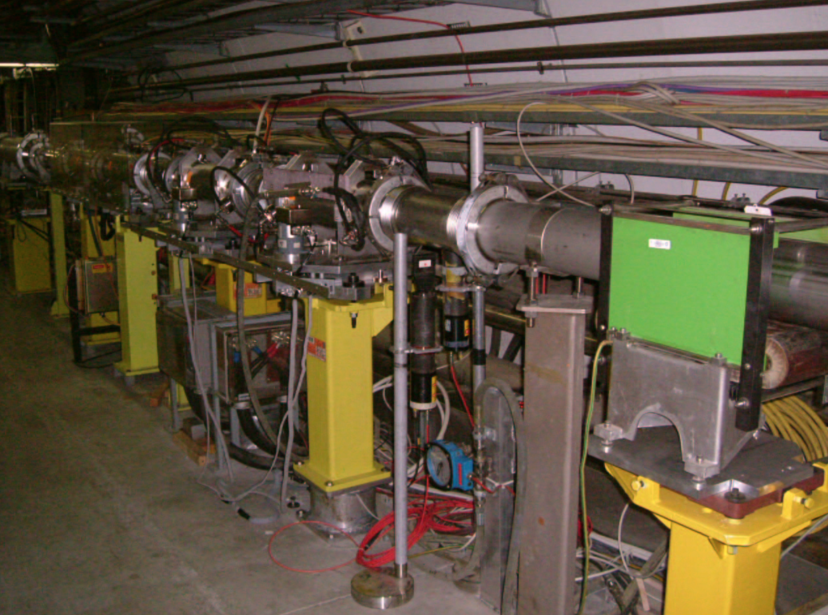
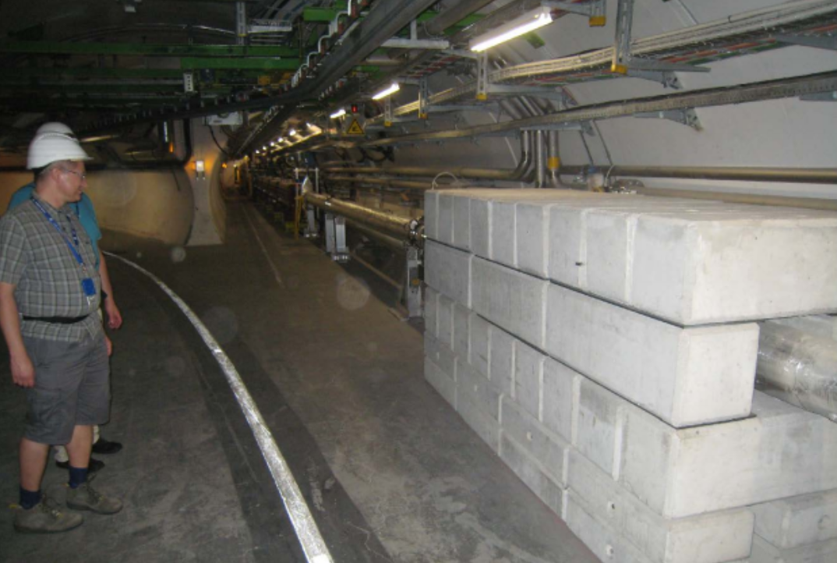
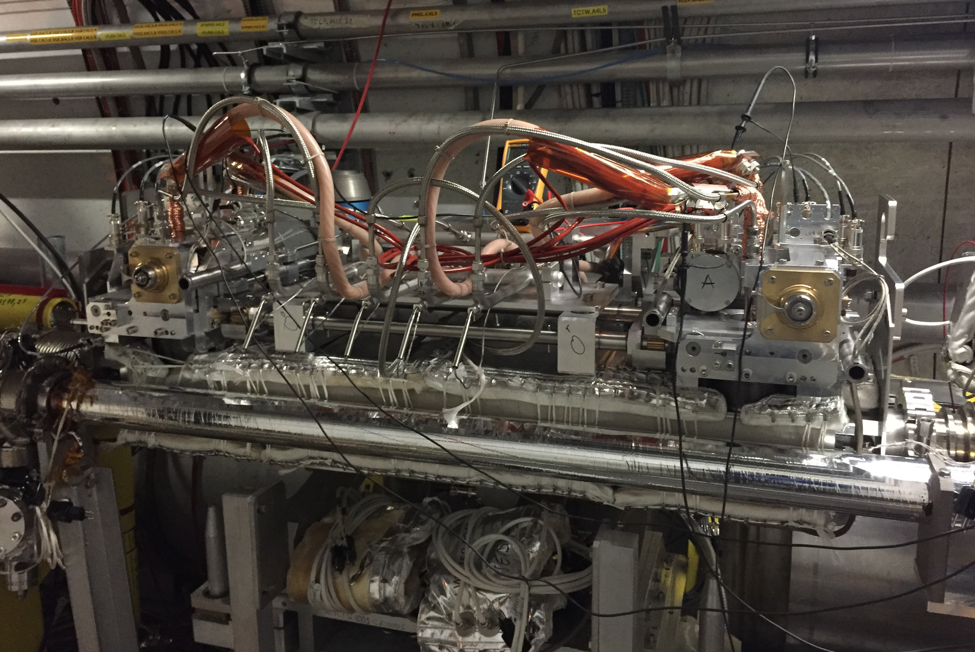
Beam-Beam Long-Range compensation, the journey
J.-P. Koutchouk et al.
Wires in the SPS
Since 2004
W. Fischer et al.
Wires in RHIC
2006
C. Milardi et al,
Wires in DAΦNE
Since 2006
F. Zimmermann et al.
Specification of the
LHC prototypes
2013
1st Workshop on (HL-)LHC
Wire Compensation
December 2015
Experiment in the LHC
July 2017
1997
V. Shilsev et al.
e⁻ Q-compression
2000
J.-P. Koutchouk
DC wires for LHC
2008
U. Dorda
PhD Thesis
2012
T. Rijoff
M.Sc.Thesis
2015
S. Fartoukh et al.
PRST-AB 18, 121001
March 2017
2nd Workshop on (HL-)LHC
Wire Compensation
2004, wires in SPS
2008, technical investigation in LHC
2017, wires prototypes in the LHC
Synergic efforts between BE-BI, Collimation Team, EN-STI, EN-MME and TE-EPC to transform an idea into a prototype.
3
Notes:
The first idea to use a DC wire in LHC is of the 2000, after it several tests were done in hadron machine (SPS, in RHIC), in lepton machine Dafne the wire is an operational device.
In 2013 the specification of the LHC prototype were defined, and thanks to the synergic effort between several expert
WG 2,5,13

Slide 4
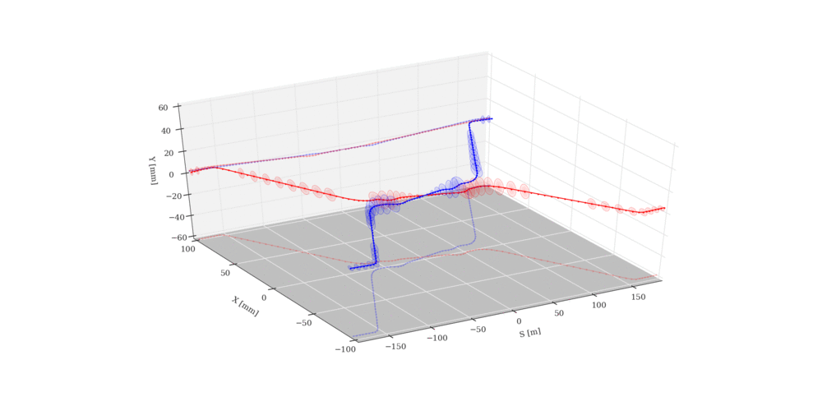
The wire compensation principle
The long-range kick (BBLR effect) can be compensated by using a DC wire.
The wire compensation is not in the HL-LHC baseline (see R. Tomàs talk).
Its potential for HL-LHC with flat optics or in combination with crab-crossing was shown by S. Fartoukh et al., PRST-AB 18, 121001, 2015.
BBCW
B1, right
BBCW
B2, right
BBCW
B2, left
BBCW
B1, left
The BBCW principle
Since 2017 two wire prototypes (BBCW) are installed in LHC. In this presentation, the HW setup and the latest LHC experimental results of the LHC wire compensation will be reported.
4
Results of the Beam-Beam Long-Range compensation experiment in LHC
Notes:
Here you can see a plot of the …
4

Slide 5
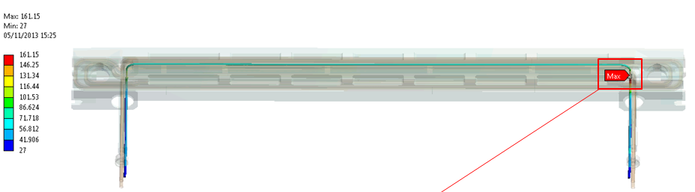
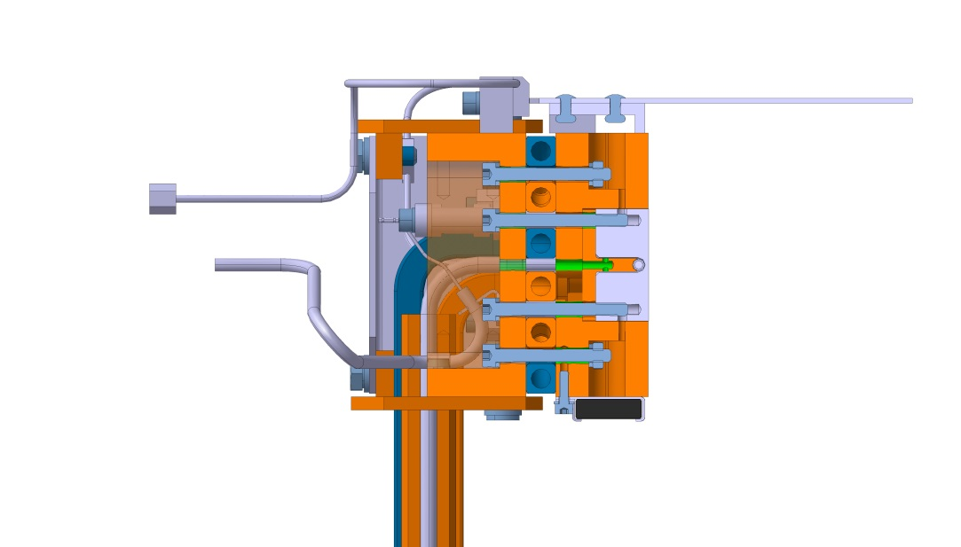
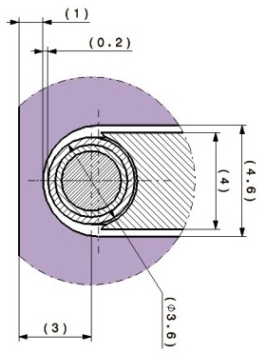
Integration of the wire in the collimator jaws
The wire-beam distance has to be of the order of few mm (function of θ_{c} and s-position): LHC wires prototypes are embedded in the jaw of two operational tertiary collimators.
≈1 m
Top view
Max. temperature at I_{W}=350 A: 161 ºC
Courtesy of F. Carra
Side view
3 mm
During the 2017, BE-BI, EN-STI and the Collimation teams performed a complete test campaign to ensure the correct functioning of the wire interlocks, the collimator motors and PUs when the wire is powered.
5
Results of the Beam-Beam Long-Range compensation experiment in LHC
Notes:
The wire-beam distance has to be of the order of few mm.
5

Slide 6
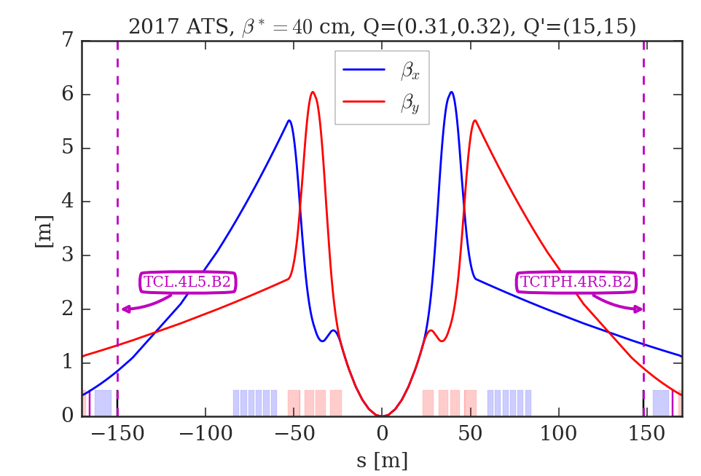
The BBCW position in LHC
The 2 BBCWs were installed in two H-collimators of B2 in IR5 (TCTPH.4R5.B2 and TCL.4L5.B2), close to the D2 separation dipoles.
Longitudinal position of the BBCW and optics used in the experiment
H-plane position of the BBCW
The ideal s-position of the BBCW is ±159 m from the IP5. The actual s-position are -150.03 and +147.94 m.
6
Results of the Beam-Beam Long-Range compensation experiment in LHC
Notes:
6

Slide 7
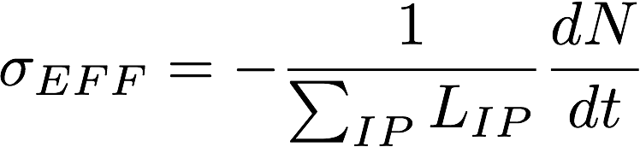
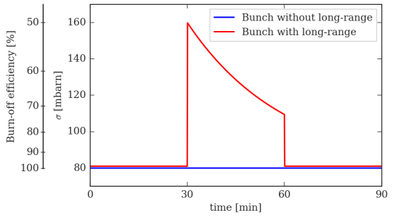
Objectives of the experiment
Prove the beneficial effect of the BBCW in a regime dominated by long-range beam-beam effect, ensuring in the mean time that the linear effects of the wire (orbit and tunes) are compensated.
Our privileged observable is the bunch “effective cross-section”:
Intensity loss-rate
Instantaneous luminosity
The IDEAL compensation, 2 bunches in B2
STEP 1
STEP 2
STEP 3
Luminosity
dominated
Long-range
dominated
Wire
compensation
7
Results of the Beam-Beam Long-Range compensation experiment in LHC
Notes:
7

Slide 8
Asymmetric filling scheme
To approach the wire to the beam the B2 has to be <3e11 p (“safe” limit).
We will mainly concentrate on the two bunches of B2 (Only HO and HO+BBLR).
All but 1 bunch in the B1 train do not have head-on encounters:
stability issues.
BCMS train
All BB encounters will occur in IR1 and IR5 but BBCW only in IR5.
8
Results of the Beam-Beam Long-Range compensation experiment in LHC

Slide 9

STEP 1
Vertical alignment of beam-wires
Luminosity
dominated
Important vertical offset (up to 5 mm) to be corrected with the vertical alignment procedure. Not trivial due to lack of V PUs [credit to N. Fuster and S. Redaelli].
9
Results of the Beam-Beam Long-Range compensation experiment in LHC

Slide 10
STEP 2
Pushing B2 to the BBLR regime
Long-range
dominated
To increase the BBLR effect:
B2 H-emittance blown-up to 5-6 mm mrad [credit to D. Valuch, S. Papadopoulou and M. Fitterer].
The tunes were set to a sub-optimal working point (0.31, 0.32).
50% H-emittance blow-up
And the half-Xing angle was reduced to 120 μrad. Important synergy with the OP experience of the crossing angle anti-leveling [credit to M. Hostettler].
from 150 to 120 μrad
10
Results of the Beam-Beam Long-Range compensation experiment in LHC

Slide 11
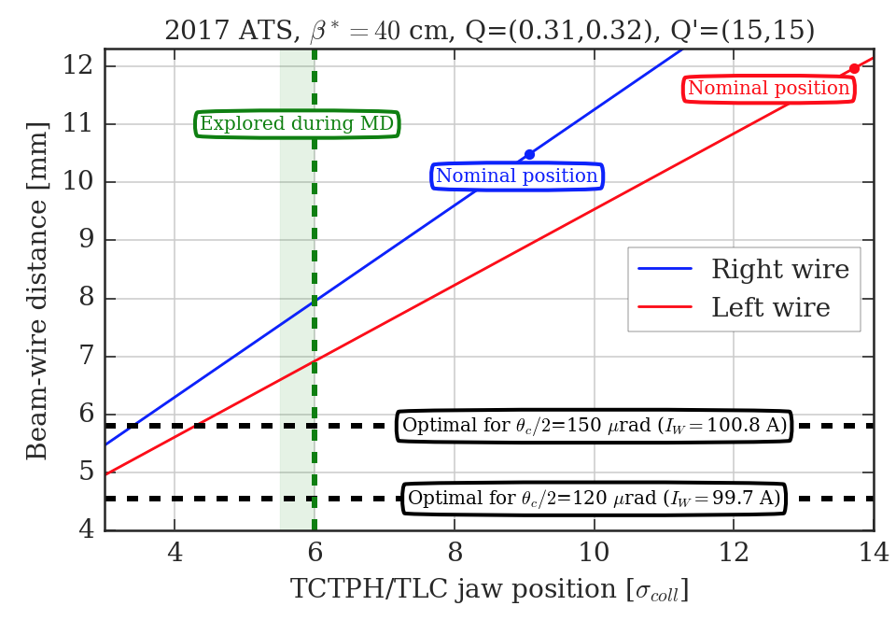
Approaching the wires to the beam
There are practical limits in the positioning of the wire with respect to the beams even for low intensity MD beams.
Given this constraint, the current can be used as a knob to cancel the effect of one specific magnetic multipole.
11
Results of the Beam-Beam Long-Range compensation experiment in LHC
Notes:
11

Slide 12
Switching ON/OFF the compensation
STEP 3
Wire
compensation
I_{W}^{MAX}=350 A
The wires were switched ON-OFF for several powering cycles.
During the powering of the wires, the tunes of the beam (and its position) has to be controlled with high precision: dipolar and quadrupolar contributions of the wires were compensated with feed-forward trims [credit to M. Solfaroli and G.-H. Hemelsoet].
12
Results of the Beam-Beam Long-Range compensation experiment in LHC

Slide 13
STEP 3
Results on the compensation (I)
Wire
compensation
ON ⇾ OFF
ON ⇾ OFF
Compensation seen from the σ_{eff} [credit to N. Karastathis].
Clear effect on the BBCW when switching-off: signal compatible with a contraction of the dynamic aperture of the machine.
13
Results of the Beam-Beam Long-Range compensation experiment in LHC
Notes:
13

Slide 14
STEP 3
Result on the compensation (II)
Wire
compensation
ON ⇾ OFF
ON ⇾ OFF
Using dBLM signals to compute the cross-section [credit to A. Poyet, A. Gorzawski]: improved time resolution.
A constant calibration factor was adopted to rescale the BLM reading to the FBCT losses.
First results from LLRB MD
14
Results of the Beam-Beam Long-Range compensation experiment in LHC
Notes:
14

Slide 15
STEP 3
Result on the compensation (III)
Wire
compensation
Perfect compensation
ON ⇾ OFF
ON ⇾ OFF
From the bunch-by-bunch intensity signals we can measure the effectiveness of the compensation on the losses [credit to M. Hostettler].
Clear effect of the BBCW.
15
Results of the Beam-Beam Long-Range compensation experiment in LHC
Notes:
15

Slide 16
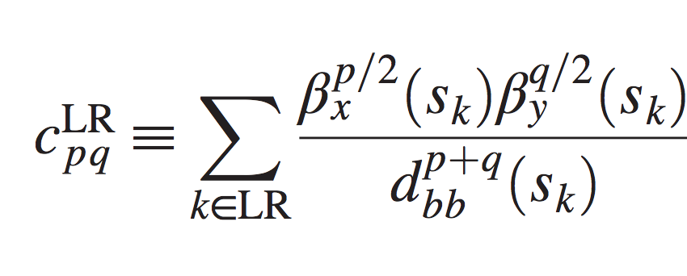
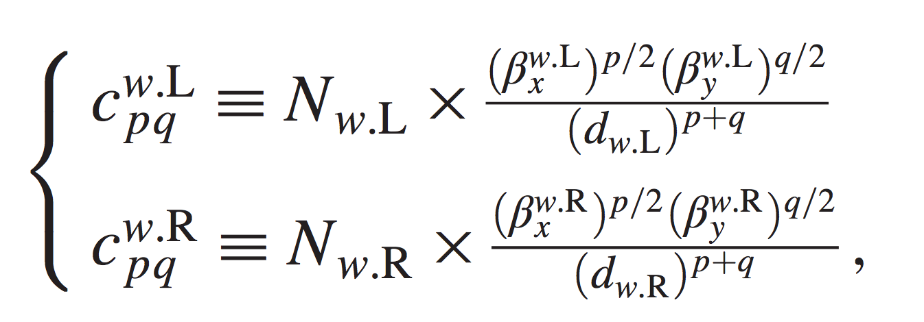
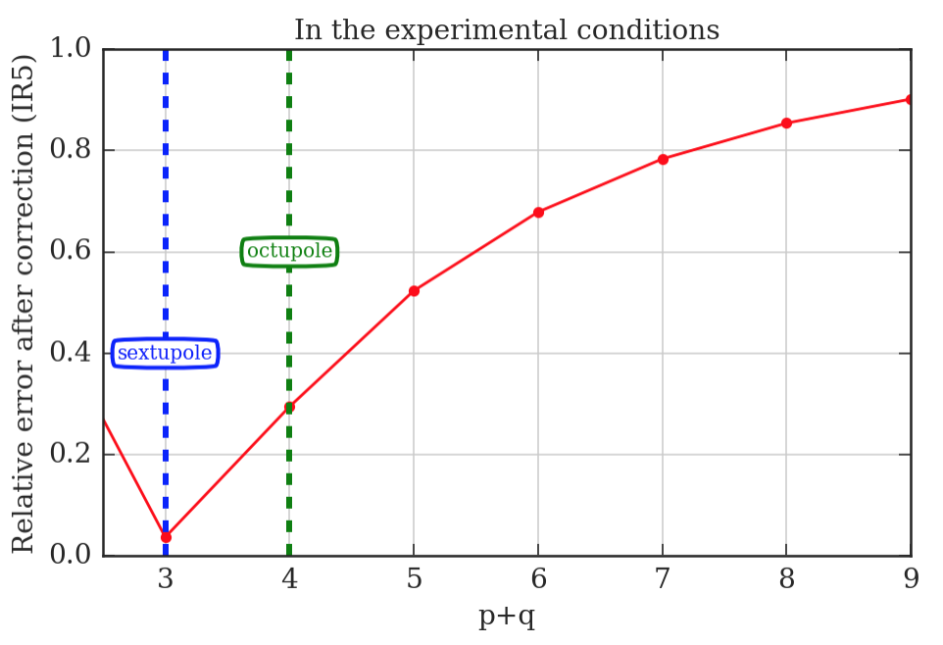
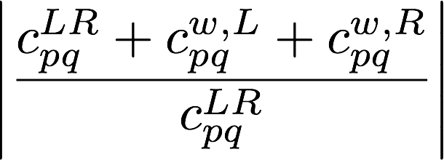
Analysis of the BBCW compensation
S. Fartoukh et al.
PRST-AB 18, 121001
Given the constraint on the minimal beam-wire distance, it was not possible to compensate all the resonances excited by the B1.
We used the maximum current of the wires (350 A) to attack as much as possible the BBLR octupolar term.
The octupolar terms induced by the BBLR in IR5 was reduced by 75%.
Strong-beam driven resonance
BBCW driven
resonance
16
Results of the Beam-Beam Long-Range compensation experiment in LHC
Notes:
16

Slide 17
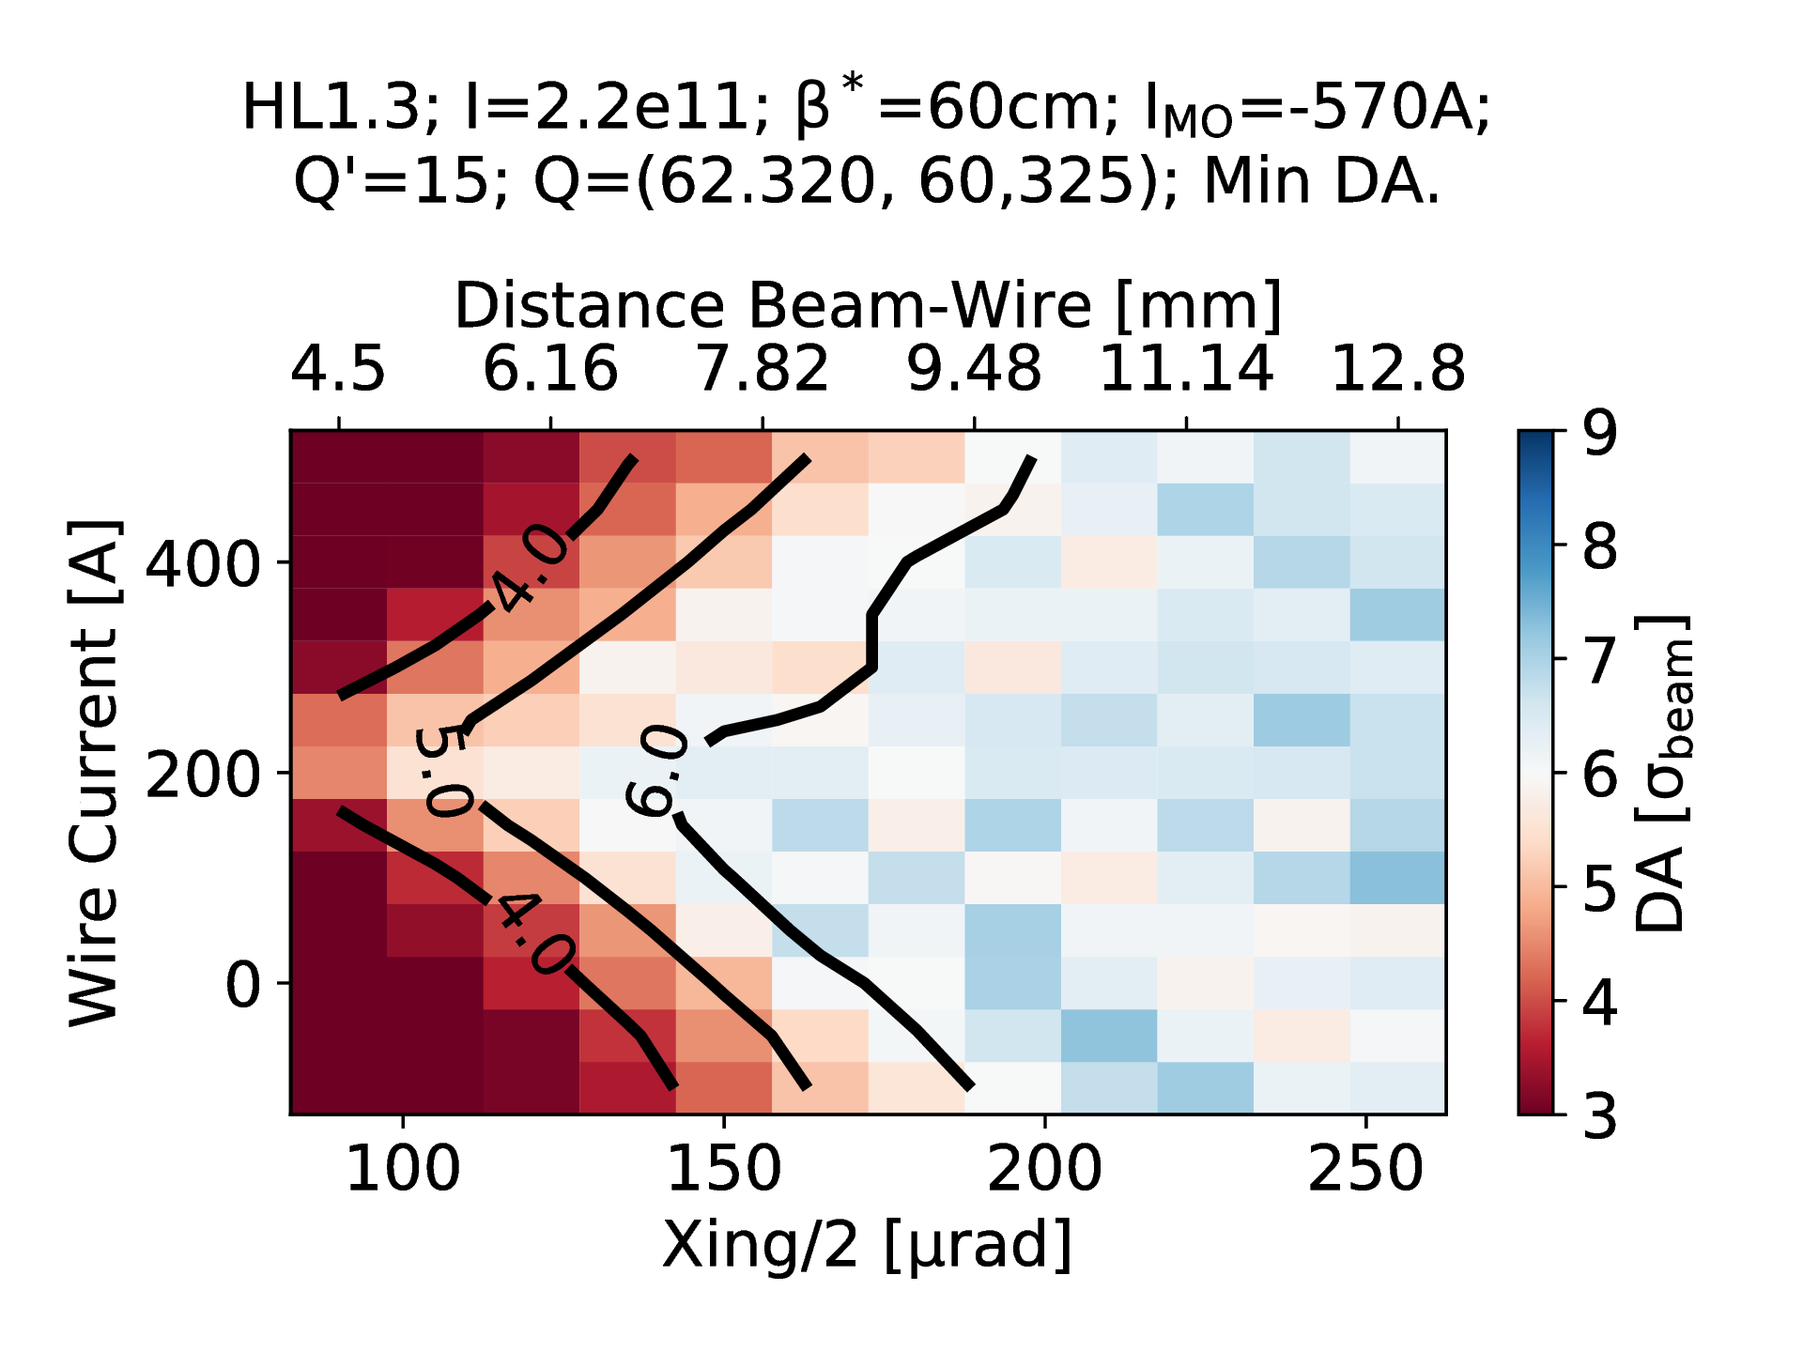
Compensation studies: from LHC to HL-LHC
In the beam-beam team significant efforts are put on the wire compensation tracking studies with the two-fold aim to benchmark the LHC results and optimize the HL-LHC scenario with the wires.
For HL-LHC, preliminary results without a full optimization of the longitudinal and transverse wire position, are showing an additional gain of the order of 30 μrad for the half-crossing angle.
Distance Beam-Wire [σ, ε_{n}=2.5 μm]
8.4
12.6
16.8
21
+ 30 μrad
Preliminary.
HL-LHC start of the levelling
Courtesy of D. Pellegrini
17
Results of the Beam-Beam Long-Range compensation experiment in LHC
Notes:
17

Slide 18
Summary and plans
During 2017 it was observed for the first time in LHC the effect of a direct compensation of the BBCW. Present understanding indicates that it can be related to the partial compensation of the octupolar effect.
In two weeks: new MD (compensation at β*=30 cm). AIM: explore the parameter space and correlate it with the analytical model and the tracking results. Margins of improvements on the beta-beating and the orchestration of the feedforward trims, the systematic measurement of the B2 profiles, the B2 tail re-population during the compensation…
In YETS17/18: two vertical wires will be installed in IR1 (s-position of the wires less favorable than in IR5 for the compensation).
In 2018: compensation experiment in IR1 and IR5.
In parallel to the experimental studies, significant efforts put in simulation studies to benchmarking the LHC results and to study in more details the wire potential for the HL-LHC.
18
Results of the Beam-Beam Long-Range compensation experiment in LHC
Notes:
18

Slide 19
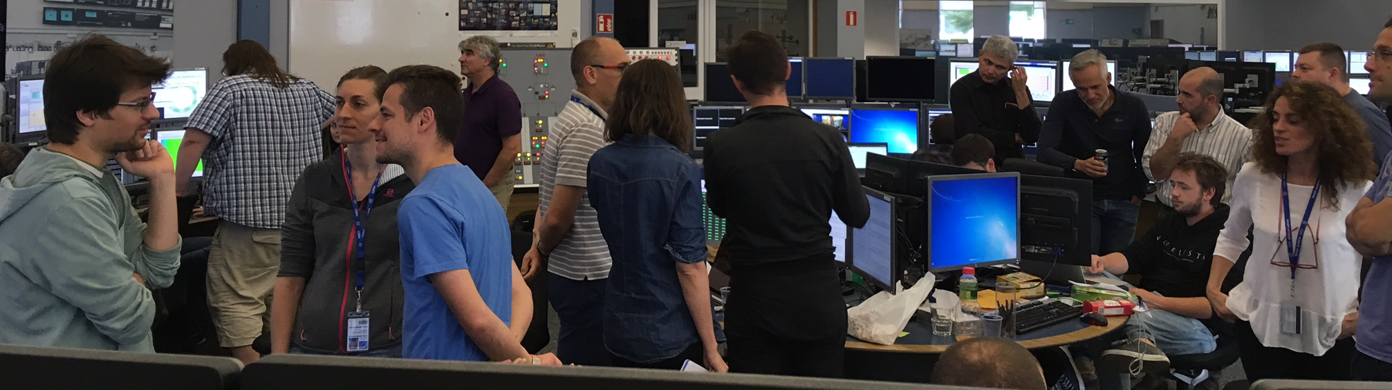
Thank you for the attention!
BBLR compensation MD team: D. Amorim, H. Bartosik, R. Bruce, X. Buffat, L. Carver, G. Cattenoz, E. Effinger, S. Fartoukh, M. Fitterer, N. Fuster, M. Gasior, M. Gonzales, A. Gorzawski, G.-H. Hemelsoet, M. Hostettler, G. Iadarola, R. Jones, D. Kaltchev, K. Karastatis, S. Kostoglou, I. Lamas Garcia, T. Levens, A. Levichev, L. E. Medina, D. Mirarchi, J. Olexa, S. Papadopoulou, Y. Papaphilippou, D. Pellegrini, M. Pojer, L. Poncet, A. Poyet, S. Redaelli, A. Rossi, B. Salvachua, H. Schmickler, F. Schmidt, K. Skoufaris, M. Solfaroli, G. Sterbini, R. Tomas, G. Trad, A. Valishev, D. Valuch, C. Xu, C. Zamantzas, P. Zisopoulos and all participants to the design, production and commissioning of the wire compensator prototypes (WP2, WP5, WP13 and LHC MD coordinators).

Slide 20
BACK-UP SLIDES
20

Slide 21
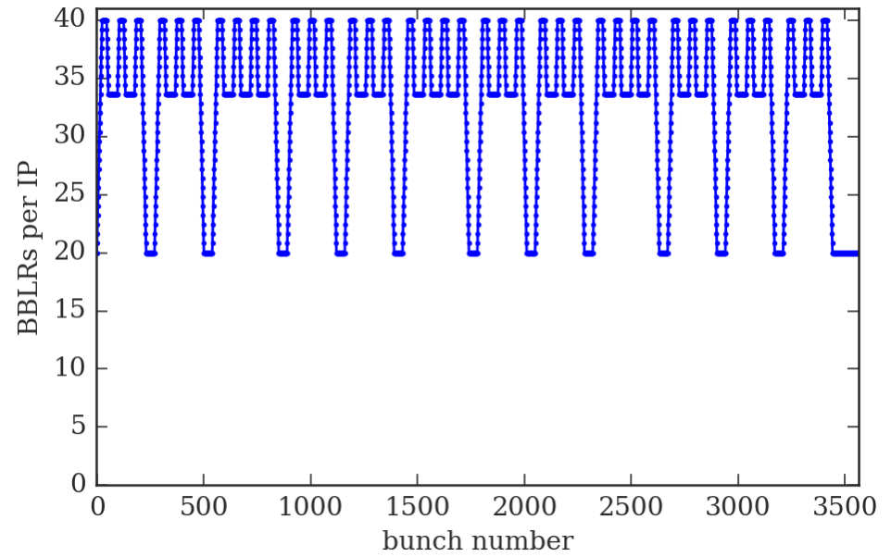
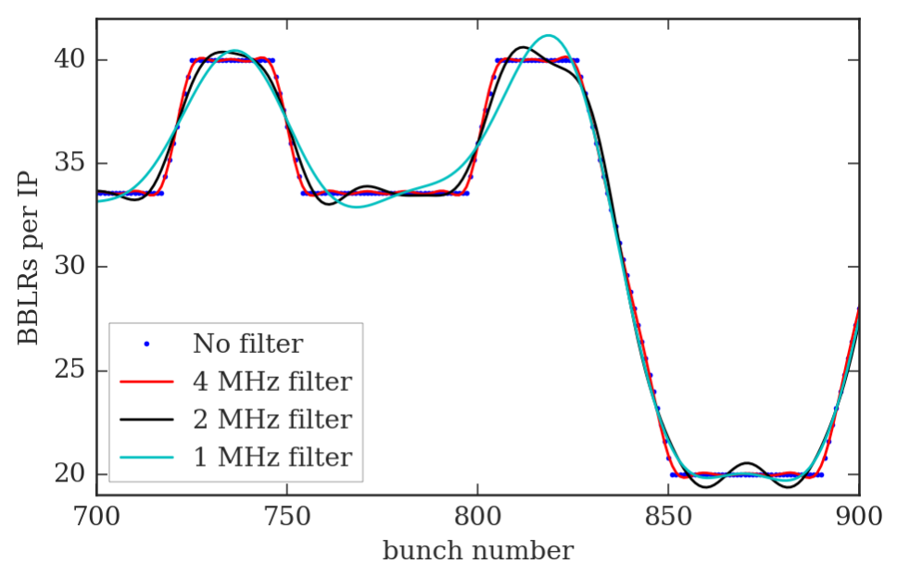
PACMAN bunches and I_{w} modulation
The needed I_{w} modulation BW is of the order of 4 MHz (x10 lower than the bunch frequency).
The wavelength in vacuum of a 4 MHz EM wave is ~75 m.
21

Slide 22
MD2202
10 h MD.
The FILL5898 was dumped (RF on B1, not clear the reason, RF experts suggest a glitch on the interlock). Half-RF detuning.
The observations we report concern the FILL5900. Full-RF detuning.
22

Slide 23
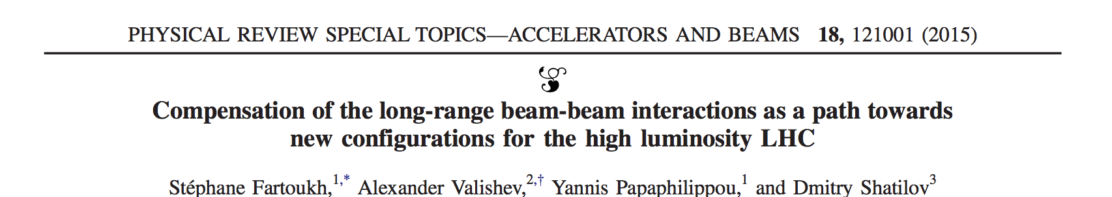
Numerical results from the RDT
We will use the RDT criterion presented and described in details in
Goal: compensate the BBLR RDTs by using 2 BBCs per IP.
Strong-beam driven RDTs
BBCW driven RDTs
Assuming
  the same N_{w} and d_{w} for both BBCWs,
  that the strong beam acts as a DC wire,
  that the phase advance between BBLRs and BBLRs/BBCW is 0 or 180 deg.
the paper gives N_{w} and d_{w} to compensate 4 RDTs (p1q1, q1p1, p2q2, q2p2) in closed form.
It is shown as a numerical evidence that by compensating 4 RDTs one can minimize ALL RDTs if the position of BBCW is conveniently chosen.
Using the paper’s formalism, we will show numerical results on the present LHC (2017 ATS).
23
Notes:
23

Slide 24
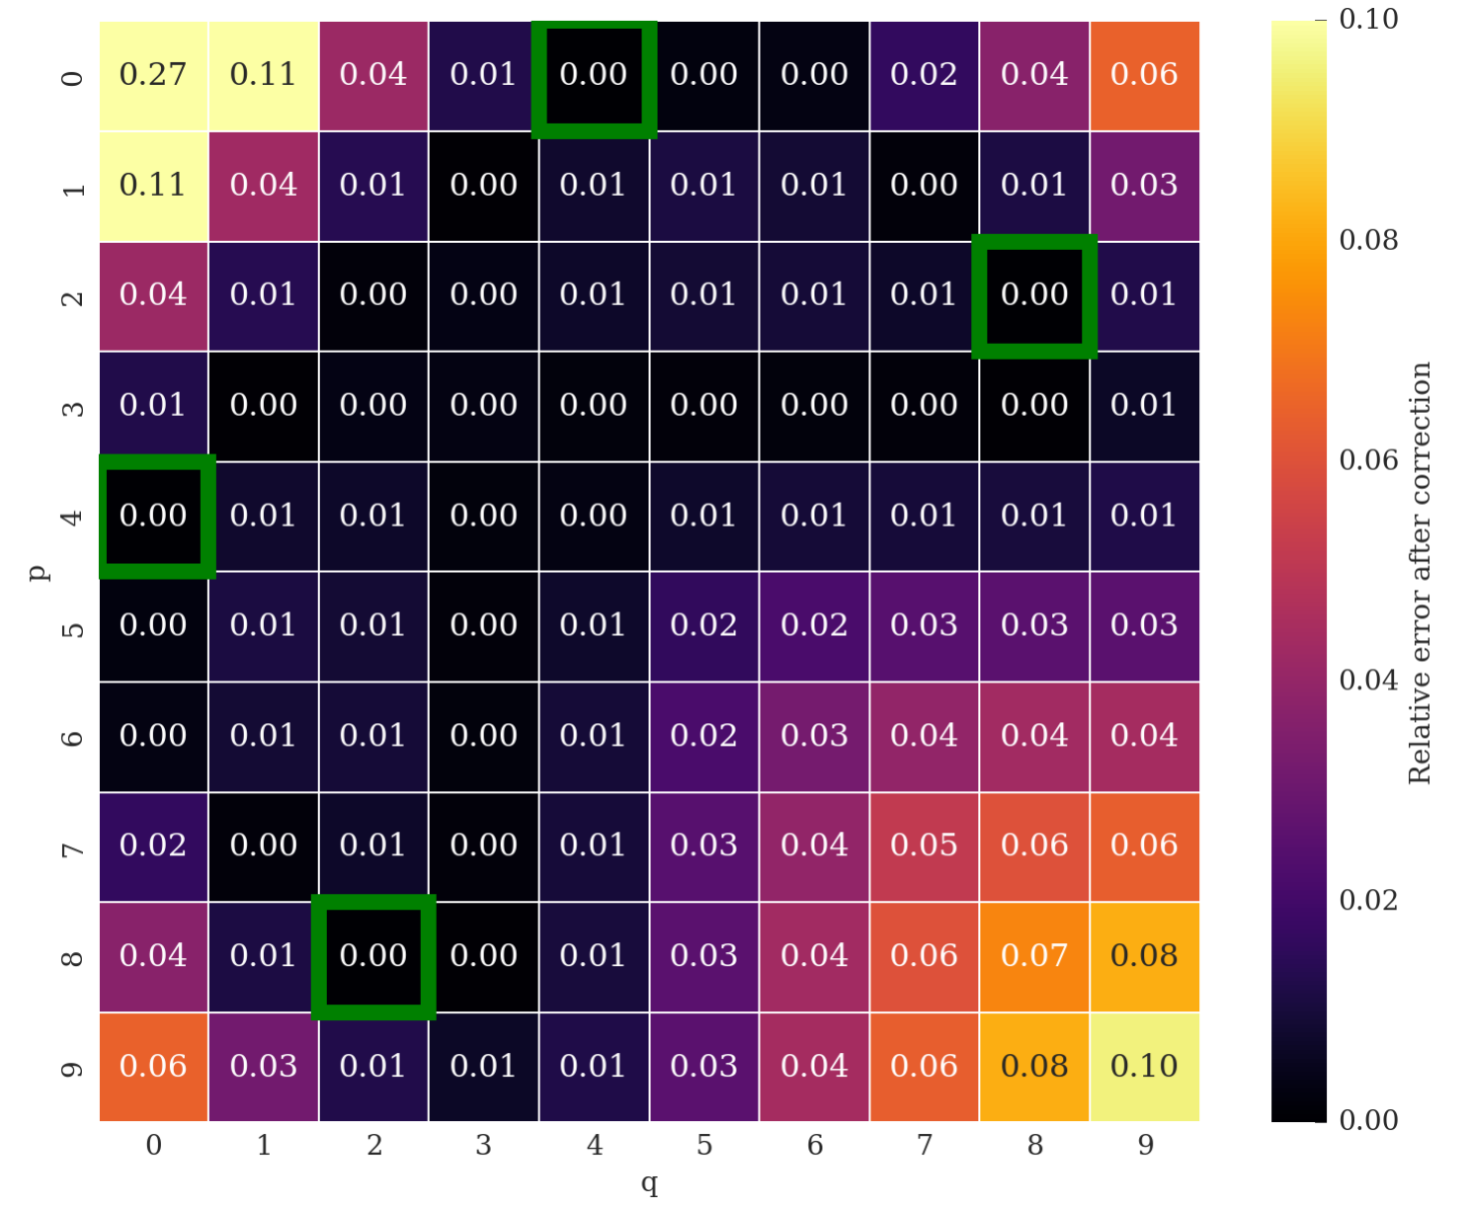
IDEAL CASE: 2 BBCW for IP at s_{opt}=+-159 m
RDT compensation map
dipole driven
quad driven
in color code
The green boxes are the 4 RDTs used to set N_{w} and d_{w}
As expected (under the mentioned assumptions) the compensation is covering many more RDTs than the 4 used to set the BBCWs (green boxes). The p+q=1 and p+q=2 could be addressed by using “local” linear magnets (Q4s and the Q4 correctors).
24
Notes:
24

Slide 25
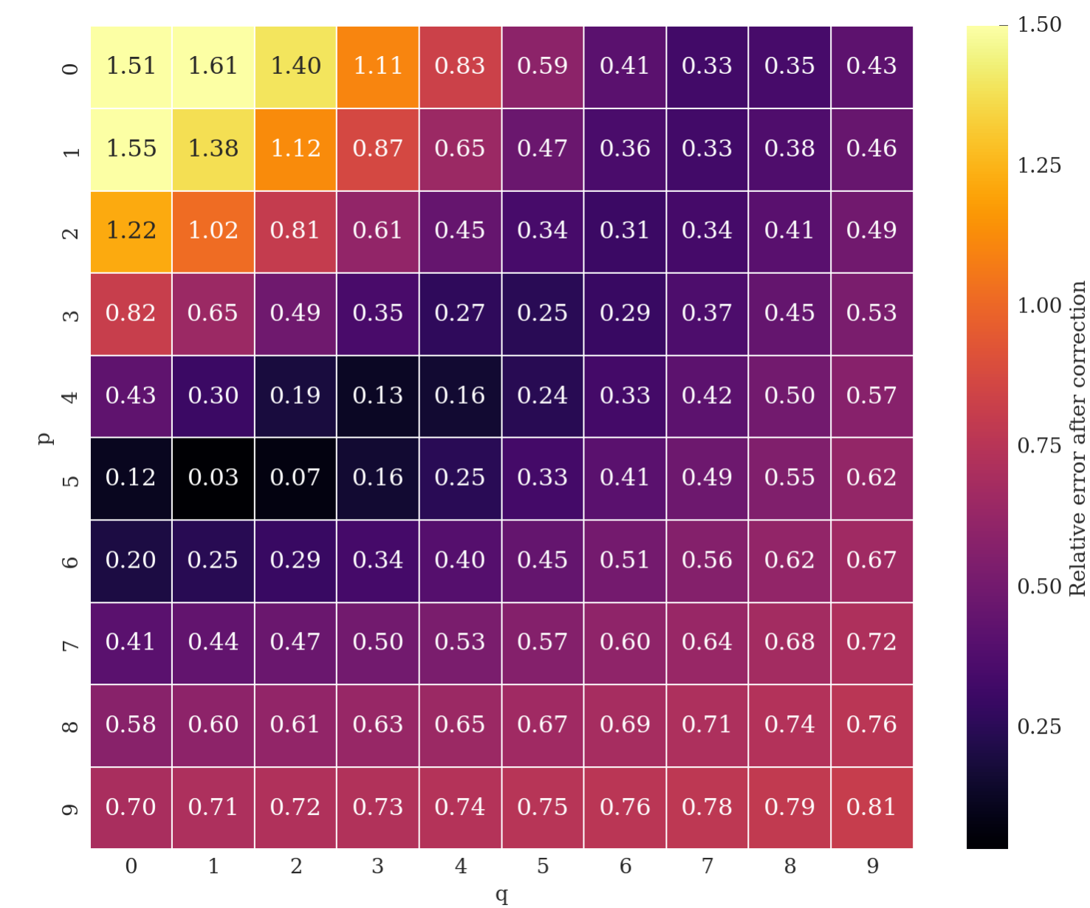
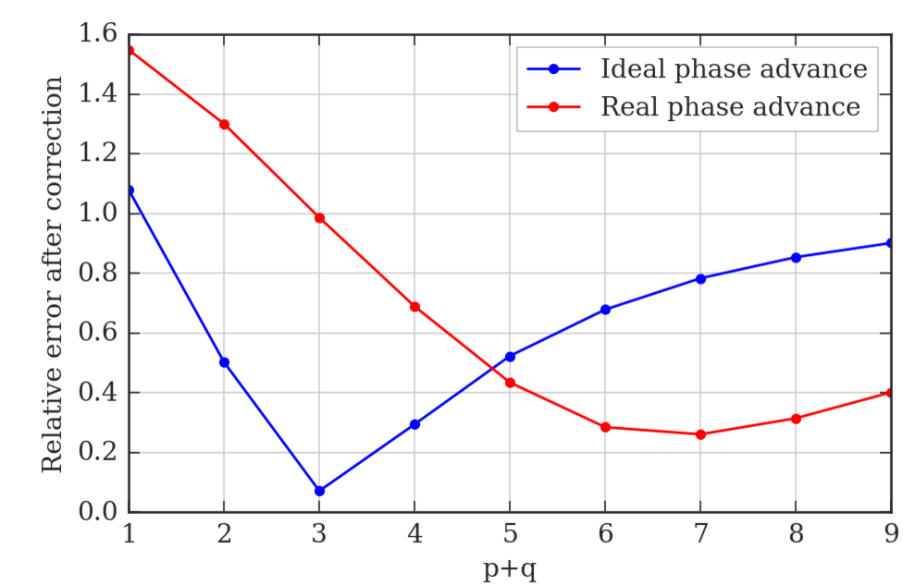
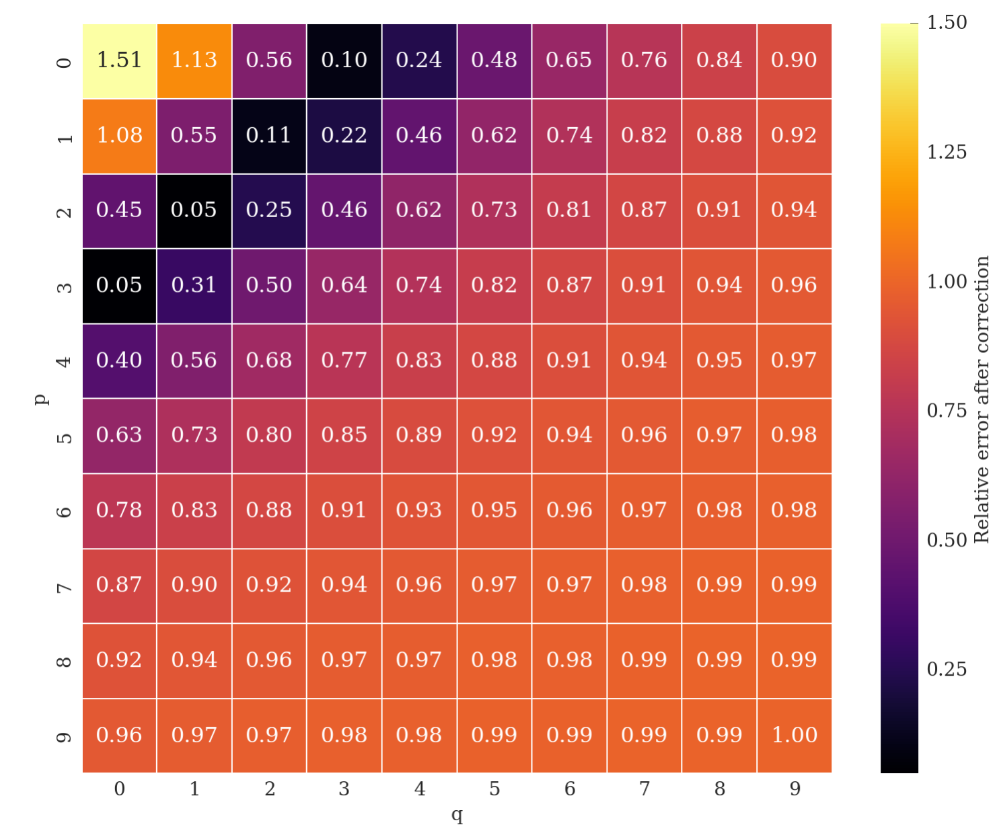
The MD results and the RDT
Real phase advance considered
The observed effect of the BBCW can be related to a partial compensation of the detuning terms.
Ideal phase advance considered (β*→0)
25
Notes:
25

Slide 26
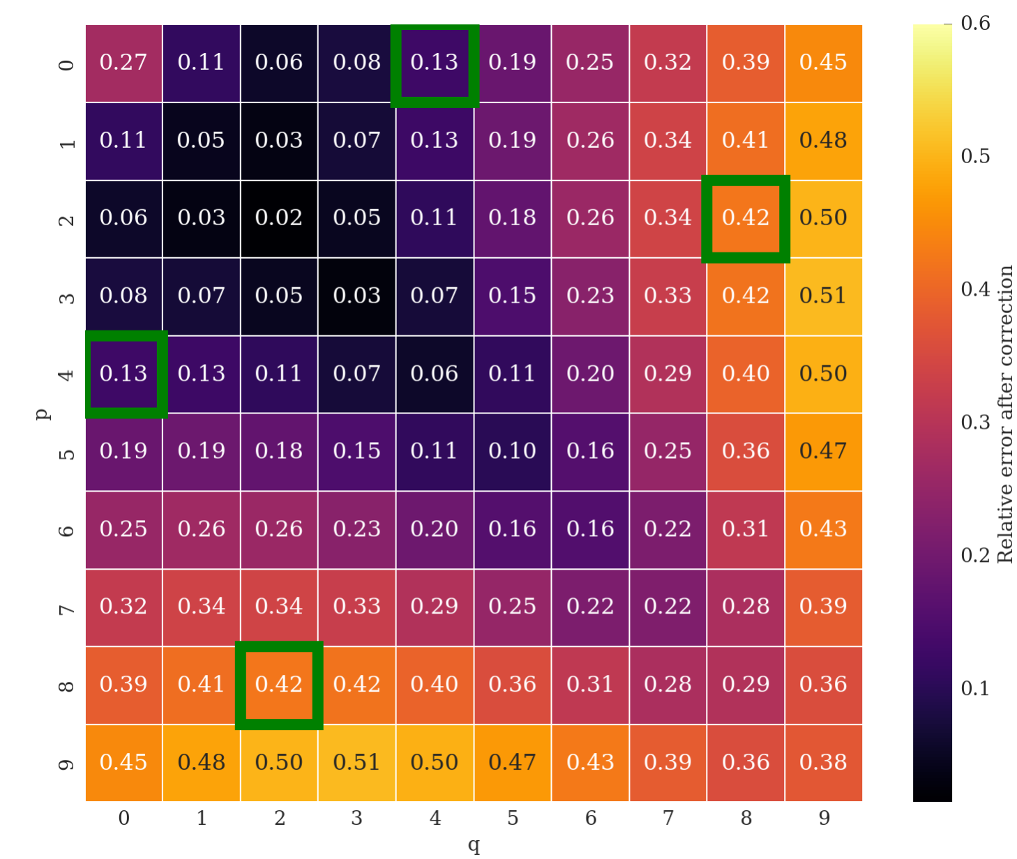
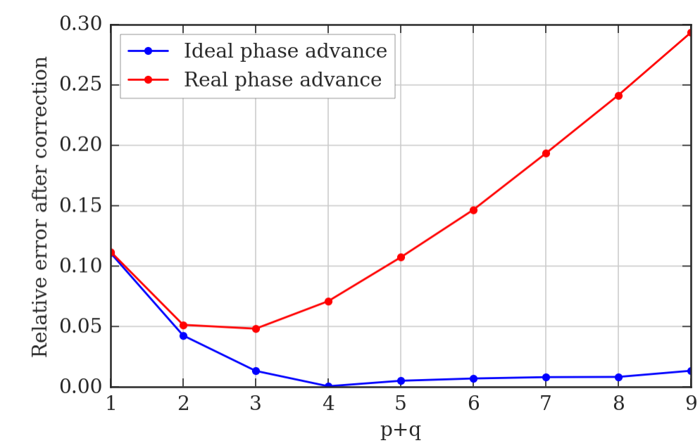
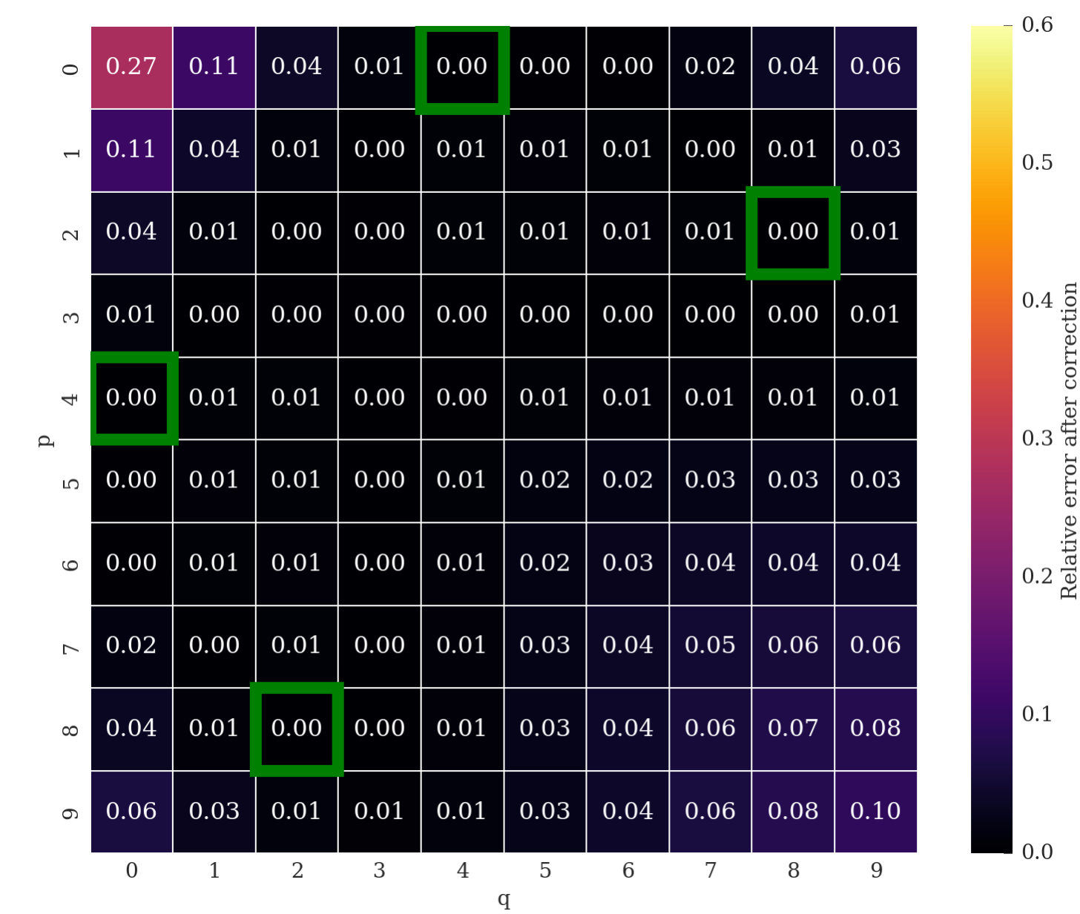
IDEAL CASE: considering the phase advance.
Real phase advance considered
Ideal phase advance considered (β*→0)
One can quantify a posteriori the effect of the phase advance.
The compensation of the RDT does degrade. The compensation of detuning terms (Q-footprint compression) is not affected.
26
Notes:
26

Slide 27
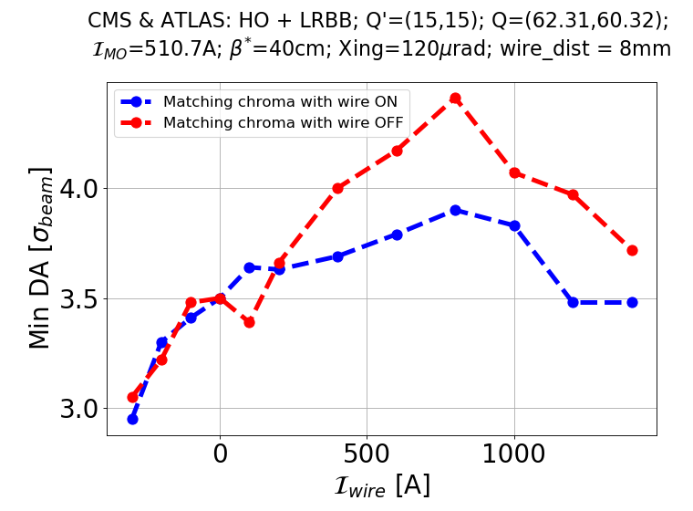
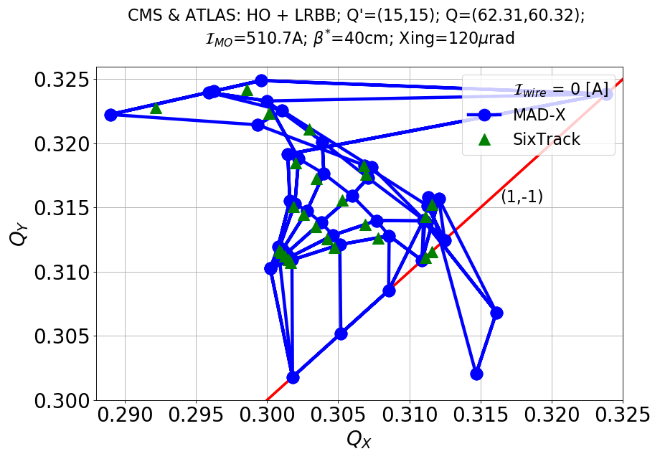
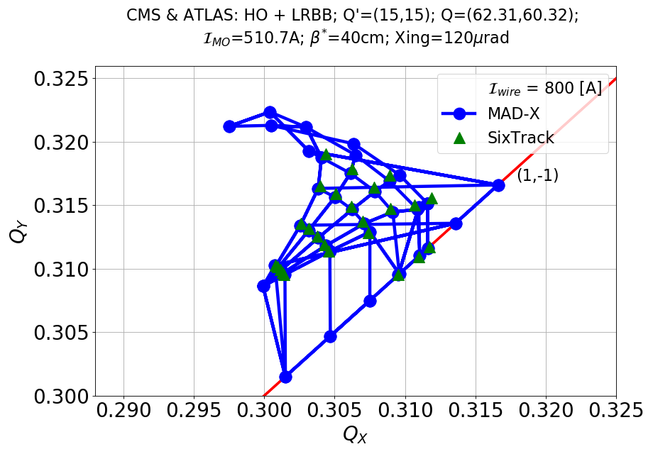
DA simulations with Wire in MD-like conditions I
MD-like conditions: d_{w}=8 mm. LR in IR1/5 but wire only in IR1, real aspect ratio at wire position, phase advances.
A modest gain of DA is observed for 8 mm wire-beam distance.
Optimal DA for 800 A.
With no rematch of the chromaticity (as in the MD), the gain of DA is improved.
Good agreement between footprints from MADX and Sixtrack.
Improvement observed but no clear identification of the optimum.
K. Skoufaris
First results from LLRB MD
27

Slide 28
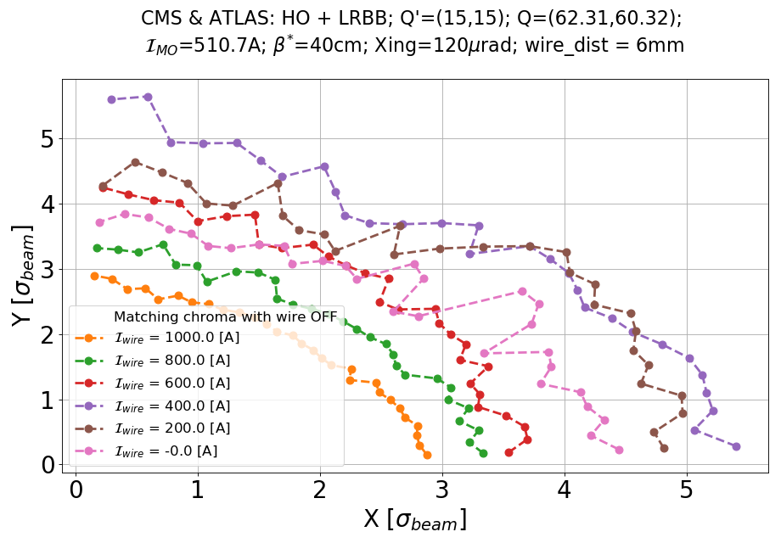
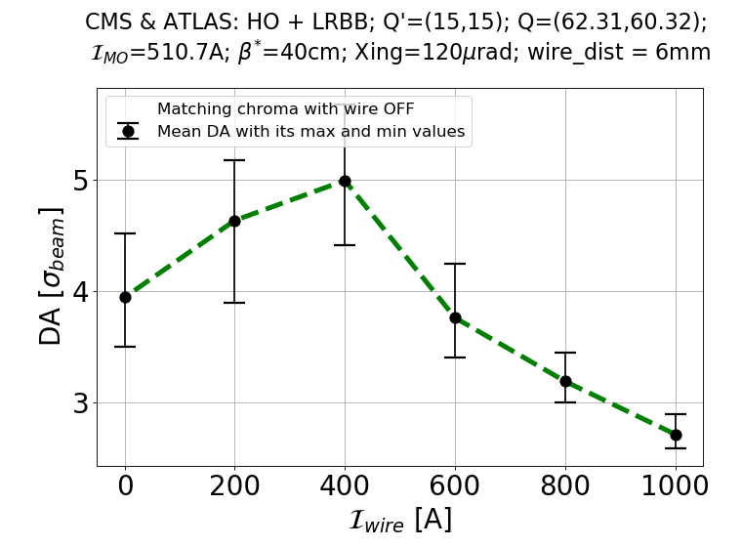
DA simulations with Wire in MD-like conditions II
Push d_{w} to 6 mm
Still not ideal conditions: LR in IR1/5 but wire only in IR1, aspect ratio at wire position, phase advances.
1σ (@2.5 μm) DA gained for an optimal wire current of ~400 A.
Clear improvement over all the angles.
400 A
0 A
K. Skoufaris
First results from LLRB MD
28

Slide 29
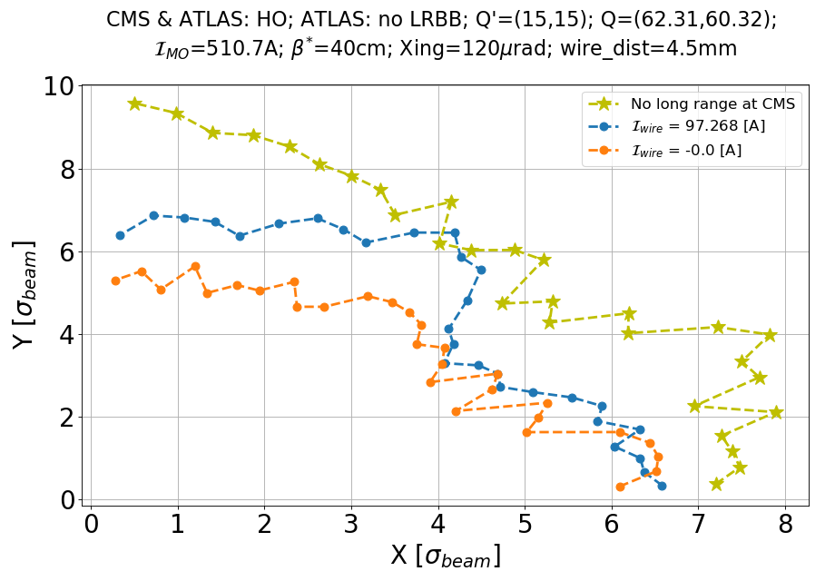
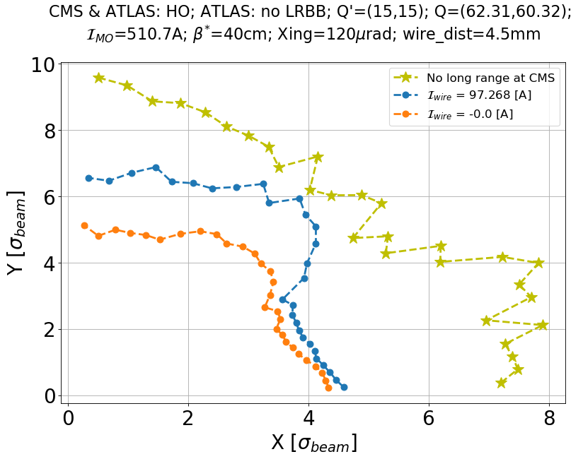
“Strong beam”-wire equivalence: tracking
Standard Strong Beam Zero-emittance-long-range Strong Beam
K. Skoufaris
The zero-emittance-LR strong beam does not show a better DA.
Effect of phase advance? Plans to test with the wire at ~70 m for better phases.

Slide 30
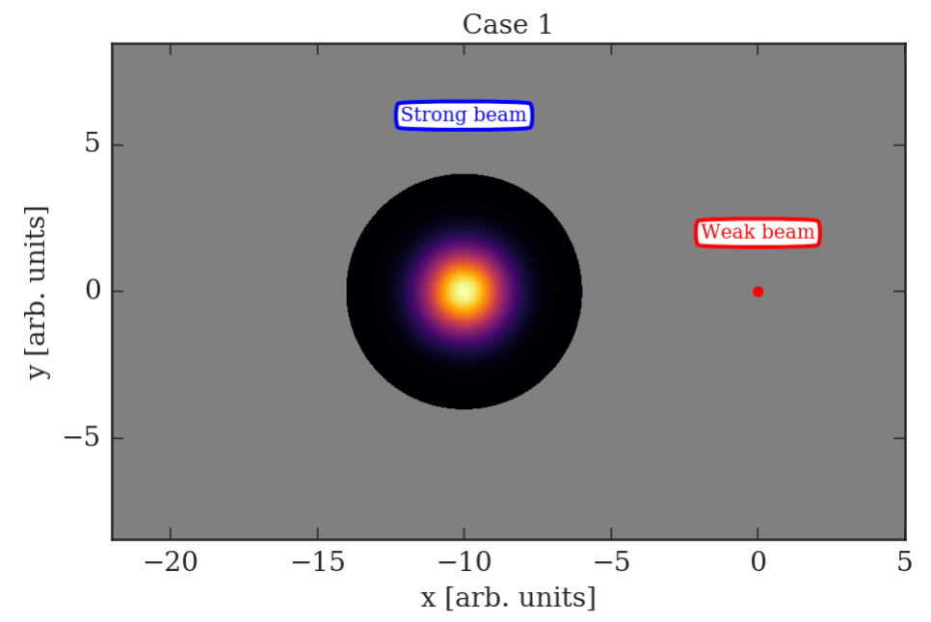
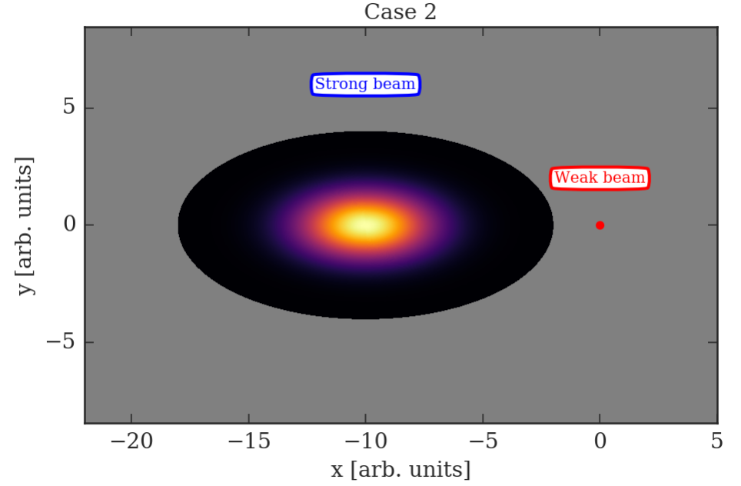
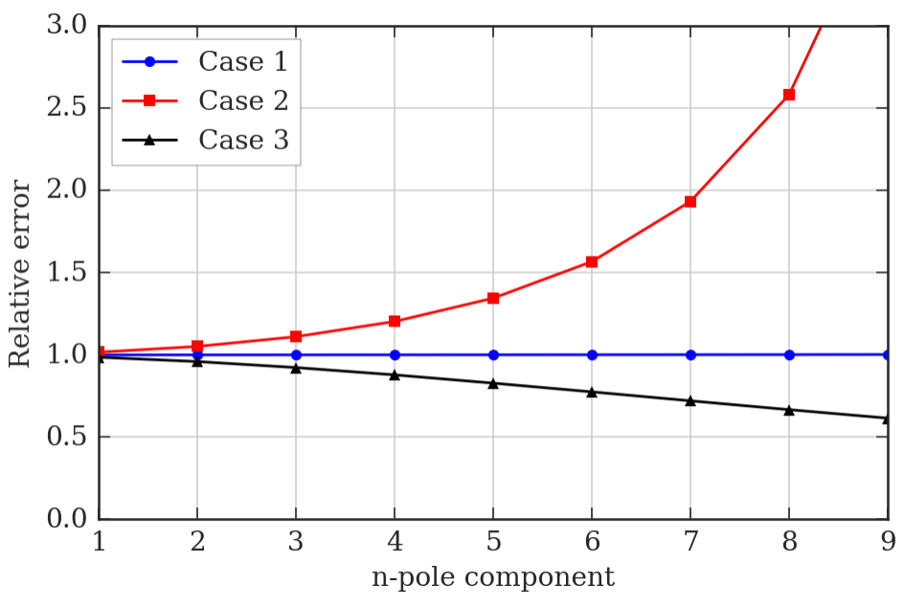
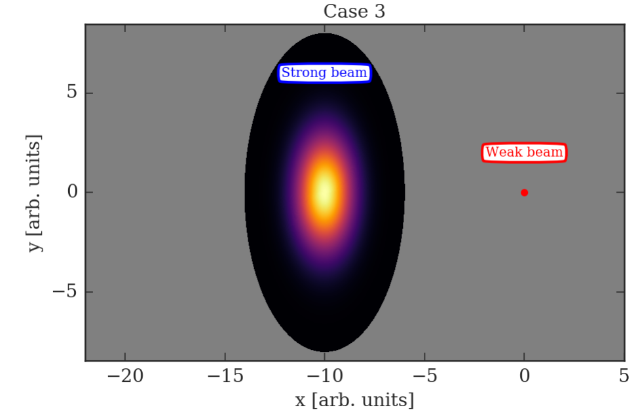
“Strong beam”-wire equivalence
For β_{x}≠β_{y} the “strong beam”-wire equivalence is not valid anymore
We compare the strong beam field and the wire field in terms of multipoles
Case 1: β_{x}=β_{y} , perfect equivalence
Case 2: β_{x}=4*β_{y} , see plot below
Case 2: β_{y}=4*β_{x} , plot below
We assume bi-Gaussian density (4 σ cut)
30

Slide 31
First attempts of BBCW in HLLHC1.3
B1 tracking with operational settings for emittance, tunes, chroma, octupoles.
4 wires (L/R IP1/5) installed in the crossing plane.
The wires are arbitrarily placed at +/-150m from the IPs.
The distance is tuned so that the beam-wire normalised separation is the same as the normalised crossing.
Likely a suboptimal configuration to be further refined.
β* = 60 cm | H Beta [m] | V Beta [m]
wire_l1.b1 | 1052 | 1181
wire_r1.b1 | 1178 | 1054
wire_l5.b1 | 1054 | 1182
wire_r5.b1 | 1181 | 1055
β* = 20 cm | H Beta [m] | V Beta [m]
wire_l1.b1 | 3006 | 3641
wire_r1.b1 | 3649 | 2999
wire_l5.b1 | 2995 | 3645
wire_r5.b1 | 3636 | 3003
31

Slide 32
BBCW MD: sanity checks on H/V-position
The H-position of the beam is well under control.
The V-position and correctors behaviour confirm a very good V-alignment of the BBCW.
32

Slide 33
BBCW MD: Q trims
The Q-trims are mostly due to the feedforward.
33

Slide 34
BBCW MD: dipolar trims
The correctors trims are mostly due to the crossing angle settings.
34

Slide 35
BBCW MD: optimizing HO collision
35

Slide 36
BBCW MD: wires H-positioning
The hectic activity on the BBCW positioning.
36

Slide 37
BBCW MD: instability of B1
During next MD we will use stronger octupole settings to avoid the instability of the non-colliding bunches in B1.
37

Slide 38
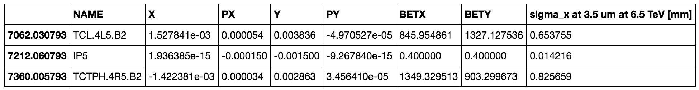
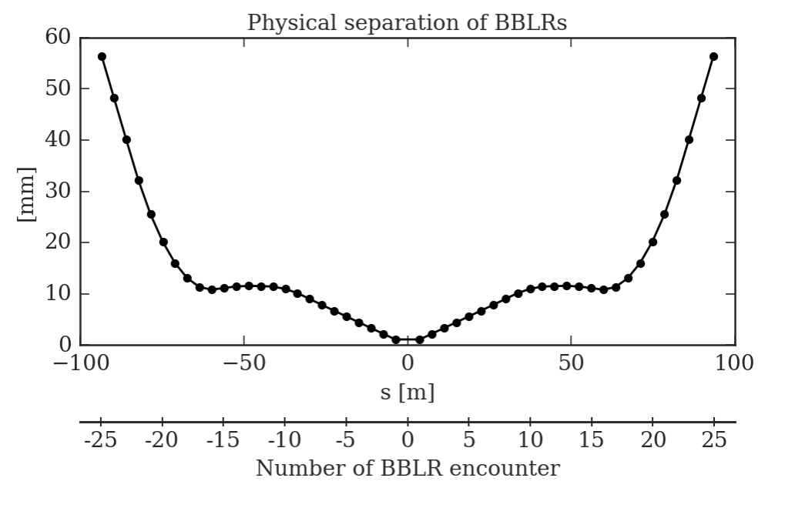
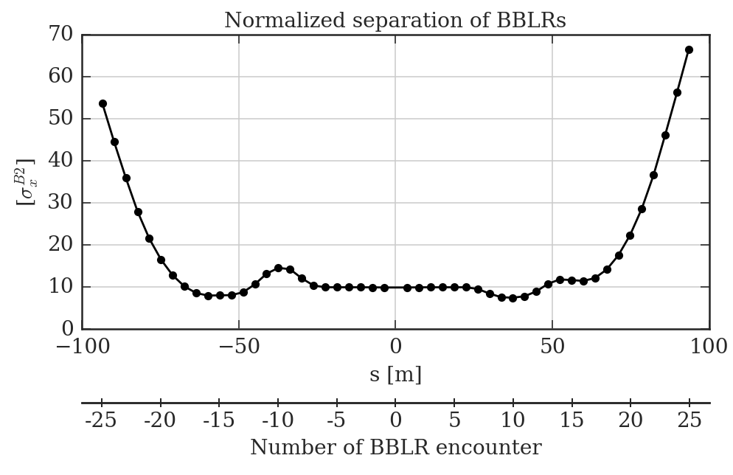
ATS 2017 optics
38

Slide 39
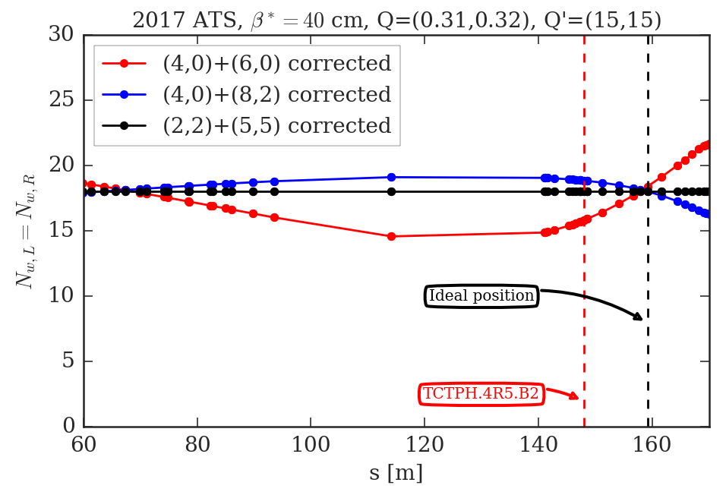
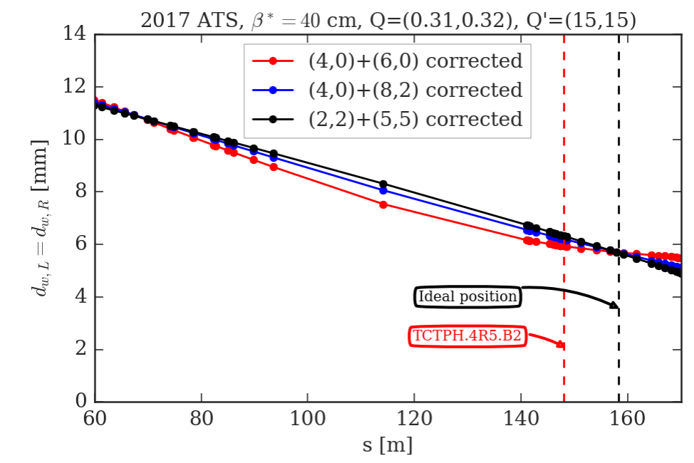
RDT criterion for ATS 2017 and θ_{c}=150 μm
By plotting the N_{w}(s) and d_{w}(s) for different RDT minimization strategy, one sees there are specific s-positions, s_{opt}, that minimizes more than the usual 4 RDTs.
The BBCW is positioned ~10 m apart with respect to the optimal position.
39
Notes:
39

Slide 40
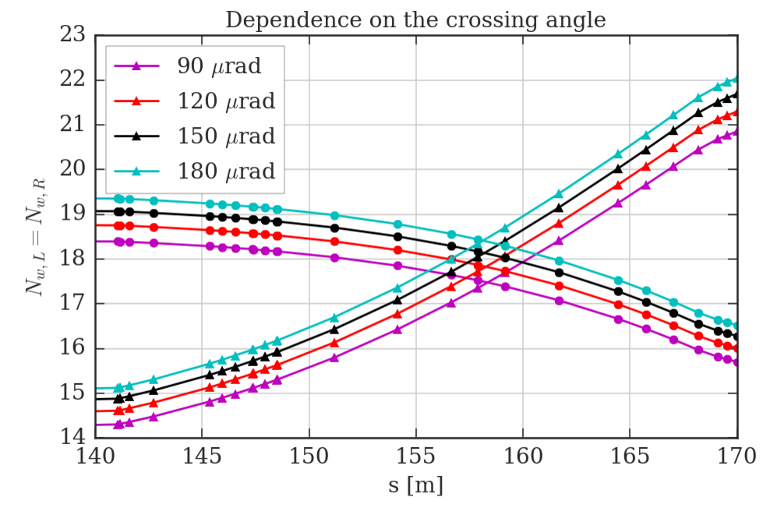
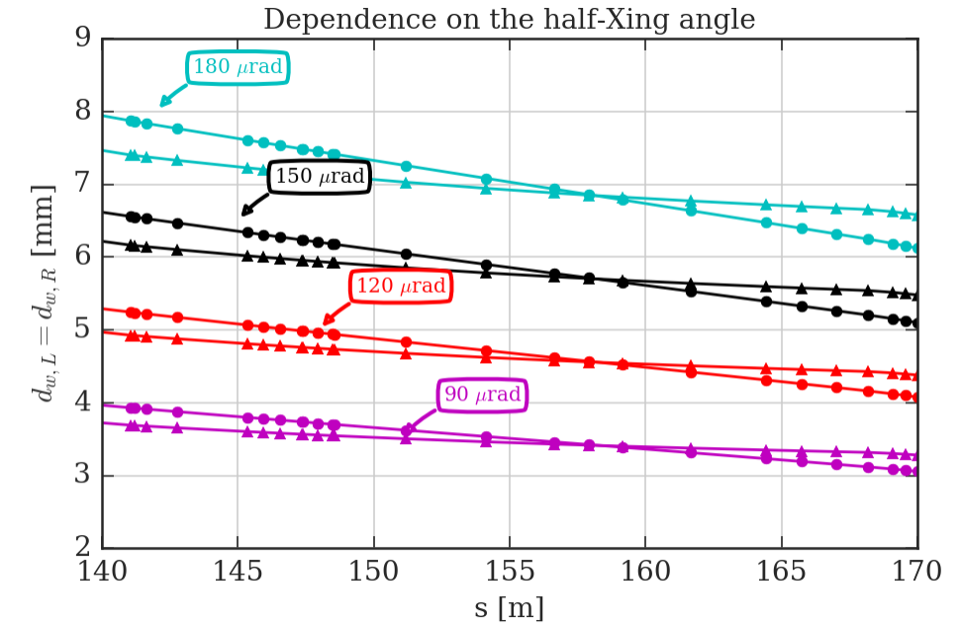
s_{opt}, N_{w} and d_{w} on crossing angle
There is no dependence of s_{opt} on the crossing angle.
N_{w} dependence on the crossing angle is marginal (smaller crossing angle, smaller N_{w}).
d_{w} is linearly dependent on the crossing angle.
40
Notes:
40

Slide 41
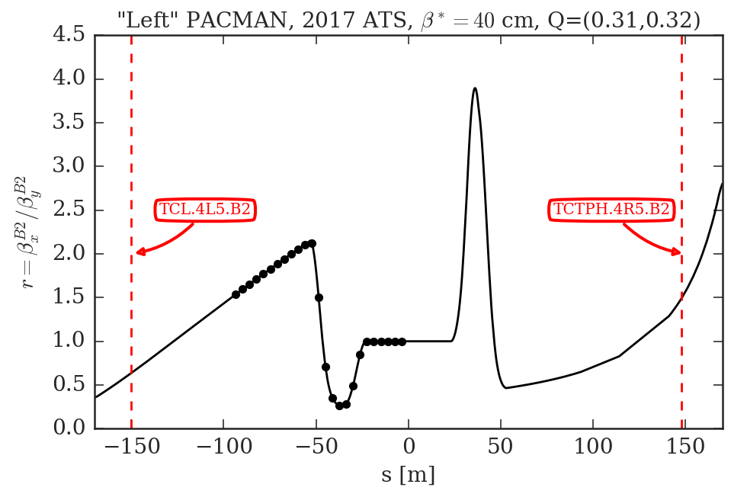
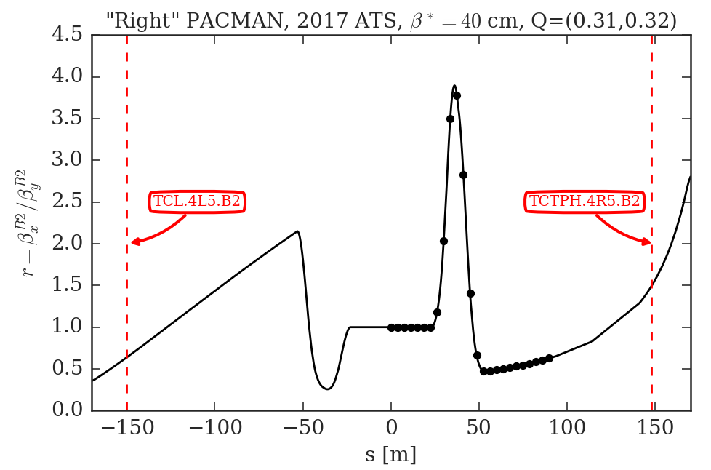
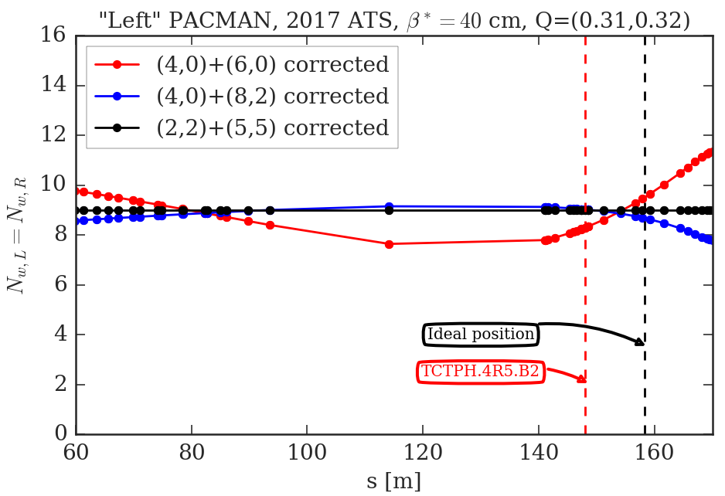
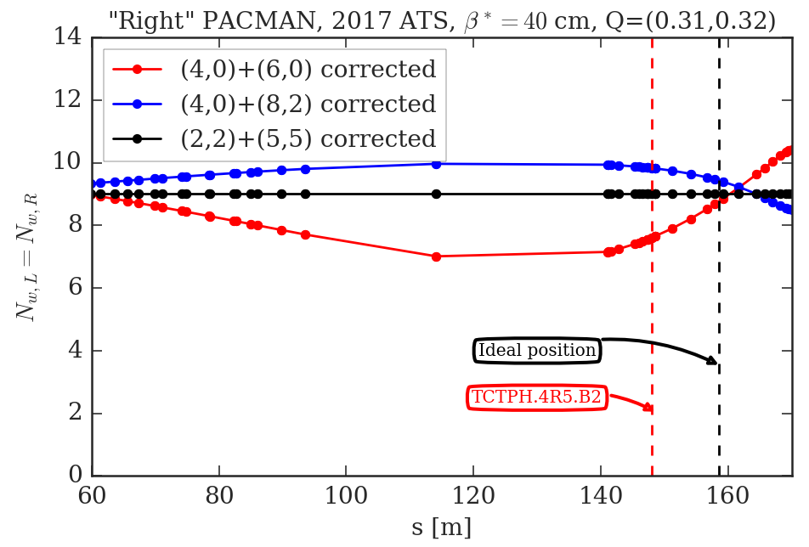
PACMAN bunches and s_{opt}
The s_{opt} depends on the PACMAN pattern.
41

Slide 42
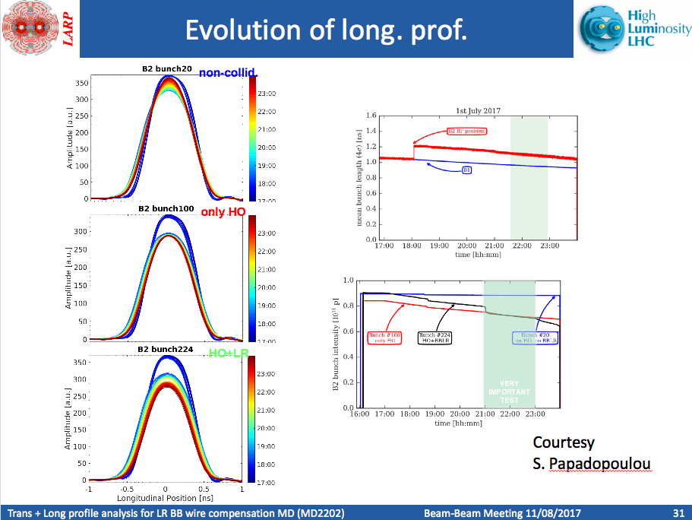
BBCW impact of the beam profiles (I)
A very detailed presentation by Miriam and Stefania at https://indico.cern.ch/event/658908/
Longitudinal profiles
42

Slide 43

BBCW impact of the beam profiles (II)
A very detailed presentation by Miriam and Stefania at https://indico.cern.ch/event/658908/
Transverse profiles
43

