Slide 1


The 11T Dipole Prototype Construction and Preparation for Testing, and
The Connection Cryostats
F. Savary on behalf of WP11
https://indico.cern.ch/event/647714/

Slide 2

Outlook
Introduction and master plan
The 11T dipole full assembly
Design feature of the prototype
Main magnet parameters
Cable performance requirements
Coil characteristics
Main manufacturing steps
Collaring tooling & process
Progress on the prototype construction
Training of short models
Connection cryostats for IP2

Slide 3
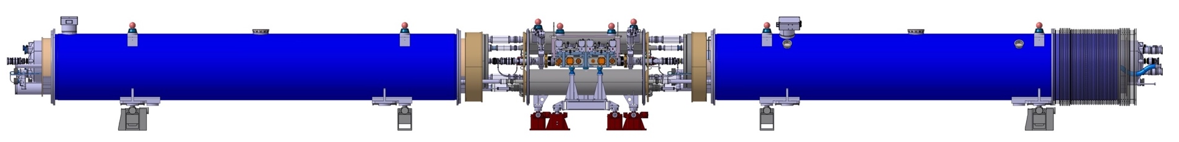
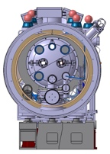
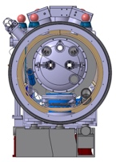
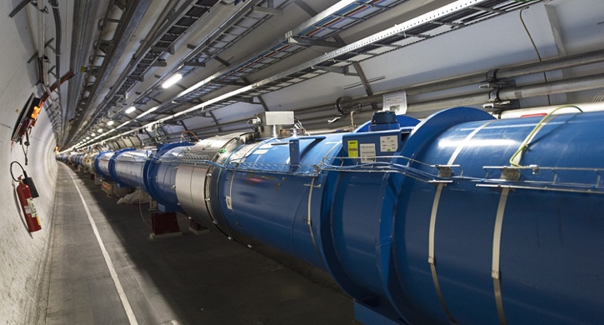

Introduction
15.66 m
The HL-LHC Project implies beams of larger
intensity ➥ additional collimators are needed
in order to intercept and absorb higher beam
losses (dynamic heat loads on cryogenics and
risk to quench superconducting magnets)
  Two collimators, one per beam, installed on
  either side of interaction point 7 (IP7) for both proton
  and heavy-ion collimation losses, in the Dispersion Suppressor region
Replace a standard Main Dipole by a pair of shorter 11 T Dipoles producing the same integrated field of 119 T·m at 11.85 kA

Slide 4

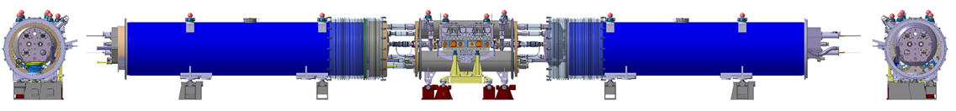
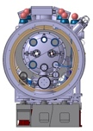
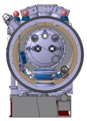
Masterplan of WP11
TODAY
12774.7
P2
New connection …
… Cryostat for Collimator
P2
5309
2156
5309
6752
6752
P7
11T Dipole …
… Full Assembly
P7
15660

Slide 5
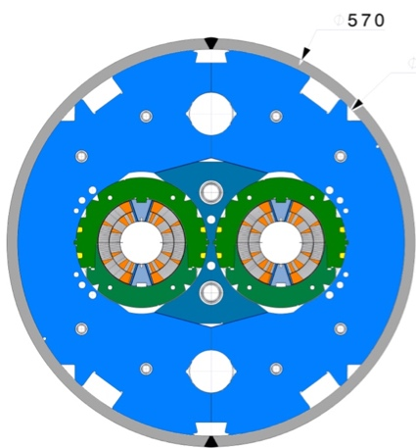
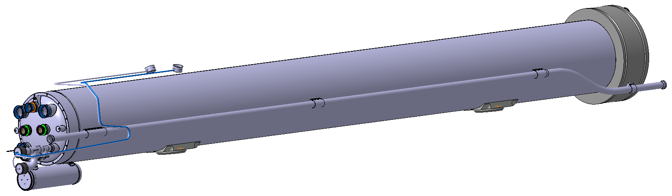
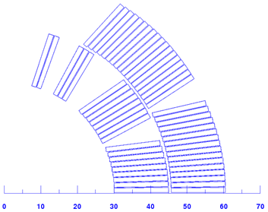
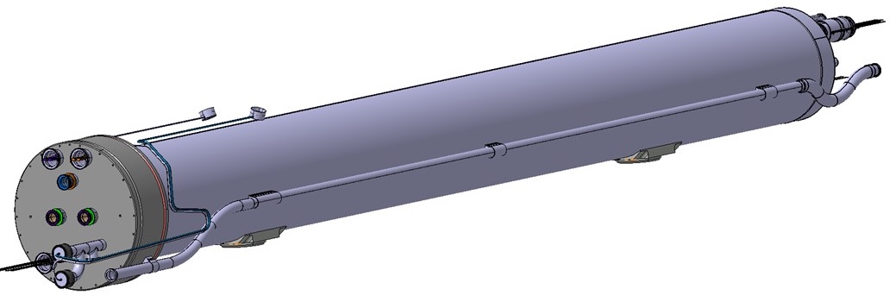
The 11T Dipole Full Assembly
LBH_A
By-pass cryostat
LBH_B
Prototype cryo-assembly
194.52 mm
LMBHA
OD 570 mm
ID 60 mm
2 layers
6 bloks
56 turns
Prototype cold mass assembly
LMBHB

Slide 6
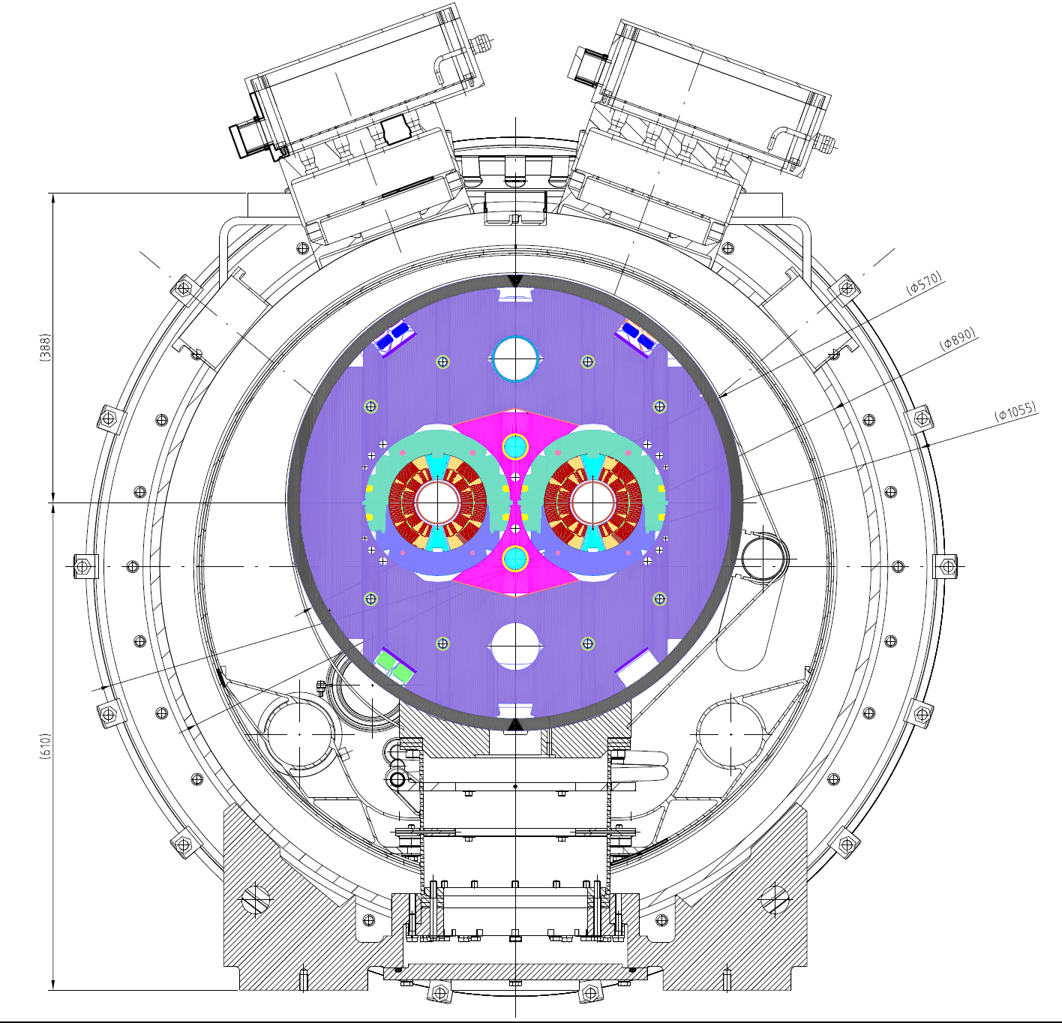
Design features of the prototype
Parameter | Value
Bore field @ I_{NOM} | 11.23 T
Nominal current | 11.85 kA
Operating T | 1.9 K
Load line margin | 20 %
Magnet aperture | 60 mm
# turns (inner/outer) | 56 (22/34)
Cable bare width | 14.7 mm
Cable bare mid-thickness | 1.25 mm
Keystone angle | 0.79°
Strand diameter | 0.7 mm
# strands per cable | 40
Cu to non Cu ratio | 1.15 ± 0.1
RRR after reaction | > 150
Minimum strand critical current, Ic (12T, 4.222 K) | 438 A
IFS boxes
Heat Exchanger Tube
Main Quadrupole Bus Bars
Yoke
Magnet OD: 570 mm
Cryostat ID/OD: 890/914 mm
End Flange ∅: 1055 mm
Coils (2 layers, no I-L splice)
Superinsulation
N-line with Auxiliary Bus Bars
Thermal shield
Beam Tube
Collars
Shrinking cylinder
Main Dipole Bus Bars
Support post (composite)

Slide 7
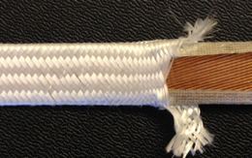
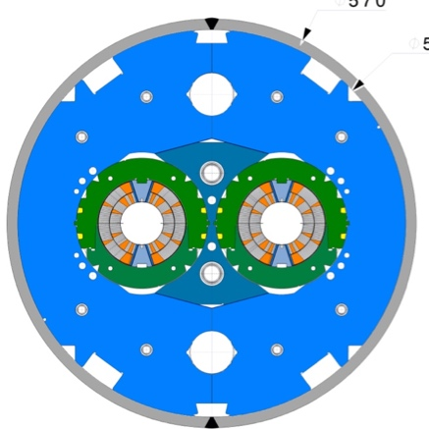
Magnet main parameters
Parameter | Value | Unit
Aperture | 60 | mm
Distance between apertures at RT / 1.9 K | 194.52 / 194.00 | mm
Magnetic length | 5.307 | m
Coil length | 5.415 | m
Magnet length, between end plates | 5.799 | m
Cold mass assembly length | 6.252 | m
Cold mass assembly outside diameter | 570 | mm
Operating temperature | 1.9 | K
Nominal operation current | 11.85 | kA
Bore field @ nominal current | 11.23 | T
Peak field @ nominal current (without strand self-field and without cryostat) | 11.59 | T
Stored energy/m at I_{nom} | 0.9663 | MJ/m
Differential inductance/m at I_{nom} | 11.97 | mH/m
Cable bare width before reaction | mm | 14.7
Cable bare mid-thickness before reaction | mm | 1.25
Keystone angle | Degree | 0.79
Strand diameter | 0.700 ± 0.003 | mm
Number of strands per cable | 40 | -
Cable insulation thickness per side azimuthal, free status / @ 30 MPa | 0.150/0.110 | mm
Magnetic measurements at RT have shown that the coils have to be made longer by 40 mm to get the right magnetic length
  Epoxy resin CTD-101K
  Mica tape, COGEBI FIROX®, 80 μm
  S2-glass braided on cable
Braiding optimized
for thickness of
100 𝜇m @ 5 MPa
for series production

Slide 8
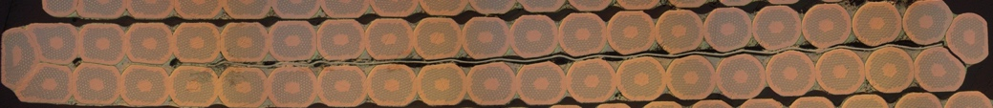
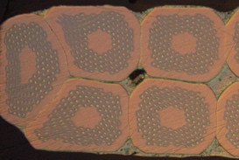
Cabling Specs - Cable Performance
Parameter | Value
Number of strands | 40
Strand diameter (mm) | 0.7
Width (mm) | 14.7
Mid-thickness (mm) | 1.25
Thick/thin edge (mm) | 1.149/1.351
Keystone angle (degree) | 0.79
Transposition pitch (mm) | 100
Packing factor (%) | 87.3
Compaction thin/thick edge (%) | 17.95/3.48
Core material | AISI 316L
Core width (mm) | 12
Core thickness (𝜇m) | 25
RRP cable
Courtesy A. Bonasia
Cable performance requirements
I_{c} degradation lower than 5 %
RRR of extracted strands above 100
Courtesy B. Bordini

Slide 9
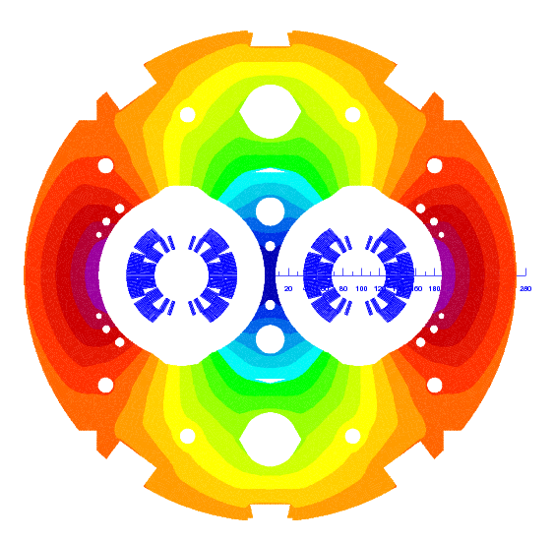
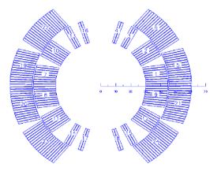
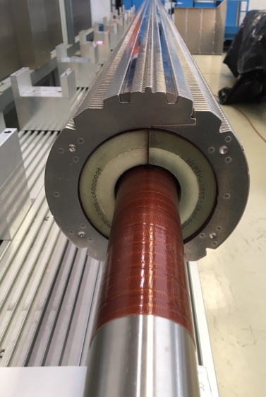
Coils characteristics
Development conductor
Final conductor
Parameter / Coil ID | CR4 | CR5 | CR6 | CR7
Strand type RRP | 132/169 & 150/169 | 150/169 & 144/169 | 108/127 | 108/127
Cu/Sc, average | 1.18 | 1.06 | 1.14 | 1.15
RRR, average | 250.6 | 168.0 | 293.6 | 297.0
Critical current, I_{c} [A] (12 T, 4.222 K), average | 404.6 | 451.6 | 449.0 | 460.7
Mid-thickness [mm] | 1.2512 | 1.2486 | 1.2502 | 1.2495
Width [mm] | 14.710 | 14.701 | 14.694 | 14.694
Keystone angle [°] | 0.80 | 0.81 | 0.79 | 0.79

Slide 10
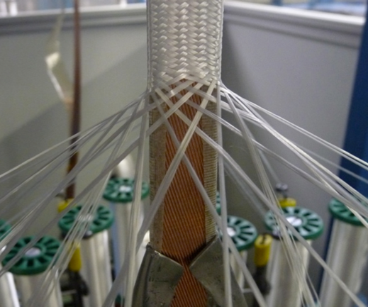
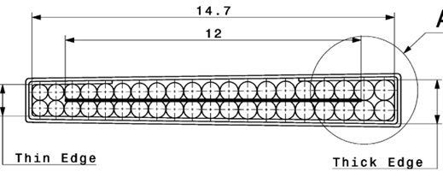
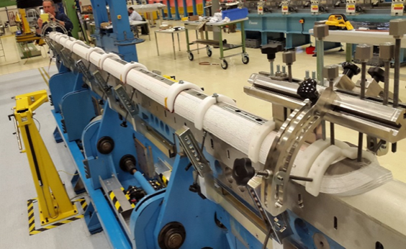
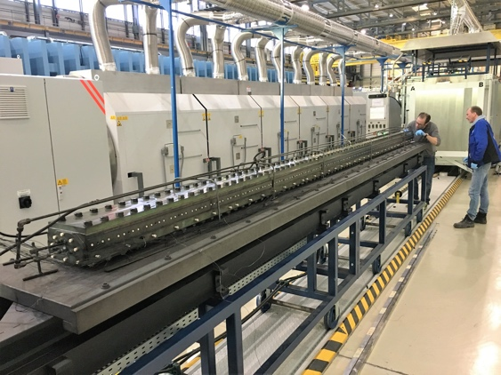
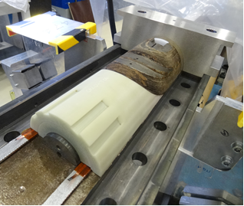
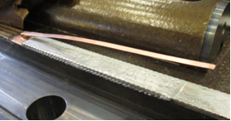
Main manufacturing steps, 1
Cable insulation and braiding
  25 mm wide, and 80 μm thick Mica tape rolled around the cable in a C-shaped profile, and a 70 μm thick layer of S2-glass braided over the Mica layer
Winding and binder curing
  A ceramic binder is applied after winding to glue the turns together, and avoid the coil dislocation during subsequent steps
Reaction and splicing
  In a reaction fixture, under Ar atmosphere, 150 hours including 3 plateaus at 210, 400, and 650°C
Impregnation
  Resin system CTD101K, processed @ 60°C under vacuum, then pressurized to 3.5 bar before gelling @ 110 °C and curing @ 125°C

Slide 11
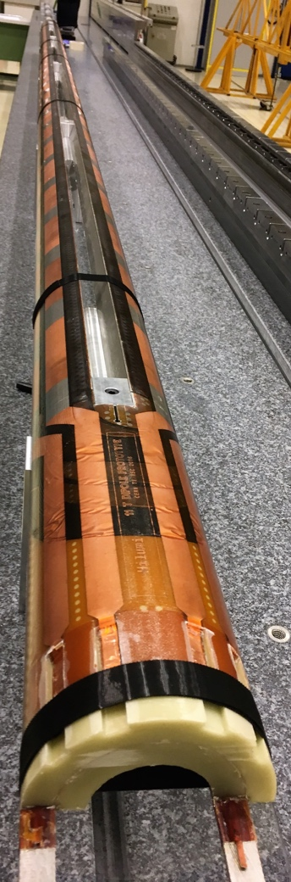
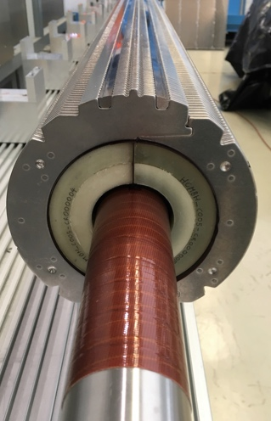
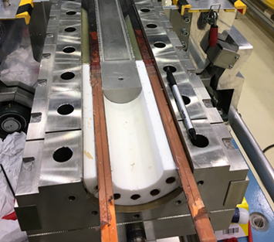
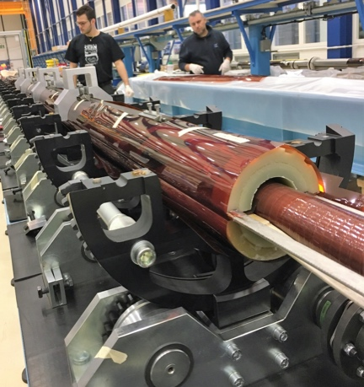
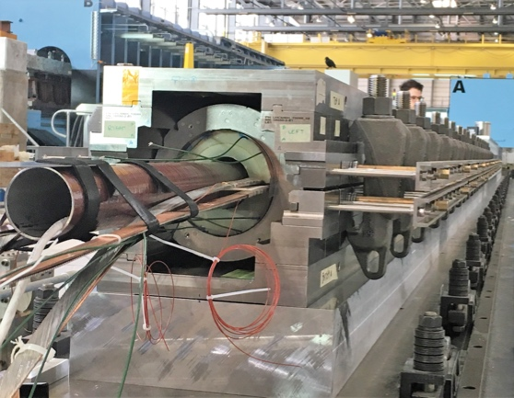
Main manufacturing steps, 2
Coil pairing and assembly
  With ground insulation, collaring shims, removable pole, cold bore tube, coil protection sheet, and collar packs
Collaring
  F = 10 MN/m (of which 50-60 % are taken by the coils)
  Local stress in coils up to 150 MPa, and
  probably higher due to the Mica tape
Yoking, and welding of the
15 mm thick shrinking
cylinder made of 316LN
  TIG welding, 13-15 passes
  and tensile stresses of the order
  of 220 MPa
Cold mass finishing
  Spool pieces, eletrical joints,
  V-taps, instrumentation feed
  thru system, end covers, N-line,
  supports, …

Slide 12
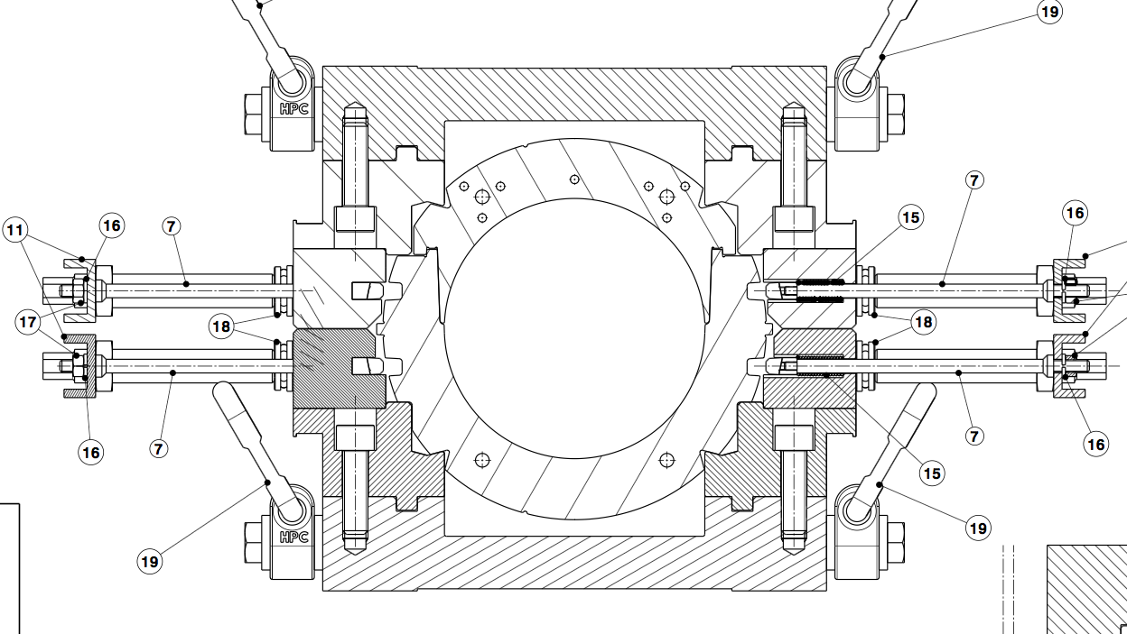
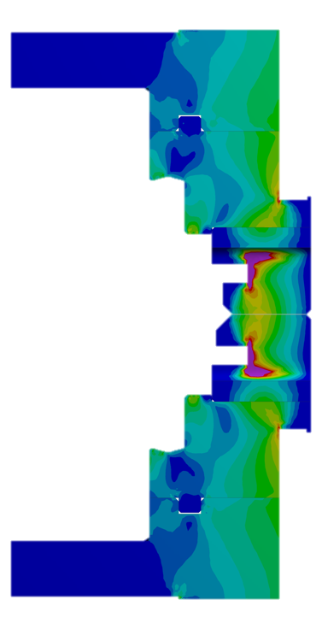
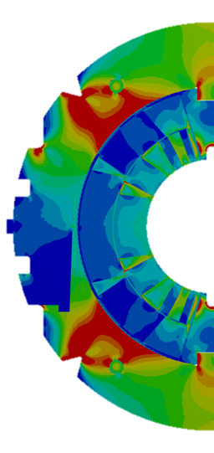
Collaring tooling & process
𝛿_{collaring} = size of the tooling, corresponding to the closure of the tooling on collaring tooling shims
Thickness of collaring tooling shim, and F_{COLLARING} are determined such that:
  Keys can be inserted successfully at minimum collaring force
  Stress at mid-plane at full collaring
  force < allowable stress with margin
  (w.r.t. irreversible degradation)
  Spring back as small as possible
F_{COLLARING}
F_{COILS}
Collaring
tooling
shim
F_{COLLARING} = F_{COILS} + F_{TOOLING}
F_{TOOLING}
𝛿_{collaring}
Courtesy C.H. Löffler

Slide 13
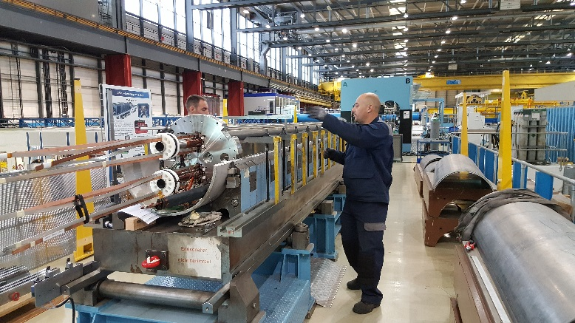
Progress on the Prototype construction, LMBHB
The collared coils assemblies are ready, and assembled in the yoke
The cryostating and the cold tests are planned in the beginning of 2018

Slide 14
Progress on the Prototype construction
The bottom tray and the main cryostat
Images by courtesy of M. Struik

Slide 15
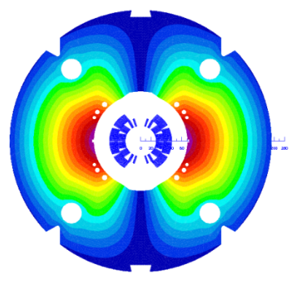
Training of short models
12.8 kA
11.85 kA
The last models, MBHSP104 and MBHSP105, exhibit limitation due to conductor degradation in the mid-plane (due to excessive stress)
Re-collared with 15 MPa lower pre-stress, and put together in a two-in-one structure MBHDP102, which did not perform better
Courtesy G. Willering

Slide 16

Observations, and actions
Peak stresses are observed with Fuji paper along the
edges of the cable in the mid-plane, higher on the side of
the thin edge, and on the inner layer
The use of Mica for the cable insulation of the coils, in
addition to impregnated fiberglass, is a necessary feature
The Mica tape will be made wider to reduce peak stresses
In addition:
  The thickness of the cable insulation, so far 110 𝜇m @ 30 MPa (not 100 𝜇m as wanted) will be reduced to 100 𝜇m @ 5 MPa, thanks to optimized braiding parameters
  The collaring procedure will be optimized further based on:
    E-modulus measurements on ten-stacks
    E-modulus measurements on full coil cross-sections (see Workshop on Nb₃Sn Rutherford cable characterization for accelerator magnets, talk by Jose Luis Rudeiros Fernandez)
    Collaring tests on a fully representative and instrumented collared coils assembly
    Measurements at cold of the irreversible degradation due to stress applied at room temperature on final cable with final insulation scheme
  Two additional models made of RRP conductor will be made to demonstrate effectiveness of the modifications
S. Izquierdo Bermudez et al. in MSC-MDT
Task Force being set up within TE-MSC

Slide 17
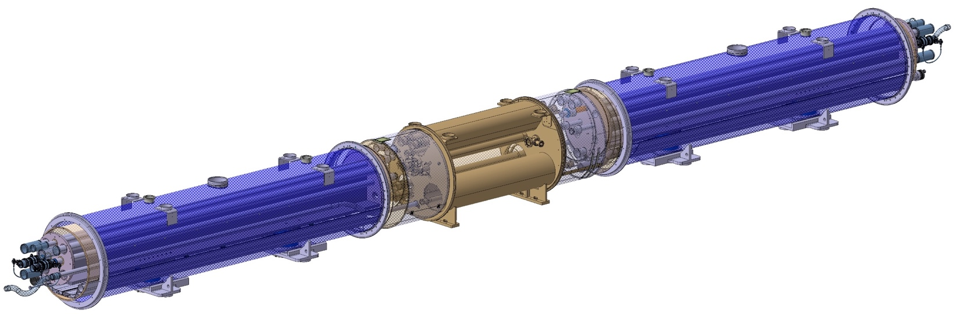
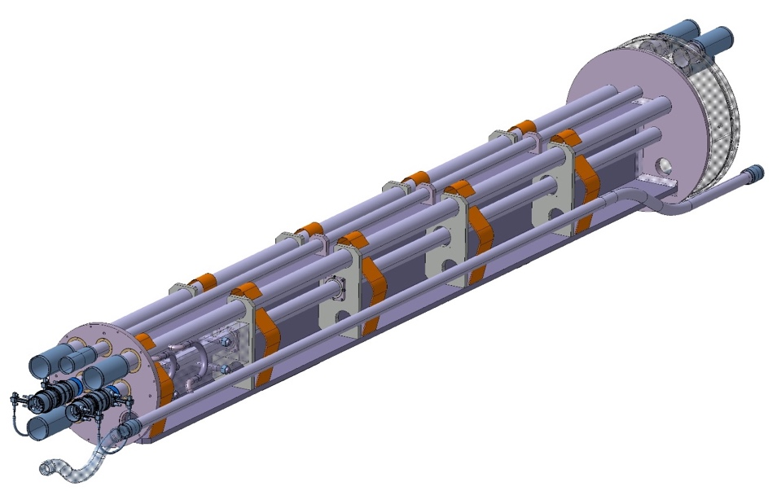
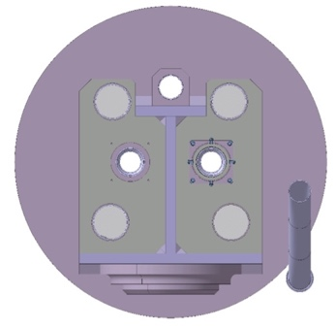
Connection cryostats for IP2
2 special connection cryostats, one on either side of IP2, with RT space for collimator
Re-use concept of existing connection cryostats:
  Pipes corresponding to interconnection
  cryogenic lines
  Cold mass providing
  mechanical strength
  and overall stability
  of the assembly
  Shuffling module for helium cooling and busbars lyras
  Standard bottom tray and thermal shield
  Standard LHC dipole support posts
11675 mm
2 positions :
LEBR.11L2 in sector 12
LECL.11R2 in sector 23
Courtesy A. Vande Craen

Slide 18
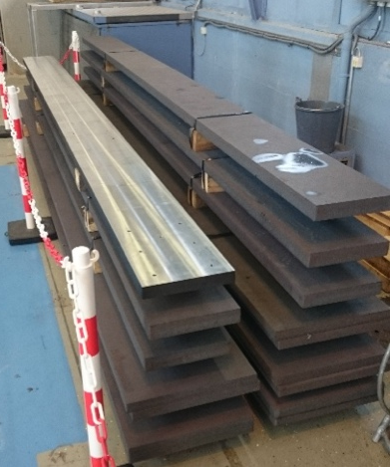
Status
The design is finished. It has been reviewed in May this year (https://indico.cern.ch/event/630930/)
The fabrication of the components for the 6 units (4 to be installed + 2 spares) is ongoing
  Some of them were delivered to CERN
  A first set of plates composing the mechanical structure was received
The assembly of the first unit should start in December
Images by courtesy G. Barlow, M. Moretti, A. Vande Craen

Slide 19
Summary
The construction of the 11T dipole prototype is coming to an end, after a long process of tooling design and construction, and the careful development of manufacturing procedures
The prototype will be cryostated and tested in the beginning of next year
The results of the cold tests of the last magnet models and the recent study of the stress distribution in the mid plane of the coils trigger the need of further optimization. The cause for the limited performance is identified, and actions are being launched to cure it
The construction of the new connection cryostats for collimators is progressing according to plan

Slide 20
Thank you for your attention

