Slide 1
Dynamic aperture requirements from lifetime considerations
Dario Pellegrini (CERN)
For: F. Antoniou, G. Arduini, R. De Maria, S. Fartoukh,
M. Giovannozzi, P. D. Hermes, G. Iadarola, N. Karastathis,
Y. Papaphilippou, G. Sterbini, F. Van Der Veken.
7th HL-LHC Collaboration Meeting – Madrid, November 2017

Slide 2
Scope and Outline
Identification of Dynamic Aperture requirements:
Observe lifetime evolution in the LHC.
Understand correlations between DA and lifetime.
Move towards losses and lifetime simulations.

Slide 3
Lifetime observations in 2016

Slide 4
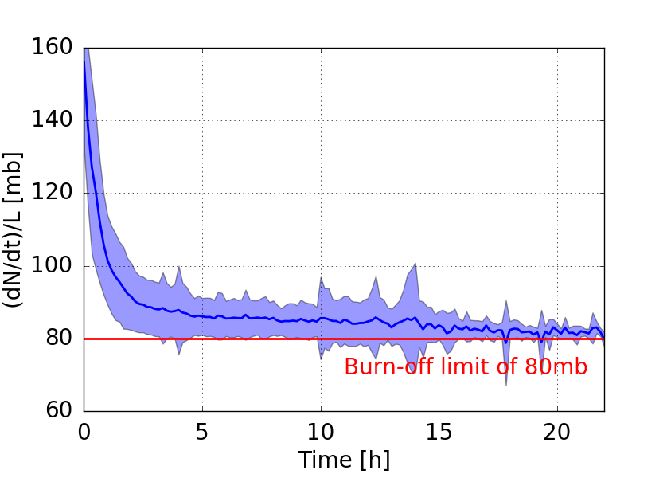
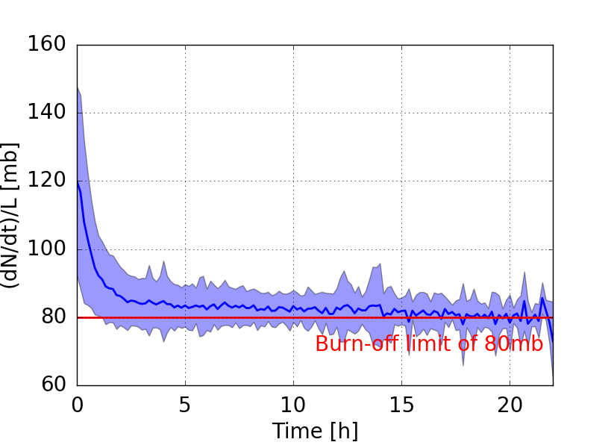
Losses along the fill
Beam 1
Beam 2
F. Antoniou
Normalized loss-rate, approaches burn-off limit within first 2-3h.
Observed correlations between early losses and DA along the 2016.

Slide 5
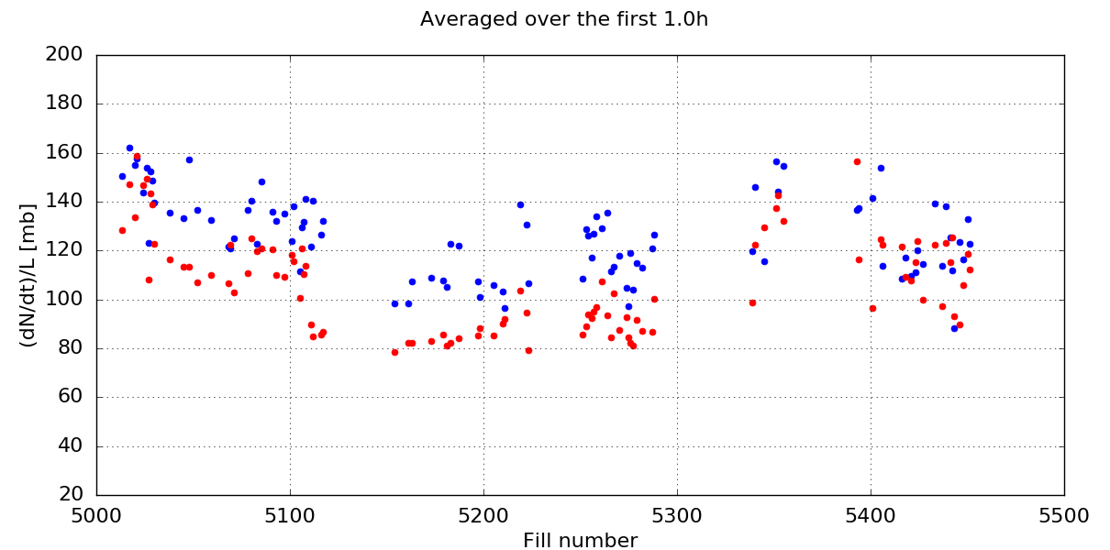
1st hour losses along 2016
Beam 1
Beam 2
B1 Tune Adj
Transition to BCMS
Crossing angle reduction
Burnoff Limit
Larger DA over this period
F. Antoniou

Slide 6
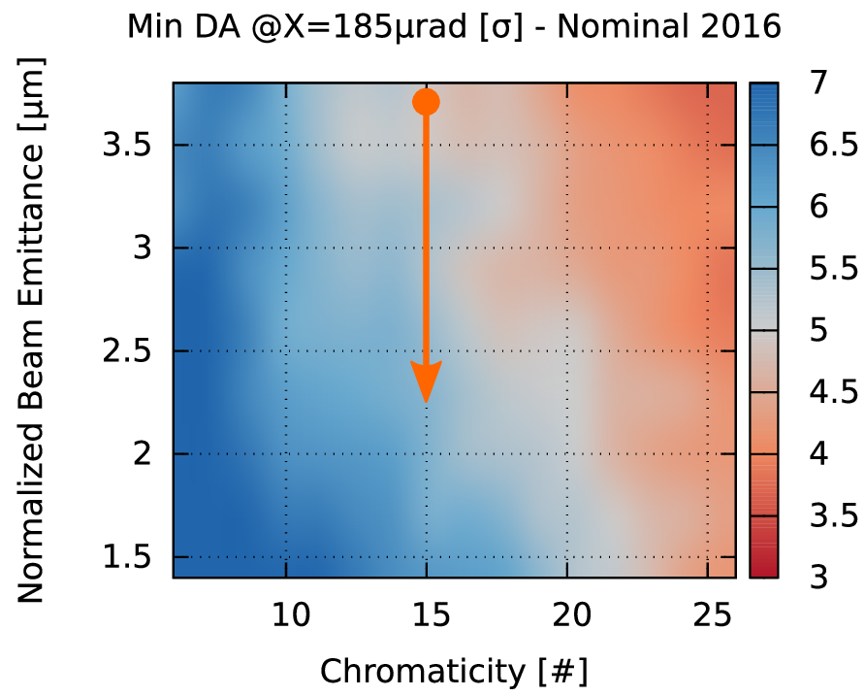
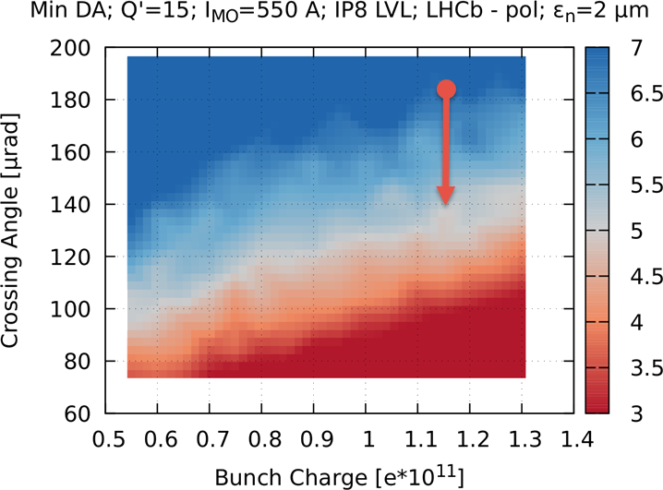
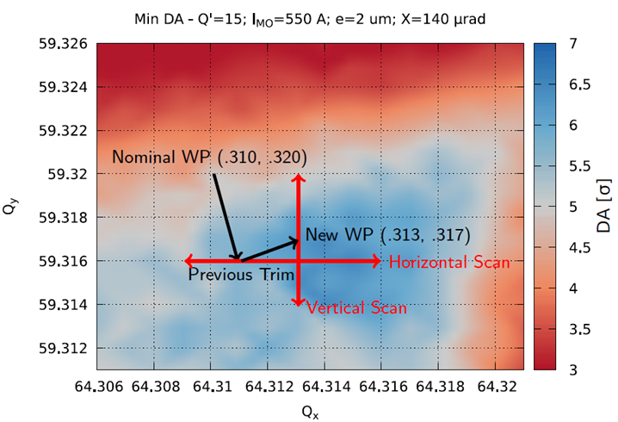

DA follow up along 2016 Run
Reduction of emittance, increasing the DA from 5 to 6 σ
Reduction of crossing angle, reducing the DA from 6 to 5 σ
Tune adjustment restoring the DA from 5 to 6 σ

Slide 7
Lifetime observations in 2017

Slide 8
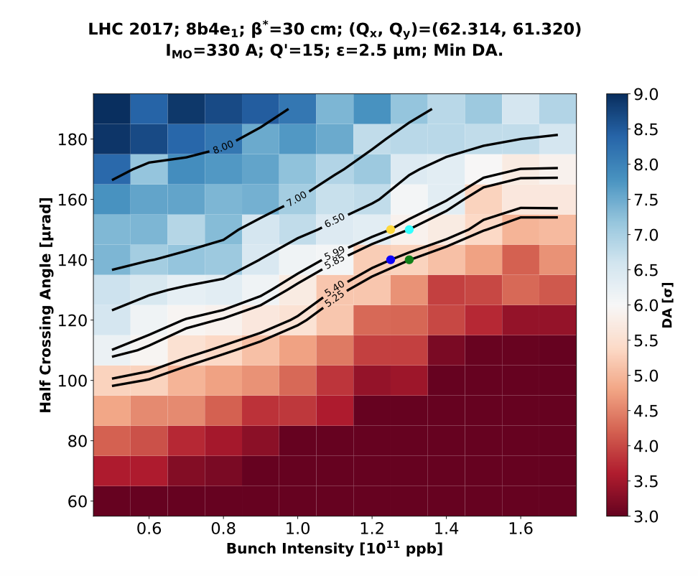
Crossing angle anti-leveling: a test for DA
Each intensity allows for a specific crossing angle in terms of DA.
Steps for crossing angle reduction based on DA simulations.
Steps translated into time for operation…
N. Karastathis et al.

Slide 9
Crossing angle anti-leveling: a test for DA
Reduction steps not always applied at the right intensity.
Sometimes resulting in aggressive settings.
N. Karastathis et al.

Slide 10
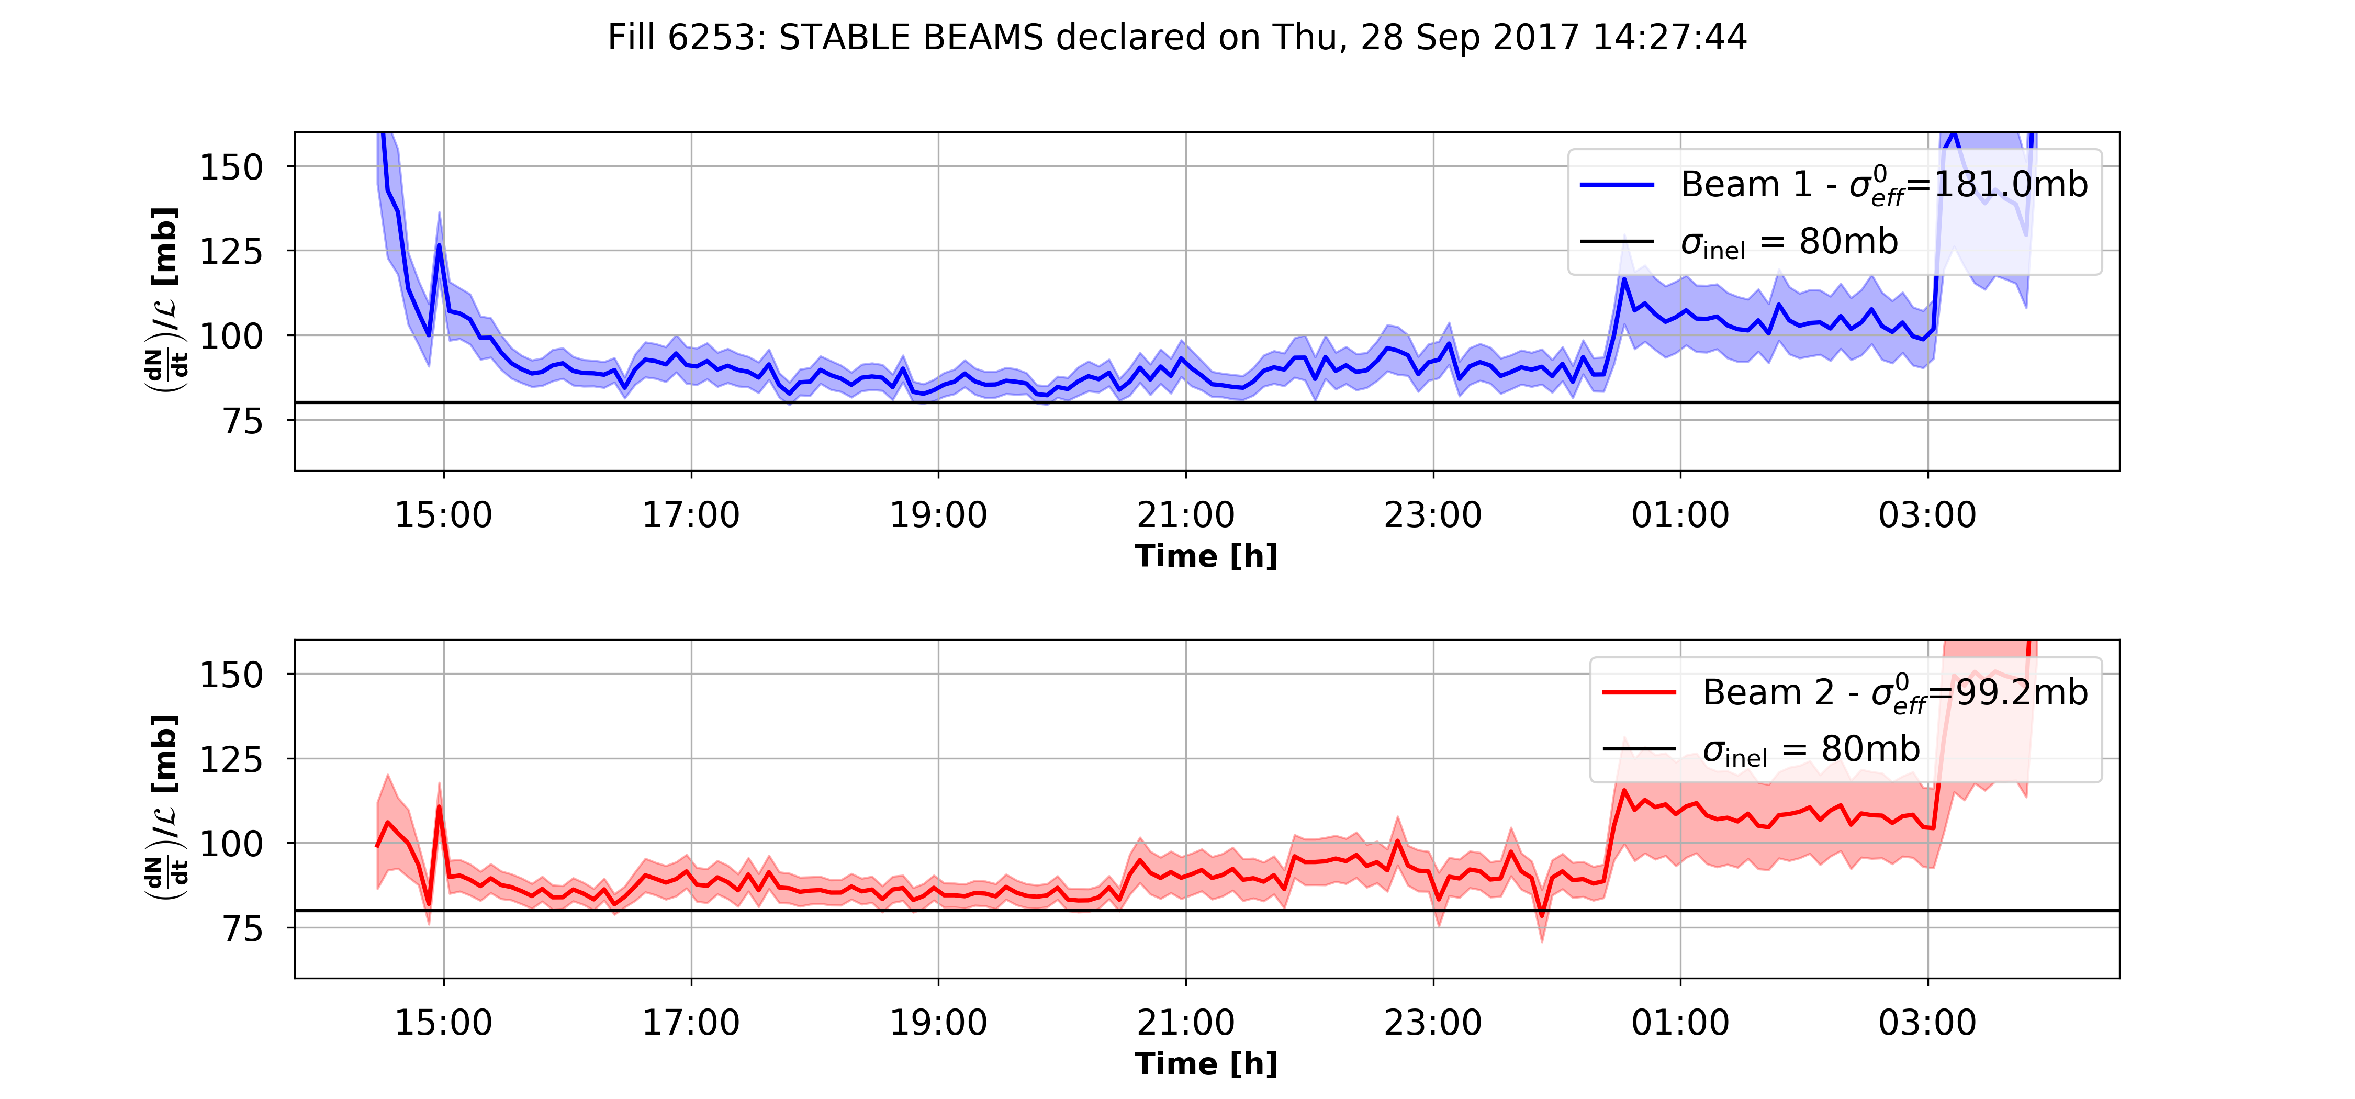
Crossing angle anti-leveling: a test for DA
110μrad
100μrad
Fill 6253 - 8b4e - Tue 28 Sep 2017
N. Karastathis
Lifetime approaches the burnoff limit very quickly.
Aggressive settings impact on the beam lifetime and cross section.

Slide 11
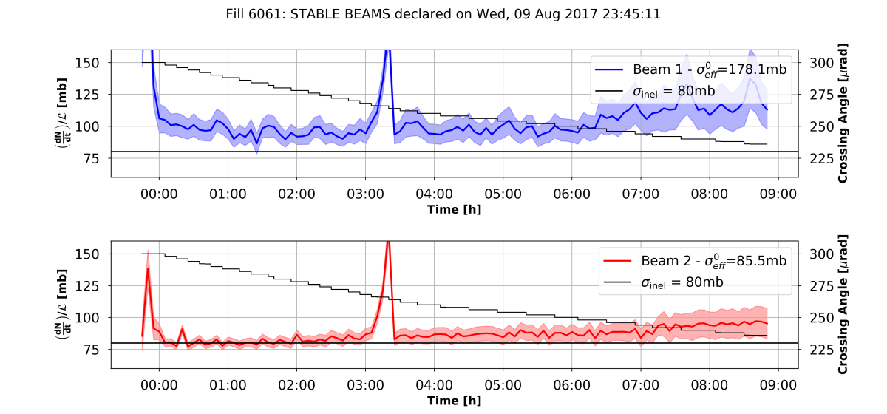
Fill 6061: Continuous variation of crossing angle
Atlas lumi issue
N. Karastathis
Smooth losses without large dips
Proposed for HL-LHC

Slide 12
Putting all together
Feed the machine settings (crossing angle, chromaticity, octupoles, filling scheme) and measurements on selected bunches (intensity, emittance) to DA simulations.
Benchmark with lifetime.
MD2209 (G. Iadarola, D. Pellegrini et al.) Crossing angle with high intensity 8b4e bunches chosen:
  Reduction of the crossing angle in steps;
  Very good tune and luminosity control along the fill;
  Attempt to recover lifetime at the smallest crossing angle by reducing octupoles and chromaticity.

Slide 13
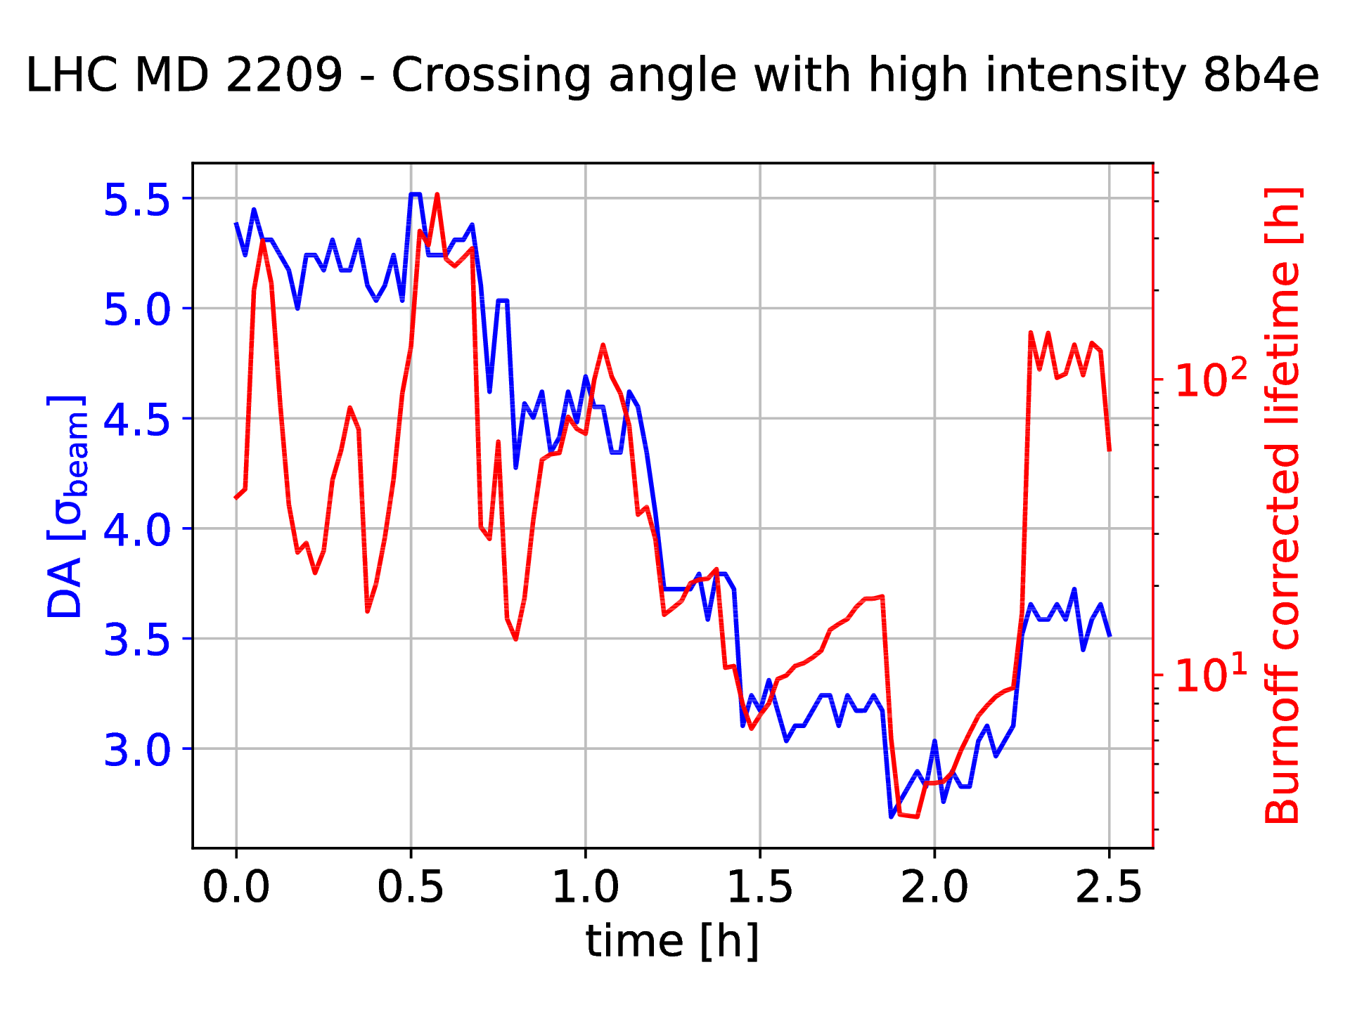
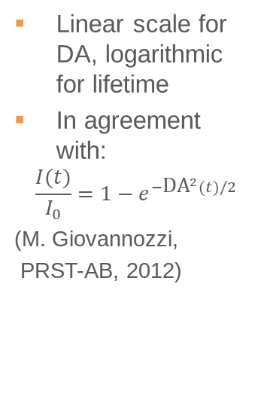
Lifetime vs DA
Linear scale for DA, logarithmic for lifetime
In agreement with:
$$\frac{I(t)}{I_{0}}=1−e^{−{\text{DA}}^{2}(t)/2}$$
(M. Giovannozzi,
PRST-AB, 2012)
Burnoff lifetime
≈ 20 h @1.2e11 p

Slide 14
Lifetime vs DA
Linear scale for DA, logarithmic for lifetime
In agreement with:
$$\frac{I(t)}{I_{0}}=1−e^{−{\text{DA}}^{2}(t)/2}$$
(M. Giovannozzi,
PRST-AB, 2012)
Burnoff lifetime
≈ 20 h @1.2e11 p
Tune and Luminosity optimisation

Slide 15
Lifetime vs DA
Linear scale for DA, logarithmic for lifetime
In agreement with:
$$\frac{I(t)}{I_{0}}=1−e^{−{\text{DA}}^{2}(t)/2}$$
(M. Giovannozzi,
PRST-AB, 2012)
150
Crossing angle steps
130
Burnoff lifetime
≈ 20 h @1.2e11 p
110
100
90
Tune and Luminosity optimisation

Slide 16
Lifetime vs DA
Linear scale for DA, logarithmic for lifetime
In agreement with:
$$\frac{I(t)}{I_{0}}=1−e^{−{\text{DA}}^{2}(t)/2}$$
(M. Giovannozzi,
PRST-AB, 2012)
150
Crossing angle steps
130
Burnoff lifetime
≈ 20 h @1.2e11 p
110
100
90
Tune and Luminosity optimisation
Chromaticity and octupoles reduction

Slide 17
Lifetime vs DA
Linear scale for DA, logarithmic for lifetime
In agreement with:
$$\frac{I(t)}{I_{0}}=1−e^{−{\text{DA}}^{2}(t)/2}$$
(M. Giovannozzi,
PRST-AB, 2012)
150
Crossing angle relaxation
Cannot well reproduce.
Need lifetime simulations taking into account particles lost previously.
Possible degradation of the core.
Crossing angle steps
130
110
100
100
90
Tune and Luminosity optimisation
Chromaticity and octupoles reduction

Slide 18
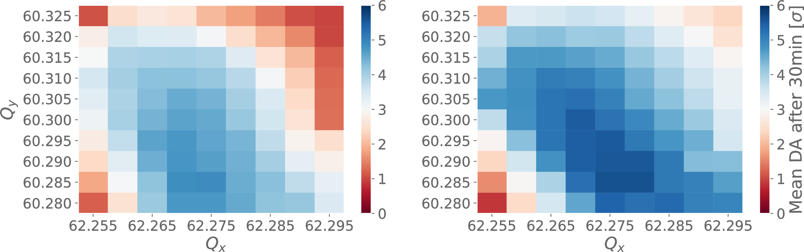
DA in the HL-LHC at injection
Beam 1 Beam 2
F. Van Der Veken
Field quality is not limiting at injection.
DA degradation observed from I_{MO} = 40 A and Q’ = 15, still sufficient for a limited time at flat bottom (similar situation as today).
Investigations to understand difference between the two beams on going.

Slide 19
Simulating Losses

Slide 20
Steps toward losses and lifetime simulations
To compute losses one needs to know:
Beam profile and tail content of the beam;
DA evolution over long periods of time: ~1h;
Diffusion processes, tail repopulation…
Discussed here: 1 and 2 at injection.

Slide 21
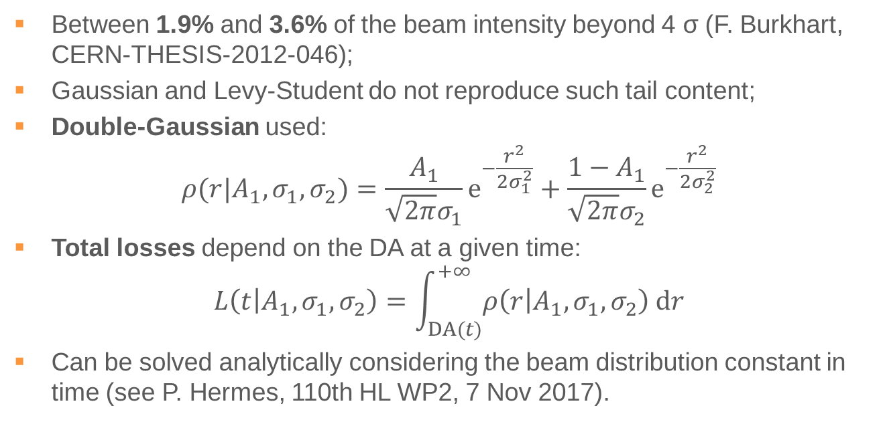
Beam profile and tail content
Between 1.9% and 3.6% of the beam intensity beyond 4 σ (F. Burkhart, CERN-THESIS-2012-046);
Gaussian and Levy-Student do not reproduce such tail content;
Double-Gaussian used:
$$ρ(r|A_{1},σ_{1},σ_{2})=\frac{A_{1}}{\sqrt{2π}σ_{1}}e^{−\frac{r^{2}}{2σ_{1}^{2}}}+\frac{{1−A}_{1}}{\sqrt{2π}σ_{2}}e^{−\frac{r^{2}}{2σ_{2}^{2}}}$$
Total losses depend on the DA at a given time:
$$L\left(t | A_{1},σ_{1},σ_{2}\right)=\int_{DA(t)}^{+∞}{ρ\left(r | A_{1},σ_{1},σ_{2}\right) \text{d}r}$$
Can be solved analytically considering the beam distribution constant in time (see P. Hermes, 110th HL WP2, 7 Nov 2017).

Slide 22
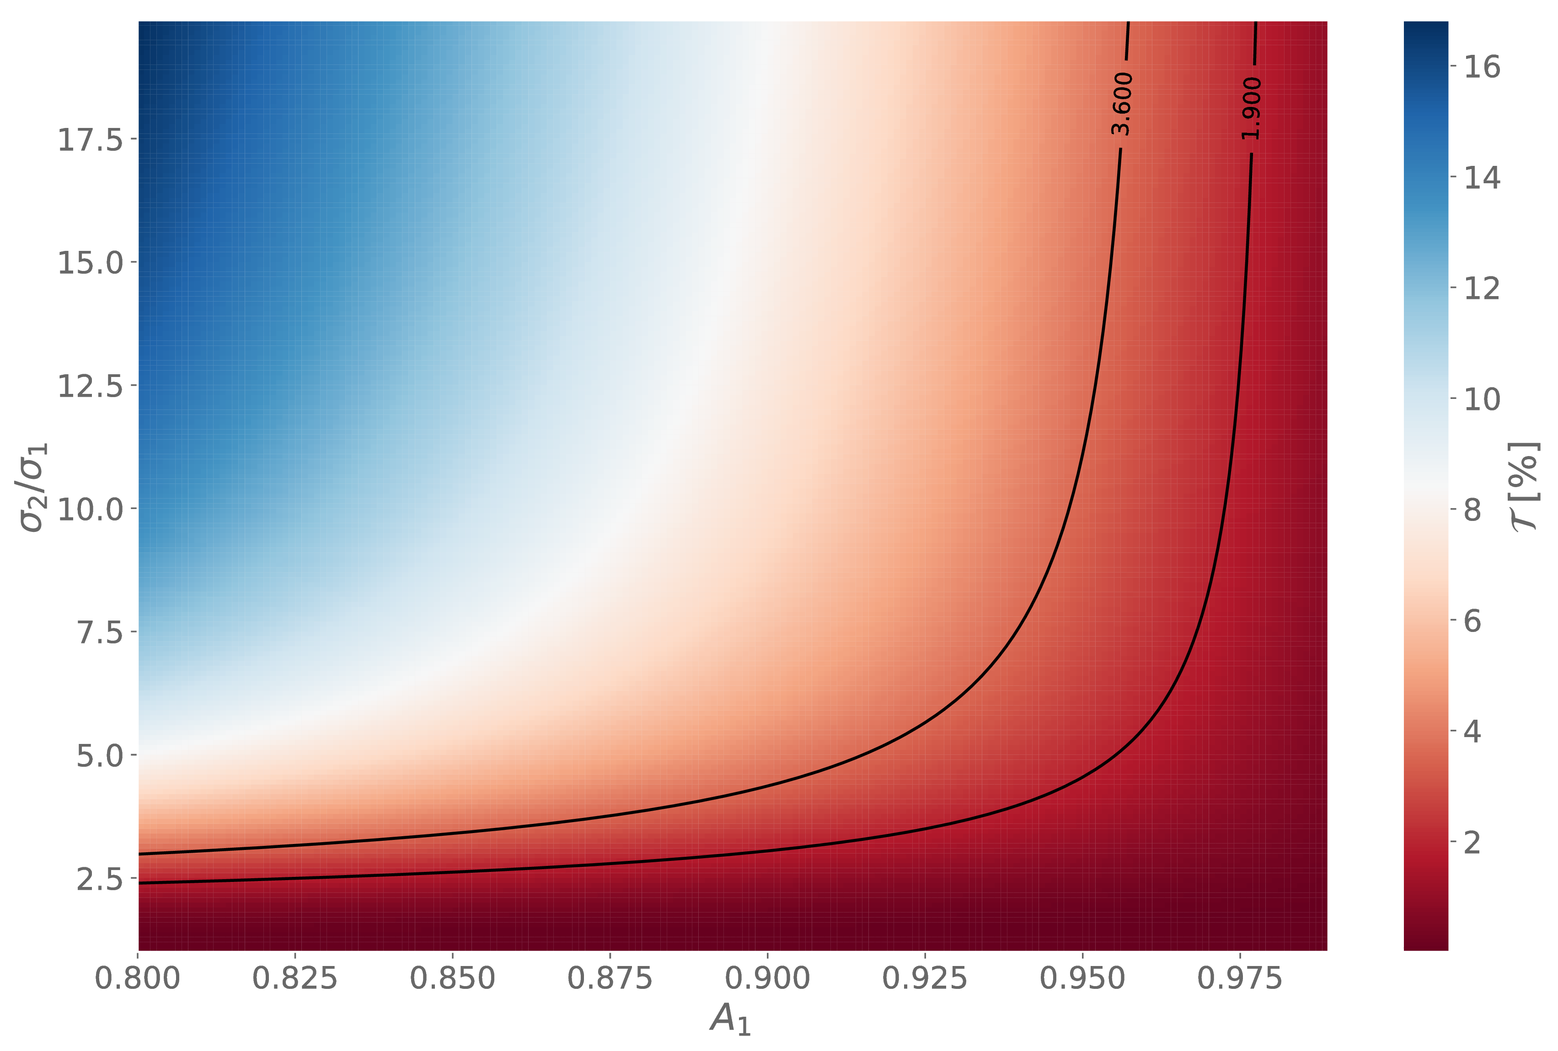
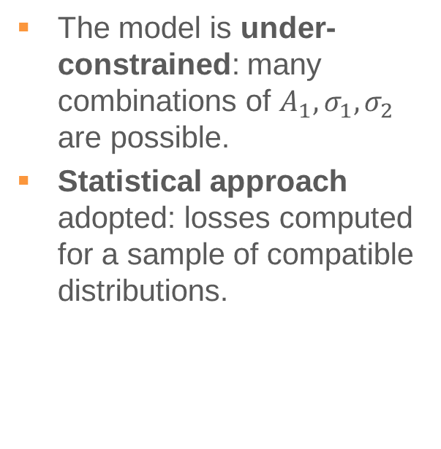
Finding the parameters of the distribution
The model is under-constrained: many combinations of $A_{1},σ_{1},σ_{2}$ are possible.
Statistical approach adopted: losses computed for a sample of compatible distributions.
P. D. Hermes

Slide 23
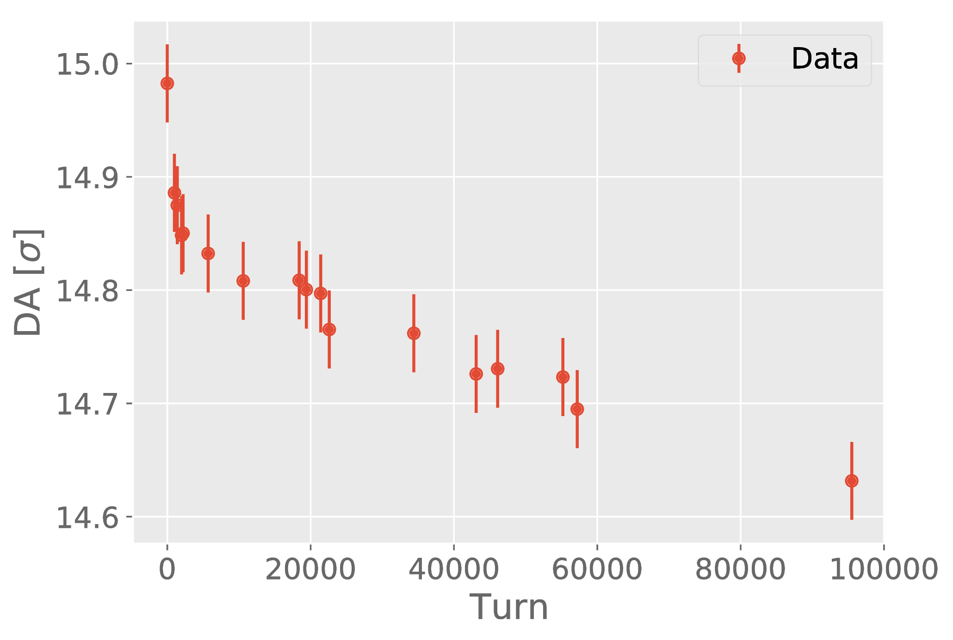
DA evolution over long time scales
P. D. Hermes
From Sixtrack simulations

Slide 24
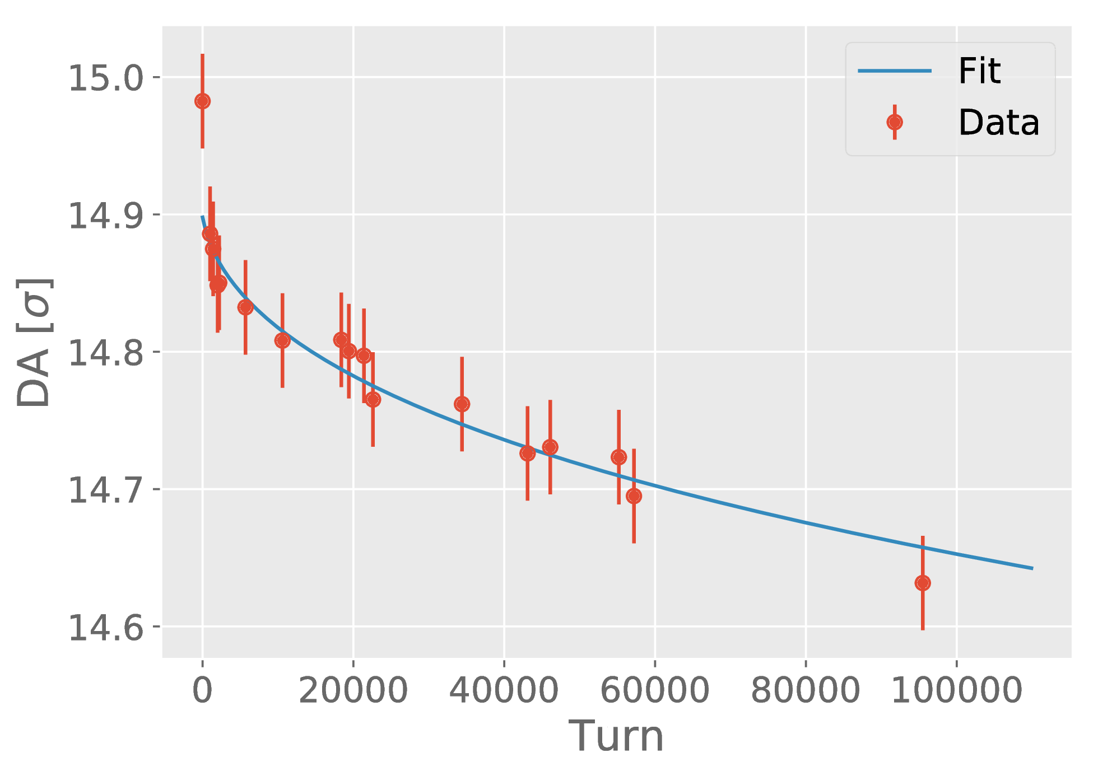

DA evolution over long time scales
P. D. Hermes
From Sixtrack simulations
$$D\left(t\right)=D_{∞}\frac{b}{{({\log{t}})}^{k}}$$

Slide 25
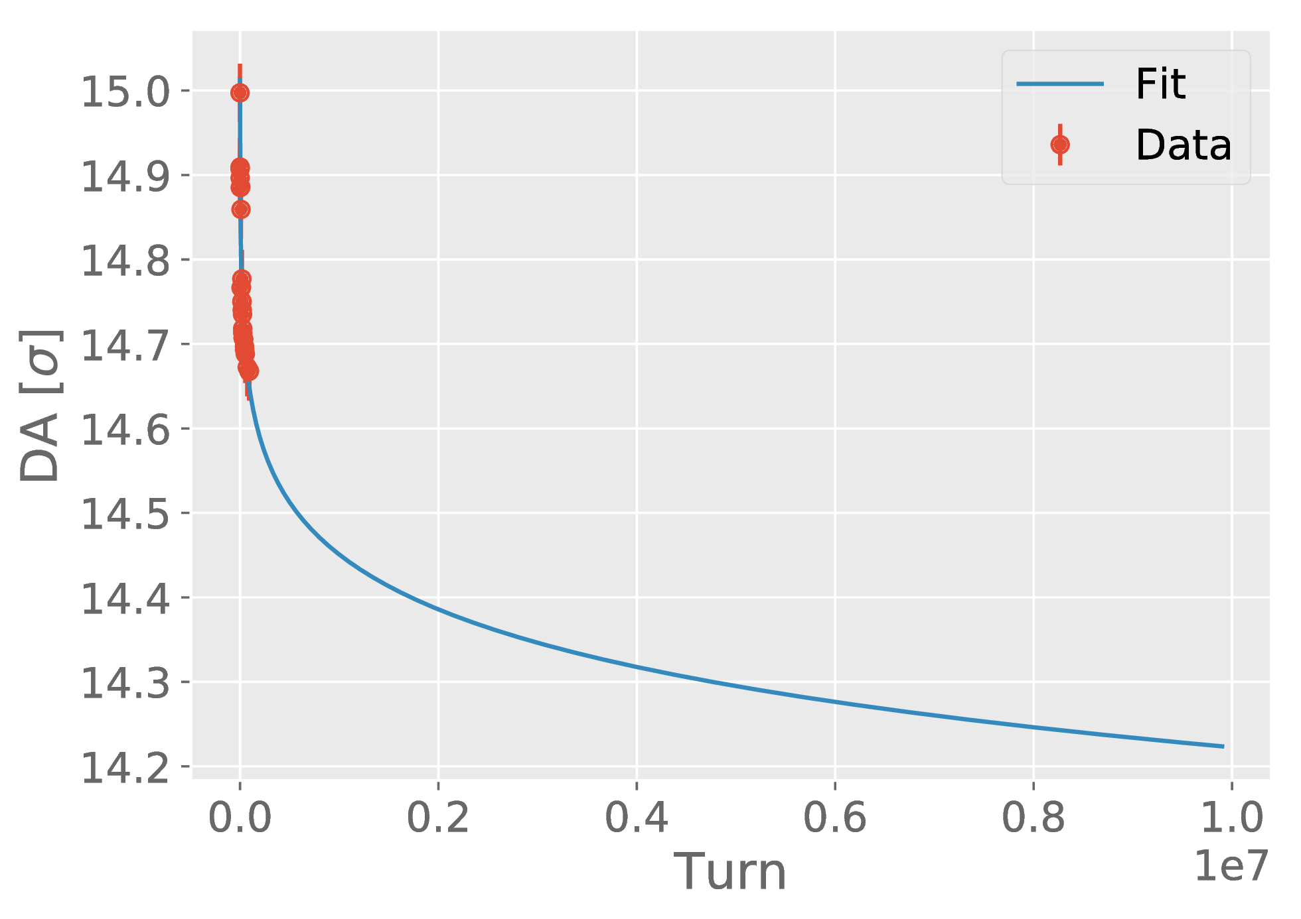
DA evolution over long time scales
P. D. Hermes
From Sixtrack simulations
$$D\left(t\right)=D_{∞}\frac{b}{{({\log{t}})}^{k}}$$
Extrapolation

Slide 26
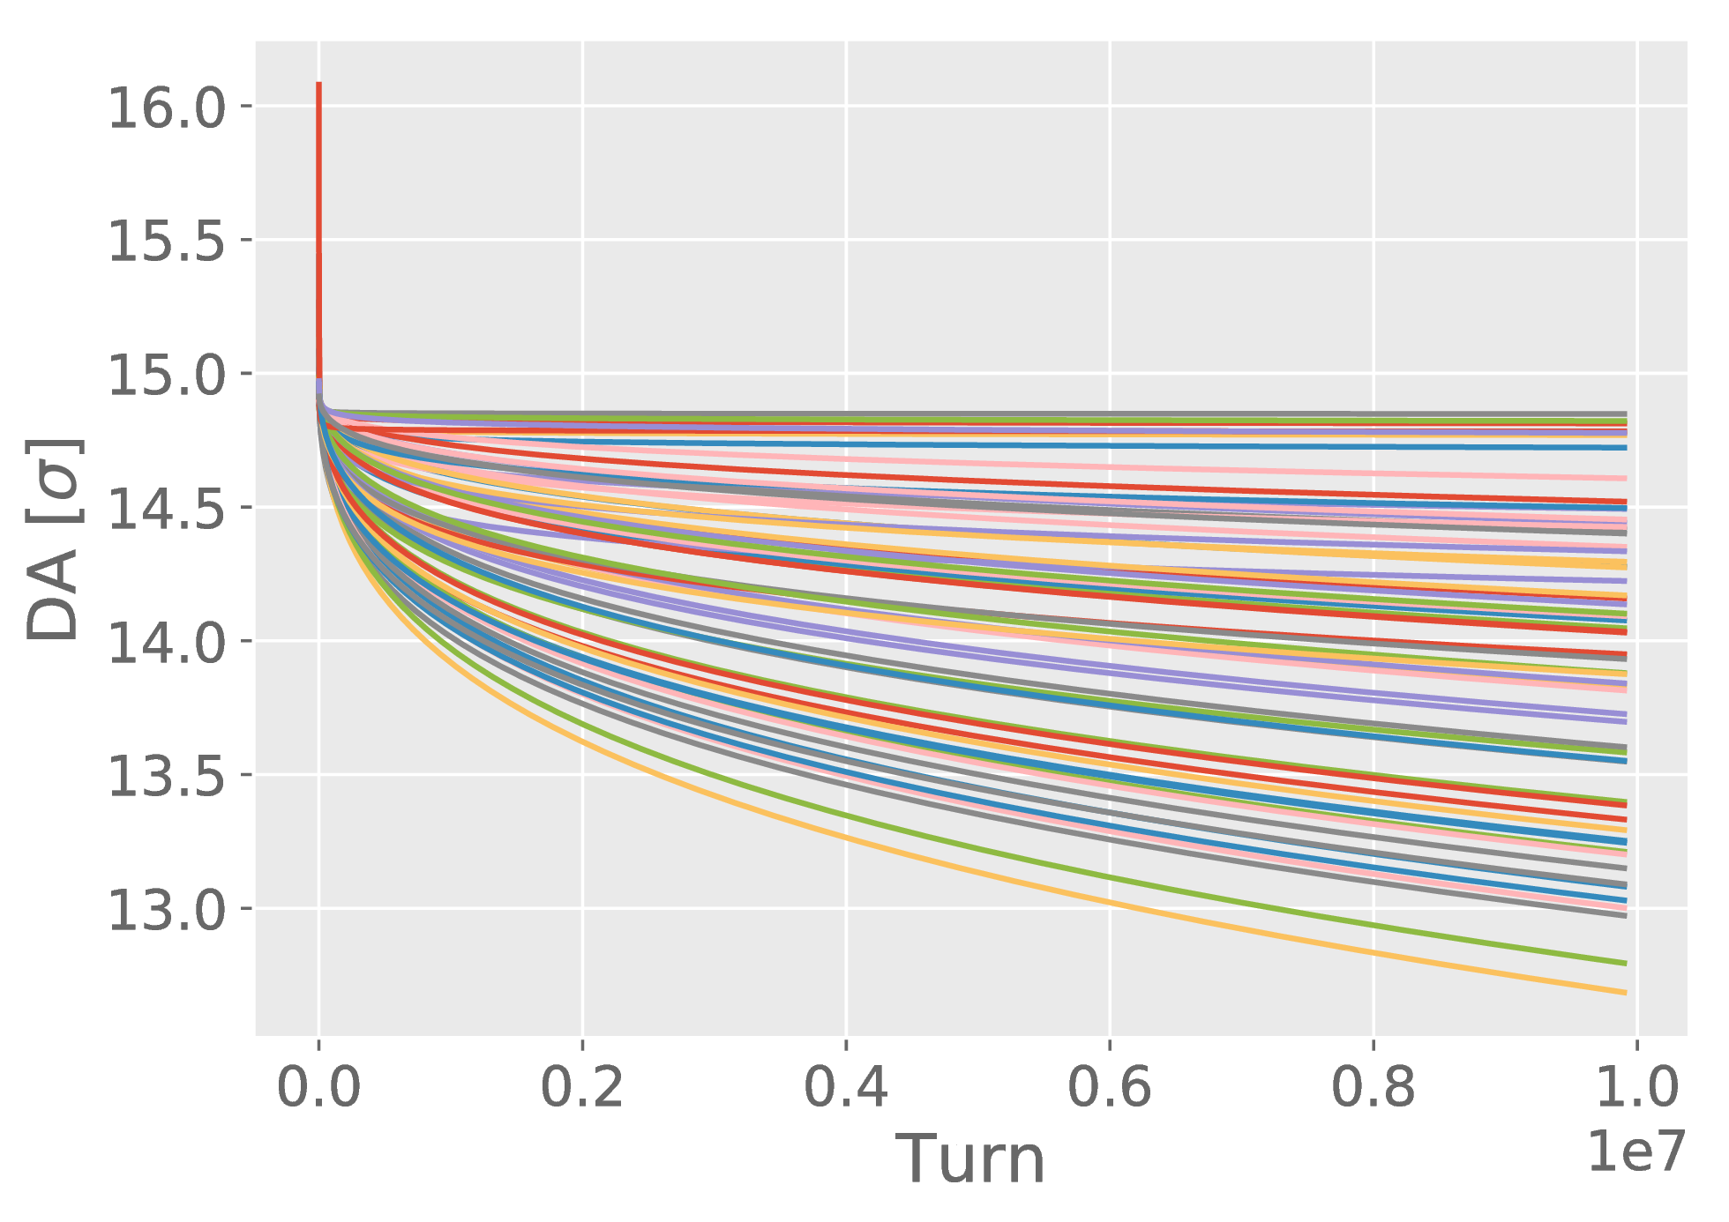
DA evolution over long time scales
P. D. Hermes
From Sixtrack simulations
$$D\left(t\right)=D_{∞}\frac{b}{{({\log{t}})}^{k}}$$
Many seeds for field errors:
fit parameters sampled from distributions
Extrapolation

Slide 27
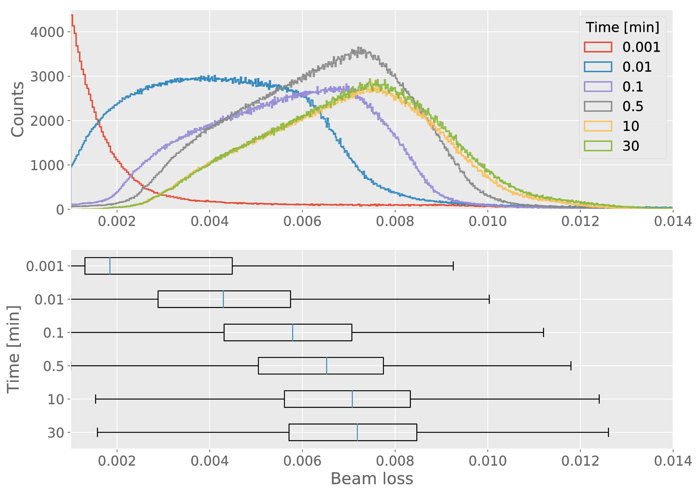

Losses for the LHC at injection
General analytical expression for losses: $L\left(t | A_{1},σ_{1},σ_{2},D_{∞},b,k\right)$.
DA computed for LHC B1 Injection, Q’ = 20, I_{MO} = 40 A, ε = 2.5 μm.
Statistical analysis for many compatible sets of $(A_{1},σ_{1},σ_{2},D_{∞},b,k)$.
P. D. Hermes

Slide 28
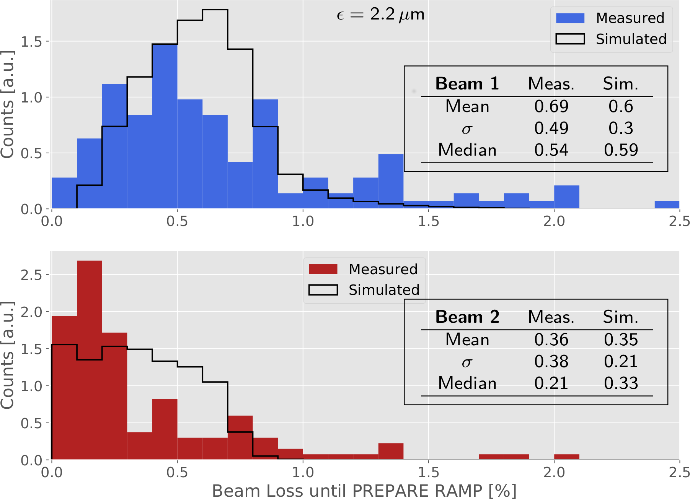
Benchmarking over the 2016 Run
Losses measured as sum of injected bunches minus total intensity at prepare ramp.
Considering the time spent at flat bottom by each injected bunch.
Different behaviors of the two beams also in simulation. Need to understand the origin.
Impact of beam-beam at injection being investigated.
Possibility to improve the analysis by taking into account the actual emittance (and other quantities) along the run.
P. D. Hermes

Slide 29
Conclusions
  Experience gained from extended lifetime and performance follow-up during 2016 and 2017 and several MDs and tests (flexible crossing angle very useful!).
  Established DA targets for machine operation (with beam-beam):
    6σ conservative, needed in the design phase in order to cope with uncertainties;
    5σ aggressive, could be pushed during operation for performance enhancement.
  Effort to simulate losses and lifetime, positive results benchmarking injection over the 2016 Run, in spite of large uncertainties in the model. Now being extended to 2017 (different optics) and to collision.
  Need better understanding of diffusion processes: impact of small DAs on the beam core, effects from noise…
  Need more information on the beam tails, coronagraph?

Slide 30
Backup

Slide 31
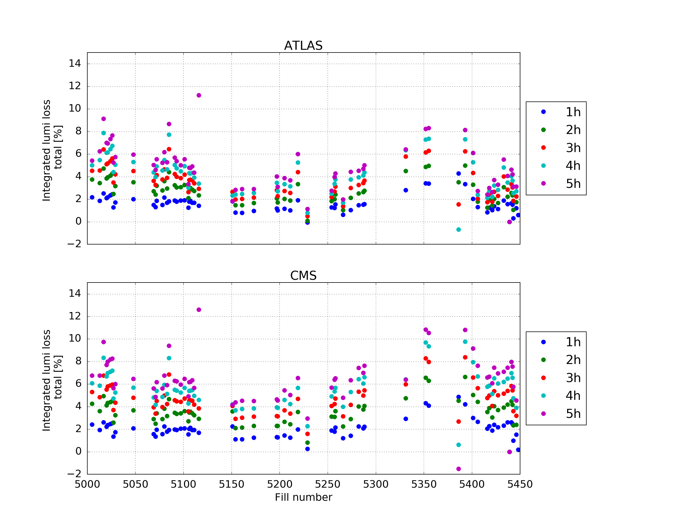
Luminosity loss in 2016
  The integrated luminosity loss along the fills from:
  emittance blow-up (compared to the expected evolution), extending for the entire fill duration.
  beam losses localised in the first few hours.
  The contribution of losses is up to 2~3 %, while the crossing reduction came with a 10 % increase.
  Trading DA for performances can be worth the losses.
Some uncertainty from BSRT recalibrations
F. Antoniou

Slide 32
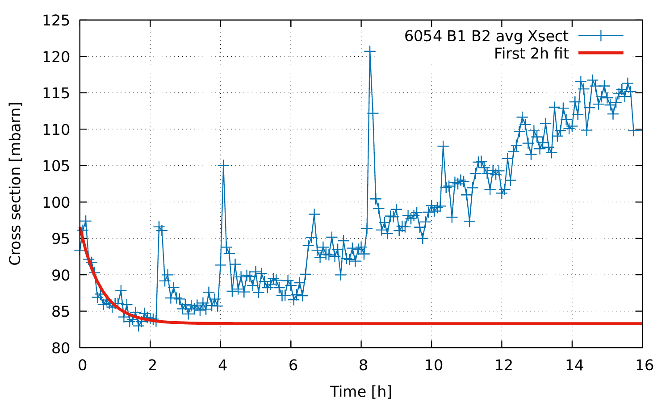
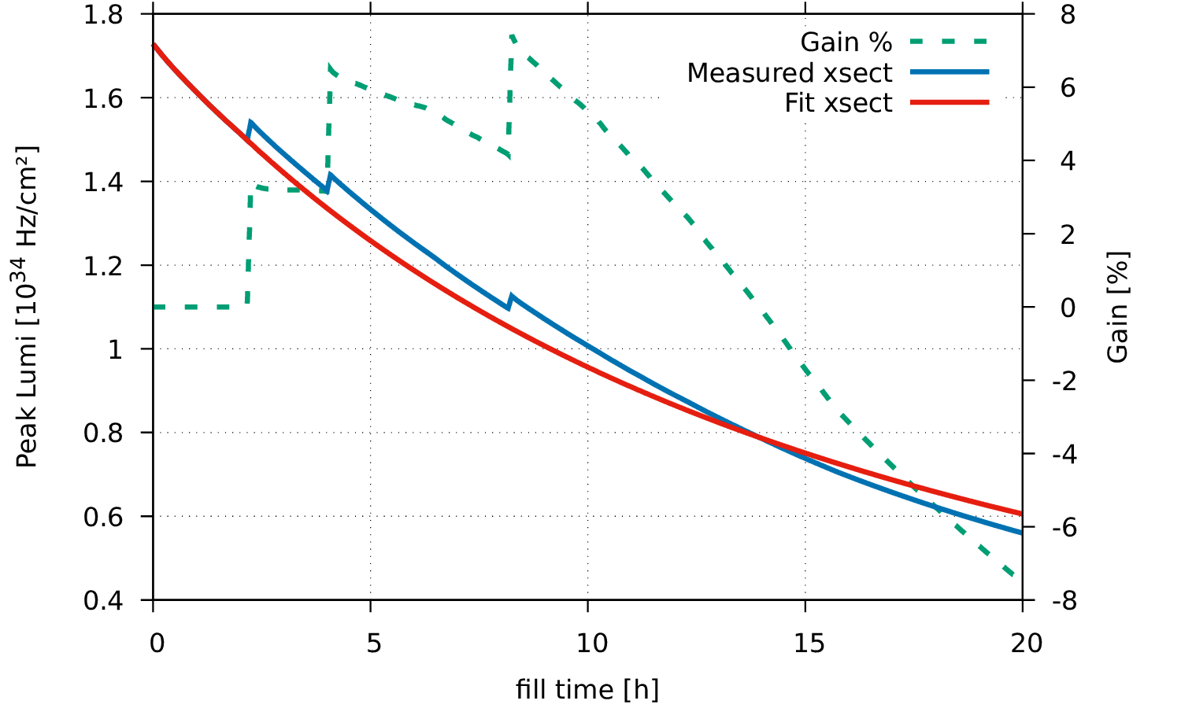
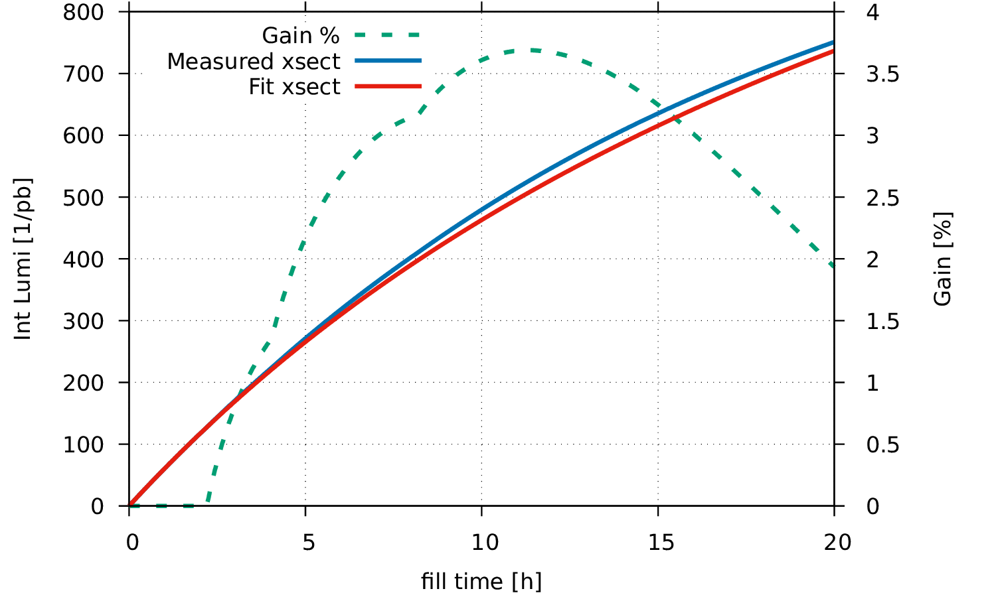
Performance with crossing angle steps
Perform integration with:
  Measured (fill 6054) cross section and realistic crossing angle steps,
  Cross section fitted on the first 2h and fixed crossing angle.
Aggressive crossing steps, still ~3% gain of integrated luminosity.
120 µrad
130 µrad
150
140

