Slide 1

Field quality to achieve the required lifetime goals (with beam-beam)
G. Arduini, S. Fartoukh, N. Karastathis, R.de Maria, E. Metral, Y. Papaphilippou, D. Pellegrini, R. Tomàs Garcia
7th HL-LHC Collaboration Meeting - 15.11.2017, CIEMAT, Madrid, Spain

Slide 2
Outline
Working Point Optimization
  Start of Collisions
  End of levelling to achieve Dynamic Aperture (DA) targets
  During the course of the levelling
Operational Scenarios
  Adaptive crossing angle levelling scenario
  Baseline
Effect of field imperfections on DA
Summary

Slide 3
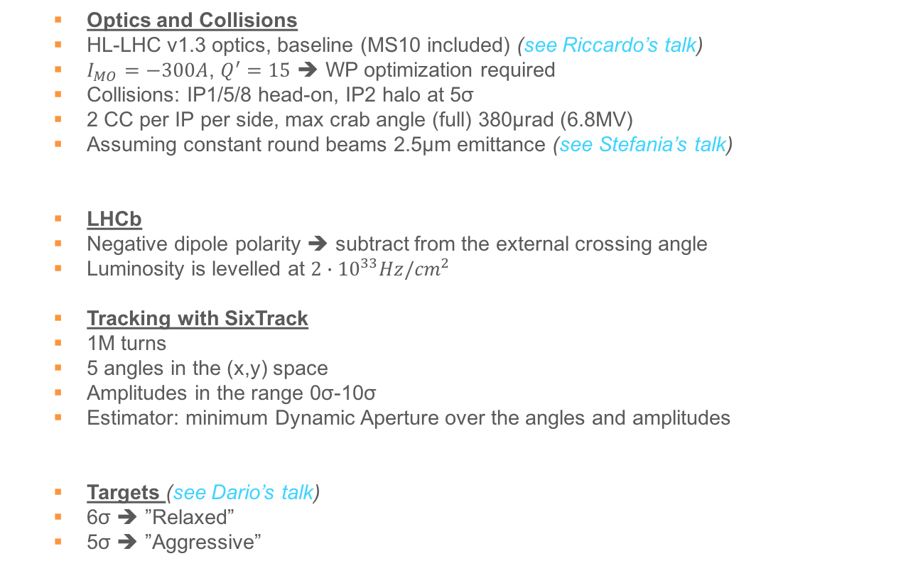
Simulation Setup
  Optics and Collisions
  HL-LHC v1.3 optics, baseline (MS10 included) (see Riccardo’s talk)
  $I_{MO}=−300A$, $Q^{′}=15$ ➔ WP optimization required
  Collisions: IP1/5/8 head-on, IP2 halo at 5σ
  2 CC per IP per side, max crab angle (full) 380μrad (6.8MV)
  Assuming constant round beams 2.5μm emittance (see Stefania’s talk)
  LHCb
  Negative dipole polarity ➔ subtract from the external crossing angle
  Luminosity is levelled at ${2∙10}^{33}Hz/{cm}^{2}$
  Tracking with SixTrack
  1M turns
  5 angles in the (x,y) space
  Amplitudes in the range 0σ-10σ
  Estimator: minimum Dynamic Aperture over the angles and amplitudes
  Targets (see Dario’s talk)
  6σ ➔ ”Relaxed”
  5σ ➔ ”Aggressive”

Slide 4
Working Point Optimization: Start of Collisions
(.320, .325)
(.31, .32)
D. Pellegrini et. al

Slide 5
Working Point Optimization: β*=15cm
(.320, .325)
(.320, .325)
(.31, .32)
(.31, .32)
(.315, .320)
D. Pellegrini et. al
(.320, .325)
(.31, .32)
(.315, .320)

Slide 6
Working Point Optimization: During Fill
(.320, .325)
(.320, .325)
(.31, .32)
(.31, .32)
(.315, .320)
(.315, .320)
(.320, .325)
(.320, .325)
(.31, .32)
(.31, .32)
(.315, .320)
(.315, .320)

Slide 7
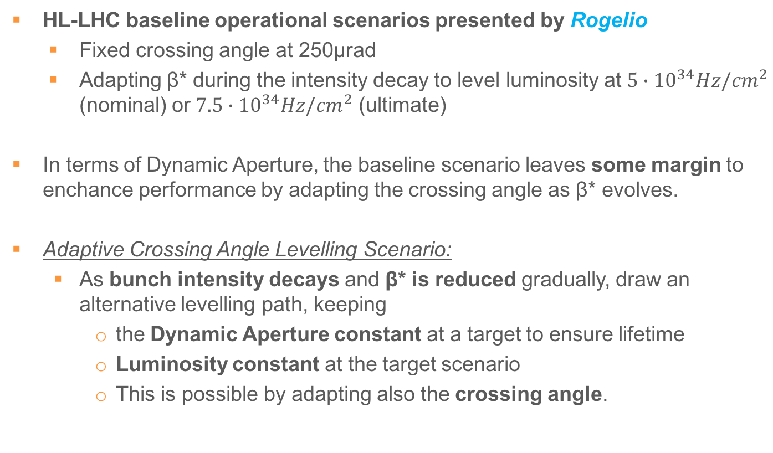
Adaptive Crossing Angle Levelling Scenario
  HL-LHC baseline operational scenarios presented by Rogelio
    Fixed crossing angle at 250μrad
    Adapting β* during the intensity decay to level luminosity at $5∙{10}^{34}Hz/{cm}^{2}$ (nominal) or $7.5∙{10}^{34}Hz/{cm}^{2}$ (ultimate)
  In terms of Dynamic Aperture, the baseline scenario leaves some margin to enchance performance by adapting the crossing angle as β* evolves.
Adaptive Crossing Angle Levelling Scenario:
  As bunch intensity decays and β* is reduced gradually, draw an alternative levelling path, keeping
    the Dynamic Aperture constant at a target to ensure lifetime
    Luminosity constant at the target scenario
    This is possible by adapting also the crossing angle.

Slide 8
Start of Collisions: ${N_{b}=2.2∙10}^{11}ppb$
relaxed
DA [σ]
Baseline
aggressive

Slide 9

Start of Collisions: ${N_{b}=2.2∙10}^{11}ppb$
Disregarding lifetime concerns, peak luminosity at 15cm: ${\sim 1.4∙10}^{35}Hz/{cm}^{2}$ ➔ Pileup > 300 evts
relaxed
DA [σ]
Luminosity [${10}^{34}Hz/{cm}^{2}$]
Baseline
aggressive
Relaxed (6σ)
Aggressive (5σ)
Ultimate Relaxed (6σ)

Slide 10
Start of Collisions: ${N_{b}=2.2∙10}^{11}ppb$
relaxed
DA [σ]
Luminosity [${10}^{34}Hz/{cm}^{2}$]
r.m.s Length of Luminous
Region [cm]
Baseline
aggressive
Relaxed (6σ)
Aggressive (5σ)
Ultimate Relaxed (6σ)

Slide 11
Start of Collisions: ${N_{b}=2.2∙10}^{11}ppb$
Reduction of crossing angle at constant luminosity, reduces pileup (by elongating the luminous region) and triplet irradiation.
relaxed
DA [σ]
Luminosity [${10}^{34}Hz/{cm}^{2}$]
r.m.s Length of Luminous
Region [cm]
Baseline
aggressive
Relaxed (6σ)
Aggressive (5σ)
Ultimate Relaxed (6σ)
Scenario | Half-crossing angle [μrad] | β* [cm]
Baseline | 250 (21.8σ) | 64
Relaxed | 154 (14.0σ) | 69
Aggressive | 133 (12.1σ) | 69
Ultimate Relaxed | 209 (15.1σ) | 44

Slide 12
Start of Collisions: ${N_{b}=1.9∙10}^{11}ppb$
Draw the levelling path by following iso-DA and iso-Luminosity configurations when bunch intensity decays
relaxed
DA [σ]
Luminosity [${10}^{34}Hz/{cm}^{2}$]
r.m.s Length of Luminous
Region [cm]
Baseline
aggressive
Relaxed (6σ)
Aggressive (5σ)
Ultimate Relaxed (6σ)
Scenario | Half-crossing angle [μrad] | β* [cm]
Baseline | 250 (18.3σ) | 45
Relaxed | 183 (14.1σ) | 50
Aggressive | 162 (12.6σ) | 51
Ultimate Relaxed | 251 (14.5σ) | 28

Slide 13
End of Levelling
To determine the exact point in which we exit the levelling we search for which intensity and crossing angle we reach $β^{∗}=15cm$
DA [σ]
Luminosity [${10}^{34}Hz/{cm}^{2}$]
Baseline
Relaxed (6σ)
Aggressive (5σ)
Ultimate Relaxed (6σ)
Scenario | Half-crossing angle [μrad] | I [ppb]
Baseline | 250 (10.5σ) | 1.22
Relaxed | 235 (9.9σ) | 1.19
Aggressive | 207 (8.8σ) | 1.13
Ultimate Relaxed | 260 (11σ) | 1.53

Slide 14
Evolution of Parameters
For the adaptive scenarios, include crossing angle “anti-levelling” à la LHC after the end of levelling
Slightly delay the end
of levelling
max crabbing
angle: 380μrad
anti-levelling

Slide 15
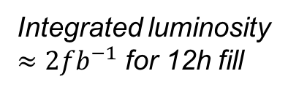
Evolution of Parameters
Integrated luminosity
$≈2{fb}^{−1}$ for 12h fill
Elongating luminous
region by ~15%
➔ reducing the peak
pileup density by 7%

Slide 16
Effect of Field Multipole Errors
Estimate the effect of the multipolar errors on the DA with beam-beam.
Track particles using 60 realizations of the machine (seeds)
Apply field errors from table “errortable_v5”.
Not correcting for D2 and MCBXF ➔ under study (Massimo et al)
We focus on a few interesting configurations at the start and at the end of the levelling:
  Aggressive, Relaxed adaptive Scenarios
  Baseline Nominal Scenario
  Ultimate Scenario
We perform a statistical analysis in terms of minimum and average DA of the results over the 5 angles and 5 amplitude ranges.

Slide 17
Field Errors at the End of Levelling

Slide 18
Field Errors at the End of Levelling
Aggressive
Relaxed
Baseline
Ultimate

Slide 19
Field Errors at the End of Levelling

Slide 20
Field Errors at the End of Levelling
6.9σ
6.6σ
6.6σ
6.4σ
6.0σ
6.0σ
5.6σ
5.1σ
5.4σ
5.2σ
5.0σ
4.3σ
STD: 0.3σ
STD: 0.3σ
STD: 0.3σ
STD: 0.3σ
Average spread of the various realizations of 0.3σ

Slide 21
Field Errors at the End of Levelling

Slide 22
Field Errors at the End of Levelling
8.2σ
7.5σ
7.5σ
7.8σ
7.0σ
6.8σ
6.8σ
6.8σ
6.5σ
5.9σ
6.1σ
5.0σ
STD: 0.3σ
STD: 0.3σ
STD: 0.3σ
STD: 0.4σ
Average spread of the various realizations of 0.3σ (0.4σ for ultimate)

Slide 23
Field Errors at the Start of Levelling

Slide 24
Field Errors at the Start of Levelling
Preliminary
Aggressive
Relaxed
Baseline
Ultimate

Slide 25
Field Errors at the Start of Levelling
7.3σ
7.2σ
6.3σ
6.7σ
6.6σ
5.7σ
5.9σ
5.1σ
5.3σ
5.8σ
4.8σ
4.6σ
STD: 0.1σ
STD: 0.3σ
STD: 0.3σ
STD: 0.3σ
Spread of 0.3σ, with the exception of the aggressive at ~0.1σ

Slide 26
Field Errors at the Start of Levelling
8.7σ
8.0σ
7.5σ
7.7σ
6.8σ
7.0σ
6.3σ
6.5σ
5.3σ
6.0σ
5.1σ
4.9σ
STD: 0.1σ
STD: 0.2σ
STD: 0.2σ
STD: 0.2σ
Spread of 0.2σ, with the exception of the aggressive at ~0.1σ

Slide 27
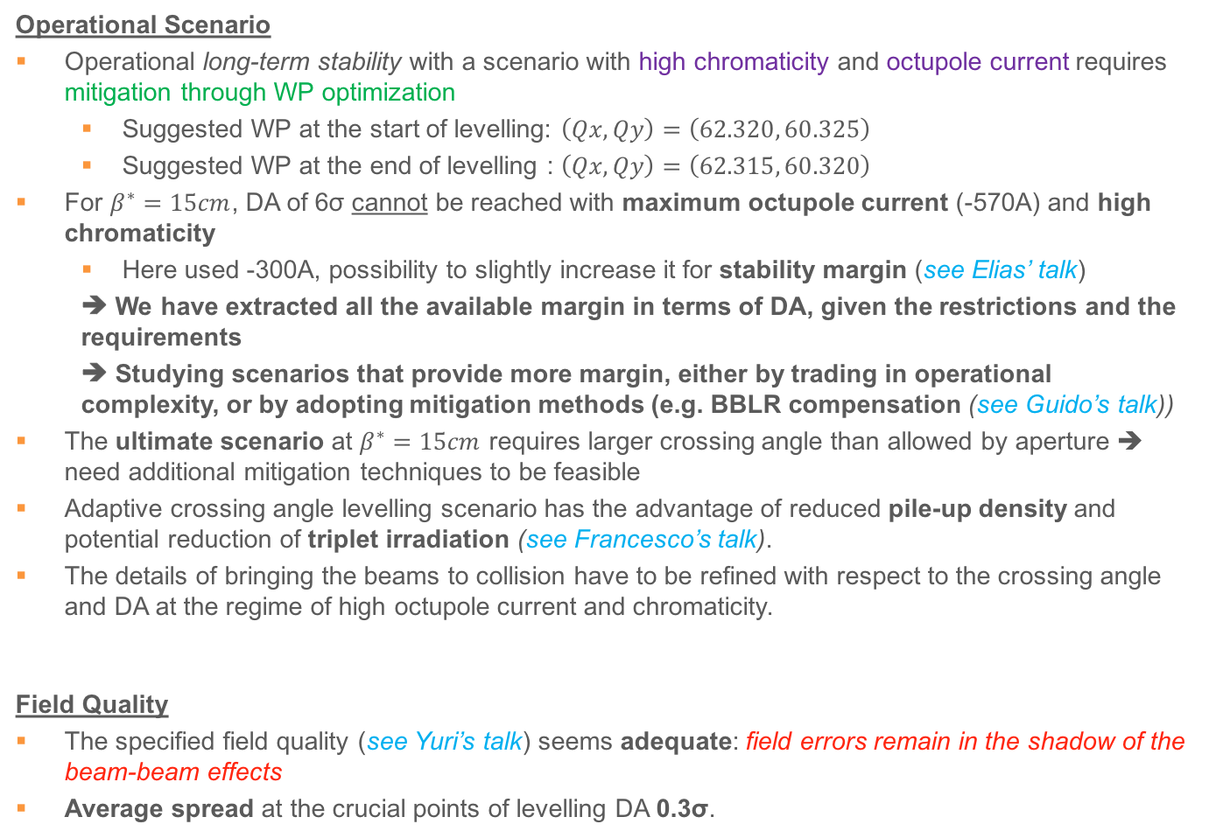
Summary and Overview
Operational Scenario
Operational long-term stability with a scenario with high chromaticity and octupole current requires mitigation through WP optimization
  Suggested WP at the start of levelling: $\left(Qx, Qy\right)=\left(62.320, 60.325\right)$
  Suggested WP at the end of levelling : $\left(Qx, Qy\right)=\left(62.315, 60.320\right)$
For $β^{∗}=15cm$, DA of 6σ cannot be reached with maximum octupole current (-570A) and high chromaticity
  Here used -300A, possibility to slightly increase it for stability margin (see Elias’ talk)
  ➔ We have extracted all the available margin in terms of DA, given the restrictions and the requirements
  ➔ Studying scenarios that provide more margin, either by trading in operational complexity, or by adopting mitigation methods (e.g. BBLR compensation (see Guido’s talk))
The ultimate scenario at $β^{∗}=15cm$ requires larger crossing angle than allowed by aperture ➔ need additional mitigation techniques to be feasible
Adaptive crossing angle levelling scenario has the advantage of reduced pile-up density and potential reduction of triplet irradiation (see Francesco’s talk).
The details of bringing the beams to collision have to be refined with respect to the crossing angle and DA at the regime of high octupole current and chromaticity.
Field Quality
The specified field quality (see Yuri’s talk) seems adequate: field errors remain in the shadow of the beam-beam effects
Average spread at the crucial points of levelling DA 0.3σ.

Slide 28
Thank you for your attention
and many thanks to all the volunteers!

Slide 29
SPARE SLIDES

Slide 30
Positive Octupoles
(.320, .325)
(.31, .32)
(.315, .320)

Slide 31
End of Levelling with WP of start of levelling

Slide 32
Parameter Evolution

Slide 33
Low Chroma / Octupoles

Slide 34
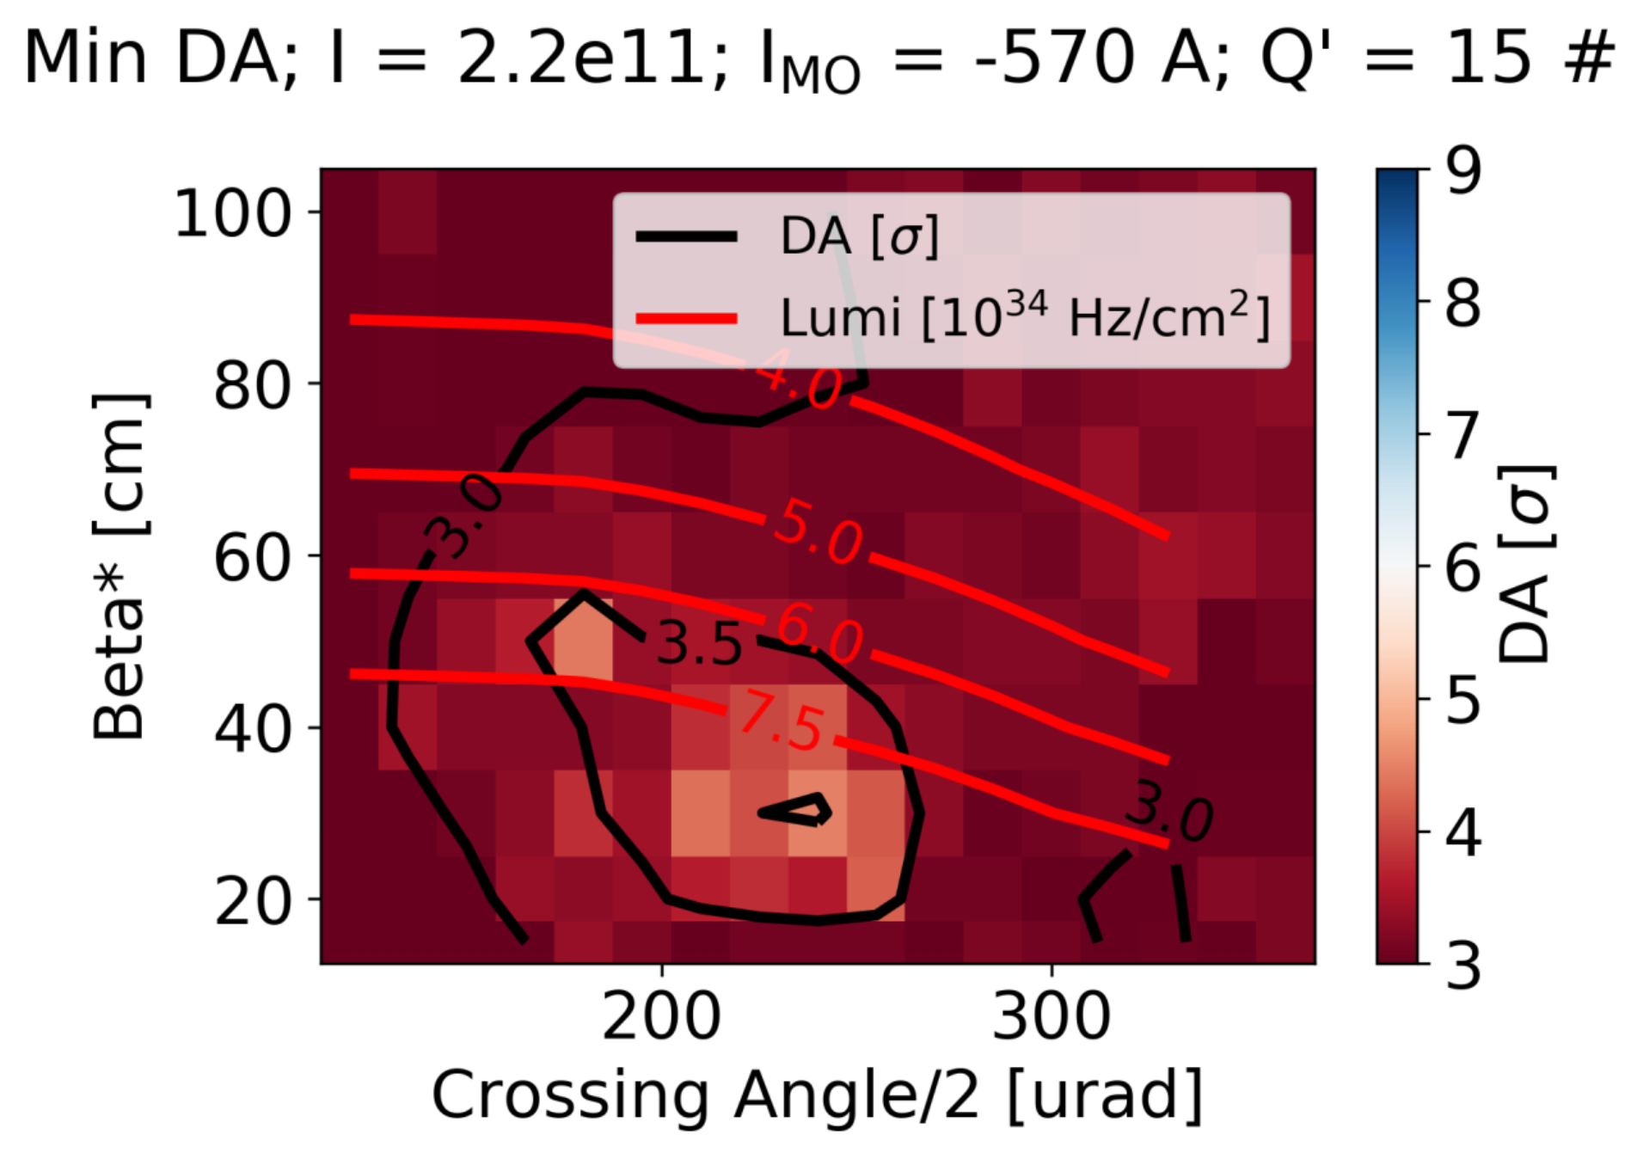
High Chroma / Octupoles

