Slide 1
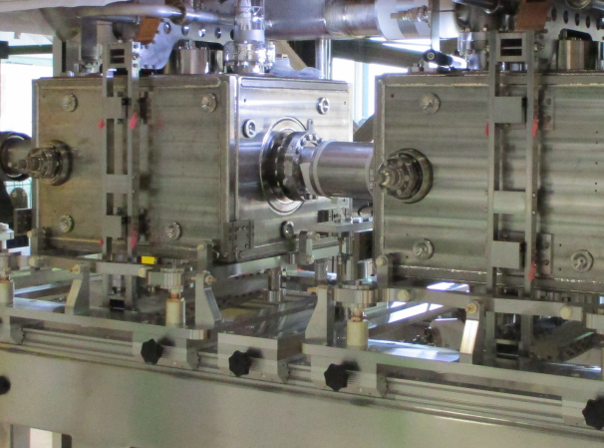

DQW HOM Measurements, Analysis and Application
J. A. Mitchell ^{1, 2}
¹Engineering Department, Lancaster University Graeme Burt
²BE-RF Section, CERN Rama Calaga
7th HL-LHC Collaboration Meeting
CIEMAT, Madrid, 13-16 November 2016

Slide 2
Introduction
Tests of the DQW with HOM couplers.
  Measurements taken.
  Measurement deviation from simulations.
Impedance and power for HL-LHC.
  Current scenario.
  Mode tolerance study.
HOM coupler design re-visited.
  Damping the impedance below the threshold.
  New spectral power.

Slide 3
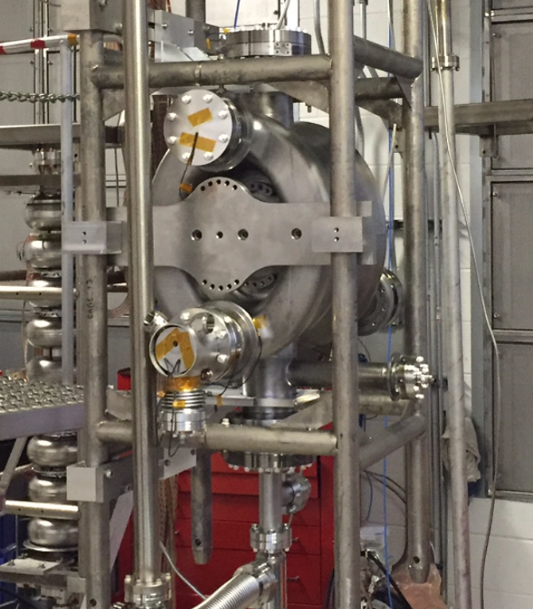
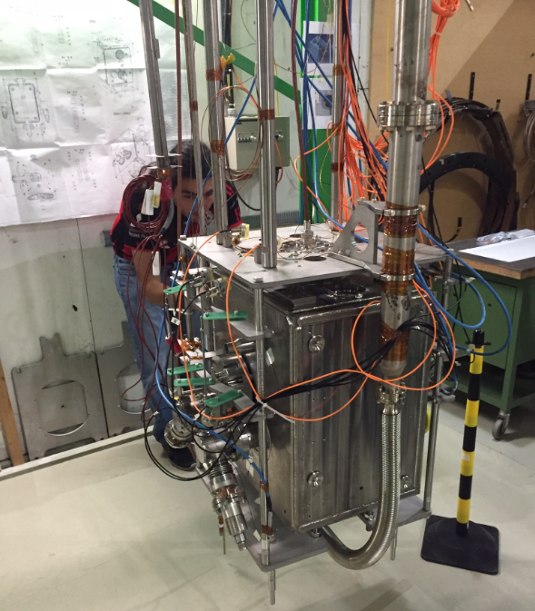
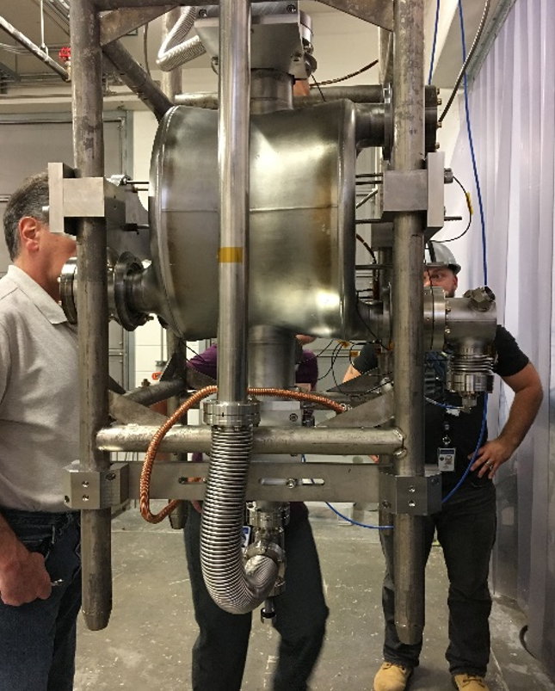
DQW Tests with HOM Couplers
No of HOM Couplers | Cavity | Helium Vessel?
1 | NWV-DQW-001 | N
3 | CERN-DQW-001 | Y
1 | NWV-DQW-002 | N
Tuesday, A. Castilla Loeza, CERN DQW cold tests summary [1730]

Slide 4
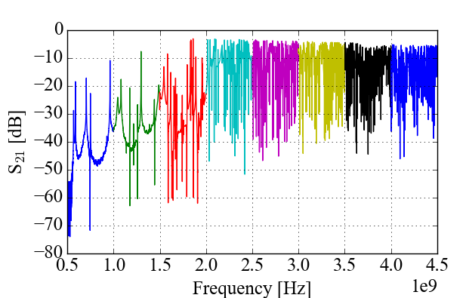
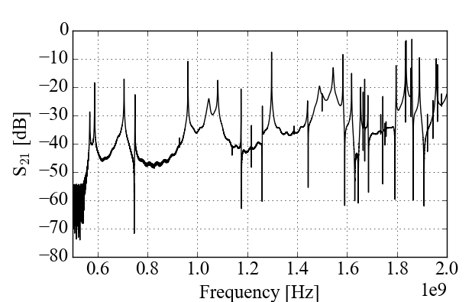
DQW Tests with HOM Couplers
JLAB Spectral Measurements
S₂₁ measurements between HOM coupler and cold test Power Coupler (PC).
Temperatures: 300, 4.5 and 2 K.
Discrete frequency bands taken and stitched for increased resolution.
f_{cut-off} = 2.09 GHz
Nb coated flanges on both beam pipes.

Slide 5
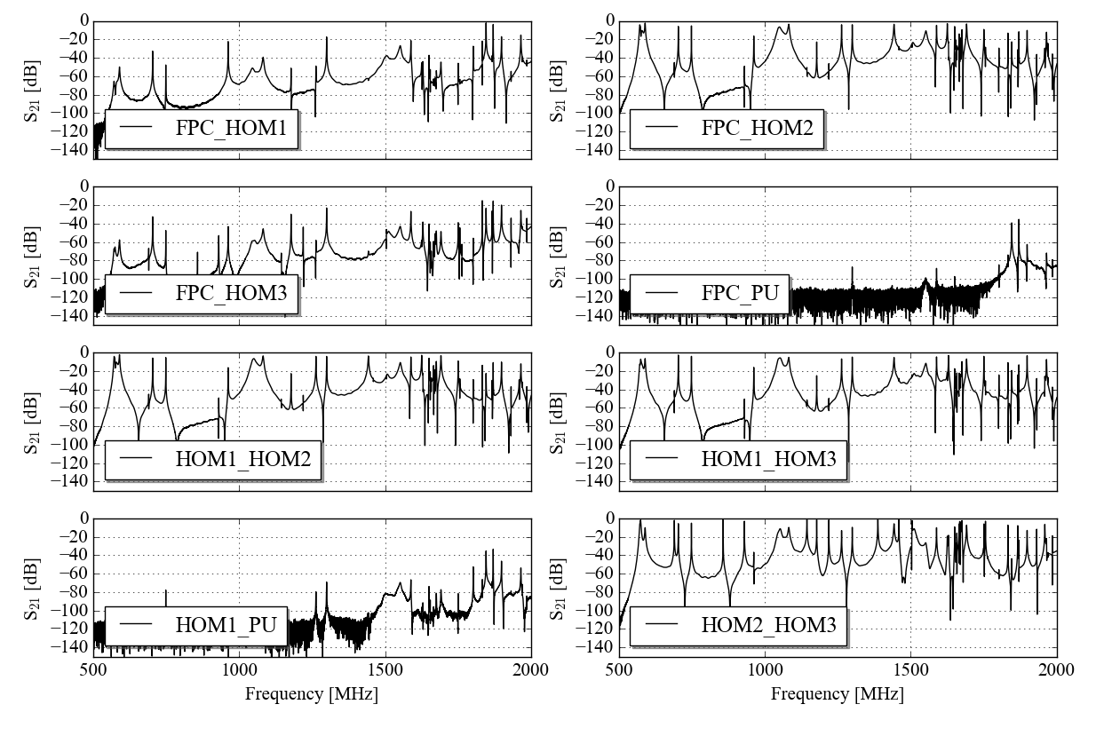
DQW Tests with HOM Couplers
CERN Spectral Measurements
5 ports with couplers (PC, PU, HOMC1, HOMC2, HOMC3).
8 port configurations measured to measure all modes.
Temperatures: 300 and 2 K.
Discrete frequency bands taken and stitched for increased resolution.

Slide 6
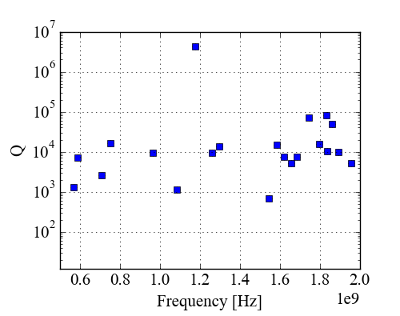
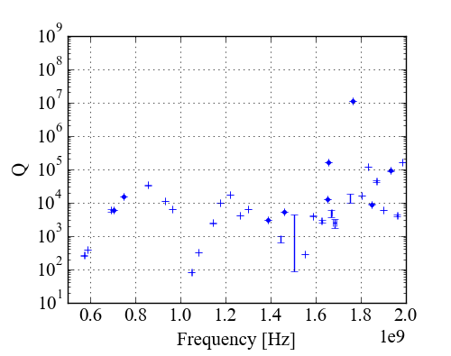
DQW Tests with HOM Couplers
HOM Measurements
Narrow frequency bands measured at centre frequency of mode.
Frequency and Q-factor recorded using Lorentzian fit function.
JLAB
CERN

Slide 7
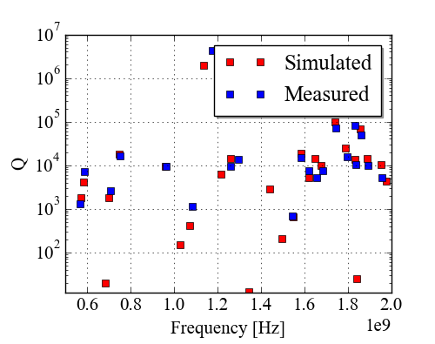
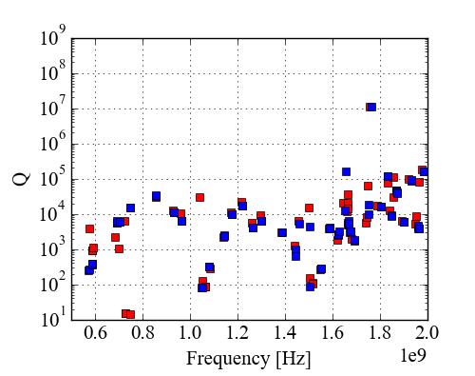
DQW Tests with HOM Couplers
HOM Measurements
Narrow frequency bands measured at centre frequency of mode.
Frequency and Q-factor recorded using Lorentzian fit function.
SPS pick-up not used.
JLAB
CERN
Cavity has +5mm retraction on all HOM couplers (non-conformity error) [1].
Simulation takes this into account.
Possible source of error:
Non-conformity is not exactly +5mm on all ports.
Cold test power coupler and pick-up may perturb some modes.
JLAB cavity is not tuned to the correct fundamental frequency.
f₀ = 403 MHz

Slide 8
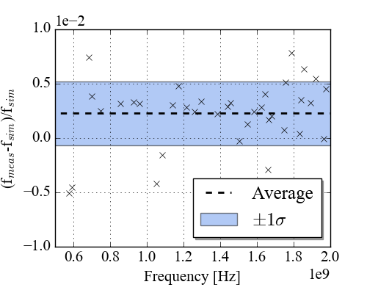
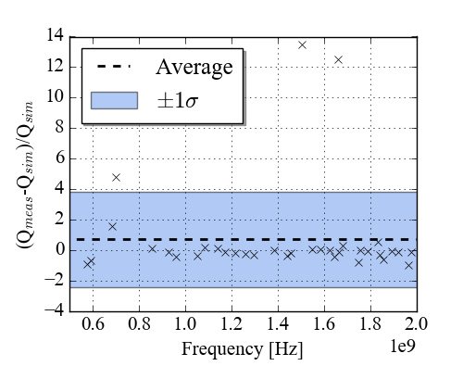
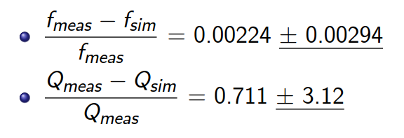
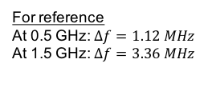
Frequency and Q Spread
Deviation in measured mode parameters from simulated for CERN-DQW-001 partially dressed test.
Mode tolerances for impedance, power and beam stability simulations.
The spread should be applied as a tolerance study. To do this the current impedance and power spectra should be noted.
For reference
At 0.5 GHz: $Δf=1.12 MHz$
At 1.5 GHz: $Δf=3.36 MHz$

Slide 9
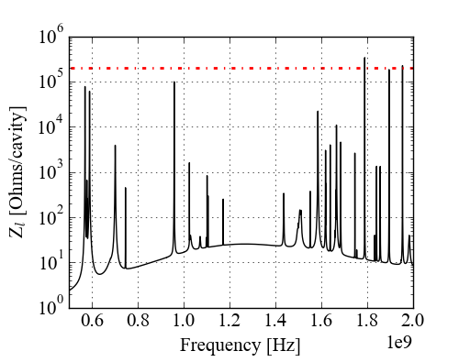
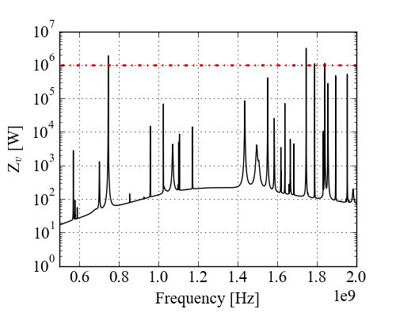
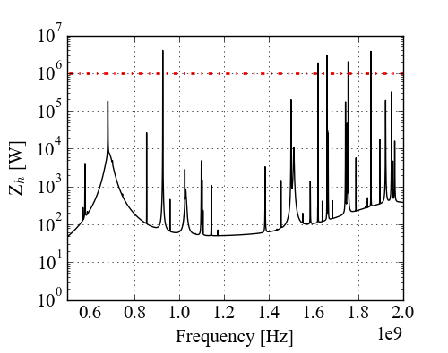
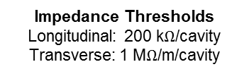
Analytical Tolerance Study
Cavity Impedance Spectra
Impedance spectra calculated in order to calculate the power.
Currently some modes are above thresholds.
Impedance Thresholds
Longitudinal: 200 k$Ω$/cavity
Transverse: 1 M$Ω$/m/cavity

Slide 10
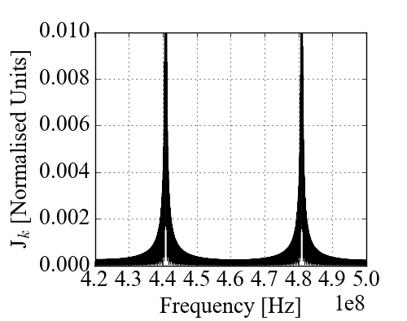
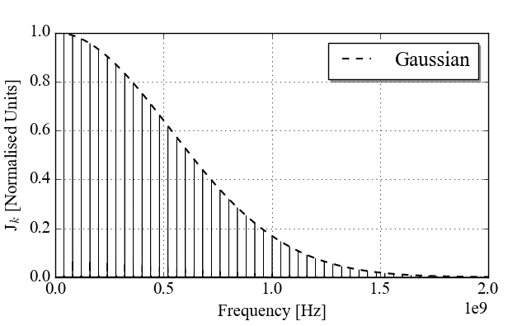
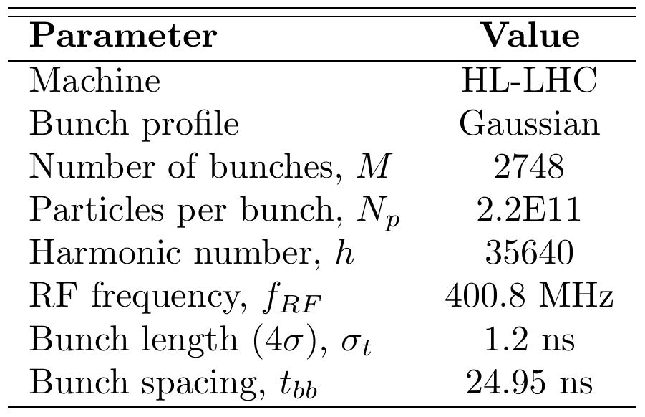
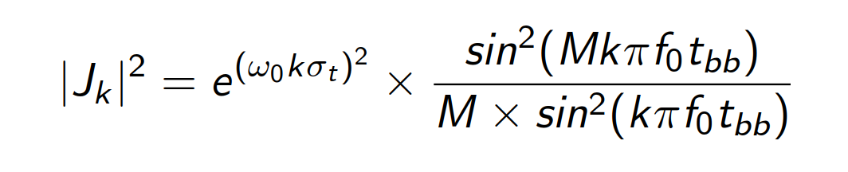

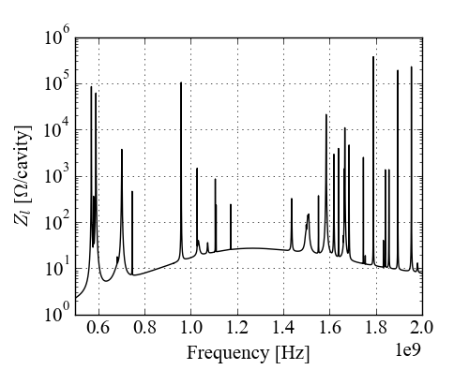
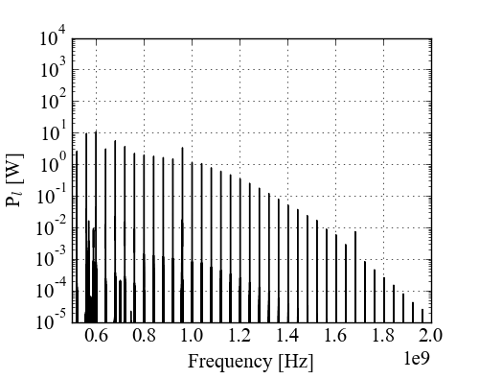
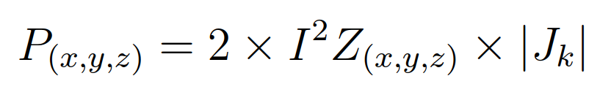
Analytical Tolerance Study
Cavity Power Spectra
Resulting longitudinal power from HL-LHC parameters calculated.
[2, 3]

Slide 11
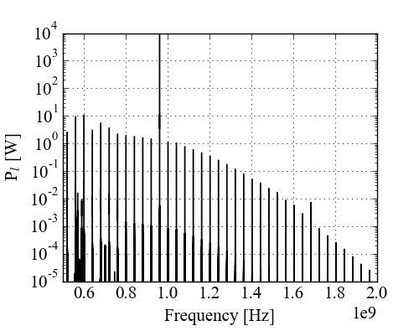
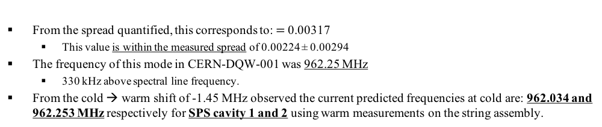
Analytical Tolerance Study
Problematic Mode
Applying a frequency offset to the modes shows that there is one mode solely capable of substantially increasing the power.
Frequency shift of 0.3% of 958.87 MHz mode
Shift of +3.14 MHz to 958.87 MHz mode.
From the spread quantified, this corresponds to: $=$0.00317
  This value is within the measured spread of 0.00224 ± 0.00294
The frequency of this mode in CERN-DQW-001 was 962.25 MHz
  330 kHz above spectral line frequency.
From the cold → warm shift of -1.45 MHz observed the current predicted frequencies at cold are: 962.034 and 962.253 MHz respectively for SPS cavity 1 and 2 using warm measurements on the string assembly.

Slide 12
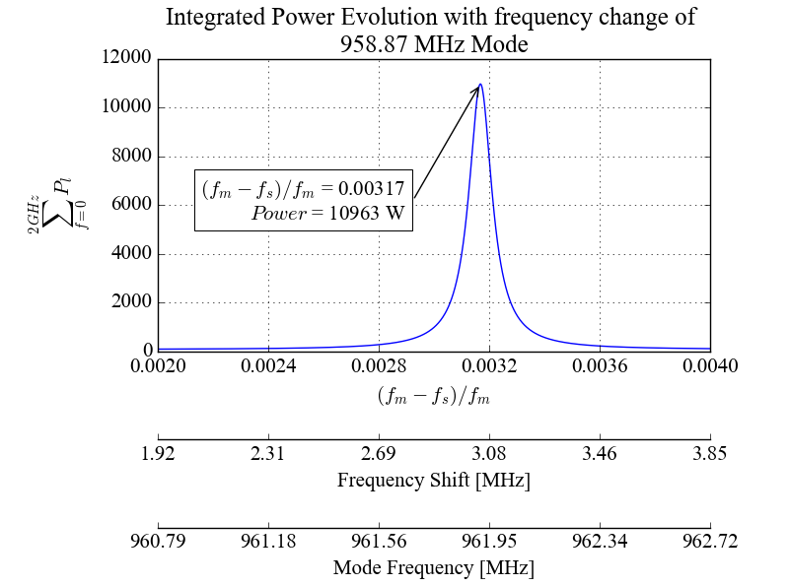
Analytical Tolerance Study
Problematic Modes
From the cold → warm shift of -1.45 MHz observed the current predicted frequencies at cold are: 962.034 and 962.253 MHz respectively for SPS cavity 1 and 2 using warm measurements on the string assembly.
What power would result in HL-LHC?
962.034 MHz
1727 W
962.253 MHz
309 W
*The mode frequencies have risen past the worst case scenario – showing feasibility of the 11 kW power generation.

Slide 13
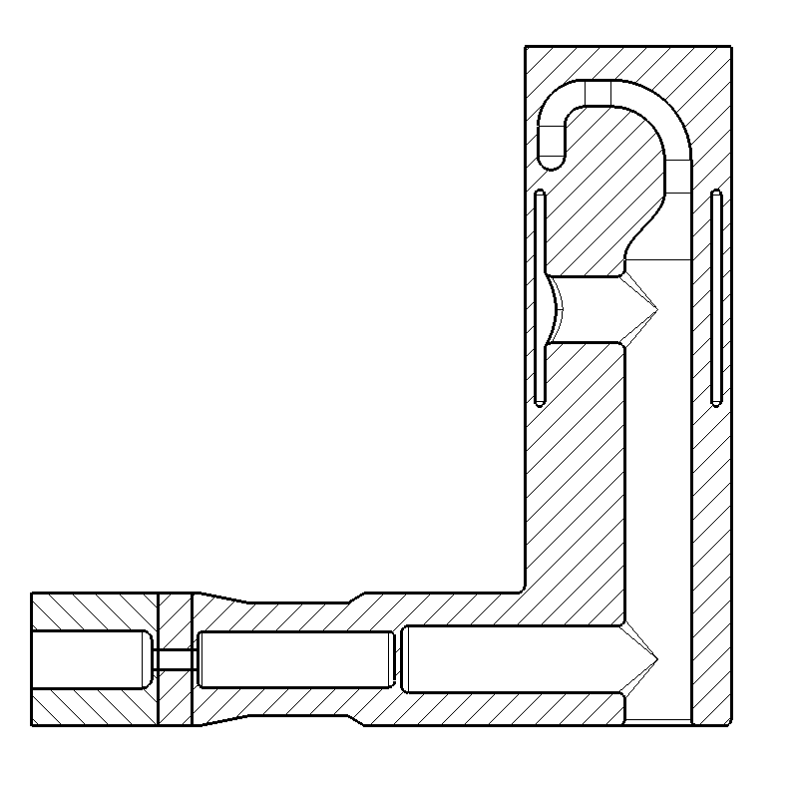
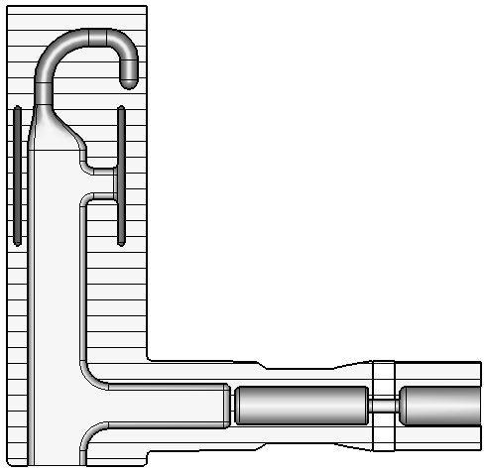
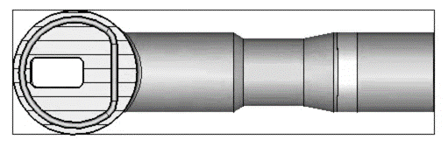
HOM Coupler Design Changes
HOM coupler improvements:
  Improve the ease of manufacture.
  Damp impedance thresholds to below the documented thresholds.
  Further damp the mode at 959 MHz → reduce power below 1 kW.
Flat section on jacket
Easier to weld stub to jacket
Raised bend section
Shell can be extruded rather than machined from bulk
Rectangular cross-section for shaft and stub
Easier machining

Slide 14
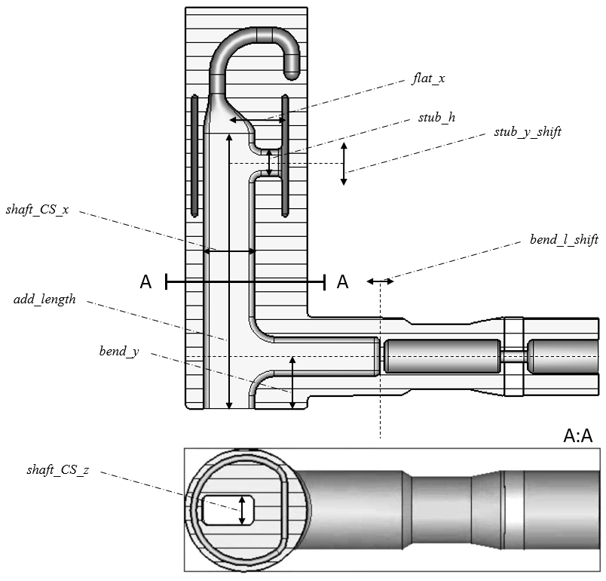
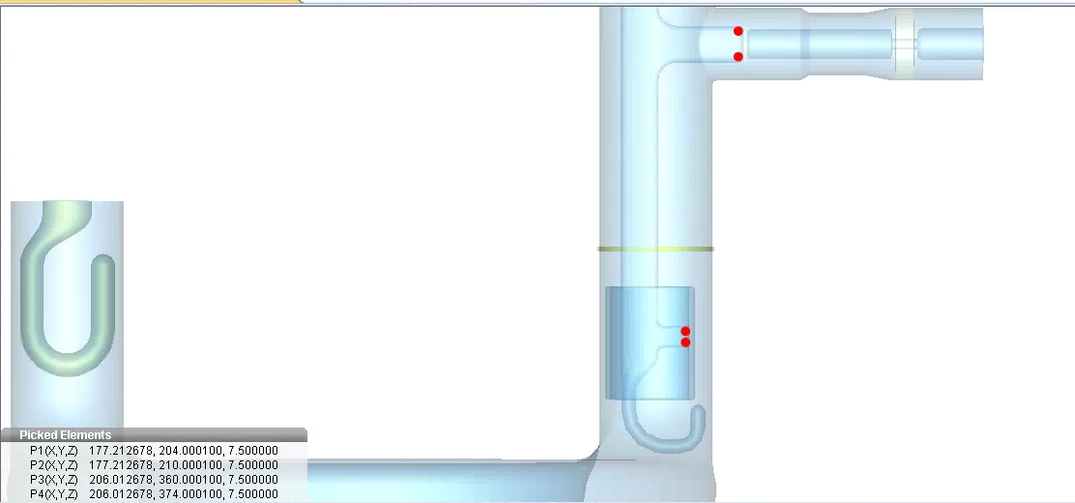
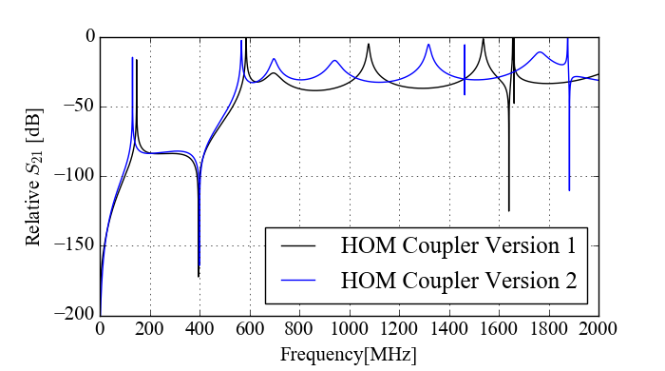
HOM Coupler Design Changes
RF Improvements
HOM coupler improvements:
  Improve the ease of manufacture.
  Damp impedance thresholds to below the documented thresholds.
  Further damp the mode at 959 MHz → reduce power below 1 kW.
By altering the geometries of the HOM coupler, the transmission response was altered to better damp modes above the impedance threshold.

Slide 15
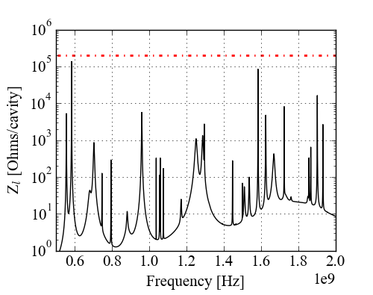
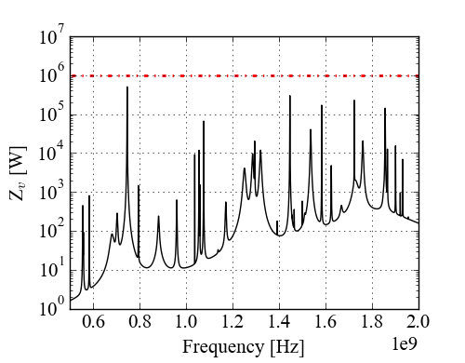
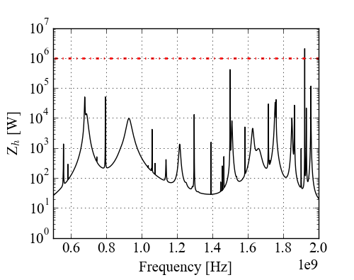
HOM Coupler Design Changes
New Cavity Impedance Spectra
959 MHz mode:
  Q: 1E4 → 0.057E4
  R_{l}: 1E5 → 0.056E5
All modes apart from one (1920 MHz) are below threshold.

Slide 16
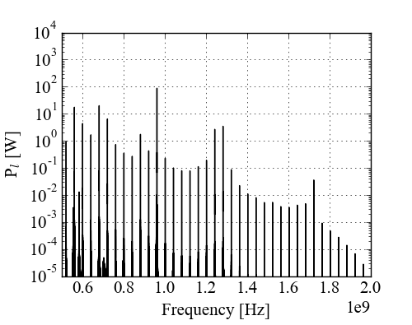
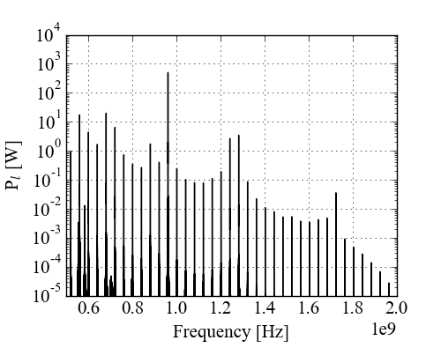
HOM Coupler Design Changes
New Cavity Power Spectra
Nominal
Detrimental mode shifted
Current HOM coupler
New HOM Coupler

Slide 17
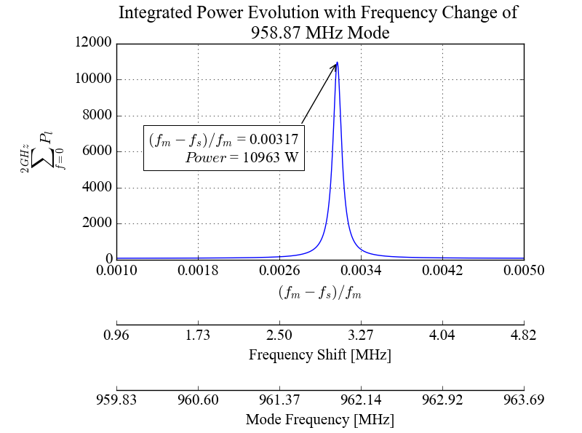
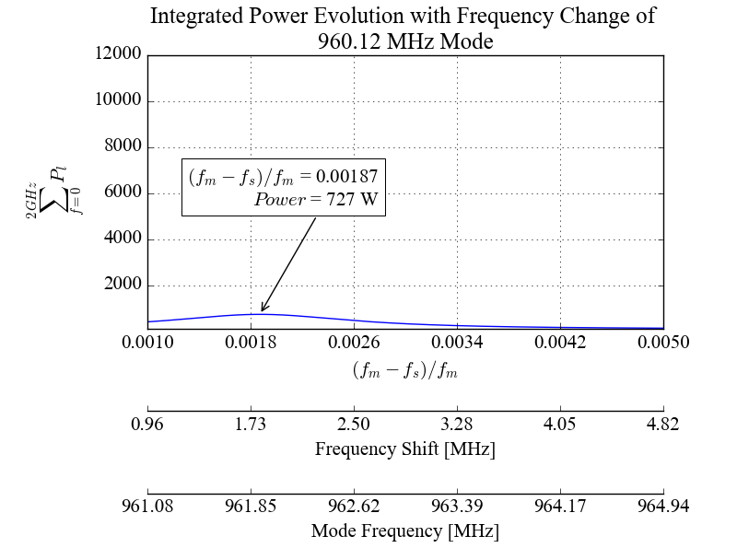
HOM Coupler Design Changes
New power with 960 MHz mode deviation
Power generated with deviation of the mode at ~ 960 MHz is much lower for the new HOM coupler.
Frequency has changed slightly meaning that the shift necessary for maximum power has reduced from 0.3% to 0.2%.
However, the power produced has reduced by a factor of 15.

Slide 18
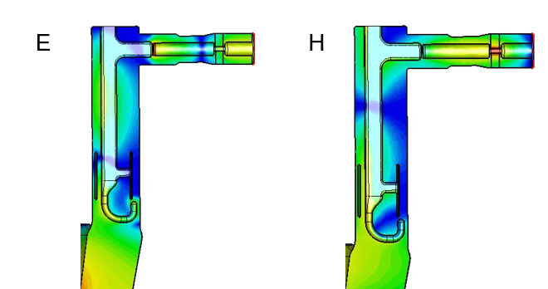
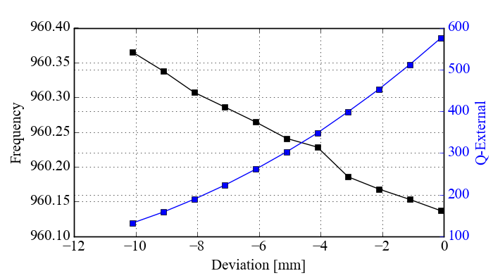

HOM Coupler Design Changes
Further Analysis
The integrated power with the mode exactly on 960 MHz has reduced from:
  11 kW to 742 W
However, the mode frequency has shifted from 958.87 MHz to 960.1 MHz.
  At 960 MHz:
  $\frac{λ}{2}=15.6 cm$
16 cm
Coupler geometries which effect the frequency of this mode are being investigated.
In addition, it was commented that the distance between the hook and capacitive jacket should be increased. This has now been performed and has a minimal effect on the mode damping.

Slide 19
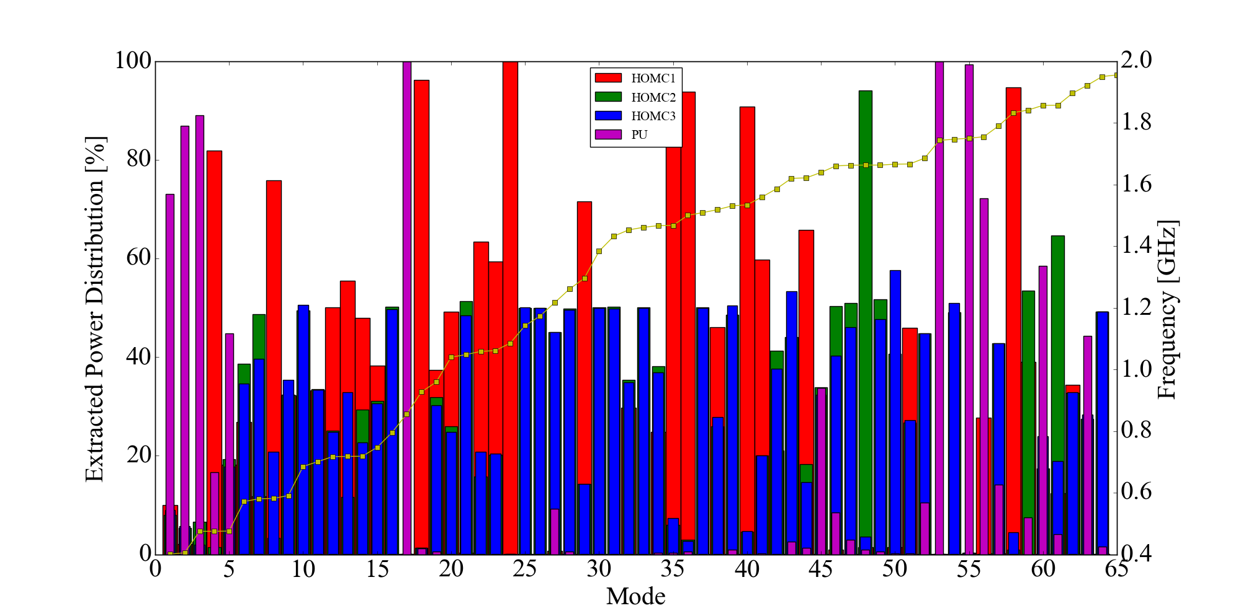
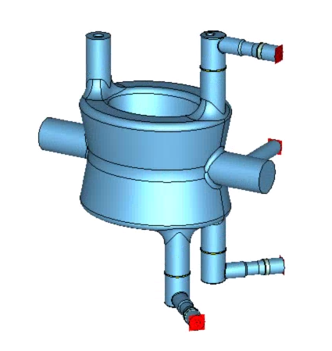
Power Directionality
It is important to take into account that mode power is not equally split through each coupler.
Using the ratio of the external Q-factors corresponding to individual port simulations it is possible to see how the extracted power is distributed.
  → The simulations assume no power is extracted by the FPC or beam pipes and do not take into account Ohmic losses in the cavity.
Multiplying the mode impedance by the percentage will give a power spectrum for each coupler.
Using current HOM coupler design:

Slide 20
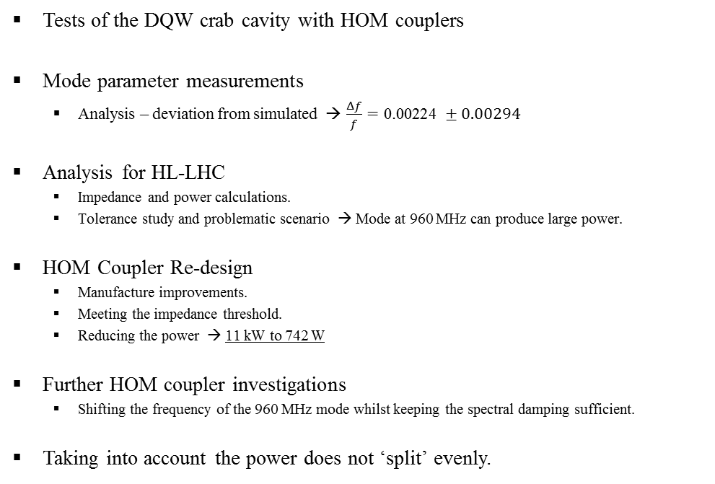
Conclusion
Tests of the DQW crab cavity with HOM couplers
Mode parameter measurements
  Analysis – deviation from simulated → $\frac{Δf}{f}=\text{0.00224} ±0.00294$
Analysis for HL-LHC
  Impedance and power calculations.
  Tolerance study and problematic scenario → Mode at 960 MHz can produce large power.
HOM Coupler Re-design
  Manufacture improvements.
  Meeting the impedance threshold.
  Reducing the power → 11 kW to 742 W
Further HOM coupler investigations
  Shifting the frequency of the 960 MHz mode whilst keeping the spectral damping sufficient.
Taking into account the power does not ‘split’ evenly.

Slide 21
References
Questions?
Paula Freijedo, “HL-LHC: Quality - Non Conformity Report ”. EDMS 1759686: https://edms.cern.ch/ui/#!master/navigator/document?P:1771791600:1242869639:subDocs
I. Karpov, Beam dynamics studies for FCC-ee, 30 May 2017.
F. Caspers et al., IMPEDANCE MEASUREMENT OF THE SPS MKE KICKER BY MEANS OF THE COAXIAL WIRE METHOD, PS/RF/Note 2000-004.

