Slide 1
The Main RF System and its Implications for HL-LHC
P. Baudrenghien, R. Calaga,
E. Shaposhnikova, H. Timko,
CERN, BE-RF

Slide 2
Content
Beam dynamics
  Single-bunch loss of Landau damping
  Controlled emittance blow-up
  Multi-bunch stability
  Instabilities at injection
  Bunch flattening
RF power and full detuning
  Available power
  Half and full detuning
  Power limitations at injection
  High-harmonic RF system

Slide 3
BEAM DYNAMICS
Beam Stability and Studies
Acknowledgements:
J. Esteban Müller, S. Albright, T. Argyropoulos, I. Karpov, A. Lasheen

Slide 4
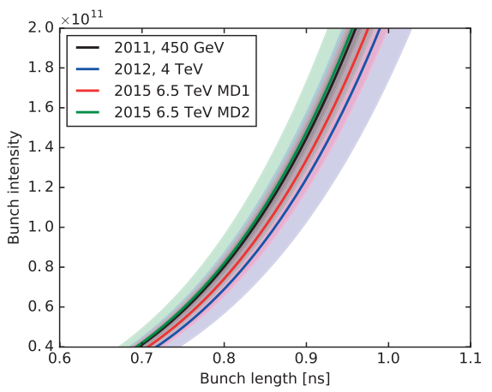
Present Stability Threshold
Combined from different measurements:
LHC effective Im(Z/n) = 0.09 Ω
J. E. Müller, PhD thesis

Slide 5
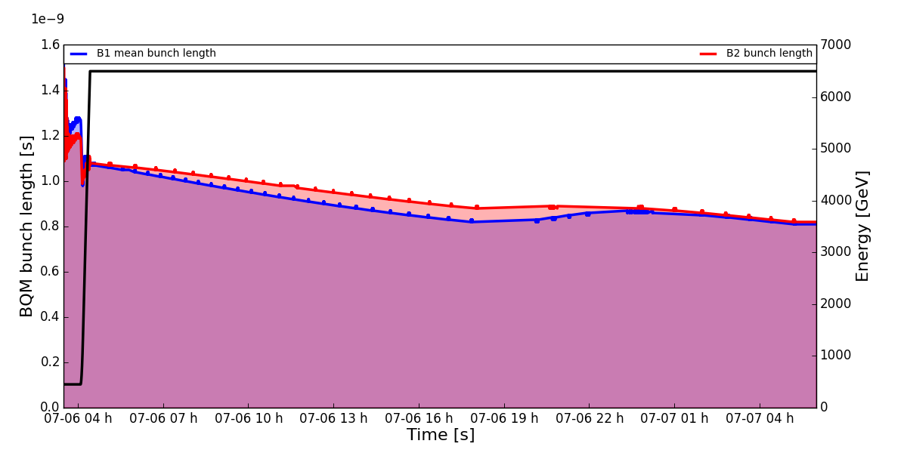
Loss of Landau Damping
Single-bunch loss of Landau damping in long fills observed according to predicted threshold
Long physics fill
06/07/2016
Bunch length oscillations in physics around 0.9 ns for 1.15×10¹¹ ppb injected

Slide 6
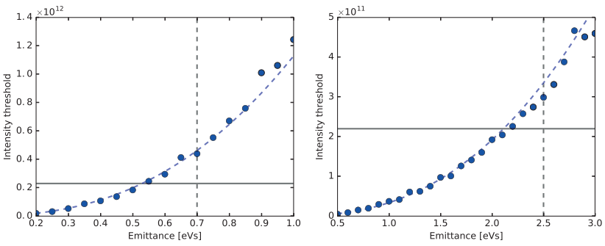
Single-Bunch Stability
Assuming an HL-LHC effective Im(Z/n) = 0.11 Ω
Baseline was updated from 7.5 cm to 9 cm according to our recommendations to mitigate loss of Landau damping
  For 7 TeV, 16 MV (pure 400 MHz), with 10 % spread in bunch length and 10 % margin
J. E. Müller, PhD thesis
450 GeV, 8 MV
7 TeV, 16 MV
BASELINE

Slide 7
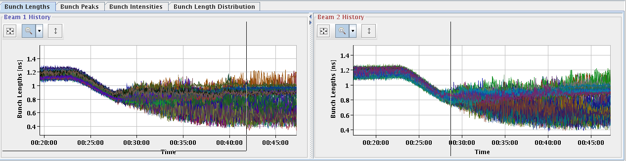
Controlled Emittance Blow-up (1)
Is at the limit of stability at present and could become a problem
  If operated close to the threshold of LLD, bunch lengths diverge
  Assumed mechanism: via synchrotron frequency shift due to intensity effects
Measurement on 27/08/2015: emittance blow-up with 0.85 ns target
To be studied

Slide 8
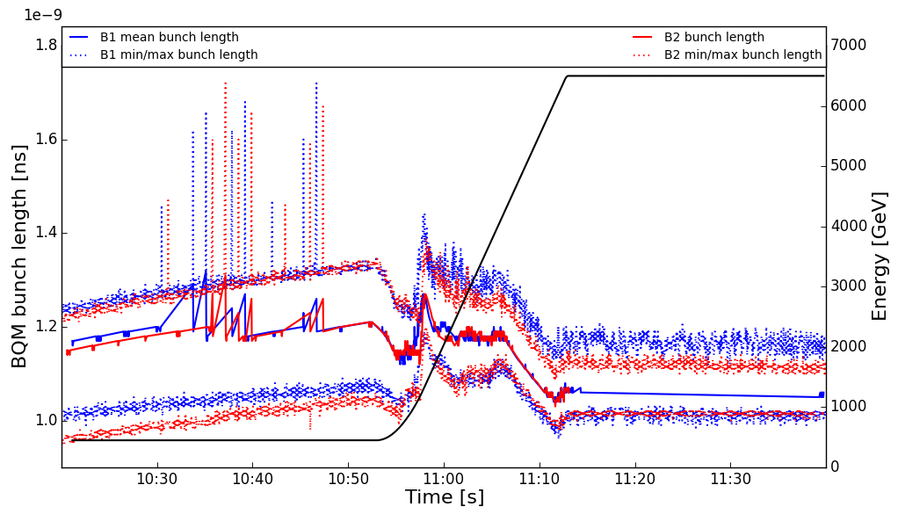
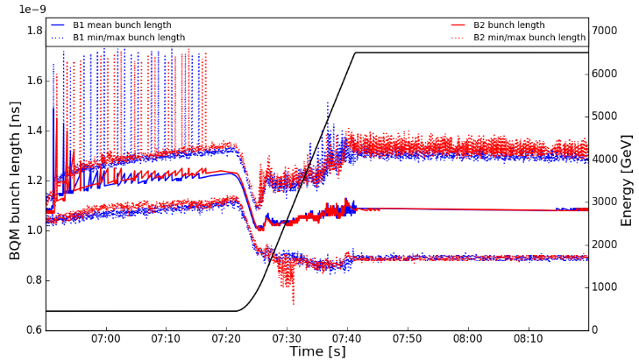
Controlled Emittance Blow-up (2)
In 2016-17, the target bunch length was 1.1 ns for 1.15×10¹¹ ppb
  Need to keep a longer bunch length in the first part of the ramp for better convergence
  Operating at the limit
With constant target of 1.1 ns: spread is 410-450 ps
With target of 1.25 ns in the first 2/3 of the ramp:
spread is decreased to 120-160 ps
To be studied

Slide 9
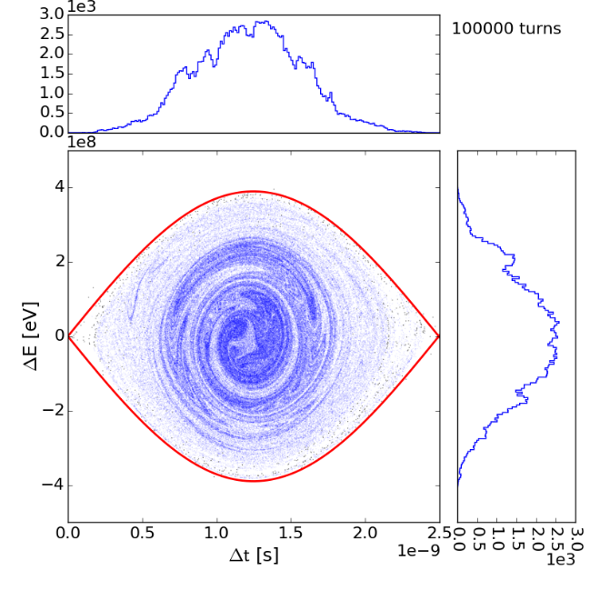
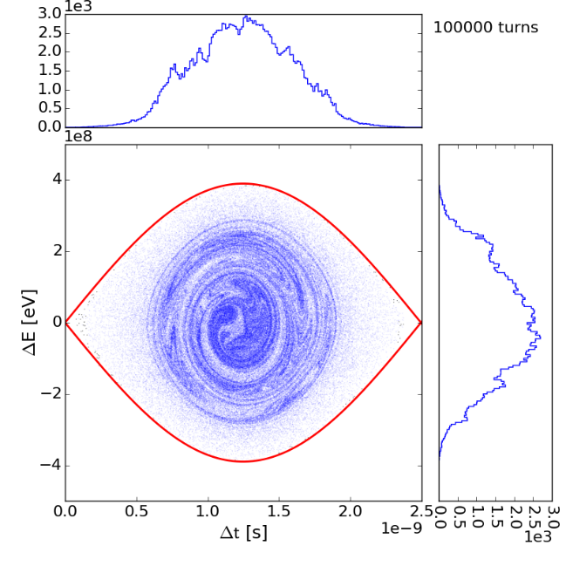
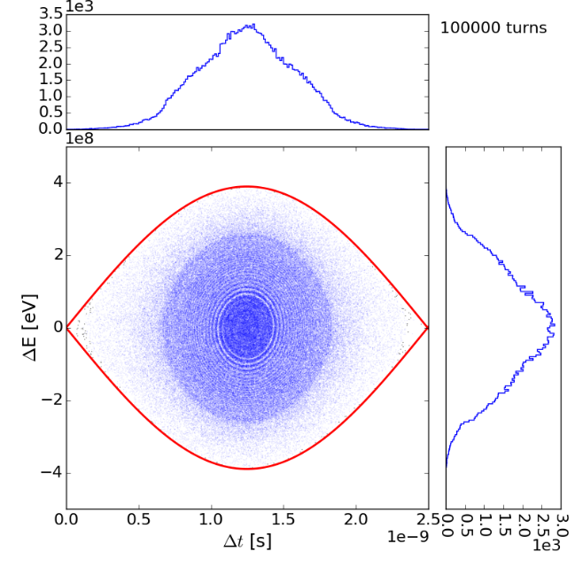
Controlled Emittance Blow-up (3)
Simulations of diffusion show resonant excitation and island creation in phase space; studies to be continued
Noise (0-1.1)×f_{s0}
Noise (0.85-1.1)×f_{s0}
Modulation at 0.93×f_{s0}
To be studied

Slide 10
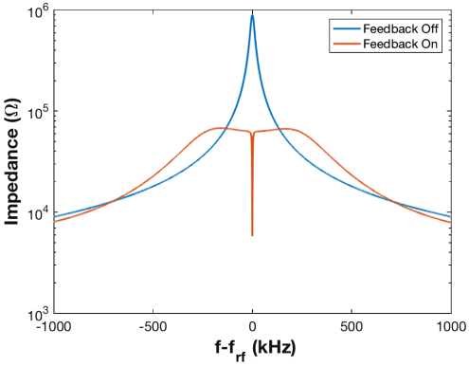
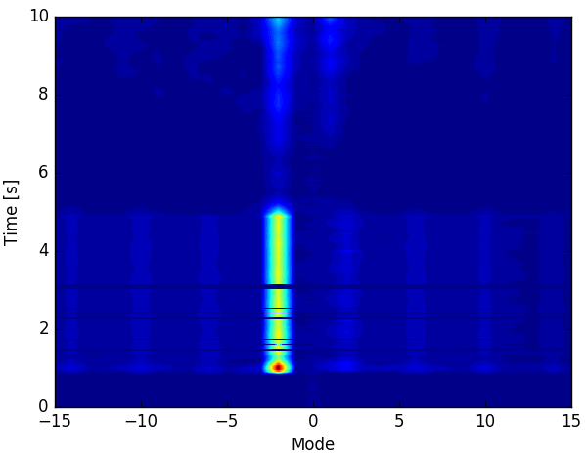
Coupled-Bunch Stability (1)
MDs performed in Run2 confirm that the impedance of the cavity fundamental is not expected to cause CBI at 2.2x10¹¹ ppb.
  Conclusion: sufficient stability margin both for the beam and the RF feedback for HL-LHC
Cavity fundamental impedance w/ & w/o RF feedback
Exciting the most unstable mode with given settings during the MD

Slide 11
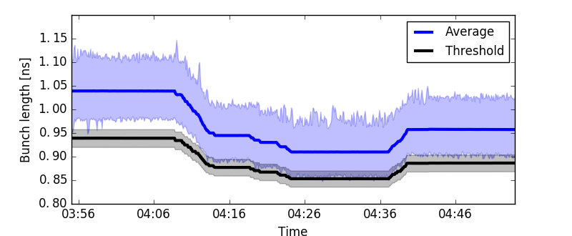
Coupled-Bunch Stability (2)
Total impedance with all HOMs
  Probing HL-LHC parameters with nominal bunch length and reduced emittance (voltage) at arrival to flat top
  No CBI observed w/ 2200 b, but to be confirmed w/ full machine
    Coupled-bunch threshold is not lower than the single-bunch one
Working close to the single-bunch stability threshold (B2)
To be studied

Slide 12
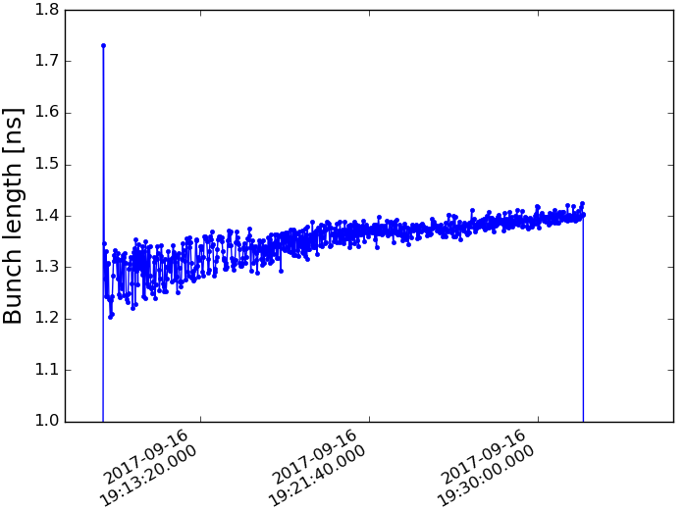
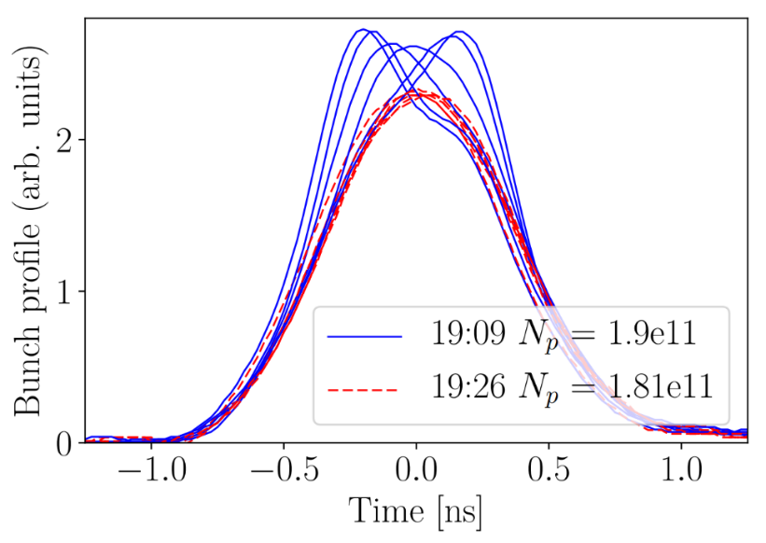
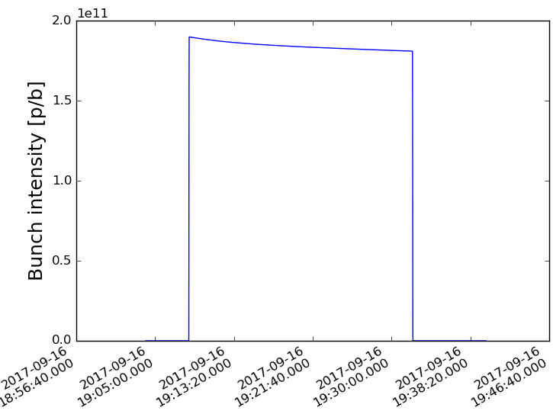
Instabilities at Injection (1)
Persistent injection oscillations and instabilities observed
  Amplitude much larger than seen on stable phase
  Stronger on B2
~20 min
The 20 min of oscillations lead to ~10 % bunch lengthening (IBS only 3 %) and ~5 % particle loss for bunches with < 2×10¹¹ ppb!
~20 min
LHC MD2042
To be studied

Slide 13
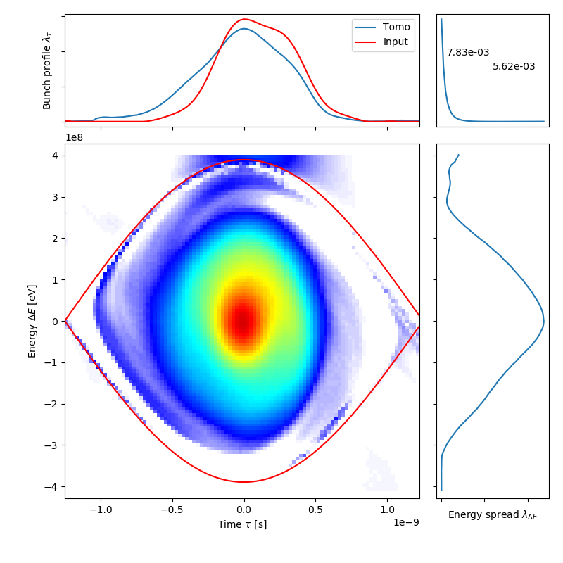
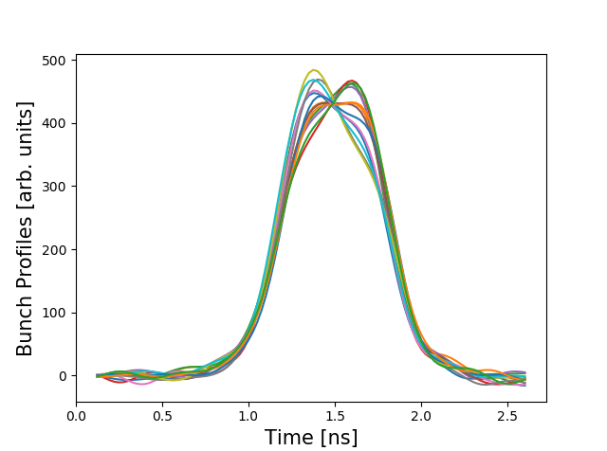
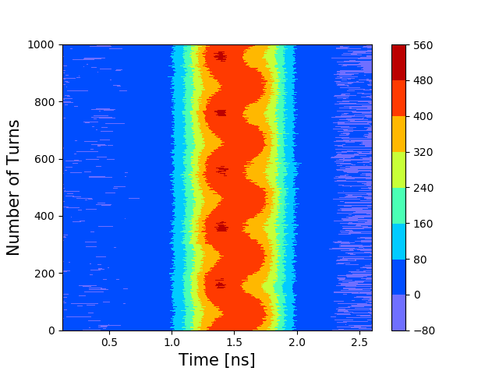
Instabilities at Injection (2)
New diagnostics in the LHC: tomographic reconstruction of the longitudinal phase space from high-resolution bunch profiles
RF team

Slide 14
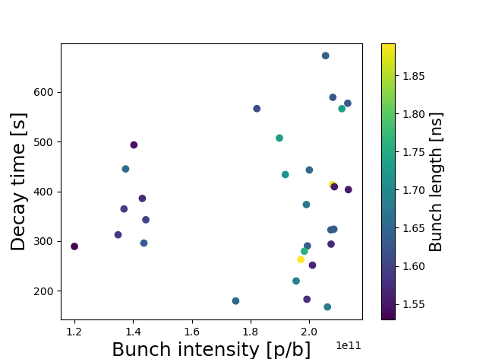
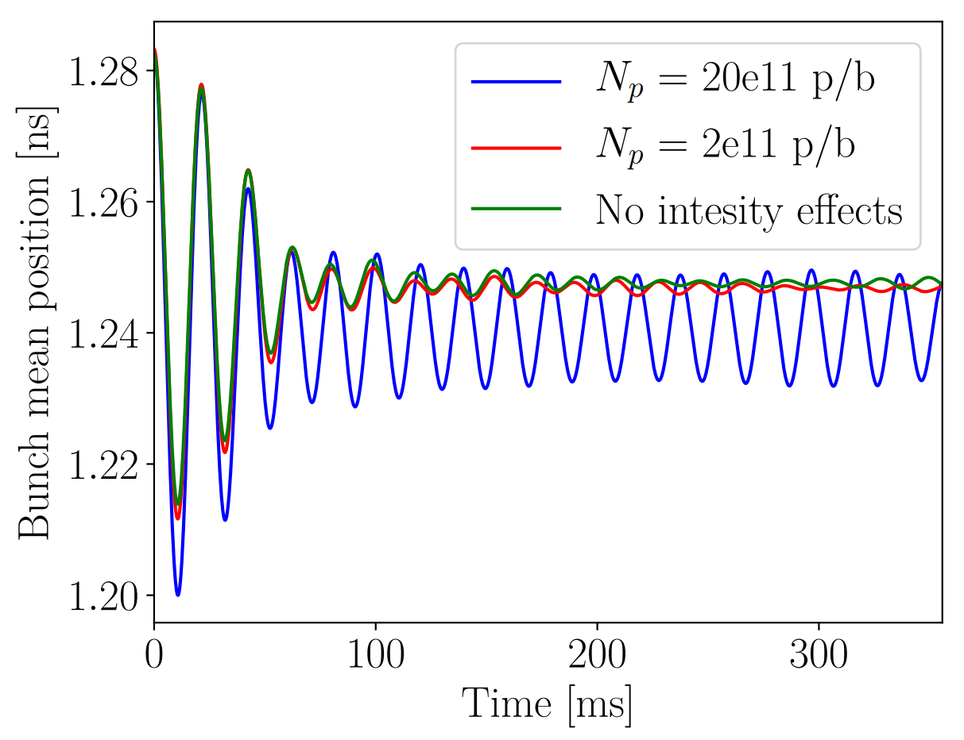
Instabilities at Injection (3)
BLonD simulations with
LHC impedance model
450 GeV, phase loop closed
LHC MD2042
Measured decay time: 300 s for 1.9×10¹¹ ppb, 1.7 ns (4 sigma) at injection
Simulated decay time: ~45 ms
To be studied

Slide 15
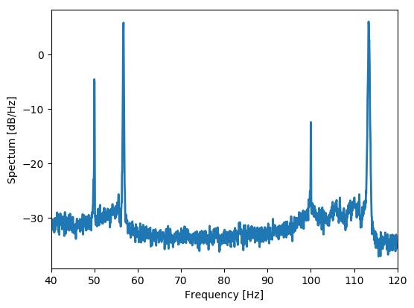
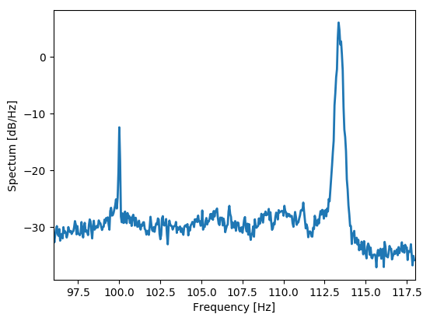
Schottky Spectrum at Injection
Suggests that the central synchrotron frequency at injection is closer to 56.7 Hz than the theoretical 55.2 Hz
  Could be explained with an RF voltage of 6.4 MV instead of 6 MV
Peak-detected Schottky spectrum at injection
To be studied

Slide 16
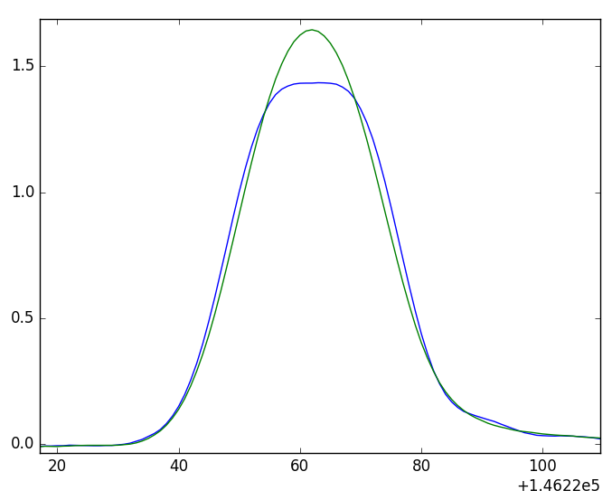
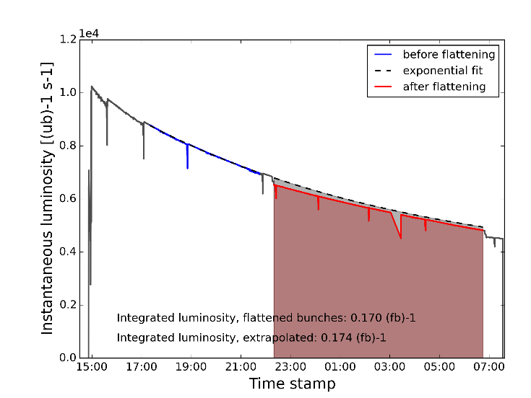
Bunch Flattening
Bunch length in physics could be adjusted, if necessary, using sinusoidal RF phase modulation; operational in the LHC since 2016
  Vertex reconstruction is not accurate enough for LHCb for bunch lengths < 0.9 ns (for one polarity)
Increases bunch length by 150-200 ps
Luminosity loss ~2.5-4.5 % in IPs 1&5
Loss-free mechanism
Before
After
ATLAS Luminosity, 6th August 2016
Bunch flattening in Stable beams
17th June 2016 (B2)

Slide 17
POWER AND FULL DETUNING
Limitations and Experience
Acknowledgements:
T. Mastorides, O. Brunner, C. Schwick

Slide 18
Available Power at Present
Klystron DC power: max. 550 kW
  Current limited by the power converter, max. ~9.5 A
  Voltage limited by the gun tank, max. ~58 kV
Klystron RF power: limited by the klystron efficiency
  Originally the efficiency was ~55 %, i.e. 300 kW
  With present settings, the efficiency has dropped to ~45-50 % for most klystrons, i.e. ~250-280 kW
    Can be reverted to the maximum efficiency settings
O. Brunner, private comm.

Slide 19
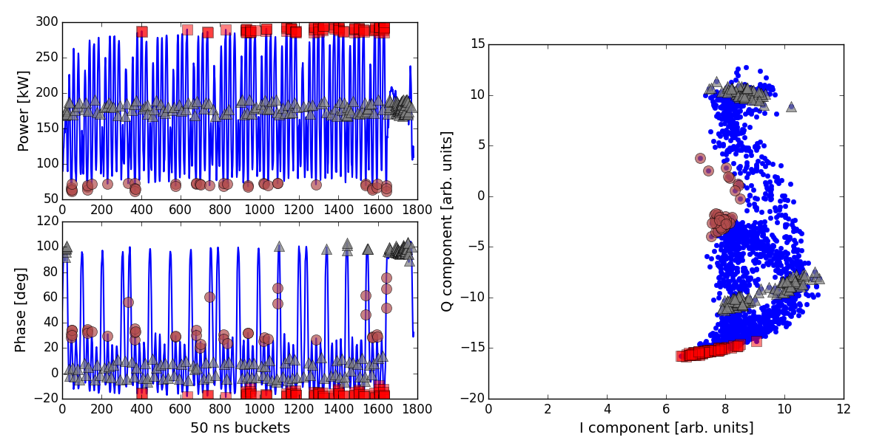
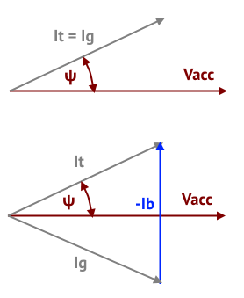
Recap: Half-Detuning
Till 2016: constant RF phase & amplitude in beam segment. Large power transients and mean power not minimal (2244 b, fill 4565, 02/11/2015):
↓ Beam present
↓ Beam absent
← Beam absent
← Beam present

Slide 20
Full Detuning: Concept
Idea: minimize the imaginary (reactive) part of the generator current
V₀ cavity voltage amplitude
Δω detuning of the cavity
φ(t) cavity phase along the ring
i_{b}(t) beam current amplitude
Choose Δω and φ(t) such that the second term vanishes.
T. Mastorides et al., PRSTAB

Slide 21
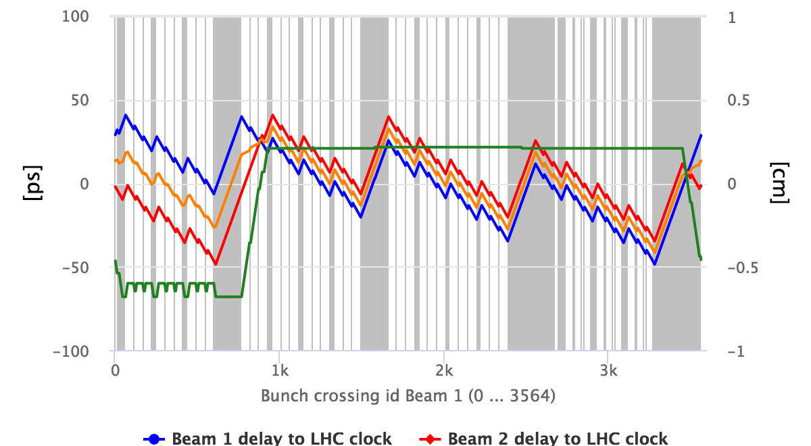
Full Detuning: Experience in Run2
Successfully commissioned in the beginning of 2017
  Was running reliably since
Logging for cavity voltage amplitude & phase was put in place
  Experiments use this to predict shift in collision time/position
↓ Beam absent in grey area
C. Schwick, LPC meeting
Phase delay Beam 1
Delay of collision
Phase delay Beam 2
Shift of IP in Z
For HL-LHC (in the 25 ns standard scheme and w/ a 3 μs abort gap): peak-to-peak phase modulation is
70 ps

Slide 22
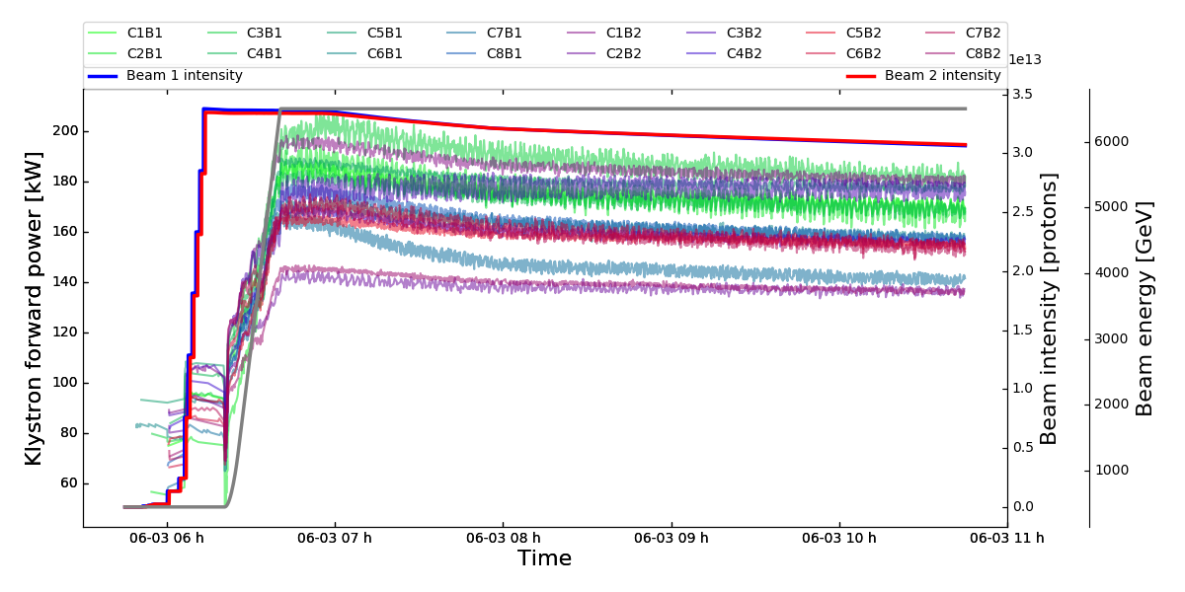
Full Detuning: Experience in Run2
With 2017 beam parameters, the (mean) power consumption at arrival to flat top was reduced to about 100 kW in all cavities
  Power required is independent on beam current
03/06/2017
Half detuning
Expect
190 kW @ 1.5 MV,
0.5 A DC
Estimated accuracy on power measurement ±20 %

Slide 23
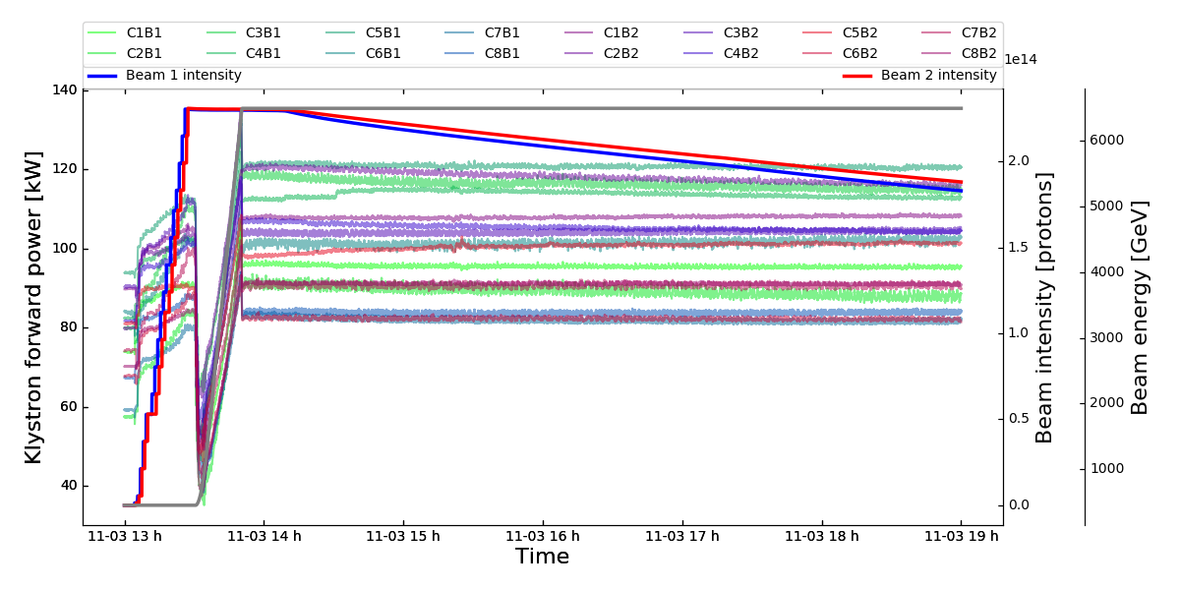
Full Detuning: Experience in Run2
With 2017 beam parameters, the (mean) power consumption at arrival to flat top was reduced to about 100 kW in all cavities
  Power required is independent on beam current
03/11/2017
Full detuning
Expect
104 kW at
1.5 MV, QL=60k
Estimated accuracy on power measurement ±20 %

Slide 24
Power Limitations at Injection (1)
The half-detuning scheme is still used at injection.
Full detuning is switched on adiabatically before the ramp.
  Power limitations of today remain
  Will need 8.5 MV (9.1 MV) instead of 6 MV (6.4 MV) at LHC injection to accomodate for larger dp/p spread coming from SPS after voltage upgrade (10 MV instead of 7 MV at flat top)
    To be studied: can we lower the injection voltage at the present?
Together with the increase in intensity, the power increases by a factor 2.86 in the half-detuning scheme, i.e. close to 300 kW
  Doable with baseline, but there is no margin
To be studied
BASELINE

Slide 25
Power Limitations at Injection (2)
If limiting, could think of serveral options
  Introduce voltage phase modulation at SPS flat top to inject into the LHC in the full-detuning scheme?
    C.f. beam loading in SPS displaces bunches within a batch by ±130 ps
  Upgrade RF amplifiers (new klystrons/IOTs, possibly new circulators)
    Not preferable
  Additional 400 MHz RF cavity
    Need less voltage per cavity
  Additional 800 MHz RF cavity
    Preferable for stability and provides also extra voltage
To be studied
OPTIONS

Slide 26
High-Harmonic RF System (1)
For stability considerations (ramp and flat top), the installation of an 800 MHz RF system is preferred to the 400 MHz one
  As a mitigation of LLD as it increases the spread in the synchrotron frequency distribution
  To mitigate the bunch length divergence of the controlled emittance blow-up
    All other CERN machines perform the controlled emittance blow-up in
    double-harmonic RF
  Also, with an 800 MHz system, having shorter bunches becomes feasible again

Slide 27
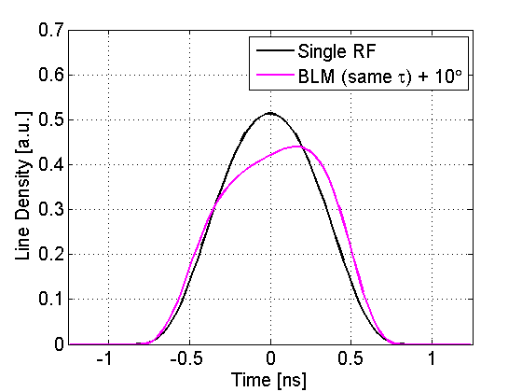
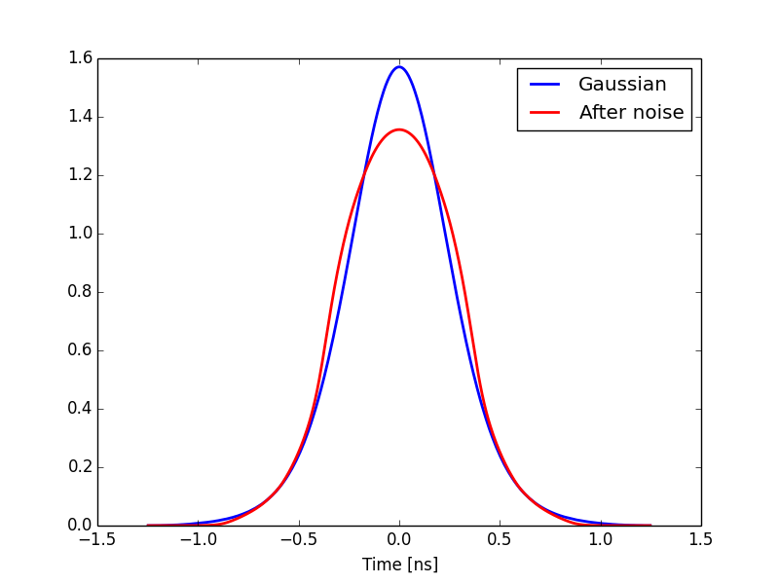
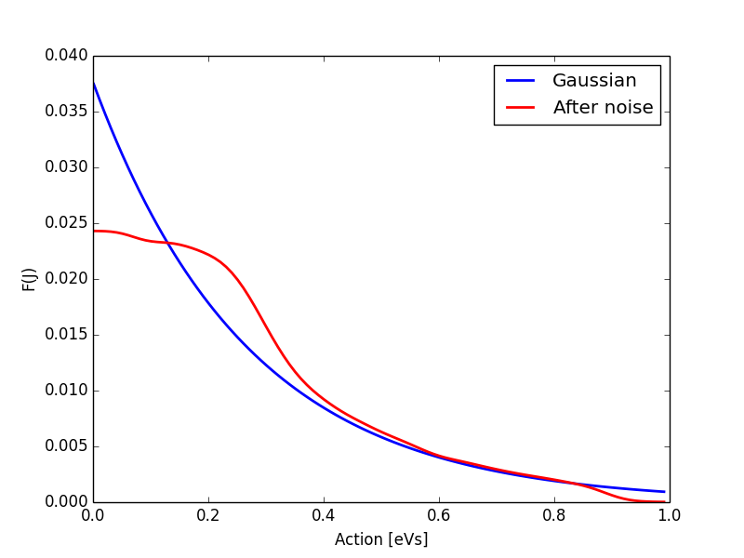
High-Harmonic RF System (2)
V₈₀₀/V₄₀₀ = 2
Given the full detuning, only
bunch-shortening mode is feasible
V₈₀₀/V₄₀₀ = 0.5
LHC controlled emittance blow-up in double-harmonic RF:
flattened bunch core

Slide 28
Conclusions
Baseline from RF point of view
  RF power available: 300 kW
    If limiting at injection, could install additional 400 MHz cavities
    For more stability (shorter bunch length), 800 MHz remains an option
  Full detuning during ramp and on flat top
  Bunch length: 9 cm r.m.s.
    Sufficient single- and coupled-bunch stability margin
Still some studies to be performed on
  Divergence of controlled emittance blow-up
  Instabilities at injection
  Coupled-bunch instability with full machine
  Power limitations and minimum voltage at injection

Slide 29
References (1)
Single-bunch loss of Landau damping
J. Esteban Müller et al., LHC Longitudinal Single-Bunch Stability Threshold,
CERN-ACC-NOTE-2016-0001, (2016).
J. Esteban Müller, Longitudinal Intensity Effects in the CERN Large Hadron Collider,
PhD Thesis, doi:10.5075/epfl-thesis-7077, EPFL, (2016).
E. Shaposhnikova and J. Esteban Müller, Longitudinal beam parameters and stability,
talk at the 6th HL-LHC meeting, 15/11/2017.
E. Shaposhnikova and J. Esteban Müller, Bunch length and particle distribution for (HL-)LHC,
talk at the HL-LHC WP2 meeting, 12/01/2017.
Coupled-bunch instabilities
J. Esteban Müller et al., LHC MD 652: Coupled-Bunch Instability with Smaller Emittance (all HOMs),
CERN Note CERN-ACC-NOTE-2017-0017, (2017).
T. Mastorides et al., RF system models for the CERN Large Hadron Collider with application
to longitudinal dynamics, PRSTAB 13, 102801 (2010).
P. Baudrenghien and T. Mastorides, Fundamental cavity impedance and longitudinal coupled-bunch
instabilities at the High Luminosity Large Hadron Collider PRSTAB 20, 011004 (2017).

Slide 30
References (2)
Controlled emittance blow-up and bunch flattening
H. Timko et al., LHC MD 1279: Bunch Flattening in Physics,
CERN Note CERN-ACC-NOTE-2017-0019, (2017).
J. Esteban Müller et al., LHC MD 232: Longitudinal Impedance Evaluation,
CERN Note CERN-ACC-NOTE-2017-0016, (2017).
Full detuning and power
D. Boussard, RF Power Requirements for a High Intensity Proton Collider,
PAC’91, San Francisco, USA, (1991).
J. Tückmantel, Adaptive RF Transient Reduction for High Intensity Beams,
MOPLS006, EPAC’06, Edinburgh, Scotland, (2006).
P. Baudrenghien and T. Mastorides, Proposal for an RF Roadmap towards Ultimate Intensity in
the LHC , MOPPC015, IPAC’12, New Orleans, USA, (2012).
T. Mastorides et al., Cavity Voltage Phase Modulation to Reduce the High-Luminosity Large
Hadron Collider RF Power Requirements, PRSTAB 20, 101003 (2017).
C. Schwick and J. Boyd, RF Detuning, talk at the LHC Machine Committee, 5th July 2017.
R. Calaga, HL-LHC RF Road-map, talk at the Chamonix workshop, 24th September 2014.

Slide 31
SPARE SLIDES

Slide 32
Beam Parameters (Slide from 2016)
Longitudinal beam parameters in single- and double-RF systems for stable operation at 7 TeV with minimum (average) bunch length
RF system | V1 [MV] | V2 [MV] | N_{th} [10¹¹] | Bunch length (4σ) [ns] | Emittance (2σ) [eVs] | dE/E (2σ) [10⁻⁴]
400 MHz | 16.0 | 0.0 | 2.2 | 1.2 (9 cm rms) | 3.0 | 2.36
400 & 800 MHz (BSM) | 16.0 | 8.0 | 2.2 | 0.85 | 2.1 | 2.32
400 & 800 MHz (BSM) | 16.0 | 4.0 | 2.2 | 1.0 | 2.5 | 2.34
200 MHz | 6.0 | 0.0 | 2.4 | 2.3 | 4.85 | 1.97
200 & 400 MHz (BSM) | 6.0 | 3.0 | 2.4 | 1.7 | 3.6 | 2.0
Based on single-bunch stability threshold (loss of Landau damping) for beam
With 10% spread in bunch length and assuming 10% margin (uncertainty in emittance blow-up and effect of SR damping)
BASELINE
E. Shaposhnikova, 6th HL-LHC meeting

Slide 33
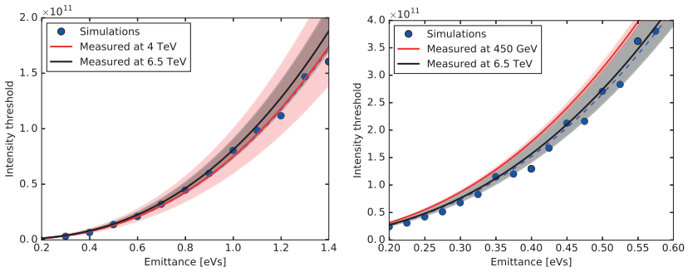
Present LHC Threshold
Single-bunch loss of Landau damping
450 GeV, 5 MV
4 TeV, 12 MV
J. E. Müller, PhD thesis

