Slide 1
First Experimental Results on Damage Limits of
Superconducting Accelerator Magnet Components due to Instantaneous Beam Impact
V. Raginel, M. Bonura, D. Kleiven, K. Kulesz, M. Mentink, R. Schmidt, C. Senatore, A. Siemko, A. Verweij, A. Will, and D. Wollmann
7th HL-LHC Collaboration Meeting, 13.-16.11. 2017, CIEMAT Madrid

Slide 2
Motivation of the study – HL-LHC ultra-fast failure
Injection Failure LHC
LHC BEAM
particle shower
Quench ! Damage ?
Injection kicker magnet
Superconducting magnet
Injection absorber
One such event per year in today’s LHC. No damage.
For HL-LHC beam, peak energy deposition of 100 Jcm⁻³ in the D1 magnet without mask [1] – similar in Q5 in case of asynchronous beam dump [2].
Will the magnets survive?
What are the damage mechanisms and limits of superconducting magnets ?
[1] A. Lechner et all, Protection of superconducting magnets in case of accidental beam losses during HL-LHC injection, In Proceedings of IPAC15
[2] B. Auchmann et all, Quench and Damage Levels for Q4 and Q5 Magnets near Point 6, CERN EDMS 1355063, 2014
Notes:
Will the magnet survive? = Will it be still operational after beam impact?

Slide 3
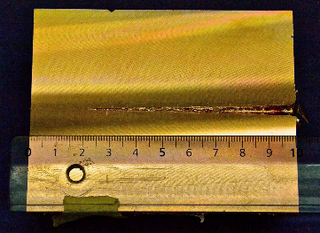
Beam – matter interaction
The fast (μs) interaction of an high energy beam with matter leads to:
  Temperature rise Ieading in the worst cases to phase transition (melting, vaporization, plasma ….).
  Dynamic stresses that can lead to extended mechanical damage - deformations, cracks.
Damage experiment on solid copper
Burkart, F., et al. Journal of Applied Physics 118.5 (2015): 055902.

Slide 4
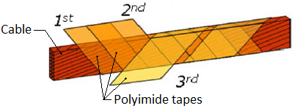
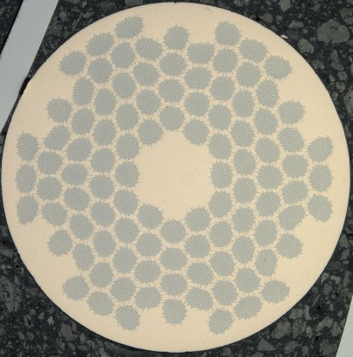
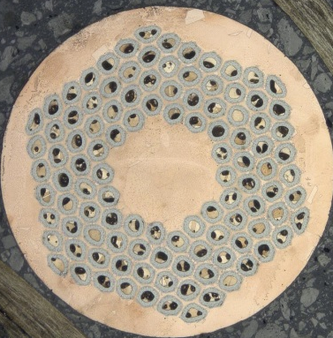
Magnets most sensitive parts
Polyimide insultation
Decomposition of the polyimide when expose to high temperature
  Reduction of the dielectric strength
Fessia, P., et al. IEEE Transactions on Applied Superconductivity 20.3 (2010): 1622-1625.
Nb-Ti and Nb₃Sn superconducting cables
Reduction of the J_{c} induced by:
  High temperature
  Mechanical stress, deformation and cracks
200 μm
200 μm
Nb-Ti strands (LHC dipole)
Nb₃Sn RRP type (HL-LHC triplet)

Slide 5
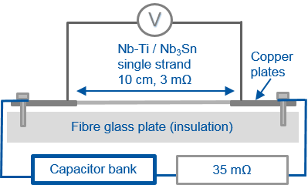
Experimental Road Map
Polyimide insulation degradation due to heating over hours [1]
  Cable stacks heated over hours in furnace between ~460 K and ~860 K.
  Polyimide dielectric strength measured with high voltage.
J_{c} degradation of Nb-Ti and Nb₃Sn due to heating over seconds [2]
  Nb-Ti and Nb₃Sn single strands heated up between ~640 K and ~1250 K using a capacitive discharge.
  Strand were in air at room temperature.
  J_{c} degradation measured via
  magnetization measurements
  Identification of degradation mechanisms
  via microscopic analysis
Degradation of polyimide insulation and of Nb-Ti & Nb₃Sn critical current density induced by impact of a 440 GeV proton beam
[1] V. Raginel, et al, “Degradation of the insulation of the LHC main dipole cable when exposed to high temperatures”, IPAC’16
[2] V. Raginel, et al, “Change of critical current density in Nb-Ti and Nb3Sn strands after millisecond heating”, IPAC’17

Slide 6
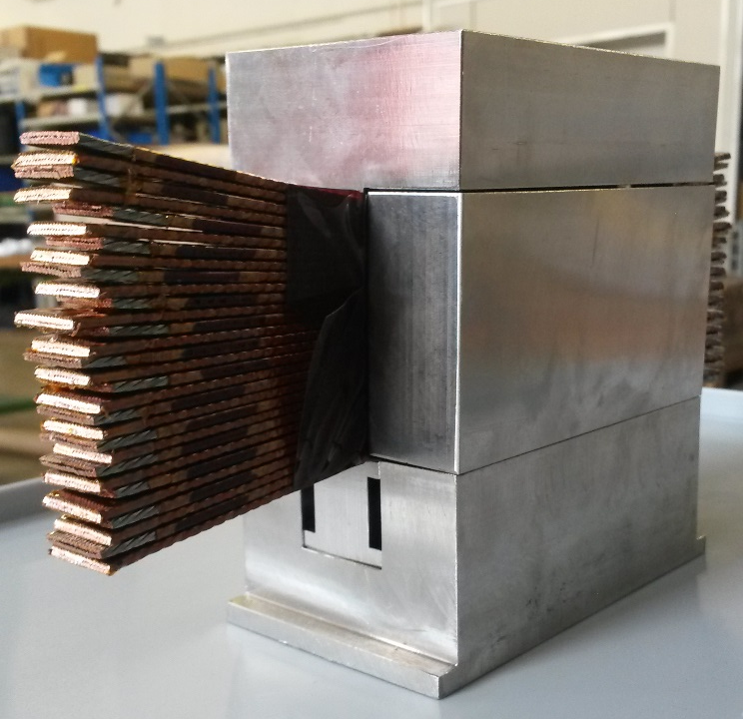
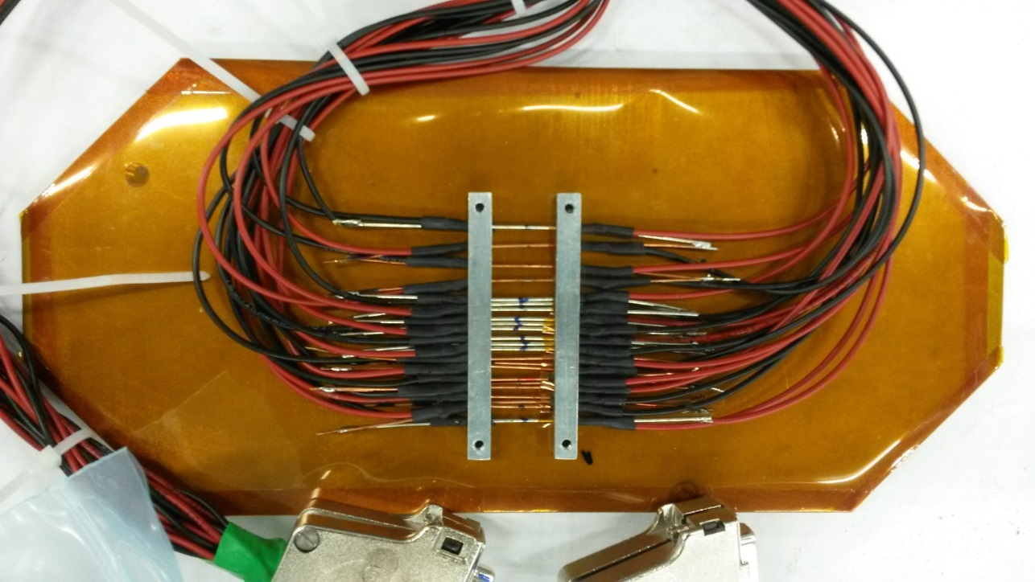
Beam Experiment: Samples
At CERN HiRadMat facility sending 440 GeV proton beam pulses on:
Samples at room temperature within an inert atmosphere (Argon).
Nb-Ti & Nb₃Sn strands
30 Nb-Ti cables
~ 5 cm

Slide 7
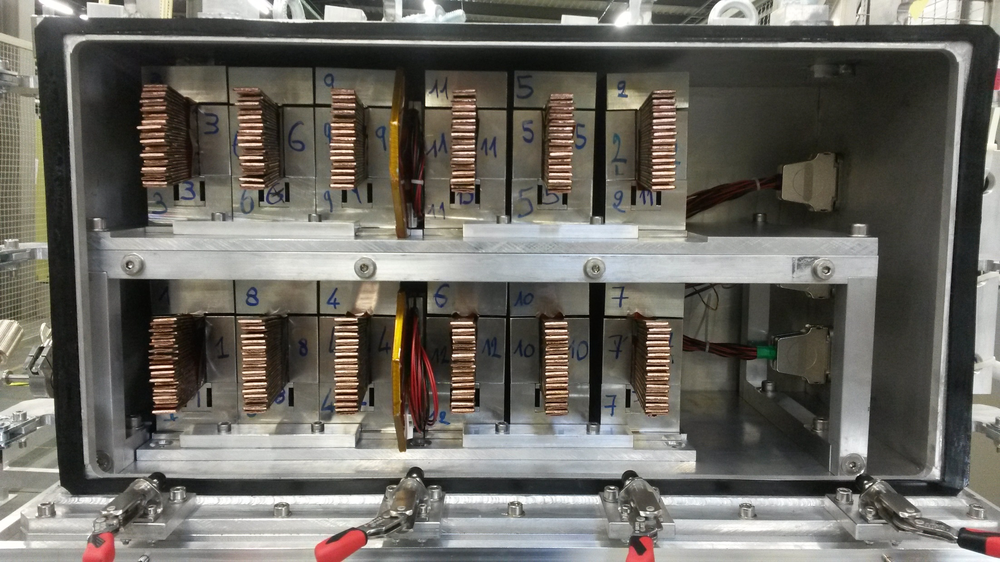
Experimental setup
Nb-Ti cable stacks
in steels moulds
Nb-Ti and Nb₃Sn strands fixed on a steel plate
Second Picture with the tank open

Slide 8
Experimental setup
p+
6x10¹¹ p+
Second Picture with the tank open
1.3x10¹² p+
2.6x10¹² p+
933 K 1026 K
445 K
823 K
1035 K
960 K
882 K
706 K
V. Raginel, D. Wollmann

Slide 9
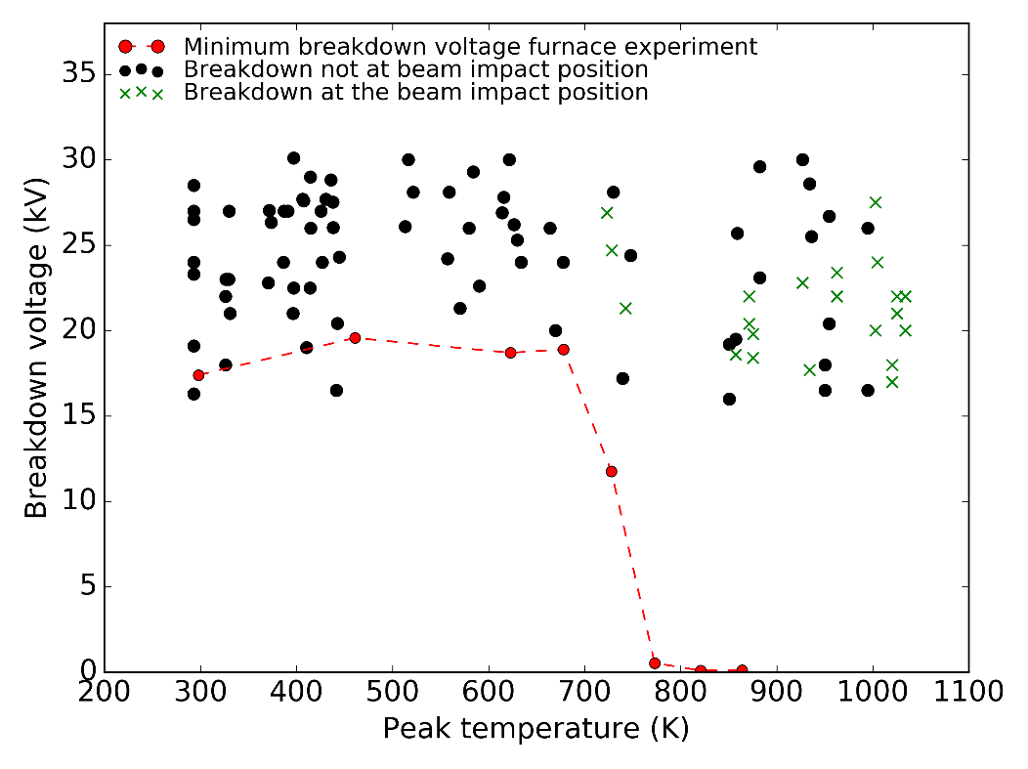
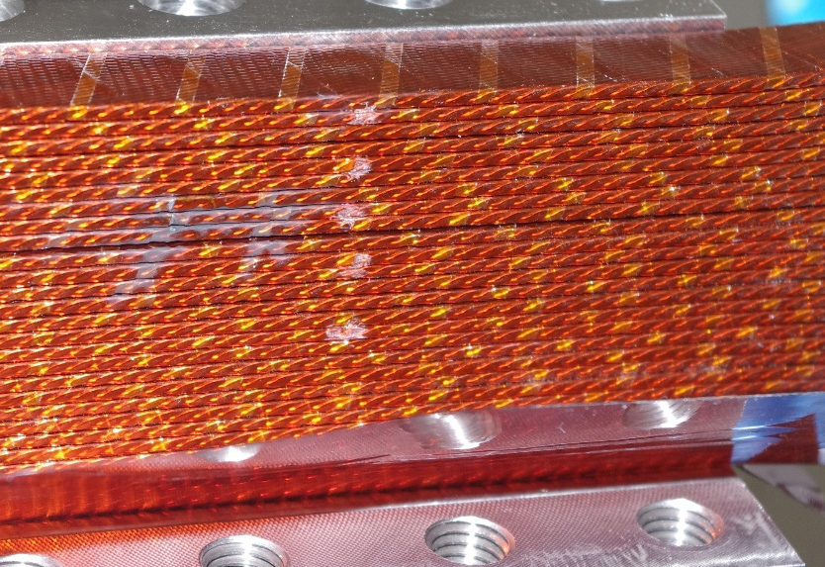
Polyimide insulation degradation
beam impact
Side view of a Nb-Ti cable stack after beam impact
Degradation due to chemical decomposition as function of temperature and exposure time.
No degradation measured after beam impact – temperature up to ~1050 K (2.5 kJ cm⁻³) for few ~ms
  Weakening of the insulation at the point of the beam impact was observed for T > 850 K (1.9 kJ cm⁻³).

Slide 10
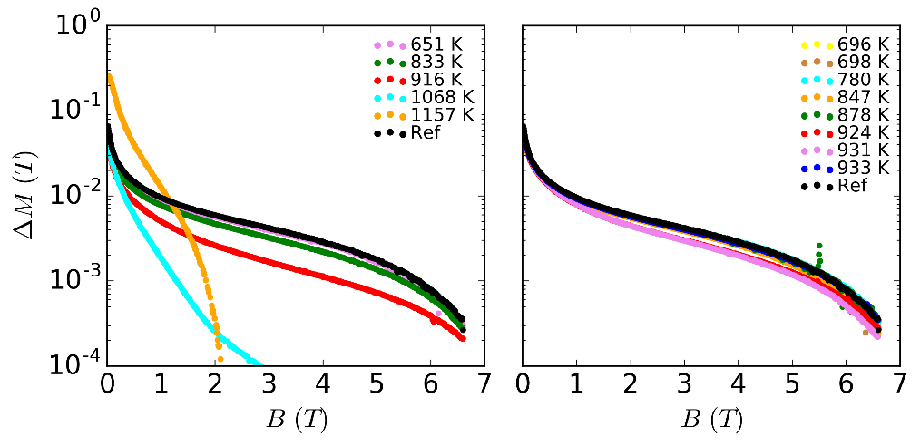
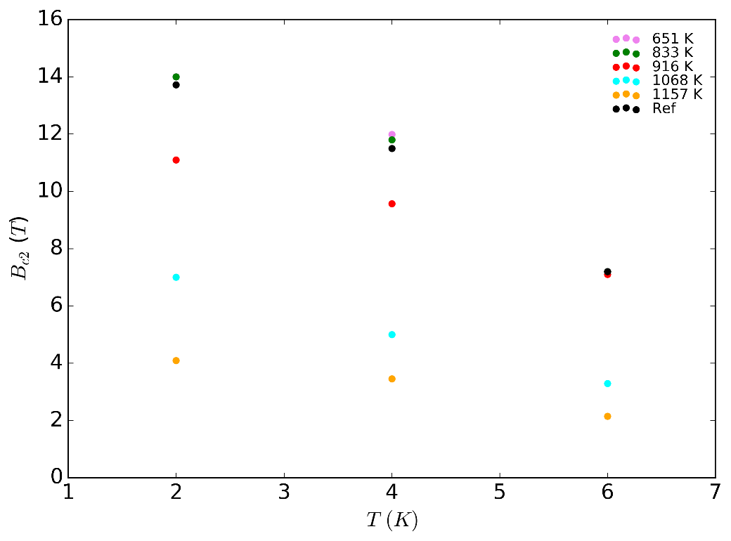
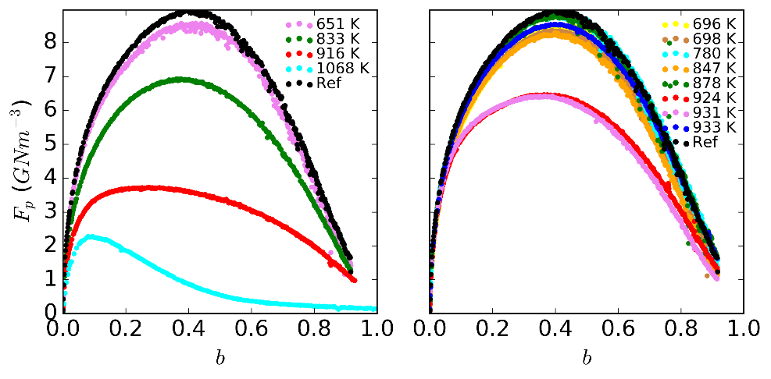
J_{c} degradation of Nb-Ti
Capacitive discharge
Beam impact
Capacitive discharge, ΔM degradation (∝ J_{c}) above 651 K
After beam impact, ΔM degradation above 878 K (2.2 kJ cm⁻³)
F_{p} decrease and F_{pmax} shifts toward lower b.
Change of pinning behaviour
Decrease of B_{c2}(T) for T ≥ 916 K in discharge case. No decrease for beam case.
Variation of Ti content in filaments
@ 6 K
@ 6 K
@ 6 K
ΔM ∝ J_{c} x d_{f}
@ 6 K
F_{p} = J_{c} x B
b = B / B_{c2}(T)

Slide 11
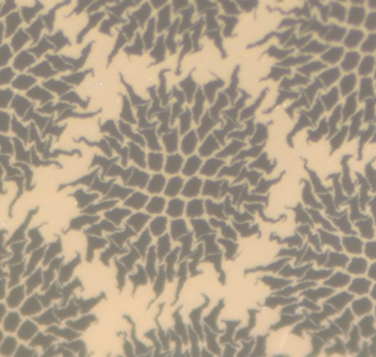
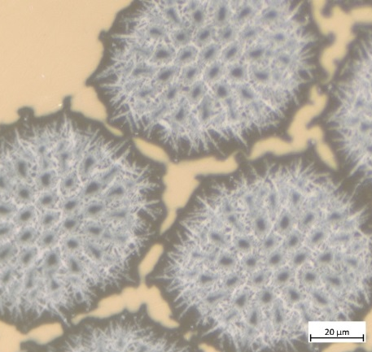
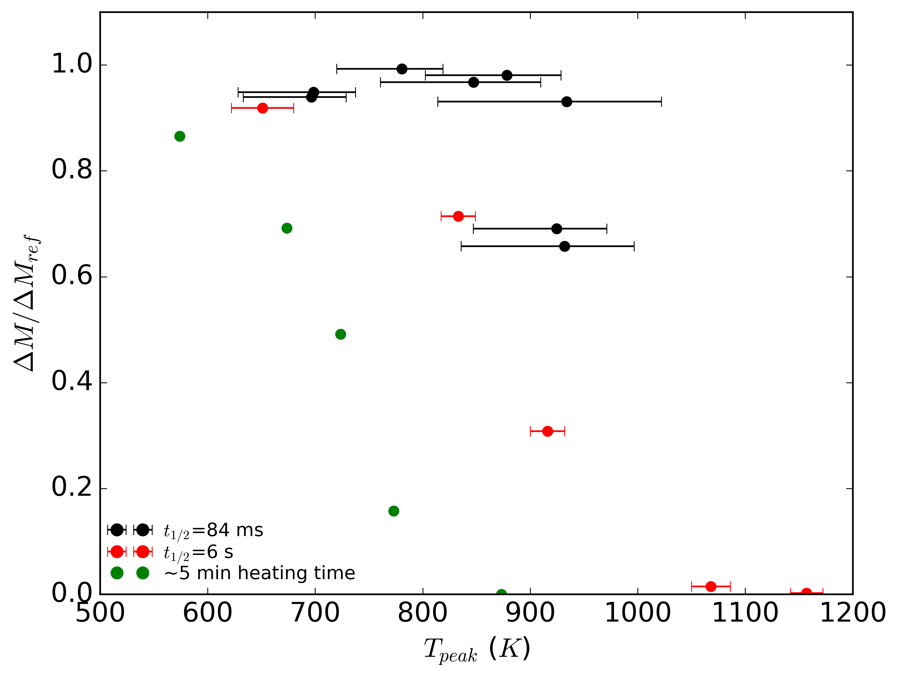
J_{c} degradation of Nb-Ti
Ref
1157 K
At T=1157 K (discharge case), filament merging is observed
J_{c} decreases with increasing exposure time
Diffusion process & change of pinning behaviour
Degradation of J_{c} caused by variations of α-Ti precipitates size and spacing
If higher temperature or longer exposure time, Ti diffuses outside filaments to form Cu-Ti compound
=> B_{c2}(T) reduction, filament merging
Nb-Ti
@ 4 K and 5 T
*
* C. Scheuerlein et all., Journal of Physics: Conference Series, vol. 234, no. 2. IOP Publishing, 2010

Slide 12
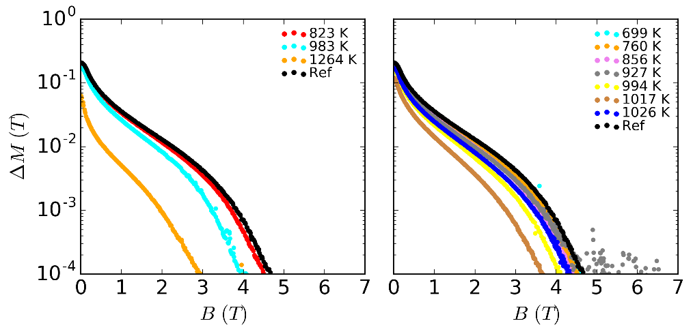
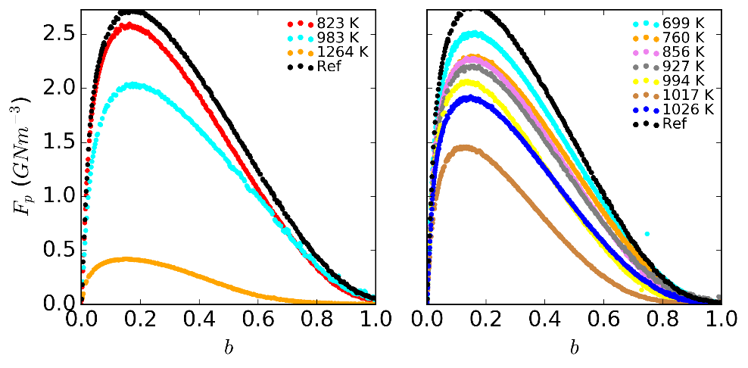
J_{c} degradation of Nb₃Sn
Capacitive discharge
Beam impact
Ref.
Capacitive discharge, J_{c} degradation for T > 823 K
All samples degraded after beam impact, T ≥ 699 K (1.4 kJ cm⁻³)
F_{p} decrease and no shift of F_{pmax}
No change of pinning behaviour
No grain growth observed (SEM analysis)
Decrease of B_{c2}(T) not observed, however Tin content measurements are planned
@ 15 K
@ 15 K
1264 K
@ 15 K
@ 15 K

Slide 13
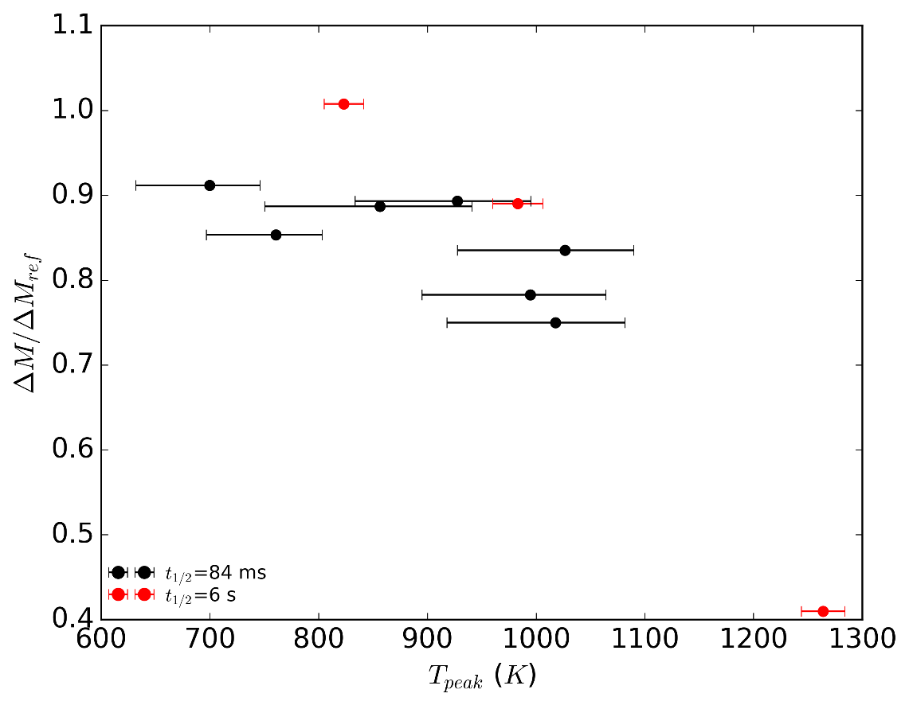
J_{c} degradation of Nb₃Sn
Contrary to Nb-Ti, J_{c} decreases with decreasing exposure time
Indication degradation due to beam impact is dominated by stresses and potentially cracks caused by fast heating and high thermal gradients
Further investigations to identify the origin
@ 4 K and 5 T

Slide 14
Conclusions and Outlook
Polyimide insulation
  No degradation induced by beam up to 1050 K, however observation of a weakening for T > 850 K (1.9 kJ cm⁻³)
  Chemical decomposition due to exposure to high temperature
Nb-Ti strands
  J_{c} degradation for peak temperatures above 900 K (2.2 kJ cm⁻³) in case of (single) beam impact
  Degradation dominated by diffusion processes
Nb₃Sn strands
  J_{c} degradation due to beam impact observed in all samples
  – lowest peak temperature 700 K (1.4 kJ cm⁻³)
  Grain growth is excluded. Further investigations to identify degradation mechanism
  Probably caused by stresses and cracks induced by the fast heating and high thermal gradients
Experimental validation of results with beam at liquid Helium temperature scheduled for mid-2018

Slide 15
Acknowledgements
TE/MPE: R. Denz, F. Boisier, F. Rodrigues-Mateos, J. Mourao, M. Favre, M.J. Bednarek, B. Auchmann, M. Valette
TE/MSC : C. Scheuerlein, A. Ballarino, D. Richter, A. Bonasia, S. Luzieux, G. De Rijk, N. Bourcey, D. Tommasini, R. Lopez, P. Fessia
TE/VSC: G. Bregliozzi, J. Finelle
BE/RF: G. Mcmonagle, G. Ravida
HiRadMat team: A. Fabich, A. Bouvard, V. Clerc
EN/MME: M. Guinchard, O. Sacristan Frutos, M. Meyer, S. Sgobba
EN/STI: D. Grenier, A. Lechner

Slide 16
Thank you for your attention!
Questions?

Slide 17
Spare slides

Slide 18
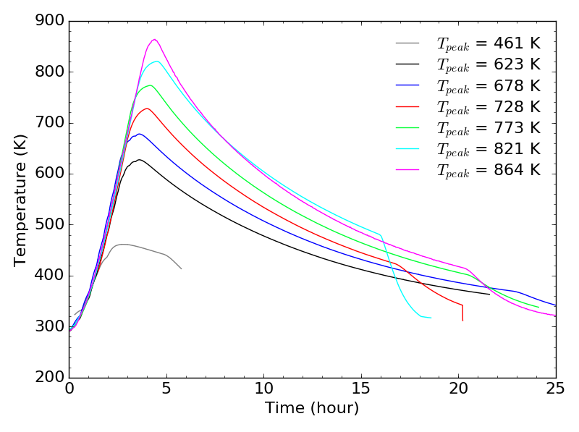
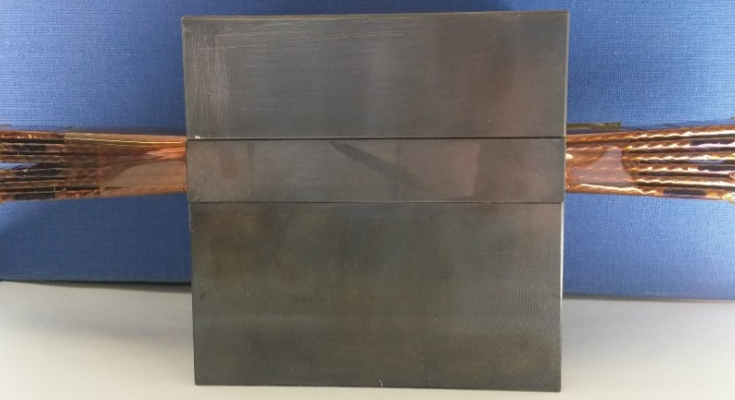
Insulation degradation due to hours heating
Insulated cable stacks heated over hours in furnace between 461 K and 864 K in inert atmosphere (Argon).
Dielectric strength is measured via cable-to-cable breakdown voltage measurement after heat treatment.
25 cm
~7 hours
Stack of 6 Nb-Ti cables
Vivien Raginel

