Slide 1


Interlocking for HiLumi –
What will be different?
HL Annual Meeting Madrid 13 – 16 November 2017
J. Uythoven
Many thanks to A. Antoine, A. Balatsoukas, R. Bruce, D. Hugle,
C. Martin, R. Mompo, I. Romera, R. Secondo, J. Steckert,
M. Valette, D. Wollmann

Slide 2
Interlocking for HiLumi –
Why it will be different
Differences because of new HL systems – new hardware to be interlocked with different failure modes
  11 T magnets in Point 7
  Inner triplet CLIQ and Quench Heaters
  Crab Cavities
  Hollow e-lens (optional)
  Beam-Beam wire compensators (optional)
  New collimators (TCTs and TCLs)
New interlocking hardware
New Failure modes due to different operational parameters – pushing performance

Slide 3
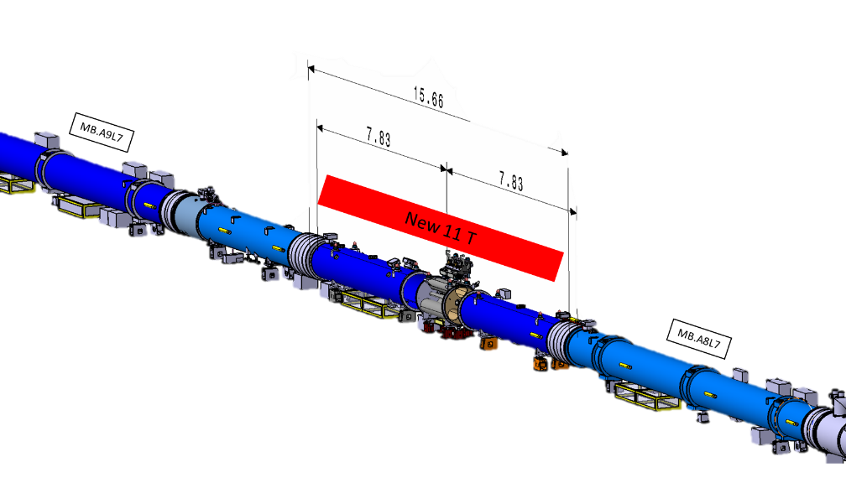
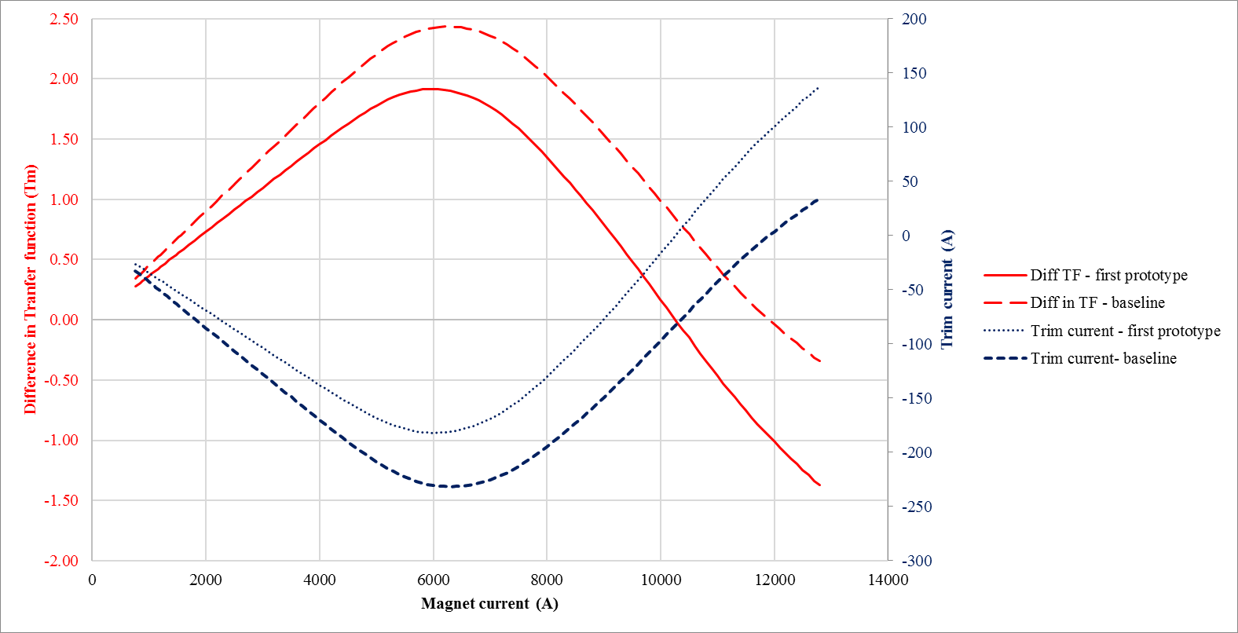
New HL Systems: 11 T Magnet (1/3)
See edms #1764166, 4.3
Two standard RB dipoles replaced by 11 T dipoles at Point 7,
giving the additional required
space for collimators in the centre.
  MBA.B8L7 & MBB.B8R7
The 11 T magnets are connected in series with the RB circuit
Difference in transfer function between 11 T and standard RB dipoles compensated by a trim circuit powering the11 T magnets
  Trim current between -200 A
  (-250 A) and +150 A (+100 A)
  Installed in the odd side of the IP

Slide 4
New HL Systems: 11 T Magnet (2/3)
Required interlocking of the trim circuit:
Event | Action
 | Dump | FPA Both | SPA main | SPA Trim
Quench of RB or 11 T circuit | X | X*
Powering failure RB circuit | X |  | X
Powering failure Trim circuit | X |  |  | X
Switch opening requested by PC of RB | X | X
Cryo failure | X |  | X | X
* How ?

Slide 5
New HL Systems: 11 T Magnet (3/3)
PIC RB quench loop odd side
PIC RB quench loop even side
PC ±250A
PIC
odd
3 km QPS
RB quench loop
11 T trim proposal
QPS
QPS
PIC
even
PC 13kA
PIC 11T quench loop
Requirement of new PIC functionality linking two hardware loops to be confirmed – check failure mode
Independent operation of main and trim circuits
  Clear diagnostics in case of trim PC interlock
  No changes to general PIC layout – trim circuit will be like any other circuit
  The trim quench loop will be opened by the PIC in case of demand by the Global Protection being active → no hardware modification of PIC required
  Possibility to back-up the Global Protection function between the two circuits in hardware, linking the two loops
    This would require some new hardware development and would make these 2 PICs non standard
    To be determined if this is required → check of detailed failure modes, could not performing a FPA on the trim circuit damage the magnet?

Slide 6
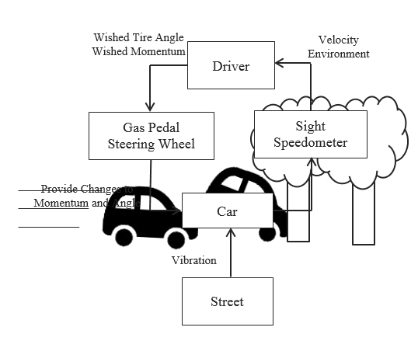
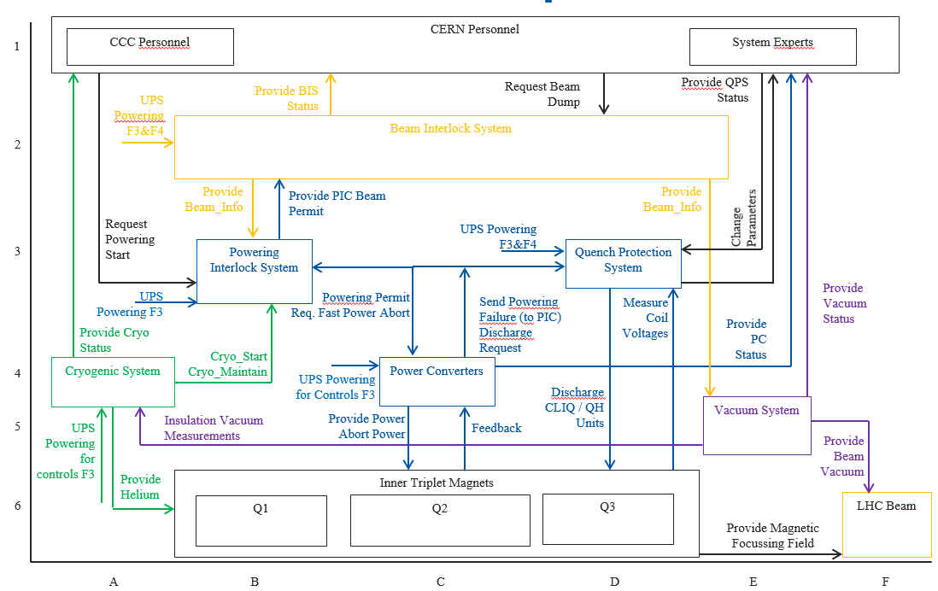
New HL Systems: Inner Triplet
Quench Protection using novel CLIQ system being defined in detail
  Re-triggering of Quench Heaters and CLIQs in case off erratic being defined in detail
    Protection of the circuits & magnets
    Need to ensure to dump the beam before firing the Quench Heaters
A faster quench loop controller as for the main circuits ?
  Does the PIC quench loop need its own source for the triplet as well?
  Do we need better / different / faster PIC diagnostics, can this affect the PIC2 design
  More details needed
Failure Analysis HL Inner Triplet Protection using System Theoretic Process Analysis (STPA): MSc.-thesis by Dennis Hugle
150 Potentially unsafe control actions which need to be checked & covered

Slide 7
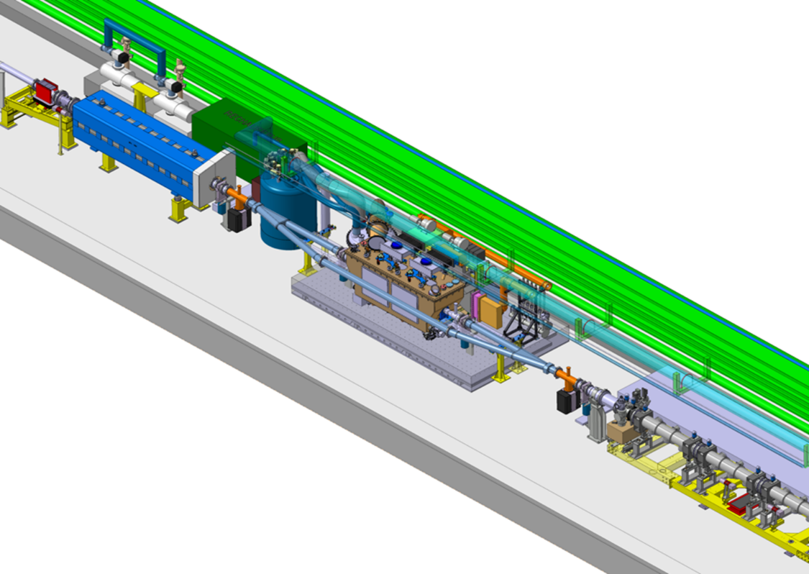
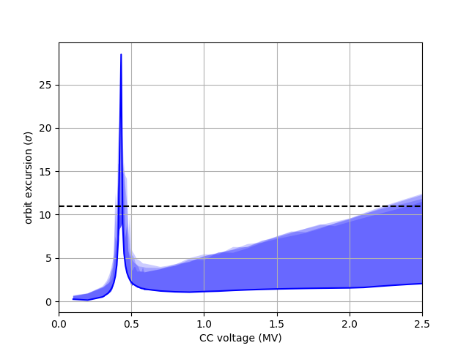
New HL Systems – Crab Cavities (1/2)
First Milestone is the installation of two HL-LHC crab cavity modules in a single cryomodule in the SPS for 2018
Spec in edms #1843638 (under prep.)
55 GeV
Test programme foresees to check on cavity failure modes
Resonant excitation in case of phase detuning failures at low voltage
SPS vertical aperture

Slide 8
New HL Systems – Crab Cavities (2/2)
SPS
  Interlocking based on two User Inputs to the BIS
  SPS Ring BIS → equivalent in the LHC: needs one CIBU
    RF should be OK, including HOM power
    Additional BLMs and BPMs: to be checked if we need them for HL
  SPS extraction BIS if cavity is ‘in beam’ → aperture restriction, does not apply to LHC
  Interlocking for Personal Safety due to dark current (different chapter, for SPS the CC will be an EIS)
HL-LHC
  Need most likely one CC BIS entry in case of CC problems
  Fast crab cavity failure modes and effect on beam under study
    Learn from the beam experiments in the SPS
  Up to 1.5 σ / turn → fast detection at the Primary Collimators (see later)
  Need fast detection – not a faster BIS
    BIS signal travel time from IP7 to IP6 is already very fast (not redundant)

Slide 9
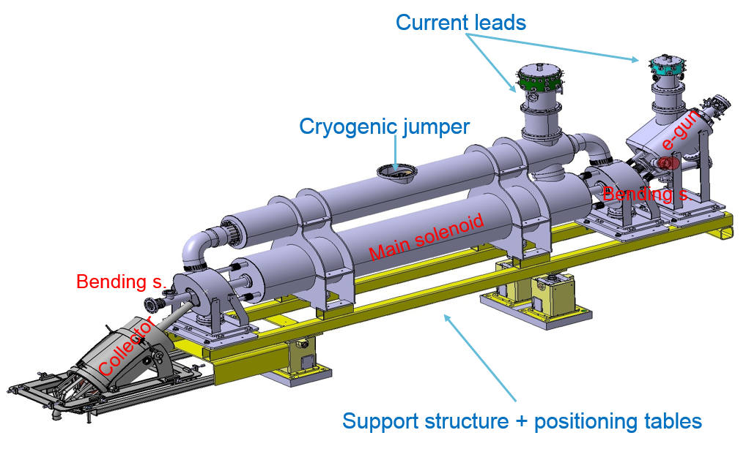
New HL Systems – Hollow e-lens
Not baseline. Will need to have an input to the PIC,
like other sc magnets
  Interlock on solenoids and bends
  In case of quench, missing dipole
  kick could cause losses
  To be checked if reaction
  time is an issue
The challenge will be the operation without beam tails
  No tails – BLMs don’t see the big losses coming → core of the beam directly hitting the collimator → very fast rise time of losses
  Mitigate by witness bunches with untouched or blown-up halo
  If important for machine protection: how can we in hardware guarantee the presence of tails ?
    This might be one input to the BIS, but we need the detection system !
  If depleted halo is obligatory (like for crab cavity failures) → need to interlock as well on depletion of tails of the majority of the bunches → need more details !

Slide 10
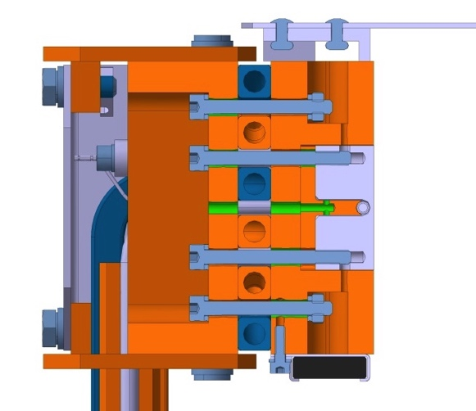
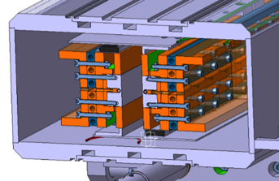
New HL Systems – New Collimators
Tungsten inserts
(Inermet® IT180)
BBLRC wire
Wire in-jaw collimator
  Not part of the baseline but already 2 → 4 installed in the LHC
  The overheating of the wire is protected by a connection to the WIC – standard warm magnet interlock control system – based on voltage measurement over the wire
    Voltage measurement will need a more reliable solution – isolation amplifier etc. – if it becomes baseline
  No dangerous failure modes to the beam detected, but to be interlocked
If crystal becomes part of baseline, few more changes to the interlocking, but nothing fundamental
TCTs and TCLs
  No difference relative to today
  Possibly SIS interlocks on the TCT BPMs

Slide 11
New Interlocking Hardware
All interlock systems will by the time of LS3 have obsolete electronics, V2 of all interlock systems:
  BIS2, SMP2, PIC2, FMCM2, WIC2
Following the above, the Functional Specification of these systems is not going to be very different from the present systems - see previous slides
Only system where development has started is the Beam Interlock System BIS, with the intermediate version BIS1.23 which could be implemented for 2023 if required
  Optical part of the BIS: weakest part of a strong system – for which an alternative is presently being studied

Slide 12
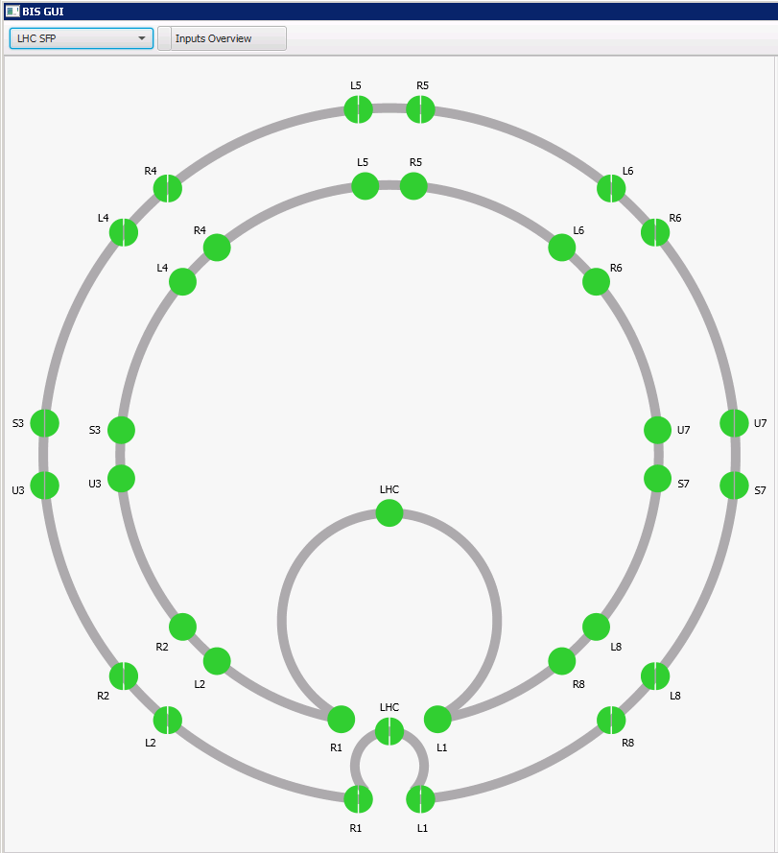
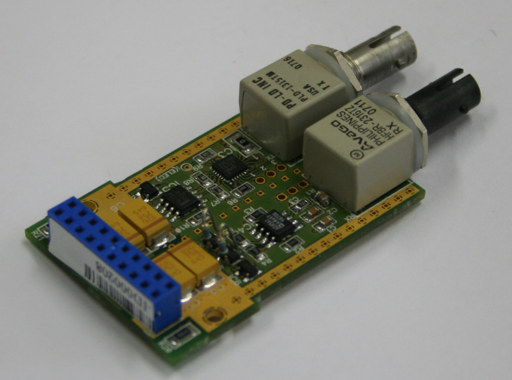
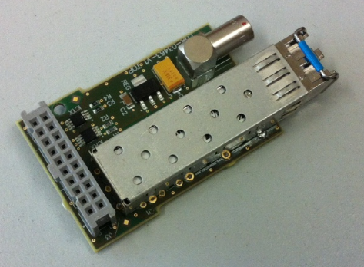
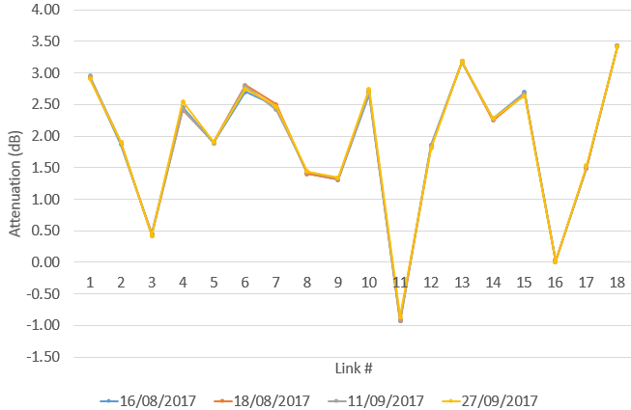
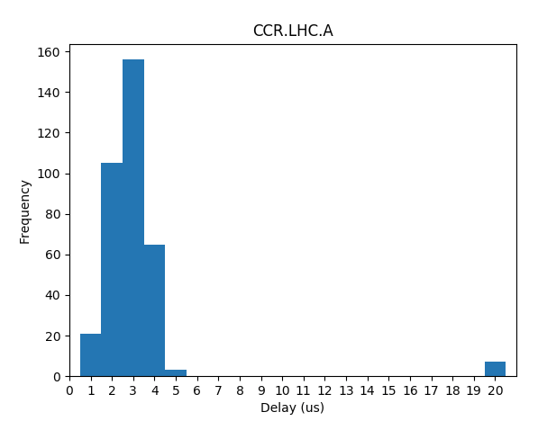
Beam Interlock System Developments
Current CIBO module:
- Home made
- Low power margin
- High temp drift
- No monitoring
New SFP module:
- Industrial standard
- High output power
- Low temp drift
- Monitoring function
Two new BIS loops have been installed in parallel of the operation LHC BIS loops
Data Aug – Oct 2017
Few explained exceptions
Measured attenuation of new LHC optical fibre links installed in the LHC: Very Stable !
Don’t need to disconnect to measure the power
Delay in μs between operational and test loop local permit when beams are dumped: OK

Slide 13
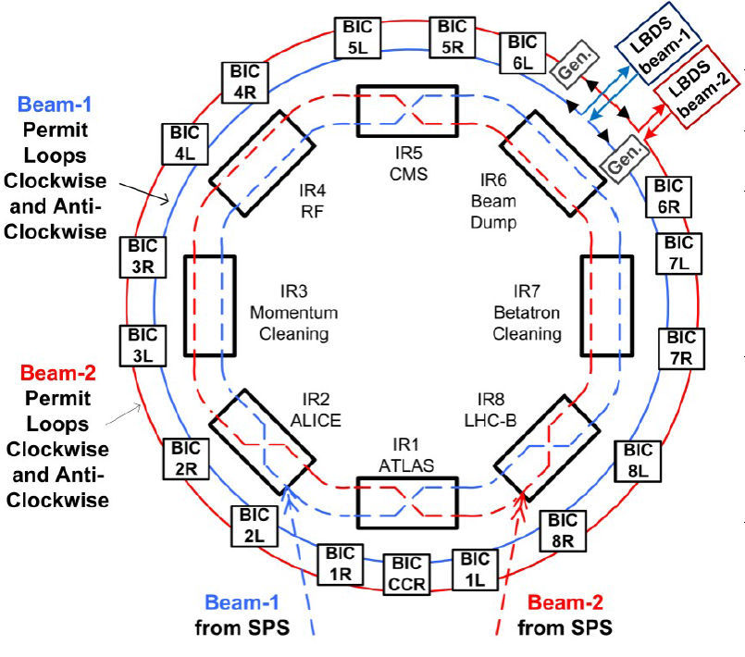
BIS → BIS 1.23 → BIS 2
LS2* LS3
*If required
Expected changes in Functional Specification
  Number of users per Beam Interlock Crate
  Also issue for SPS
  Rigidity of inputs B1 – B2 – Both Beams and Maskable or not
Expected changes Technical Specification
  Power monitoring of optical loops
  Bus system – stay with VME ?
  Use of a third optical loop for monitoring ?
  Link to Safe Machine Parameters
Unchanged
  Reliability
  Delay
  Modularity and scalability
  Standard User Inputs
BIS 1.23 Tests:
For 2018 include additional TSU from Beam Dumping System in the test loop
Introduction of ‘False’ frequency

Slide 14
Conclusions: Interlocking HL-LHC
HL-LHC will be more critical to operate
  Very high intensity bunches, fast instabilities – like 16L2 – need a very reliable beam interlocking system
  The criticality of having depleted tails and the presence of witness bunches need to be studied in further detail for specific failure modes
  This might require new (redundant) hardware; fast detection systems in IP7; dI/dt on witness bunch with ADT?
  If BB wire collimator: more reliable interlocking as input to the WIC required
Effect on the interlock systems
  Additional clients to the BIS which would be covered by present system
  Minor effect on the V2 of the present interlock system is expected
  BIS V2 will not need to be faster – fast failures to be caught by the beam at the TCP/TCS in point 7
  PIC V1 for 11 T might need to link two quench loops in hardware – non standard – study of failure modes ongoing to determine if this required
  PIC V2 design needs further input / study of requirements for inner triplet protection
BIS V2
  First promising tests in the LHC of new optical loops using SFP. Tests with TSU foreseen for 2018.

