Slide 1

Crab Cavity failures: parameters and combined failures
Matthieu Valette, D. Wollmann, B. Lindstrom,
A. Santamaria Garcia, K. Sjobak
CERN
7th HiLumi meeting – Madrid - 14 November 2017

Slide 2
Outline
Introduction: Crab Cavity failure studies
  Main failure parameters
  Dependency of losses on phase advance
  Passive protection from phase advance
  Interlocking
Combined failures associated with CC failures
  Missing beam-beam kick scenarios during dumps
  Associated orbit shift and losses
Conclusion and outlook

Slide 3
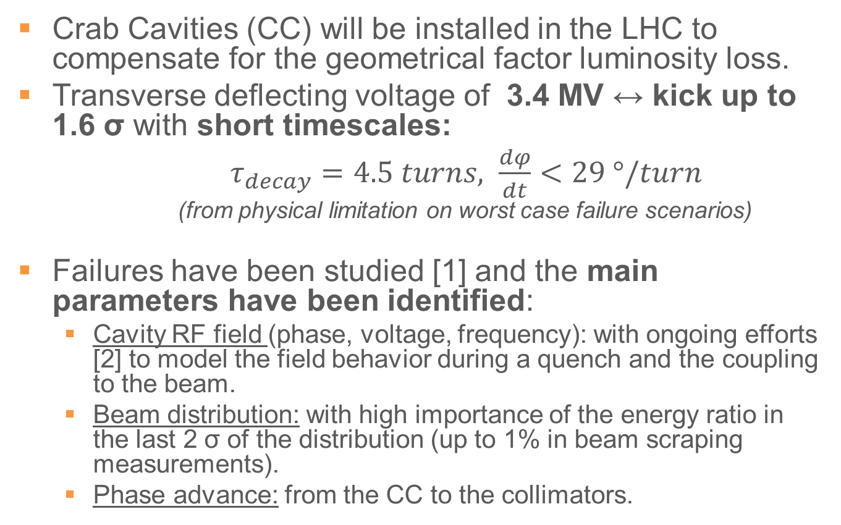
Crab Cavities Failures Studies
Crab Cavities (CC) will be installed in the LHC to compensate for the geometrical factor luminosity loss.
Transverse deflecting voltage of 3.4 MV ↔ kick up to 1.6 σ with short timescales:
$τ_{decay}=4.5 turns, \frac{dφ}{dt}<29 °/turn$
(from physical limitation on worst case failure scenarios)
Failures have been studied [1] and the main parameters have been identified:
  Cavity RF field (phase, voltage, frequency): with ongoing efforts [2] to model the field behavior during a quench and the coupling to the beam.
  Beam distribution: with high importance of the energy ratio in the last 2 σ of the distribution (up to 1% in beam scraping measurements).
  Phase advance: from the CC to the collimators.
[1, Crab Cavity Failure Studies Meetings 1-8]
[2, Modeling the Low Level RF Response on the Beam during Crab Cavity Quench, IPAC’17, K. Sjobak et al.]

Slide 4
Phase advance to the collimation system
The losses during failures studied until now (voltage drop, phase jump, detuning) depends strongly on the phase advance from the CC to the TCP [3].
  E.g. 5-turn losses for a 60⁰/turn detuning of 2 CC out of 4: ATLAS B2: 0.03% (16⁰) CMS B1: 2.04% (-134⁰)
Using a simple model (linear optics + analytical calculation of the losses), the phase advance from CC to collimators was scanned, assuming a 29⁰/turn detuning failure for 1 CC out of 2:
A phase advance below 25⁰, allows keeping the losses before dump below damage limits
(0.15% of HL-LHC beam)
[3, Time Scale of Crab Cavity Failures Relevant for HighLumi LHC, IPAC’16, A. Santamaria Garcia et al.]

Slide 5
Interlocking
Relying on phase advance for protection implies:
  Reliable phase adv. from the CC to the TCPs during a failure, i.e. a new interlock on phase adv. (as for the TCT [4]) needs to be studied and proposed.
  A reliable and fast (<1 turn) interlock from the CC field: very fast failures of the crab cavities need to be already taken into account during the early stage of the low level electronics development and benefit from the SPS tests of 2018.
  Verifying that no other aperture restriction is exposed due to avoiding the TCP: SixTrack simulations (with 4 CC) show the TCS damage limit is not reached within 50 turns for ATLAS B2 (15⁰).
[4, PC Interlock status, MPP 19/6/17, K. Fuchsberger, M. Schaumann]

Slide 6
Combined failures
The previous considerations allow little margin and don’t take combined failures into account.
Synchronous failure of other equipment is interlocked against and usually involves longer timescales.
Correlated failures have to be studied:
  CC are independent systems but are coupled via the beam loading and it should be verified via FLUKA simulations if a large UFO can quench two CCs.
  The loss of long range beam-beam (LRBB) kick has already been identified [5] as a source of orbit shift for Hi-Lumi and would happen systematically in case of CC failure, due to the dump.
[5, PhD dissertation, T. Baer, Hamburg 2013]

Slide 7
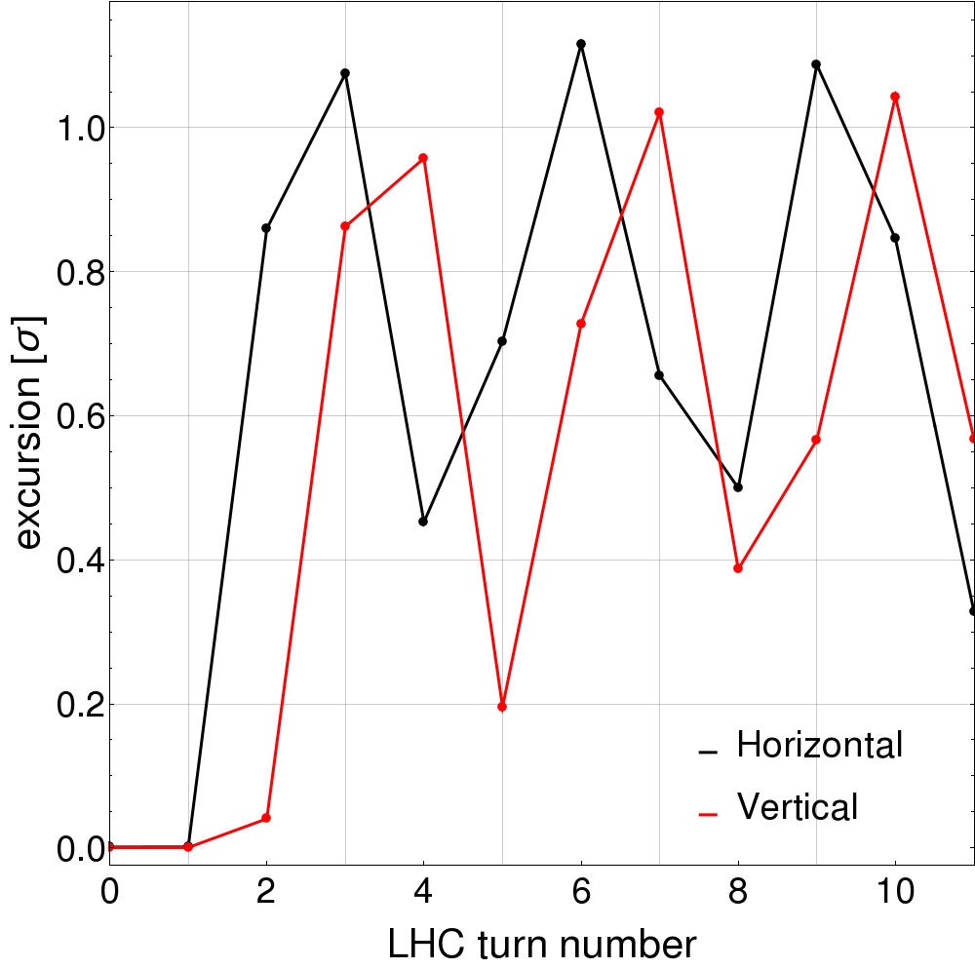
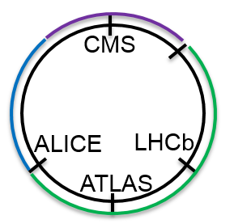
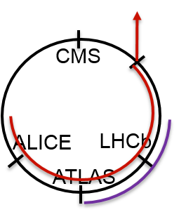
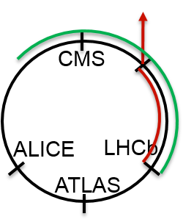
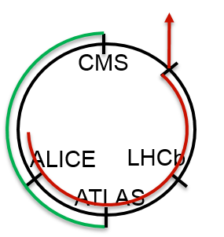
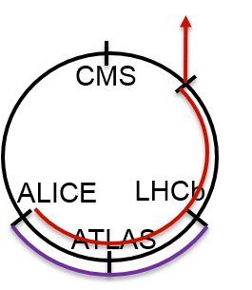
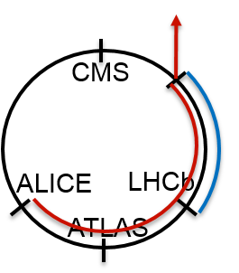
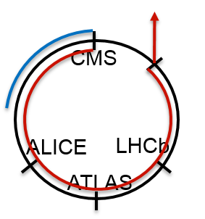
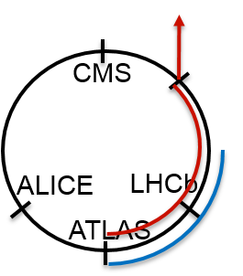
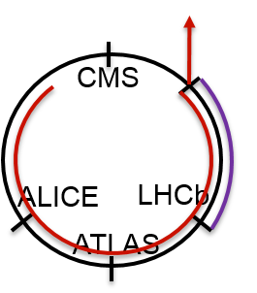
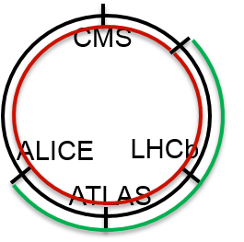
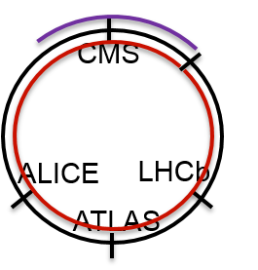
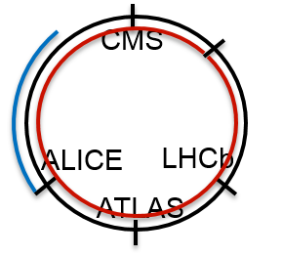
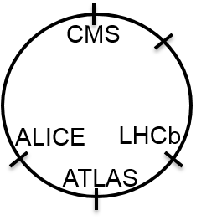
Missing beam-beam kick scenarios
A delay of up to two turns can occur between the dumps of B1 & B2.
Due to the non-synchronicity of the abort gaps in IR6 and the position of the crossing IPs, there are several different scenarios.
The orbit offsets associated with these various scenarios were simulated with MAD-X.
Example for B1:
25% of the beam will see BB only in LHCb
50% of the beam will see missing BB from CMS
Orbit shift after dump of B2 in scenario 1
25% of the beam will see missing BB from ALICE

Slide 8
Associated losses
Within 2 turns of a CC failure, a residual crabbing of up to 1 σ could be observed in the collimation area.
The losses were estimated analytically from the tilted distribution and the offset, and weighted according to each LRBB kick loss scenario.
CC failing | 1 turn dump delay | 2 turn dump delay
ATLAS / B1 | 0.017% | 0.070%
ATLAS / B2 | 0.018% | 0.069%
CMS / B1 | 0.091% | 0.236%
CMS / B2 | 0.019% | 0.105%
None | 0.010% | 0.060%
Above collimation damage limit
(0.15% of full beam)

Slide 9
Conclusion and outlook
The losses caused by a CC failure are strongly phase advance dependent. It is therefore possible to mitigate these failures by adjusting this parameter (especially for CMS B1).
Correlated failures exist, such as the missing beam-beam kick due to the dump of the other beam.
A dedicated interlock from the CC, based on field and phase, is necessary and should request the dump of both beams, to limit delays to one turn.
Other combined failures such as the quench of two CC due to an UFO are still to be studied.

Slide 10
Thank you for your attention, any questions ?

Slide 11
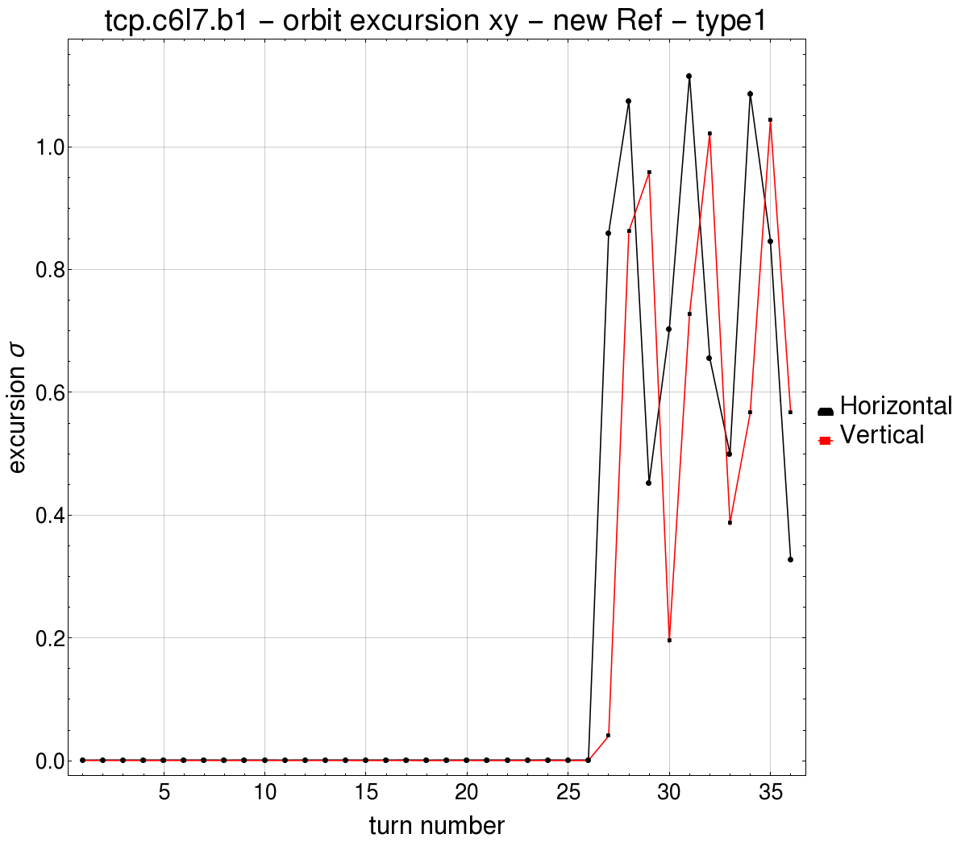
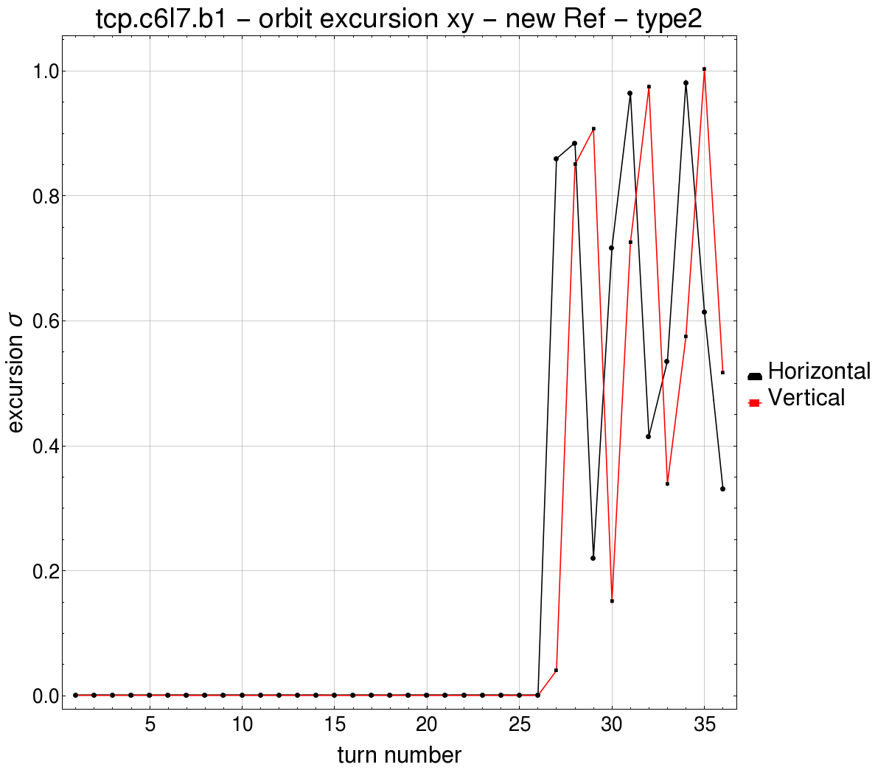
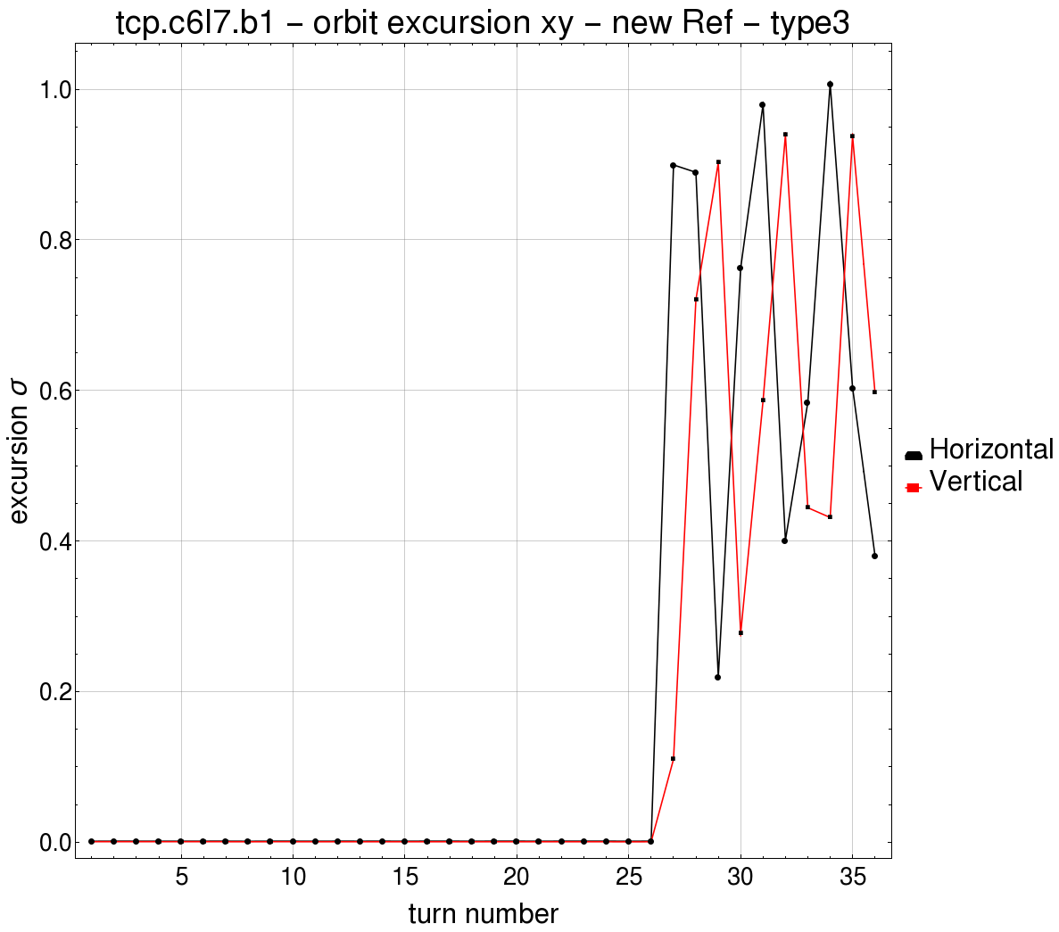

Slide 12
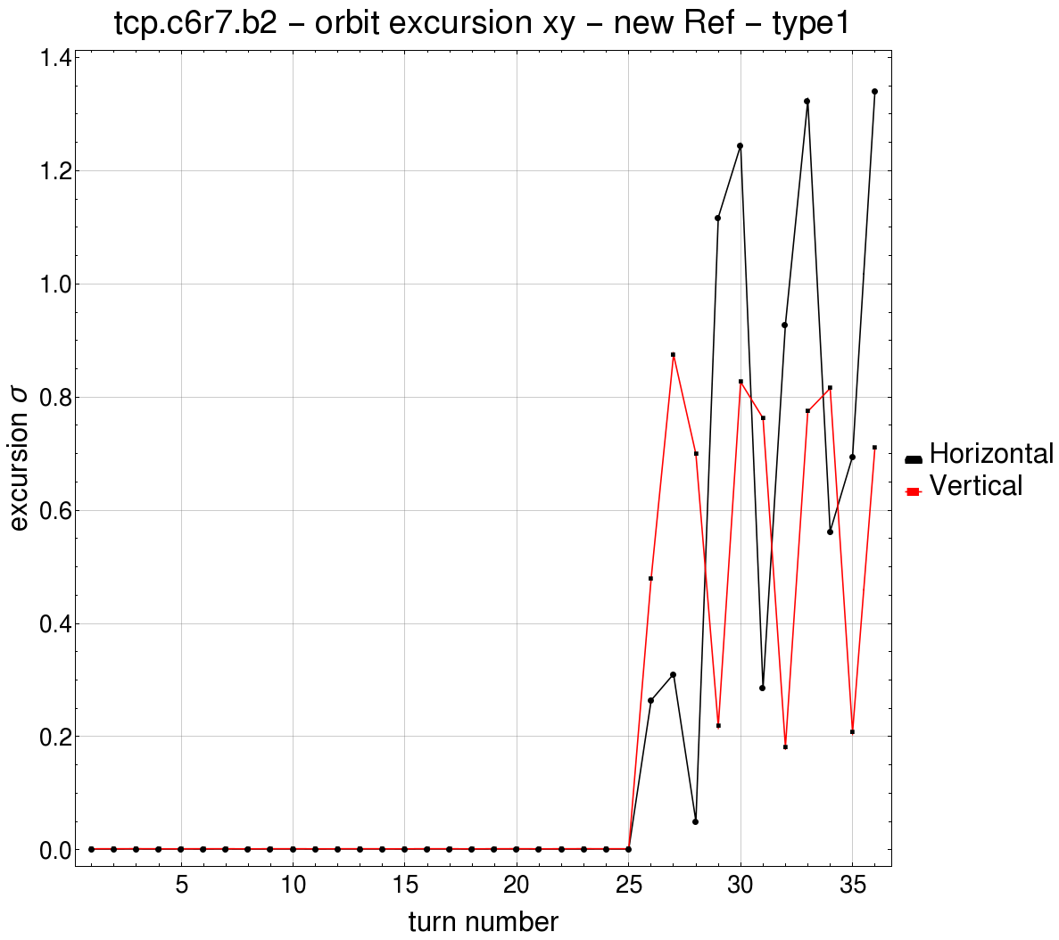
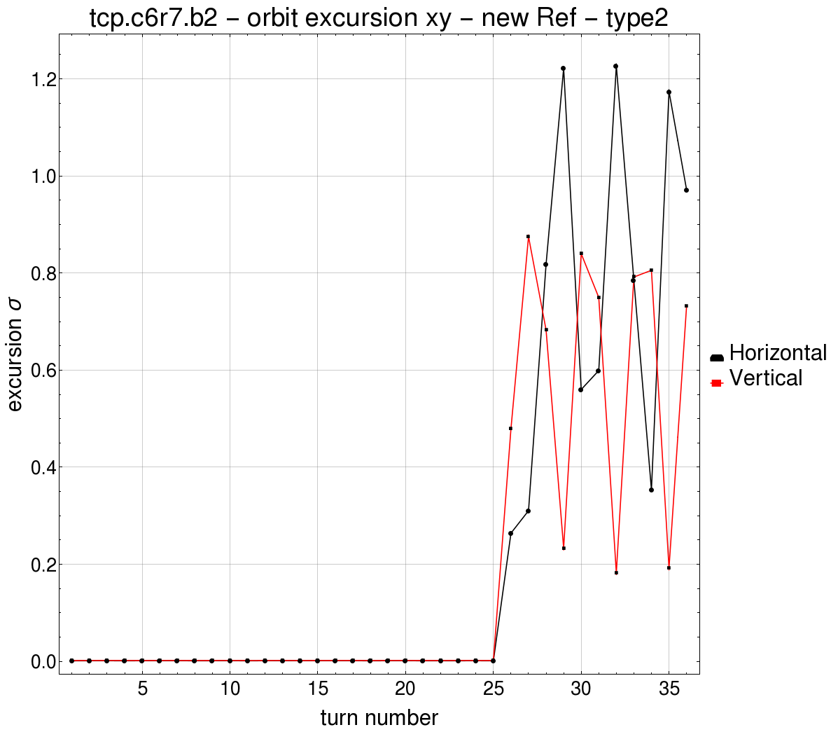
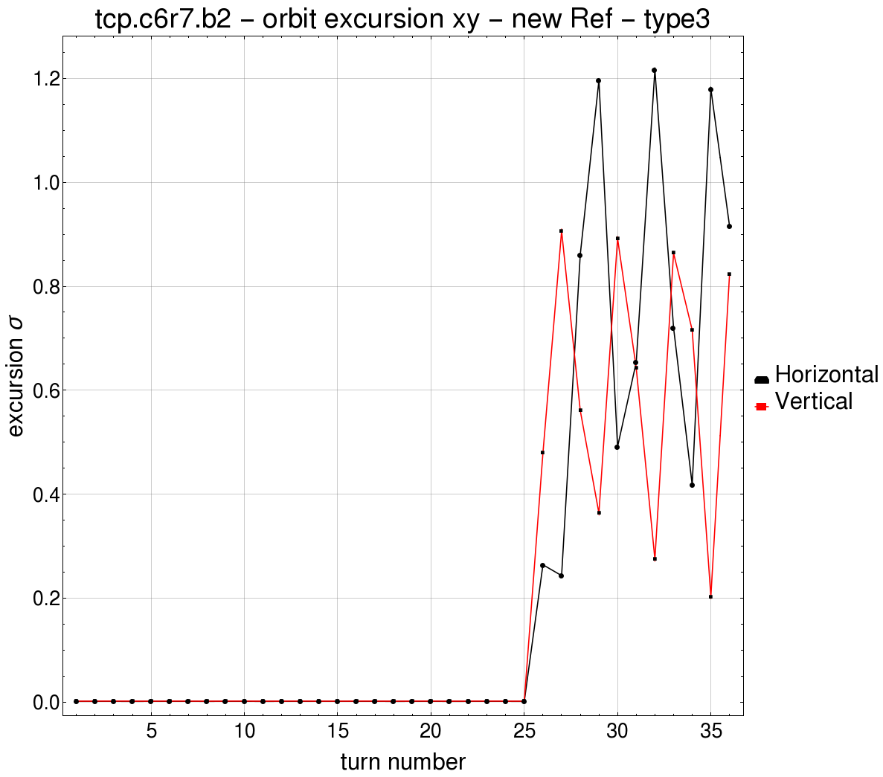
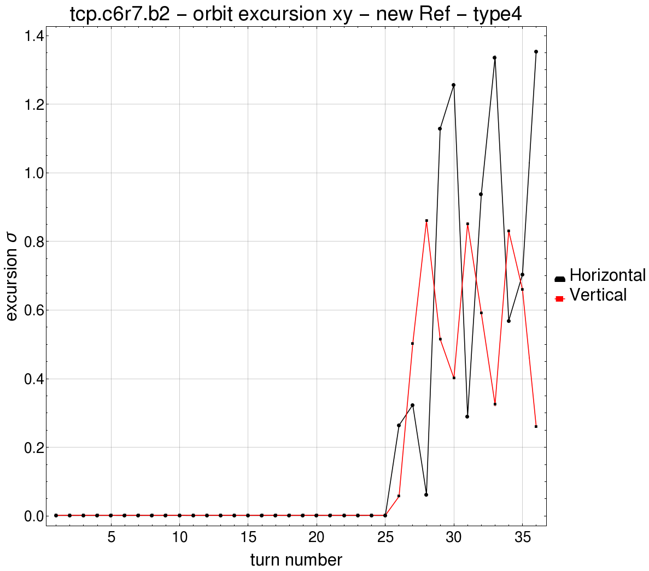

Slide 13
Model
The LHC optics are simulated with transfer matrixes, the only input needed are the phases advances:
*Only TCPs are considered since the TCS are 2$σ$ further
φ_{CC->TCP}
Beam 1
Collimation*
This parameter is the only variable in this study
As a multi turn effect the effect of the failure mostly depends on
Q-φ_{CC->TCP}
the tune was kept constant in this study
φ_{IP}
Q_{x}/Q_{y}
CC normal
CC failing

Slide 14
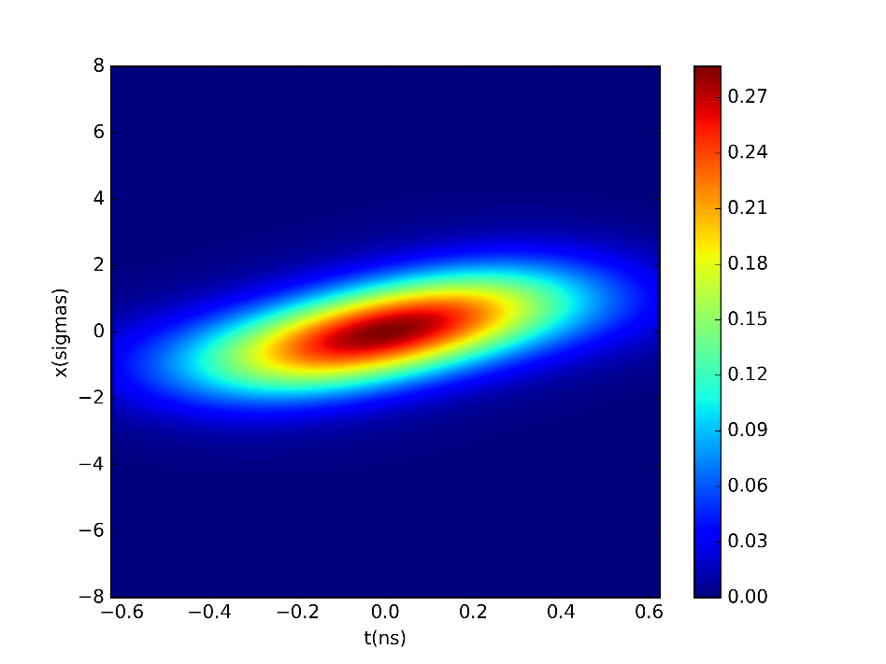
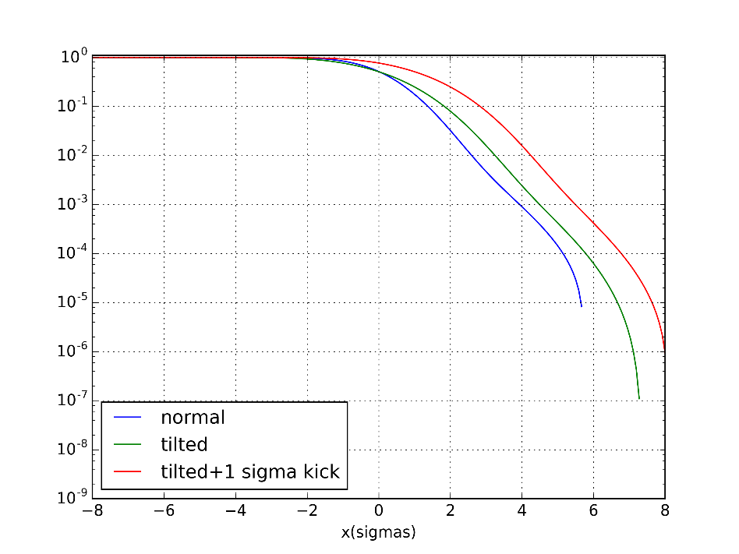
Model
The tilted beam distribution is then reconstructed from the position of these three particles.
The distribution is then integrated from the aperture limit, this proportion of the beam is thenlost.
Beam distribution
Distribution integrals
5.7σ
5.7σ

Slide 15
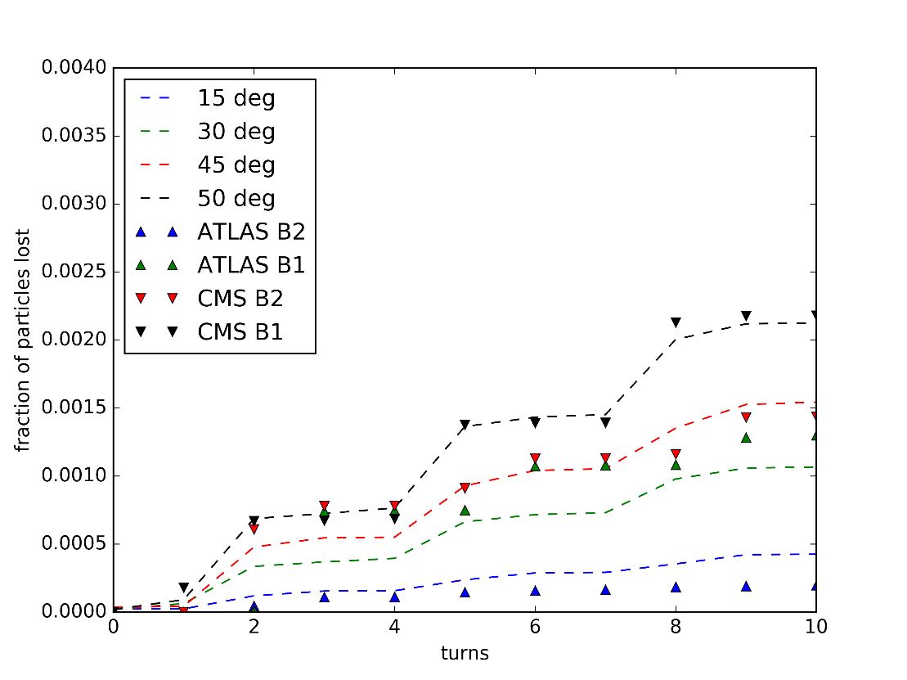
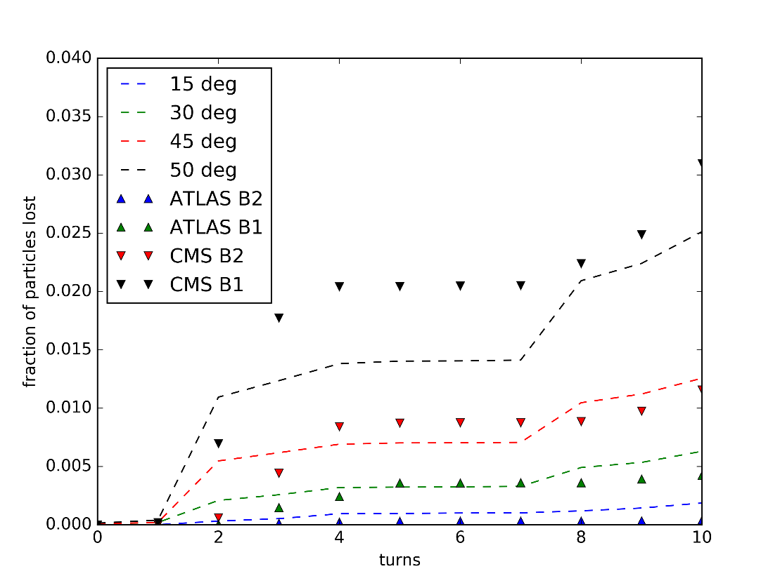
Results
The results from these calculations are here compared with SixTrack simulations done for the 4 sets of Crab Cavities (2 IP*2 Beams) for two reference failure cases:
  60 degrees phase jump
  60 degrees per turn detuning
Phase jump
Detuning
Very important losses (>>damage limits) are underestimated
Losses for low phase advances are overestimated (conservative)

Slide 16
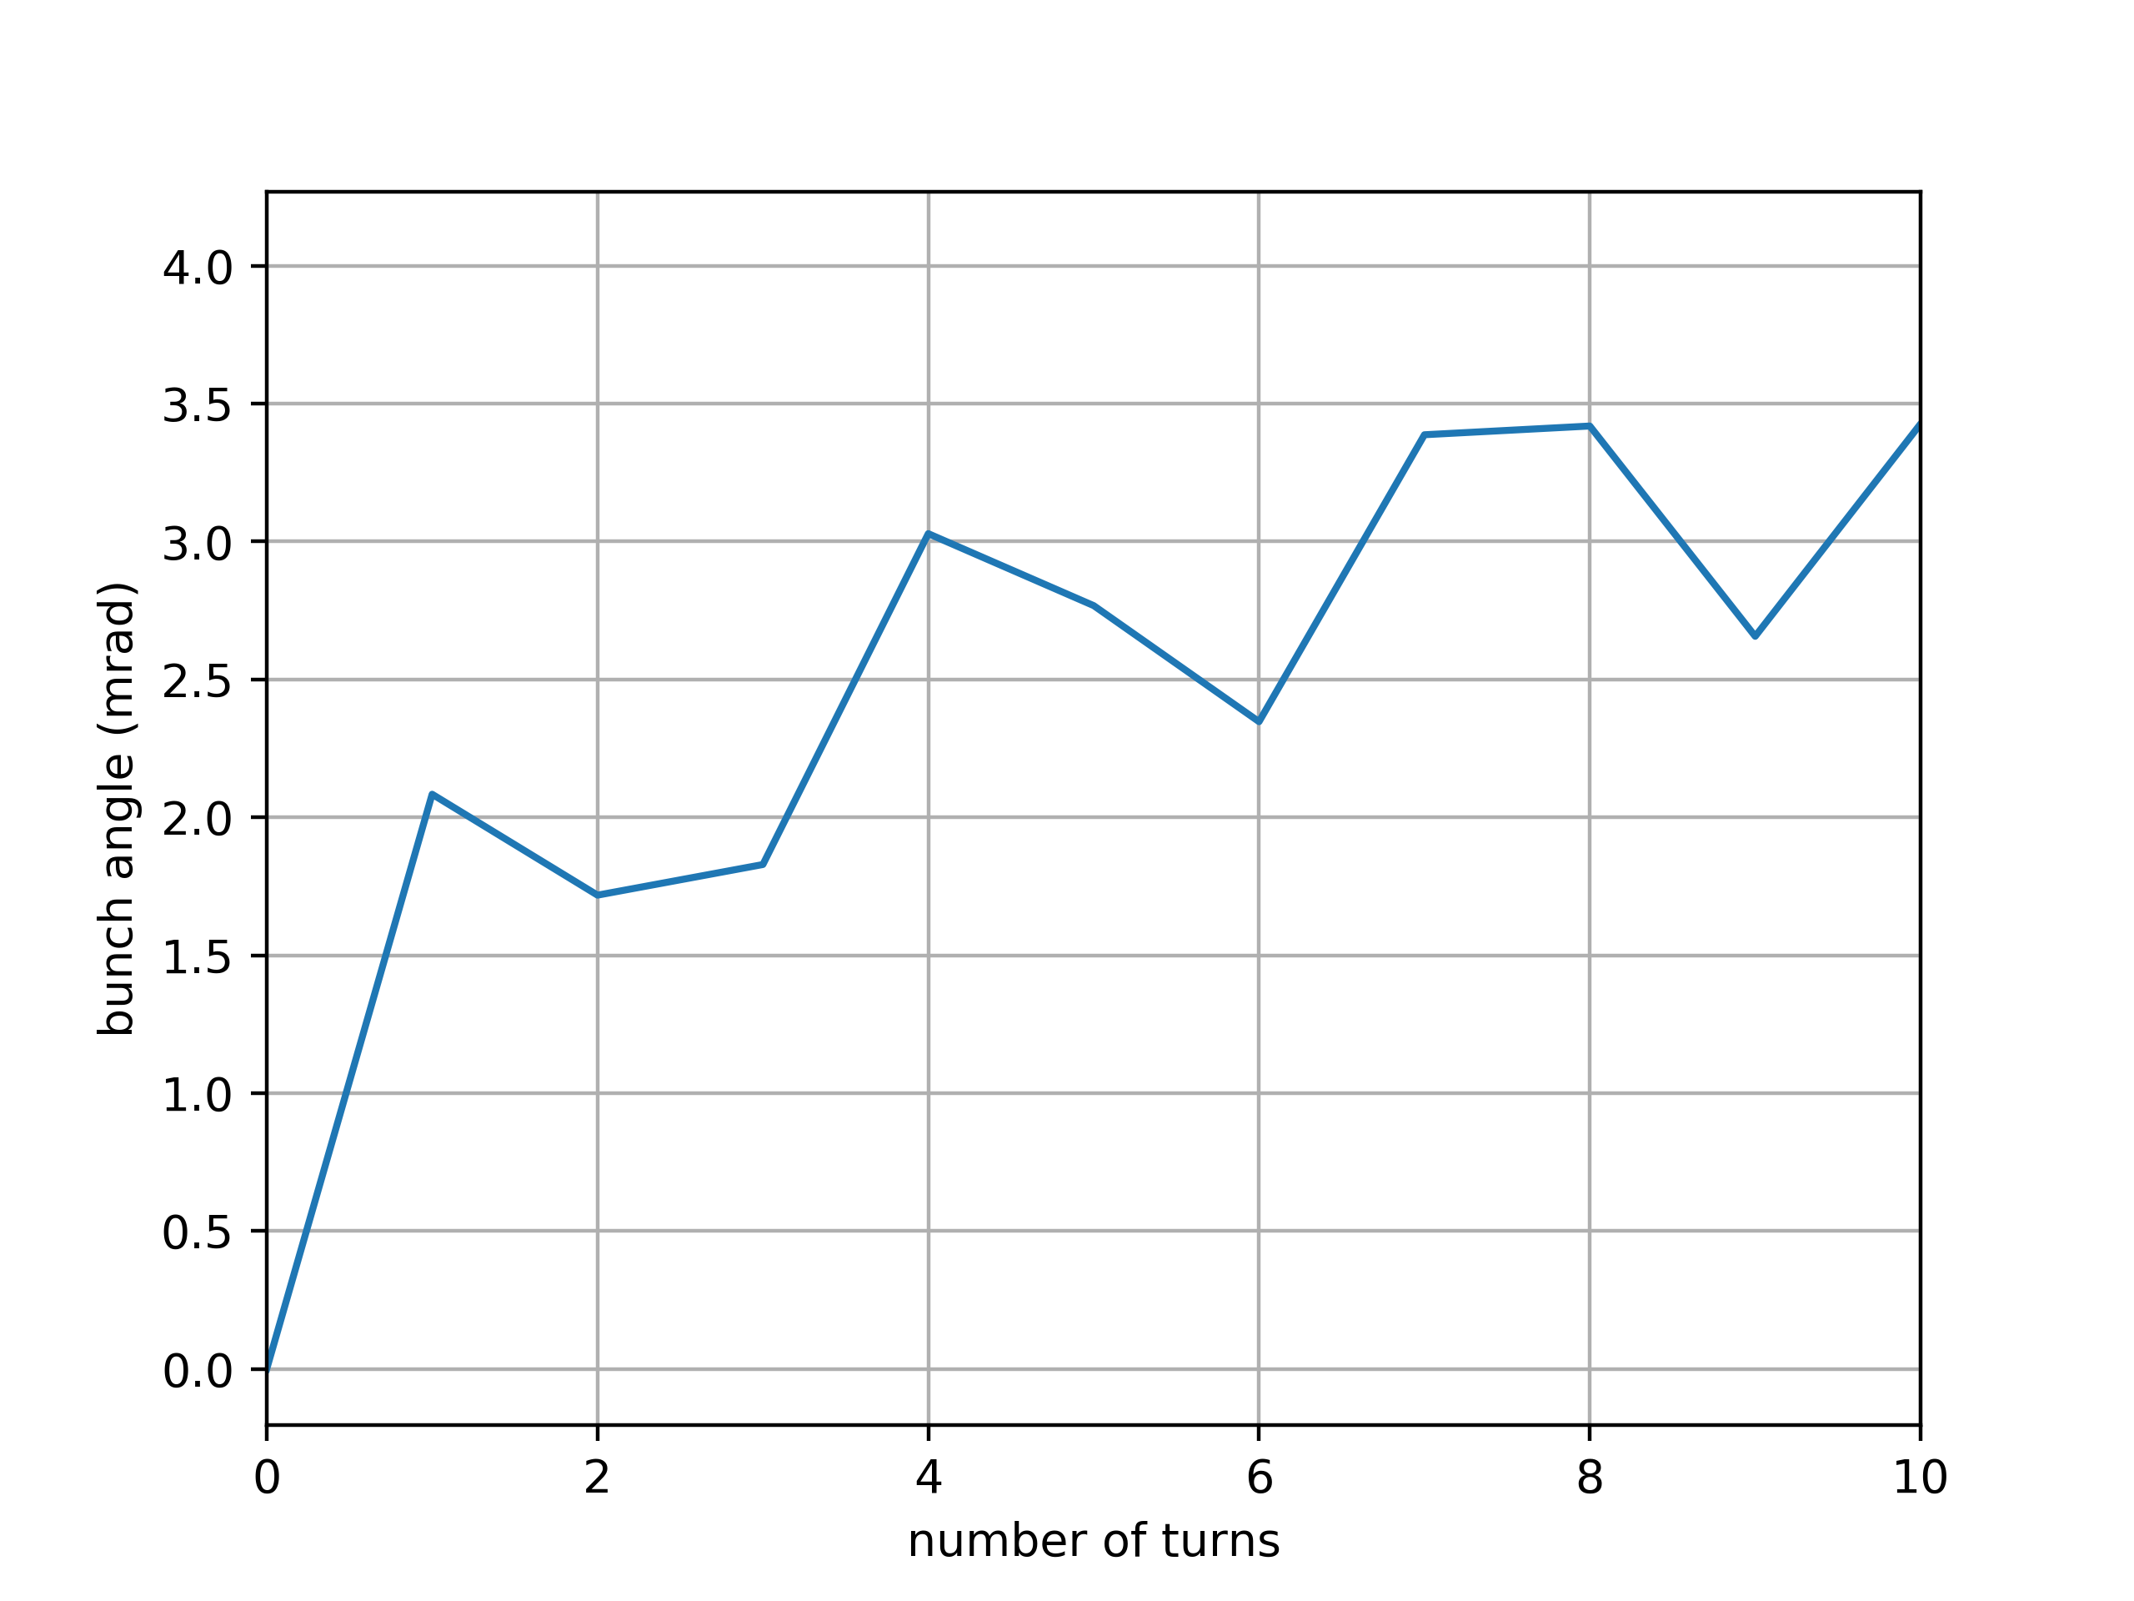
Crabbing @TCP in the first few turns of a CC failure

Slide 17
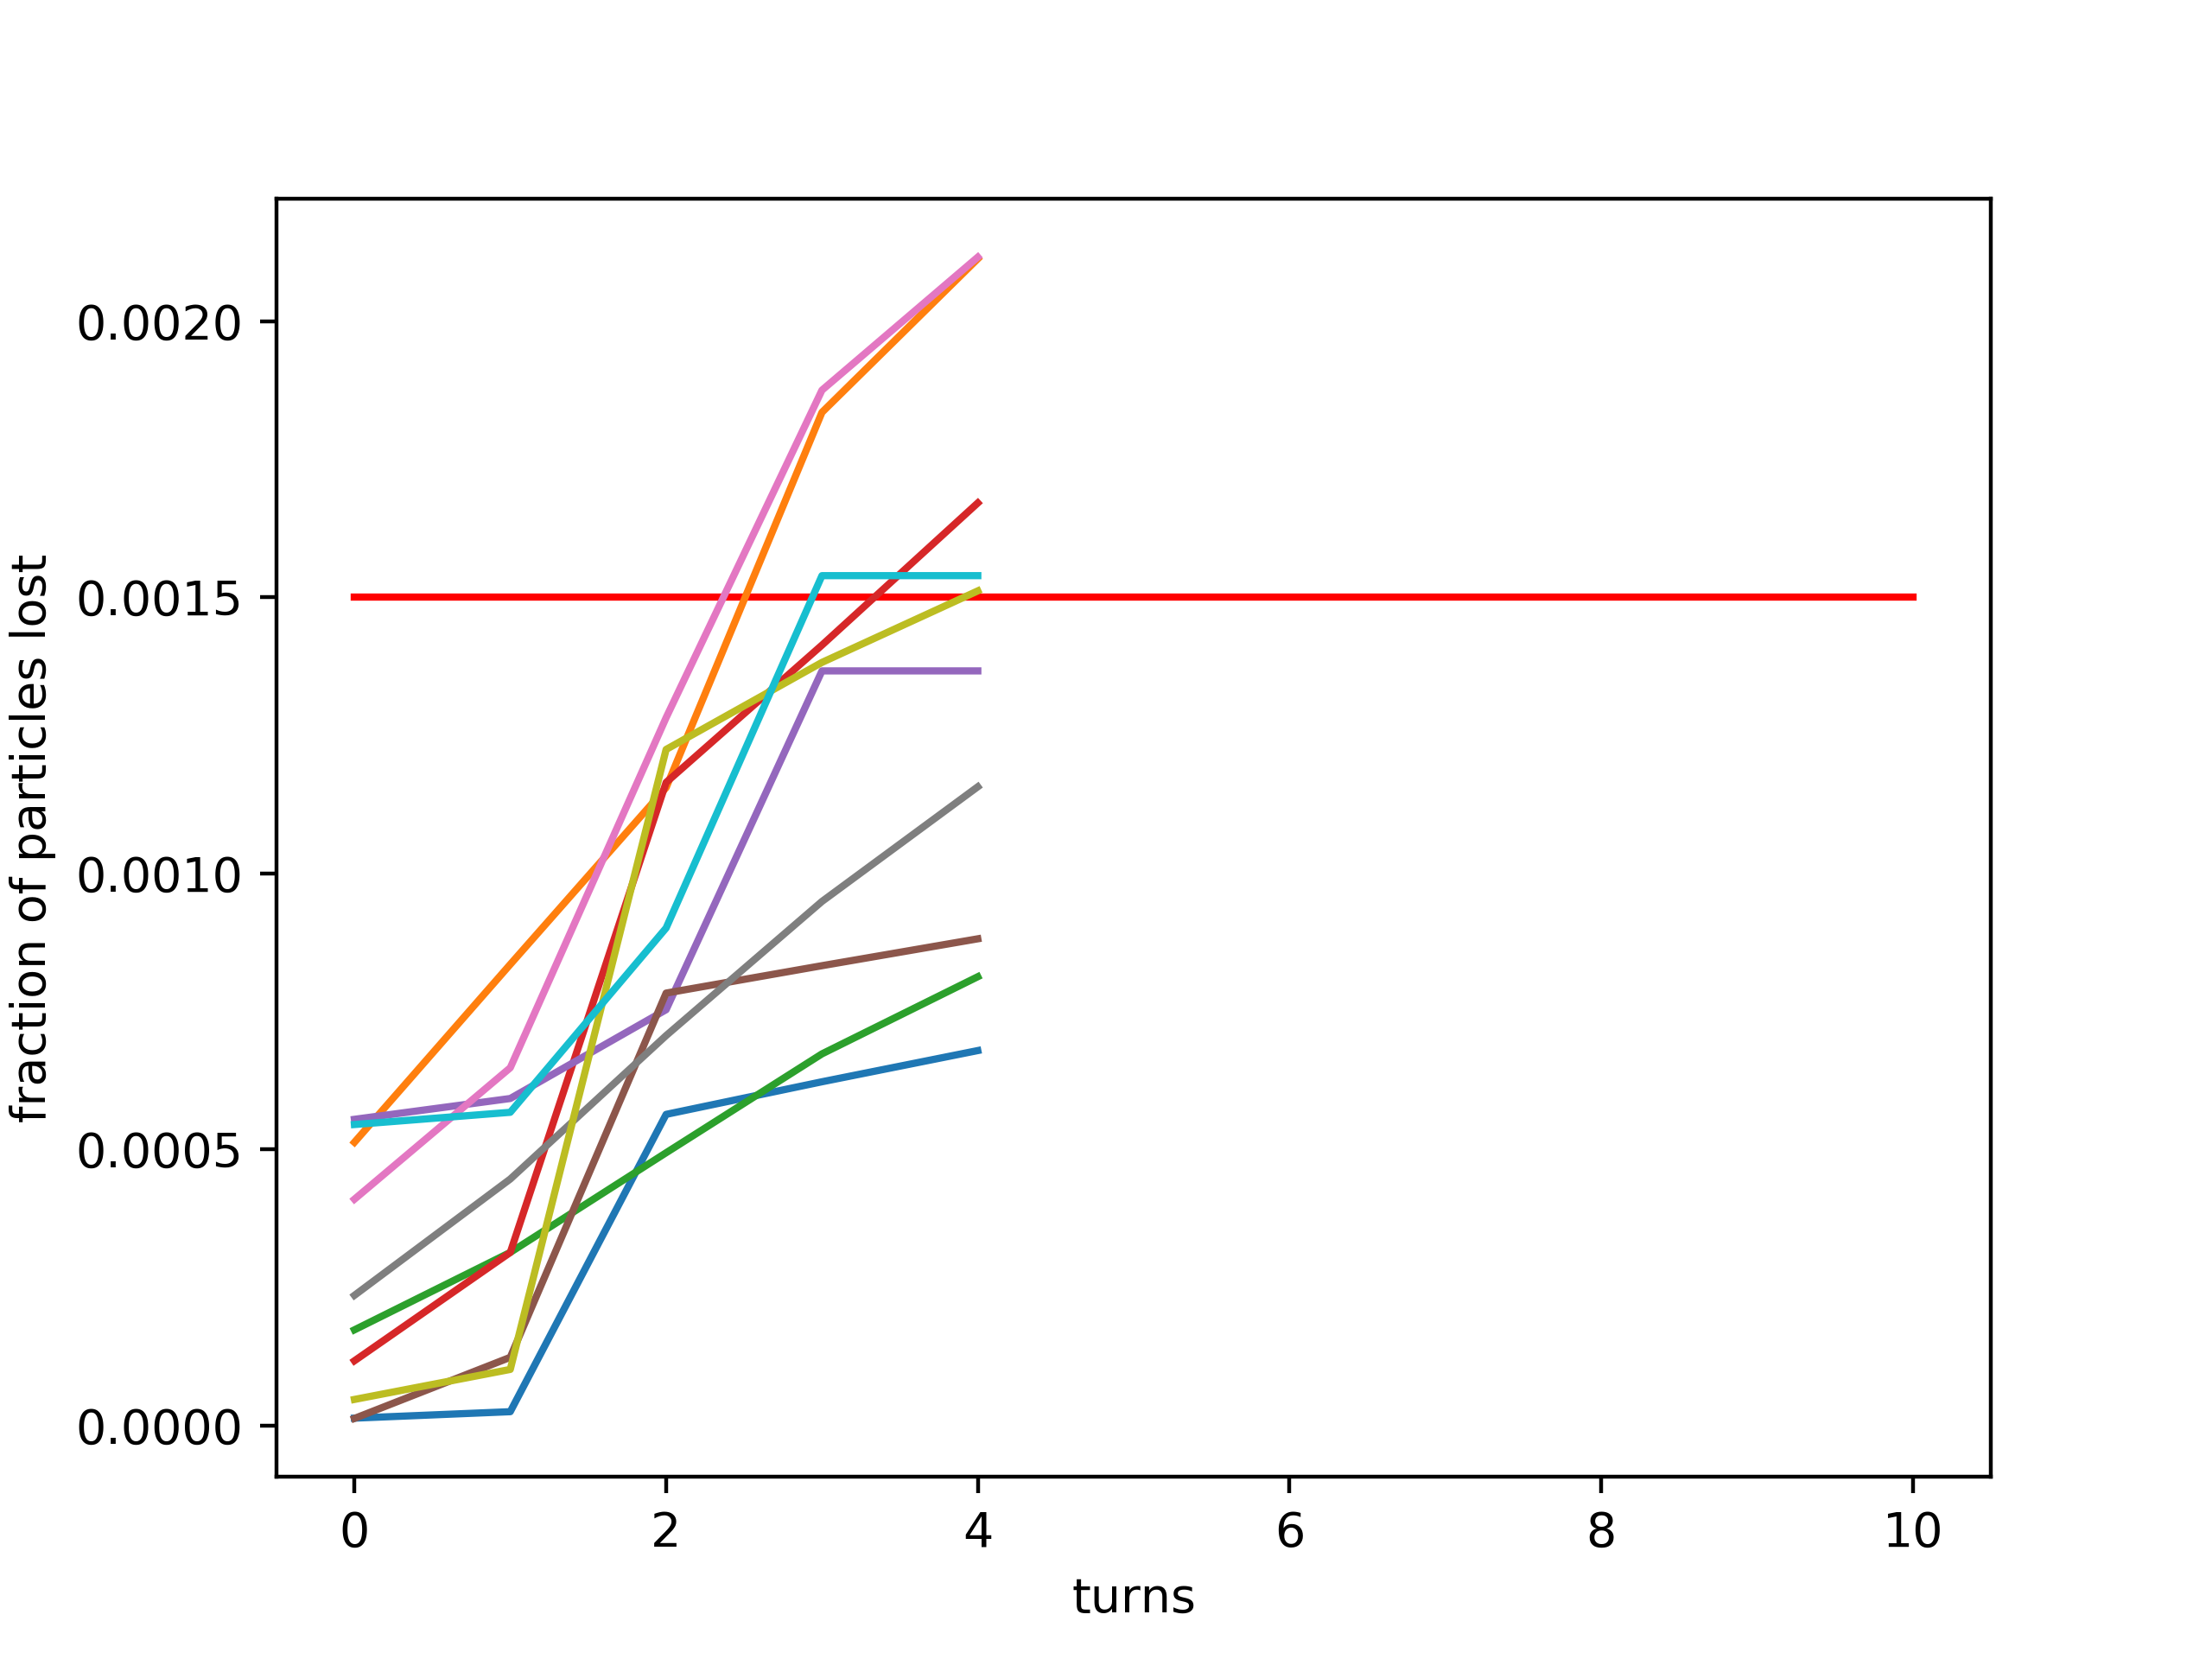
Losses wrt phase advance
5º
8º
11º
14º
17º
20º
23º
26º
29º
32º

