Slide 1

HiRadMat 28 & 35 TCDI / TDI material tests on ASL 3D Carbon/Carbon and SGL Graphite R7550
7th HL-LHC Collaboration Meeting – 15th November 2017 - Madrid
Inigo Lamas Garcia – CERN (EN-STI)
CERN – 7th HL-LHC Collaboration Meeting – 15th November 2017 – Ciemat Madrid

Slide 2
Motivations for HRMT28
Assess the Integrity of Graphite for TCDIs and TDIs during Run 3 and test an alternative material: 3D CC. The goal is to reproduce the highest intensity beam that the TCDI and the TDI can see during their life time.
Cross-check simulations.
Beam | Intensity | Sig X[mm] × Sig Y[mm] | Max Temperature [°C] | M-C Safety Factor*
Run 3 BCMS | 5.76 E13 | 0.320×0.511 | 1450 | 0.8 [~1]
HiRadMat requested beam | 3.46 E13 (originally requested 1.3 E11 ppb) | 0.313×0.313 | 1342 | 0.75 [0.96]
HiRadMat alternative beam (phase II) | 2.6 E13 | 0.25×0.25 | 1371 | [0.97]
*The Mohr Coulomb safety factors are calculated with a graphite tensile limit of 30 MPa, and the values between brackets consider a graphite tensile limit of 40 MPa which is the value considered by SGL for the R7550 graphite.

Slide 3
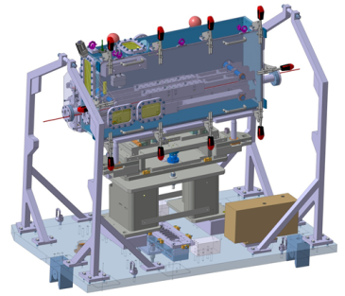
Experimental Set Up
On-Line Instrumentations
Vacuum vessel
GlassyC Beam Windows
Jaws
5th Axis
Plug-In System
Graphite 2123 PT
(Mersen)
3D C/C
A412
(Mersen)
Collimator Feet
Beam instrumentation:
BTV, working also for high intensity shots
BPKG (Working only in the horizontal plane)
Wire scanner (in SPS ring), working for up to 3 batches
Beam
Graphite Sigrafine® R7550
(SGL)
Sepcarb®
3D C/C
(Airbus Safran Launchers)

Slide 4
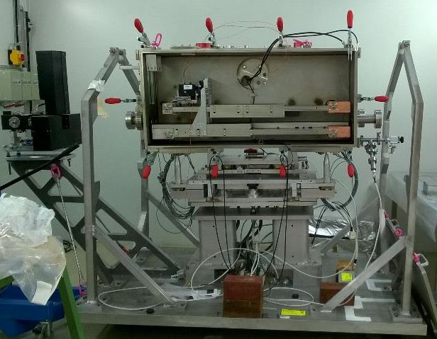
Experimental Set Up
Experiment preparation in 867/R-P58

Slide 5

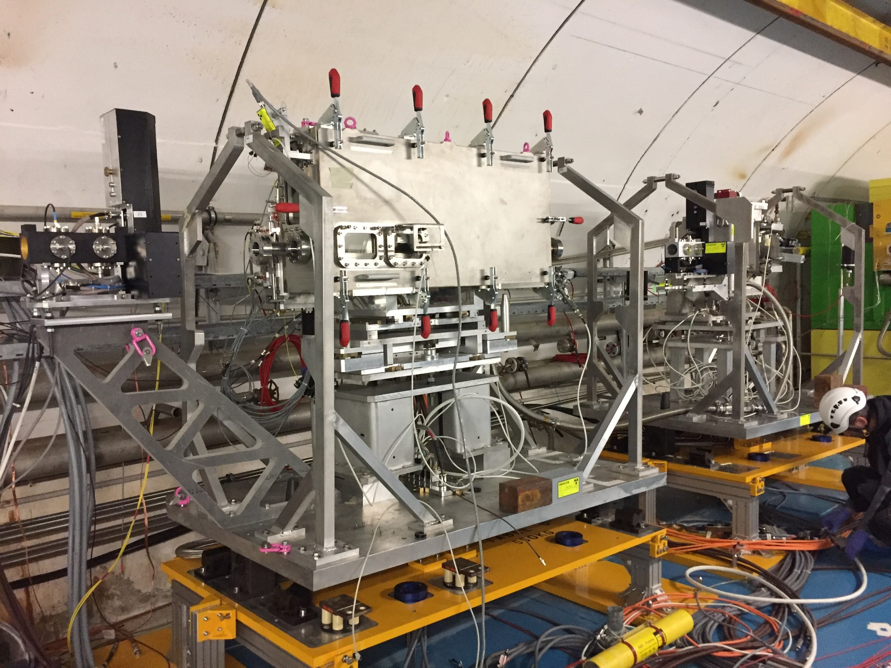
Experimental Set Up
Experiment installation in TNC

Slide 6
HRMT 28 in a nutshell
4 low density materials impacted for BID applications;
About 15 people involved in the experiment operation itself;
About 1.12E15 total POT spread over 3 runs;
23 hours spent in the CCC, aligning the experiment and data acquisition;
3 Gb of collected data;
Residual dose rate | After 9h of cool down | After 44h of cool down
PMIHR02 | 1 mSv/h | 227 µSv/h

Slide 7
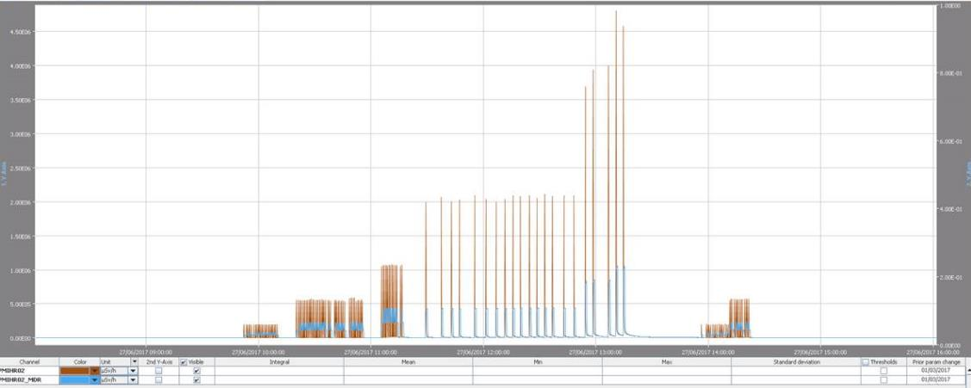
High intensity shots on the 27/06/2017
BTV.524 measurements
Target | Time | Intensity | Sigma X (mm) | Sigma Y (mm) | Position in X (mm) | Position in Y (mm)
ASL Sepcarb 3D CC | 12h54min02s | 2.47E+13 | No Signal on BTV
 | 12h58min07s | 2.49E+13 | 0.24 | 0.25 | -0.46 | 0.73 | Strange signal on LDV
 | 13h06min14s | 2.50E+13 | 0.24 | 0.24 | -0.45 | 0.74
 | 13h10min21s | 3.35E+13 | 0.2 | 0.23 | -0.44 | 0.73
 | 13h14min26s | 3.34E+13 | 0.2 | 0.22 | -0.44 | 0.72
For this run, a red filter in front of the BTV camera in TT61 has been installed
216 bunches beams
288 bunches beams
RP Monitor PMIHR02, showing residual dose rate versus time
72 bunches beams on dump
72 bunches beams on target
12 bunches beams on dump
Some BTV tests after HRMT28 experiment
1 bunch beams on dump

Slide 8
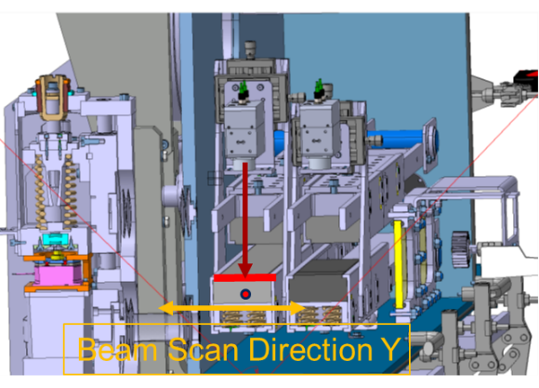
Optometer alignment with the beam (graphite)
A precise alignment of the LDV with the beam was achieved (better than 0.15 mm)

Slide 9
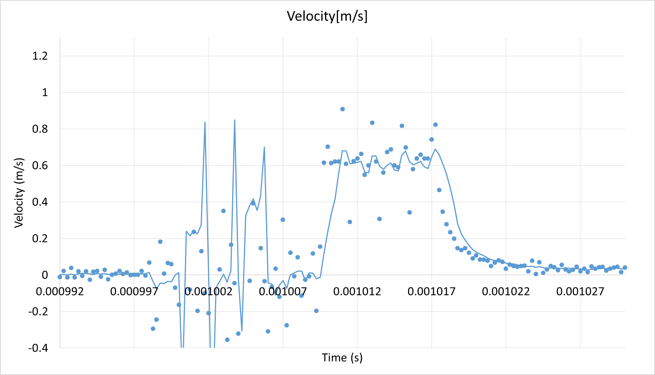
Graphite (SGL) surface displacement when impacted
Preliminary results
7.75 µs
~7.5 µs
Quick analysis:
Correct bunch length
Expected magnitude of the surface displacement (with respect to simulations)
Corresponds to the measurement got in 2016

Slide 10
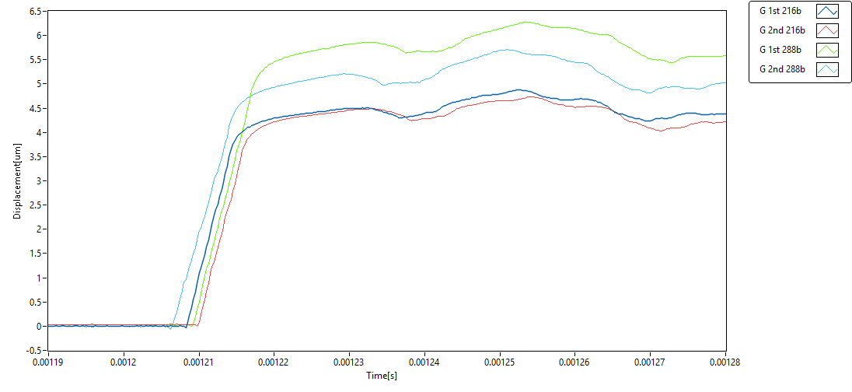
Graphite (SGL) surface displacement for 4 consecutive high intensity shots
Preliminary results
Intensity
2.39E+13
2.37E+13
3.23E+13
3.23E+13
The very similar (shape) surface displacement curves over time dhows that no beam induced damage occurs on the material, shot after shot;
The amplitude difference for the last two shots can be due to the impact parameter difference (last pulse is 0.3 mm deeper).

Slide 11
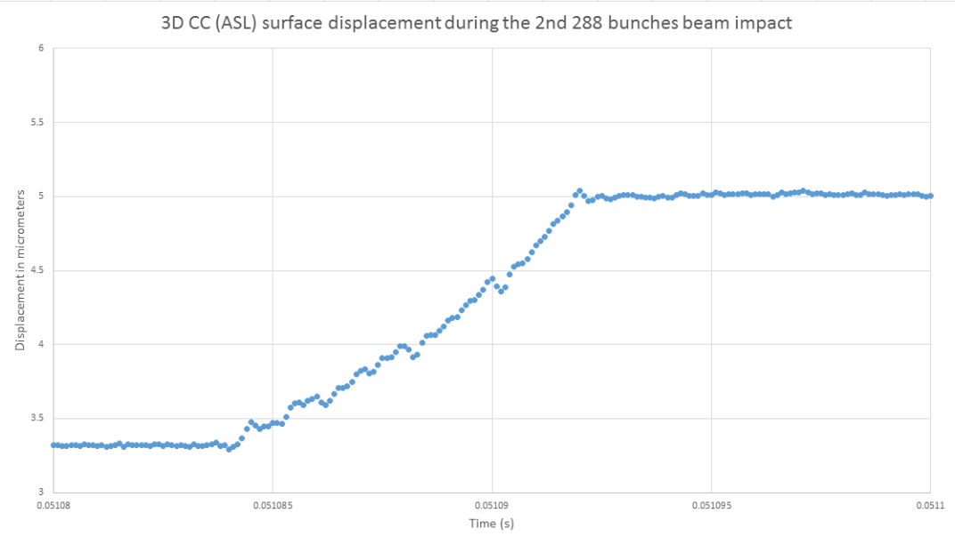
3D CC surface displacement when impacted (LDV 10 MHz)
Preliminary results
7.5 µs
Quick analysis:
Correct bunch length
Expected magnitude of the surface displacement

Slide 12
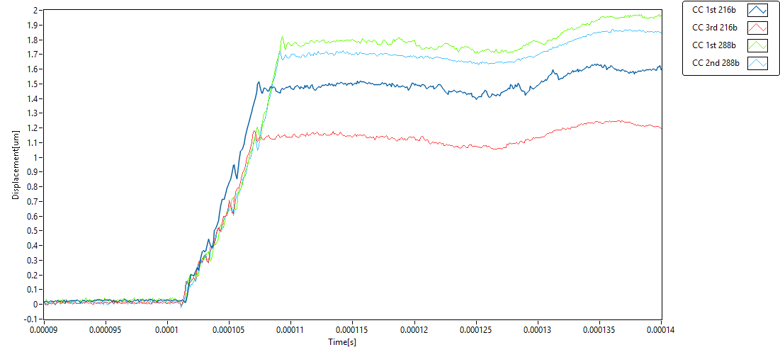
3D CC (ASL) surface displacement for 5 consecutive high intensity shots (LDV interface 10 MHz), 27-06-2017 (one 216 b shot not recorded)
Intensity
2.47E+13
2.50E+13
3.35E+13
3.34E+13
The very similar surface displacement curves over time are is an indicator that no beam induced damage occurs on the material, shot after shot.
The amplitude difference for the 1st and 3rd shots at 216b can be due to a small spot offset in X.

Slide 13
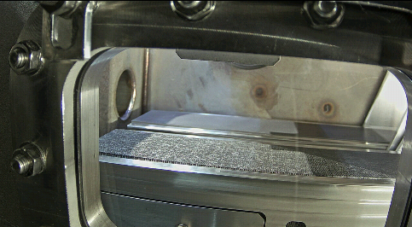
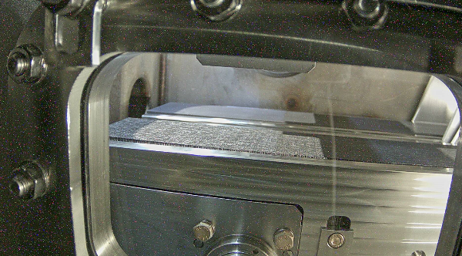
Jaw surfaces (ASL 3D CC and SGL Graphite)
Online pictures
After 2x216 and 2x288 bunches shots on graphite
Before impact on graphite
Beam

Slide 14
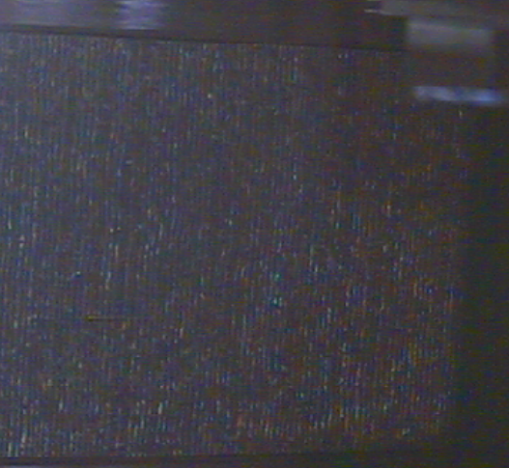
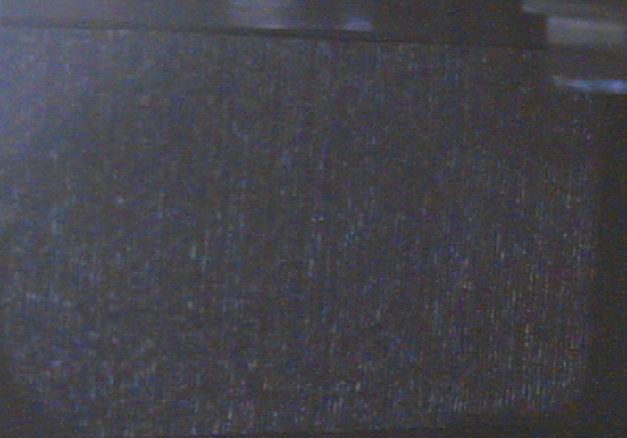
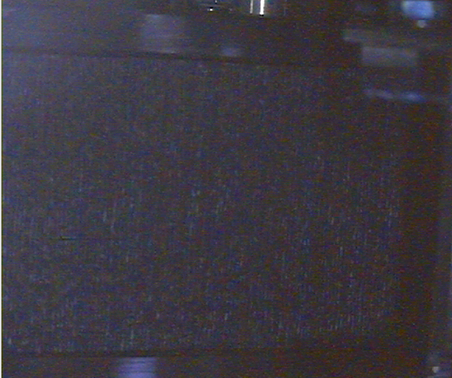
Jaw surface (ASL 3D CC)
After 2x216 and 2x288 bunches shots
Beam
Before impact on 3D CC
After 5x216 and 4x288 bunches shots
Beam
Online pictures

Slide 15
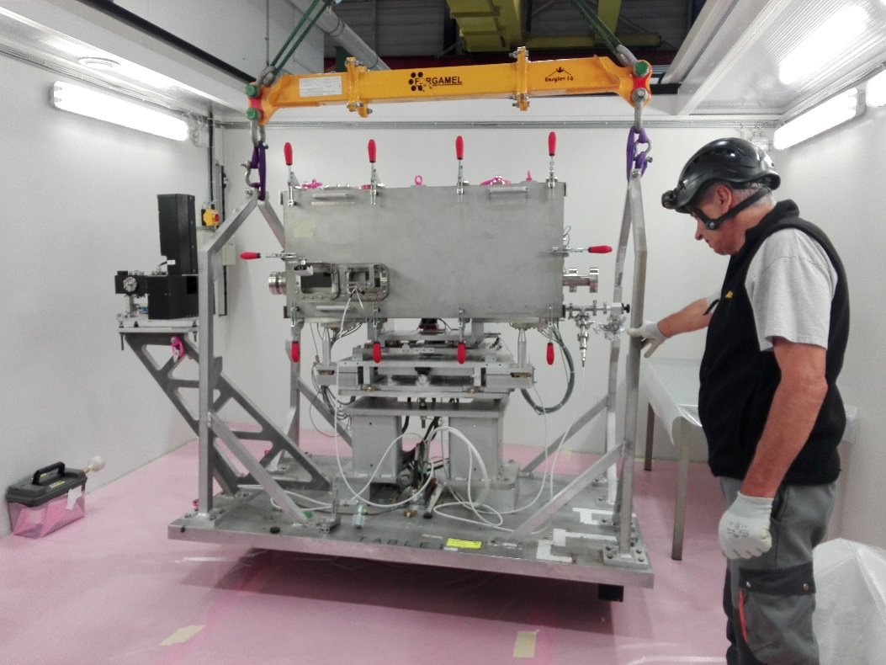
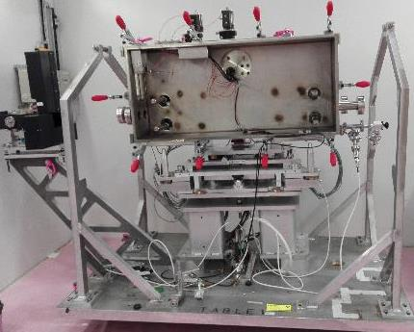
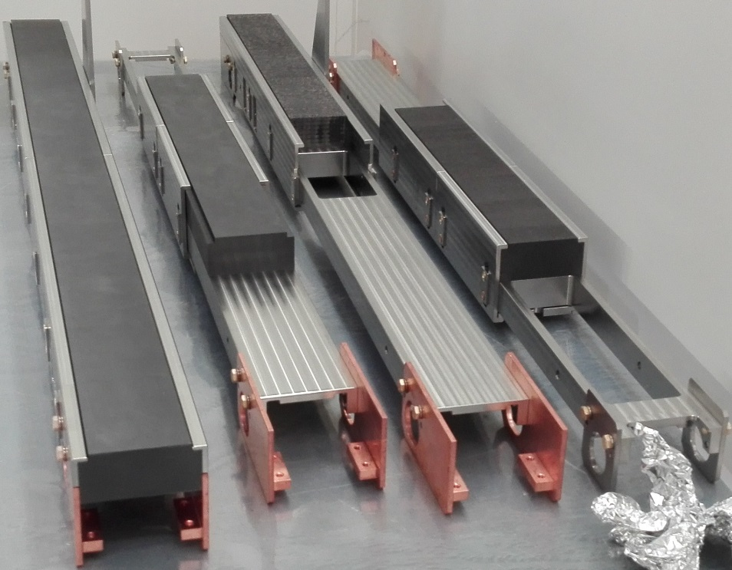
Experiment dismantling in 867/R-P58
Installation in a fully cleaned bunker
The opened vacuum vessel with jaws removed

Slide 16
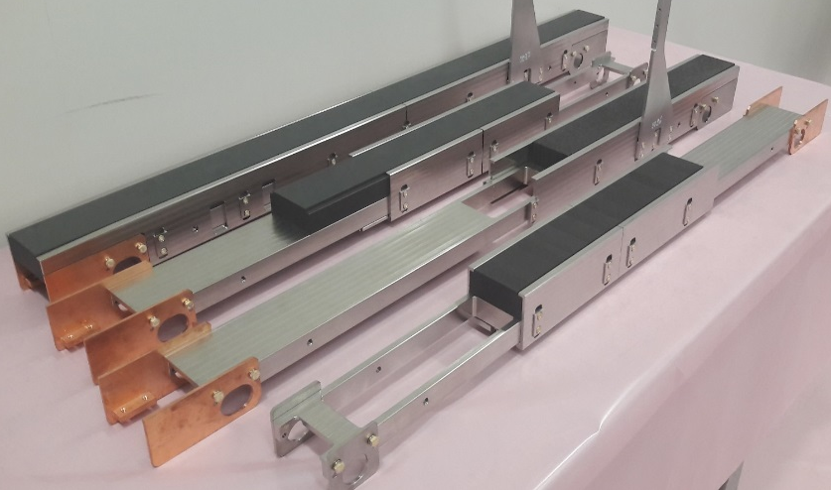
Targets (jaws) dismounting in 867/R-P58
4
3
2
1
RP measurements on the 25.07.17 at 16h45
1 / contact: 320 µSv/h, 10 cm: 70 µSv/h, 40 cm: 25 µSv/h
2 / contact: 370 µSv/h, 10 cm: 73 µSv/h, 40 cm: 27 µSv/h
3 / contact: 280 µSv/h, 10 cm: 52 µSv/h, 40 cm: 15 µSv/h
4 / contact: 280 µSv/h, 10 cm: 63 µSv/h, 40 cm: 17 µSv/h

Slide 17

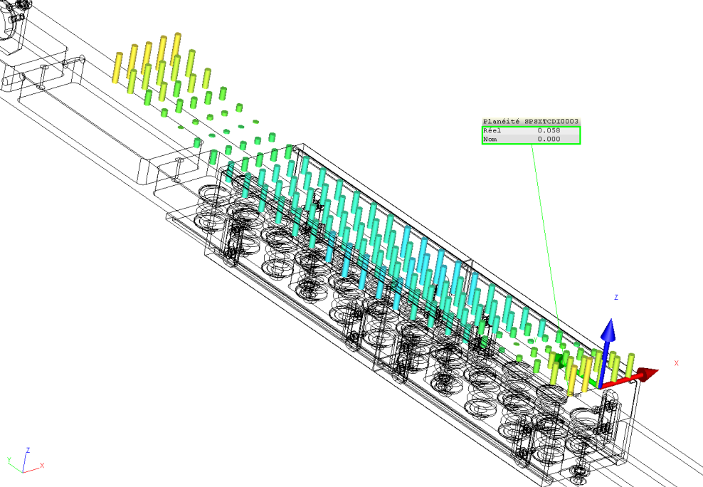
Jaws metrology measurements
Jaw flatness measurement before and after beam impact:
Jaw flatness | Graphite Sigrafine® R7550 (SGL) | Graphite 2123 PT (Mersen) | 3D C/C A412 (Mersen) | Sepcarb® 3D C/C (Airbus Safran Launchers)
Before Impacts | 80 µm | 56 µm | 128 µm | 44 µm
After Impacts | 96 µm | 58 µm | 82 µm | 44 µm
Possible bloc movement during handling
Before beam impact
After beam impact

Slide 18
HRMT-28 Summary (I)
SGL Graphite and ASL 3D CC are undamaged after several high intensity shots, as it was expected by the trend of the surface displacement curves which is very regular from shot to shot;
After a quick qualitative analysis, SGL Graphite and ASL 3D CC are “behaving” as expected by the simulations;
Metrology is showing the same global shape before and after impact;
Next steps:
→Detailed comparisons with simulations;
→Ultrasound tests of the graphite, micro-tomography of the 3D CC.

Slide 19
HRMT-28 Summary (II)
The jaw material baseline (510 mm of 3D CC and 1590 mm of graphite) is compliant with HRMT28 results: both materials are able to survive the beam.
Graphite has always been considered slightly weaker than 3D CC → experimentally, it’s not yet possible to determine by how much as both materials survived all the shots.
Installing 3D CC in the machine is also useful to push this material validation from the UHV and mechanical point of views.
A TCDIL collimator made of 100% graphite jaws is also suitable for Run 3 beams.
TCDIL collimators are expected to withstand grazing to close to grazing impacts.

Slide 20
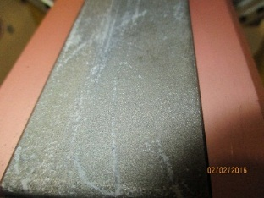
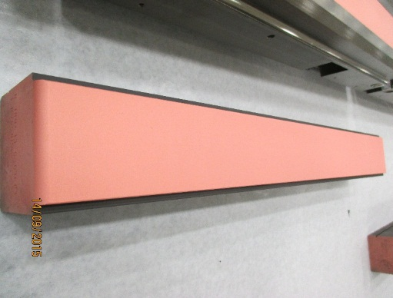
Motivations for HRMT35
After dismantling the TDI (10/01/2016), severe damage on the Ti coated surface on the hBN absorbing blocks was found.
The absorbing blocks of the currently installed TDI are made out of Cu sputtered Graphite R4550.
Given the past issues and the general uncertainties on coatings behavior when grazed by a high intensity proton beam, there is a high priority recommendation by the LHC Machine Committee (LMC#256) to test and validate the sputtered Cu performance under the worst impact conditions that the TDI could face.
In order to gain important information for future beam intercepting devices such us TCPPM and TCSPM, other coating configurations (by acting on the subtract and the thickness of the deposited layer) were tested on low-Z materials such as R4550, 2D Tatsuno CFC and Molybdenum Graphite (MoGr).

Slide 21
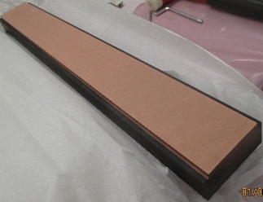
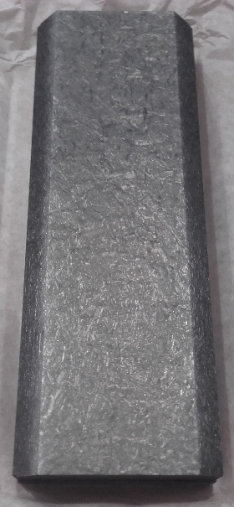
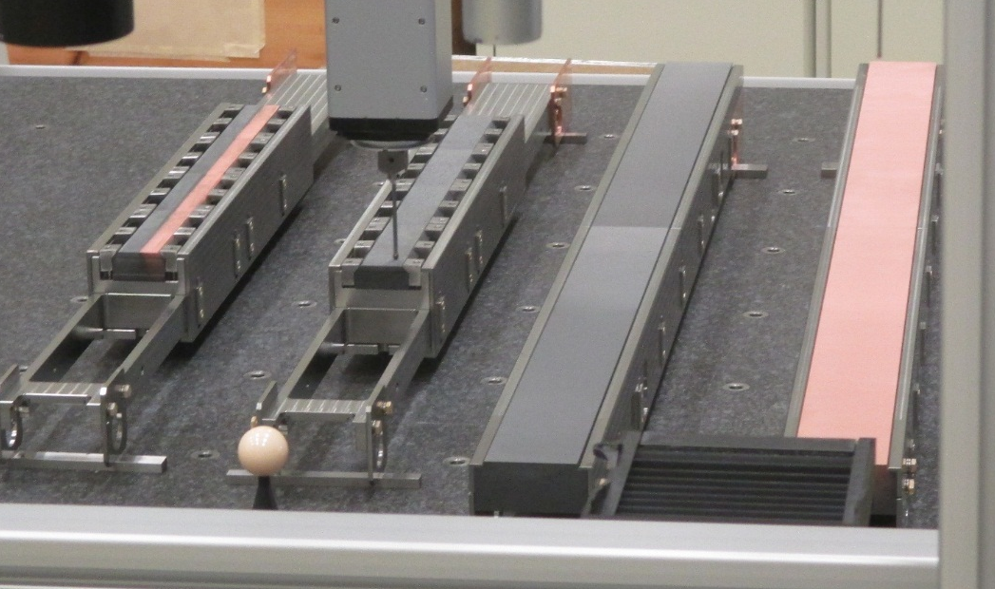
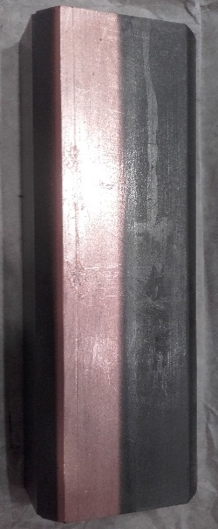
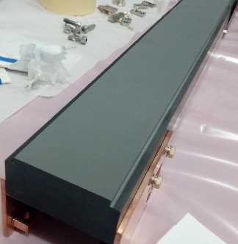
Experimental Set Up
The HRMT 28 tank and test bench will be used for this experiment
Modifications will be performed on the jaw configuration in order to host up to 4 different absorbing materials and coating configurations:
  SGL Graphite R4550 TDI coating configuration with Cu coating;
  SGL Graphite R4550 TDI coating configuration with Mo coating;
  Tatsuno 2D CFC in a TCxPM configuration with Mo coating (+SiC-SiC);
  Molybdenum Graphite (MoGr) with Mo and Cu coating.
500
1200

Slide 22
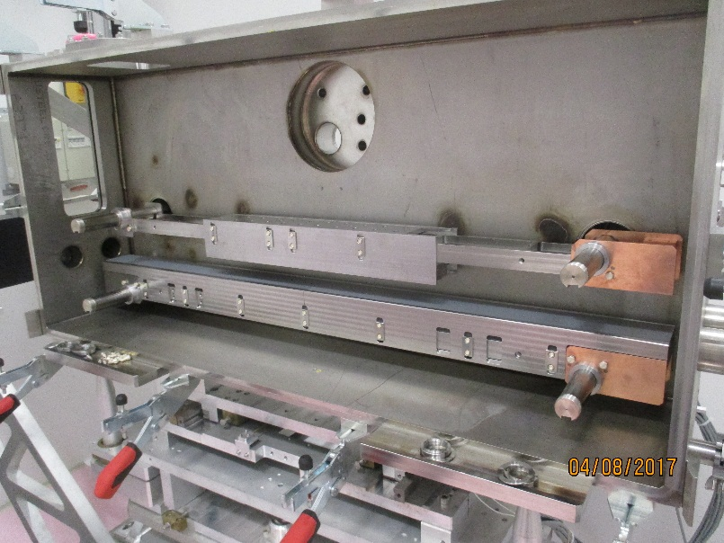
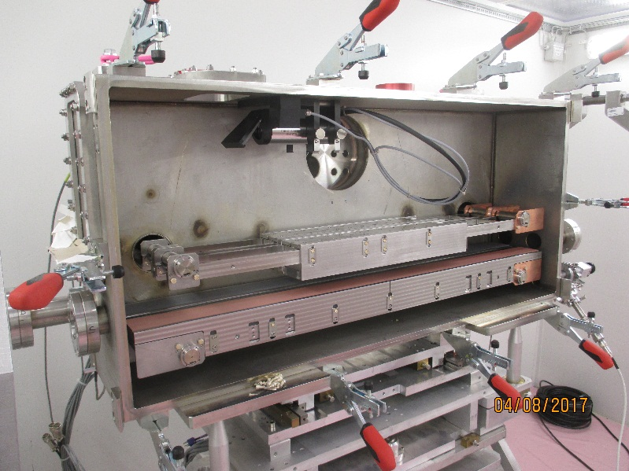
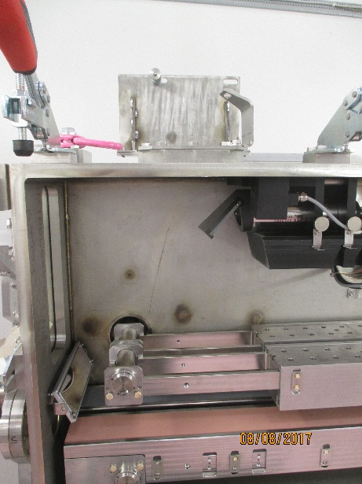
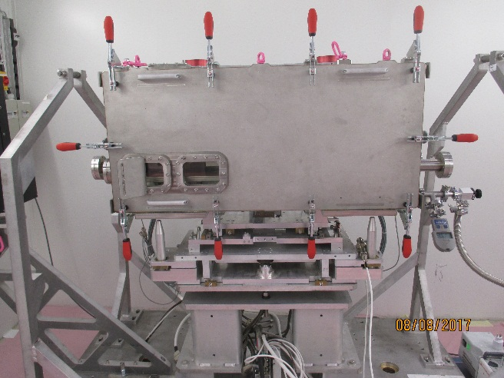
Experimental Set Up
First set of jaws assembly
Second set of jaws assembly
Vertically assy to reduce beam jitter
HD RadHard Camera
Mirror
Closed tank under primary vacuum

Slide 23
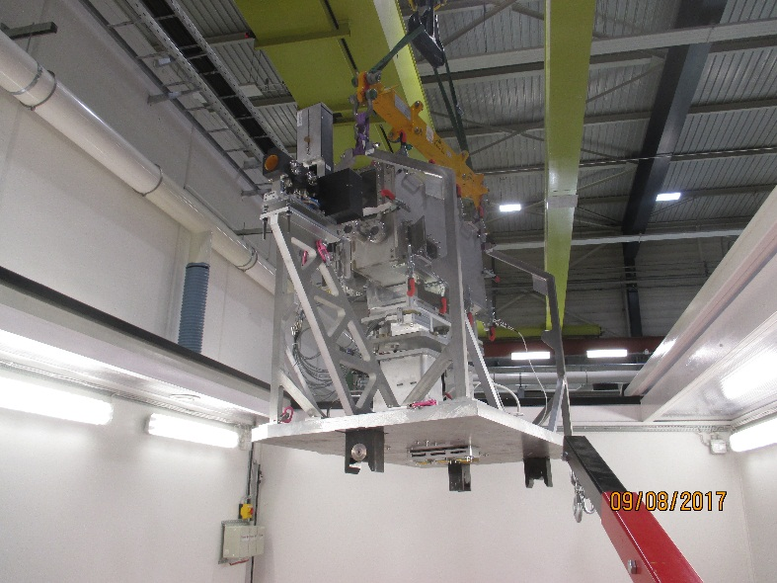
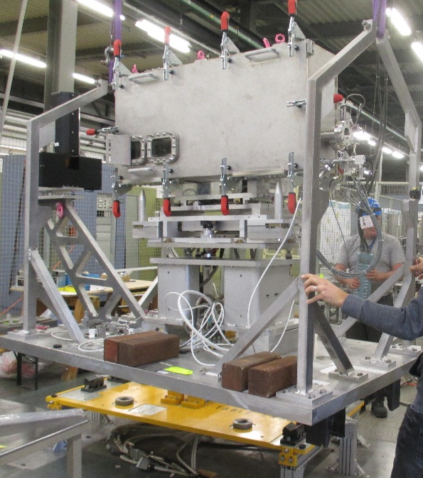
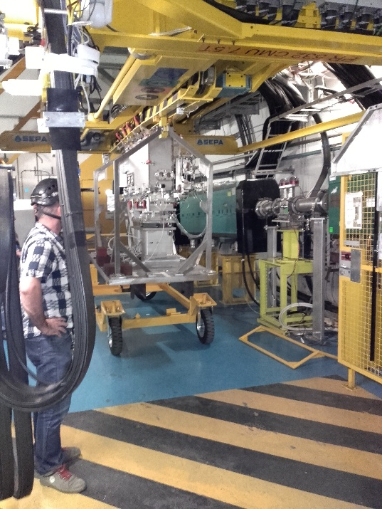
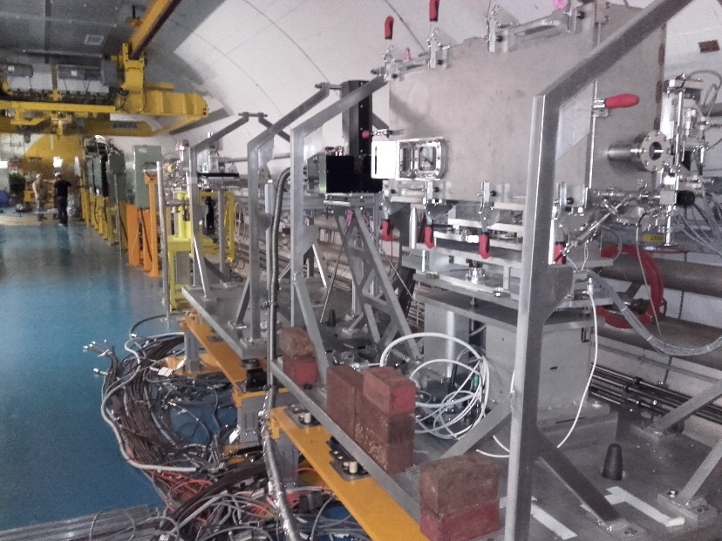
Experimental Set Up
Transport 867-BA7
BA7:
- Alignment
- Electronic tests
Transport to TNC table 2 position
TNC:
- Cameras connection and adjustment
- Vacuum line connection

Slide 24
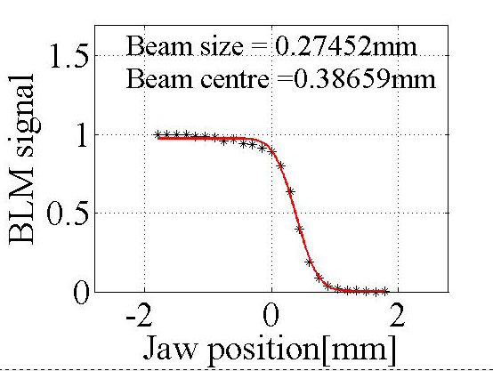
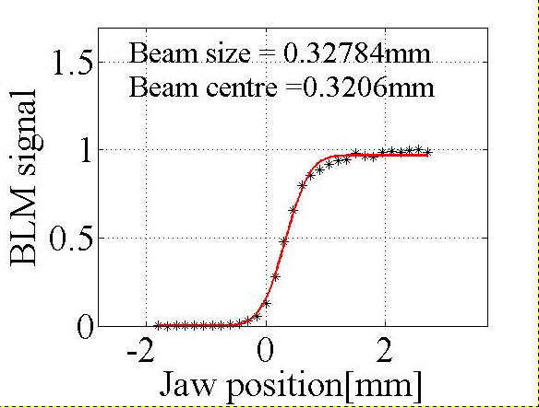
Alignment Graphite Cu coated jaw
First BBA took place 21th August 2017:
    BBA on Graphite/Cu and CFC/Mo jaws with INDIV (~1,2E11ppp, x 50 shots)
      Left/Top jaw (CFC with Mo Coating)
        Beam center = 0.387 mm
        Beam size = 0.275 mm
      Right/Bottom jaw (Graphite with Cu coating)
        Beam center = 0.320 mm
        Beam size = 0.330 mm
    We assume an average beam center of 0.350 mm and the nominal beam size of 0.3 mm.

Slide 25
Impacts type 1 on Graphite with Cu coating jaw
Time | Number of Bunches | Total Intensity (ppp) | Nominal sigma (mm) | Impact type 1 (sigma) | 5th axis (mm)
21/08-21:15 | 144 | 1,73E13 | 0,3 | 0 | 110
21/08-21:17 | 144 | 1,73E13 | 0,3 | 0 | 110
21/08-21:20 | 144 | 1,73E13 | 0,3 | 0 | 110
21/08-21:25 | Try to inject 288 bunches. Problems with high intensity beam stability.
22/08-12:22 | Check BBA with few INDIVs.
22/08-12:38 | 288 | 3,53E13 | 0,3 | 0 | 110
22/08-12:40 | 288 | 3,56E13 | 0,3 | 0,25 | 110
22/08-12:44 | 288 | 3,55E13 | 0,3 | 0,5 | 110
22/08-12:46 | 288 | 3,58E13 | 0,3 | 0,75 | 110
22/08-12:50 | 288 | 3,53E13 | 0,3 | 1 | 110
22/08-12:53 | 288 | 3,53E13 | 0,3 | 2 | 110
22/08-12:56 | 288 | 3,54E13 | 0,3 | 3 | 110
22/08-12:59 | 288 | 3,58E13 | 0,3 | 5 | 110
22/08-13:01 | 288 | 3,59E13 | 0,3 | 7 | 110
22/08-13:04 | 288 | 3,58E13 | 0,3 | 9 | 110

Slide 26
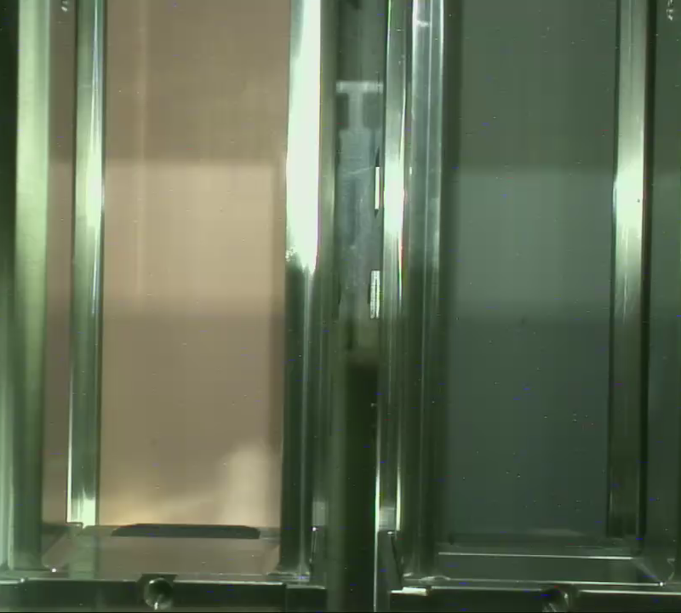

Impacts type 2 on Graphite with Cu coating jaw
Time | Number of Bunches | Total Intensity (ppp) | Nominal sigma (mm) | Impact type 2 (sigma) | 5th axis (mm)
22/08-13:13 | 288 | 3,52E13 | 0,3 | 0 | 100
22/08-13:15 | 288 | 3,58E13 | 0,3 | 0 | 100
22/08-13:17 | 288 | 3,56E13 | 0,3 | 0 | 100
22/08-13:19 | 288 | 3,56E13 | 0,3 | 0 | 100
22/08-13:22 | 288 | 3,58E13 | 0,3 | 0 | 100
22/08-13:24 | 288 | 3,57E13 | 0,3 | 0 | 100
HD RadHard camera any before impact
HD RadHard camera after first impact

Slide 27
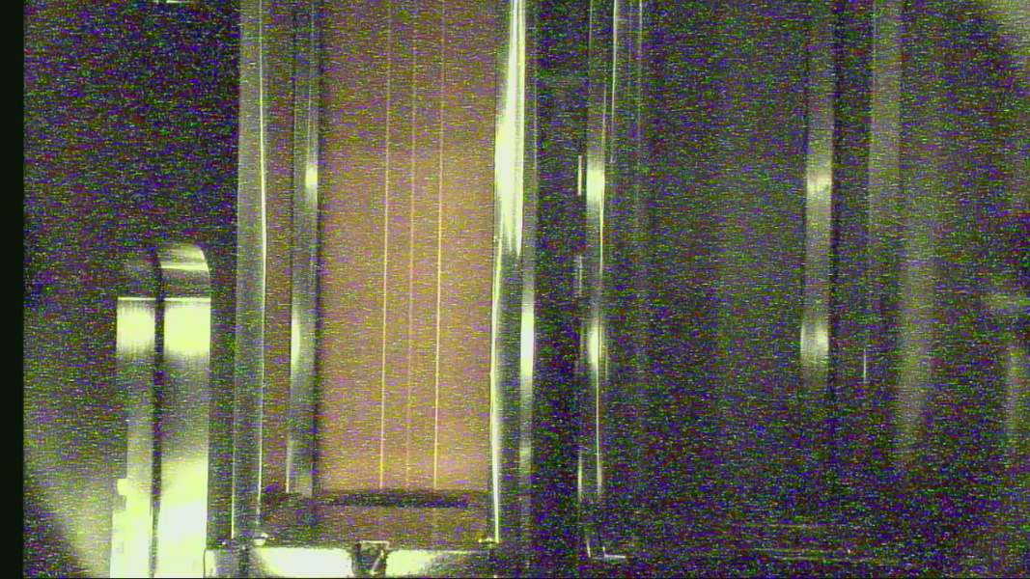
Impacts type 3 on Graphite with Cu coating jaw
Time | Number of Bunches | Total Intensity (ppp) | Nominal sigma (mm) | Impact type 3 (sigma and tilt rad) | 5th axis (mm)
22/08-13:32 | 288 | 3,49E13 | 0,3 | 0 and 0 | 119
22/08-13:36 | 288 | 3,50E13 | 0,3 | 0 and -300 | 119
22/08-13:38 | 288 | 3,57E13 | 0,3 | 0 and -150 | 119
22/08-13:41 | 288 | 3,49E13 | 0,3 | 0 | 119
22/08-13:43 | 288 | 3,53E13 | 0,3 | 0 and +150 | 119
22/08-13:45 | 288 | 3,58E13 | 0,3 | 0 and +300 | 119
HD RadHard camera after Graphite Cu coating impacts

Slide 28
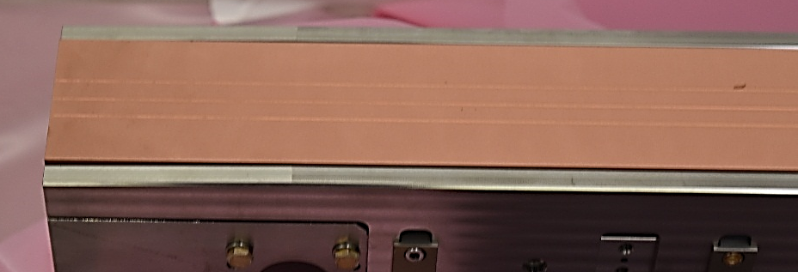
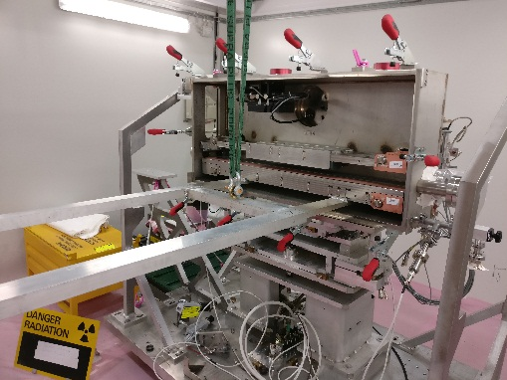
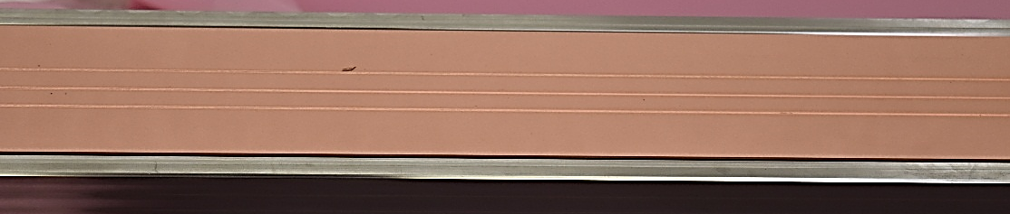
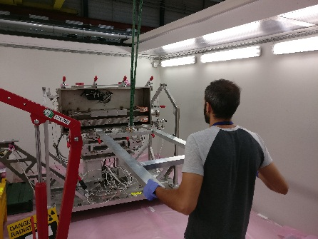
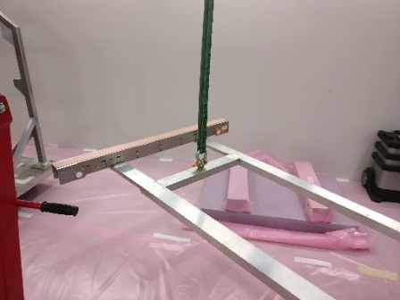
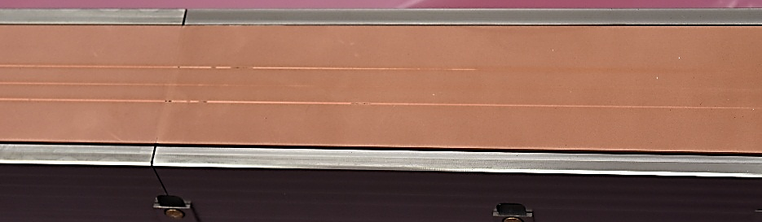
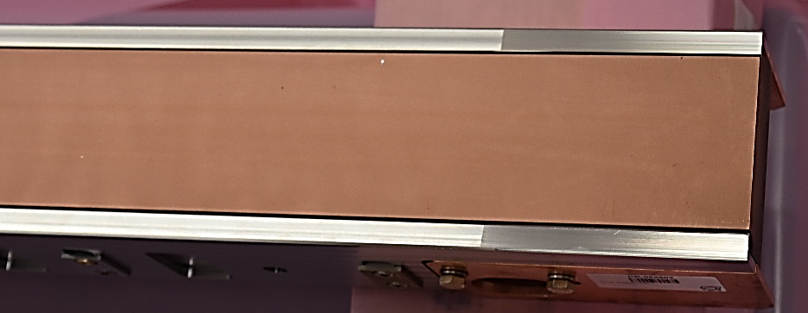
First Visual Inspection of Graphite with Cu coating jaw
1mSv/h at contact
Impact type 2
Upstream
Impact type 1
Impact type 3
Surface CO2 blasted before Cu sputtering ~3 um
Downstream

Slide 29
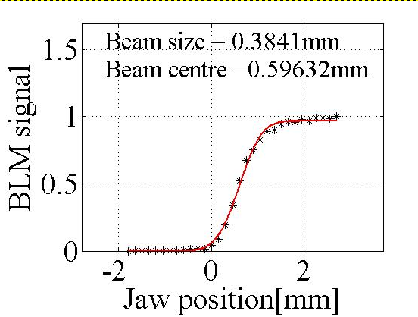
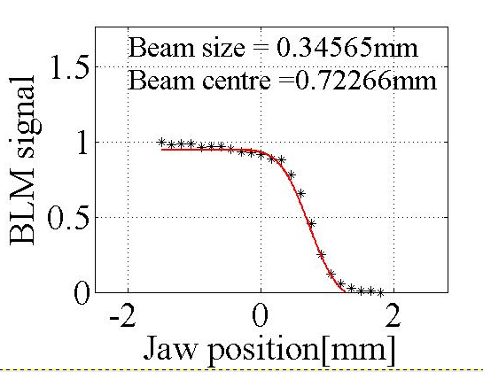
Alignment Graphite Mo coated jaw
Second BBA took place 23th August 2017:
    BBA on Graphite/Mo and MoGr/Cu/Mo jaws with INDIV (~1,2E11ppp, x 50 shots)
      Left/Top jaw (MoGr with Mo/Cu coating)
        Beam center = 0.720 mm
        Beam size = 0.350 mm
      Right/Bottom jaw (Graphite with Mo coating)
        Beam center = 0.600 mm
        Beam size = 0.380 mm

Slide 30
Impacts type 1 on Graphite with Mo coating jaw
Time | Number of Bunches | Total Intensity (ppp) | Nominal sigma (mm) | Impact type 1 (sigma) | 5th axis (mm)
23/08-2:25 | 288 | 3,54E13 | 0,3 | 0 | 7
23/08-2:27 | 288 | 3,56E13 | 0,3 | 0 | 7
23/08-2:29 | 288 | 3,49E13 | 0,3 | 0,25 | 7
23/08-2:31 | 288 | 3,48E13 | 0,3 | 0,5 | 7
23/08-2:34 | 288 | 3,46E13 | 0,3 | 0,75 | 7
23/08-2:36 | 288 | 3,46E13 | 0,3 | 1 | 7
23/08-2:38 | 288 | 3,45E13 | 0,3 | 2 | 7
23/08-2:40 | 288 | 3,44E13 | 0,3 | 3 | 7
23/08-2:42 | 288 | 3,44E13 | 0,3 | 5 | 7
23/08-2:44 | 288 | 3,47E13 | 0,3 | 7 | 7
23/08-2:46 | 288 | 3,46E13 | 0,3 | 9 | 7

Slide 31
Impacts type 2 on Graphite with Mo coating jaw
Time | Number of Bunches | Total Intensity (ppp) | Nominal sigma (mm) | Impact type 2 (sigma) | 5th axis (mm)
23/08-2:53 | 288 | 3,48E13 | 0,3 | 0 | 0
23/08-2:55 | 288 | 3,49E13 | 0,3 | 0 | 0
23/08-2:57 | 288 | 3,47E13 | 0,3 | 0 | 0
23/08-2:59 | 288 | 3,49E13 | 0,3 | 0 | 0
23/08-3:31 | 288 | 3,48E13 | 0,3 | 0 | 0
23/08-3:33 | 288 | 3,45E13 | 0,3 | 0 | 0

Slide 32
Impacts type 3 on Graphite with Mo coating jaw
Time | Number of Bunches | Total Intensity (ppp) | Nominal sigma (mm) | Impact type 3 (sigma and tilt rad) | 5th axis (mm)
23/08-3:10 | 288 | 3,47E13 | 0,3 | 0 and 0 | 14
23/08-3:12 | 288 | 3,50E13 | 0,3 | 0 and -300 | 14
23/08-3:14 | 288 | 3,40E13 | 0,3 | 0 and -150 | 14
23/08-3:17 | 288 | 3,38E13 | 0,3 | 0 | 14
23/08-3:19 | 288 | 3,48E13 | 0,3 | 0 and +150 | 14
23/08-3:21 | 288 | 3,48E13 | 0,3 | 0 and +300 | 14

Slide 33
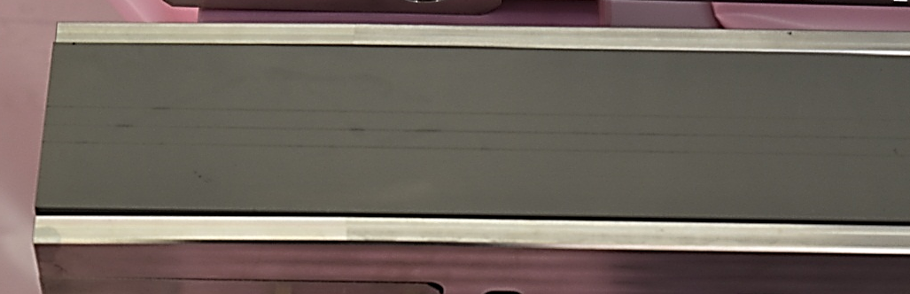
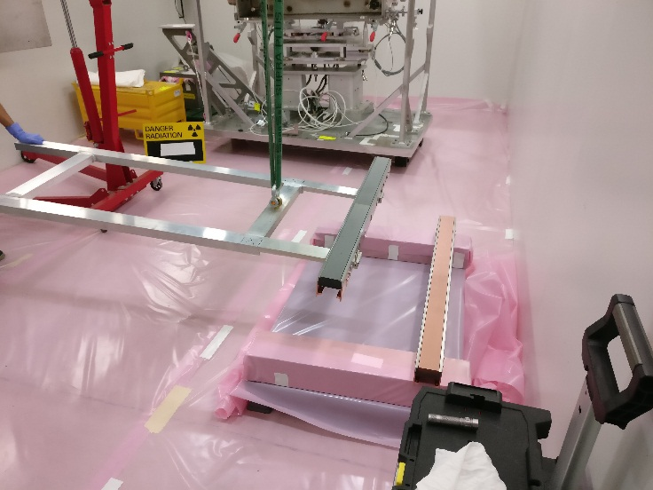
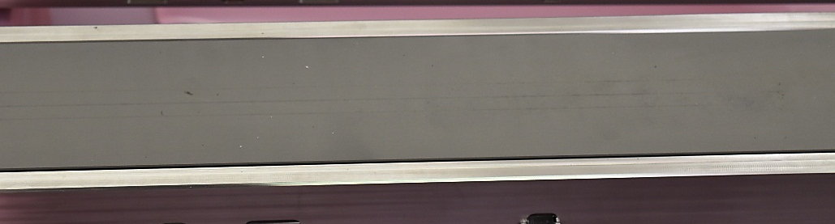



First Visual Inspection of Graphite with Mo coating jaw
Impact type 2
Upstream
1mSv/h at contact
Impact type 1
Impact type 3
Surface CO2 blasted before Mo sputtering ~3 um
Downstream

Slide 34
HRMT-35 Summary
HRMT35 preliminary results indicate quite good coating adhesion with no apparent surface rupture for Cu coated graphite;
The currently installed TDI and its SGL R7550 graphite blocks sputtered with Cu can perform under the worst impact conditions;
Further PIE (e.g. coating adhesion tests and tomography) will be performed when residual dose rate will allow;

Slide 35
Thank you for your attention

