Slide 1

CLIQ and Quench Heater firing: effect on the beam
Matthieu Valette, D. Wollmann, B. Lindstrom, E. Ravaioli, L. Bortot, A. Fernandez Navarro
CERN
7th HiLumi meeting – Madrid - 15 November 2017

Slide 2
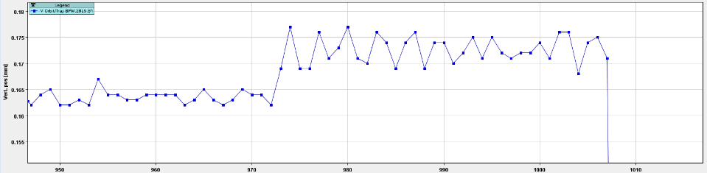
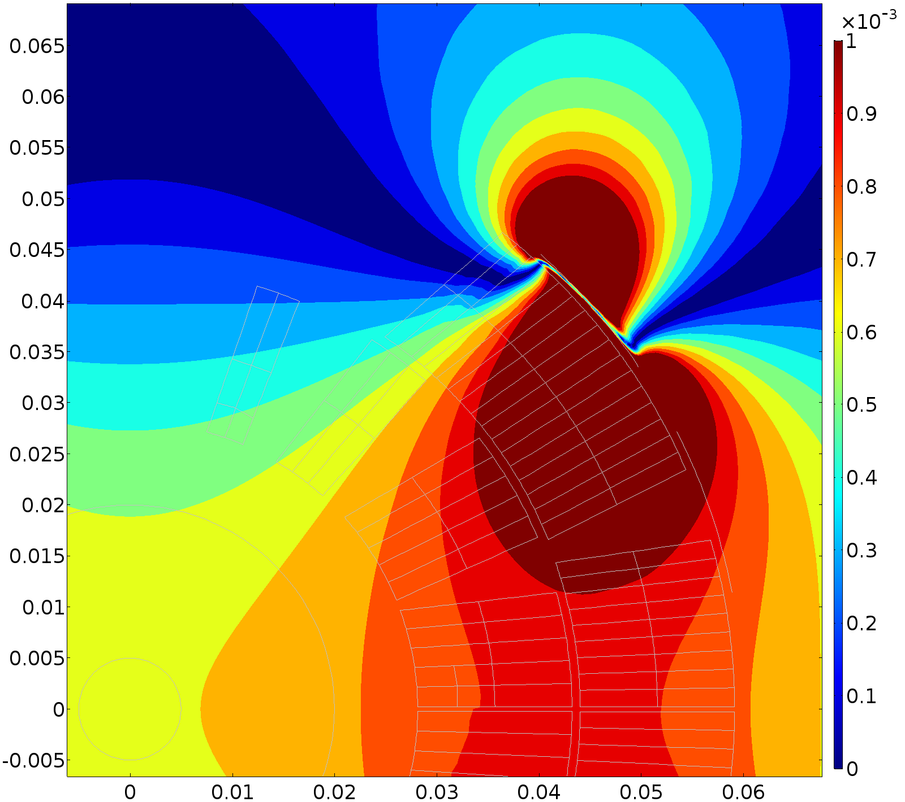
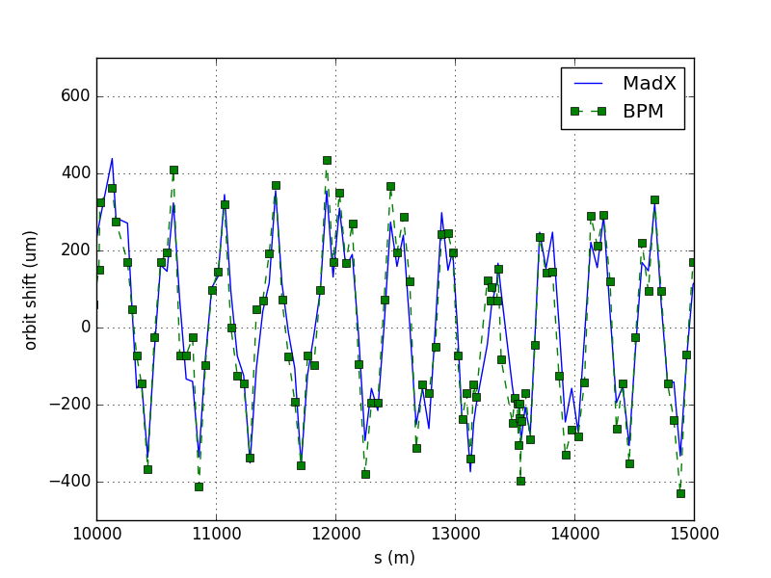
From observation to LHC tests
10µm
In 2016, before dumps with quenches: fast (<1 turn) but small vertical orbit shift of the LHC beam.
QH firing is a potential cause, the induced magnetic field was simulated in COMSOL.
Confirmed in an LHC test and fits the MAD-X simulations.
35 turns, ~3ms
QH induced magnetic field
(T)
Measured and simulated orbit change

Slide 3
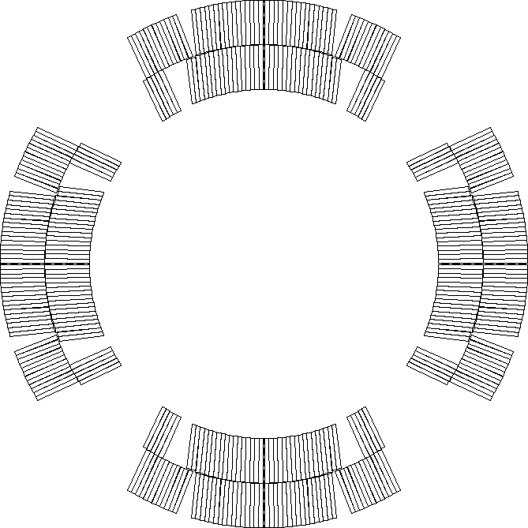
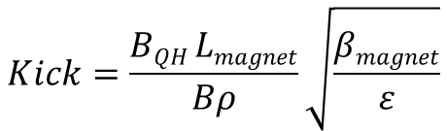
Simulation results
kicks > 1.2 σ
are dangerous
The LHC MB is protected by 4 QH strips powered with 80 A.
Some HL-LHC magnets will be protected with up to 24 strips with 134/200 A, e.g. MQXF:
An analysis was done for the QH kicks of HL-LHC magnets.
Magnet | BL (T.m) | β (m) | kick (σ)
MB | 0.01 | 420 | 0.49
MQ | 0.002 | 575 | 0.15
D1 | 0.008 | 18 km | 1.98
D2 | 0.0125 | 5.8km | 2.44
11T | 0.02 | 144 | 0.42
Triplet w/out IL | 0.11 | 4.5km - 21km | 28.8
Triplet with IL | 0.20 |  | 52.0
Optics: HLLHCv1.2
The triplet QH have very large kicks, beam would end up in aperture if fired before the dump => Ensure the beam is dumped before these QH are fired
$$Kick=\frac{BQH Lmagnet}{Bρ}\sqrt{\frac{βmagnet}{ε}}$$

Slide 4
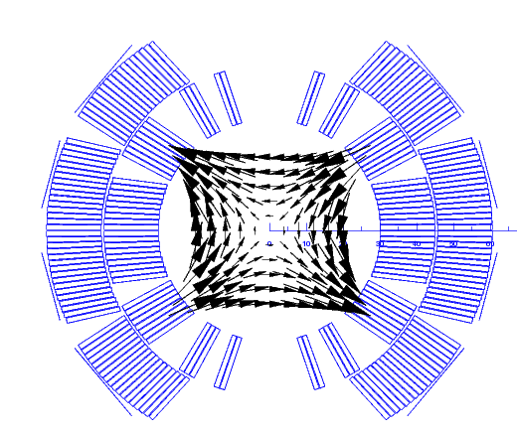
Possible mitigations
In the previous table: all QH kicks add up and are fired at the same time.
Can be mitigated by the triggering causing a dump and delays.
Remaining failure case: spurious triggering of one circuit.
Alternative connection schemes would allow:
  reducing the kick from the Q2b
    IL QH from 2.4 σ to 1.7 σ
    OL QH from 1.7 to 1.2 σ
  having a quadrupole field in the 11 T-dipole instead of a dipole kick
alternative
baseline
-
-
+
+
~0.11 T.m⁻¹
Compared to 200 T.m⁻¹ for the arc quads with similar β
+
+
-
-
Courtesy S. Izquierdo

Slide 5
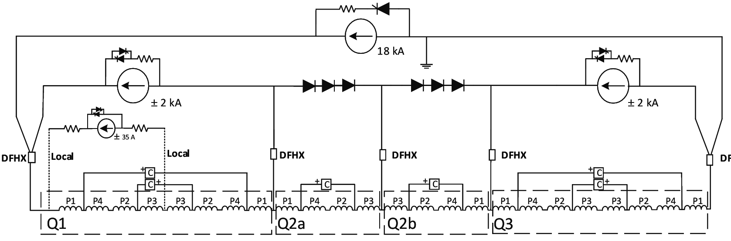
Spurious CLIQ discharge
The triplet will also be protected by CLIQ.
2 kA discharged in the coils if fired.
Same considerations as for the QH: spurious firing as the main failure case.
I_{CLIQ}
I_{CLIQ}
I_{nominal}
I_{nominal}

Slide 6
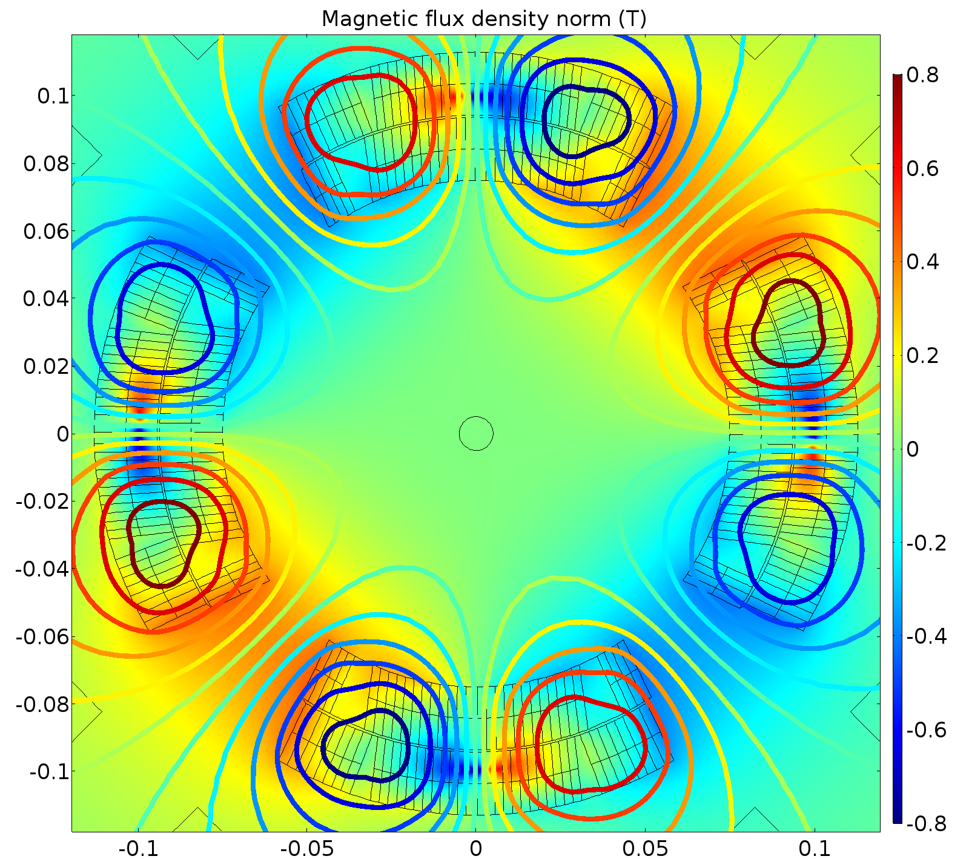
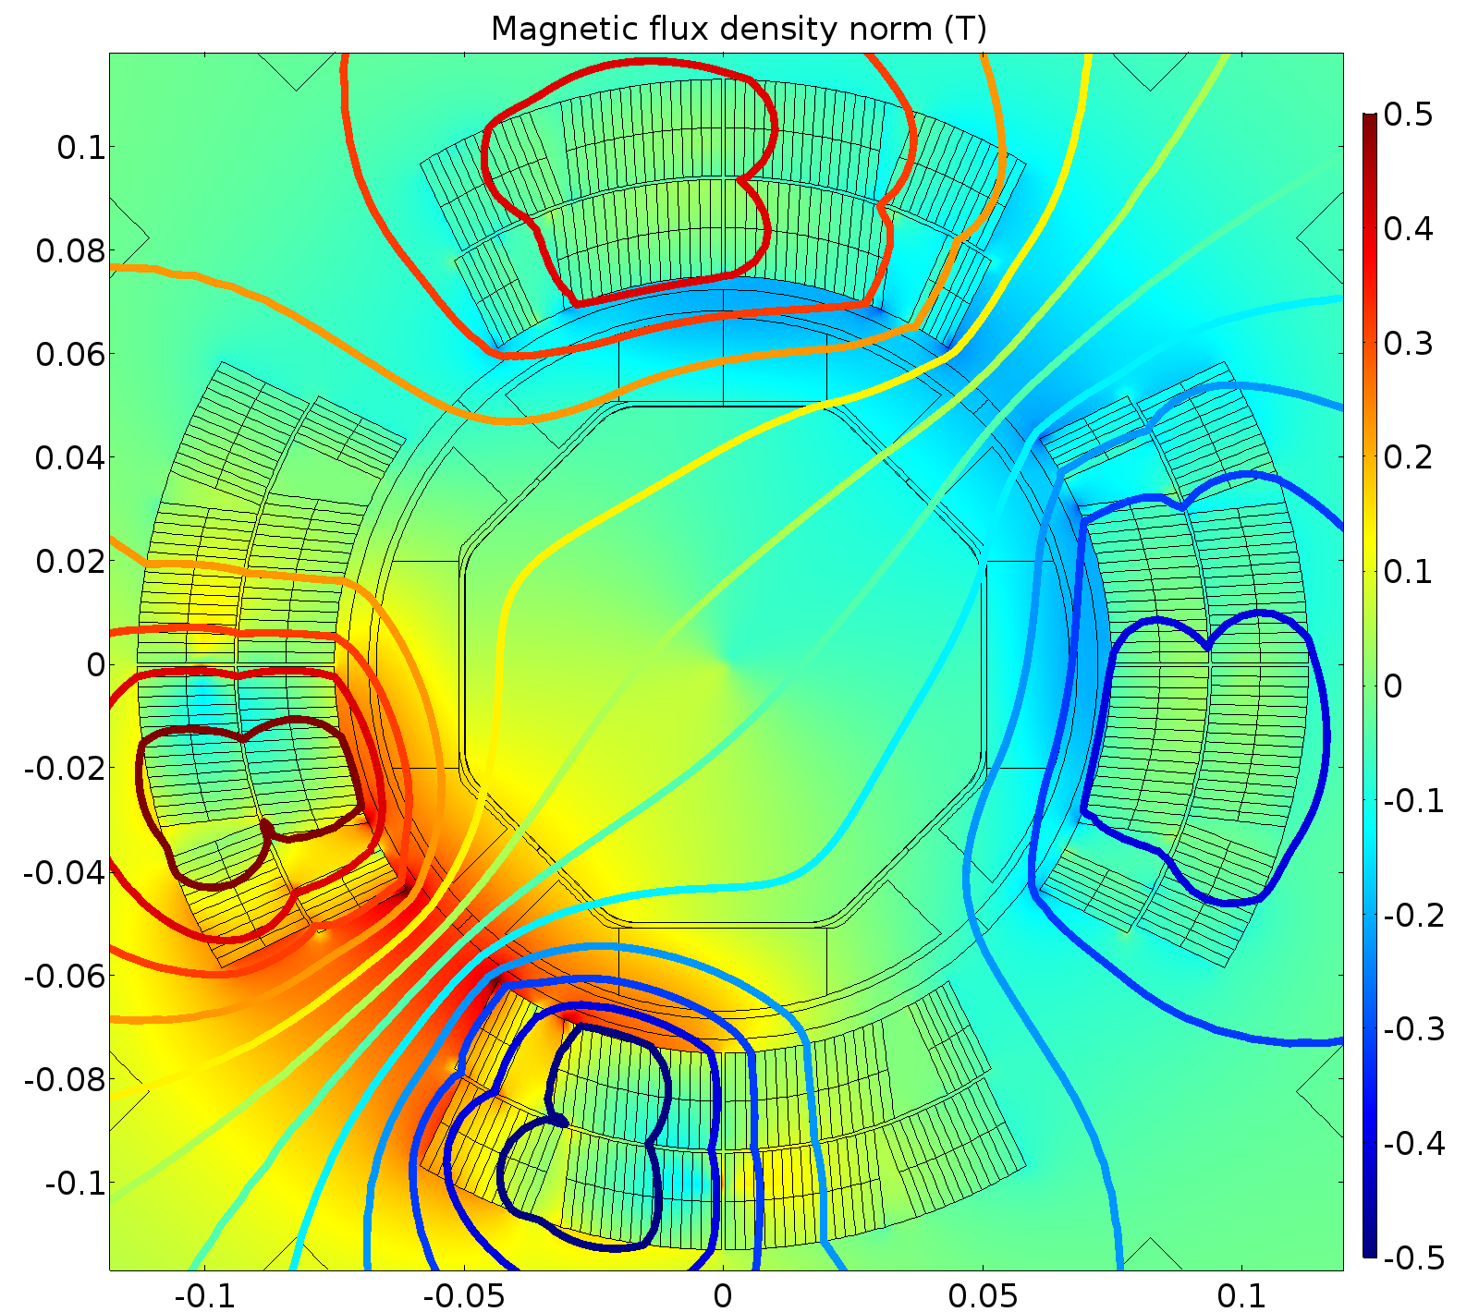
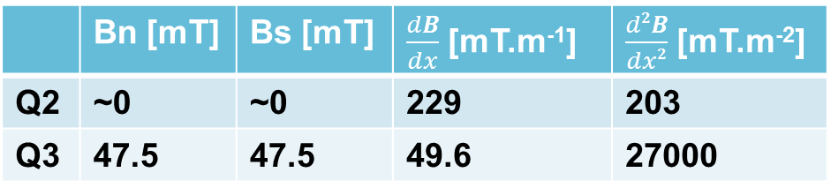
Magnetic Field Simulations
A CLIQ discharge in one of the Q2 magnets would reduce its focusing gradient.
Due to asymmetry, a discharge in a Q1 or Q3 magnet would have dipole components in the beam area.
Q2
 | Bn [mT] | Bs [mT] | $\frac{dB}{dx}$ [mT.m⁻¹] | $\frac{d2B}{dx2}$ [mT.m⁻²]
Q2 | ~0 | ~0 | 229 | 203
Q3 | 47.5 | 47.5 | 49.6 | 27000
Q3

Slide 7
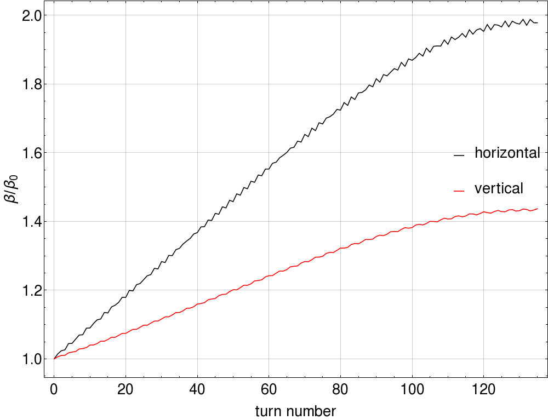
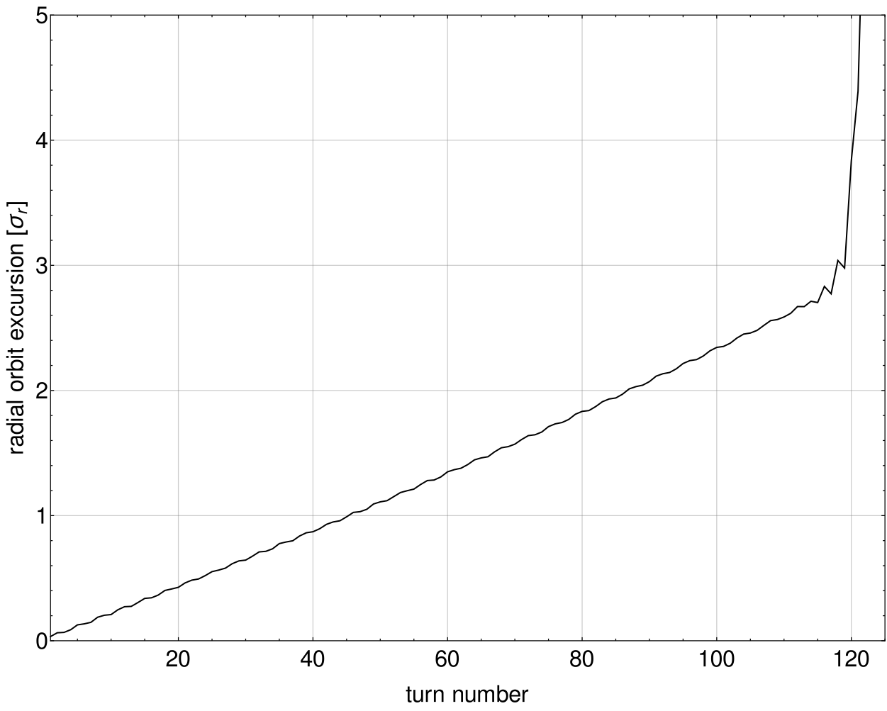
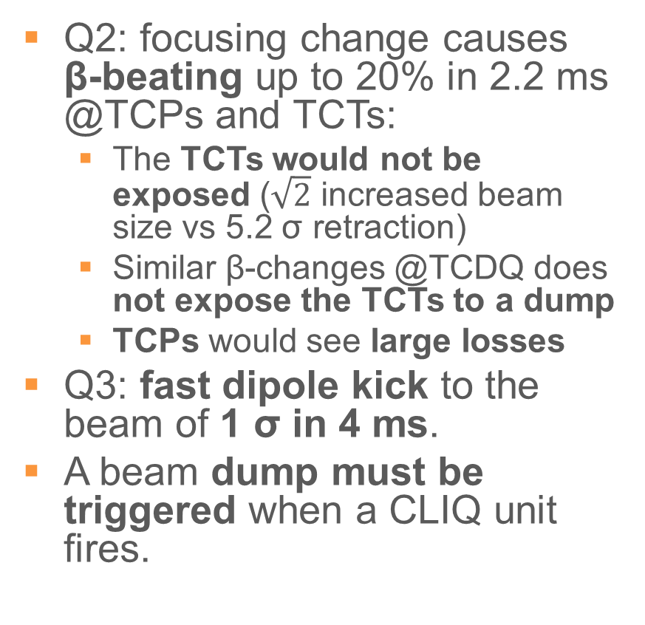
Beam Tracking Simulations
Optics: HLLHCv1.2
Q2: focusing change causes β-beating up to 20% in 2.2 ms @TCPs and TCTs:
  The TCTs would not be exposed ($\sqrt{2}$ increased beam size vs 5.2 σ retraction)
  Similar β-changes @TCDQ does not expose the TCTs to a dump
  TCPs would see large losses
Q3: fast dipole kick to the beam of 1 σ in 4 ms.
A beam dump must be triggered when a CLIQ unit fires.
Q2
20 % – 2 ms
LHC – D1 failure
Q3
Time [ms] | I_CLIQ [A] | Relative current change
2 | 310 | 1.9%
4 | 620 | 3.8%
1 σ – 4 ms

Slide 8
Conclusions & outlook
Kicks from QHs in most HL-LHC superconducting magnets were calculated: very large kicks are to be expected for the triplets and IPDs.
This effect can be mitigated by faster interlocking on QH firing.
Spurious firing can not be interlocked against and is very fast (<1 turn for MB)
  Additional mitigation: lower the dipole kick of QH by using different connection schemes.
  Extra reaction time might come from long cables to the power supply for MQXF, to be studied.
CLIQ discharge in Q2: slowly rising β-beating, no exposure of TCTs to be expected, but large losses in IR7.
CLIQ discharge in Q3: Orbit changes too fast to rely on QPS.
=> It is necessary to interlock the CLIQ units on discharge.

Slide 9
Thank you for your attention, any questions ?

Slide 10
