Slide 1

Triplet and TCT protection during asynchronous dump in HL-LHC
R. Bruce, S. Redaelli
Acknowledgement: C. Bracco, F. Cerutti, S. Mallows, A. Mereghetti, E. Quaranta, A. Sbrizzi, A. Tsinganis
HL-LHC TCC 4/5/2017

Slide 2
Introduction
Risk of hitting and damaging sensitive elements during asynchronous beam dumps
  TCTs and triplets most exposed, need to stay sufficiently far behind the dump protection
  Lower limit on normalized triplet aperture => limit on β* => major performance limitation of the LHC
Need to study asynchronous beam dumps in detail also for HL-LHC. Limits on performance?

Slide 3
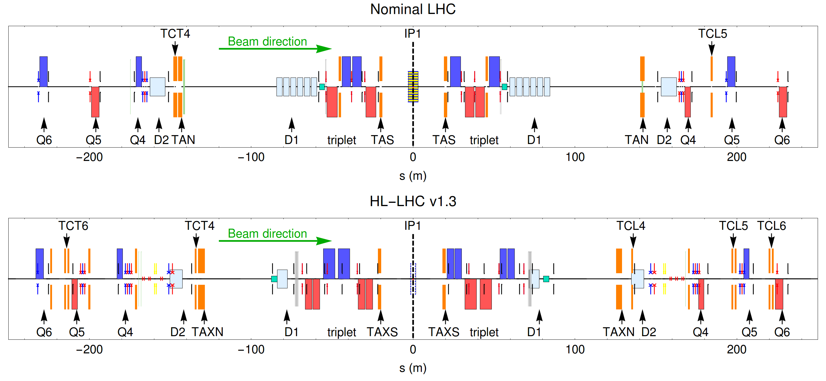
IR layout in HL v1.3

Slide 4
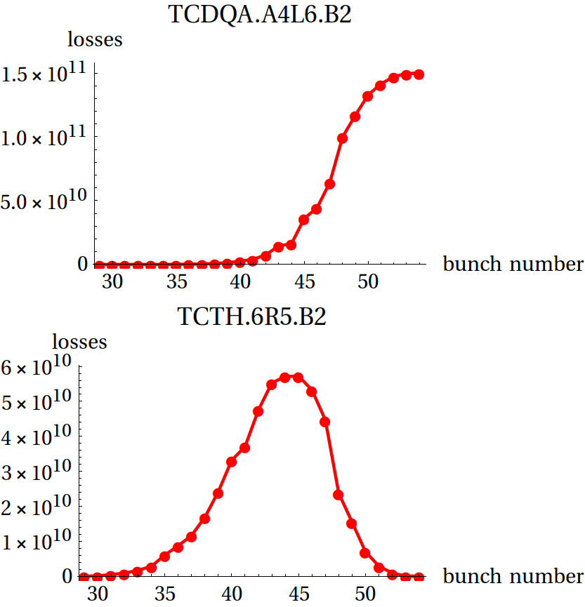
Simulation setup for asynch. dump
Studies with SixTrack, several bunches receiving different kicks tracked separately, full collimation system in place
First bunches: small kicks, pass through the whole ring
Later bunches: large kicks, hit TCDQ, TCDS or are extracted
Intermediate range of bunches risk to hit TCTs and aperture
Need to simulate only these bunches

Slide 5
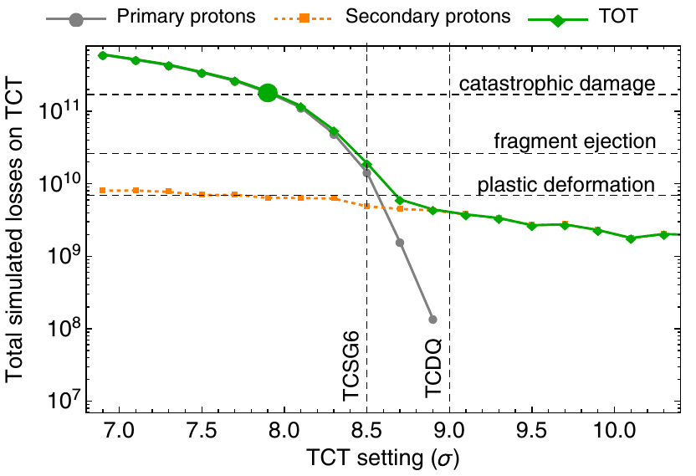
Recap: previous simulations of asynch. dump
Sensitivity study: Simulate losses on tungsten TCTs as function of setting
Up to HL-LHC v1.2, risk for critical losses on TCTs
  Phase advance between
  dump kickers and
  some TCTs close
  to 90 deg
Needed significant
retraction between
TCDQ and TCTs to
ensure safety
in 3.5 μm
E. Quaranta et al., PRAB 20, 091002 (2017)
7 Tev, β*=15 cm, TCSP/TCDQ at 10.1/10.6 σ

Slide 6
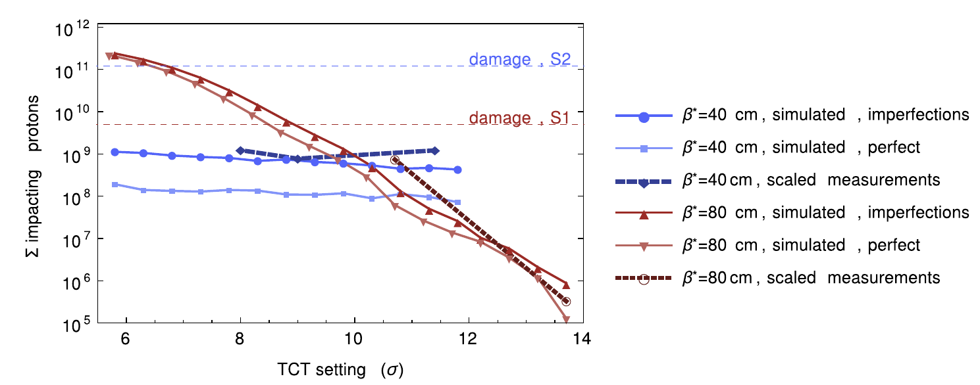
Possible solutions
2 options to mitigate limitation (both being pursued)
  Upgrade to more robust TCTs. Need to make sure that downstream magnets are still protected
  Rematch phase advance between dump kickers and TCTs to be close to zero
    done in the LHC – made it possible to reach β*=40 cm in 2016
“bad” phase
“good” phase
R. Bruce et al., NIM A 848 (2017) 19–30

Slide 7
HL-LHC phase advance
In new optics v1.3, significant improvement of phase advance between dump kickers and TCTs (see talk R. De Maria)
optics | TCT6 IR1 B1 | TCT6 IR5 B1 | TCT6 IR1 B2 | TCT6 IR5 B2
HL-LHC v1.2 15 cm | 106 | 285 | 137 | 101
HL-LHC v1.3 15 cm | 180 | 155 | 154 | 152

Slide 8
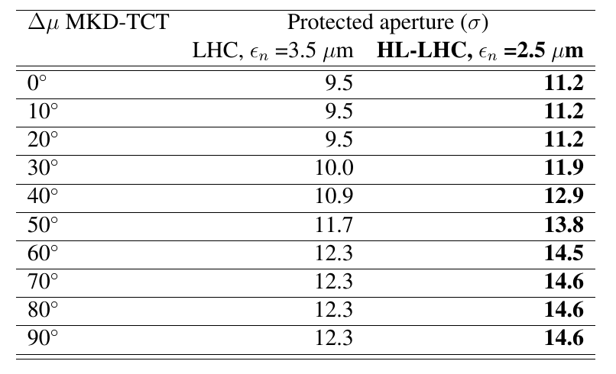
Calculation of allowed settings vs phase
Achieved phase in HL v1.3 allows tighter TCTs and aperture
Calculation of protected aperture for different MKD-TCT phase advance (see talk R. Bruce later today)
    CERN-ACC-2017-0051
    CERN-ACC-2017-0051

Slide 9
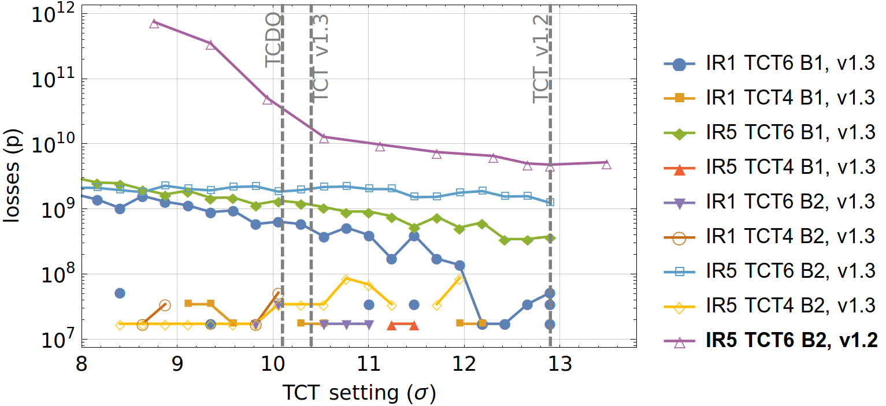
Simulated TCT losses in HL-LHC v1.3
Conclusion: tungsten TCTs well below damage limit for secondary impacts
New operational setting at 10.4 σ is fine
Damage, spread-out impacts

Slide 10
Additional considerations
Need to worry not only about damage to the TCTs themselves, but also to the downstream elements
  Magnets
  Experiments
Set up FLUKA study of shower from TCTs during asynch. dump
  Results in next talk (A. Tsinganis)

Slide 11
Cases studied
Several cases considered
  Old “bad” phase advance in HL-LHC v1.2
  HL-LHC v1.3, with “good” phase advance
  Impacts on TCT4 or TCT6
  Different TCT materials
    Inermet (tungsten): material of present LHC TCTs
    CuCD (copper-diamond) : Improve TCT robustness by factor 15-20, but worse protection expetced since lighter material
    MoGr (Molybdenum graphite): Even lighter and more robust
In all cases, simulating IR5 (worst case)

Slide 12
Scenario: bad phase
Primary beam hit the TCT
Study case where margin TCT-triplet is exhausted
Track protons kicked by dump kickers in IR6 (using HL v1.2 phase advance) to TCTs
Rescale coordinates to fit the opening of the TCT in HL-LHC v1.3
  can then use same FLUKA geometry for both cases
Impacts from single bunch
  Pessimistic case in terms of impact distribution and comparable to earlier studies
    Scaling to other scenario
  Full bunch, with 2 σ impact parameter
  Half bunch hitting edge of TCT

Slide 13
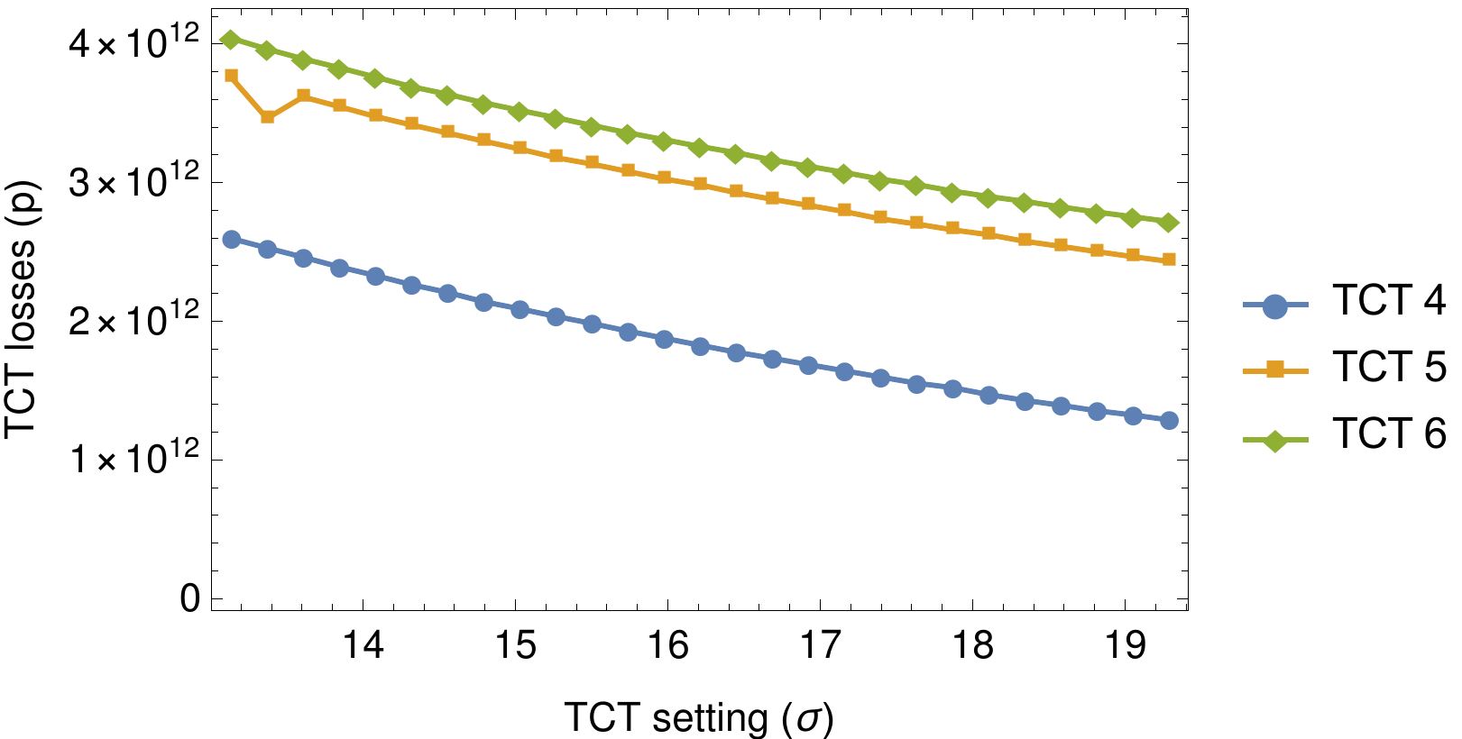
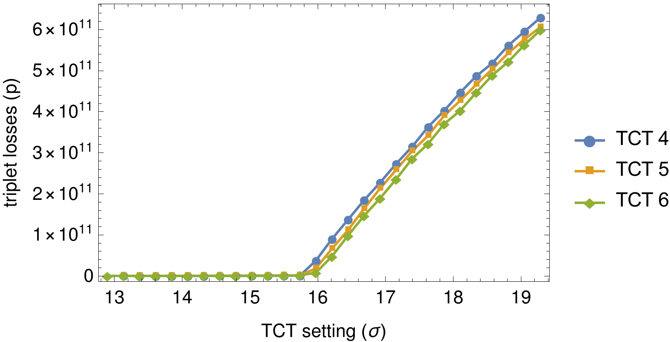
Protection of triplet, HL-LHC v1.2, β*=15 cm
IR5, B2
For pessimistic case with maximum impact on downstream elements:
  Open TCT until it is on the limit of protecting the triplet aperture
  Open IR6 TCDQs to allow primary impacts on TCTs
  Simulates the case of imperfect machine (errors in IR6 and/or IR5)
For FLUKA study, assuming TCT setting of 15.7 σ (for 2.5 μm emittance)

Slide 14
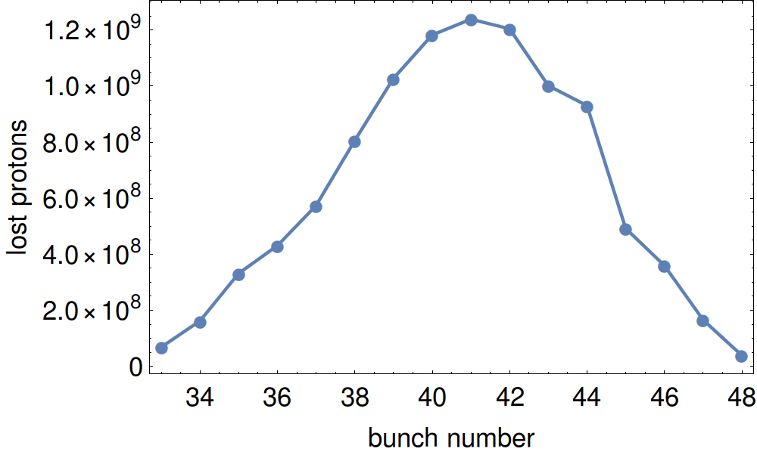
Scenario: good phase
Dominated by secondary beam outscattered in IR6 collimators
Keep TCT and IR6 at nominal settings
  TCTs at 10.9 σ and TCDQ at 10.6 – previous baseline
Fractions of several 16 bunches hit
In total, around 1E10 protons hitting TCT
Normalized to
2.2E11 p/bunch

Slide 15
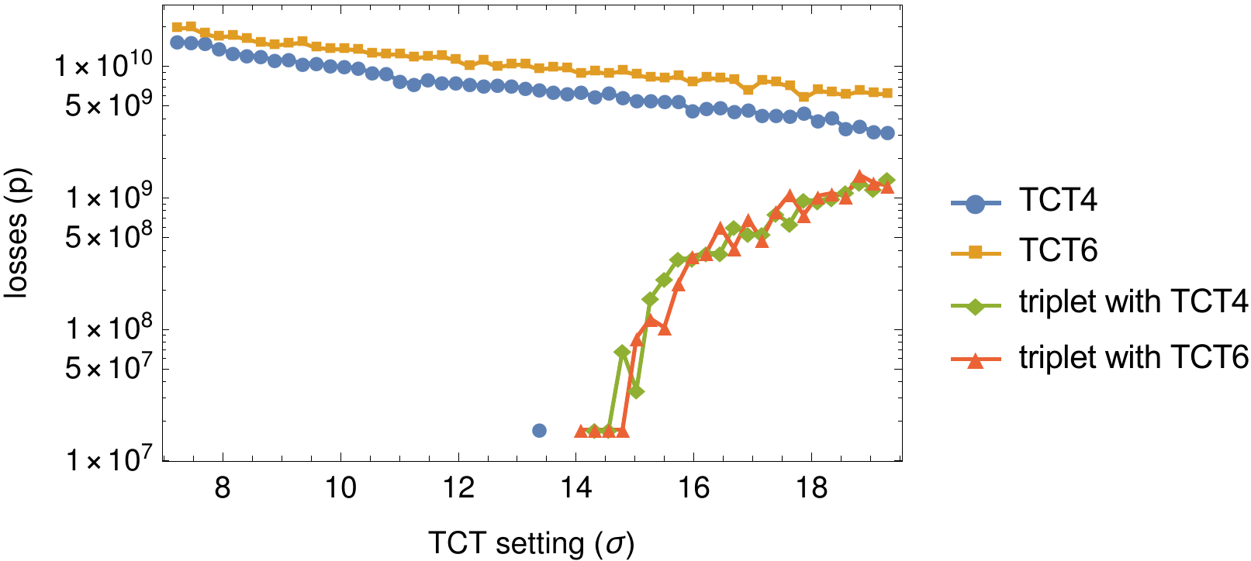
Protection of triplet, HL-LHC v1.3, β*=15 cm
Variation of losses with TCT setting
Losses appear in triplet with TCT around 14 σ (2.5 μm emittance)
IR5, B2

Slide 16
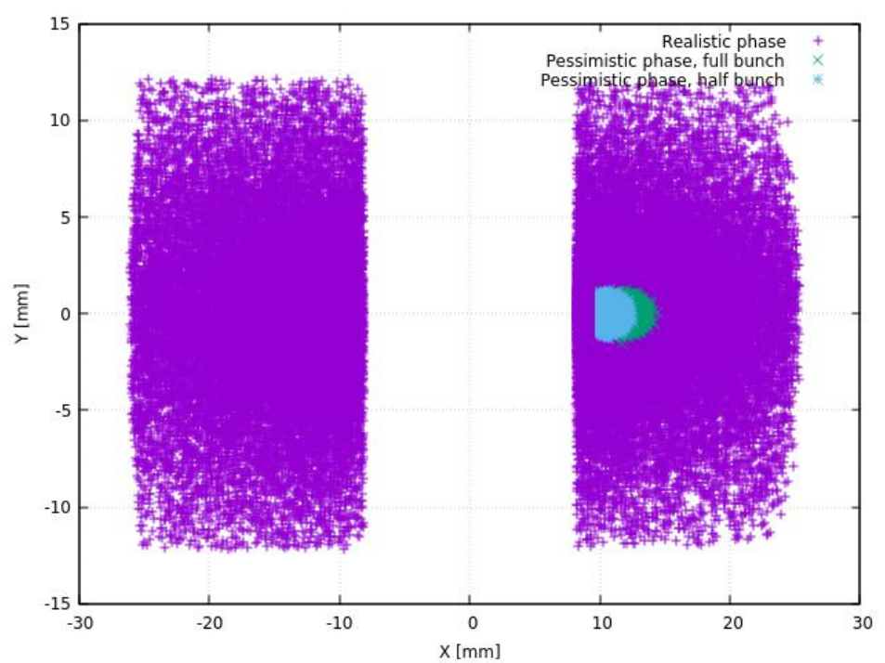
Comparison of impacts in both scenarios
Secondary losses distributed over both jaws and much more spread out
FLUKA results for the different cases: see next talk A. Tsinganis
Plot by A. Tsinganis

Slide 17
Next steps
Ideally, energy deposition studies in downstream elements and the damage limits could be used to decide on TCT material
Choose material where the largest number of protons impacting the TCT is tolerated without damage to any element (TCT, magnets detector)
Damage limit of experiments evolving
  ATLAS: HiRadMat tests indicate that damage limit on current IBL could be significantly higher (at least a factor ~1000) than the lower limit previously measured of 1E10 MIPs / cm^2 (see talk B. Di Girolamo)
  CMS: Previous limit of 1E9 MIPs/cm^2 believed to be too pessimistic – under study. Hope to have an update in a few months
Additional consideration: experimental background from TCTs. Impact of material choice to be quantified

Slide 18
Conclusions
Risk of damage to TCTs and triplets could impose major performance limitations
Two ways of mitigating
  Improved optics with rematched phase advance between dump kicker and TCT
  More robust TCTs
HL-LHC v1.3: Improved phase advance.
  Very large improvement in losses on TCTs / triplets compared to v1.2 seen
  Only secondary protons reach TCTs in realistic cases – below estimated tungsten damage limit with good margin
Study of risk of damage on downstream elements due to shower from TCT
  Tracking studies for several scenarios – starting conditions at face of TCT passed to FLUKA (see next talk A. Tsinganis)
  Energy deposition and accurate damage limits to be used for decision on material

Slide 19
Thanks for your attention!

Slide 20
Simulation setup
Using SixTrack with collimation, one simulation per bunch (different kick angles)
Baseline HL collimator settings (CERN-ACC-2017-0051)
  Explore different TCT configurations and optics
  TCT4, TCT6 or TCT5 (installed just upstream of Q4)
On second turn, bunch receives kicks from each MKD
Single module pre-fire type 2 assumed (waveforms provided by M. Fraser)
Post-processing: sum losses over all bunches, normalize to HL bunch intensity at top energy 2.2E11

Slide 21
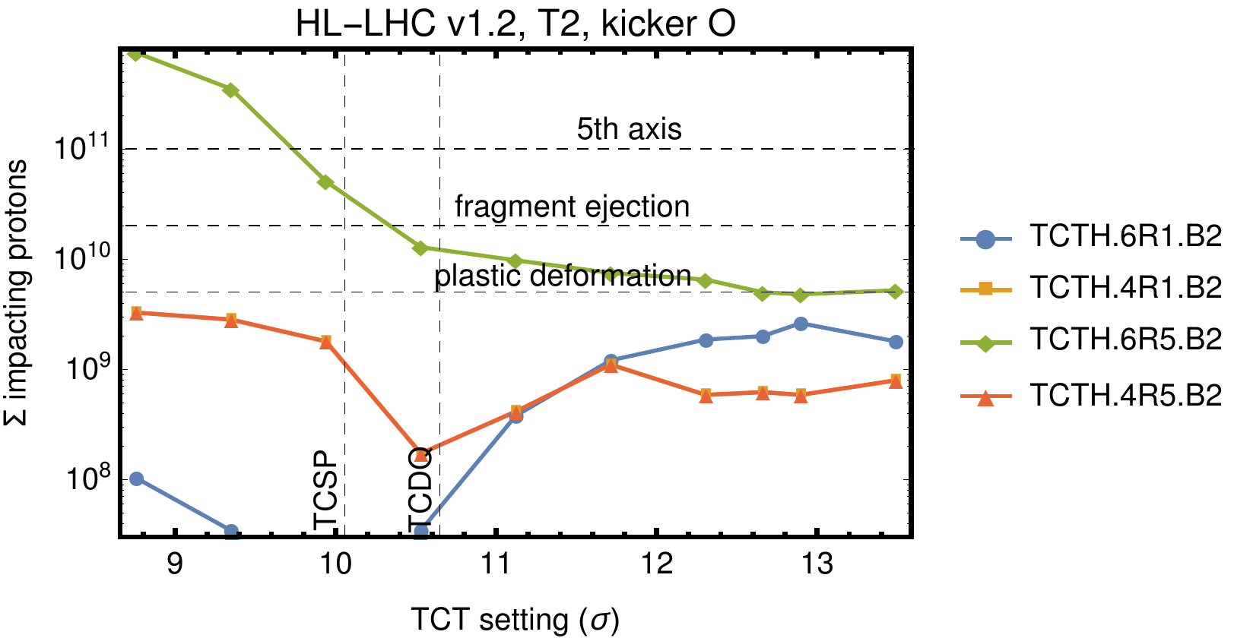
Results: HL-LHC v1.2, β*=15 cm
Worst case: IR5 B2
All collimators kept constant, scan in TCT setting, TCT4+6 both in
Conclusion: risk for damaging losses with imperfect (smaller) TCT setting (“bad” phase)

Slide 22
Phases: IR5 B2 TCTs, HL-LHC v1.2, β*=15 cm
A few degrees of phase advance between TCT6 and triplet
Element | Fractional phase advance from MKD.O
TCTPH.6R5.B2 | 101.5
TCTPH.5R5.B2 | 102.7
TCTPH.4R5.B2 | 103.5
Q3R5 | 104.1
Q2R5 | 104.2
Q1R5 | 104.3

Slide 23
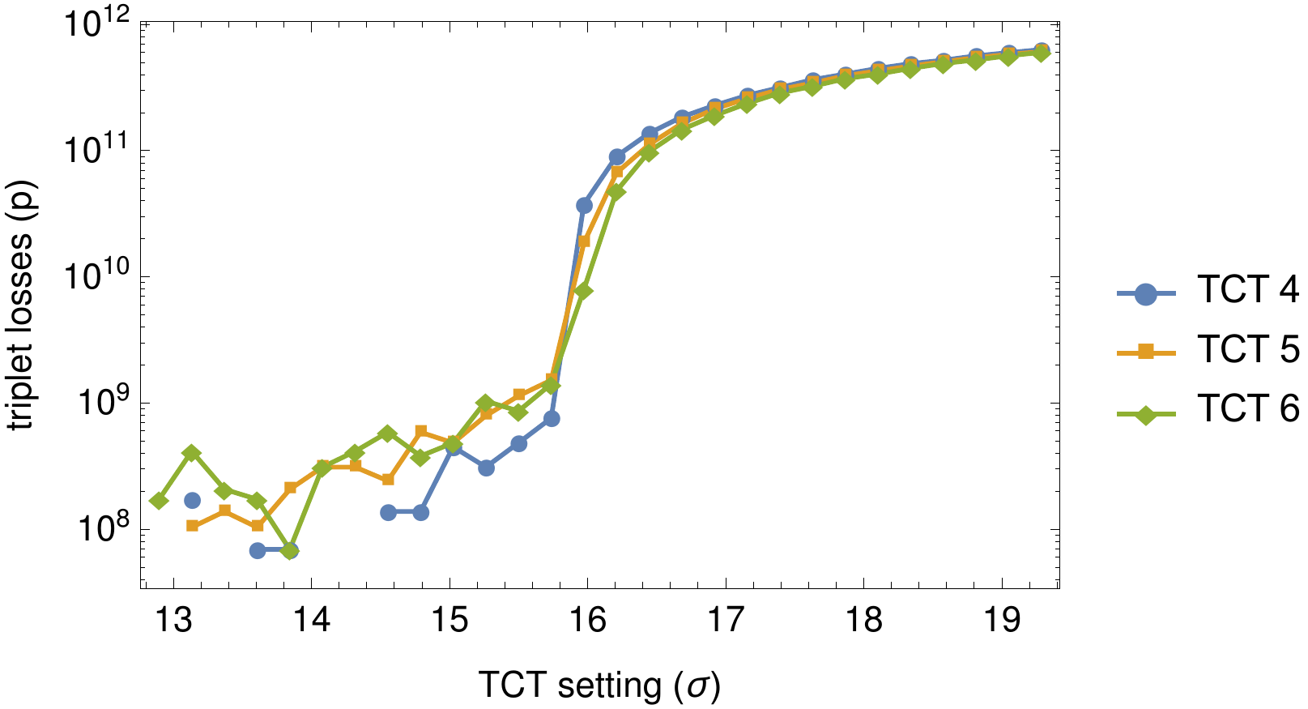
Triplet losses (log scale)
When TCT setting is inside triplet aperture, TCT4 protects better (direct shadowing at almost same phase)
IR5, B2, v1.2, 15cm

Slide 24
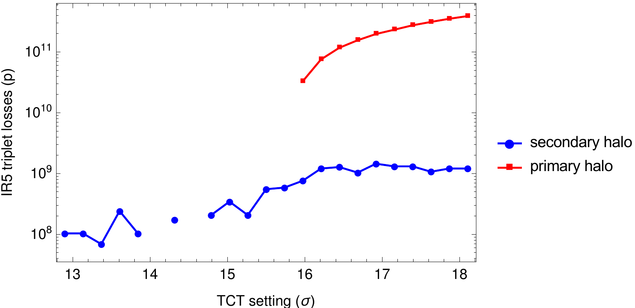
Decomposition of triplet losses
As triplet is also at bad phase, it starts intercepting primary losses when the TCT is open enough
  In these simulations, IR6 open

Slide 25
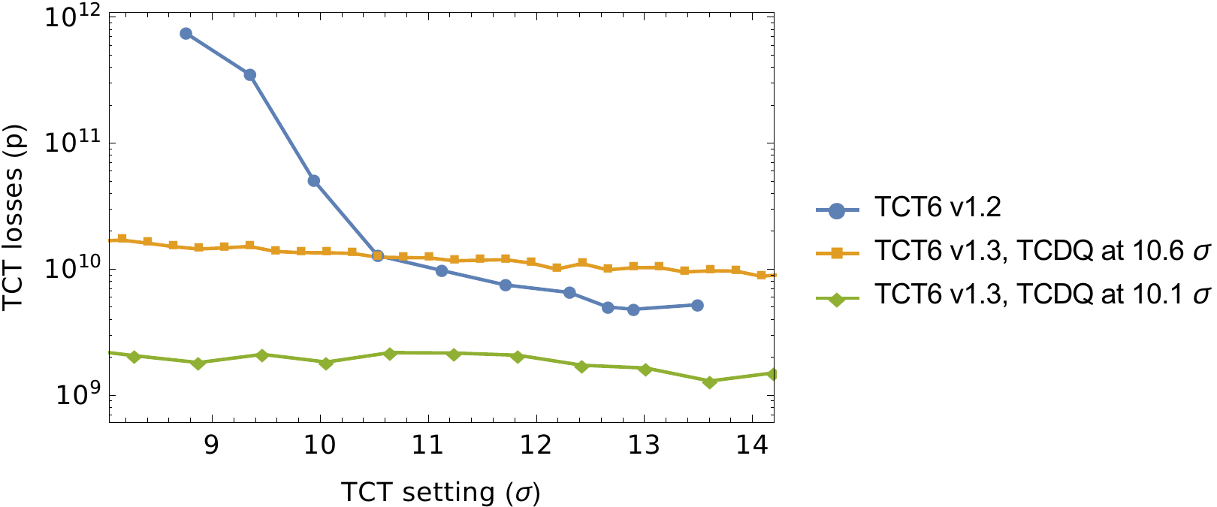
TCDQ at same setting as TCSP?
Cases shown so far assume TCDQ at 10.6 σ and TCSP at 10.1 σ
Recent studies C. Bracco, A. Lechner: maybe we could allow TCDQ also at 10.1 σ?
Significantly reduces the secondary protons exiting IR6
Triplet losses below simulated statistics

Slide 26
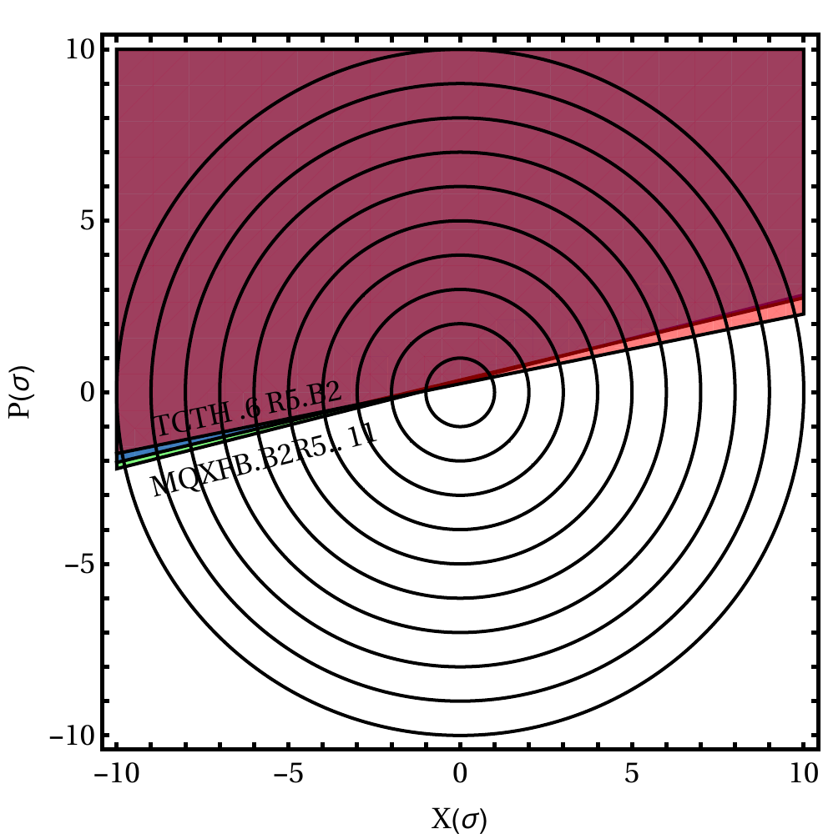
Phase space of TCTs / triplets
TCT4 is closer to triplet in phase
TCT6 is closer to 90 deg (102 deg, phase increasing downstream)
At the same setting in σ, TCT6 intercepts slightly more of the core than TCT4
When TCT is more open than triplet (in σ), TCT6 protects better
If phase would be between 0 and 90 deg, TCT4 would instead protect better

