Slide 1
Consequences of asynchronous beam dump on TCTs 4 & 6 of IR5
A. Tsinganis, F. Cerutti (EN/STI)
R. Bruce, S. Redaelli (BE/ABP)
7th Annual HiLumi Collaboration Meeting – Madrid, November 13-16, 2016

Slide 2
Outline
Introduction
Impact on TCTH4 *
Impact on TCTH6 **
Leakage to the experiment
Summary
* 6th HiLumi Annual Meeting (Paris) https://indico.cern.ch/event/549979/contributions/2295233/
^{** ColUSM #89}
https://indico.cern.ch/event/646799/

Slide 3
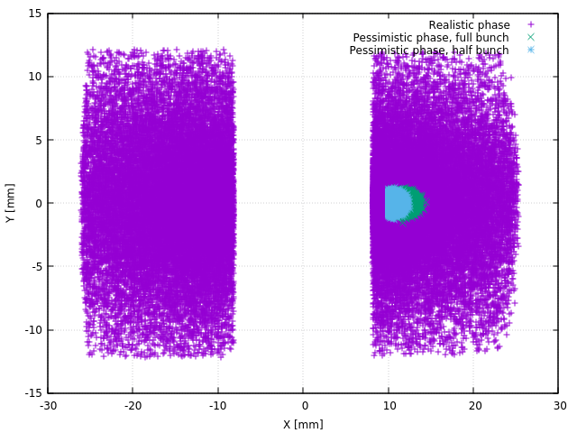
Introduction
Goal: evaluation of impact from asynchronous beam dump on TCTH4 or TCTH6 (IR5) on:
  The triplet and matching section magnets and beam screen
  The experiment
Different scenarios studied (as shown in previous talk by R. Bruce)
  “Pessimistic” case: single (half or full) bunch impact on one jaw
  “Realistic” case: fractions of several bunches impact on both jaws *
* Only 10¹⁰ protons impacting in total
2
1

Slide 4
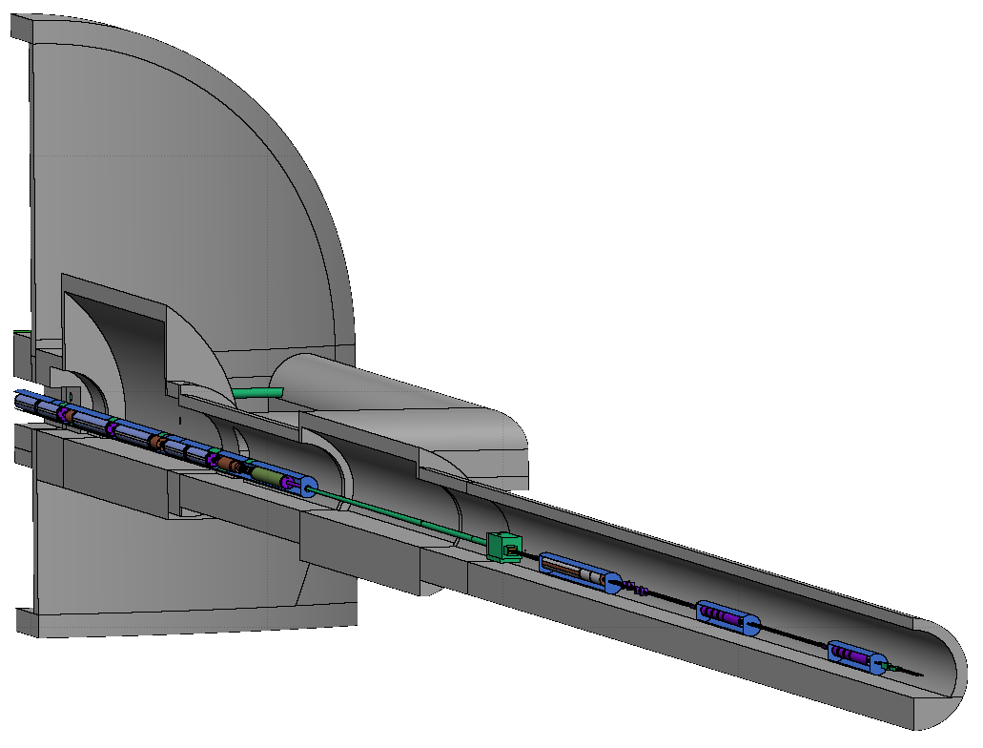
FLUKA model
Interface plane at 22.6m
Losses from SixTrack loaded at appropriate location (TCT4 or TCT6)
Radiation propagated towards the experiment, recorded at interface plane
Jaw materials considered:
  Inermet
    heavier, higher local absorption and damage, better protection
  Molybdenum graphite
    lighter, lower local absorption and damage, weaker protection
  Copper-diamond
    an intermediate case
TCTH4
TCTH6
Q1 Q2 Q3 CP D1 TAXN D2 Q4 Q5

Slide 5
Impact on TCT4

Slide 6
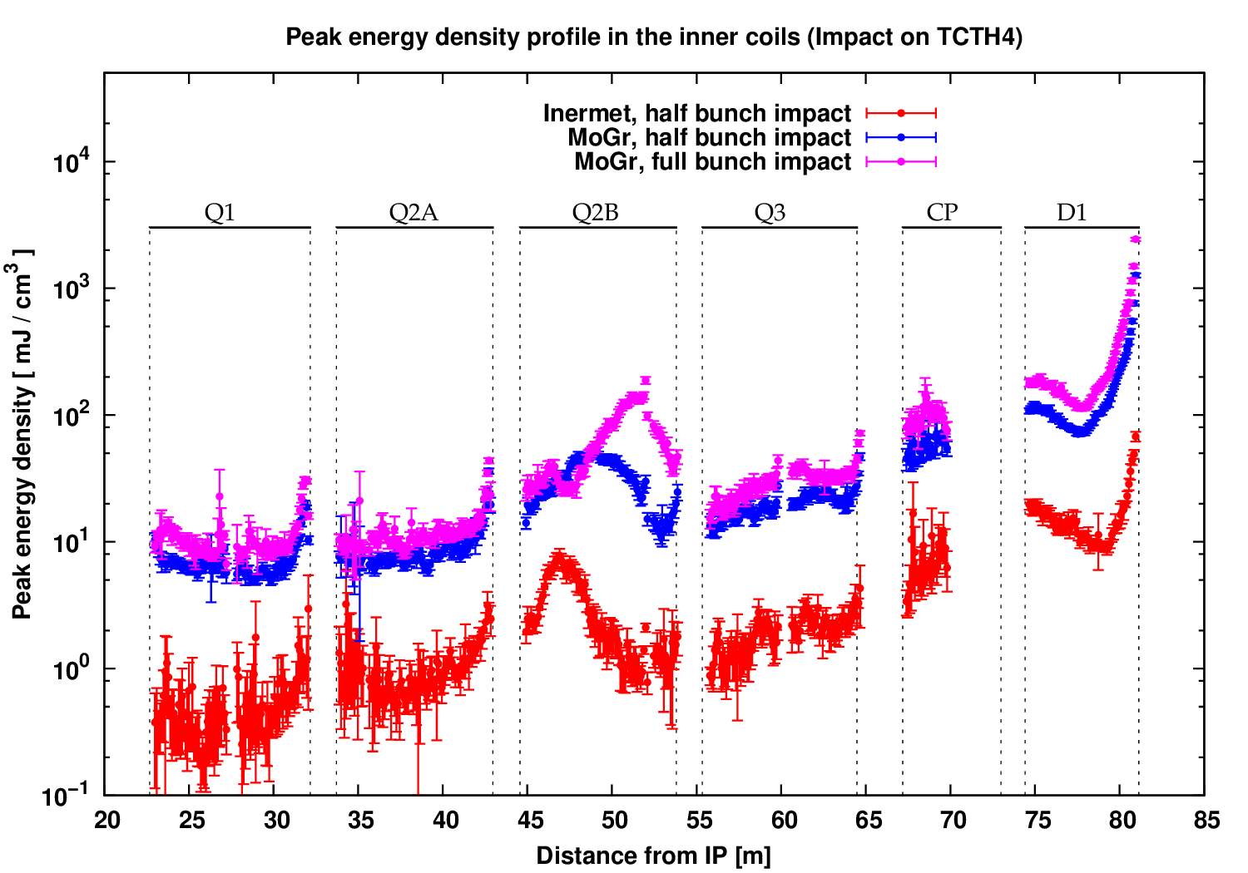
Triplet - D1 exposure (“pessimistic” case)
20mJ/cm³
All values well below damage limit (>1 kJ/cm³) (D. Wollman talk on Tue PM)
Values higher by at least a factor of 10 with MoGr TCT4
(Only D1 would quench with Inermet TCT4)

Slide 7
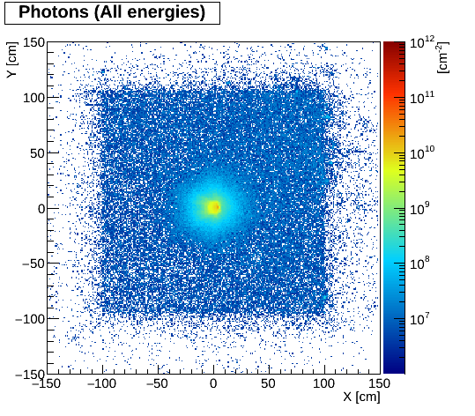
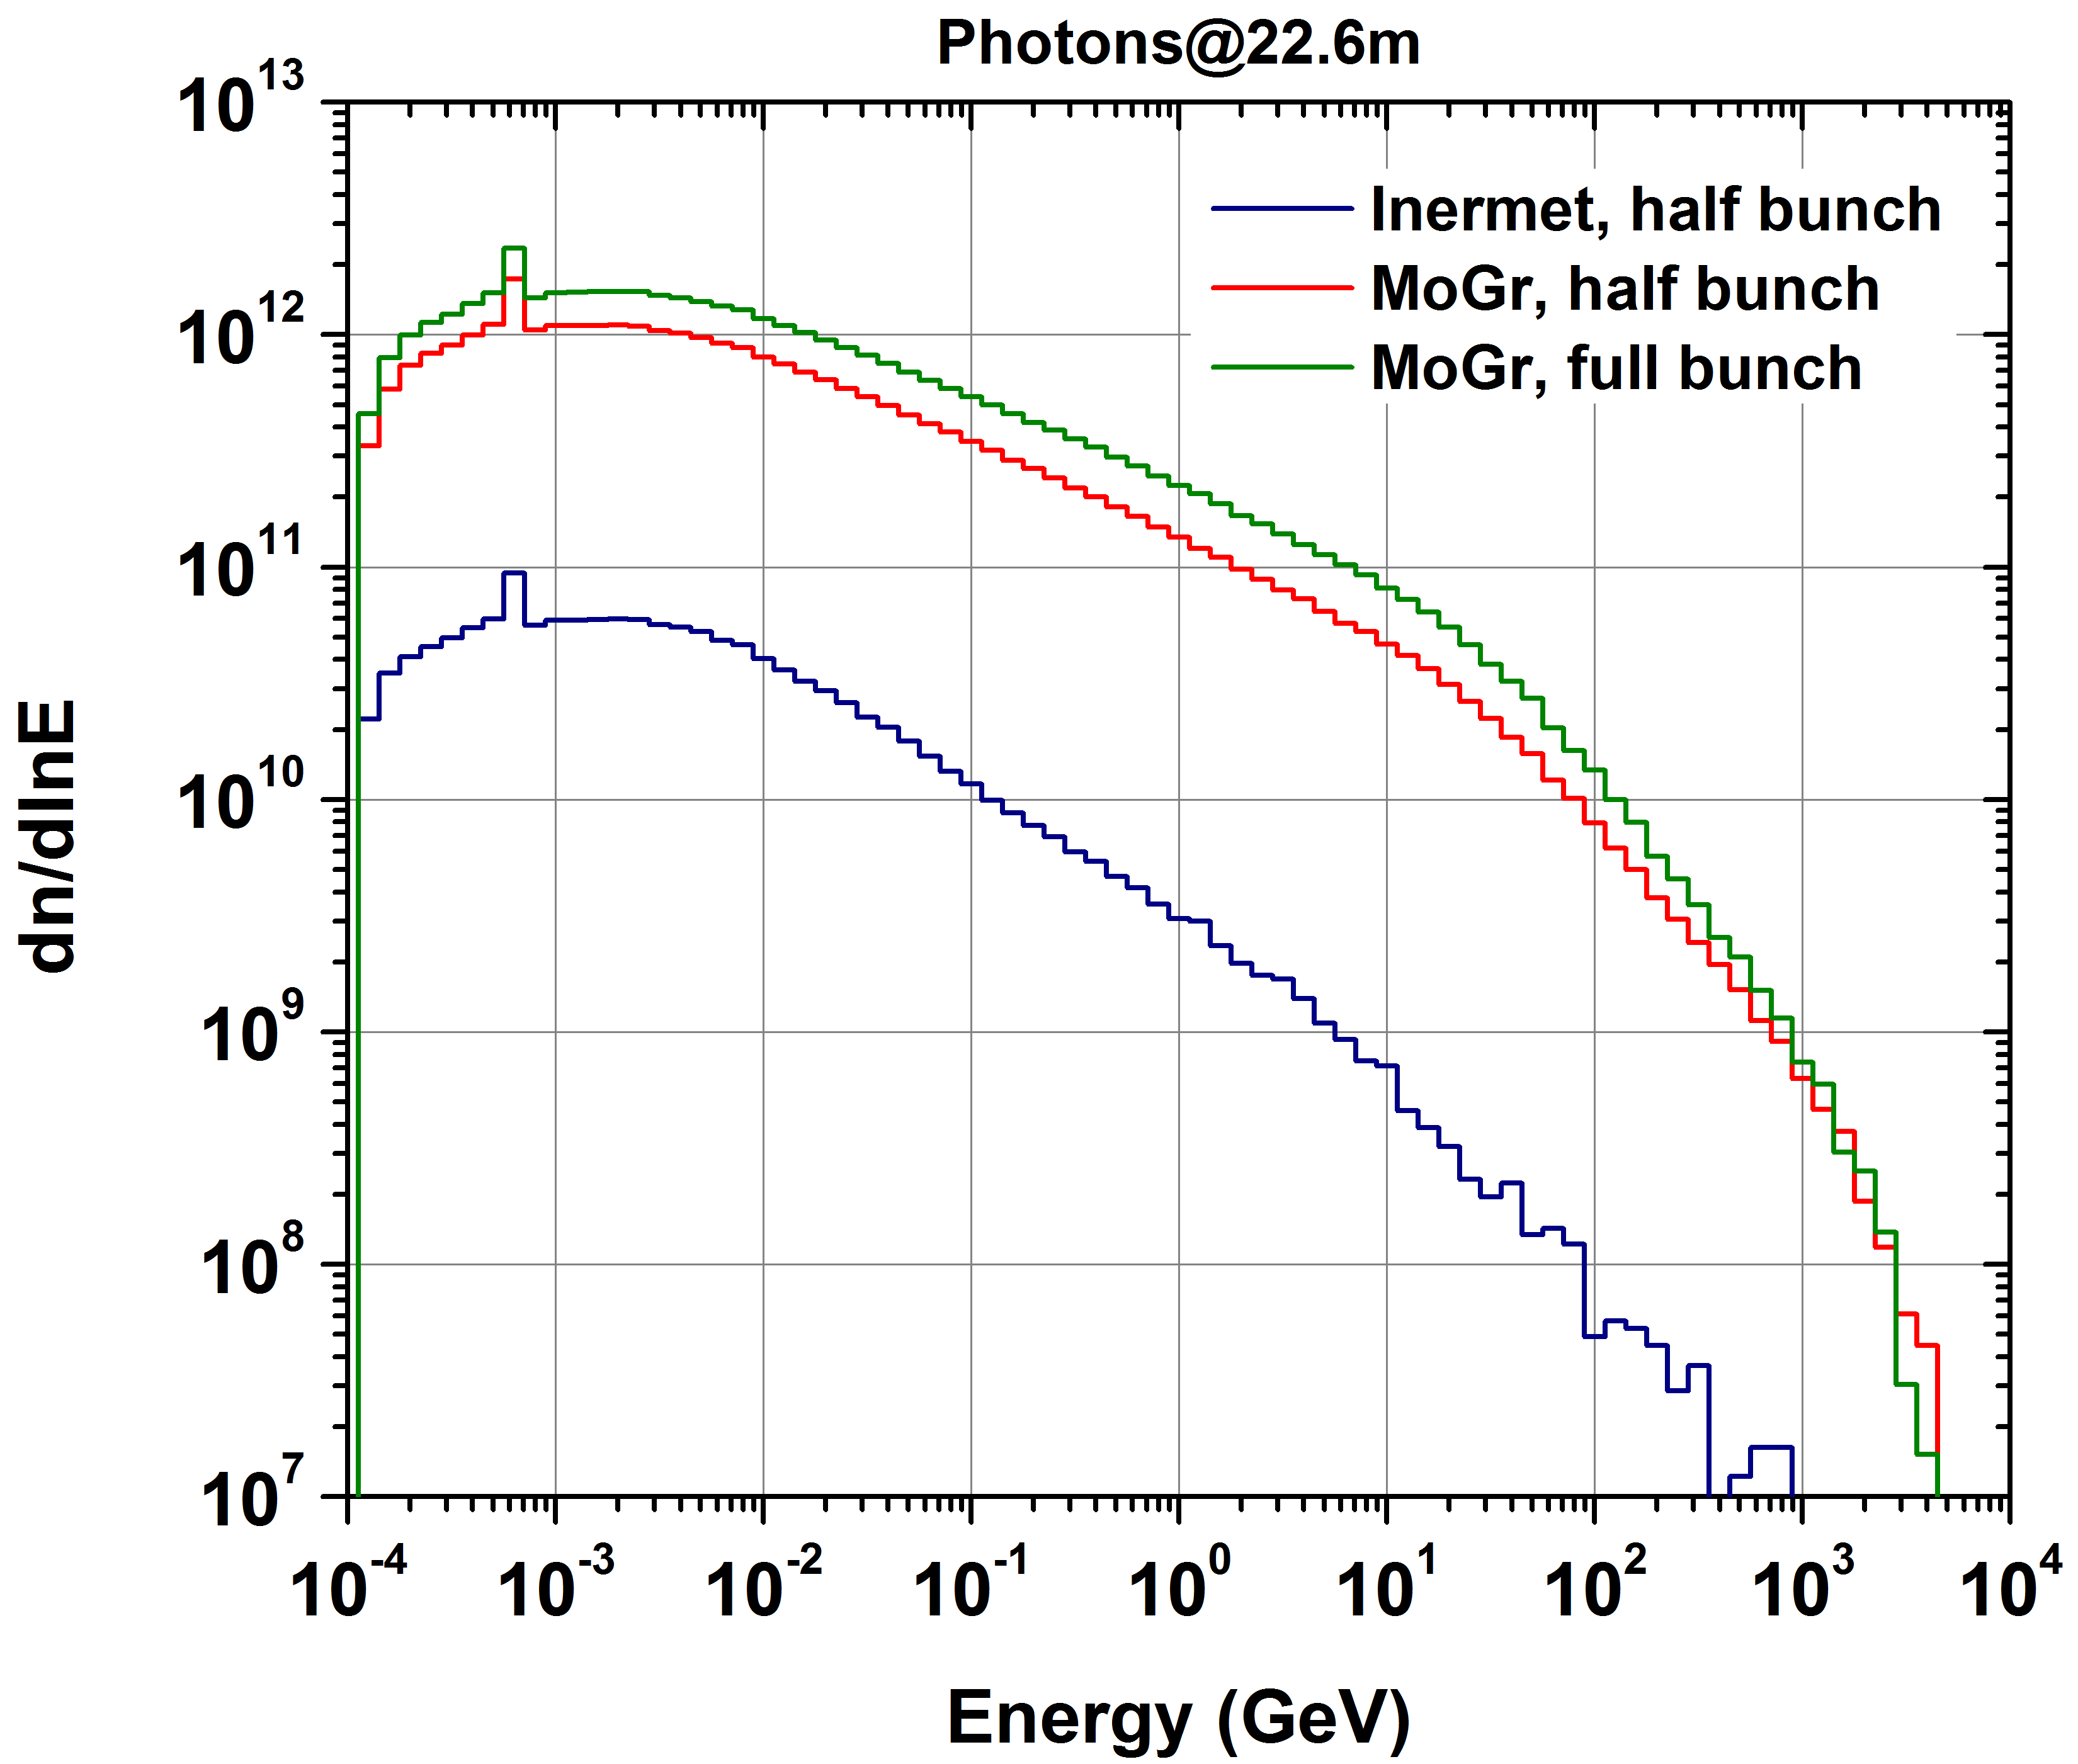
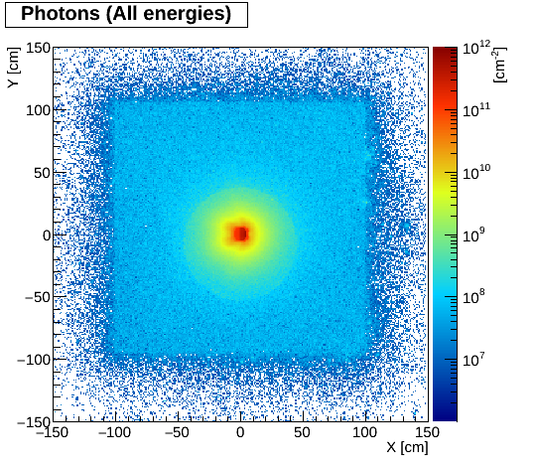
Leakage to experiment: Photons
(transport threshold = 100keV)
Inermet,
half bunch
MoGr,
full bunch
One order of magnitude increase with MoGr with respect to Inermet

Slide 8
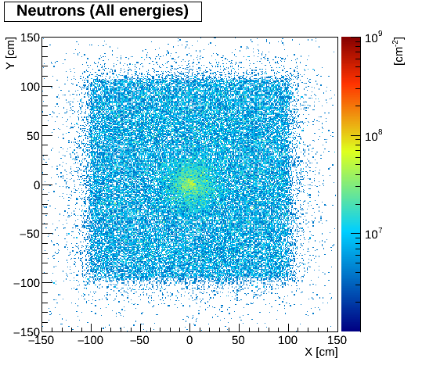
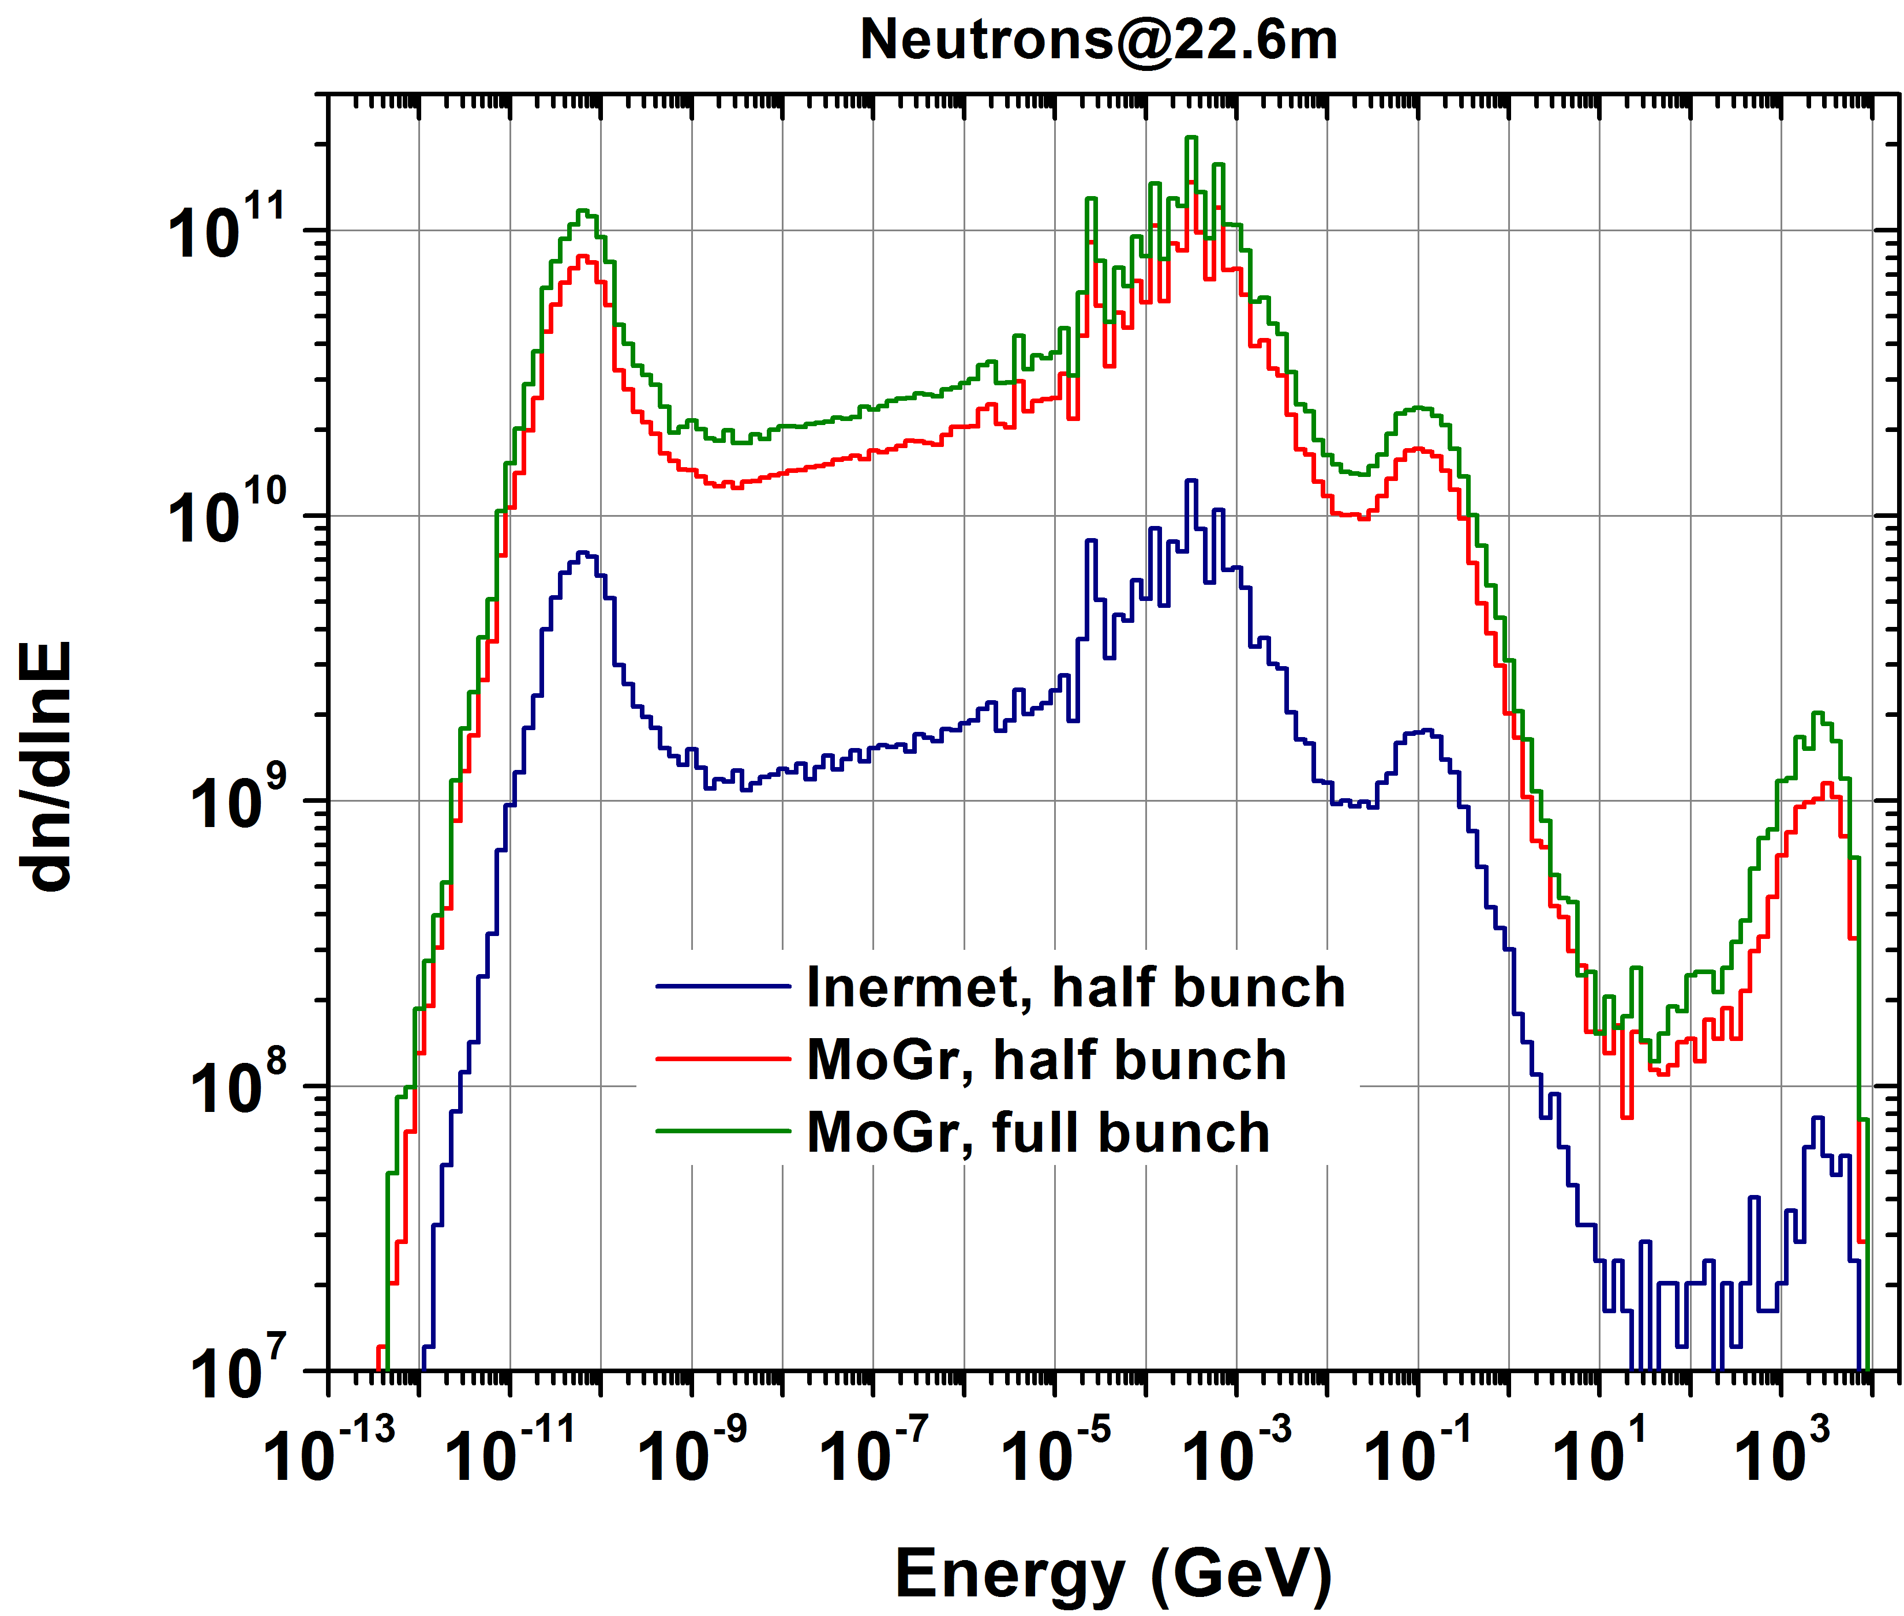
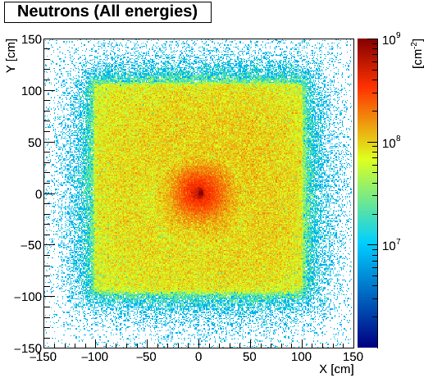
Leakage to experiment: Neutrons
Inermet,
half bunch
MoGr,
full bunch
One order of magnitude increase with MoGr with respect to Inermet

Slide 9
Impact on TCT6

Slide 10
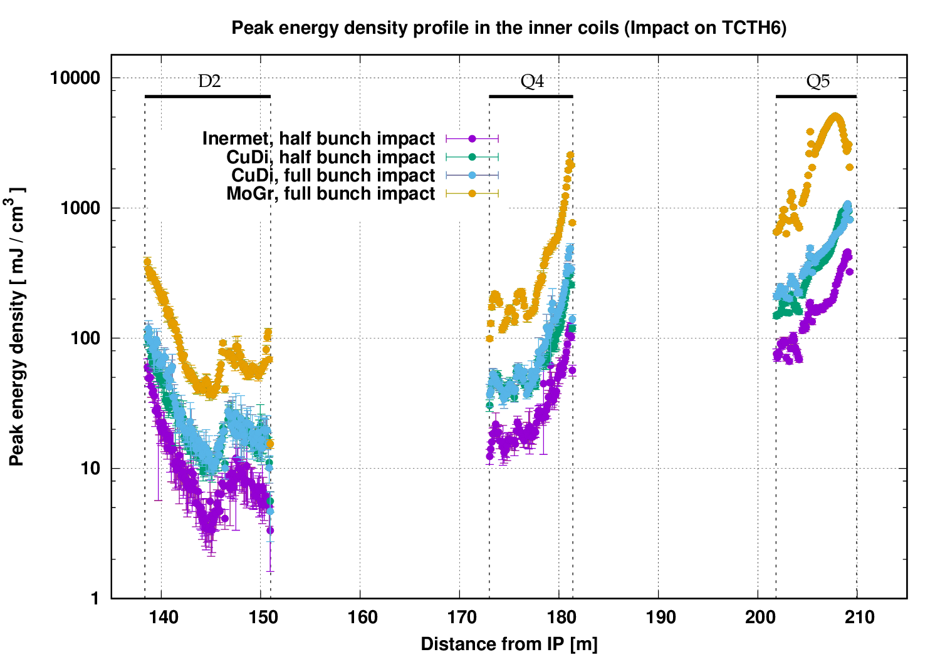
D2 - Q5 exposure (“pessimistic” case)
20mJ/cm³
Max value approaching 10 J/cm³ (MoGr), still far from expected damage limit
Strong dependence on jaw material choice
<20 J/cm³ in Q5 beam screen (for MoGr full bunch – worst case)
The damage limit cannot be approached even with the envisaged Q5 aperture reduction to 56mm

Slide 11
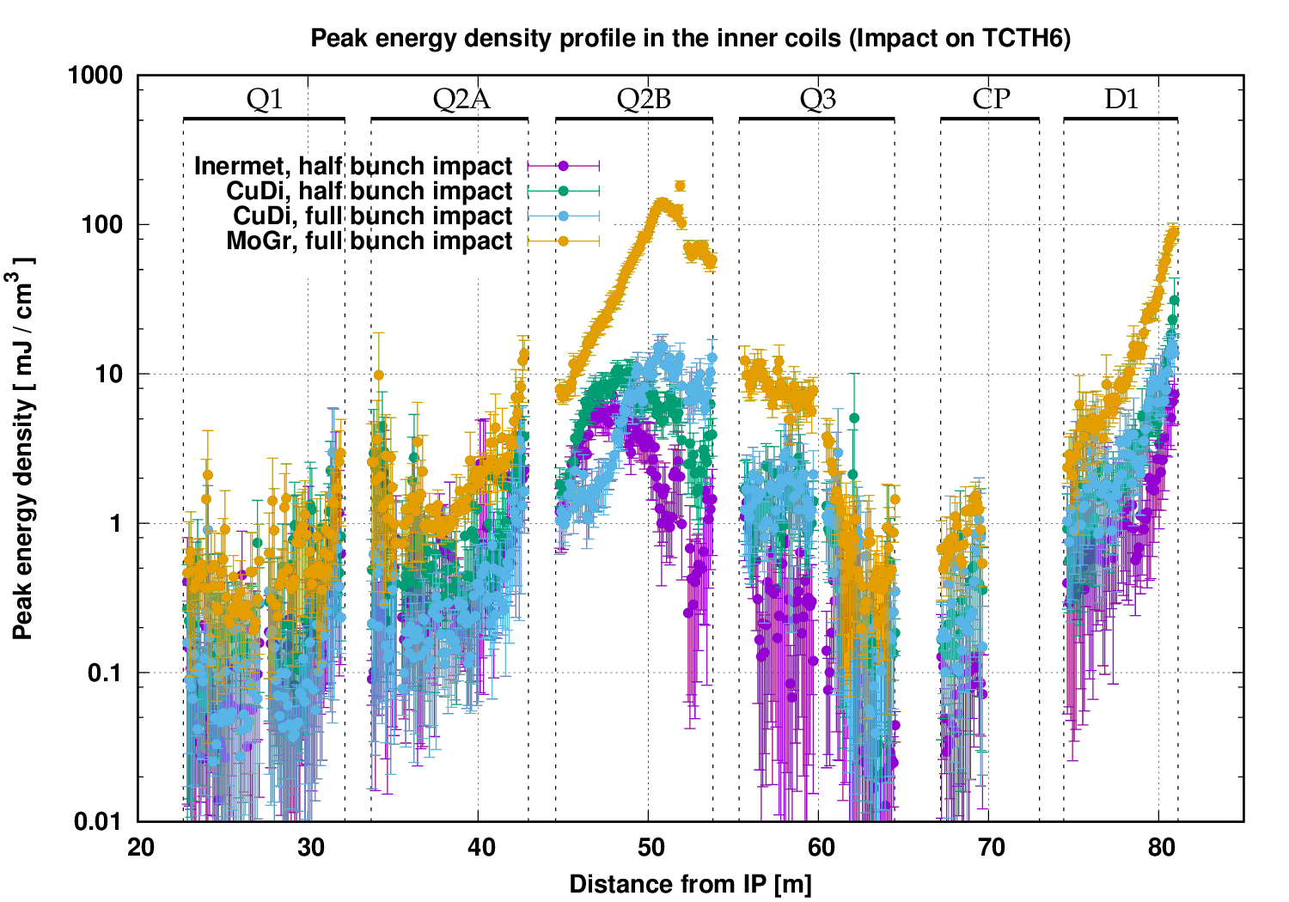
Triplet - D1 exposure (“pessimistic” case)
20mJ/cm³
Values drop in the triplet-D1 region, but quenches are not excluded

Slide 12
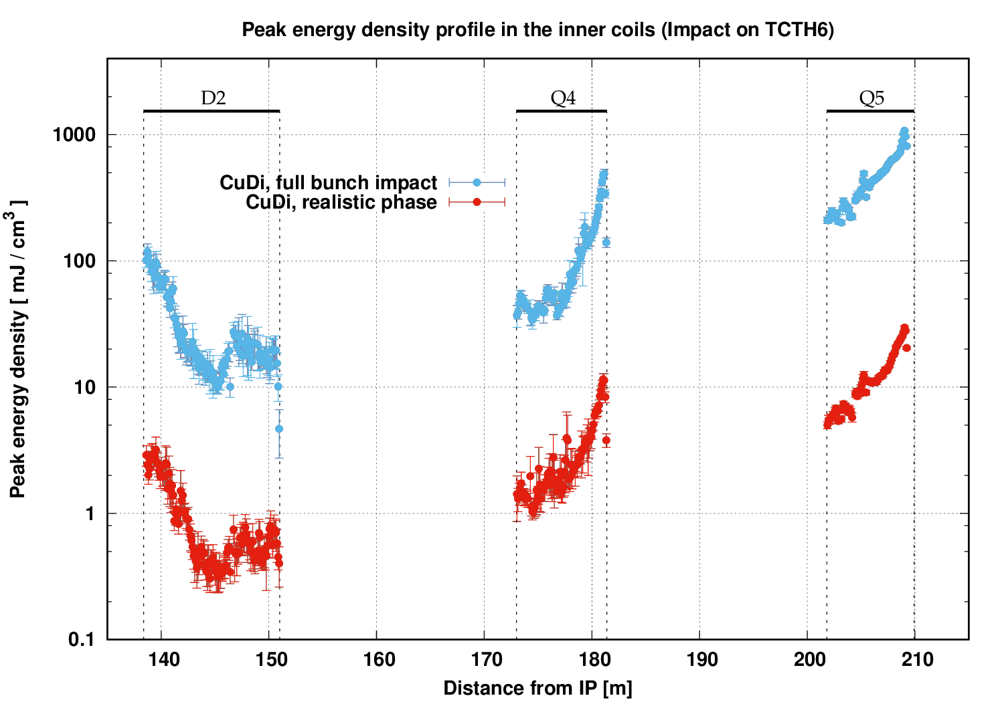
D2 - Q5 exposure: comparison of the two cases
20mJ/cm³
Peak energy density values are about 20-30 times lower in the realistic case compared with the pessimistic case, mainly scaling with the impacting population

Slide 13
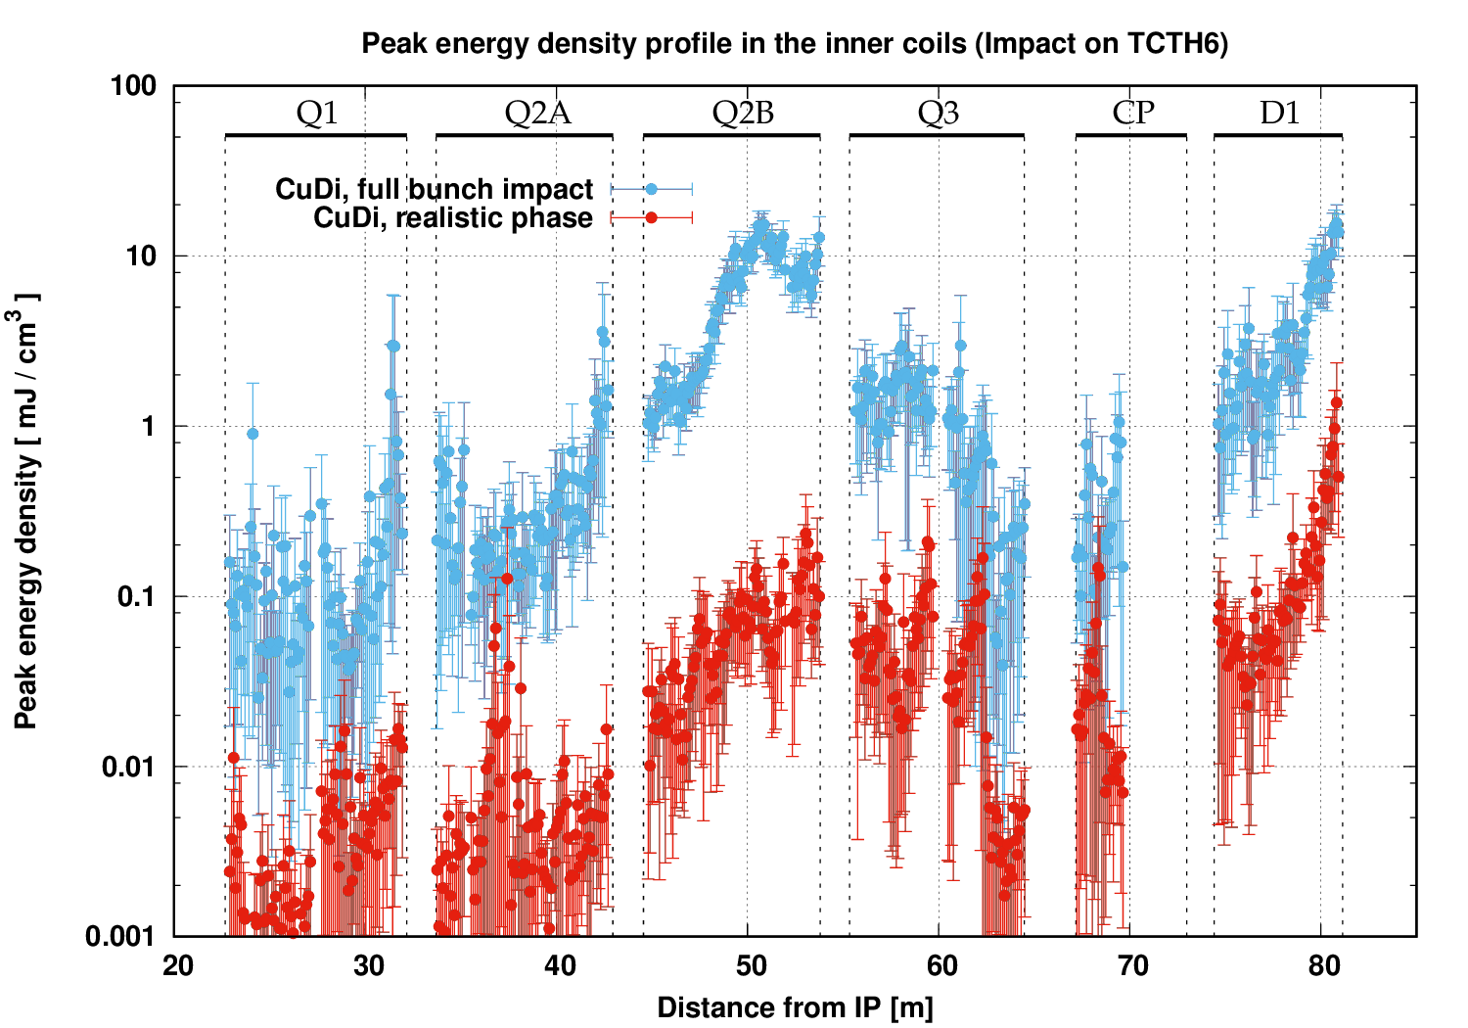
Triplet - D1 exposure: comparison of the two cases
20mJ/cm³
Values below ~ 1 mJ/cm³ in the realistic case

Slide 14
Leakage to the experiment: particle population
Full bunch impact on MoGr jaw
Particles crossing the scoring plane at 22.6m
  Impact on TCT4:
    85% photons
    10% neutrons
    0.1% protons
  Impact on TCT6:
    92% photons
    2% neutrons
    0.1% protons
Total population one order of magnitude lower for the TCT6 impact (4.8x10¹³ vs 3.2x10¹²)

Slide 15
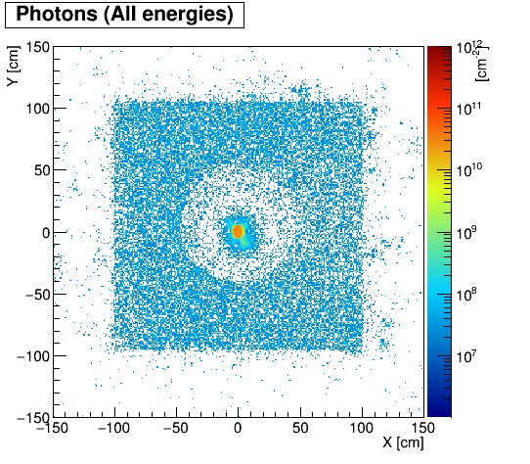
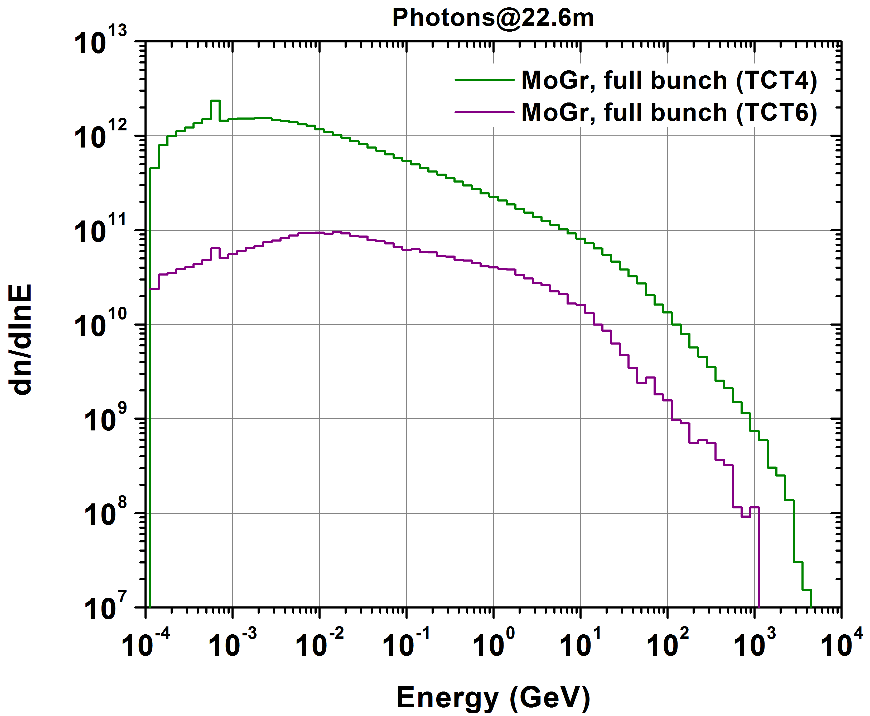
Photons
(transport threshold = 100keV)
MoGr, full bunch on TCT4
MoGr, full bunch on TCT6
About one order of magnitude decrease when impacting on TCT6

Slide 16
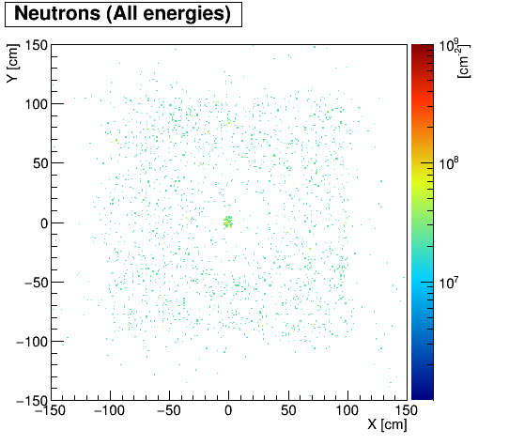
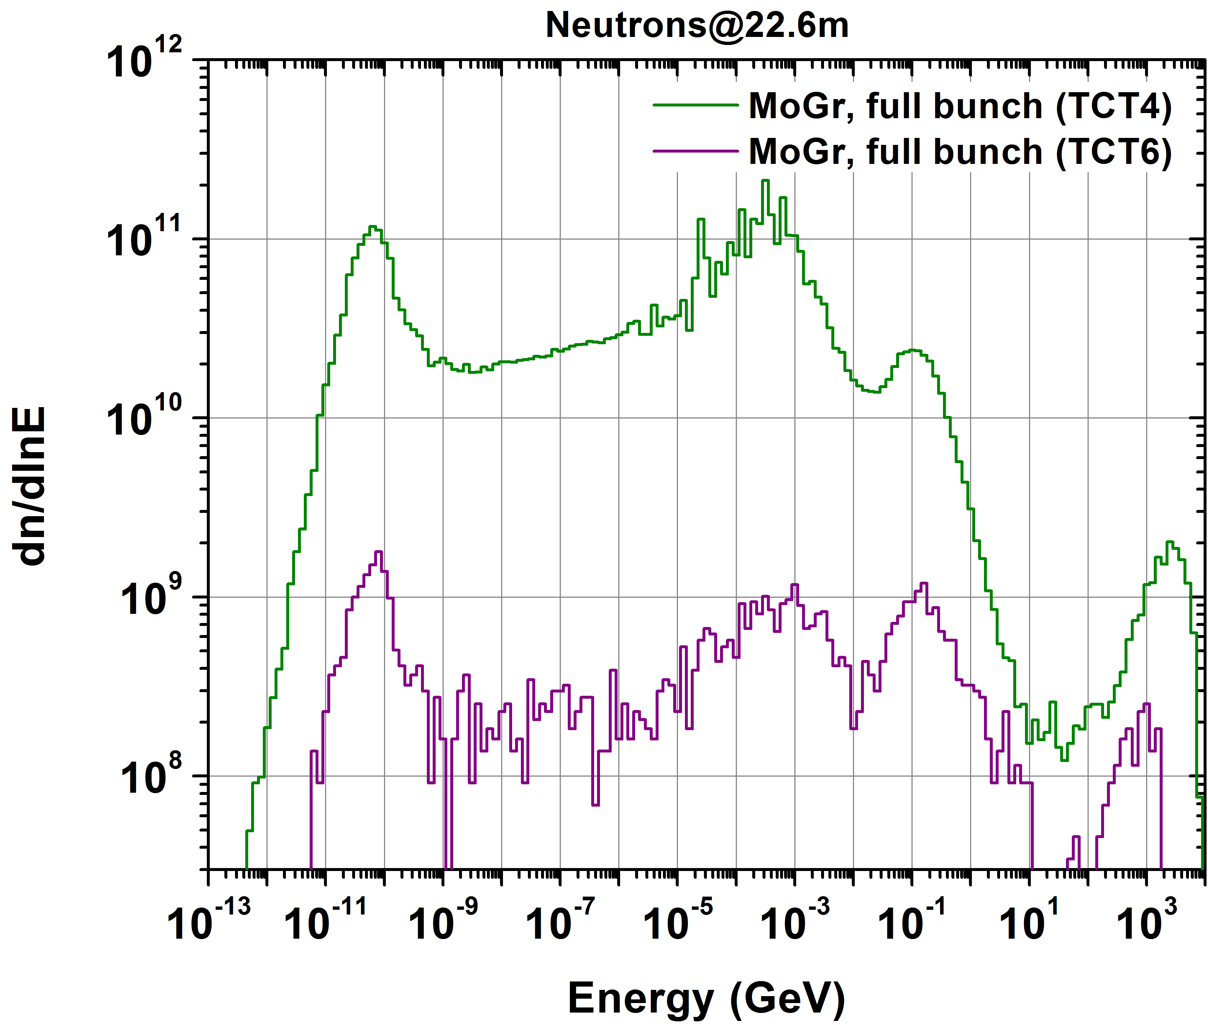
Neutrons
(no transport threshold)
MoGr, full bunch on TCT4
MoGr, full bunch on TCT6
Decrease up to two orders of magnitude when impacting on TCT6

Slide 17
Summary
  The present baseline, featuring TCT pairs both in cell 4 and 6, is shown to stay safely below the material damage threshold (over the Q1-Q5 region) in case of an asynchronous beam dump, for all TCT jaw material options.
  Still, the choice of jaw material naturally leads to significant variations in terms of protection effectiveness on one side and collimator robustness on the other.
  Quench occurrence is not considered here as a relevant criterion (TCTs are not designed to prevent quenches in case of failures).
  The realistic scenario (with fractions of several bunches scattered on the TCT) further improves the picture.
  The leakage to the experiment from an impact on TCT6 is clearly reduced by the distant origin compared with an impact on TCT4.

