Slide 1
Status of Hardware for quench detection and circuit monitoring for HL-LHC
Jens Steckert
Acknowledgements:
D. Blasco Serrano, R. Denz, S. Georgakakis, J. Kopal, E. de Matteis, J. Spasic &
TE-MPE-EP colleagues
Thanks to G. Willering & SM18 crew for SM18 tests
7th HiLumi Collaboration Meeting, Madrid, 13-16 Nov. 2017

Slide 2
Topics
uQDS concept
uQDS components & specification
Status of Digital Platform
Status of frontend channel
Application of uQDS to 11T magnet
Results from 11T SM18 measurements

Slide 3
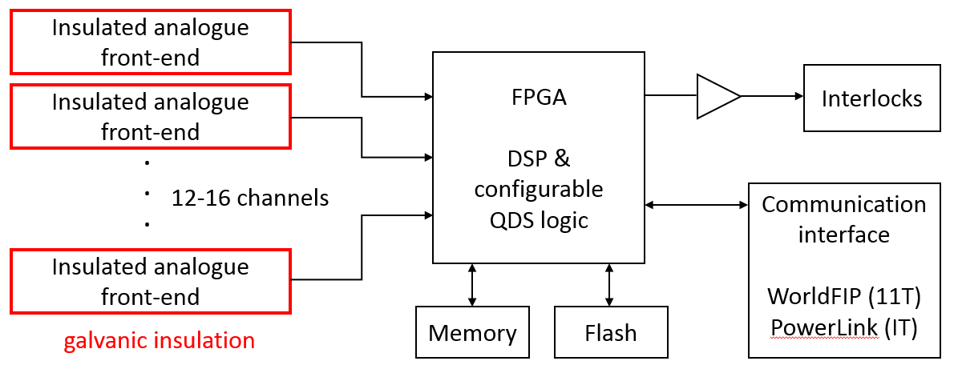
uQDS concept
Generic solution for various QDS tasks
Multiple insulated front-end channels connected to one logic device performing the QDS task
QDS function defined by FPGA configuration
Front-ends flexible enough to cope with all required input signals ranges & resolutions

Slide 4
uQDS components
Digital platform houses FPGA, interlocks and communication interface. Performs quench detection algorithms
Mid-plane connects Front-end with Digital platform and power supplies
Frontend amplifies signal, digitizes and provides galvanic insulation

Slide 5
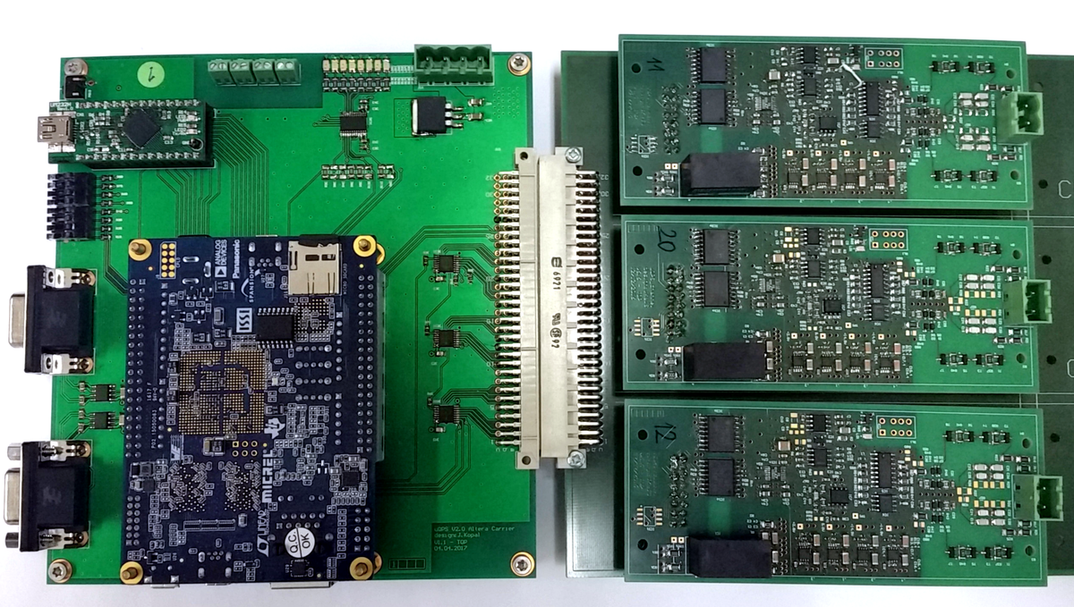
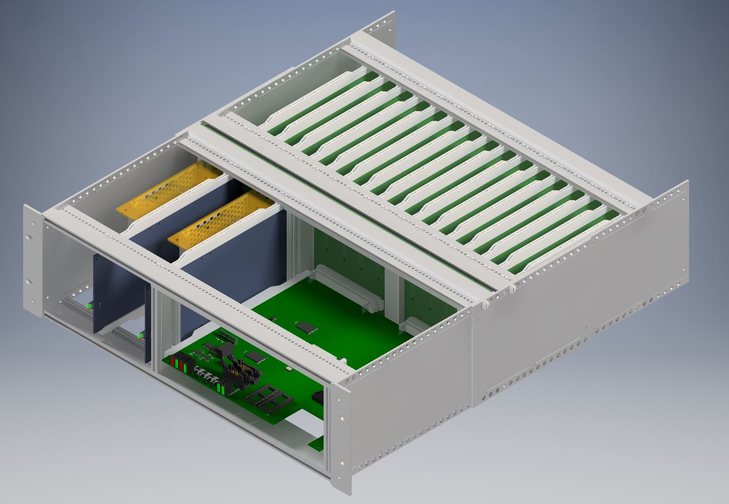
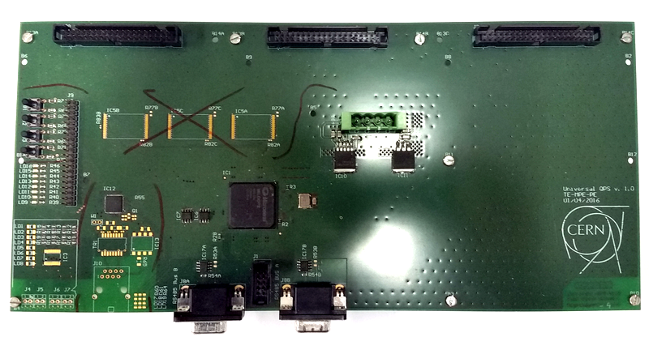
Status of the digital platform
V1.5
v1.0
v1.5
v2.0
First board with Microsemi IGLOO2 (M2GL060)
Hosts up to 3 frontends
Communication via RS485 (2.5Mbit)
➔ Proof of concept
Intel Cyclone V dev. board on carrier
Supports channel carrier with 6 frontends
Communication via USB 2.0 and RS485
➔ Intermediate solution for SM18 and LHC tests
Based on IGLOO2 (M2GL150)
Supports up to 16 front-ends via mid-plane
Communication via RS485, USB 2.0, USB 3.0 or WorldFIP
➔ First prototype for 11T QDS

Slide 6
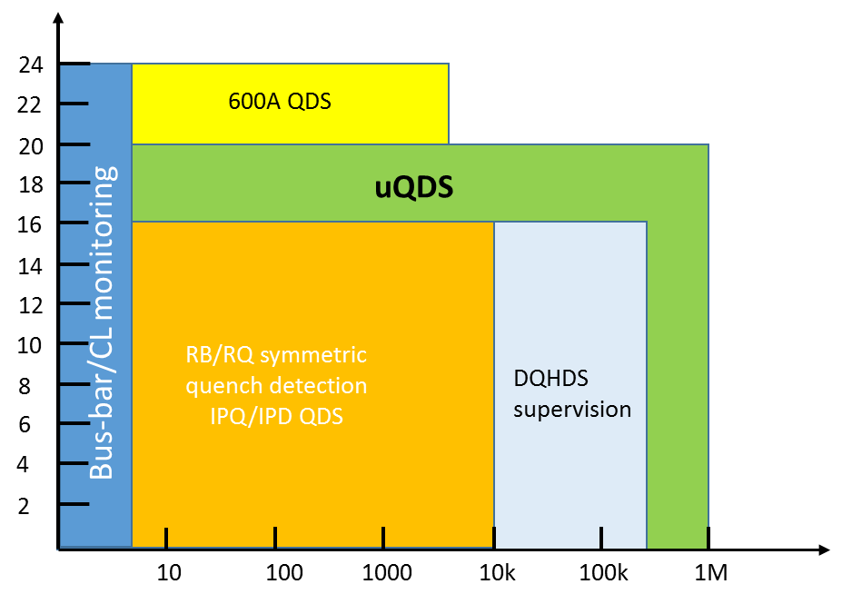
Front-end channel status
Design/Prototyping process started already end of 2015
Challenging design (20bit/1Msps), final verification by prototype testing only
(Calculations/SPICE do not show noise…)
Several prototypes built and evaluated in LHC and SM18
First uQDSv2.0 compatible version expected end of this year
Serves as universal QDS
data acquisition channel
Covers all existing quench
detector requirements
Resolution [bits]
ADC sample rate [Hz]

Slide 7
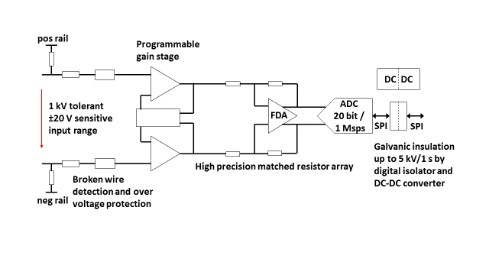
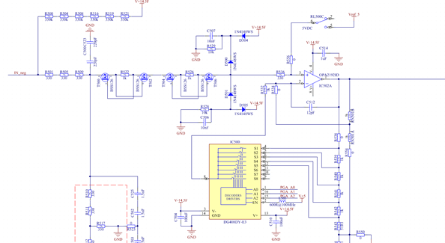
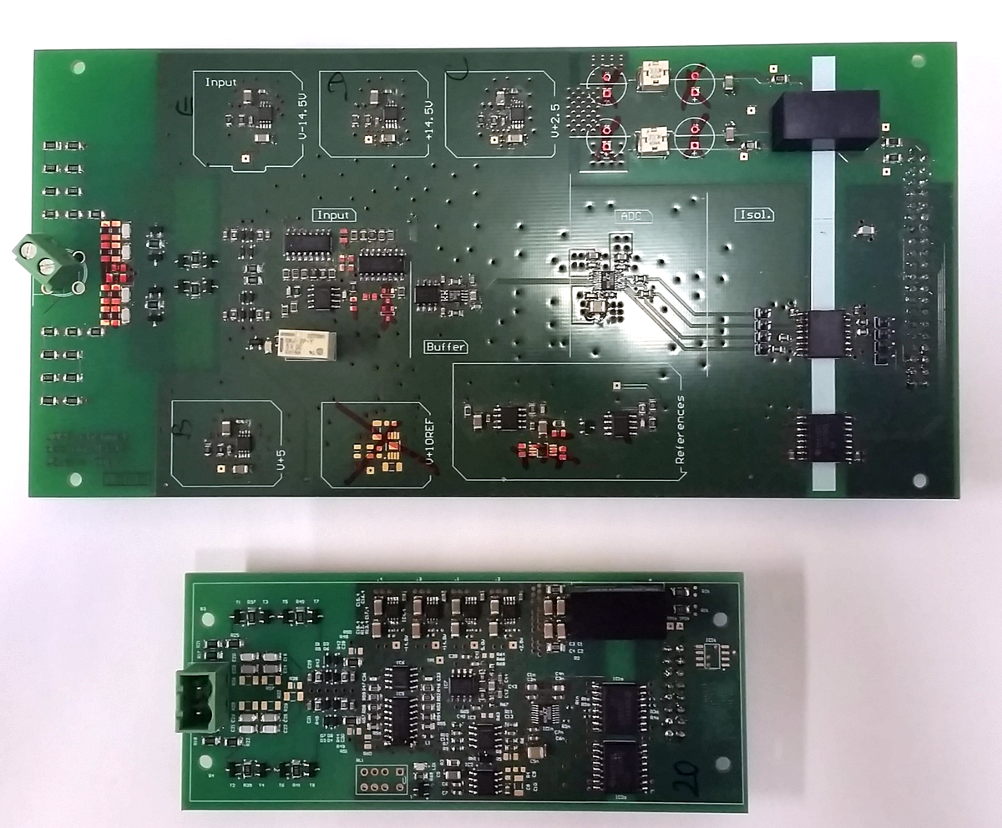
Front-end channel specifications/design
Parameter | Value
Resolution (20-bit ADC) | 105nV/LSB .. 48uV/LSB
ADC speed | Up to 1Msp/s
Analogue bandwidth/ gain | 150kHz @ G=1 140kHz @ G=9 84kHz @ G=45 12kHz @ G=450
Active input voltage range | +/-50mV .. 22.5V
Max differential input voltage | 1kV/1s
Galvanic insulation | 2.5kV/20min
v5.6
v6.6

Slide 8
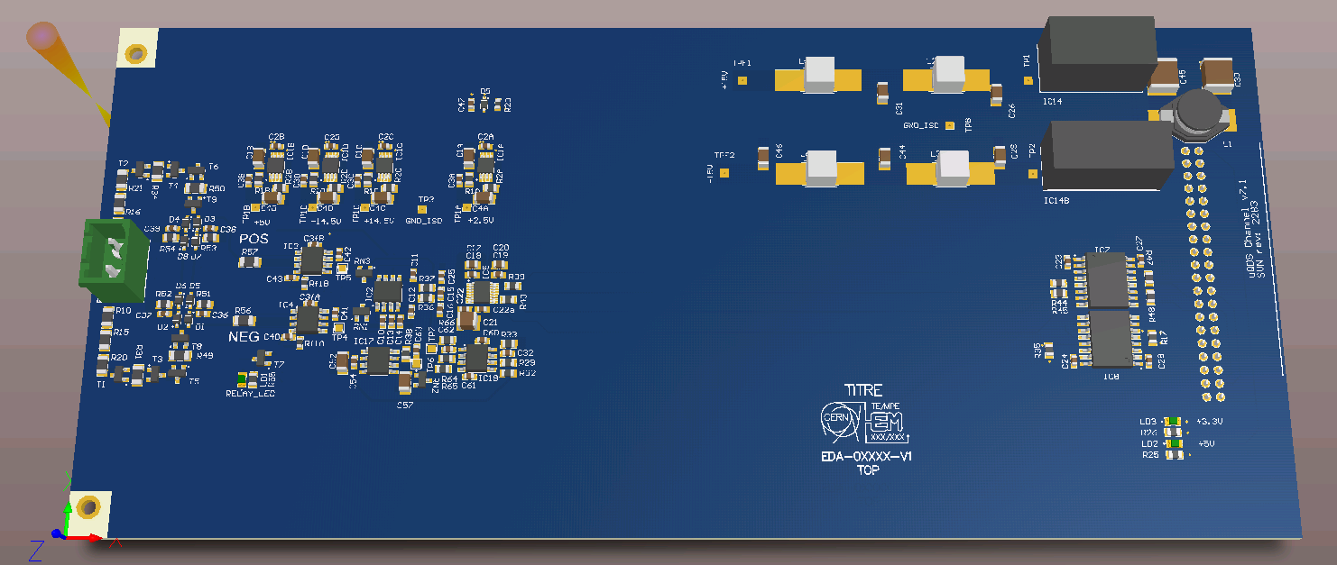
Front-end channel outlook
Generation 7 based on v5.6 circuit currently in prototype assembly
Form factor increased again to euro card size (220 mm x 100 mm) to fit in uQDS v2.0 box and leave enough space for future options
Optimization of DC-DC converter filtering
Intensive high voltage stress testing upcoming

Slide 9
Specifications of uQDS box 2.0
Up to 16 front-end channel interfaces
Microsemi IGLOO2 FLASH FPGA for processing
Four Interlocks, PhotoMOS based T_{open} <1ms
Supports WorldFIP or future field bus via FMC extension slot
Supports USB2.0 + USB3.0 for fast data read-out in test facilities
Redundant power supplies
Radiation tolerant up to RR73/RR77 environment (~1Gy/a, 50..100Gy TID)
➔ Preliminary specifications, final hardware will evolve to v2.x with optimized specifications

Slide 10
uQDS version 2.0, system overview
Front-end channels
Analogue, high voltage
Redundant power supplies
Digital platform
Galvanic
insulation
2.5kV
uQDS v2.0
Chassis 3U, 19”
Digital mid-plane

Slide 11
Application of uQDS to the 11T magnet

Slide 12
Application of uQDS to the 11T magnet
Requirements:
Detect asymmetric and symmetric quenches
Detect quenches of the interconnection bus-bar
Cover all bus-bars in the magnet assembly
Monitoring of the quench heaters
Allow circuit current dependent settings
Quench detection crates will be located in the “RR” area ~75m away from the magnet
Quench heaters will be located as close as possible to the magnet while monitoring resides in “RR” area
Integration boundaries:

Slide 13
uQDS for 11T magnet: integration
RR77 (RR73)
RB Interlock loop
4 physical cables,
2 per IFS
Beam
4
11T uQDS B
Tunnel
IFS x2
IFS x2
11T uQDS A
…
11T
11T
MQ.8R7
MB.A9R7
MB.B9R7
8 x HDS
8 x HDS
Trigger links
11T HDS mon + trg. Fan-out
U_HDS, I_HDS, HDS trigger
HDS cabling not fully defined yet !
Connection to Controls
via WorldFIP
~100m

Slide 14
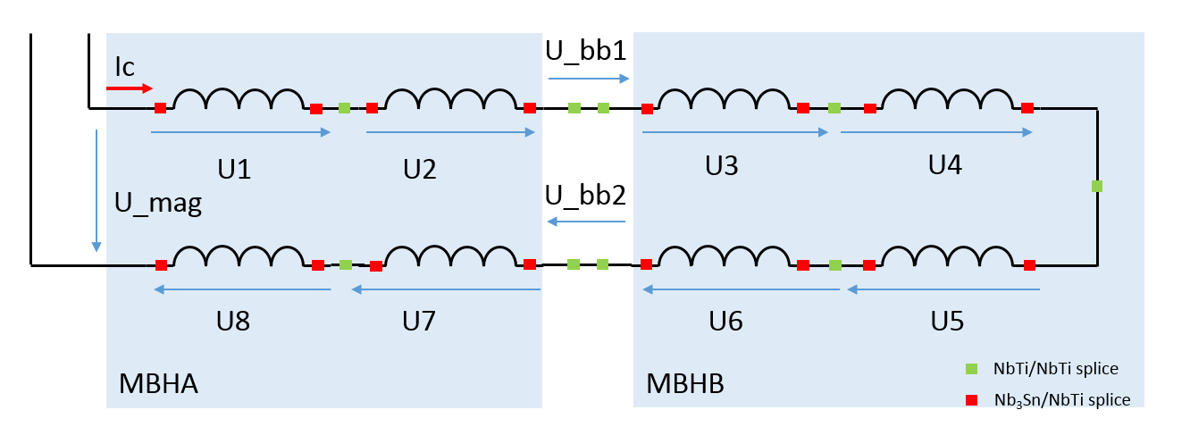
11T instrumentation/channel distribution
8x pole voltages for asymmetric and symmetric quench detection
2x interconnection bus-bar for bus-bar protection
1x total magnet voltage
1x circuit current (for current dependent settings)
12 channels per QDS box
Fully redundant scheme (Vtaps → cables → QDS boxes)
All superconducting splices & bus-bars covered

Slide 15
11T Quench detection
Comparisons between pole voltages used for quench detection
Fast detection between neighbouring poles
(SM18 saw good common mode rejection)
Detection of symmetric quenches by comparing pole voltages further apart
➔ Exact algorithms to be defined !
(instrumentation should permit a wide range of detection schemes)
To evade flux-jumps and other noise a time discrimination filter will be used
Length of time discrimination filter can be set as a function of the circuit current (Susana’s talk for the circuit review)
→ filter out flux-jumps at low currents

Slide 16
11T trigger & HDS controller
Receive trigger from QDS box A and B
Provide safe trigger fan-out
(2 x uQDS to 16x DQHDS)
Monitor quench heater voltage & current
(uses 4x DQHSU card)
➔ Type test concerning cable length upcoming (HDS diagnostics cables have to be extended from 1m (RB) → ~100m (11T))

Slide 17
Some results from SM18

Slide 18
SM18 measurements
Follow Nb3Sn magnet development by “testing” uQDS on the new magnets
Study flux-jumps, quench precursors, oscillations etc.
Estimate what level of filtering is necessary
➔ Lots of noise/fast transients present in measurements due to power converter
(Thyristor based)

Slide 19
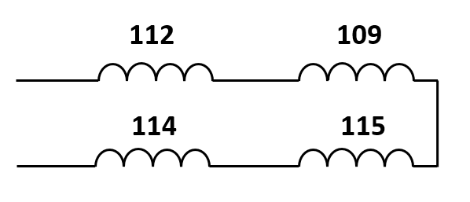
SM18 measurements
Participated in test of 11T 2m model magnet (double aperture)
Sampling rate of 500ksps, raw data transmitted via USB2.0
Signal processing offline:
  10us width median filter
  50kHz 10th order Bessel low-pass
  Decimation by 5
Following plots show aperture 1 only
(112 and 109) during first training ramp to ~11kA
Model magnet constructed from non-final conductor
  ➔ Results not representative for final 11T magnet
AP1
AP2

Slide 20
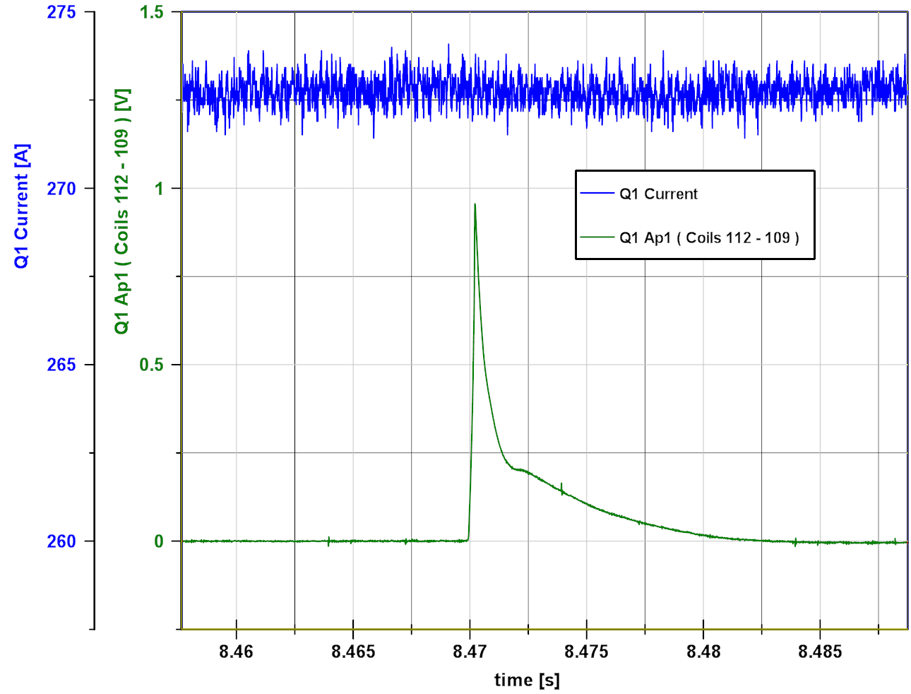
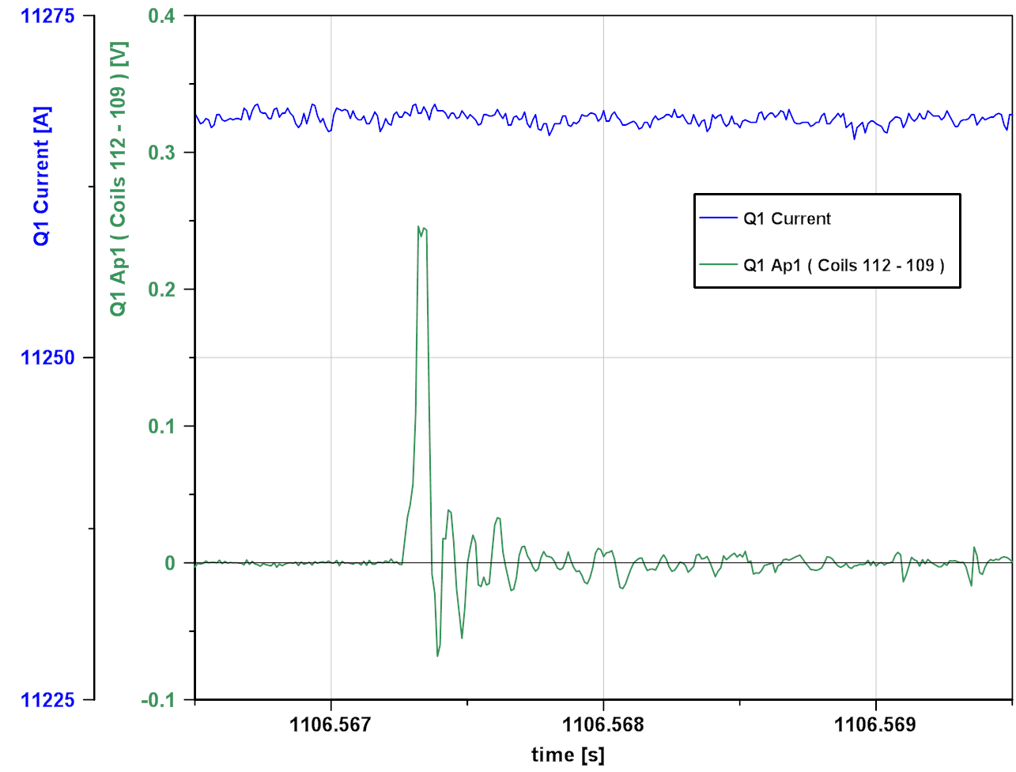
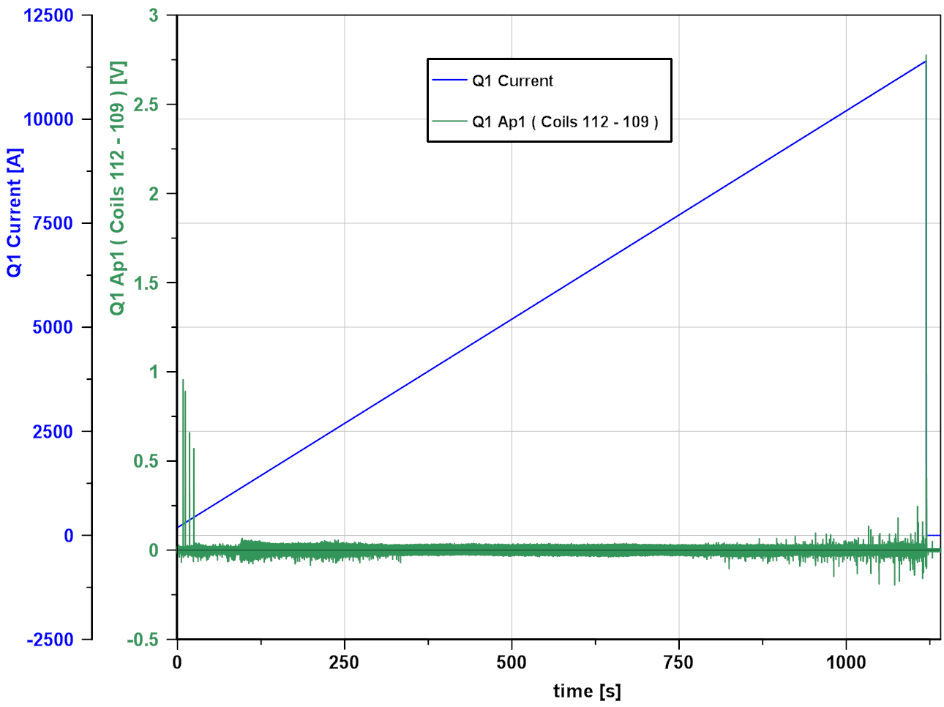
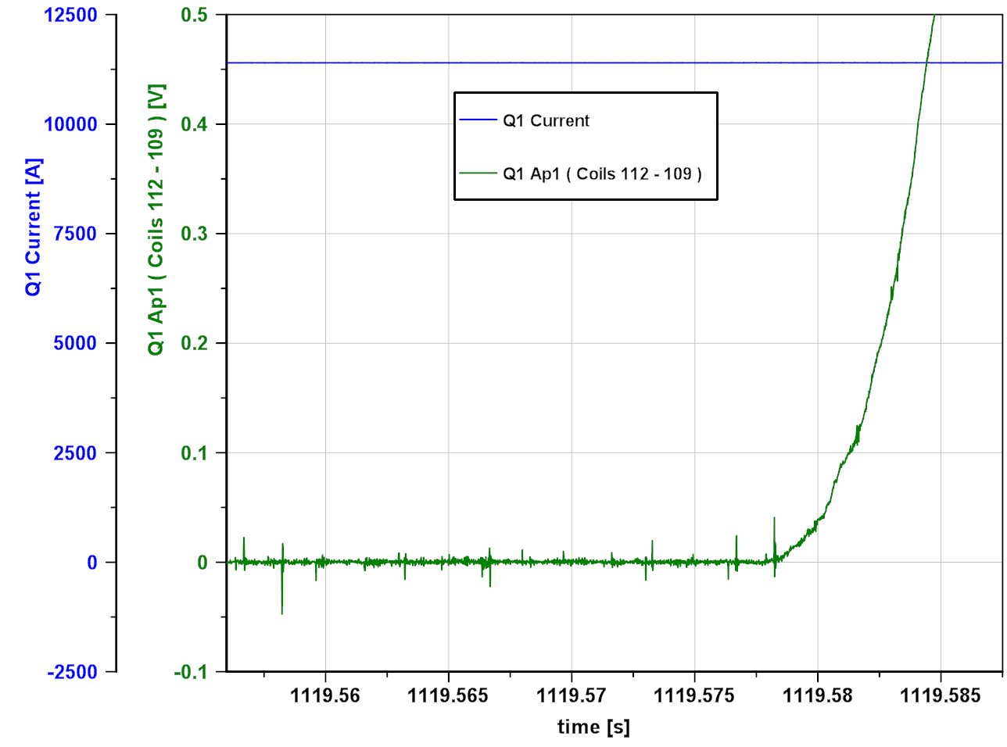
SM18 measurements 11T prototype Nov 2017
2m model magnet made from non- final cable !

Slide 21
Conclusion/Outlook
Development is progressing well
Basic design of 11T QDS defined
Instrumentation of 11T defined
Integration studies ongoing, major points clear
Version 2.0 of uQDS expected end of this year
Final version for 11T QDS next year
IT QDS on base of uQDS for 11T
Looking forward to test final QDS on final 11T in SM18

