Slide 1

Detailed global view on protection and detection of the circuits
R. Denz
Acknowledgements:
A. Ballarino, S. Izquierdo Bermudez, G. Kirby, M. Mentink, F. Rodriguez Mateos, H. Prin, A. Siemko, J. Steckert, A. Verweij, D. Wollmann, S. Yammine
7th HL-LHC Collaboration Meeting, Madrid, November 16th 2017

Slide 2

Circuit Table v7.2-1

Slide 3
Instrumentation
All voltage taps used for quench detection are redundant
All corrector circuits requiring active quench detection systems are equipped at least with a midpoint voltage tap
  In specific cases the “midpoint” voltage tap must be located asymmetrically
  In case dedicated detection systems for the bus-bars are regarded as useful, the respective voltage taps must be provided
HTS leads and MgB₂ links will be equipped with their respective voltage taps
  Routing of the link instrumentation wires through the cold part is not required
Voltage taps may be specified and added for diagnostic purposes only; the corresponding signals can be processed by the QPS supervision

Slide 4
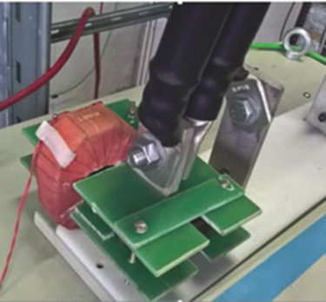
Current sensors
Dedicated current sensors for quench detection systems will be used for all the circuits requiring current depending detection settings
  Nb₃Sn magnets, corrector circuits
  Required resolution is low → resistive part of HTS current lead could serve as sensor
Newly developed didt sensors will be installed for various purposes:
  Improved symmetric quench detection, e.g. for Q4, Q5, Q6
  Better compatibility of certain corrector magnet circuits with HL-LHC operational requirements e.g. higher acceleration, fast feed back
    IT orbit correctors in point 2 and 8, sextupole correctors …

Slide 5
Interlocks
The HL-LHC interlock architecture is derived from the standard LHC interlock specification
Hardwired interlocks:
  Current loops linking the power converter(s), the powering interlock controller (PIC), the energy extraction system (if applicable) and the quench detection systems.
  Any rupture of the current loop will stop the power converter. The PIC initiates a beam dump request via the beam interlock controller.
  CLIQ and quench heater power supplies (DQHDS) are directly triggered by the quench detection systems (active high); these units will be equipped with redundant trigger inputs.
  In case of a self-triggering CLIQ unit all CLIQ units will fired
HL-LHC will use redundant fast interlocks
  Beams will be dumped prior to CLIQ and DQHDS activation

Slide 6
Detection settings
Element | Threshold | Evaluation time | Remark
MQXF, MBXF, MBRD, MBH | ±100 mV | 10 ms | Higher thresholds at lower currents may be required e.g. ±200 mV for I < 2 kA
Corrector magnets | ±100 mV | 10 ms | Longer evaluation times may be required in certain cases. High threshold at low current recommended e.g. ±2 V for I < 50 A
HTS lead - resistive part | ±100 mV | 1 sec
HTS lead – HTS part | ±1 mV - ±5 mV | 100 ms
MgB₂ cables | 50 mV – 100 mV | 100 ms
Detection settings are still preliminary (besides the ±100 mV, 10 ms of course …) and need to be confirmed.

Slide 7
Inner triplets
Quench Detection Systems (QDS):
  Magnets, bus-bars, MgB₂ links, HTS leads
  Dedicated QDS for the different elements; detection settings can be specified accordingly
Protection systems:
  Quench heaters (inner & outer layer), CLIQ
    24 + 48 DQHDS, 6 CLIQ units
Protection strategy:
  Any detection trigger will activate all CLIQ and Quench Heater Discharge Power Supplies (DQHDS)

Slide 8
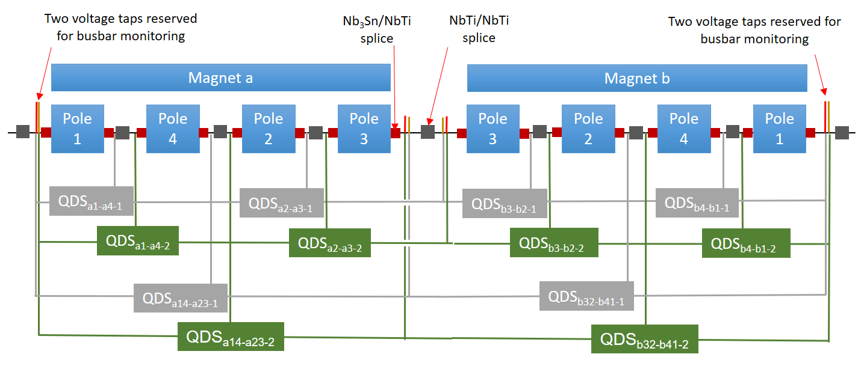


Inner triplet – instrumentation scheme Q1a & Q1b
Q1a and Q1b each have unique individual currents, so that a finer subdivision of balanced sections is needed
Two layers of quench detection, and two-fold QDS redundancy
  1st layer: balanced individual poles (e.g. pole 1 vs pole 4) → 2 x QDS channels
  2nd layer: balanced groups of two poles (e.g. poles 1+4 vs 2+3) → 2 x QDS channels
  Total: 12 x QDS channels for Q1

Slide 9
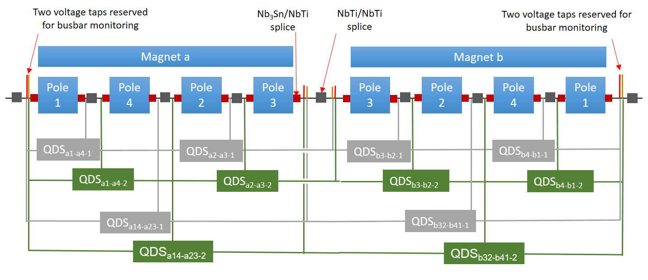
Inner triplet – instrumentation scheme Q2 & Q3
Same current for: Q2a and Q2b, and Q3a and Q3b → less QDS detectors are needed
Groups of two poles are balanced against each other (e.g. poles 1 & 4 versus 2 & 3) → 2 x QDS channels
Magnets are balanced against each other (Magnet a vs b) → 2 x QDS channels
Total: 6 x QDS channels for Q2, and 6 x QDS channels for Q3

Slide 10
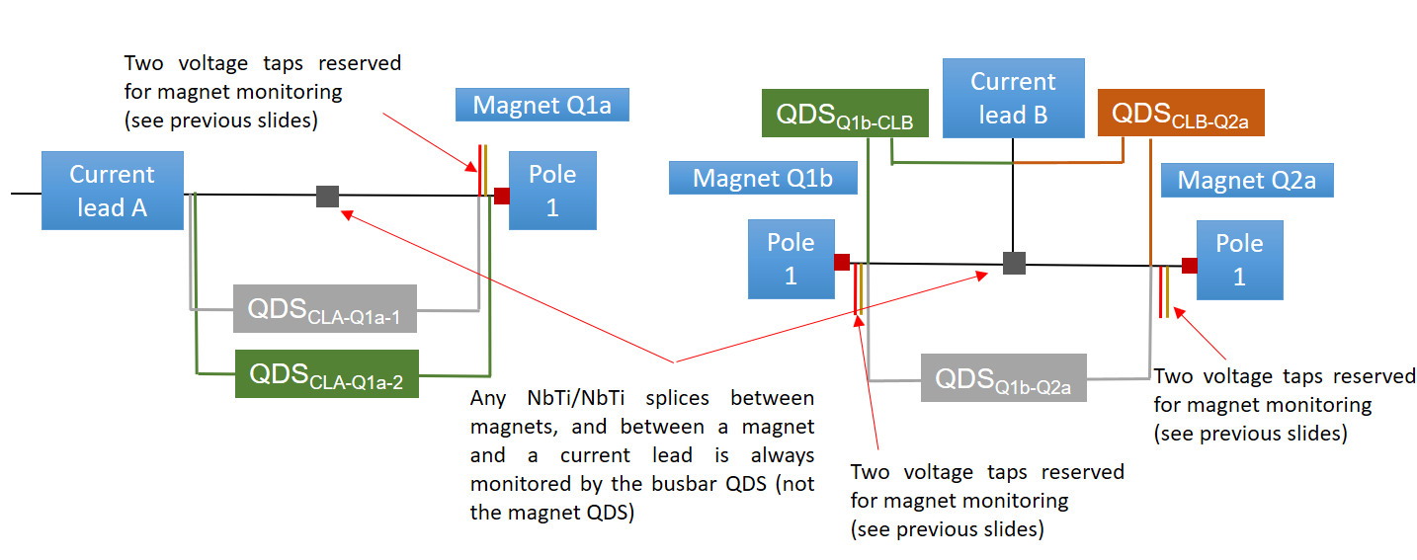
Inner triplet – bus-bar quench detection scheme
Bus-bar protection underneath current leads A and E: 2 x 2 QDS channels monitoring bus-bars
Bus-bar protection for T-sections between Q1a-Q2a, and Q2b-Q3a: 2 x 3 QDS channels monitoring bus-bars
Bus-bar between Q2a and Q2b is monitored by the magnet QDSs

Slide 11
Inner triplet – instrumentation summary
Summary | Qty | Voltage taps | QDS channels
Magnets | 6 | 6 x 2 x 7 or 6 x 2 x 5 | 12 (Q1) + 6 (Q2) + 6 (Q3)
HTS leads | 5 | 5 x 2 x 4 | 10
SC link | 5 | 5 x 2 x 2 | 10
Total |  | 164 or 120 | 54
Final voltage tap configuration still to be confirmed.
Routing of voltage taps and required twisting to be confirmed.

Slide 12
Inner triplet – correctors
Orbit correctors (MCBXF):
  QDS: magnets, bus-bars, MgB₂ links, HTS leads
  Protection systems: energy extraction by PC crowbar; optional energy extraction systems
Superferric order 2 (MQSXF):
  QDS: magnets, bus-bars, MgB₂ links, HTS leads
  Protection systems: energy extraction by PC crowbar; optional energy extraction systems
Superferric order 3, 4, 5, 6:
  QDS: MgB₂ links, HTS leads
  Protection systems: energy extraction by PC crowbar

Slide 13
D1, D2 and D2 corrector
D1 and D2 dipoles:
  QDS: magnets, bus-bars, MgB₂ links, HTS leads
  Dedicated QDS for the different elements; detection settings can be specified accordingly
  Protection systems: quench heaters
  4 (D1) x DQHDS, 8 (D2) x DQHDS
D2 corrector
  QDS: magnets, bus-bars, MgB₂ links, HTS leads
  Protection: energy extraction by PC crowbar; optional energy extraction system
  As the CCT magnet could experience symmetric quenches, each of the two apertures will be equipped with a non-central tap

Slide 14
Q4, Q5 and Q6
QDS: magnets, bus-bars, HTS leads → refurbished existing LHC systems adding additional features
  Dedicated QDS for the different elements; detection settings can be specified accordingly
  Enhanced quench heater circuit supervision
  Improved symmetric quench detection with the help of didt sensors
Protection systems: quench heaters
Q4, Q5 and Q6 correctors
  Protection by PC crowbar detection by PC as presently implemented in LHC for 60 A and 120 A corrector circuits

Slide 15
11 T dipoles
QDS:
  Magnet and bus-bars inside 11 T assembly
  nQPS layer of RB circuits needs to be re-configured after installation of 11 T dipoles
Protection systems:
  Quench heaters, energy extraction systems of main circuits
  2 x 8 DQHDS

Slide 16
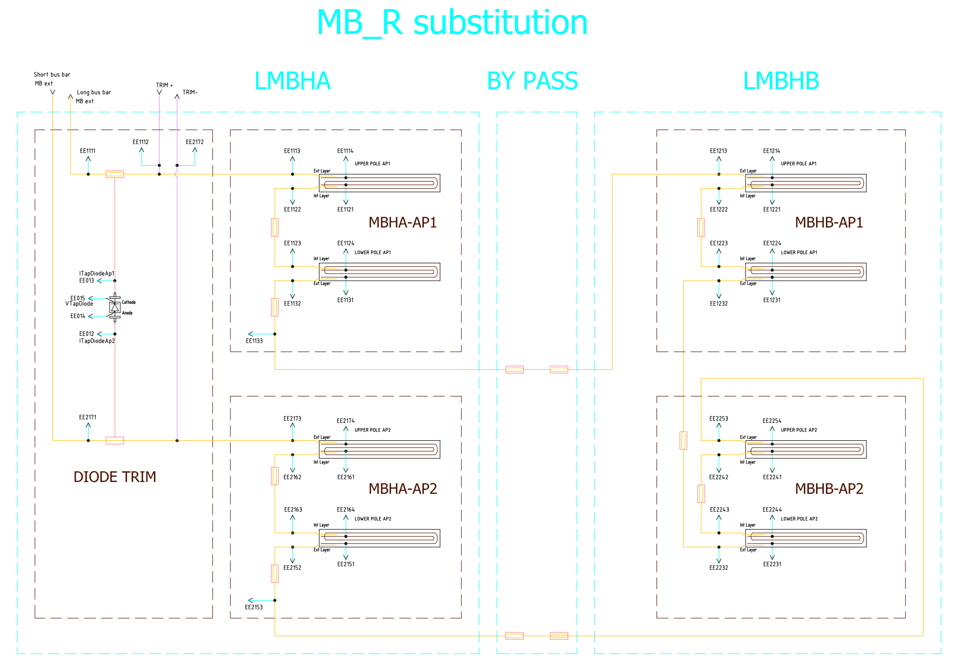
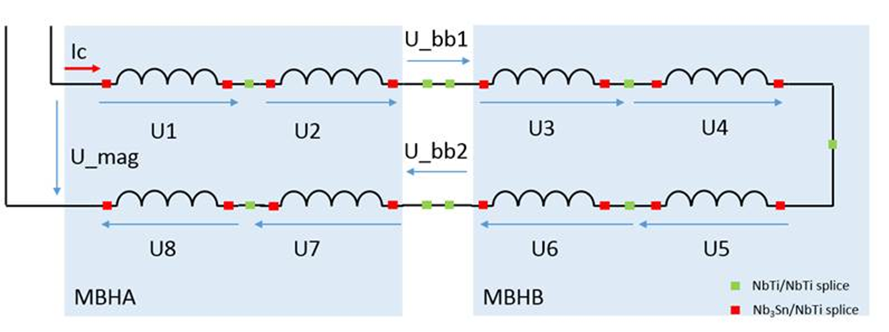
11 T – instrumentation scheme

Slide 17
11 T – instrumentation summary
In total 16 magnet voltages, four bus-bar voltages, two total magnet voltages and two circuit currents are treated by the redundant QDS systems
Detection of aperture symmetric quenches will be assured by comparing MBHA with MBHB
The choice of taps will always include bus-bars and splices around the concerned magnet pole so that all internal bus-bars are covered by QDS
nQPS for RB.A67 and RB.A78 needs to be re-configured as 11 T dipole cannot be used as reference magnet
See as well LHC-MBH-ES-0001 EDMS 1764166 (under approval)

Slide 18
Summary
Definition of protection of the various HL-LHC superconducting circuits advancing well and almost concluded
  Still some open questions like optional energy extraction systems
Detailed implementation of instrumentation schemes started
  Completed for 11 T dipoles
  Some details to be clarified for inner triplets
  Still to be done for D1, D2, correctors etc.
Quench detection algorithms and settings established
  Based on present knowledge about the magnets and other superconducting elements
  Final validation after tests with prototypes

