Slide 1


Status of D1 Development
Tatsushi NAKAMOTO (KEK)
On behalf of CERN-KEK Collaboration for D1 Development for HL-LHC
7th HL-LHC Collaboration Meeting, CIEMAT, Madrid, Nov. 14, 2017

Slide 2
Content
Test results of MBXFS1b
  Training Quench
  Quench Protection Studies
  Magnetic Field Measurement
Development of 2nd 2-m Model: MBXFS2
  Summary of Design Updates
  Magnetic Design
  Enhancing Mechanical Support of Coils
  New QPH and Other Items
Summary

Slide 3
Content
Test results of MBXFS1b
  Training Quench
  Quench Protection Studies
  Magnetic Field Measurement
Development of 2nd 2-m Model: MBXFS2
  Summary of Design Updates
  Magnetic Design
  Enhancing Mechanical Support of Coils
  New QPH and Other Items
Summary

Slide 4
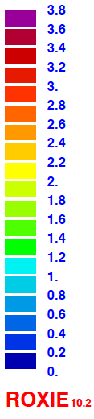
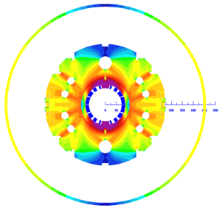
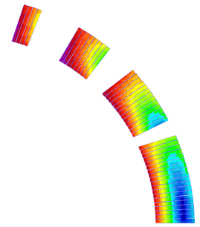
Design overview (w/ 2 HX holes) up to 1st Model
 | A series production | 2 m model
Coil aperture | 150 mm
Field integral | 35 T m | 9.8 T m
Nominal field | 5.57 T
Peak field | 6.44 T (SS), 6.56 T (coil end)
Operating current | 12.0 kA
Operating temperature | 1.9 K
Field quality | <10⁻⁴ w.r.t B₁ (R_{ref}=50 mm)
Load line ratio | 75.4%（SS）, 76.6%(coil end） at 1.9 K
Differential inductance | 4.0 mH/m
Conductor | Nb-Ti: LHC-MB outer cable
Stored energy | 340 kJ/m
Magnetic length | 6.33 m | 1.73 m
Coil mech. length | 6.57 m | 2.00 m
Magnet mech. length | 6.72 m | 2.15 m
Heat load | 135 W (Magnet total) 2 mW/cm³ (Coil peak) > 25 MGy
Radiation dose
4
8
13
4 blocks
44 turns
19
Technical challenges
・Large aperture： Management of coil size and pre-stress.
・Radiation resistance：Radiation resistant material for coil parts. Cooling capability.
・Iron saturation：Good field quality from injection to nominal current

Slide 5
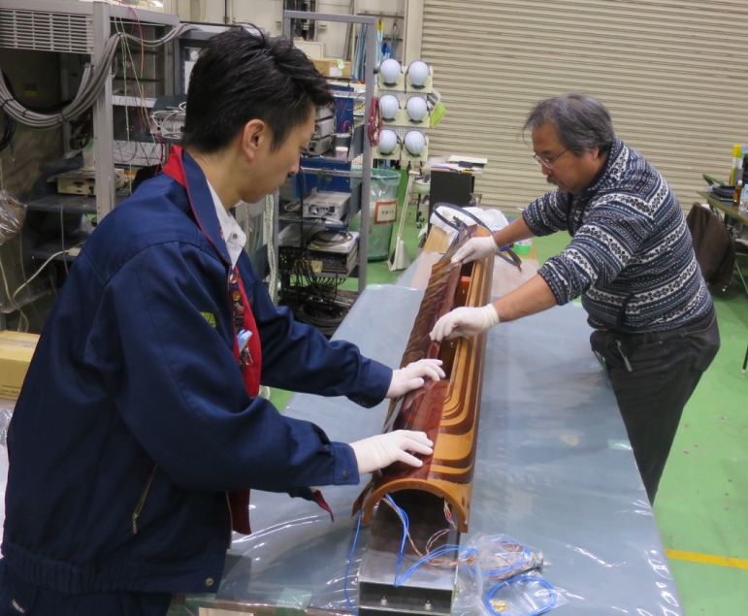
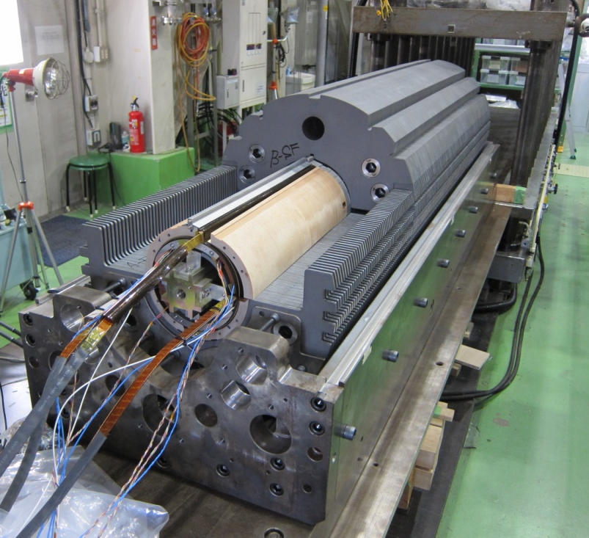
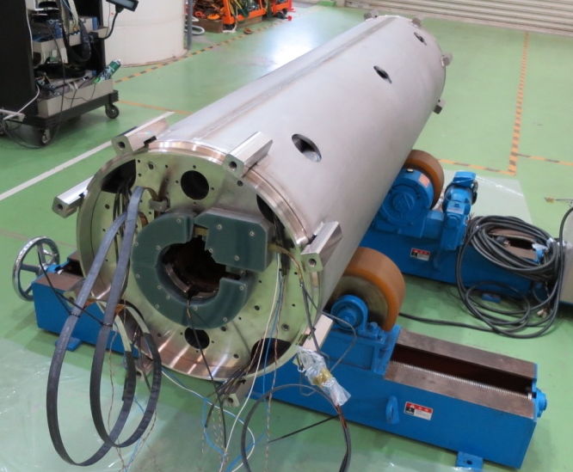
Increasing Coil Pre-stress in MBXFS1b
MBXFS1b
MBXFS1
Pre-stress after yoking in MBXFS1b is 35 MPa higher than that in MBXFS1.

Slide 6
Conditions of training quench
Energy extraction
  Dump resistor :73 mΩ (1st cycle), 50 mΩ (2nd cycle-2)
Voltage threshold: 0.1 V
Time threshold: 10 ms
Temperature: 1.9 K, 2.1 K and 4.4 K
Ramp rate
  Typically 10 A/s
  50–200 A/s for fast ramp test
Quench origin and propagation: voltage taps, quench antennas
Stress/strain measurements: collar (coil pre-stress), yoke, shell and bullet

Slide 7
Training plot (comparison btw #1 and #1b)
15 → 3 quenches to the nominal current (12 kA)
5 quenches to the ultimate current (13 kA)
Current-holding at 13 kA for 1 min, 12 kA for 1 hr → OK
Training performance is improved significantly in the MBXFS1b.

Slide 8
Training plot and history of test items
T=1.9 K if not stated
Warm-up to RT
Partially thermal cycle
2.1 K
4.4 K
MFM, Heater test,
Full energy dump
Fast ramp
MFM
1st cycle
2nd cycle-1
2nd cycle-2
1 st cycle / 2nd cycle-1
  I_{q} at the first quench after complete thermal cycle = 107% of I_{nom}
→ Good quench memory

Slide 9
Quench start location
Run | Quench start location
 | Coil | CB No. | Turn No. | Voltage tap
1st cycle
01b.QA008 | T | 3 | 5th | SS, RE side
01b.QA009 | T | 1 | 26-27th | ?
01b.QA010 | T | 3 | 5th | ?
01b.QA011 | Failure in data acquisition
01b.QA013 | B | 3 | 5th | SS/RE coil end
2nd cycle-1
01b.QA032 | B | 2, 3 | 12-13th | SS/LE coil end
01b.QA033 | B | 3 | 5th | RE coil end
2nd cycle -2
01b.QA138 | B | 3 | 5th | ?
01b.QA139 | T | 3 | 5th | ?
01b.QA140 | B | 1 | 26-27th | ?
01b.QA141 | T | 1 | 26-27th | ?
01b.QA142 | T | 1 | 26-27th | ?
01b.QA145 | T | 3 | 5th | ?
01b.QA146 | B | 1 | 26-27th | ?
01b.QA147 | B | 3 | 5th | RE coil end
01b.QA148 | T | 3 | 5th | SS/ RE coil end
01b.QA149 | B | 2 | 13th | SS/LE coil end
01b.QA150 | T | 1 | 26-27th | ?
01b.QA151 | B | 3 | 5th | RE coil end
01b.QA154 | T | 1 | 26-27th | ?
35%
10%
50%
50% at the 5th turn (peak field)
In part of quenches, a quench position could be determined precisely from the voltage tap signals.
For the rest of quenches, analysis of quench antenna signals is necessary to identify the quench start location.

Slide 10
Temperature and ramp rate dependence
200 A/s
Ramp rate is 10 A/s
if not stated.
150 A/s
10 A/s
100 A/s
10 A/s
50 A/s
2.1 K
1.9 K
4.4 K
Temperature dependence
  I_{q} at 4.4 K ~ 100% of SSL
  I_{q} at 2.1 K is comparable to Iq at 1.9 K
  → I_{q} is limited by Lorentz force.
  I_{max} through the tests = 13.548 kA (88% of SSL at 2.1 K)
Ramp rate dependence
  I_{q} increases despite of increasing ramp rate.
  → The magnet was still under training.

Slide 11
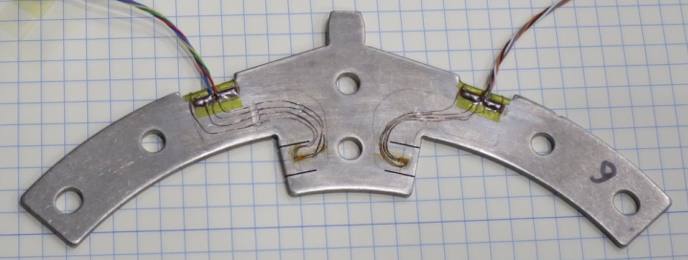
Coil pre-stress in the straight section
Coil pre-stress measured
using the strain gauges at the collar pole
Both sides of collar pole
x 3 longitudinal positions
After reassembly
Nominal
Before reassembly
Nominal
Ultimate
#1b
#1
In half of the measured points, coil pre-stress still increases at the nominal current in #1b, which is much better than #1.
The plateau was observed for all strain gauges at the ultimate current.
Coil pre-stress should be further increased by 10-15 MPa.

Slide 12
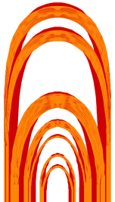
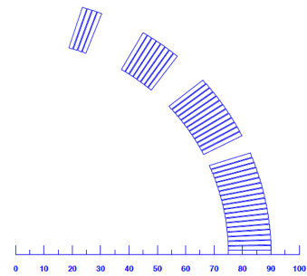
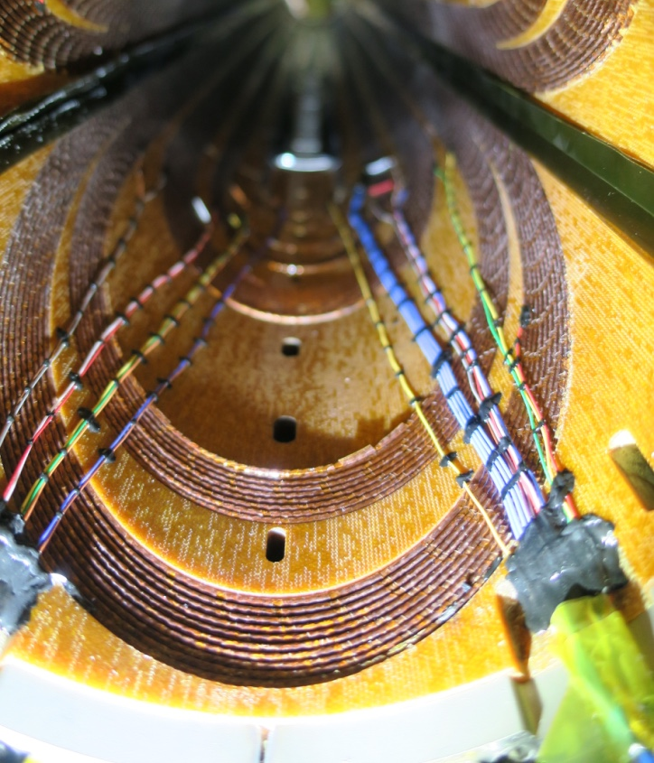
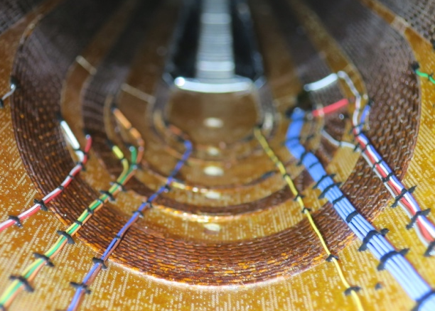
Coils after magnet test (#1b, after magnet test)
CB4
CB3
CB2
CB1A
CB1B
CB2
CB3
CB4
CB1
Largest deformation
(CB1B innermost turn,
26-27 turn)
Second largest deformation
(CB2 innermost turn,
12-13 turn)
Cable deformation towards the coil bore was observed even in #1b.
Large deformation occurred in the turns same as #1.
The largely deformed turns coincide with ones at which quench started.
But, it has not been clarified if such cable deformation can cause quench.
→ Mechanical support of the cable at coil end should be reinforced.

Slide 13
Content
Test results of MBXFS1b
  Training Quench
  Quench Protection Studies
  Magnetic Field Measurement
Development of 2nd 2-m Model: MBXFS2
  Summary of Design Updates
  Magnetic Design
  Enhancing Mechanical Support of Coils
  New QPH and Other Items
Summary

Slide 14
Parameters for quench simulation
Detection time
Current decay
Validation
time
Quench delay time
& Decay start (Quench by QPH)
Current
Coil voltage
Voltage
threshold
QPH
Quench
Time
Shut off & QPH On
Spot heater test → Detection time
QPH test → Delay time
Full energy dump test → Current decay

Slide 15
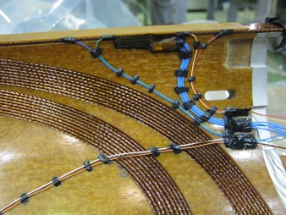
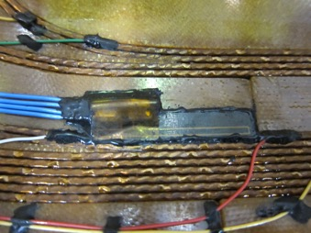
Spot heater test
Two spot heaters for each coil (high field, low field regions)
At each magnet current, amplitude and duration of pulsed current to a SPH were adjusted until quench occurred.
Maximum current to the magnet: 12.2 kA
Detection time was evaluated from balanced voltage rise.
Lead end
Return end
Spot heater at low field region
Spot heater at high field region

Slide 16
Quench detection time evaluated by SPH
#1
#1b
Low B field
High B field
Quench detection time :
  Time to balance voltage (ΔV_{bal}=0.1V) + 10msec validation
Measurements taken at MBXFS01 and MBXFS01b (right fig.)
  Confirmed the reproducibility at I=9.5kA
  Detection time @ operation current (~12kA) : 20 ms / 50 ms for High / Low field region

Slide 17
Delay time
t₀
t_{eff}
Delay time
Minimum required
peak power density
QPH
voltage
Balanced
voltage
Delay time (msec)
View from LE
QPH2
Top coil
QPH1
Only one out of four QPHs
was fired.
QPH3
Bottom coil
QPH4
Peak power density (W/mm²)
Definition of delay time:
Time difference between QPH firing and the onset of V_{bal}
Delay time up to 12.5 kA could be successfully evaluated.
Minimum required peak power density to induce quench at 688 A (I_{inj}) =0.35 W/mm²

Slide 18
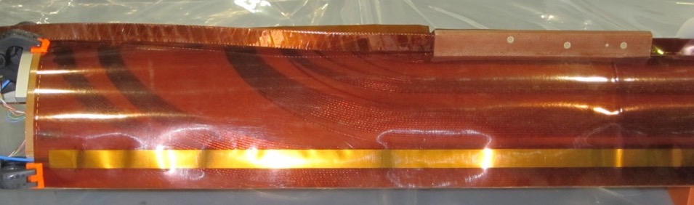
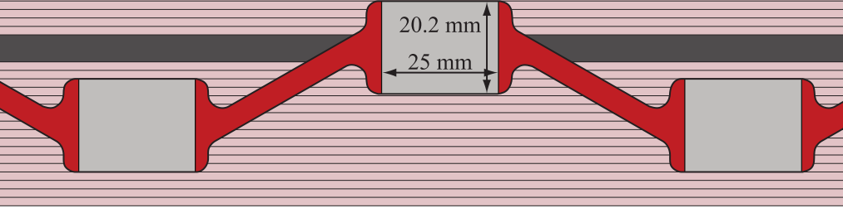
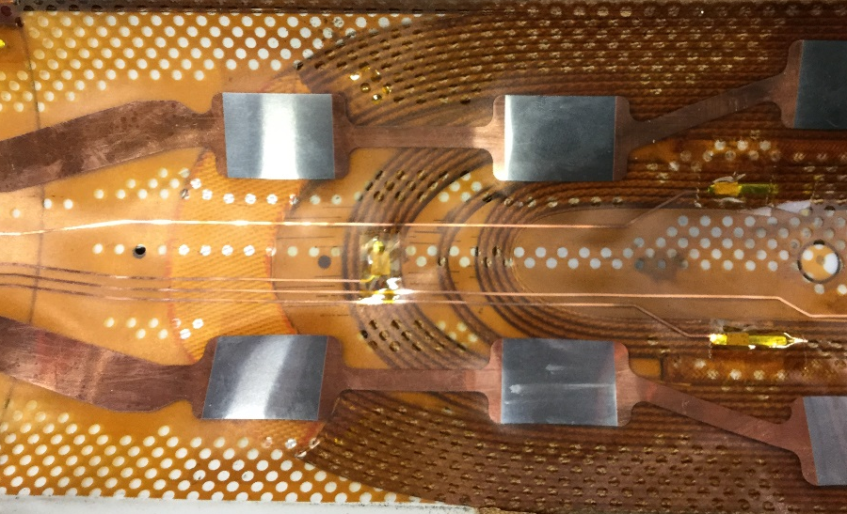
MIITs and dissipated energy
MIITs
?
MBXFS1b
Full energy dump test
Magnet current (kA)
QPH similar to MQXF’s one…
As a result of full energy dump test, MIITs reached the allowable limit (MIITs=32 at 300 K) even at 10.5 kA (while I_{nom}=12 kA).
New design of QPHs needed to reduce the peak temperature.

Slide 19
Content
Test results of MBXFS1b
  Training Quench
  Quench Protection Studies
  Magnetic Field Measurement
Development of 2nd 2-m Model: MBXFS2
  Summary of Design Updates
  Magnetic Design
  Enhancing Mechanical Support of Coils
  New QPH and Other Items
Summary

Slide 20
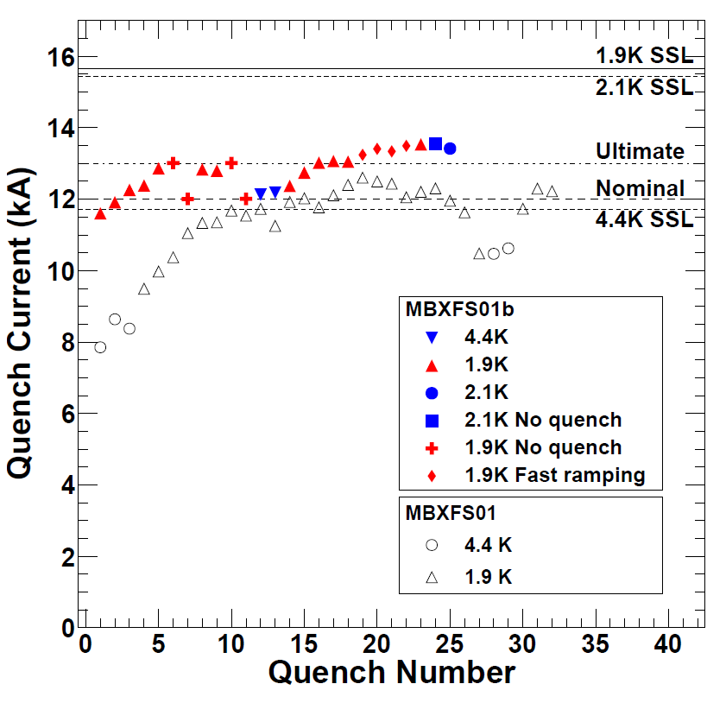
Menus
1st cycle
2nd cycle
DC loop
Z-scan(short)
DC loop
  MFM at the magnet center
  0 A → 12.2 kA → 0A
  Transfer Function
  Current dependence of multipole components
Z scan
  Long rotating coils
  688 A, 1 kA, 2kA, … 12 kA
  Field distribution along the magnet.
  Field integral
DC loop
Z-scan(long)
Training of MBXFS1b
  Nominal current after two quenches
  Ultimate current after 5 quenches
  Current holding: 13 kA for 1 min, 12 kA for 1hour.
  Magnetic Field Measurement was done after quench training.

Slide 21
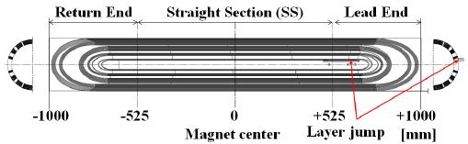
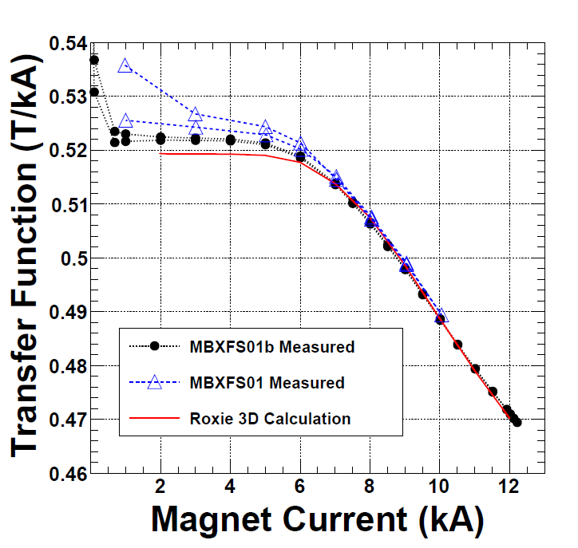
Transfer Function
$$T.F.\left(I,z=0\right)=$$
$$\frac{B_{1}(I,z=0)}{Current}$$
R_{ref} in all of ROXIE calculations was taken to be 50 mm.
ROXIE 3D: Calculated as an average B1 over z = ±175 mm
Magnet exhibited saturation at currents greater than 5-6 kA.
Measurements are consistent with the ROXIE 3D calculation.

Slide 22
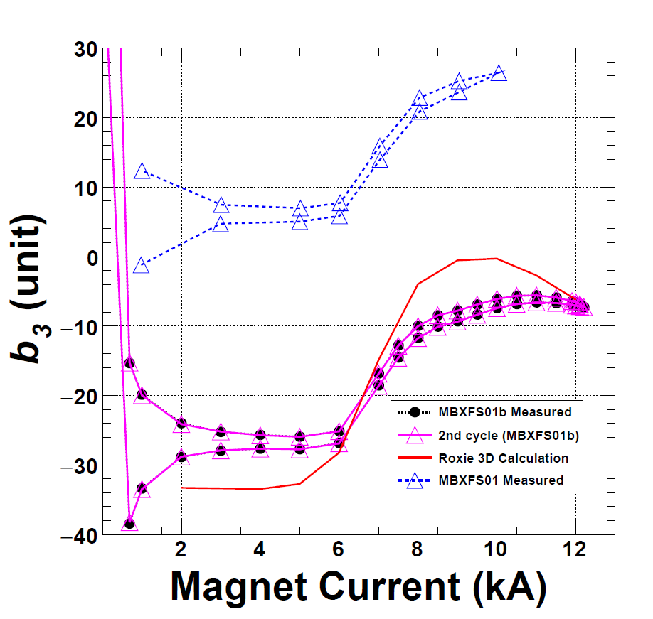
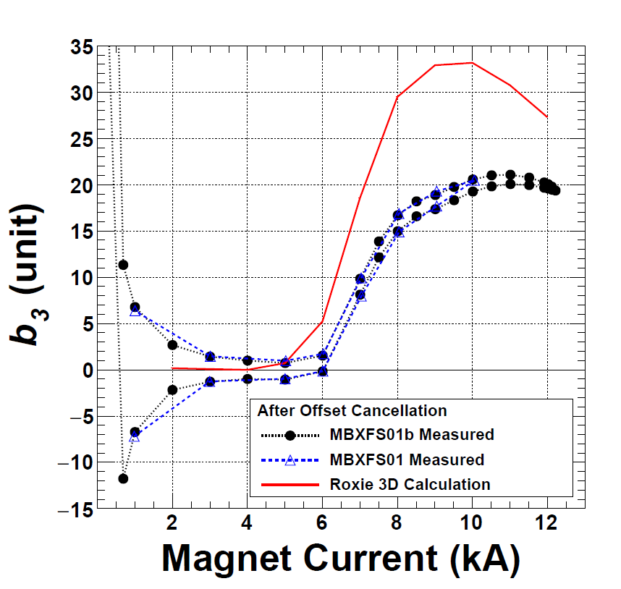
b₃ at Coil center
$$b_{n}\left(z=0,I\right)$$
$$=\frac{B_{n}(z=0,I)}{B_{1}(z=0,I)}×{10}^{4}$$
$$b_{n}\left(I,z=0\right)=$$
$$\frac{B_{n}(I,z=0)}{B_{1}(I,z=0)}×{10}^{4}$$
After offset cancellation
Shim effect
MBXFS1b reproduces the previous result (MBXFS01).
Above 6kA,
The influence of iron yoke saturation is well reproduced, but the mismatch still exists.
  > 10 units @ 9-10 kA
  Above 10 kA, not ramp down (look like flat)
There is a difference between ramp up and down at b₃. (Hysteresis curve)
Note: ROXIE 3D model is not completed. The coil block geometry is given by approximation.

Slide 23
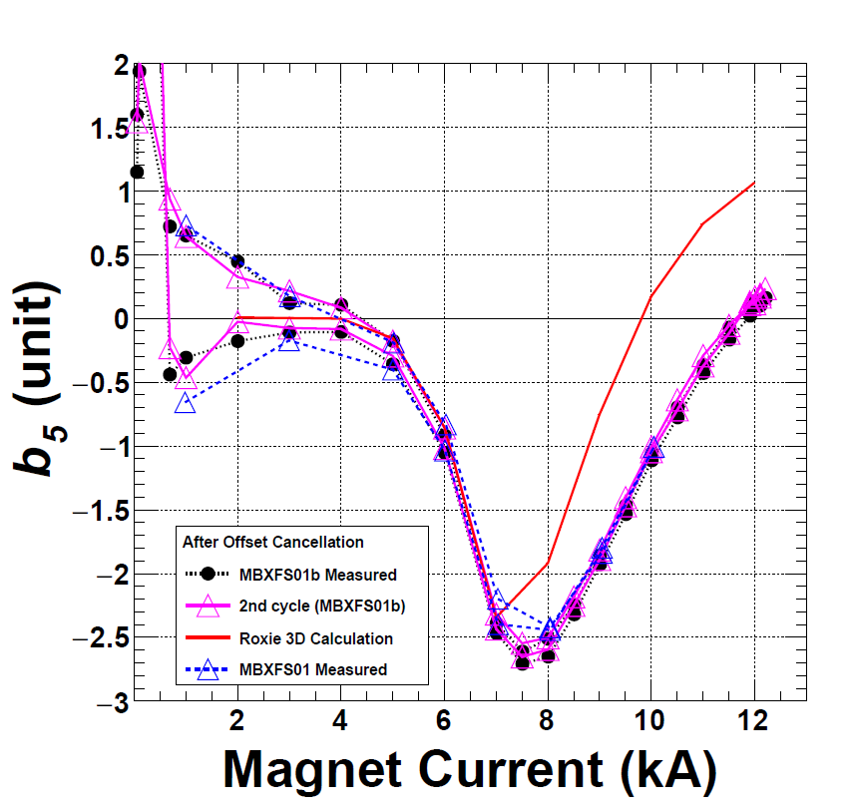
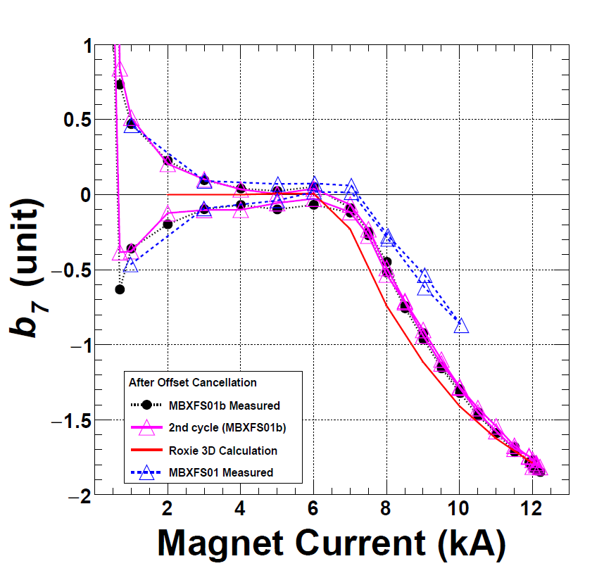
b₅ and b₇ after offset cancellation
b₅
b₇
Above 6kA,
  Measurements are consistent with the ROXIE 3D calculation.
  Hysteresis cannot be seen.

Slide 24
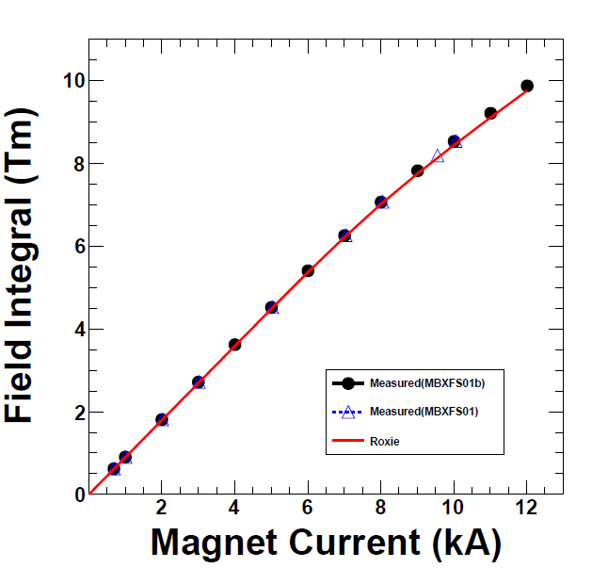
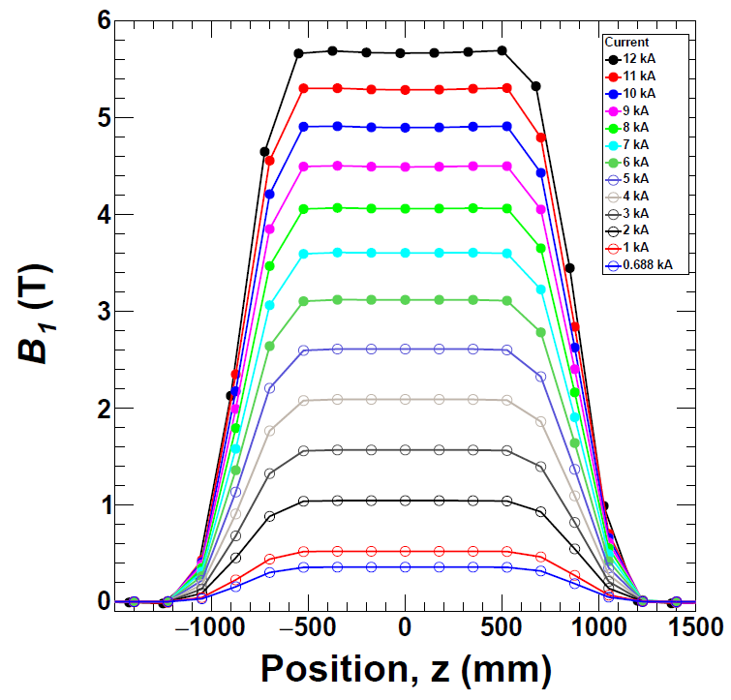
Z-Scan : Current Dependence, B₁
by long coil
←RE
LE→
Integral region: -1750 ~ +1750 mm
9.88 Tm @ 12.013 kA
  9.76 Tm @ 12kA (ROXIE 3D)

Slide 25
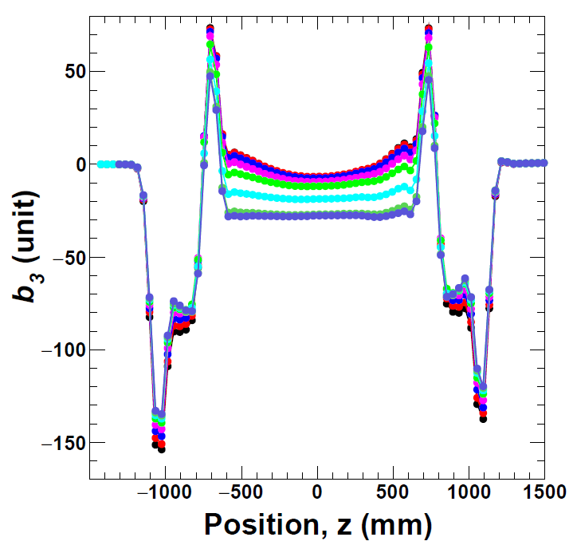
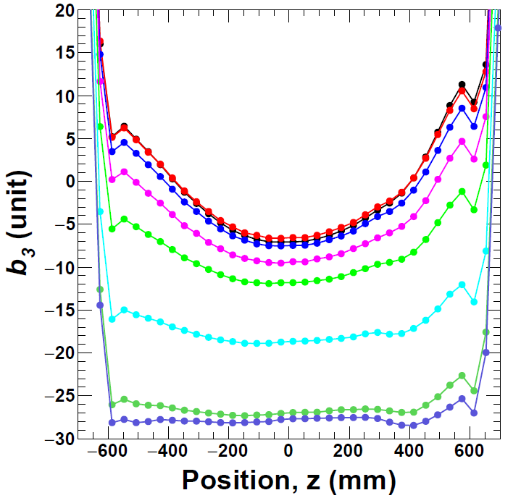
Z-Scan: Current Dependence, b₃ by long coil
$$b_{3}\left(z,I_{n}\right)$$
$$=\frac{B_{3}(z,I_{n})}{B_{1}(z=0,I_{n})}×{10}^{4}$$
12kA
11kA
10kA
9kA
8kA
7kA
6kA
4kA
Influence of coil end on b₃ was observed in the straight section .

Slide 26
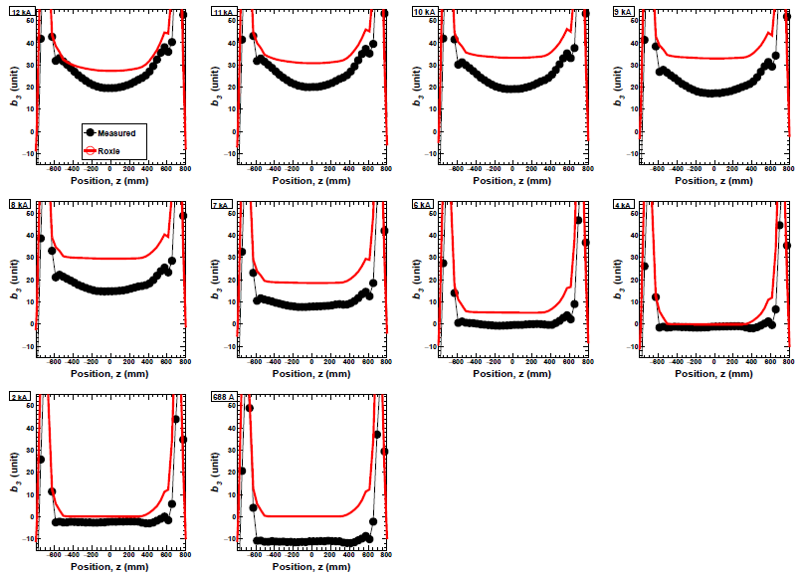
Z-Scan : Current Dependence, b₃
Meas. vs Calc. by long coil.
12kA
11kA
10kA
9kA
Measured
Roxie 3D
8kA
7kA
6kA
4kA
2kA
688A
Calculation is almost flat at the straight section.
*after offset calibration

Slide 27
Content
Test results of MBXFS1b
  Training Quench
  Quench Protection Studies
  Magnetic Field Measurement
Development of 2nd 2-m Model: MBXFS2
  Summary of Design Updates
  Magnetic Design
  Enhancing Mechanical Support of Coils
  New QPH and Other Items
Summary

Slide 28
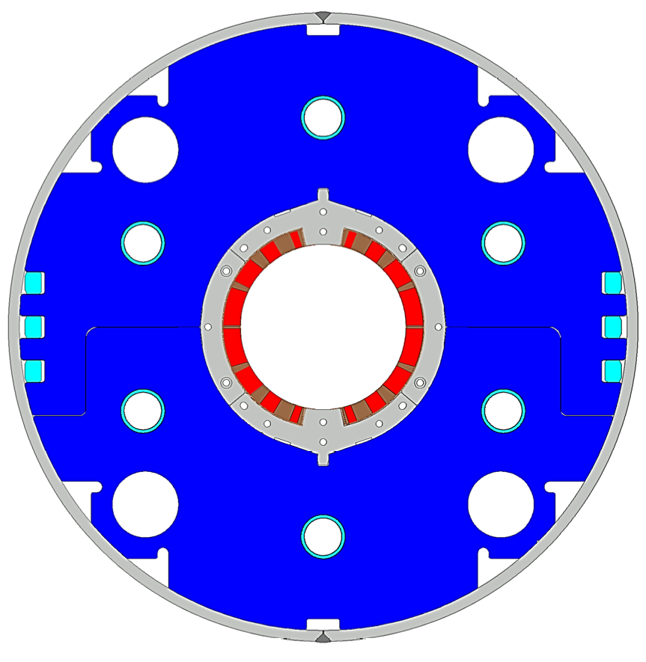
Design Parameters: 1st vs 2nd Models
4
8
13
4 blocks
44 turns
19
Item |  | MBXFS1, 1b | MBXFS2
Target pre-stress / load | lateral | #1: 80 Mpa, #1b: 110 MPa | 115 MPa
 | axial | 51 kN/coil | ? kN/coil
Coil | 2D | 4 blocks (4+8+13+19)
 | Coil end | 7 blocks | 8 blocks
 | Resin | 100 % CE (BT-2160RX) | Epoxy + CE (EC-1HA, B, w/ filler?)
 | length | 525,1100,375mm | 561.2,1025.5,413.3mm
QPH |  | straight | zigzag
Yoke |  | 2 HX holes | 4 HX holes
Cold tube Support |  | No | Yes
Nominal Current |  | 12.000 kA | 12.047 kA
Main Field |  | 5.573 | 5.569
Coil Peak Field |  | 6.56 T | 6.58 T
Load line ratio |  | 76.3% | 76.7%
Coil Mech. Length (full-scale) |  | 6518 mm | 6580 mm

Slide 29
Content
Test results of MBXFS1b
  Training Quench
  Quench Protection Studies
  Magnetic Field Measurement
Development of 2nd 2-m Model: MBXFS2
  Summary of Design Updates
  Magnetic Design
  Enhancing Mechanical Support of Coils
  New QPH and Other Items
Summary

Slide 30
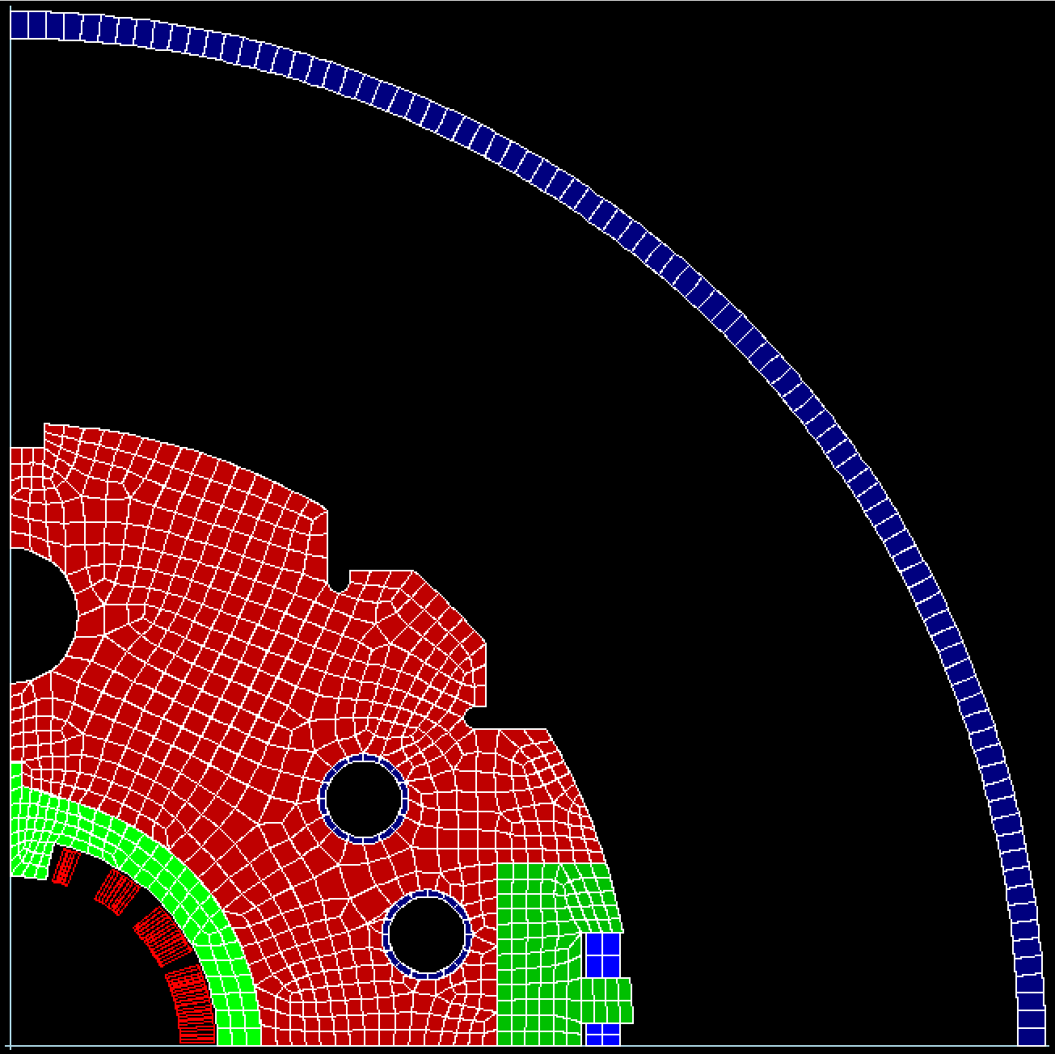
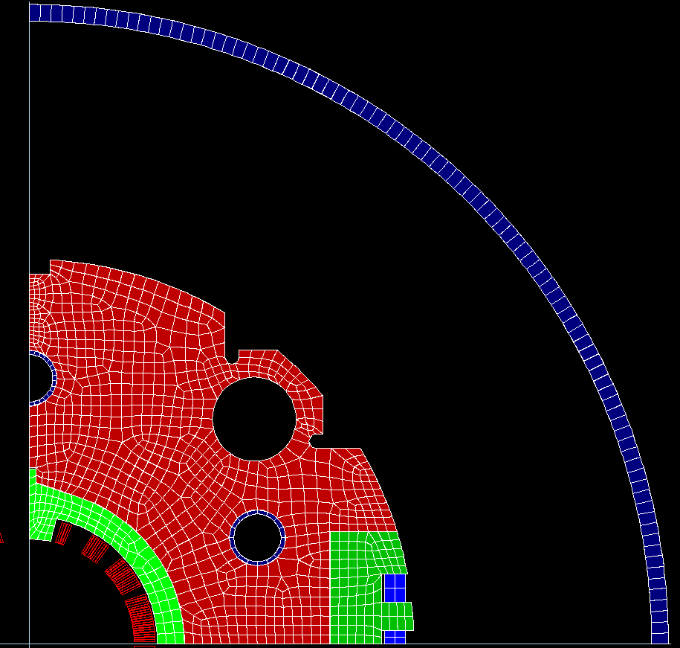
Magnetic design in 2D
MBXFS1
MBXFS2
HX hole
φ60 at R190
Field tuning hole
φ34 at R190
HX hole
φ60 at θ45º
and R227.5
Field tuning hole
φ34 at θ15º,35º
and R180
Field tuning hole
φ34 at θ25º
and R180
Stack tube
Change of HX holes: 45º, φ60, R227.5
A number of calculations using ROXIE 2D were performed to determine a new iron cross section. In these calculations, size and position of the field tuning holes were systematically changed mainly to minimize iron saturation effect on multipole coefficients.
One of the cross sections with four HX holes was selected for the 2nd model and the later magnets. This result was compared with the 1st model with two HX holes.

Slide 31
Field quality at nominal current by ROXIE 2D
MBXFS1
 | 1st model Ver3.0.0 | 2nd model Ver4.0.1
Nominal current (kA) | 12.0 | 12.047
Main field (T) | 5.573 | 5.569
b3 (unit) | -0.059 | -0.028
b5 (unit) | -0.097 | -0.045
b7 (unit) | -0.111 | -0.054
b9 (unit) | 0.284 | 0.139
b11 (unit) | 0.360 | 0.176
b13 (unit) | -0.663 | -0.695
b15 (unit) | -1.115 | -1.157
b17 (unit) | -0.788 | -0.815
b19 (unit) | 0.399 | 0.402
MBXFS2
Nominal current in the modified model was
determined to generate the main dipole field
of 5.57 T.

Slide 32
Variation of b_{n} with current: ROXIE 2D
MBXFS2
MBXFS2
MBXFS1
Saturation effect on b₃ is larger in MBXFS2.
(Maximum b₃ during ramping-up is 8.5 units at 8.5 kA.)

Slide 33
Coil block arrangement
MBXFS1
MBXFS2
4
4
3
3
2
2
α2
1
1
φ2
ROXIE coil parameters
after optimization at I_{nom} (deg)
 | 1st model | 2nd model
φ1 | 1.0255 | 1.1346
φ2 | 27.8582 | 27.8721
φ3 | 50.3081 | 50.2969
φ4 | 70.6354 | 70.6992
α2 | 26.0000 | 26.0000
α3 | 52.3508 | 52.4212
α4 | 68.0015 | 68.0015
Only very small change in coil block arrangement.
Reuse of tooling.

Slide 34
Coil end design
MBXFS1
ROXIE
original
model
4-B
4-A
3-B
3-A
2
1-A
1-B
4-B
3-A
2
1-A
1-B
4-A
3-B
Actual
coil
MBXFS2
4-B
4-A
3-B
3-A
2-B
2-A
1-A
1-B
4-B
3-A
2-B
1-A
1-B
4-A
3-B
2-A
Coil end shape was re-optimized for the 7 m production magnet and this will be applied to the 2nd model.
In the 1st model, the cable was inclined more than the original design. In the 2nd model, the measured cable angles were reflected to the design parameters to realize better fit between the cable and the end spacers.
The second coil block will be also subdivided to make it easier to predict the cable angle and increase the adjustable parameters for minimizing multipoles.

Slide 35
Field integral in 7 m magnet by ROXIE 3D
 | RE (unit) | SS (unit) | LE (unit) | Total (unit) | Target value (unit) | Expected (unit)
z | -4000~-2870 | -2870~2720 | 2720~4000 | -4000~4000
BL (Tm) | 1.422 | 31.344 | 2.262 | 35.027 |  | 35.027
b3 (unit) | -3.607 | 8.805 | -2.132 | 3.066 | 3.057 | 0.009
b5 (unit) | -0.281 | 0.048 | 0.298 | 0.065 | -0.228 | 0.292
b7 (unit) | -0.287 | 0.016 | -0.058 | -0.330 | 0.067 | -0.397
b9 (unit) | -0.269 | 0.091 | -0.167 | -0.345 | 0.109 | -0.454
b11 (unit) | -0.119 | 0.167 | -0.086 | -0.038 |  | -0.038
b13 (unit) | -0.055 | -0.620 | -0.054 | -0.729 |  | -0.729
b15 (unit) | -0.035 | -1.030 | -0.060 | -1.124 |  | -1.124
b17 (unit) | -0.011 | -0.726 | -0.027 | -0.765 |  | -0.765
b19 (unit) | 0.006 | 0.359 | 0.015 | 0.380 |  | 0.380
a1 (unit) | 0.001 | 0.148 | -5.539 | -5.391 |  | -5.391
a3 (unit) | 0.000 | 0.039 | 1.808 | 1.847 |  | 1.847
Simplified iron model
for 3D calculation
Detailed iron model
for 2D calculation
The 2D calculation results with the simplified iron model was set as a target.
b3-b9 can be controlled within 0.5 unit with respect to the target values.

Slide 36
Other parameters
 |  | 1st model | 2nd model
Nominal current |  | 12.000 kA | 12.047 kA
Peak field | SS | 6.44 T | 6.45 T
 | Coil end | 6.56 T | 6.58 T
Load line ratio | SS | 75.4% | 75.6%
 | Coil end | 76.3% | 76.7%
Coil mechanical length (7 m model, at warm) |  | 6518 mm | 6580 mm
Peak field and load line ratio are almost the same.
Coil mechanical length is 62 mm longer than the previous design. (Still feasible for the test in the KEK vertical cryostat)

Slide 37
Content
Test results of MBXFS1b
  Training Quench
  Quench Protection Studies
  Magnetic Field Measurement
Development of 2nd 2-m Model: MBXFS2
  Summary of Design Updates
  Magnetic Design
  Enhancing Mechanical Support of Coils
  New QPH and Other Items
Summary

Slide 38
Increase of azimuthal coil pre-stress in SS
(Oversize of wedges)
Arc length
Oversize
Total arc length of wedges per quadrant is
enlarged by 1.14 mm wrt that of model-01 to reach the target pre-stress of 115 MPa at pole.

Slide 39
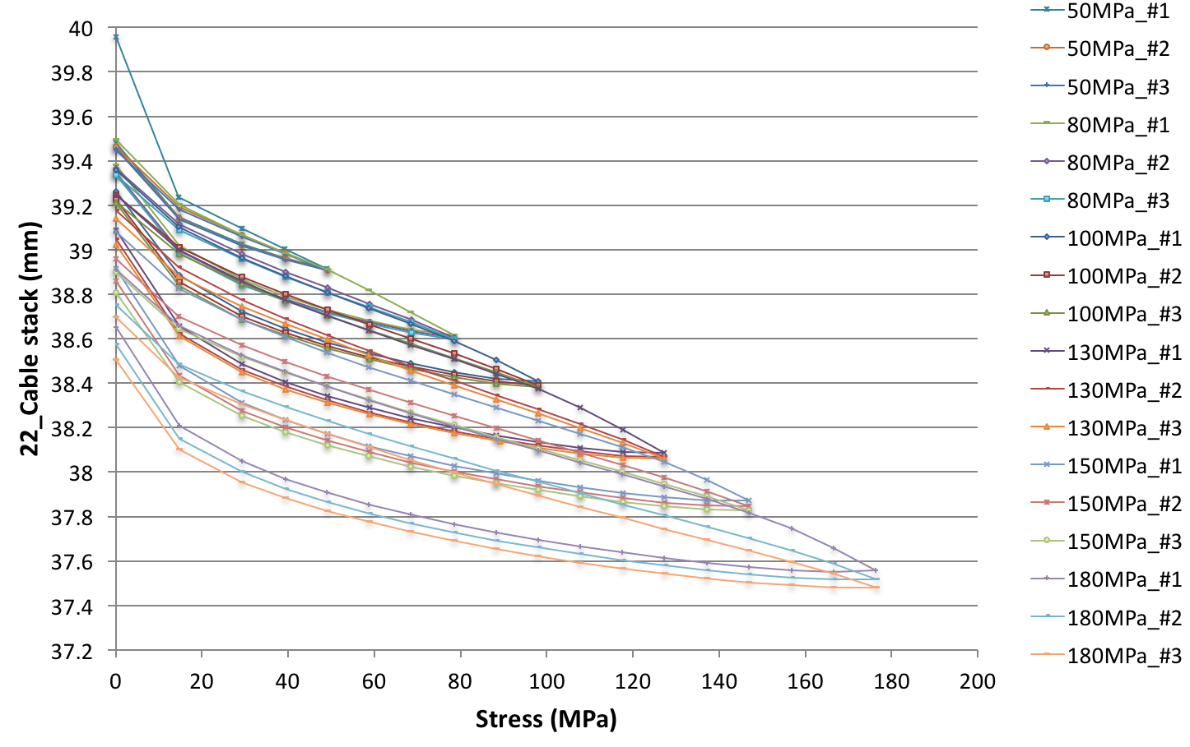
Stress dependence of azimuthal coil size
(Size Meas. up to 180 MPa)
22 cable stack
Creep deformation becomes more remarkable above 130 MPa.
Further study on creep effect is planned.

Slide 40
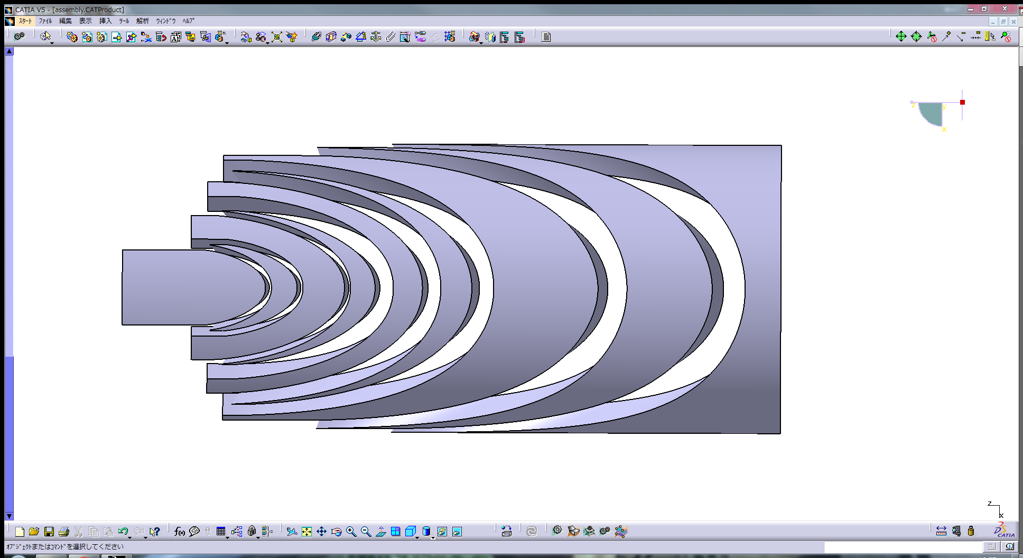
Countermeasures against coil deformation
at coil end ( Oversize of end spacers)
Oversize
RE9
RE8
RE7
RE6
RE4
RE2
RE1
RE5
RE3
End spacer shown in red
will be oversized.
In the1st model, end spacers were not oversized except for the end saddles.
In the 2nd model, part of end spacers will be oversized in the similar way to wedges.
  Total oversize at each z position is controlled to be the same as that of wedges.
  At the end of end saddles, oversize is set to be 0.6 mm so that pre-stress of full GFRP part is 115 MPa.
Strain gauges will be implemented on the end spacers to monitor coil pre-stress at coil end.

Slide 41
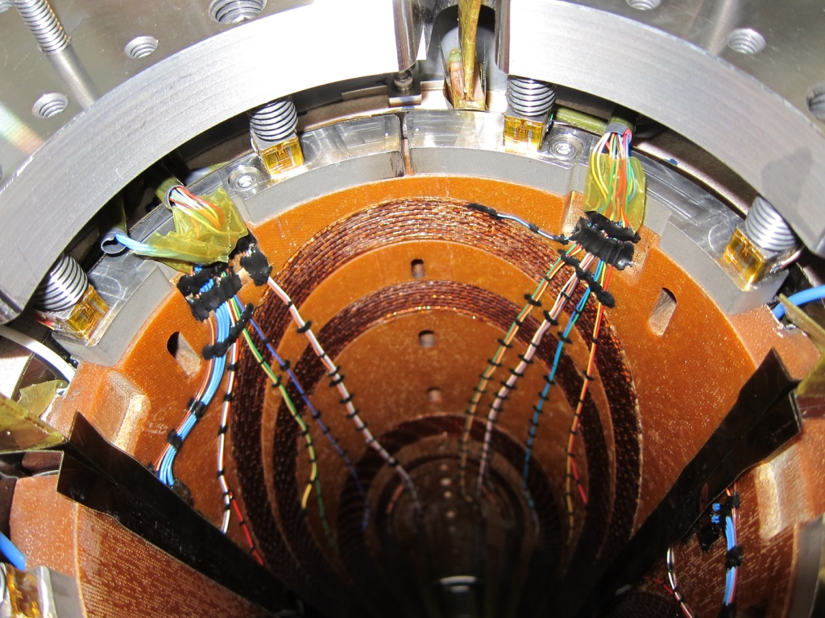
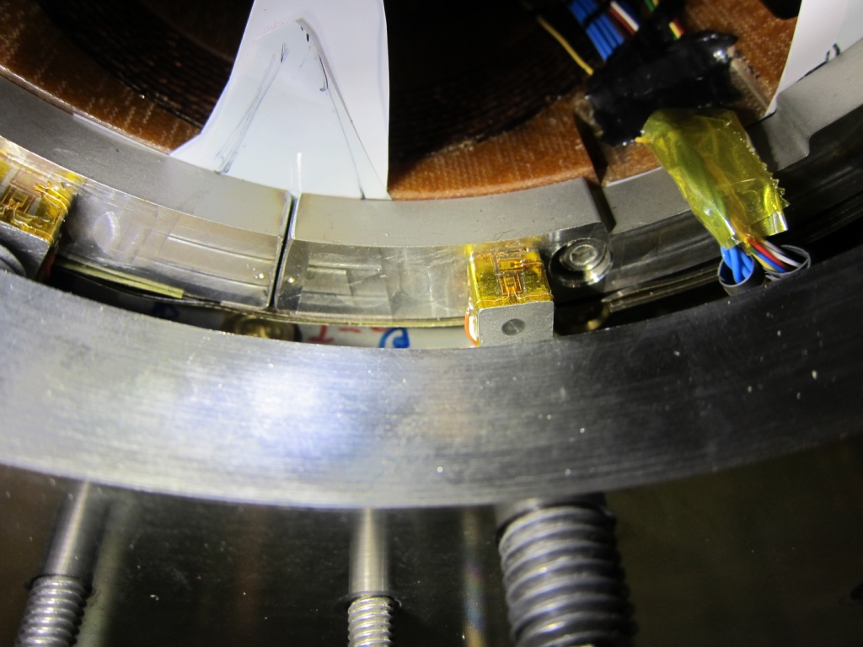
Countermeasures against coil deformation
at coil end ( Increase of axial pre-load)
Plastic deformation
In the 1st model, axial pre-load was determined empirically.
Pre-load will be increased to help mechanical support of a cable.
(Target value has not been decided.)
The blocks which are pushed by the bullets were plastically deformed in 01b. Material should be changed from SUS304L.

Slide 42
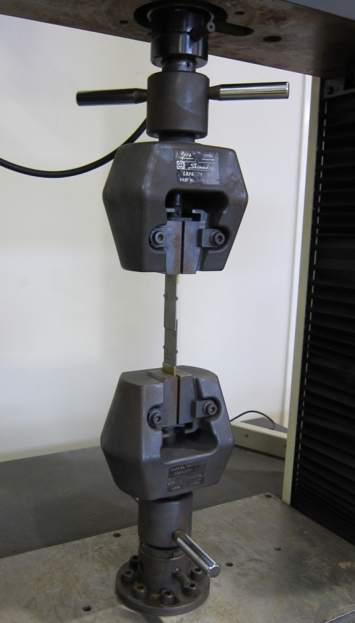
Study of resin: Epoxy & CE
Epoxy-blended cyanate ester will be used as adhesive between GFRP parts and cables (EC-1HA, -1HB w/ or /w/o filler).
  Proven resin for ITER TF coils
  100% cyanate ester for MBXFS1
Recommended curing cycle: 120ºCx12h+150ºCx24h+190ºCx30m
Study for preferable curing conditions (shorter time and lower temp.) by shearing test for bonding strength
EC-1HA
w/o filler
EC-1HA-F7P
w/ filler, low vis.
EC-1HB-F7P
w/ filler, high vis.
Recom. Cycle
50 % Recom. Cycle
Recom. Temp. -20ºC

Slide 43
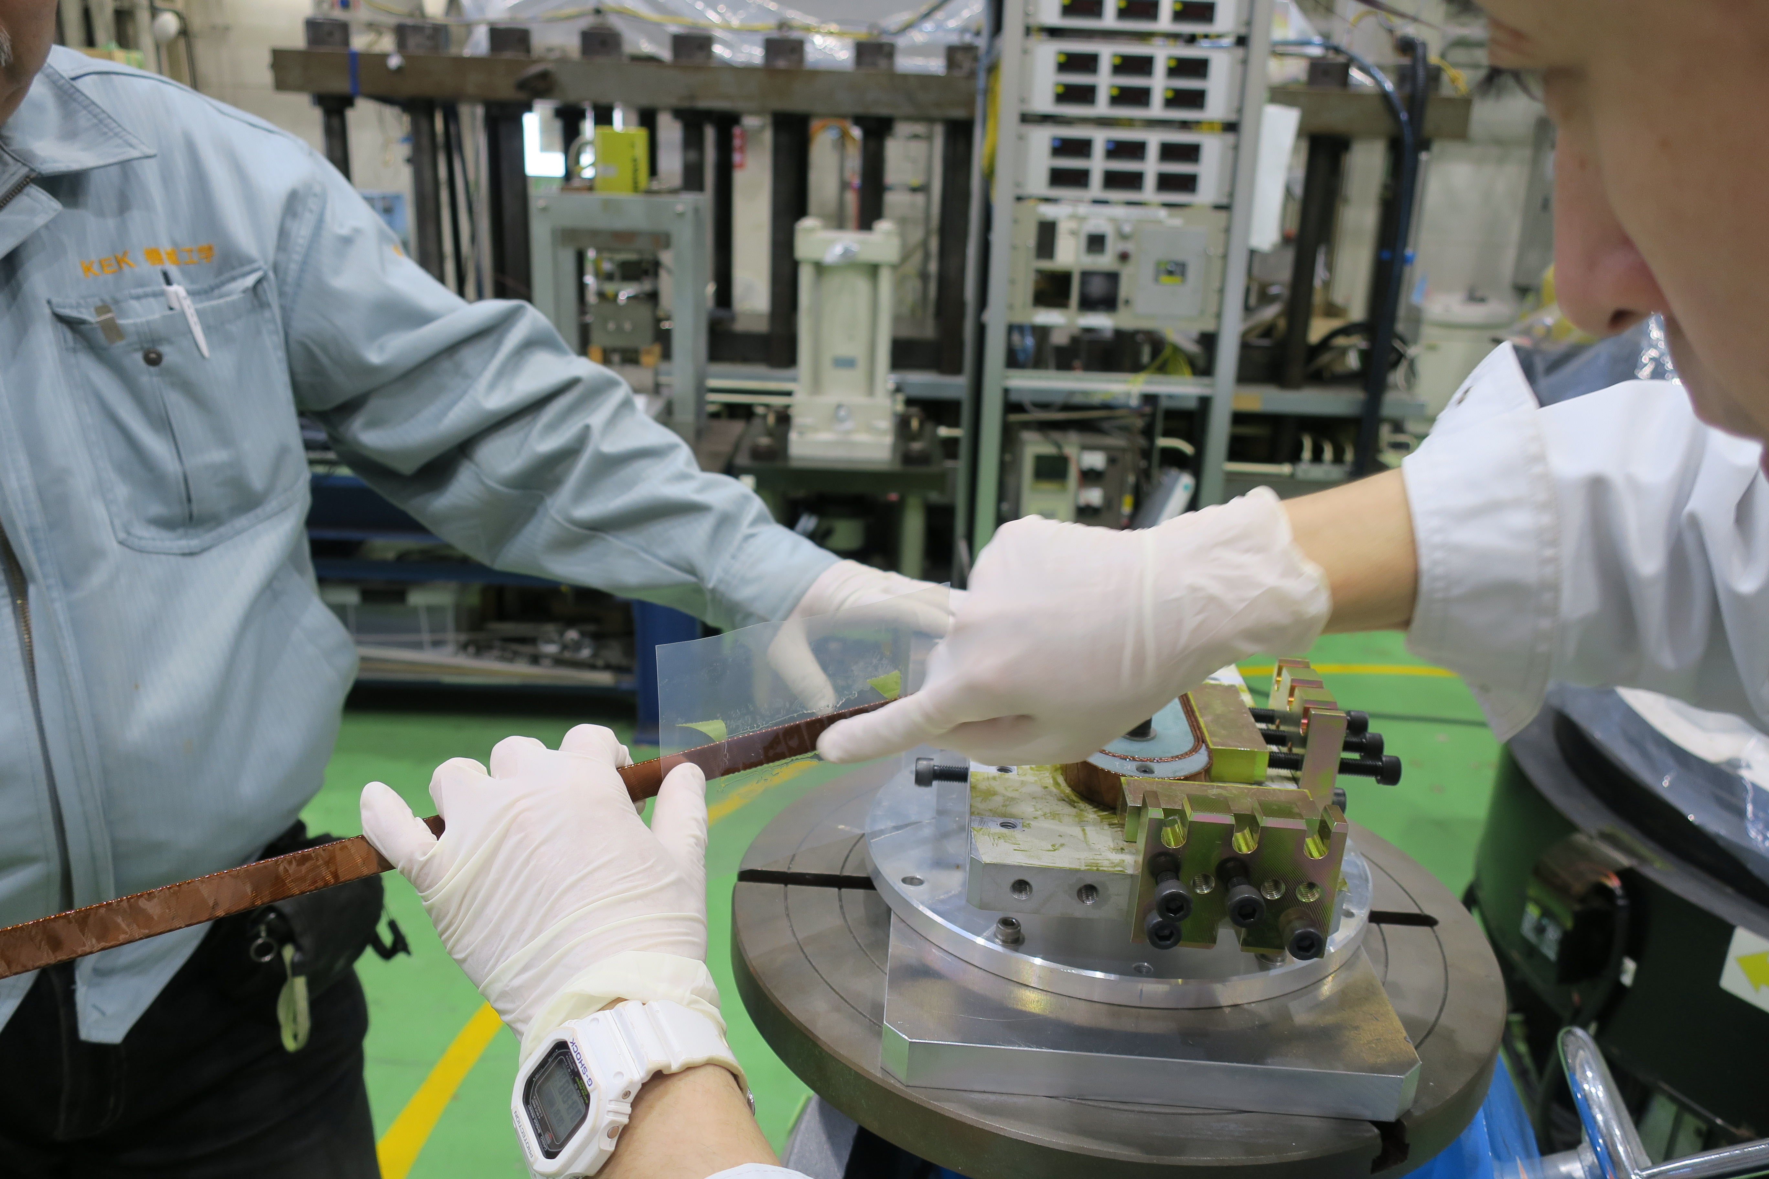
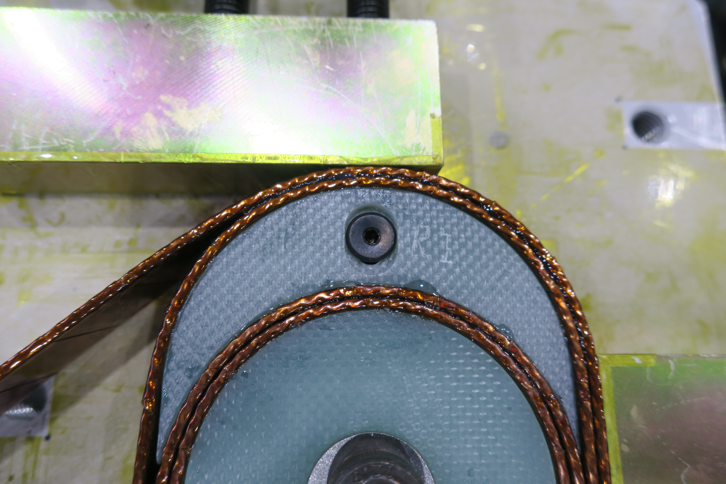
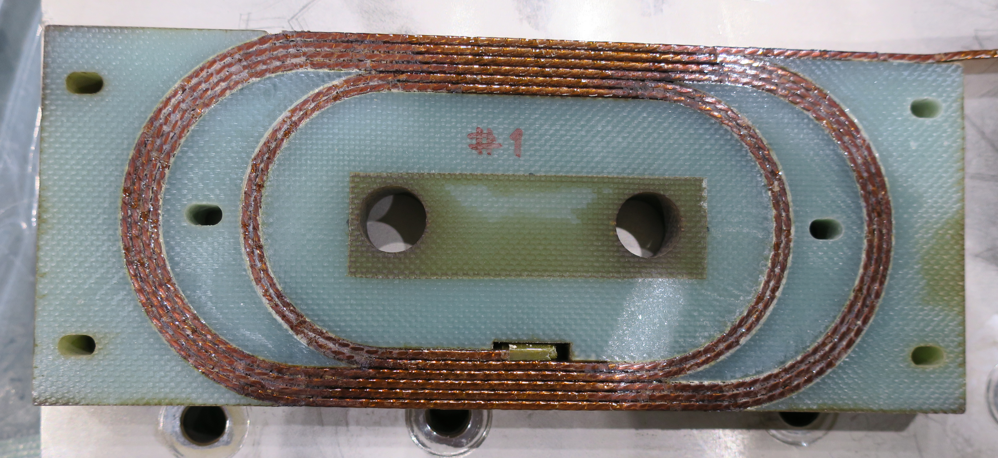
Test Coil Winding w/ Resins
R&D of wet-winding or injection w/ block
New resin (epoxy & cyanate ester, proven for ITER) with filler
  Appropriate viscosity and lifetime.
  120ºCx12h + 150ºCx24h +190ºCx0.5h
R&D of test coil winding w/ wet-winding is ongoing: outcomes will be implemented in the 2nd model.

Slide 44
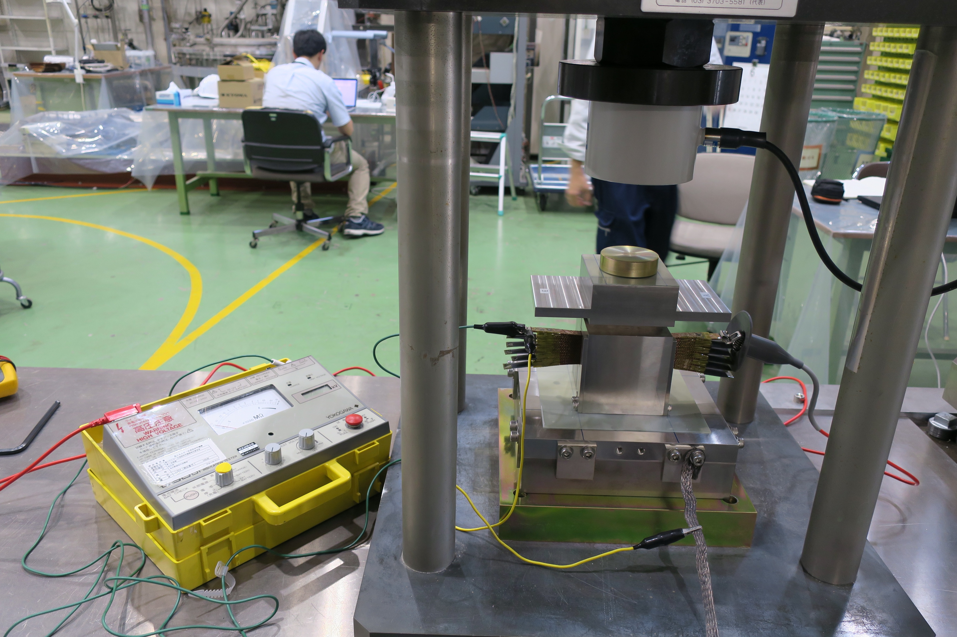
Increase of azimuthal coil pre-stress in SS
(Cable 10 Stack: Insulation Endurance)
Compressive stress
up to 200 MPa
Inspected
insulation
layer
(N=6)
22 cable stack
Hi-pot test under compressive stress for a 22 cable
No degradation of insulation resistance up to 200 MPa at 3 kV for 1 min
Degradation of electrical insulation due to creep deformation should be also checked.

Slide 45
Content
Test results of MBXFS1b
  Training Quench
  Quench Protection Studies
  Magnetic Field Measurement
Development of 2nd 2-m Model: MBXFS2
  Summary of Design Updates
  Magnetic Design
  Enhancing Mechanical Support of Coils
  New QPH and Other Items
Summary

Slide 46
Quench Protection Heater Design
Under discussion w/ CERN experts
Most likely candidate: A & B, all 2 strips in quad. will be fired.

Slide 47
Iron yoke

Slide 48
Cold tube support
Plan: cold test of the 2nd model at CERN in 2018
Behavior of the insulated cold tube with the tungsten shield during the quench will be studied. (C. Garion)
New mechanical feature to support the cold tube in horizontal position
A gap between the cold tube and the inner coil surface: ~1.5 mm
Cold bore tube
Beam screen for Q1-Q3
Elastic supporting system
Cold bore
Tungsten alloy blocks
Thermal links
Cooling tubes
Support structure
(tentative)
Beam screen tube
C. Garion, HL-LHC Collaboration meeting 2017

Slide 49
Schedule
2017
4/4
2018
1/4
2018
2/4
2018
3/4
2018
4/4
Coil winding starts in Nov.
Cold test in May 2018
Cold test in Dec 2018
Apart from 2-m models, possible in-kind contribution scenarios for D1 magnets (MBXFs) are in consideration.

Slide 50
Summary
Development of beam separation dipole (D1) for HL-LHC has been carried out by KEK.
  With a scope of Japanese in-kind contribution to the project.
Modified 1st model magnet (MBXFS1b) with higher pre-stress showed improved training quench performance.
  Nominal current was reached at the third quench and ultimate current was also achieved after five quenches.
Development of the 2nd model magnet (MBXFS2) has been carried out.
  Several design updates (enhanced coil pre-stress, 4 HX holes, improved coil end shape & wet-winding, new QPH, etc.) have been implemented.
  Coil winding will start in November, 2017 and cold test will be performed in May 2018.
  Continuously followed by the 3rd model magnet (MBXFS3) in 2018.

Slide 51
Supplemental slides

Slide 52
MBXFS1b Test Program
1st test cycle (12th – 24th Feb)
  Training quench at 1.9 K
  → This presentation
  Magnetic field measurement
    DC loop at coil center and Z-scan w long rotating coils
    up to 12 kA
2nd test cycle (19th Mar – 9th Apr, 17th-19th Apr)
  Training quench
    Quench memory
    Ramp rate dependence
    Temperature dependence
  Magnetic field measurement
    Z-scan w long rotating coils at a short pitch
  Heater test (Spot heater, QPH, Full energy dump)

Slide 53

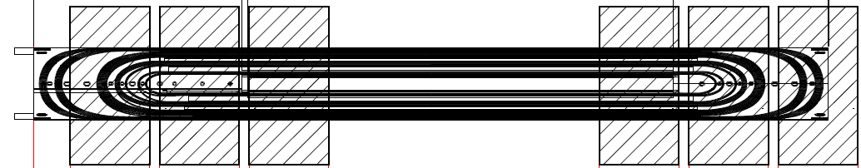
Identification of quench start location
Voltage taps (View from the inner surface)
Notation of coil blocks
CB4
CB3
CB2
CB1
Quench antennas
CB1
CB2
CB3
CB4
LE
RE
QA1
QA2
QA3
QA4
QA5
QA6
Voltage taps: 42 in total per coil, data acquired for 27 taps during training
Quench antenna: 6 longitudinal positions
Detecting 6N, 6S, 8N, 8S components at each position

Slide 54
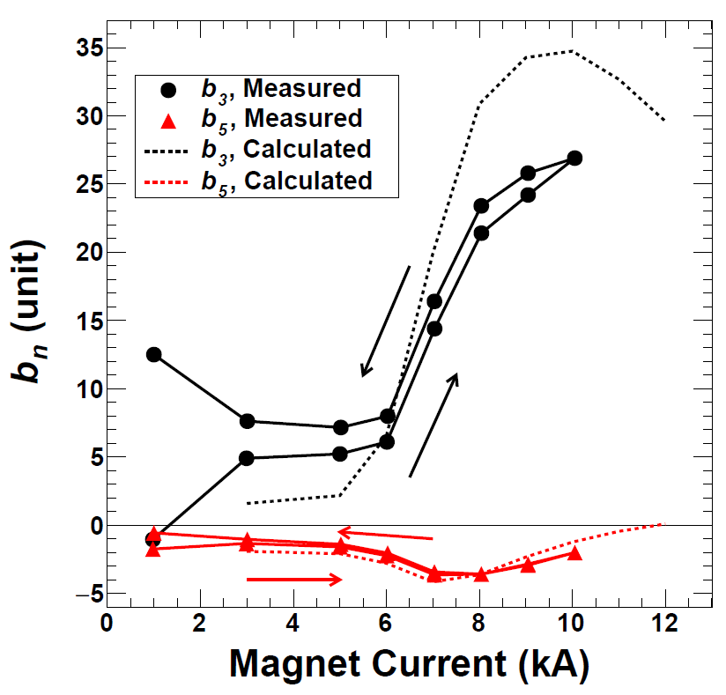
Remark 2 ~MFM of MBXFS1~
Current Dependence
Z-scan
b_{n} (unit)
Up to 10 kA
to avoid the quench
Magnet Current (kA)
Position z(mm)
Measurements are consistent with the design values with Main dipole(B₁) and filed integral.
Un-allowed multipoles are less than 10⁻⁴ with respect to the dipole field.
Current Dependence：The influence of iron yoke saturation on b₃ is well reproduced, but the mismatch still exist above 6 kA.
Z-scan：Influence of coil end was observed in the straight section.

Slide 55
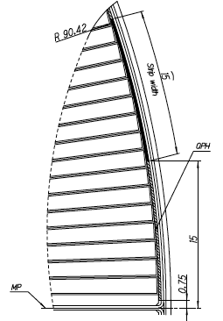
QPH test
Energy deposition test at different charged energy of a PS
PSs from CERN with C=7.05 mF and maximum charged voltage of 800 V were utilized to fire QPHs.
Only one QPH was connected with a 3 Ω dummy resistor in series for each test to evaluate delay time.
Maximum current: 12.5 kA
A SUS strip in a QPH with t25 μm x w15 mm x l2 m without Cu ilands covers 9 turns in CB1 (low field)
Since quench protection with a dump resistor was a baseline, we did NOT design the QPH used in MBXFS1 and 1b. The purpose of this QPH test was to obtain
the experimental data necessary for quench simulation and QPH design for the second model.
Heater
strip

Slide 56
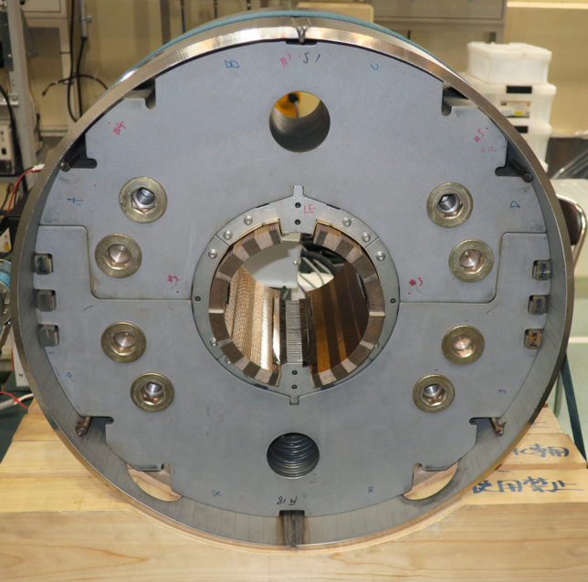
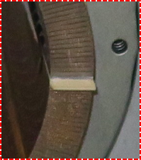
Remark 1 ~ Shim insertion ~
G10 shim
  The 0.8 mm-thick shims were inserted to the MP to increase coil pre-stress.
  →It is expected that multipole components are affected.
  The purpose of this MFM mainly to confirm the effect of the iron saturation above 6 kA and the influence of coil end.
  The MFM results in this report were corrected with taking into account the feed down effects.

Slide 57
Axial strain
During cooling-down
During excitation
Bottom coil, RE
Ramp-down
Ramp-up
Strain gauges were newly instrumented at the bullets.
No sign of detaching the bullets from the coil during cooling-down
Strain at the bullets starts to increase at 5–6 kA.
Load calculated from the strain variation
= 0.6 – 0.7 tonf/coil
  Axial pre-load applied at RT: 5.2 tonf/coil
  Axial Lorentz force: 19 tonf/coil (ROXIE calc.)
aaa

Slide 58
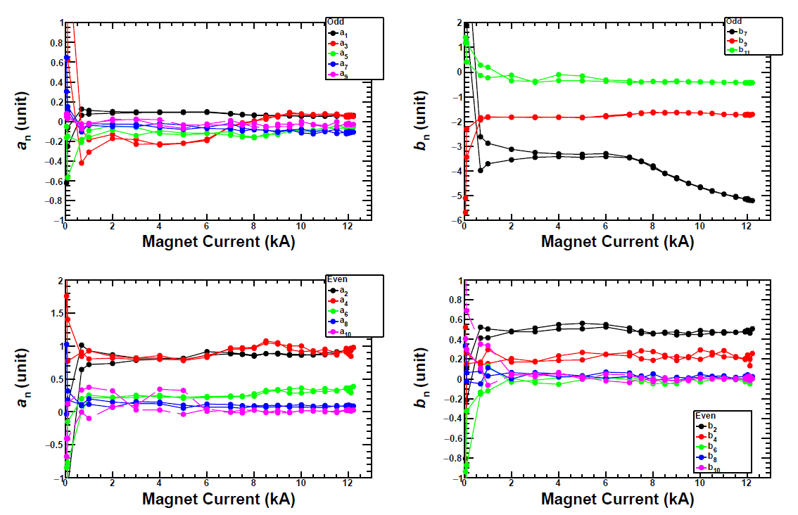
DC Loop: Other Harmonics at Magnet Center
$$b_{n}\left(I,z=0\right)=\frac{B_{n}(I,z=0)}{B_{1}(I,z=0)}×{10}^{4}$$
odd
a1
a3
a5
a7
a9
b7
b9
b11
Un-allowed
Even
a2
a4
a6
a8
a10
Un-allowed
Un-allowed
b2
b4
b6
b8
b10
Un-allowed multipole components are less than 10 ⁻⁴ with respect to the dipole field.

