Slide 1
D2 (MBRD) Status Update
A.Bersani, B.Caiffi, R.Cereseto, P.Fabbricatore S.Farinon, A.M.Ricci (INFN)
A.Foussat, N. Peray (CERN)

Slide 2
Index
Short model (MBRDS1) : Construction at ASG Superconductors
  Ongoing activities
  Copper wedges
  Stacking Tests
  Planning
  Test preparation at CERN
Prototype (MBRDP1) : The way from design to contract for construction
  TDR
  Technical Specification
  Further documentation
  Schedule for procurement
Integration.

Slide 3
The D2 cross section

Slide 4
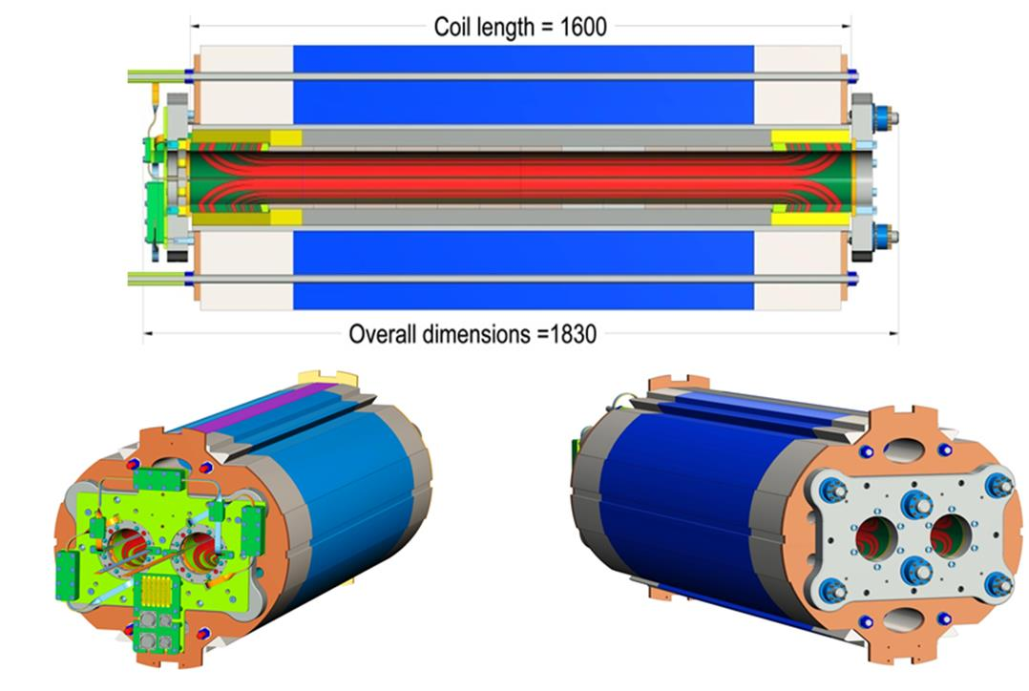
The INFN/CERN design of the short model

Slide 5
The contract to ASG Superconductors for short model (1.6 m) construction
The contract: The contract to ASG Superconductors was awarded on November 30th. The contract is of the type: To be built under specification, with frozen magnetic lay-out (coil and iron). The contractual delivery time was 15 months, leading the delivery of short model to Feb 28th 2018. Later on the delivery was moved to May 5th for including in the schedule the construction of coil mock-ups and at least one practice coil.

Slide 6
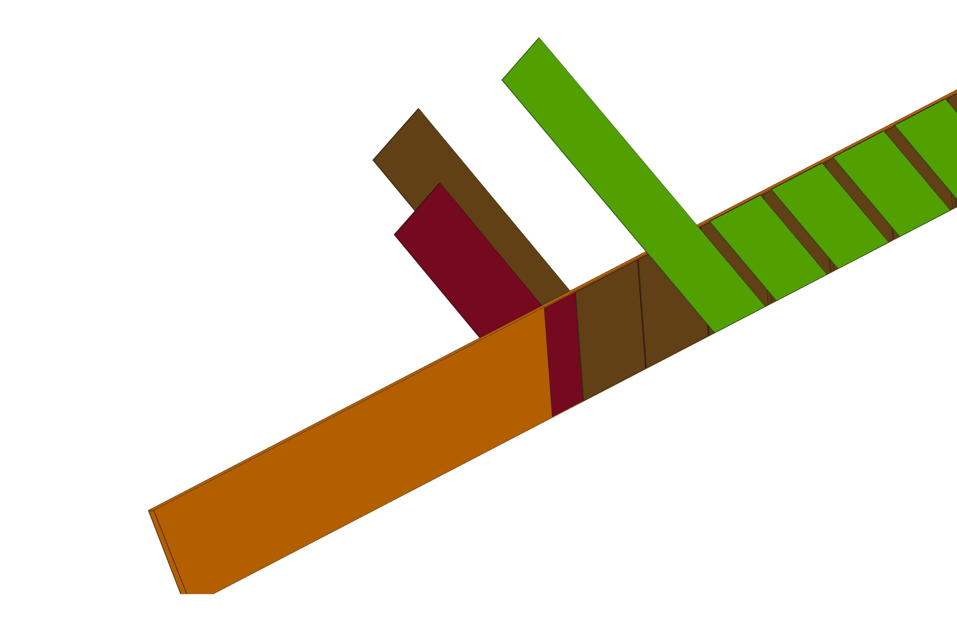
The need for constructing mock-ups and a
practice coil (not included in the short model spec.)
After contract start we changed the insulation lay-out moving from the known scheme used by us in the SIS300 dipole to a new scheme.
Why? Two rised issues : The 25 µm tape and the overlapping 2/3 are critical
1th layer: Kapton 50μm thick not overlapped
2nd layer: Kapton 25μm not overlapped and staggered with respect the 1th layer
3rd layer: 68 50μm thick with adhesive
From SIS300 scheme → To a new scheme for D2
In principle the expected insulation thickness after curing should be the same (about 100 μm) , but ...after many discussions it was agreed to proceed with two construction and tests of two mock-ups, practice coil and more extensive stack tests

Slide 7
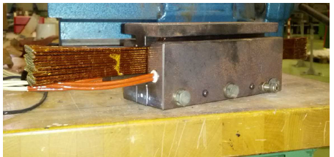
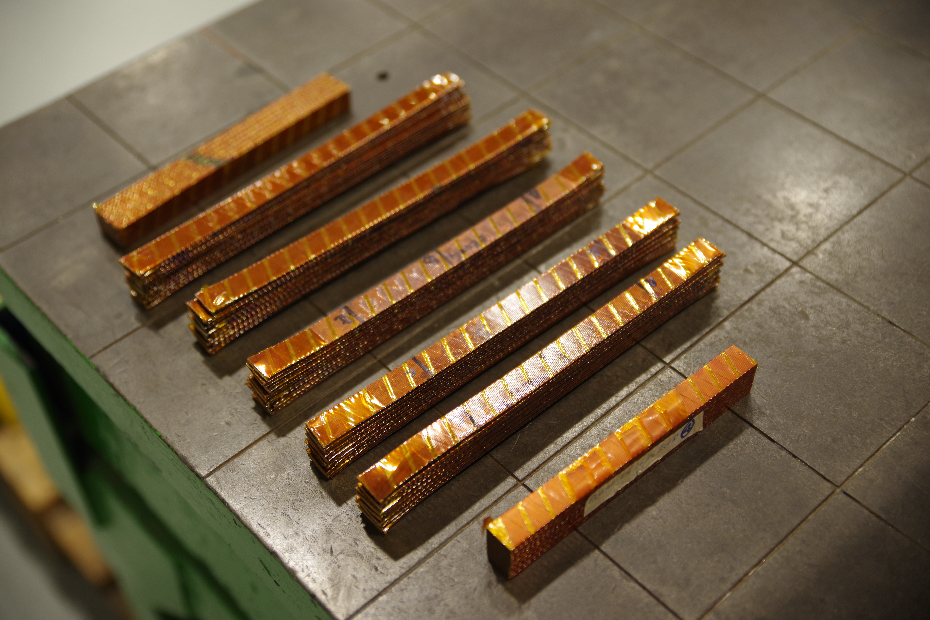
Conductor stacks (12 cables)
The stack test campaign is started
We are waiting for two information:
Dimensions of the conductor insulation after curing
Stress-strain curve (loading and unloading) of the conductor

Slide 8
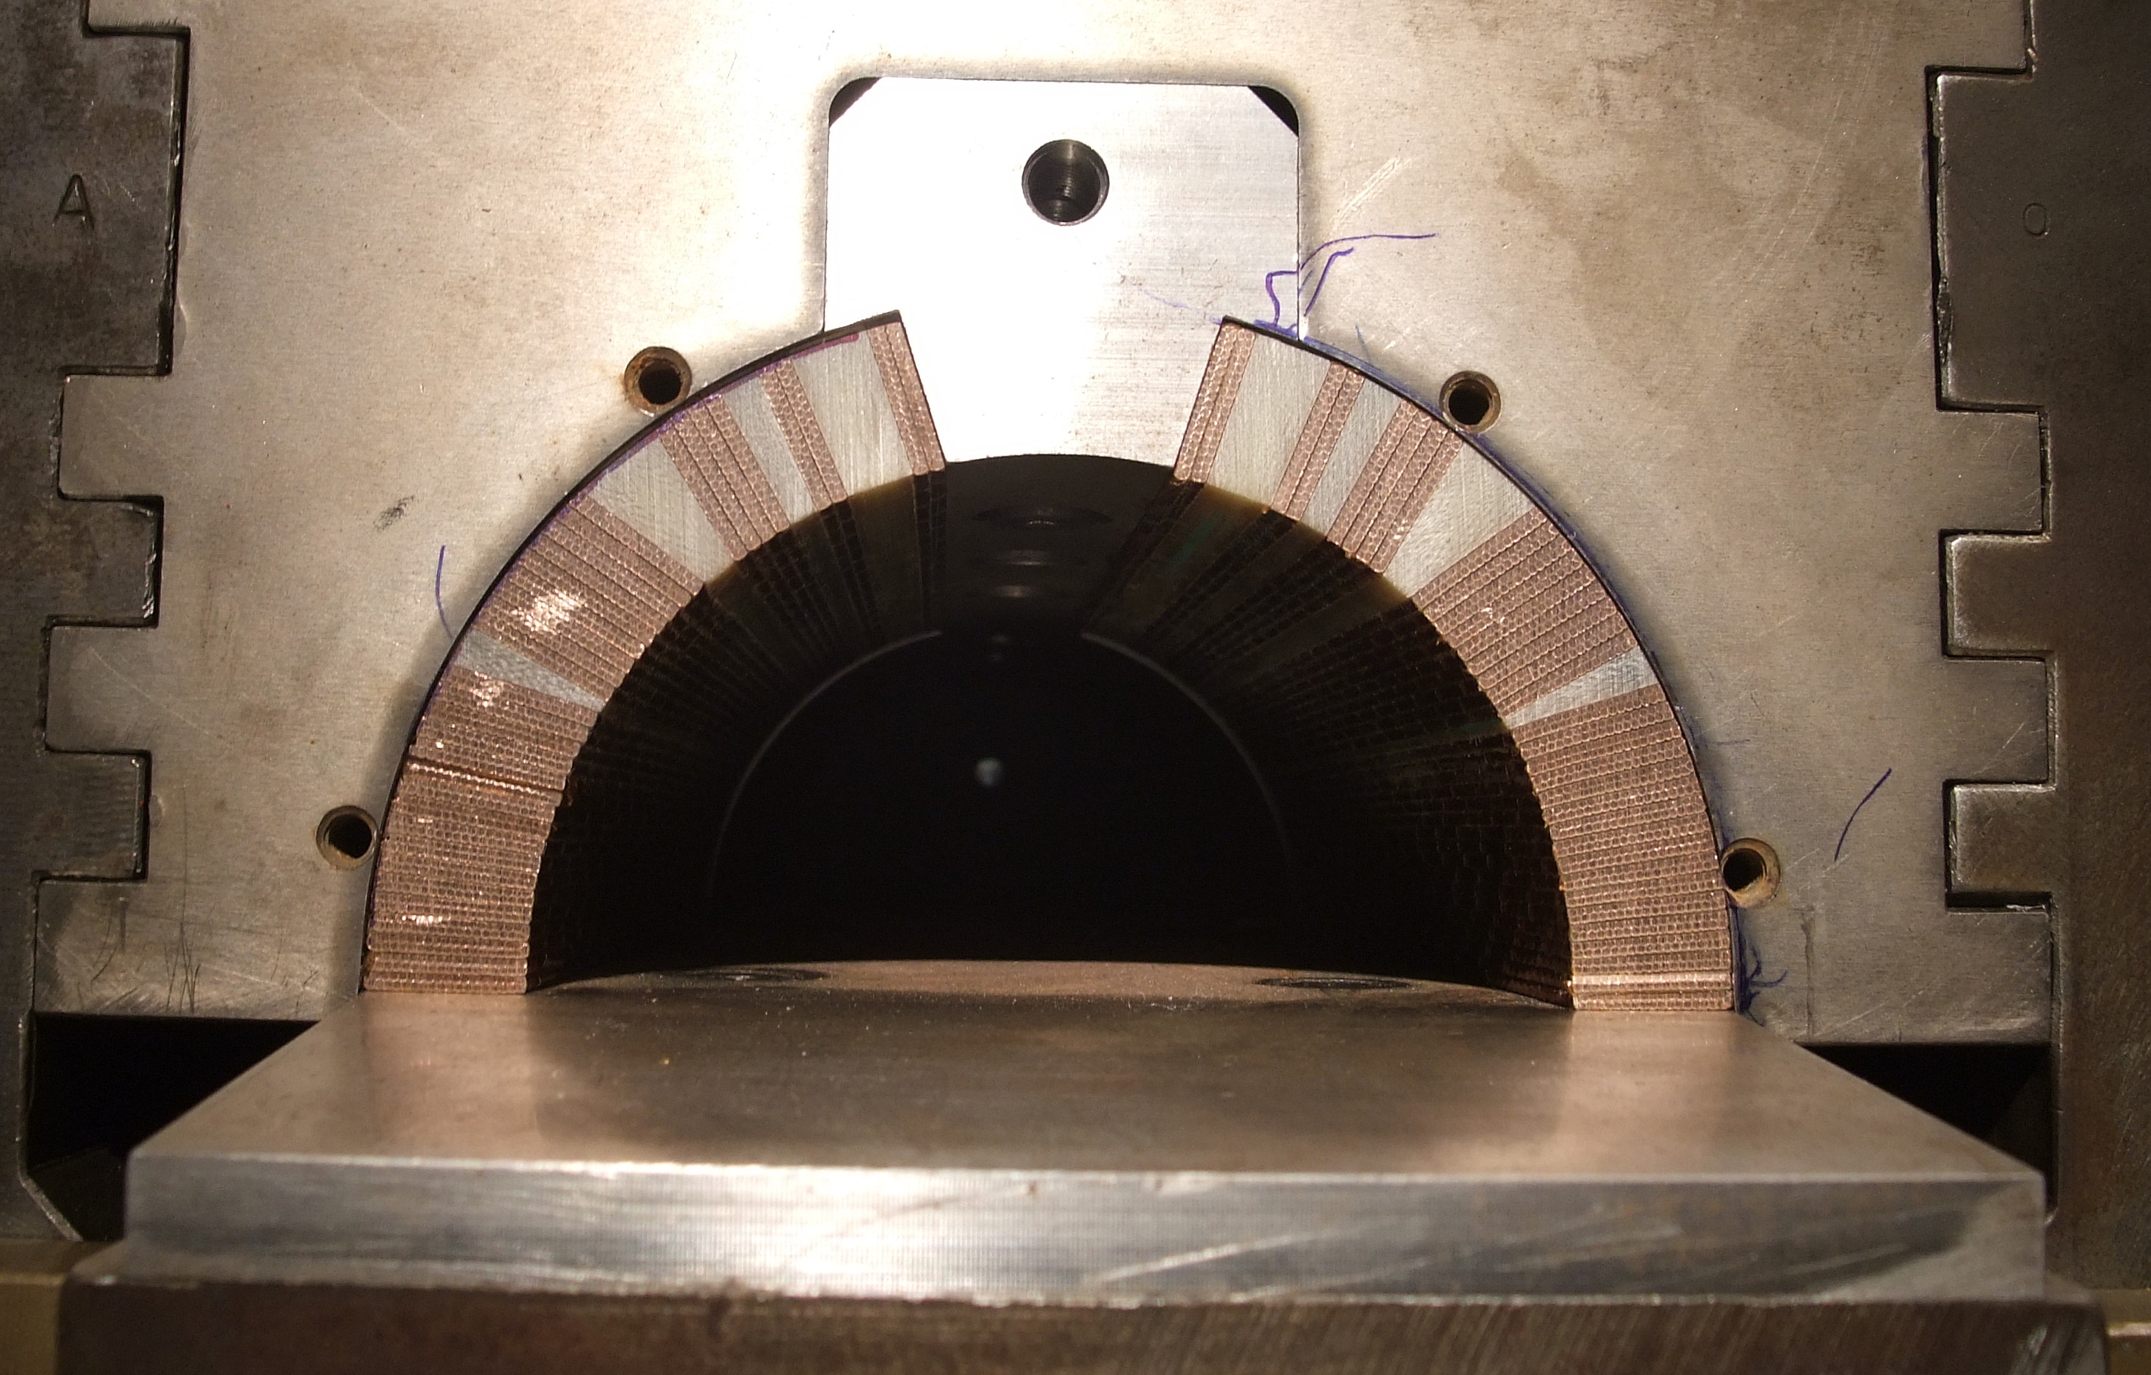
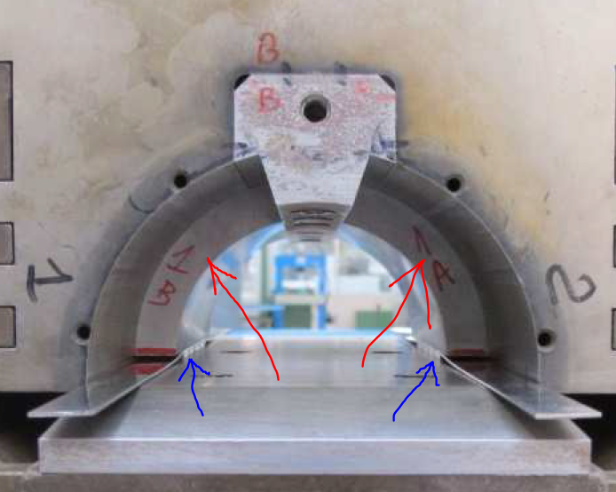
Mock-up (Arc piled conductors+wedges)
Example- SIS300
The tool is ready
As soon as the wedges will be available the mock-ups will be constructed and tested proving the input for parameters of the coil curing

Slide 9
Longitudinal wedges: From G11 to Copper
Design modification: After a remark by our collaboration that G11 (used in SIS300) can have, on long time, a degradation of mechanical properties, the risk to involve this material in D2 was considered too high and a decision to move to “classical” copper wedges (with poly-imide insulation) was taken (March 2017).
Issue: The sub-supplier of ASG Superconductor provided wedges (done by machining) out of specification (tolerance on thickness) .
Solution found: Involving a new sub-supplier using a different technique.
Consequences: The schedule is moving forward of some months.

Slide 10
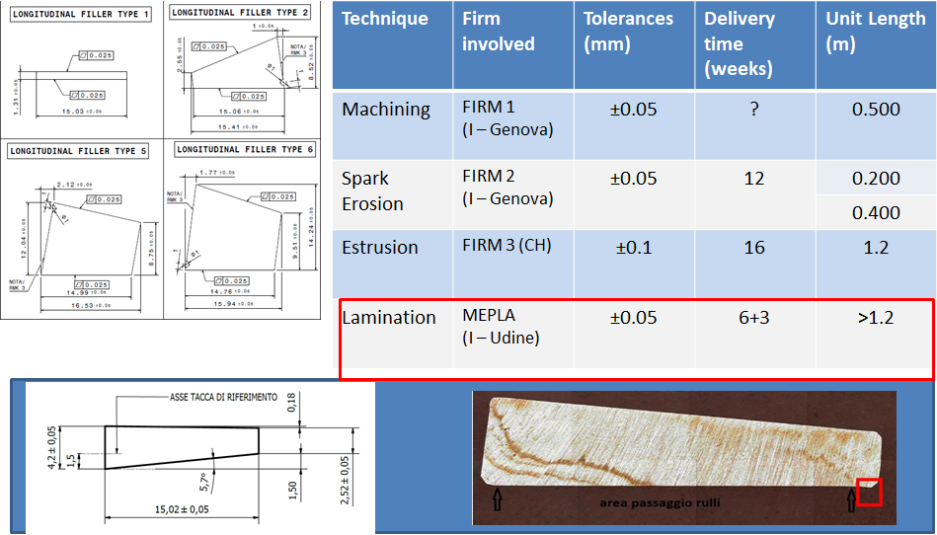
Copper wedges - 10 different types –
After failure of first sub-supplier
4 companies with different techniques involved. Two were qualified

Slide 11
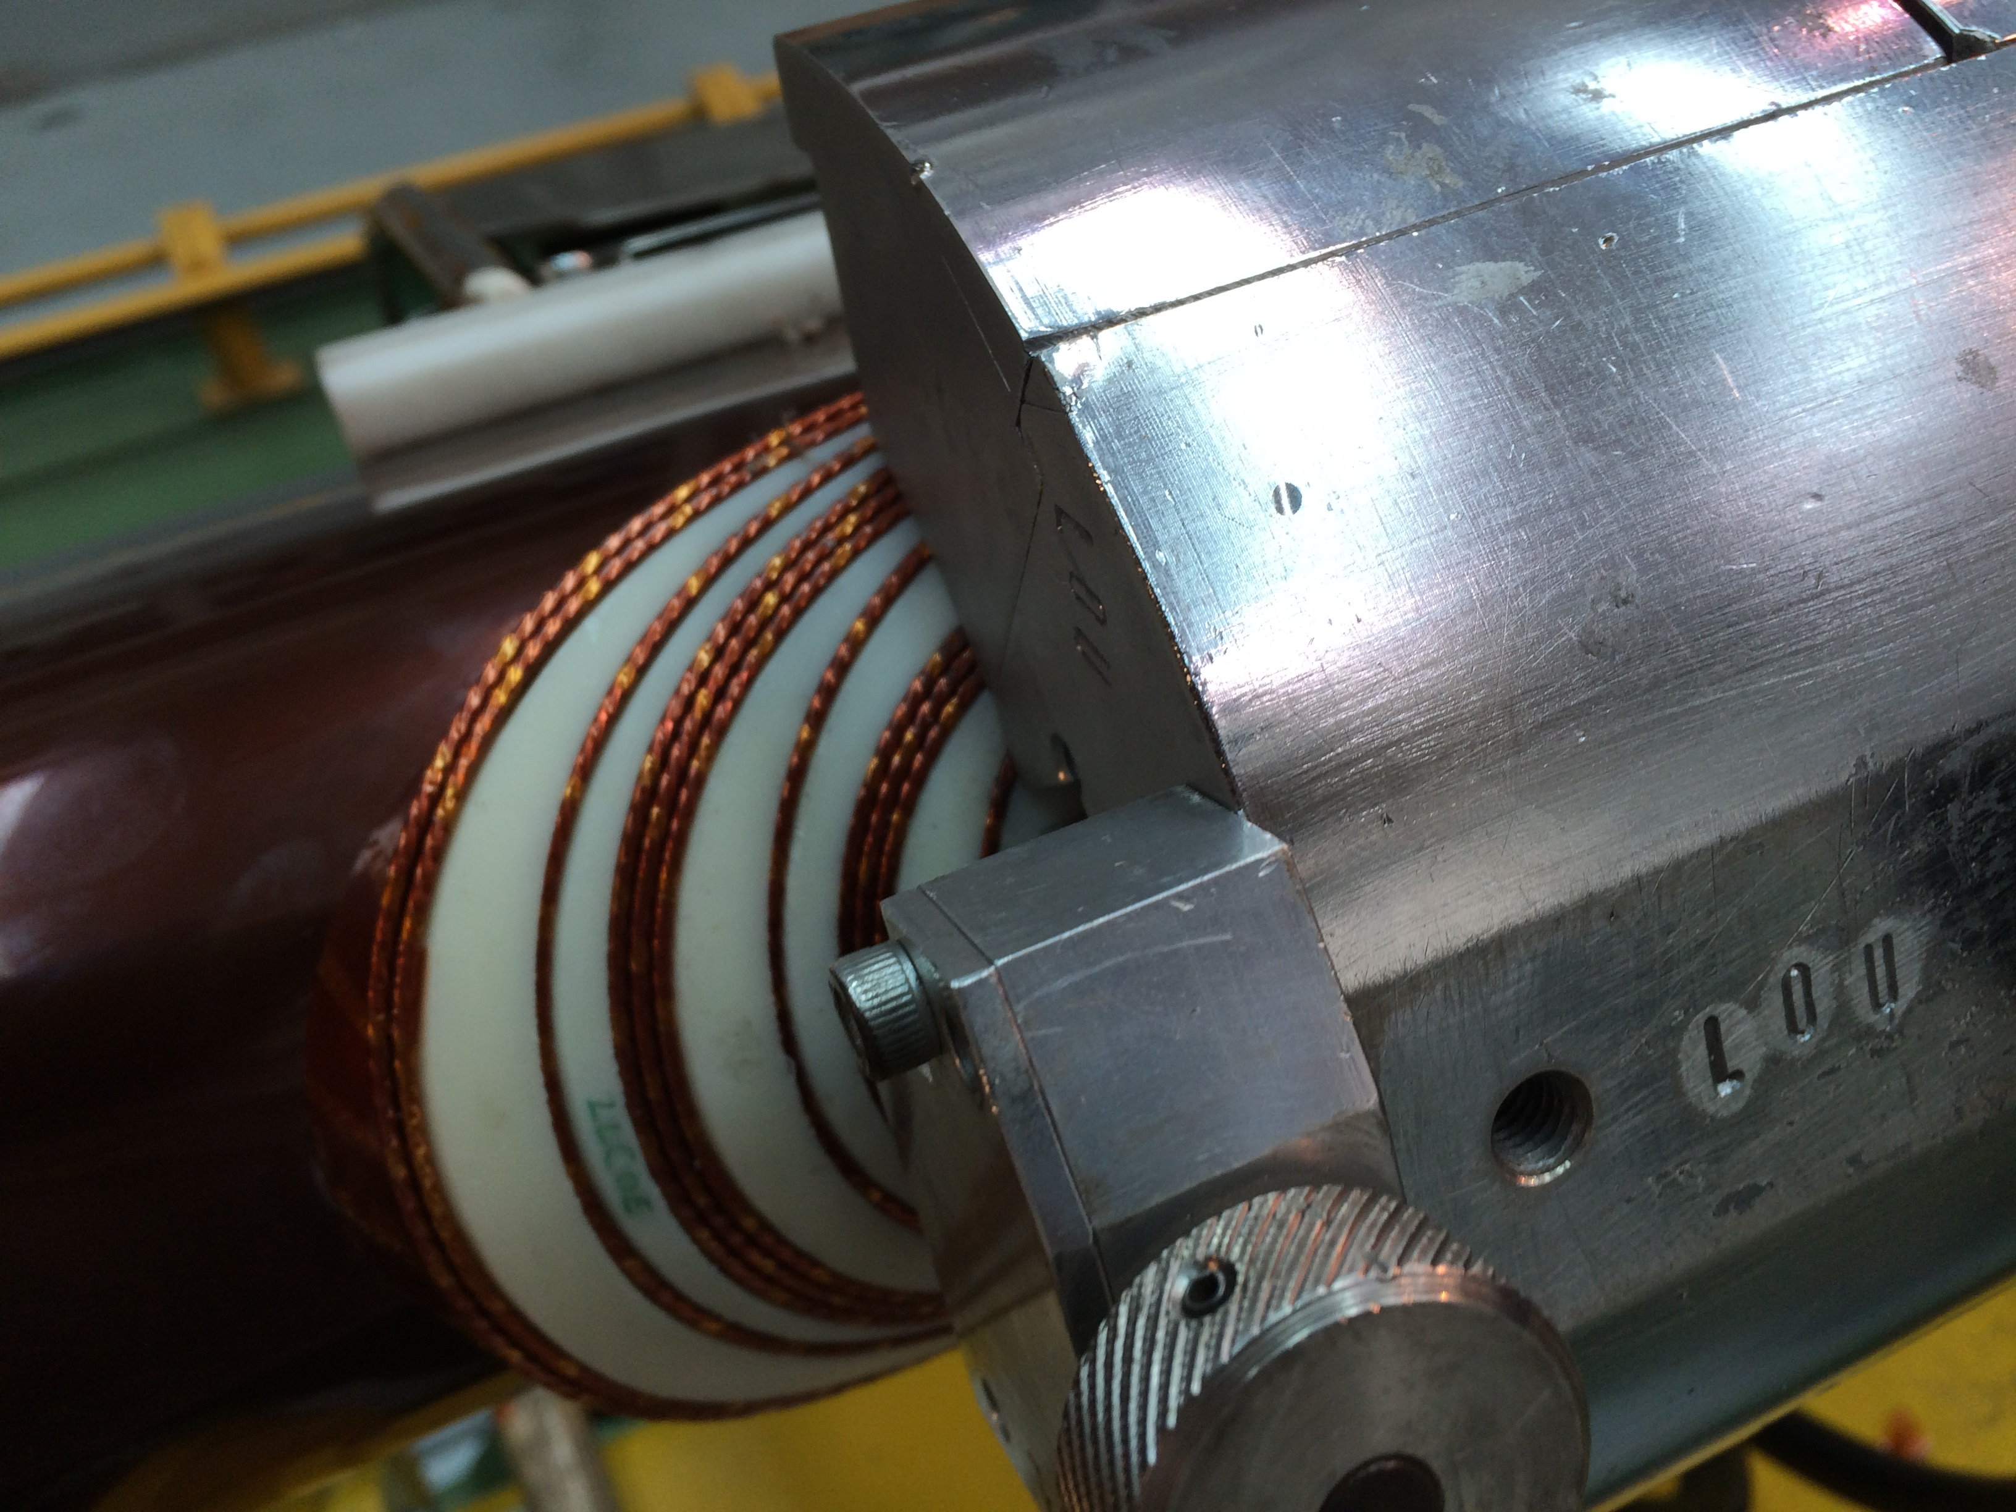
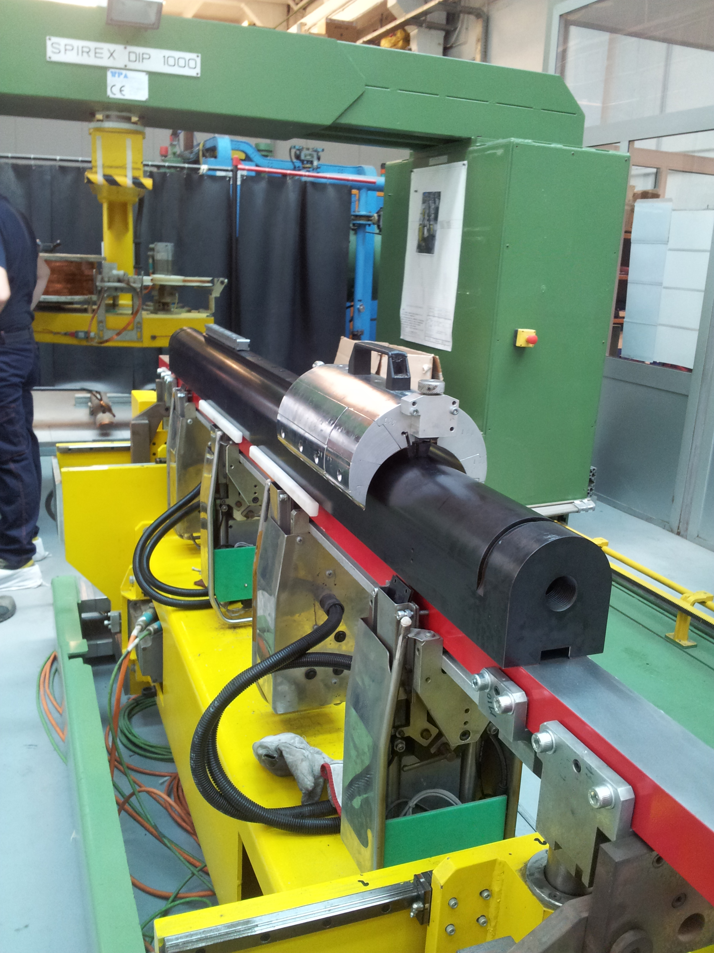
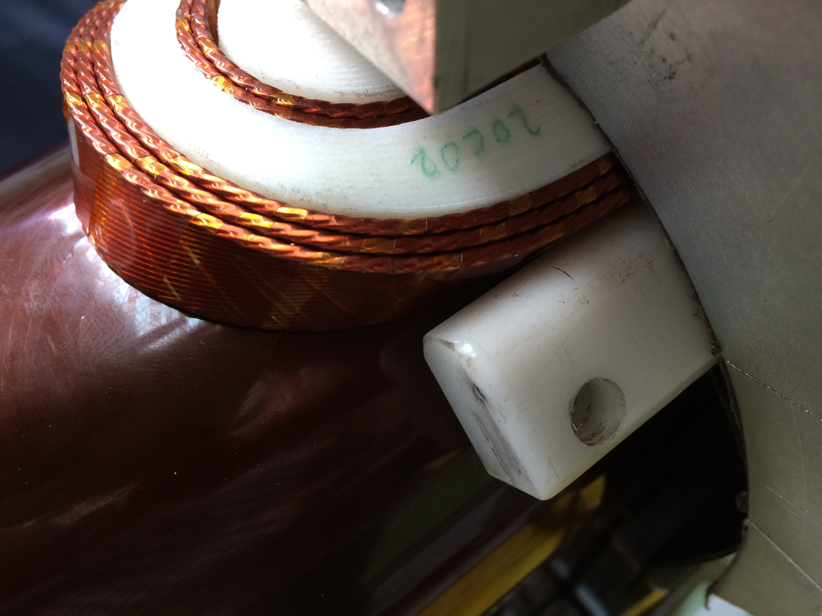
Winding test done using 3D printed wedges and end spacers

Slide 12
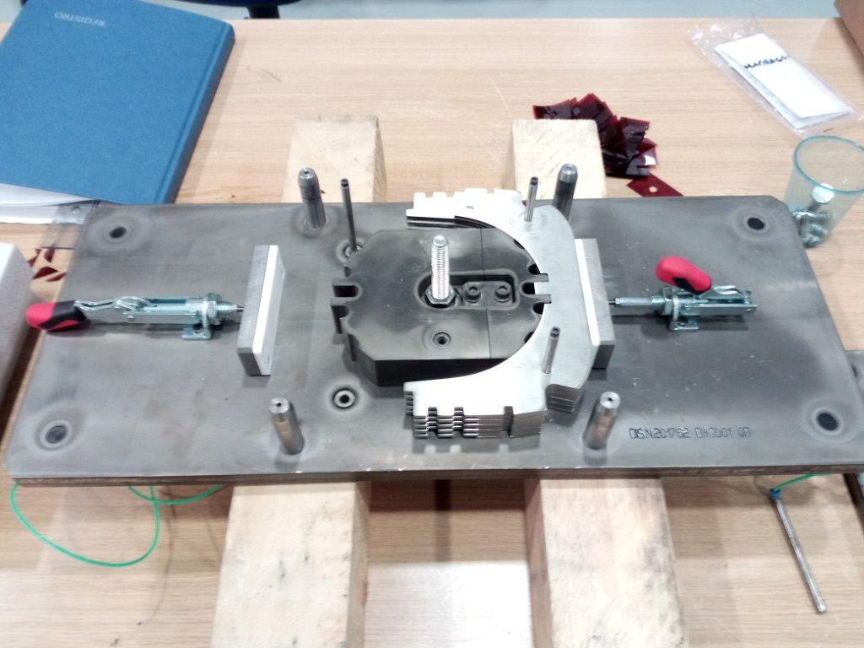
The collars for short model are done through laser cut + machining.
For prototype only fine blanking
Dimensional checks have given excellent results

Slide 13
Short Model Test at CERN
The test of the Short Model is under discussion since the «D2 Short model Cryogenic test interface meeting #01” held at CERN on June this year.
One important point is related to the type and number of sensors to be integrated into the short model. A complete list has been decided as well as the sharing CERN-ASG-INFN

Slide 14
From Short Model to Prototype
Activity | Planned
TDR and SPECS ready | October 31 2017
Request for tender to INFN | December 2017
Request for quotation | January 15 2018
Evaluation of offers | March 15 2018
Approval of tender | April 15 2018
Contract start | May 30 2018
Prototype delivery to CERN | October 2019 (agreed deadline CERN-INFN)
The TDR is a document with full description of prototype including drawings and design analyses (magnetics, mechanics, quench, interface ). It is close to be finalised.
Since some information will be available after mock-up and practice coil construction we are finalising TDR and SPEC within November end, with a temporary cross section
At the contract start we will provide the final information (see following slides)

Slide 15
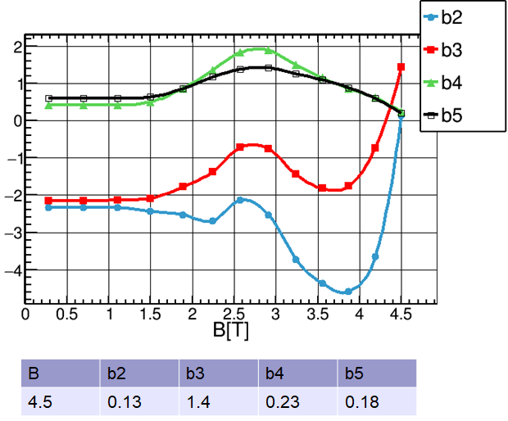
Fine tuning: short model – 2D Field quality – Magnetic model

Slide 16
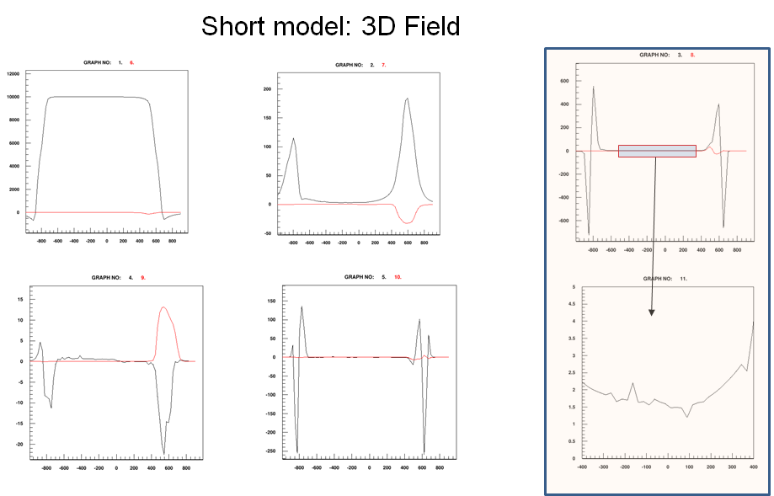
Short Model 3D Magnetic Field
We know that the 2D block lay-out shall be modified for accounting the coil end effects→ Small modifications of the block angles

Slide 17
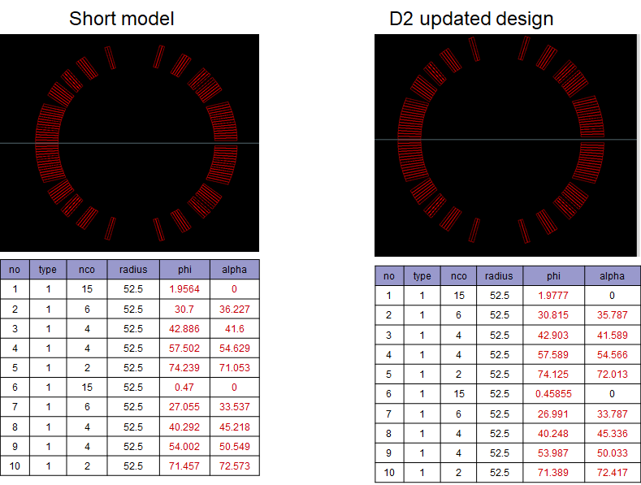
Design modifications from short model to prototype

Slide 18
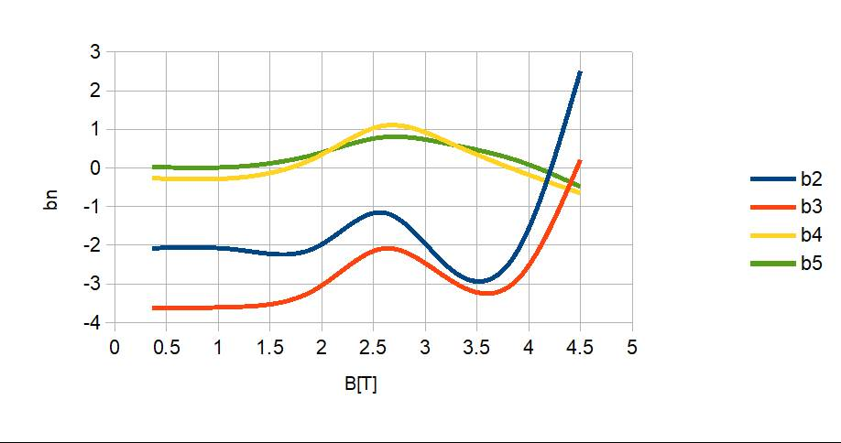
Prototype – Integrated field quality
Magnetic design considering coil end effects
All fine! But … the mechanical deformation modifies the cross section as well →

Slide 19
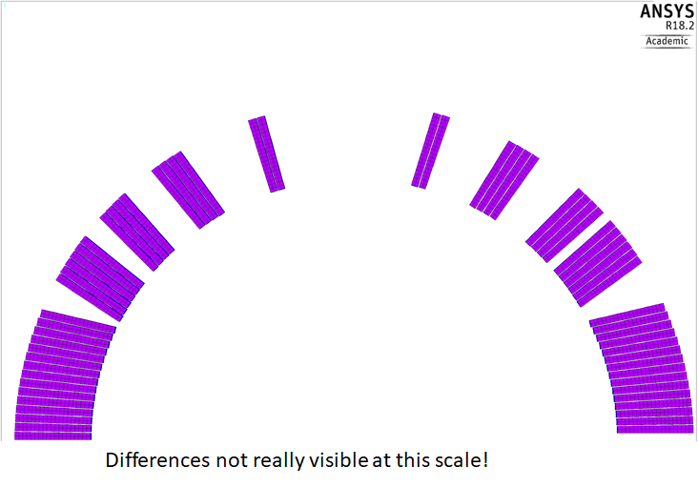
Short model cross section modifications due to mechanical effects
Roxie – magnetic model
ANSYS - mechanics

Slide 20
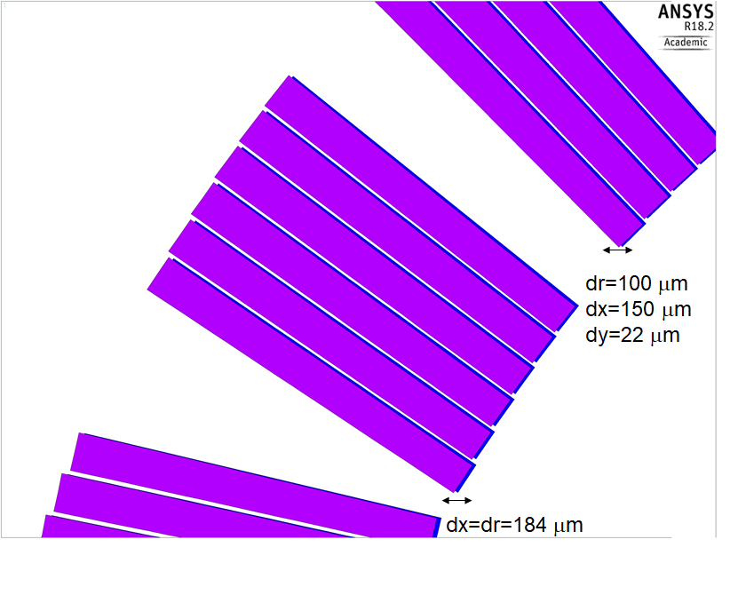
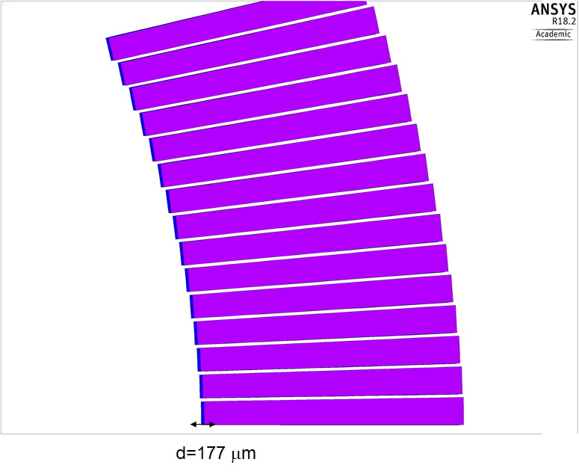
A more close view shows local modifications up to ~200 μm
A more close view shows local modifications up to ~200 μm
Roxie – magnetic model
ANSYS - mechanics

Slide 21
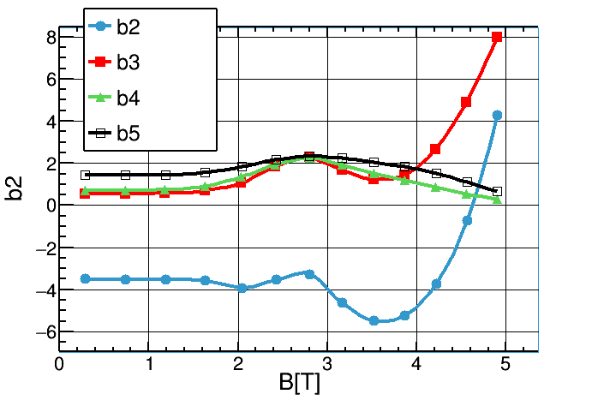
Short model – 2D Field quality (Roxie) – After mechanical deformation
We are able to modify the 2D cross section for accounting the modifications given by the mechanical deformation. Final decision after more progresses of the short model construction (better knowledge of the coil mechanical properties)

Slide 22
Activities for finalising the contract for the prototype construction
Technically, we wait for stacking tests and freeze the prototype cross section for TDR and SPEC not including the modifications required for accounting the computed mechanical deformations.
We need to finalise two further documents:
  Contract Terms and Conditions (including deposit, guarantee, warranty, penalties, ..);
  The criteria used for evaluating the offers.
Together TDR and SPEC, the above documents must be approved by INFN Council and no more amendable
We will launch the tender phase on January 2018 with the aim to have a formal start of the contract on June 2018.
We can provide the final cross section at the latest in July 2018 or after the two apertures have been at least integrated into the Al-sleeves

Slide 23
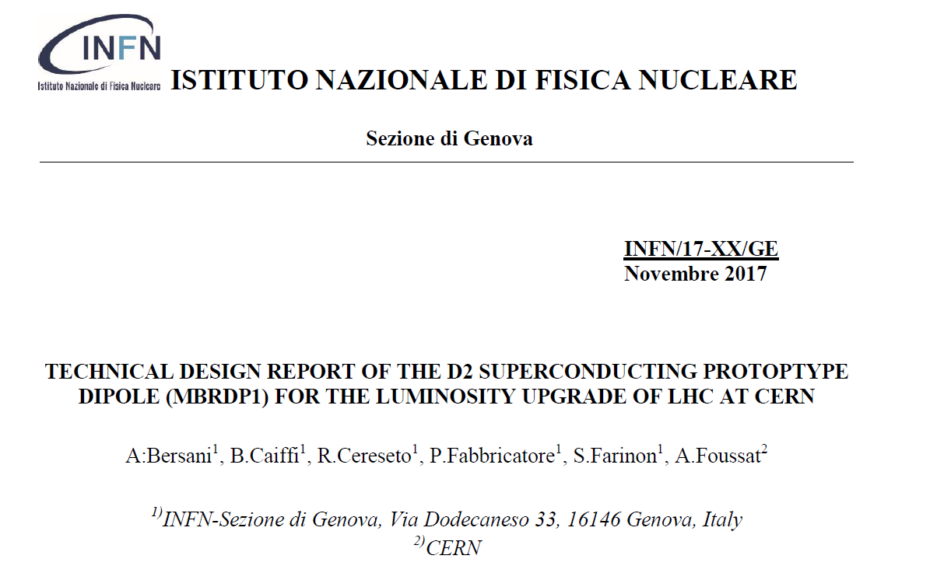
TDR

Slide 24
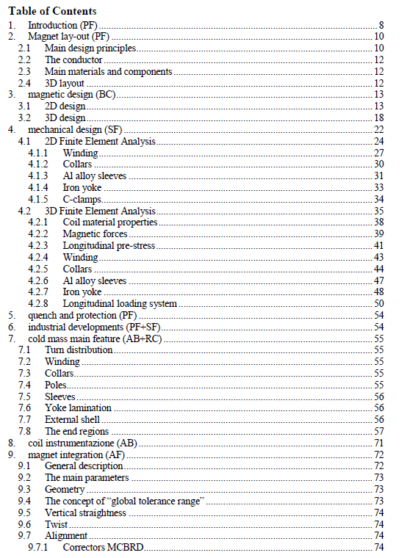
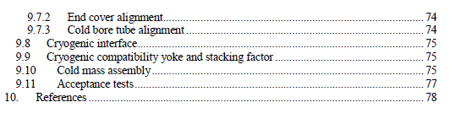
TDR
Outline

Slide 25
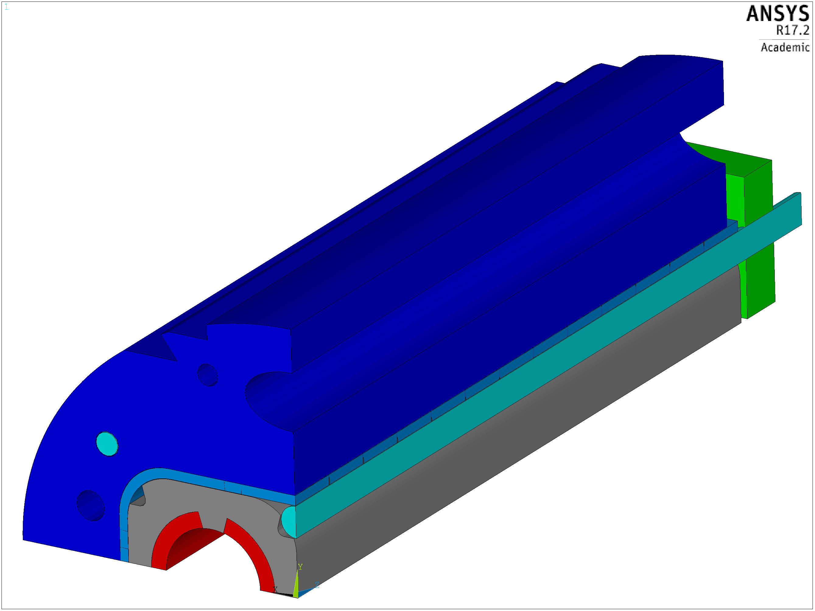
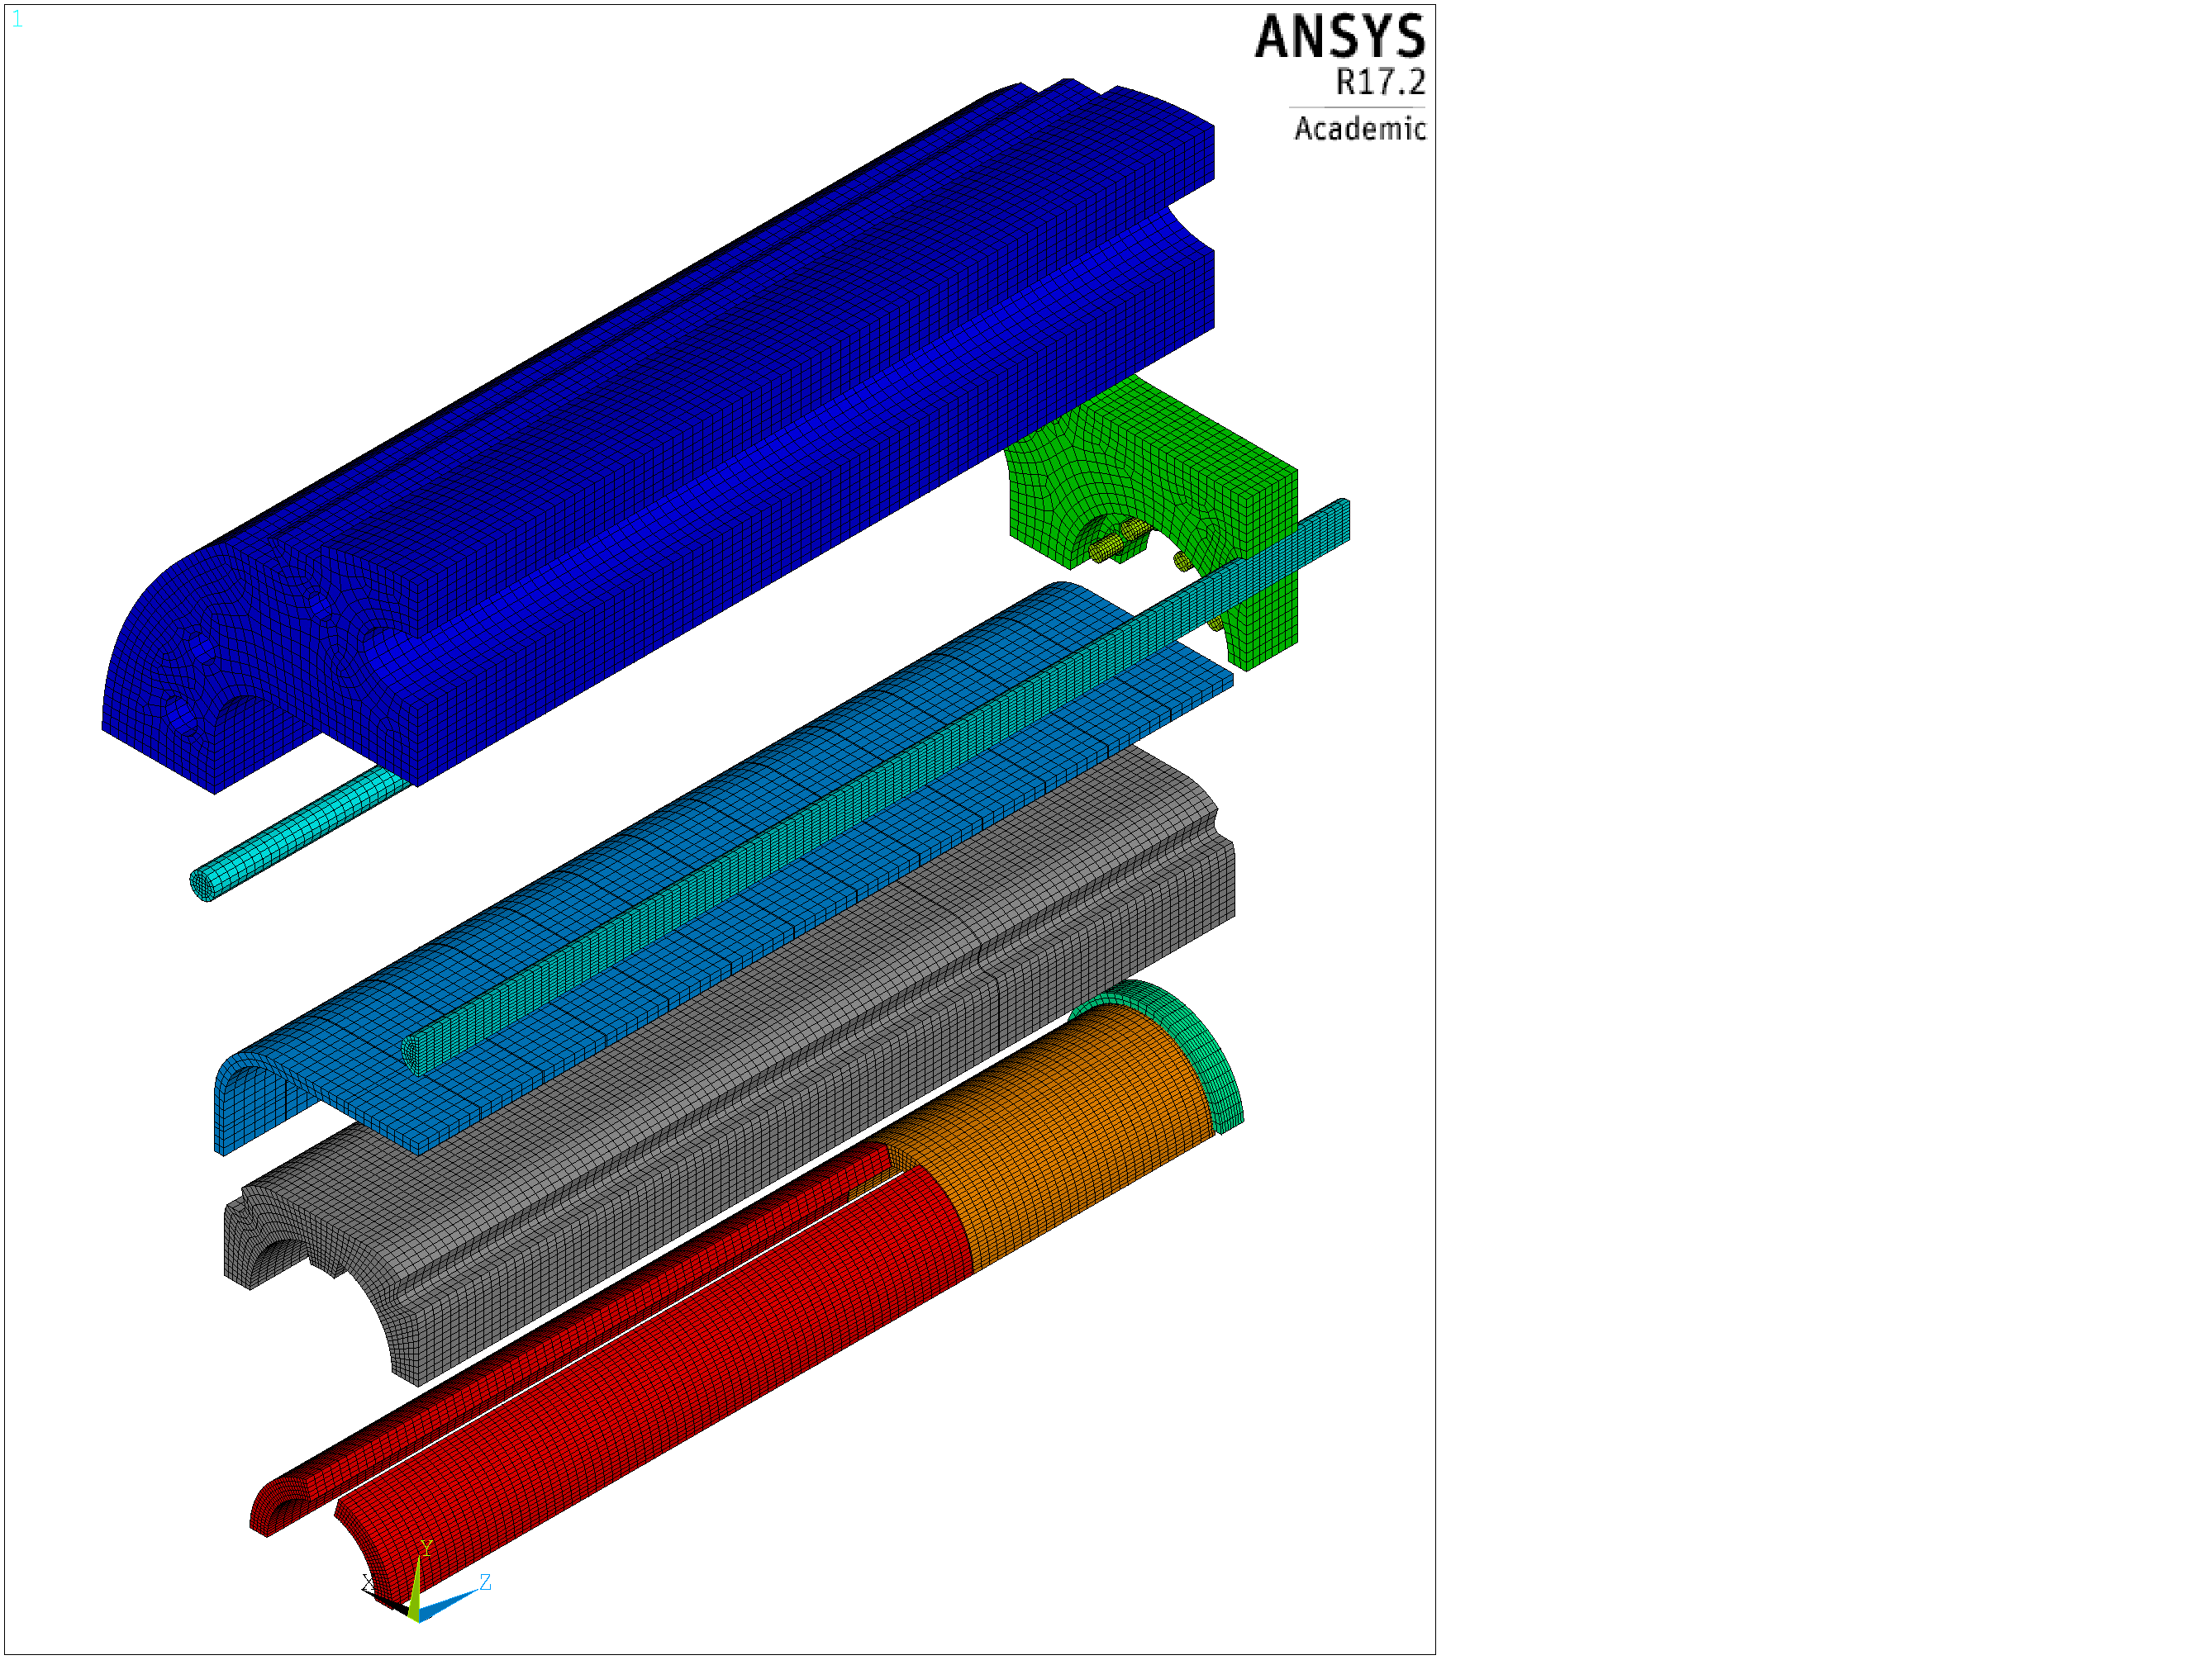
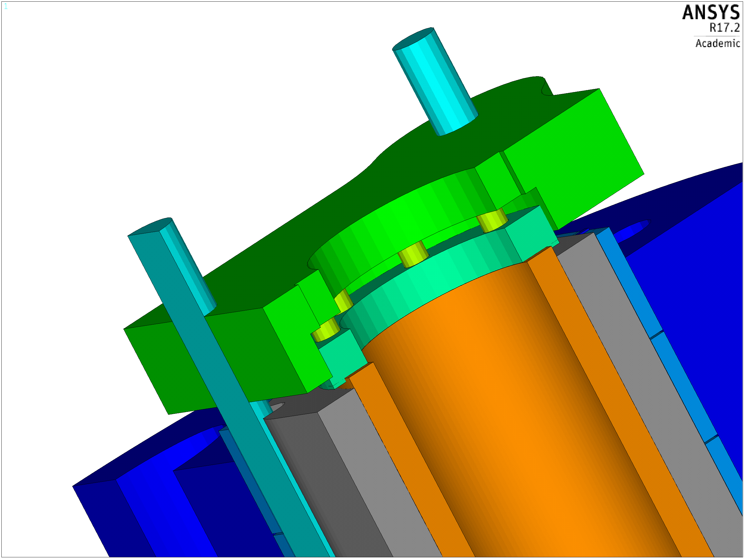
Models for FE analysis

Slide 27
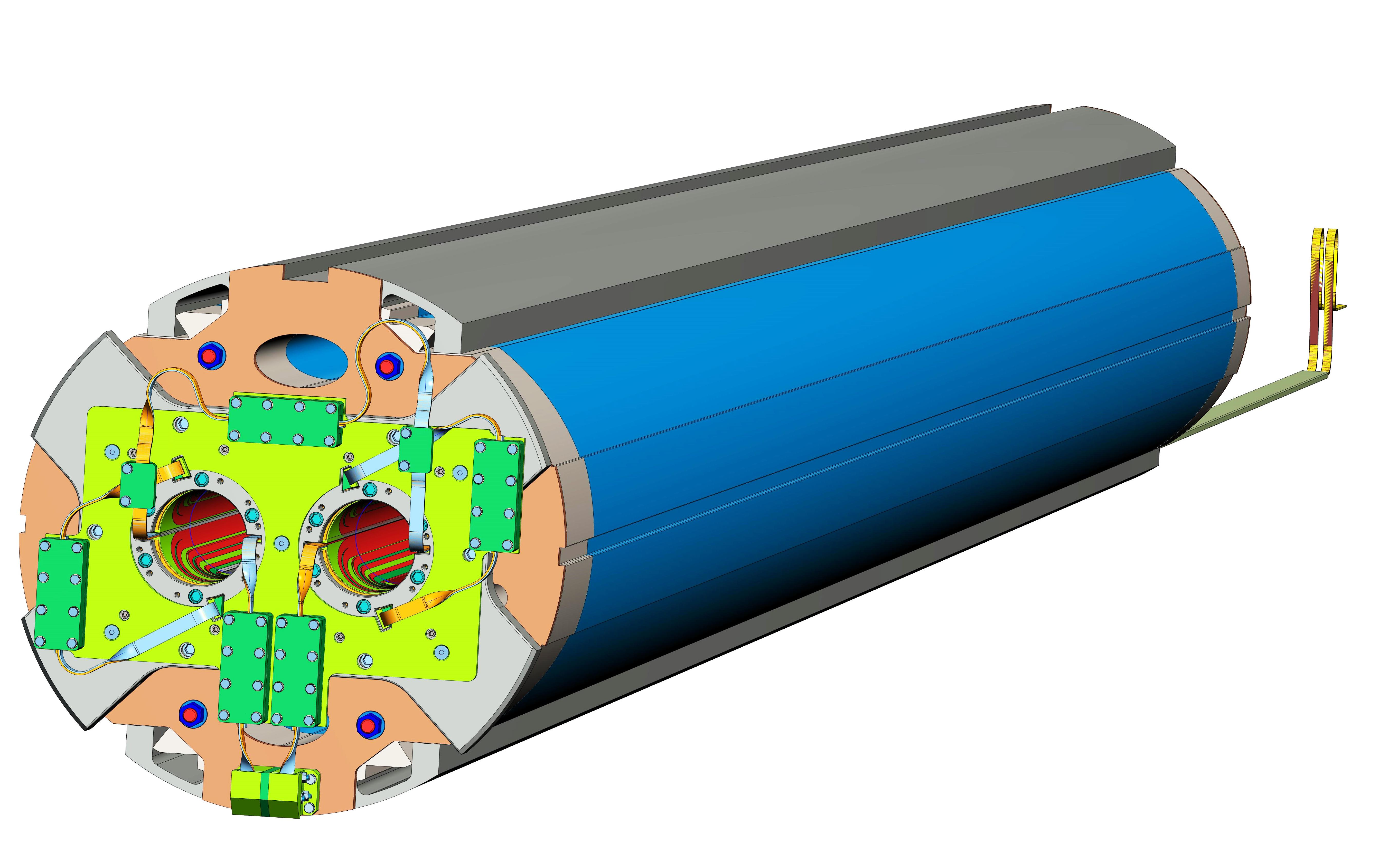
The D2 prototype (MBRDP1)

Slide 28
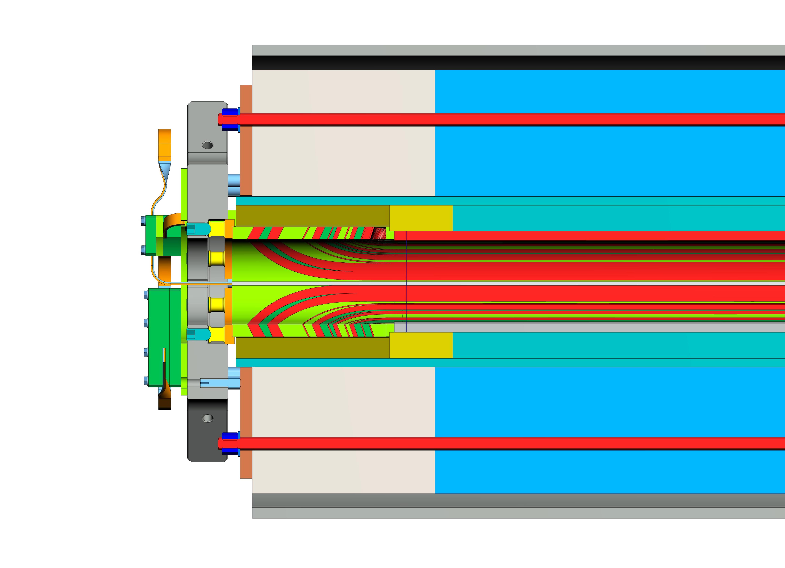
MBRDP1: Detail of the end magnet (connection side)

Slide 29
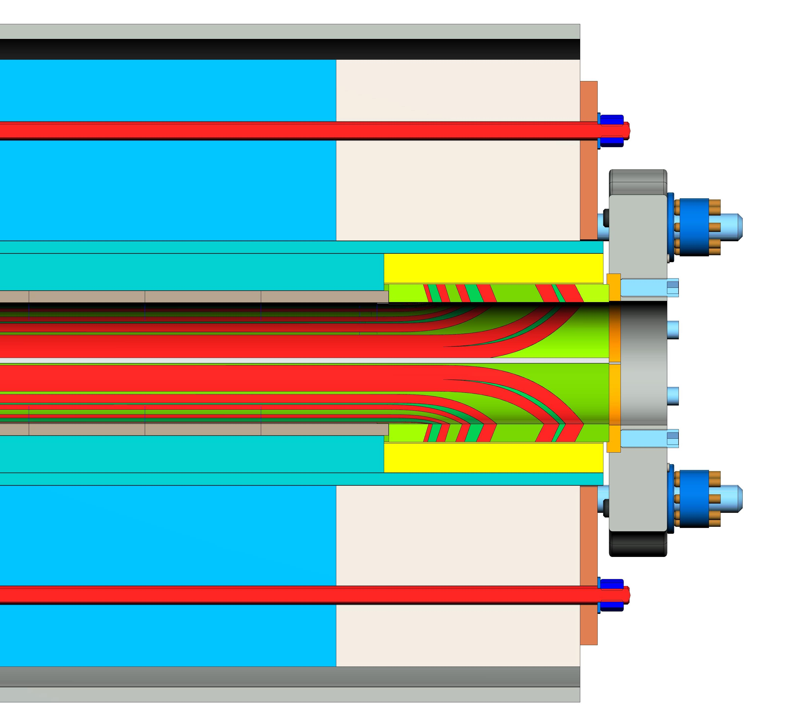
MBRDP1: Detail of the end magnet
(opposite connection side)

Slide 30

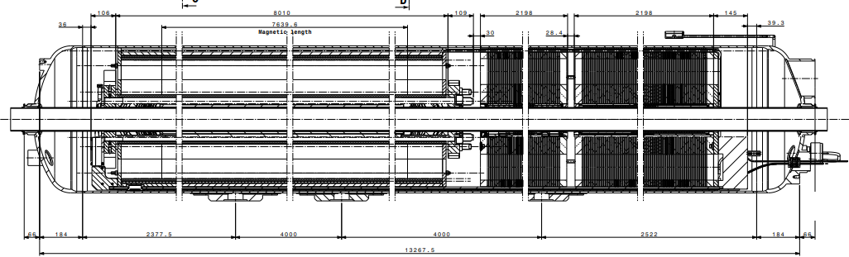
Short model and LMBRD integration
Short model cold test design in SM18 and instrumentation plan under finalization
Design assembly drawings of LMBRD cold mass (CM) including MCBRD CCT correctors is complete.
  Start procurement of cold mass parts (long shells, end covers) and qualification bus tests from 2018
  Pending interfaces design of in-cryostat cryogenics piping, new heat exchanger.
  Next CM assembly sequence drawings, associated press tooling under study
  Large LMBRD handling tooling under procurement
On going design of cold mass welded parts, prototyping tests, inspection plan per EN13445 following PED Directive 2014/68/EU requirements

Slide 31
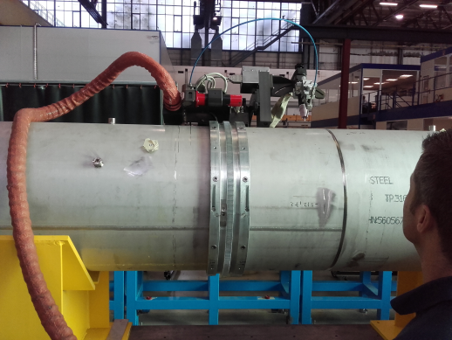
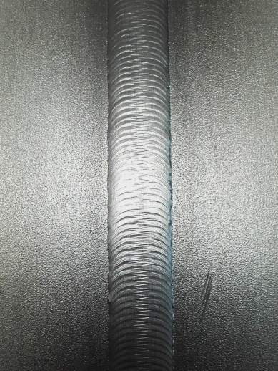
LMBRD Assembly tooling
  Cold mass assembly sequence drawings under CAD work (MSC-LMF) [1]
  Welding press equipment tooling for OD630 mm under study ( common to MQX-F)
  Large LMBRD 30 t handling tooling under procurement (common to MQX-F) by Dec 2017. [2]
  Alternative orbital TIG welding back-up solution to the long 14 m shell recently tested. [3]
  [2]
  [3]
  [1]
-Pasquale Fabbricatore -7th HL-LHC Collaboration Meeting - CIEMAT 14th November 2017
31

Slide 32
Conclusions
The Short Model (MBRDS1) is under construction at ASG Superconductors. The delivery to CERN (May 2018) can shift due to some issues with copper wedges procurement.
The set-up for test at CERN has been agreed (including instrumentation)
The documentation for launching tender for prototype (MBRDP1) in January 2018 is under preparation and close to be finalised. Some drawings will be preliminary (final drawings at the contract start)
The integration of D2 was studied in detail

Slide 33
Thank you for your attention

