Slide 1



Status of MQYY
Helene Felice for the MQYY team
CEA: D. Simon, M. Segreti, J.M. Rifflet, A. Madur, S. Somsom, R. Machado-Correia, A. Bonelli, J.M. Gheller, D. Bouziat, A. Acker, P. Graffin, H. Neyrial
CERN: : A. Foussat, J. C. Perez, N. Bourcey, L. Fiscarelli, O. Dunkel, G. Kirby, J. Fleiter, E. Todesco, M. Guinchard, P. Gros-Claude, P. Viret
QUACO team: M. Lossasso, I. Bejar-Alonso, F. Toral, T. Martinez, P. Krawczyk, R. Nietubic
14th November 2017 – HL-LHC Collaboration Meeting 2017

Slide 2
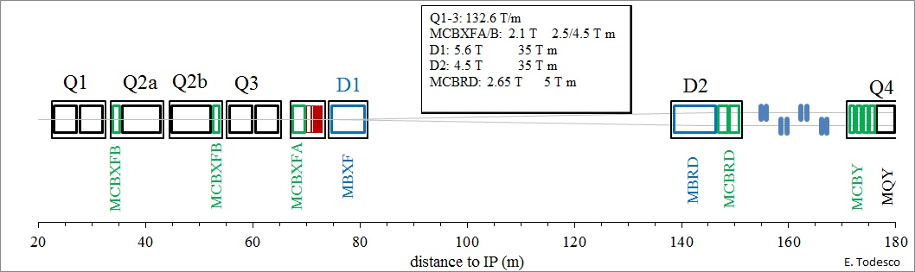
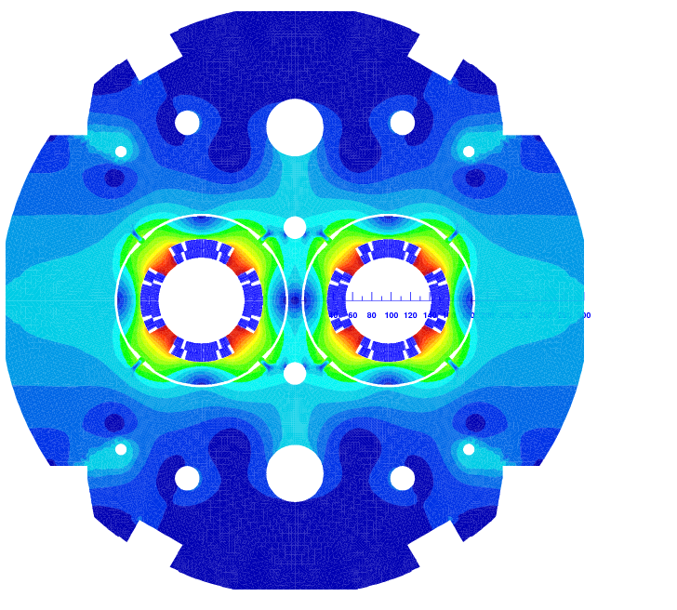
History of MQYY development
Q4 is the LHC MQY, double aperture quadrupole with 70 mm aperture
Layout of the magnets close to the interaction point
Initial HL-LHC baseline: use of MQYY, a new double aperture quadrupole with 90 mm aperture
2011: CEA- CERN initiative (J.M. Rifflet et M. Segreti) within the High Lumi design study (FR contribution)
March 2014: CERN/CEA collaboration agreement => activities on MQYY (WP2)
September 2015: Formal decision to change the cable
June 2016:
  Decision to keep MQY to reduce cost (MQYY out of the baseline)
  Decision to continue with the development of MQYY short model and prototype
    Updated CEA-CERN collaboration content: Single aperture model MQYYM developed by CEA and CERN
    Parallel development: two prototypes developed in the QUACO initiative

Slide 3
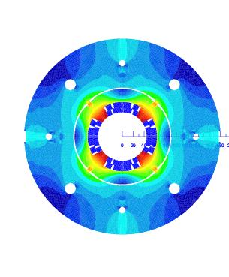

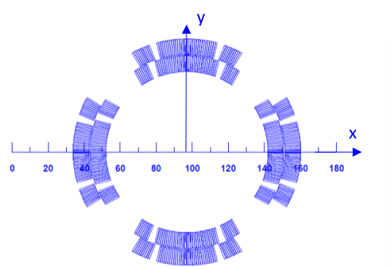
Short Model and Prototypes
2 different paths
MQYYM Expected to be completed and tested by end of 2018
11/2016
11/2017
08/2018
05/2020
Concept. Design
PHASE 1
4 months
11/2016 to 03/2017
Engineering Design
PHASE 2
13 months
07/2017 to 08/2018
Manufacturing
PHASE 3
18 months
11/2018 to 05/2020
Baseline magnetic design provided but not imposed
ROXIE provided without the BEM FEM module
Mechanical support structure design up to companies

Slide 4
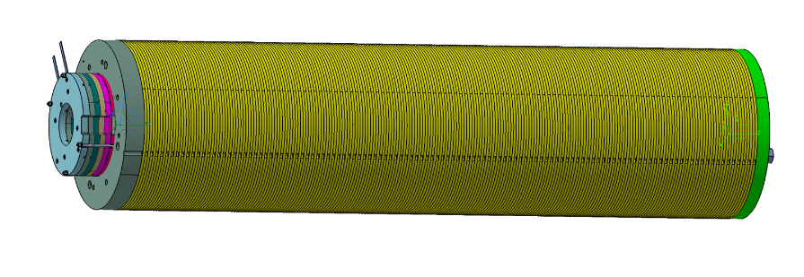
Overview of MQYYM
MQYY
Physical length | 1350 mm
Magnetic length at 1.9 K | 1204 mm
Outer diameter | 360 mm
Bare cable width | 8.8 mm
Bare cable thickness | 0.77/0.91 mm
Insulation thickness at nominal | 0.080 mm
Short sample current | 5980 A
Operating Gradient | 120 T/m
Operating current | 4550 A
Bpeak at operation | 6.42 T
Loadline margin | 23 %
Prestress level | 60 MPa
MQYYM

Slide 5
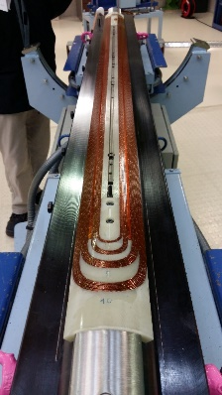
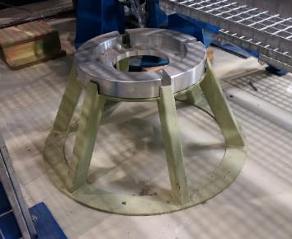
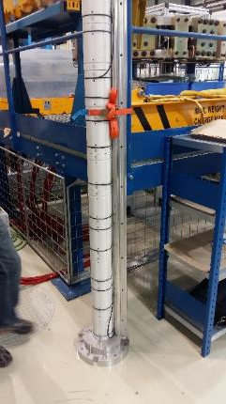
MQYYM Manufacturing plan
Conductor from CERN
  Insulated conductors for 10 coils at CEA
Coils fabricated at CEA/Saclay
  Winding and polymerization
  Coil instrumentation
Assembly will be performed at CERN (927) by CEA team supported by 927 team
  Collaring using 927 collaring press
  Connection box assembly
  Yoking
  Warm Magnetic measurements
All components designed by CEA
All interface tooling or specific tooling designed by CEA. Design is supported/reviewed by N.Bourcey and J.C. Perez
  Winding tooling
  Assembly tooling (based on CERN exisiting tooling)
  Coil measuring tooling (based on CERN exisiting tooling)
  GPI forming tooling
  …
Procurement
  < 5 kCHF: order placed directly by CEA
  > 5 kCHF: procurement through CERN but followed by CEA
    Writing of a CERN spec by CEA team
    Nordine Azizi / Arnaud Foussat (CERN)
    Hubert Neyrial / Hélène Felice (CEA)
Most of the orders

Slide 6
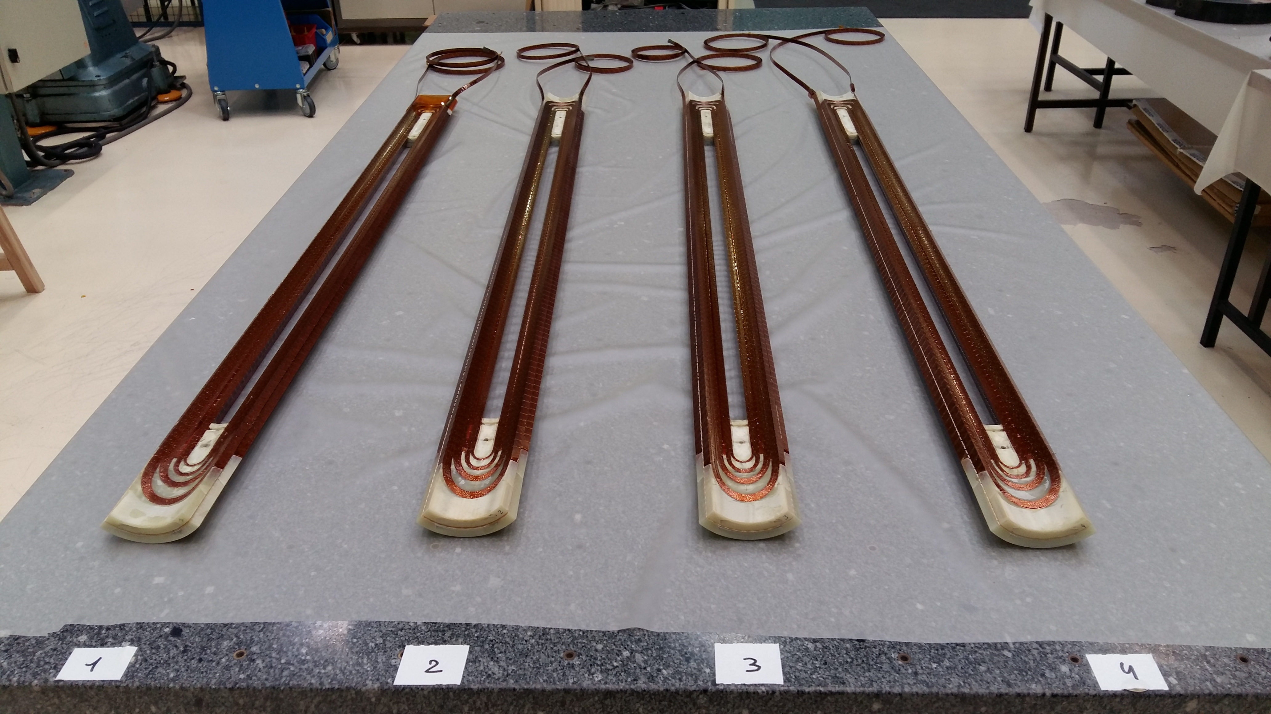
Coil Fabrication status
 | Fabrication dates
Coil 0 | 22/03-27/04/2017
Coil 1 | 17-31/07/2017
Coil 2 | 4-14/09/2017
Coil 3 | 15-29/09/2017
Coil 4 | 23-31/10/2017
Coil 5 | 27/11-9/12/2017
Coil 6 | 8-19/01/2018
Coil 7 | 5-16/02/2018
Initial plan in agreement: 10 coils
Cable at CEA for 10 coils
End parts manufactured for 8 coils (coils 0 to 7)
5 coils made: coil 0 + coils 1 to 4
Discussion to be planned on final number of coils to manufacture
  Minimum proposal: Coils 5 and 6 => MQYYM proposal: coils 2/3/5/6

Slide 7
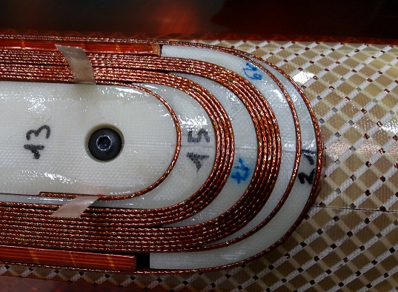
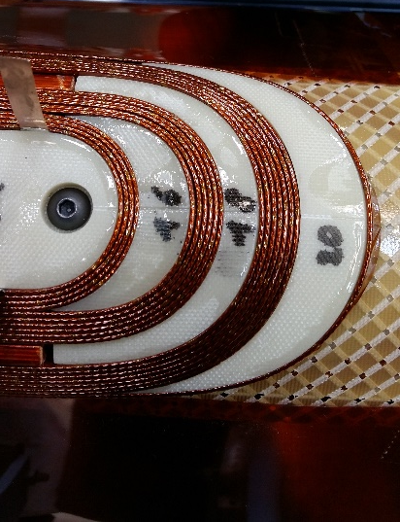
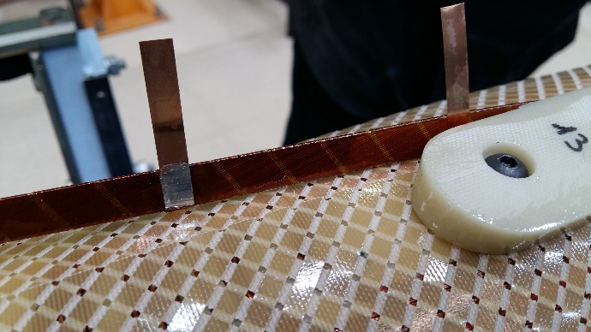
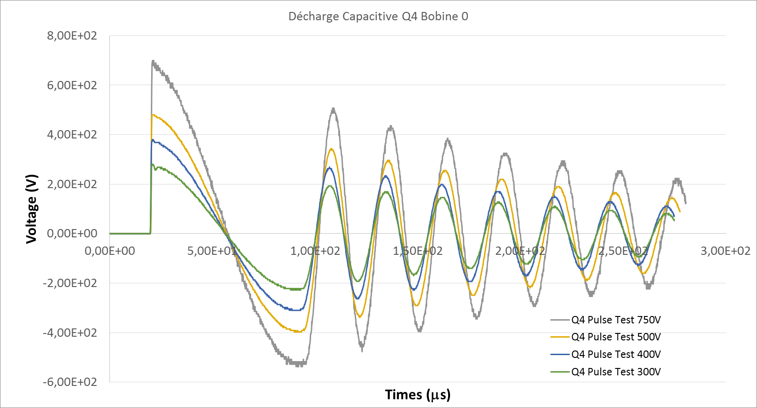
Fabrication: coil 0
Good matching of the coil parts with the winding
CuBe Broken flags after polymerization
=> Require smoothing of the sharp edges to avoid damaging the flags
Impulse test showing change of frequency as V increases
=> Turn to turn weakness?
likely due to the weld of the vtaps using Tin Indium solder (fusion T < polymerization T!)
Layer 2 winding
Soldered vtaps

Slide 8
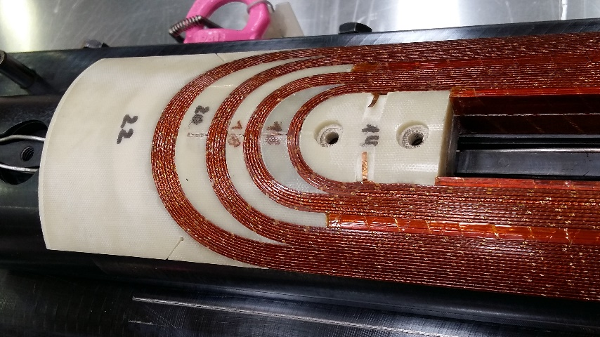
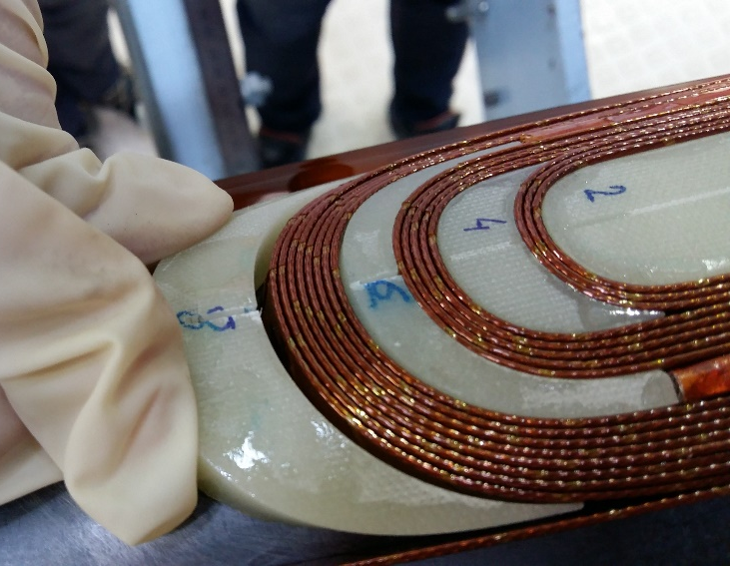
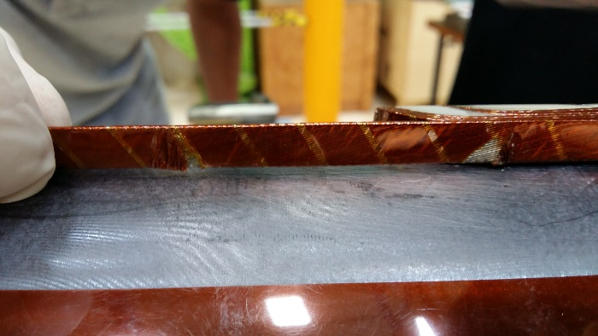
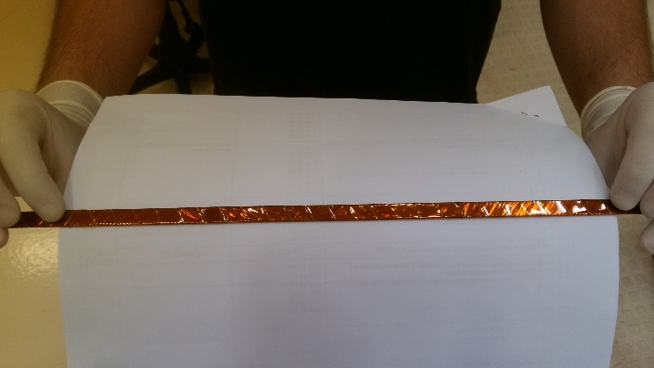
Coil 1
Vtaps:
  narrower CuSn₆ flags and SnAg solder
  Grooves added in the end part
Slit in some of the spacers, filled with G10 pieces before polymerization
Finalization of procedures for insulation of angular wedges
Coil 1
Coil 1

Slide 9
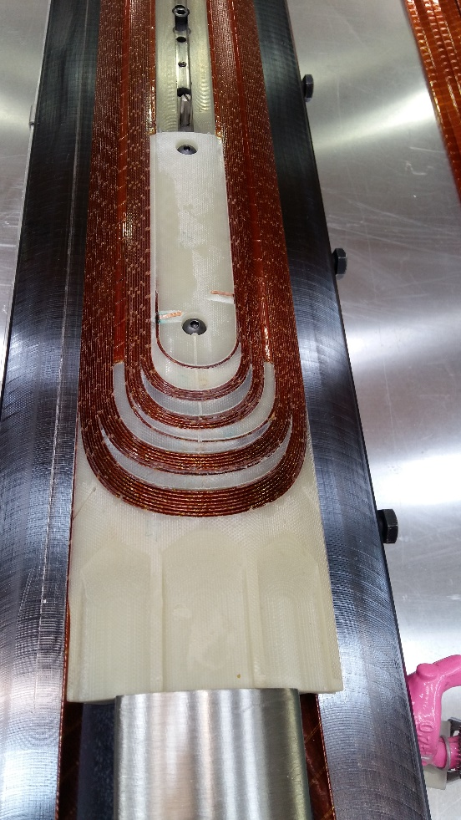
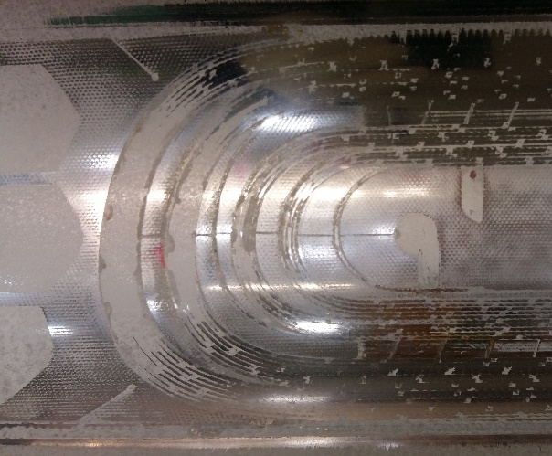
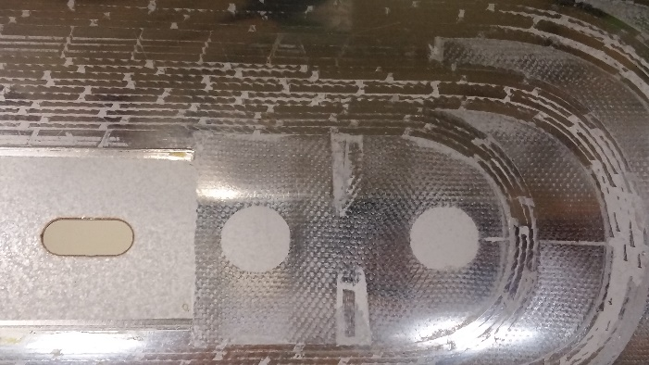
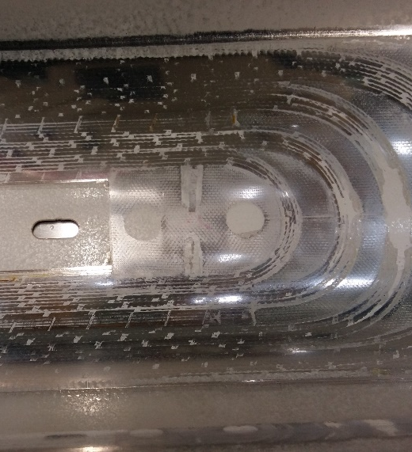
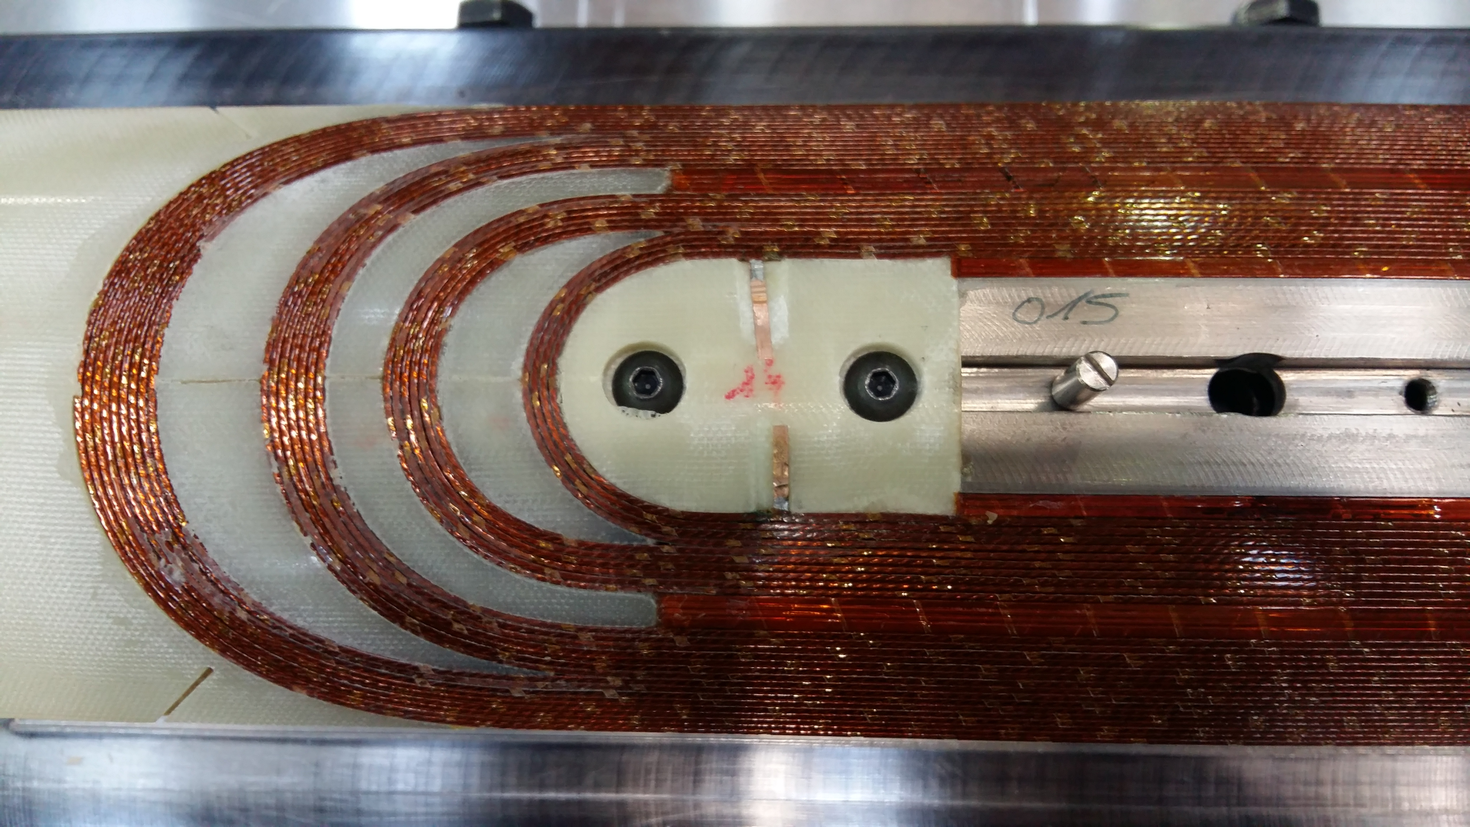
Coil 2 to 3
Coil 2
No major issue during coil fabrication of coil 2 and 3
Concern on vtap flags: grooves are not deep enough => some compression of the taps
Coil 2
Coil 3
OK
Coil 3
Coil 3
NOT OK

Slide 10
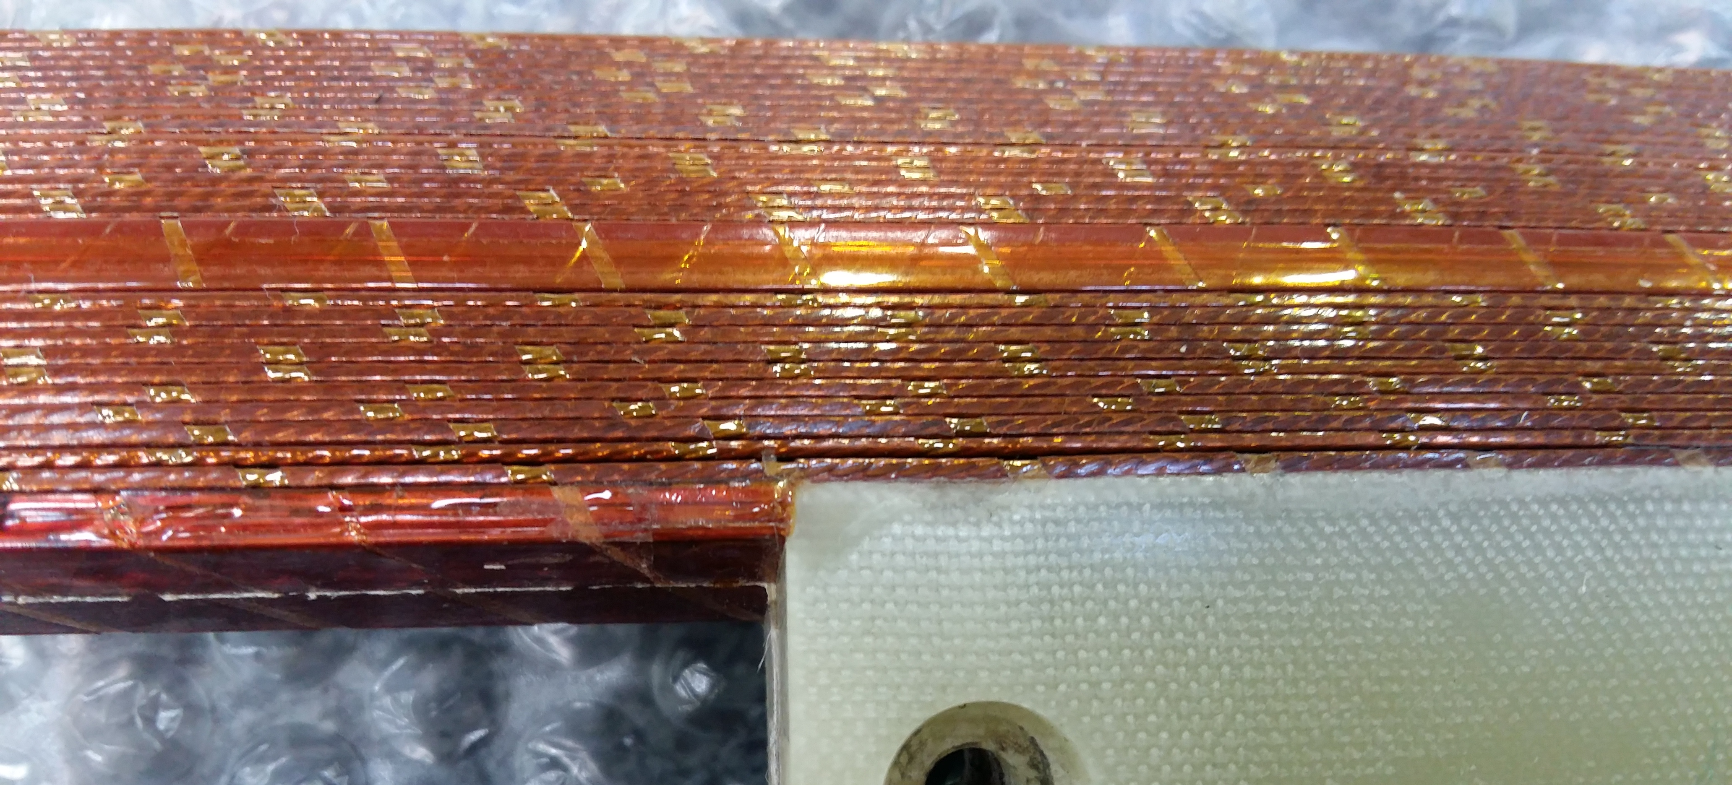
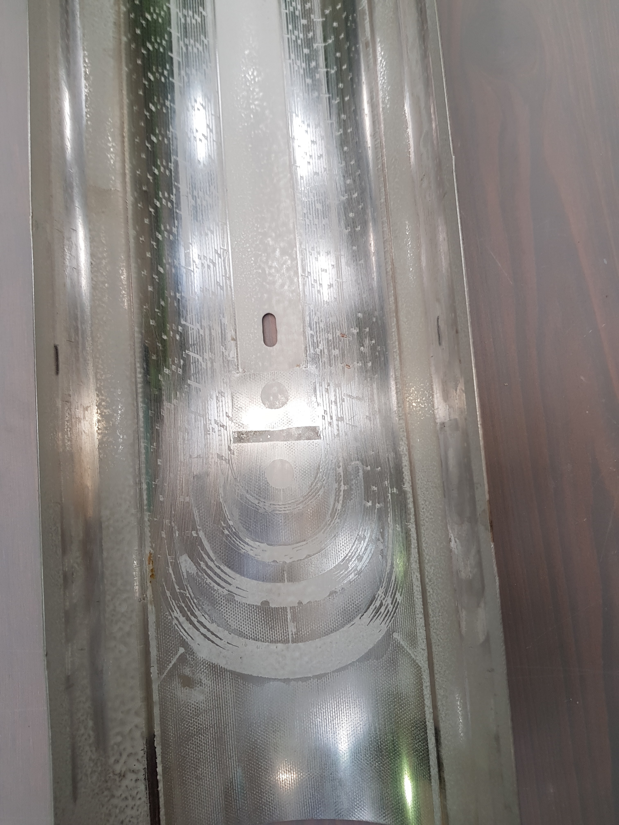
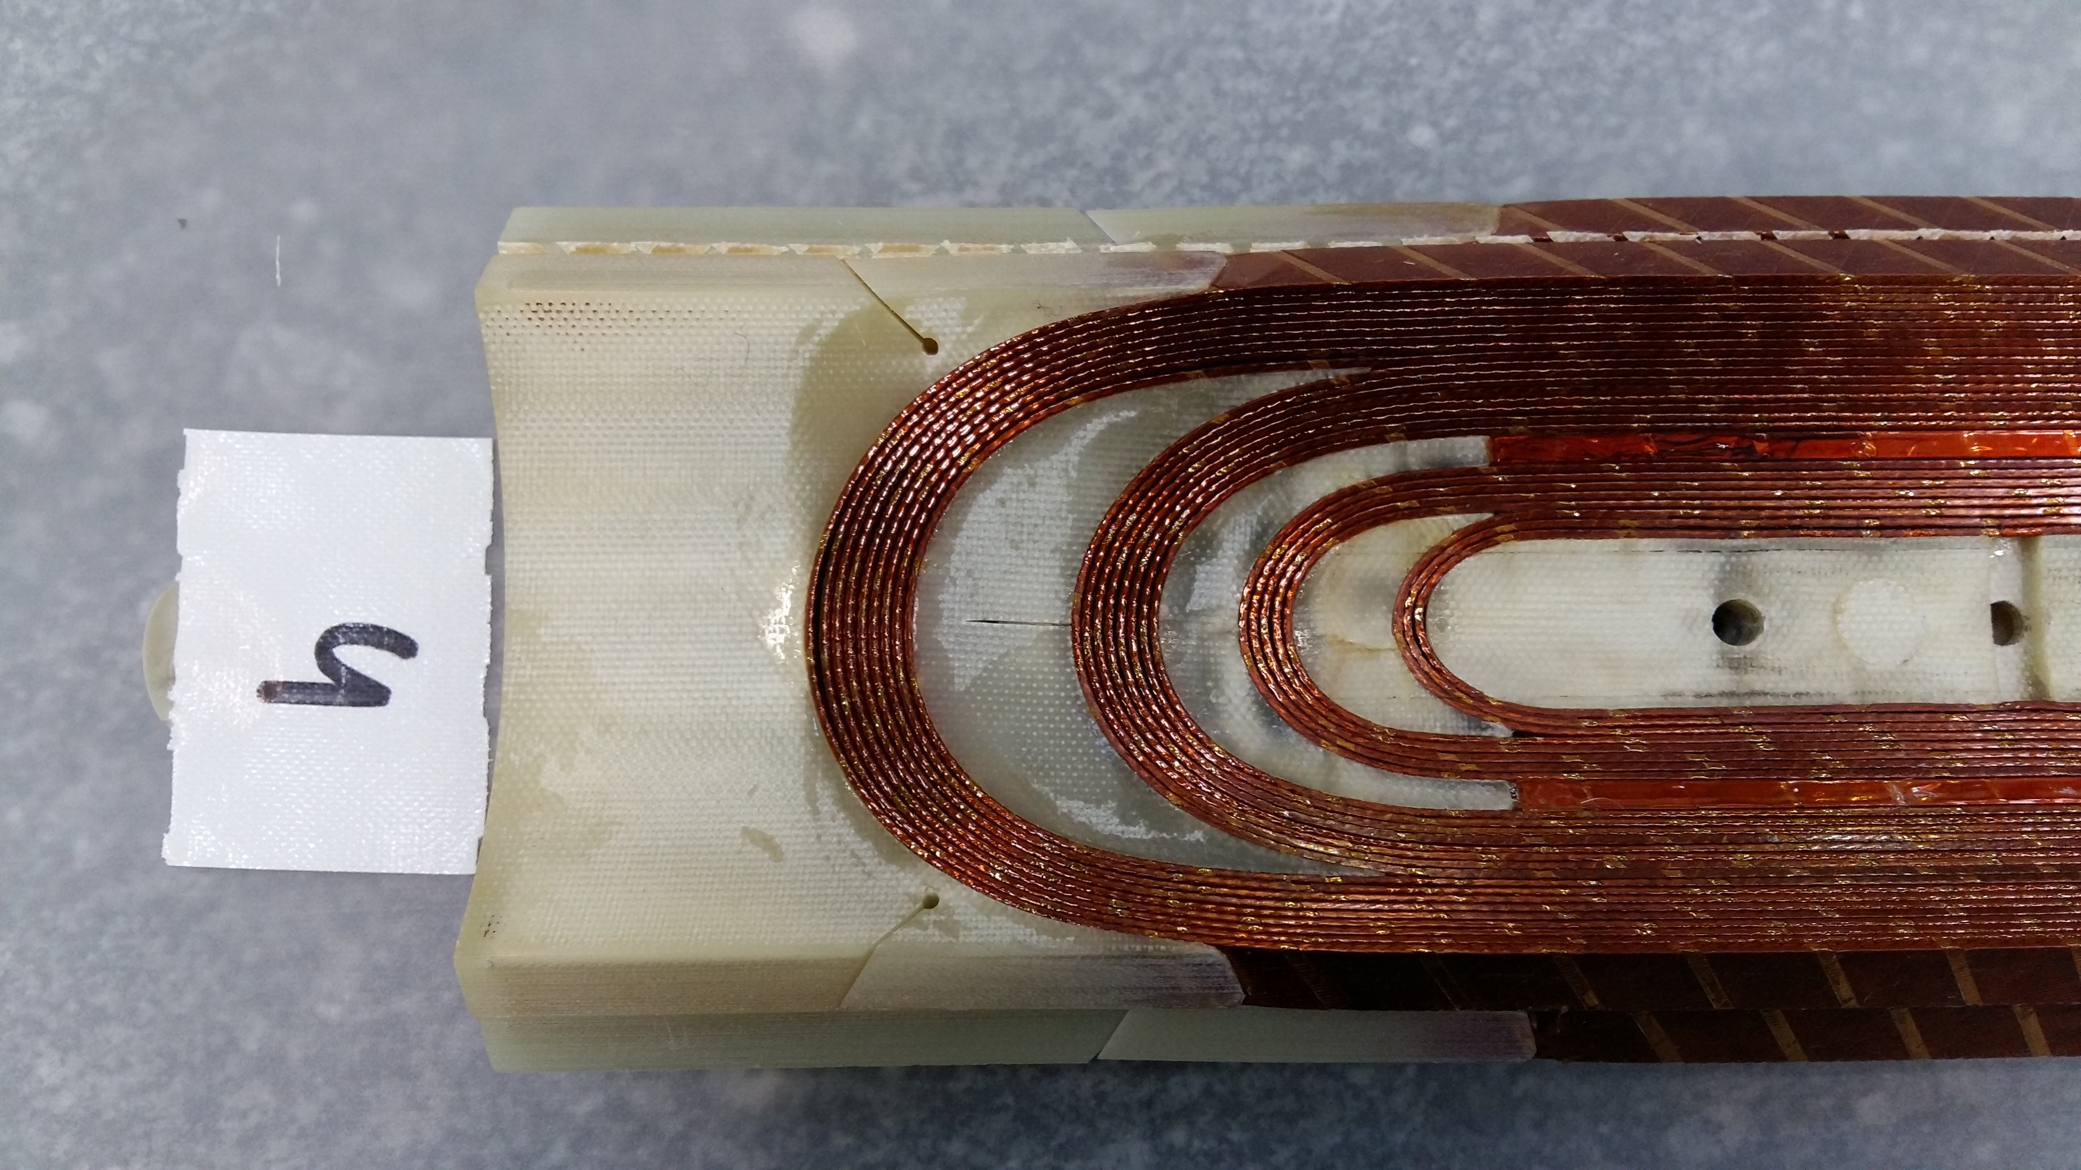
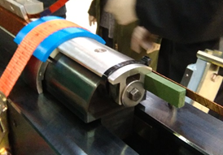
Coil 4
OK
Vtaps/endpart groove problem solved
But :
Unglued turn on the outer layer => adhesive missing? Unexpected cleaning?
gap in the last but one turn in the RE IL: investigation ongoing. Last turn winding tension relaxation after lead cutting is suspected

Slide 11
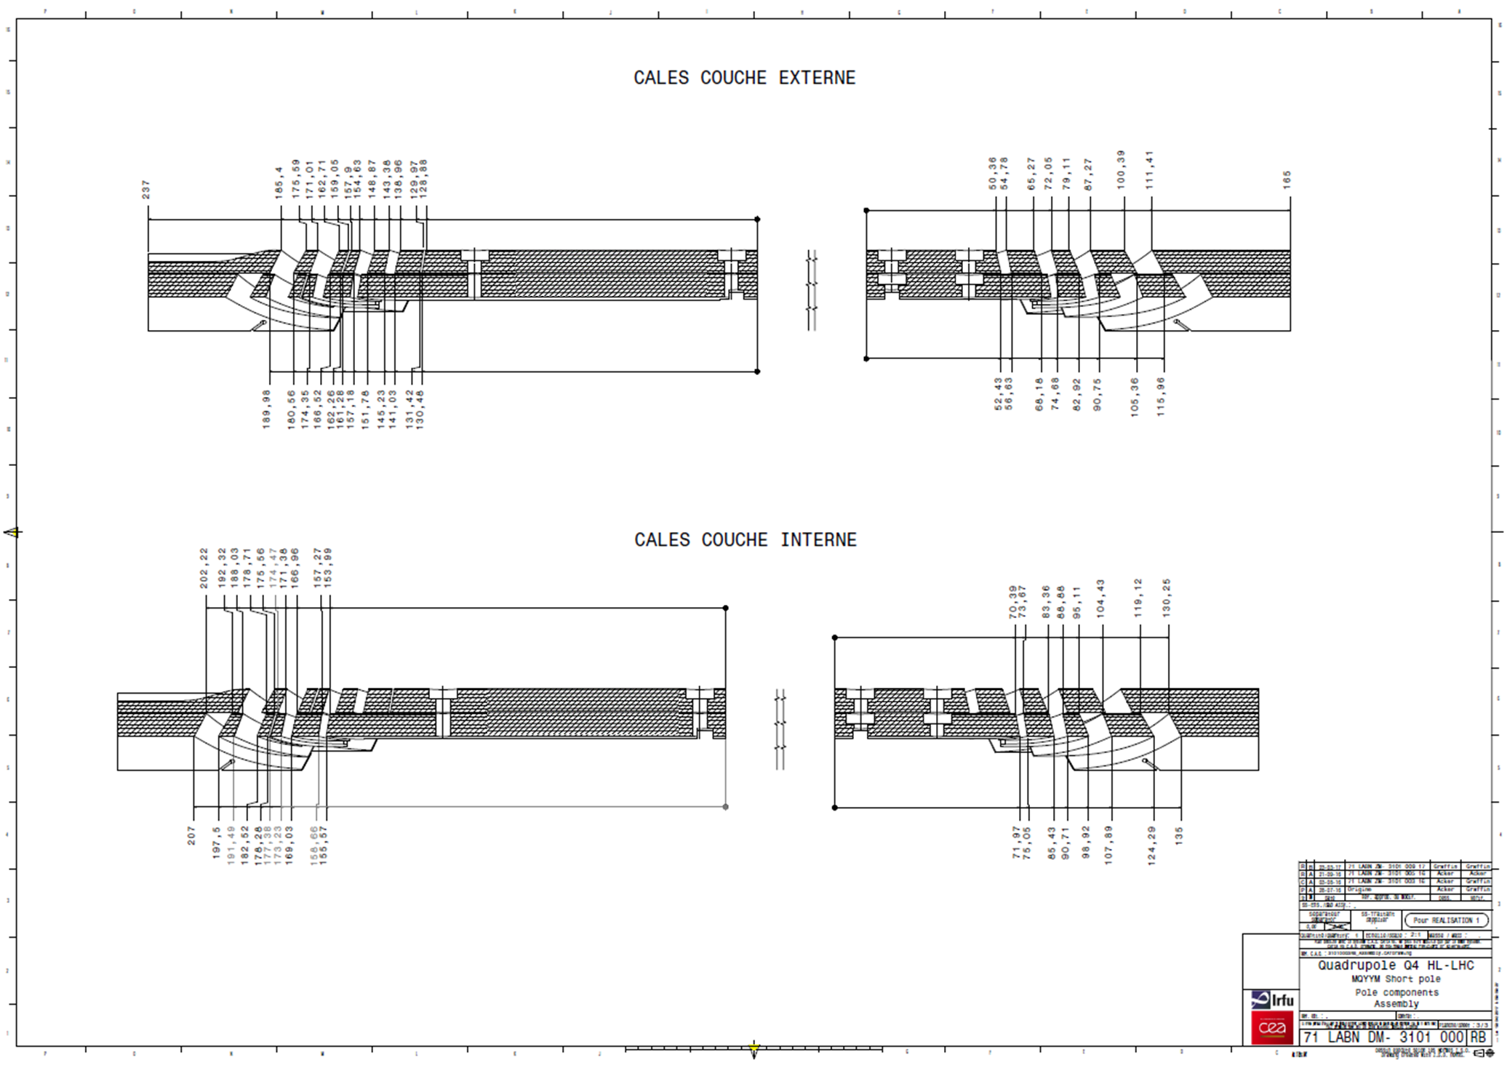
Comparison of coil dimensions
Coils are 5 mm longer in average than nominal (1350 mm):
  Coil 0: 4.9 mm longer
  Coil 1: 4.2 mm longer
  Coil 2: 5.3 mm longer
  Coil 3: 5.4 mm longer
  Coil 4: 5.3 mm longer
Length build-up in end regions
Measurements taken with a large caliper. Uncertainty of about 0.5 mm

Slide 12
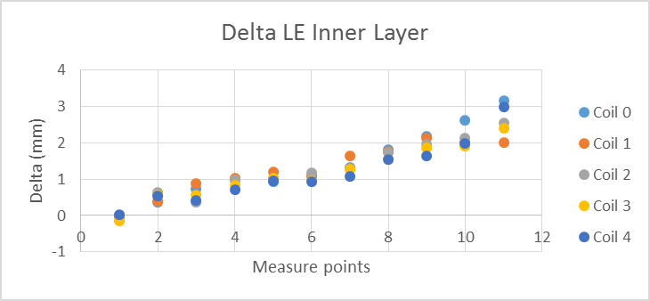
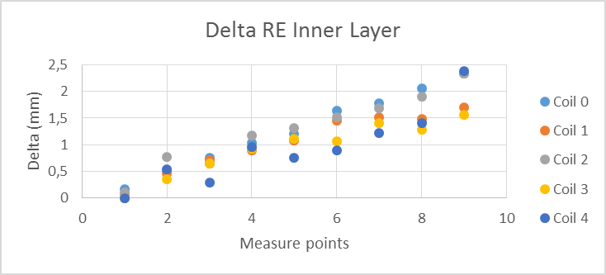
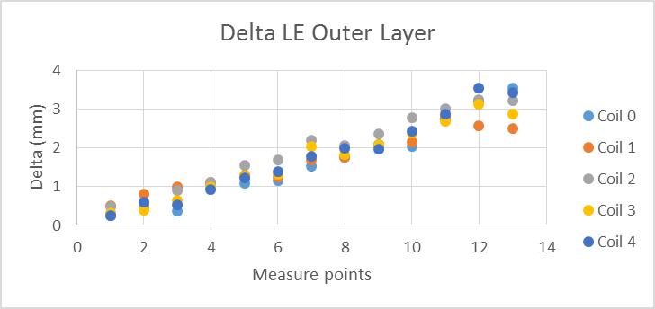
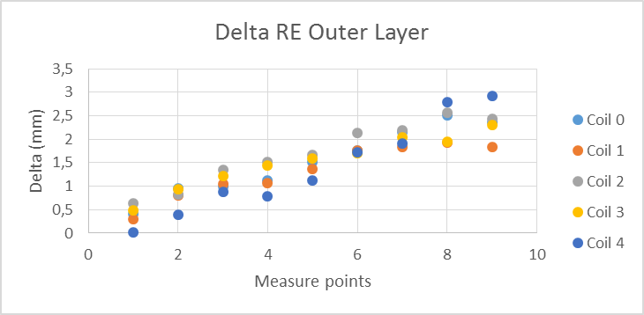
Comparison of coil dimensions
Delta = Actual size – Nominal size
Change of torque on endparts after winding from coil 1 to 2 to reduce winding tension relaxation in the straight section
Spread of delta is unclear for now

Slide 13
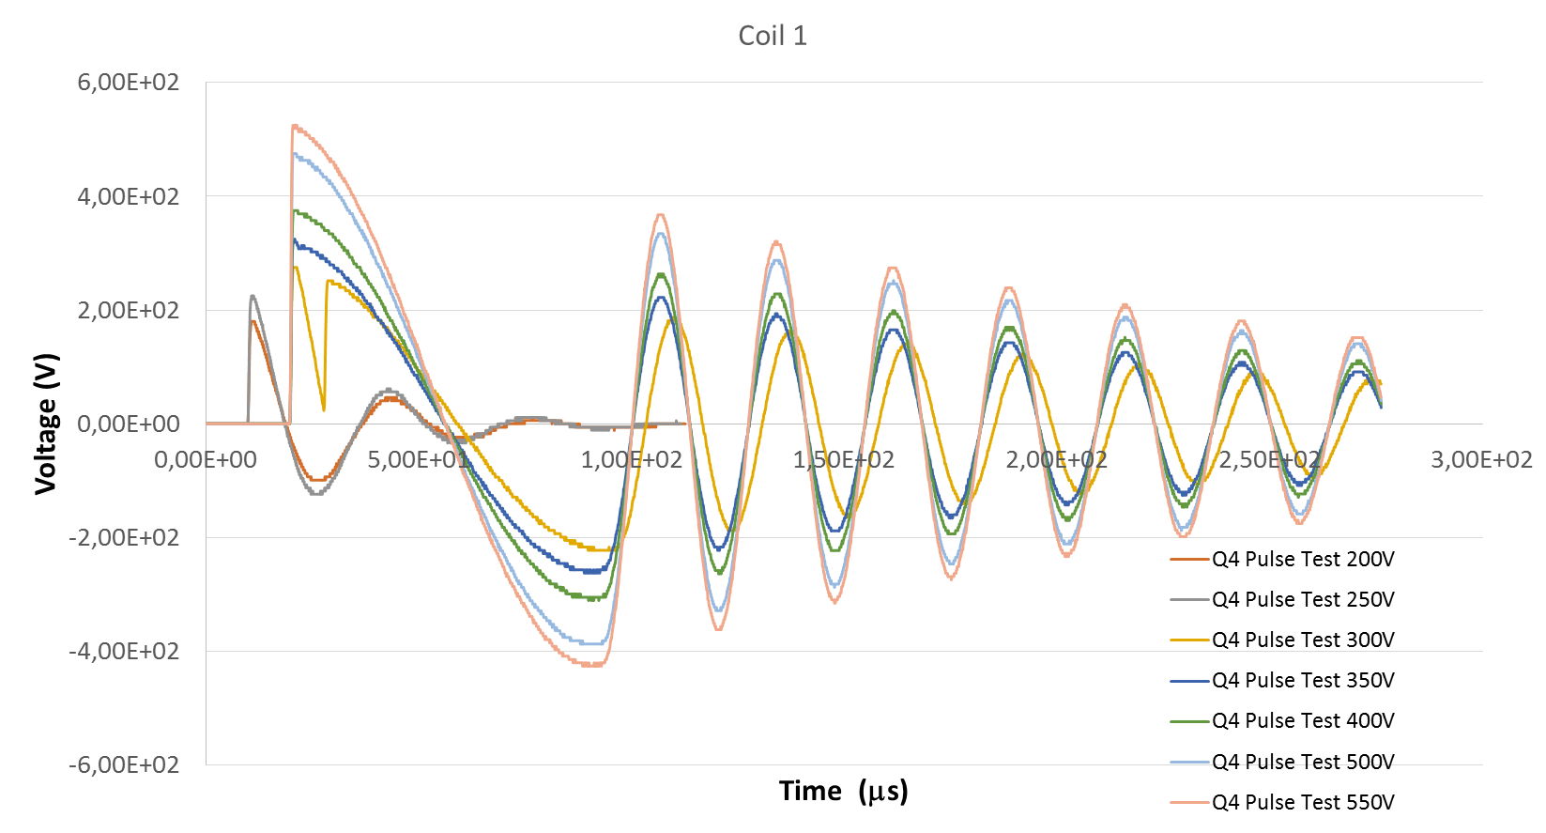
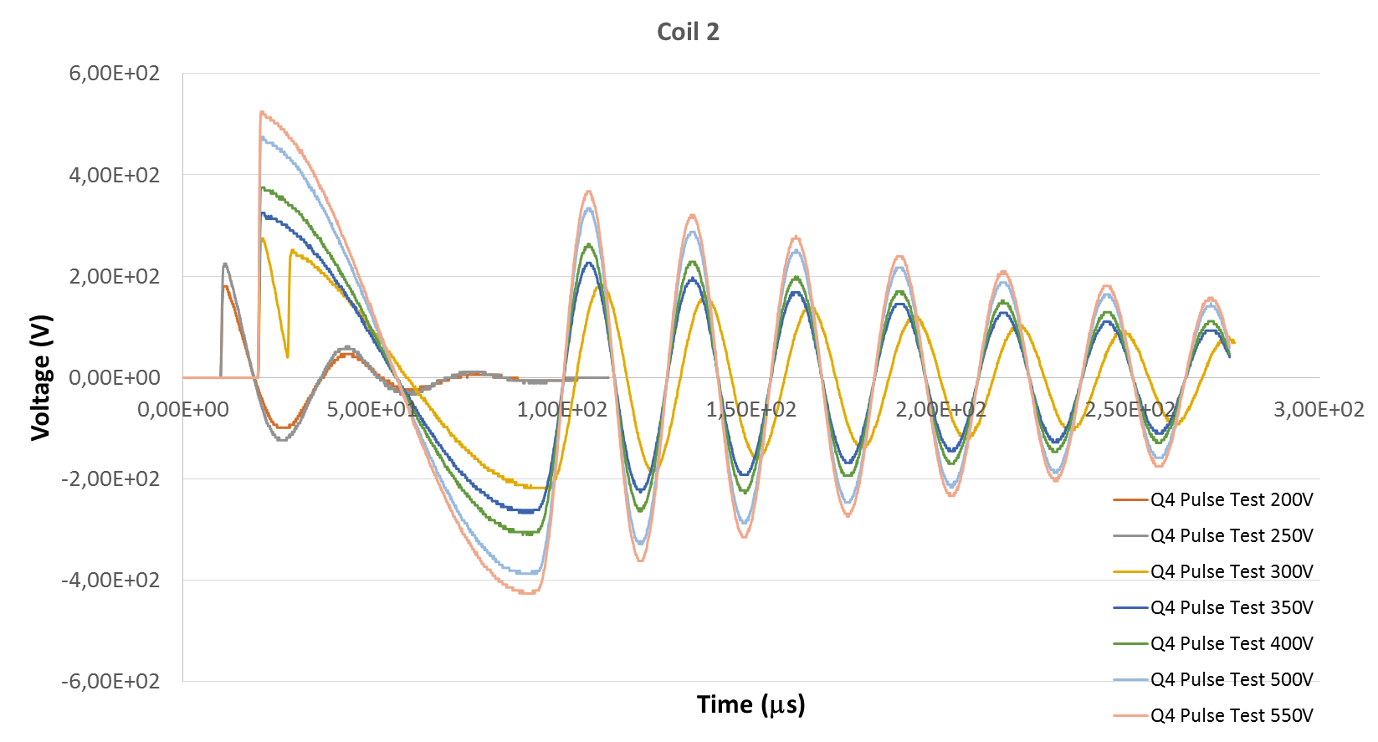
Electrical tests on coil 1 and 2
Coil 1
R (DC measurement) | 568
L (mH) at 100 Hz | 1.99
Average f_{pulse} (kHz) | 35.2 +/-2.9
Average f_{pulse} (kHz) from 300 V | 36.2 +/- 1
Coil 2
R (mΩ) | 567
L (mH) at 100 Hz | 1.97
Average f_{pulse} (kHz) | 35.3 +/- 3.7
Average f_{pulse} (kHz) from 300 V | 36.6 +/-1.3

Slide 14
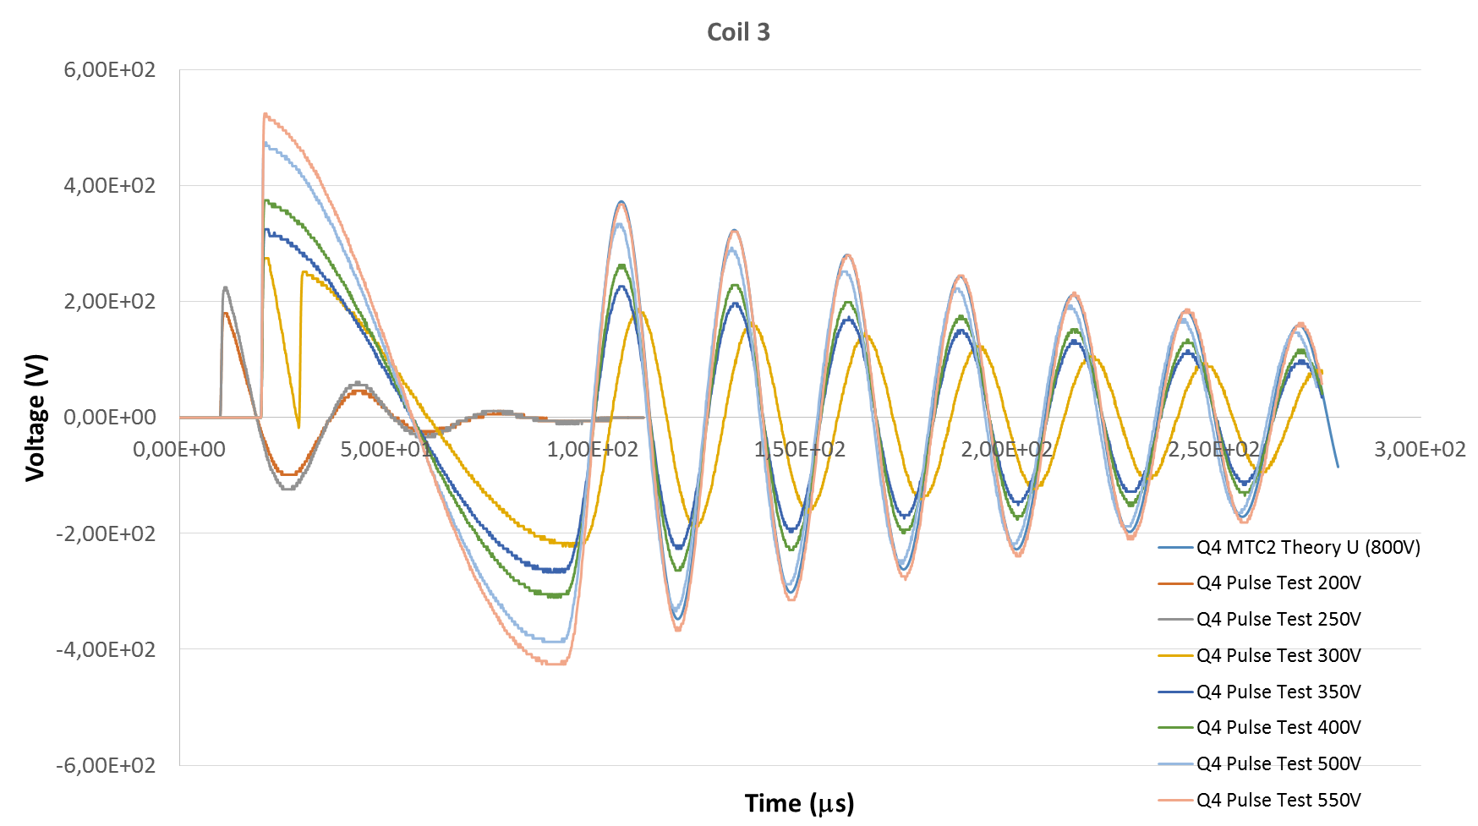
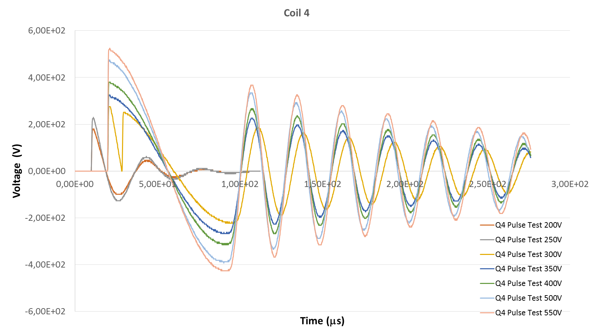
Impulse test Coil 3 and 4
Coil 3
R (mΩ) | 568
L (mH) | 1.98
Average f_{pulse} (kHz) | 35.3 +/- 2.9
Average f_{pulse} (kHz) from 300 V | 36.3 +/- 1.1
Coil 4
R (mΩ) | 567
L (mH) | 1.99
Average f_{pulse} (kHz) | 35.6 +/- 2.5
Average f_{pulse} (kHz) from 300 V | 36.5 +/- 0.8
Electrical validation of the coils 1 to 4

Slide 15
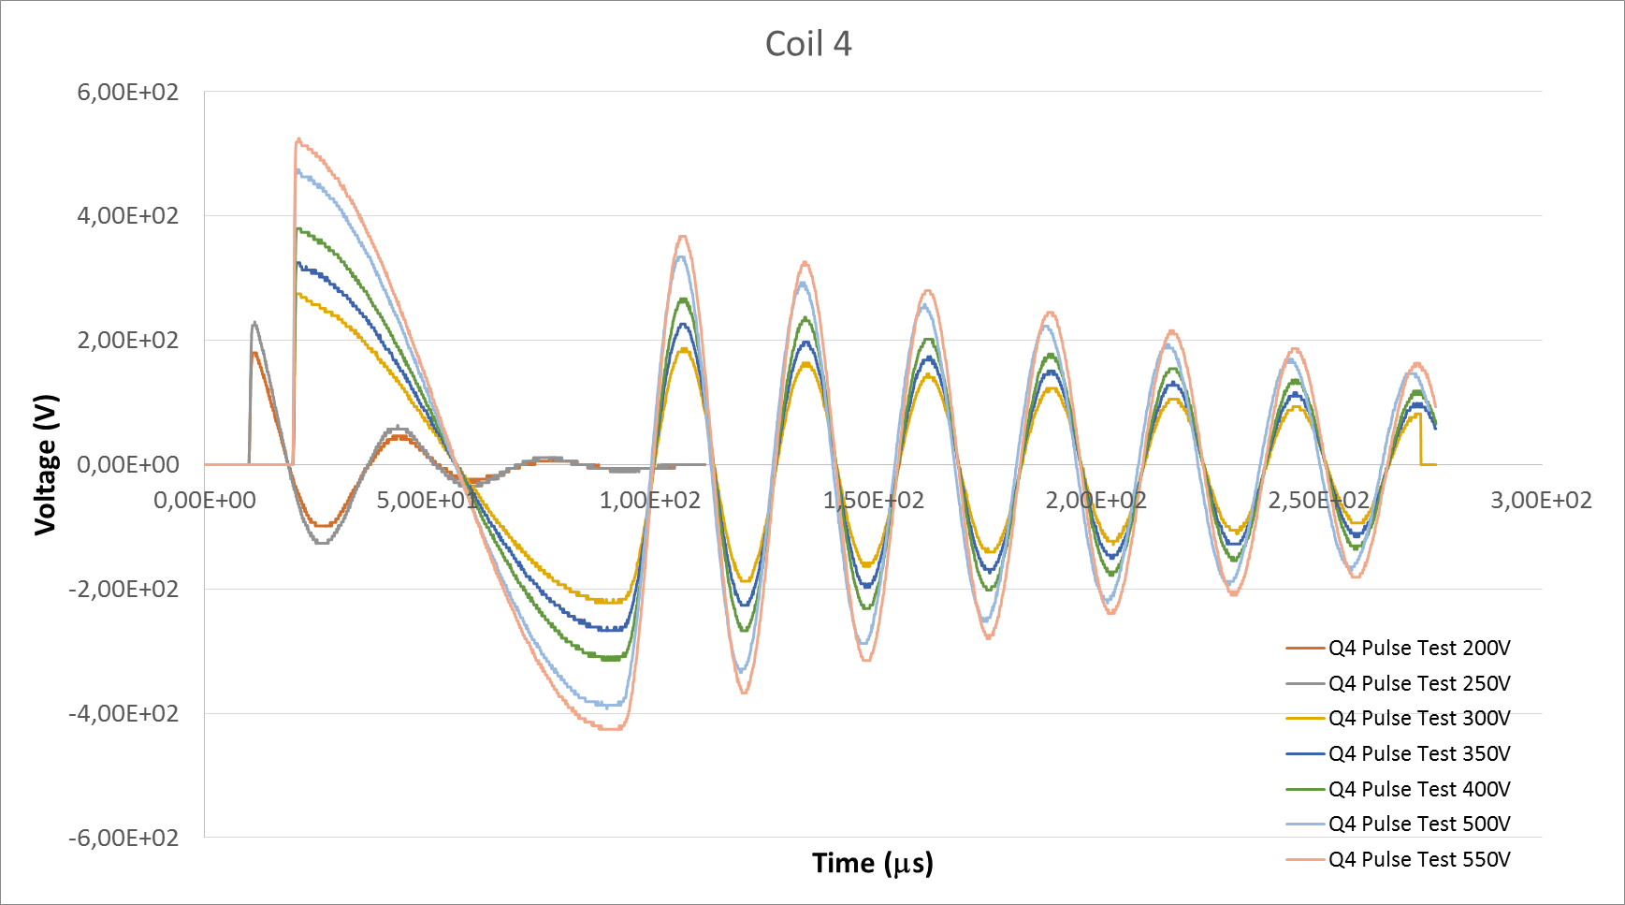
Impulse test Coil 3 and 4
Coil 3
R (mΩ) | 568
L (mH) | 1.98
Average f_{pulse} (kHz) | 35.3 +/- 2.9
Average f_{pulse} (kHz) from 300 V | 36.3 +/- 1.1
Coil 4
R (mΩ) | 567
L (mH) | 1.99
Average f_{pulse} (kHz) | 35.6 +/- 2.5
Average f_{pulse} (kHz) from 300 V | 36.5 +/- 0.8
Electrical validation of the coils 1 to 4

Slide 16
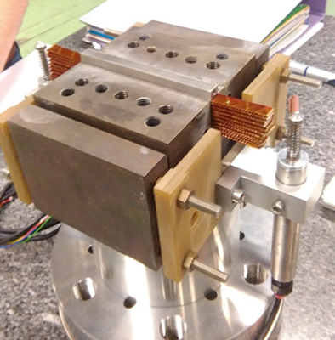
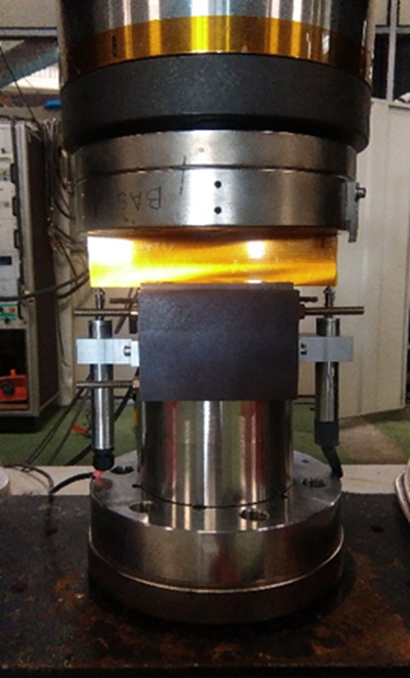
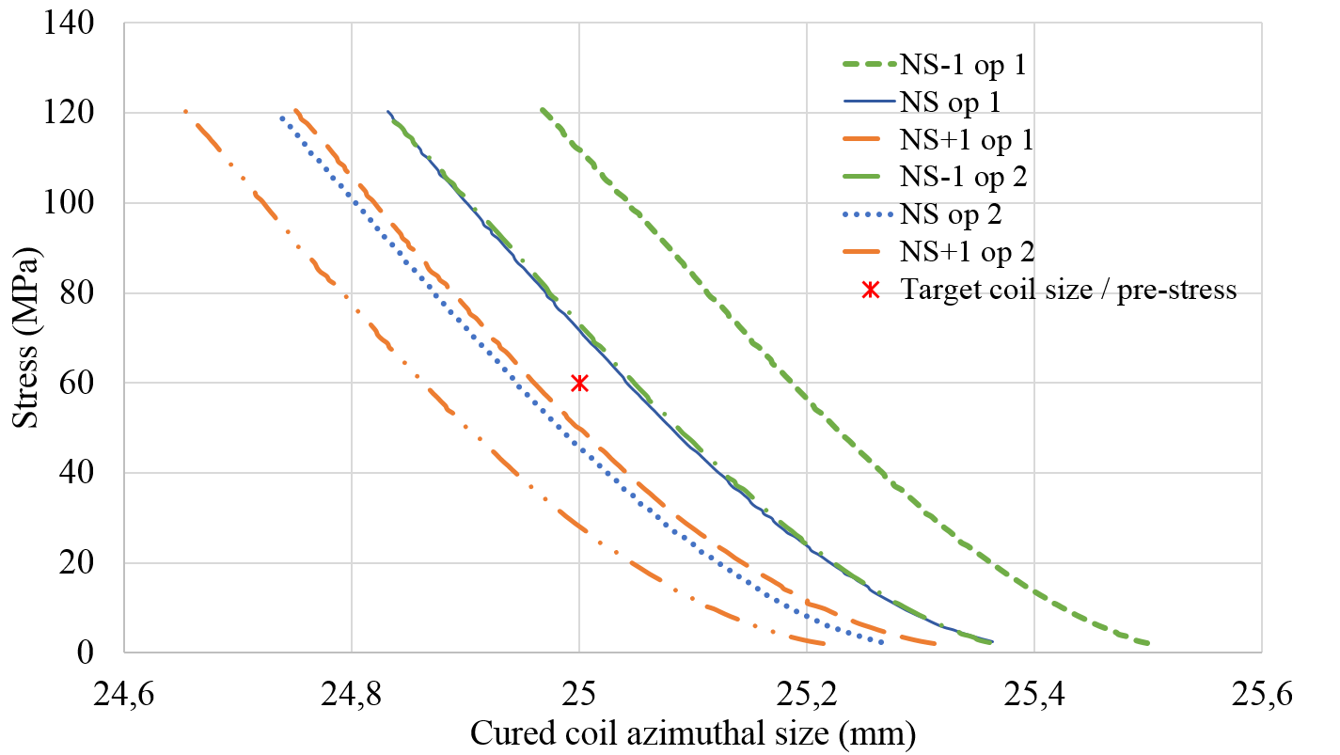
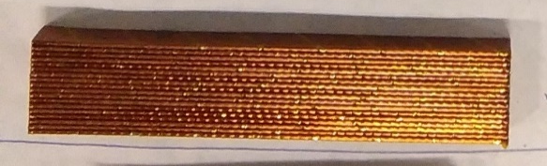
Supporting activity:
Ten Stacks Measurements at CEA
Objective 1: Rigidity measurement
Stack size | Avg Rigidity (GPa)
NS - 0.1 mm | 7.3
NS | 7
NS + 0.1 mm | 6.9
Cross-check ongoing at CERN
+ at cold
+ creep (change of dimension under constant compression)
+ stress relaxation (change of compression under constant dimension)
Stack of 18 conductors cured at:
Nominal size
NS - 0.1 mm
NS + 0.1 mm
Objective 2: Curing shim choice

Slide 17
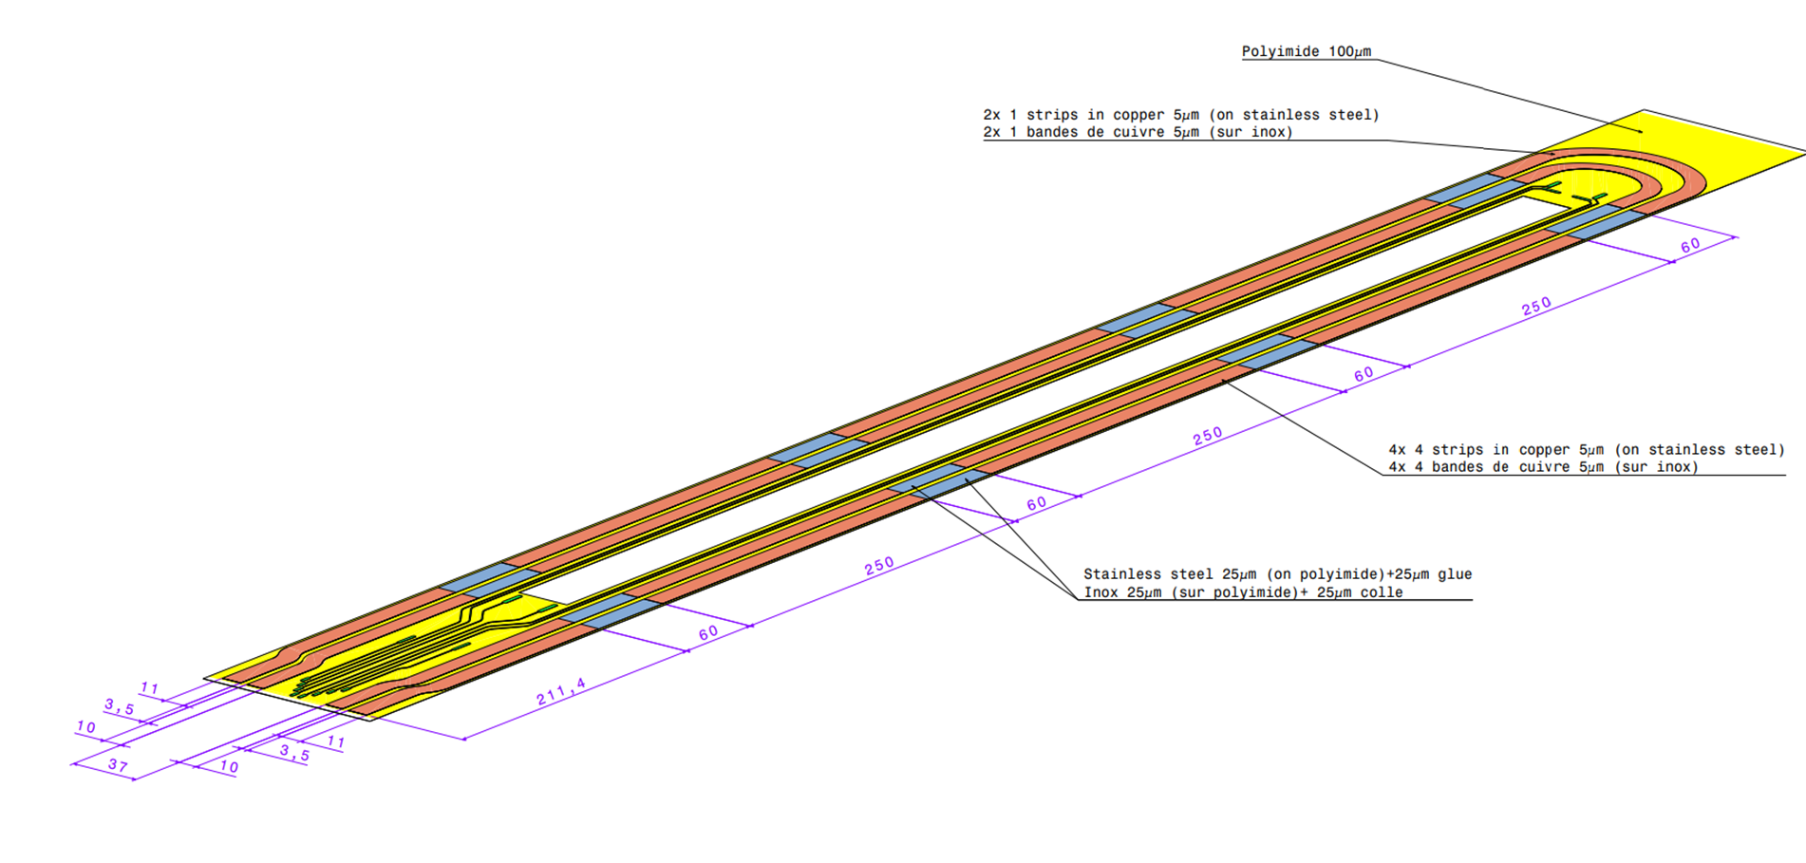
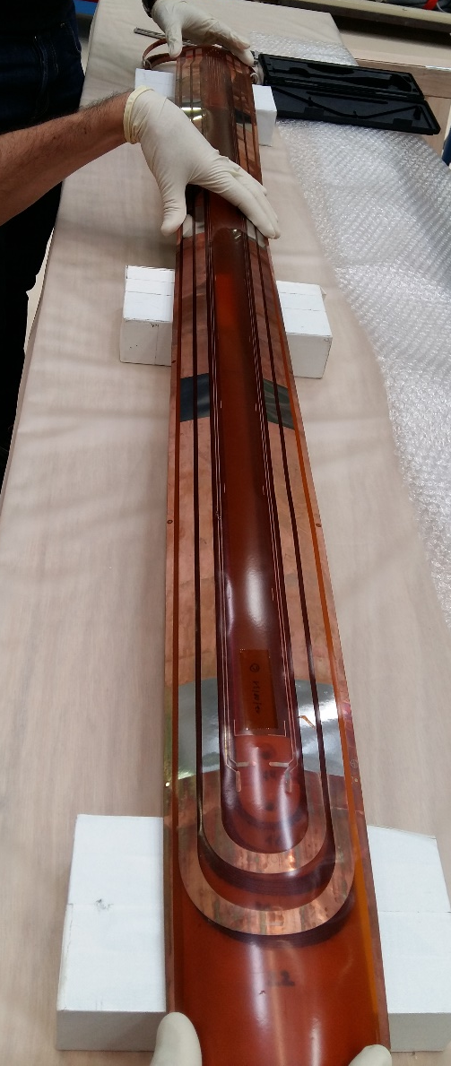
Traces
0,1 mm Kapton
0,025 mm SS
0,005 mm Copper
Agreement to order 1 prototype trace to CERN
Decision to produce 5 traces at CERN for efficiency reason
Delivery of traces at CEA on 06/09/2017
Measurements of the trace thickness at CEA: 145 μm of Kapton (instead of 100)
  Marginal Impact on hot spot temperature
  Main Impact on magnet build-up
Matching of vtaps pad and flags ok on coil 1
Matching test of vtaps planned on coils 2 to 4
=> fabrication of new traces under discussion

Slide 18
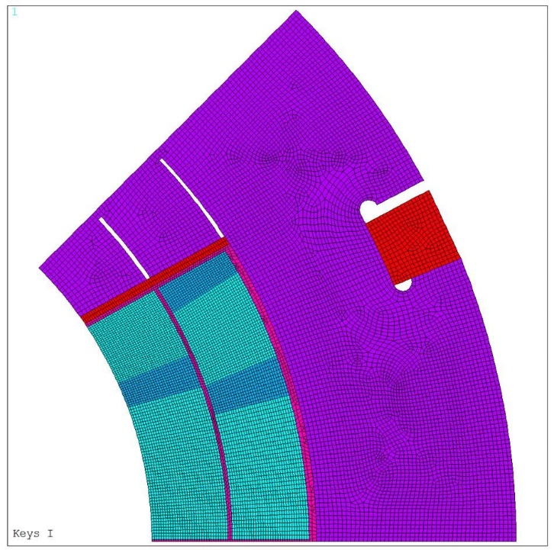
Collar Instrumentation
Instrumentation with strain gauges of 4 collars (top/bottom/left/right noses) at 3 given longitudinal positions (close to LE, at the center and close to RE)
    Possible to reduce to 2 locations to reduce the wiring
Instrumentation of collar flanges
Instrumentation by M. Guinchard’s team
ANSYS analysis ongoing => slit dimension for unidirectionnal stress field

Slide 19
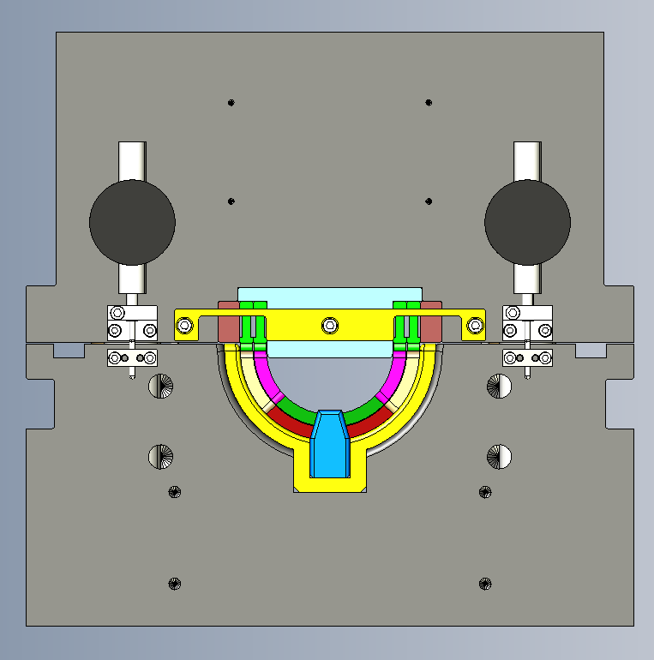
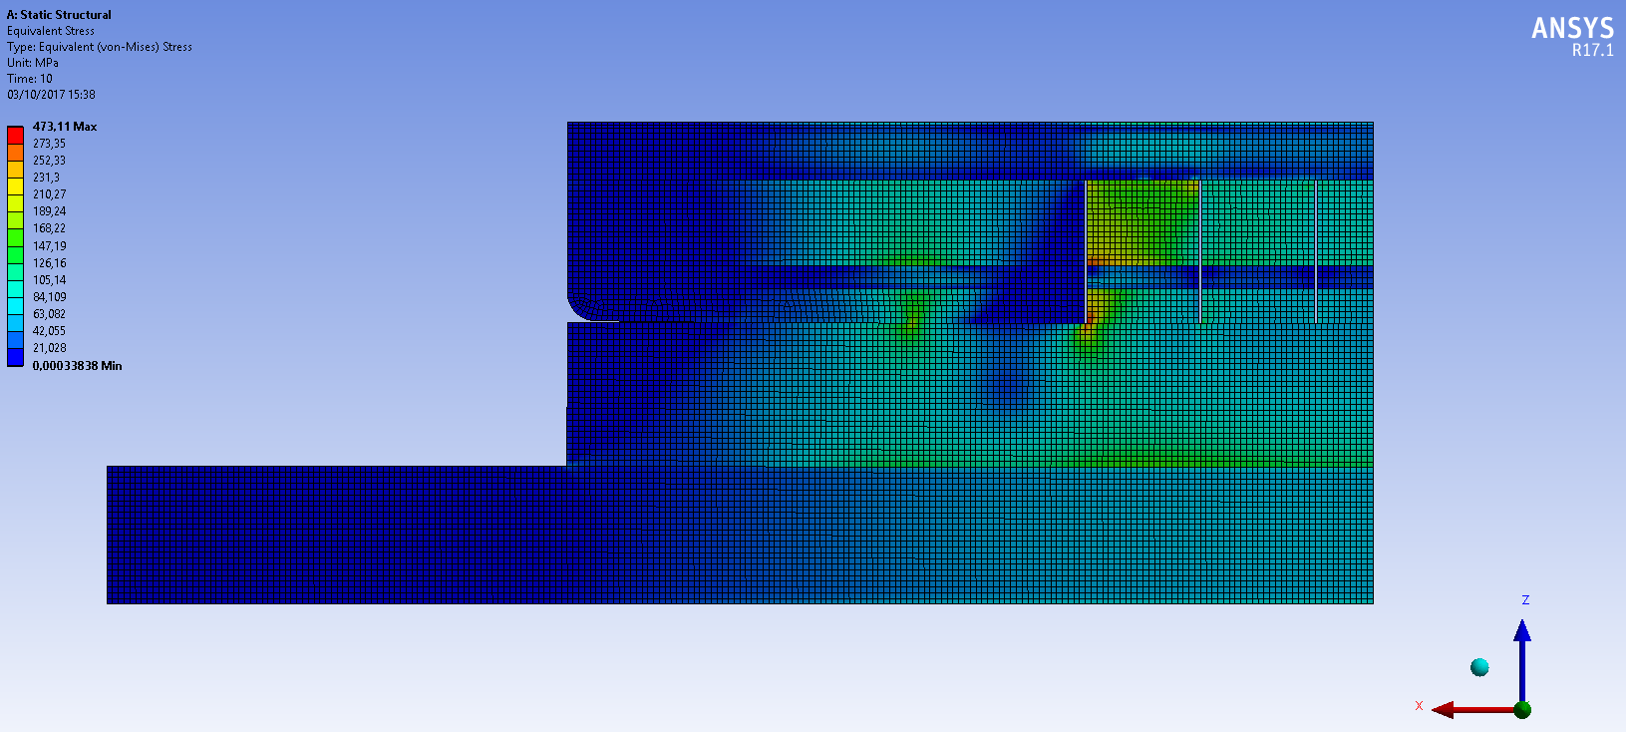
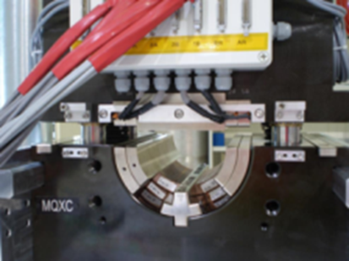
Mechanical measurement of the coils
CAD Adaptation of mechanical measurements tooling completed (feedback from JC Perez)
FEA analyses done to validate the measuring bars dimensions
CFT has been launched
Offers expected November 21st 2017: small number of parts, difficulty
=> Concern on offers
Item procurement on the critical path
Instrumentation
Instrumentation, software and calibration of the bars by M. Guinchard’s team
Calibration on the press:
  CERN +CEA
Measuring bar
Al Wedge
Conductor
Von Mises Stress (65 MPa on the conductor)
Courtesy of JC Perez

Slide 20
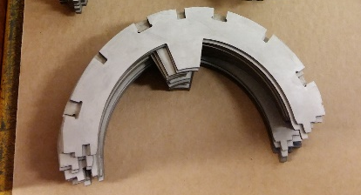
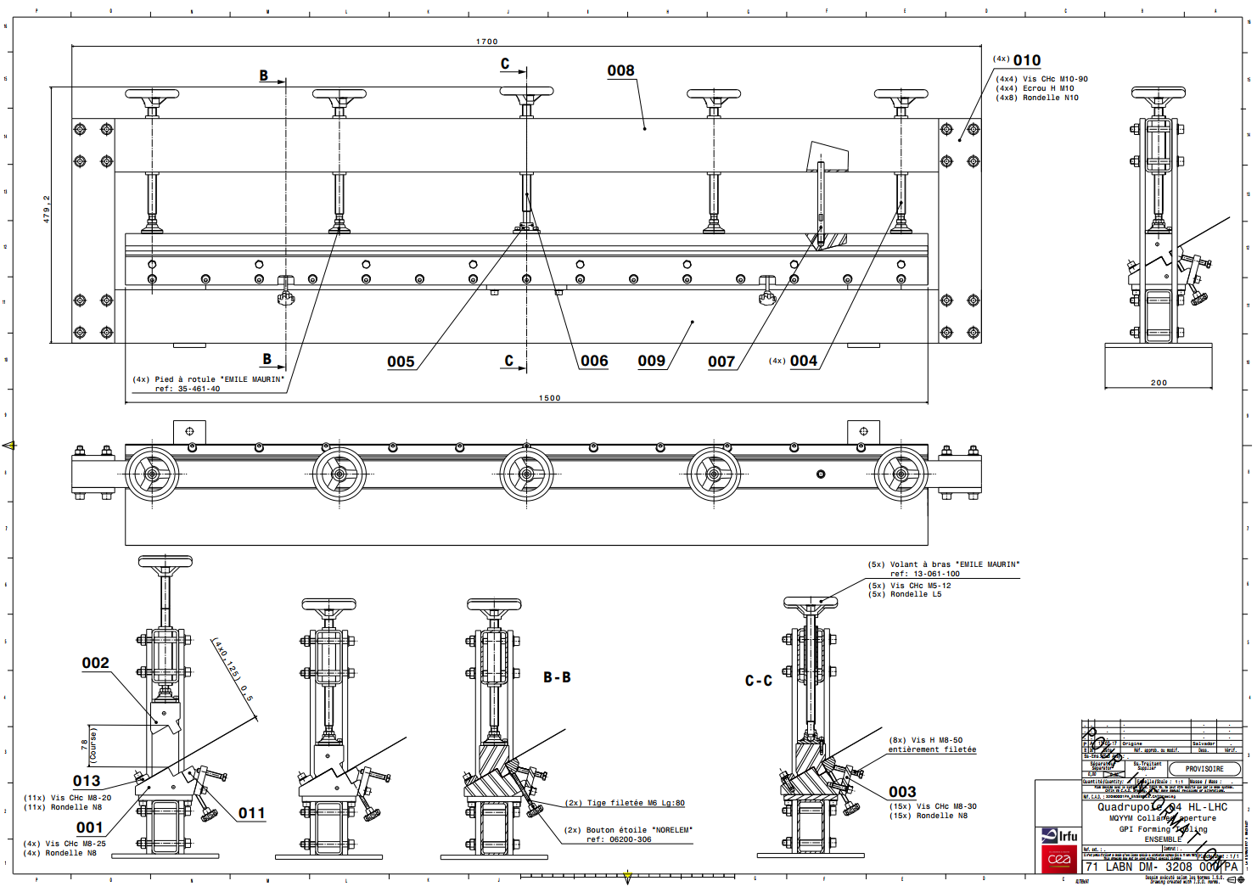
Status on components and tooling
Orders and call for tenders
Collars: delivered at CERN in 09/2017 .
Yoke laminations : delivered at CERN in 10/2017
Connection box + G11 components: specification in preparation, drawings ready, cross-checks with instrumentation
Flange and mechanical parts: specification in preparation, drawings ready (to be adjusted for the routing of the instrumentation)
Protection shoe and pole turn protection shims: Order placed mid October 2017
Assembly tooling: order placed on 26/09/2017
CAD
GPI forming tooling: designed by CEA. Drawings in preparation
Design developed in discussion with N. Bourcey and J.C. Perez
Transportation tooling and splicing tooling: ongoing design

Slide 21
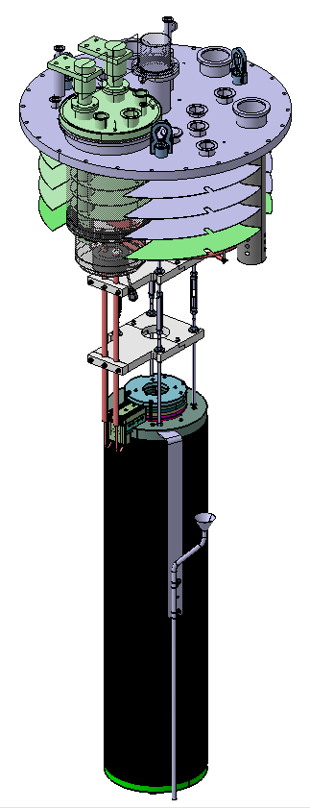
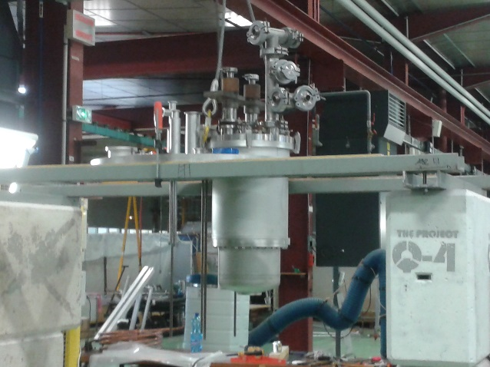

MQYYM: preparation of the test facility
Cryogenic facility
Effort carried out by J.M Gheller
CEA 8 m vertical cryostat equipped with a 3 m long « sock » (tank)
Adaptation of an existing top plate
Saturated LHe bath at 1.9 K 23 mbar
the top plate and 4.2 K lead assembly ongoing
Data acquisition and magnet protection
Effort carried out by Denis Bouziat
Support from another group at CEA (DIS)
Agreement made on work sequence and resources to be ready for the test

Slide 22


Plan for Magnetic Measurements
  Cold Probe, rotating unit and DAQ system will be provided by CERN
  Agreement on a probe: 47 mm in diameter, 5 modules of 222 mm in length
  Main difference identified between CERN and CEA facilities:
    CERN: pressurized bath
    CEA: saturated bath (23 mbar)
    => Design of a sealed system using the cold probe provided by CERN
  Agreement on the fact that the operation of the system will be done by CEA (supported/trained by CERN)
Magnetic measurement technical review at CEA on June 14th 2017 to validate the design
Drawings under review before CFT and finalization of the specification
Training of Damien Simon planned in Fall 2017 on magnetic measurement acquisition system

Slide 23





MQYYM schedule
Critical path

Slide 24
MQYYM : Summary and NEXT steps
SUMMARY
MQYYM Magnet design completed
Coil 1 to 4 completed
  Electrical measurements validate the coils 1 to 4
  Visual inspection not satisfactory for coil 4: investigation ongoing
The best is done to keep a reasonnable schedule:
  Tight connection between CERN and CEA teams
Coil rigidity measurement tooling on the critical path
Assembly preparation and test preparation on track
Mechanical instrumentation defined
Cross-check on rigidity measurements ongoing
NEXT STEPS
Complete the procurement of the tooling and coil components
Finalize some tooling design (transport, splicing…)
Decision on number of coils to be manufactured
Proceed with MQYYM fabrication
Test remains foreseen in Fall 2018

Slide 25


QUACO 101
QUACO : a EU Pre-Commercial Procurement in 3 phases aiming at the fabrication of 2 MQYY prototypes
PCP « spirit » : innovation
A consortium of 4 laboratories:
CERN, CEA, CIEMAT and NCBJ
4 companies selected for Phase 1
Phase 1: conceptual design
  completed from Nov 2016 to March 2017
Phase 2: Engineering design and mock-ups – ongoing
Phase 3: Fabrication of 2 prototypes by 2 companies
Magnetic design provided by the consortium based on CEA design
Mechanical structure to be designed by the companies

Slide 26

Status of QUACO
3 companies remain in the game in Phase 2:
  Antec-Tecnalia-SupraSys, Spain
  Elytt, Spain
  Sigmaphi, France
3 different designs are being explored – Details cannot be provided for confidentiality reasons
Follow-up carried out by the consortium team
Phase 2 objectives:
  Demonstrate the validity of the mechanical concept by mock-ups
  Finalize the magnet design
  Finalize the tooling design
  Be ready for components and tooling procurement in Phase 3 (no procurement in phase 2)
Some material provided by CERN as part of the consortium:
  Cockrill Iron Steel plates
  YUS 130 Stainless steel plate
  Insulated NbTi cable
  Protection Heaters
Administative constraint: between each phase => new tendering process
The technical team has some concerns due to the very agressive schedule imposed by the PCP

Slide 27

Beyond QUACO preparation of the MQYYP test
Similar timeline between MQ and MQYYP test
Agreement to find synergy between MQ and MQYYP tests => STAARQ project at CEA
To minimize equipment cost and development cost
To minimize down time between magnet tests
CEA Team: J.M. Gheller, H. Allain, H. Felice,C. Lorin, D. Simon, J.C. Barriere, J. Belorgey, F. Molinié, J. Relland
Target date for operation: End of 2019
Cryogenic facility
Design and fabrication of an inner cryostat to be inserted in the 8 m vertical cryostat
Pressurized LHe bath at 1.9 K
Introduction of Lambda plates in the main Lambda plate to accommodate the anticryostats and bus bars
Connection to a liquifier
Data acquisition and magnet protection
Upgrade under discussion
Max Dump resistor: 100 mohm
Power supply: 20 kA
HTS current leads under investigation
H. Allain (CEA)

Slide 28
Next steps and Milestones for MQYY
Short Model MQYYM
  Fabrication of last coils at CEA: early 2018
  Aperture collaring and yoking at CERN: late spring 2018
  Test at CEA: Fall 2018
Prototype MQYY
  End of Phase 2: August 2018
  Selection of two companies to proceed to the prototype fabrication phase (phase III): October 2018
  Prototype delivery at CEA mid 2020
  Test at CEA
CERN/CEA collaboration agreement
QUACO
CERN/CEA collaboration agreement

