Slide 1
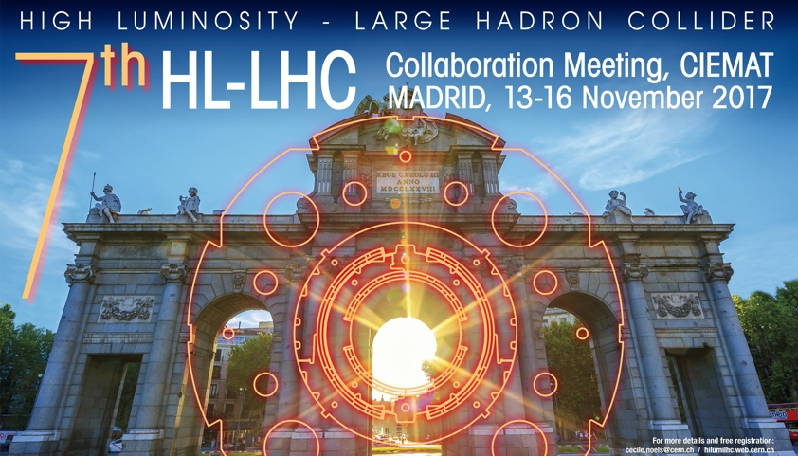

High Order Correctors status
Marco Statera
on behalf of the LASA team
INFN Milano - LASA
7th HL-LHC Collaboration Meeting
CIEMAT, Madrid – 15 November 2017

Slide 2

OUTLINE
Introduction
Status of work progress
  MCOXFP1 construction and test
  MCDXFP1 construction and test
  next prototypes design and production status
Integration
MgB2 demonstrator status
Test cryostat for next prototypes and for series production
Conclusions and next steps

Slide 3
SCOPE
The INFN-LASA follows the design, construction and test of the 5 prototypes of the High Order (HO) corrector magnets for the HL interaction regions of HL-LHC
This activity is founded by INFN (Magix “activity”), and with an agreement CERN contributes for about 50%
The INFN-LASA will follow the series production of the HO corrector magnets for the HL interaction regions of HL-LHC

Slide 4
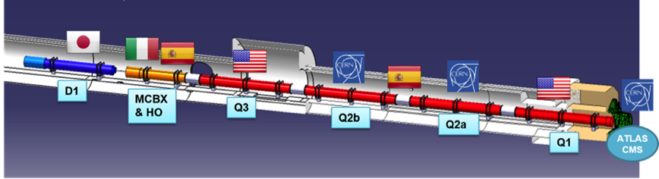
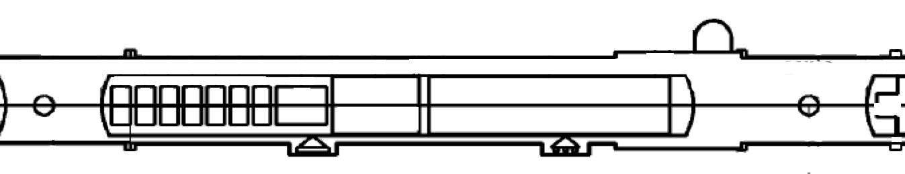
THE LOW BETA SECTION AND
THE HIGH ORDER CORRECTORS
73.6 m
IP
a2
b3
b4
b5
b6
by P. Fessia
a3
a4
a5
a6

Slide 5
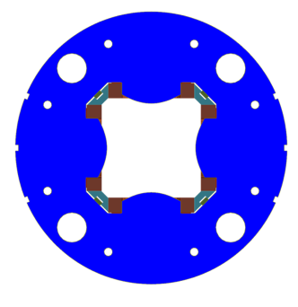
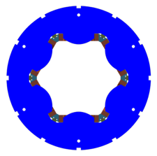
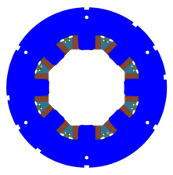
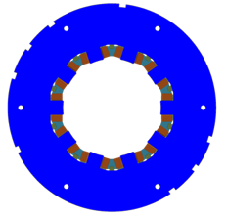
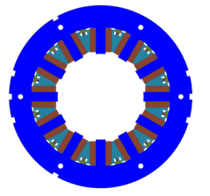
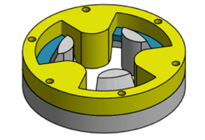
HO CORRECTOR MAGNETS ZOO
OD460
MCSXFP1
MCOXFP1
OD320
a2
a3
b3
a4
b4
Tested 2016
Tested 2017
Tested 2016
MQSXFP1
From 6-pole to 12-pole magnets exist in both normal and skew form
NbTi superconducting coils
superferric design
60% margin @ 1.9 K
existing power supplies
no energy extraction (but 4P)
a5
b5
a6
b6
MgB₂
round coil
Tested 2017
MCDXFP1
MCTXFP1

Slide 6
MCOXFP1 - THE OCTUPOLE
MCSXFP1
MCOXFP1
a2
a3
b3
a4
b4
MQSXFP1
a5
b5
a6
b6
MgB₂
round coil
MCDXFP1
MCTXFP1

Slide 7
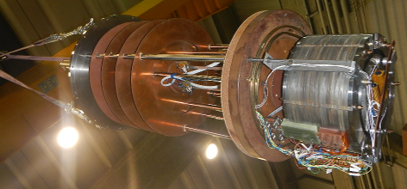
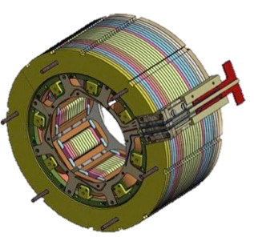
MCOXFP1
 | nominal | design
length | 160 mm | 183 mm
integrated field @ Iop @ r50 mm | 46 Tmm | 46 Tmm
magnetic length | 87 mm | 99 mm
energy @Iop | 1.4 kJ | 1.07 kJ
harmonics |  | B12=11.6 B20=-3.0
DURATRON
PEI U2300 coils
electrical connections redesigned
183 mm
OD 320 mm

Slide 8
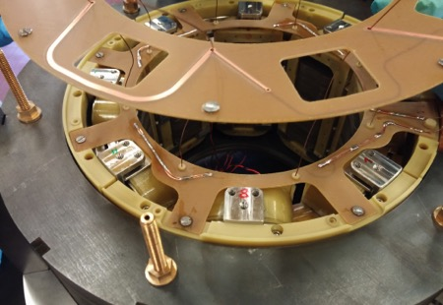
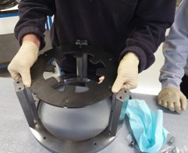
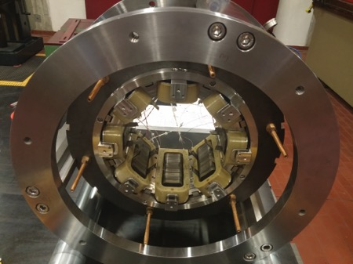
MCOXFP1 ASSEMBLY 1
assembly procedure
same as 6pole
new electrical connections
lamination
Copper 2 mm wide
0.035 mm thick
two printed circuit boards
coils’ connections
signals
alignment frame
spacers
fixed longitudinally
wedges in position
the wedges are fixed
CuBe rods

Slide 9
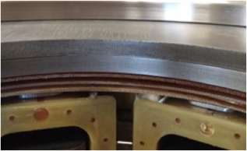
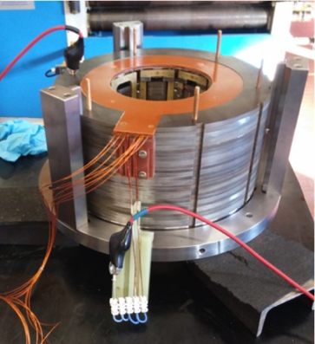
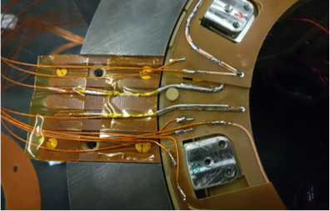
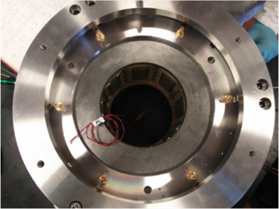
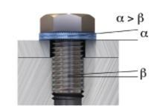
MCOXFP1 ASSEMBLY 2

Slide 10
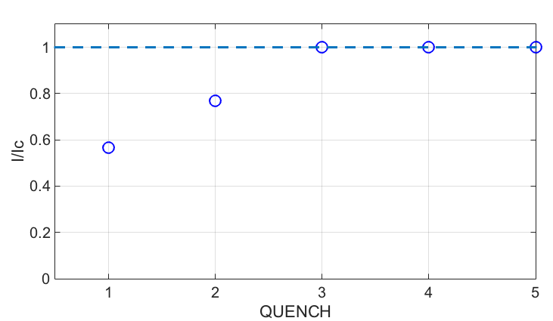
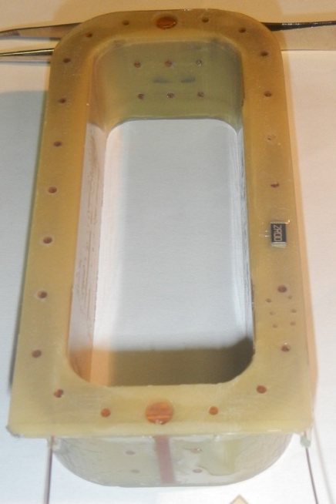
MCOXFP1 COILS
s.s.l.
12 coils produced
HCMCOXFC01-I1000001
nominal current
heigth
single coil’s cold test:
2 training quenches
reached short sample sample 247 A
inner long
B1 | M08-01
B2 | M08-08
B3 | M08-07
B4 | M08-06
B5 | M08-09
B6 | M08-10
B7 | M08-11
B8 | M08-12
inner short
coils’ assessment
Geometry
6pole average σ 0.09 mm
8pole average σ 0.13 mm
Resistance
number of turns
HV insulation
all coils above 1.8 TΩ at 5 kV
outer long
outer long

Slide 11
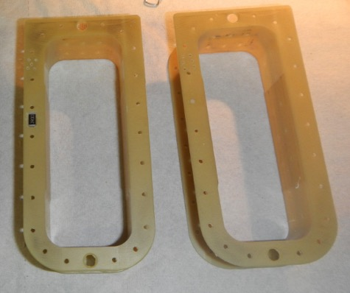
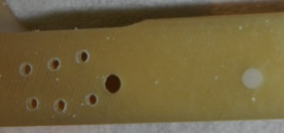
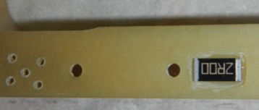
HEATERS
Two heaters are installed
DURATRON thickness reduced by hand in coil B5
A Φ 2 mm Aluminum nitride (AlN) ceramic insert in one hole of coil B6
quench induced at 4.2 K, I= 73 A
10.1 J
4.4 J
AlN
1 mm thick
By INTELLION S.a.r.l.

Slide 12
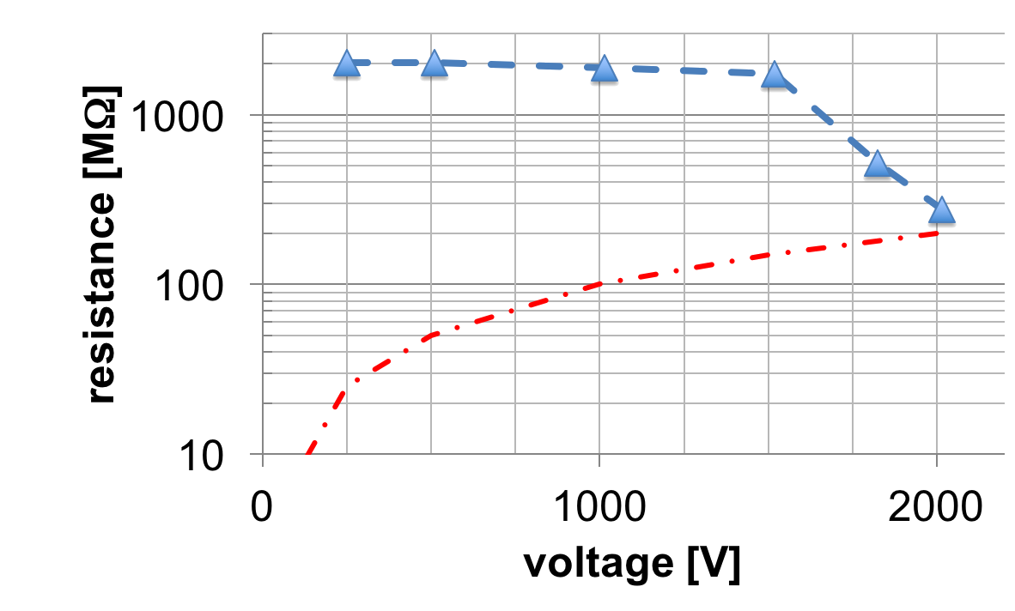
MCOXFP1 GROUND INSULATION
MCOXFP1 as assembled
10 uA limit

Slide 13
8POLE TEST
qualification @ 4.2 K
qualification 1h @ 108% @2.17 K
training @4.2 K
working condition test
w/o energy extraction
thermal cycle
qualification @ 4.2 K

Slide 14
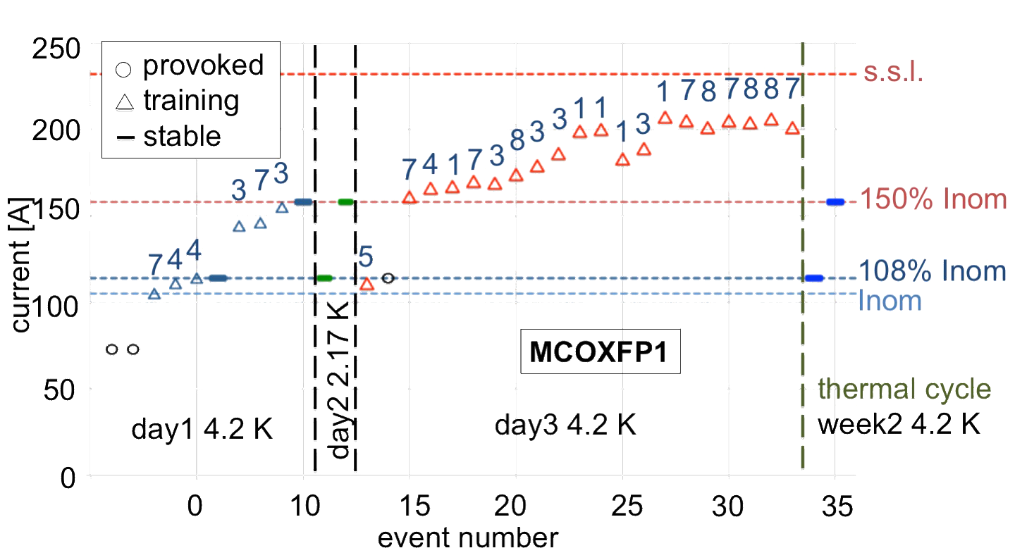
8POLE COLD TEST RESULTS
stable at ultimate current (108% Inom) and at 150% Inom
26 quenches – I_{max}= 207 A (89.2 % s.s.l.)

Slide 15
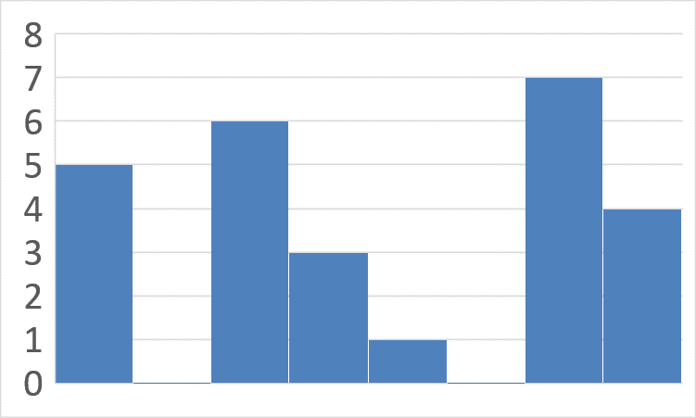
QUENCH SEQUENCE
7
4
4
3
7
3
5
7
4
1
7
3
8
3
3
1
1
1
3
1
7
8
7
8
8
7
Not all coils had training
Single tested coil (B1) has training I> 150% Inom
No evidence of induced quench effect
H
H
B1
B2
B3
B4
B5
B6
B7
B8

Slide 16
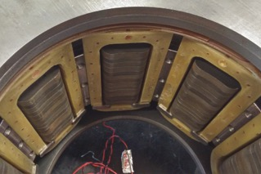
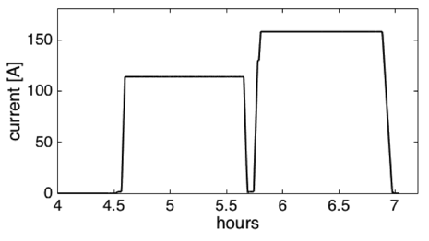
8POLE COLD TEST RESULTS - 2
He II test: 2.17 K
1h @ 108% Inom (114 A)
1h @ 150% Inom (158 A)
no quenches occurred
1h@ 150% In
qualification
1h@ 108% In
tests @ 4.2 K
full training: Imax 89% of s.s.l.
working condition test
qualification @4.2 K after a thermal cycle

Slide 17
QUENCH PROTECTION IN LHC
Protection in LHC
  Existing power supplies
  Measuring current
  Time range 60-180 ms
  Max current: ultimate current (114 A)
Protection at LASA
  Total voltage and differential voltage (half magnet)
  Quench induced by heater (and AlN insert)

Slide 18
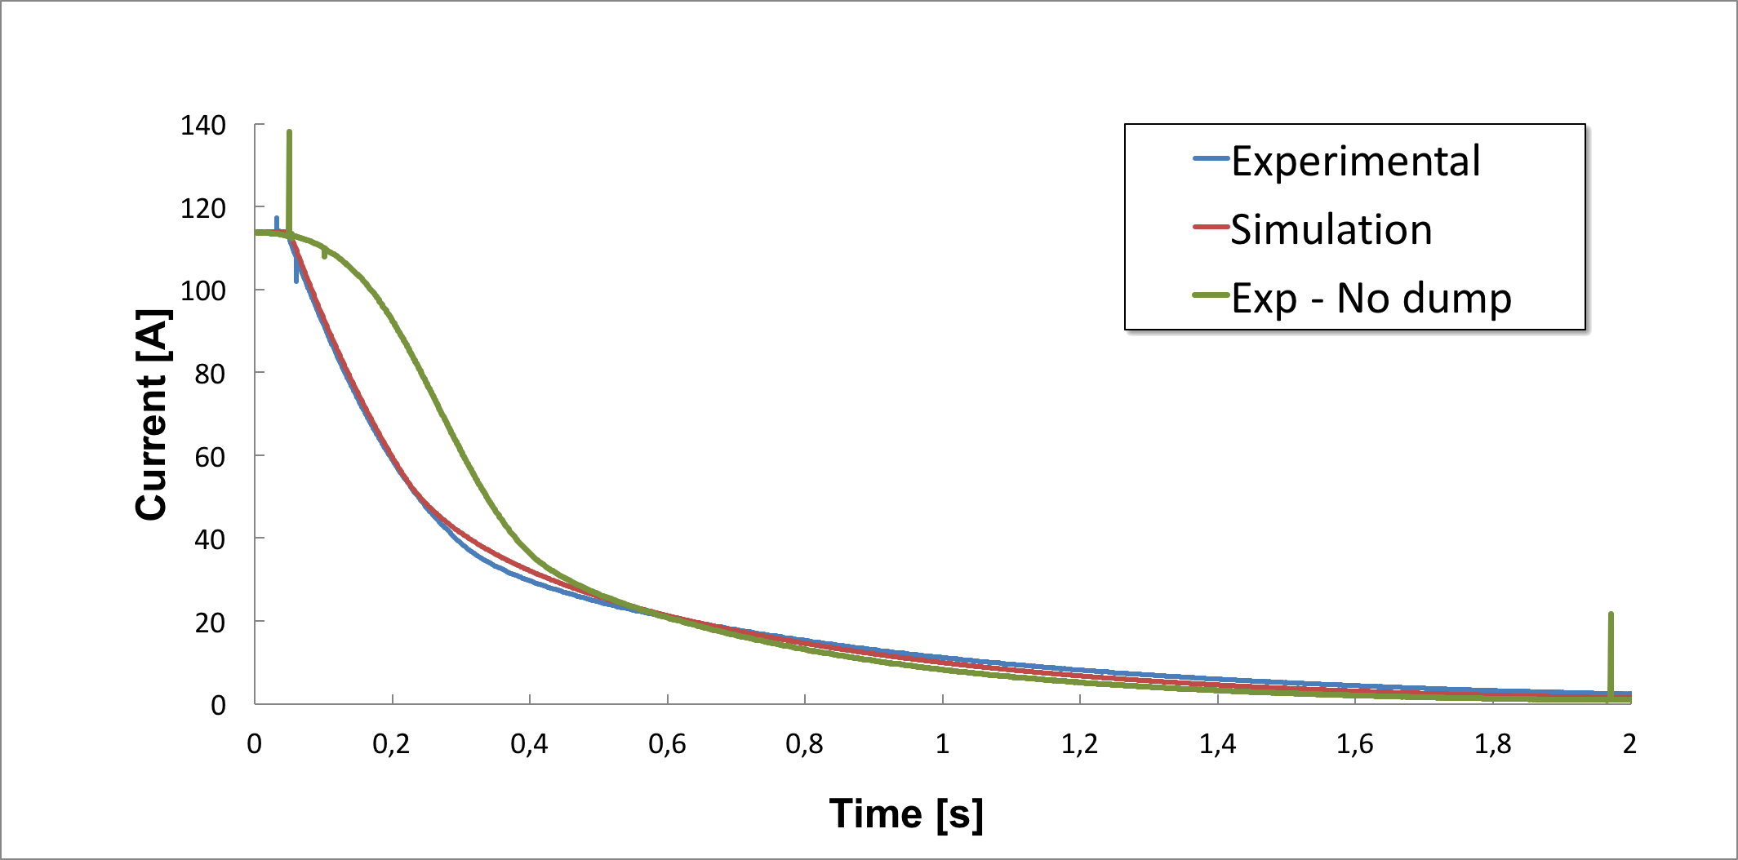
QUENCH PROTECTION (no ENERGY EXTRACTION)
  Quech induced by heater (and AlN insert)
  threshold up to 5.0 V
  total time before relay opening: 145 ms
  ΔI = 8 A @ 145 ms PS dependent
tuning of the simulation by QLASA
  inductance
  current decay
  voltages
no dump
training
200 ms
time

Slide 19
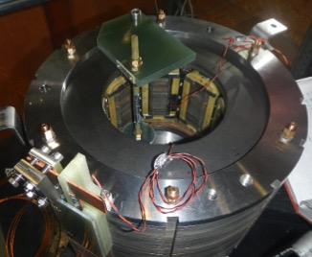
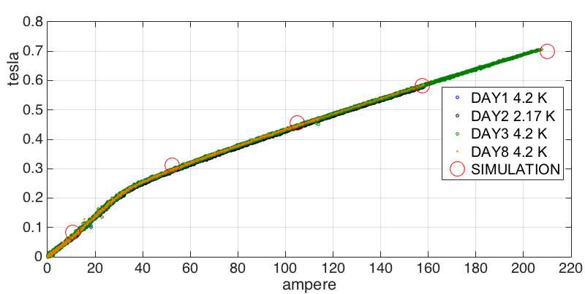
PRELIMINARY FIELD MEASUREMENT
preliminary measurement of the field
single point
in front of a pole
radius of 50±1 mm (correction applied)
reproducible
5 mT
saturation 30 A
complete measurement at CERN (2017?)

Slide 20
MCDXFP1 THE DECAPOLE
MCSXFP1
MCOXFP1
a2
a3
b3
a4
b4
MQSXFP1
a5
b5
a6
b6
MgB₂
round coil
MCDXFP1
MCTXFP1

Slide 21
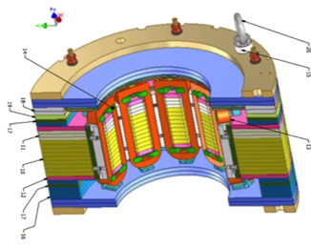
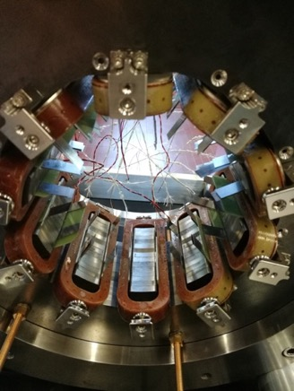
MCDXFP1 10POLE
 | nominal | design
length | 172 mm | 183 mm
integrated field @ Iop @ r50 mm | 25 Tmm | 26 Tmm
magnetic length | 95 mm | 97 mm
harmonics |  | B15=11.6 B25=-0.7
183 mm
5 coils BTS2
5 coils hybrid
COILS
  Updated BTS2 Arisawa design
  Hybrid BTS2/DURATRON
Improved electrical connection design, pcbs supporting and integration with connection box
M. Todero and D. Pedrini

Slide 22
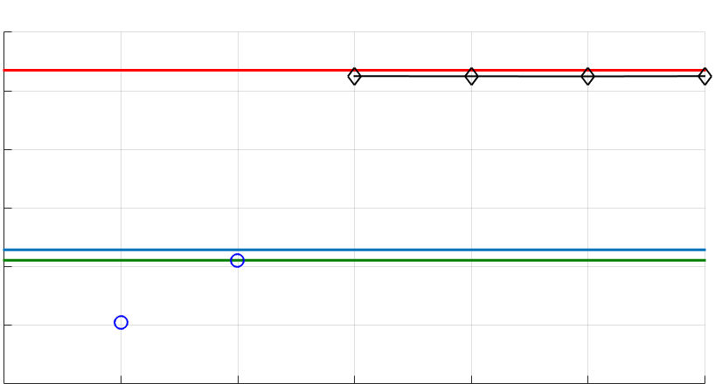
MCDXFP1 COILS’ ASSESSMENT
300
Single coil test
s.s.l.
16 coils produced
4 batches
1st batch single coil test
and LHe cooldown
2nd batch LN₂ cooldown
98% of coils’ s.s.l.
200
current [A]
Iult
100
Inom
provoked
B1 | M10-05
B2 | M10-08
B3 | M10-09
B4 | M10-11
B5 | M10-13
B6 | M10-06
B7 | M10-10
B8 | M10-12
B9 | M10-14
B10 | M10-15
BTS2
1
3
5
event number
Geometry
8pole average σ 0.13 mm
10pole average σ 0.11 mm
Resistance
number of turns
HV insulation
(Al wrap) all coils above 36 GΩ at 2.5 kV
DURATRON

Slide 23
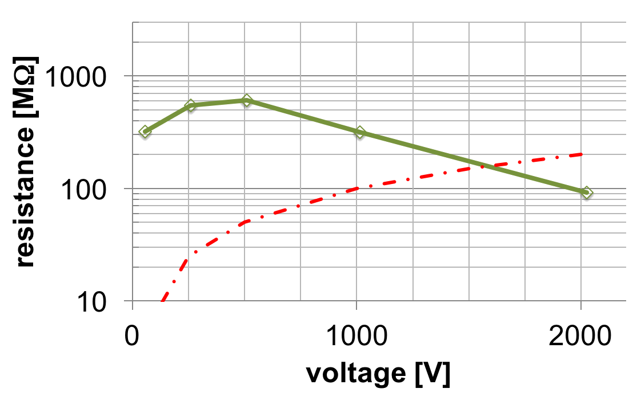
MCDXFP1 GROUND INSULATION
MCDXFP1 as assembled
10 μA limit

Slide 24
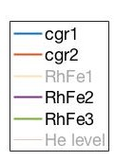
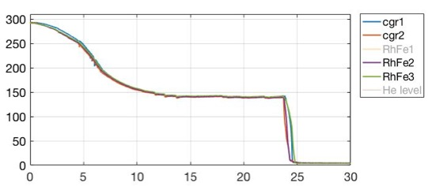
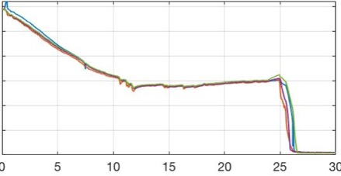
THERMAL CYCLES
Cooldown in about 1 day
  Nitrogen heat exchanger
Warmup in about 1 week
  Standard warming speed below 10 k/h
  Using heaters 30-40 K/h (temperature range 20 K -60 K )
temperature
hours
hours

Slide 25
MCDXFP1 TEST
Week 1
  4.2 K 1h @ I_{ult} , 121 A (115% I_{op})
  2.17 K 1h @ I_{ult} , 121 A
Week 2
  4.2 K 1h @ I_{ult} , 121 A (115% I_{op})
  no energy extraction quench test
  (operating conditions simulation)
  training

Slide 26
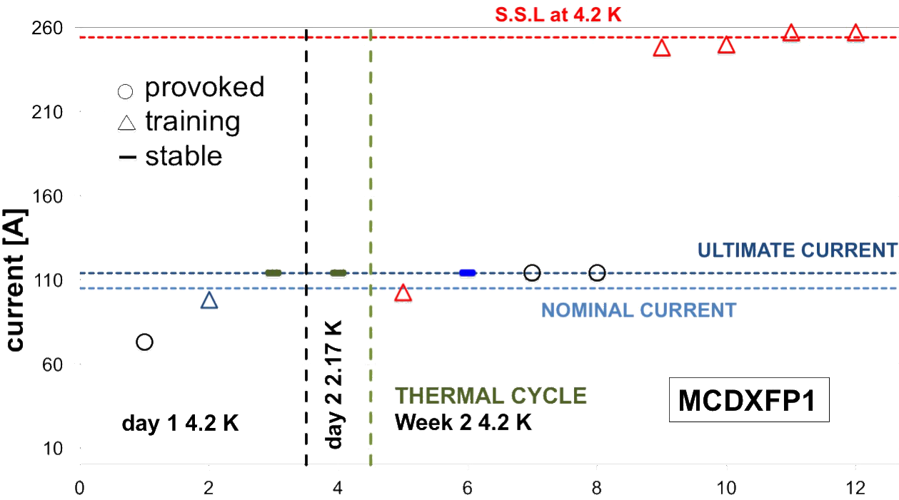
MCDXFP1 QUENCH SEQUENCE
B3-B4
B3-B4
B7-B8
B9-B10
B3-B4
B3-B4
event number
One provoked
One 98 A quench
Ultimate 114 A -1 h test (4.2 K and 2.17 K)
Reached 100% S.S.L at 4.2 K

Slide 27
QUENCH vs COILS TECHNOLOGY
Quench detection detects 2 coils
Quench heater on coil B3 (3 provoked)
4 quenches on B3-B4
1 quench on B7-B8
1 quench on B9-B10
B1 | M10-05
B2 | M10-08
B3 | M10-09
B4 | M10-11
B5 | M10-13
B6 | M10-06
B7 | M10-10
B8 | M10-12
B9 | M10-14
B10 | M10-15
BTS2
4
No sensitive difference between coils’ technology
1
DURATRON
1

Slide 28
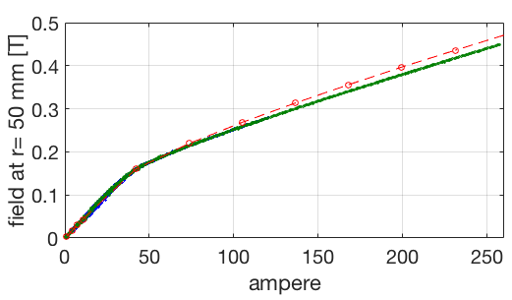
SINGLE POINT MAGNETIC FIELD
Single Hall probe
r_{ref}= 50 mm
Errors not shown
Good reproducibility
Harmonic measurements
at CERN (2017?)
4.2 K and 2.17 K
4.2 K after thermal cycle
O simulations

Slide 29
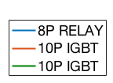
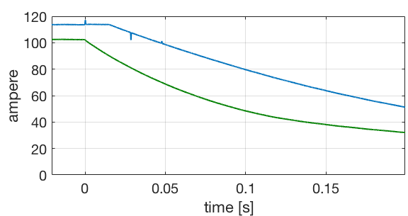
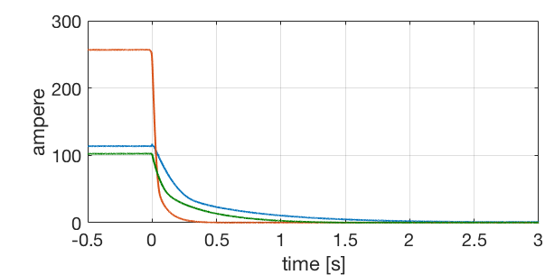
QUENCH PROTECTION SYSTEM UPGRADE
2 IGBTS working in parallel
Same components as 10 kA switch (by A. Paccalini and M. Quadrio)
15 ms
<1 ms
trigger

Slide 30
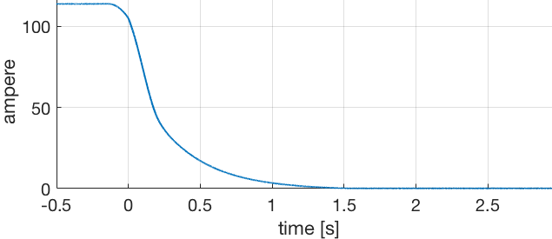
QUENCH PROTECTION (no ENERGY EXTRACTION)
Protection in LHC
  Measuring current
  Time range 60-180 ms
  Max current: ultimate current (114 A)
Protection at LASA
  Quech induced by heater (and AlN insert)
  Increase validation time
  Reached 120 ms and 140 ms at ultimate current
MCDXFP1 survived

Slide 31
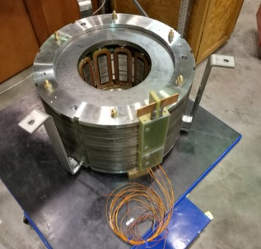
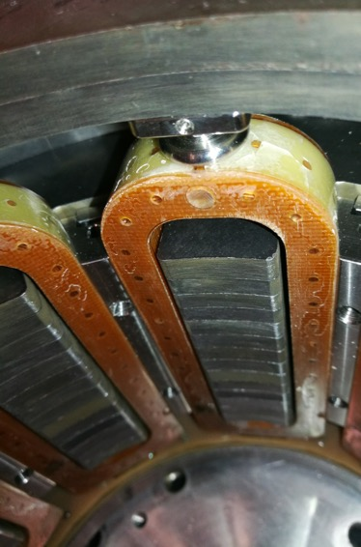
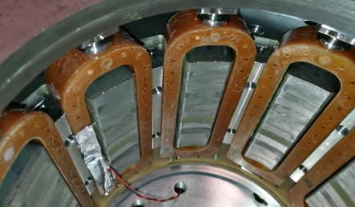
AFTER THERMAL CYCLE
Detailed inspection on one side
One defect on coil M10-14
No detached wedges

Slide 32
NEXT STEPS: MCTXFP1 AND MCQSXFP1
MCSXFP1
MCOXFP1
a2
a3
b3
a4
b4
MQSXFP1
a5
b5
a6
b6
MgB₂
round coil
MCDXFP1
MCTXFP1

Slide 33
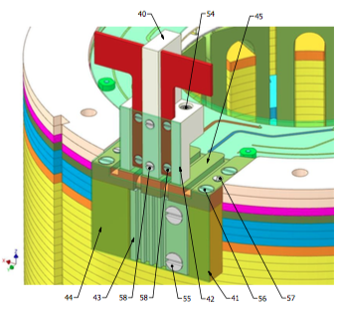
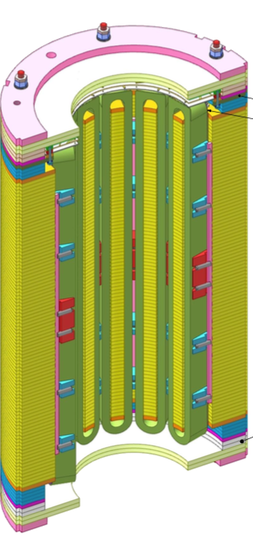
DODECAPOLE MCTXFP1
connections
at LASA
PCB boards
Normal (Skew) | nominal | simulation
length plate to plate | 514 mm (166 mm) | 575 mm (200 mm)
integrated field @ I_{op} @ r50 mm | 0.086 Tm (0.017 Tm) | 0.086 Tm (0.017 Tm)
magnetic length | 430 mm | 471 mm
energy @I_{op} | 4.35 kJ | 7,78 kJ
harmonics @I_{op} |  | B18= -6.2 B30= -3.5
connections
box
at CERN
OD320
coils
432 windings
Φ 0.5 mm NbTi
500 mm long
Full BTS2 technology
575 mm

Slide 34

SKEW QUADRUPOLE MCQSXFP1
 | nominal | simulation
length plate to plate | 903 | 814
integrated field @ I_{op} @ r50 mm | 1.0 Tm | 1.016 Tm
magnetic length | 807 mm | 671 mm
energy @I_{op} | 24 kJ | 36 kJ
I_{op}=182 A - φ 0.7 mm NbTi
protection: 1.5 Ω dump
50% energy extracted
OD 460 mm
Modified holes for Heat Exchanger
The poles are modified hyperbolas
B(@z=0,r=50 mm) = 1.5 T
Transfer Function
8.86 Tm/kA ÷ 5.58 Tm/kA
saturation at ~0.3 I/Inom
harmonics
B6= -30 U at low current
B6= 30 U at I_{op}
B10= -8 U ÷ -12 U
754 windings
φ 0.7 mm NbTi

Slide 35
DELIVERY AND TEST
Tender approved by INFN
contract sent to company – arrived 4 weeks later
Start end of October (T₀)
Updated schedule
  4/6/2018 MCTXFP1 delivered to LASA
  (T₀ + 7 months)
  4/9/2018 MCQSXFP delivered to LASA
  (T₀ + 10 Months)
Test at LASA 2 months

Slide 36
INTEGRATION
Cold mass
Magnet length vs magnetic design
Position in the cold mass
Alignment
Electrical connections (box definition and position)
Fix threads and nuts by resin (CTD 101K) and anti vibration washers
Position and diameter for the Heat Exchanger (MCQSXFP)
Power supply and protection
Reduction of nominal current 134 A -> 105 A
  But MCQSXFP1 (4P)
  MCSXFP1 (6P) to be updated (no major changes)
Quench protection w/o energy extraction in LHC
Documentation
All produced magnets are in MTF/EDMS
Test reports and test summaries
Acceptance procedures
Workflow
MIPs in preparation

Slide 37
QUENCH PROTECTION
No dump | Quadrupole | Sextupole I_{nom}=134 A | Octupole | Decapole | Dodecapole
Peak voltage to ground | 633 V | 135 V | 70 V | 36 V | 251 V
Hot spot temperature | 132 K | 164 K | 131 K | 122 K | 147 K
4P | Ground at magnet end | Ground at half dump | Ground at half magnet
0 Ω | 633 V | 633 V | 422 V
0.5 Ω | 474 V | 447 V | 316 V
1 Ω | 407 V | 357 V | 271 V
1.5 Ω | 358 V | 287 V | 238 V
QLASA simulations by V. Marinozzi
HO correctors tested
V_{test} 1.5 kV at RT
But 4P
6p to be reviewed
Room Temperature test
V_{test}=(2 x V_{mx} + 500) x2

Slide 38

GROUND INSULATION
MCSXFP1 20 months
MCOXFP1
MCSXFP1
MCDXFP1
10 μA limit

Slide 39



ROUND COIL MAGNET
Fe
φ 380
Demonstrator
Mechanics design ongoing
Winding machine done
mould construction done
First batch of insulated MgB₂ wire delivered at LASA
coil
demonstrator
100 mm
Fe
M. Todero and D. Pedrini
C. Uva

Slide 40


ROUND COIL MAGNET II
Test Cu coil
M. Quadrio and A. Paccalini
SCHEDULE
Winding MgB₂ wire in 2017
Impregnation in 2017
Cold test of the coil 1Q2017
Magnet assembly 2Q 2018

Slide 41


NEW CRYOSTAT
Safety
Valve and disk
Connections X3
Cryostat for testing MCTXFP1 (12P), MCQSXFP1 (4P) and series magnets
520 mm inner diameter
About 3 m cold volume (with top flange insulation)
Up to 4 magnets (3 possible configurations)
Flange modification, thermal insulation, magnet support, room temperature connections.
Ordered end 2017
Mag.meas.
CL
2+4
HE inlet

Slide 42

TEST CONFIGURATIONS
Prototypes
Single magnet test
Series production
3 batches
  18 magnets
  2X12P 2X4P
  5 cooldowns
600
2350
4P
12P

Slide 43
TEST STATION UPGRADE
New cryostat all components ordered
New main switch for power supply (fast solid state switch, Δt<1 ms) DONE
New power supply for magnet test (200 A, 50 V)
ORDER ONGOING
New acquisition system for test monitoring
ORDER ONGOING
Installation of system for magnetic measurement at low/room temperature (supplied by CERN)

Slide 44
CONCLUSIONS
magnet |  | assembly | Cold test | Field measurement
MCSXFP1 | 6P | 2015 | 2016 | 2016
MCOXFP1 | 8P | 2016 | 2017 | 2017?
MCDXFP1 | 10P | 2017 | 2017 | 2017?
MCTXFP1 | 12P | 2018 | 2018 | 2018
MCQSXFP1 | 4P | 2018 | 2018 | 2018

Slide 45
CONCLUSIONS AND NEXT STEPS
MCOXFP1
  Tested
MCDXFP1
  Assembled
  First cooldown and thermal cycle results
MCQSXFP1 and MCTXFP1: 2018
MgB₂ RCSM
  Winding end 2017
  Test 2018
New cryostat (MAGIX)
  Flange and magnet support 1Q 2018

Slide 46
THANK YOU
LASA team
F. Alessandria, G. Bellomo, F. Broggi, S. Mariotto, A. Paccalini, D. Pedrini, A. Leone, V. Marinozzi, M. Quadrio, M. Sorbi, M. Statera, M. Todero, C. Uva

Slide 47
SPARE

Slide 48





MCOXFP1 COILS - spares
machined from bulk
4 parts
>1 mm BTS2 – new design
0.15 mm BTS2
1.05 mm BTS2
1.3÷1.5 mm DURATRON
machined from bulk

Slide 49


