Slide 1
Detection of beam losses in the triplet and cold BLM sensitivity
A. Tsinganis, F. Cerutti, A. Lechner (EN/STI/FDA)
with A. Mereghetti, Y. Zou (BE/ABP)
7th Annual HiLumi Collaboration Meeting – Madrid, November 13-16, 2016

Slide 2
Outline
Introduction
Layout and optics
Loss scenario
Results
  Peak power density in coils
  BLM response
  “cryoBLM” response
Summary

Slide 3
Introduction
Goals of this study:
  First calculation of BLM pattern in the Hilumi triplet for stable operation and for a loss scenario in IR5
    Disentangling of losses and collision debris
  Evaluation of “cryoBLM” effectiveness with respect to conventional BLMs

Slide 4
Layout, optics and loss scenario

Slide 5
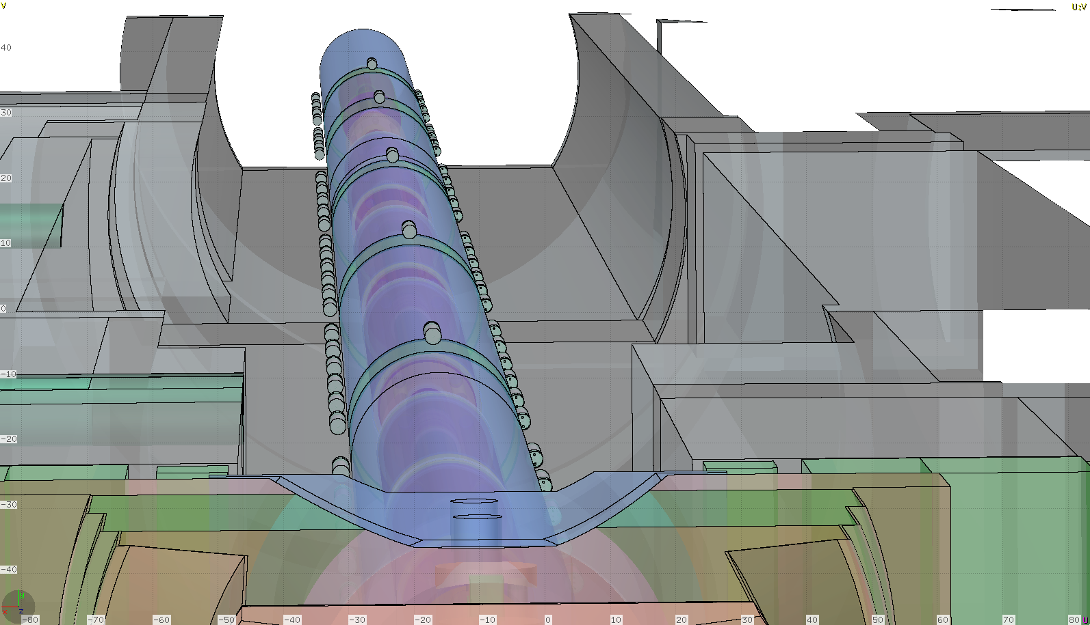
Simulated geometry (triplet-D1)
HL-LHCV1.3 (255μrad half crossing angle, β*=20cm)

Slide 6
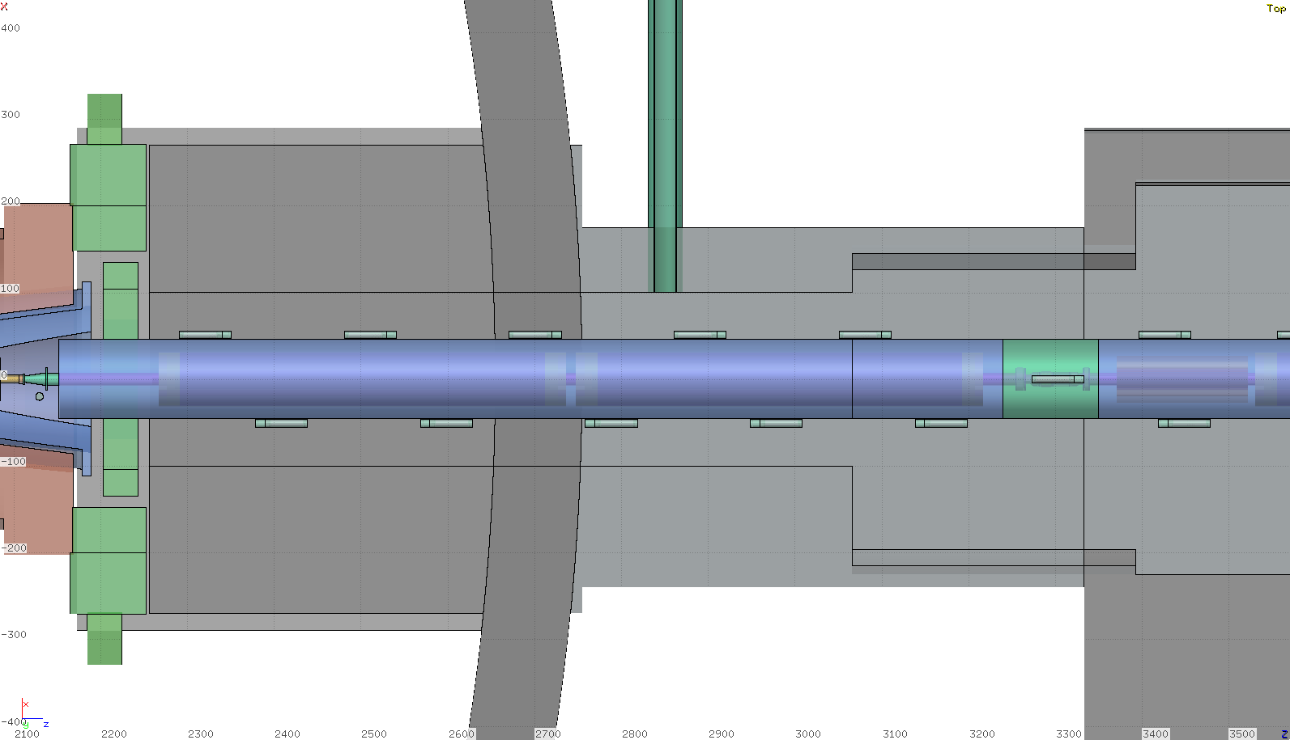
Simulated geometry (triplet-D1)
Several BLMs placed to obtain a finer-grained information

Slide 7
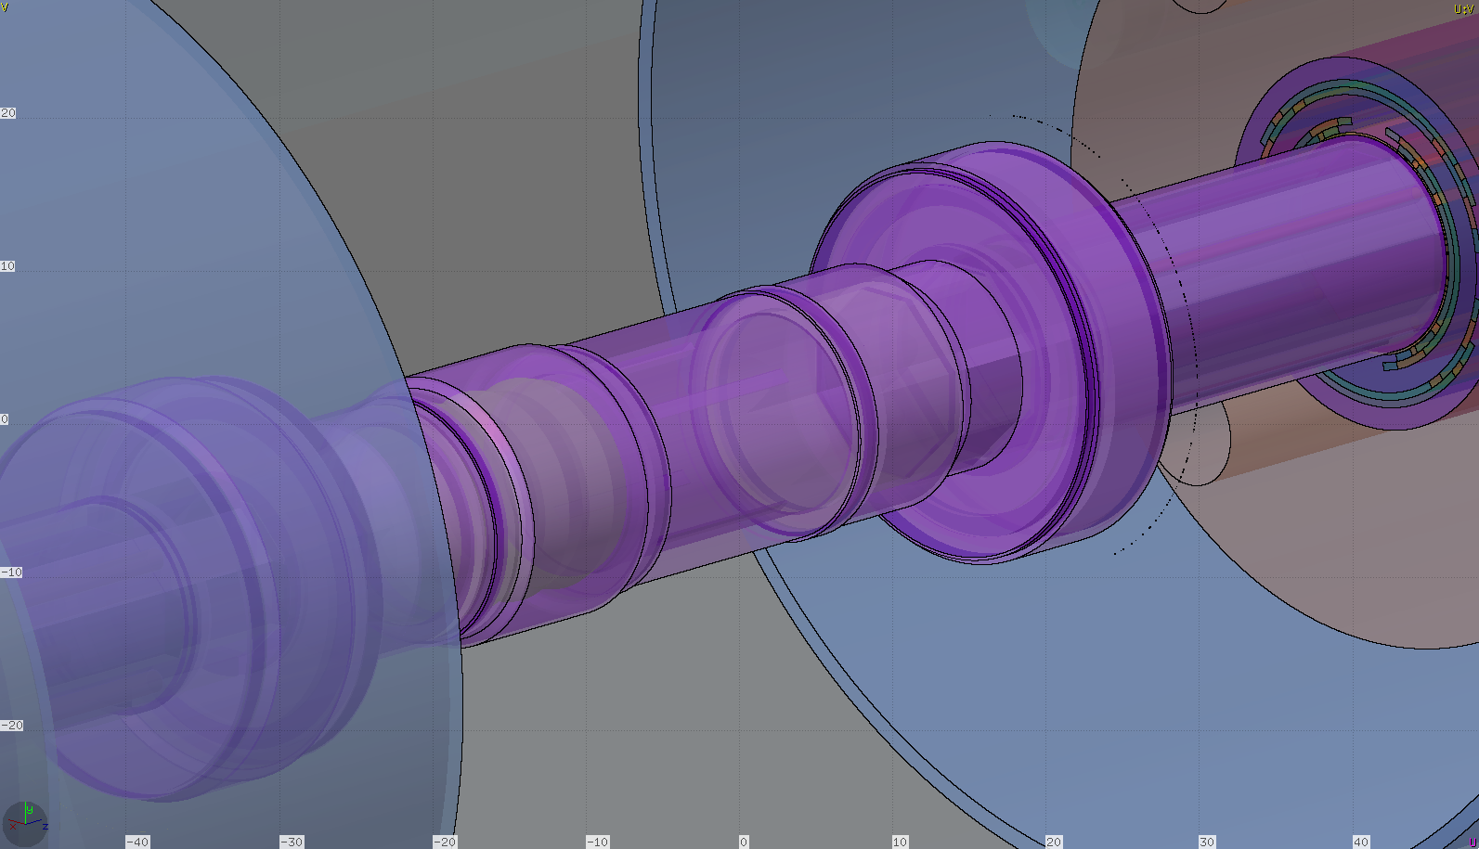
Scoring for “cryoBLMs”
Additional scoring added on the interconnect flanges

Slide 8
Loss scenario
Tracking calculations performed by Y. Zou & A. Mereghetti with:
  7.0 TeV beam momentum, 𝜷∗=15cm, 295μrad half crossing angle
  Open TCTs in IR1/2/5/8
    Aim: to simulate missing protection from TCTs
  Open TCLA in IR7, TCSG in IR6, TCDQ in IR6
    Aim: to increase losses in the triplet
  TCLs open
Highest losses recorded right of IP5 (incoming beam)

Slide 9
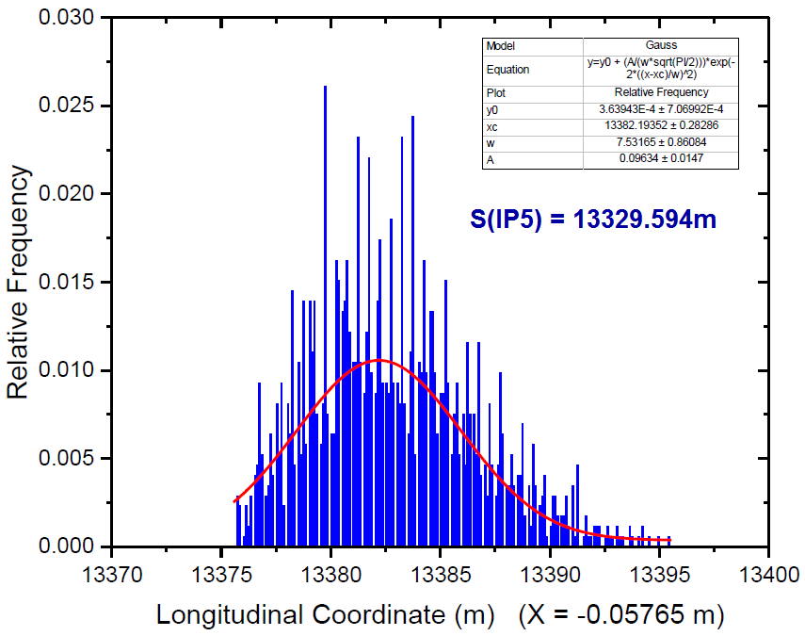
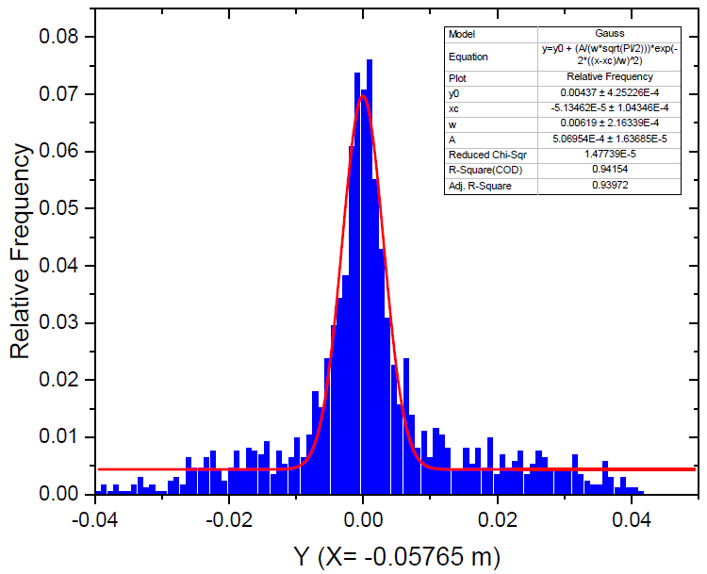
Loss scenario
Only losses on horizontal plane were considered (dominant contribution)
In FLUKA, events were sampled from the fitted distributions in s, x, x’, y, y’
Losses concentrated between Q3 and Q2B

Slide 10
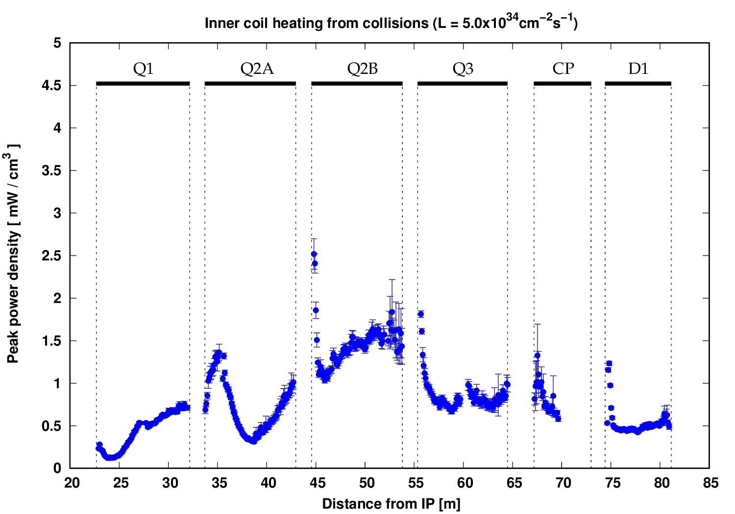
Triplet-D1: Peak power density profile
(Debris, L=5.0x10³⁴ cm⁻² s⁻¹)

Slide 11
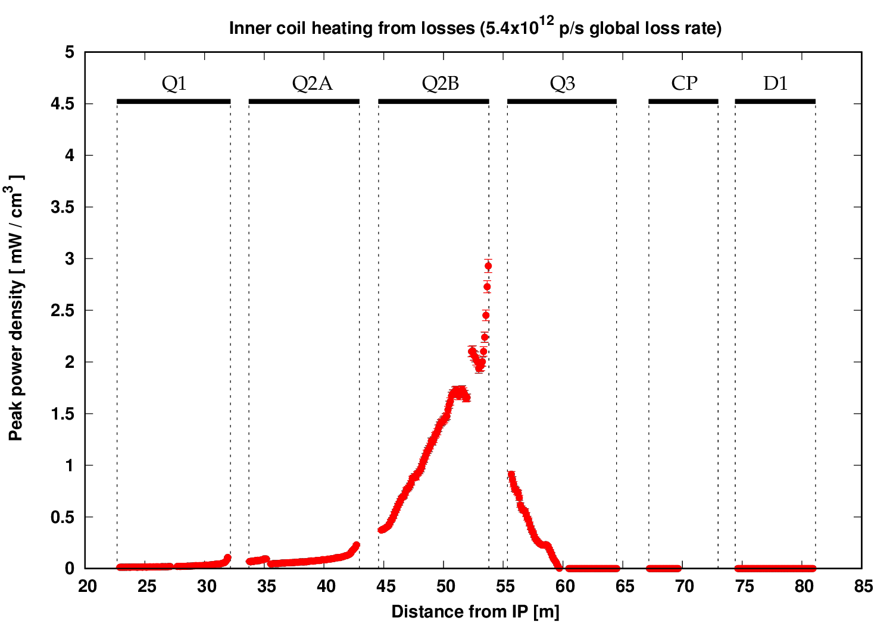
Triplet-D1: Peak power density profile
(Losses)
MCBX corrector
Normalised in order to reach the 4mW/cm³ design limit in the MCBX corrector when added to the debris load

Slide 12
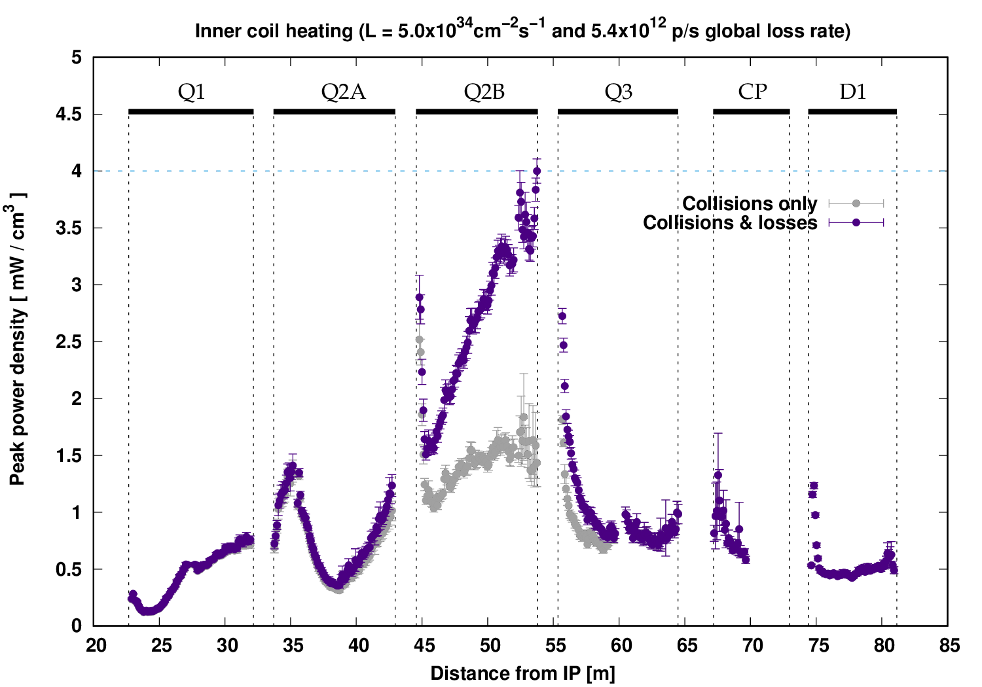
Triplet-D1: Peak power density profile
(Debris and losses, 4mW/cm³ maximum value)
Corresponds to 3.0x10⁸ p/s lost locally ➔ 5.39x10¹² p/s global loss rate
Two minutes of beam life-time, ~6 MW of power lost
Such an abnormally low life-time is dumped in the collimation system, hence local detection is not essential

Slide 13
BLM pattern

Slide 14
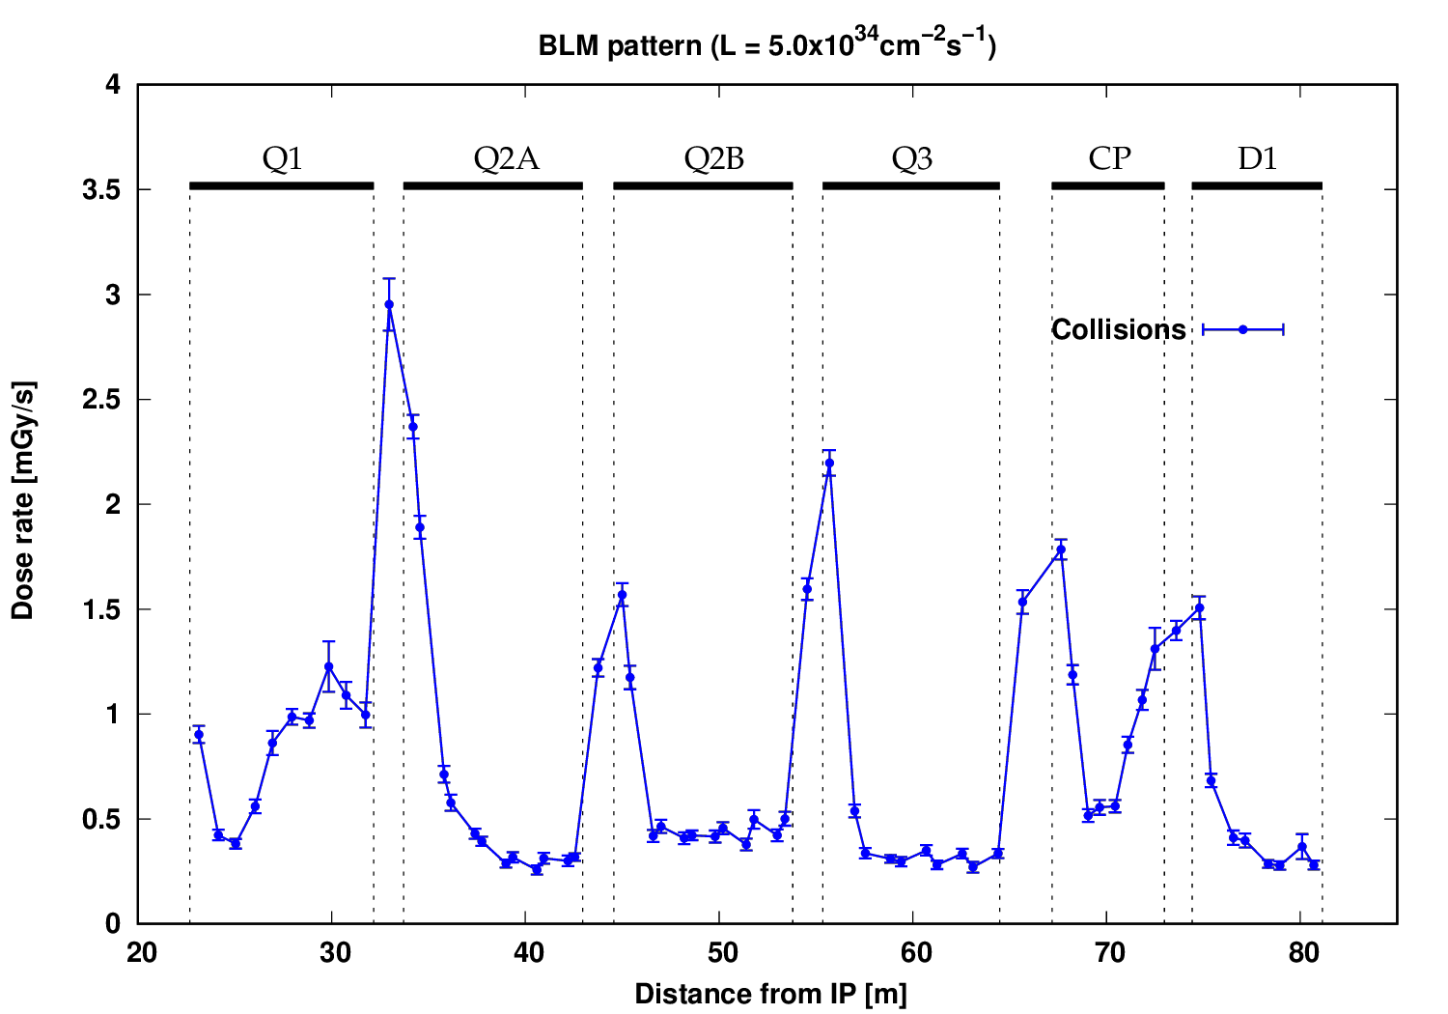
Normal BLM response to collision debris
“cryoBLM”
positions
This high-resolution pattern could guide the optimisation of the BLM placement

Slide 15
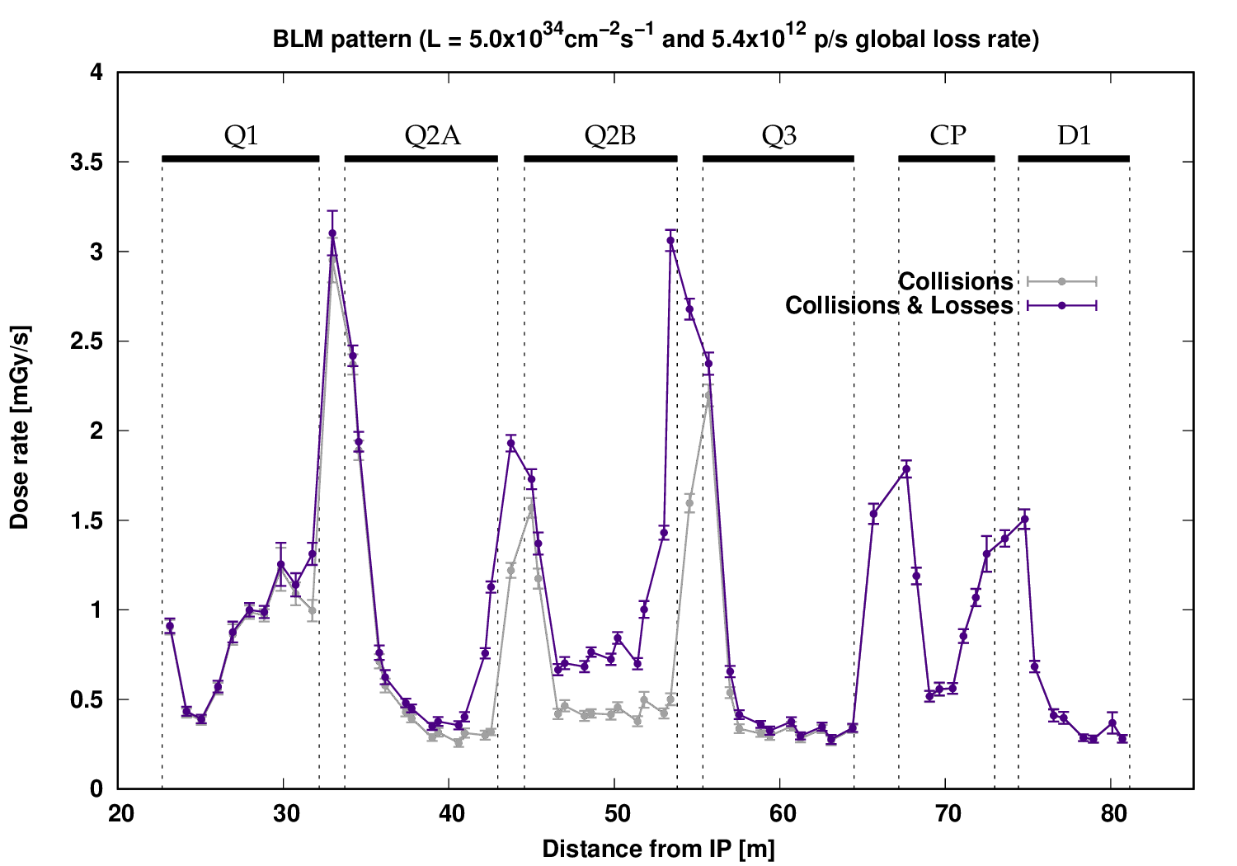
Normal BLM response: debris and losses
Highest sensitivity at end of Q2B

Slide 16
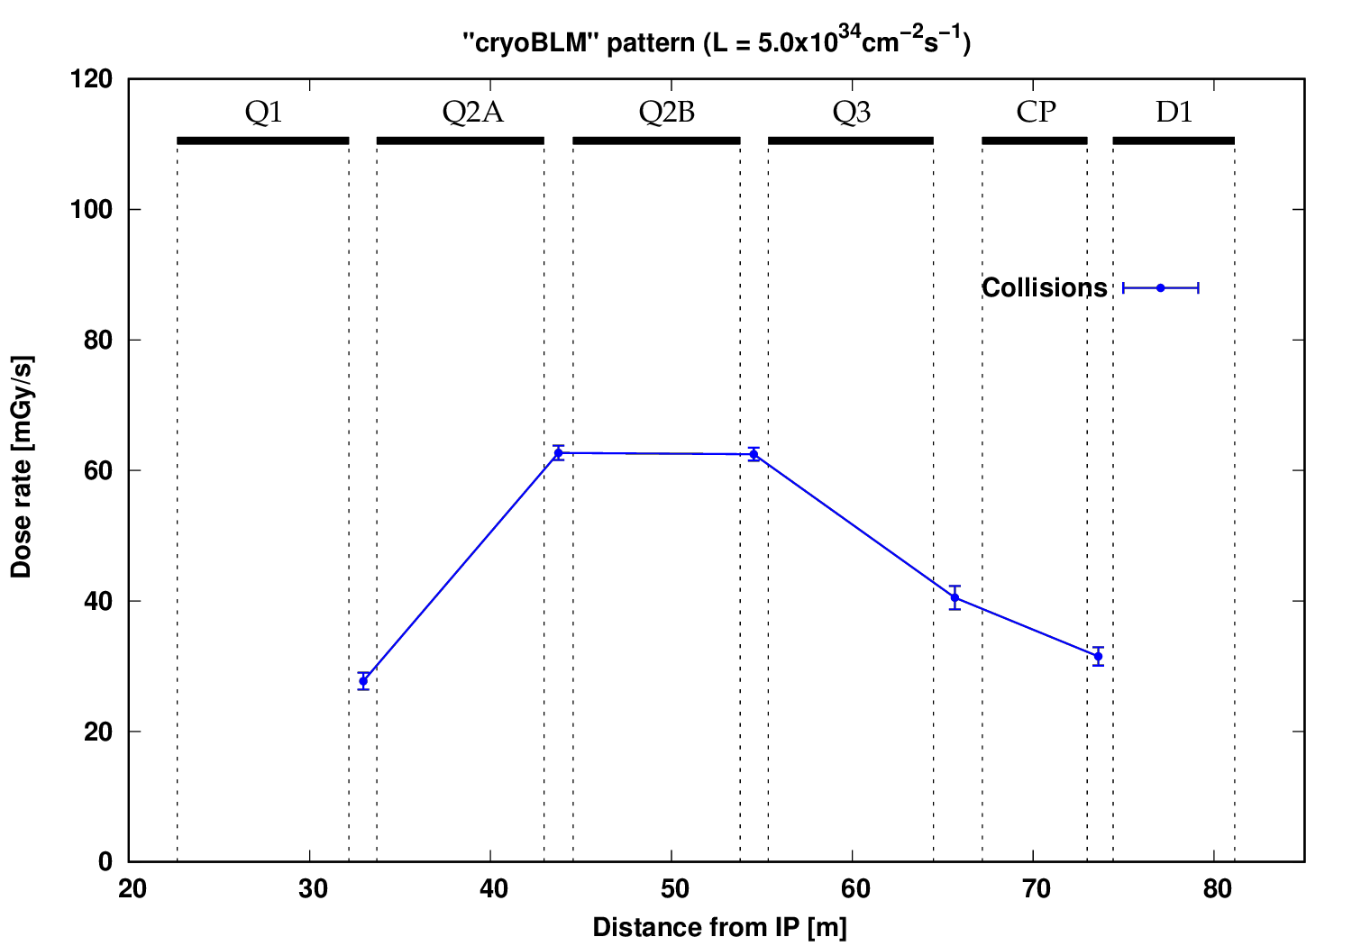
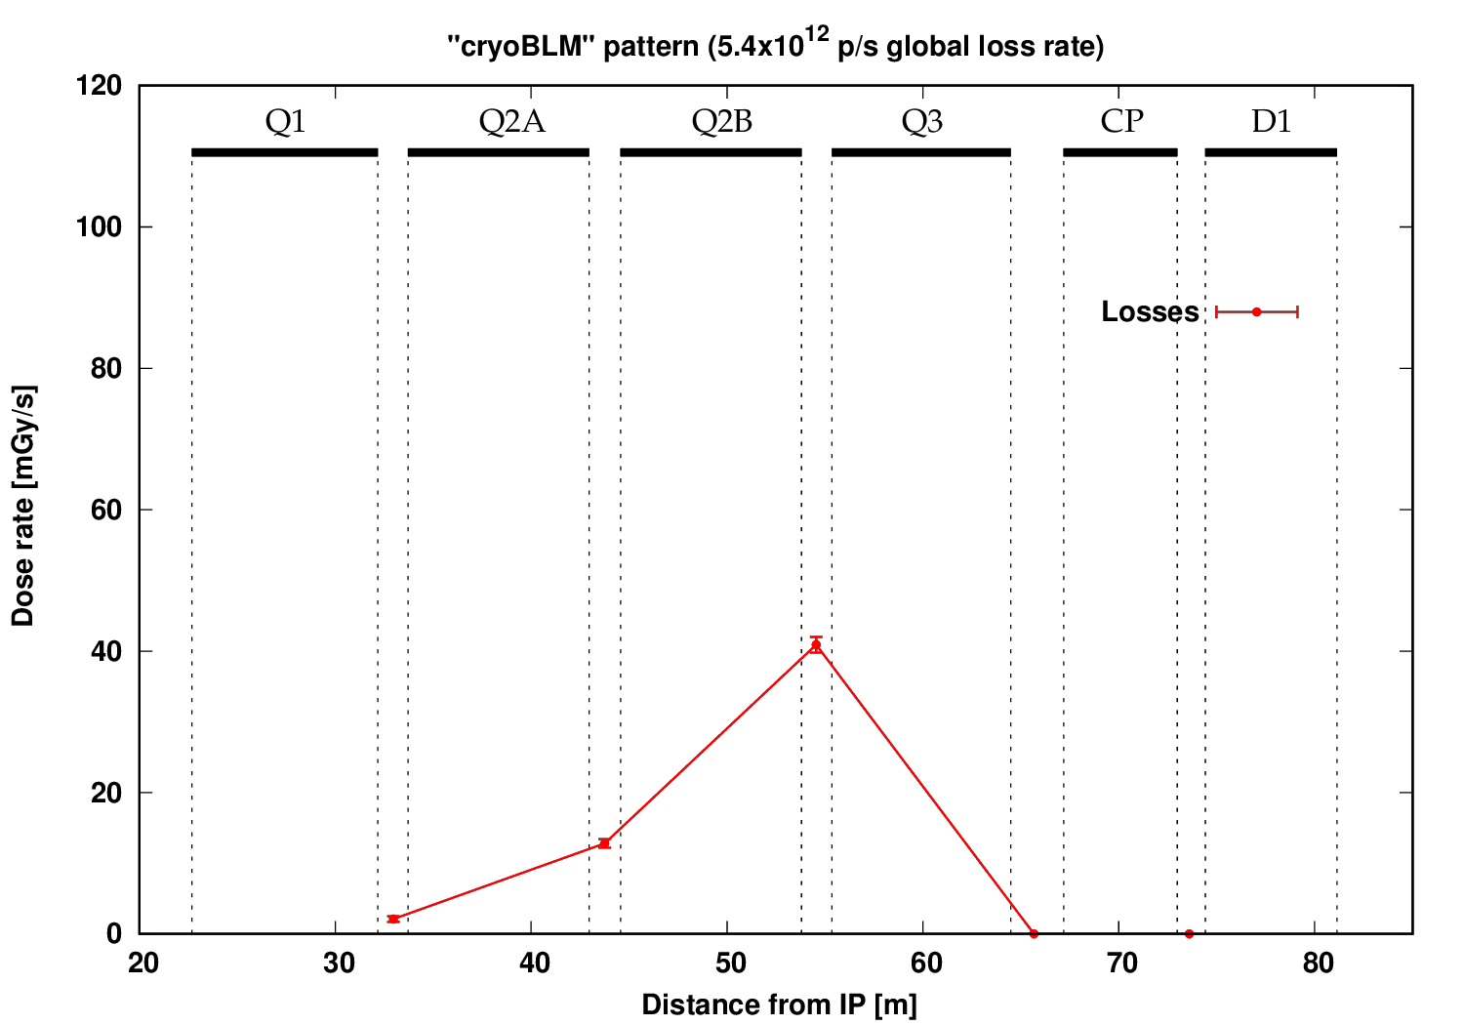
“cryoBLM” response: debris vs. losses comparison
“cryoBLM” values have a strong azimuthal dependence → their exact placement is critical
The maximum values were considered for this study
“cryoBLM” values (debris)
Dist. from IP [m] | Min. [Gy/s] | Max. [Gy/s]
32.97 | 0.018 | 0.028
43.75 | 0.021 | 0.064
54.55 | 0.026 | 0.065
65.67 | 0.019 | 0.039
73.6 | 0.019 | 0.032

Slide 17
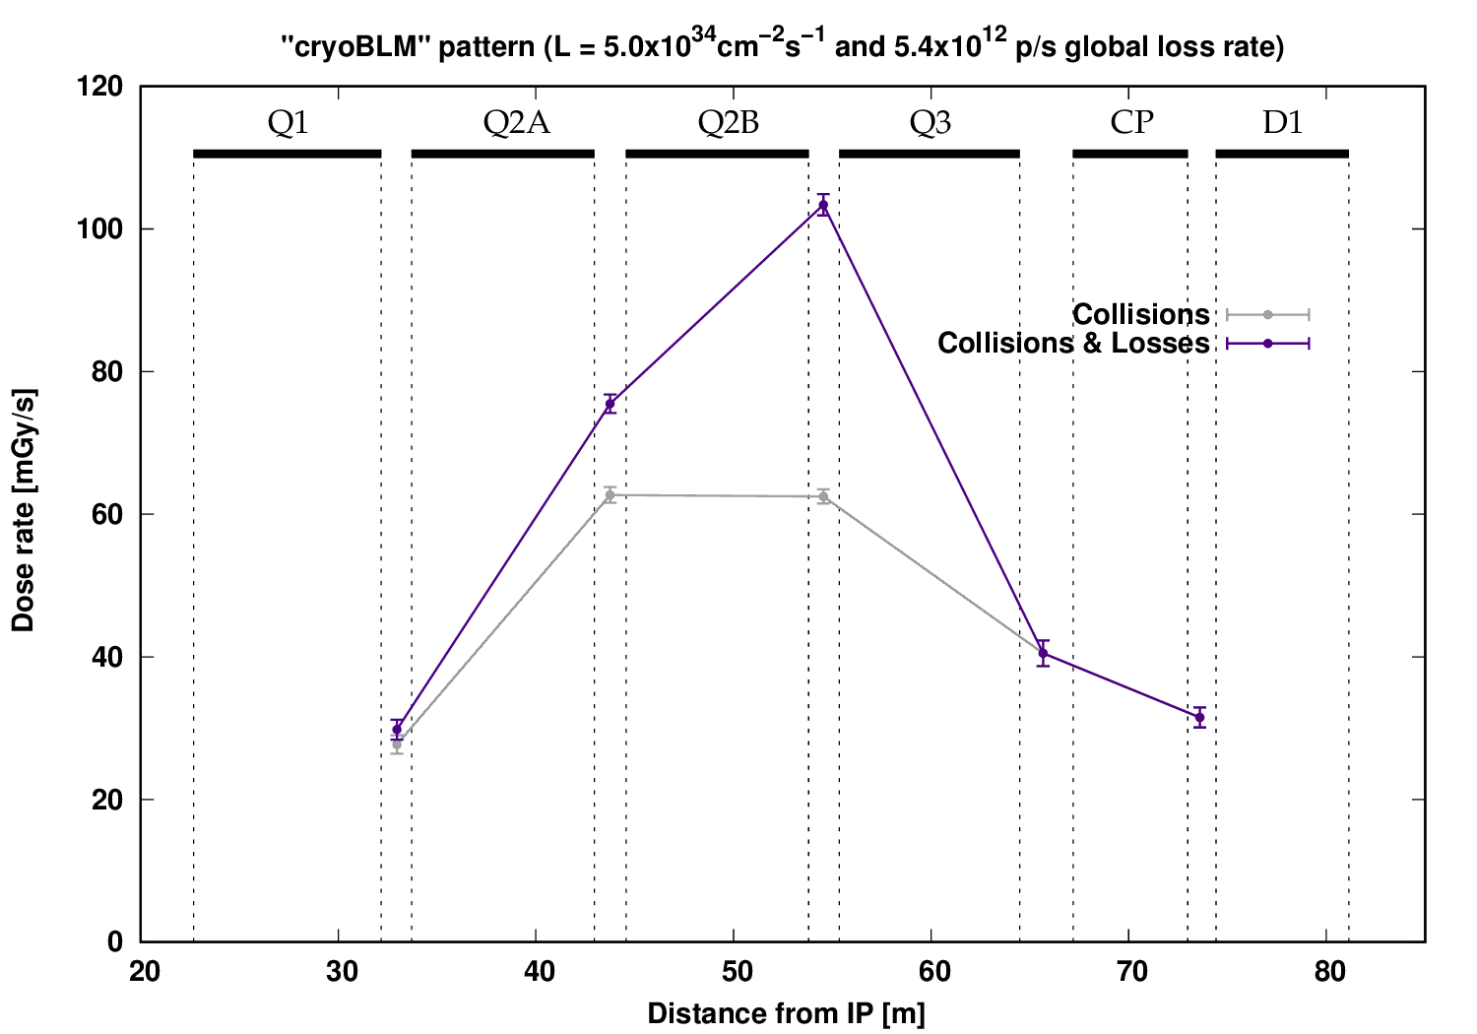
“cryoBLM” response: debris and losses
Highest sensitivity also at end of Q2B
Not comparable to the normal BLM sensitivity gain due to the less favourable positioning

Slide 18
Summary
Abnormal losses in the triplet would only represent an operational threat for beam life-times that are sufficiently low to induce a dump in the collimation region by design
Even for the corresponding extreme loss rate, the presence of cold BLMs does not necessarily increase the detection sensitivity compared with what could be achieved with conventional BLMs, whose placement is less constrained and can be optimised to maximise pattern changes

