Slide 1

Beam Gas Vertex status and upgrade plans
Sotiris Vlachos for the BGV collaboration
HL-LHC Collaboration meeting, Madrid 14 Nov. 2017

Slide 2
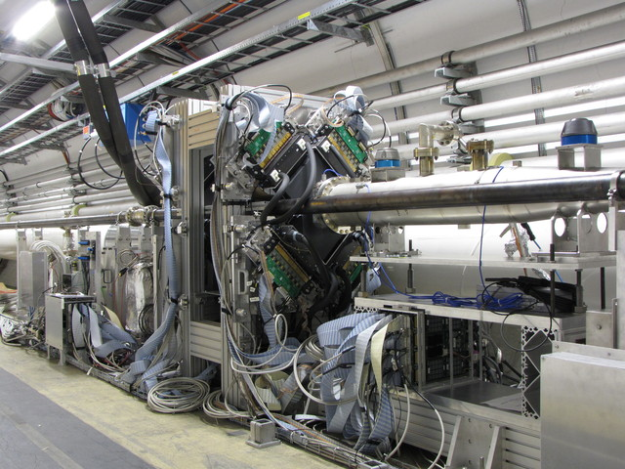
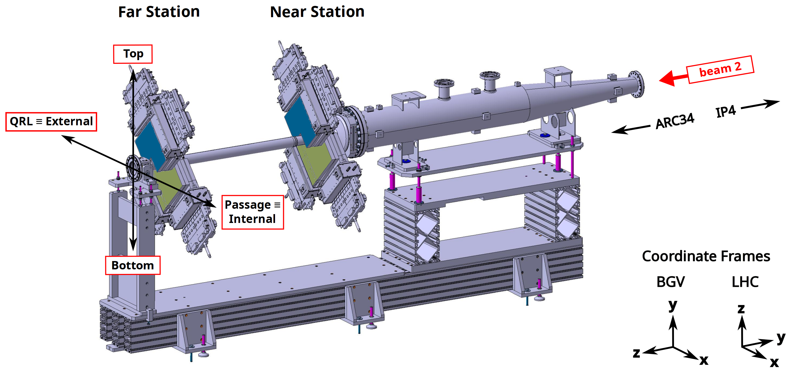
Beam Gas Vertex Detector
Non destructive beam size measurement for HL-LHC not limited by accelerator luminosity
Tracks from beam-gas interactions to reconstruct beam spot
Ne @ 10⁻⁸ mbar injected at interaction volume
Goals:
statistical uncertainty: 5% in 3 min for 10^11 p/bunch
systematic uncertainty (vertex resolution): 5%
Should allow ε measurements with similar precision
Demonstrator built around Beam 2, in Pt4
Demonstrator fully commissioned,
Data analysis ongoing

Slide 3
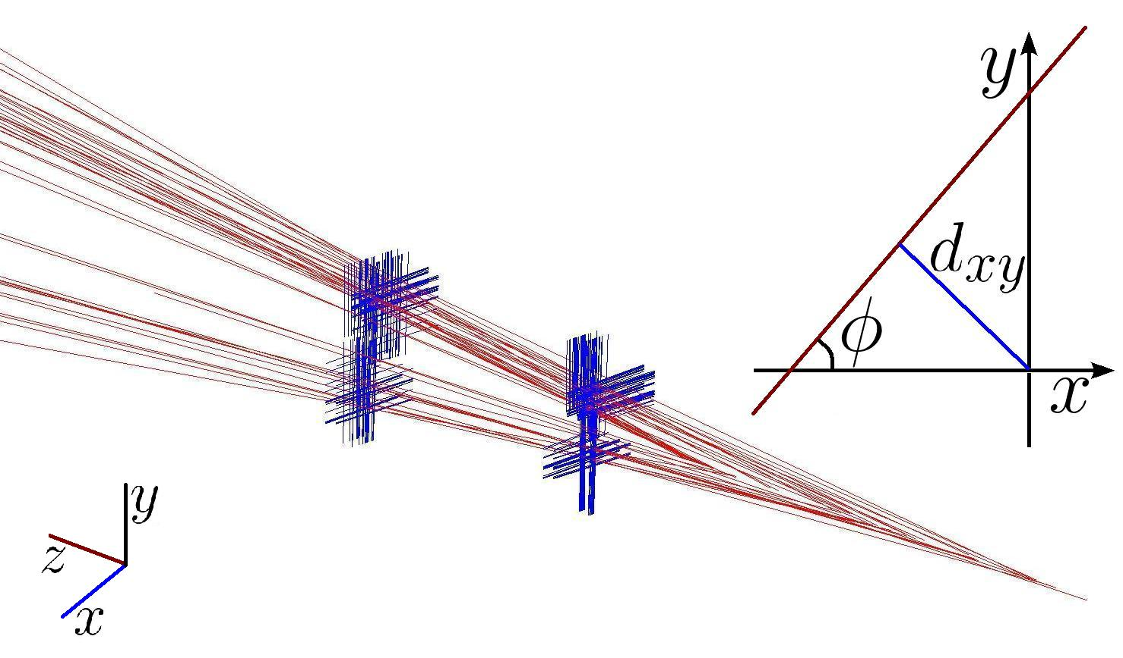
First look at BGV real data
A typical BGV event,
Blue lines : SciFi strips with significant energy deposit
Red lines : reconstructed tracks

Slide 4
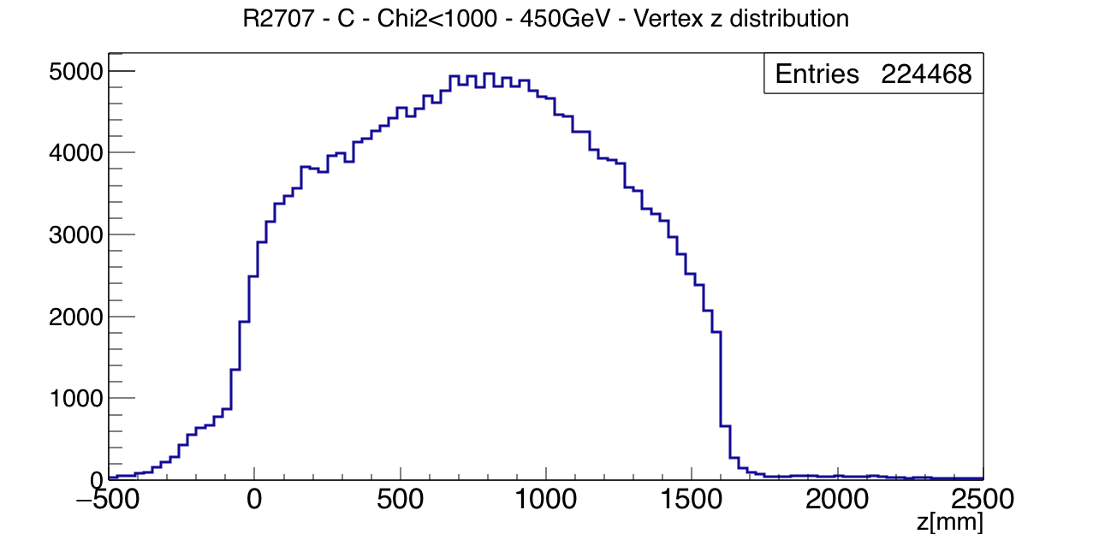
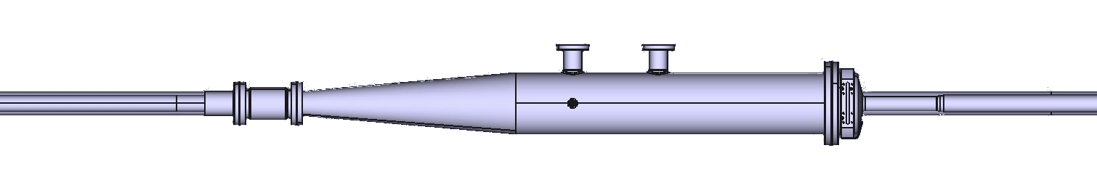
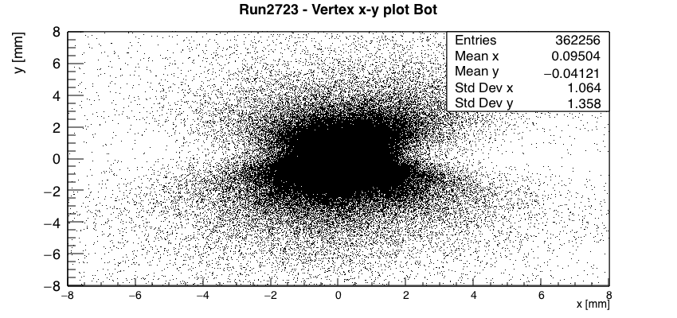
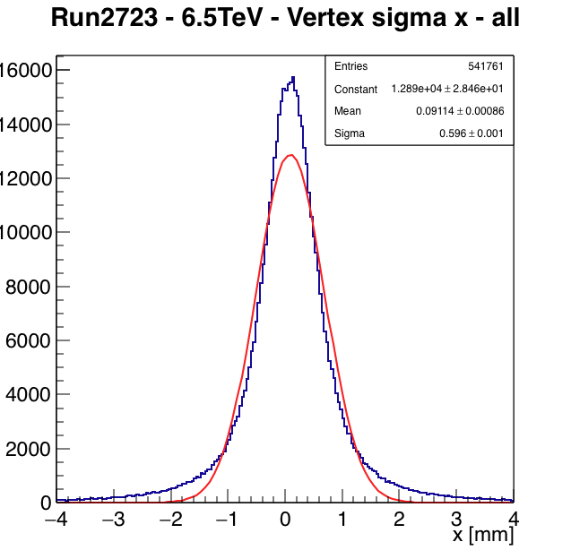
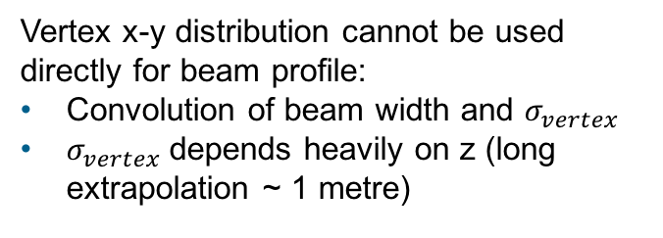
Vertex distribution in the BGV gas volume
Vertex reconstruction
Vertex x-y distribution cannot be used directly for beam profile:
Convolution of beam width and $σ_{vertex}$
$σ_{vertex}$depends heavily on z (long extrapolation ~ 1 metre)

Slide 5
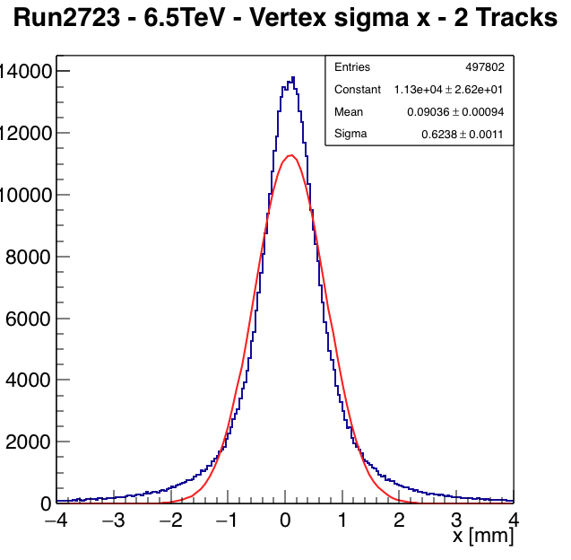
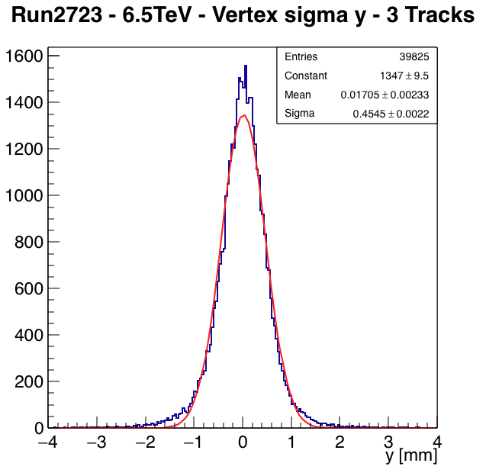
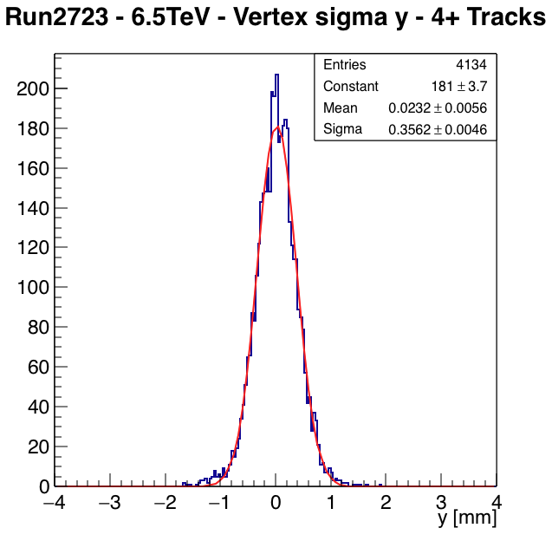

X-projection of vertex distribution
2-prong vertices
3-prong vertices
4-prong vertices
$σ_{vertex}$ ∝$\sqrt{Number of tracks}{ σ}_{IP}$
High prong vertices allow also better event selection, gaussian position distribution

Slide 6
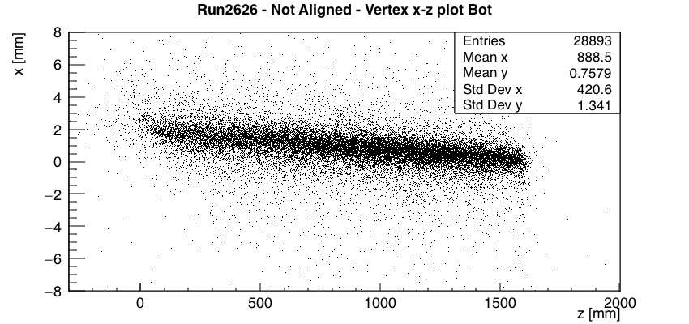
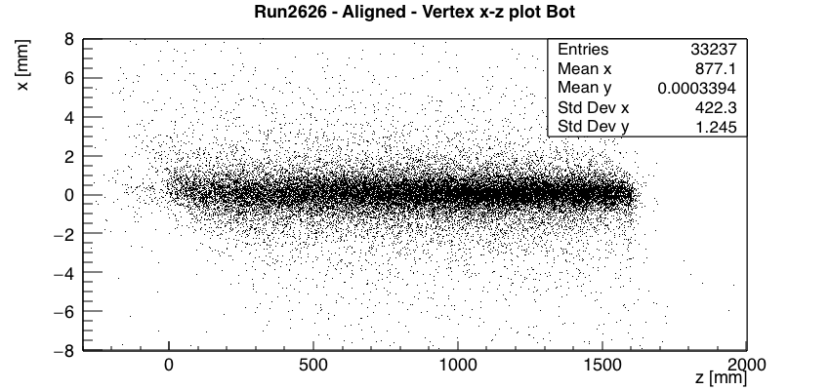
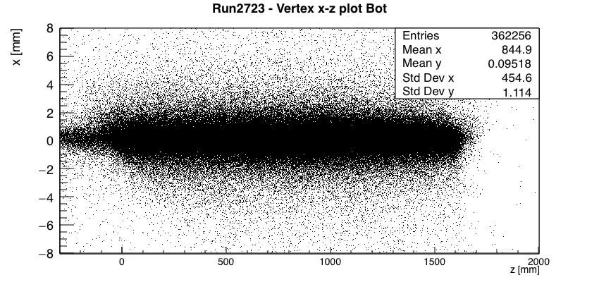
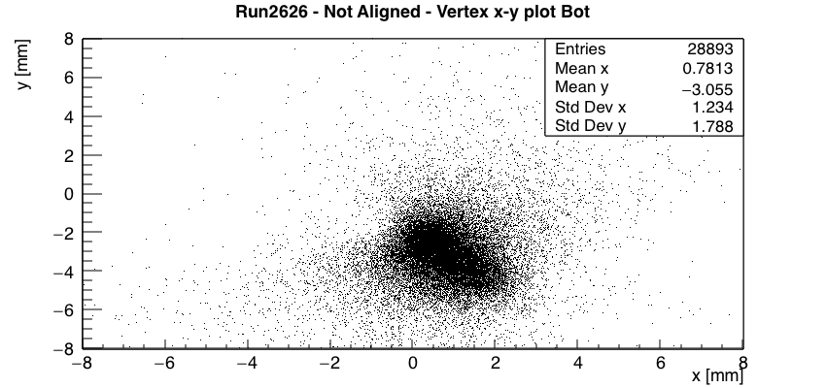
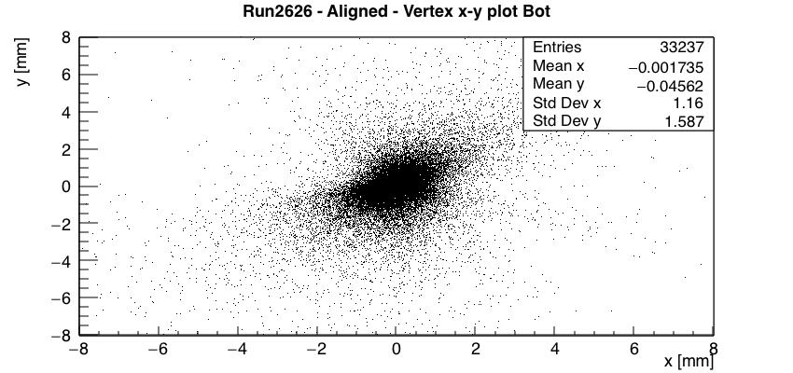
Vertex reconstruction,
Focus along beam direction
Raw data
After relative plane
alignment O(1mm)
Run 2626,
used to estimate corrections
Run 2723,
High statistics,
same corrections used

Slide 7
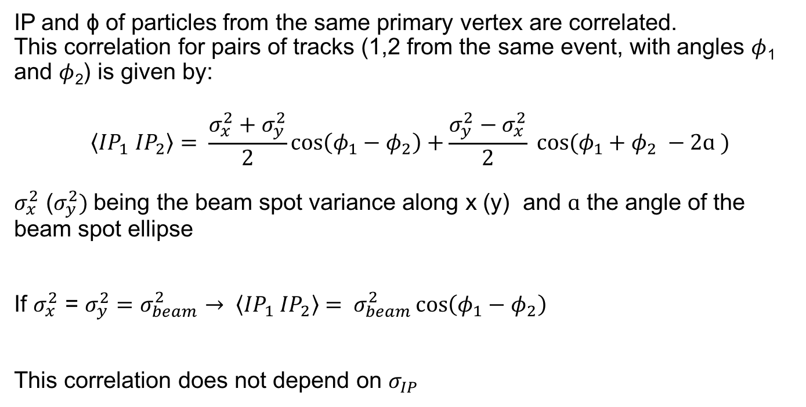
Beam width measurement
IP and ɸ of particles from the same primary vertex are correlated.
This correlation for pairs of tracks (1,2 from the same event, with angles $φ$₁ and $φ$₂) is given by:
$$\left\langle {IP}_{1}{ IP}_{2}\right\rangle = \frac{σ_{x}^{2}+σ_{y}^{2}}{2}\cos\left(φ_{1}−φ_{2}\right)+\frac{σ_{y}^{2}−σ_{x}^{2}}{2} cos⁡(φ_{1}+φ_{2} −2ɑ )$$
$σ_{x}^{2}$ ($σ_{y}^{2})$being the beam spot variance along x (y) and $ɑ$ the angle of the beam spot ellipse
If $σ_{x}^{2}$ = $σ_{y}^{2}=σ_{beam}^{2}→ \left\langle {IP}_{1}{ IP}_{2}\right\rangle$ $= σ_{beam}^{2}\cos\left(φ_{1}−φ_{2}\right)$
This correlation does not depend on $σ_{IP}$

Slide 8
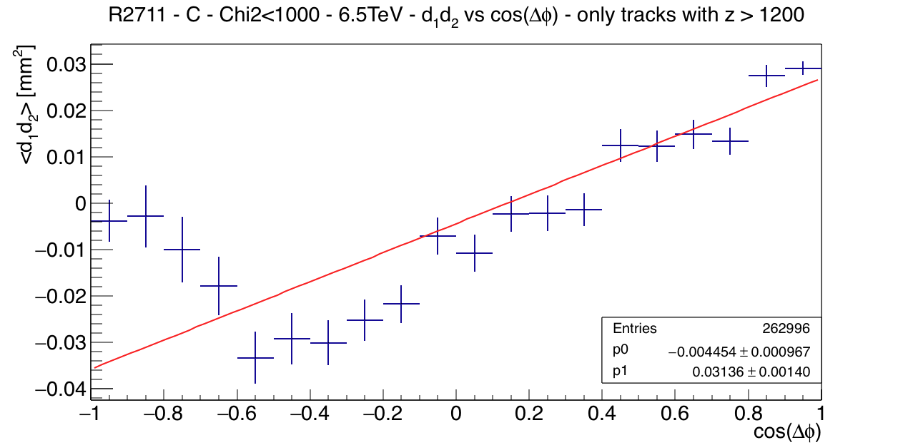


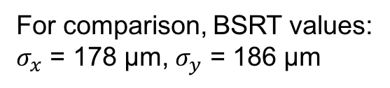
IP correlation $→$ $σ_{beam}$ @ 6.5 TeV
Fill #6358, BGV run duration 500 sec
$σ_{beam}$ = 177 ± 37 (stat) μm
For comparison, BSRT values:
$σ_{x}$ = 178 μm, $σ_{y}$ = 186 μm
Preliminary results, no systematic errors, no calibration
Fill #6358: Physics pp run, 6.5 TeV, 1868 bunches, 2.28e14 p

Slide 9
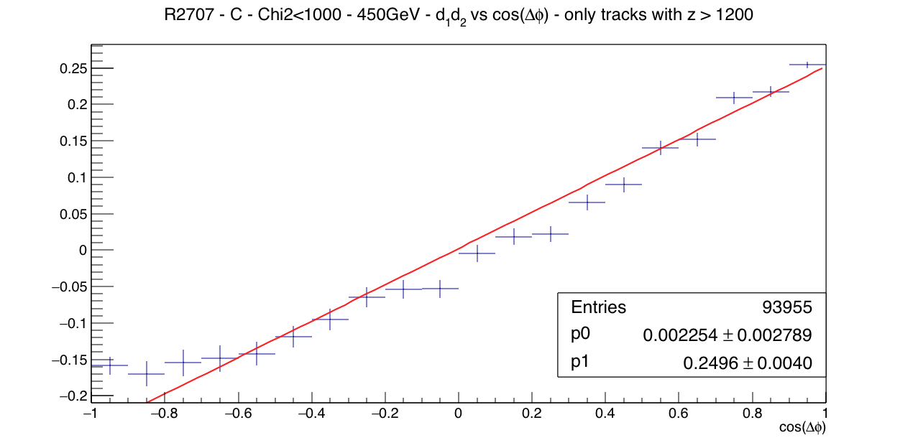
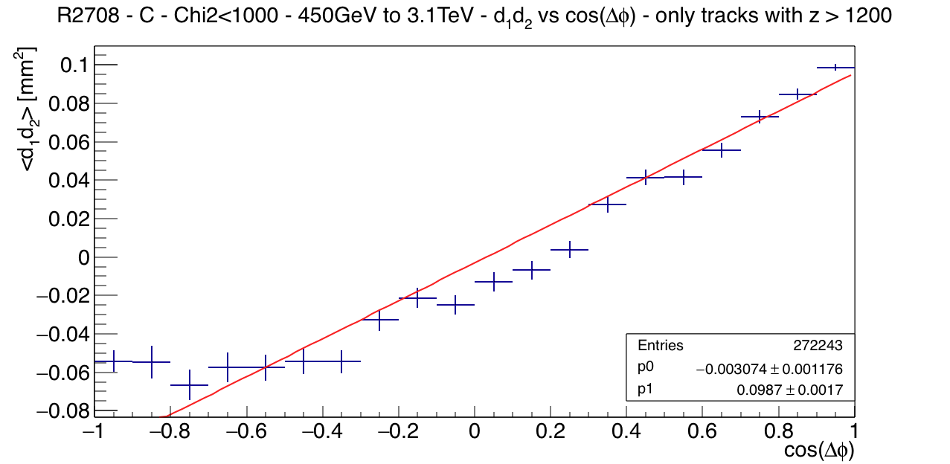
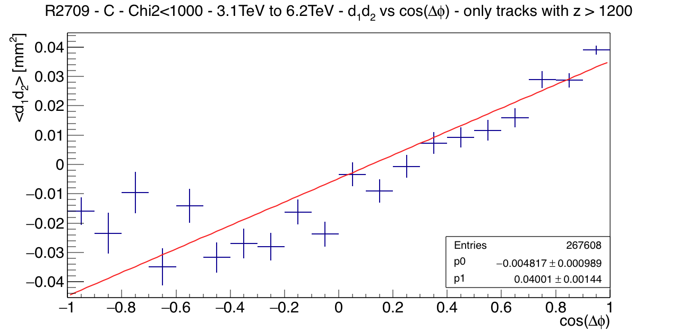




Beam energy dependence of $σ_{beam}$
450 GeV → $σ_{beam}$ = 500 ± 63 μm
450 GeV – 3 TeV → $σ_{beam}$ = 314 ± 41 μm
3 TeV – 6 TeV → $σ_{beam}$ = 200 ± 38 μm

Slide 10
BGV beam width measurements
Three 6.5 TeV runs at fills:
#6358 (2.28e14 p, 1868 b)
#6358 (2.09e14 p, 1868 b)
#6364 (1.38e14 p, 1868 b)

Slide 11
BGV for HL-LHC == BGV₂
BGV₂ = Optimized BGV design for best vertex resolution
Two important detector design considerations for best IP and vertex resolution:
Good spatial resolution at each detector plane (≤ 100 μm)
Thin detectors in radiation lengths to minimize multiple scattering effects
In addition
Choice of BGV₂ placement in LHC (optimal beam width to be measured wrt vertex resolution)
Min. possible reduced beam pipe diametre (currently 54 mm) to reduce extrapolation error

Slide 12
BGV₂ detector design considerations
Detector technology
and thickness
  Si-Strips
  MSGS (Micro-Megas)
Gas volume exit window
  Be
  Thin Al
Number of detectors along z
Exit Window
Additional detector plane

Slide 13
BGV₂ detector options
Thin, high precision detectors:
Si-Strip detectors: ‘industry standard’ 300 μm thick, 200 μm pitch → σ ~ 60 μm, max. sensor size 10x10 cm²
MicroMegas (micro pattern gas detector): 150 μm thick, 400 μm pitch → σ ~ 70 μm, sensor size 30x30 cm²
Both can be built in x-y configurations
Alternatively SciFi based detectors can also be considered

Slide 14
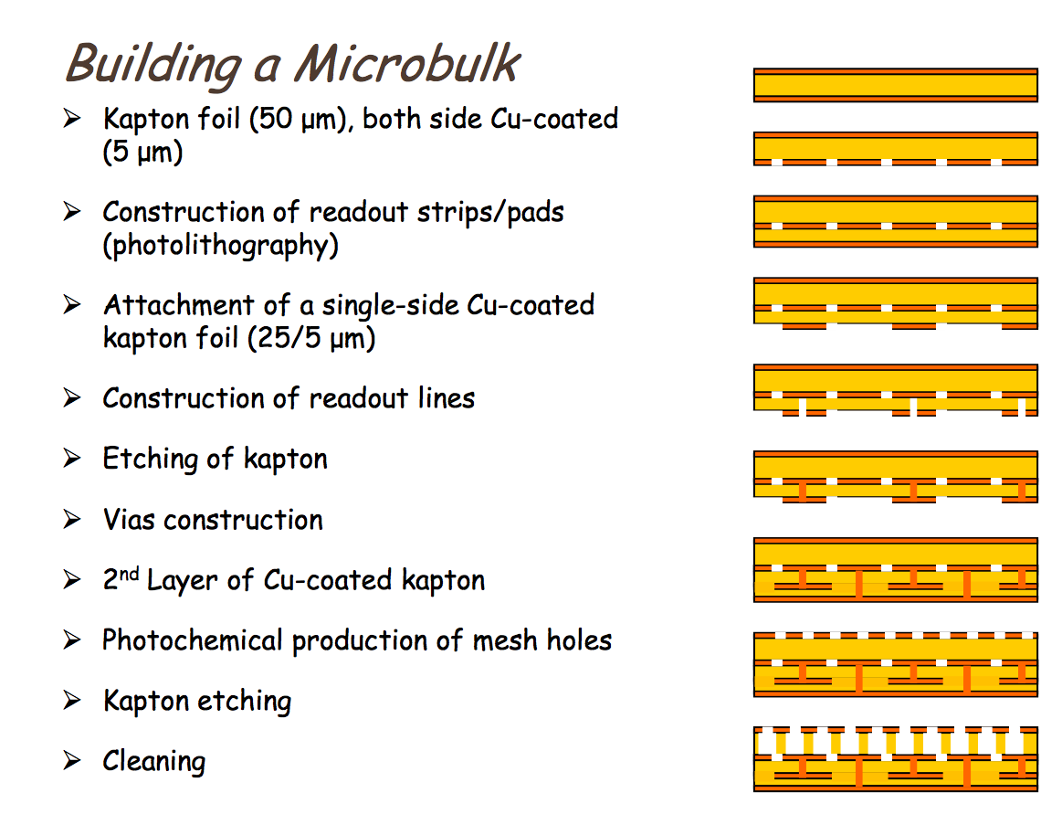
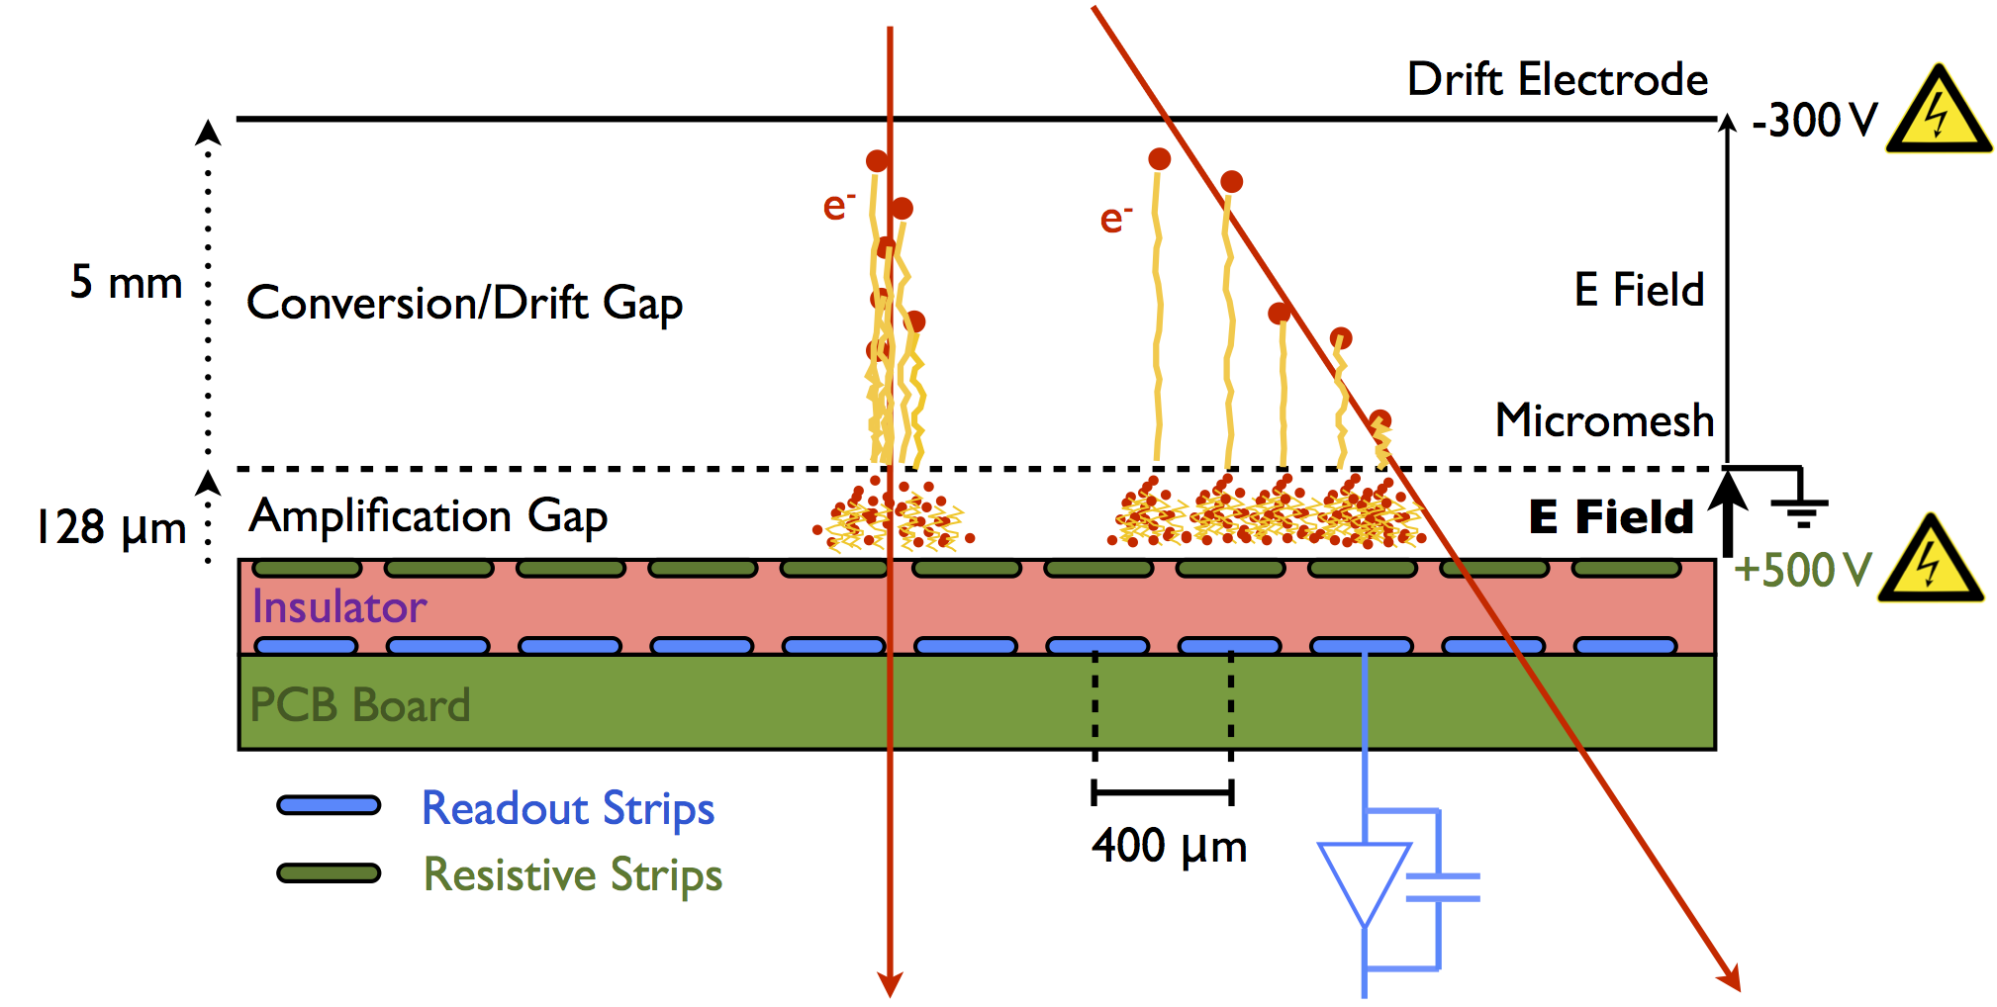
MicroBulk MM
To be used in high rate environments, with a resistive strip plane
(BGV ~ 1KHz/cm²)

Slide 15
Technology comparison
Silicon Strip sensors
MicroMegas detector
300 μm thick planes
200 μm strip pitch
Industry-made sensors
Available analog R/O F/E chip, digital chip under development
‘Commercial’ DAQ and control system
Required interconnections between sensors
~40% more expensive
150 μm thick planes
400 μm strip pitch
Joint CERN-Saclay development
Digital R/O F/E chip under development
Data transmission using GBT chip
Some R/D needed for final design
½ radiation length due to material
X-Y option offers an additional ½ in X₀

Slide 16
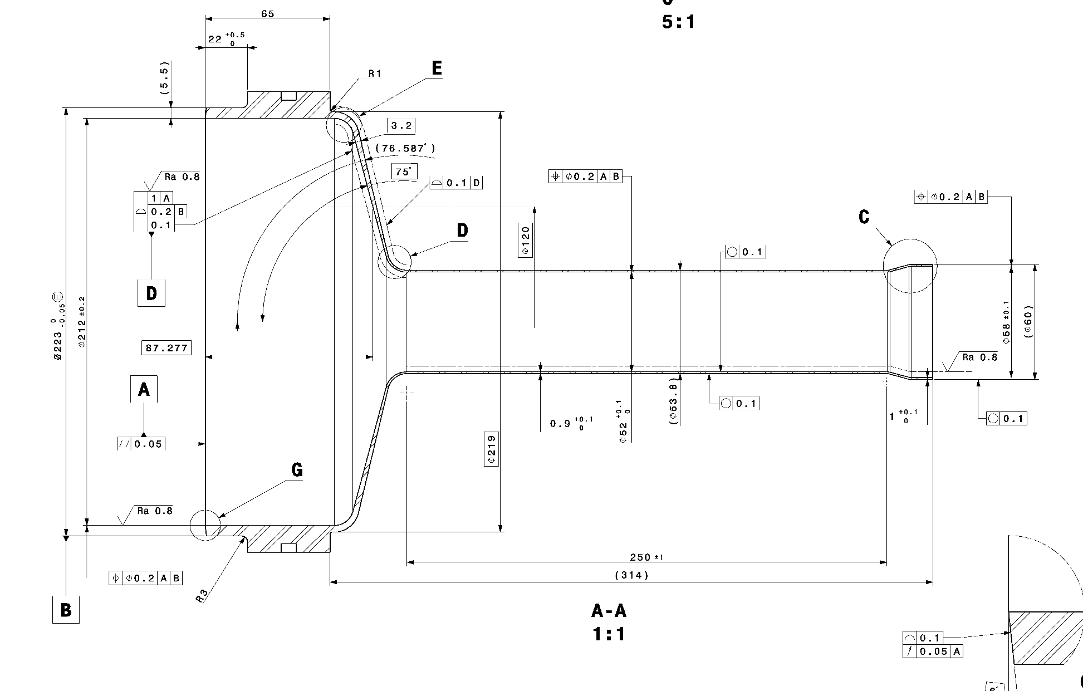
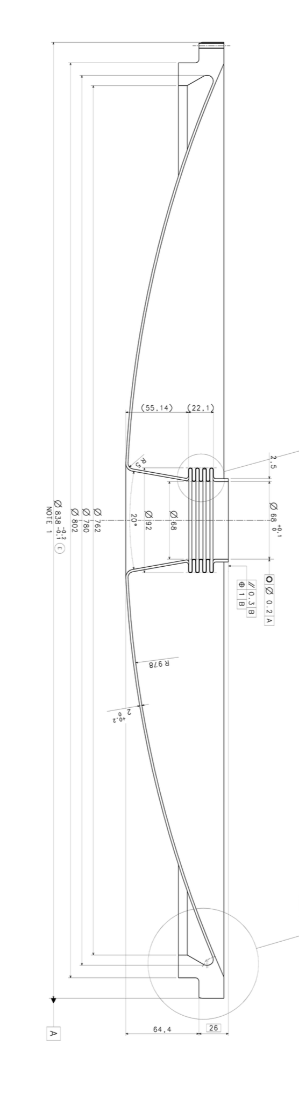
Gas volume exit window
Current window thickness 0.9 – 3.2 mm
New window thickness 0.9 mm(?)
Or Be window with current design (similar improvement in resolution)

Slide 17
BGV Demonstrator
Very encouraging first results
Final BGV₂ design
Optimization ongoing
Installation schedule compatible with LS3

Slide 18
Backup Slides
BGV Location
Alignment corrections introduced in analysis
Material Budget
Gas target system
Trigger system
Precision tracker
MM read-out scheme

Slide 19
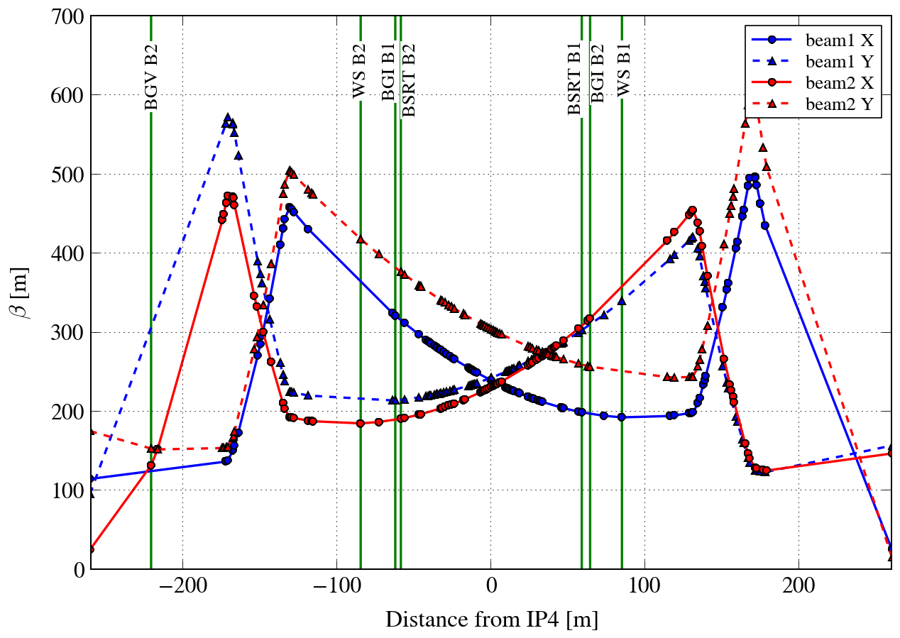
BGV location
Single beam demonstrator @ LHC, point 4, beam 2 ring
at ~ -220m , beam 2 has β_{x} ≅ β_{y} ≅ 150 m
at 7TeV and ε_{N} ≅ 2.5μm, σ_{beam} ≅ 0.22 mm
β_{x} ≅ β_{y} allows beam pipe diameter reduction

Slide 20
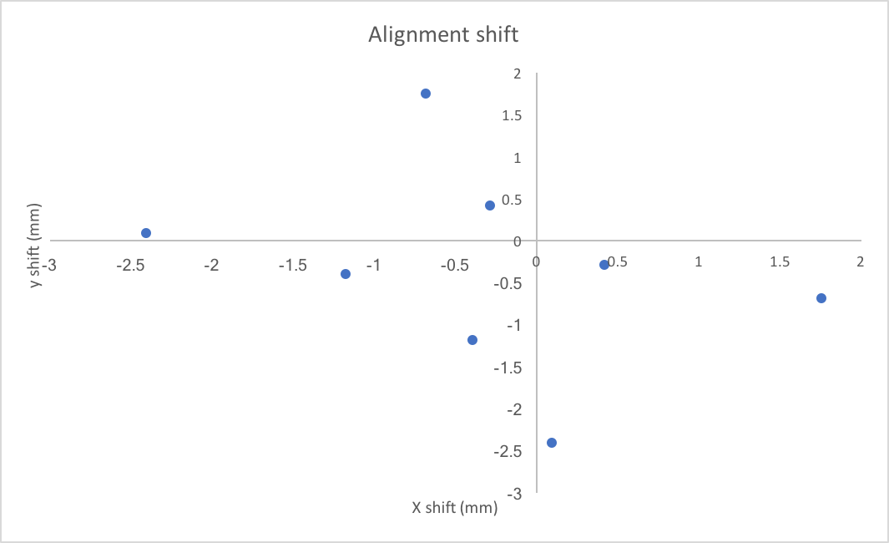
BGV module shifts due to alignment procedure

Slide 21
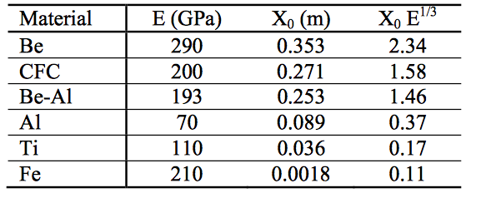
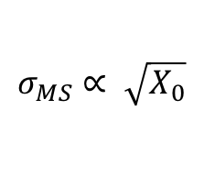

BGV Material budget
Exit window ~ 3% X₀
One detector plane ~ 3% X₀
$$σ_{MS}∝ \sqrt{X_{0}}$$
Be instead of Al → ½ $σ_{MS}$ due to exit window
Table from R. Veness et al., Proceedings of IPAC2011
1mm SciFi ~ 1mm Kapton ~ 0.5mm Si in X₀

Slide 22
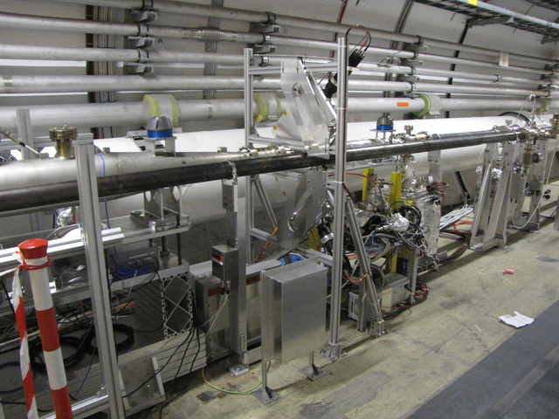
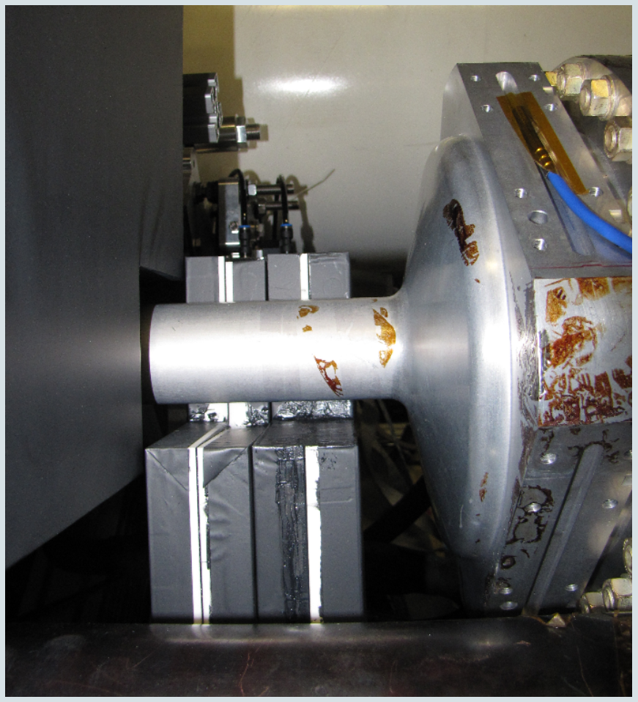
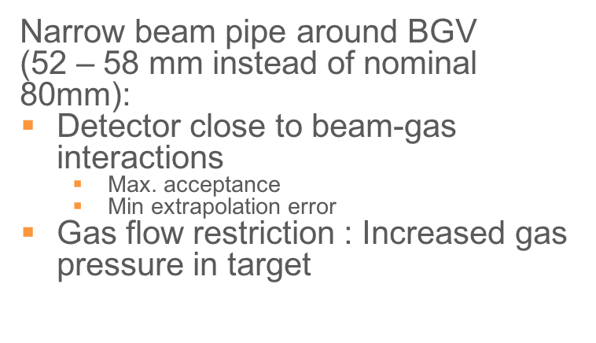
The gas target
2m long gas volume:
0.75m conical tube (minimal beam impedance)
1.25m long cylinder (main interaction region)
Thin (1 – 3 mm) exit window to reduce multiple scattering
Narrow beam pipe around BGV
(52 – 58 mm instead of nominal 80mm):
Detector close to beam-gas interactions
    Max. acceptance
    Min extrapolation error
Gas flow restriction : Increased gas pressure in target (${10}^{−7}$ mbar)

Slide 23
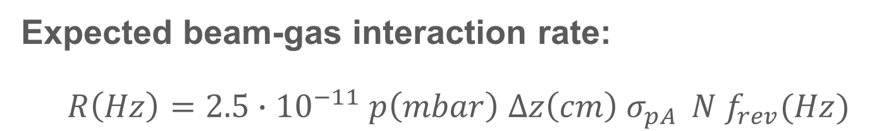

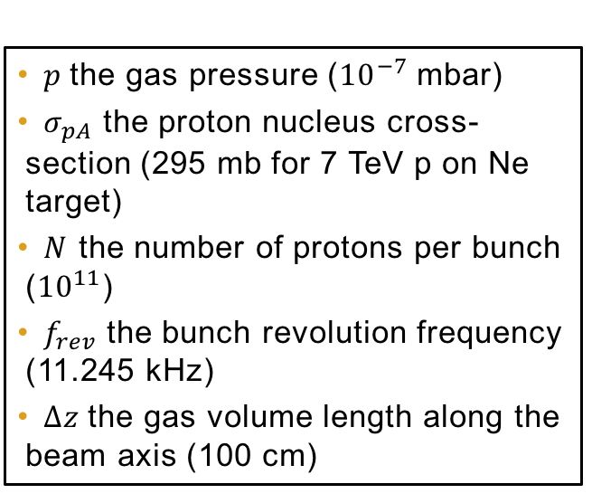
Gas target operating conditions
Expected beam-gas interaction rate:
$$R\left(Hz\right)=2.5∙{10}^{−11} p\left(mbar\right) ∆z\left(cm\right) σ_{pA } N f_{rev}(Hz)$$
$p$the gas pressure (${10}^{−7}$ mbar)
$σ_{pA}$ the proton nucleus cross-section (295 mb for 7 TeV p on Ne target)
$N$ the number of protons per bunch (${10}^{11}$)
$f_{rev}$ the bunch revolution frequency (11.245 kHz)
$∆z$the gas volume length along the beam axis (100 cm)
$R=81 Hz$ per bunch

Slide 24
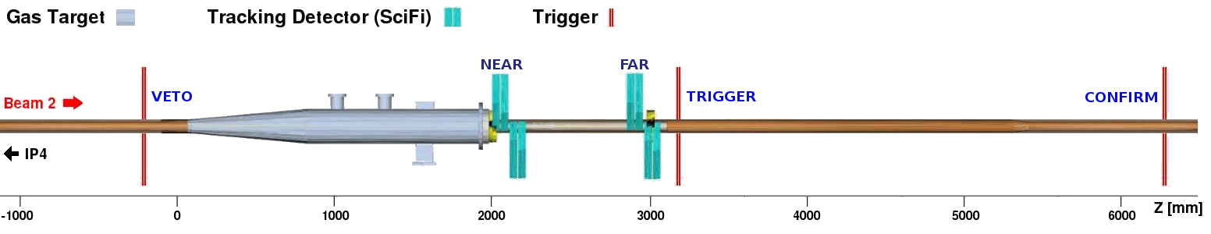

The trigger system
Set of three scintillator planes (30x30 cm above and below beam line), not in particles’ path between beam-gas collision and tracking measurements:
VETO (upstream, before precision tracker)
SIGNAL and CONFIRM (downstream, after tracker)
TRIGGER = SIGNAL · CONFIRM · $\overline{VETO}$
Trigger rate ≃ 300 Hz per LHC bunch

Slide 25
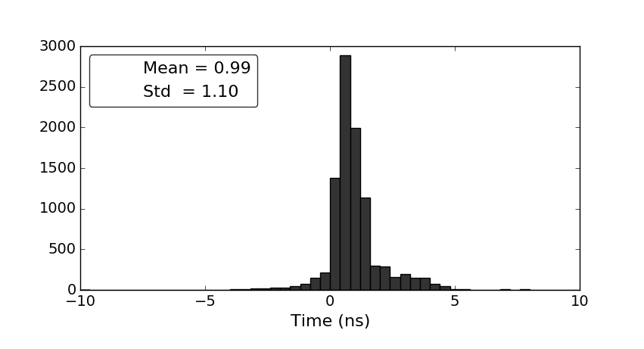
Trigger detector performance
1 ns resolution – easy beam bunch identification
Background contamination < 10⁻⁴
LHC bunch structure as seen by BGV Trigger
Adjusted time difference between
SIGNAL and CONFIRM planes
Standalone measurement:
Ghost charge fraction = 0.29% ± 0.03%

Slide 26
Micromegas readout scheme
On-detector
Off-detector
VMM
TTC
Event monitor
ROD
...
VMM
VMM
VMM
FELIX
network
FELIX
Config
# of VMMs per FEB:
MM: 8
ROC
calibration
Trigger monitor
DCS
SCA
GBTX
GBTX
GBTX
Bidirectional fiber
miniSAS cables
Front end board
L1DDC
One way fiber

Slide 27
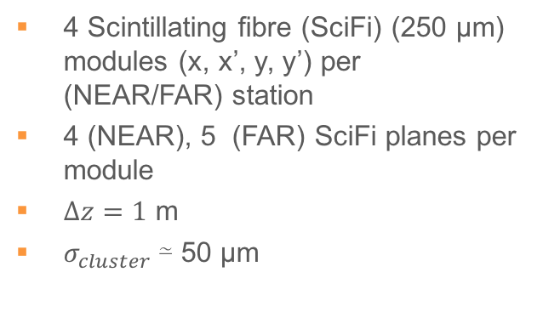
The precision tracker
4 Scintillating fibre (SciFi) (250 μm) modules (x, x’, y, y’) per (NEAR/FAR) station
4 (NEAR), 5 (FAR) SciFi planes per module
$Δz=1$ m
$σ_{cluster}$≃ 50 μm

Slide 28
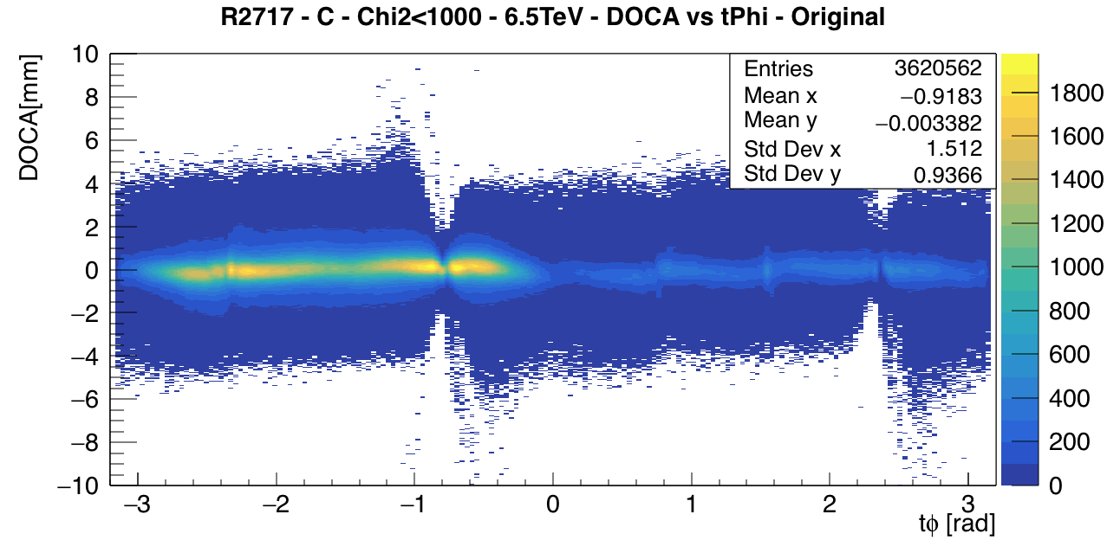
Alternative Beam position measurement
y₀
Real primary vertex position
beam 2 positioned at (0,0)
of the BGV reference frame
IP
IP = x₀sin(ɸ) – y₀cos(ɸ)
ɸ
x₀

