Slide 1
Beam-Gas Curtain (BGC) profile monitor: Progress with gas jet testing
Hao Zhang (Cockcroft Institute)
With thanks to:
V.Tsoganis, C.Welsch(Cockcroft Institute)
P.Forck, S.Udrea (GSI)
M.Ady, E.Barrios Diaz, N.Chritin, T.Doddington, R.Jones, R. Kersevan, A.Mariet, P.Magagnin, S.Mazzoni, A.Rossi, G.Schneider, R.Veness, (CERN BE-BI, TE-VSC, EN-MME)
7th HL-LHC Collaboration meeting, 15th November 2017

Slide 2
Outline
Motivation
  Potential diagnostics for e-lens project and HLLHC
  Principle of beam induced fluorescence (BIF) detection with supersonic gas jet
Progress with gas jet testing
  Experimental setup
  Supersonic gas jet generation and gas dynamic simulation
  Characterization of the jet density
  First measurement using BIF with gas jet
Development of second gas jet prototype (version 2)
  Improvement
  Progress of the production

Slide 3
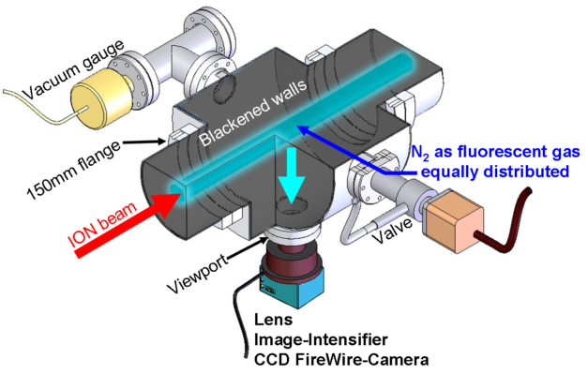
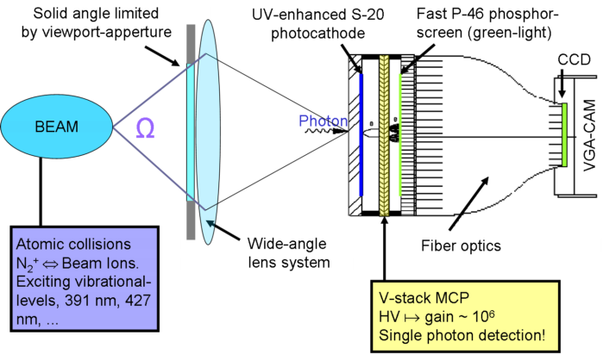

Principle of detection
BIF detection using residual gas
Particle Beam propagate to the jet curtain perpendicularly
*Credit: GSI, http://www-bd.gsi.de/dokuwiki/doku.php
BIF detection using supersonic gas jet
Gas jet curtain 45 degree tilted
*Credit: GSI, http://www-bd.gsi.de/dokuwiki/doku.php

Slide 4
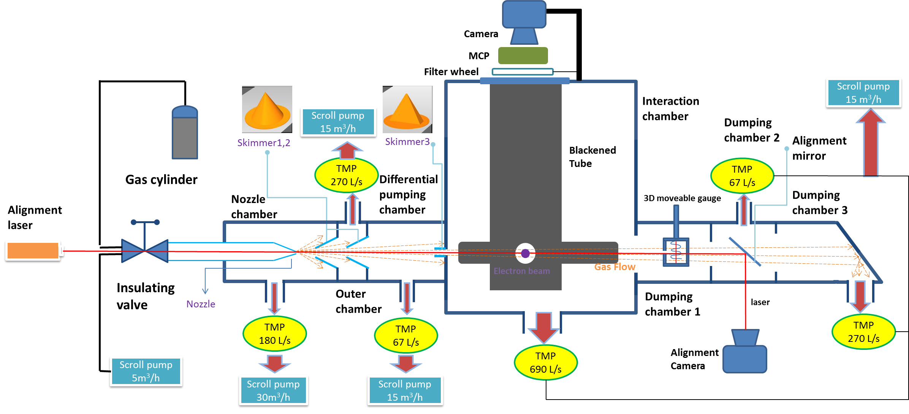
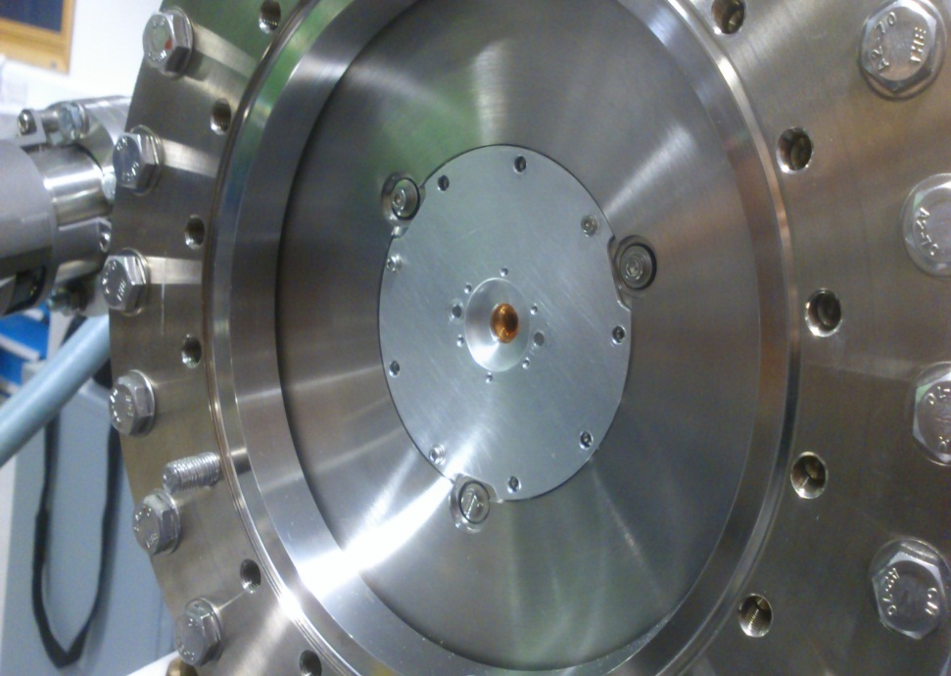
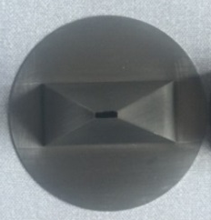
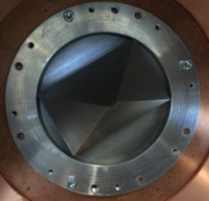
Modified monitor (version1) for beam induced fluorescence test
Nozzle
First &Second skimmers
Third skimmers
Off centred nozzle hole
30 μm
180 μm & 400 μm
7.2 mm *1.8 mm
4.0 mm * 0.4 mm

Slide 5
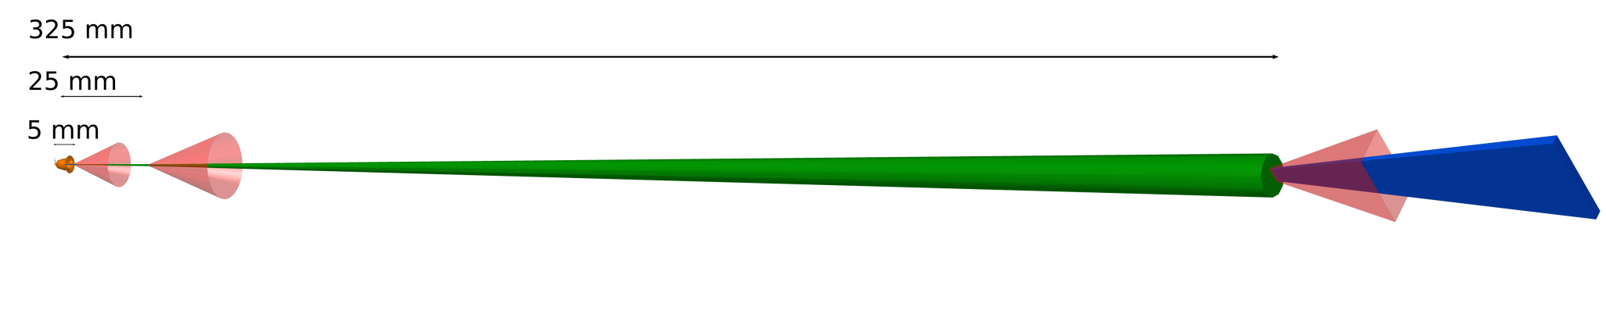
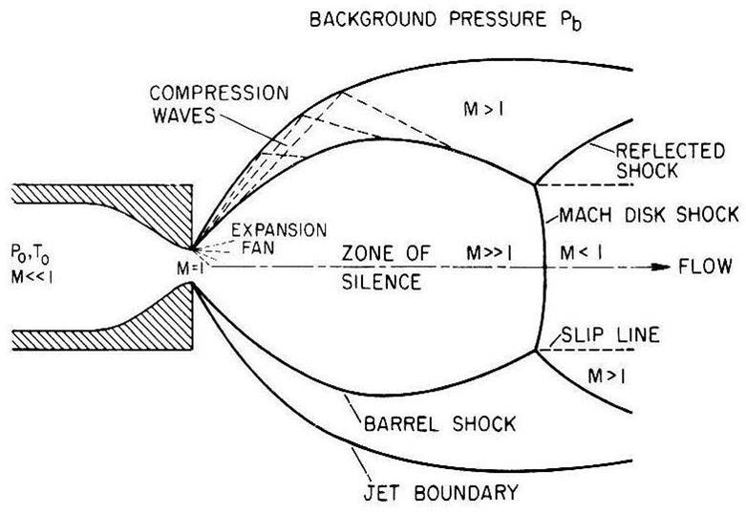
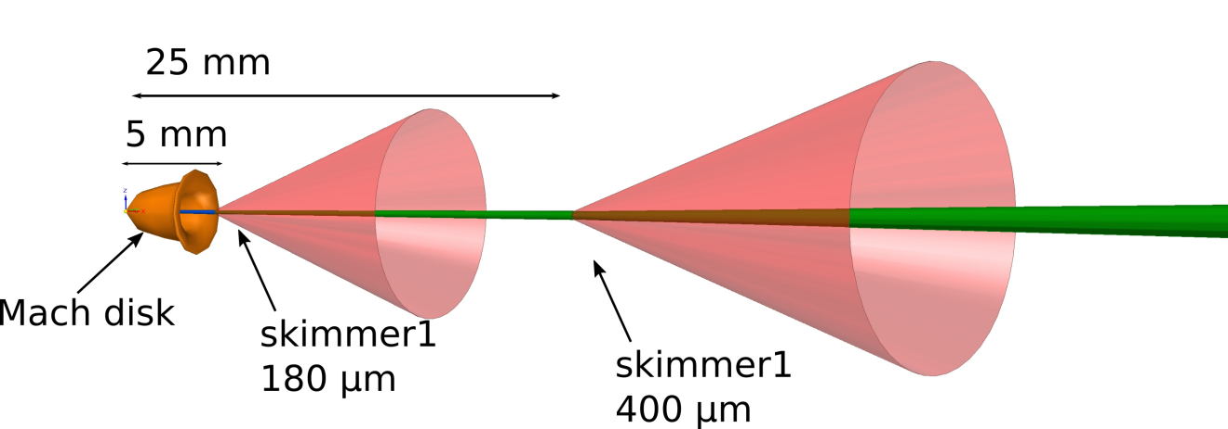
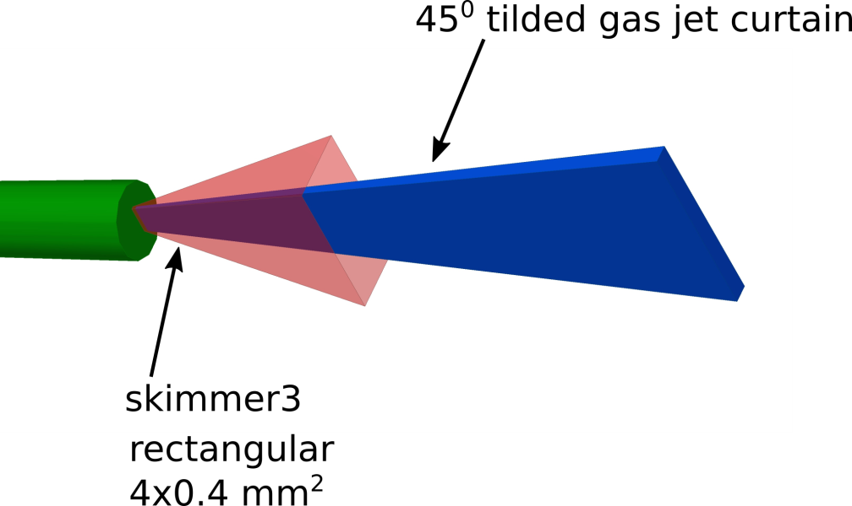
Generation of supersonic gas jet
3

Slide 6
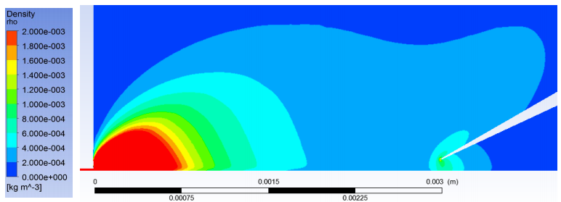
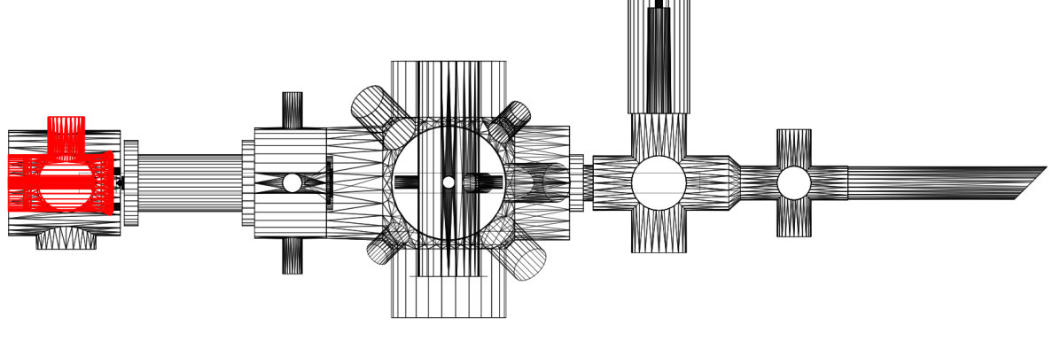
Progress of the gas dynamics simulation
Viscous-flow regime before 1st skimmer (ANSYS CFX)
The model is basic and have a converging issue when the chamber pressure is lower than 10⁻³ mbar, thus the divergence calculated from CFX is not accurate.
Credit: P. Magrgnin
Molecular flow after 1st skimmer (Monte Carlo simulation)
Interaction Chamber
Molflow model：simulated from the 1st skimmer and input from the viscous-flow simulated in ANSYS CFX
Credit: M. Ady

Slide 7
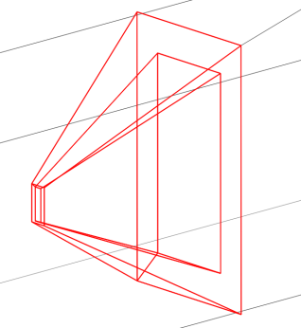
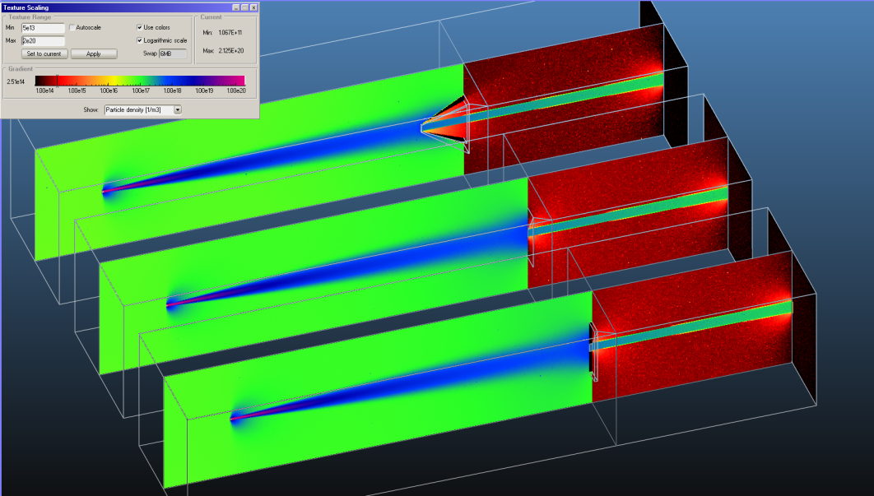
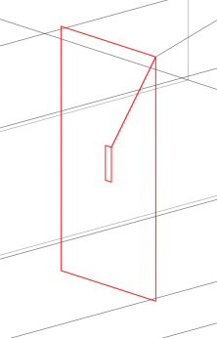
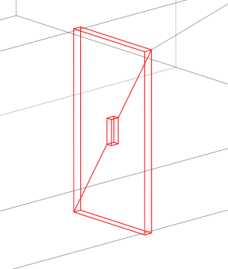
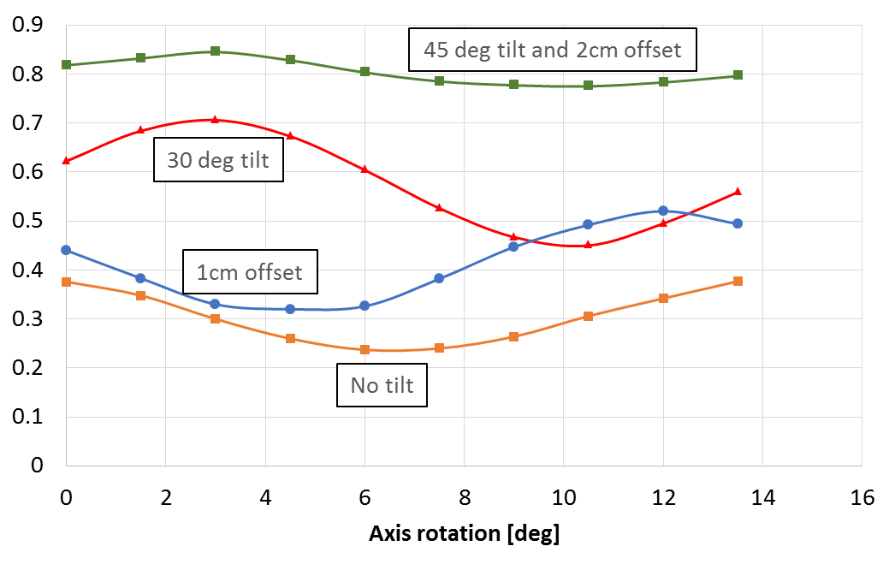
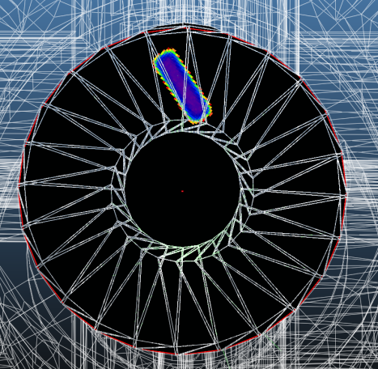
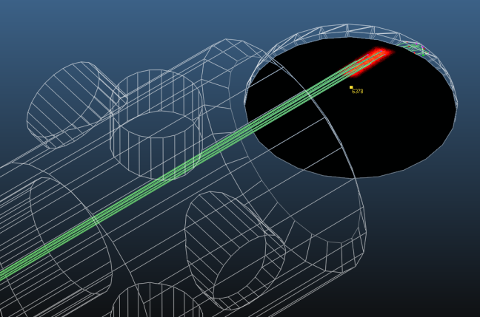
Study of skimmer shape and pumping efficiency
3rd skimmer shape VS density
Original ‘pyramid’ skimmer
78x18mm
Thin plate with hole
(theoretical)
Thick plate with hole
(3mm thickness)
Offset the turbo pump and Tilt the turbo pump for better jet dumping
Credit: M. Ady

Slide 8
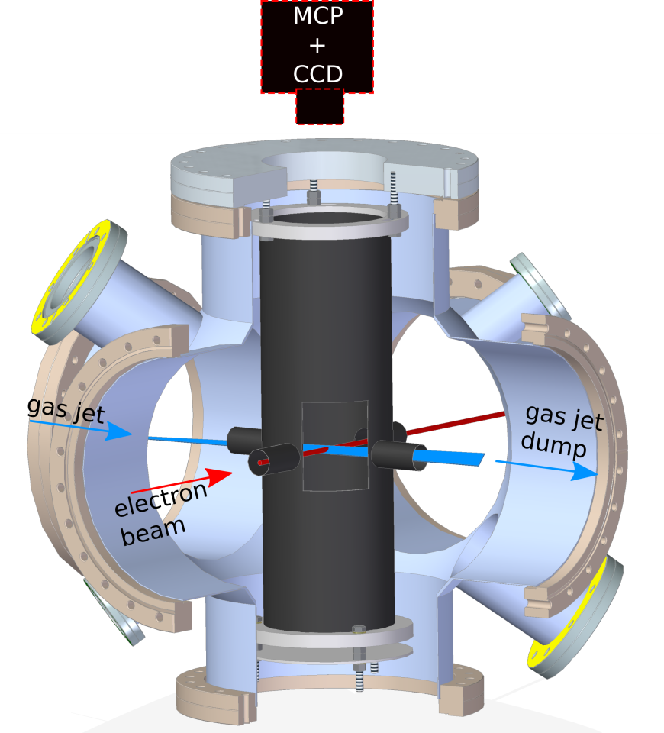

Details on the interaction chamber
σ (cross section, N₂, 391 nm) | 9.2*10⁻¹⁹ cm²
I (electron current) | ~10 uA
n (gas jet density) | (~10⁻⁶ mbar)
d (jet thickness) | 2.8 mm
Ω (acceptance solid angle) | 4π·10⁻⁵ sr
T (Transmittance of optics) | 0.65
T_{f} (Transmittance of band pass filter) | 0.3
η_{pc} (MCP photocathode efficiency) | 0.2
η_{MCP} (MCP detection efficiency) | 0.5
N_{γ} [photon number] ~ 0.08*Δt [t]

Slide 9
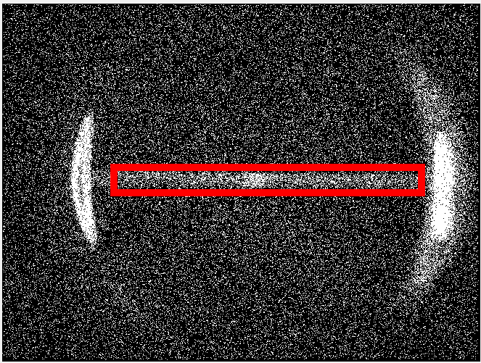
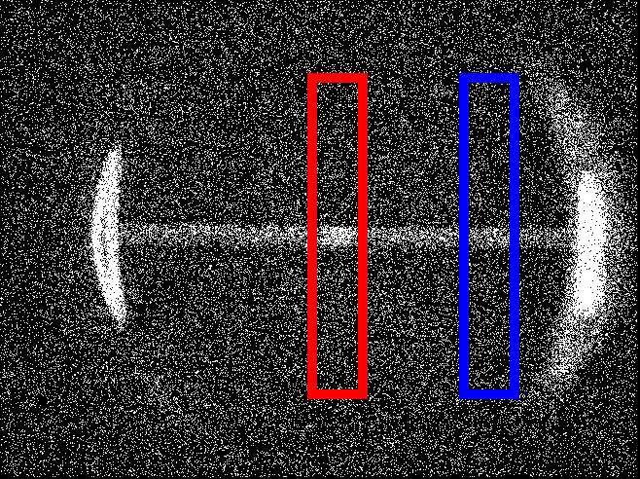
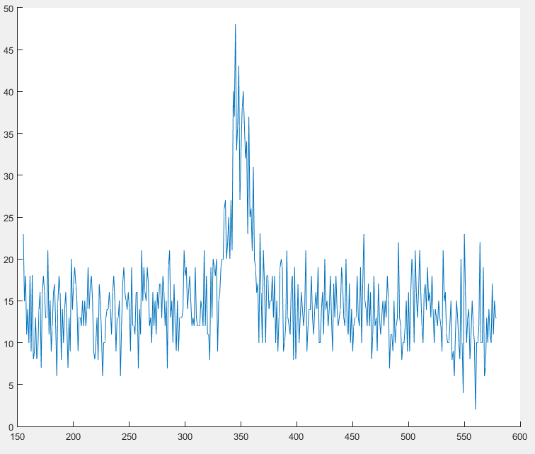
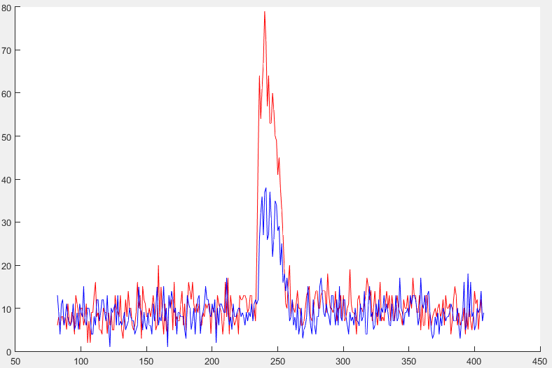
Gas jet image from fluorescence
Shutter time: 8000s, MCP 1.0 V
E-gun: ~10 microA, 3.5keV energy
ROI
y
x
Residual gas image
FWHM
4.62 mm
FWHM
3.13 mm

Slide 10
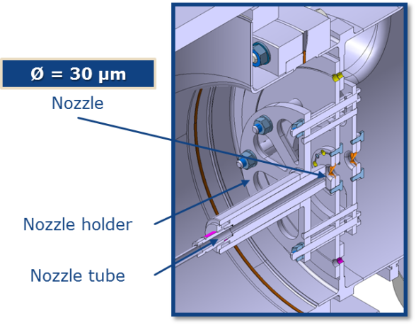
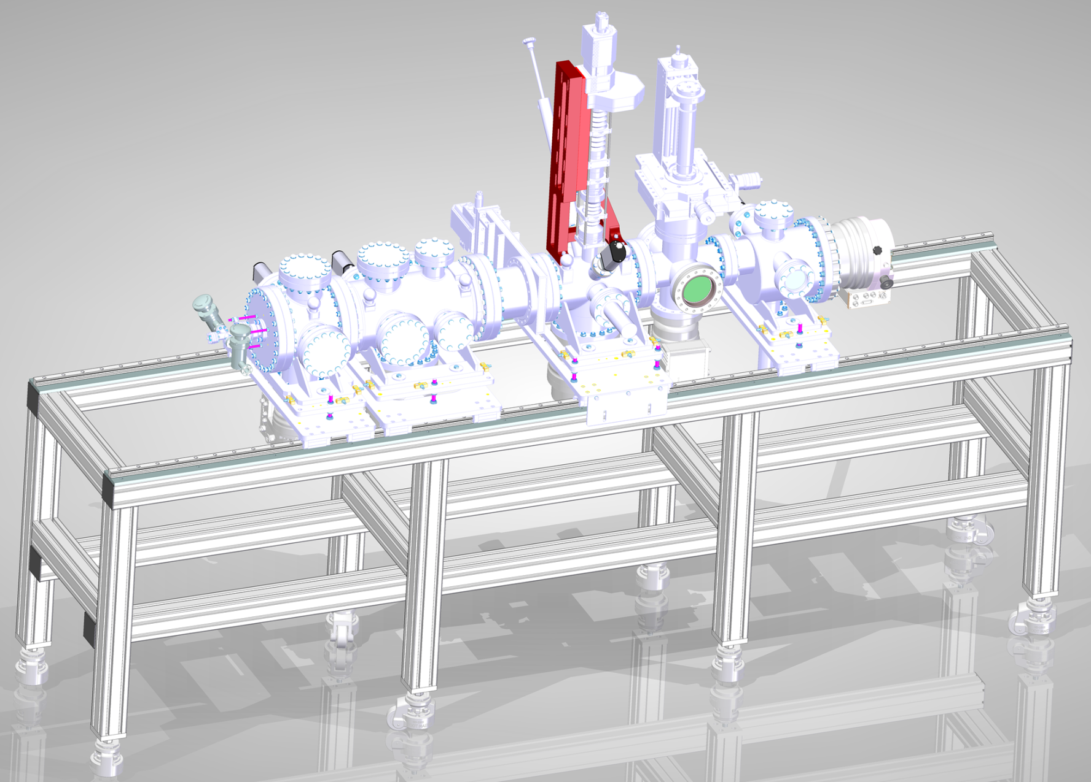
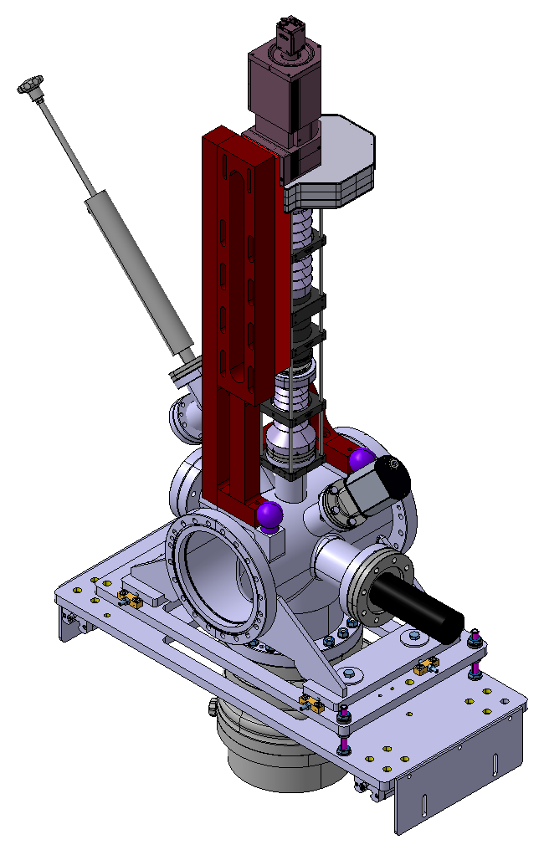
Progress of the new gas jet
  Fixed x and y motion of the nozzle
Larger pumping speed for all the turbo pumps
3.0 meter
  New electon gun up to 100uA is purchased
New optical system is designed for this system.
See next talk from P. Forck
Notes:
Need a scale for the mechanics

Slide 11
Open issues
The gas density
  Better nozzle-skimmer alignment
  Combinations of sizes, distances of nozzle and skimmer
  Higher stagnation pressure
The E-gun
  Not reached the maximum current
  Test with other higher current electron source
Gas species
  Nitrogen is tested currently
  Candidates could be Neon, Argon.

Slide 12
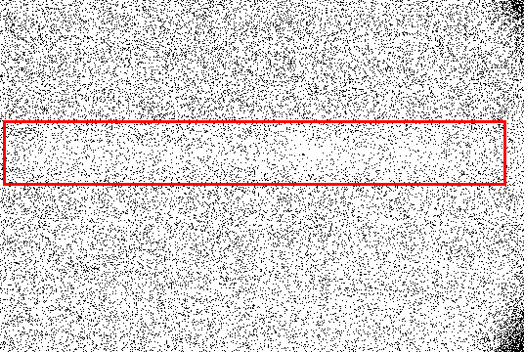
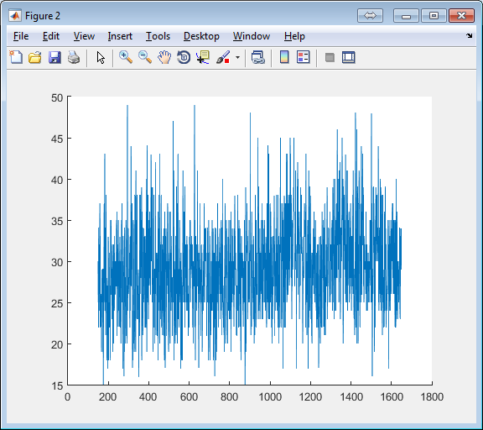
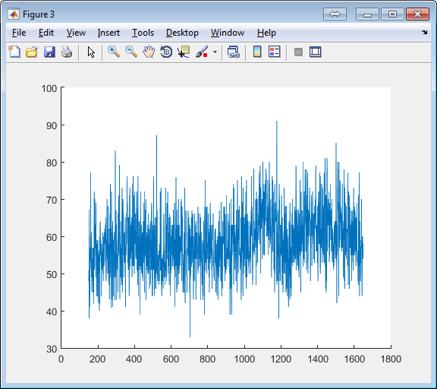
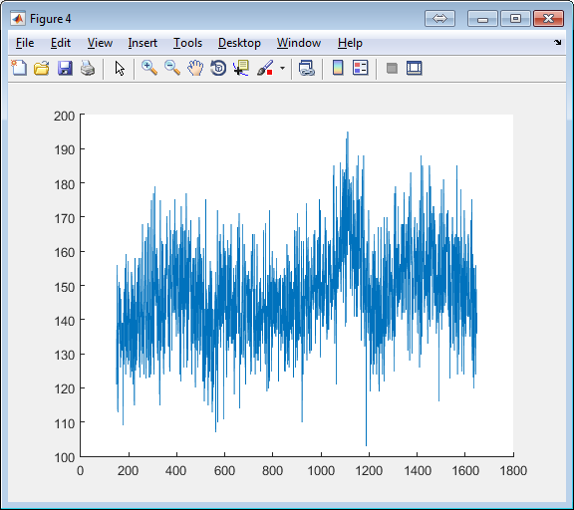
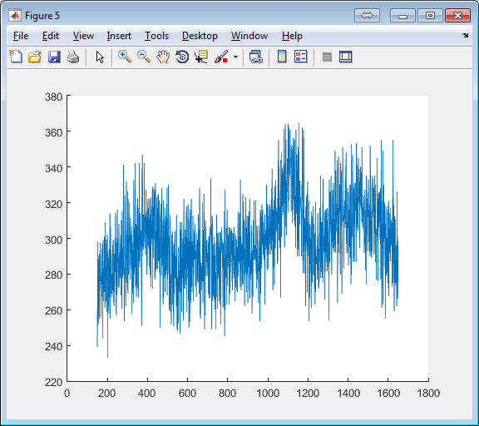
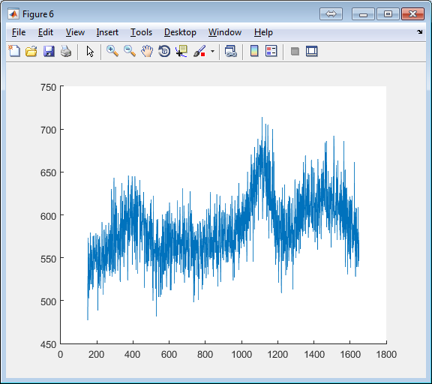
Upgrade the electron gun and optical system
200 s
400 s
1000 s
2000 s
4000 s

Slide 13
Summary
A prototype beam profile monitor using supersonic gas jet have been built to detect the beam induced fluorescence.
  The setup is modified from the previous beam jet ionization monitor.
  Simulations have been set up for the gas jet generation
  First measurement of a 2D beam image with gas jet using BIF mode.
A second prototype monitor has been designed and in process of production
  The new setup will be ready for testing earlier next year.

Slide 14
Thanks for your attention
Thanks to the BGC collaboration:
V.Tsoganis, C.Welsch(Cockcroft Institute)
P.Forck, S.Udrea (GSI)
M. Ady, E.Barrios Diaz, N.Chritin, T.Doddington, R.Jones, R. Kersevan, A.Mariet, P.Magagnin, S.Mazzoni, A.Rossi, G.Schneider, R.Veness, (CERN BE-BI, TE-VSC, EN-MME)
7th HL-LHC Collaboration meeting, 15th November 2017

Slide 15
Nozzle location respected to 1st skimmer
Fix position of the moveable gauge
Scan the nozzle horizontally and vertically

Slide 16
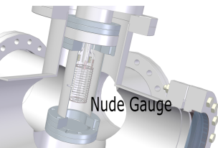
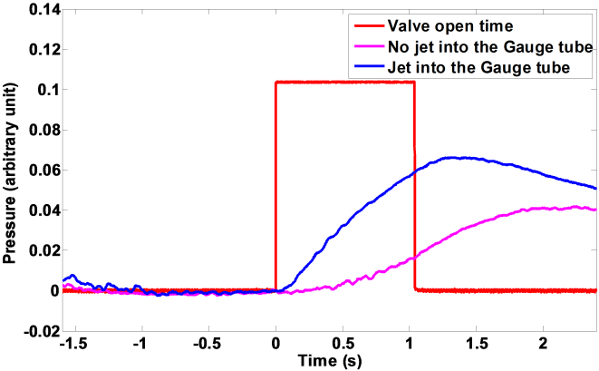
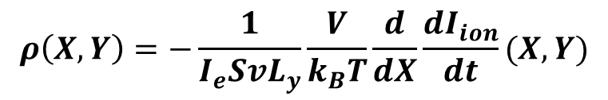
Characterizing gas jet density distribution
Side view of the detection
Gas molecule will experience 20000 collision with tube wall per second
Third skimmer
Assumption:
Gas molecular from jet entering the slit will immediately evenly distributed inside the tube.
Residual gas in and out is in a equilibrium state.
There is no molecular from the jet escaping the tube.
D: 40 mm
Front view of the detection
Tube
Slit size: L_{x}, L_{y}
Slit
Jet
Jet velocity
Volume of the small chamber
Ion current
$$ρ\left(X,Y\right)=−\frac{1}{I_{e}SvL_{y}}\frac{V}{k_{B}T}\frac{d}{dX}\frac{dI_{ion}}{dt}(X,Y)$$
Emitting current
Sensitivity

Slide 17
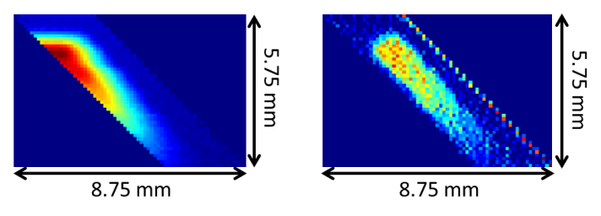

Density distribution measurement for small skimmer
Skimmer size | 4×0.4 mm²
Oriental angle | 45˚
I_{ion}(X,Y)
$$ρ\left(X,Y\right)$$
Resolution: 1pixel = 0.1mm
1.55 mm
5.44 mm
Differentiate the data in horizontal axis
Jet size in interaction point is estimated as : 4.54 mm * 0.83 mm
σ_{jet} = 0.29 mm

Slide 18
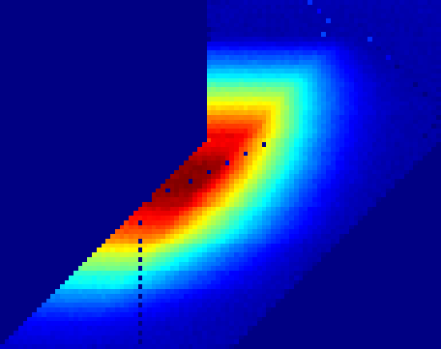
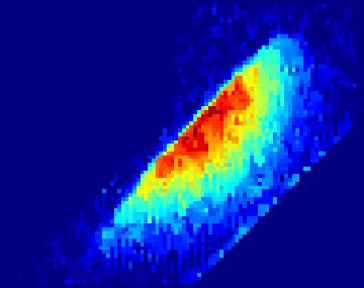

Density distribution measurement for large skimmer
Skimmer size | 7.2×1.8 mm²
Oriental angle | 45˚
I_{ion}(X,Y)
$$ρ\left(X,Y\right)$$
Resolution: 1pixel = 0.2mm
4.5 mm
14.7 mm
15.2 mm
15.2 mm
19.2 mm
19.2 mm
Differentiate the data in horizontal axis
Jet size in interaction point is estimated as : 10.03 mm * 2.81 mm
σ_{jet} = 0.99 mm

