Slide 1

Update on BPM development for IR1/IR5 LSS
HL-LHC WP13
C. Boccard, N. Chritin, M. Krupa, T. Lefevre,
G. Schneider, M. Wendt
7th HL-LHC Collaboration Meeting – Madrid – 15.11.2017

Slide 2
Outline
HL-LHC inner triplet BPMs
Challenges
Current state of the project
String test
Conclusions and outlook

Slide 3
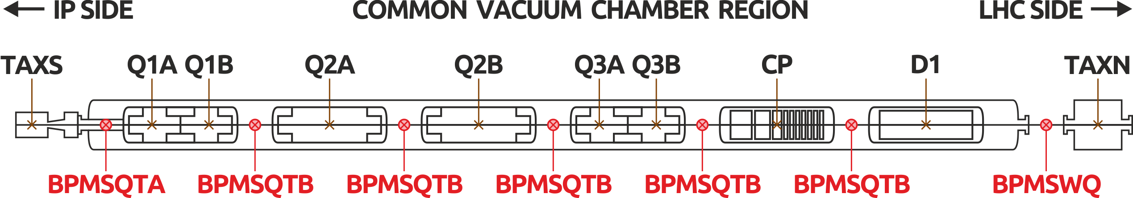
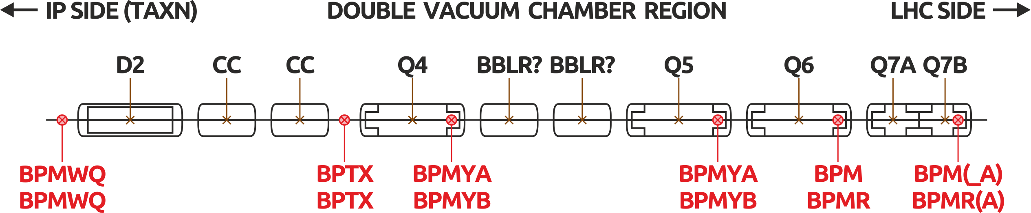
BPMs per HL-LHC IP side

Slide 4
New BPMs per HL-LHC IP side
1x BPMSQTA | cryogenic tungsten-shielded directional coupler, aperture A (small)
5x BPMSQTB | cryogenic tungsten-shielded directional coupler, aperture B (large)
1x BPMSWQ | warm directional coupler
2x BPMWQ | warm (non-directional) button
In total:
9 BPMs x 2 IPs x 2 sides = 36 new BPMs to be installed

Slide 5
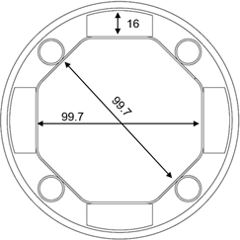
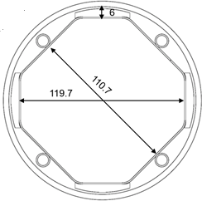
Design priorities
Main focus on the cryogenic directional couplers BPMSQTA and BPMSQTB which are required for string test in 2020
Minimising differences between the two designs
Studying possibilities of reusing parts of the design for the non-cryogenic BPMSWQ
A
B

Slide 6
Challenges
Both beams in a single vacuum chamber
Octagonal vacuum chamber
Cryogenic BPMs installed in vacuum
Tungsten blocks at H and V planes to absorb collision debris
Heat load due to electron cloud
Complicated integration and alignment

Slide 7
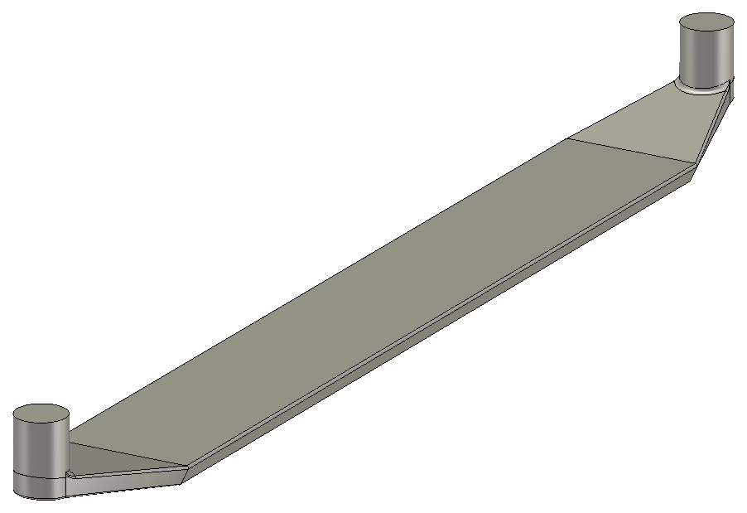
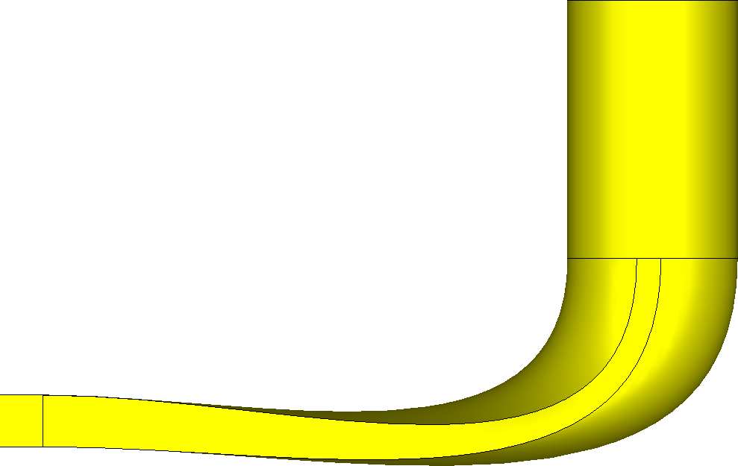
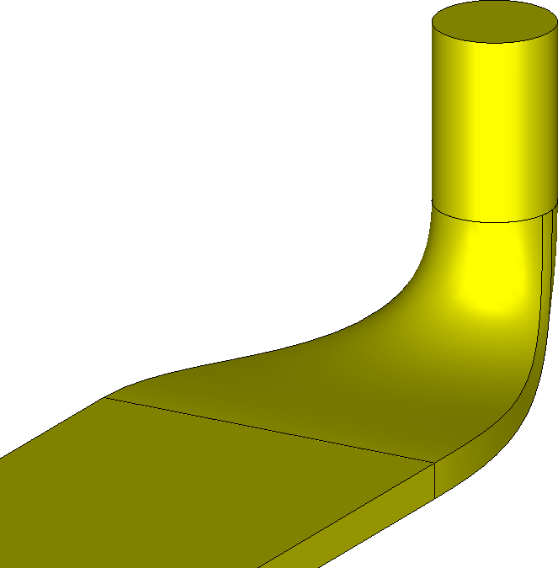
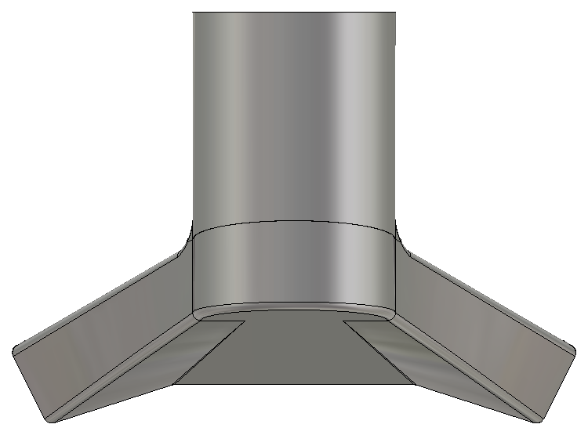
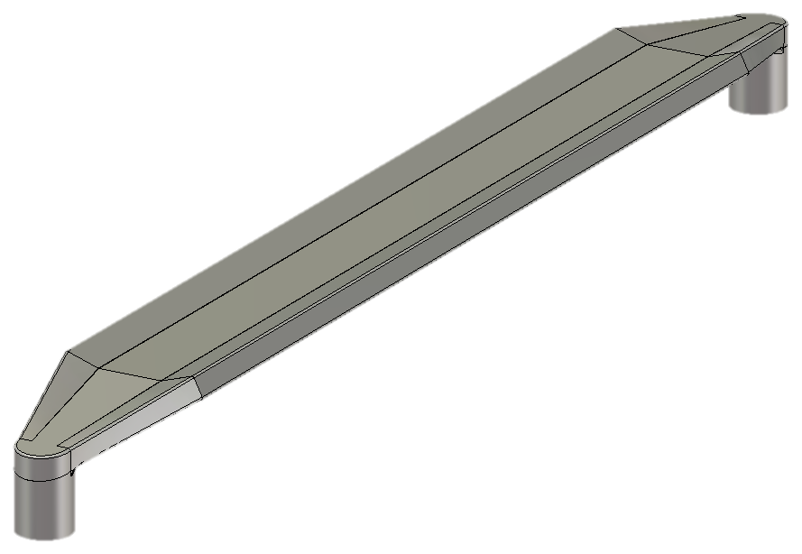
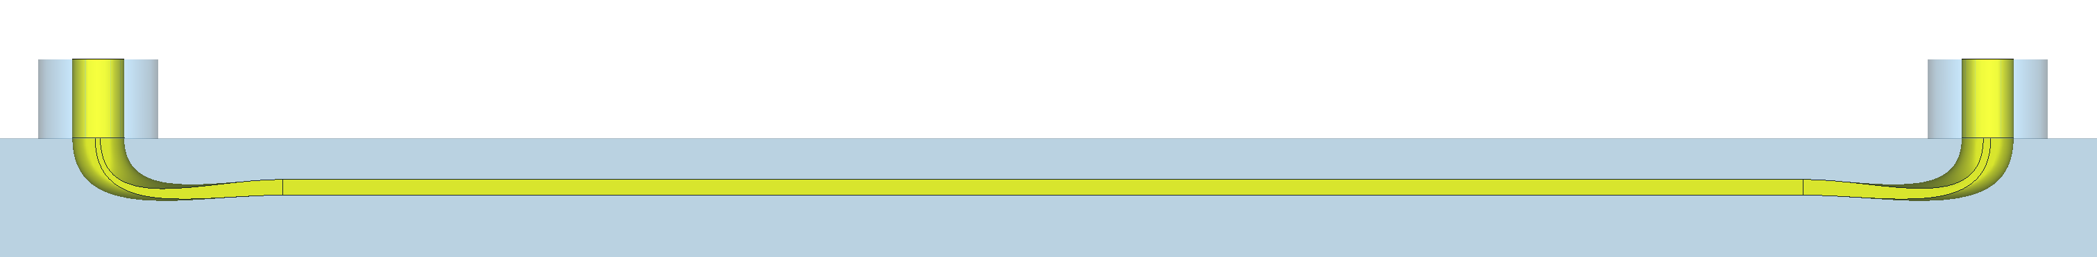
Electrode design
2016
2017
3D printing of the 2016 electrode very challenging
Major simplification of the electrode shape in 2017
Additional performance improvements achieved

Slide 8
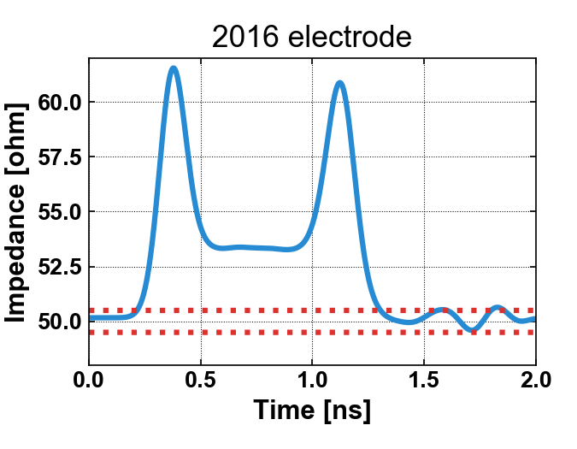
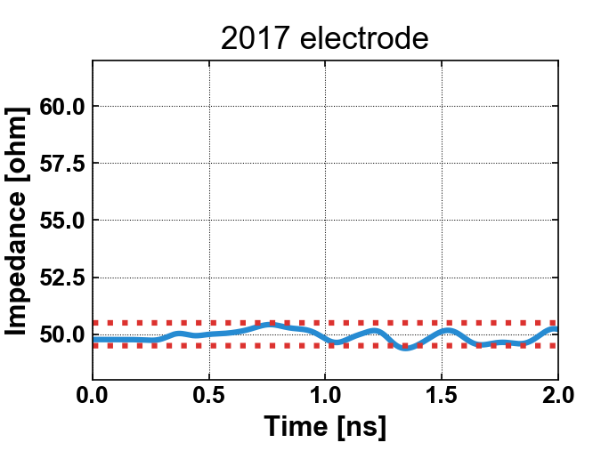
Electrode simulations - TDR
Goal: electrode impedance stable at 50 ± 0.5 Ω

Slide 9
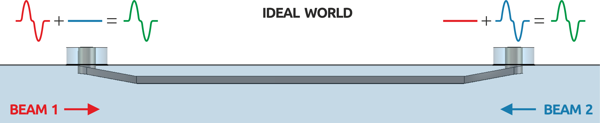
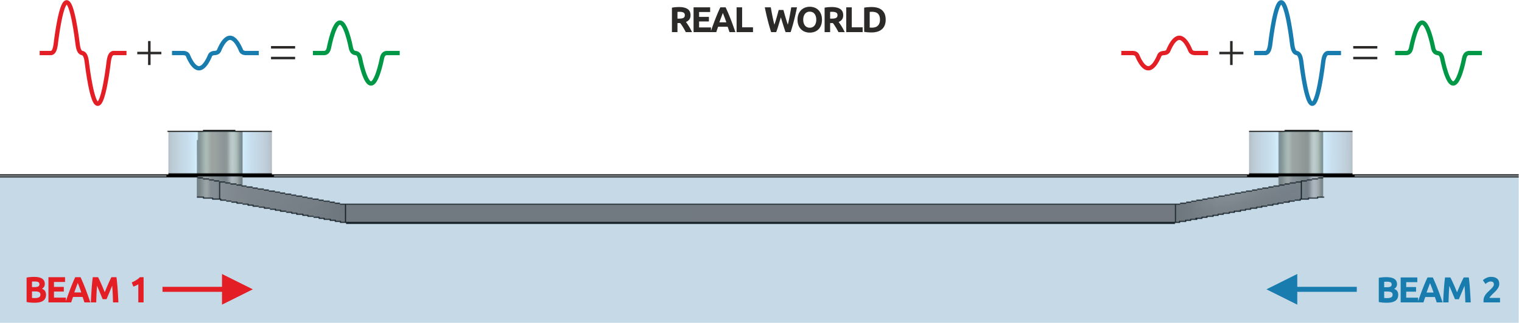
BPM directivity

Slide 10
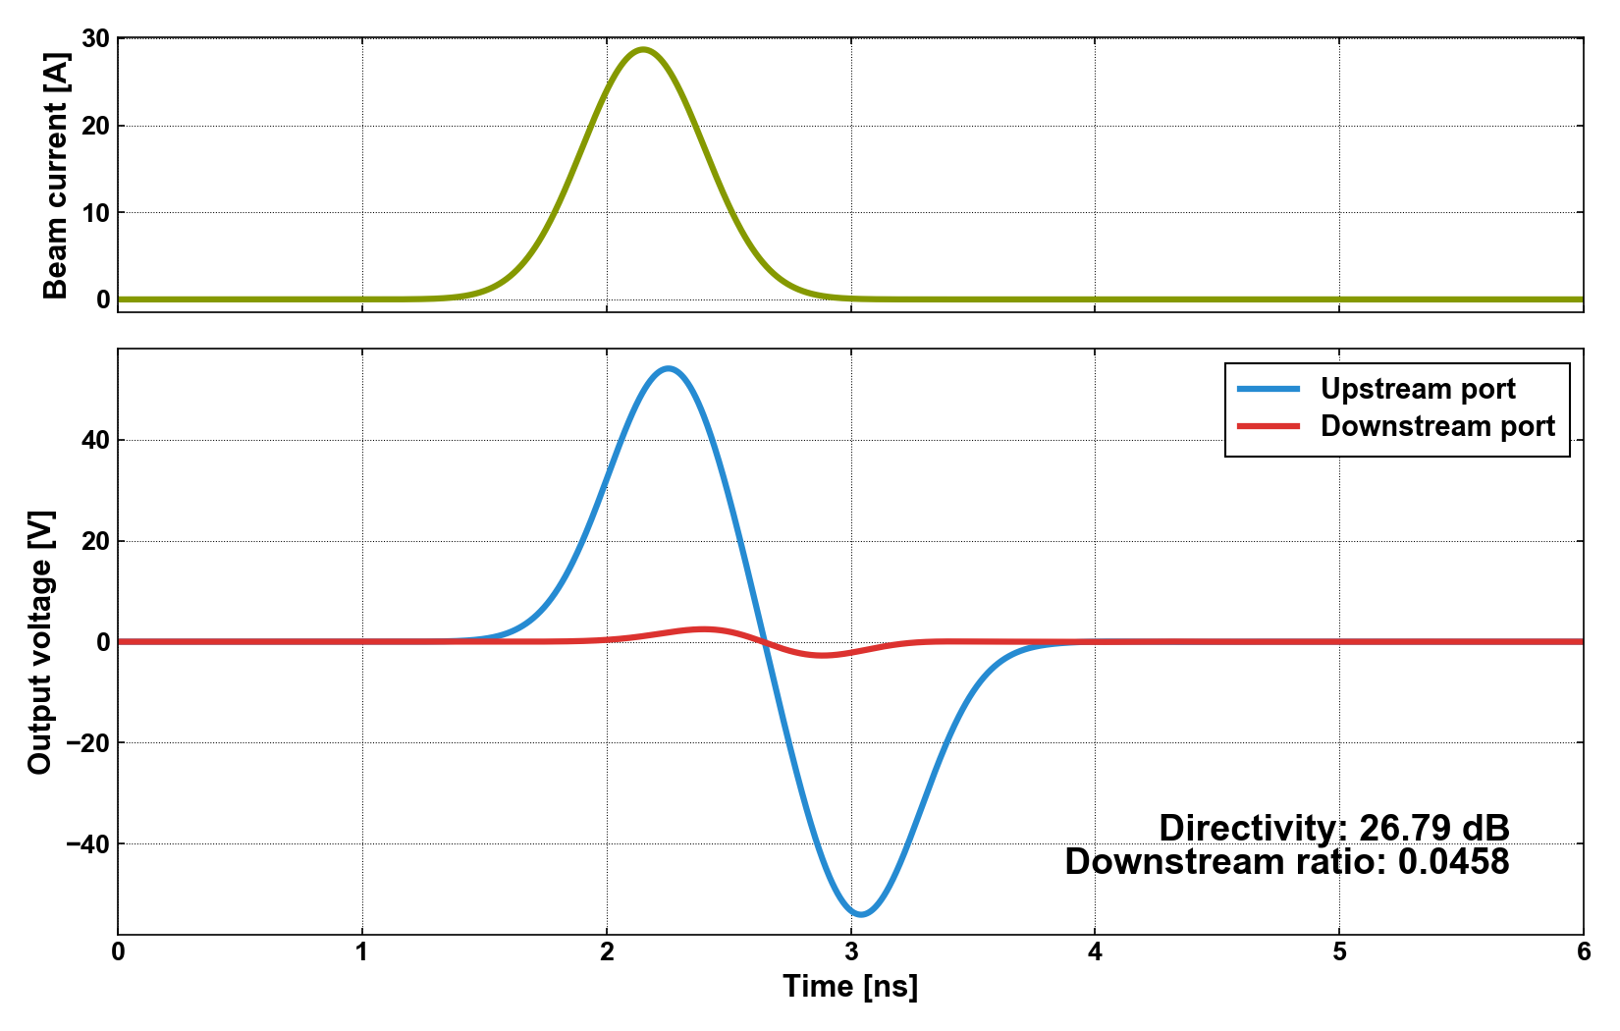
Electrode simulations - directivity
Dream: 30+ dB directivity → 0.0316 downstream ratio

Slide 11
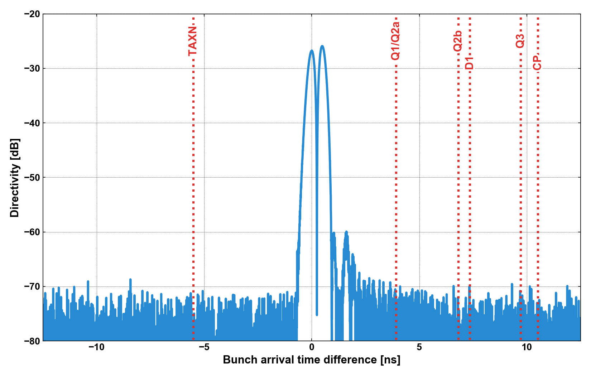
Electrode simulations - directivity
Optimisation: temporal bunch separation at BPM locations

Slide 12
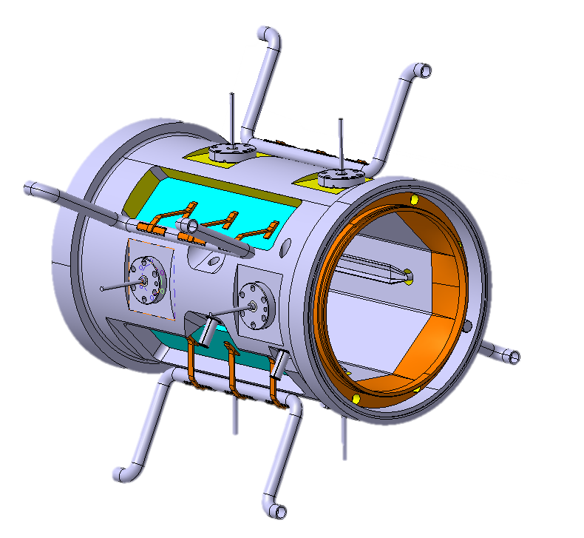
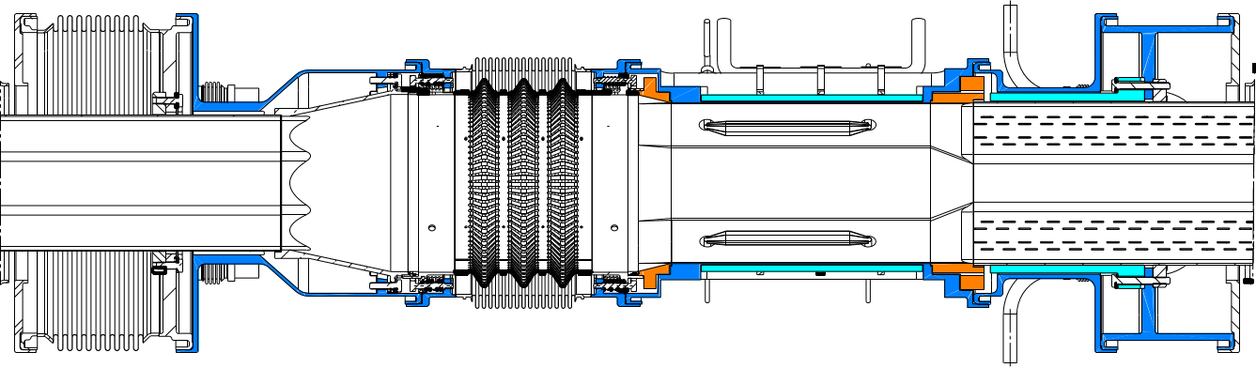
Mechanics, integration and alignment
Courtesy: N. Chritin
Mechanical design well advanced
Integration with the interconnects and
alignment ongoing with other WPs

Slide 13
Heat load estimations
Main sources of heat load:
Collision debris absorbed by W: 1.5 W
Collision debris absorbed by BPM: 1 W
Electron cloud: 2 W (20 W uncoated)
Beam: 0.5 W
Cables: 0.4 W
Total per BPM: ~ 6 W (coated),
~ 24 W (uncoated)

Slide 14
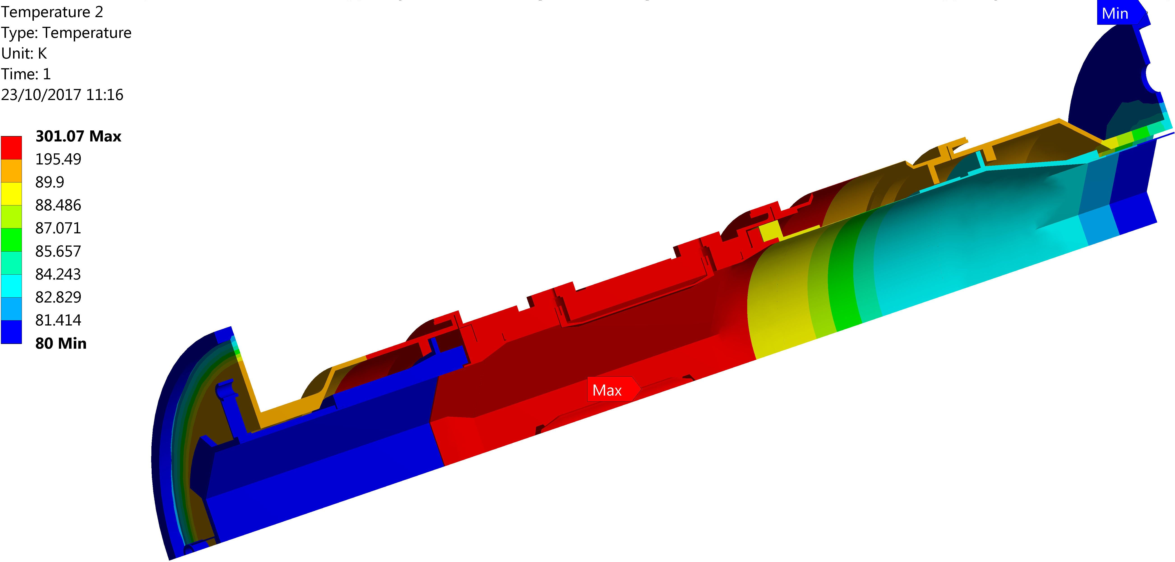
Lack of active cooling
Courtesy: M. Pasquali
BPM 220 K above beam screen’s temperature

Slide 15
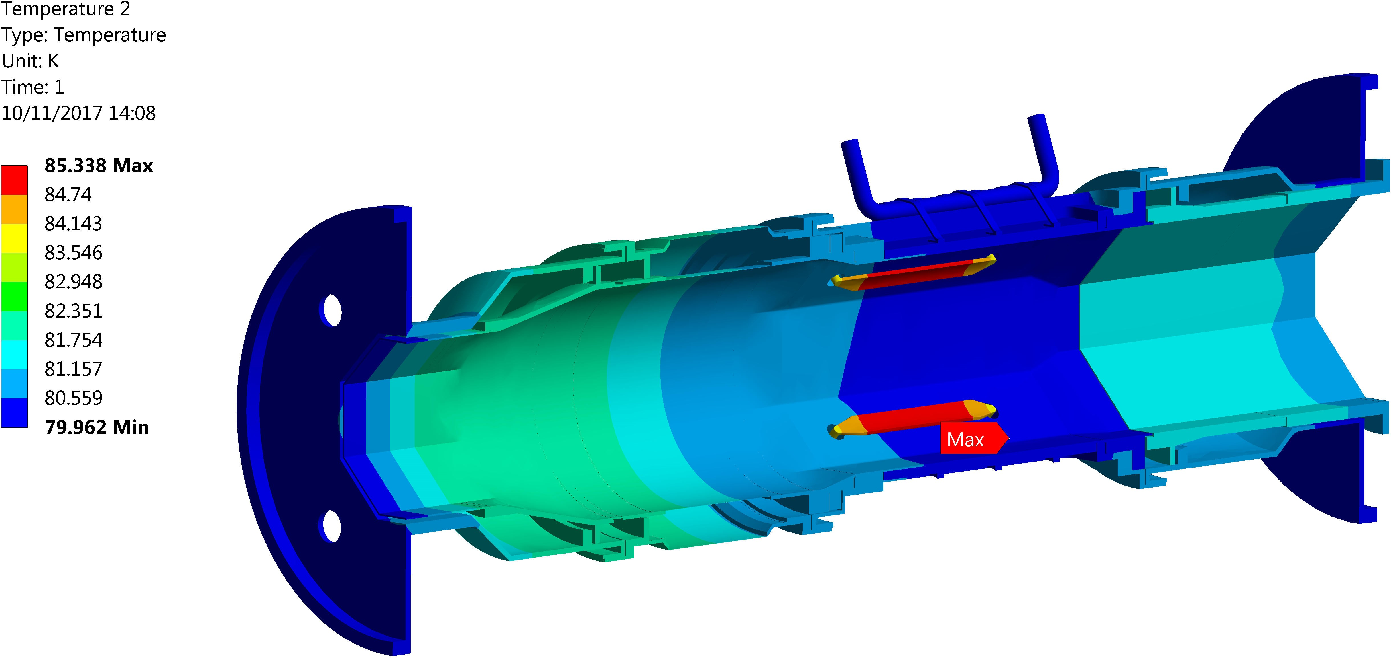
With active cooling
Courtesy: M. Pasquali
Cooling inspired by the beam screen solution
Electrodes 5 K above beam screen’s temperature

Slide 16
Other thermomechanical considerations
Thin skin BPM body deformation due to pressure difference – 60 μm
Electrode-body thermal expansion
differential – 100 μm (steady state)
Electrode thermal deformation – ~10 μm
More simulations ongoing

Slide 17
String test
6 cold BPMs required – 1 x BPMSQTA and
5 x BPMSQTB – verification whether full BPMs are really needed
Possibility of including warm BPMSWQ under study
The BPMs need to be ready in 2020

Slide 18
Conclusions and outlook
Development of new HL-LHC BPMs on track
Focus put on design of the BPMs required for the string test
Current main activities: advanced transient thermomechanical simulations, full interconnect integration, feedthrough studies

Slide 19
Thank you for your attention!
Acknowledgements: A. Demougeot, D. Draskovic, D. Duarte Ramos, R. Fernandez Gomez,
G. Iadarola, R. Jones, M. Pasquali

Slide 20
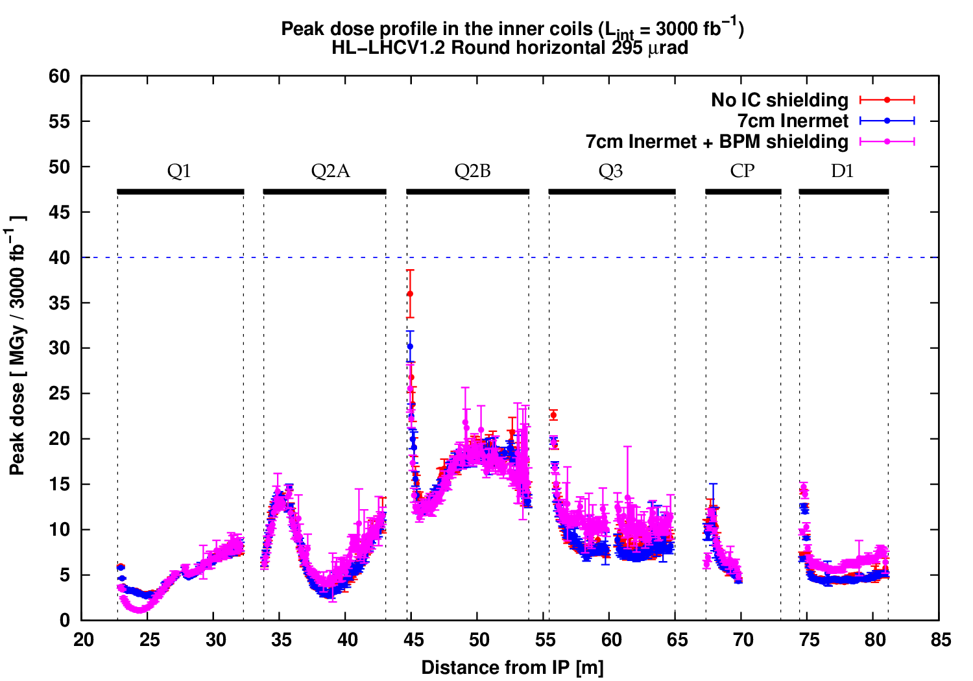
Back up: Tungsten shielding
Courtesy: A. Tsinganis, F. Cerutti

Slide 21
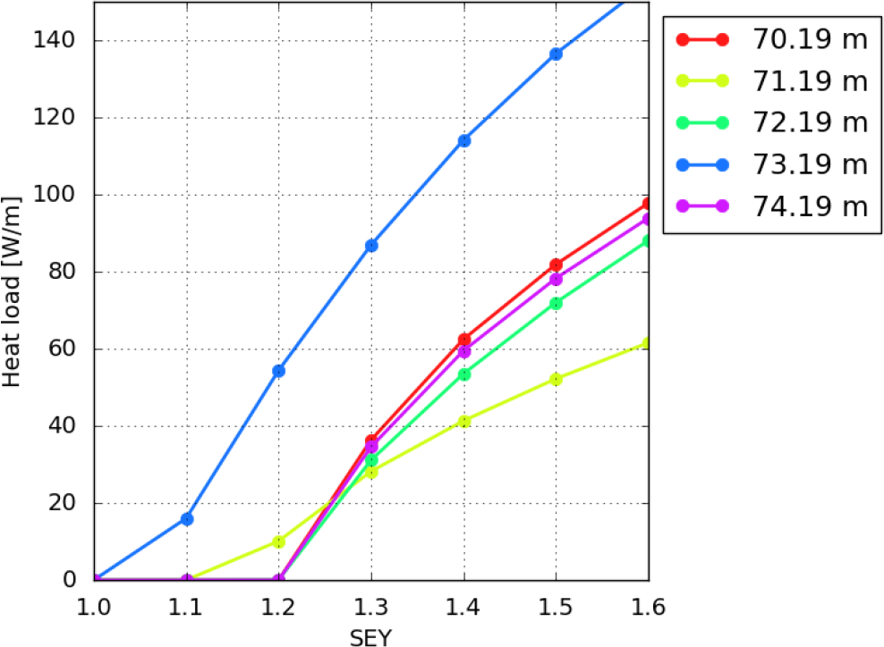
Back up: Heat load
Courtesy:
G. Iadarola

Slide 22
Back up: Locations
Number | 1 | 2 | 3 | 4 | 5 | 6 | 7
Type | BPMSTQA | BPMSTQB | BPMSTQB | BPMSTQB | BPMSTQB | BPMSTQB | BPMSQW
Distance from IP [mm] | 21853 | 33073 | 43858 | 54643 | 65743 | 73697 | 86846
Location comments | Between TAXS and Q1A | Between Q1B and Q2A | Between Q2A and Q2B | Between Q2B and Q3A | Between Q3B and CP | Between CP and D1 | After D1, WARM
N | 5.34 | 8.34 | 11.23 | 14.11 | 17.08 | 19.21 | 22.72
Periodicity number
Preceding ideal position [mm] | 20,570 | 31,790 | 43,010 | 54,230 | 65,450 | 72,930 | 84,150
N = floor(N)
Succeeding ideal position [mm] | 24,310 | 35,530 | 46,750 | 57,970 | 69,190 | 76,670 | 87,890
N = ceil(N)
Distance from ideal position [mm] | -1,283 | -1,283 | -848 | -413 | -293 | -767 | 1,044
Towards the IP. Negative number means it's too far from the IP
TOF from ideal position [ns] | -4.28 | -4.28 | -2.83 | -1.38 | -0.98 | -2.56 | 3.48
Towards the IP. Negative number means it's too far from the IP
Bunch arrival time difference [ns] | 3.92 | 3.92 | 6.82 | 9.72 | 10.52 | 7.36 | -5.51
Negative numbers mean the bunch going towards the IP arrives first

Slide 23
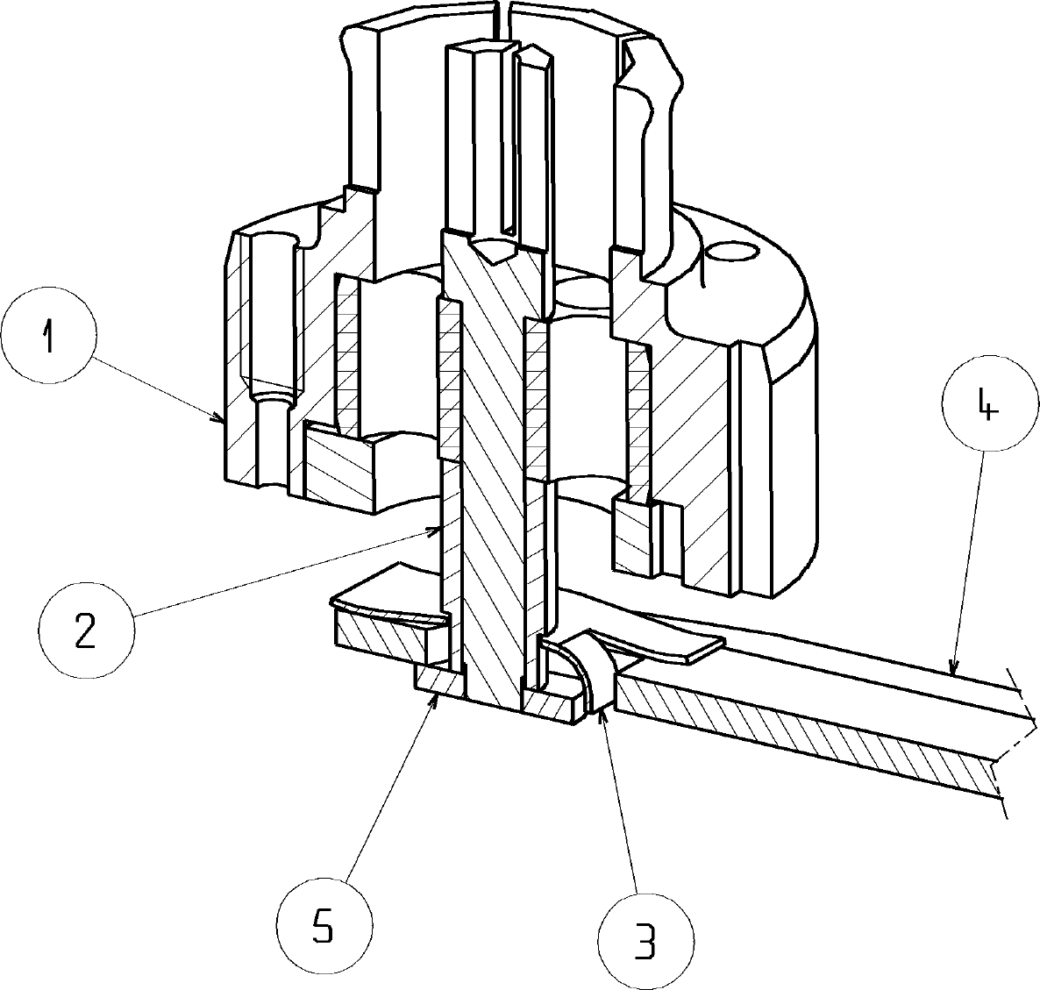
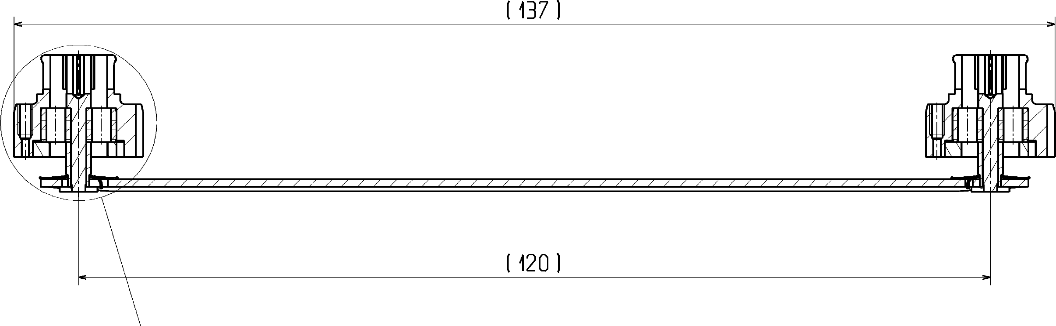
Back up: LHC electrodes
Courtesy: C. Boccard, P. Clergue

