Slide 1

Status and plans for e-beam R&D
Adriana Rossi (CERN BE-BI-EA)
Alexey Levichev, Danila Nikiforov, Alexey Barnyakov, Mariya Maltseva (BINP), Alexander Pikin (BNL),
Sergey Sadovich (CERN), Giulio Stancari (FNAL)
7th HL-LHC Collaboration Meeting, 13-16 November 2017, CIEMAT Madrid

Slide 2
Context
Electron beams can be used in conjunction with proton/ion beams for
Electron cooling (for ex. at CERN LEIR, AD, ELENA),
Space charge compensation (GSI SIS18, FNAL IOTA)
Beam-beam compensation (at FNAL Tevatron and BNL RHIC)
Halo diffusion enhancement (at FNAL Tevatron)
At HL-LHC e-lenses are being studied for:
  BBLR for Beam-Beam Long-Range compensation
  HEL for Halo diffusion enhancement
  BBHO for Beam-Beam Head-On compensation
  Landau damping

Slide 3
Electron beam applications (1/3)
Electron cooling is a method to shrink the emittance (size, divergence, and energy spread = lower the temperature) of a charged particle beam without removing particles from the beam. Electron are injected at the same velocity as the ion/proton beam, via Coulomb scattering they exchange momentum and at thermodynamic equilibrium (= same momentum), since the electrons are much lighter, they will have increased their velocity, and the opposite for the ions/protons.
  Few tens of mA x 5-10 kV electrons
Space charge compensation, where the electric field generated by electron beams (Gabor lenses) are used to focus ion/proton beams, whose space charge would otherwise cause emittance blow-up.
  Electron beam with transverse and longitudinal distribution plus current intensity ~ matching beam to be focused

Slide 4
Electron beam applications (2/3)
Beam-beam compensation: The strongly nonlinear beam-beam force excites high-order betatron resonances, particles diffuse into the tails of the transverse distributions causing emittance growth and beam losses.
Beam-beam tune spread might be reduced by:
x_{w} y_{w}
  for Long-Range Beam-Beam (parasitic encounters)
    compensation with e-beam wire (WP13)
    concept being tested in LHC with copper wires embedded in collimator (see G.Sterbini’s talk, Wed.)
    at HL-LHC required electron beam ~ 200Am (for 2 wires per HL IP)
    ≅≅ 60Am x several tens of kV (2 e-lenses per HL IP) wire like
  for Head-On Beam-Beam (IP collisions)
    collisions of the proton bunch with a space charge of a low energy e-beam, having the same Gaussian transverse distribution as the p-beam (WP13?)
    at RHIC ~0.2A proton beam with beam-beam parameter 0.007
    used total of 2 e-lenses with ~2Am (=1A x 2m) x 10kV (2 IPs)
    HL-LHC ~1.1A proton beam with beam-beam parameter 0.033
    → → ≅ 5.5Am (scaling with current plus 2 e-lenses per HL IP) x 15-20kV

Slide 5
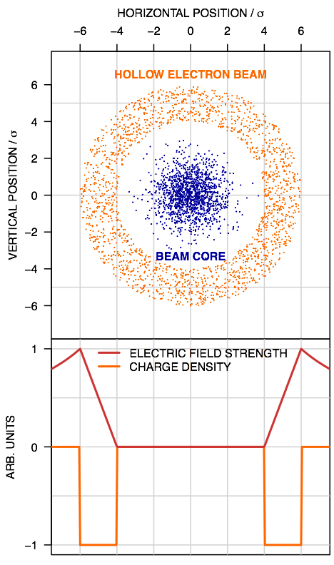
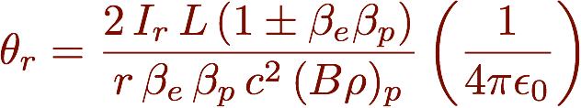
Electron beam applications (3/3)
Halo diffusion enhancement: Loss spikes have already affected the operation of the LHC, and control of beam losses is recognised as a critical concern for performance at HL-LHC due to the higher beam energies and intensities (for ex. for Crab Cavity failure).
Hollow electron lenses are being designed and (if approved as baseline) will be installed in IR4 (during LS3) as active mean to increase diffusion rate of halo particles. Halo
  at HL-LHC required hollow electron beam
  ~ 15Am (1×3m e-lens per beam) × 15-20kV
Courtesy of
G. Stancari

Slide 6
Electron Lens schematics (typical values)
Electron gun (A)
Modulator (KHz to MHz)
Instrumentation
Current transformers
BPMs
Collector
Overlap/transvers profile monitors
Main SC solenoid 4-6 T
Gun solenoid > 0.2T
Bending SC solenoids ~3T
Gas Curtain Monitor (BGC)
See talks by R.Veness et al.
International Review on the e-lens concept readiness for integration into the HL-LHC baseline 19 Oct. 2017

Slide 7
Hollow Electron Lens
Electron gun 5Ax15-20kV
Collector
V_{CA}
cathode
grid
anode
+
–
+
–
+
–
Cathode
Heater
10Ax40V
Control electrode
4kVx40mA
V_{CA}≤20kV, I_{anode}
33kHz,
200ns rise time
V_{CO}
Anode modulator
Anode/grid modulator 40MHz
– +
Cathode –
Collector
PC
–
+
High voltage (~15kV)
High current
V_{CA}-V_{CO}, I_{beam}=5A
Cathode
PC
High voltage (15-20kV)
low current (losses)
V_{CA}, I_{tube}

Slide 8
Outline
Hollow Electron Lens
  Current design
  Electron beam studies
  New campaign of simulations for HEL
Brief Long-Range Beam Beam studies
Experimental results: existing and future facilities
Summary

Slide 9
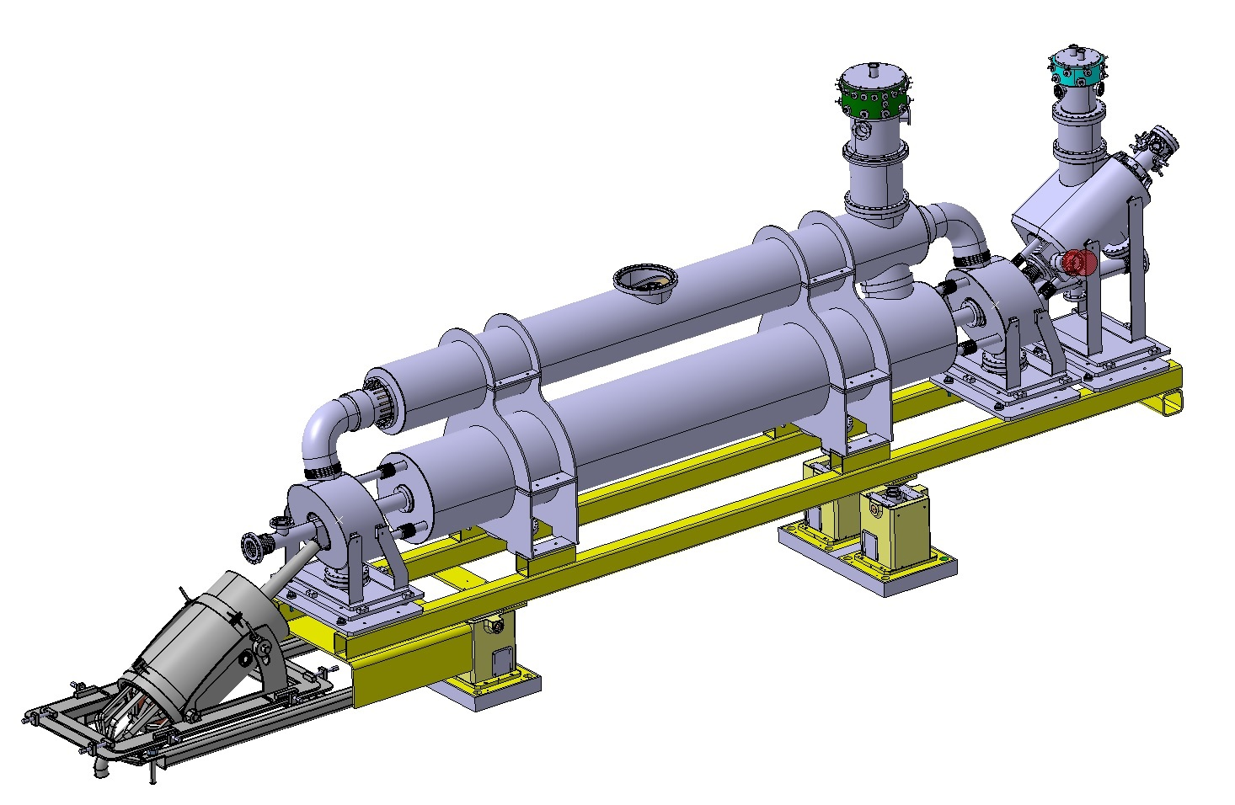
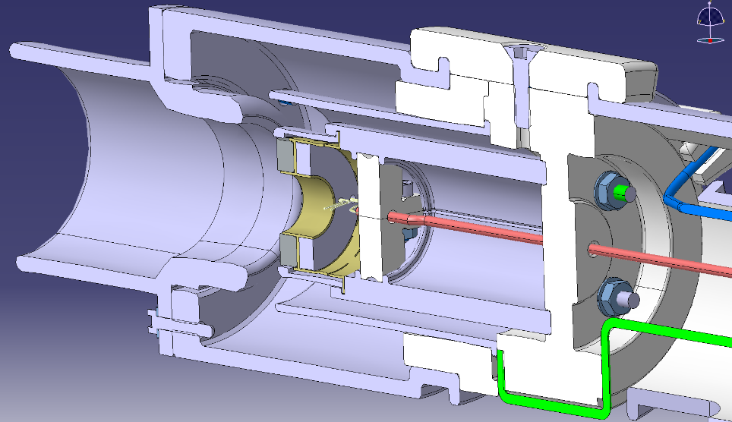
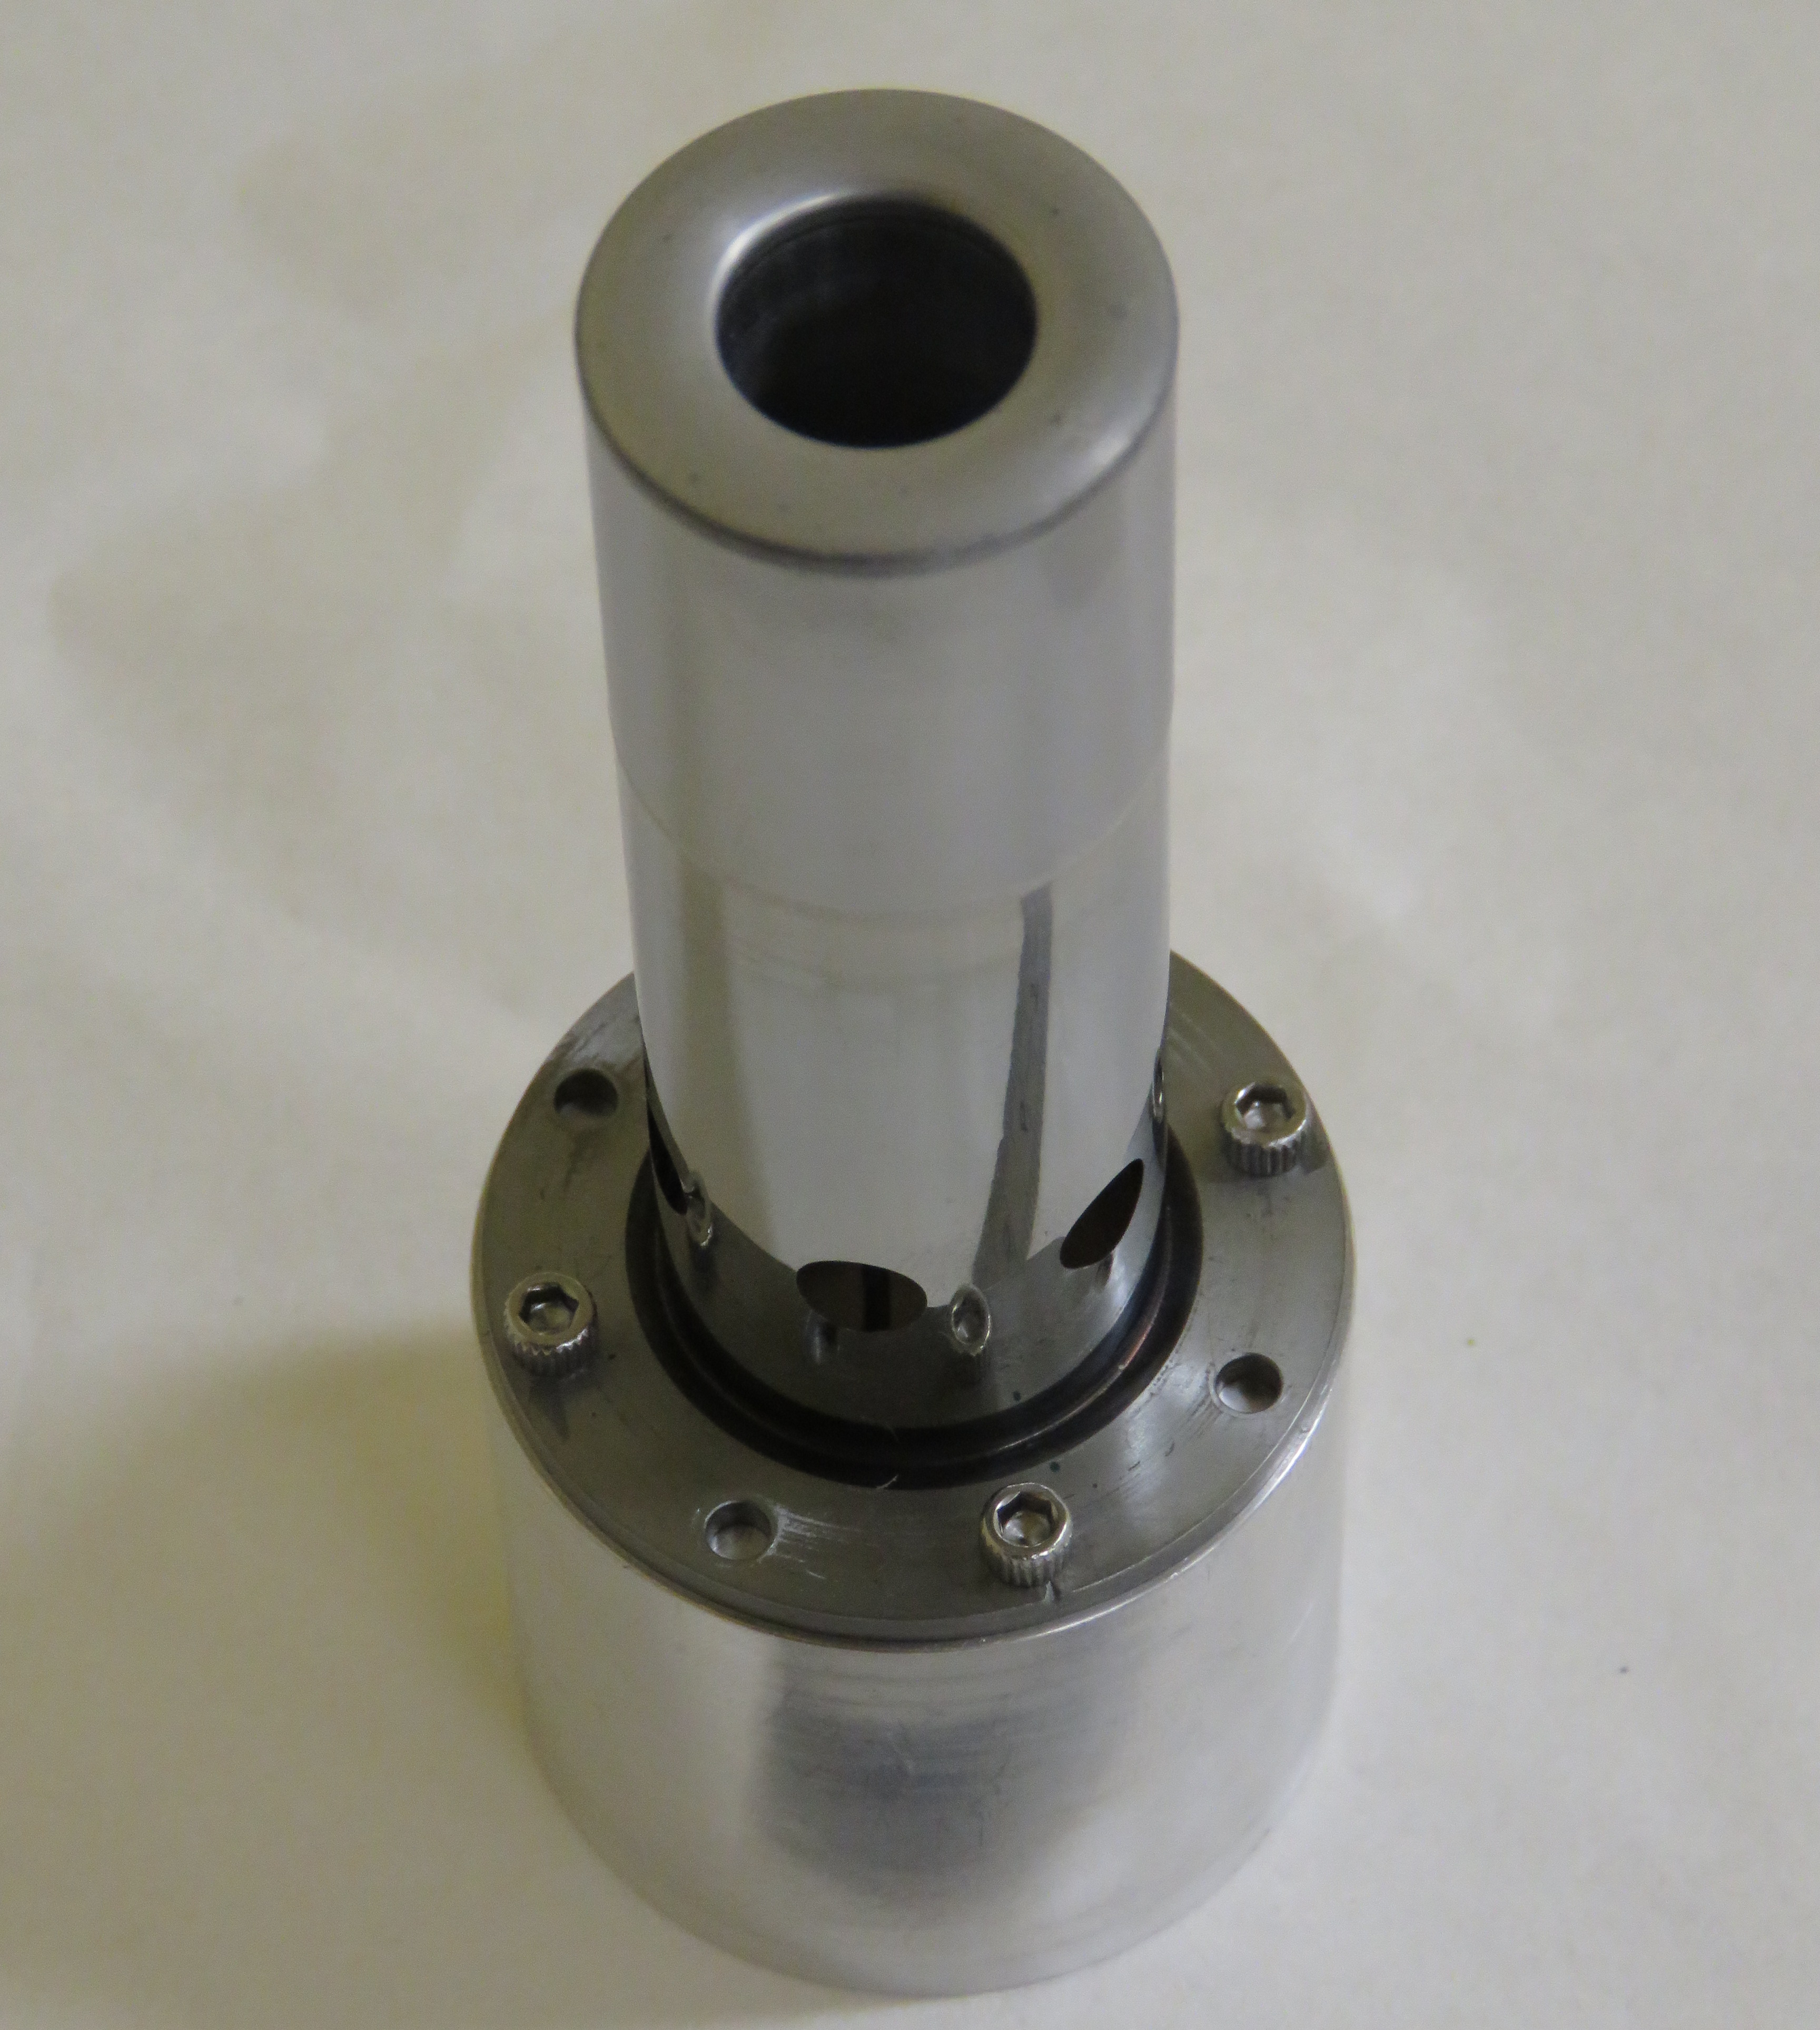
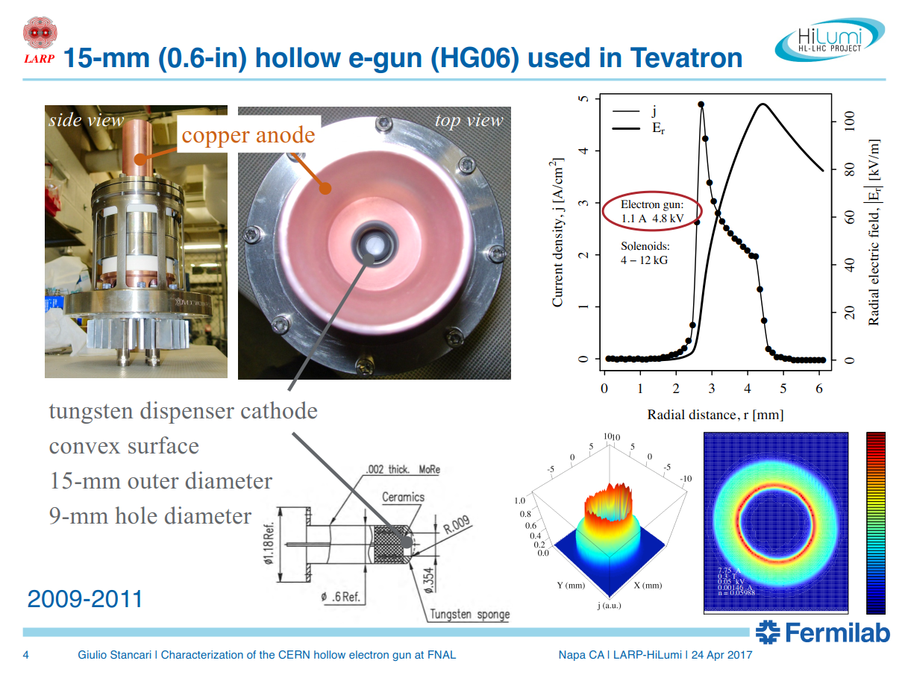
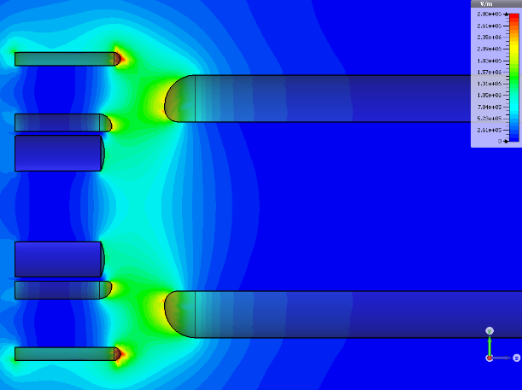
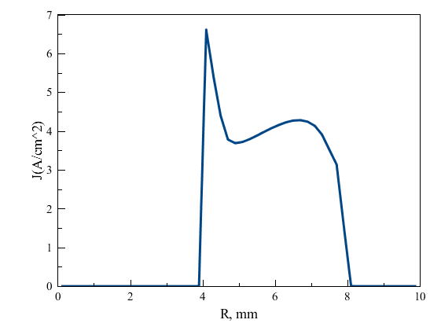
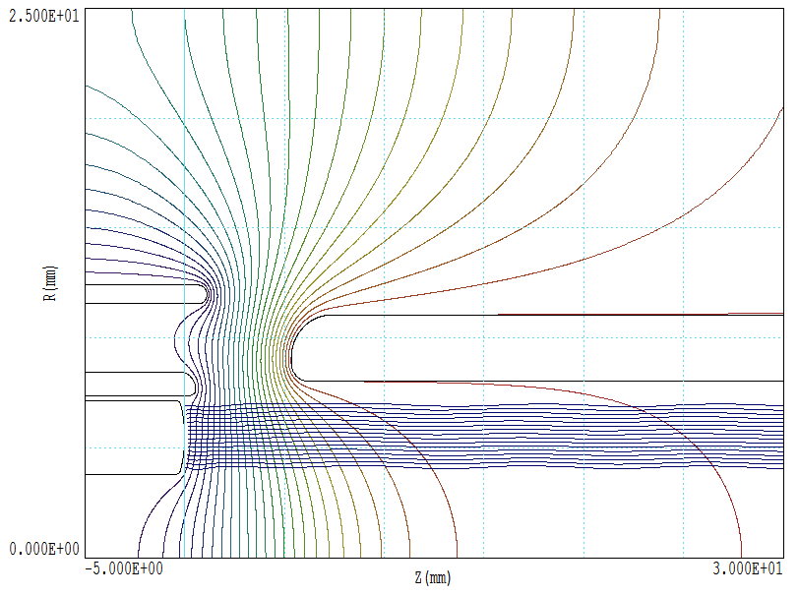
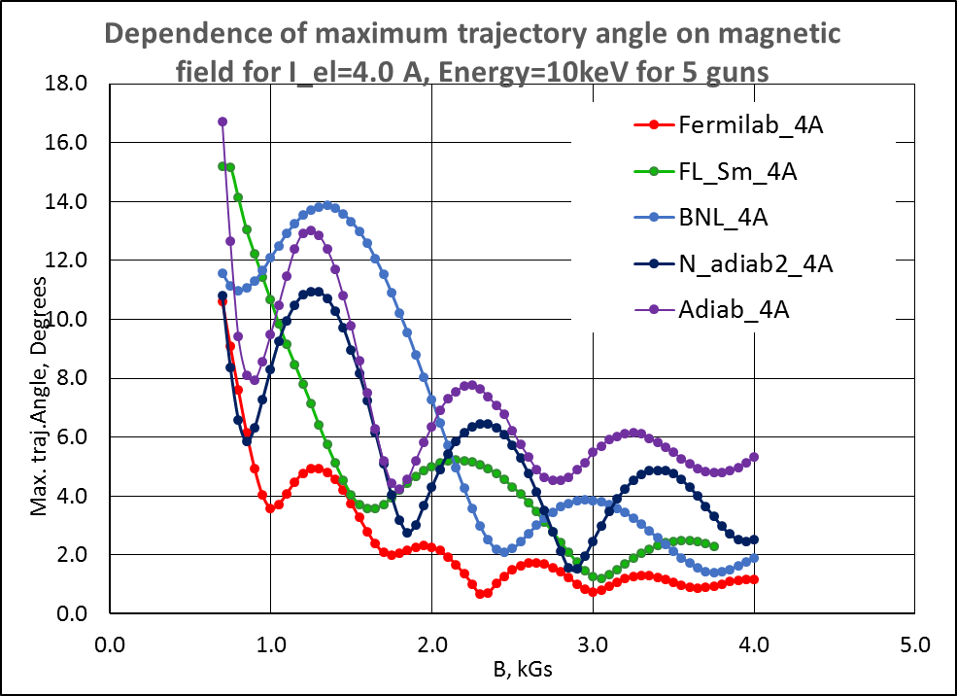
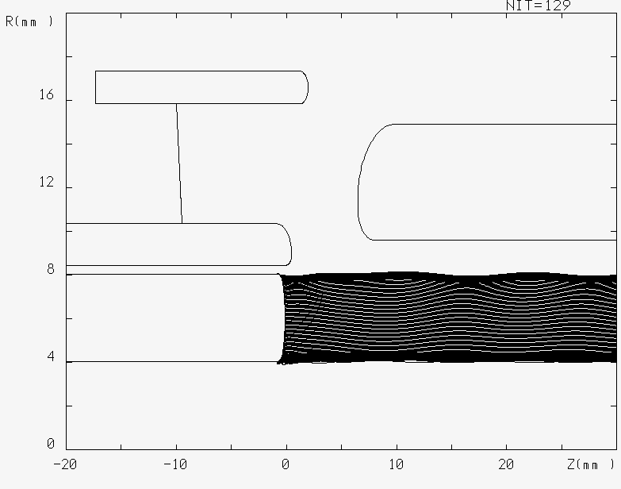
HEL current design
e-gun
Gun (scaled design from FNAL)
bending solenoid
bending solenoid
anode
cathode
main solenoid
D. Perini, C. Zanoni, G. Gobbi CERN EN-MME 19/10/2017
International Review in the HEL concept readiness
for integration into the HL-LHC baseline
collector
A. Pikin BNL
TRAK code
G. Stancari FNAL – WARP code
A. Levichev et al. BINP – UltraSAM code, see talk @WP5, Thu

Slide 10
Perveance . . .
For non-relativistic beams, E=U+K
U = potential of the pipe walls (ground) – potential of the beam
The pipe perveance P_{p} defines the minimum potential difference with which the beam can be transported through the pipe, and depends on geometrical factors (pipe and beam size), beam current and kinetic energy (initially beam velocity ν = √(2*e* U_{o}/m) with U_{o} accelerating potential).
Analytical estimate for P_{p}
(cylindrical capacitance,
assuming round e-beam)
International Review on the e-lens concept readiness for integration into the HL-LHC baseline 19 Oct. 2017
Notes:
Estimation of Perveance assuming round beam

Slide 11
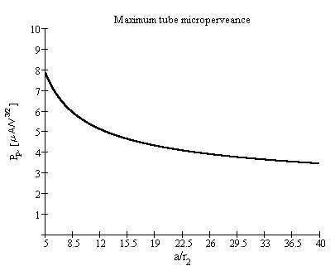
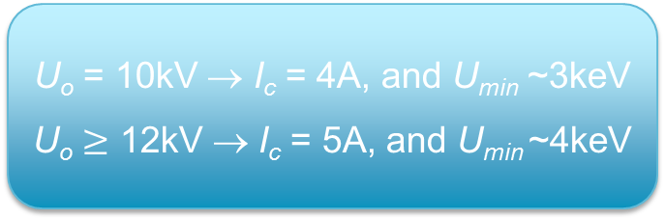
… and critical electron current
I_{c}=P_{p}U_{o}^{3/2}
Maximum current trough a pipe
for a given accelerating potential U_{o}
For I~I_{c}, the minimum beam
energy in the pipe will be ~U_{o}/3
U_{o} = 10kV
r_{p}/r_{b} =22.2 (40/1.8mm)
I_{c} = 4A
U_{o} = 10kV → I_{c} = 4A, and U_{min} ~3keV
U_{o} $≥$ 12kV → I_{c} = 5A, and U_{min} ~4keV
International Review on the e-lens concept readiness for integration into the HL-LHC baseline 19 Oct. 2017
Notes:
Estimation of Perveance assuming round beam

Slide 12
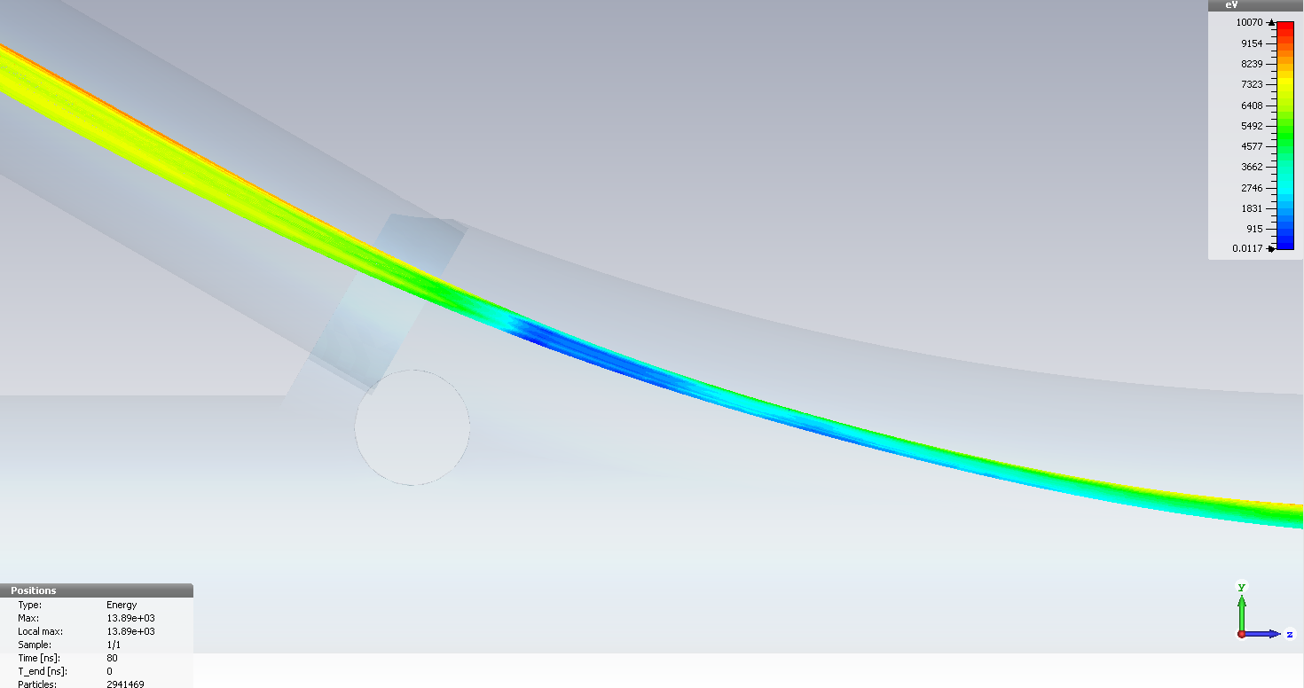
Effect of compression and virtual cathode: 10 kV accelerating voltage and 5A current
BINP team Code: CST
See A.Levichev’s talk @WP5, Thu
Electrons loose energy up to being lost or reflected back
International Review on the e-lens concept readiness for integration into the HL-LHC baseline 19 Oct. 2017

Slide 13
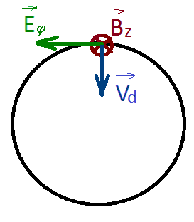
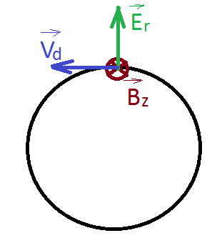
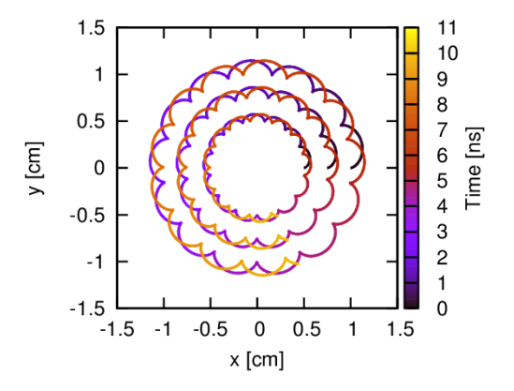
Effect of drift velocity
Larmor motion: electrons rotating along the magnetic line
with longitudinal velocity
Drift velocity derives from the ExB (e-beam electric field
significant for large e-currents)
Rotation velocity, larger at larger radius
Circular beam frequency
In case of non azimuthally uniform beam there could be an angular component of the electric field causing beam to tilt by Φ.
Courtesy of Daniel Noll
International Review on the e-lens concept readiness for integration into the HL-LHC baseline 19 Oct. 2017

Slide 14
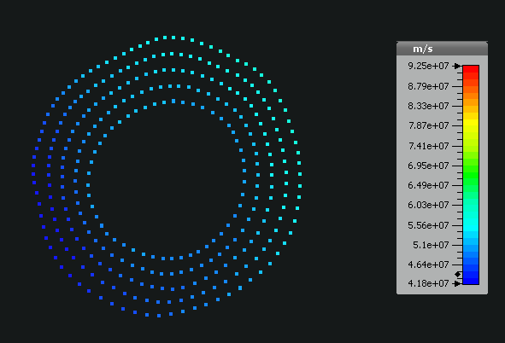
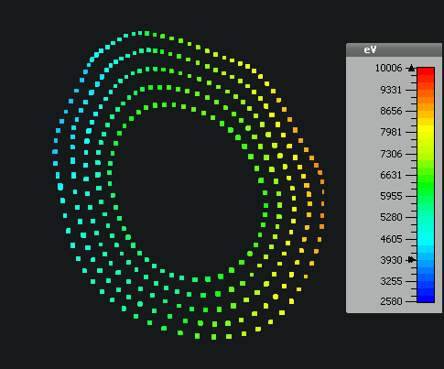
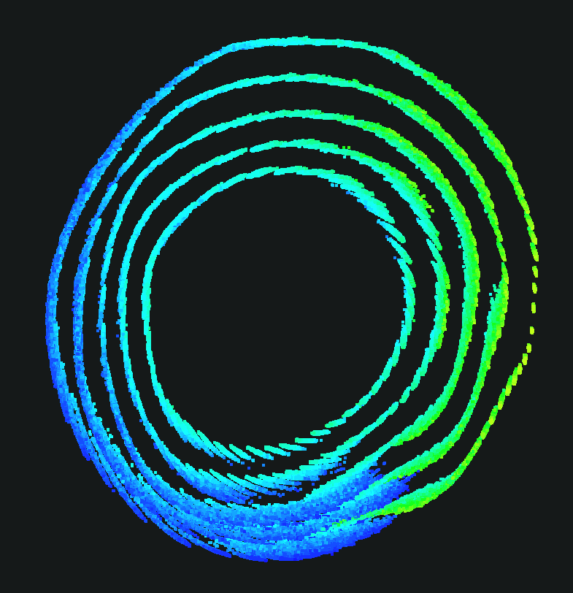
Effect of drift velocity
CST simulation of a 5A beam deforming along the HEL (BINP)
See A. Levichev’s talk Thursday @WP5
Figures of merit :
Fraction of turn along the main solenoid
Ratio between plasma and Larmor frequency
Courtesy of
G. Stancari
International Review on the e-lens concept readiness for integration into the HL-LHC baseline 19 Oct. 2017

Slide 15
New campaign of simulations for HEL
5T, 2.9A (≈≅ 0.2urad kick to 7TeV protons), 15kV, 60mm vacuum chamber to get to a set of ‘working’ parameters for the C&S review March ‘18
Validation of current simulations (codes and assumptions)
  comparing with data taken at FNAL (next slides) with CST, WARP, PiC (BENDER),
  in collaboration with FNAL (G.Stancary), BINP (A.Levichev’s team), CERN (S.Sadovich)
Review magnetic field and dimension of cathode

Slide 16
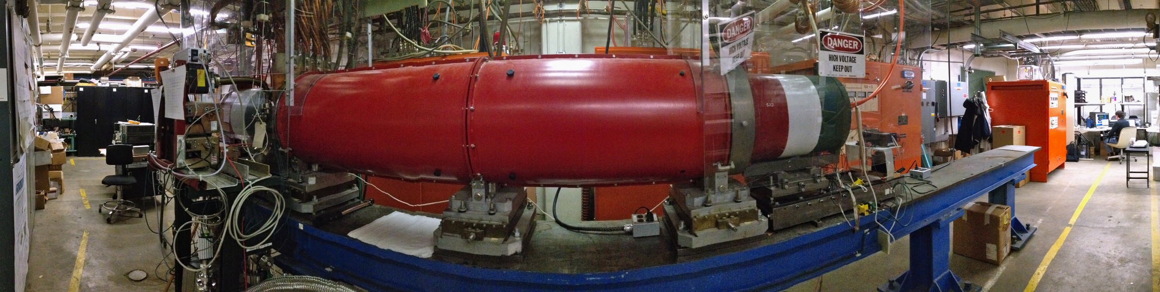
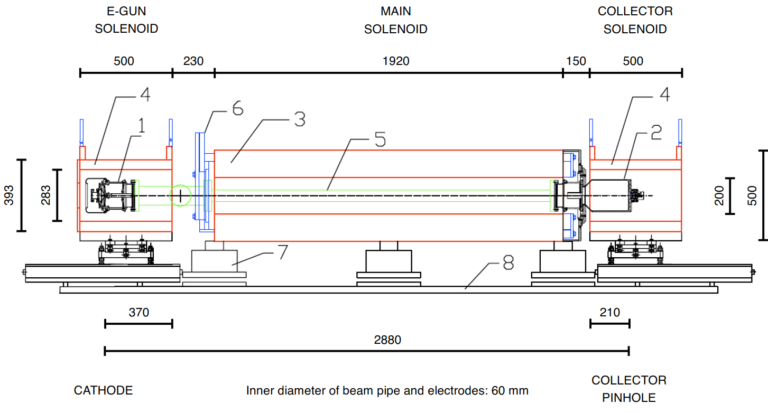
E-lenses experimental data: test stand
FERMILAB – Tevatron
https://cdcvs.fnal.gov/redmine/projects/elens/wiki/Test_Stand
Operational, up to 10 kV, 8υs x 1Hz pulses (or higher at < 5A)
Used to test CERN guns, will be used for testing guns for space-charge compensation at IOTA ring. Could be used to test HF modulators.
International Review on the e-lens concept readiness for integration into the HL-LHC baseline 19 Oct. 2017

Slide 17
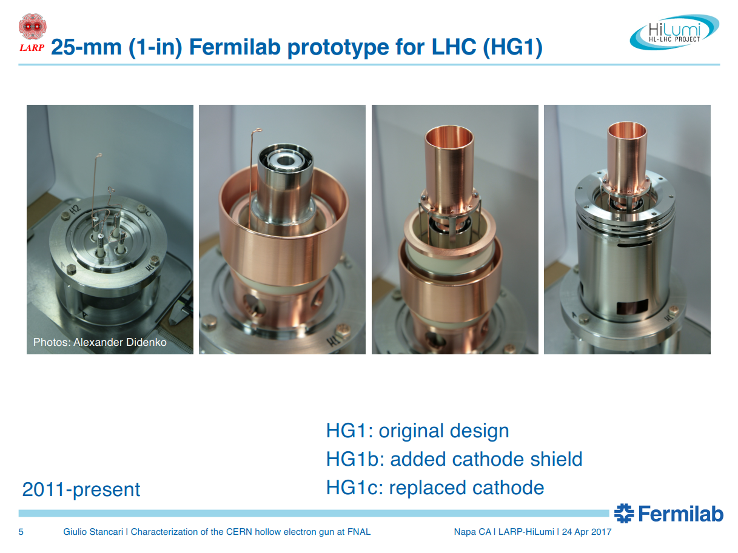

Slide 18
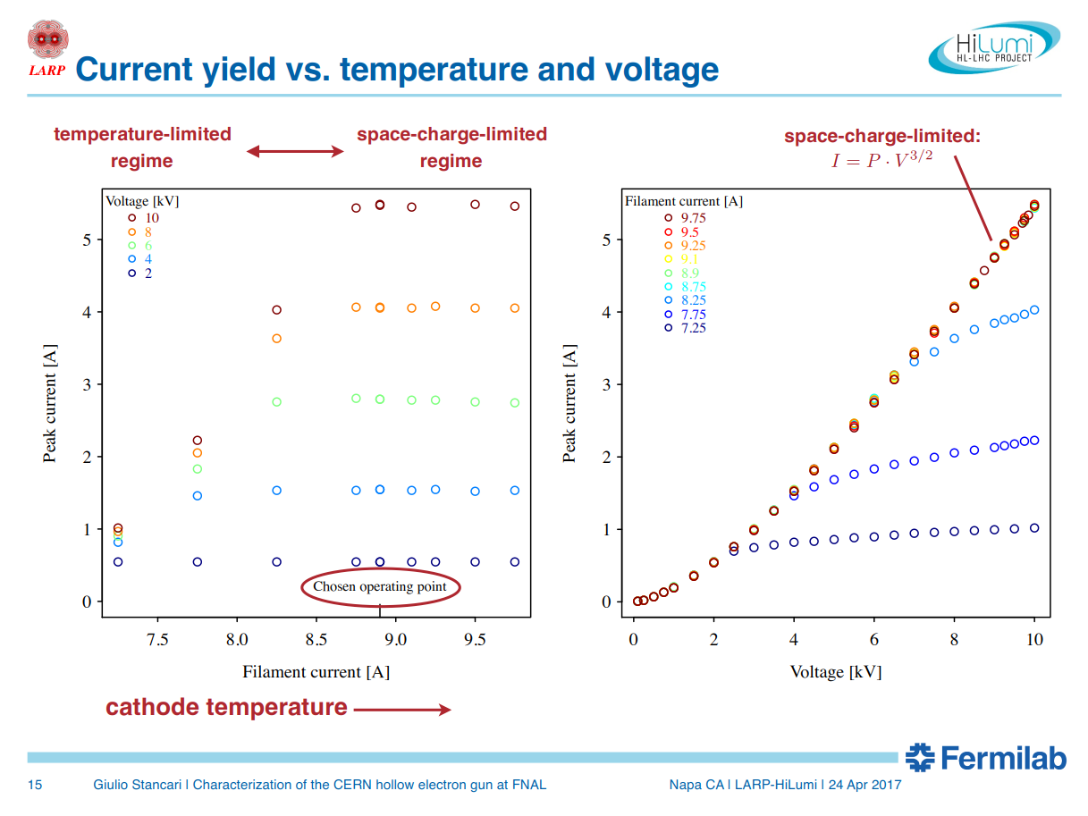

Slide 19
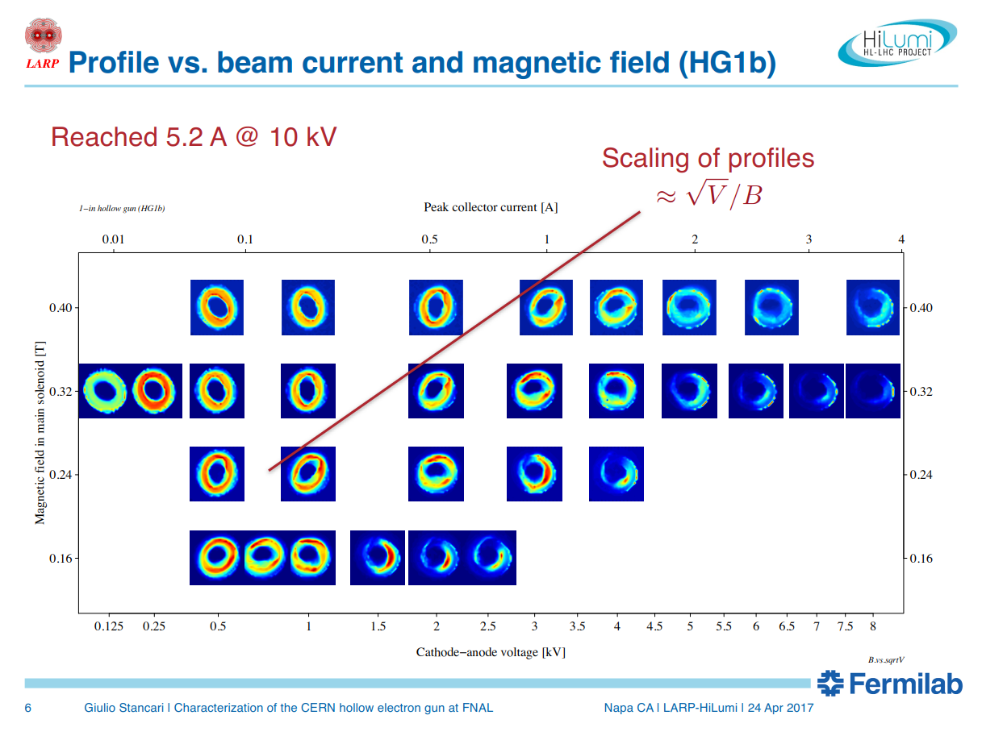
HG1B ∅25 cathode – ∅63 chamber

Slide 20
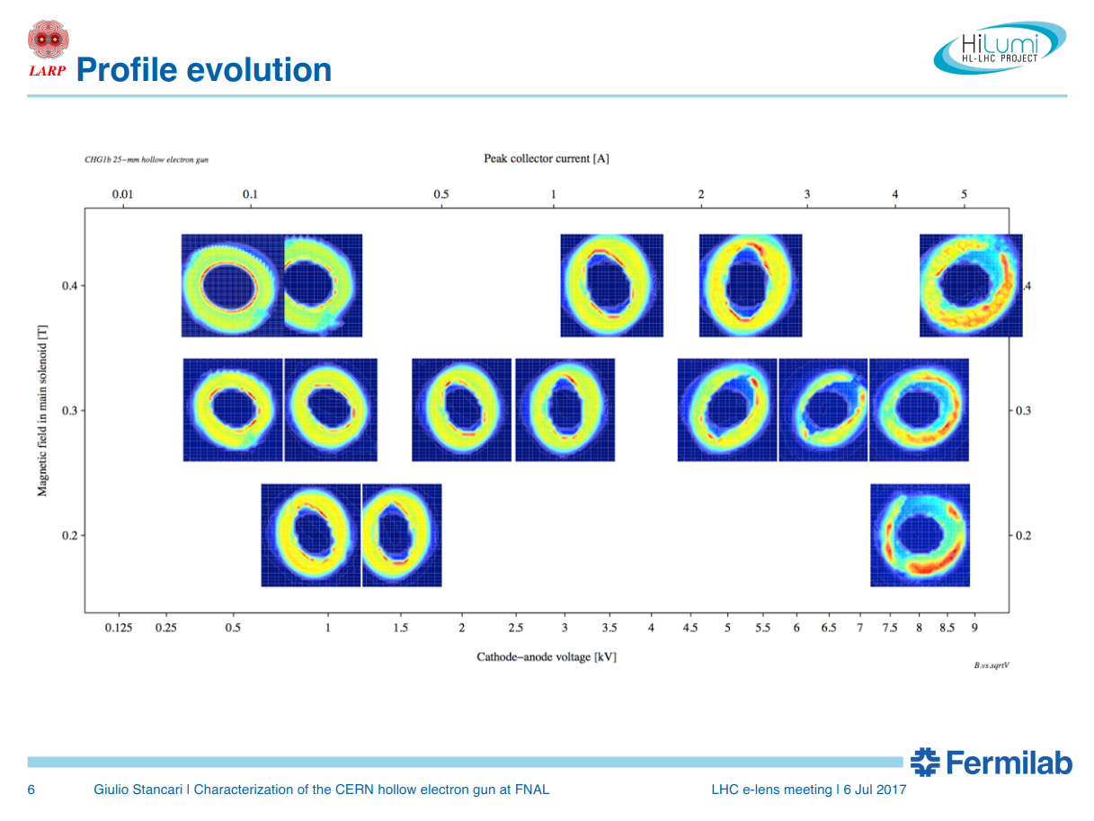

CHG1B ∅25 cathode – ∅63 chamber
peak collector current [A^{1/2}]
magnetic field in main solenoid
(gun solenoid at 0.2T)
Without compression
cathode-anode voltage [kV^{1/2}]

Slide 21
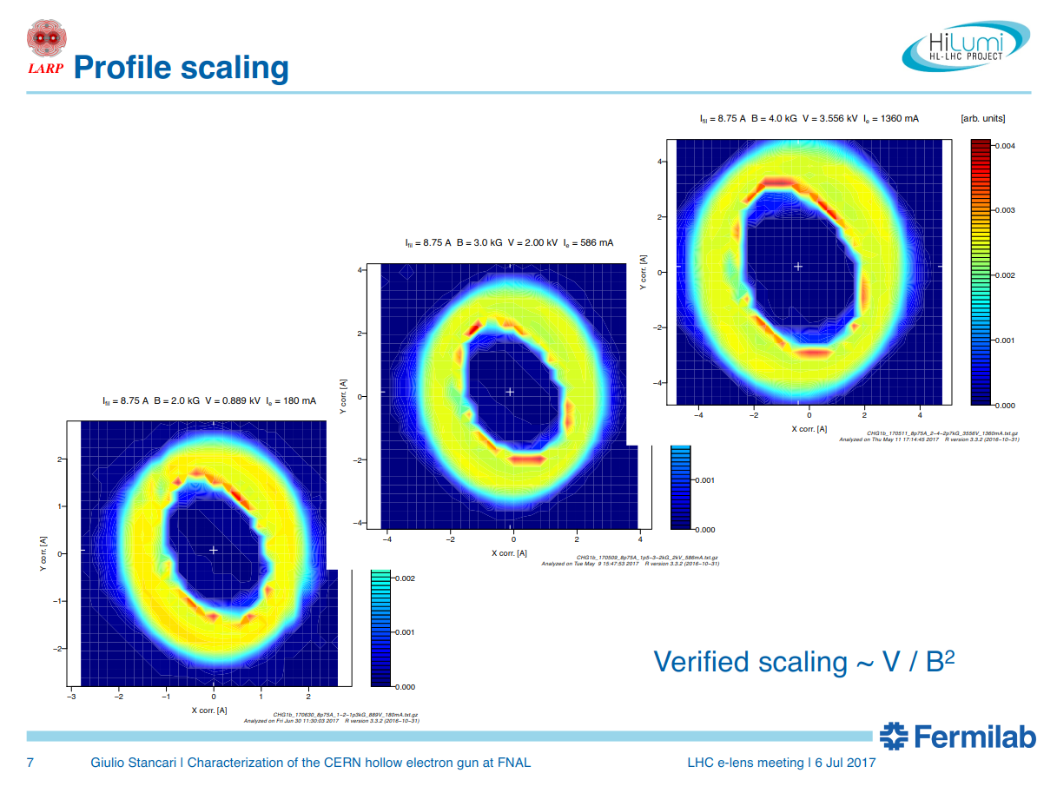
We can see beam deformation
already at <0.5A

Slide 22
Main differences with HEL
Ratio between the pipe and beam size is ~3
→ pipe perveance ~ 10A
Uniform pipe ∅
No bends (we cannot
see effect of drifts due to
B x gradB)
U_{o} = 10kV

Slide 23
Test facility at CERN (1)
Foreseen for ARIES studies WP16 –
Intense, RF modulated E-beams (IRME)
  Design and build a test stand for testing this gun including instrumentation suitable for measuring the transverse and longitudinal profiles of the RF modulated electron beam
  Measure the properties of the RF modulated electron beam created by the gun using this test stand
  Space Charge Compensation for the ion beam at the Heavy Ion Synchtron SIS18 (to be used as injector to SIS100)
  transversally and longitudinally matched e-beam of 50x70mm oval, 5(average)-10(peak) A, 22kV

Slide 24
Test facility at CERN (2)
Foreseen to test high intensity e-gun for
Beam-Beam Long Range compensation
  Few mm round e-beam, up to 20A, 20-35kV
  Modulated at 40MHz for bunch by bunch
  Could be modulated at 4MHz (102nd HiLumi WP2 Meeting https://indico.cern.ch/event/662031/)
If HEL becomes baseline tests at CERN
  beam instrumentation, modulators, interlocks,
  understanding safety and technical aspects of e-lenses operation
  preparation infrastructure for test and commissioning of components of HEL@LHC

Slide 25
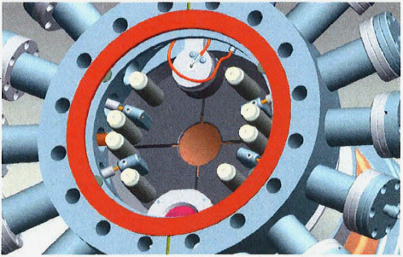
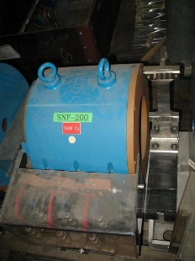
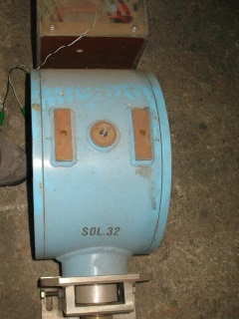
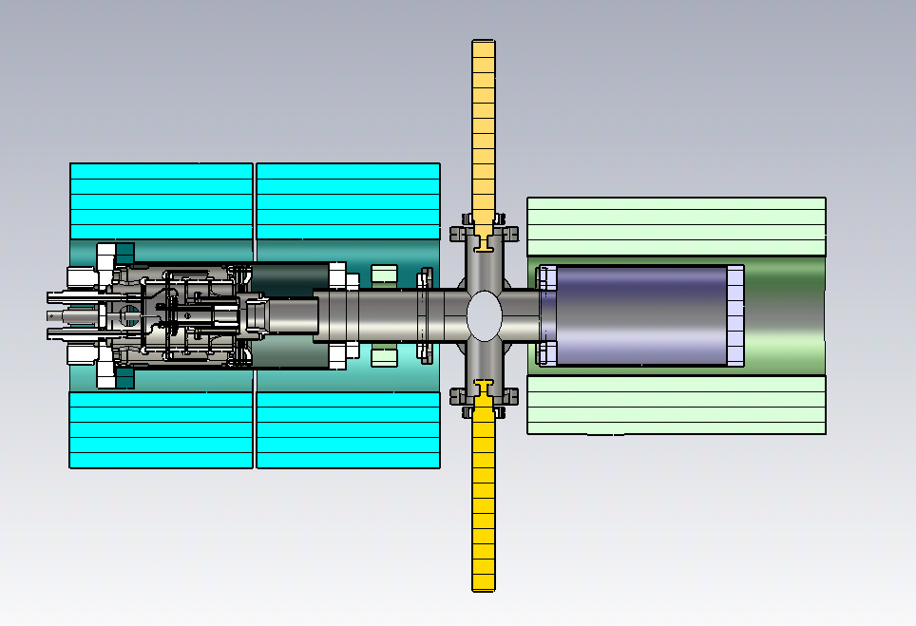
Test-stand development at CERN:
Basic configuration – stage 1
Example of diagnostic box at RHIC e-lenses
Up to 0.2T
Up to 0.42T (400A)
magnets at CERN
Purpose of this stage:
  Preparation:
    Commissioning diagnostic procedures (current, profile, position)
Commissioning HV system
Safety and technical aspects of operation
Electron gun tests: characterization & simulations
Design diagnostic box
Tests with Beam Gas Curtain monitor
Gun solenoid (twins), collector solenoid, diagnostic box (pin-hole Faraday cup + YAG screen monitor), HV system.
International Review on the e-lens concept readiness for integration into the HL-LHC baseline 19 Oct. 2017

Slide 26
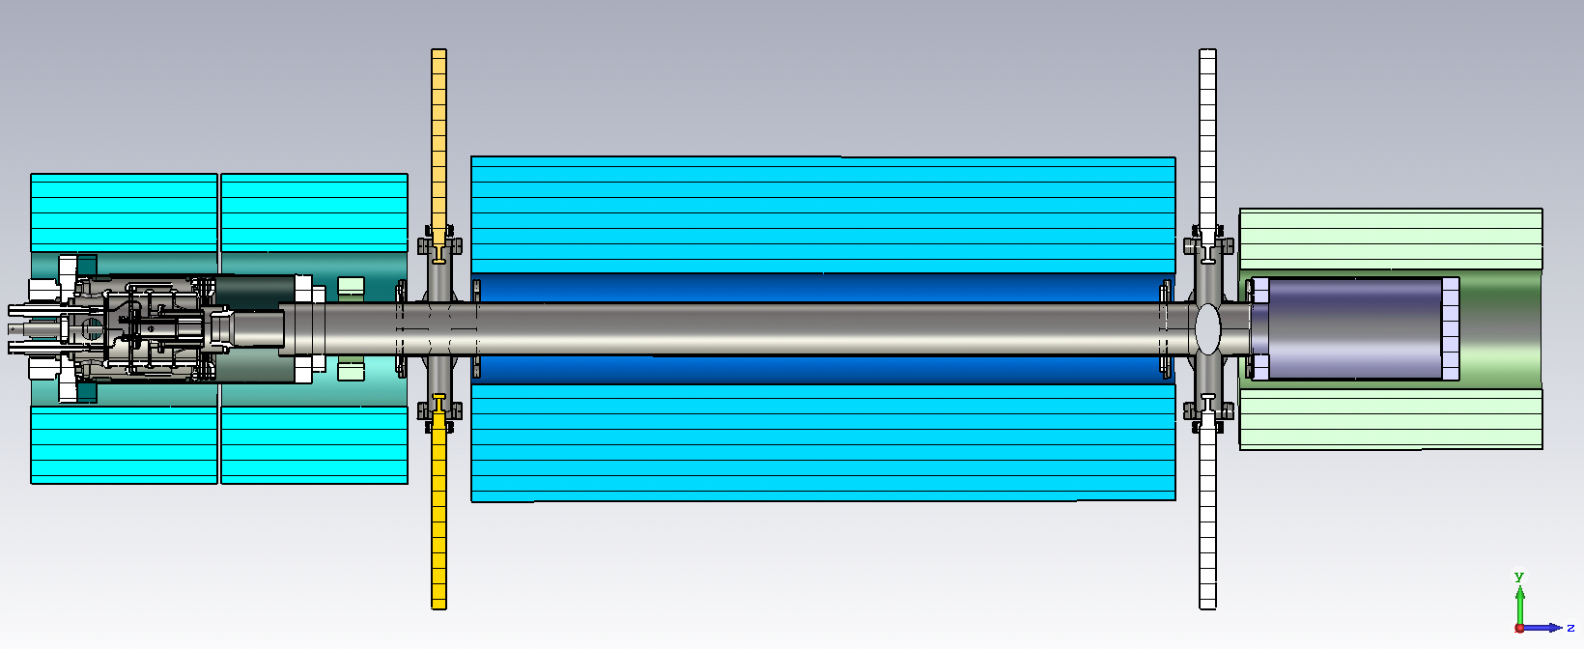
Test-stand development at CERN. Upgrade
Addition of main solenoid – stage 2
BGC
Main solenoid could be 0.4-0.5Tx1m or higher (in the latter case a dry SC solenoid may be cheaper and would expand range of investigation)
Purpose of this stage:
Allow drift and see beam deformations/rotations/…
Test Beam Position Monitor ‘shoe-box’ or stripline type with very HF modulation
Test effect of very HF modulation (%current) on beam dynamics (microbunching?)
Study electron beam dynamics in regime close to virtual cathode
Computer model validation
Study electron beam dynamics with compression (need at least 1-2T field)
International Review on the e-lens concept readiness for integration into the HL-LHC baseline 19 Oct. 2017
Notes:
For ~200 kGBP we can find a dry SC solenoid with 4T, ∅240mm bore, 980mm length. 5G stray field around 500 mm Price include a cold head, compressor and lines.

Slide 27
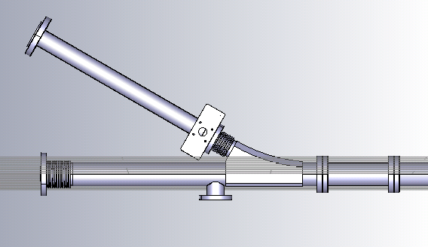
Test-stand development at CERN. The future!
Addition a bend – stage 3
Purpose of this stage:
Measure effect of B x gradB on deformation of beam with high current density
Computer model validation
International Review on the e-lens concept readiness for integration into the HL-LHC baseline 19 Oct. 2017
Notes:
For ~200 kGBP we can find a dry SC solenoid with 4T, ∅240mm bore, 980mm length. 5G stray field around 500 mm Price include a cold head, compressor and lines.

Slide 28
Summary
Electron Lenses are currently studied at CERN for HEL and LRBB (HOBB?)
HEL is being proposed as baseline to HL-LHC (IR4), studies to find ‘working’ e-beam parameters are ongoing.
A test stand at CERN will allow:
  Studying/characterisation e-lenses’s modules:
    E-gun (5A DC - 20A DC),
    Modulator of electron beam
    Beam diagnostics: profile, position, …
    Prototype of collector
    * Compatibility with elliptical beams
  Investigate electron dynamics
  Testing computer models and studying beam dynamics
    UltraSAM, Trak, CST, WARP
    LHC e-lenses simulation
  Understanding safety and technical aspects of e-lenses operation
    Software control (correctors, etc.)
    Interlocks
  Preparation infrastructure for test and commissioning of components of HEL@LHC
International Review on the e-lens concept readiness for integration into the HL-LHC baseline 19 Oct. 2017

Slide 29
Thank you
Many thanks to Diego Perini, Stefano Redaelli, Giorgia Gobbi, Carlo Zanoni

Slide 30
Beam-Beam long range
wire
x_{w} y_{w}
E-lens

Slide 31
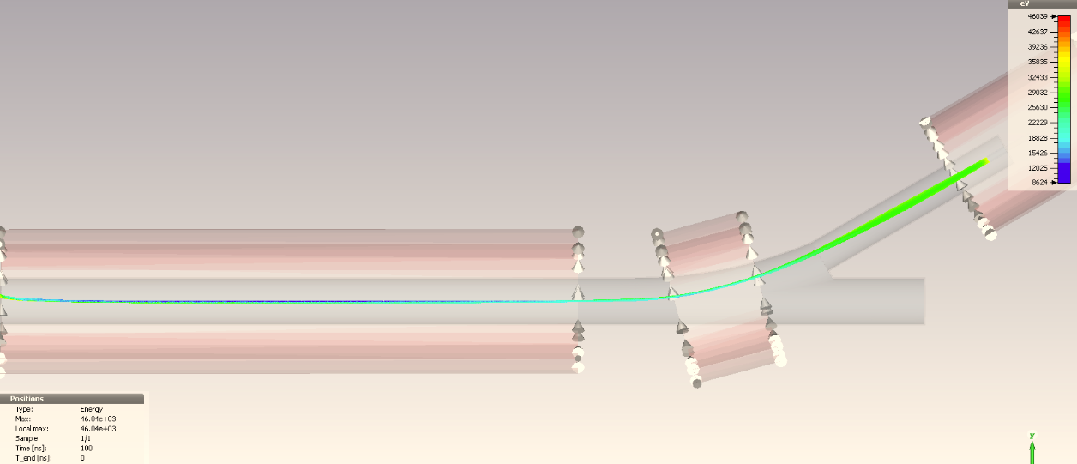
Beam dynamics I_{e}=20 A, U_{o}=35 kV
(LRBB compensation)
Minimum potential = 35kV
Due to the compression (v×B) and asymmetry of vacuum chamber at insertion, the beam potential is decreased and becomes also asymmetric with particles at different velocities
Alternatives are being studied + effects on LRBB compensations
A. Barnyakov, D. Nikiforov, A. Levichev
BINP-CERN, 18.10.2016

Slide 32
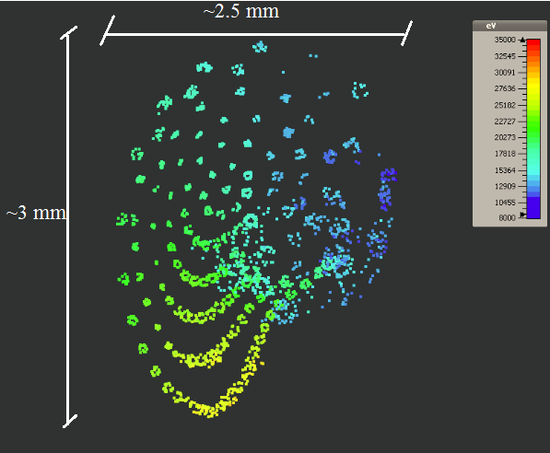
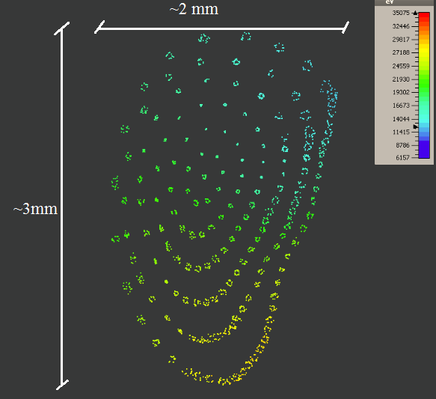
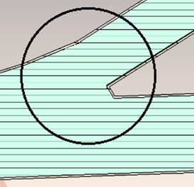
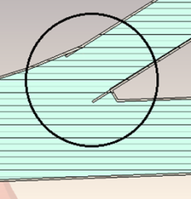
Beam dynamics I_{e}=20 A, U_{o}=35 kV
(LRBB compensation)
Attempt to symmetrized vacuum chamber
Transverse beam space

