Slide 1

Failure cases for the Crab Cavities in the SPS
Matthieu Valette, D. Wollmann, B. Lindstrom
CERN
7th HiLumi meeting – Madrid - 15 November 2017

Slide 2
Outline
Introduction
  CC layout and main parameters
  Operating modes
  Aperture restrictions and damage limits
Failure cases for the Crab Cavities
  Most relevant failures
  Tracking simulations result
  Critical parameters and timescales
Machine protection in the SPS
  Test program
  Validation steps
Conclusions

Slide 3
SPS tests - Main parameters and layout
Two Crab Cavities (Double Quarter-Wave) will be installed in the SPS for tests during 2018
They will be located in a common cryostat, downstream of QDA.61710
Beam parameter |  | CC parameter
Beam energies | 55, 120, 270 GeV | RF voltage | 2.5 MV
Tunes | 26.13, 26.18 | Klystron power | 80 kW
β_{x} | 40 m | Frequency | 400.79 MHz
β_{y} | 80 m | Tuning range | 100 kHz
Bunch length (4σ) | 1.8 ns | Aperture (circular) | 84 mm

Slide 4
Foreseen operating modes
Two main modes are foreseen:
Phased: both cavities have the same phase and their kicks add up, large crabbing in the ring.
Transparent: the cavities are operating in opposite phases, the residual crabbing is a factor ~200 lower in the ring.

Slide 5
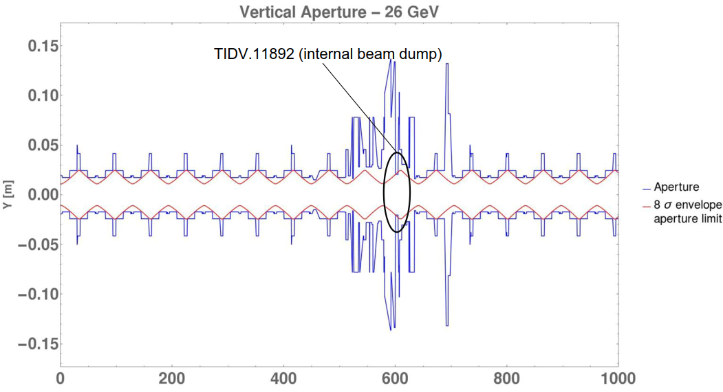
Aperture limitations and damage limits
The aperture limitation in the SPS is located at the internal dump at s=600 m (40*20 mm).
The normalized aperture increases with energy:
Beam energy (GeV) | Aperture (σ)
55 | 11
120 | 16
270 | 24

Slide 6
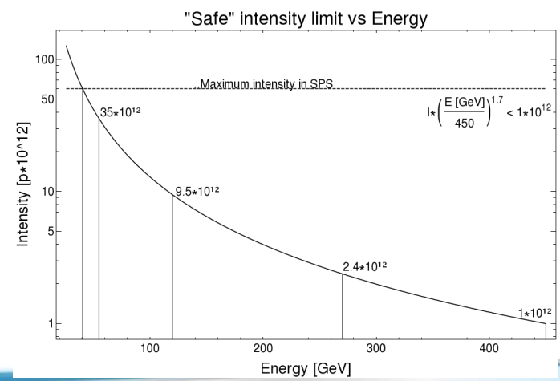
Aperture limitations and damage limits
The maximum intensity in the SPS is 6E13 p+.
At the considered energies the ‘’safe’’ intensities will be lower:

Slide 7
Nominal operation – phased mode
The particles will oscillate around the nominal orbit with a certain amplitude.
With the full voltage on both cavities (2.5 MV), the particles within the 4 σ bunch length will have the following spread which goes down with beam energy:
Beam energy (GeV) | Max vertical spread in phased mode (σ/mm) | Aperture (σ/mm)
55 | 8.6 / 15.6 | 11 / 20
120 | 5.4 / 6.8 | 16 / 20
270 | 3.6 / 3.1 | 24 / 20

Slide 8
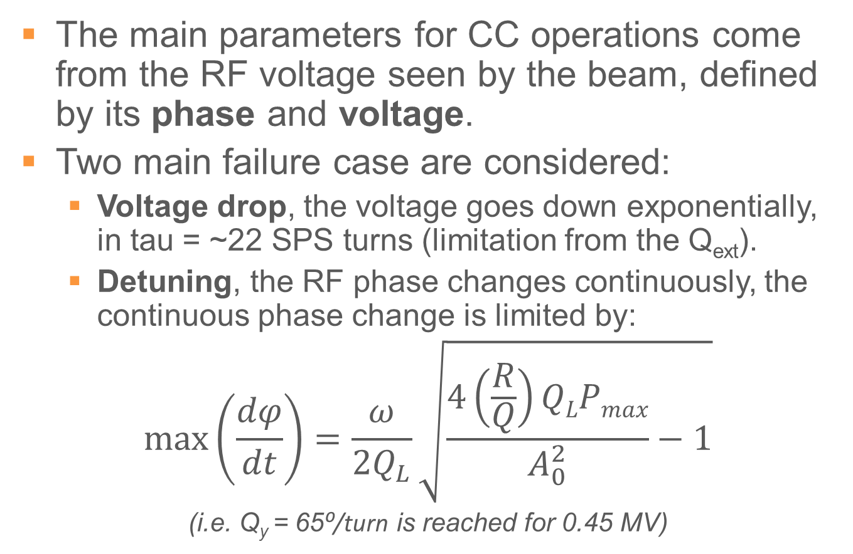
Considered CC failure cases
The main parameters for CC operations come from the RF voltage seen by the beam, defined by its phase and voltage.
Two main failure case are considered:
  Voltage drop, the voltage goes down exponentially, in tau = ~22 SPS turns (limitation from the Q_{ext}).
  Detuning, the RF phase changes continuously, the continuous phase change is limited by:
$$max⁡\left(\frac{dφ}{dt}\right)=\frac{ω}{2Q_{L}}\sqrt{\frac{4\left(\frac{R}{Q}\right)QLPmax}{A_{0}^{2}}−1}$$
(i.e. Q_{y} = 65⁰/turn is reached for 0.45 MV)

Slide 9
Failure case matrix
Operating mode → ↓ Failure case | Transparent | Phased
Voltage drop | Equivalent to phased mode with one cavity. | Reduction of the kick by a factor two.
Detuning | Can excite the beam coherently, if on resonance with tune, the beam core is kicked. | Same as transparent mode, but with lower margins because of the initial crabbing.

Slide 10
Tracking simulations
Focusing on detuning in transparent mode (phased mode can be obtained by adding the initial crabbing).
Five particles are tracked:
  The synchronous one
  Two particles +/- 1 σ longitudinally
  Two particles +/- 2 σ longitudinally
The phase change per turn is the maximum physically possible with a given voltage (i.e. Q_{y} = 65⁰/turn is reached for 0.45 MV)

Slide 11
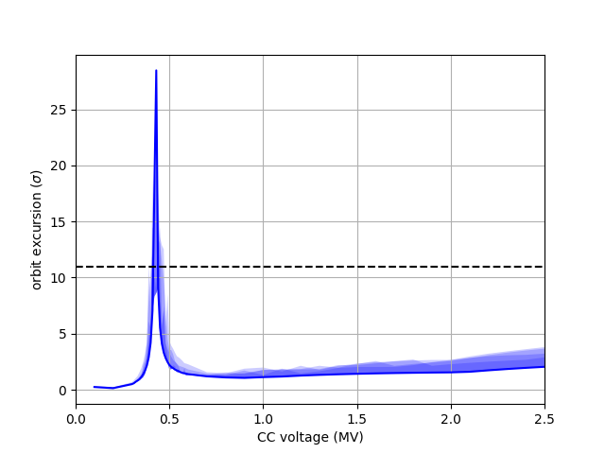
Results: 55 GeV, transparent mode
Reference particle orbit excursion
4 particle with higher orbit excursion
3 particle with higher orbit excursion
2 particle with higher orbit excursion
1 particle with higher orbit excursion
Resonance with tune can occur for low voltages (<0.45 MV).
The full beam would be lost in 50 turns.
Necessary to test this failure case with low beam intensities to verify if the LLRF can drive it.
1 σ=1.8 mm
SPS aperture
Taking into account orbit and optics errors

Slide 12
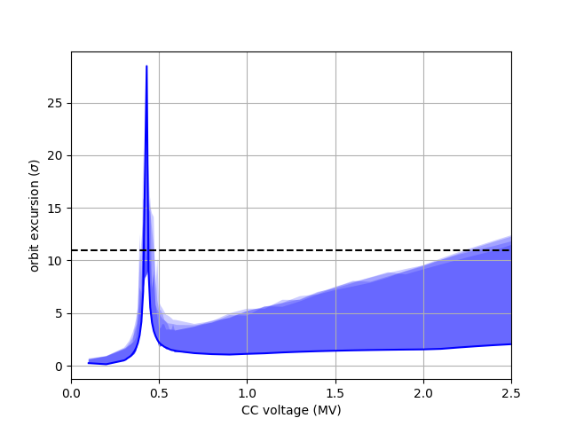
Results: 55 GeV, phased mode
Reference particle orbit excursion
4 particle with higher orbit excursion
3 particle with higher orbit excursion
2 particle with higher orbit excursion
1 particle with higher orbit excursion
Initial crabbing added with maximum amplitude allowed by the voltage for all non-synchronous particles (very conservative).
At 55 GeV with >1.5 MV this failure can lead to high losses.
1 σ=1.8 mm
SPS aperture
Taking into account orbit and optics errors

Slide 13
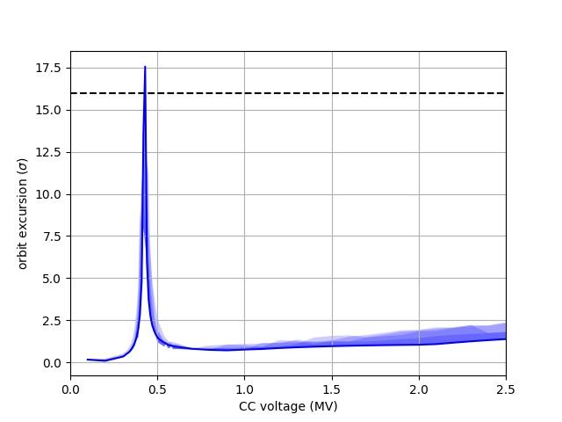
Results: 120 GeV, transparent mode
Reference particle orbit excursion
4 particle with higher orbit excursion
3 particle with higher orbit excursion
2 particle with higher orbit excursion
1 particle with higher orbit excursion
Resonance with tune can occur for low voltages (<0.45 MV)
The full beam would be lost in 50 turns.
High voltage operation is safe.
1 σ=1.25 mm
SPS aperture
Taking into account orbit and optics errors

Slide 14

Results: 120 GeV, phased mode
Reference particle orbit excursion
4 particle with higher orbit excursion
3 particle with higher orbit excursion
2 particle with higher orbit excursion
1 particle with higher orbit excursion
Resonance with tune can occur for low voltages (<0.45 MV)
The full beam would be lost in 50 turns.
High voltage operation is safe.
1 σ=1.25 mm
SPS aperture
Taking into account orbit and optics errors

Slide 15
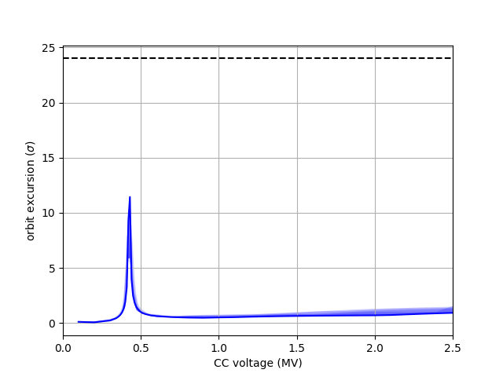
Results: 270 GeV, transparent mode
Reference particle orbit excursion
4 particle with higher orbit excursion
3 particle with higher orbit excursion
2 particle with higher orbit excursion
1 particle with higher orbit excursion
Resonance with tune can occur for low voltages (<0.45 MV)
Losses should be low in this situation (margin>10 σ), even in phased mode with full voltage.
1 σ=0.83 mm
SPS aperture
Taking into account orbit and optics errors

Slide 16
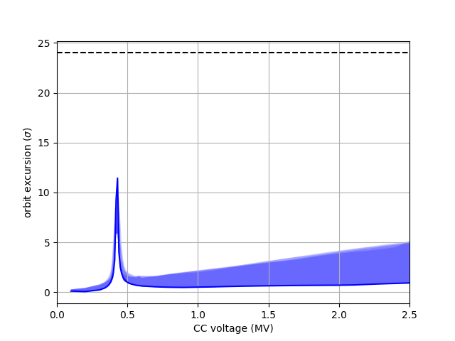
Results: 270 GeV, phased mode
Reference particle orbit excursion
4 particle with higher orbit excursion
3 particle with higher orbit excursion
2 particle with higher orbit excursion
1 particle with higher orbit excursion
Resonance with tune can occur for low voltages (<0.45 MV)
Losses should be low in this situation (margin>10 σ), even in phased mode with full voltage.
1 σ=0.83 mm
SPS aperture
Taking into account orbit and optics errors

Slide 17
Proposal: test program
Verify the physical limitations set on the current failure scenarios (field responses and timescales) and benchmark the tracking simulations.
  Cause a detuning with maximum amplitude with the controller at low cavity voltage to verify the possibility of coherent excitation.
  Measure loss maps during simulated failures and turn by turn losses if dBLMs are made available at the collimators.
Verify the Quench limits and measure the effects of a quench on voltage and phase.
  With RF power, driving the cavity to quench voltage.
  With Beam induced losses (once confirmed realistic from FLUKA simulations it will require the installation of a wire scanner next to the cavities)
These steps should be validated with safe stored beam energies before going to higher intensities and lower beam energies.
Since the RF field is coupled to the beam via beam loading during a failure, the effect on RF field of an off-centered beam in the cavities should be measured with a growing 4-corrector bump. Some orbit interlocking at the cavities position might be necessary.

Slide 18
Conclusions
Voltage drops are not a source of concern as long as the phase does not vary during a failure, which has to be confirmed by the RF modeling.
Detuning failures can lead to large kicks to the core of the beam and significant losses, operation at low voltage (<0.5 MV) has to be validated by testing the associated failure cases before going to higher intensities and lower energies.
Operation with high voltages (>1.5 MV) at 55 GeV in phased mode should be avoided.
Reflection on redundant diagnostics for interlocking on RF phase and voltage has to start from the SPS tests stage to be made available in the LHC where detuning is also the main failure case.

Slide 19
Thank you for your attention, any questions ?

