Slide 1

Cryogenics update for HL-LHC
(crab cavities activity in SM18 M7 and SPS BA6)
Krzysztof Brodzinski
With contribution from: S. Claudet, L. Delprat,
J.H. Derking, C. Fluder, A. Lees, J. Metselaar and O. Pirotte
HiLumi Annual Meeting, Madrid, Spain – 16 November 2017

Slide 2
Outline
Introduction
SM18 M7 activities
  Planning, test program, status
SPS BA6 activities
  Main equipment fabrication and delivery status, commissioning and operation perspectives
Conclusion and final remarks

Slide 3
Introduction and timeline
Prior to installation in LHC, the crab cavity prototype modules will be tested in SM18 (without beam) where cryogenics will provide necessary connections in M7 bunker,
SPS is not equipped with any cryogenic infrastructure except BA4 where ColdEx experiment is running, therefore BA6 cryogenic installation has to be built from scratch,
The SM18 cryogenic infrastructure commissioning is underway,
The baseline to commission SPS cryogenic infrastructure is YETS (beginning of 2018)
CC series production
HiLumi LHC
1st SPS test

Slide 4
SM18 M7 cryogenic activities – status
Annual CERN closure
The planning for M7 activities:
Remark: if the cryo commissioning and cool down goes smoothly and faster than foreseen some days for RF test between 12th and 18th Dec. may be allocated.

Slide 5
SM18 M7 cryogenic activities – status
SM18 cryo infrastructure, installed
M7 Valve Box, not delivered on time, replaced by “Plan B” solution delivered and installed by CERN. This solution allows for testing but with reduced diagnostics of the crab cryo module (precise heat load measurement will be possible in SPS)
Cryogenic Service Box (pressure tested, cold cycled at 80 K, tightness tested at factory AS Scientific in UK), installed in M7.
Crab Cavity Cryo module, pressure and tightness tested in SM18 – ready for installation

Slide 6
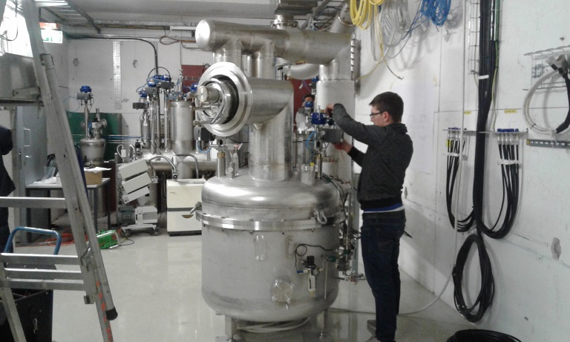
SM18 M7 cryogenic activities – status
SM18 cryo infrastructure
M7 “Plan B” solution
Interface to the Crab cryo module,
connection from Monday 20th Nov.
Cryogenic Service Box

Slide 7
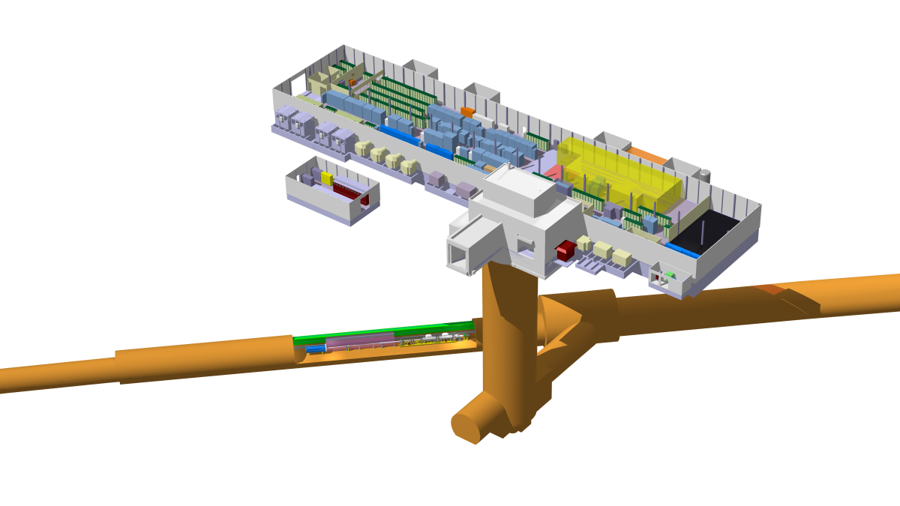
SPS cryogenic infrastructure
Legend:
VB1 – valve box 1
VB2 – valve box 2
SB – service box
CCM – crab cavity module
Cryogenic He transfer line
Warm He pipework
Cryogenic LN2 transfer line
Compressor station
GHe storage
LN2 storage
BA1
VB2
150L LHe
SB
CCM
100L LHe
BA5
LN2 phase separator
90m transfer line
He pump
He heater
VB1
150L LHe
refrigerator

Slide 8
SPS cryogenics – planning
G. Vandoni – BE-RF
The planning is very ambitious regarding parallelism of activities. One week of access more could bring more reliability and efficiency for visual inspections and tuning of the cold system.

Slide 9
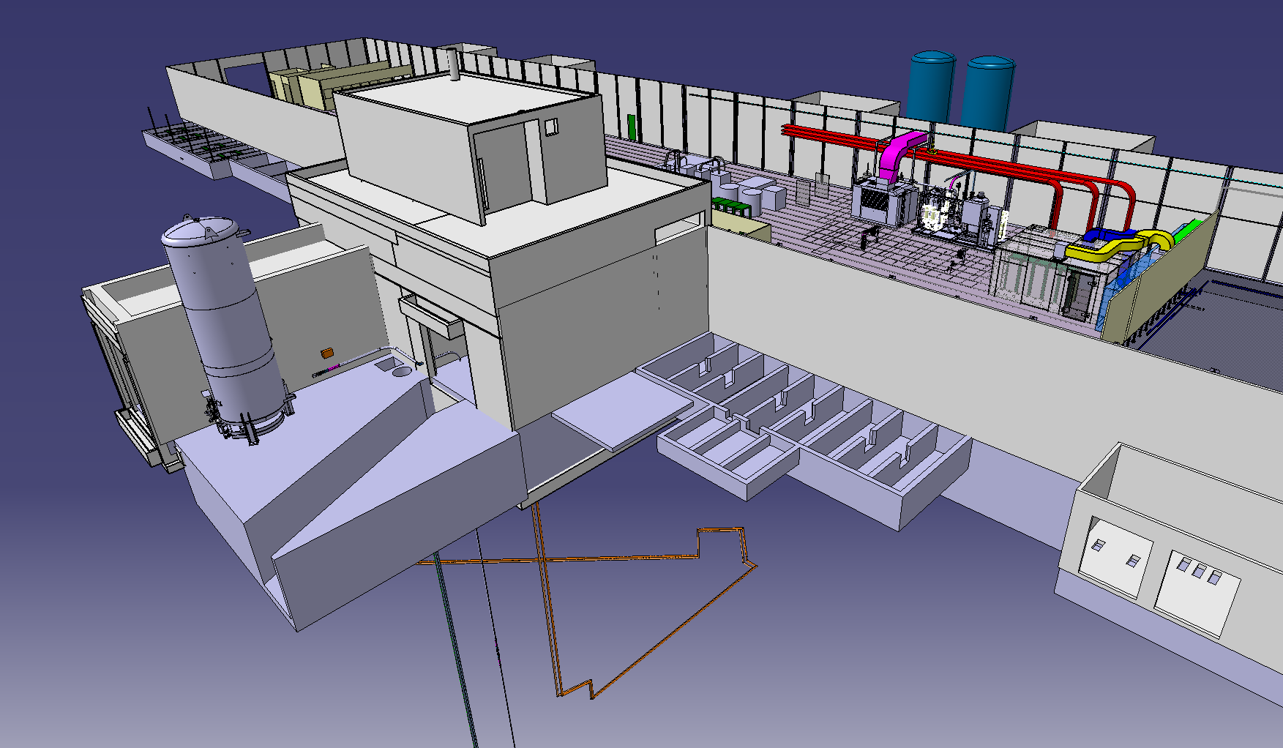
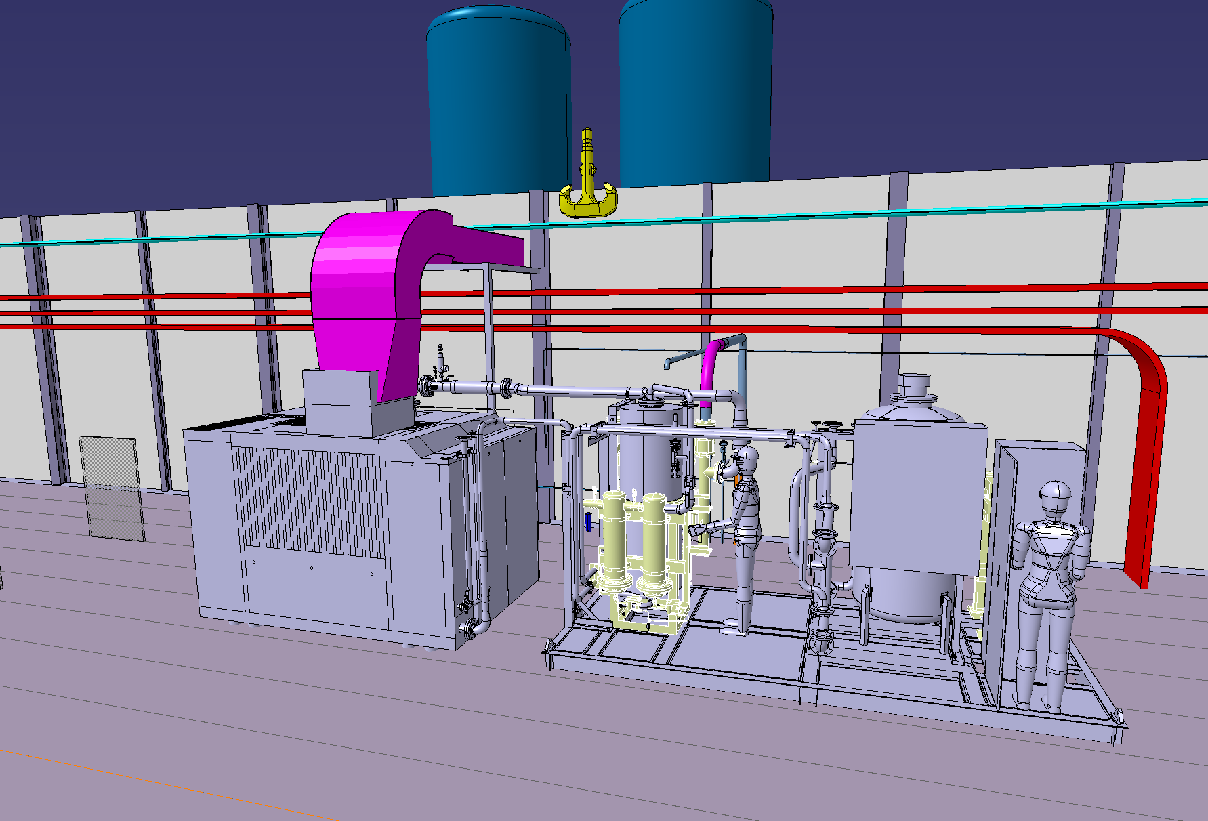
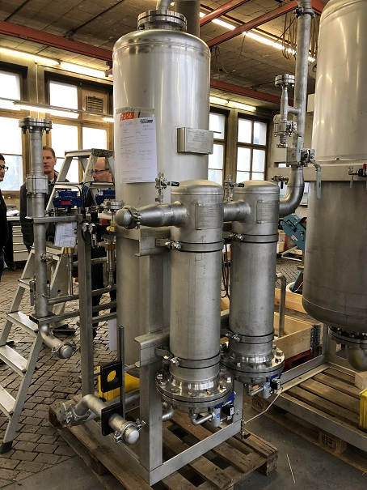
SPS BA6 cryogenics – status
BA6 – cryo surface equipment
Compr. station and oil removal system
Oil removal system – status 10th Nov.
Entire compressor station and oil removal system will be delivered and installed at BA6 from mid-Jan 2018.

Slide 10
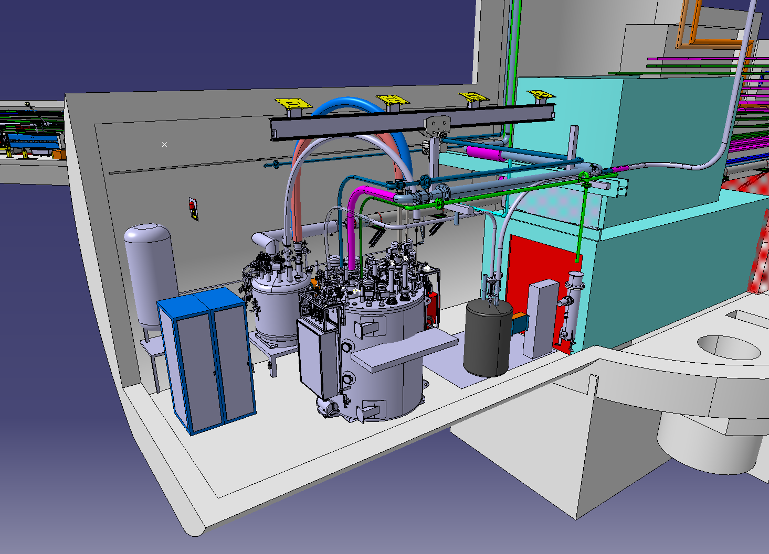
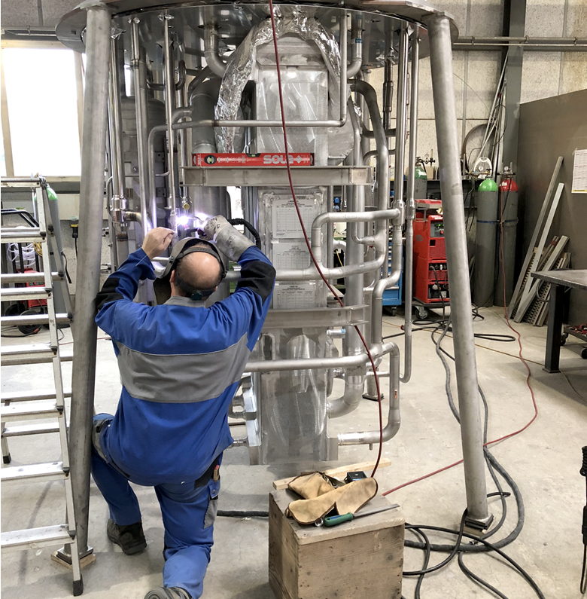
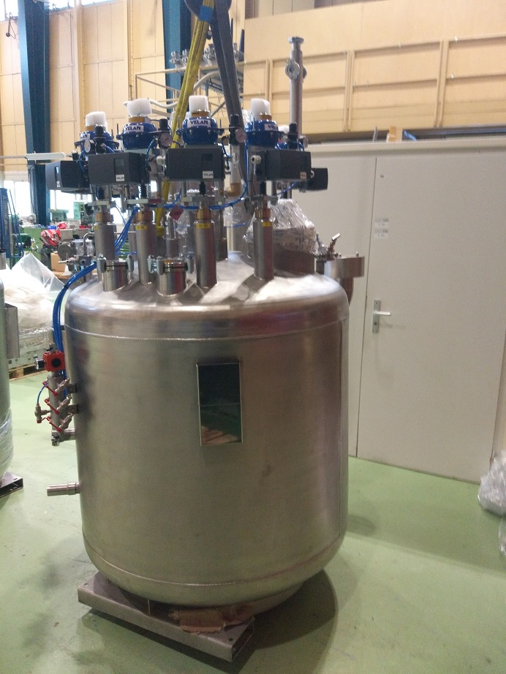
SPS cryogenics – status
Transfer line – installed in EYETS
Main refrigerator
LN2 phase separator (fabrication underway in UK, delivery mid Jan.
VB1
Main refrigerator on 10th Nov. – on time for delivery 17th Jan OK.
VB1 and VB2 were delivered to CERN

Slide 11
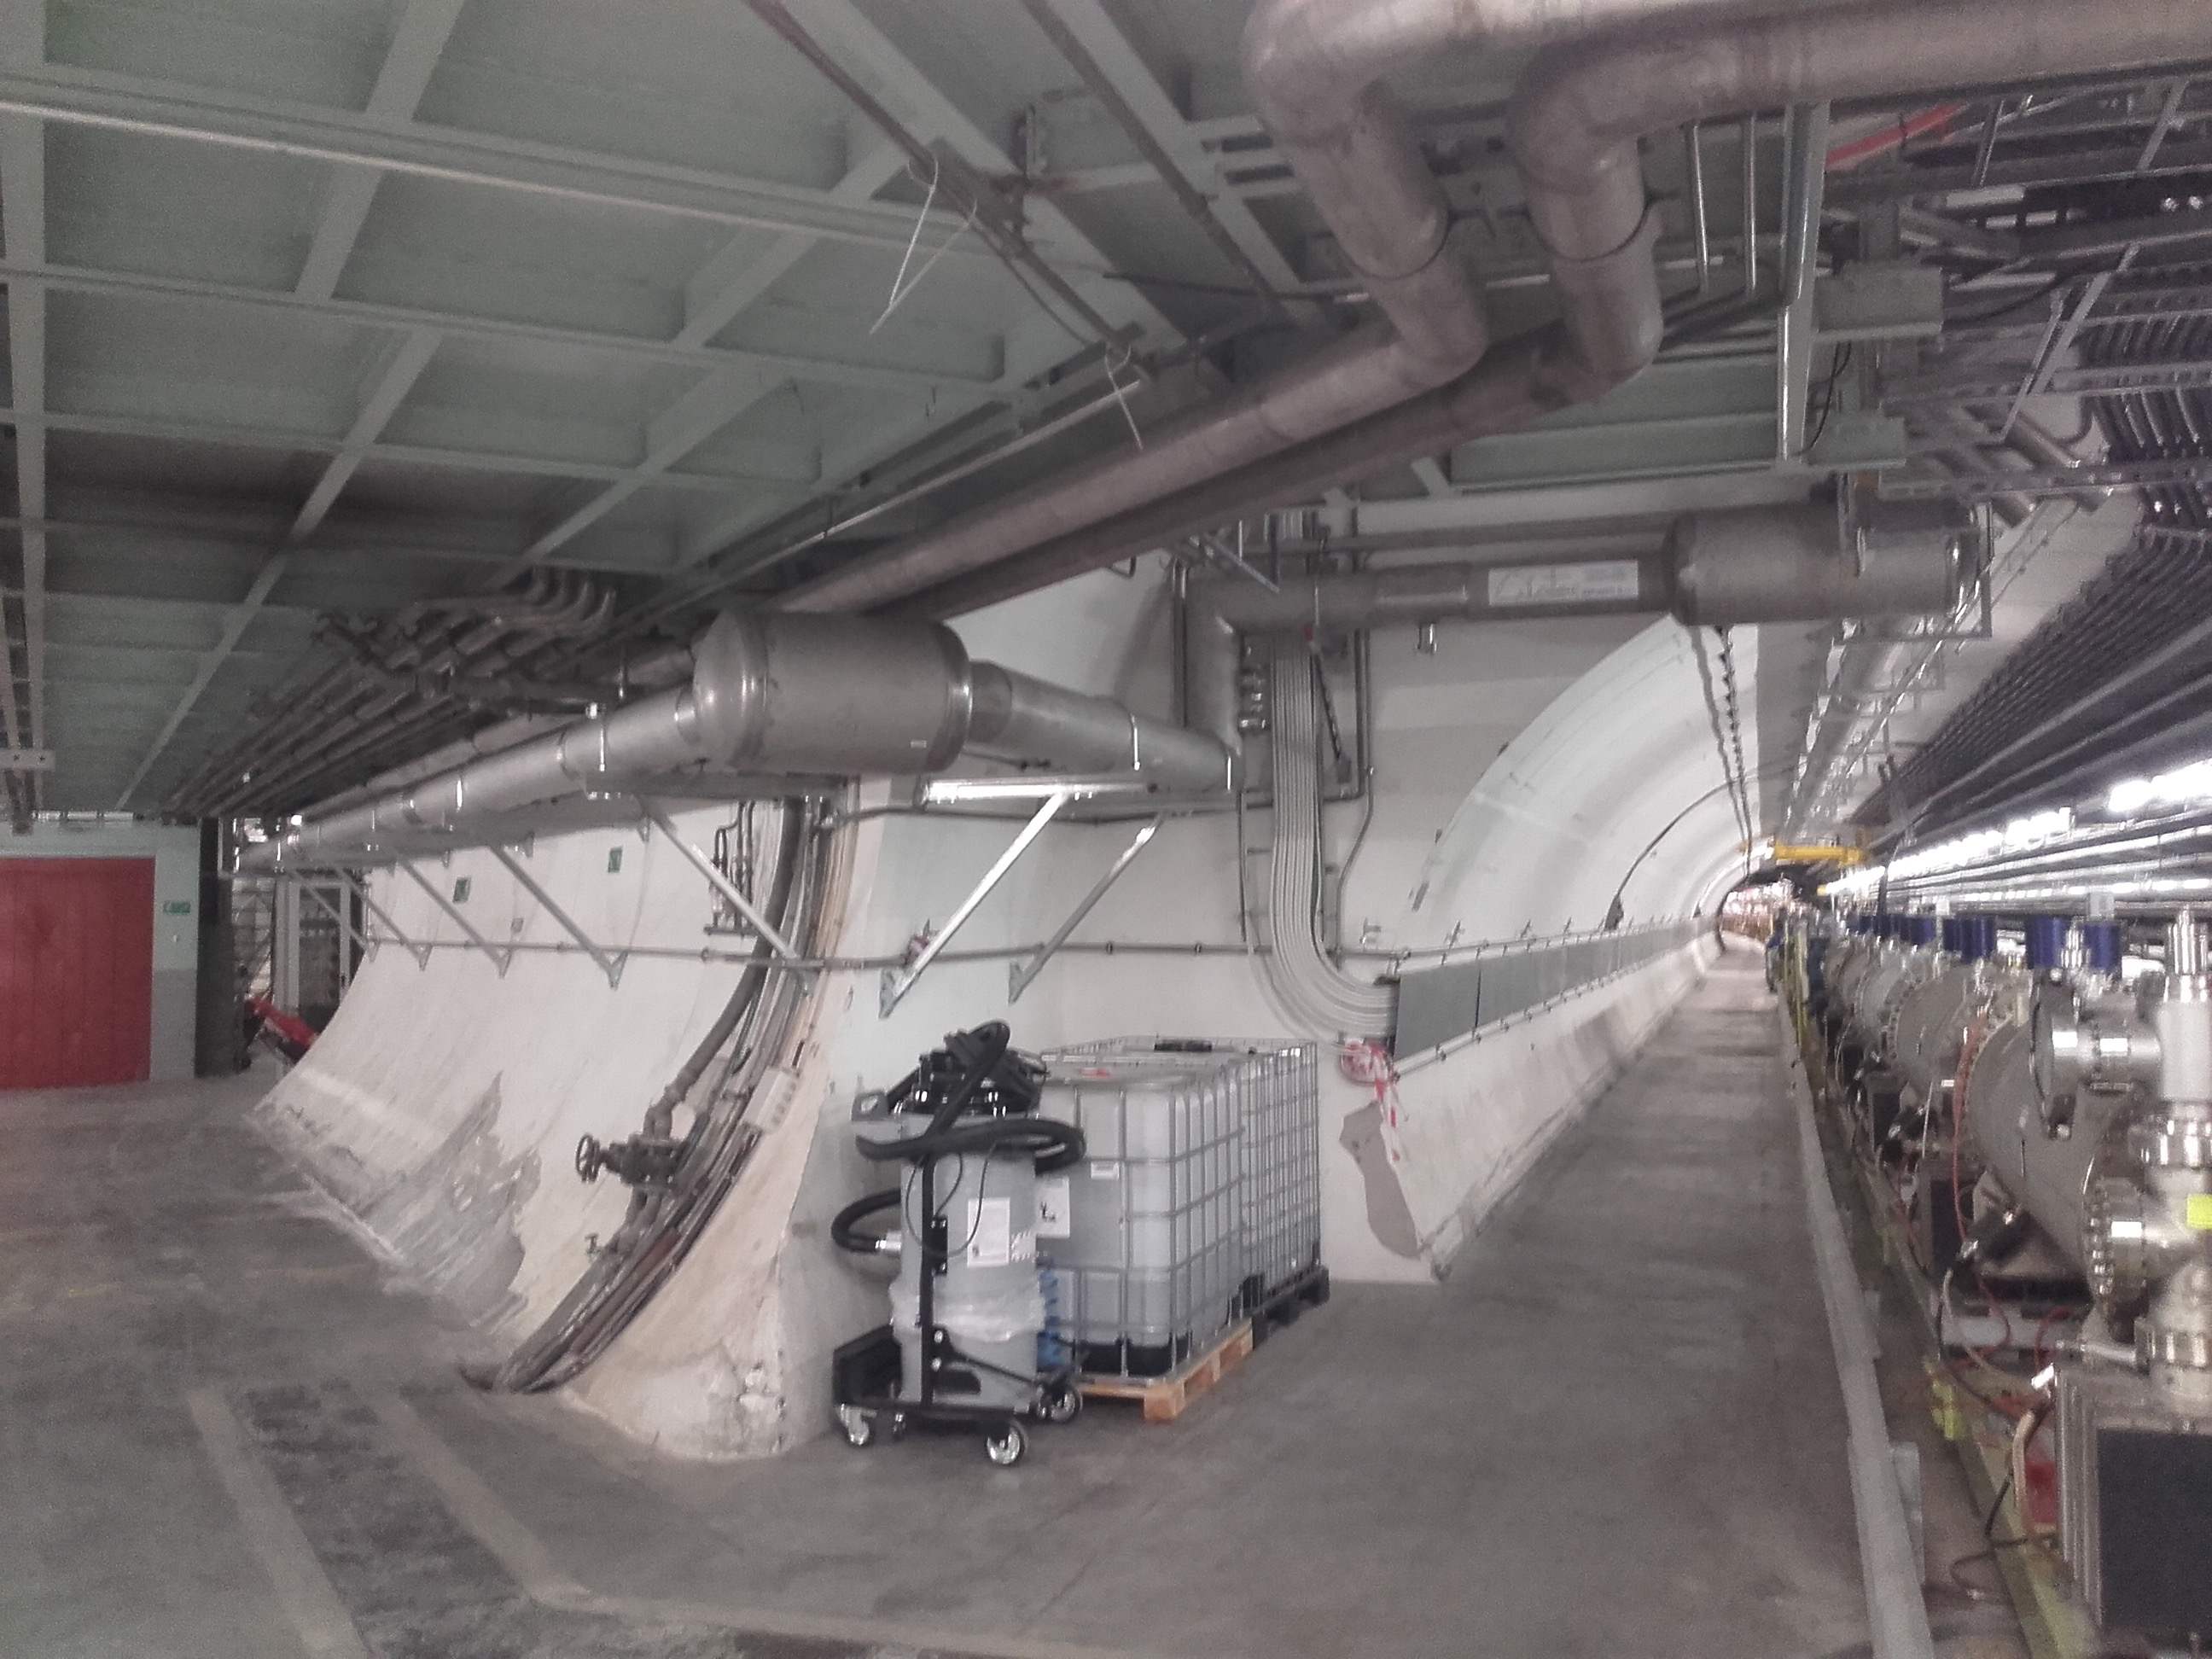
SPS cryogenics – status
80 m cryo distribution line installed during Feb-Mar 2017
From Cold-Box & Valve Box 1
To Valve Box 2 & RF Cryostat

Slide 12
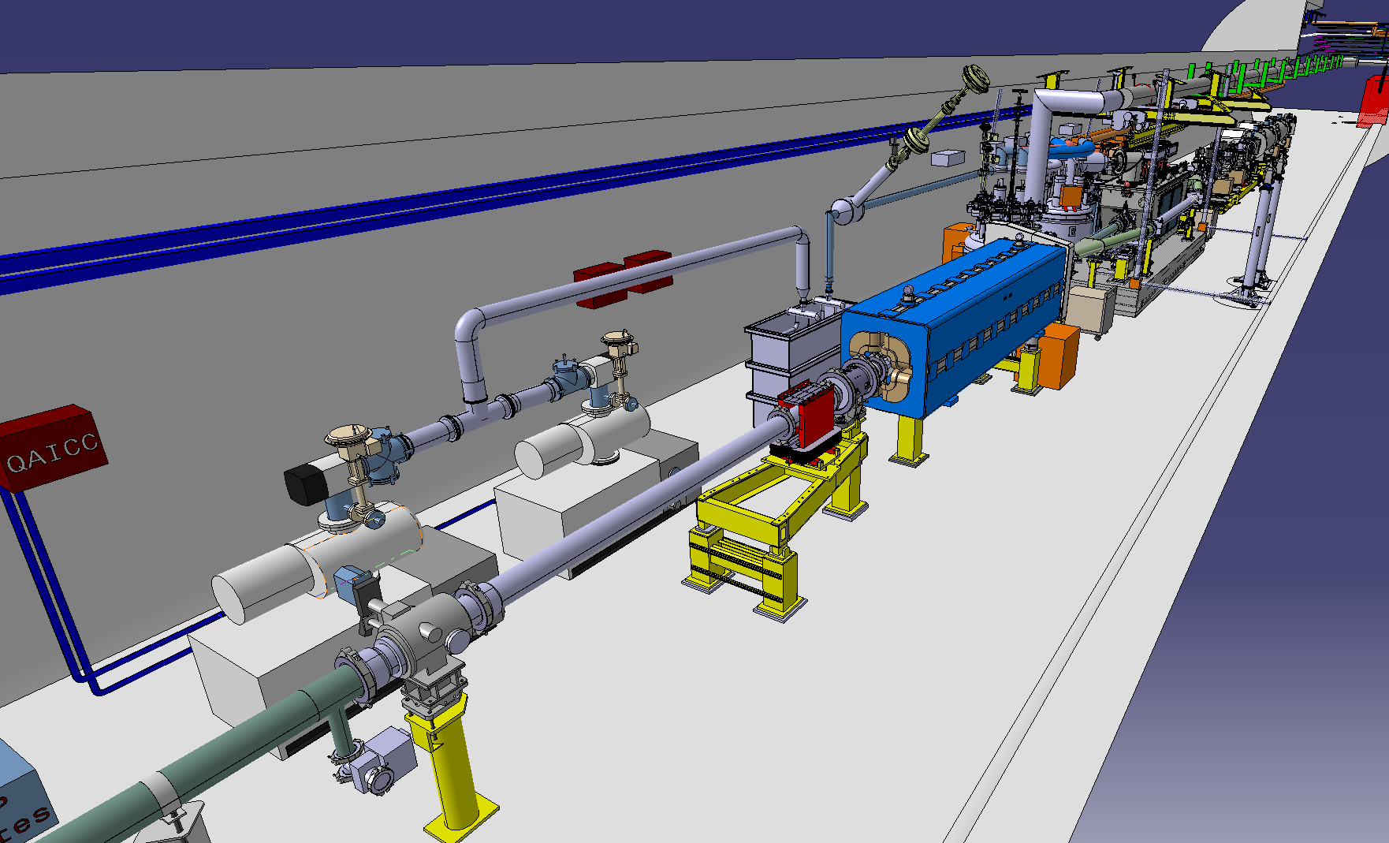
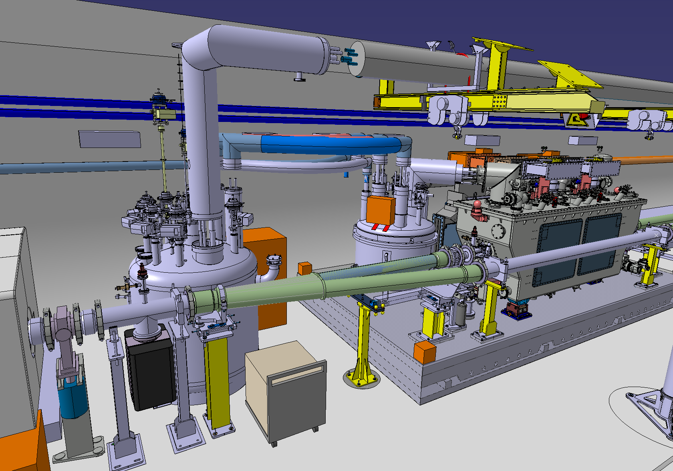
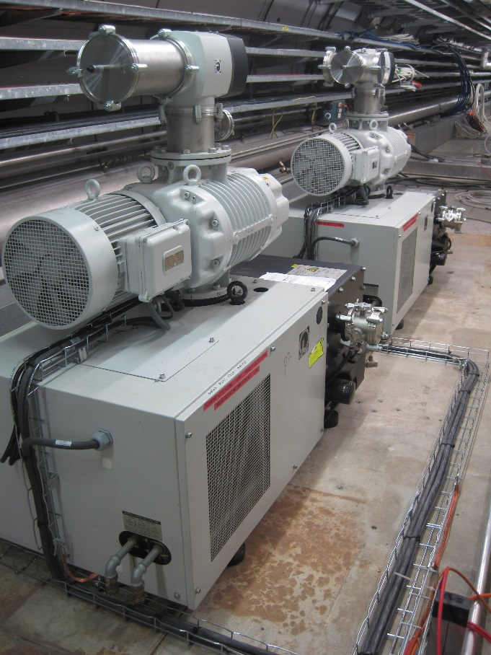
Transfer line and valve boxes – status
He pumps (installed)
He H2O heater
(available at CERN)
VB2
Transfer line
Flex lines fabrication underway in UK – on time
Service Box
The He pumps are installed in LSS6, will be connected with utilities and hydraulically with He process pipes during next YETS Jan, Feb 2018.

Slide 13
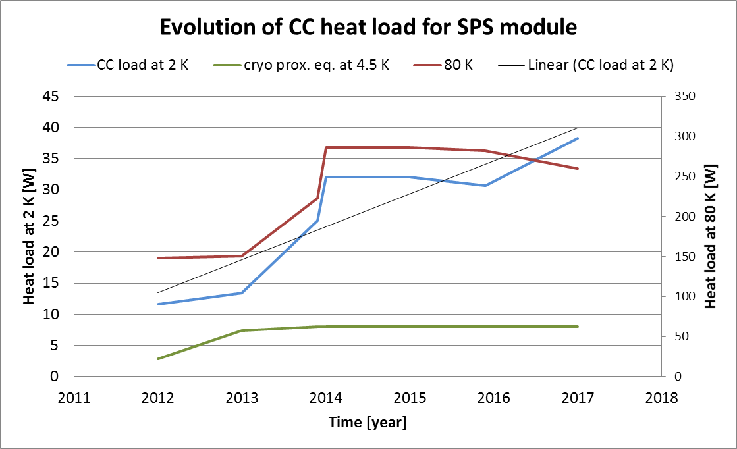
SPS cryogenics – heat load evolution
DQW static HL: 16.8 W @ 2 K
DQW dynamic HL: 20.4 W @ 2 K
Cryo prox. equipment: 8 W @ 4.5 K

Slide 14
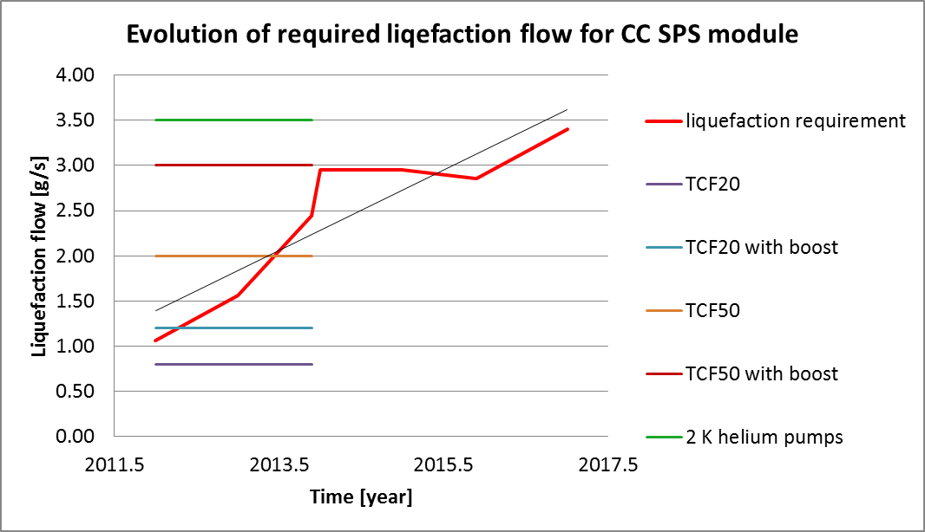
SPS cryogenics – limitations evolution
New 4.5 K cold box will have liquefaction capacity of ~7 g/s and will allow for using of full capacity of 2 K pumping units (~3.5 g/s @30 mbar) as well as to cover client and distribution heat load with safety factor of ~1.5.
Warning! No additional helium pumps can be added to the infrastructure respecting present planning and integration constraints.

Slide 15
Conclusions and final remarks
The cryogenic equipment for M7 test was installed, however “Plan B” was applied to replace originally foreseen M7 valve box (less diagnostics available).
Most of the cryogenic equipment for SPS was fabricated and partially installed (transfer lines, VBs, SM, He pumps), the main refrigerator, LN2 separator and some local lines are in final fabrication stage and will be delivered on time for installation during YETS.
The control system and control logic for M7 and BA6 are under construction. Will be commissioned in M7 just before the cool down and in BA6 in February.
Safety reviews were performed in 2015 and 2017 with no major issue noticed.
YETS time dedicated for installation and commissioning is very dense and success oriented. It will require good coordination between different working teams to succeed.

Slide 16
THANK YOU !
QUESTIONS?

